Slide 1


Slide 2

Motivation
Bring new features that have been recently been added to different types of vehicles to motorcycles
Improve upon similar products currently available in the market
To give riders easy access to data such as the proximity of potentially hazardous objects in his or her blind spots, details of the bike (e.g. cardinal direction, speed), and general details (e.g. time)

Slide 3
Goals and Objectives
Easy to charge
Helmet module should be small in order to be easily mounted
The screen should be easily read but not obstructive to the rider’s field of vision
Left, right, and rear facing sensors should increase the rider’s safety and awareness of surroundings
The rider should be able to see the information without having to look down

Slide 4
Similar Products
 | Head On | Skully AR-1 | NUVIZ | LiveMap | Reevu | BikeHUD
Cardinal direction | X | X |  | X |  | X
Speed | X | X | X |  |  | X
Rear detection | X | X |  |  | X
Left/right detection | X | X
Time | X | X | X
Cost | $$ | $$$$ | $$$ | $$$$ | $$$ | $$

Slide 5
Requirements and Specifications
Attribute | Value
Number of sensors | 3
Sensor detection distance | 6-600cm
Sensor measuring angle | 30 degrees
Sensor power consumption | 5-15 mW
Sensor frequency | 40kHz
Display size | 2.2”
Display resolution | 320 x 240 resolution, 18 bit color
Display current consumption | 100mA
Display voltage | 3.3-5V
Microcontroller current consumption | 0.1uA-0.2mA
Wireless communication module operating range | 10 meters
Notes:
No parasitic draws from bike
Not increase helmet weight by 1.25

Slide 6
Requirements and Specifications Continued
Solar panel output | 50mA at 4.8V
Solar panel dimensions | 73mm x 94mm
Battery capacity | 2000 mAh
Battery voltage | 3.7 V
Real time clock accuracy | +/- 2 minutes/year
Real time clock operating voltage | 3.3 V
Real time clock current consumption | 110 uA (standby); 200uA (active)
Electronic compass operating voltage | 2.5 V
Electronic compass current consumption | 1uA (standby); 300uA (active)
GPS operating voltage | 3.0- 4.3 V
GPS current consumption | 180uA - 25mA
GPS position accuracy | 2.5 m
Overall weight | <600 grams
Overall Helmet Module Current Consumption | <200 mA

Slide 7
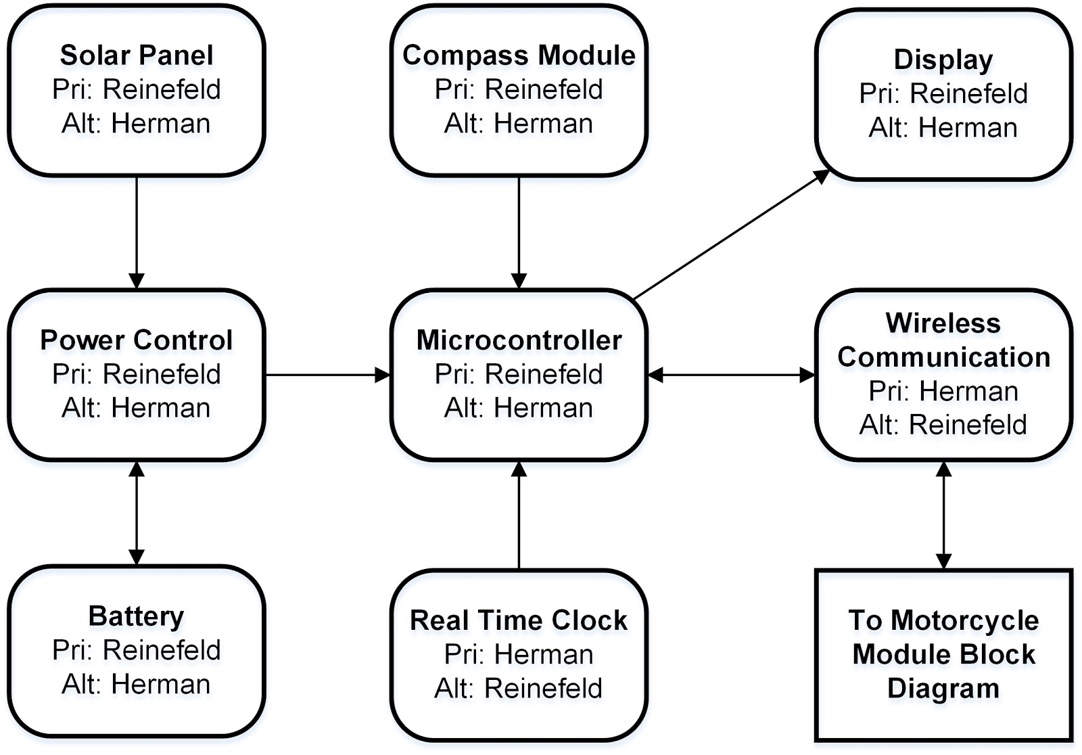
Helmet Hardware Block Diagram

Slide 8
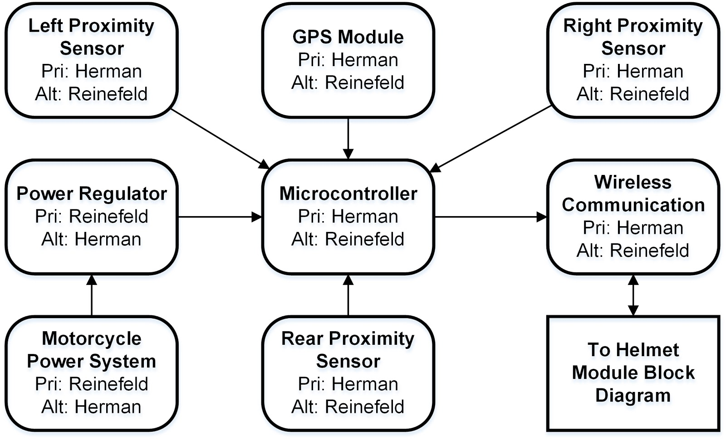
Motorcycle Hardware Block Diagram

Slide 9
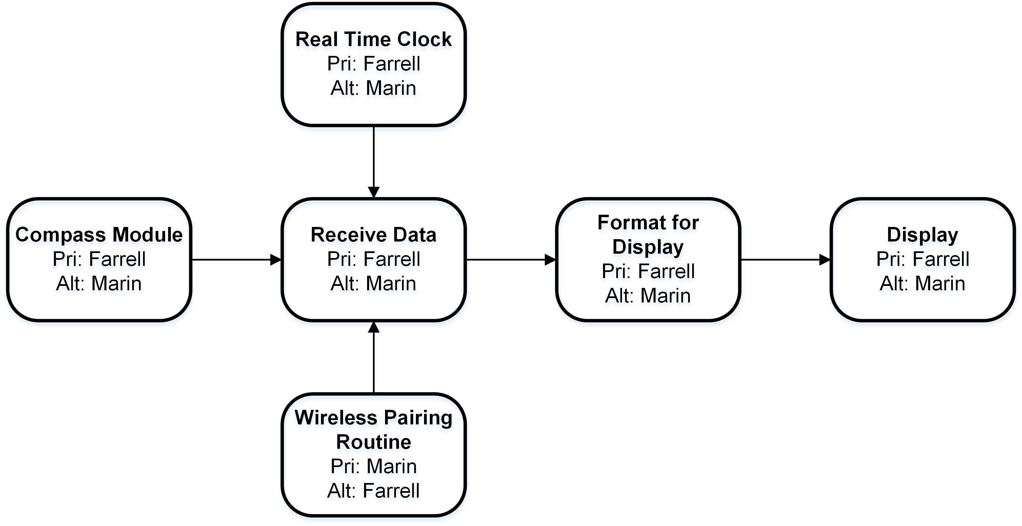
Helmet Software Block Diagram

Slide 10
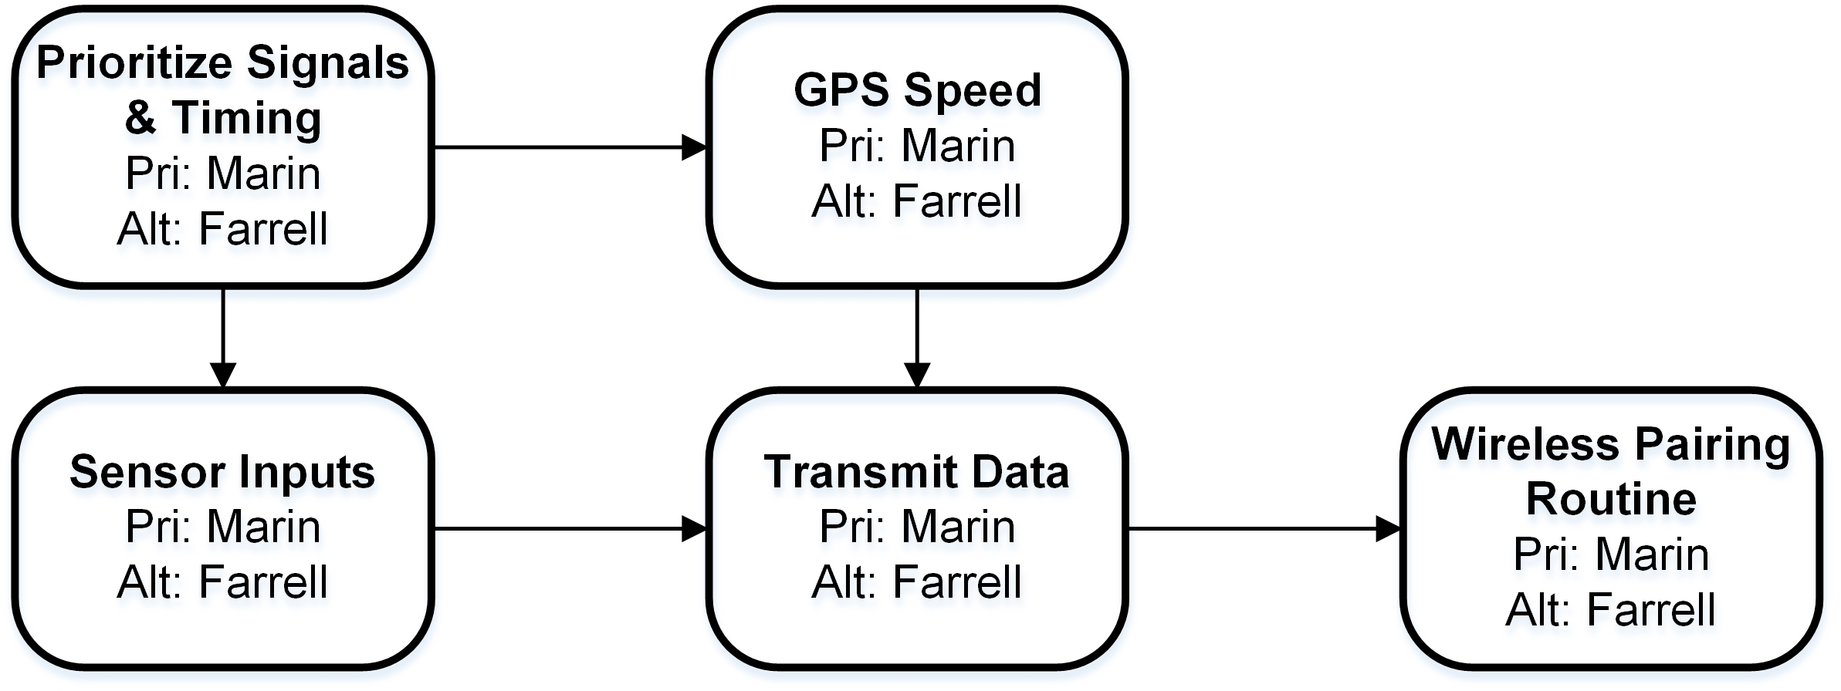
Motorcycle Software Block Diagram

Slide 11
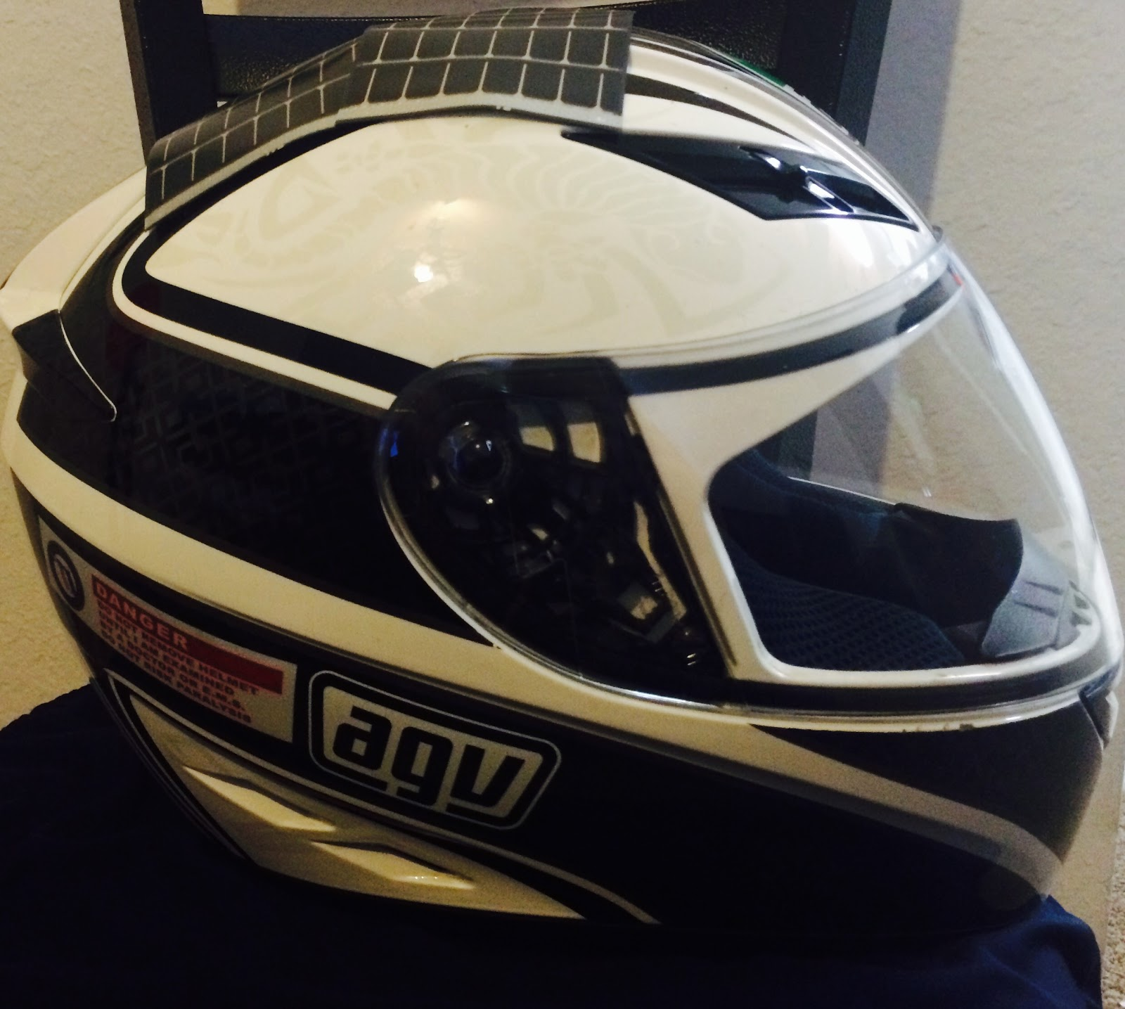
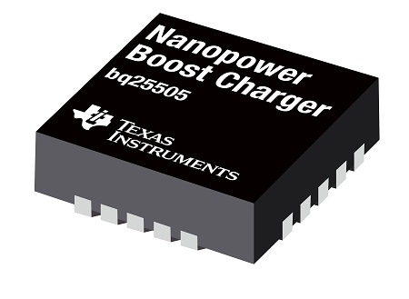
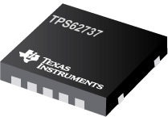
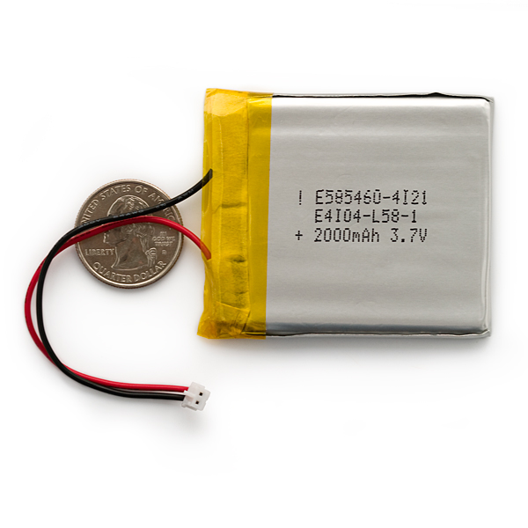
Helmet Module Power System
Components

Slide 12
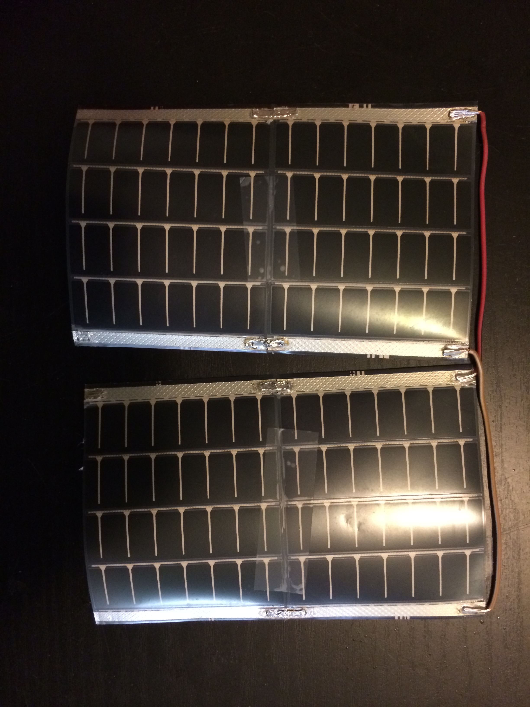
MPT4.8-75 Solar Panel
Purpose: Provide power to the helmet system.
Flexible enough to be molded to helmet
Output voltage of 4.8 V
Output current of 50 mA per panel
Small enough so four can fit on top of helmet with room for more if necessary
Total current needed: 180 mA
Manufacturer | Cost
PowerFilm Solar | $7.24/ea

Slide 13
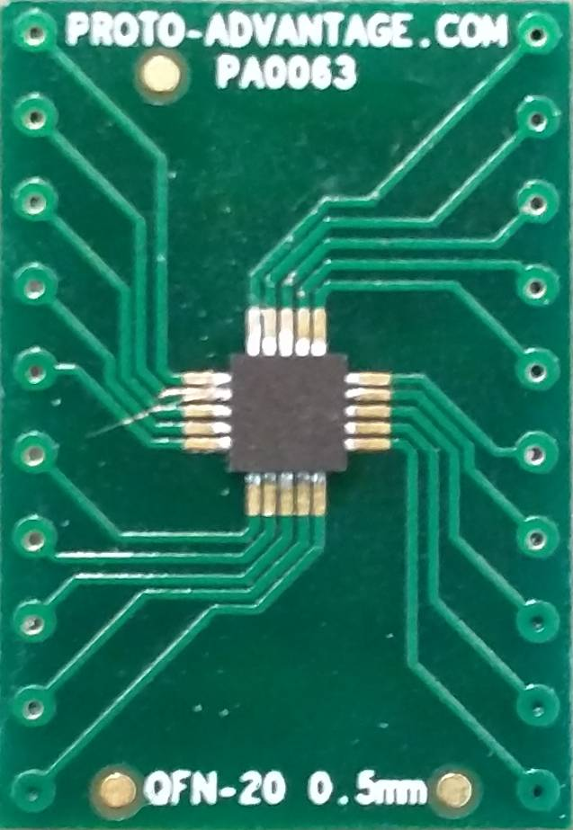
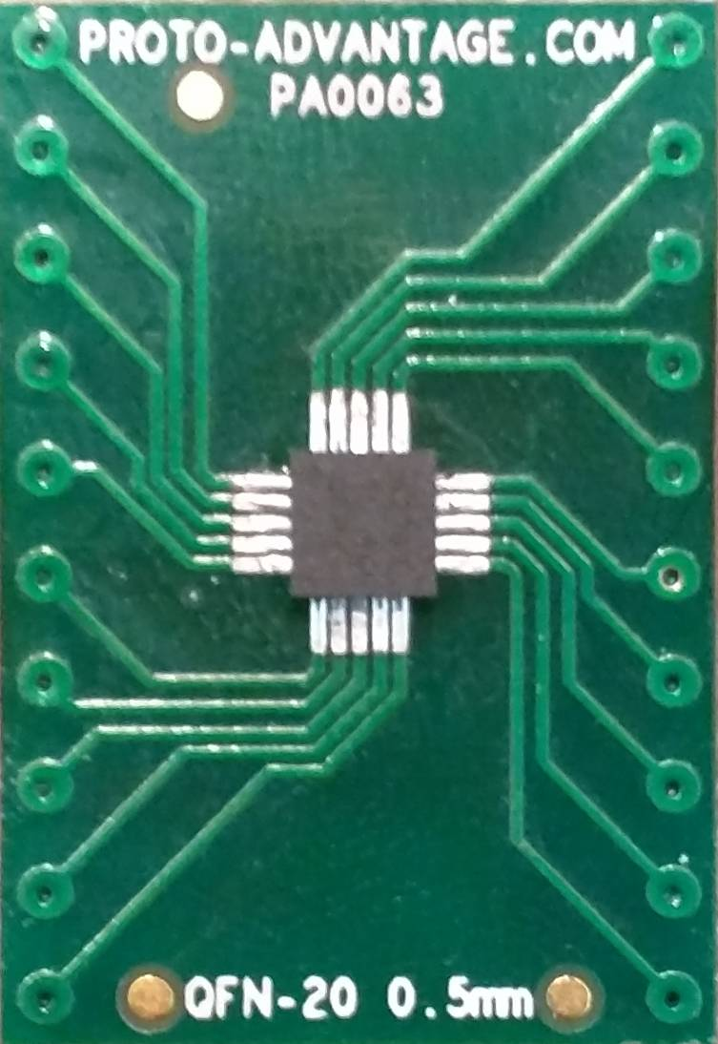
BQ25505 Nano Power Boost Charger & TPS62737 Power Buck Converter
Purpose: Manage battery charging, harvest solar power, and provide voltage to all components on the helmet system.
Specifically designed for energy harvesting applications
Provides battery charging and protection
Provides 3.3V input to microcontroller, compass, Bluetooth module, and screen
Manufacturer | Cost
Texas Instruments | $5.40 (BQ25505)
Texas Instruments | $2.50 (TPS62737)

Slide 14
Polymer Lithium Ion Battery
Purpose: Store power from solar panels on helmet.
3.7 V at 2000mAh
Comes with standard 2-pin JST-PH connector
Lithium polymer is safer for the rider to wear
Small size makes for easy placement on helmet
Manufacturer | Cost
UNIONFORTUNE | $12.95

Slide 15
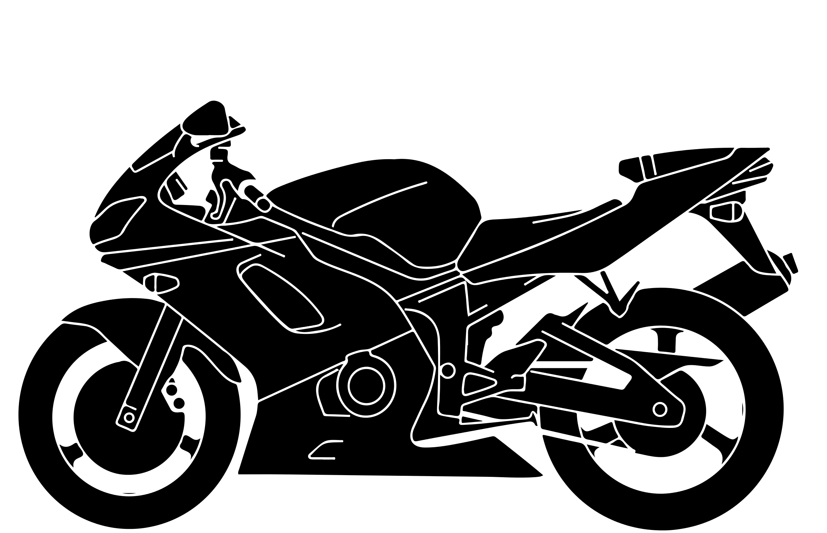
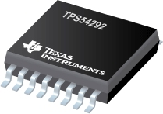
Motorcycle Module Power System
Components

Slide 16
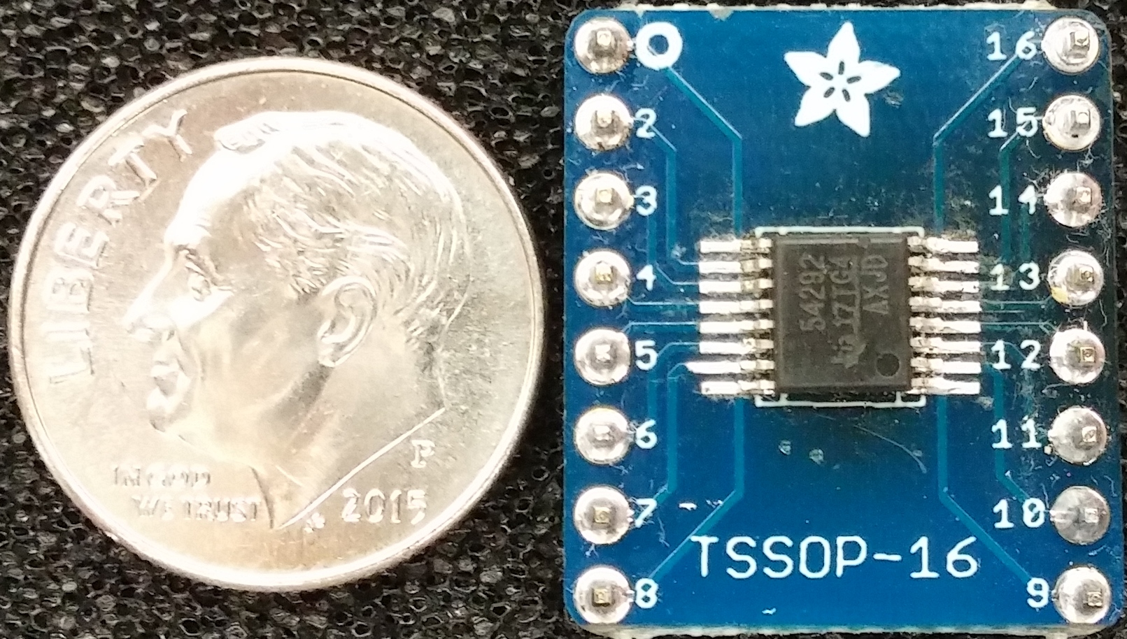
TPS54292 Dual Synchronous Step-Down Converter
Purpose: Step down voltage from motorcycle battery.
4.5 V to 18 V input range
Dual output to be set to 3.3V and 5 V
Overcurrent protection 2.2A/3.8A
Thermal shutdown protection at 145° C
Manufacturer | Cost
Texas Instruments | $18.90

Slide 17
Microcontroller Unit (MCU) Selection
Selection of ATMEGA328P
Fair compromise between processing power and power consumption
Ample memory
Sufficent number of I/O pins
Popularity of this family of MCUs has resulted in an abundance of development boards, compatible accessories, and relevant open source code
Negligible cost
Attribute | MSP430 G2553 | MSP430 FG4618 | ATMEGA 328P | ATMEGA1280 | ARM STM32F405VG
Power Use | 7.9mW | 9.6mW | 26mW | 50mW | 144mW
I/O Pins | 16 | 80 | 23 | 86 | 82
Comm. Ports I²C/SPI/UART | 1/2/1 | 1/1/1 | 1/2/1 | 1/5/4 | 3/3/4
Processor Frequency | 16MHz | 8MHz | 20MHz | 16MHz | 168MHz
Memory Flash/RAM | 16kB/0.5kB | 116kB/8kB | 32kB/2kB | 128kB/8kB | 1MB/194kB
Cost | $1.00 | $8.35 | $1.85 | $9.50 | $6.65

Slide 18
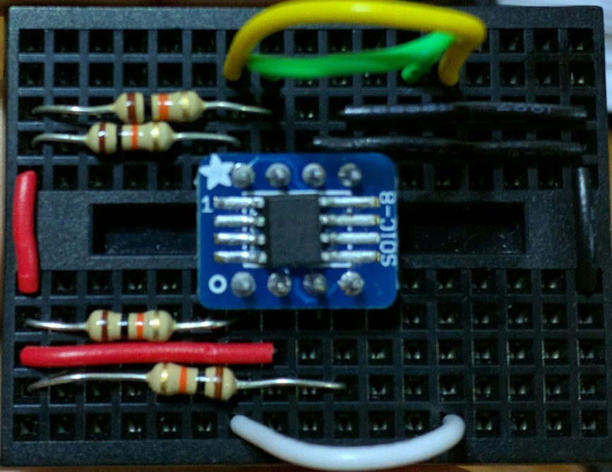
DS3231 Real Time Clock
Purpose: Allow the Head On unit to provide accurate time even after the unit is powered on and off
Initial time will be set by a connected computer. The user can set the time at any moment thereafter
Keeps track of days, month, and year along with automatic adjustment for leap years and months with less than 30 days
I²C serial interface for reduced pin use
Low power consumption (1 µA draw for timekeeping) makes it capable of running for years off of a coin cell battery
Manufacturer | Cost
Maxim Integrated Products | $4.41

Slide 19
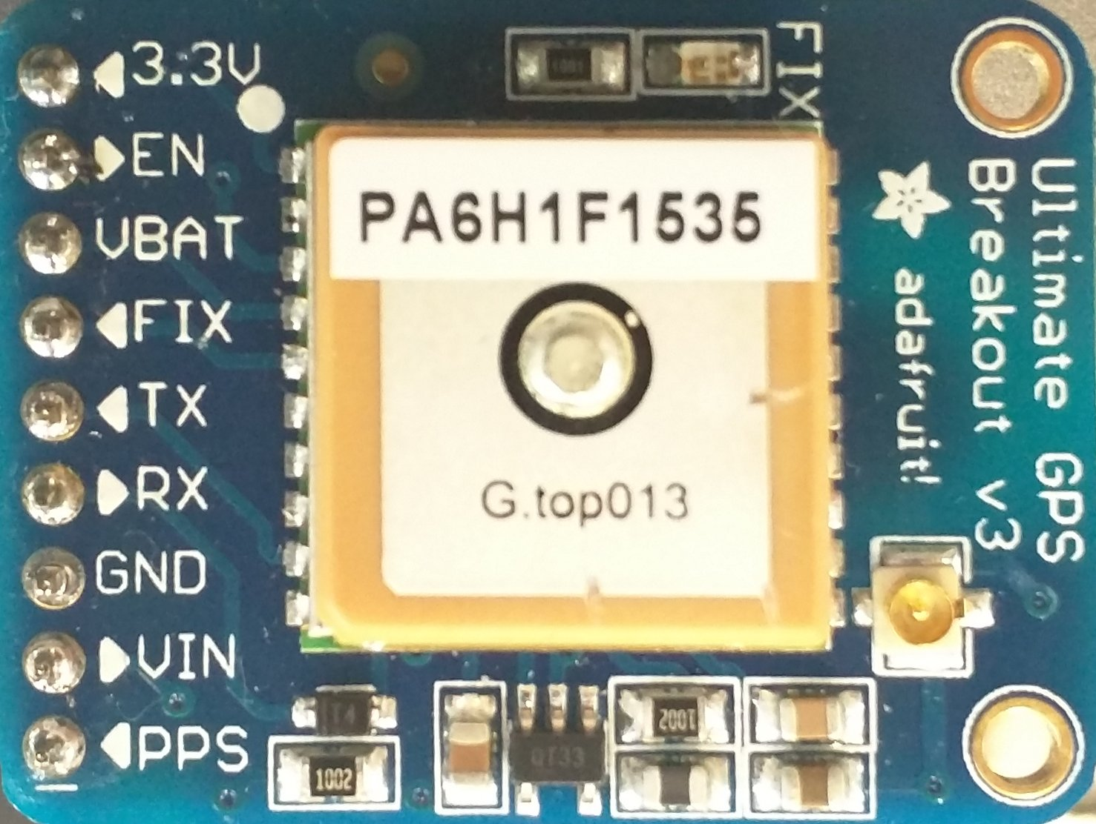
Global Positioning System (GPS)
Purpose: Allow the Head On unit to provide acurate speed information to the rider
Low power consumption: >140mW peak search >73mW average tracking, >90uW in standby
I²C compatible but connected to the hardware UART for dedicated communication with MCU
Horizontal position accuracy of < 2.5 meters
Built-in antenna and LNA with close to 20dB gain
Supports major Satellite Based Augmentation Systems (WAAS, EGNOS, MSAS, GAGAN)
Manufacturer | Cost
GlobalTop Technology Inc. | $29.95

Slide 20
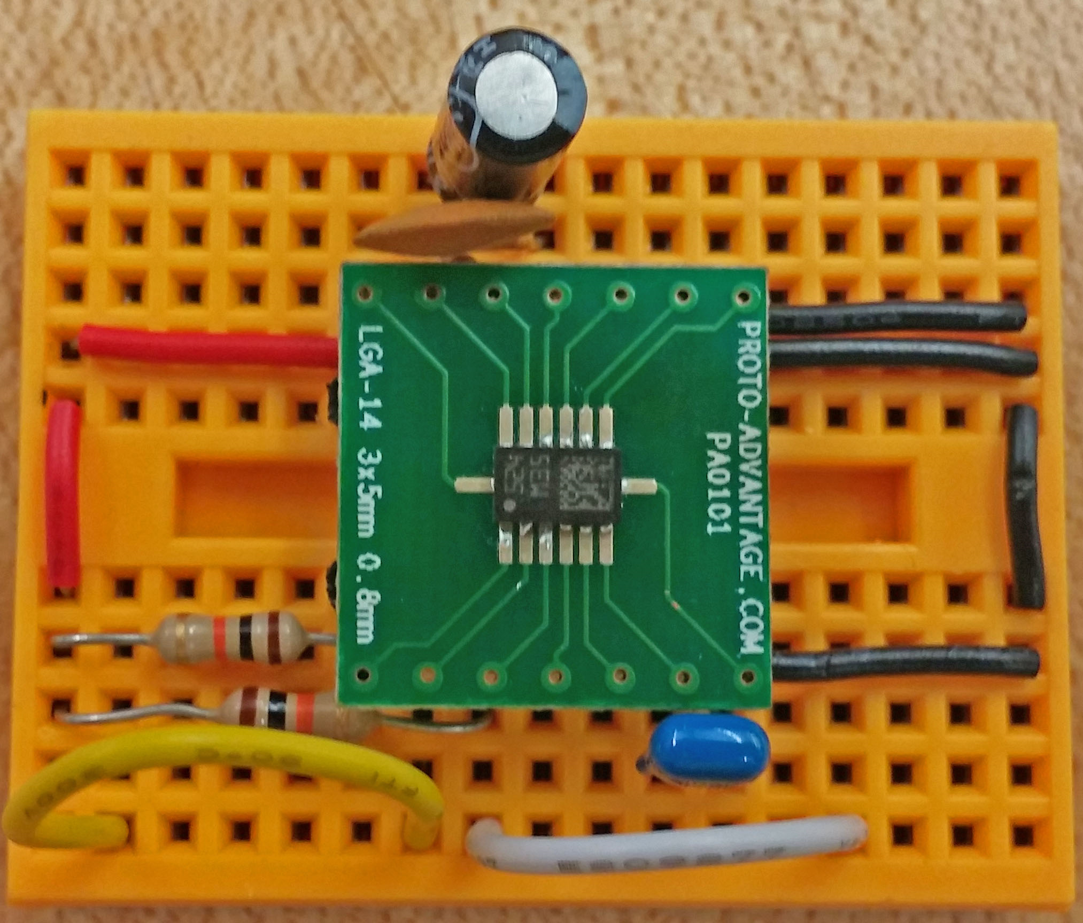
LSM303D Electronic Compass
Purpose: Provide the rider with proper cardinal direction at all times, especially when the rider is not moving.
I²C serial interface for reduced pin use
Integrated 3 axis accelerometer for possible use as a tilt sensor
Implementation on the helmet unit allows the rider to be further aware of directionality by only needing to turn his or her head instead of entire motorcycle
Magnetometer and accelerometer can be turned on and off individually for low power consumption. Normal eCompass consumption is 300 μA
Manufacturer | Cost
STMicroelectronics | $5.80

Slide 21
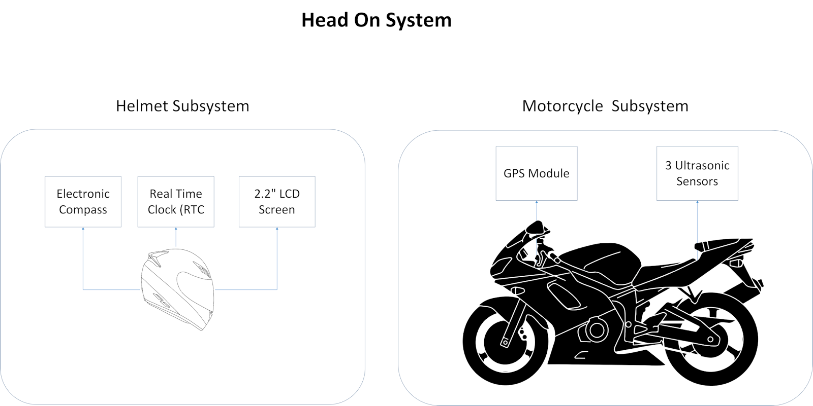
Wireless Communication
The motorcycle unit and helmet unit required a way to communicate data from the GPS and ultrasonic sensors on the bike.
Wired technology was considered at first; however, the hassle of having an extra wire on the rider and safety risk of having the rider attached to the bike ruled it out.
Three forms of wireless technology were considered: ZigBee, Wi-Fi, and Bluetooth

Slide 22
Wireless Communication Selection
Attribute | Wi-Fi | ZigBee | Bluetooth (Class 2)
Standard | 802.11 (a,b,g,n) | 802.15.4 | 802.15.1
Frequency | 2.4 and 5 GHz | 2.4 GHz | 2.4 GHz
Operating Range | 100 meters | 10 - 100 meters | 10 meters
Data Throughput | 25 Mbps (g) | 250 kbps | 0.7 - 2.1 Mbps
Network Acquisition | 3-5 s | 30 ms | < 10 s
Security | High | High | Low
Relevant Power Consumption | High | Very Low | Medium
Example Battery Life | Hours | Months to years | Months to years
ZigBee featured both high security and the lowest power consumption , yet the lowest data throughput of the three technologies
Wi-Fi allowed operation on a lesser used band with high security; however, had high power consumption and implementation complexity.
Bluetooth consumed less power than Wi-Fi, provided ample throughput, less complex, and more than sufficient operating range

Slide 23
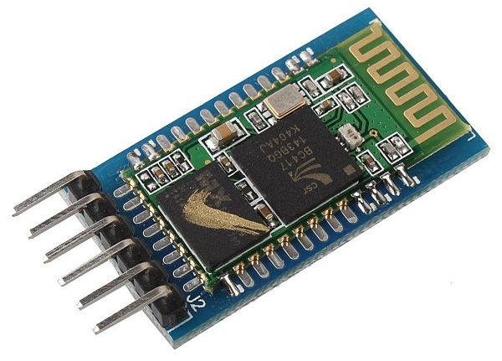
HC-05 Bluetooth Module
Purpose: Allow the motorcycle and helmet units to interface with each other
Low connection setup complexity
Flexibility of setting each module to a master or slave
Capable of remembering the last paired device for auto pairing
Low power consumption with 30 mA maximum draw
Features two modes:
  - Command mode
  - Data mode
Manufacturer | Cost
Sunkee | $7.75

Slide 24
Display Selection
 | 1.8” color TFT LCD display | 2.2” 18-bit color TFT LCD display | Serial Graphic LCD 160x128 | 3.2” Serial TFT LCD with touchscreen | 16x2 Parallel Character LCD
Manufacturer | Adafruit | Adafruit | Sparkfun | Sparkfun | Crystalfontz
Part No. | 358 | 1480 | 08884 | 11677 | CFAH1602D-YTI-ET
Power | 3.3/5V @ 100mA | 3.3/5V @ 50mA | 6/7 V @ 220mA | 4/5.5V @ | 3.3/5 @1.2mA
Cost | $19.95 | $24.95 | $69.95 | $84.95 | $10.72
Overall dimensions | 1.35" x 2.2" x 0.25" | 1.59" x 2.61" x 0.23" | 4.0” x 5.0” x 0.65" | 2.21” x 3.63” x0.63” | 3.35” x 1.18” x 0.52”
Purpose: Display indicator signals to the rider based on input from the modules
Factors to consider:
Size
Cost
Compatibility with GUI design

Slide 25
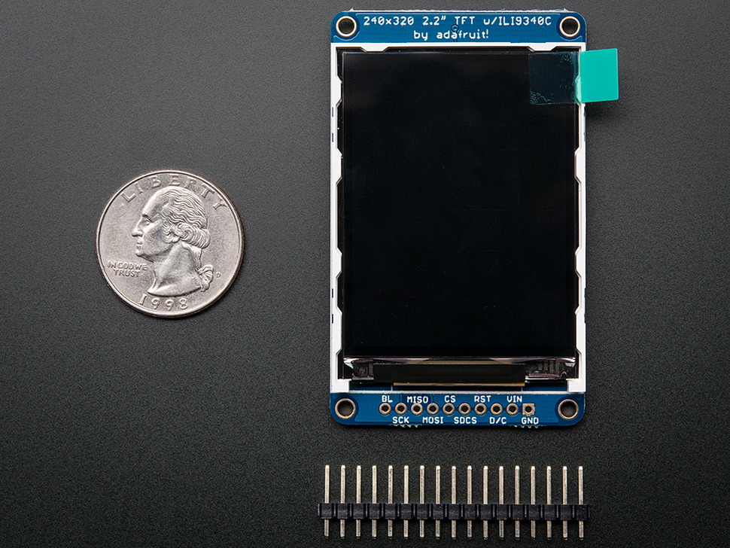
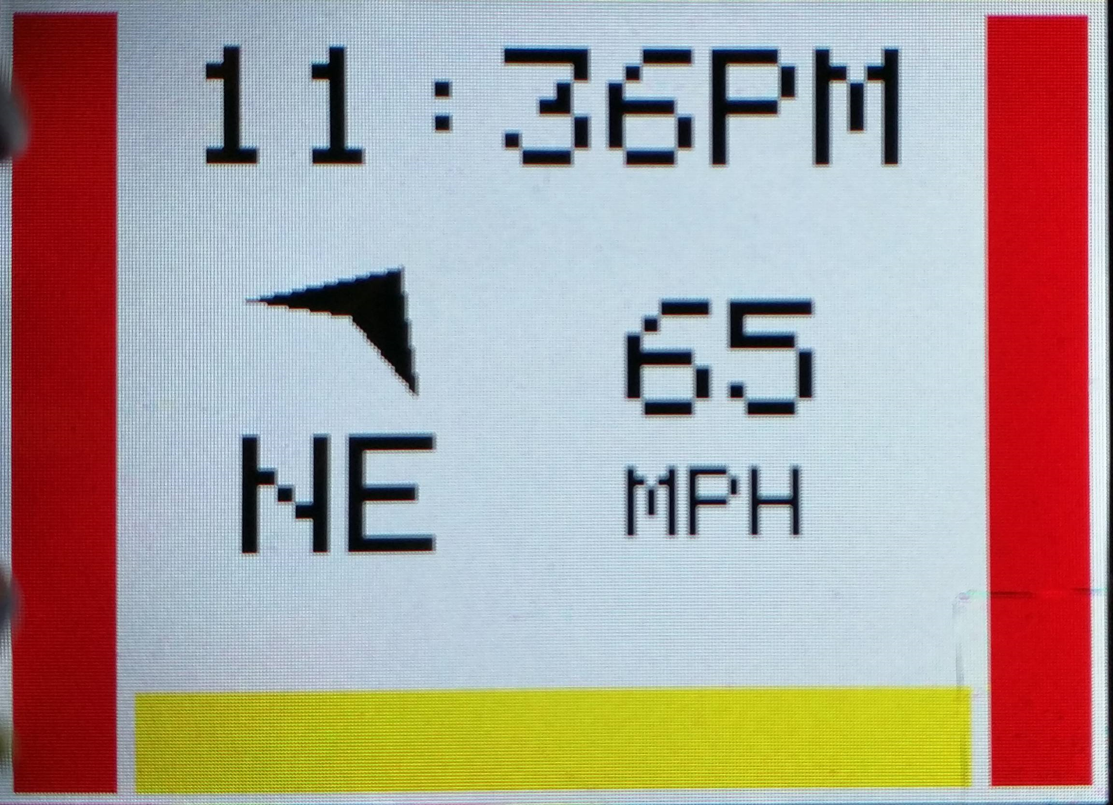
Adafruit 2.2” TFT LCD Display
Screen: 55.23mm x 40mm x 2.46mm
Backlight
4 wire SPI
320x240 color pixels
Indicators will change based on data from the modules

Slide 26
Sensor Selection
Purpose: Detect objects to the left, right, and rear of the rider.
Factors to consider:
Cost
Detection distance
Both sensors were tested to determine actual range
- HC-SR04 sensors were only
accurate to about 90cm
- LV-MaxSonar-EZ sensors were
accurate to approximately 600cm
 | HC-SR04 Ultrasonic Sensor | LV-MaxSonar-EZ 1010 Ultrasonic Sensors
Manufacturer | RobotLinking | MaxBotix
Part No. | 746591610098 | MB1010
Maximum range | 400cm | 645 cm
Resolution | 0.3cm | 1”
Power | 75 mW | 5-15 mW
Cost | $8.69/5 sensors | $29.95
Overall dimensions | 45 x 20 x 15mm | 19.9 x 22.1 x 15.5mm

Slide 27
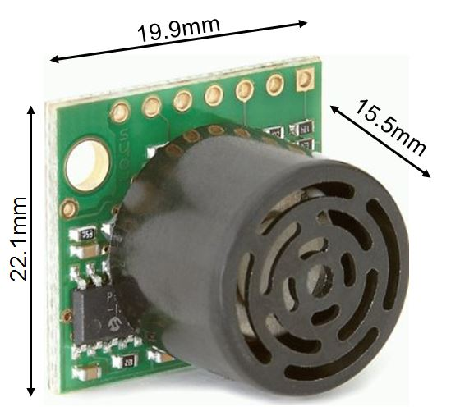
LV-MaxSonar-EZ 1010 Ultrasonic Sensors
Independent connections
  Each sensor would need to receive its own trigger signal and data connection
  Slower detection rate but less sensor interference
Multiple sensors per connection
  Uses fewer pins
  Less processor interaction
  The entire array can be triggered at the same time providing simultaneous range data
  Requires only one trigger signal connection, but an individual data connection for each sensor
  Faster detection rate
Manufacturer | Cost
MaxBotix inc. | $24.95

Slide 28
Sensor Threshold Levels
 | Distance (cm) | Indicator Color
No Hazard | > 600
Warning | 400-600
Danger | < 400

Slide 29
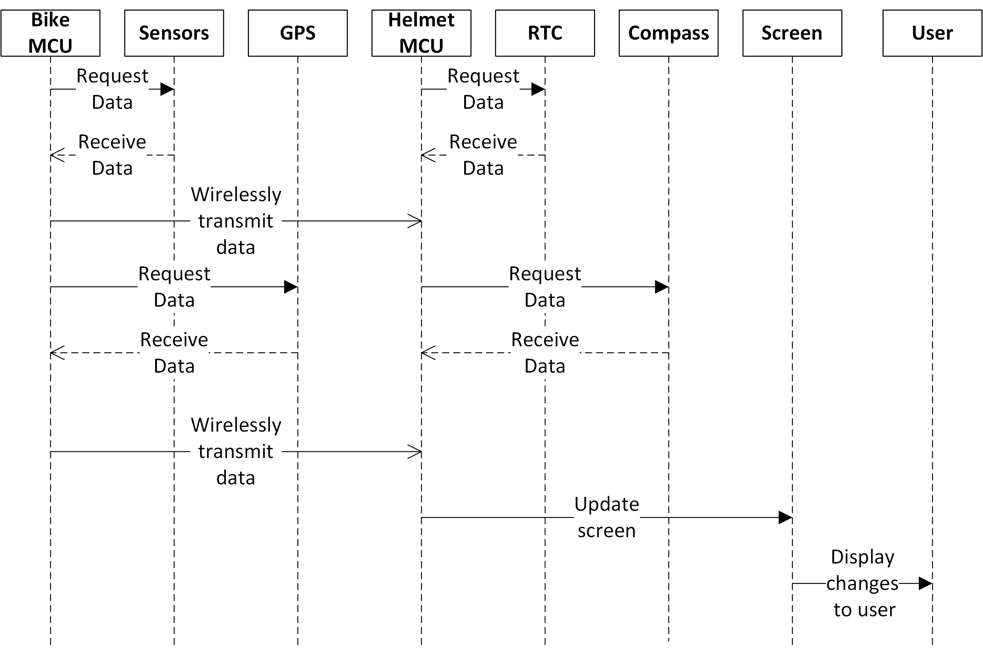
Sequence Diagram

Slide 30
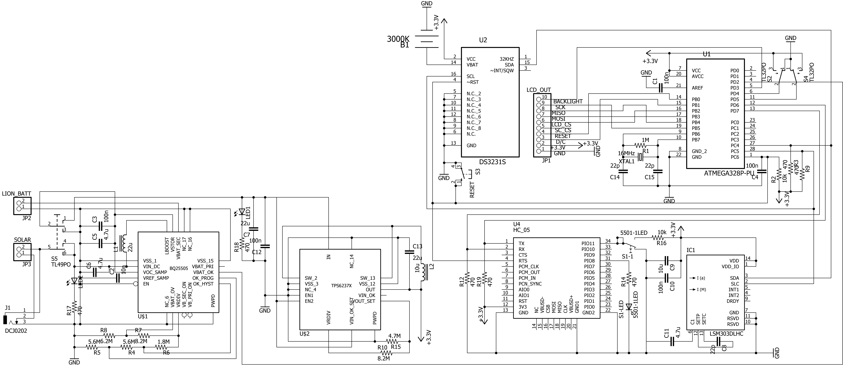
Helmet System Schematic

Slide 31
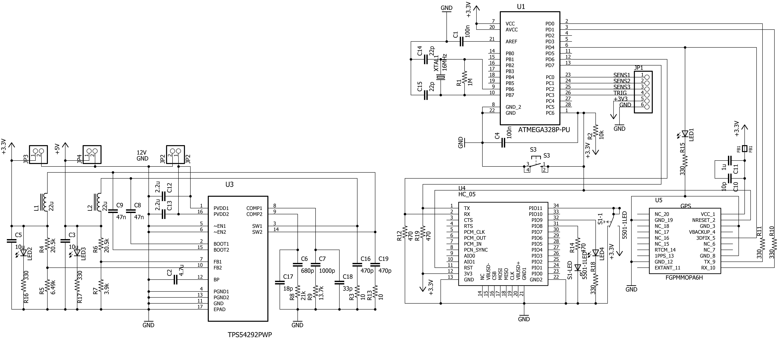
Motorcycle System Schematic

Slide 32
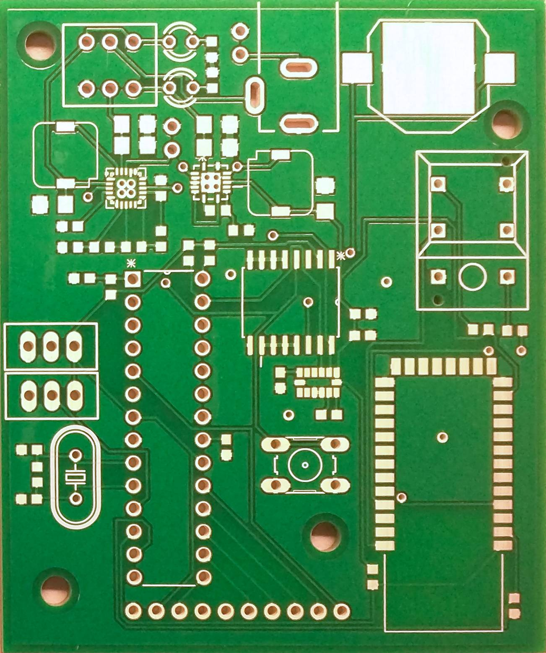
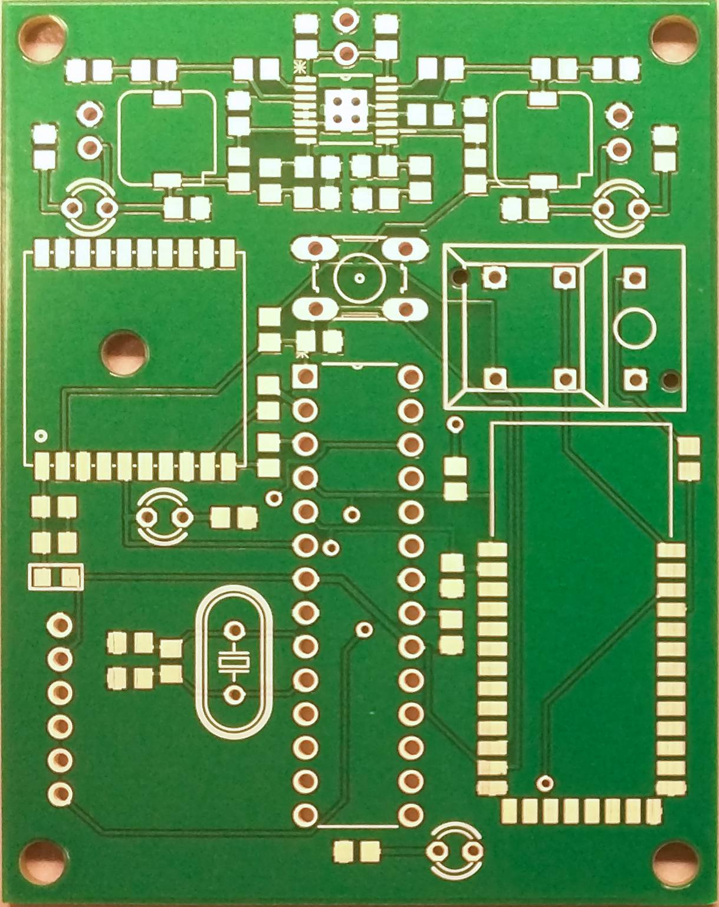
Printed Circuit Boards
Helmet Module
Motorcycle Module

Slide 33
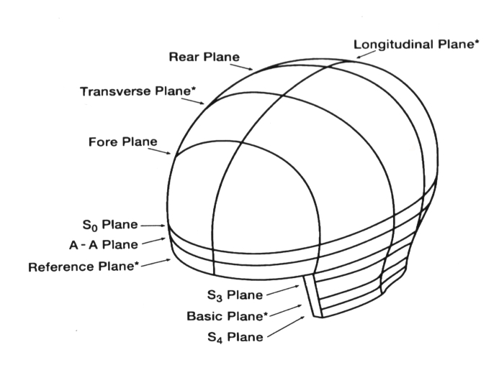
Standards
Federal Motor Vehicle Safety Standard No. 218 (Department of Transportation)
-Section 5.4: “The helmet shall provide peripheral vision clearance of at least 105 degrees
to each side of the mid-sagittal plane.” (shown below)
-Section 5.5: “A helmet shall not have any rigid projections inside its shell. Rigid projections
outside any helmet's shell shall be limited to those required for operation of essential
accessories, and shall not protrude more than 0.20 inch (5 mm).”

Slide 34
Standards
Snell Memorial Foundation Helmet Safety Standards
- “Any feature projecting more than 7 mm beyond the outer surface must readily break
away; all other projections on the outer surface shall be smoothly faired and offer minimal
frictional resistance to tangential impact forces.”
- “The helmet shall provide peripheral visual clearance as measured using a reference
head form appropriate to the size of the helmet. This peripheral vision includes a
horizontal clearance of at least 210º, an upward clearance of at least 7º and a downward
clearance of at least 30º.”
American Association of State Highway and Transportation Officials
- Maximum lane width is 12 feet.

Slide 35
Testing
Speed
      - Compared speed read and displayed to speed shown on motorcycle speedometer
Compass
- Compared cardinal direction read by compass to the one shown by the stock Apple compass
app
Time
- Compare time displayed by real time clock to the time given by time.gov
Sensors
- Objects were placed at varying distances and the indicator colors were observed

Slide 36
Budget and Spending
Supplier | Part Number | Nomenclature | Total
Mouser | A2235-H | GPS Modules SiRFStarIV GPS receiver SMT ROM mod | $28.84
Mouser | LSM303DLHC | Accelerometers E-compass 3D accel & 3D magnetometer mod. | $11.60
Mouser |  | Surface mount components, locking toggle switch, SMD Inductor 10uH, Battery Holder | $89.13
Texas Insturments | TPS54292PWPR | Dual, Fully-Synchronous Buck Converter With Integrated MOSFET | $31.50
Texas Insturments | BQ25570RGRR | Ultra Low Power Harvester Power Management IC with Boost Charger | $27.00
Texas Insturments | TPS62737RGYR | Programmable Output Voltage Ultra-Low Power Buck Converter with 200 mA Output Current | $10.00
Adafruit | 1480 | 2.2" 18-bit color TFT LCD display with microSD card breakout | $24.95
Adafruit | 790 | Ultimate GPS Module - 66 channel w/10 Hz updates | $29.95
Adafruit | 1120 | Triple-axis Accelerometer+Magnetometer (Compass) Board | $14.95
Adafruit | 746 | Ultimate GPS Breakout - 66 channel w/10 Hz updates | $39.95
Adafruit | 601 | Adafruit AVR ATmegaXX8 Pinout Sticker - 10 pcs | $2.95
Adafruit | 1207 | SMT Breakout PCB for SOIC-16 or TSSOP-16 - 3 Pack | $3.95
Adafruit | 1212 | SMT Breakout PCB for SOIC-8, MSOP-8 or TSSOP-8 - 6 Pack | $2.95
Adafruit | 1480 | 2.2" 18-bit color TFT LCD display with microSD card breakout | $24.95
Sparkfun |  | Polymer Lithium Ion Battery - 2000mAh, Break Away Headers | $14.45
Maxim Integrated | DS3231MZ/V+ | ±5ppm, I2C Real-Time Clock | $0.00
Amazon | HC-05 | Sunkee 30ft Wireless Bluetooth RF Transceiver Module serial RS232 TTL HC-05 for arduino | $25.53
Amazon | MB-102 830 | Frentaly Point Prototype PCB Breadboard, DIP-20 SMT Adapter, DIP-14 SMT Adapter | $22.06
Amazon | MB-1010 | Ultrasonic Distance Sensor | $119.80
Amazon | HC-SR04 | 5PCS Ultrasonic Module HC-SR04 Distance Sensor for Arduino UNO MEGA R3 Mega2560 | $8.59
Amazon | Atmega328P-PU | 3-pack NEW Atmega328p-pu Chip w/ Arduino UNO Bootloader | $13.49
Amazon |  | 50 Value Resistor & 32 Value Capacitor Assortment Kit & Assorted Clear LED Light Emitting Diodes 5 Colors Pack of 300 | $26.98
Amazon |  | Hilitchi 515 Pcs 40 Pin 2.54mm Pitch Single Row Dupont Connector Kit | $19.99
Amazon |  | Mounting Accessories & Battery Tender Ring Terminal Harness with Black Fused 2-Pin Quick Disconnect Plug | $25.29
PentaLogix |  | QuickTurn Prototype PCB | $237.60
OSH Park |  | Helmet Module 3 boards & Bike Module 3 boards at $33.45 per batch of three | $61.25
 |  | Shipping & Expedited Services | $358.25
 |  | Total | $1,275.95
 |  | Funding | $532.48
 |  | Budget | $592.00

Slide 37
Progress to Date

Slide 38
Future
More dynamic display
Transparent or projected display
Solar power
More user interaction
Design modifications to meet industry standards

Slide 39
Questions?

