Slide 1
Autonomous firefighting robot
Philip Fritz EE
Dylan Moro EE
Bryanna Saavedra EE
Dustin James EE

Slide 2
Project Description/Requirements
A small autonomous vehicle
Ability to navigate maze autonomously
Fire detection and suppression
Manual drive capability
Lightweight and rugged in design
Notes:
A small autonomous vehicle able to navigate a maze and detect fire. After the fire has been detected, the vehicle will approach and extinguish the fire. The vehicle will also have the capability to be manually overridden and controlled via wireless remote with FPV video relayed to a small monitor.

Slide 3
Motivation
Safer than sending human search and rescues
Can fit into smaller spaces than a person can
A scalable design that could be used in the field
  Fire suppression using more robust methods
  Image processing for human detection
  Chassis could be upgraded to a tank style body
Can go where there is a limited supply of oxygen

Slide 4
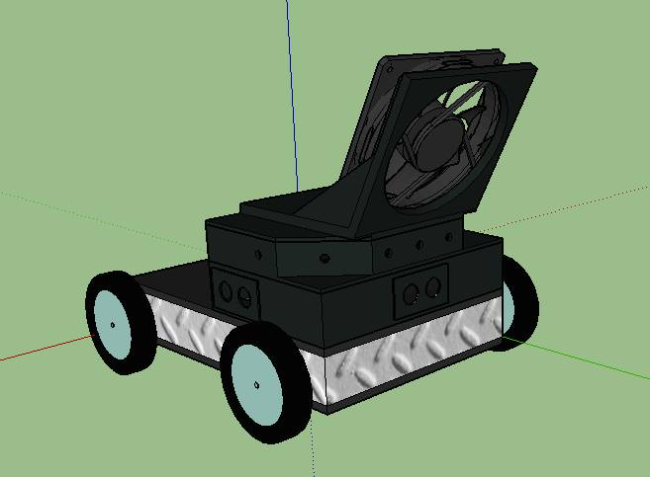
Constraints/Requirements
Environmental constraint: use of chemical extinguishers
School regulations mandate that during demonstrations, flame must be no larger than a tea candle size
Maze must fit in the demonstration area
Robot must have small turning radius
Maze must be easy to assemble and disassemble
Robot must be light enough to carry to the scene
Notes:
Edf jet

Slide 5
Specifications
All components must run off of 12 V or lower
Current draw must not exceed 50 A
Under 40 lbs for portability
Wheel base must be no wider than 18 in
Battery should last more than 15 minutes
Sensors should have at least a 180 degree combined field of view

Slide 6
Hardware Overview

Slide 7
Proximity Sensor
Purpose - To detect distance from edge of wall.
Possible solutions
  Image Processing
  LIDAR
  Ultrasonic
  Etc.
Chose Ultrasonic for proximity detection.

Slide 8
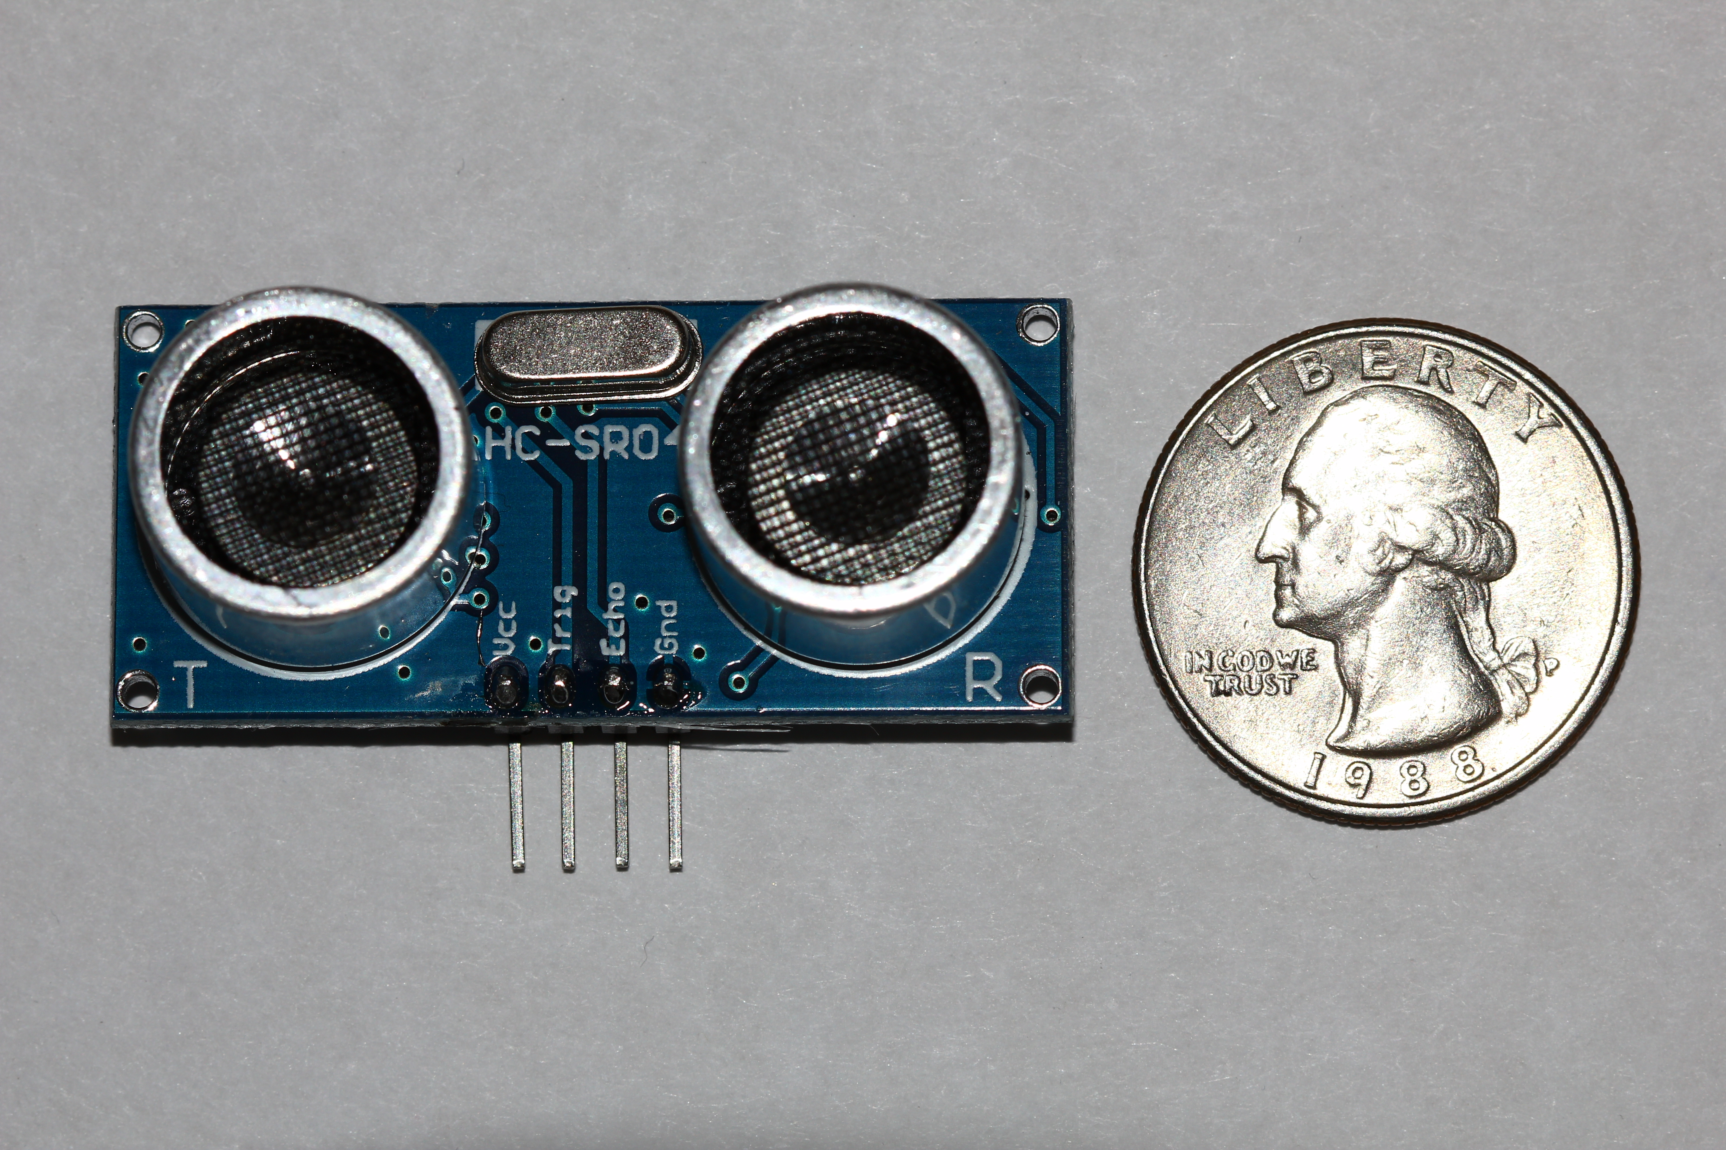
HC-SR04 Ultrasonic Sensor
Operating voltage - 5V
Continuous operating current – 15mA
I/O pins – 2
Max reading distance – 400cm
Min reading distance – 2cm
Cost - $7.95
Total measuring angle (degrees) – 60
Dimensions – 1.3 x 0.4 x 0.1 inches
Procured from – Amazon.com
Notes:
Start: brief description of purpose for using ultrasonic Sensor and how it works

Slide 9
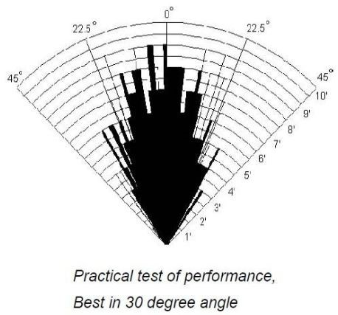
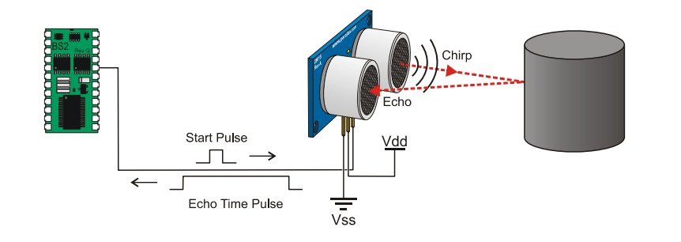

Use of Ultrasonic Sensor
Distance=$\frac{speed of sound X time taken}{2}$
Number of Sensors used – 3

Slide 10
Flame Sensor
Purpose – To detect distance and direction from flame.
Possible solutions
  Image processing
  Temperature sensing
  Infrared/visible signature detection
Chose infrared/visible signature detection

Slide 11
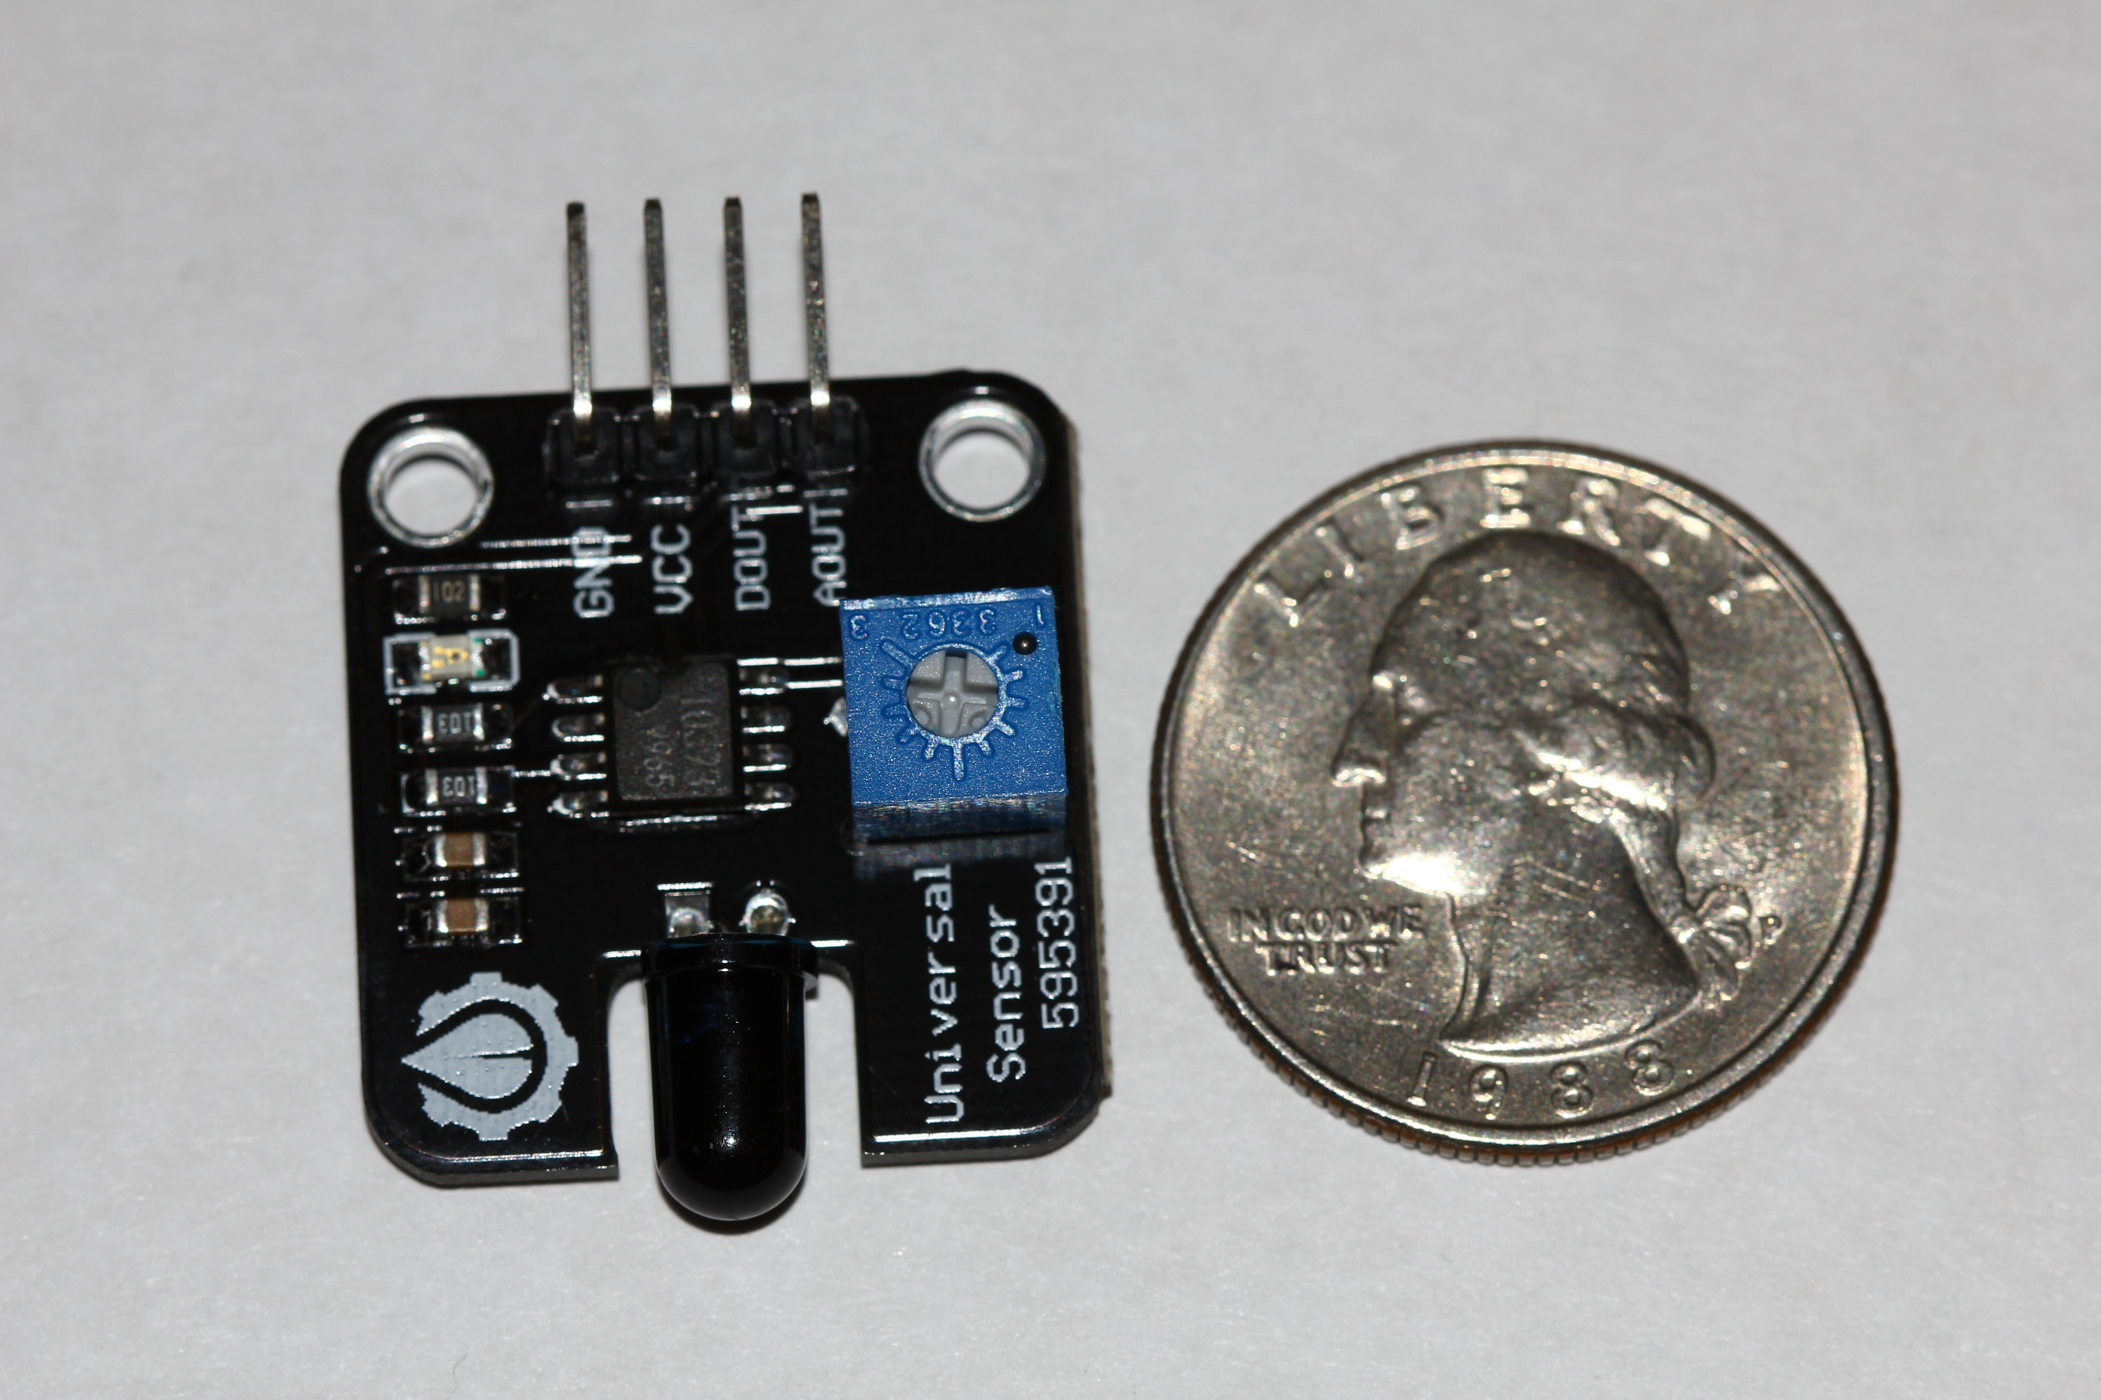
YW Robot Infrared Sensor
Operating voltage – 5v
Continuous operating current – 20mA
I/O pins – 2
3 adjustable sensitivity settings
Approximately 60 degrees detection angle
Detects light waves between 760 nanometer to 1100 nanometer
Cost- $4.40
Procured from Amazon.com

Slide 12
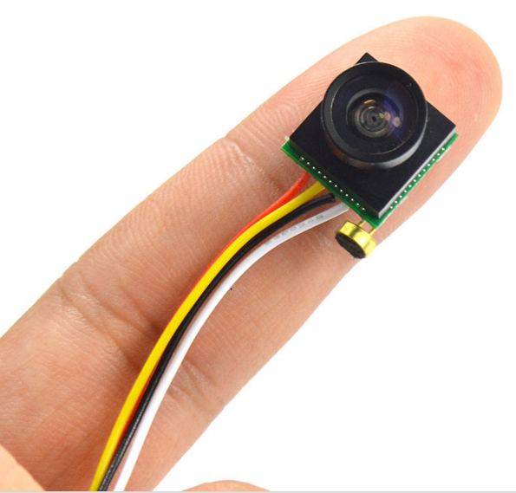
Mini CMOS Wide Angle FPV Camera
Purpose – To assist in manual navigation
Viewing angle – 170 degrees
  Humans binocular view is only approximately 120 degrees
Operating voltage – 9-12v
Continuous operating current – 55mA
Size - 2x1.6x1.5cm
Picture resolution – 1280 x 960
Cost - $15.99
Procured from http://www.dx.com/

Slide 13
7"LCD TFT FPV Monitor
Resolution:480（H） X 234（W）
Operating voltage: DC12V
Rating power:7.5W
Screen size:150mm X 90mm
Size:179mm X 120mm X 20mm
Current draw: 0.625 A
Cost: $49.92
Purchased from: Amazon.com

Slide 14
Radio Control Transmitter
Purpose – To control robot during manual mode operations
Possible solutions
  2.4 GHz radio frequency
  5.8 GHz radio frequency
  Xbee
  Infrared
  Bluetooth 3.0
Chosen method – 2.4 GHz radio frequency

Slide 15
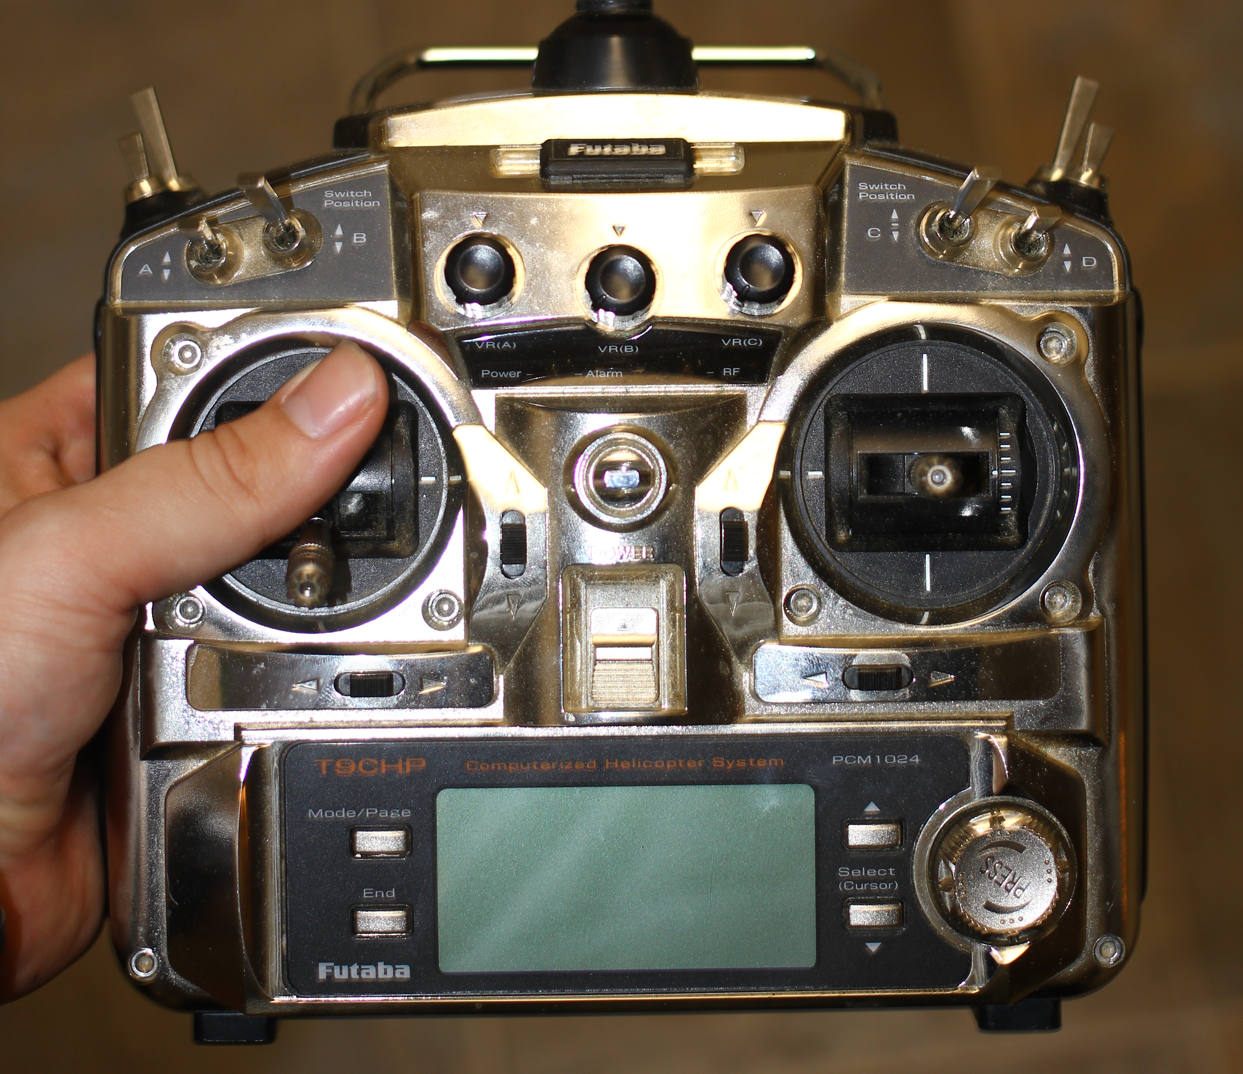
Futaba 9c with 2.4 GHz Spektrum Transmitter Module
Easily available (already acquired)
2.4 GHz radio frequency commonly propagates further than other options
Uses encoding schemes such as DSM and DSM2 to avoid cross interference
2.4 GHz transmitter controllers are generally easy to program
Futaba 9c offers 9channels of operation
Notes:
Add picture

Slide 16
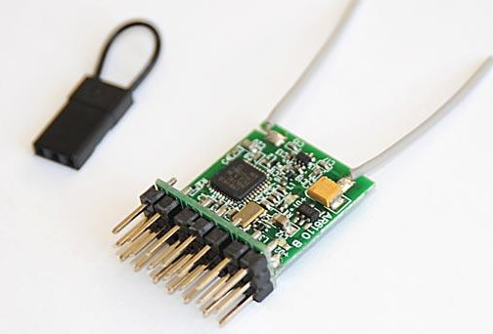
Orange Rx R615X DSM2/DSMX 6CH 2.4 GHz Receiver
6 PWM channels
Operating voltage – 3.7-9.6 volts
Continuous operating current – 40mA
Weight – 3.7g
Size – 19.5x30x10mm
Compatible with DSM2/DSM module systems
Cost-$15
Procured from HobbyKing.com
Notes:
Picture needed

Slide 17
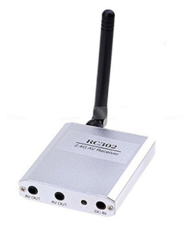
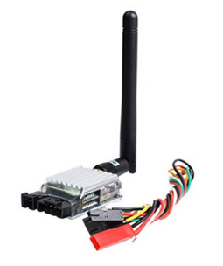
8CH Boscam Wireless Transmitter Receiver 5.8 GHz
Operating voltage (Rx/Tx) – 7-15v
Continuous operating current (Tx) – 300mA
Continuous operating current (Rx) – 100mA
Operating radio frequency – 5.8GHz
Dimensions (Tx) – 55 x 26 x 17mm
Dimensions (Rx) - 61 x 52 x 13mm
Weight (Tx) – 52g
Weight (Rx) - 120g
Cost - $34
Procured from Amazon.com

Slide 18
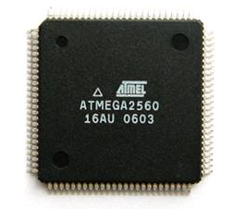
MCU
Chose Atmega 2560
Flash: 256 Kbytes
Max I/O pins: 86
CPU: 8-bit
Max operating frequency: 16MHz
Open source libraries
Operating voltage: 1.8-5.5 v
PWM channels: 15
Dimensions: 16 x 16 mm
Cost: $16.75
Purchased: digikey.com

Slide 19
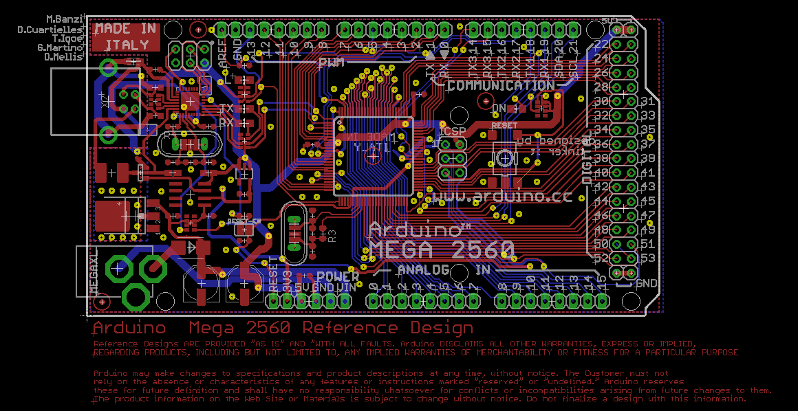

Slide 20
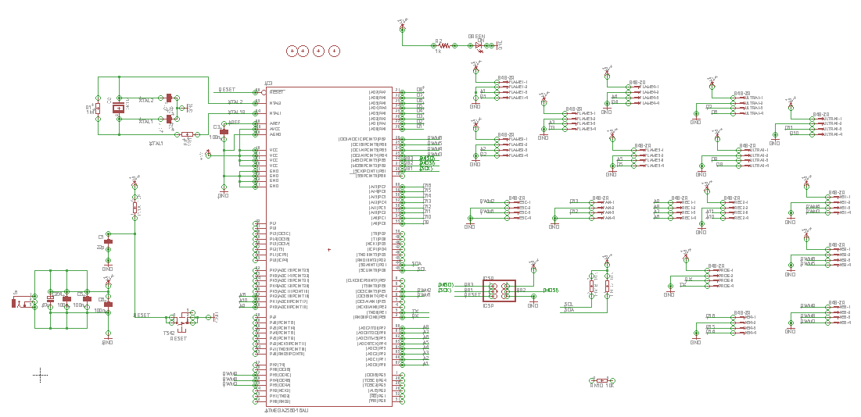

Slide 21
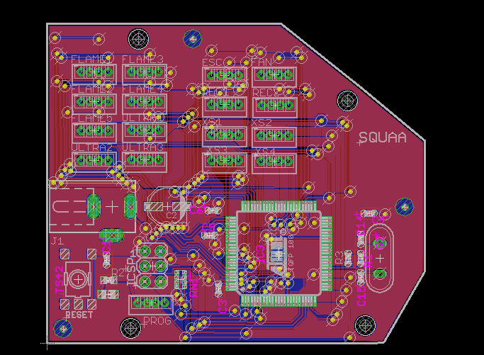

Slide 22
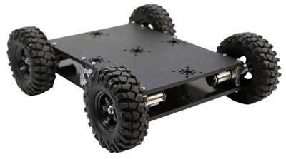
Chassis
Dimensions of chassis: 7.5 x 10.5 in
Dimensions of wheels: 4.3 in
Weight: 3.35 lbs
Materials: ABS plastic and aluminum
Benefits:
  Low profile
  Lightweight
  Sturdy
Purchased from: servocity.com
Price: $169.99

Slide 23
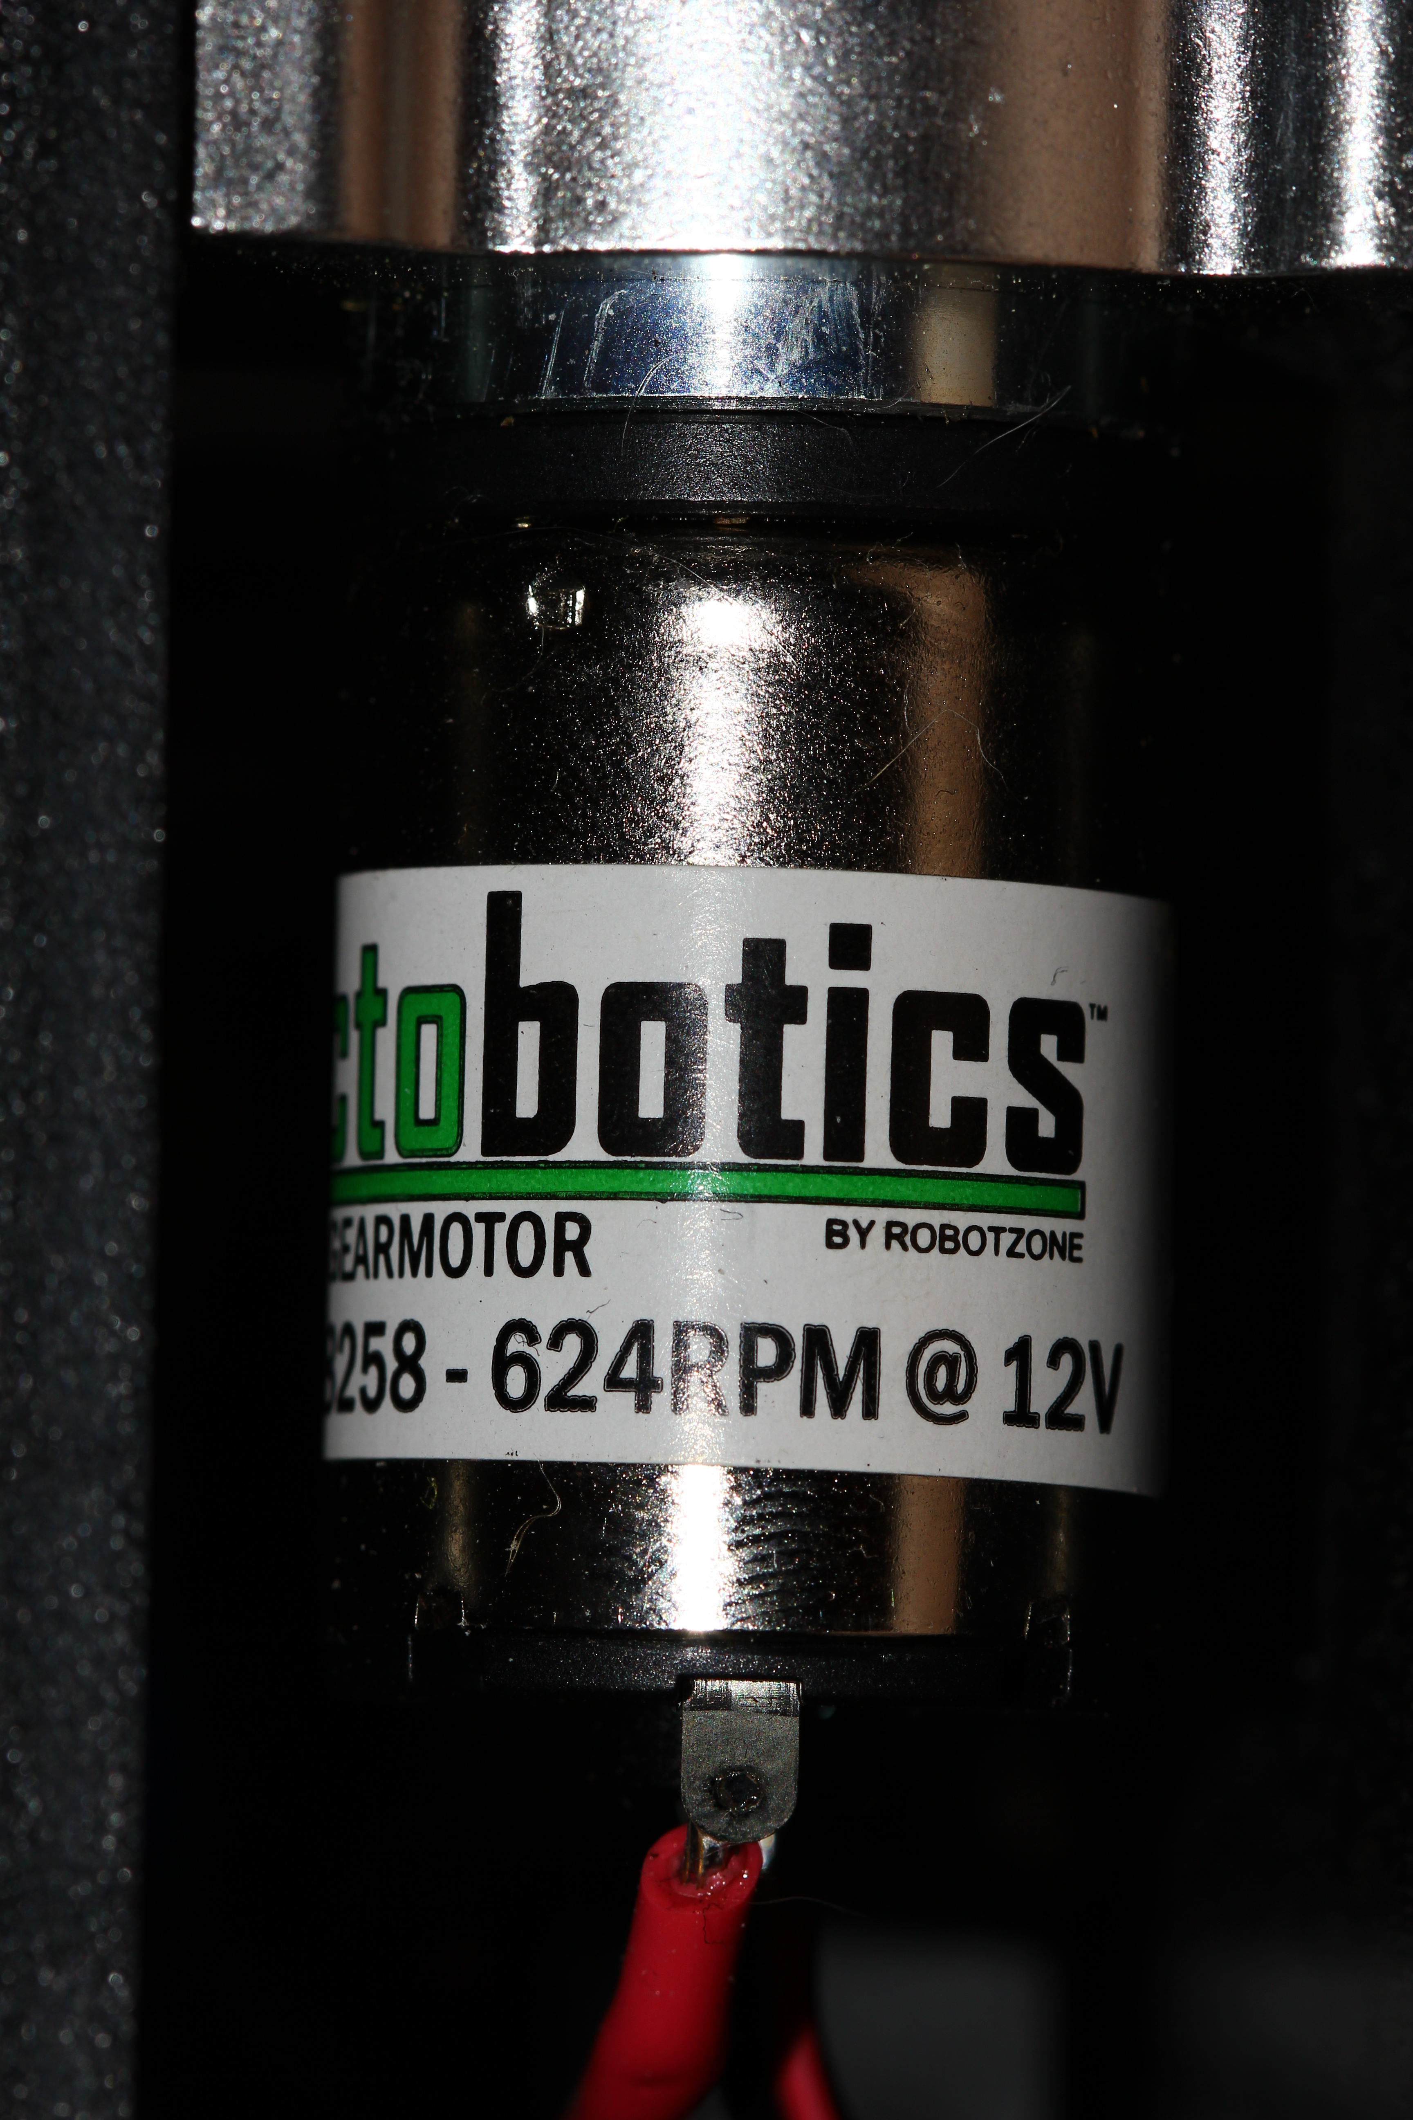
Chassis Motors
624 RPM Precision Planetary Gear Motors
Operating voltage: 3-12 V DC
Rated load: 8.33 ounces per in
No load current: 0.19 A
Max stall current: 4.9 A at 12 V DC
Stall torque: 41.7 oz per in
Gear ratio: 19:1
Weight: 82 g
43.7 x 20 mm
Notes:
Add picture

Slide 24
Chassis Motor Controller
Hobbywing Quicrun 1060 Brushed ESC
Operating voltage: 8.4-12.6 V
Forward continuous/peak current: 60/360 A
Reverse continuous/peak current: 30/180 A
Dimensions: 36.5 x 32 x 18 mm
Weight: 39 g
Benefits:
  Forward/reverse/brake function
  Fail safe protection
  Low voltage protection
  Water and dust proof
Purchsed from: Amazon.com
Price: $22.30
Notes:
Add picture

Slide 25
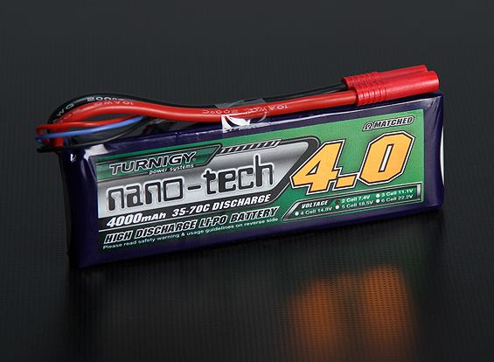
Power Supply
Turnigy Nanotech 3s LiPo
Capacity: 4000 mAh
Discharge: 35C constant/70C burst
Connector: xt60
Dimensions: 152 x 49 x 21 mm
Weight: 335 g
Purchased from: amazon.com
Price: $36.99

Slide 26
Power Regulation
RC Servo UBEC
Operating input: 5.5-26 V
Output voltage: 5V
Maximum current output: 3 A
Benefits:
  Lightweight
  Compact
  versatile
Price: $8.28
Purchased: amazon.com

Slide 27
Software and Algorithm Development
Programming language – C++
Programming environment – Arduino IDE
2 operating modes
  Manual
  Autonomous

Slide 28
Manual Mode
Purpose
  Realistic design – transport, functionality
  Testing purposes
  If autonomous mode fails and control is lost
Triggered by remote control at any time
Uses pulseIn function from Arduino ide library
  pulseIn(pin,value,timeout)
    Pin – assigns input pin to read PWM
    Value- if value is assigned HIGH the function waits for the pin to go HIGH, starts timing, then waits for pin to go LOW
    Timeout-amount of time waited for pin to go HIGH before timing out

Slide 29
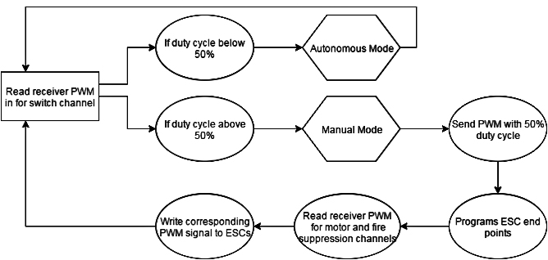
Manual Mode

Slide 30
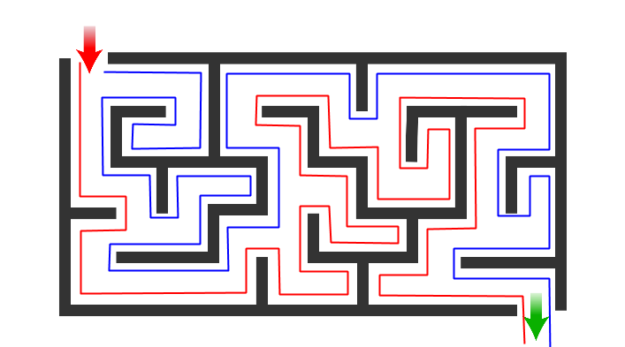
Autonomous Mode
Right hand Rule
  Effective
  Always works if there is one entrance
  Used in real fires when vision is obstructed

Slide 31
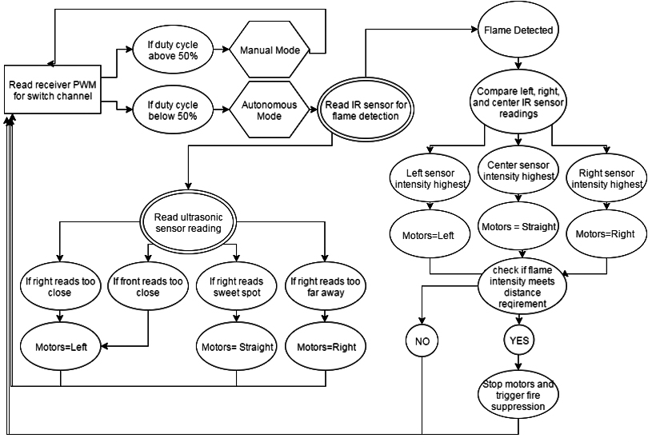
Autonomous Mode

Slide 32
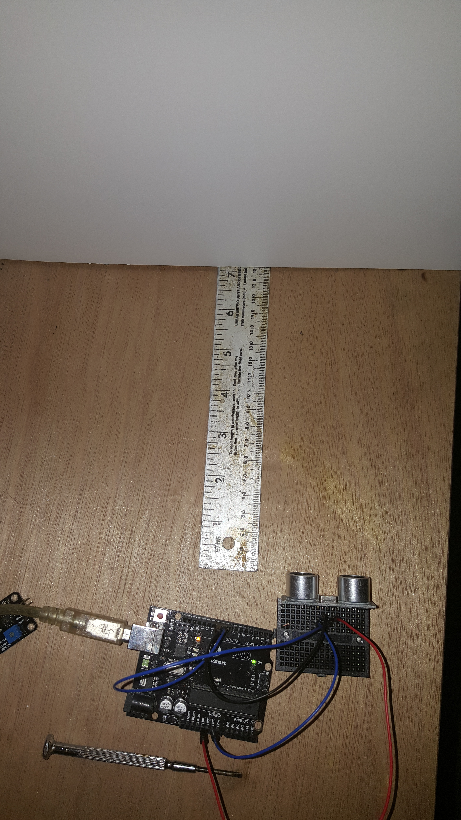
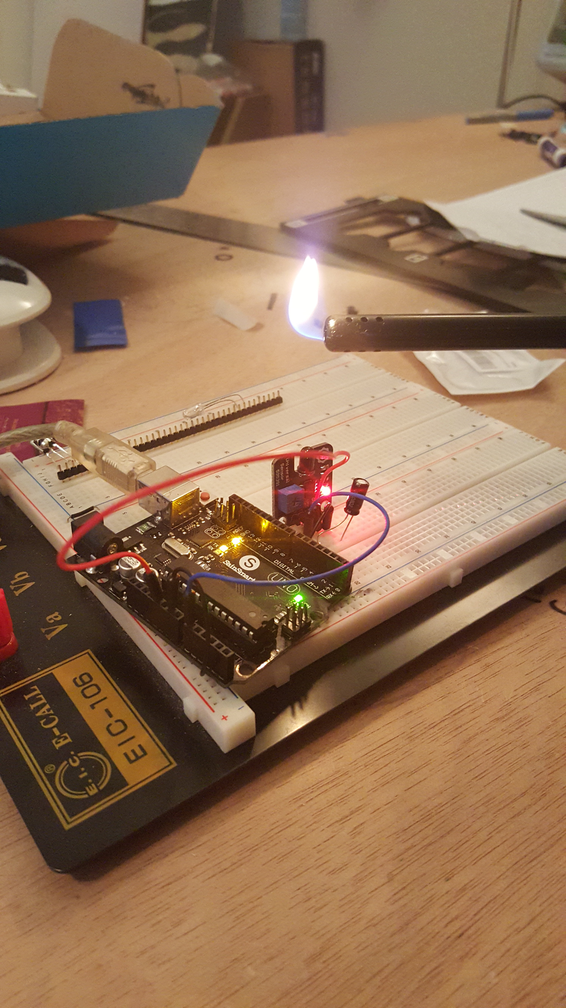
Testing

Slide 33
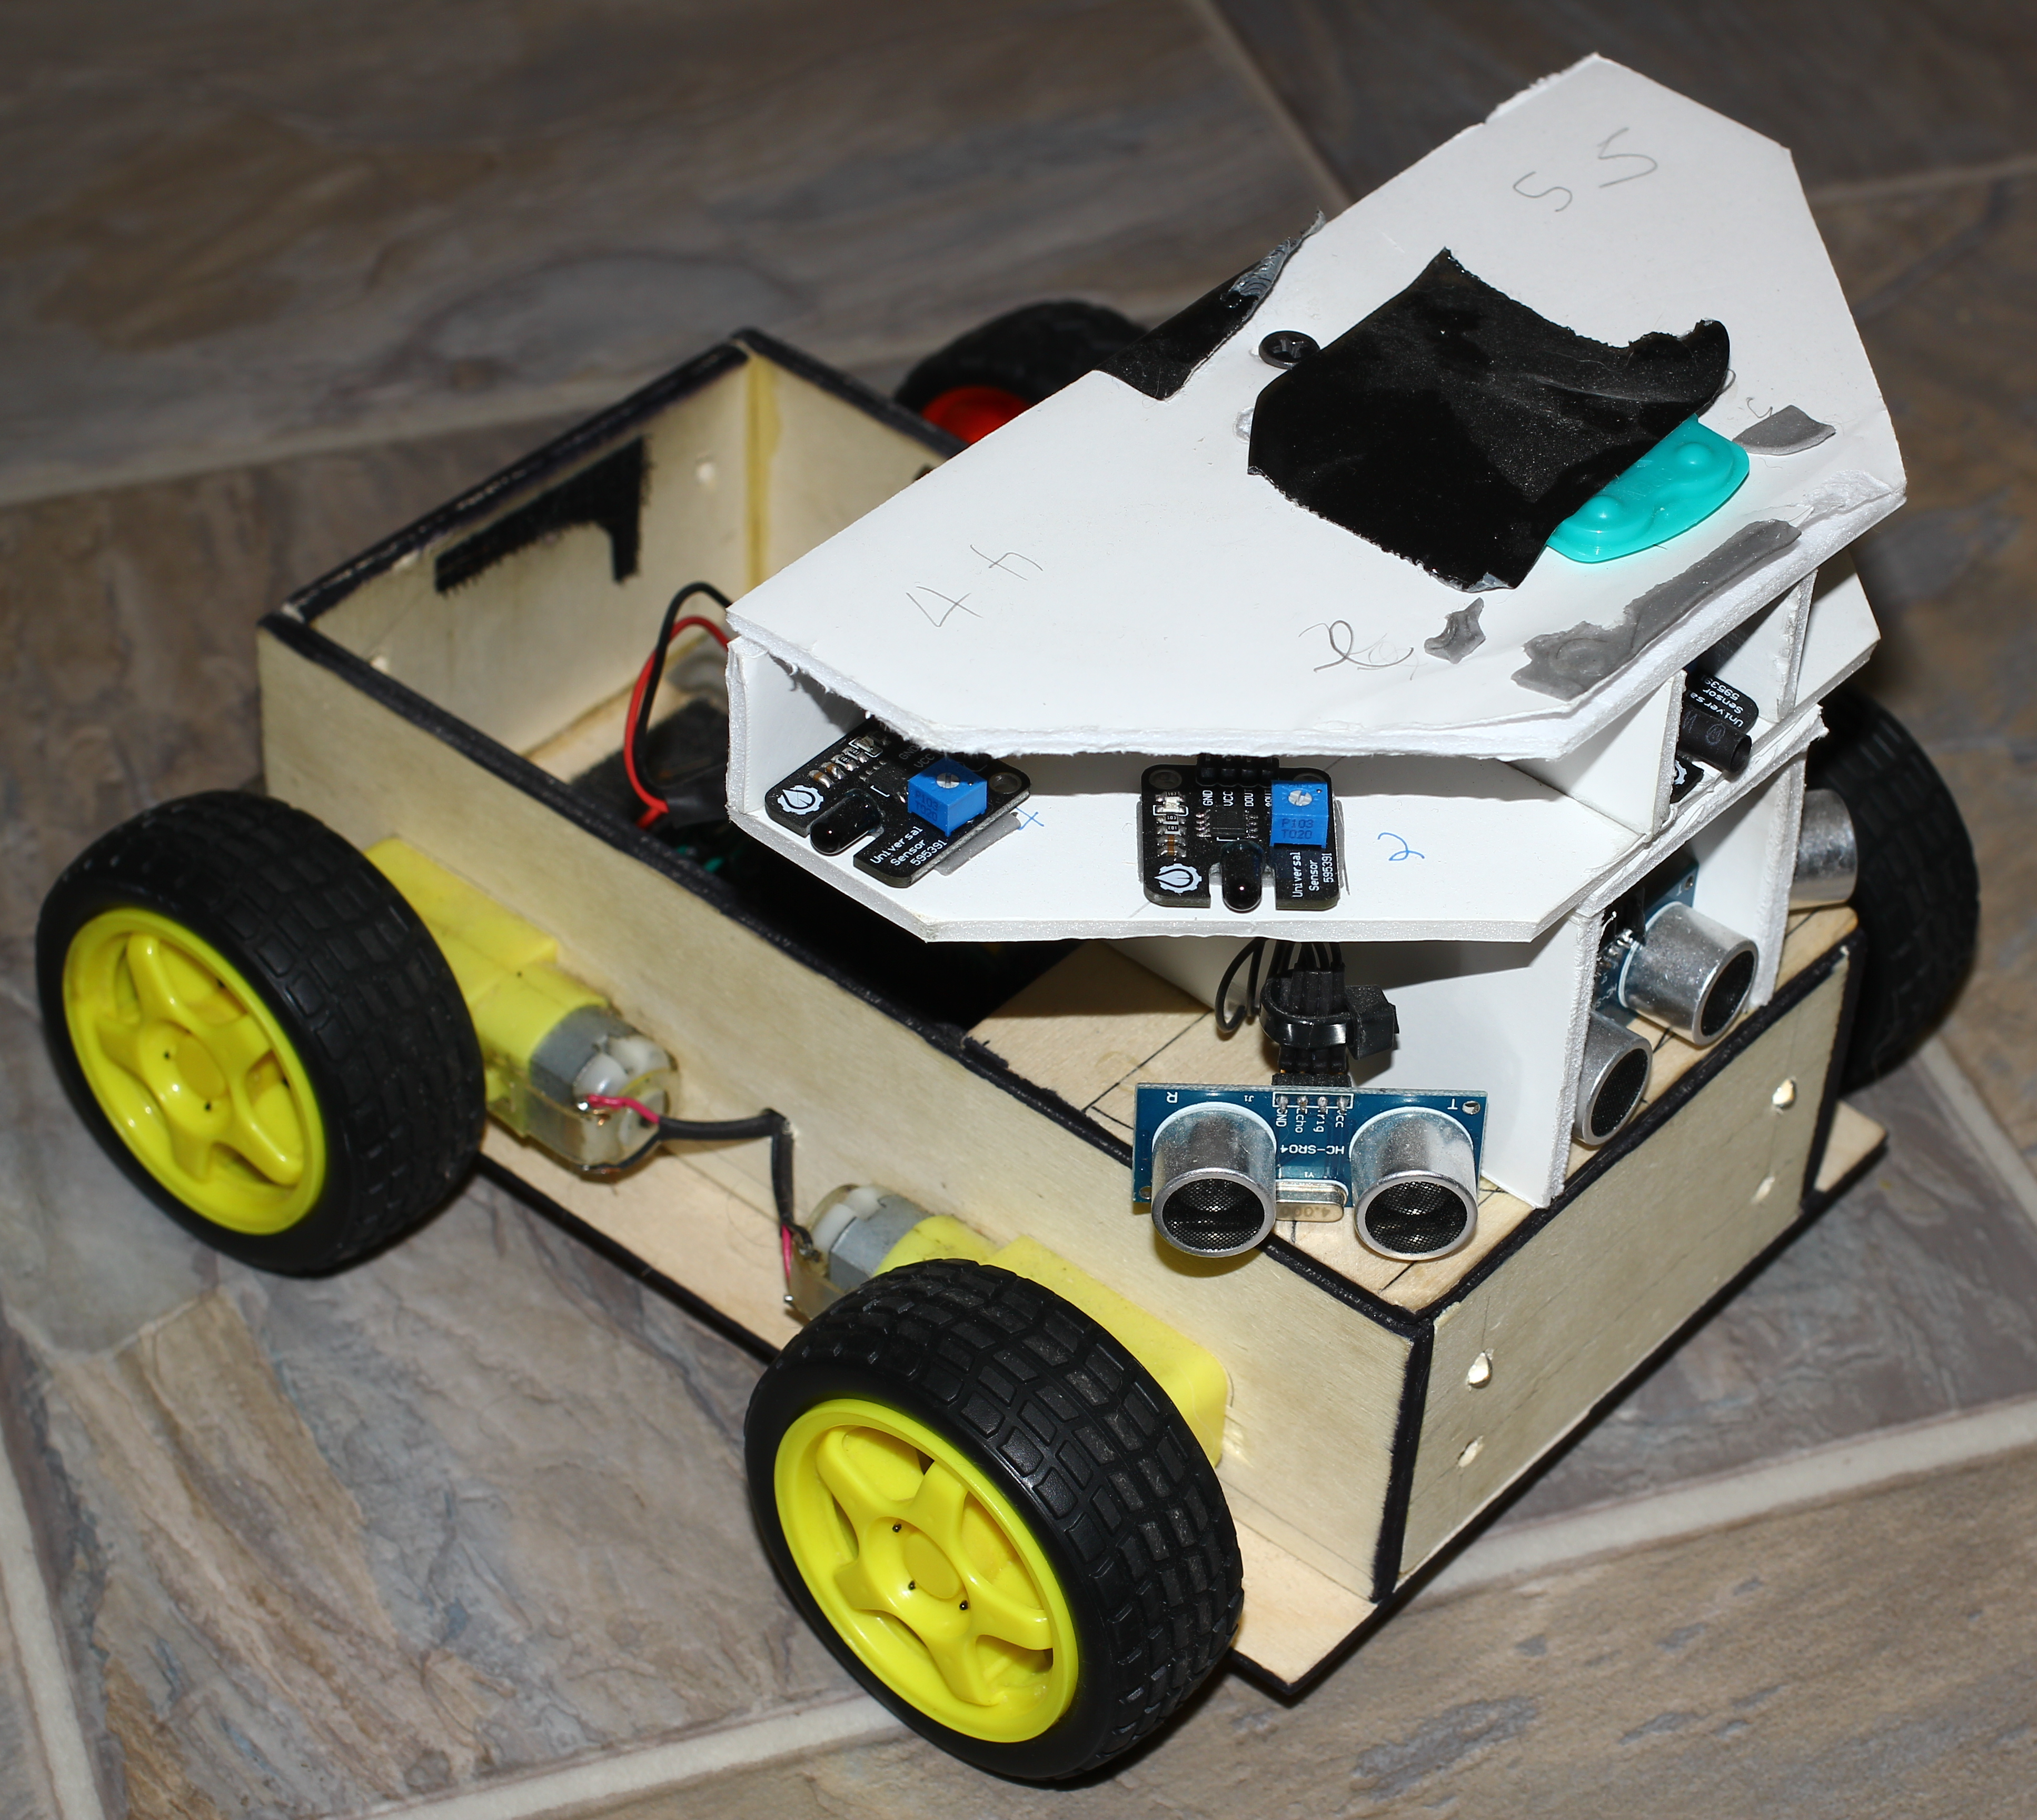
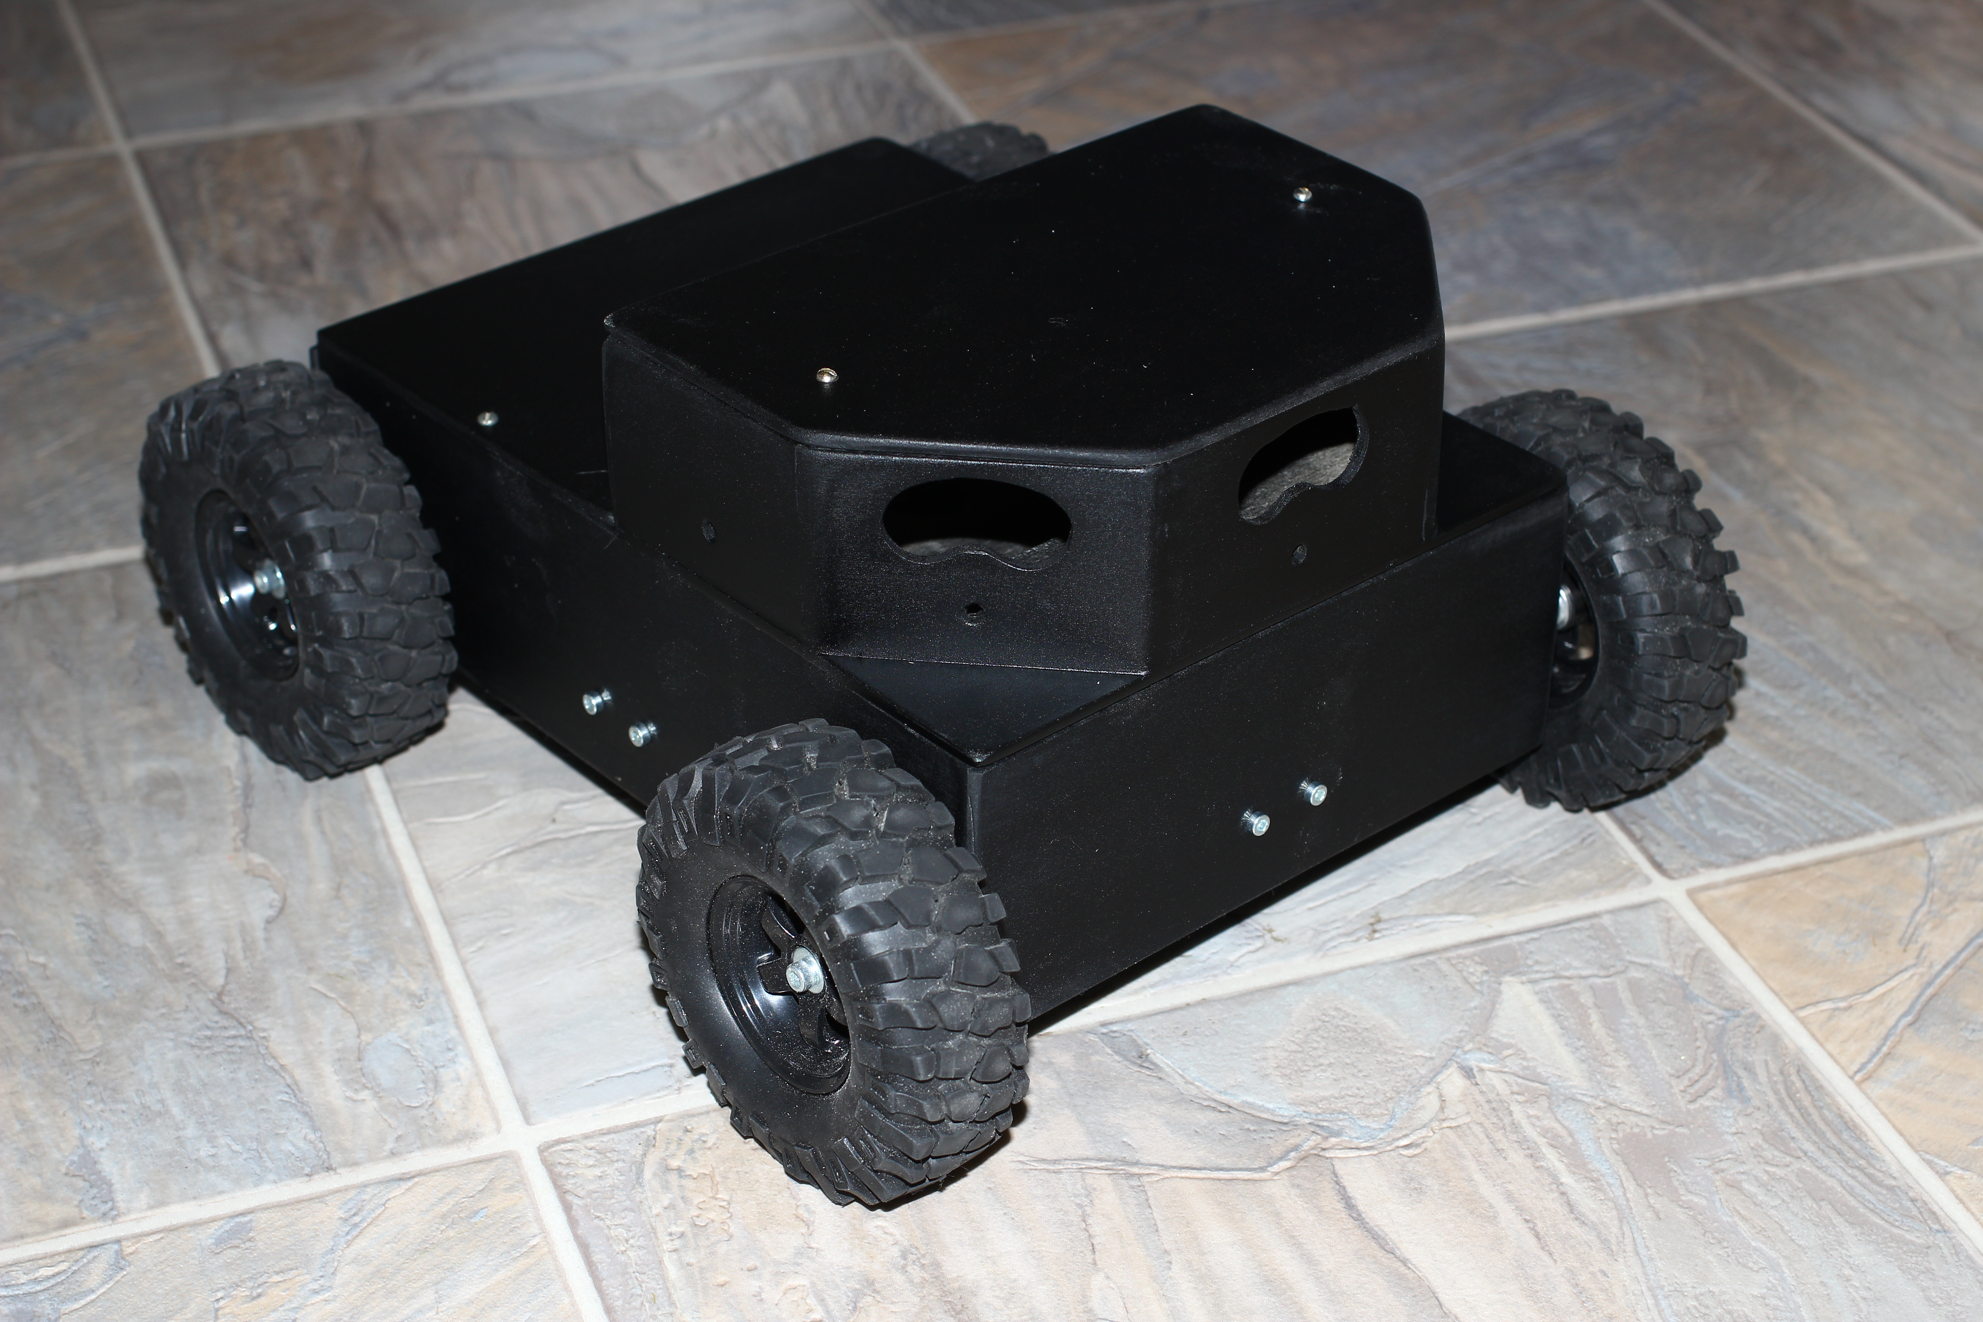
Prototype to Integration
Notes:
Old vs new

Slide 34
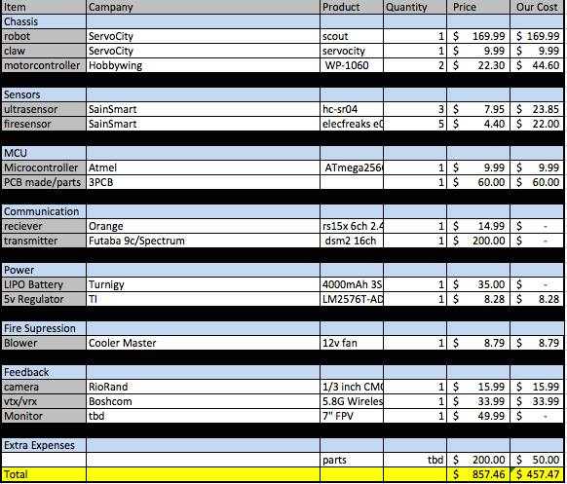
Expenses

Slide 35
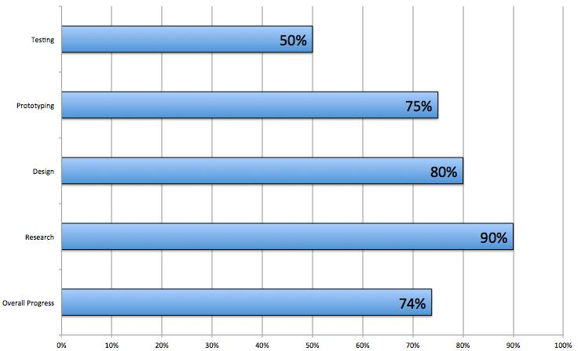
Progress

Slide 36
Complications
Continuing with maze after extinguishing fire
Smoothing movements and filtering sensor values
Efficiency of code
Library cross interference
Notes:
With the prototype, after the fire was extinguished, it had a hard time going back to the wall
Library cross interference: we've had issues when trying to move servos at the same time as reading a sensor, the same timer is used.

Slide 37
Division of Labor
 | Sensors | Programming | Packaging | PCB Design | Admin. Content
Philip | S | P | S
Dylan |  | S |  | P
Bryanna | P |  |  |  | S
Dustin |  |  | P |  | P
P = primary
S = secondary

Slide 38
Questions?

