Slide 1

HAQS:
Harmonic Analysis for Quality of Service
Sponsored by…...…...................
Critical Design Review
Group 19
Brian Angiel (EE), Nick Hellenbrand (EE), Louis Hofer (CpE), Kevin White (EE)
Notes:
ALL

Slide 2
Motivation
Nonlinear components cause distortion in power signals due to non-sinusoidal current draw
  Power transferred at harmonic frequencies:
    Cannot be used for “real work”
    Cause components to overheat
Total Harmonic Distortion (THD) is a quantitative measure of the amount of distortion in a signal
Allows the user to evaluate the quality of the power received
Notes:
K

Slide 3
Goals and Objectives

Slide 4
Primary Goals
System will be used to measure the quality of a power signal
Final design will incorporate a microcontroller to determine harmonic content
Minimize power consumption of the designed system
Information and UI will be displayed on a Touchscreen LCD
Data can be stored on removable media
Notes:
K

Slide 5
Requirements
Interface with single-phase and three-phase power outlets
    60 Hz, 120 VAC
Analyze voltage and current waveforms
Measure harmonic content up to the 51st harmonic, as well as subharmonics
Display Quality of Service, in the form of THD, on the LCD
Adhere to all applicable standards
Notes:
K

Slide 6

Relevant Standards
Total Harmonic Distortion Reporting Standard
    Comparing the harmonic content with a waveform's fundamental frequency
Electrical Safety Standards
    Occupational Safety & Health Administration (OSHA)
SPI Communication Standards
    Certain Slave/Master interactions depend upon different clock edges
    Some require extra clock idle time
  I2C Communication Standards
  Necessary Start / Stop conditions needed
Notes:
L

Slide 7
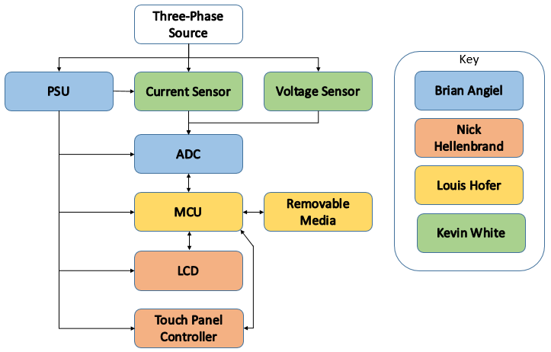
System Block Diagram
Notes:
L

Slide 8
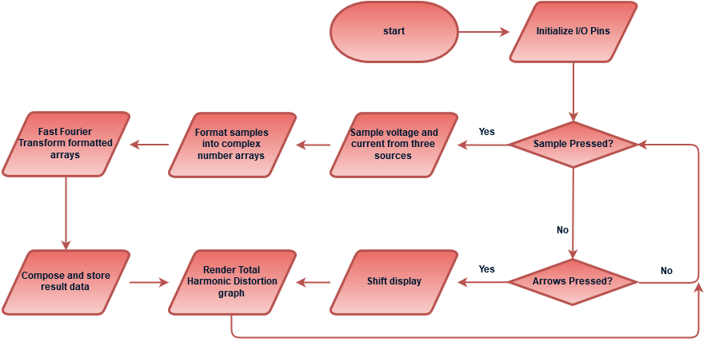
Process Flow Diagram
Notes:
L

Slide 9
Design and Implementation

Slide 10
Voltage Sensing Circuit
Voltage Divider
    Use series of large resistors to reduce current draw
    Limit power wasted by sensor
    Linear components will not introduce harmonic distortion
    Utilizes an antialiasing filter to remove content beyond the 51st harmonic
Considered Transformer
    Harmonics are created when the core reaches saturation
Notes:
K

Slide 11
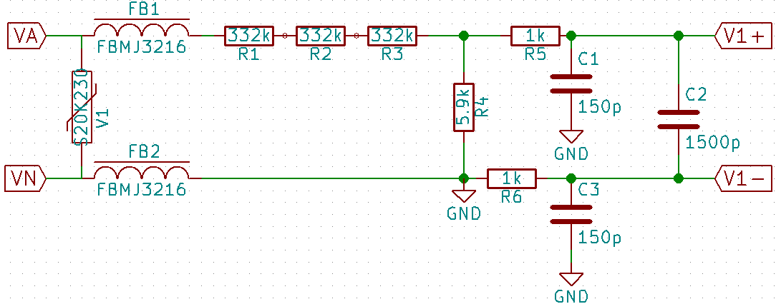
Voltage Sensing Circuit
Notes:
K

Slide 12
Current Sensing Circuit
  Current Transformer
    Passive sensor
    Electrically isolated from the metered system
    Current dependent voltage readings based on the specified burden resistor
    Current is determined simply using Ohm's Law
    Also utilizes an antialiasing filter to remove content beyond the 51st harmonic
  Considered Shunt Resistors and Hall Effect Sensors
    Use power to accurately sense current
    Shunt is not electrically isolated from the system
Notes:
K

Slide 13
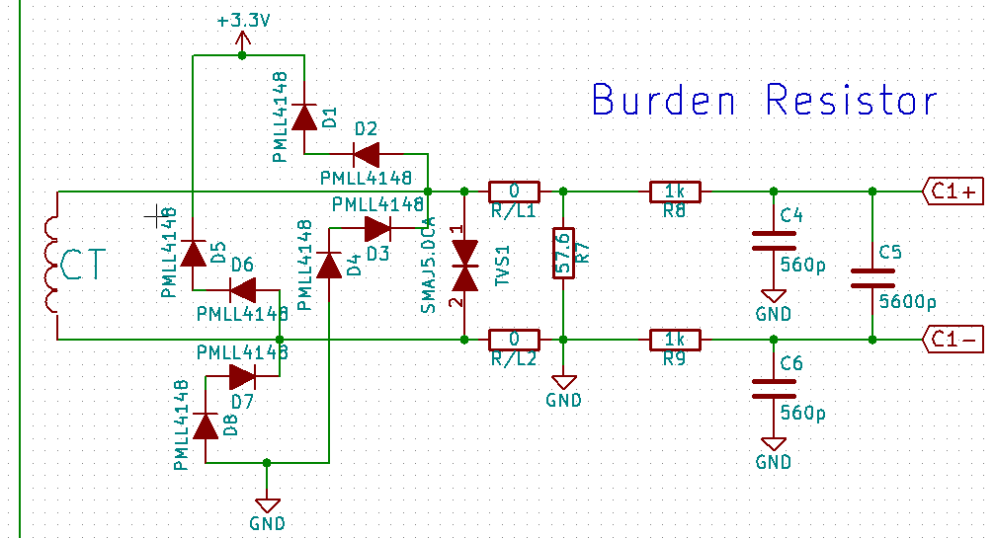
Current Sensing Circuit
Notes:
K

Slide 14
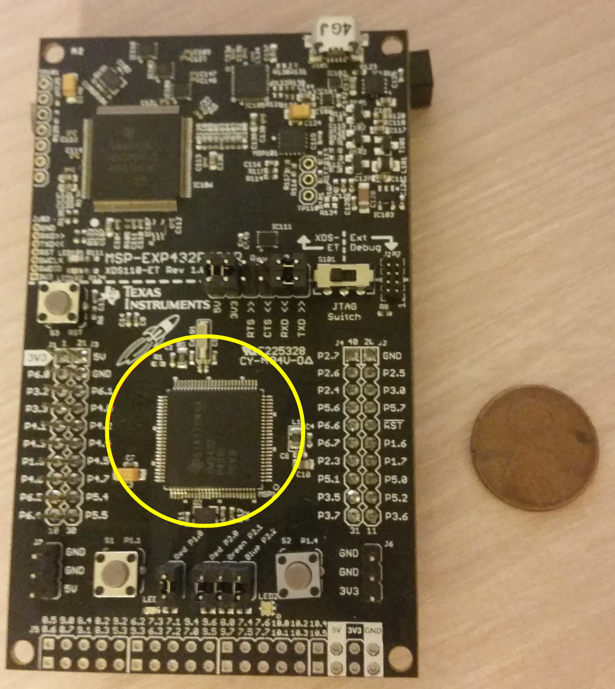
Microcontroller Unit
MSP432P401R
    Low power per clock rate
    Sufficient GPIO and Communication pins
    Integrated Floating Point Unit (FPU)
    Available as LaunchPad for easy development
Considered other MSP MCUs
    Insufficient communication pins
    Higher power per clock rate
Notes:
L

Slide 15
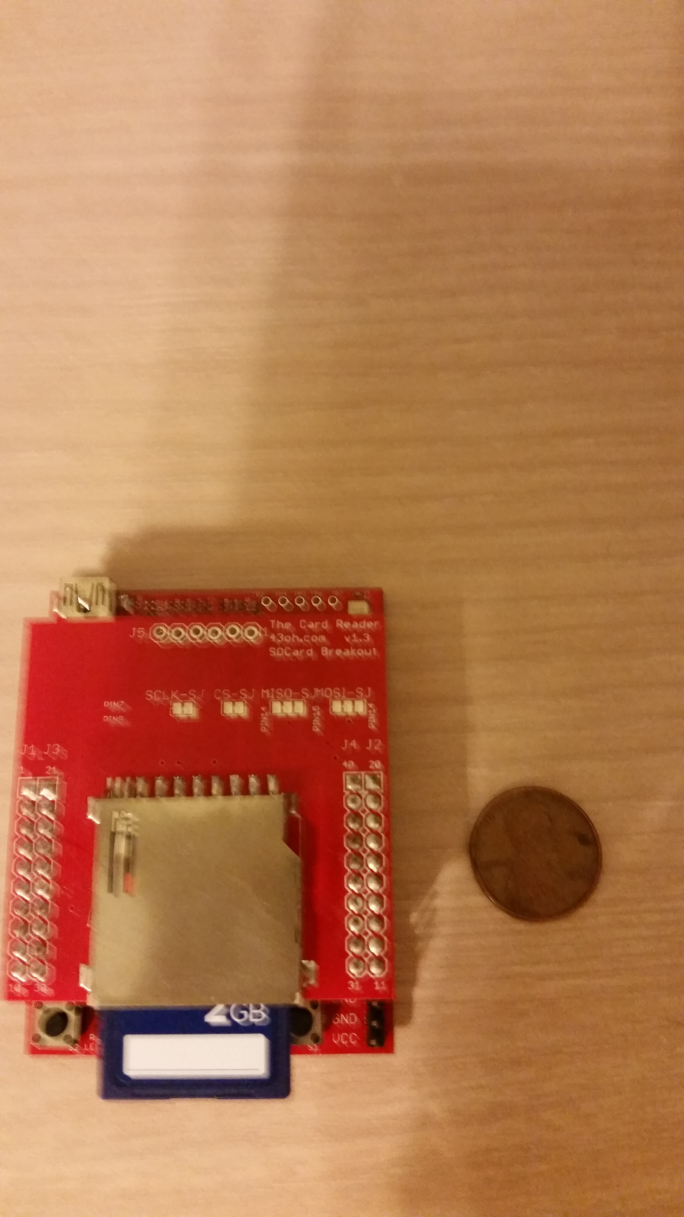
Removable Media
Standard SD Card
    Accessible and affordable
    Libraries for mounting SD cards
    Evaluation hardware available for prototyping
Considered Micro-SD, SDHC
    Harder to physically manipulate
    Inaccessible size given file system
Notes:
L

Slide 16
File System
Petit FatFs
    Optimized for use in smaller embedded systems
    Small RAM consumption and code size
    FAT32 format compatible
    Easily maintains one file on volume
Considered Generic FatFs
    Can write to larger volumes
    Can maintain multiple files
    Larger RAM consumption and code size
Notes:
L

Slide 17
Touchscreen LCD
ER-TFTM050-2 LCD Display & GSL-1680 Capacitive Touch Controller
    Cost effective
    Easily integrated with the MCU
Considered Resistive Touch LCD, Seven-segment LCD & Physical UI
    Resistive Touch is less accurate/responsive
    Seven-segment is too limited
    Physical UI increases required surface area
Parameter | Value
Communication | 4 Wire SPI (LCD) 2 Wire I2C (Touch Controller)
Size | 5"
Display Resolution | 480 x 272
LCD & Touch Controller Cost | $35.60 (BuyDisplay)
Notes:
N

Slide 18
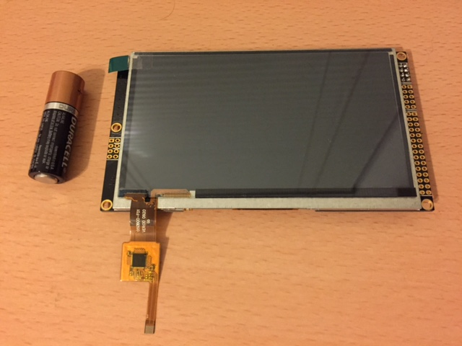
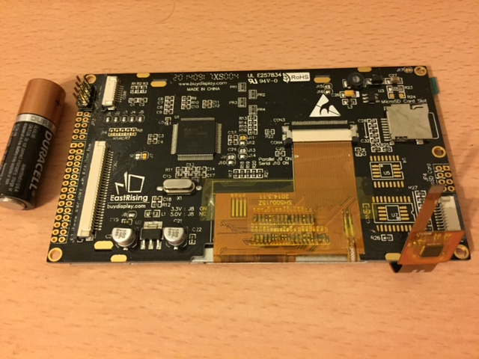
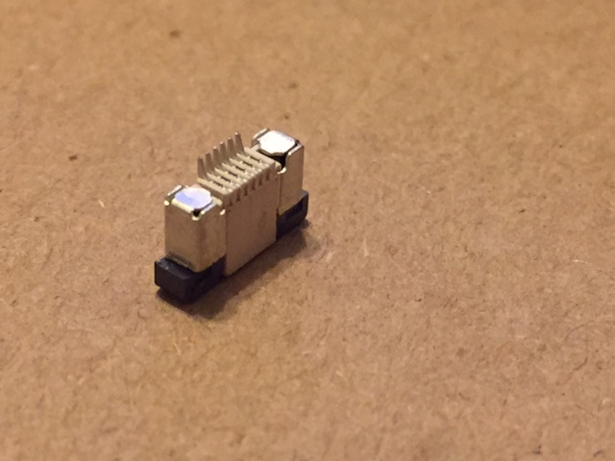
Touchscreen LCD with ZIF Connector
Notes:
N

Slide 19
Analog-to-Digital Converter
Sigma-Delta ADC
    Chosen for its high resolution and accuracy
    Speed concerns not relevant for our purposes
Six differential inputs to maintain signal integrity
Minimum sampling rate of twice the 51st harmonic frequency (6240 Hz)
Considered Integrated ADC, SAR ADC
    Difficulty finding an MCU with sufficient number of communication ports & resolution/architecture
    Accuracy and timing concerns with SAR
Notes:
B

Slide 20
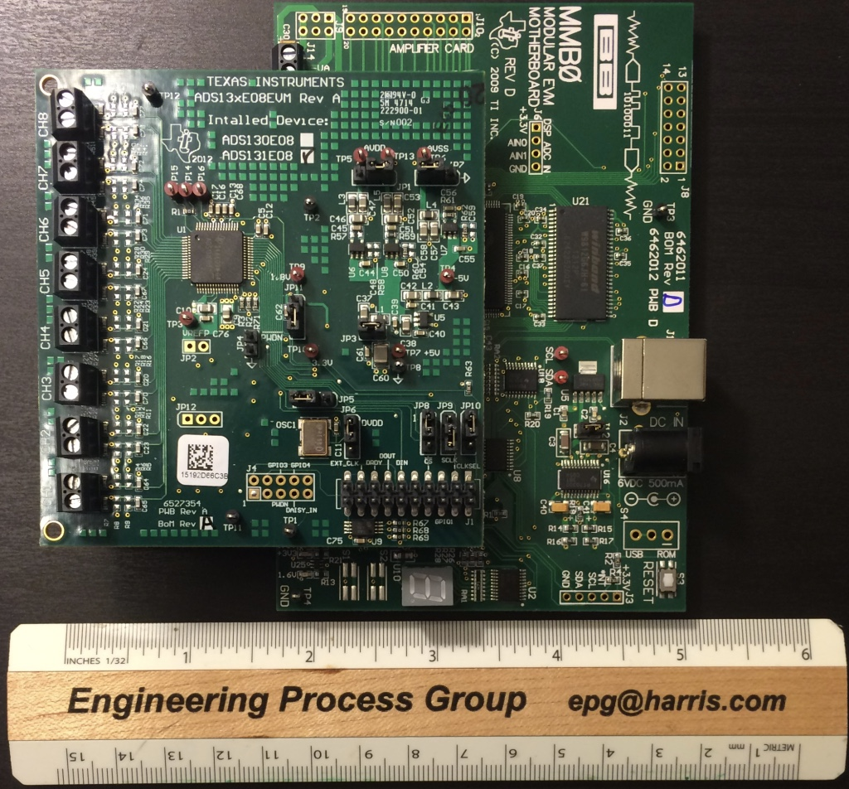
ADS131E08EVM-PDK
Parameter | Value
Architecture | Sigma-Delta
Resolution | 24-bit
Inputs | 8, differential
Sampling Rate | 8 ksps
Chip Cost | $16 (Digikey)
EVM Cost | $200 (Digikey)
Notes:
B
Did we switch to the 8ksps sampling rate?

Slide 21
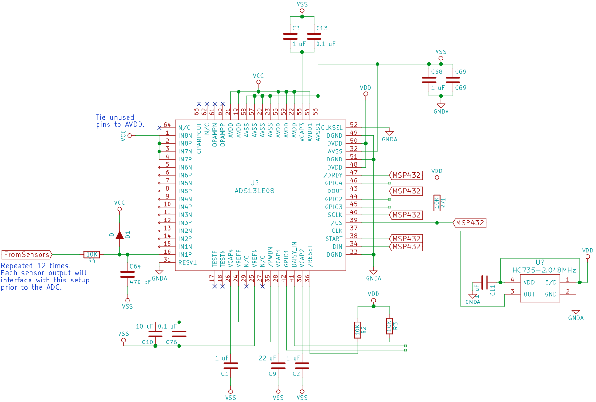
ADS131E08
Schematic
Notes:
B
Do we need to change schematic because of new programmable oscillator?

Slide 22
Power Supply Design
Designing PSU using TI reference designs and WEBENCH
Table below outlines component requirements
Component | Voltage Applied
ADS131E08 | AVDD = +2.5V, AVSS = -2.5V DVDD = +3.3V
MSP432P401R | AVCC|DVDD = +3.3V
ER-TFTM050-2 | VDD = +3.3V VDDIO = +3.3V
GSL-1680 | V_a = +3.3V V_d = +3.3V
Parameter | Requirements
Power | 5 W
Voltage Rails | +3.3V +2.5V -2.5V
Notes:
B

Slide 23
TI Reference Design – PMP8477
Parameter | Value
Vin(max) | 100 VRMS
Vin(min) | 132 VRMS
Vout | 5 VDC
Iout | 2 A
Pout | 10 W
Topology | Flyback Quasi-Resonant Primary Side Regulation
Notes:
B

Slide 24
PSU Primary Stage – PMP8477
Notes:
B

Slide 25
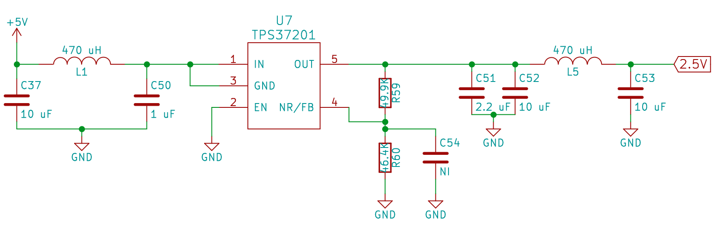
Buck Converters
Part | Regulated Voltage | Price
TPS37201 | +2.5V | $0.76 at Digikey
TPS72301 | -2.5V | $4.45 at Digikey
TPS563200 | +3.3V | $2.39 at Digikey
Notes:
B

Slide 26
Successes and Difficulties

Slide 27
Sensor Circuits
Successes
    Preliminary design and testing is complete
    Current transformer performs near specifications
Difficulties
    Few current transformers with applicable frequency range
    Possible redesign using Hall effect sensors if CT is problematic
    Determining how to implement the connection of the sensors to the power source
Notes:
K

Slide 28
Microcontroller Unit
Successes
    Executed the implemented FFT
    Prepared software for writing results to SD Card
    Communication with peripherals
    Clock Rate
Difficulties
    Communication with peripherals
    Clock rate
Notes:
L

Slide 29
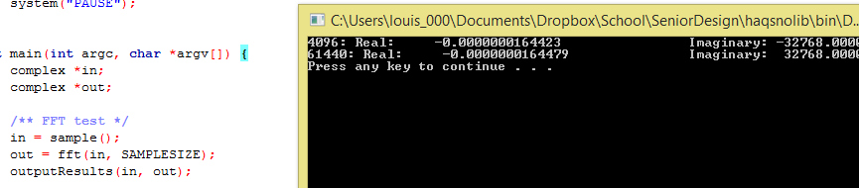
FFT Software Output
Simulated 1024 Hz sine wave with a sample size of 65536 sampled at a rate of 16384
Notes:
L

Slide 30
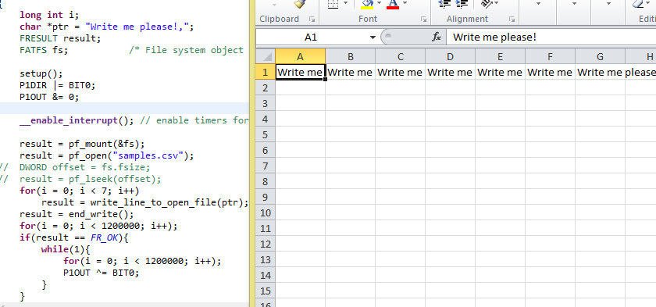
SD Card Communication Testing
Notes:
L

Slide 31
LCD
Successes
    Determined optimal power range for design efforts
    Overcame communication blockade with MCU
    Displaying UI
Difficulties
    Displaying UI
Notes:
N

Slide 32
Analog-to-Digital Converter
Successes
    Evaluation Module proves operation and viability of ADS131E08
    Analog components surrounding ADC have been determined
    Digitized signals from sensor circuits
    Timing and communication with MCU
Difficulties
    Grounding issues with EVM and Function Generator
    Documentation and Software
    Jumper and Register Configurations
    Timing and communication with MCU
Notes:
B

Slide 33
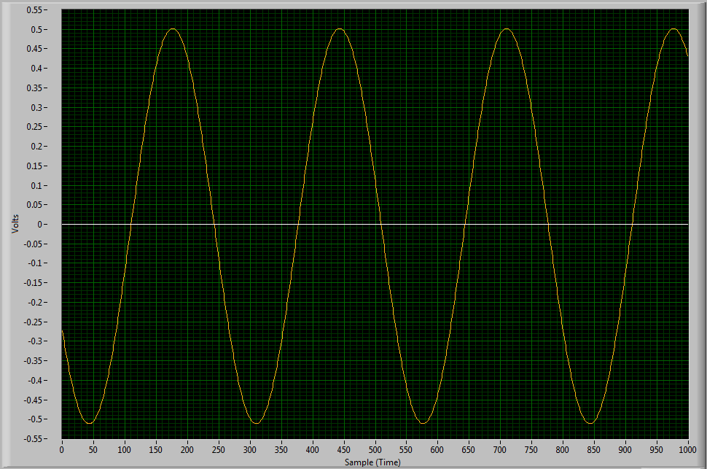
ADC Output Example
Input:
Sine Wave
1 Vpp
60 Hz
Notes:
B

Slide 34
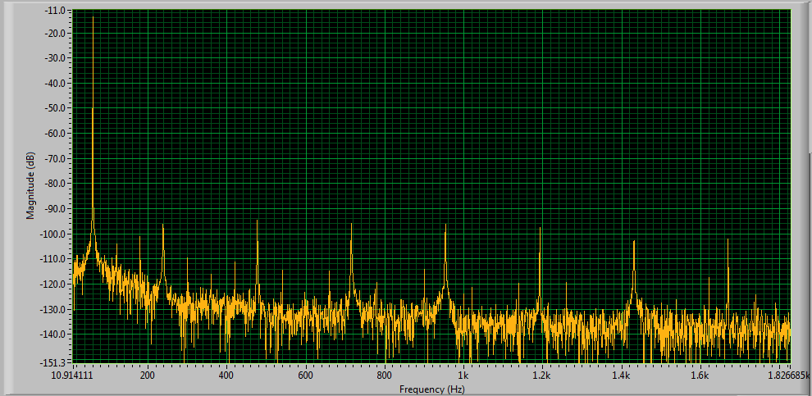
ADC FFT Output
Notes:
B

Slide 35
Power Supply Unit
Successes
    Reference Designs have made the process easier
    Selected base design and regulators for voltage rails
    Acquired ideal transformer for the selected design
Difficulties
    Researching and deciding upon topologies
    PCB layout with PSU
Notes:
B

Slide 36
Administrative Content

Slide 37
Advisors and Sponsors
Chung Yong Chan, PhD
Robert Reedy, P.E.
Notes:
N

Slide 38
Roles and Responsibilities
 | Brian Angiel | Nick Hellenbrand | Louis Hofer | Kevin White
PSU | P
Voltage Sensors | s |  |  | P
Current Sensors |  |  |  | P
ADC | P |  |  | s
MCU |  | HW | SW
LCD |  | P | s
Removable Media |  |  | P
Touch Panel Controller |  | P | s
Key:
P = primary
s = secondary
SW = software
HW = hardware
Notes:
N

Slide 39
Facilities and Equipment
University of Central Florida (UCF) Smart Lab
UCF Senior Design Lab
Texas Instruments Innovation Lab
Three-phase power outlet found in Engineering 1, Room 456
Notes:
N

Slide 40
Budget
Part | Supplier | Quantity | Cost
MSP432P401R | TI | 1 | $13*
ADS131E08 | TI | 1 | $16*
RLTI-1072 | Renco | 5 | $100*
Voltage Regulators | TI | 3 | $8*
C-CT-10 Current Transformers | Digikey | 3 | $113.76
ER-TFTM050-2 | BuyDisplay | 1 | $35.60
GSL1680 | BuyDisplay | 1 | -
SD Card Socket | 43oh | 1 | $1.50
PCB Manufacturing |  | 2 | $200
Part | Supplier | Quantity | Cost
Capacitors | Digikey |  | $15
Resistors | Digikey |  | $15
Diodes | Digikey |  | $5
S20K230 MOV | Digikey | 3 | $2.85
SMAJ5.0CA TVS Diodes | Digikey | 3 | $1.29
Misc |  |  | $30
SMD Mounting Service |  |  | $75
Shipping |  |  | $60
Total |  |  | $555
* Parts provided free of charge by sponsors
Notes:
N

Slide 41
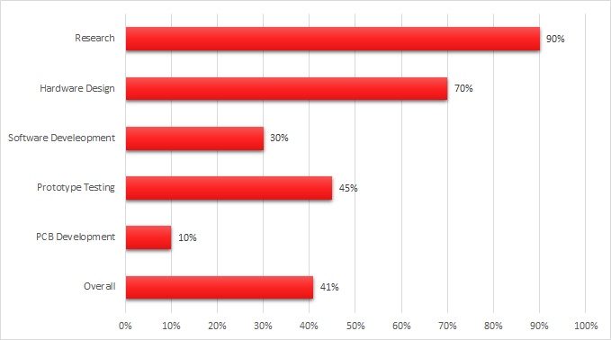
Progress
Notes:
N

Slide 42
Plans for Success

Slide 43
Meetings
    Meetings with Chung Yong Chan
    Every Monday
    Team Meetings
    Everyday
Notes:
N

Slide 44
Questions?
Notes:
B

