Slide 1
Electri-Surf
Group 22:
  Alex Amoros – Computer Engineering
  Anthony Higgins – Electrical Engineering
  Ryan Taylor – Electrical Engineering

Slide 2
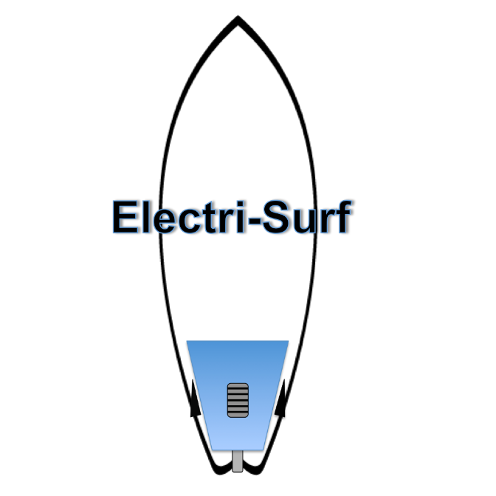
Project Goal
Design and implement an electric surfboard controlled with a wireless throttle and powered by a rechargeable battery

Slide 3
Motivation
To Produce a fun project that people may find interesting
Gain hands on experience
Combine learning with an outdoor hobby

Slide 4
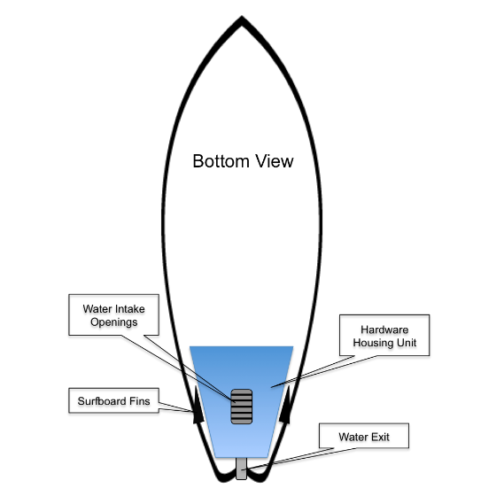
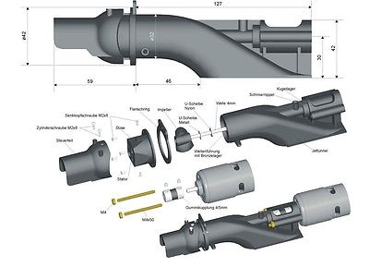
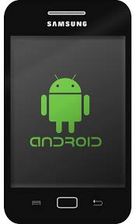
Project Concept
Jet Drive
G
Phone

Slide 5
Project Specifications
Ride Time: 30 minutes
Weight: Less than 40 lbs.
Wireless Connection Range: 1-2 m
Battery Durability: 2 recharges per 24 hours
Speed: 5-10 mph

Slide 6
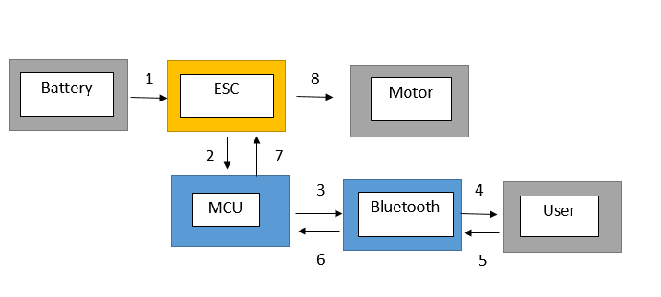
System Block Diagram

Slide 7
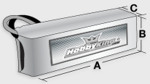
Power Source
ZIPPY | Flightmax
Type | Lipo
Voltage | 22.2 V
Capacity | 4500 mAh
Configuration | 6 cell
Discharge | 45C - 55C burst
Weight | 789 grams
Length A | 145 mm
Height B | 51 mm
Width C | 52 mm

Slide 8
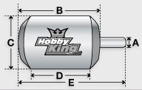
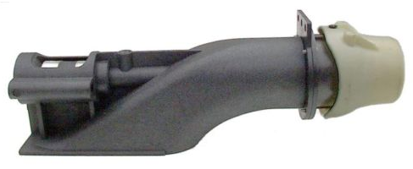
Propulsion
Motor - Turnigy | AquaStar
Weight | 508 grams
Max Current | 105 A
Max Voltage | 37 V
Power | 3050 W
Shaft A | 5 mm
Diameter C | 39 mm
Total Length | 103 mm
Jet Drive | Pump Unit
Model | Jet2805
Max RPM | 20,000
Total Length | 171 mm
Diameter | 28 mm
Propulsion | Impeller

Slide 9
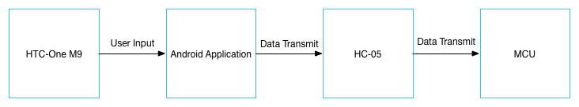
Microcontroller
The microcontroller that we required for our project had a couple of requirements to meet:
Low price
Support PWM(Pulse Width Modulation)
UARTSerial support.
Couple of pins for general LED usage.

Slide 10
Microcontroller
Our first choice was TI’s TMS320F28062 microprocessor.
We were delighted about the microprocessor and met our requirements and more. The only problem that we ran into our design was the lack of CAD files for the microcontroller.

Slide 11
Microcontroller
Our second microprocessor that we considered was the ATmega328P. Fewer than the other microcontroller, ATmega328P could still perform the requirements of the project.

Slide 12
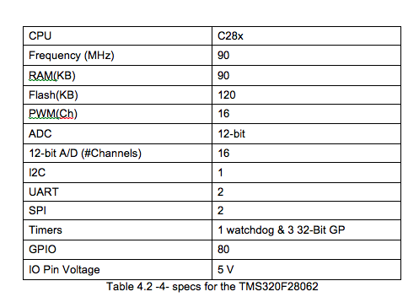
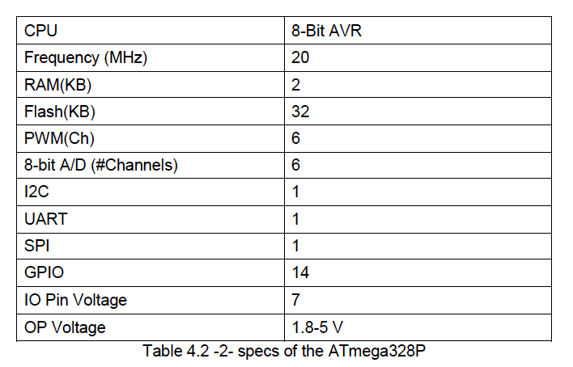
Microcontroller
ATmega328P
TMS320F28062

Slide 13
Bluetooth Communication
Save time using the a smart phone as the handheld control.
Ideal due to the fact most smart phones have Bluetooth incorporated inside the phones.
Do not have to build, hardware wise, a hand control for the board.

Slide 14
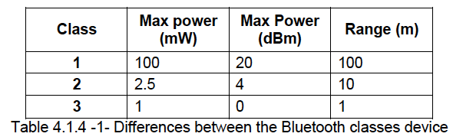
Bluetooth Communication

Slide 15
Bluetooth Communication
The Bluetooth module that was chosen for the project was the HC-05. Here’s a comparison of other Bluetooth modules that we compared.
Bluetooth Module | CC2564MODN | BT900 | HC-05
OPERATING VOLTAGE | -.5-4.8 V | 3.6 V | 3.3V DC
Size | 7.1 mm x 7.1 mm x 2mm | 2.5mm x 12.5mm x 19mm | 27mm x 13mm x 2mm
Signal range(m) | 10 | 100 | 1
Data Speed | 2.1 Mbps | 3 Mbps | 3 Mbps
Price USD | 13.97 | 15.35 | 10.68
Complex interface | Easy | Easy | Easy
Max Baud Rate | 9600 | 9600 | 9600

Slide 16
Mobile App
Android Application
Using Android Studio IDE
Have an option for for Guest and Administrator
Gives total control over the surfboard’s settings for the user

Slide 17
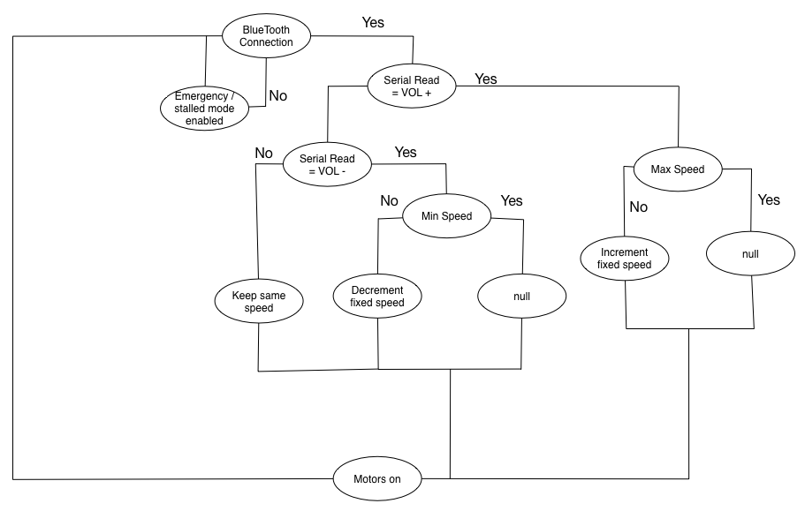
Mobile App

Slide 18
Speed Control
Electronic Speed Control (ESC)
Connects directly to motor, PCB, and battery
Regulates current sent to motor
  Programmed through ATmega328p
  Via pulse width modulation (PWM)

Slide 19
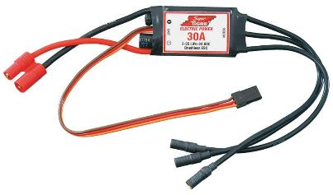
Electronic Speed Control
Using 120A ESC
Contains universal battery eliminating circuit (UBEC)
No need to have a battery power receiver
  Converter inside esc that drops voltage

Slide 20
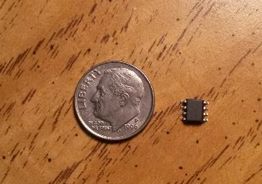
Battery Monitoring
DS2438 smart battery
  Maxim Integrated
Designed for max 12V battery
Circuit implemented to widen capable input range
LED representation

Slide 21
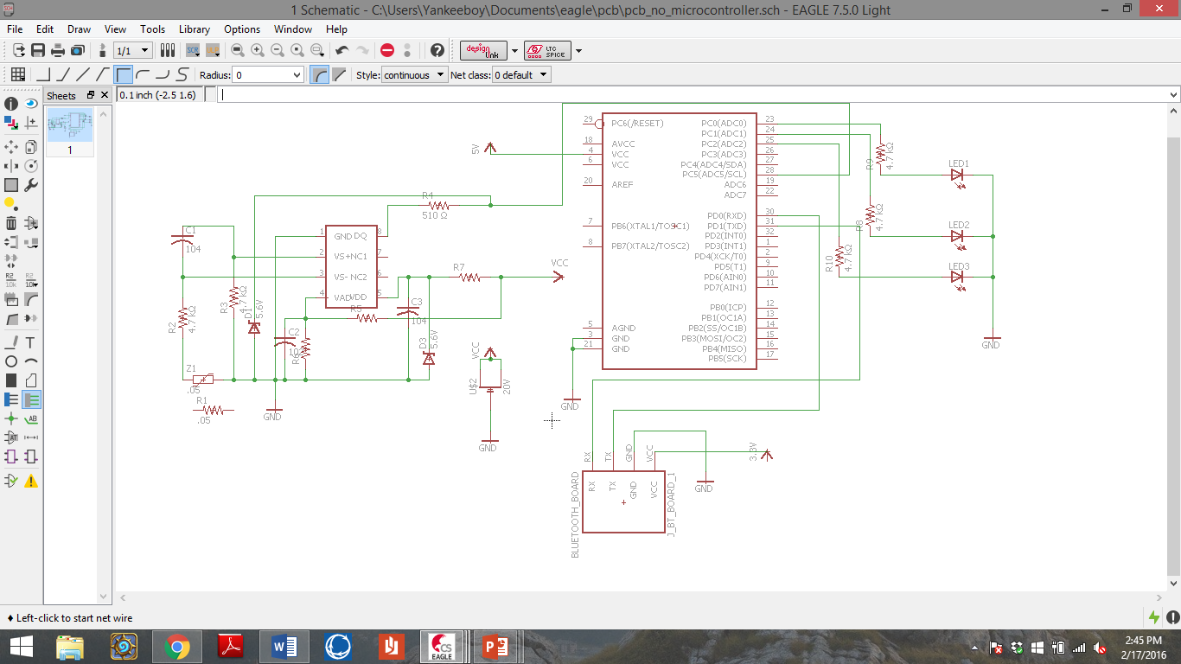
Battery Monitoring

Slide 22

Battery Monitoring
Calculating true voltage
Measure VAD pin
$$Vactual=\frac{Vmeasured ∗\left(R5+R6\right)}{R6}$$
$R5=\frac{R6 ∗\left(Vmax−VAD\right)}{VAD}$

Slide 23

PCB Design
EAGLE
No experience
  Not 100% confident in design
  Multiple runs expected
Limited CAD files
  Switched parts

Slide 24
PCB Schematic

Slide 25
Difficulties
Parts out of stock
CAD files
Little experience

Slide 26
Safety Concerns
Rider Safety
  Engine shut off mechanism
  Battery level awareness
Water Hazard – hardware preservation
  Water and electricity don’t mix

Slide 27
Division of Labor
Member | PCB Design | Mobile App | Bluetooth/ Coding | Waterproofing | Testing | Design Assembly | Administration
Anthony | ✔ |  |  | ✔ | ✔ | ✔ | ✔
Alex |  | ✔ | ✔ |  | ✔
Ryan | ✔ |  |  | ✔ | ✔ | ✔ | ✔

Slide 28
Budget
Part | Cost
Surfboard | TBD
Jet Drive | $69.95
Battery | $68.68
Motor | $69.89
Battery Charger | $23.00
ESC – Electronic Speed Control | $29.28
Battery Monitor | Free
Microcontroller | $13.72
Developmental Board | $25.00
Bluetooth | $5.25
LED’s | Free
Waterproofing Supplies | TBD
PCB | TBD
Current Total | $304.77

Slide 29
Progress

Slide 30
Future Plans
Ordering PCB ASAP
Test motor response with phone app
Mount to housing unit and waterproofing
Finalize testing/build prototype

Slide 31
Questions?

