Slide 1
Electri-Surf
Group 22:
Alex Amoros – Computer Engineering
D. Anthony Higgins – Electrical Engineering
Ryan Taylor – Electrical Engineering

Slide 2
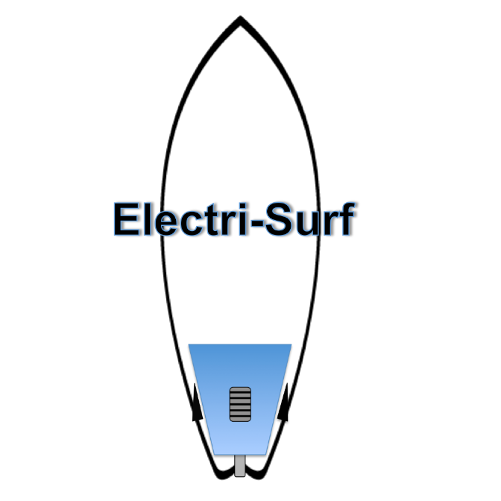
Project Goal
Design and implement an electric surfboard controlled with a wireless throttle and powered by a rechargeable battery

Slide 3
Motivation
To Produce a fun project that people may find interesting
Combine learning with an outdoor hobby
Gain hands on experience

Slide 4
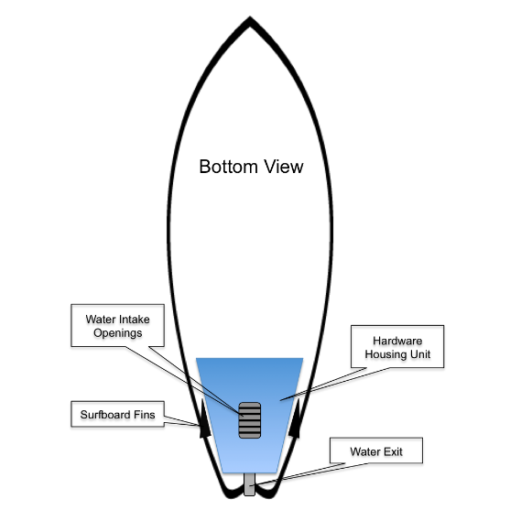
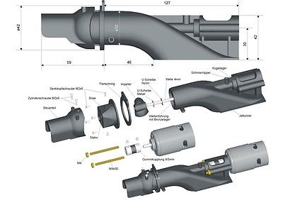

Project Concept
Jet Drive
G
Phone

Slide 5
Project Specifications
The following specifications are theoretical/ideal
Ride Time: 30 minutes
Weight: Less than 40 lbs.
Wireless Connection Range: 6-10 m
Battery Durability: 2 recharges per 24 hours
Speed: 5-10 mph

Slide 6
System Block Diagram

Slide 7
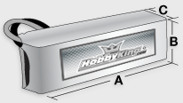
Power Source
ZIPPY | Flightmax
Type | Lipo
Voltage | 22.2 V
Capacity | 4500 mAh
Configuration | 6 cell
Discharge | 45C - 55C burst
Weight | 789 grams
Length A | 145 mm
Height B | 51 mm
Width C | 52 mm

Slide 8
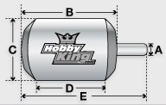
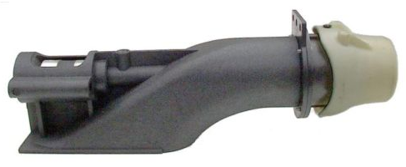
Propulsion
Motor - Turnigy | AquaStar
Weight | 508 grams
Max Current | 105 A
Max Voltage | 37 V
Power | 3050 W
Shaft A | 5 mm
Diameter C | 39 mm
Total Length | 103 mm
Jet Drive | Pump Unit
Model | Jet2805
Max RPM | 20,000
Total Length | 171 mm
Diameter | 28 mm
Propulsion | Impeller

Slide 9
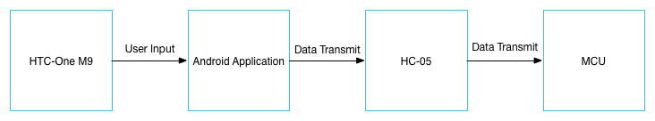
Microcontroller
The microcontroller that we required for our project had a couple of requirements to meet:
Low price
Support PWM(Pulse Width Modulation)
UARTSerial support.
Couple of pins for general LED usage.
Simple IDE usage for programming.

Slide 10
Microcontroller
Our first choice was TI’s TMS320F28062 microprocessor.
Key points of the TMS320F28062:
Simple and easy to use IDE, Energia
Well documented commands and architecture, with supportive community
Meet the requirements necessary for the project
However:
Lack of CAD file for the microcontroller

Slide 11
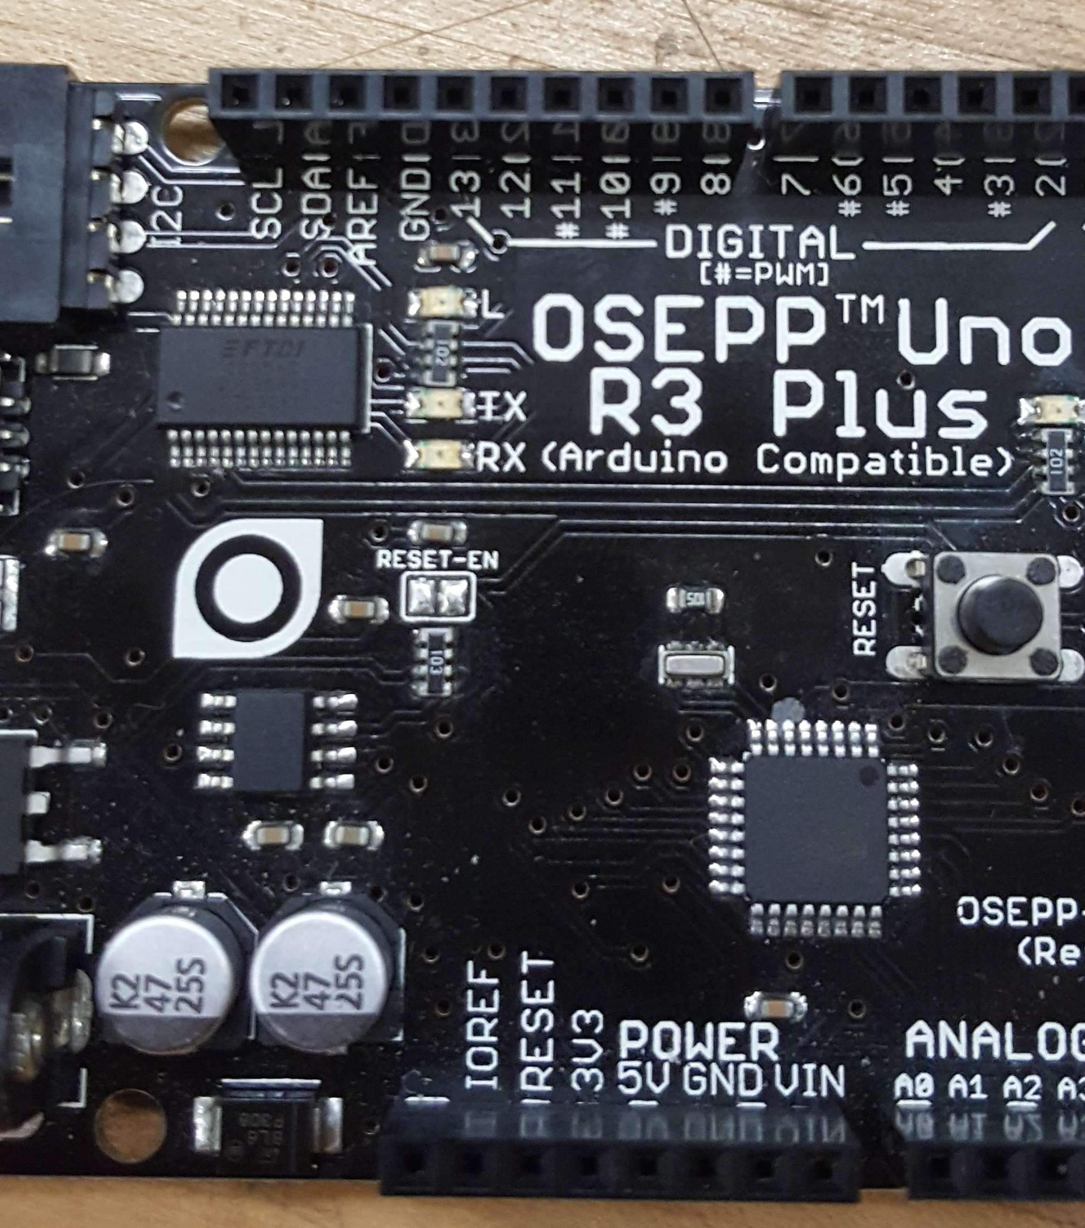
Microcontroller
ATMega328p
Second option
Development with Arduino UNO
Already owned this dev. board

Slide 12
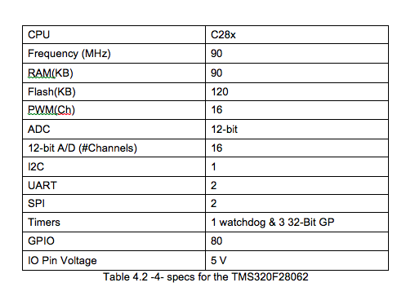
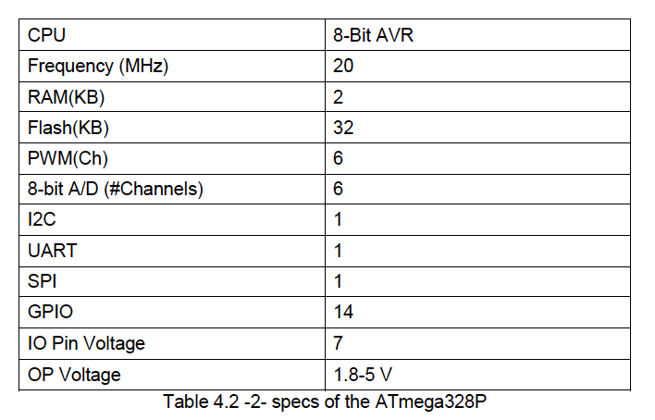
Microcontroller
ATmega328P
TMS320F28062

Slide 13
Bluetooth Communication
Used the a smart phone as the handheld control
Versatile
Convenient
Bluetooth compatible
Do not have to build, hardware wise, a hand-control device for the board.

Slide 14
Bluetooth Communication
The Bluetooth module that was chosen for the project was the HC-05. Here’s a comparison of other Bluetooth modules that we compared.
Bluetooth Module | CC2564MODN | BT900 | HC-05
OPERATING VOLTAGE | -.5-4.8 V | 3.6 V | 3.3 - 5V DC
Size | 7.1 mm x 7.1 mm x 2mm | 2.5mm x 12.5mm x 19mm | 27mm x 13mm x 2mm
Signal range(m) | 10 | 100 | 10
Data Speed | 2.1 Mbps | 3 Mbps | 3 Mbps
Price USD | $13.97 | $15.35 | $5.25
Complex interface | Easy | Easy | Easy
Max Baud Rate | 9600 | 9600 | 9600

Slide 15
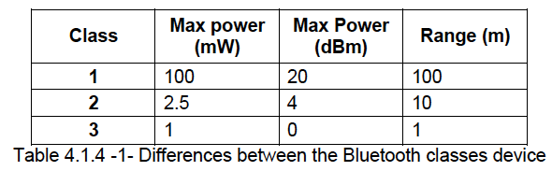
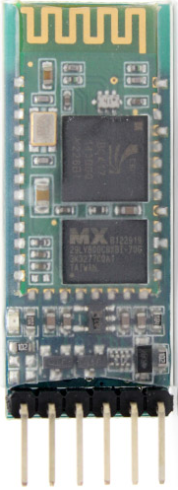
Bluetooth Communication
13 mm
26.7mm

Slide 16
Mobile App
Used Android Studio IDE for development
Have an option for Advanced Settings
Gives total control over the surfboard’s settings for the user, ie. Speed increments, slow and stop speeds for the board.

Slide 17
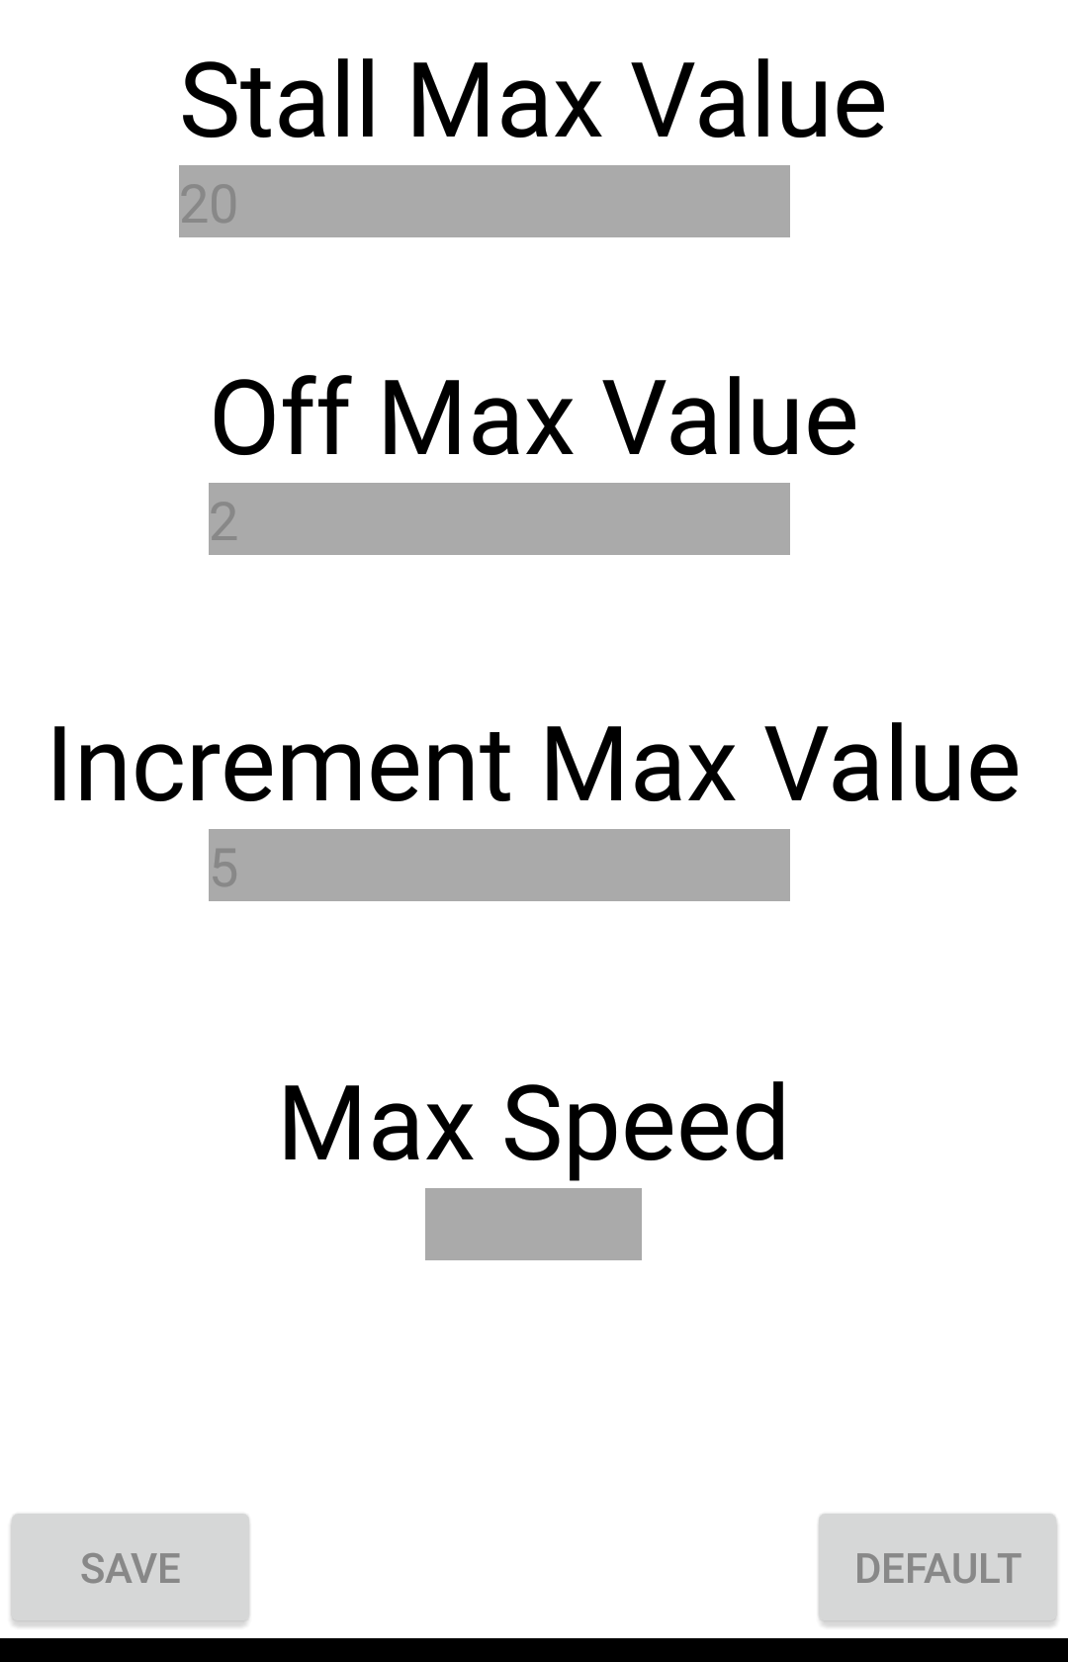
Advanced Settings
Settings within the Electri-Surf application
Accessed through home screen
Used for changing values:
Slow speed
Speed bar increment

Slide 18
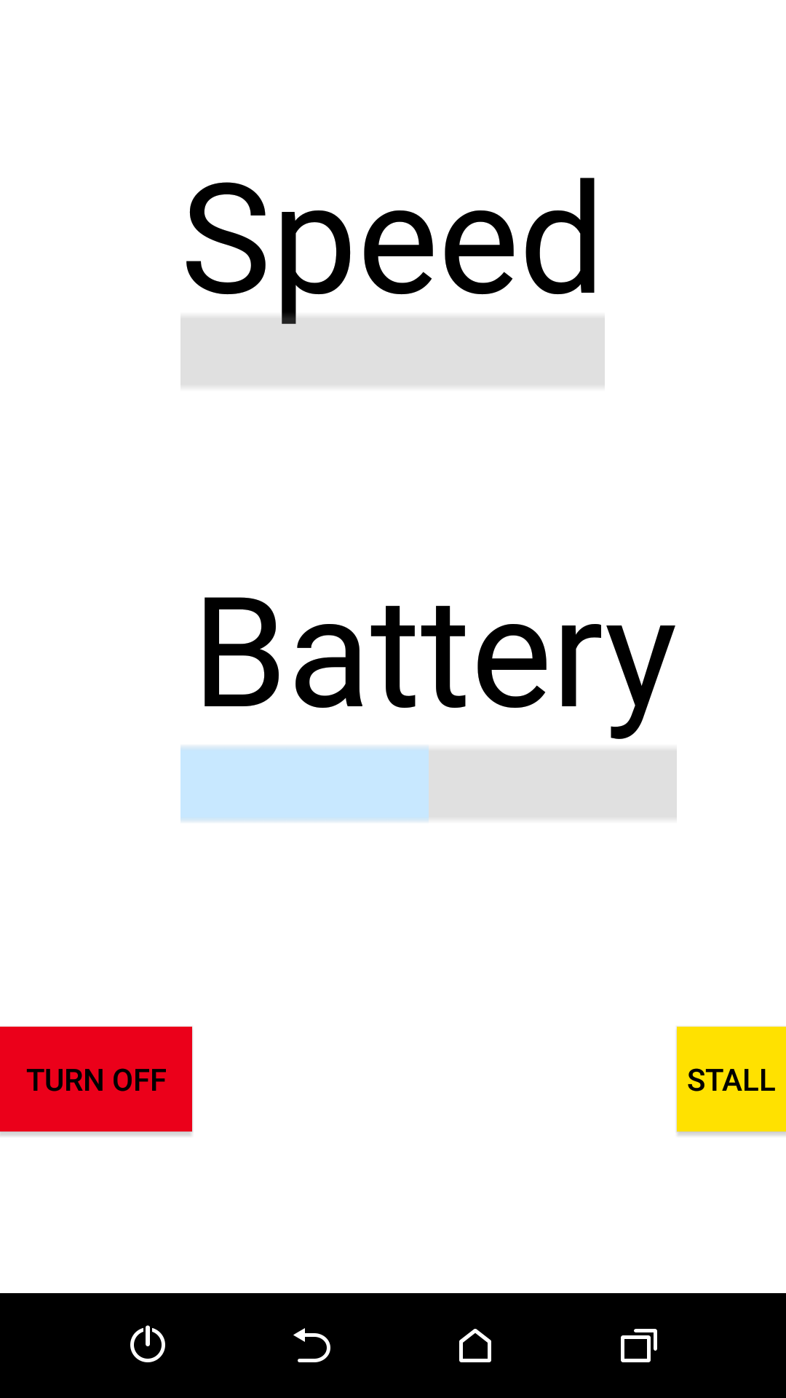
Mobile App cont.
Graphical user interface
Riding screen
Speed Control:
Phone volume keys
Touch screen capability
Progress bar indicators

Slide 19
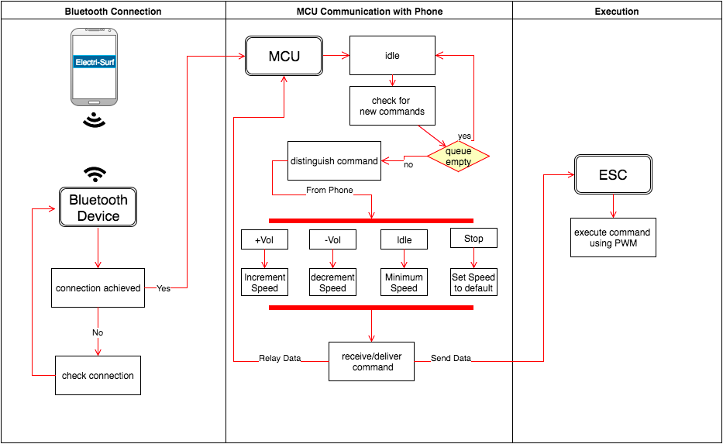
Mobile App

Slide 20
Speed Control
Electronic Speed Control (ESC)
Connects directly to motor, PCB, and battery
Regulates current sent to motor
Programmed through ATmega328p
Via pulse width modulation (PWM)

Slide 21
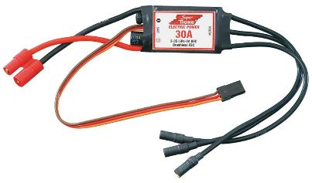
Electronic Speed Control
Using 120A ESC
Contains universal battery eliminating circuit (UBEC)
No need to have a battery power receiver
Converter inside esc that drops voltage

Slide 22
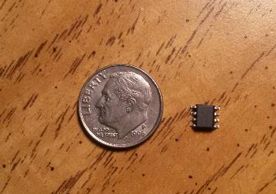
Battery Monitoring
DS2438 smart battery
Maxim Integrated
Designed for max 12V battery
Circuit implemented to widen capable input range

Slide 23
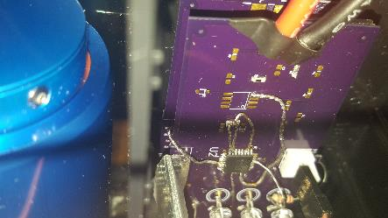
Battery Monitoring
Late issues with DS2438 functionality
Used existing voltage divider
Analog pin on microcontroller needed
Adjustments made on PCB

Slide 24
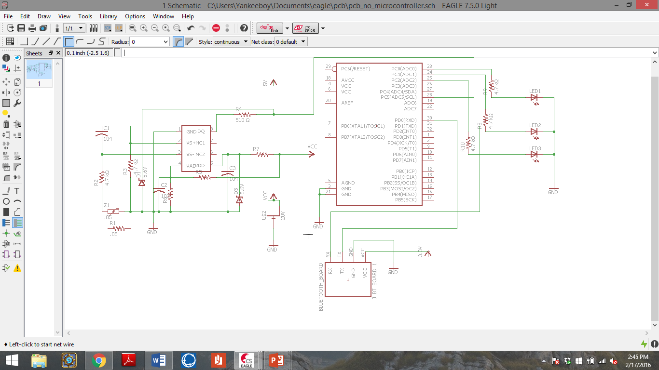
Battery Monitoring
To MCU

Slide 25
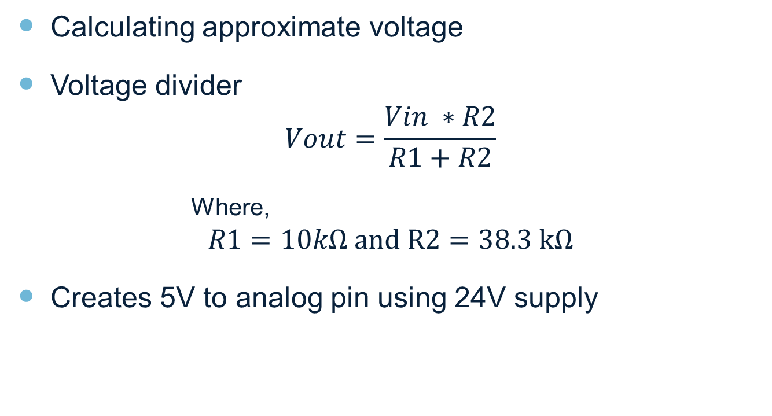
Battery Monitoring
Calculating approximate voltage
Voltage divider
$$Vout=\frac{Vin ∗R2}{R1+R2}$$
Where,
$$R1=10kΩ and R2=38.3 kΩ$$
Creates 5V to analog pin using 24V supply

Slide 26
PCB Design
EAGLE
No experience
Not 100% confident in design
Multiple runs expected
Limited CAD files
Switched parts

Slide 27
PCB Schematic

Slide 28
Safety Concerns
Rider Safety
Engine shut off mechanism
Battery level awareness
Water Hazard – hardware preservation
Water and electricity don’t mix

Slide 29
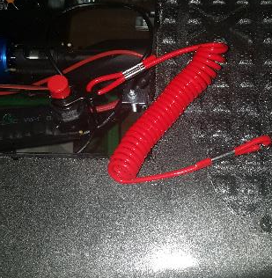
Emergency Cut-off
Sea Dog Kill Switch
Equipped with lanyard
Hard kill switch
Creates open circuit
Cut power directly from battery

Slide 30
Difficulties
Parts out of stock
CAD files
Little experience
Measurements when building

Slide 31
Division of Labor
Member | PCB Design | Mobile App | Bluetooth/ Coding | Soldering | Testing | Design Assembly | Administration
Anthony | ✔ |  |  | ✔ | ✔ | ✔ | ✔
Alex |  | ✔ | ✔ |  | ✔
Ryan | ✔ |  |  |  | ✔ | ✔ | ✔

Slide 32
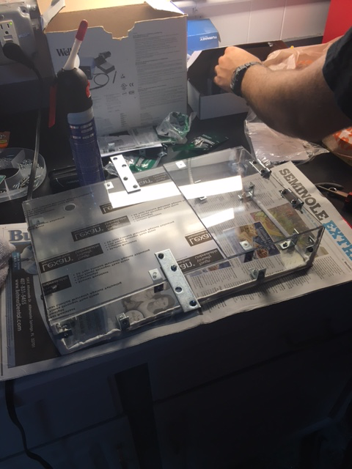
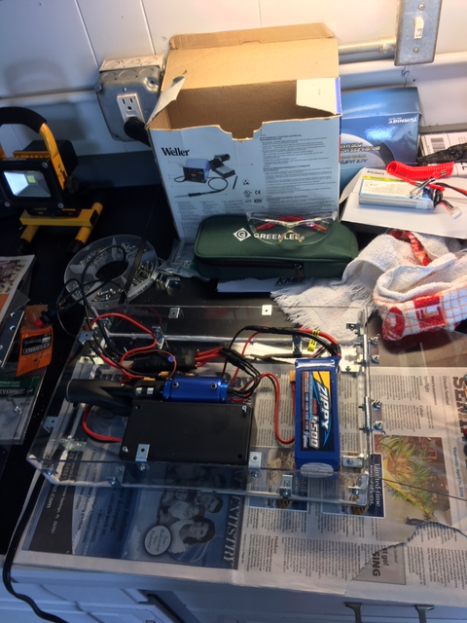
Project Construction

Slide 33
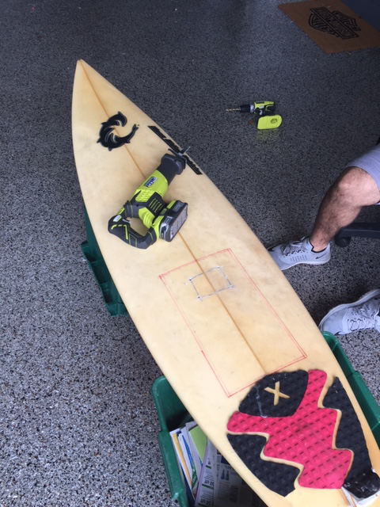
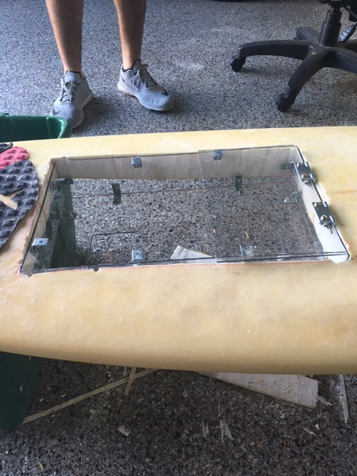
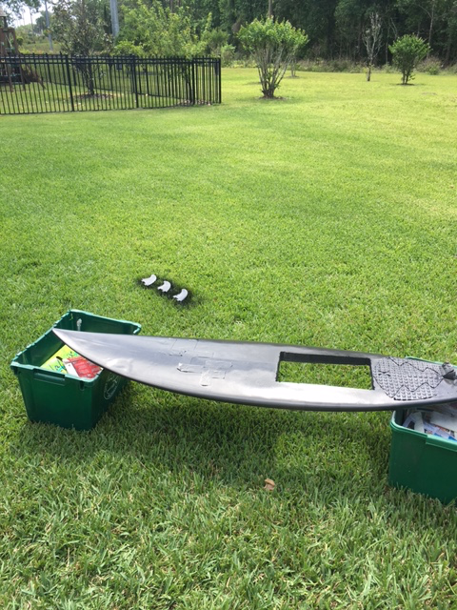
Project Construction

Slide 34
Budget
Part | Cost
Surfboard | Free
Jet Drive | $69.95
Battery | $68.68
Motor | $69.89
Battery Charger | $23.00
ESC – Electronic Speed Control | $66.99
Battery Monitor | Free
Microcontroller | $13.72
Custom housing unit | $45.71
Bluetooth | $5.25
LED’s | Free
Waterproofing Supplies | $7.56
PCB and components | $35.88
Current Total | $406.63

Slide 35
Questions?

