Slide 1


BOSA
Bragg Optical Spectrum Analyzer
Group 26
Ricardo Angeli (CPE/EE)
Justin Boga (PSE)
Yuval Mor (EE)
Andrew Trucks (PSE)
Sponsored by:

Slide 2
MOTIVATION
Project that was directly marketable post graduation
Novel approach to spectroscopy
Challenging project that honed skills we developed in school
Faster and cheaper alternative to traditional optical spectrum analyzers while retaining relatively high resolution.

Slide 3
GOALS AND OBJECTIVES
Easy to use interface
Fast setup
Light and portable design
Fiber optic cable input (FC/PC)
Outputs measured power instead of relative intensity

Slide 4
SPECIFICATIONS AND REQUIREMENTS

Slide 5
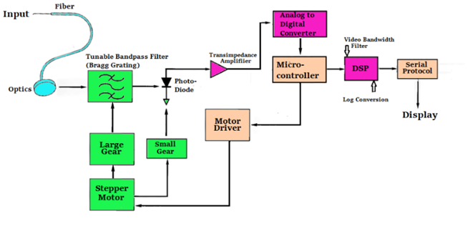
BLOCK DIAGRAM

Slide 6
Optical Subsystem

Slide 7
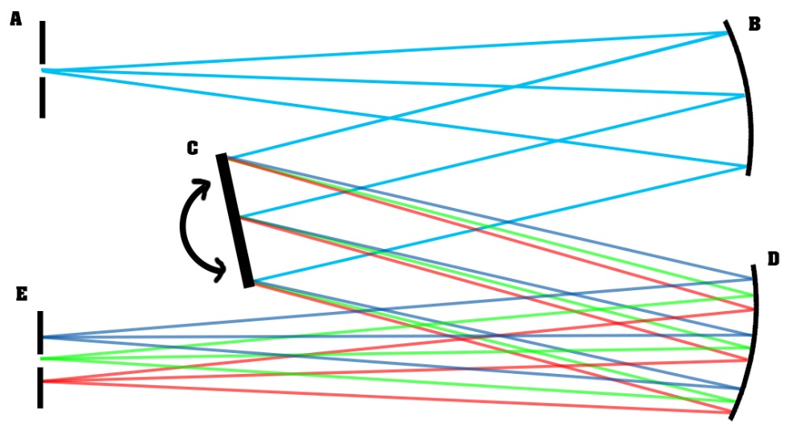
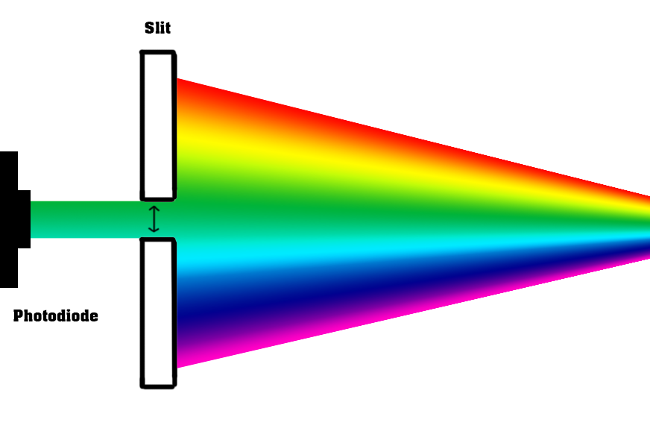
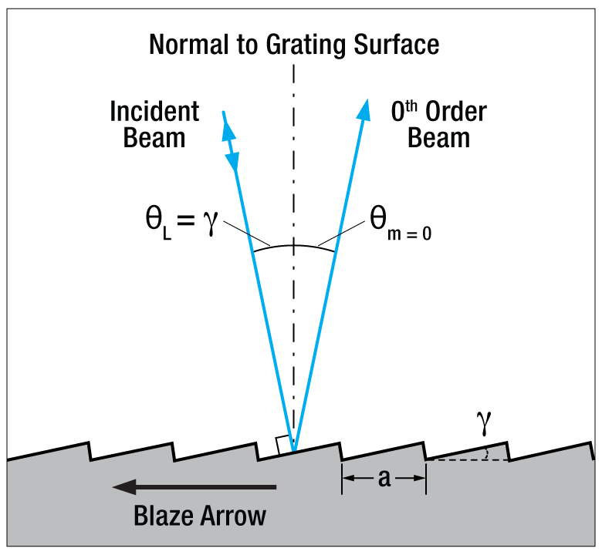
OPTICAL SPECTRUM ANALYZERS
Czerny-Turner (CT) Monochromator

Slide 8
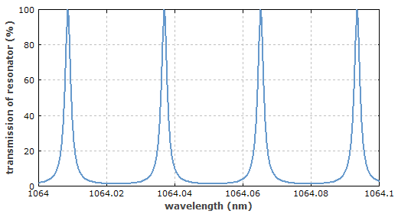
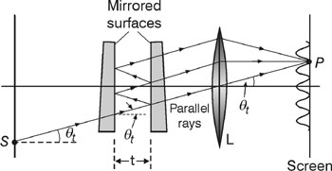
OPTICAL SPECTRUM ANALYZERS
Fabry-Perot Interferometer

Slide 9
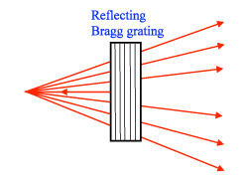
BRAGG GRATINGS
Reflecting Bragg Grating (RBG)
  λ=2nΛ*cosθ
  High Spectral Selectivity
  Angle Dependence for Frequency

Slide 10
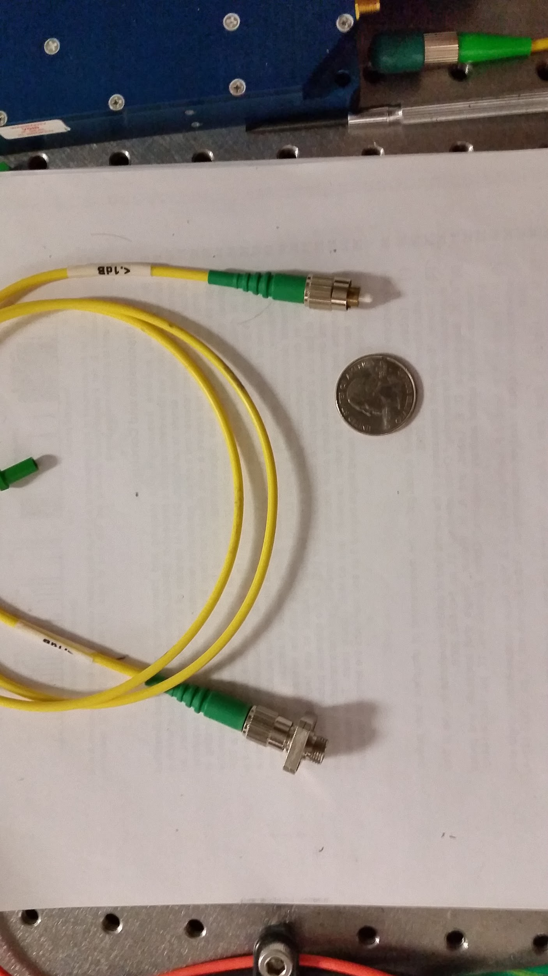
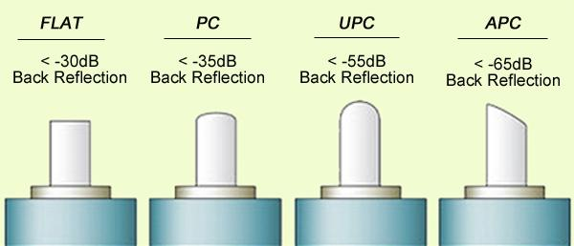
FIBER CONNECTOR
FC/PC Fiber Connector Physical Connection
Physical Connection
  Very common
  Easiest to use
  Cheapest
  Loss will be negligible

Slide 11
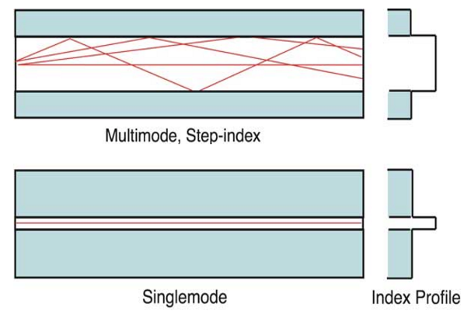
FIBER
Multimode fiber vs. Single mode fiber
SMF
  Smaller core
  Higher bandwidth
  Lower attenuation
  Used in Telecom
MMF
  Larger Core
  Lower bandwidth
  Higher Attenuation
  Used in General Fiber networks

Slide 12
FIBER
We will be using Multimode Fiber
Attenuation and Bandwidth aren’t major factors for the purposes of spectroscopy
A larger core is easier to couple into
Cheaper
Specifications
  400 um core
  NA 0.5
  Wavelength Range 300 nm to 1200 nm

Slide 13
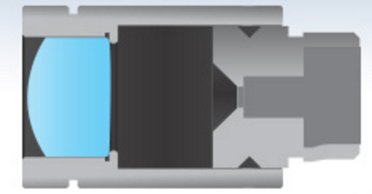
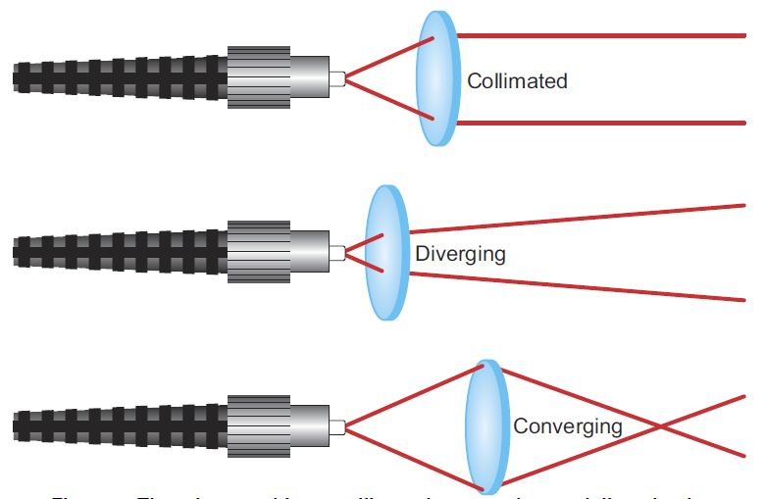
FIBER COLLIMATOR
Need collimated light to hit Bragg Grating
  Reduces loss in the system
  Need a gaussian beam to hit the grating
Current models are by ThorLabs are $120+
Solution:
  3D print a housing
  Use Edmund Optics 3 mm lens on front surface
  Fasten fiber in place exactly 1 focal length from lens

Slide 14
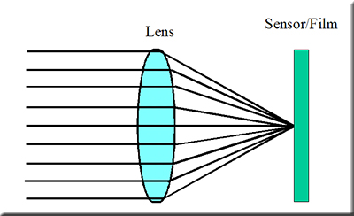
FOCUSING LENS
Lens to focus light after Bragg grating onto photodiode
Operates on the same principle of fiber collimator
Same 3 mm lens from Edmund optics will be used

Slide 15
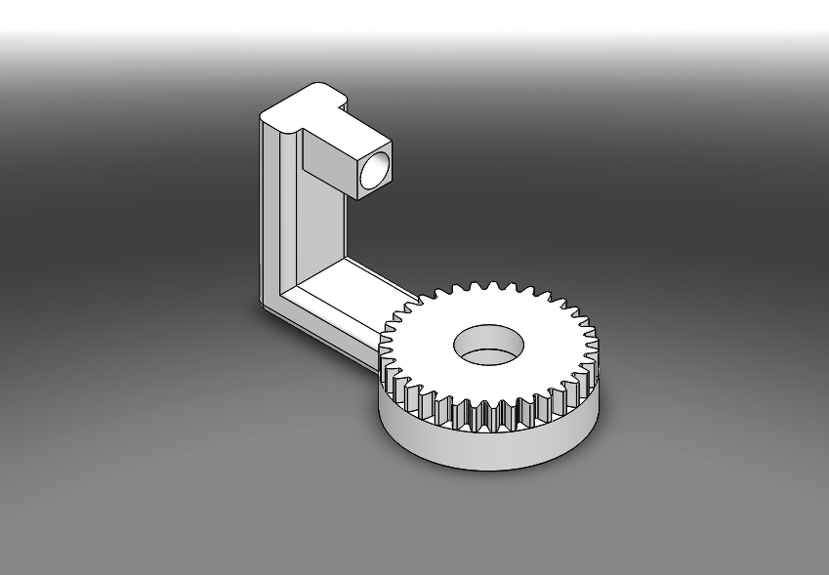
MECHANICAL DESIGN

Slide 16
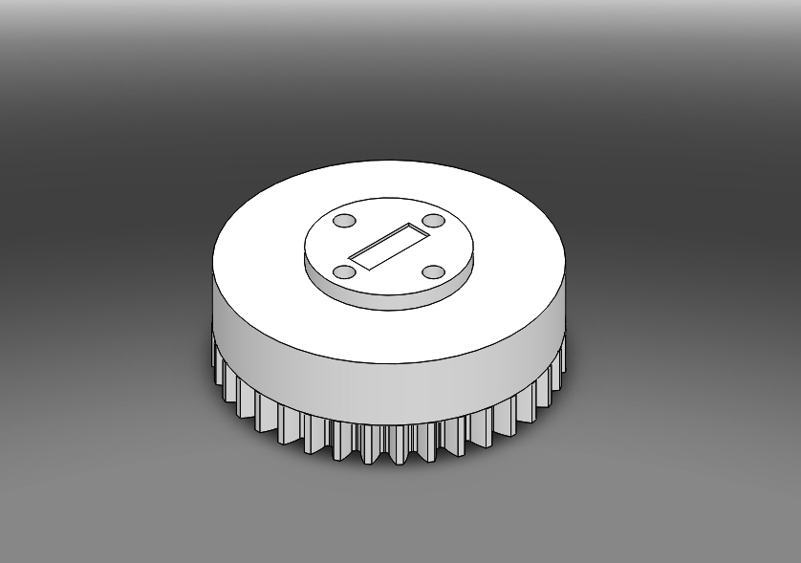
MECHANICAL DESIGN

Slide 17
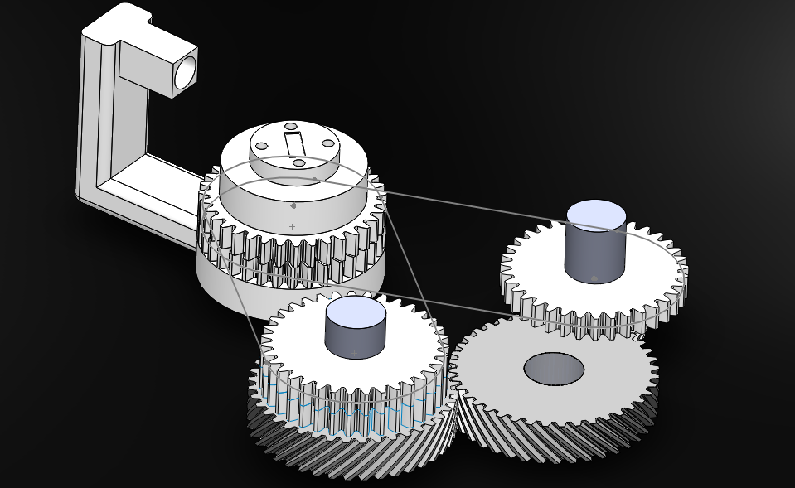
MECHANICAL DESIGN

Slide 18
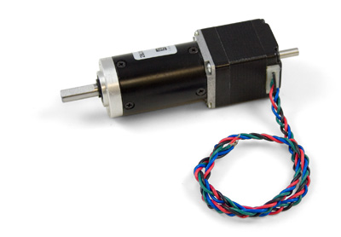
STEPPER MOTOR
NEMA-11 Bipolar Stepper
StepperOnline
US$ 38.00

Slide 19
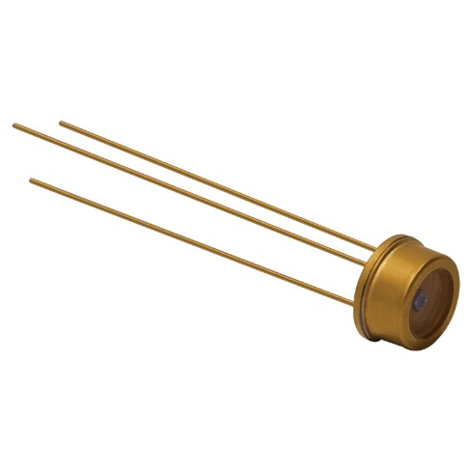
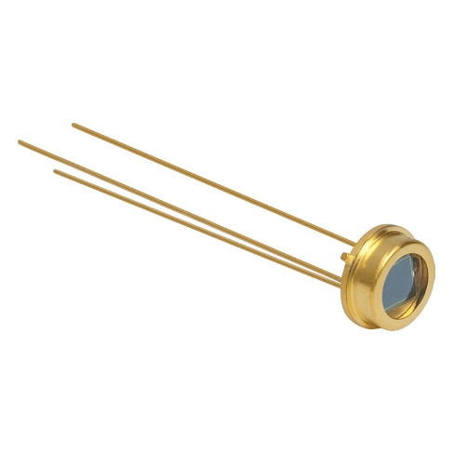
PHOTODIODE
FDS010
Thorlabs
$43.40
FDS100
Thorlabs
$13.50

Slide 20
Electrical Subsystem

Slide 21
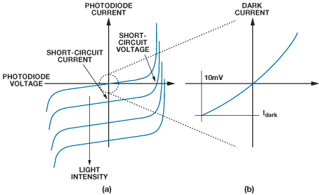
PHOTODETECTION
Transfer function of the photodiode travels up and down the current axis as light intensity varies
If voltage bias is non-zero, dark current occurs
For our purposes, we implement absence of voltage bias within the photodiode to limit noise

Slide 22
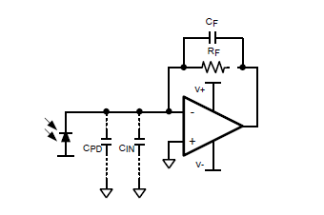
AMPLIFICATION
To convert the photodetector’s current output into voltage, a transimpedance amplifier (TIA) is used.
Essentially an op-amp connected to a high-valued feedback resistor in its simplest form.
Coupled with a programmable gain amplifier (PGA) at its output to stabilize the TIA’s gain to a factor of 1.
Example Transimpedance Amplifier

Slide 23
AMPLIFIER CONFIGURATION
The ideal operational amplifier for voltage feedback in a TIA includes:
  Low voltage noise
  Low current noise
  Low input capacitance
Op-amp to be used is the Analog Devices AD8615:
  V_{s} = 5V, R_{L} = 1 kΩ
  Input Offset Voltage = + 23 µV
  Rail-to-Rail Output
  Slew Rate = 12 V/µs
  GBW = 24 MHz
  Input Voltage Noise = 7 nV/√Hz
  Input Current Noise = .05 pA/√Hz
  Input Capacitance = 9.2 pF

Slide 24
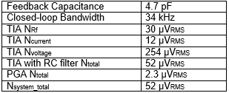
AMPLIFIER CONFIGURATION
Noise can also be reduced by adding a single pole RC filter
Optimum component values and total system noise determined by formula work
Programmable gain amplifier (PGA) also used to stabilize the gain factor to 1

Slide 25
ANALOG TO DIGITAL CONVERSION
External ADC used to sample, quantize, and encode signal
Couples as the PGA, added to tail end of TIA
Texas Instruments ADS1191
  Single Channel
  Delta-Sigma (Δ∑) design
  16 bit
  Up to 8k samples/sec (PROGRAMMABLE)
  Serial SPI I/O
  Built in PGA
  2.7-5.5V operation

Slide 26
Digital Signal Processing

Slide 27
DIGITAL SIGNAL PROCESSING
Signal is effectively averaged
  Magnitude components are summed and divided by N, number of samples
  Power spectrum is found while eliminating random noise in the signal
Current representation of the signal is intensity vs. frequency
  No DFT needed
  Factorization using a multiple equal to c achieves intensity vs. wavelength domain

Slide 28
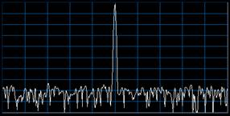
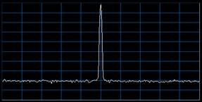
DIGITAL FILTERING
Once the amplified signal is digitized, a video bandwidth filter (VBW) is applied to the internal noise
  First order low-pass configuration
  Implemented to eliminate noise AND smooth the trace of the display
  Establishes noise floor

Slide 29

LOGARITHMIC CONVERSION
Diminishes broad scope into measurable scale
Base 10
Done for the purposes of display

Slide 30
Electronics

Slide 31
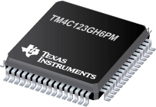
TI TM4C123GH6PM Microcontroller Architecture
32-bit ARM Cortex-M4F processor
80 MHz max clock
256 KB Flash memory
32 KB SRAM
2KB EEPROM
64-pin LQFP package
$11.42 direct from TI

Slide 32
TI TM4C123GH6PM PERIPHERALS
Built-in USB 2.0 Device/Host
Four SPI modules
Four I2C modules
Direct Memory Access (DMA)
16 PWM Outputs
12-bit Analog-to-Digital Converter (ADC)
Six GPIO blocks

Slide 33
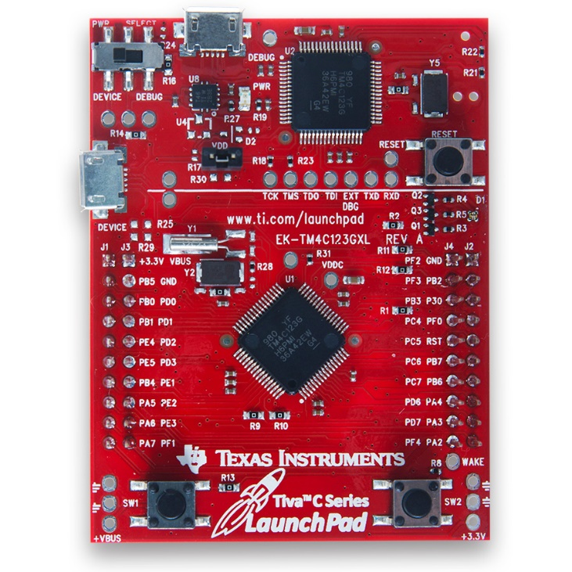
Why this micro?
Well-documented
Inexpensive dev board/programmer with debugging
Excellent C library (TivaWare)
Previous experience
Peripherals (USB, SPI, DMA)
Not limited on performance

Slide 34
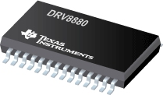
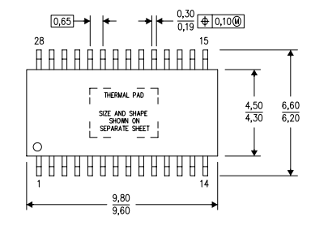
TI DRV8880 STEPPER MOTOR DRIVER
2A max current
Up to 1/16 microstepping
Simple STEP/DIR control interface
6.5V to 45V supply voltage
28-pin HTSSOP package
$4.80 direct from TI

Slide 35
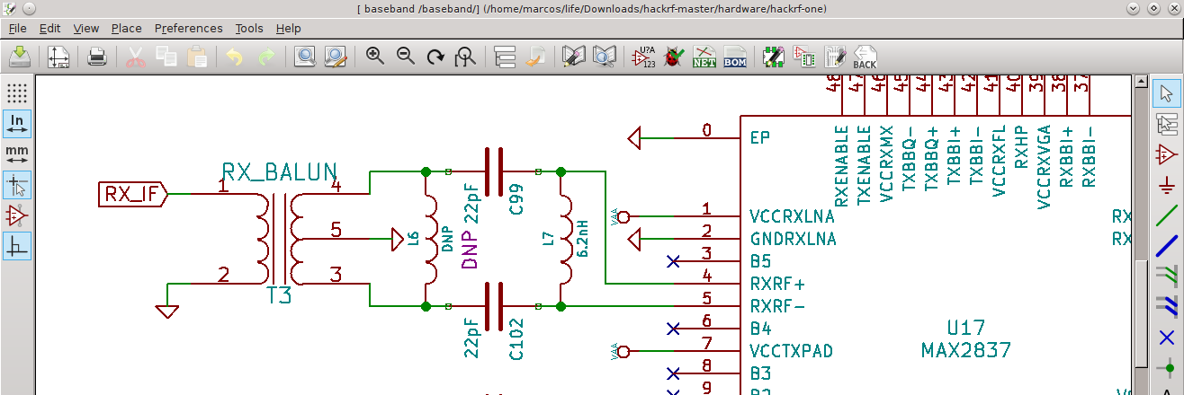

A word on EDA . . .
Chose to go with KiCAD for schematic and PCB layout. Why?
  100% free and open-source with no limitations
  Recent professional backing by CERN
  Excellent stable version 4.01 released this year
  Growing community
  Have full ownership of all your designs
  Cross-platform (Windows, Linux, OSX)

Slide 36
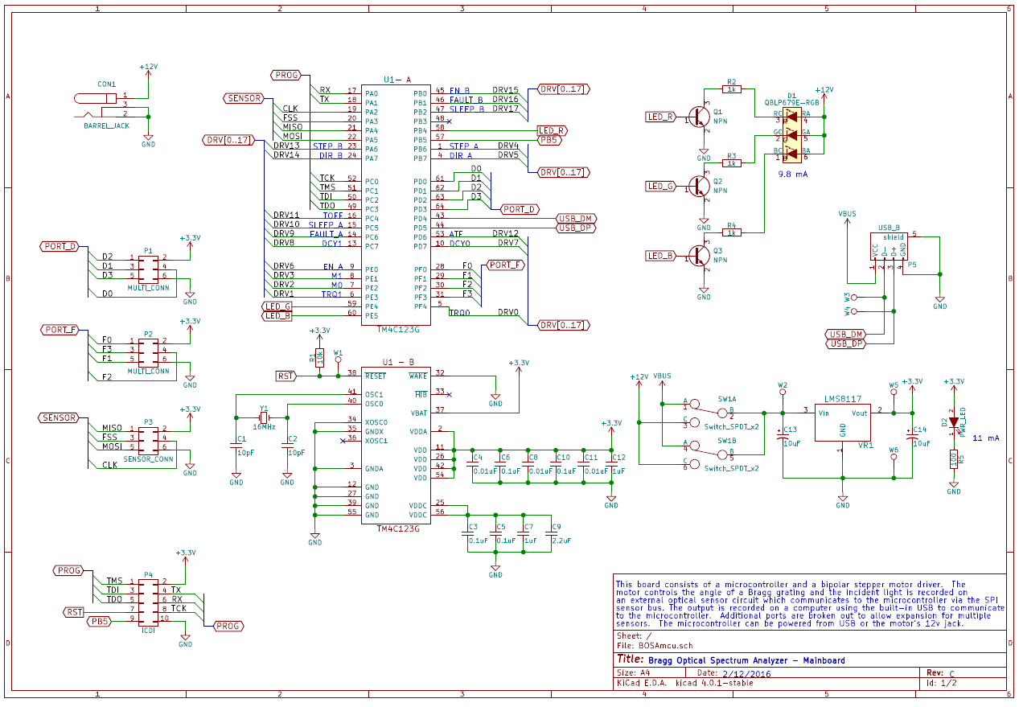
Schematic
MCU

Slide 37
Schematic
12V JACK
REGULATOR

Slide 38
Schematic
RGB LED

Slide 39
Schematic
MICRO USB
3x SPI PORTS
PROGRAMMING HEADER

Slide 40
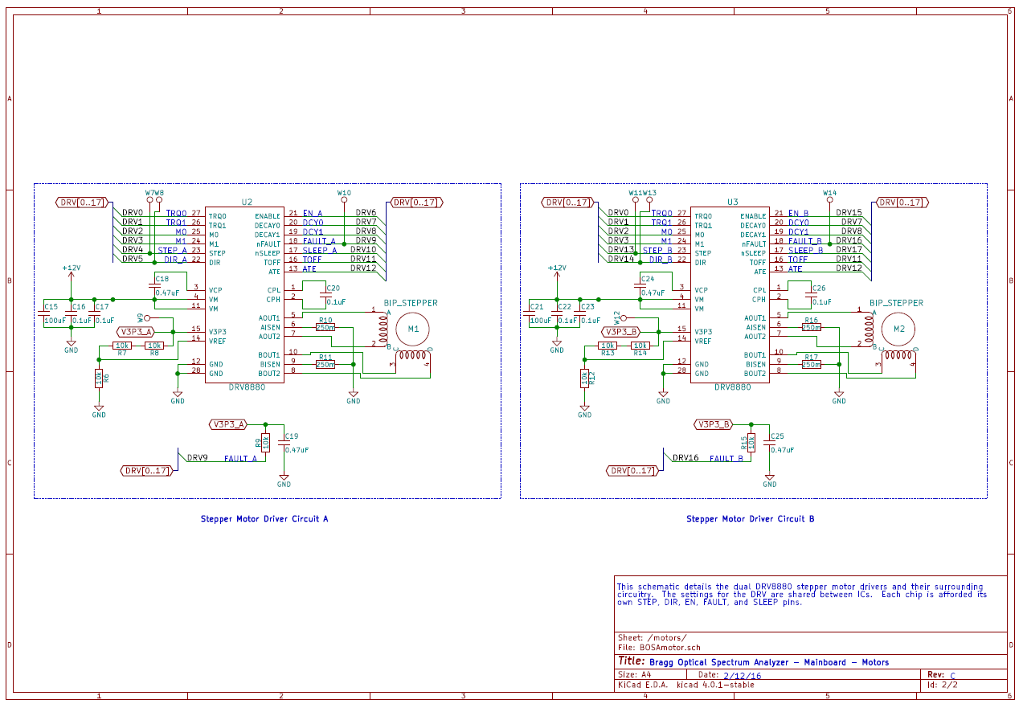
Schematic

Slide 41
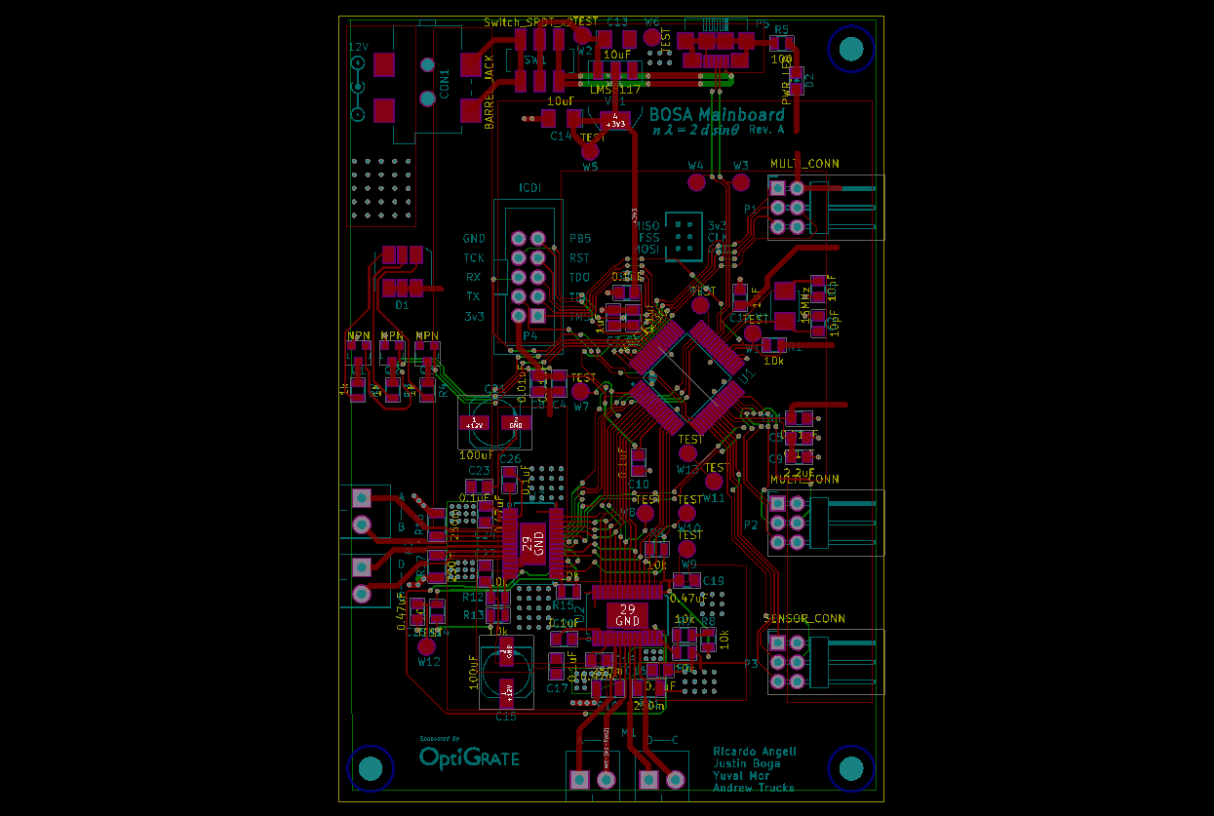
PCB Layout

Slide 42
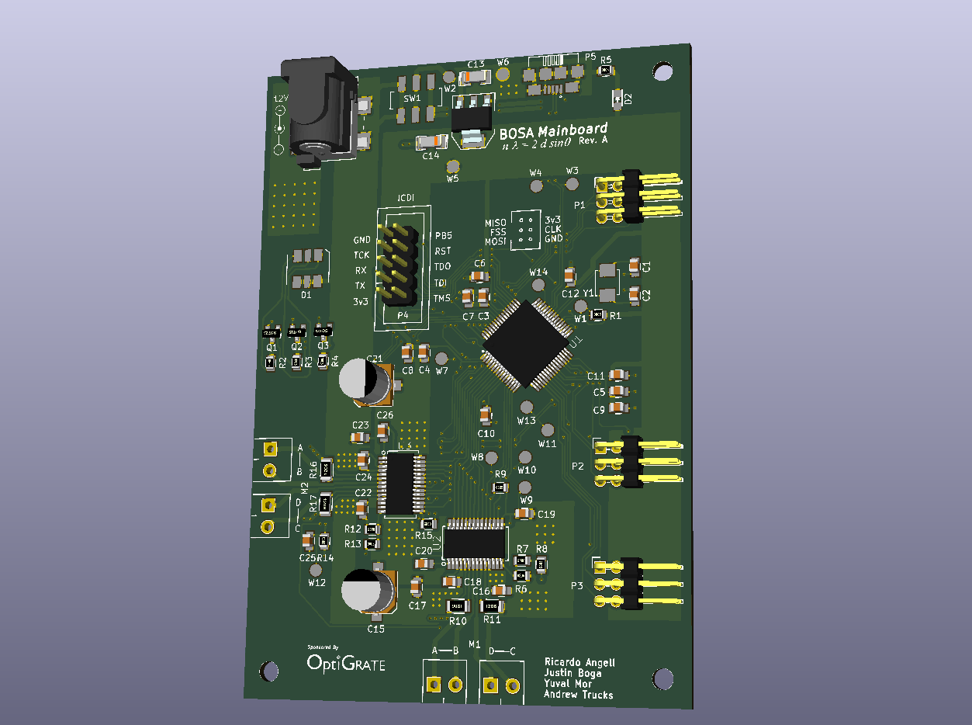

Slide 43
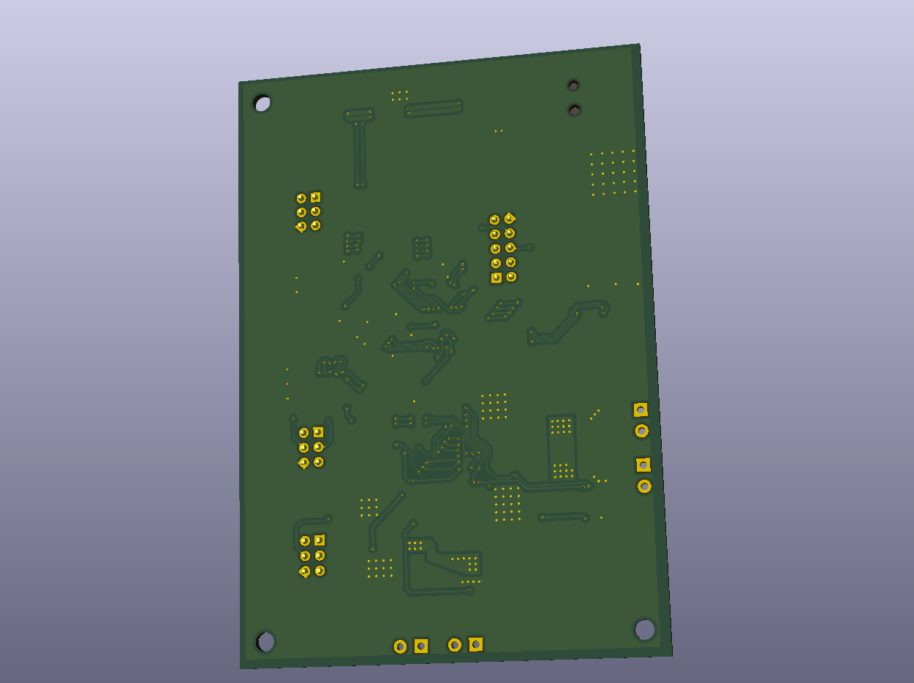

Slide 44
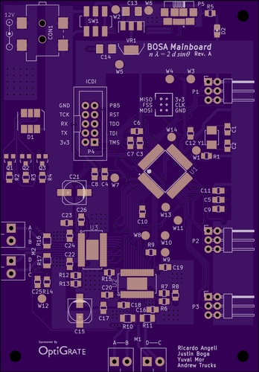
PCB Manufacturing
Decided to go with OSH Park because:
  Based in US
  High quality boards (ENIG gold coated)
  Previous experience
  Fast turn-around time ( < 2 weeks)
Cost $57.45 for 2.83x4.07 inch (11.52 sq. in.) 2-layer board.
Includes three copies.

Slide 45
Lessons learned . . .
Could shrink board area by:
  Optimizing layout
  Using 0603 parts instead of 0805
  Using upright header connectors rather than right-angle ones
  Having only one stepper motor driver or one dual-motor driver
Could save money going with PCBway or DirtyPCB (but wait longer).

Slide 46
SOFTWARE
Computer Application
Stepper Motor
Microcontroller
USB
Optical Sensor

Slide 47
EMBEDDED SOFTWARE
Control angle of Bragg grating by stepping motor
Take samples from optical sensor
Perform simple calculations & data analysis
Buffer data
Transmit data points to computer via USB

Slide 48
COMPUTER APPLICATION
Use the USB bulk protocol to . . .
  Tell microcontroller the range of the sweep
  Tell microcontroller how many sample points to take
  Receive sampled data from microcontroller
Display data points on a line graph
Display minimum and maximum peak points
Allow basic data analysis functions
Export data to CSV

Slide 49
COMPUTER APPLICATION

Slide 50
Budget
Item | Supplier | Unit Price | Quanitity | Total
CONN RCPT MICRO USB AB SMD R/A | Digi-Key | $ 1.02 | 3 | $ 3.06
IC ADC 22BIT 2.7V 1CH SPI 8SOIC | Digi-Key | $ 3.98 | 3 | $ 11.94
CONN POWER JACK 2.1X5.5MM HI CUR | Digi-Key | $ 1.89 | 3 | $ 5.67
SOLDER PASTE NO-CLEAN 63/37 5CC | Digi-Key | $ 13.88 | 1 | $ 13.88
IC REG LDO 3.3V 1A SOT223 | Digi-Key | $ 1.11 | 3 | $ 3.33
IC REG LDO 3.3V 0.4A SOT223-6 | Digi-Key | $ 2.33 | 3 | $ 6.99
NEMA-11 Bipolar Stepper with 100:1 Gearbox | Phidgets, Inc. | $ 38.00 | 1 | $ 38.00
2A Stepper Motor Driver with 1/16 Microstepping Indexer and AutoTune (STEP/DIR Ctrl) | Texas Instruments | $ 4.80 | 3 | $ 14.40
Zero-Drift, Programmable Gain Amplifier with MUX | Texas Instruments | $ 4.63 | 3 | $ 13.89
High performance 32-bit ARM® Cortex®-M4F based MCU | Texas Instruments | $ 11.42 | 3 | $ 34.26
SWITCH SLIDE DPDT 300MA 6V | Digi-Key | $ 0.46 | 3 | $ 1.38
CRYSTAL 16.0000MHZ 8PF SMD | Digi-Key | $ 0.63 | 3 | $ 1.89
RES SMD 0.25 OHM 1% 1/2W 1206 | Digi-Key | $ 0.34 | 10 | $ 3.42
RES SMD 10K OHM 1% 1/4W 0805 | Digi-Key | $ 0.02 | 50 | $ 0.97
LED RGB DIFFUSED 6SMD | Digi-Key | $ 0.93 | 3 | $ 2.79
LED GREEN DIFFUSED 0805 SMD | Digi-Key | $ 0.26 | 3 | $ 0.78
TRANS PREBIAS NPN 246MW SOT23-3 | Digi-Key | $ 0.12 | 10 | $ 1.19
CONN HEADER VERT 10POS GOLD | Digi-Key | $ 0.28 | 3 | $ 0.84
CONN SOCKET IDC 6POS DL SR 30AU | Digi-Key | $ 0.74 | 10 | $ 7.44
CONN HEADER 6POS DUAL R/A PCB | Digi-Key | $ 0.64 | 10 | $ 6.41
CAP TANT 10UF 20V 10% 1206 | Digi-Key | $ 0.59 | 6 | $ 3.54
CAP CER 10PF 50V NP0 0805 | Digi-Key | $ 0.05 | 10 | $ 0.48
CAP CER 0.1UF 50V X7R 0805 | Digi-Key | $ 0.03 | 25 | $ 0.85
CAP CER 1UF 25V X7R 0805 | Digi-Key | $ 0.08 | 10 | $ 0.81
CAP CER 2.2UF 25V X7R 0805 | Digi-Key | $ 0.21 | 3 | $ 0.63
CAP CER 10000PF 50V X7R 0805 | Digi-Key | $ 0.03 | 10 | $ 0.31
CAP CER 0.47UF 50V X7R 0805 | Digi-Key | $ 0.24 | 6 | $ 1.44
CAP ALUM 100UF 20% 35V SMD | Digi-Key | $ 0.36 | 3 | $ 1.08
CBL RIBN 6COND 0.050 GRAY 5' | Digi-Key | $ 1.71 | 1 | $ 1.71
CONN SOCKET IDC 10POS W/KEY GOLD | Digi-Key | $ 0.32 | 3 | $ 0.96
CBL RIBN 16COND 0.050 MULTI 5' | Digi-Key | $ 6.40 | 1 | $ 6.40
TERMINAL BLOCK 3.5MM 2POS PCB | Digi-Key | $ 0.68 | 6 | $ 4.08
RES SMD 1K OHM 1% 1/4W 0805 | Digi-Key | $ 0.02 | 50 | $ 0.97
RES SMD 100 OHM 1% 1/8W 0805 | Digi-Key | $ 0.01 | 50 | $ 0.62
Total |  |  |  | $ 196.41

