Slide 1
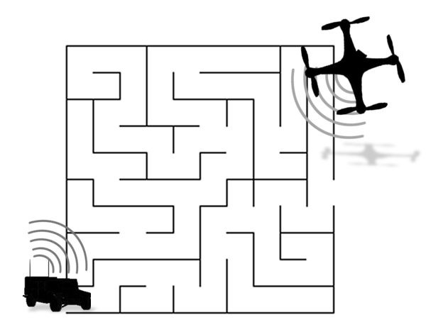


Maze Zone Drone
Group #29 Ehsan Falaki CpE
Tanner Foster CpE
Matt Szewczyk EE
Justin Yuen EE
Sponsors SoarTech
Boeing/Leidos

Slide 2
Project Description
Maze Zone Drone
locates maze points of interest from air; camera; transmits data
Ground Vehicle
receives data; maze solving algorithm; logic to solve maze.
Design Aspects
motor controllers, power systems, flight control scripts, and image processing
Aerial Vehicle
Ground Vehicle
Integration
Maze
Image Processing
Notes:
Multi-system communication effort between ground vehicle and MZD

Slide 3
Motivation
Early motivation:
Integrating drone into core of project
Crop Growth Tracking
Military “Brownout”
Possible Applications:
UCF: Parking spot locator
Military: Sensors to avoid obstacles
Notes:
Talk about “brownout” problem and possible solutions. Instead of a Drone communicating with a helicopter, we could implement a drone communicating with a ground vehicle to avoid obstacles.
Applications:
-release MZD out the window of their car at the entrance of a parking lot, allow the MZD to find a parking spot, calculate the shortest path to the spot, and even guide the vehicle to the spot with the press of button
-Military: additional infrared+thermal sensors to detect and avoid obstacles

Slide 4
Goals and Objectives
Seamless integration of separate component modules.
Few if any hard coded starting values.
Two part system, independent of an operator.
Timely completion of the maze without errors from either vehicles.
Notes:
integration covers hardware, software

Slide 5
Specification Requirements
Aerial Drone:
Maximum of 1 meter diameter (propeller to propeller)
Maximum of 2 kilograms
Minimum 10 minute hover time
Wireless communication up to 30 meters
Altitude accurate within 2 meters up to 50 meters
Ground vehicle:
Less than 0.5 cubic meters in size.
Able to run for at least 15 minutes.
Able to move at least 1/6 meters per second
Wireless communication up to 30 meters

Slide 6
Overview
Overall Project Block Diagram
Responsibility Legend:
Ehsan Falaki
Tanner Foster
Matt Szewczyk
Justin Yuen
Quadcopter
Wireless Communication
Wifi
Radio
Ground Vehicle/ Computer Base
Image Processing/Control Programs

Slide 7
Ground Vehicle Hardware
The Wild Thumper Chassis is small enough to navigate the maze, sturdy enough to house components (about 1 cubic foot)
34:1 gearbox DC motors rated at 4 mph at 7.2 volts controlled with PWM
SN754410 Motor controller chips utilized in design
MSP430G2553 embedded processor
Raspberry PI 2 Model B
3-4 Ultrasonic sensors will be mounted on the front and sides
Vehicle Block Diagram
Ultra-Sonic Sensors
Vehicle microcontroller
Wheel Drive System
Power/Charging System
Central Computer
Communication Infrastructure
Unique Vehicle Image Identifier

Slide 8
Central Computer
Feature | Rasp PI 2 B | Beagle Bone B | Odroid C1+
Processing Speed | 900 MHz Quad Core | 1 GHz ARM A8 | 1.5GHz Quad
Memory RAM | 1GB DDR2 | 512MB DDR 3 | 1GB DDR3
Storage | Micro SD | 4GB eMMC | Micro SD
EthernetWi-Fi Bluetooth Mbps | 1 10/100 | 1 10/100 | 1 1000
Composite Video | 1 | NA | NA
Number of USB Ports | 4 | 2 | 4
Camera Ports | 2 | NA | NA
Power | 5V | 5V | 5V 2A
Size | 2.44”x 1.18” | 3.4”x 2.1” | 3.23”x 2.28”
Price $ | 40 | 55 | 37
Central computer acts as the hub between the ground vehicle and the aerial drone.
Key selection aspects: Processing Speed, Size, Power Draw, and Price.
Raspberry Pi Model 2 B (Adafruit)
Beagle Bone B (BeagleBoards)
Odriod C1+ (HardKernel)
Notes:
add where you got it from

Slide 9
MSP430
 | TI Launchpad | Arduino Uno
Microcontroller | TI M430G2553 | ATMega328
Data Bus | 16 bit | 8 bit
Speed | 16 MHz | 16 MHz
Storage | 16 KB | 32 KB
RAM | 512 B | 2 KB
Digital I/O | 8 channels | 14 channels
Analog I/O | 8 channels | 6 channels
Kit cost | $4.30 @TI.com | $29.95 @Adafruit
Embedded processor interfaces with sensors and motor controllers to drive the wheels.
Key selection aspects include Processing Speed, storage, I/O channels, and Price.
MSP430G2553
Arduino Uno
Notes:
add where you got it from

Slide 10
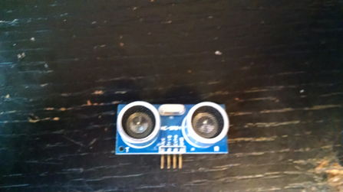
Sensors
Properties | Ultrasonic | Infrared
Does not require physical feedback | ✔ | ✔
Uses only one pin for communication |  | ✔
Range over 15cm | ✔
Returns Distances | ✔
SR-04 Sensor | $1.89 each | 3 required | HobbyKing
Notes:
Need for sensors: Eliminates constant computer vision analysis supplied overhead by drone: limited to processing power of ground vehicle and drone battery life
Pin: high/low required one communication pin. ultrasonic required 3 pins (VCC 5V, GND, SIG IN, SIG OUT)
Range: Ultrasonic has a range of 5 feet with accuracy to the milimeter
Returns: infrared returns high/low values, would be better suited to following tape on the ground as opposed too physical walls.

Slide 11
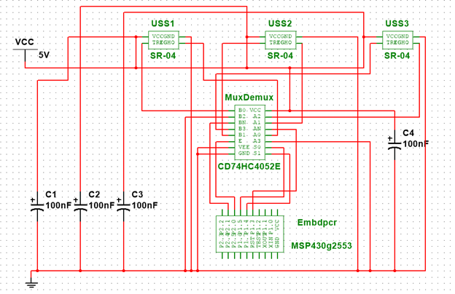
Sensor Interface
Activated in sequence
# of Sensors limited without Mux
Capacitors used to reduce electrical noise
MSP430 Pin-5 | Echo pin for the sensors
MSP430 Pin-6 | Select line 1
MSP430 Pin-7 | Select line 0
MSP430 Pin-8 | Enable pin for the MUX/DEMUX (chip is active low)
MSP430 Pin-9 | Trigger pin for the sensors
Sensor/Mux schematic
CD74HC4052E | $0.97 each | 1 required | Mouser
Notes:
Sensors activated in sequence, firing in parallel could cause interference
Runs off same power source as Sensors 5v
uses single trigger, echo pin, 3 select lines…. as opposed to three pairs of trigger and echo pins

Slide 12
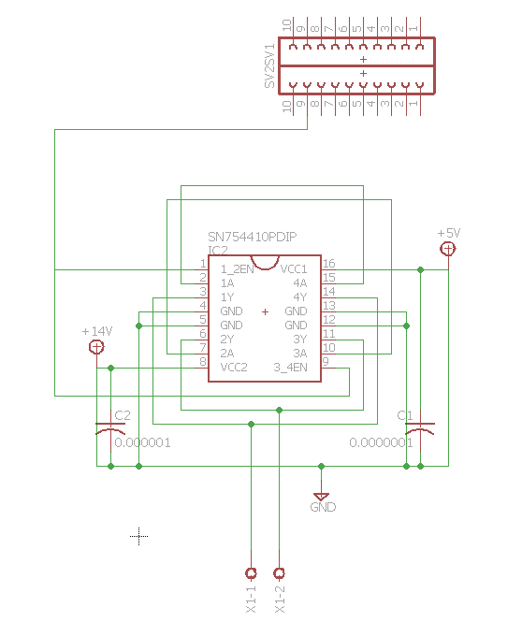
Motor Controller
Four motor controllers connect to MSP430
Originally designed to connect to one motor per 8 pin side
Capacitors used to reduce electrical noise
MSP430 Pin-10 | Left Side Forward Enable
MSP430 Pin-11 | Left Side Reverse Enable
MSP430 Pin-12 | Left Side PWM
MSP430 Pin-13 | Left Side Forward Enable.
MSP430 Pin-14 | Left Side Reverse Enable
MSP430 Pin-15 | Left Side PWM
Single motor controller schematic
SN754410 | $2.50 each | 4 required | Mouser
Notes:
One motor controller for each motor, so four total
Current draw from motor could draw as high as 2.2A, while max rated draw of chip along any one line is .5a per line/channel, 1a per side
L2329D
puts us on a pin crunch

Slide 13
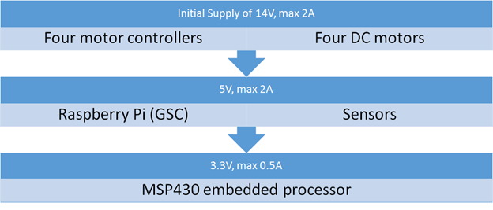
Ground Vehicle Power Supply
2 - 2S Lipo batteries
Total Input of 14.8V
2 Stage voltage stepper design
Four DC motors
Buck Converter | TPS54340 | $1.68 | TI
Raspberry Pi (GSC) Motor Controllers Sensors
Buck Converter | TPS54233 | $1.68 | TI
Notes:
motor controller turn on logic =5v, motor controller
Discuss quick comparison of lipo vs other batteries.
Option: depending how long vehicle takes too go through maze, might wire parallel vs. series, to extend battery life vs bursts. twice capacity vs twice voltage.

Slide 14
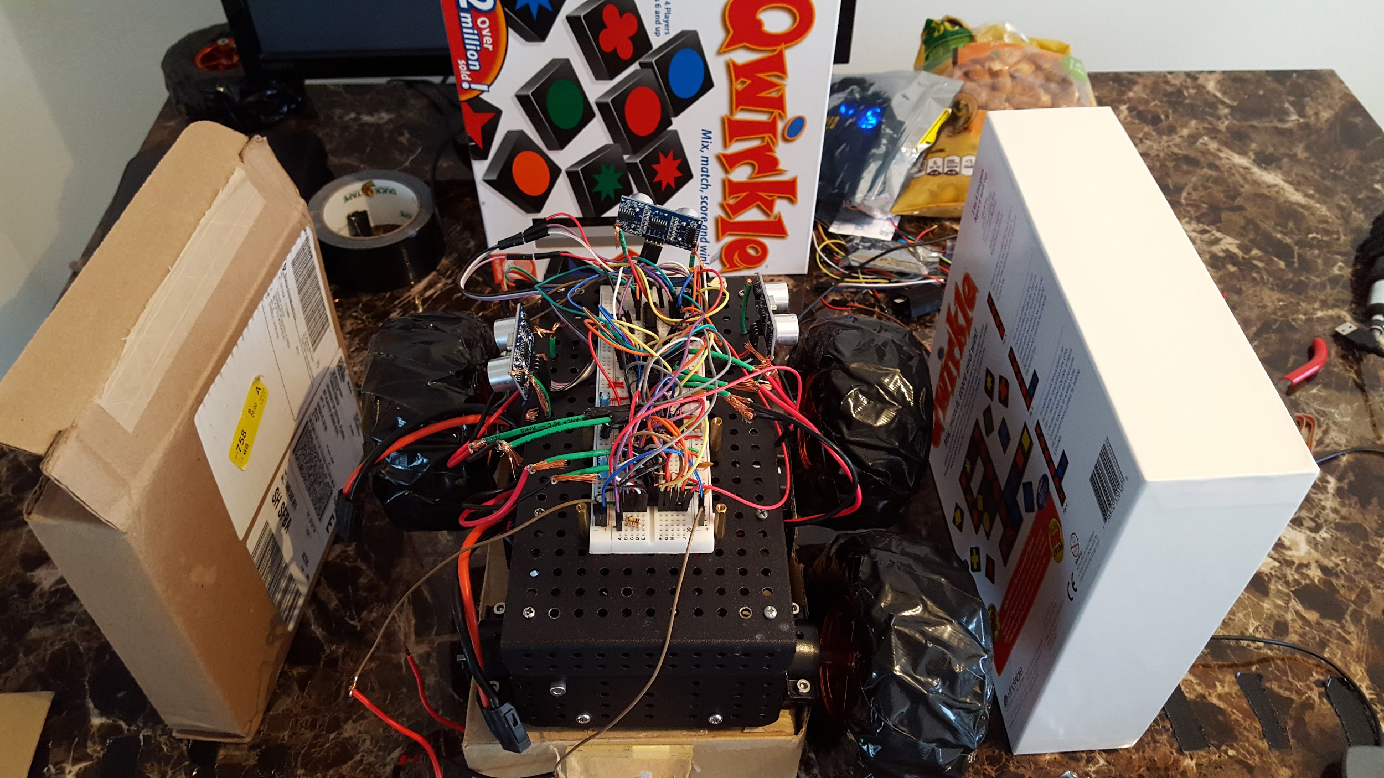
First Prototype (Ground Vehicle)
Breadboarded circuits with power supplied from the final batteries and the RPi.
To be used for prototyping the code and viability of the circuits.
Problems arising are dealt with for final production prototype.

Slide 15
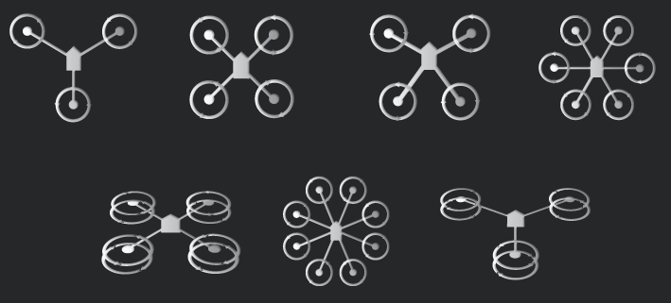
What Kind of Aerial Vehicle is Needed?
Fixed Wing
Efficient
Simple
Inexpensive
Rotary Wing
Easy to fly
Maneuverable
Able to hover
Rotary Wing Types
Helicopter
Ticopter
Quadcopter
Hexacopter
Octocopter

Slide 16
Aerial Vehicle Parts
Quadcopter Block Diagram
Frame
Flight Controller
Communication
Motors
Electronic Speed Controllers
Propellers
Power Supply
Wireless Communication Infrastructure
Power/Charging System
Camera
Electronic Speed Controllers
Flight Controller
PID
(proportional-integral-
derivative controller)
Motors
Wireless Communication Module
Flight Control Sensors

Slide 17

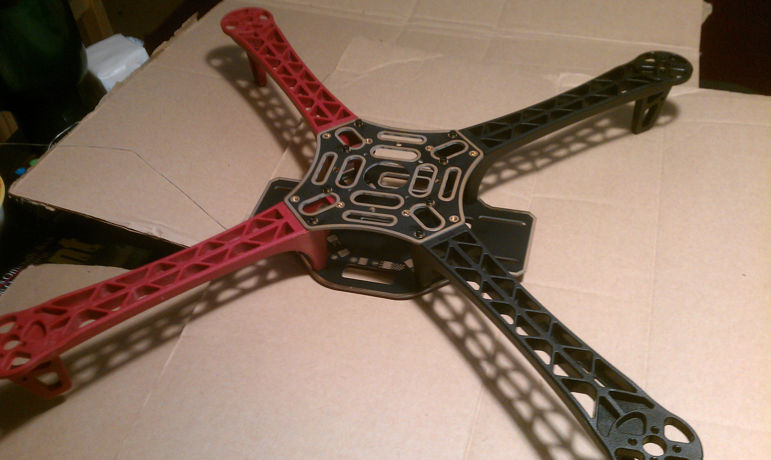
Aerial Vehicle Frame
Configuration:
Symmetrical X-type Material:
Size: 450mm motor to motor
Option: Flamewheel F450 - $19.99 - RipaFire (Amazon)
Important Factors
 | Wood | Aluminum | Carbon Fiber | Glass Fiber
Durability | ✘ | ✔ | ✔ | ✔
Weight | ✔ | ✘ | ✔ | ✔
Vibrations | ✔ | ✔ | ✘ | ✔
Price | ✔ | ✔ | ✘ | ✔

Slide 18
Aerial Vehicle Flight Controller
Required Features:
Autopilot
Sensors (IMU, Barometer, GPS, Compass)
Control via computer (Mavlink Protocol)
Option: APM 2.6 - $42.43 - Andoer (Amazon)
16MHz Atmega2560 Processor
16 MB dataflash memory
(~2 hours of logging)

Slide 19
Aerial Vehicle Communication
Manual Remote Control 2.4GHz
HobbyKing 4 Channel Transmitter
HobbyKing 6 Channel Receiver
Package - $23.55 - HobbyKing
Telemetry 915MHz
Mavlink Protocol
APM 2.6 Compatible
Over 300m range
3D Robotics Radio Set - $100.00 - 3DR

Slide 20
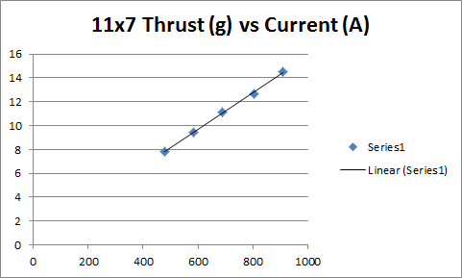
Aerial Vehicle Motors and ESCs
Motors
Brushless DC
Efficiency vs Maneuverability
SunnySky X2212 980KV II - $19.95 - Buddy RC
Electronic Speed Controllers
User Test Data - Max Amperage per Motor: 15 A
Afro 20A ESC - $12.97 - HobbyKing

Slide 21
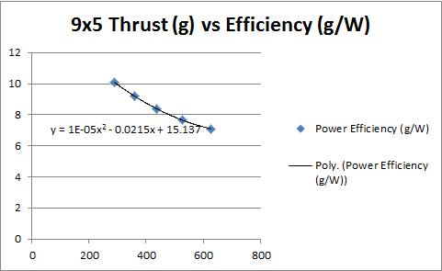
Aerial Vehicle Propellers
User Test Data:
Estimated Weight: ~1300g
1300g / 4 = 325g
Diameter x Pitch:
9”x4.7”
10”x4.7”
10”x5.5”

Slide 22
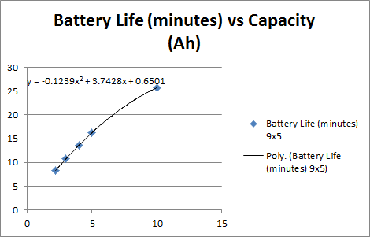
Aerial Vehicle Power Supply
Power System
Battery Capacity
Estimate Weight without battery: 900g
ESCs
11.1 V Batteries
Video Transmitter
Motors
Power Module (5 V Output)
Camera
Flight Controller

Slide 23
Ground Control Station
Mission Planner
Setup
Tuning
Parameter configuration
Simple graphical user interface
Real time control or missions
Mavproxy
Simple graphical user interface
Terminal
Real time control or missions
Control scripts

Slide 24
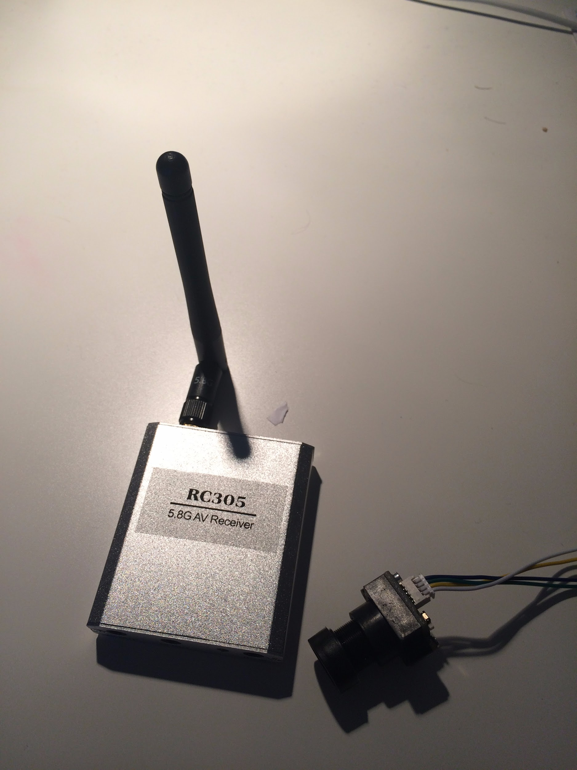
Tx/Rx Modules.
3DR telemetry radio controller for quadcopter.
SkyZone RC305 - 5.8Ghz 8 Channel AV Receiver - $16.00 - (Hobbyking)
Turnigy FPV200 Set w/LT200 5.8GHz Micro Transmitter - $30.00 (Hobbyking)
EZCap. analog to digital converter - $31.95 - EzCap-Tv (Amazon)
Notes:
Several other receivers for the Camera were considered, however due to shortages and shipping issues, other options had to be considered. All modules listed were chosen for their compatibility with a PC platform.

Slide 25
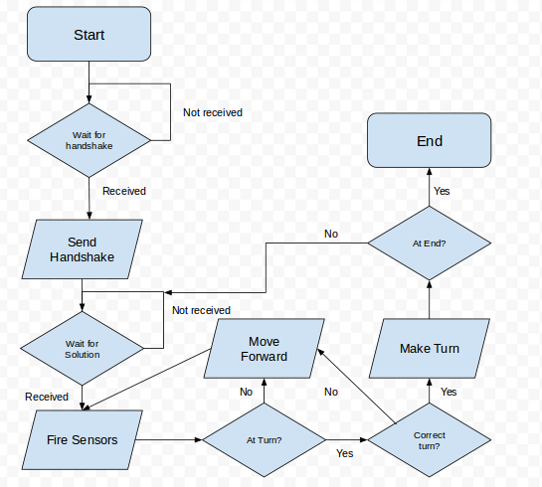
Embedded Control Program
Programmed using the energia IDE in C.
Embedded processor will communicate with the Raspberry Pi via UART.
Sensors and motor controllers take commands from the active I/O channels.
Will make decisions about the course independent of the Pi.

Slide 26
Libraries, IDEs, Programming Languages
Languages:
Python 3.4 (Object Detection, Object Tracking, API, TX/RX communication, Maze Solving)
C (Edge Detection, EMCP)
OpenCV 3.0(Object Detection, Object Tracking)
IDEs:
Energia
PyCharm

Slide 27
Image Processing
Color Filtering
Object Detection
Object Coordinate Discovery
Edge Detection
Maze Solving
Solution Translation

Slide 28

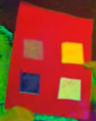
Color Filtering
Finding Hue, Saturation, and Value of the Object
Converting to HSV Color System
Filtering the Color
Reducing Noise
Expanding Object
Testing the Output

Slide 29
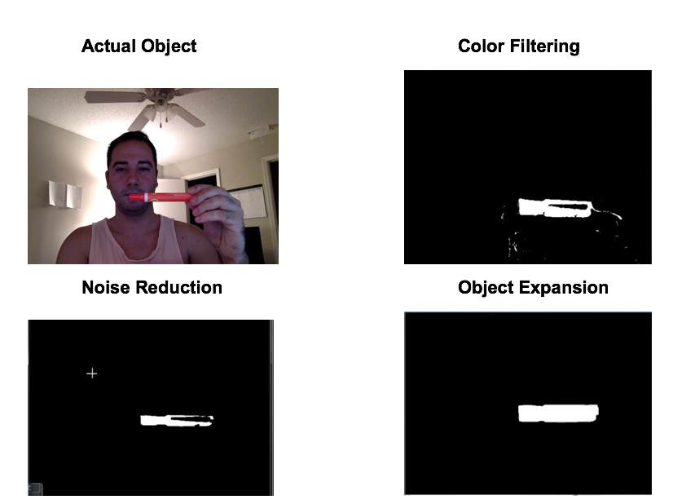

Slide 30
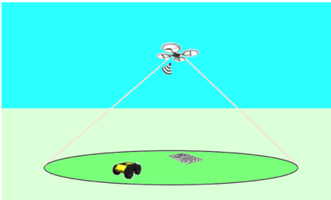
Object Detection
Grid Search
Object Coordinate in the Image
Object Distance from Quadcopter

Slide 31
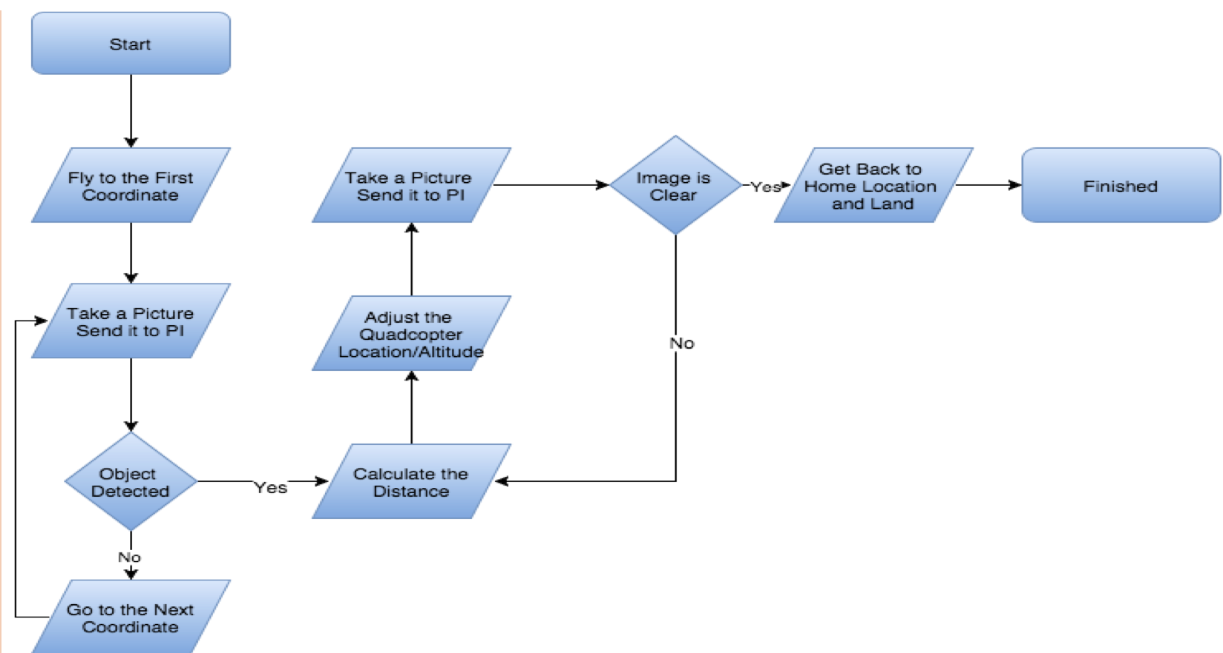
Quadcopter Control Subprogram

Slide 32
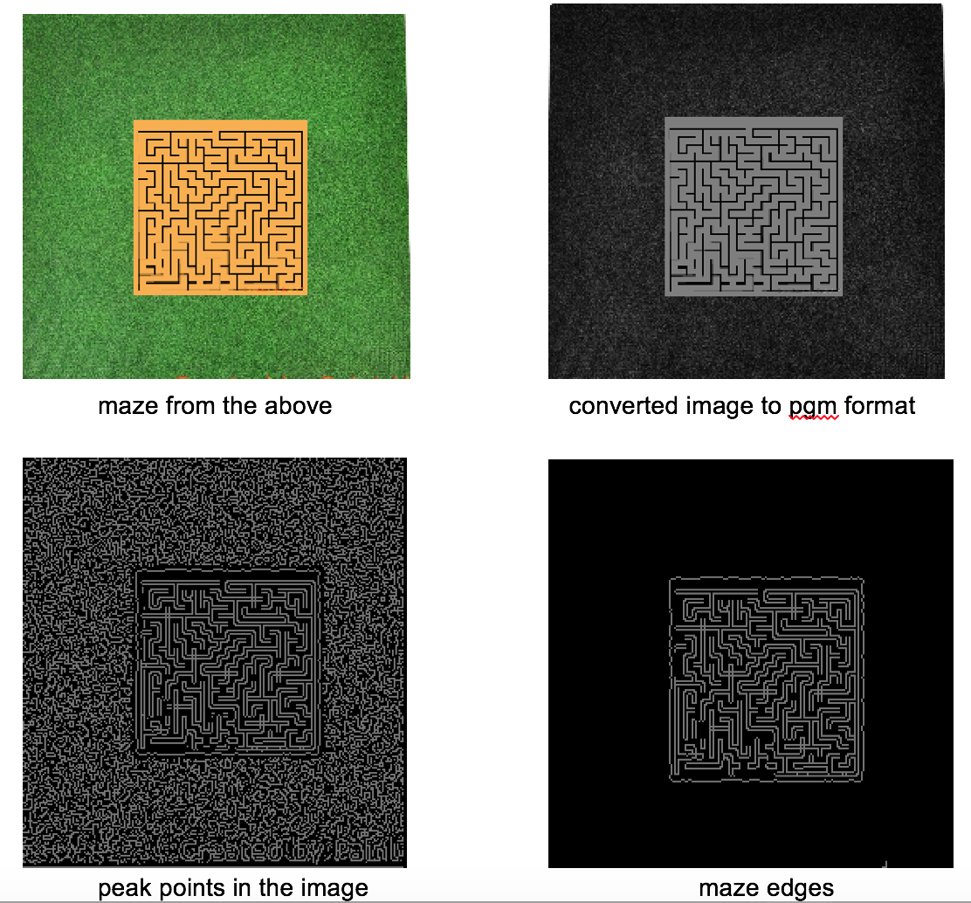
Edge Detection
Converting to PGM
Finding Peak Points
Remove Noises
Separating Edges from Background

Slide 33
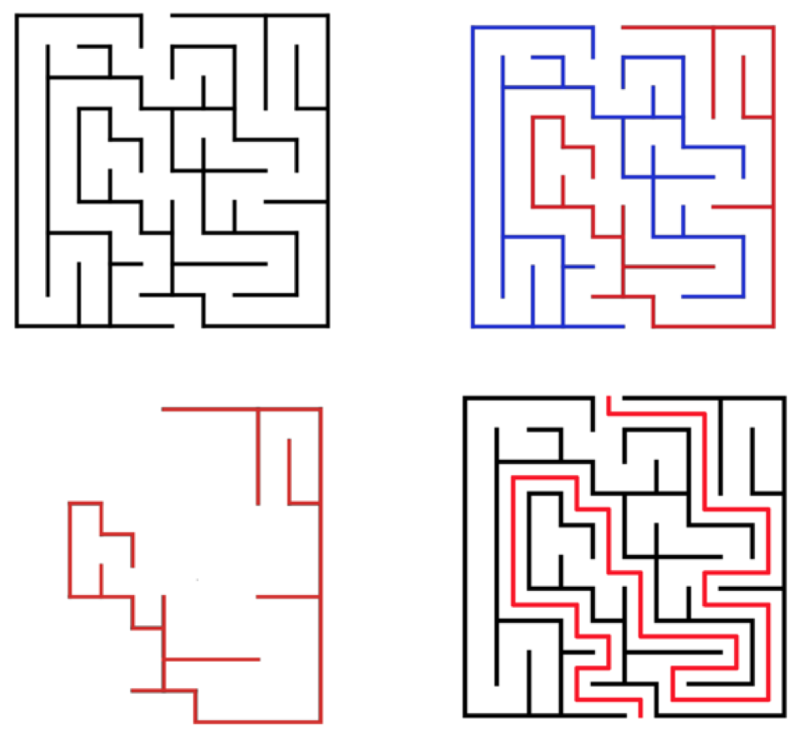
Maze Solving
Using Python
Morphological Solution
Detect two wall components by a morphological operation.
Expand two components by a
morphological operation.
'AND' region of these two is
the solution way.

Slide 34
API
Written in Python
Translating the Solution to the Ground Vehicle Directions
Translating Object Coordinates to MAVproxy Commands
Communicating from and to Ground Vehicle

Slide 35
Image Processing Constraints
Maze solving program works only on one-to-one maze.
Colors on higher altitudes are not clear enough.
Wind may introduce noise on the image.

Slide 36
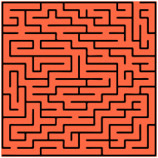
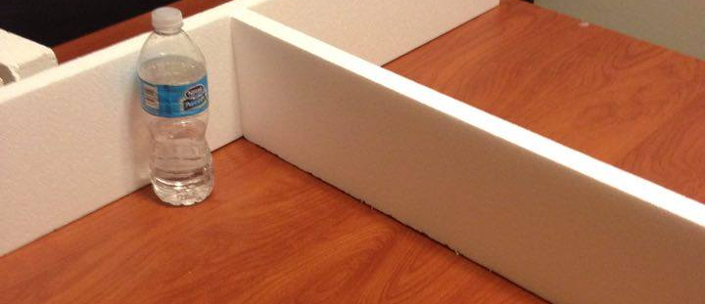
Maze
Orange Tarp background
Sheet Foam walls
Painted Orange
Cut to 14”+ blocks
Black Tops of walls
1”
6”
14”
Projected Size: 10ft x 10ft 8 blocks x 8 blocks
Smoothfoam | $80 total
Notes:
Orange tarp will give drone necessary point of interest (look at this orange blob right hurr).
Will be anywhere from 10X10 feet up too 15x15 feet depending on prototype turning radius of the ground vehicle Foam: light, easy to cut, and ton of savings versus framing lumber, especially with ground vehicle almost at a cubic foot: bigger car, bigger maze

Slide 37
Budget Ground Vehicle
Item Description | Item | Min. Quantity | Quantity Bought | Unit Price | Minimum Price | Spent Price
Chassis | acquired | 1 | 1 | $0.00 | $0.00 | $0.00
Wheels | acquired | 4 | 4 | $0.00 | $0.00 | $0.00
motors | acquired | 4 | 4 | $0.00 | $0.00 | $0.00
CPU | Rasperry Pi 2 Model B | 1 | 1 | $39.95 | $39.95 | $39.95
Embedded controller | MSP430g2553 | 1 | 1 | $0.00 | $0.00 | $0.00
Motor Controller | SN754410 | 4 | 8 | $2.50 | $10.00 | $20.00
Power Systems | TPS62170DSGR | 1 | 1 | $1.68 | $1.68 | $1.68
Power Systems | LM3670MF-3.3/NOPB | 1 | 1 | $0.95 | $0.95 | $0.95
Battery | estimate | 2 | 2 | $0.00 | $0.00 | $0.00
Ultrasonic sensors | SR-04 | 3 | 6 | $1.89 | $5.67 | $11.34

Slide 38
Budget - Maze
Item Description | Item | Min. Quantity | Quantity Bought | Unit Price | Minimum Price | Spent Price
walls | Foam | 2 | 2 | $40.00 | $80.00 | $80.00
foam cutter channel rail | 1 meter rail | 1 | 1 | $19.95 | $19.95 | $19.95
foam cutter | To cut sheet foam | 1 | 1 | $16.68 | $16.68 | $16.68
Orange Tarp | 15x15 | 1 | 1 | $24.99 | $24.99 | $24.99
marking | Black Tape
marking | Orange paint

Slide 39
Budget - Miscellaneous
Item Description | Item | Min. Quantity | Quantity Bought | Unit Price | Minimum Price | Spent Price
Breadboards | estimate | 2 | 4 | $10.00 | $20.00 | $40.00
PCB | estimate | 1 | 2 | $25.00 | $25.00 | $50.00
hardware | estimate | 1 | 2 | $40.00 | $40.00 | $80.00
Solder | acquired | 0 | 0 | $0.00 | $0.00 | $0.00
Circuit Components | estimate | 1 | 2 | $50.00 | $50.00 | $100.00
Perf Boards | 250 hole (30 pc) | 1 | 1 | $8.90 | $8.90 | $8.90
Surface Mount to DIP | 10 pin (50pc) | 1 | 1 | $5.20 | $5.20 | $5.20
Servo Leads | 10cm (10pc) | 1 | 2 | $3.98 | $3.98 | $7.96
Servo Lead Extension | 20cm (20pc) | 1 | 1 | $4.86 | $4.86 | $4.86
Heat Shrink Tubing | 5mm x 1m black | 1 | 2 | $0.68 | $0.68 | $1.36
Heat Shrink Tubing | 5mm x 1m red | 1 | 2 | $0.79 | $0.79 | $1.58
Wires | 14AWG silicone wire (10ft) | 1 | 1 | $10.99 | $10.99 | $10.99
apm connector | df13 6 to 5 connector | 1 | 1 | $1.00 | $1.00 | $1.00
battery connector | deans male 2 pack | 1 | 1 | $3.19 | $3.19 | $3.19
batter connector | deans female 4 pack | 1 | 1 | $4.99 | $4.99 | $4.99
accessory | velcro roll | 1 | 1 | $9.27 | $9.27 | $9.27
accessory | liquid electrical tape | 1 | 1 | $5.99 | $5.99 | $5.99
accessory | nylon rope | 1 | 1 | $5.21 | $5.21 | $5.21
accessory | zip ties | 1 | 1 | $6.47 | $6.47 | $6.47

Slide 40
Budget - Quad-Copter pt 1
Item Description | Item | Min. Quantity | Quantity Bought | Unit Price | Minimum Price | Spent Price
Flight Controller | APM 2.6 | 1 | 1 | $42.43 | $42.43 | $42.43
ESCs | Afro 20A | 4 | 4 | $12.97 | $51.88 | $51.88
Motors | Sunnysky X2212 KV980 II | 4 | 4 | $19.95 | $79.80 | $79.80
Motor Accessory | reverse shaft | 0 | 2 | $0.99 | $0.00 | $1.98
Motor Accessory | Nyloc Nuts (4pc) | 1 | 1 | $1.37 | $1.37 | $1.37
Battery | Zippy Compact 3s 25c 5Ah | 1 | 1 | $30.12 | $30.12 | $30.12
Battery Charger | SkyRC IMAX B6AC | 1 | 1 | $54.42 | $54.42 | $54.42
Battery Accessory | Lipo Voltage Alarm 2pack | 1 | 1 | $7.99 | $7.99 | $7.99
Battery Accessory | lipo bag | 1 | 2 | $6.27 | $6.27 | $12.54
gps/compass | 3dr | 1 | 1 | $89.99 | $89.99 | $89.99
gps accessory | gps mast | 1 | 1 | $10.00 | $10.00 | $10.00
Tx module | hk 4 channel | 1 | 1 | $0.00 | $0.00 | $0.00
Rx module | hk t6a-v2 | 1 | 1 | $0.00 | $0.00 | $0.00

Slide 41
Budget - QuadCopter pt 2
Item Description | Item | Min. Quantity | Quantity Bought | Unit Price | Minimum Price | Spent Price
telemetry | 3dr Telemetry | 1 | 1 | $100.00 | $100.00 | $100.00
Frame | f450 | 1 | 1 | $19.99 | $19.99 | $19.99
Frame accessory | landing gear | 1 | 3 | $2.15 | $2.15 | $6.45
propellers | 10x4.7 Slow Fly | 4 | 4 | $1.50 | $6.00 | $6.00
propellers | 9x4.7 Slow Fly | 4 | 4 | $1.25 | $5.00 | $5.00
propellers | 10x6 DD | 4 | 4 | $1.50 | $6.00 | $6.00
propellers | 9x4.7SF-B4 | 1 | 1 | $8.67 | $8.67 | $8.67
propellers | 10x4.7SF-B4 | 1 | 1 | $9.79 | $9.79 | $9.79
propellers | 10x5.5MR-B4 | 1 | 1 | $9.38 | $9.38 | $9.38
Camera + TX | Turnigy FPV200 | 1 | 1 | $28.42 | $28.42 | $28.42
Camera RX + EZCap | RC305 + EZ CAP | 1 | 1 | $48.89 | $48.89 | $48.89
Unexpected Costs | $200.00 |  | Estimated Minimum | $1,024.95
Original Estimate | $1,237.00 |  | Current Total | $1,245.97

Slide 42
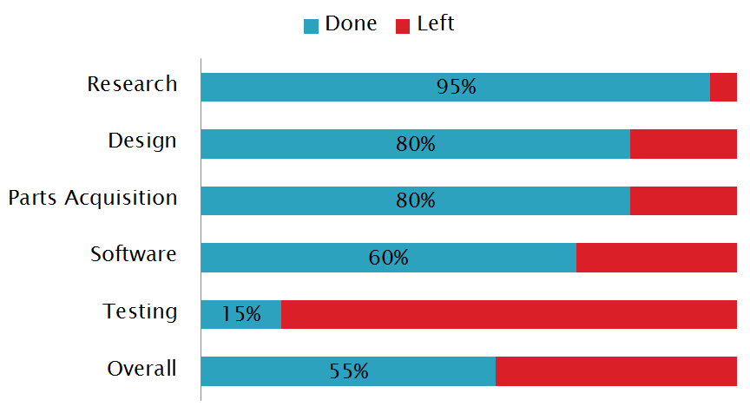
Progress
Notes:
Research: essentially done
Design: Additional design workarounds may be required+ system integration
parts acquisition: still need ultrasonic mounts, pcb, paint
Software: integration, debugging, logic for turning
testing: First Prototypes both work (lift off, wheels spin) more individual testing and control required before integration
Overall: with completion of the prototype and almost all parts acquired,

Slide 43
Immediate Plans
Finish the first prototype.
Work out the bugs in the code.
Connect the Pi to the Copter for first test flight.
Rapid prototyping for second prototype.

Slide 44
Questions?

