Slide 1

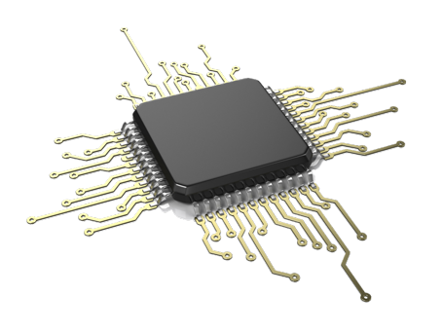

Group 34
Akash Patel (CpE)
Ayoub Soud (CpE)
Nishit Dave (EE)
Younes Enouiti (EE)

Slide 2
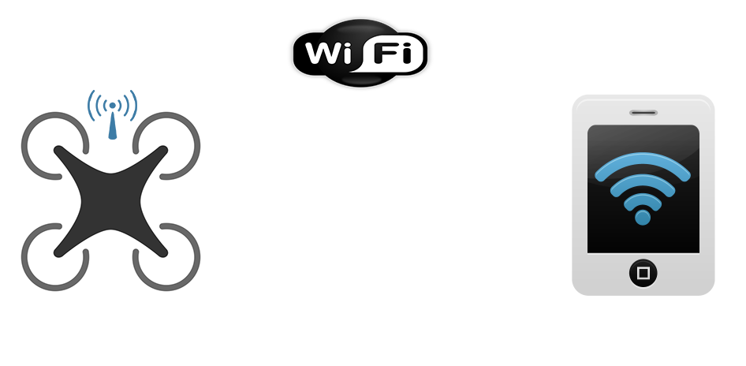
Wi-Fi Controlled Quadcopter

Slide 3

Goals and Objectives
Use of Wi-Fi control of copter in place of traditional RF control
Feed data to Autopilot through UDP protocol
Use of “RTL or LAND” mode for the flight safety
Mobile application interface for flight control

Slide 4
Specification
Component | Parameter | Design Specification
Battery | Charge Time Discharge Time | 2.5 hours (Full) 30C Constant/ 40C Burst
Mobile Wi-Fi | Wi-Fi range | 100 Ft
Quadcopter | Flight time | 10 Minutes
360Fly camera | Capacity | 32GB

Slide 5
FAA Rules and Guiedline
Effective December 21, 2015, anyone who owns a small unmanned aircraft of a certain weight must register with the Federal Aviation Administration's Unmanned Aircraft System (UAS) registry before they fly outdoors.

Slide 6
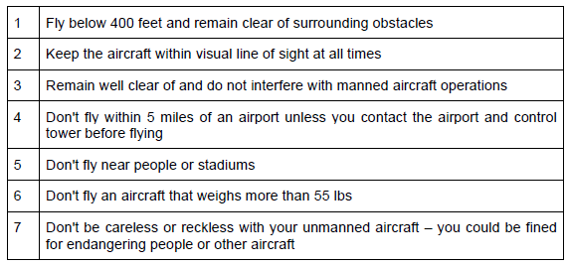
FAA Guideline

Slide 7
Related Standards
Wi-Fi Standard: The 802.11 standard has several specifications of WLANs. This standard defines the air interface between two wireless devices, client and a base station
Android App standard: App follows Android Design guidelines and uses common UI patterns and icons
Battery standards: We found many battery standards related to our project. The LiPo battery pack we are using is rechargeable and some of the standards include rules and guidelines on how to install, operate, maintain, and recharge the batteries.

Slide 8
Design Constraints
Economic: Along with many consumers, there are many states and regulators that believe the usage of UAV to be harmful and damaging.
Health and safety: The UAV has obvious limitations when it comes to safety. Drones are often causing of innocent lives lost. When it causes collateral damage it kills civilian and furthermore damages properties.
Sustainability: It’s no secret that wireless signals can be lost, hacked, or hijacked, in these cases the drone must be able to return home.
Manufacturability: 17 states have already some kind of legislation passed to restrict drone usage. This legislation has prevented manufacturers to build drones for public use.

Slide 9
Overall Block Diagram

Slide 10
MSP430 Block Diagram
Interfaces
2 USCIs
2 GPIOs
Ez-FET Lit Emulator
USB HUB

Slide 11
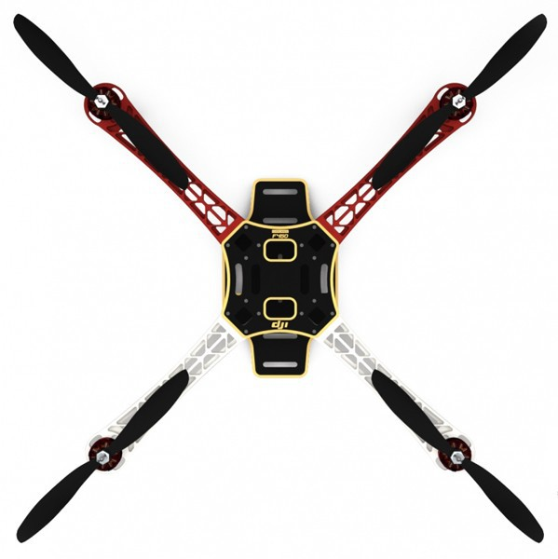
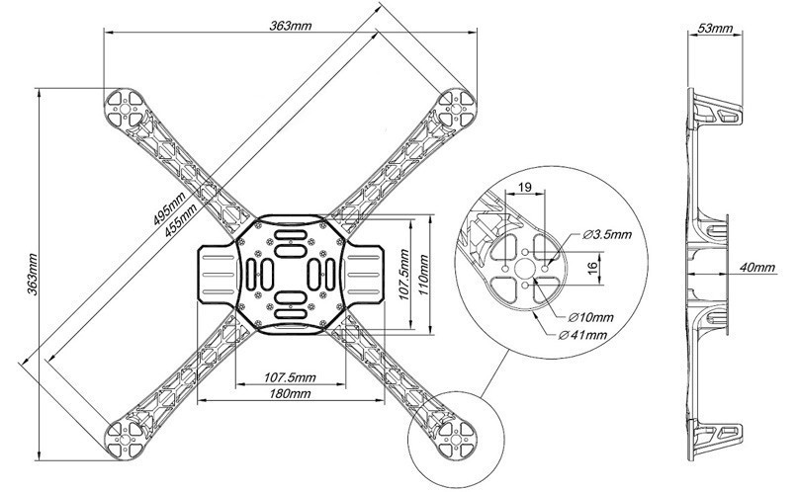
Drone’s Frame
Frame Model DJI F450 - $32
Arms Merged With Carbon Fiber Material for Durability
Dimensions: 36X36cm
Light Weight & Strong: 282g
Flexible Device Mounting Options
Easy to Obtain Replacement Parts
Take off Weight: 800g to 1600g

Slide 12
Batteries
Battery Type | Price | Available Platform | Charging | Battery Capacity
Alkaline | About $1.00 for each AA | AA, AAA, C, D configurations are available | 100 mA to 1A depending on the price | 700mAh-1300mAh in AA or AAA form
Nickel Metal-Hydride (NiMH) | Somewhat expensive, about $2.00 for each AA | AA, AAA, C, D configurations are available | 100 mA to 1A depending on the price | 100mAh-2500mah in AA or AAA form
Nickel Cadmium (NiCad) | Cheapest of All | AA, AAA, C, D configurations are available | 100 mA to 1A depending on the price | 100mAh-1500mah in AA or AAA form
Nickel Zinc (NiZn) | About $2.00 for each AA | AA, AAA, C, D configurations are available | 100 mA to 1A depending on the price | 1000mAh-4500mAh in
Lithium Polymer(LiPo) | Between $20.00 to $55.00 based on Capacity | Most common ones are 3S and 4S | 100 mA to 3A depending on the battery | 1000mAh and over based on the number of cells

Slide 13
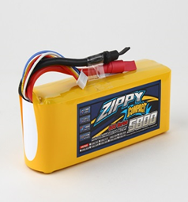
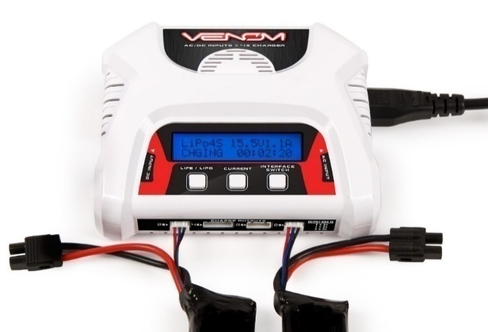
Battery
Battery Charger
ZIPPY Flightmax 5800mAh 11.1v 3S LiPo battery
Voltage: 3S1P / 3 Cell / 11.1V
Discharge: 60C Constant / 40C Burst
Weight: 448g (including wire, plug & case)
Dimensions: 158x45x32mm
Balance Plug: JST-XH
Discharge Plug: XT60
LiPO/LiFE/Li-Ion Cell Count: 2-4 Cell
Charge Current: 0.1 - 3.0A
Circuit Power: 40W
Input: DC 10.0-18.0 Volts - AC 100v-240v
Display Type: LCD
Dimensions: 130x48.25x5.6mm
Weight: 306g

Slide 14
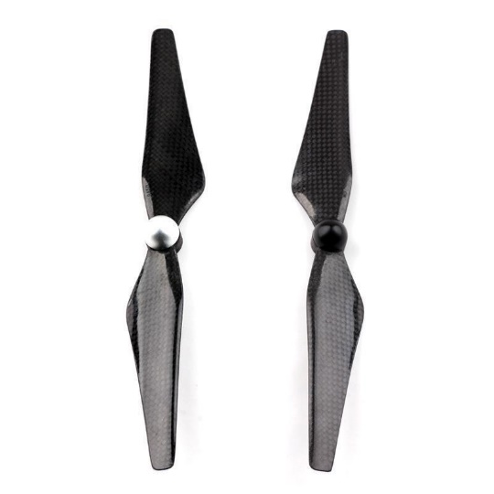
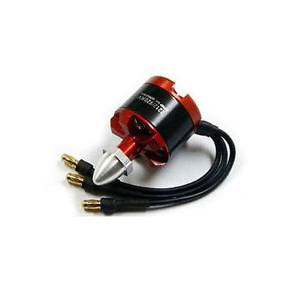
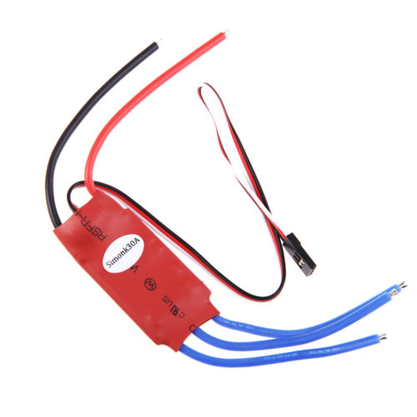
Propellers
Motors
Size: 9.4" x 5.0“
Hole Diameter: 5.1mm
Material: Carbon Fiber
Weight: 10g
RHD 2212/960kV
Max Trust: 440g
No. of cell: 2-3S
Outer Diameter: 28mm
Length: 32.2mm
Connectors: 3.5mm
Weight: 55g
ESC’s
Simonk 30Amp 30A Firmware Brushless ESC
Separate power supply for MCU and BEC
Low-voltage protection, over-heat protection and self-check functions
Equipped with built-in linear BEC or switch BEC
Continuous/Burst Current: 30A/36A
Input: 2S-3S Lipo
Dimension (L*W*H): 13cm x 8cm x 4cm
Weight : 10g (Including Wires)
BEC Mode: Linear
BEC Output: 3A/5V

Slide 15
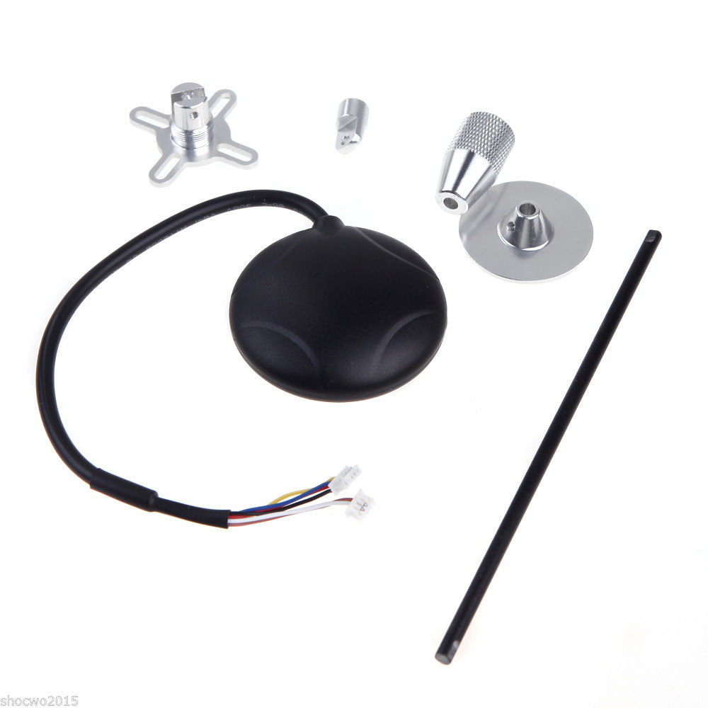
GPS
NEO-6M GPS module
10Hz update rate
Build in 25 x 25 x 4mm ceramic patch antenna
UART (TTL) port with EMI protection
3V Rechargeable Backup Capacitors
Fix indicator LEDs
Reverse polarity protection for input power
Default parameter
NMEA protocol
Baud rate : 9600
Nav rate : 1Hz
TIMEPULSE (fix LED) rate : 1Hz

Slide 16
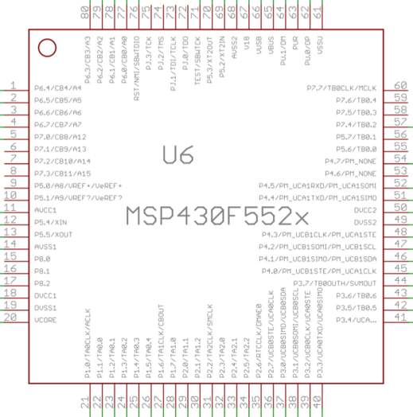
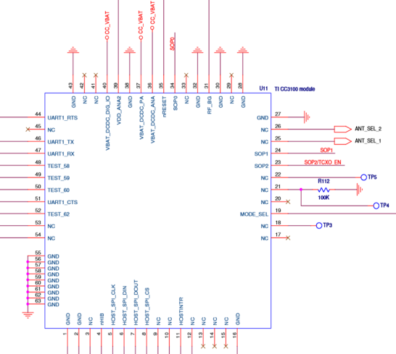
Wireless Communication
Microcontroller Choice
MSP430F5529
  Low Supply Voltage Range: 3.6 V Down to 1.8 V
  Ultra-Low Power Consumption
  Two Universal Serial Communication Interfaces
  Hardware Multiplier Supports 32-Bit Operations
  Compatible with Wi-Fi Module Chosen
  Affordable: $12.99
Wi-Fi Module Choice
CC3100
  Wi-Fi CERTIFIED Chip
  Wide-Voltage Mode: 2.1 to 3.6 V
  Interfaces with 8-, 16-, and 32-Bit MCU or ASICs Over SPI or UART Interface
  8 Simultaneous TCP or UDP Sockets
  Affordable: $24.99

Slide 17
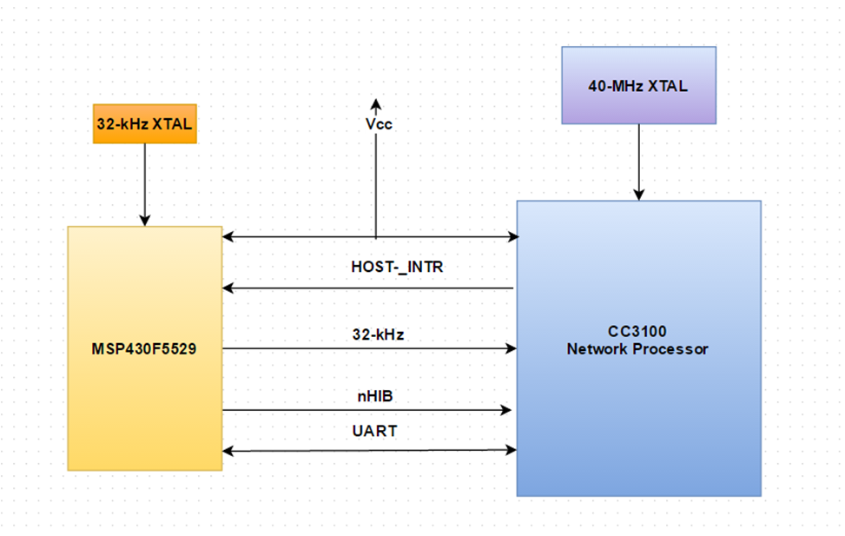
Functional Diagram of the MSP430F5529 & CC3100
SPI

Slide 18
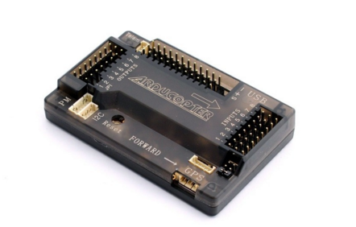
Flight Controller (APM 2.8)-Nerve center of Drone
Why APM?
Open source project from 3DRobotics
“cinema flying” and “autonomous flying”
Better for exploring and learning
Meets specification: Loiter, Circle, and follow me modes
Low power Consumption: 4.6V(min) – 5.25V(max), 200mA draw
Light weight: 31g
Affordable Cost: $40

Slide 19
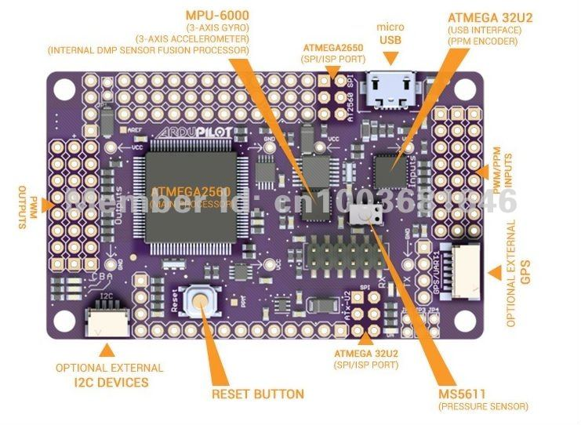
APM Specifications
ATmega2560 main processor: 8bit atmel processor running at 16 Mhz
ATmega32u4: handles USB functionality
InvenSense MPU-6000: handles gyro & accelerometer duties
Onboard barometer sensor and IMU(GPS receiver helper): allows GPS receiver to work when in tunnel or building
Interfaces: off-board GPS/compass/magnetometer module

Slide 20
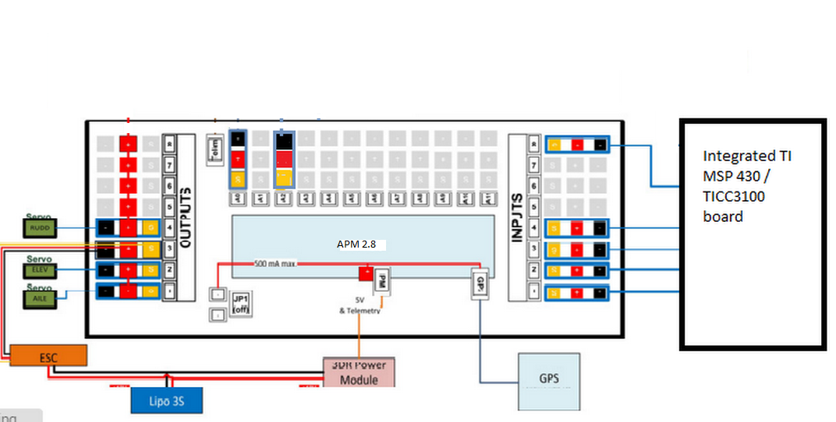
Signal sharing fromMSP430 to APM to ESCs

Slide 21
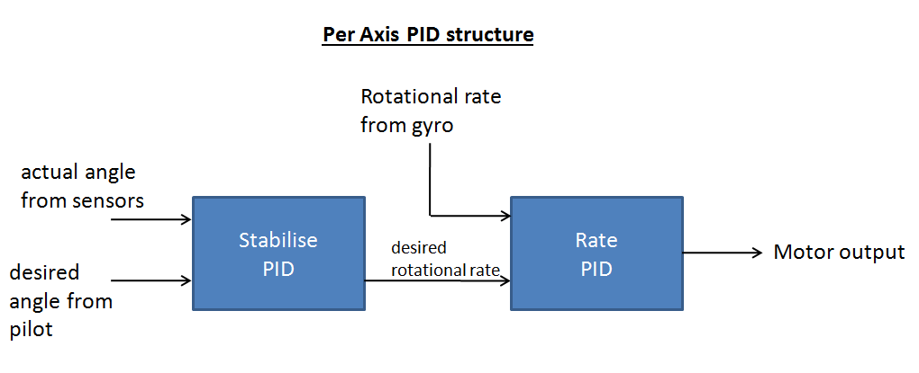
Custom Firmware

Slide 22
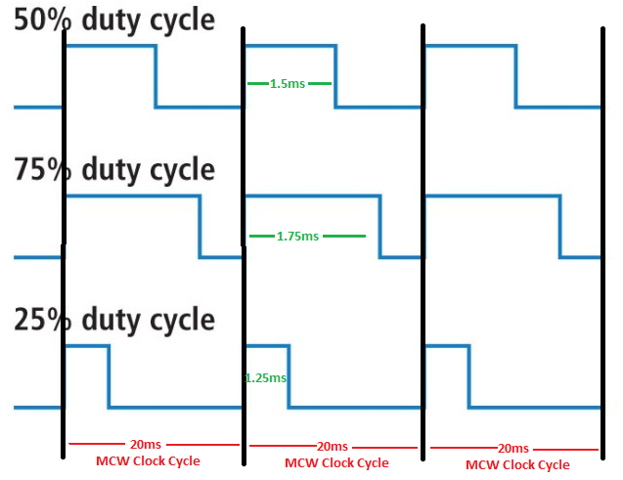
APM 2.8 PWM
APM Clock cycle: 20,000 µs (50hz)
APM 2.8 R/C PWM range: 1000-2000 µs (10%-20% duty cycle)

Slide 23
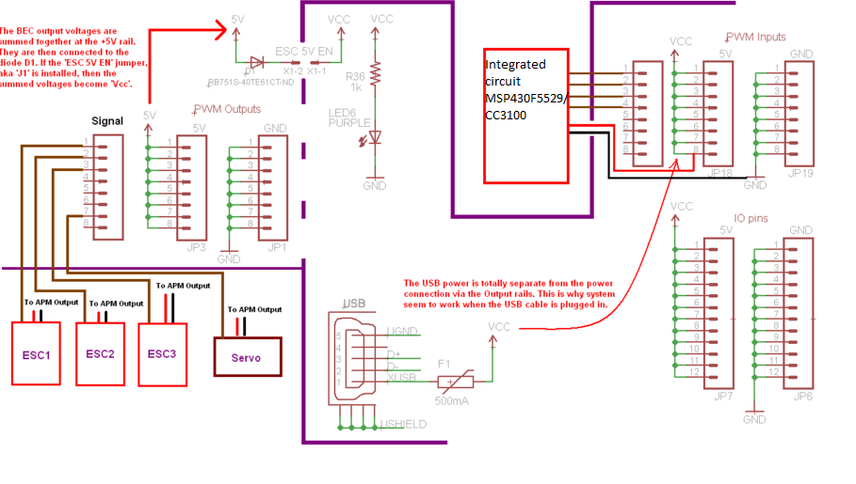
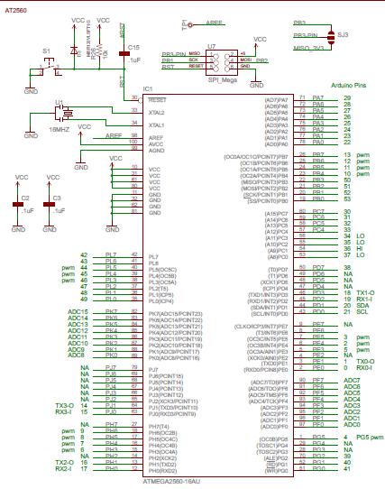
APM 2.8 schematics

Slide 24
Live video streaming
Possiblities
Raspberry Pie: far more difficult to implement
MSP430 PCB: not enough power for video streaming through Wi-Fi
360Fly Camera
Wi-Fi built in camera
Panoramic 360 degree HD video
Accelerometer sensor
Light weight- only 4.9oz
32Gb storage
Built in 1600mah Lippo battery
Resistant to rain, liquid, sweat, sand and dust
Supports mobile OS- IOS8+ and Android 4.3+
Supports PC OS- Mac OS x, Windows
Price- $400

Slide 25
Drone Flight System Components
Part | Model
Quadcopter’s Battery | ZIPPY Flightmax 5800mAh
Quadcopter’s Motors | RHD 2212/960kV
Electronic Speed Controller | EMAX 12A SimonK Firmware
Flight Controller | APM 2.8
Propellers | Carbon Fiber 9.4" x 5.0“
GPS/Compass | NEO-6M GPS & Compass Module

Slide 26
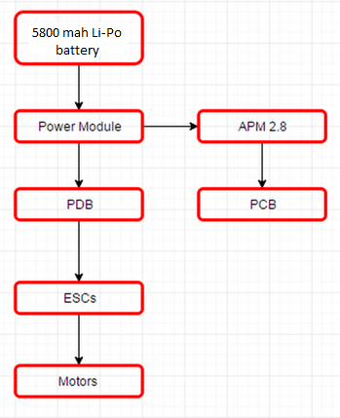
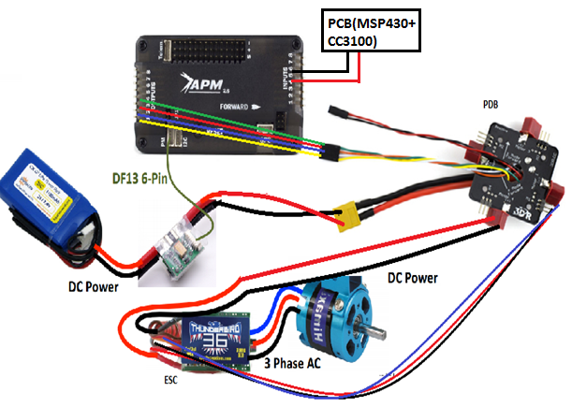
Power Distribution

Slide 27
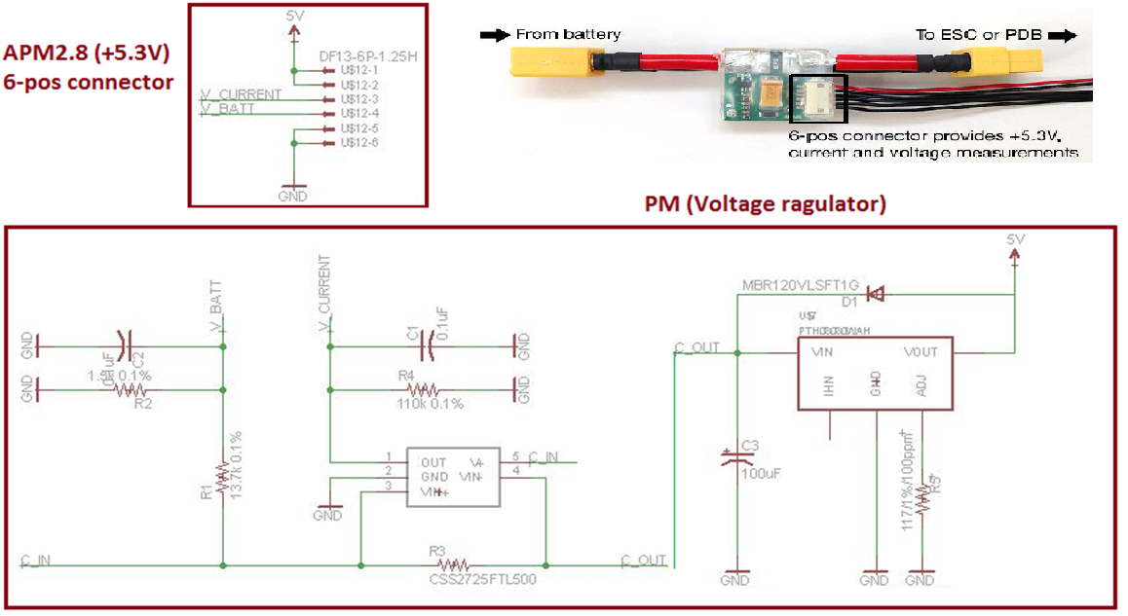
3DRPower Module (Voltage regulator)

Slide 28
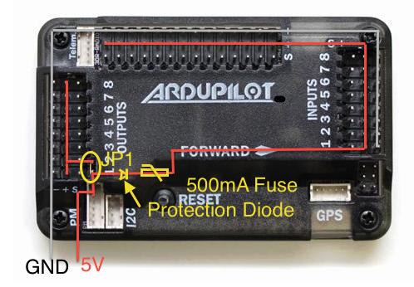
Powering APM board
Two separate circuits connected by jumper (JP1)
Two ways to provide power to APM
1. Through ESC’s BEC (JP1 needed)
2. Through Power Module (JP1 not needed)
Powering APM through 3DR PM
1. APM has PM 6-pin power port
2. Its voltage regulated, provides
consistence 5V power supply
with 200mA current.

Slide 29
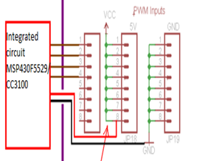
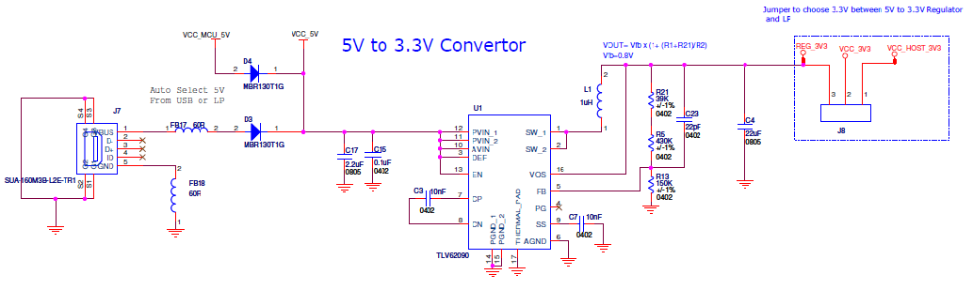
Powering PCB
MSP430F5529 MCU powering
DVCC = 3.3V
APM powering to PCB

Slide 30
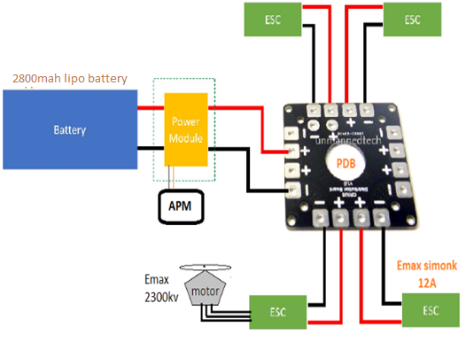
Powering Motors
3s Lippo battery power: 11.1V, 5800mah, 31.08W
Motor power consumption: 8V-12V, 7.5A, 90W
Power Modulate regulates power
PDB shares common power to all ESCs
Approximate flight time = $\frac{31.08W}{90W∗4}∗60min$=5.18min

Slide 31

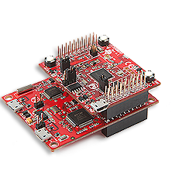
Mobile Wi-Fi Approach
CC3100 & MSP430
IP | Port Number
UDP Packet

Slide 32
Application Commands
Connect: Log In and Engage to Quad
Arm Quad: Arms the motors
Take Off: Take off the quad
Hold: Hold the quad still
Auto tune: Tuning the drone for better stability
Land: Lands the drone safely

Slide 33
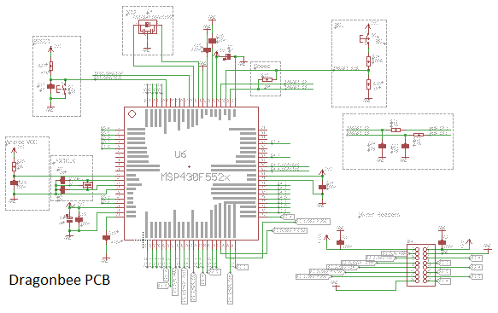
PCB Design
DragonBee PCB Schematic
CadSoft Eagle PCB Design tool for DragonBee PCB design.
Wide range of TI libraries and easy uploads of newer library.
TI MSP430F5529 LP schematic is being used for a reference.
Mainly comprised of MCUs, capacitor and resistor for power management, oscillators, timers, jumpers, and pin headers.
Created schametic, layout and a gerber file.

Slide 34
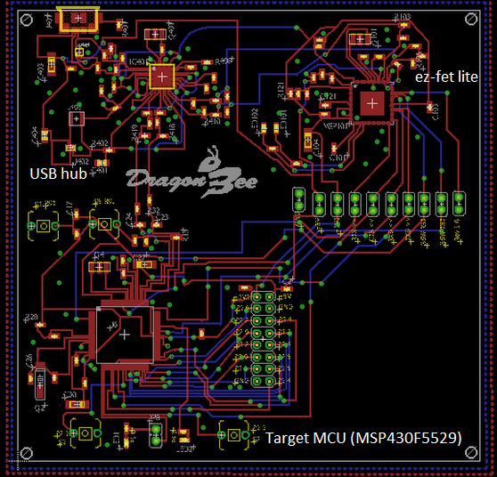
DragonBee PCB Layout
One click “Generate/switch to board” for layout.
Routing unrouted traces.
Meets design specs of both CadSoft Eagle and OSH Park.
Used to create the gerber and BOM file for fabrication and assembly.

Slide 35
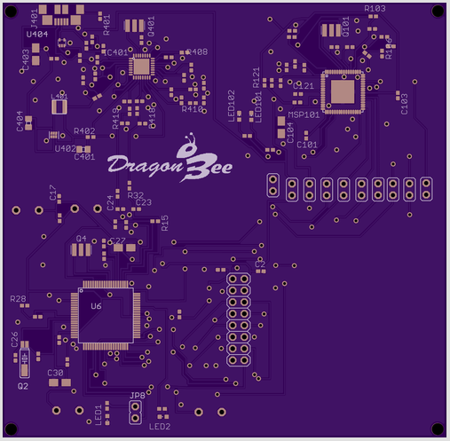
DragonBee PCB Fabrication
OSH Park is the online vendor is used to print PCB.
A 2 layer board – top and bottom GND layers.
10 mil signal trace width.
12 mil power trace width.
23 mil drill.
PCB thickness 0.063” (1.6mm).
OSH Park offered minimum of 3 copies of the PCB.
Total fabrication coast: $177.35

Slide 36
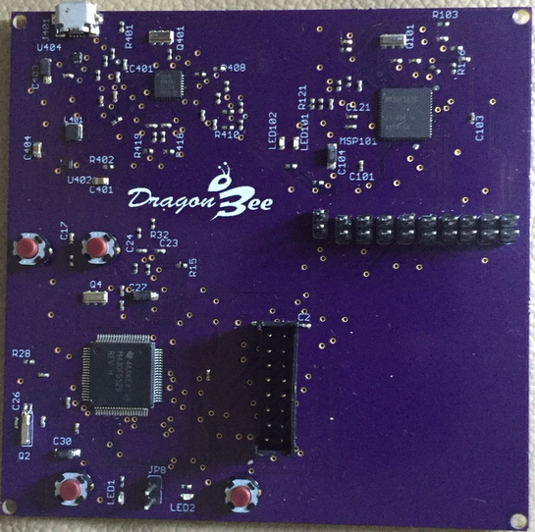
DragonBee PCB Assembly
Digi-Key components.
Used BOM file for parts ordering.
Quality Manufacture Service (QMS) for components placement.
Used BOM,PLC, and gerber files for parts placement.
Total Assembly coast: $107.15

Slide 37

Work Distribution
Name | APM | Android | CC3100 (Wi-Fi Module) | MSP430F5529 | PCB Design
Akash
Ayoub
Younes
Nishit

Slide 38
Budget and Finance
No Sponsors
Dragon Bee is a self funded project
All teammates agreed to divide the total expense equally
Mostly all part are bought and paid for

Slide 39
Budget
Item | Quantity | Price | Supplier | Bought
1. Drone Kit | 1 | $100 | ebay | Yes
2. Battery | 1 | $45 | ebay | Yes
3. Battery Charger | 1 | $49 | ebay | Yes
4. Power Module & GPS | 1 | $30 | ebay | Yes
5. 360 FLY Camera | 1 | $400 | BestBuy | Yes
6. ArduPilot Kit 2.8 | 1 | $95 | ebay | Yes
7. MSP430 | 2 | $30 | TI | Yes
8. PCB | 1 | $284 | OSH PARK | No
9. CC3100 Wi-Fi Module | 1 | $30 | ebay | Yes
10. Miscellaneous |  | $50
Total |  | $1113

Slide 40
Project Completion

Slide 41
Issues
APM sensors not very accurate
Short Range of Wi-Fi
Mobile app not preferable for flight control
Broken parts during testing
Time Constraints
Overlapping schedule of teammates

Slide 42
Future Improvements
Recode the firmware on PixHawk rather than APM 2.8
Include Mavlink for “Follow Me” Mode
Keep codding for more intresting flight modes
Stabilize the flight with more tuning
  Redesign the App to be more user friendly

Slide 43
Questions

