Slide 1
Solar-Powered Flower Sculpture
Group 21
Nickolas DeVito Computer Engineer
Kelechi Ukachi-Lois Computer Engineer
Mahaley Vann Electrical Engineer
Kibwe Williamson Computer Engineer

Slide 2
Motivation
Creating a project that is powered with renewable energy
Creating a project that is aesthetic
Having a project with various uses

Slide 3
Project Description
This project is designed to be a Solar-Powered Flower Sculpture with an Android mobile application
12 acrylic glass flower petals
12 NeoPixel digital RGBW LED strips
6 solar cells, attached to base
Android mobile app

Slide 4
Objectives
Maximizing solar power efficiency
Having a project work indoors and outdoors
Creating a user friendly app interface
Show each group member’s learned skills

Slide 5
Specification Requirements
Portable
  Dimensions: 2.2 ft x 2.2 ft x 4 in
  Weight: under 30 lbs
Solar cells
  Input voltage: max 27 V / Output voltage: min 6 V
NeoPixel digital LED strips
  RGBW functionality
Android App
  user friendly
  3 functional modes

Slide 6
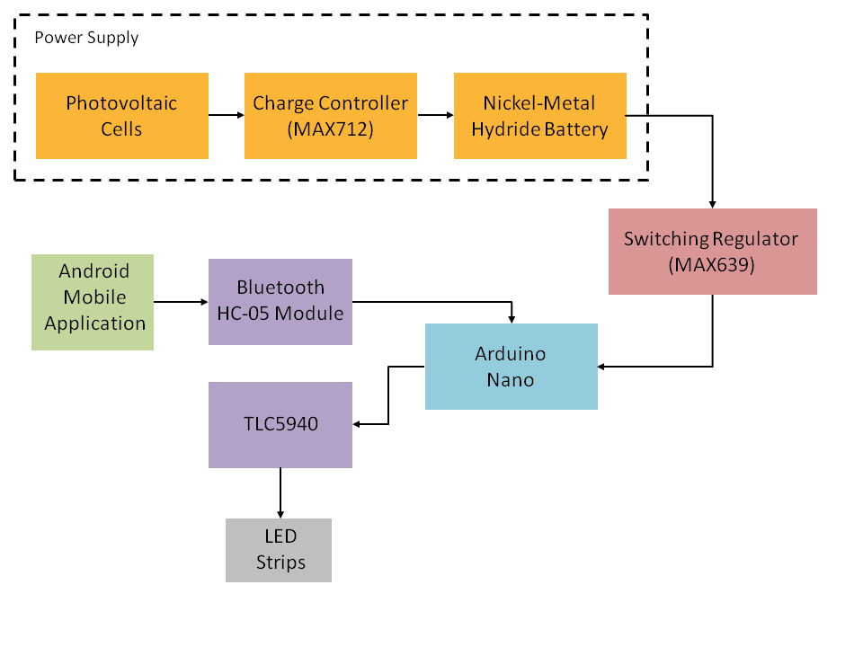
System Operations Block Diagram

Slide 7
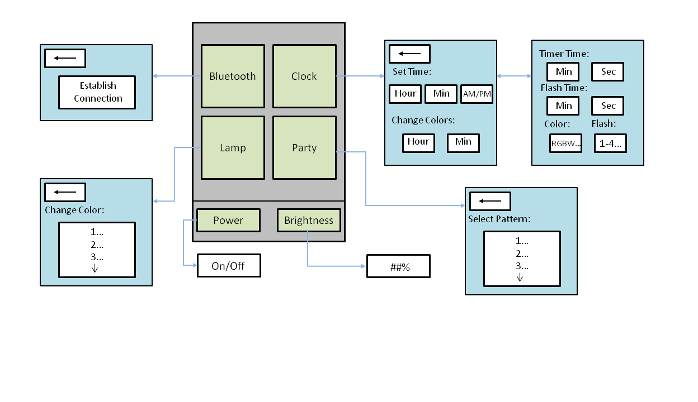
Software Flow Chart

Slide 8
Microcontroller

Slide 9
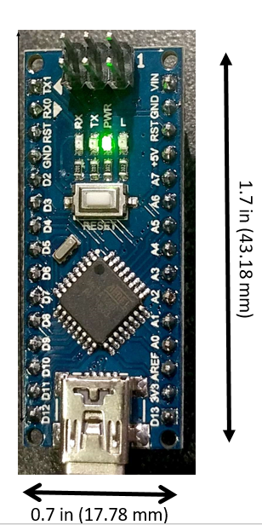
Arduino Nano
Purpose:
Control all other components
  Operation of LEDs
    Digital pins: 2, 4, 5, 6, 7, 8
    Analog pins: 0, 1, 2, 3, 4, 5
    PWM output: 3, 9, 10, 11, 13
  TLC5940
  Bluetooth module
  System power ON/OFF
Cost: $7.99

Slide 10

Arduino Software
Arduino 1.8.1. Integrated Development Environment
  Extensive libraries
  Tutorial
  Strong community support

Slide 11
Software Design Approach
Use the C programming language
Interrupt driven
Modularize software as much as possible
  Smaller software components are easier to work with
  Allowing the program to be divided into its different functional aspects
  Can be used with concurrent execution of software

Slide 12
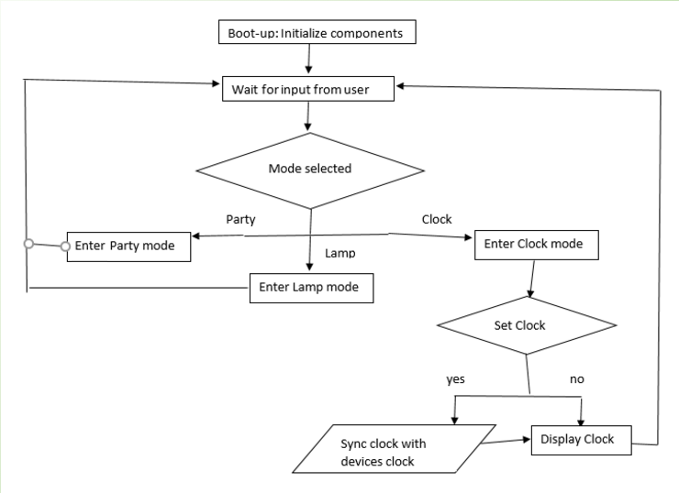
Microcontroller Software Flowchart

Slide 13
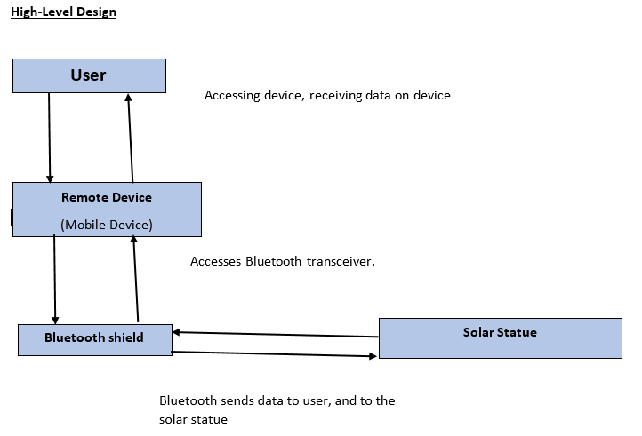
RFCOMM
Flowchart

Slide 14
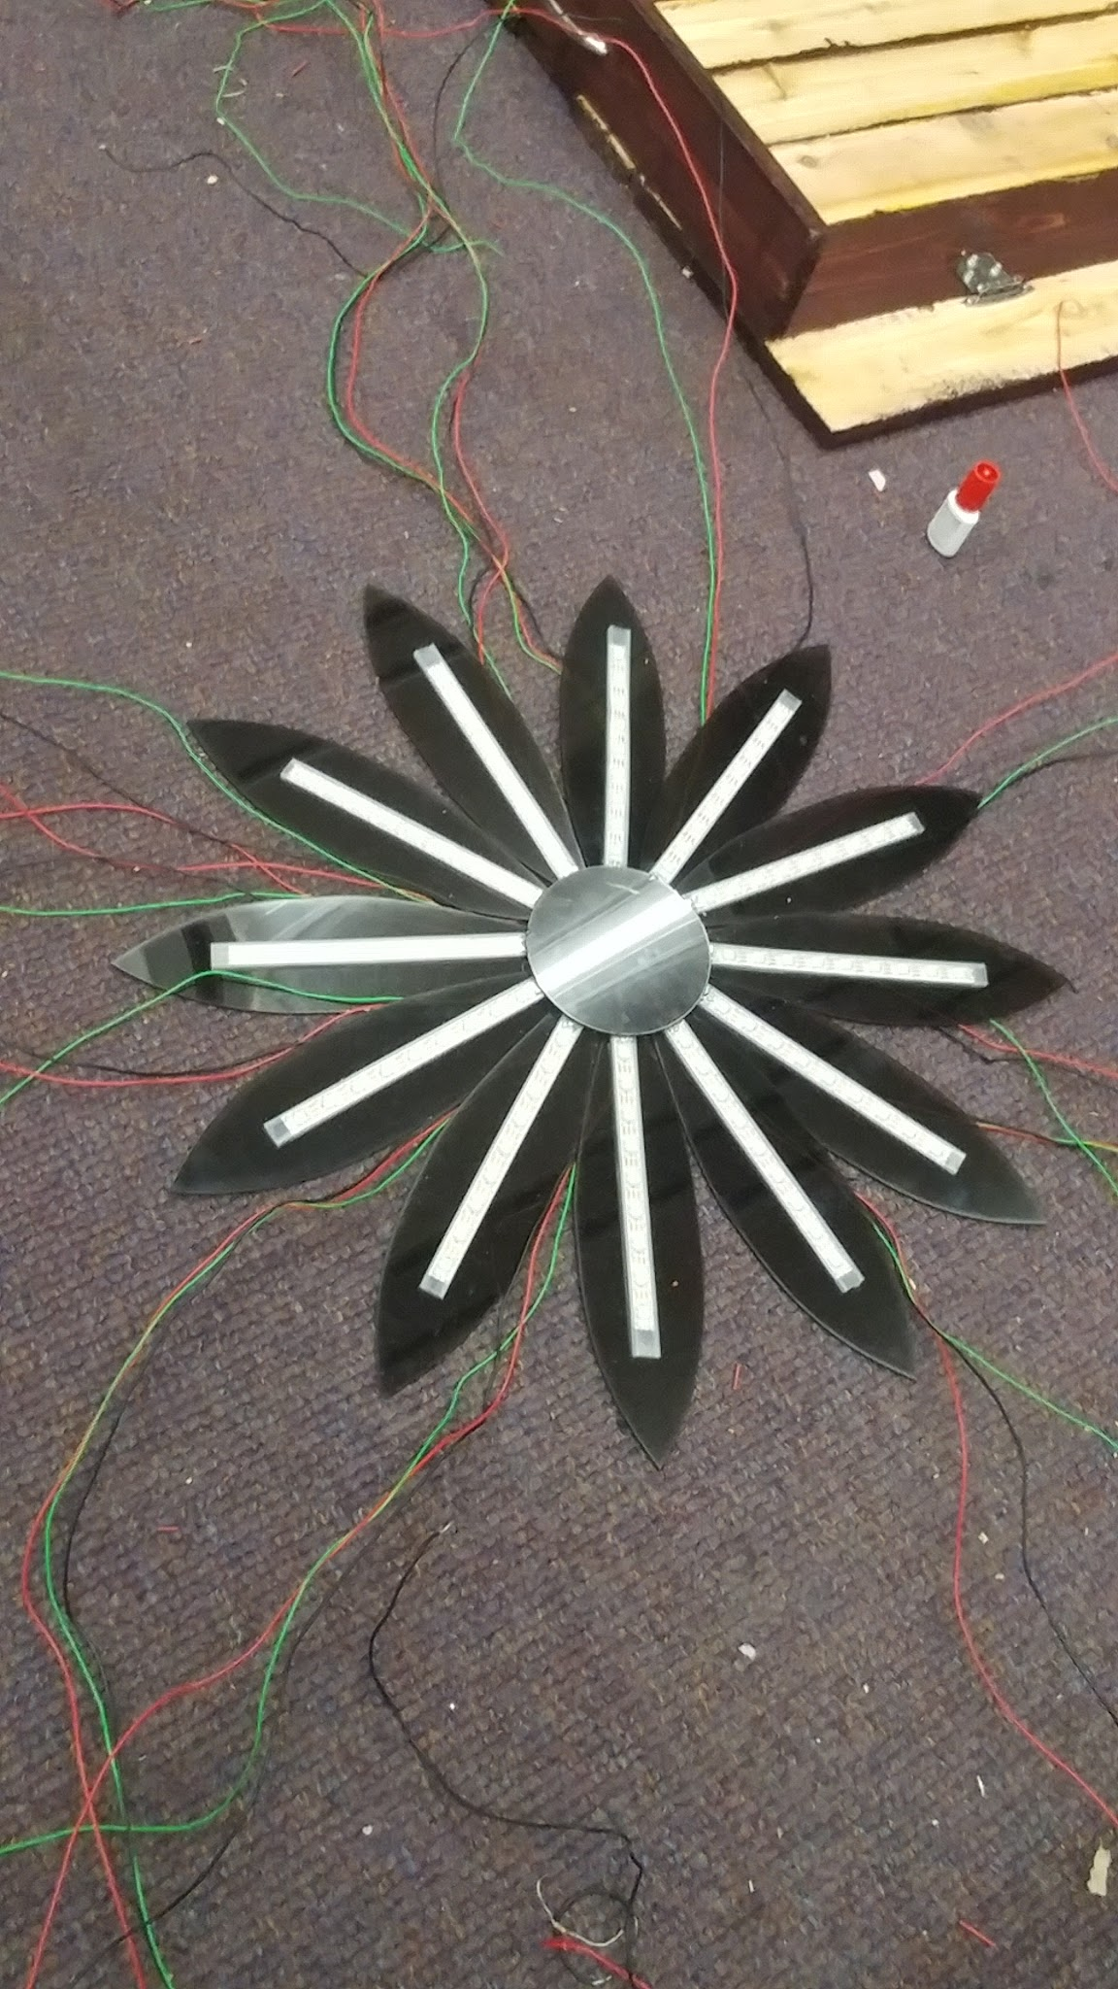
LED Arduino Implementation
Multiple LED strips outputting different
light displays at once
Strips initialized under same conditions
  Pixel color conditions
  Brightness settings
  Showing current status

Slide 15
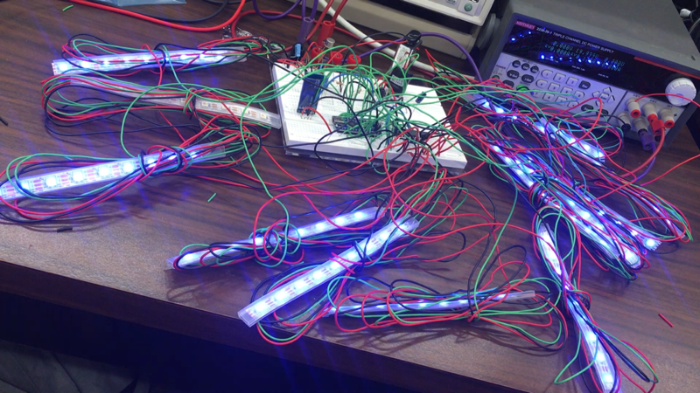
LED Arduino Implementation
Testing and prototyping
  Arduino vs. TLC
Code optimization necessary
  Code density for structure mode algorithms
  Limited microcontroller memory
  LED signal overload

Slide 16
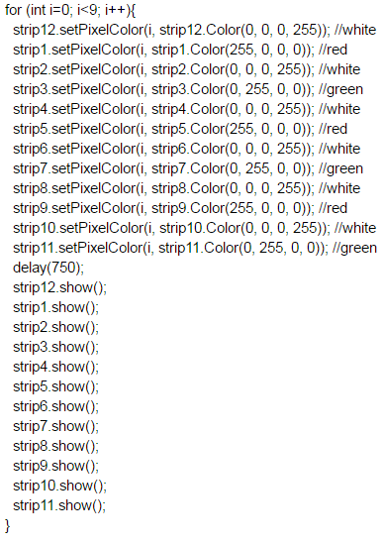
Example LED Strip Output
Color and brightness conditions assigned to each LED
Intentional Millisecond delay
Output displayed on LED strips
Sensitivity to mobile app requests

Slide 17
Mobile Application

Slide 18
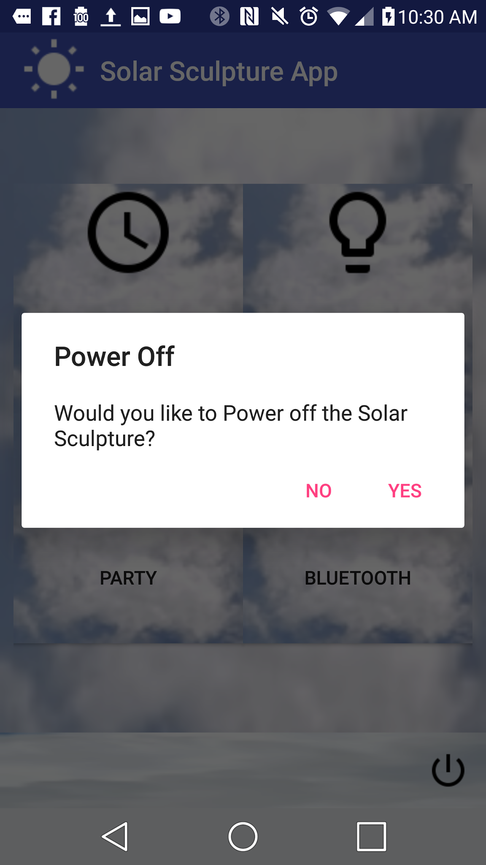
Android App
User-friendly design
  Each mode of operation given unique screen
  No dead-ends or unwanted actions
  Useful feedback
Direct manipulation of sculpture
  Connection made with bluetooth
  LED display
  Power ON/OFF

Slide 19
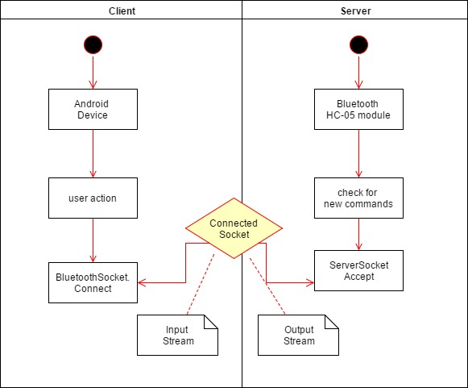
Serial Connection Process Flowchart

Slide 20



Platform Choice
Programming familiarity
  Java coding with eclipse IDE
  Open source android studio
Ease of bluetooth connectivity
Availability of testing units

Slide 21
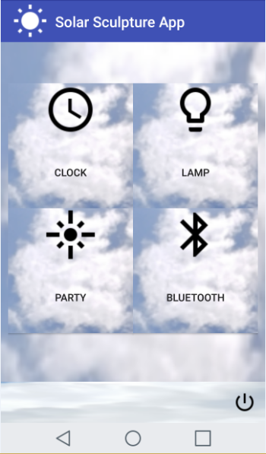
Home Screen Design
4 buttons move directly to
mode screens
Power button opens pop-up toggle switch
Appropriate icon aiding in learnability of interface

Slide 22
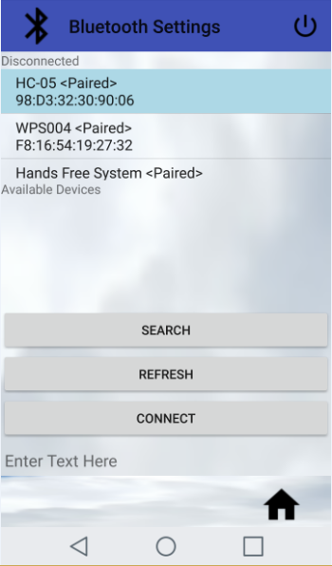
Bluetooth Mode Design
Ability to search for available Bluetooth devices
Select and connect protocol
Informs user of connection state

Slide 23
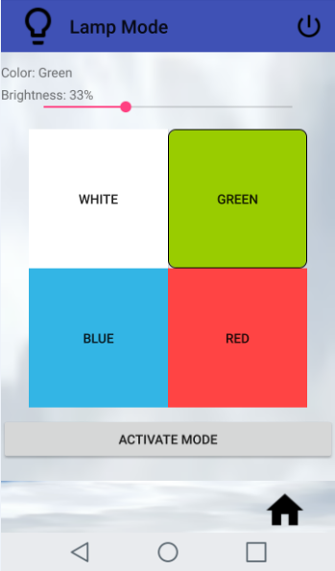
Lamp Mode Screen Design
4 highly distinguishable buttons select color
Brightness seekbar designed for slidable selection

Slide 24
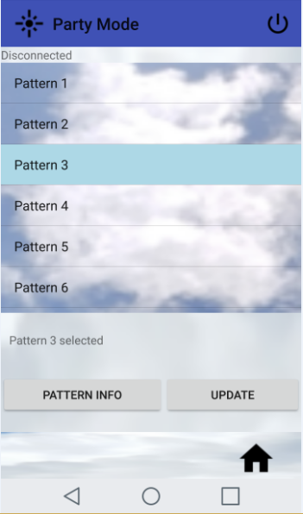
Party Mode Screen Design
Pattern button uses slider list
to choose from pre-created
LED patterns
Each pattern has its own displayable information
Equipped with home icon for app navigation

Slide 25
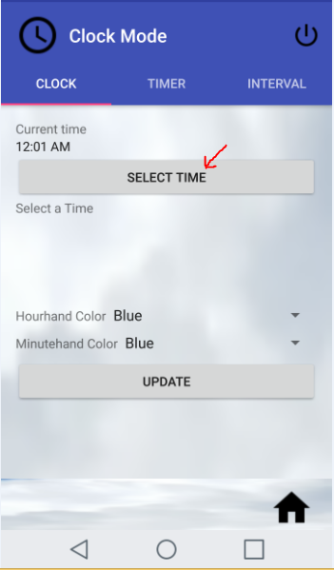
Clock Mode Design
3 tabbed activities which utilize swipe functionality
Clock, timer and interval activities
Each has its own custom design

Slide 26
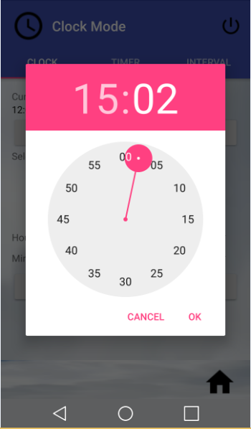
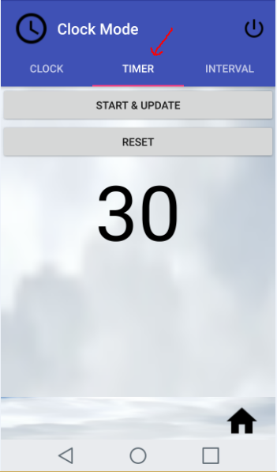
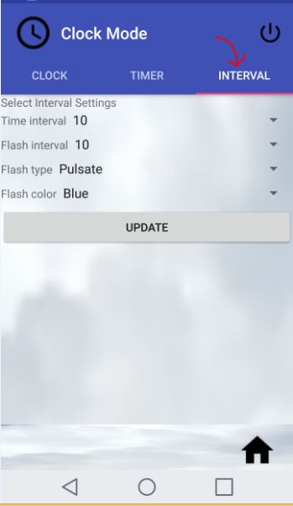
Clock Mode Design

Slide 27
Power Supply and Components

Slide 28
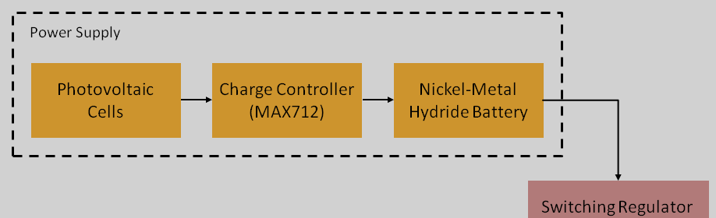
Power Supply
Requirement - power entire system
Solar cells
9V rechargeable battery

Slide 29
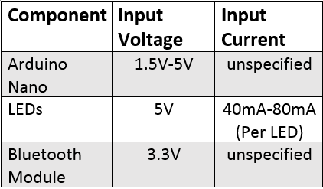
Component Power Requirements
Limitations:
Maximum current
  Arduino nano 200mA
  Bluetooth module 40mA
  LEDs 80mA (per LED)
Maximum voltage
  Arduino nano 5V (regulated)
  Bluetooth module 3.3V
  LEDs 6V

Slide 30
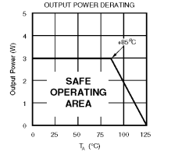
Solar Cells
Specifications:
Technology: copper indium diselenide (CuInSe₂)
Efficiency rating: ~12%
Output power: (perfect conditions)
  Per cell: 405 mW
  Total: 2.43 W
Cost: $17.05

Slide 31

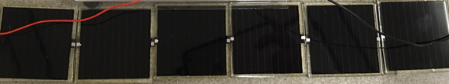
Solar Cells (cont.)
The solar cells are stacked in series to generate desired voltage.

Slide 32
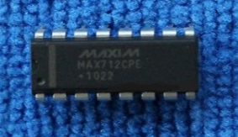
Charge Controller (MAX712)
Specification:
Two modes.
  Fast charge
  Trickle charge
Charge battery up to 20V
Max Vin: 5.5 V
Cost: $9.95

Slide 33
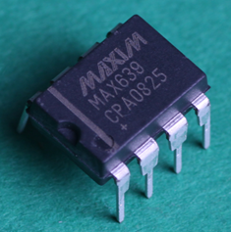
Switching Voltage Regulator (MAX639)
9V battery to 5V
Output current max: 225 mA
Input voltage: 4 V to 11.5 V
Low-battery detection comparator
Highly efficient, wide range of loads
Cost: $9.50

Slide 34
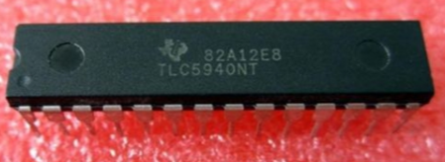
LED driver (TLC5940)
16-channel constant-current sink LED driver
Maximum input voltage
  6V
Maximum output current
  130mA
Constant-current sink
  0 mA to 60 mA (VCC < 3.6 V)
  0 mA to 120 mA (VCC > 3.6 V) *
Cost: $6.95

Slide 35
NeoPixel Digital RGBW LEDs
NeoPixel
  RGB
  White
  8-bit PWM = 32-bit color
Embedded microcontroller
  Shift registers
Maximum 5 V at 80mA (full brightness)
Cost: $26.95 per meter

Slide 36
PCB Design

Slide 37
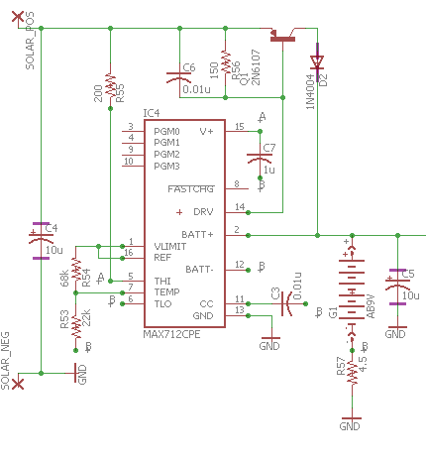
PCB Schematic (Solar Cells Holes and MAX712)

Slide 38
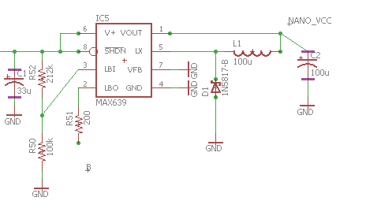
PCB Schematic (MAX639 and Battery Connection)

Slide 39
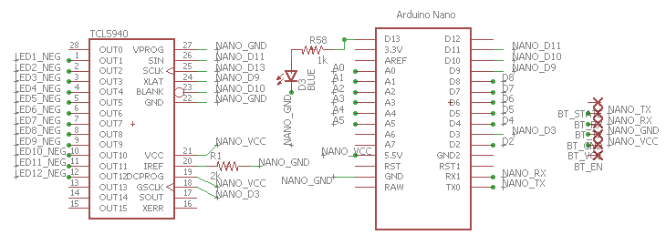
PCB Schematic (Arduino Nano/TLC5940)

Slide 40
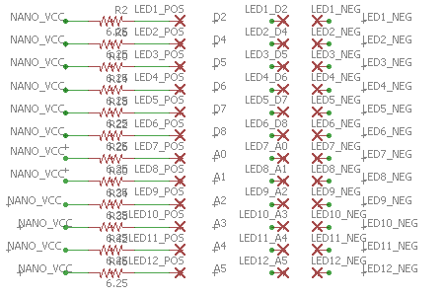
PCB Schematic (LED holes)

Slide 41
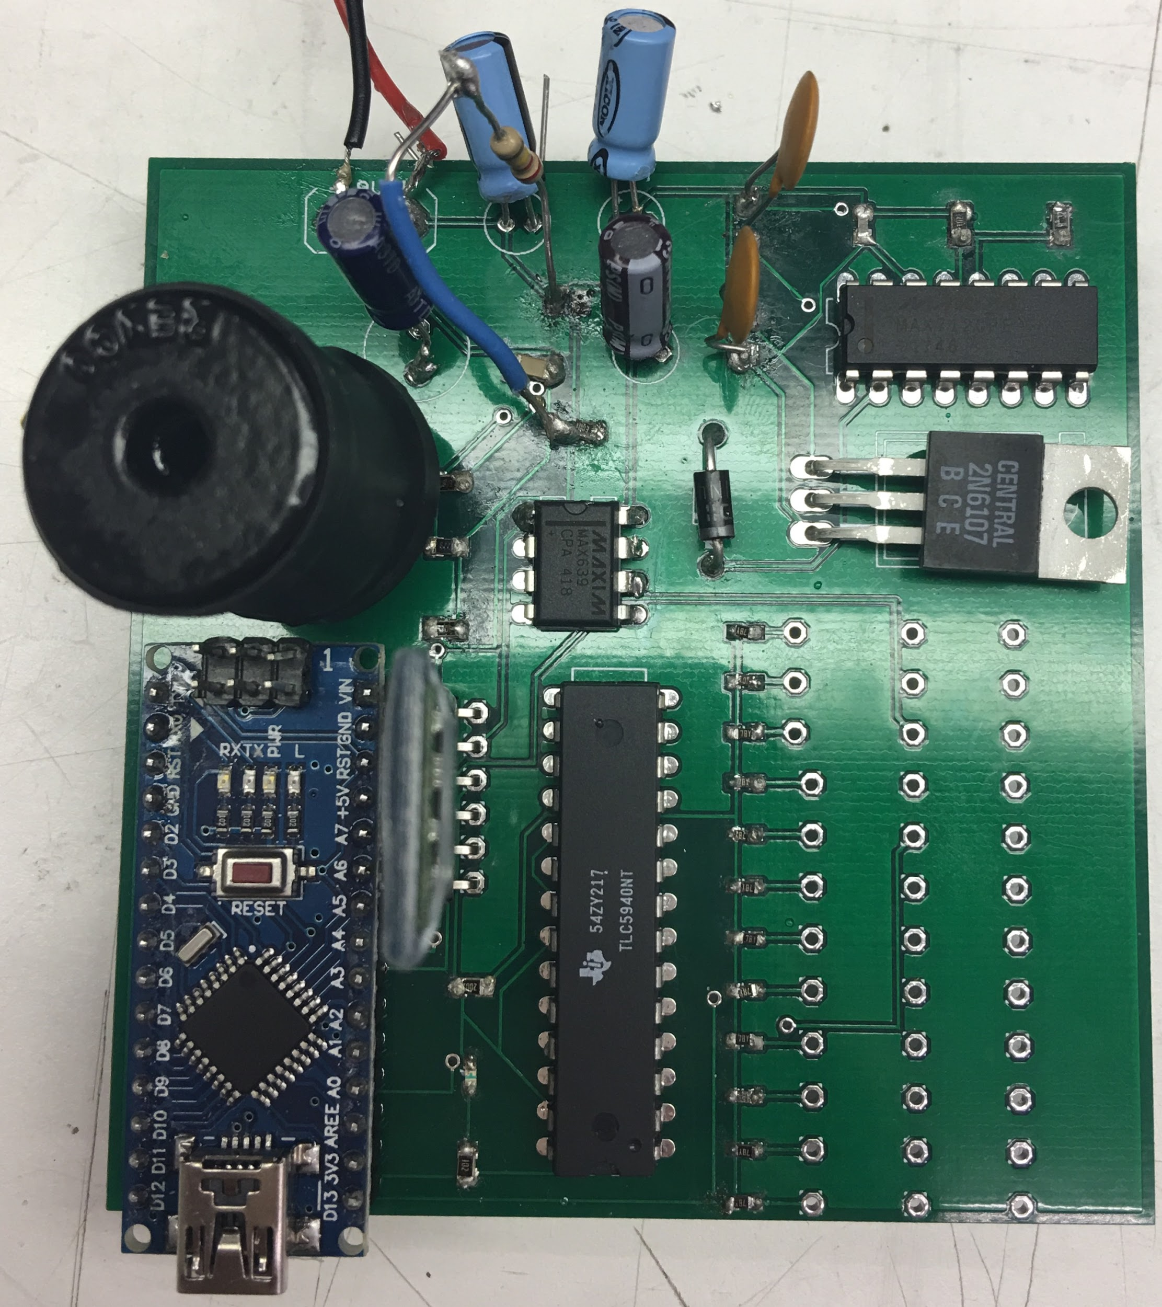
PCB

Slide 42
Administrative Content

Slide 43
Project Design Approach
Working solar-powered supply system, circuits designed and necessary values gathered
Compatible microcontroller architecture and assigned functionality
Application design and simultaneous Bluetooth connectivity
Ensured testing of working system
Sculpture assembly and aesthetic presentation

Slide 44
Project Successes
Effective circuit design
Project schematics
Necessary parts acquired early for testing
Values from breadboard testing
LED software algorithms
Microcontroller programming experience
Mobile app interface

Slide 45
Project Difficulties
Constricted microcontroller memory
  needing to optimize working code
  needing to reset faulty LED signals
Android communication buffer
  too many prompts sent at once risks performance issues

Slide 46
Significant Software Design Decisions
Selecting application platform
  Android vs IOS
    Cost
    Performance
    Availability
Adding microcontroller, removing physical user input (buttons)
  Application provides more input options
  Less cluttered design is easier to operate

Slide 47
Significant Hardware Design Decisions
Solar cells
  Small
  Efficient
Low signal LEDs are small and easy to operate
  LED strips
  programmable
Choosing Arduino Nano
  Similar specs to many other Arduino boards
    Operating Voltage/CPU Speed equivalent to Uno, Mega
  Lower price and more compact design

Slide 48
Work Distribution
 | Hardware Design | Power Supply | PCB | Software Design | Arduino Coding | Mobile App / Bluetooth |  | Sculpture Design
Nickolas |  |  |  | X | X
Kelechi |  |  |  | x |  | X |  | X
Mahaley | X | X | X |  |  |  |  | X
Kibwe |  |  |  | X | X

Slide 49
Project Budget
Description | Quantity | Cost
Arduino Nano | 6 | $7.99
Solar Cells | 6 | $2.84
TLC5940 | 3 | $7.95
PCB #1 | 1 | $54.59
PCB #2 | 1 | $27.00
LED Strips (meter) | 2 | $32.77
Battery/Battery Pack | 1 | $18.99
MAX712 | 2 | $9.95
MAX639 | 3 | $9.50
Miscellaneous |  | $76.99
Total Cost |  | $380.70

Slide 50
Questions?

