Slide 1
OSN
Optical Supplemental Navigation Device
Wilfredo Ortiz | PSE
Joseph Devenport | PSE
Cedric Harper | EE
Henry Schmitz | EE

Slide 2
Member Responsibilities
 | Wilfredo | Devin | Cedric | Henry
Transmitter | Secondary | Primary
Receiver | Primary | Secondary
Optical Module | Primary | Secondary
Power |  |  | Primary | Secondary
Processing |  |  | Primary | Secondary
Timing |  |  | Secondary | Primary
Haptic Feedback |  |  | Secondary | Primary

Slide 3
Motivation
Help blind and vision impaired individuals maneuver new and unfamiliar environments
Create an affordable supplement to the cane or guide dog
US: Approximately 1.1 million vision impaired and 200,000 totally blind
Global: 285 million vision impaired and 39 million totally blind
Cane and guide dog limited to 1 meter range
Safety and Confidence

Slide 4
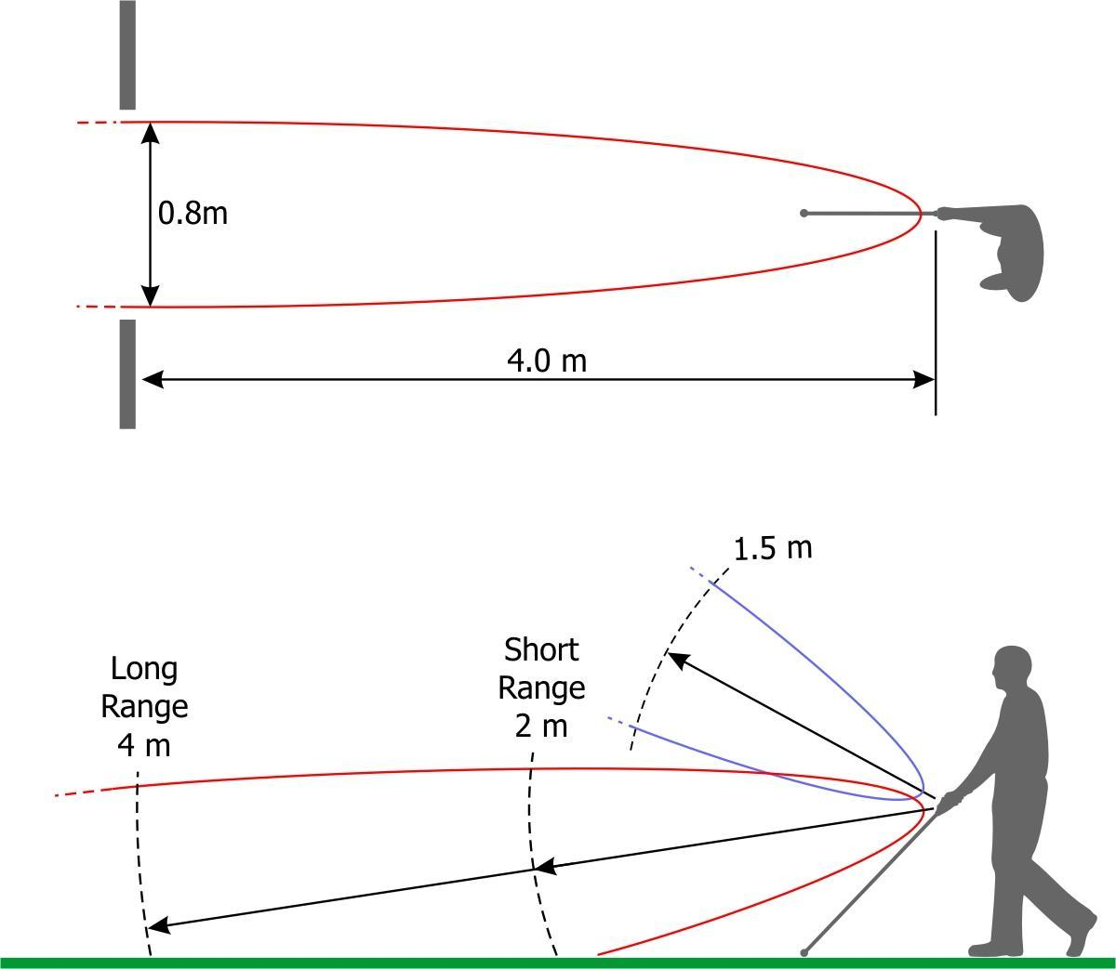
Current Ultrasonic Technology
 | Range | Price
Ultracane | 2-4 m ground/ 1.5 m chest height | $635.00
Smartcane | 1.5-3 m | $3000.00
iGlasses | 0-3 m | $96.00
Source: Ultracane

Slide 5
Current Laser Technology
 | Range | Price
Laser Cane N-2000 | 10 m | $2650
Not many products on the market currently using lidar
Group of Engineers at University of Melbourne currently prototyping a lidar system
Future technology heading towards eliminating cane altogether and using 3D lidar to map out entire rooms

Slide 6
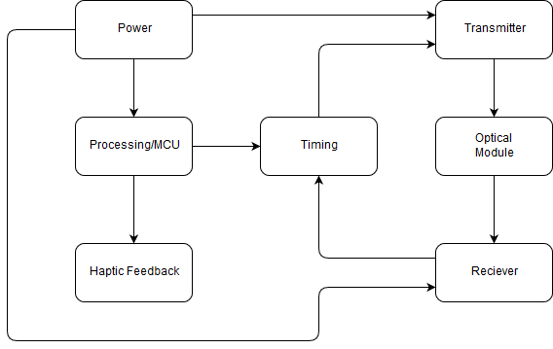
OSN Block Diagram

Slide 7
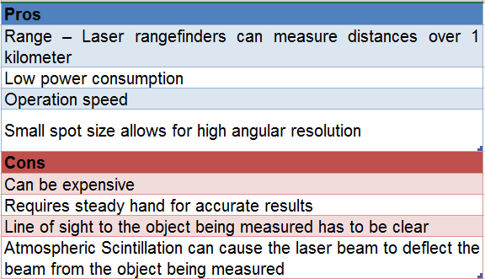
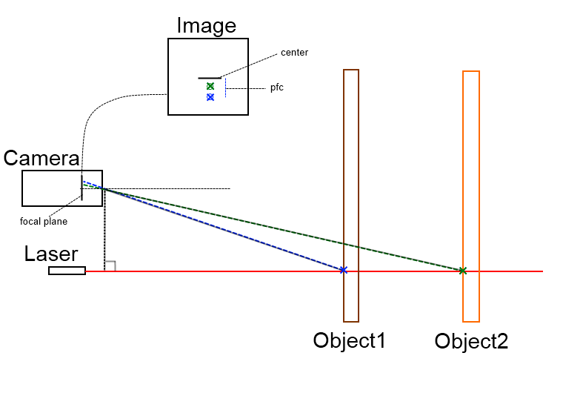
LASER
Notes:
https://hackaday.com/tag/laser-rangefinder/
https://chmodux.wordpress.com/2012/04/16/range-finding/
http://www.hizook.com/blog/2009/12/20/ultra-low-cost-laser-rangefinders-actualized-neato-robotics

Slide 8
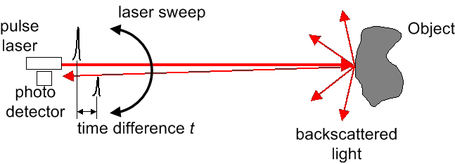
Methods of Range-Finding: Time of Flight
Pros:
Can measure long distances
Accurate aiming to targets and through gaps (very small beam divergence).
Can measure to target surfaces at any angle.
Can be set to measure through glass or to the surface of glass.
Can be used to create large scale, 3D images by scanning.
Cons:
Can be more expensive
Range is limited particles in the air (dust, rain, etc)

Slide 9
Specifications
Overall Weight | Less than 2 lbs.
Overall Size | Less than 8in by 5in by 3in (l,w,h)
Overall Cost | Less than $300
Supply Voltage | Less than 12V
Device Range | From 1m to 4m
Laser Diode Wavelength | Near IR, 800-950nm
Photodiode Absorbance | Maximum Near IR, 800-950nm

Slide 10
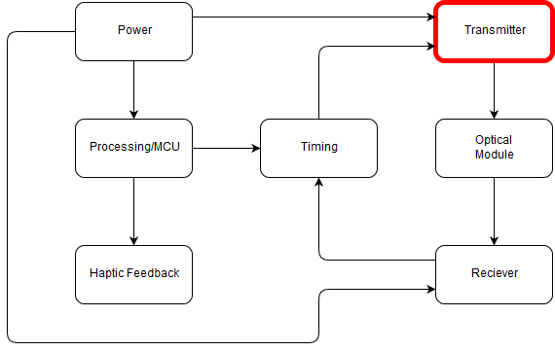
Transmitter

Slide 11
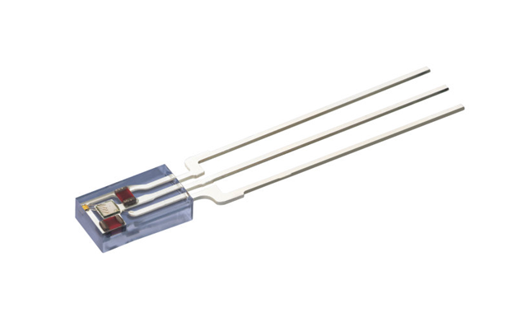
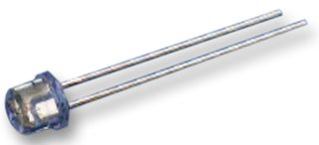
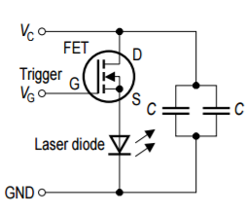
Pulsed Laser Diode
Model: OSRAM SPL LL85
Spectral range: 840 nm-860 nm
Peak Wavelength: 850 nm
Spectral Width: 4 nm
Pulse Width: 28 ns
Peak Output Power: 14 W
Duty Cycle: 0.1 %
Cost: $20
Model: OSRAM SPL PL85
Spectral range: 840 nm - 860 nm
Peak Wavelength: 850 nm
Spectral Width: 4 nm
Pulse Width: 100 ns
Peak Output Power: 13 W
Duty Cycle: 0.1 %
Cost: ~$20
Notes:
http://www.osram-os.com/osram_os/en/press/press-releases/ir-devices-and-laser-diodes/2015/low-cost-lidar--a-key-technology-to-enable-autonomous-driving-in-urban-environments/index.jsp?search_result=%2Fosram_os%2Fen%2Fpress%2Fpress-releases%2Findex.jsp%3Faction%3Ddosearch

Slide 12
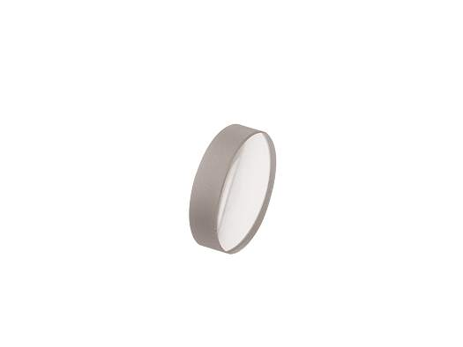
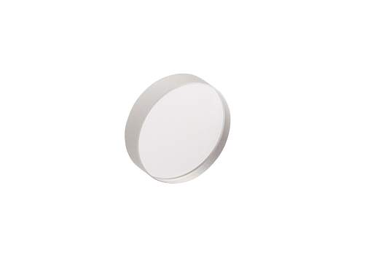
Lens Selection
Newport Model: KBX022
Lens Material: N-BK7
Diameter: 12.7 mm
Radius of Curvature: 11.868 mm
EFL: 12.7 mm
BFL: 10.26 mm
Uncoated
Cost: $35
Newport Model: SBX013AR.16
Lens Material: UV Fused Silica
Diameter: 12.7 mm
Radius of Curvature: 10.358 mm
EFL: 12.7 mm
BFL: 9.86 mm
AR Coating (650-1000 nm)
Cost: $210
Notes:
www.newport.com

Slide 13
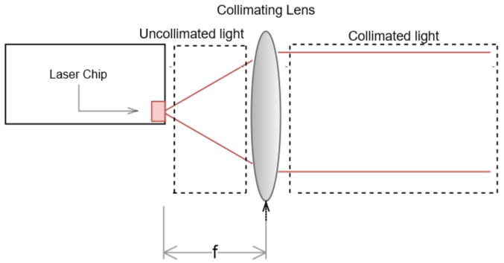
Collimation
Basically, the diverging source should be placed at the focal length of a positive lens.
Is It that simple?

Slide 14
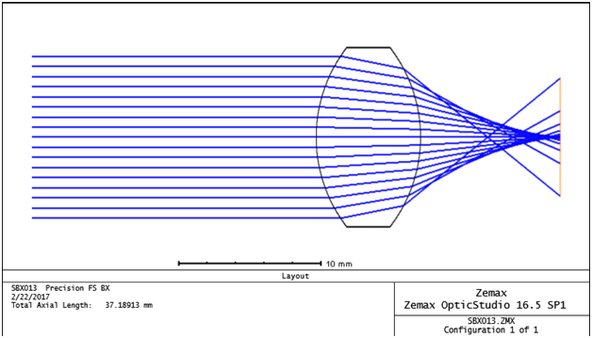
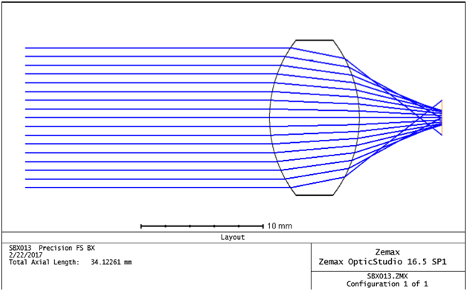
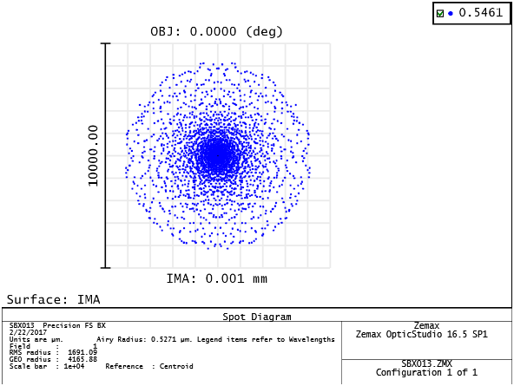
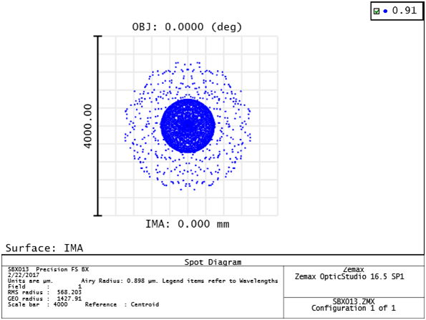
Lens Design
BFL: 10.0 mm
BFL: 6.77 mm
Spot Radius: 1.6 mm
Spot Radius: 0.57 mm

Slide 15
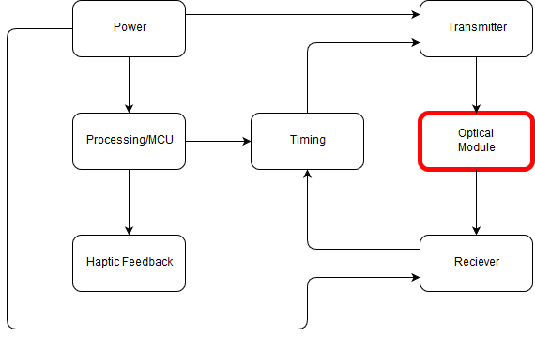
Optical Module

Slide 16
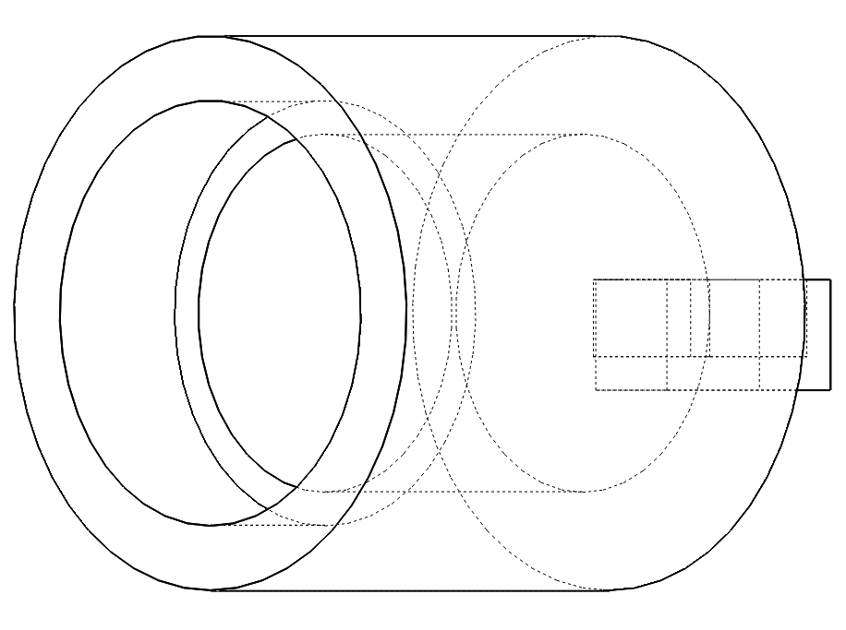
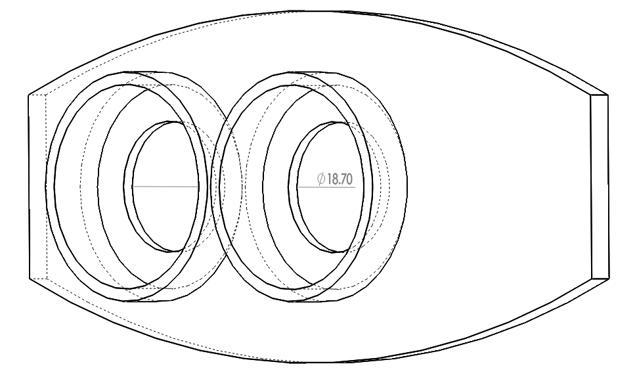
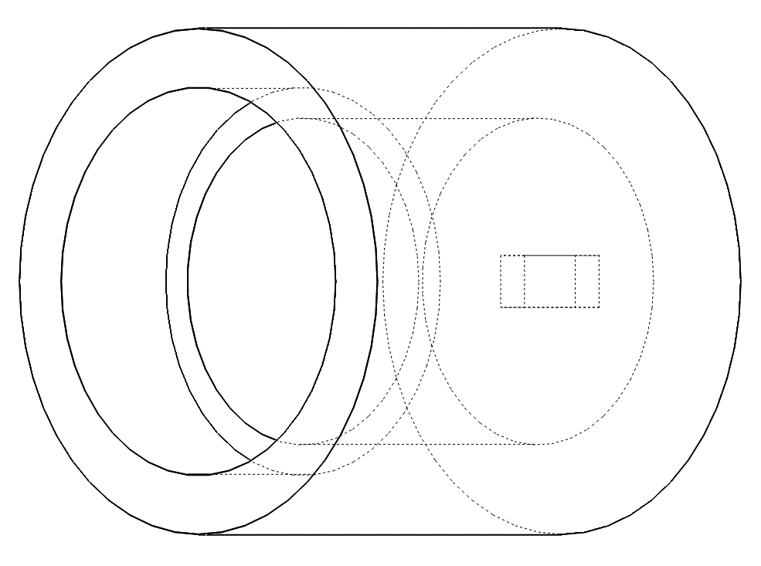
Custom made for optical alignment of components
Showcases curved design of enclosure

Slide 17
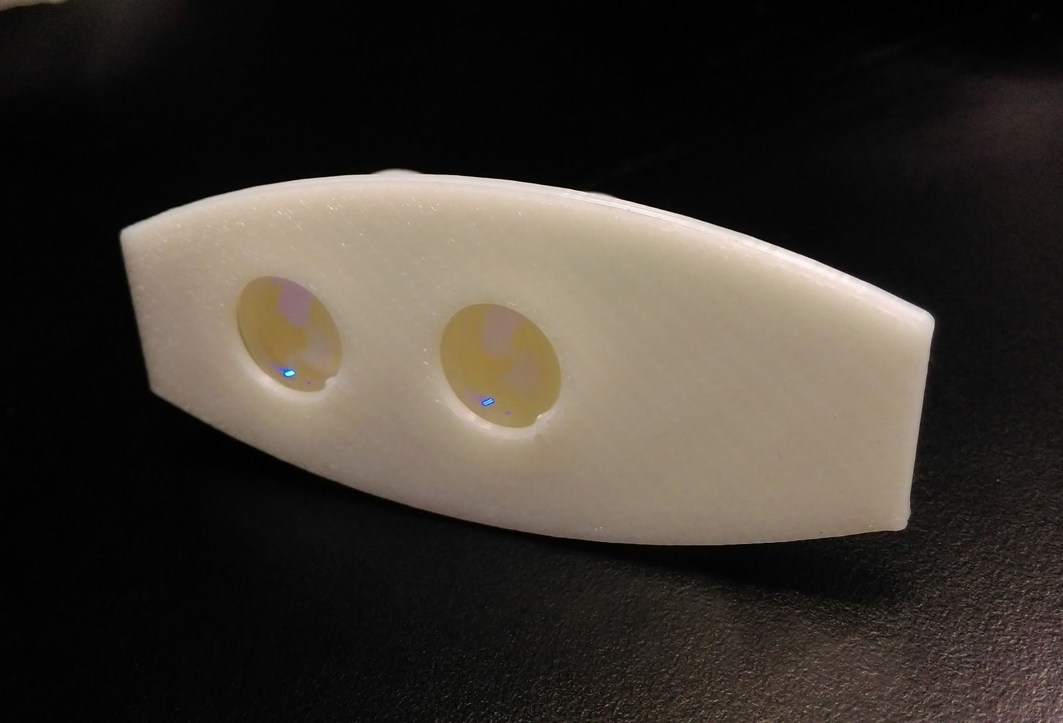
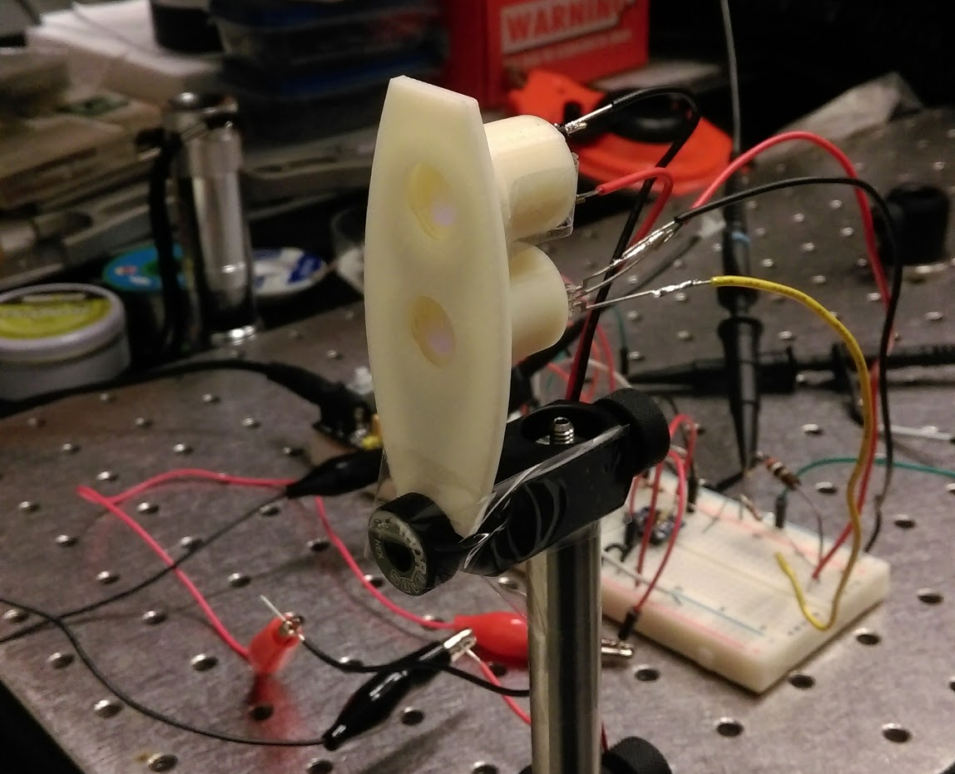
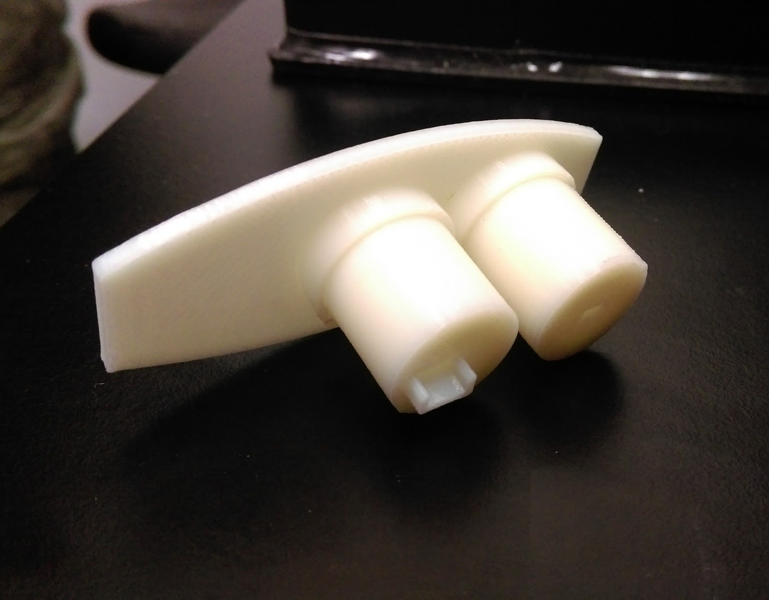

Slide 18
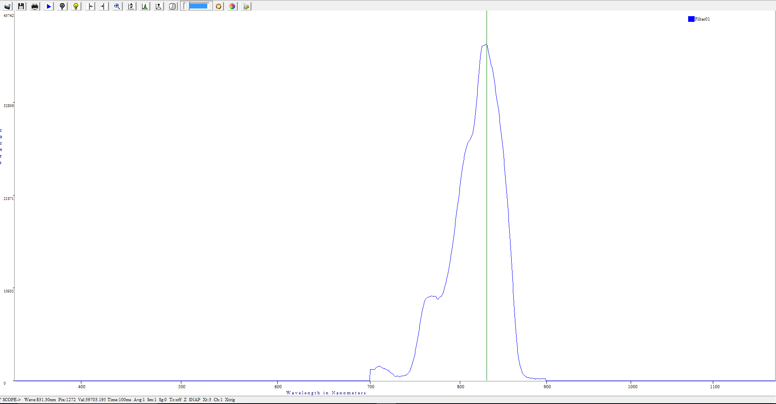
Narrow Bandpass Filter
8.0mm in diameter
Thickness of 0.55mm
Center wavelength is 850nm+/-5nm
Half-band width is 30nm
Peak transmissivity is >86%
Cut-off percentage is <1%
Mirror-glass material

Slide 19
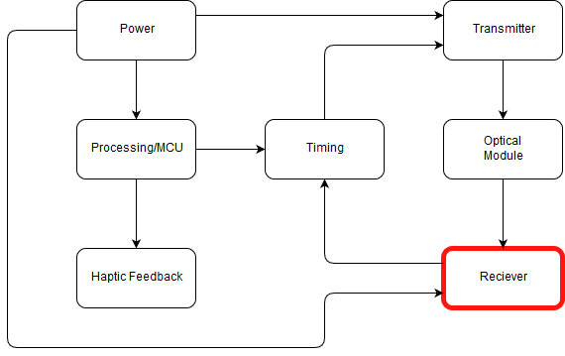
Receiver

Slide 20
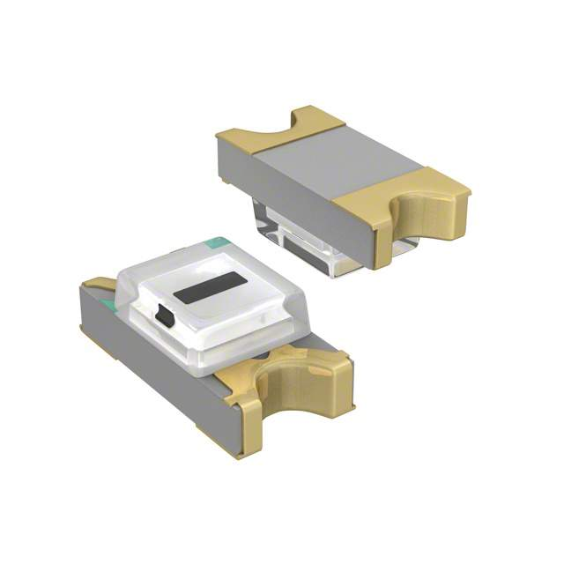

Spectral Response: 400 nm - 1050 nm
Peak Wavelength: 820 nm
Active Area: .36 mm^2
Dark Current: 0.5 nA
Terminal Capacitance: 3 pF
Rise Time : 1.8 ns
Cost: $.83
Spectral Response: 400 nm - 1000 nm
Peak Wavelength: 800 nm
Active Area: .3 mm^2
Dark Current: 0.05 nA
Terminal Capacitance: 1.5 pF
Rise Time: .5 ns
Breakdown Voltage: ~150 V
Cost: ~$82

Slide 21
OPA380 Transimpedance Amplifier
High Speed
Supply Voltage: 2.7 V-5.5 V
Slew Rate: 80 V/us
GBW: 90MHz
700 kohm Rf
3.3 V VCC

Slide 22
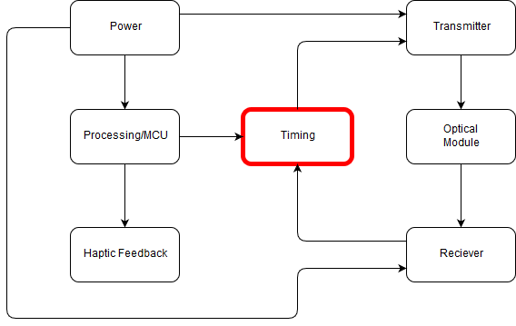
Timing

Slide 23
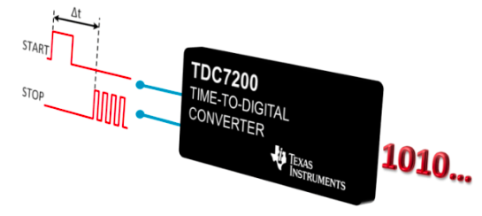
Requirement
Affordable
Set threshold for receiver signal
Down convert signal to detect in ns range
SPI communication with MCU
Low power consumption

Slide 24
TDC7200
TDC7201
Measurement Range:
Mode 1: 12 ns to 500 ns
Mode 2: 250 ns to 8 ms
Low Power Consumption: 0.5 µA
Supports up to 5 Stop Signals
Supply Voltage: 2 V to 3.6 V
Price : $5.06
Package: TSSOP (14)
Measurement Range:
Mode 1: 12 ns to 2000 ns
Mode 2: 250 ns to 8 ms
Low Power Consumption: 2.7 mA
Supports up to 10 Stop Signals
Supply Voltage: 2 V to 3.6 V
Price : $6.09
Package: nFBGA (25)

Slide 25
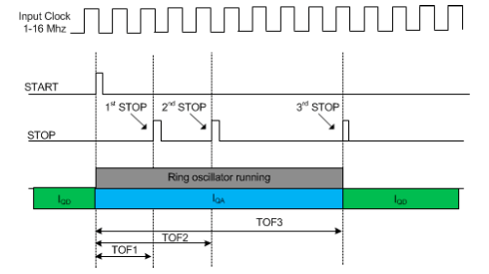
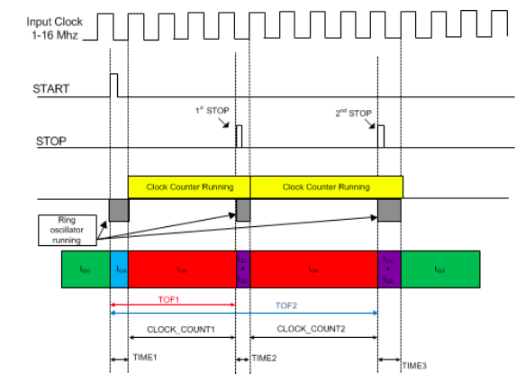
Mode 1
Mode 2

Slide 26
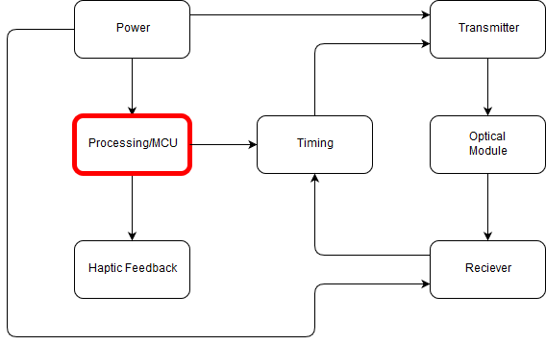
Processing

Slide 27
Requirements
Affordable
16MHz clock frequency
Output 1kHz
1-5V Operating Range
SPI communication
Sufficient GPIO Pins

Slide 28
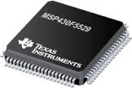
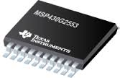
Operating frequency: 25MHz
Operating voltage: 3.6-5V
Memory: 128KB
Cost: $8.06
SPI Communication
40 GPIO Pins
Operating frequency: 16MHz
Operating voltage: 3.6V
Memory: 16KB
Cost: $1.00
SPI Communication
14 GPIO Pins

Slide 29
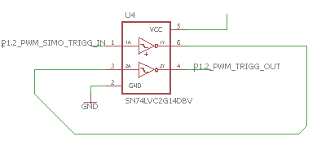
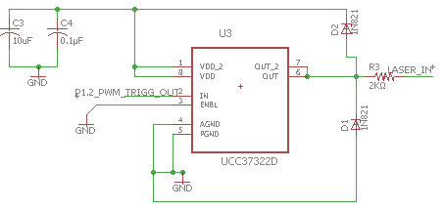
Operation: PWM
Output 1kHz square wave, 0.1% duty cycle
Timer A- SMCLK, Up Mode
Output to dual Schmitt-Trigger Inverter (create delayed TTL signal)
Signal fed into laser driver

Slide 30
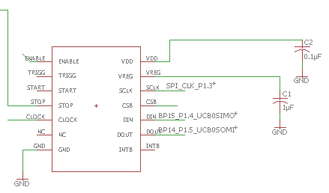
Operation: Communicating with Timing Module
Communicates via SPI
Sends configuration to TDC7200
Reads calculated distance
Executes haptic feedback

Slide 31
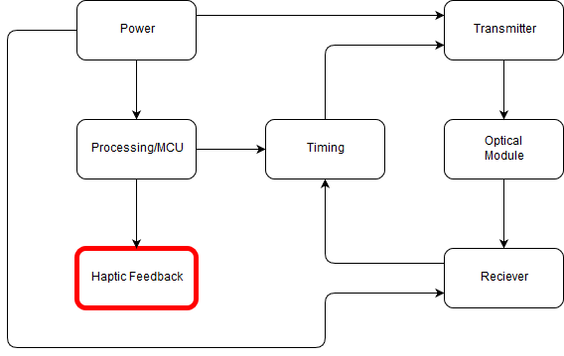
Haptic Feedback

Slide 32
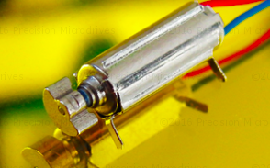
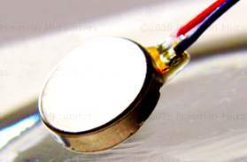
Eccentric Rotating Mass (ERM) or Linear Resonant Actuator (LRA)?
-similar prices
ERM: Small unbalanced mass on DC motor
Pager or coin style?
-more benefit in smaller size for our project

Slide 33
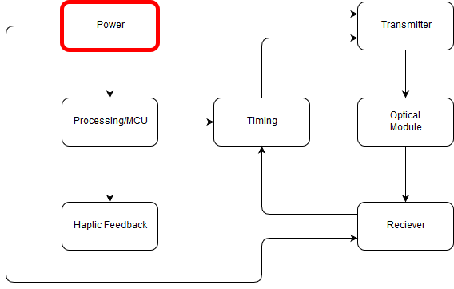
Power

Slide 34
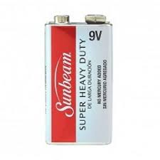
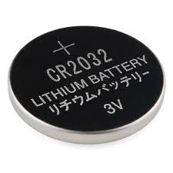
Output Voltage: 9V
Larger in Size
Requires 1 for operation
Output Voltage: 3V
Smaller in size
Requires at least 3

Slide 35
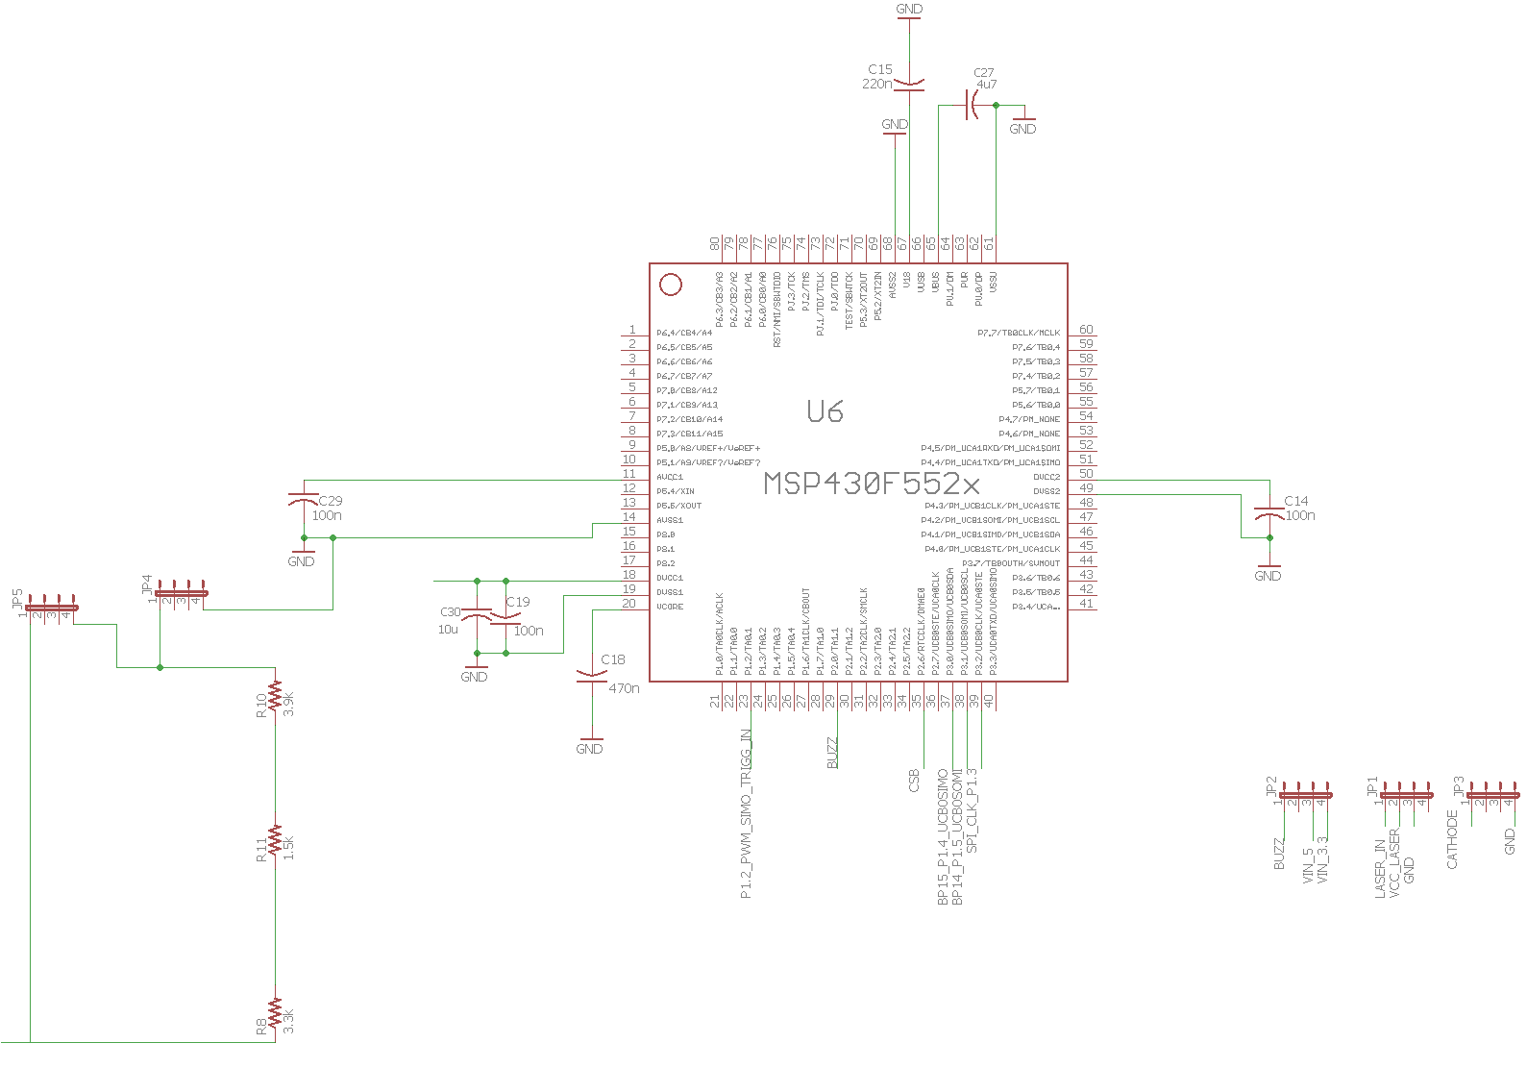
PCB Design

Slide 36
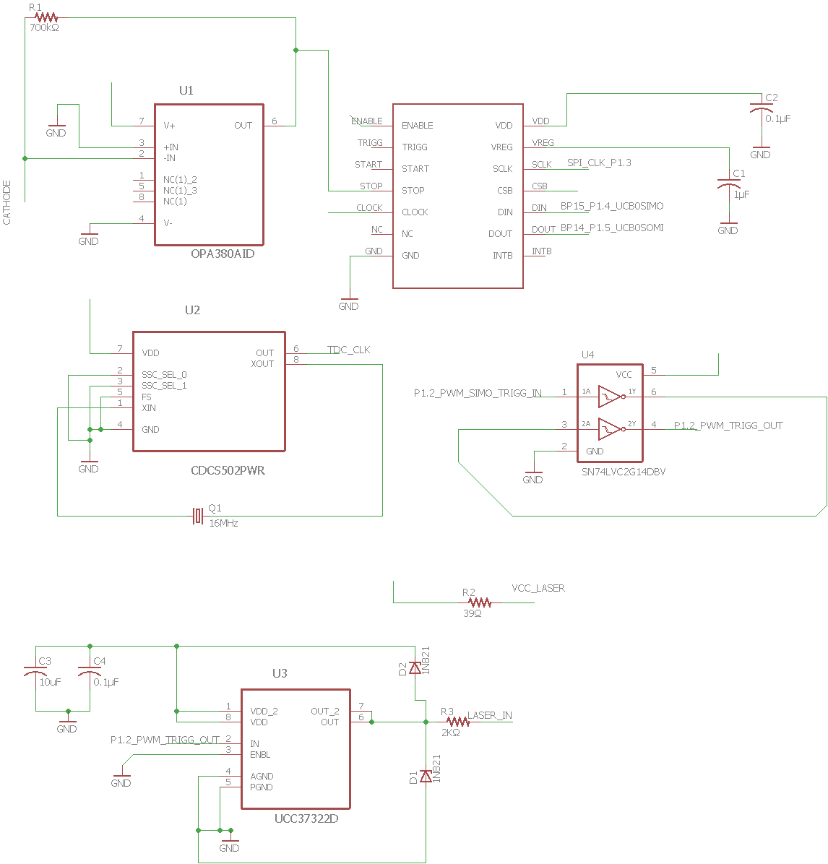
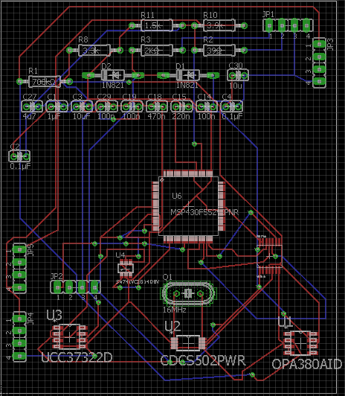

Slide 37
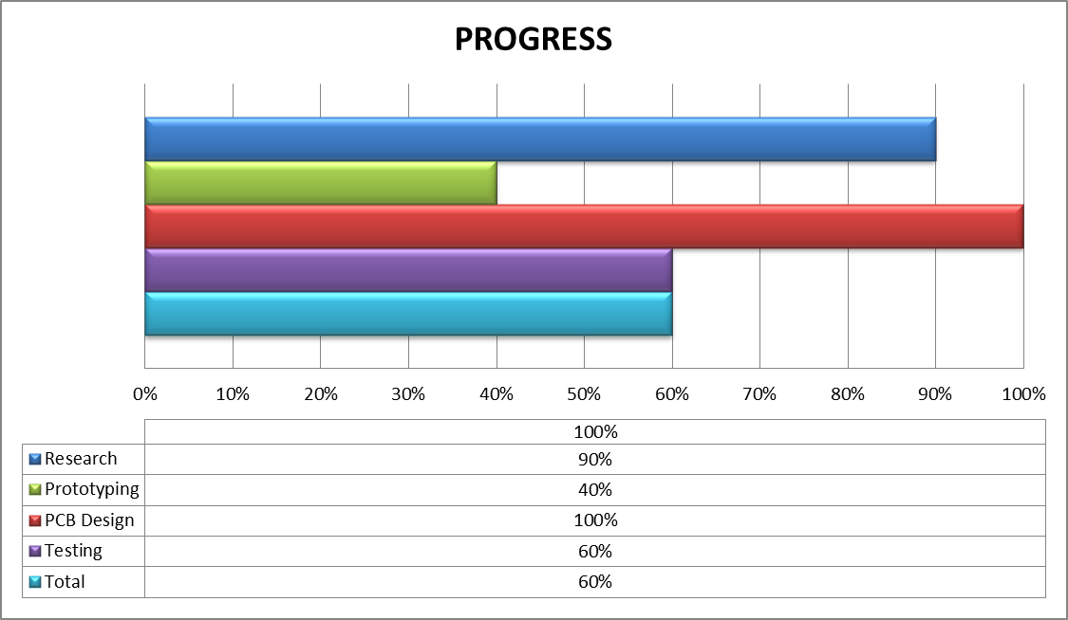
Notes:
PCB - 80%
Testing - 60%

Slide 38


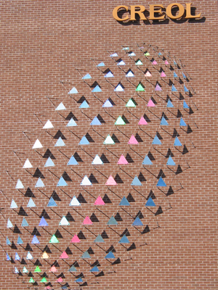

Sponsors

Slide 39
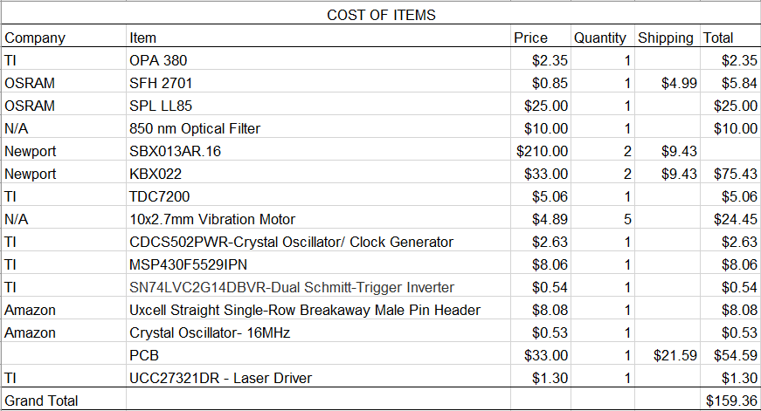

Slide 40
ISSUES
Schmitt Trigger
Code for Measurements
New iteration of Optical Module

