Slide 1
OSN
Optical Supplemental Navigation Device
Group 24
Wilfredo Ortiz | PSE
Joseph Devenport | PSE
Cedric Harper | EE
Henry Schmitz | EE

Slide 2
Motivation
Help blind and vision impaired individuals maneuver new and unfamiliar environments
Create an affordable supplement to the cane or guide dog
US: Approximately 1.1 million vision impaired and 200,000 totally blind
Global: 285 million vision impaired and 39 million totally blind
Cane and guide dog limited to 1 meter range
Safety and Confidence

Slide 3
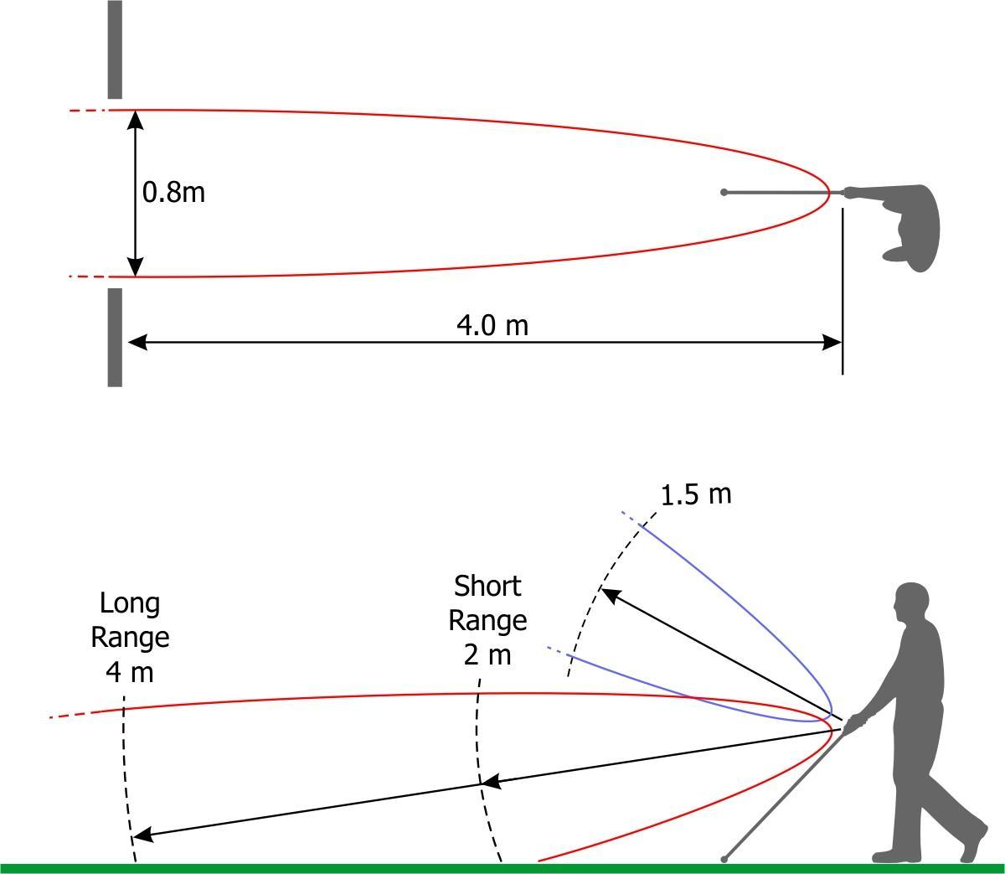
Current Ultrasonic Technology
 | Range | Price
Ultracane | 2-4 m ground/ 1.5 m chest height | $635.00
Smartcane | 1.5-3 m | $3000.00
iGlasses | 0-3 m | $96.00
Source: Ultracane

Slide 4
Current Laser Technology
 | Range | Price
Laser Cane N-2000 | 10 m | $2650
Not many products on the market currently using lidar
Group of Engineers at University of Melbourne currently prototyping a lidar system
Future technology heading towards eliminating cane altogether and using 3D lidar to map out entire rooms

Slide 5
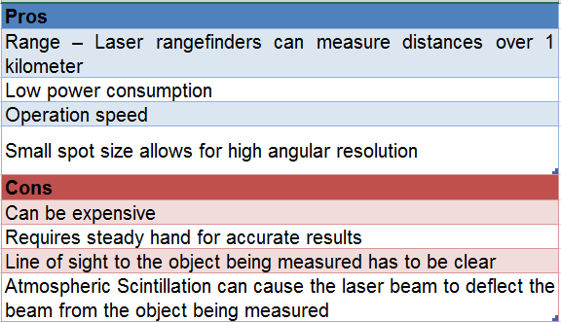
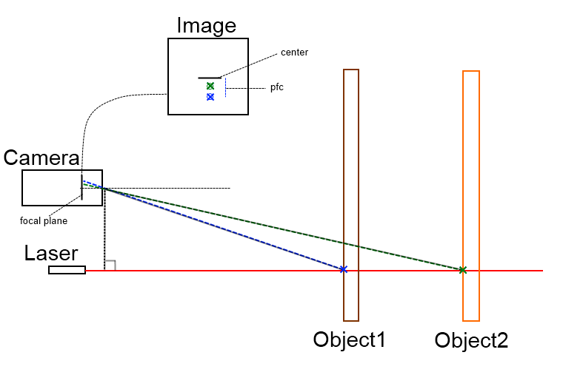
LASER
Notes:
https://hackaday.com/tag/laser-rangefinder/
https://chmodux.wordpress.com/2012/04/16/range-finding/
http://www.hizook.com/blog/2009/12/20/ultra-low-cost-laser-rangefinders-actualized-neato-robotics
What is angular resolution?

Slide 6
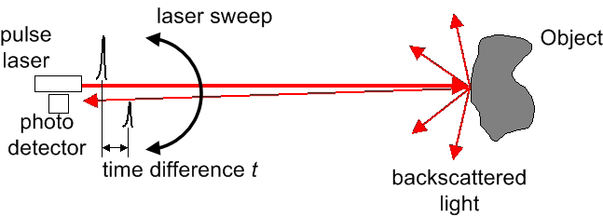
Time of Flight
Pros:
Can measure long distances
Accurate aiming to targets and through gaps (very small beam divergence).
Can measure to target surfaces at any angle.
Can be set to measure through glass or to the surface of glass.
Can be used to create large scale, 3D images by scanning.
Cons:
Can be more expensive
Range is limited particles in the air (dust, rain, etc)
Notes:
Why did we choose ToF?

Slide 7
Challenges
Circuitry fast enough for good resolution: 1 ns 1 ft
Detecting only our signal off of surfaces
Aligning Optics

Slide 8
Specifications
Overall Weight | Maximum 2 lbs.
Overall Size | Maximum 8in by 5in
Overall Cost | Maximum $300
Supply Voltage | Maximum 12V
Device Range | Maximum 5m
Laser Diode Wavelength | Near IR, 800-950nm
Photodiode Spectral Response | Silicon: 400 nm to 1050 nm

Slide 9
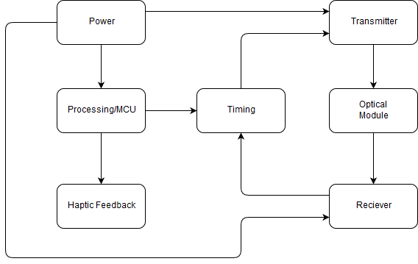
OSN Block Diagram

Slide 10
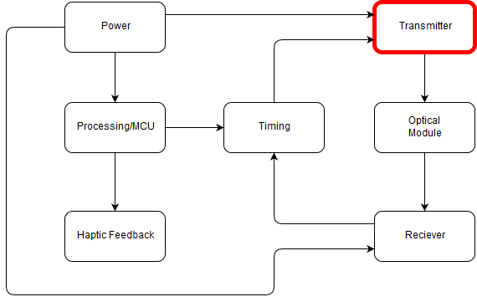
Transmitter

Slide 11
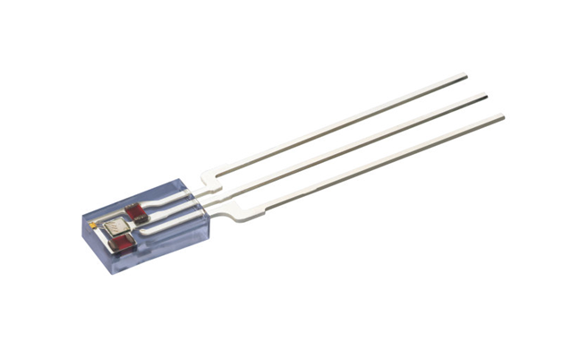
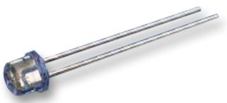
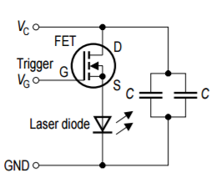
Pulsed Laser Diode
OSRAM SPL LL85
Spectral range: 840 nm-860 nm
Peak Wavelength: 850 nm
Spectral Width: 4 nm
Pulse Width: 28 ns
Peak Output Power: 14 W
Duty Cycle: 0.1 %
Cost: $20
OSRAM SPL PL85
Spectral range: 840 nm - 860 nm
Peak Wavelength: 850 nm
Spectral Width: 4 nm
Pulse Width: 100 ns
Peak Output Power: 13 W
Duty Cycle: 0.1 %
Cost: ~$20
Notes:
http://www.osram-os.com/osram_os/en/press/press-releases/ir-devices-and-laser-diodes/2015/low-cost-lidar--a-key-technology-to-enable-autonomous-driving-in-urban-environments/index.jsp?search_result=%2Fosram_os%2Fen%2Fpress%2Fpress-releases%2Findex.jsp%3Faction%3Ddosearch

Slide 12
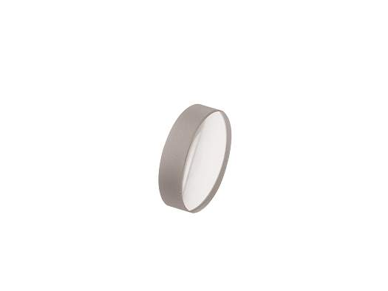
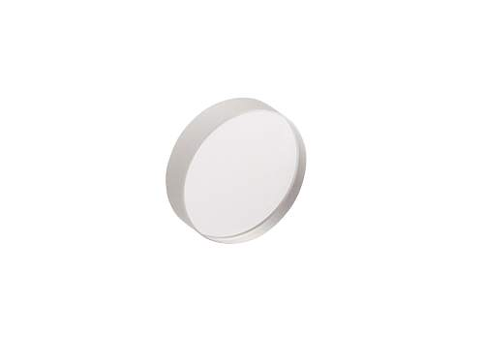
Lens Selection
Newport KBX022
Lens Material: N-BK7
Diameter: 12.7 mm
Radius of Curvature: 11.868 mm
EFL: 12.7 mm
BFL: 10.26 mm
Uncoated
Cost: $35
Newport SBX013AR.16
Lens Material: UV Fused Silica
Diameter: 12.7 mm
Radius of Curvature: 10.358 mm
EFL: 12.7 mm
BFL: 9.86 mm
AR Coating (650-1000 nm)
Cost: $210
Notes:
Why choose this focal length? - What are the requirements?

Slide 13
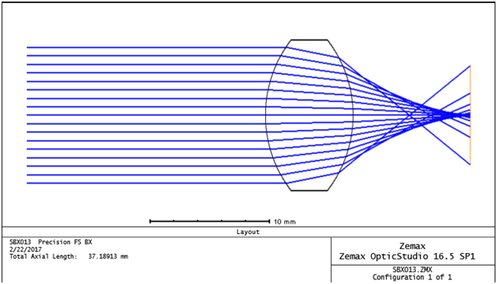
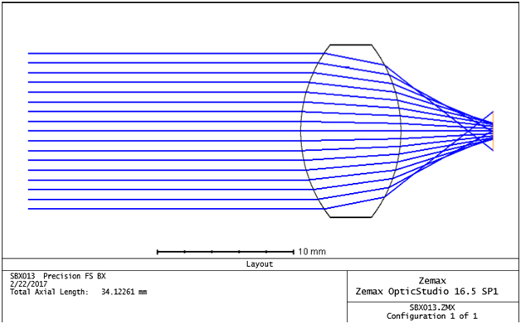
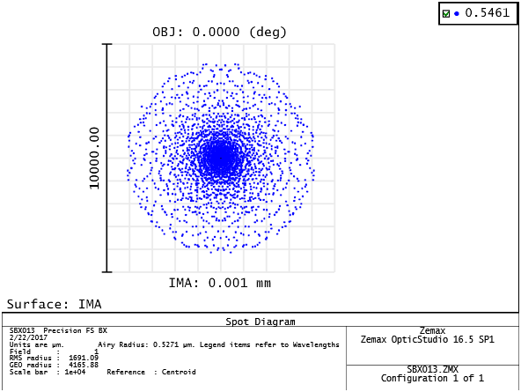
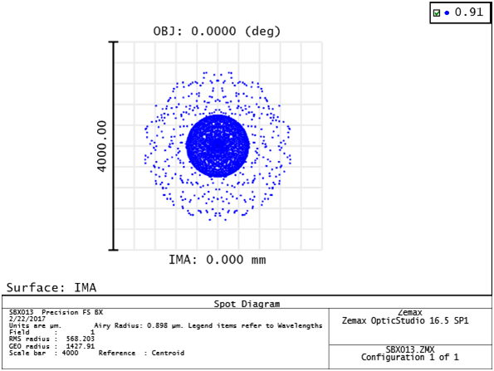
Lens Design
BFL: 10.0 mm
BFL: 6.77 mm
Spot Radius: 1.6 mm
Spot Radius: 0.57 mm
Notes:
How will you ultimately align it? How do you know the laser to lens distance?

Slide 14
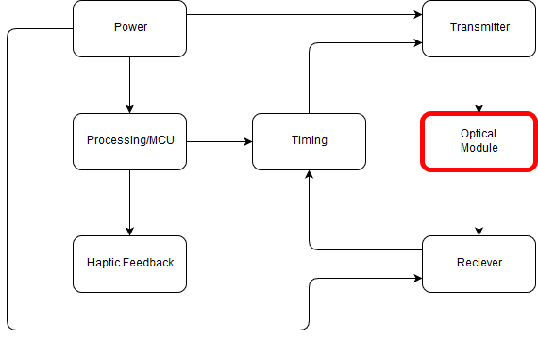
Optical Module

Slide 15
Receiver/Transmitter Modules
D
θ
D
d
f

Slide 16
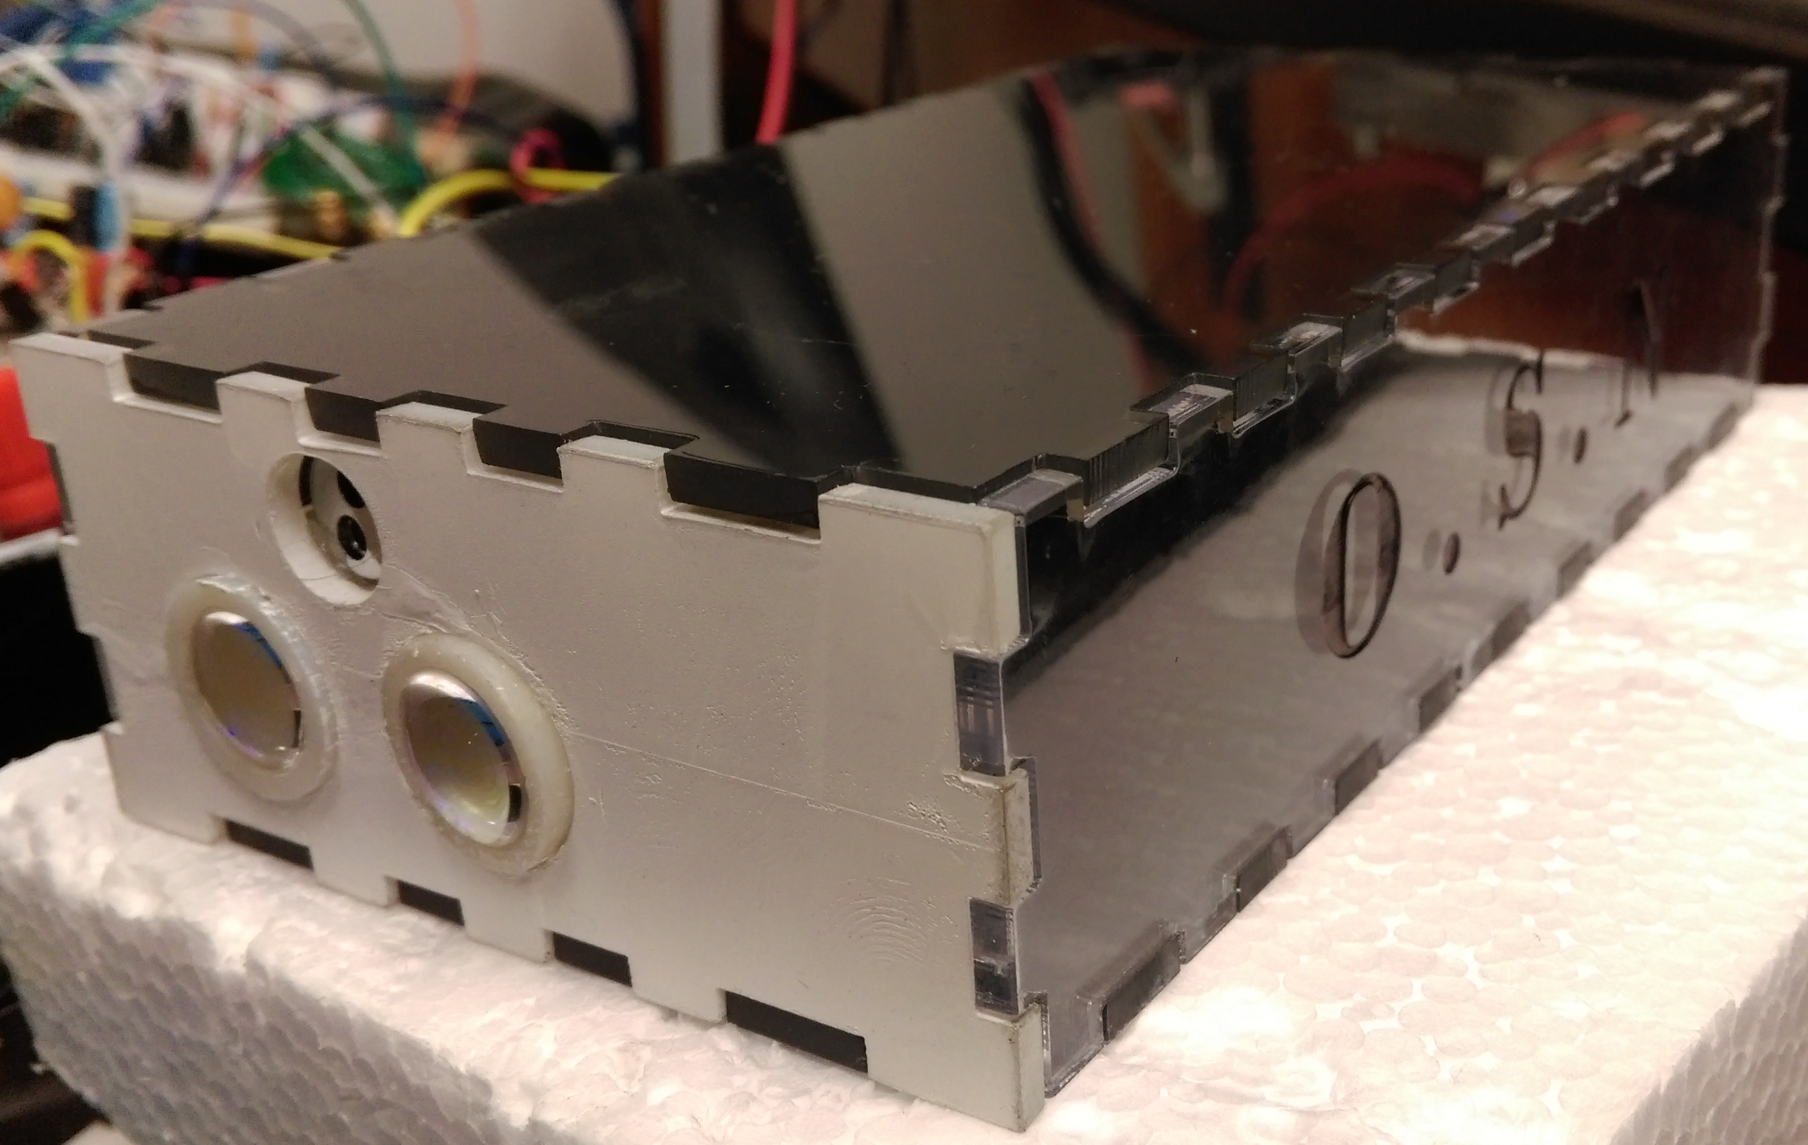
Optical Module

Slide 17
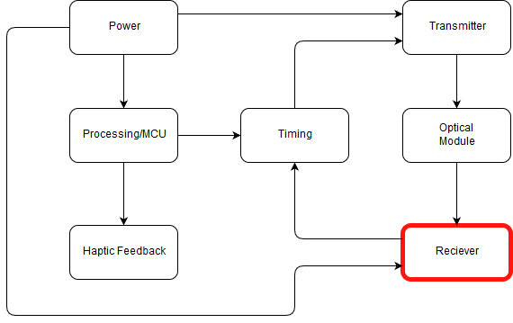
Receiver

Slide 18
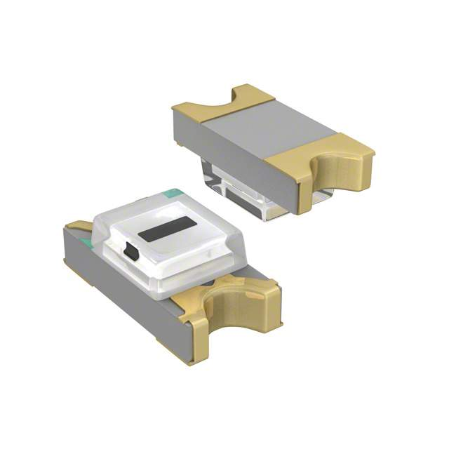

Photodiode
Osram SFH 2701
Spectral Response: 400 nm - 1050 nm
Peak Wavelength: 820 nm
Active Area: .36 mm^2
Dark Current: 0.5 nA
Terminal Capacitance: 3 pF
Rise Time : 1.8 ns
Cost: $.83
Hamamatsu S2381
Spectral Response: 400 nm - 1000 nm
Peak Wavelength: 800 nm
Active Area: .3 mm^2
Dark Current: 0.05 nA
Terminal Capacitance: 1.5 pF
Rise Time: .5 ns
Breakdown Voltage: ~150 V
Cost: ~$82
Notes:
What rise time do you need and how does this translate to spatial (distance) resolution?

Slide 19
OPA380 Transimpedance Amplifier
Amplifier
OPA656U Operational Amplifier
High Speed
Supply Voltage: 2.7 V-5.5 V
Slew Rate: 80 V/us
GBW: 90MHz
10 kΩ Rf
Supply Voltage: 2.7 V - 5.5 V
High Speed
Supply Voltage: 2.7 V-5.5 V
Slew Rate: 290 V/us
GBW: 230 MHz
10 kΩ Rf
Supply Voltage: Max 12 V
1.5 ns rise and fall time
Notes:
What challenges were there with the opamps? Comparator? Schmitt Trigger?
The comparator was oscillating due to unstable signal, this caused problems with the schmitt trigger as well.
Took feedback resistor off of the opamp because it was introducing noise.

Slide 20
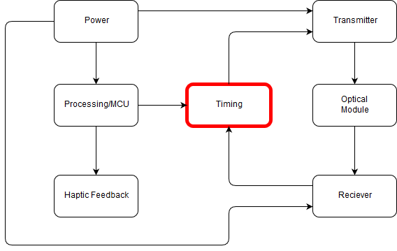
Timing

Slide 21
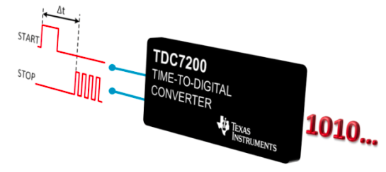
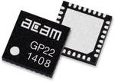
Time-to-Digital Converter
Texas Instruments TDC 7200
Measurement Range:
Mode 1: 12 ns to 500 ns
Mode 2: 250 ns to 8 ms
55 ps Resolution
Low Power Consumption: 0.5 µA
Supports up to 5 Stop Signals
Supply Voltage: 2 V to 3.6 V
Price : $5.06
Package: TSSOP 14
Acam TDC-GP22
Measurement Range:
Mode 1: 3.5 ns to 2500 ns
Mode 2: 700 ns to 4 ms
90 ps Resolution
Low Power Consumption: 1.1 uA
Supports up to 10 Stop Signals
Supply Voltage: 2.5 V to 3.6 V
Price : $7.41
Package: QFN 32
Notes:
Is the resolution enough? 12 ns? What is the difference between the range and the resolution?
7200:
Affordable
Set threshold for receiver signal
Down convert signal to detect in ns range
SPI communication with MCU
Low power consumption
7200 advantage: resolution is better with lower power consumption, easier package to solder, and TI free sample

Slide 22
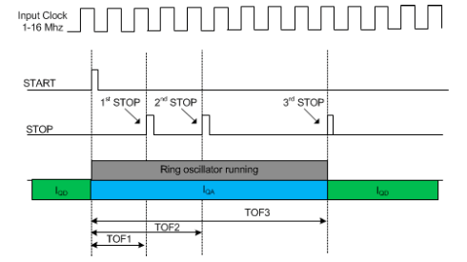
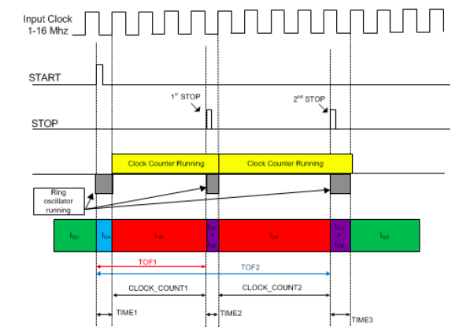
TDC Measurement Modes
Mode 1
Mode 2

Slide 23
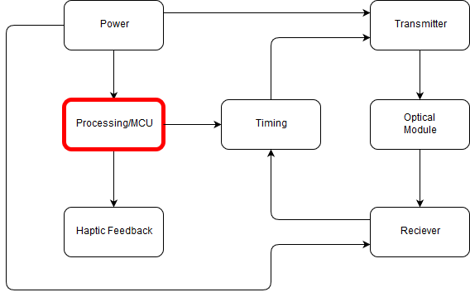
Processing

Slide 24
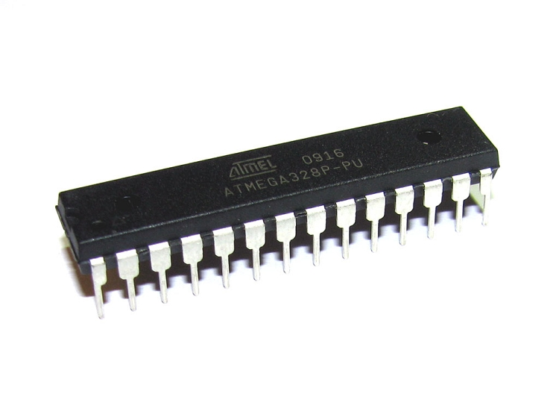
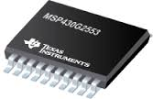
Microcontroller
Operating frequency: 20 MHz
Operating voltage: 1.8 V – 5.5 V
Memory: 32KB
Cost: $10.00
SPI Communication
23 GPIO Pins
Operating frequency: 16 MHz
Operating voltage: 3.6 V
Memory: 16KB
Cost: $1.00
SPI Communication
14 GPIO Pins

Slide 25
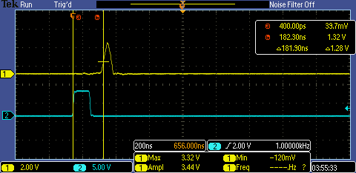
Pulse Width Modulation
Output 1kHz square wave
125 ns pulse width
Timer A- SMCLK, Up Mode
Signal fed into laser driver
Notes:
What does this do?

Slide 26
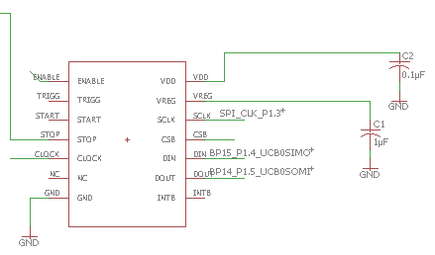
Microcontroller Communication with Timing Module
Communicates via SPI
Sends configuration to TDC7200
Reads calculated distance
Executes haptic feedback

Slide 27
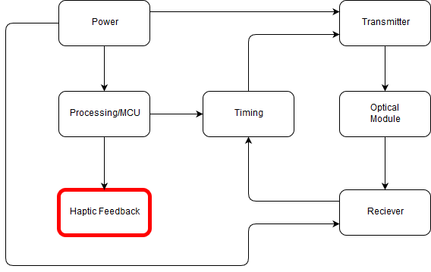
Haptic Feedback

Slide 28
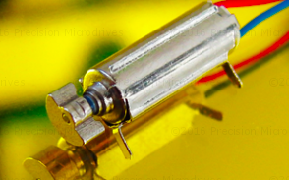
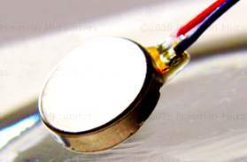
Motors
Eccentric Rotating Mass (ERM) or Linear Resonant Actuator (LRA)?
-similar prices
ERM: Small unbalanced mass on DC motor
Pager or coin style?
-more benefit in smaller size for our project

Slide 29
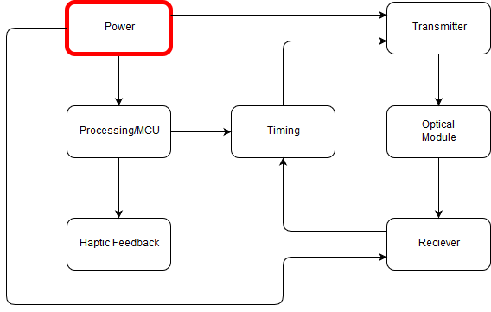
Power

Slide 30
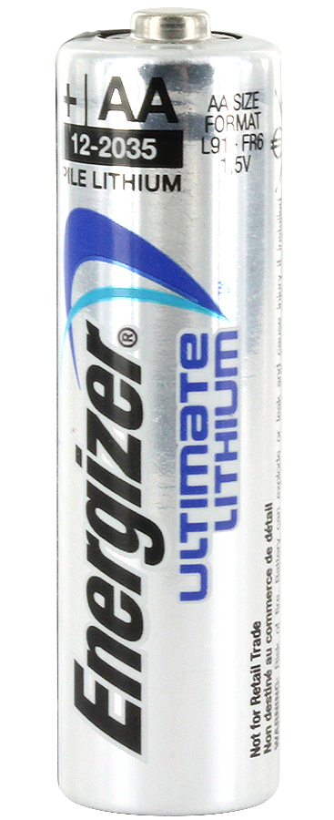
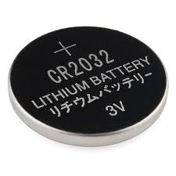
Batteries
Output Voltage: 1.5 V
Larger in Size
Requires 8 for operation
Output Voltage: 3V
Smaller in size
Requires at least 4

Slide 31
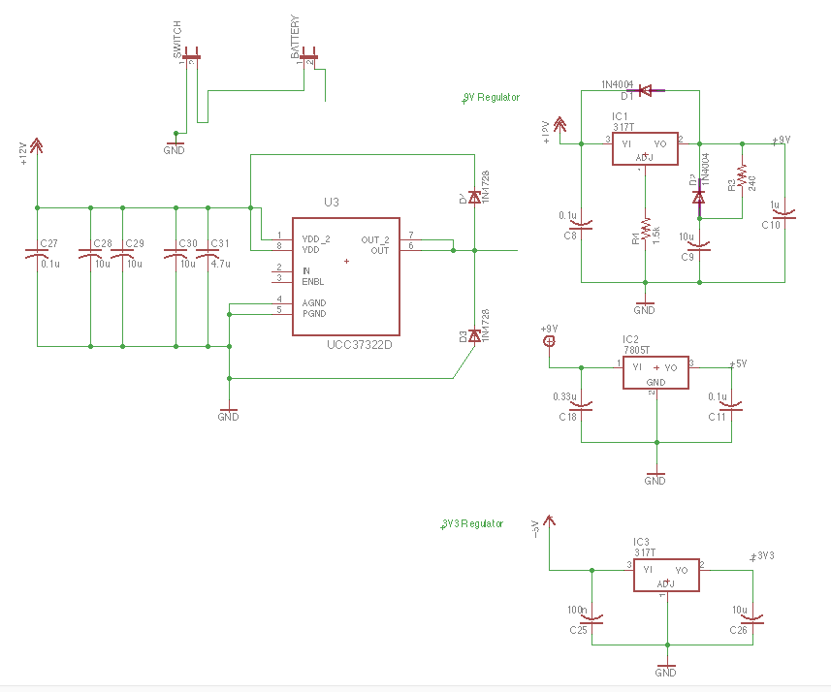
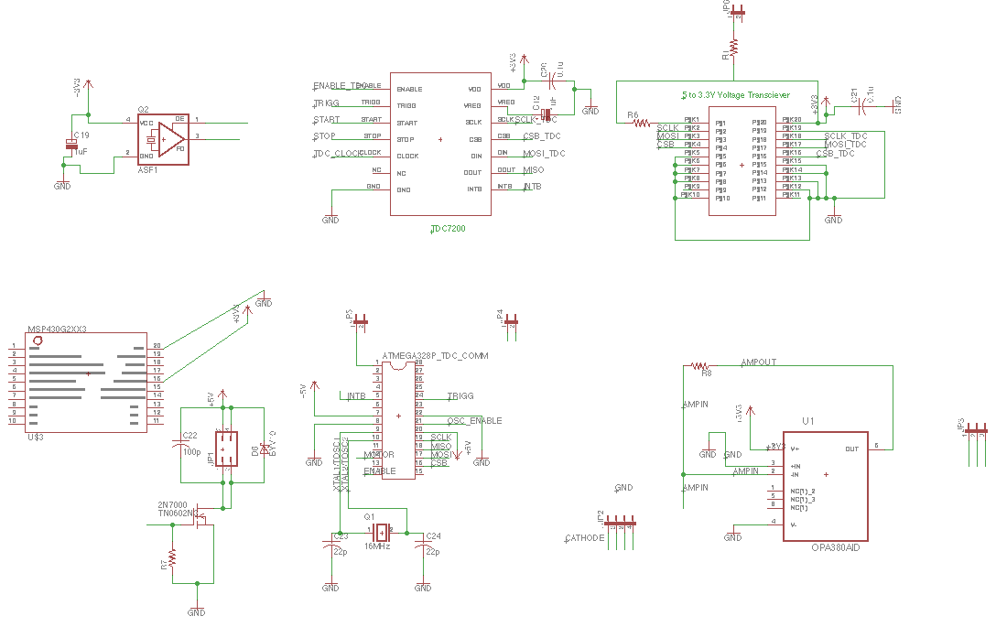
System Schematic

Slide 32
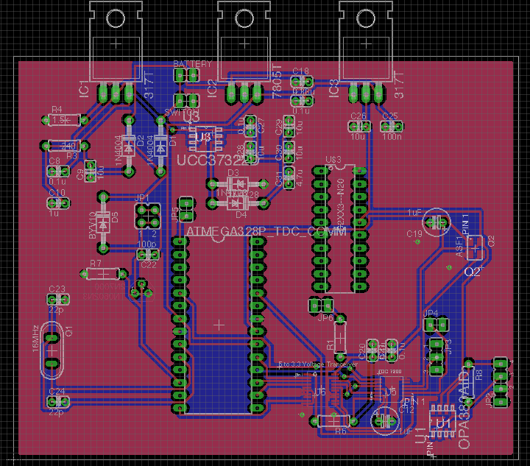
PCB Design

Slide 33
Member Responsibilities
 | Wilfredo | Devin | Cedric | Henry
Transmitter | Secondary | Primary
Receiver | Primary | Secondary
Optical Module | Primary | Secondary
Power |  |  | Primary | Secondary
Processing |  |  | Primary | Secondary
Timing |  |  | Secondary | Primary
Haptic Feedback |  |  | Secondary | Primary

Slide 35
ISSUES
Amplitude Dependent Timing Error (Walk Error)
  Timing Discriminator
    Leading Edge
    High Pass Discrimination
    Constant Fraction
  Automatic Gain Control
Detecting Reflections
  Signal-to-Noise Ratio (SNR of >= 10)
  More power at a longer wavelength
Notes:
Our SNR is

Slide 36
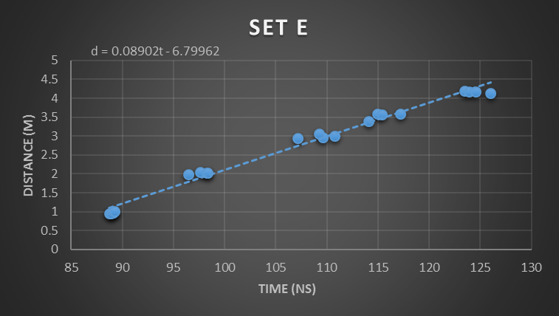
Data

Slide 37




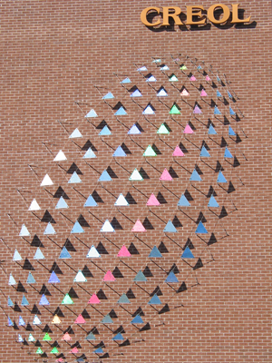

Acknowledgements
Lockheed Martin
Texas Instruments
CREOL
Newport
Center for the Visually Impaired

Slide 38
Questions?

