Slide 1

Smart Home Blackout Shades
Group 2
Stephen Fryer – CpE
Brian Mora – EE
Priyank Patel – CpE
John Rossi – EE
Sponsored by: Jetsons Living

Slide 2
Motivation
Smart home appliances are becoming very popular
Voice Assistant Speakers (e.g. Amazon Echo) are becoming very popular
Window shades operation lends itself well to automation
Sponsor wants a cheaper and more feature packed alternative to current available products

Slide 3
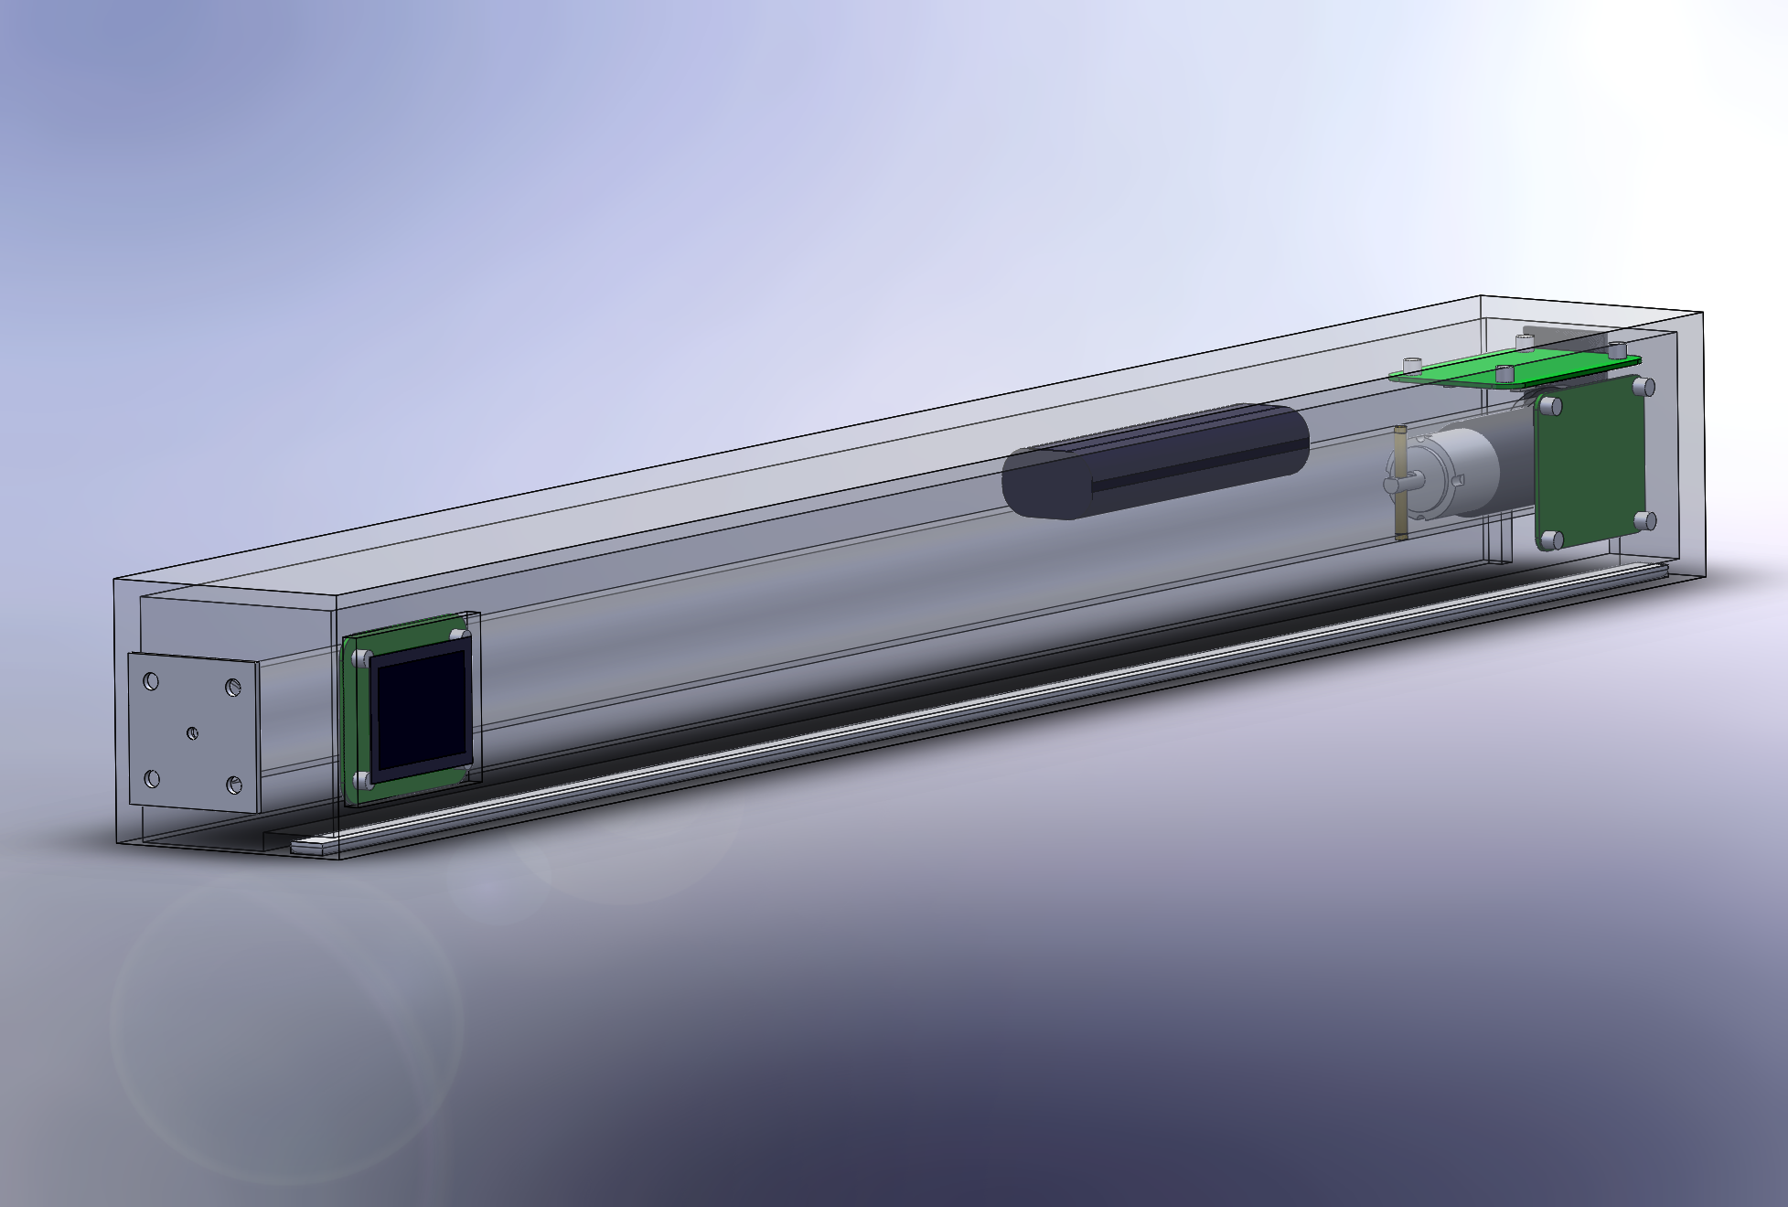
Goals and Objectives
Capable of operating completely wirelessly
Several modes of interaction
Remote control, web app, motion sensor
Solar powered
Capable of interfacing with Amazon Echo

Slide 4
Specifications
Parameter | Specification
Installation Time | 15 - 30 min
Response Time | 500 mS
Solar Panel Peak Output Power | 6 W
Motion Detection Range | > 3 m
Average Power Consumption | < 10 W
Dimensional Length | 2 ft - 5 ft
IR Receiver distance | > 10 m
Amazon Echo Skills | 3 skills

Slide 5
Hardware Design

Slide 6
Block Diagram
PV Panels
120 Volt AC
MCU and WiFi
IR Remote
Motor
Battery Charger
AC-DC
Converter
Battery
LED strip
Motion Detector
Source Select
5 Volt
Regulator
3.3 Volt
Regulator
Power
I/O
Control Line
Power Line

Slide 7
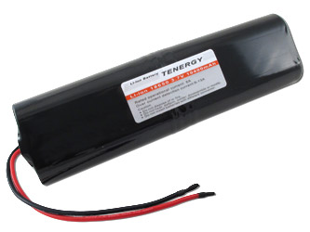
Battery
3.7V Li-Ion
Large capacity is most important factor
Simple to charge
Built-in charge protection
Vendor | All-Battery
Part Number | 31908-1
Capacity | 10,400 mAh
Dimensions | 133.5 x 38 x19 mm

Slide 8
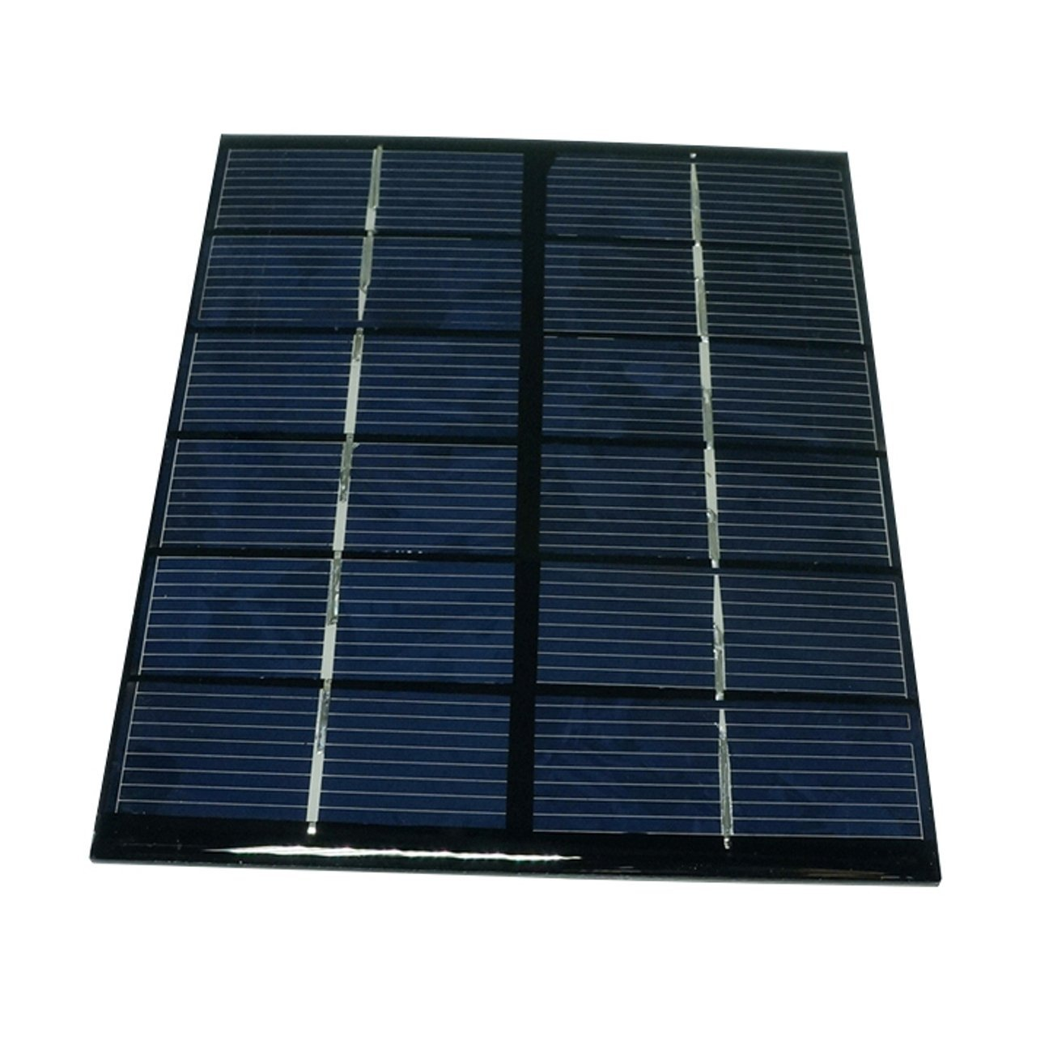
PV Panel
Available 10W panel footprints were too obtrusive
Opted for 5 2W panels in parallel to achieve more desirable footprint
Vendor | SunnyTech
Part Number | B00HQXQOIQ
Max power | 2W
Max voltage | 6V
Max current | 330mA

Slide 9
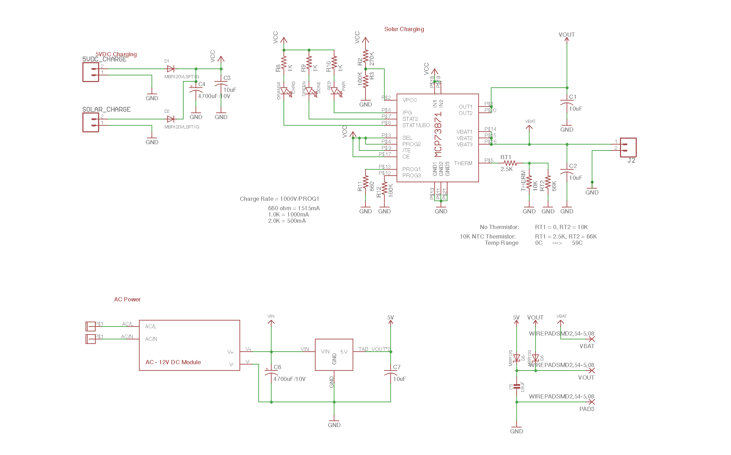
Power Board Schematic

Slide 10
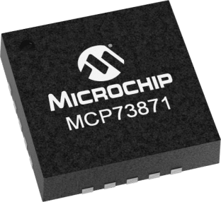
MCP73871
Battery charge management controller
Small footprint
Few external components are required for use
Over-temperature protection
Vendor | Digikey
Part number | MCP73871-2AAI/ML-ND
Charge current max | 1.1A
Battery pack voltage | 4.2V

Slide 11
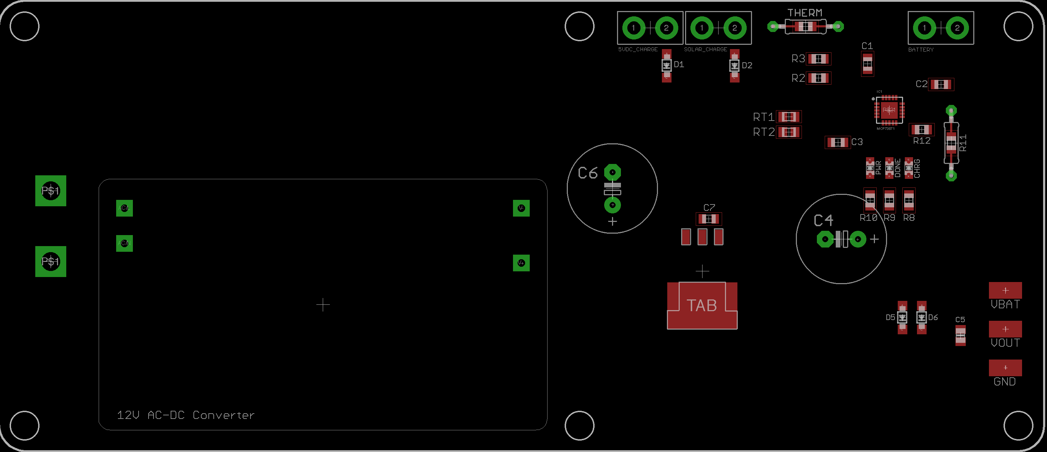
Power Board

Slide 12
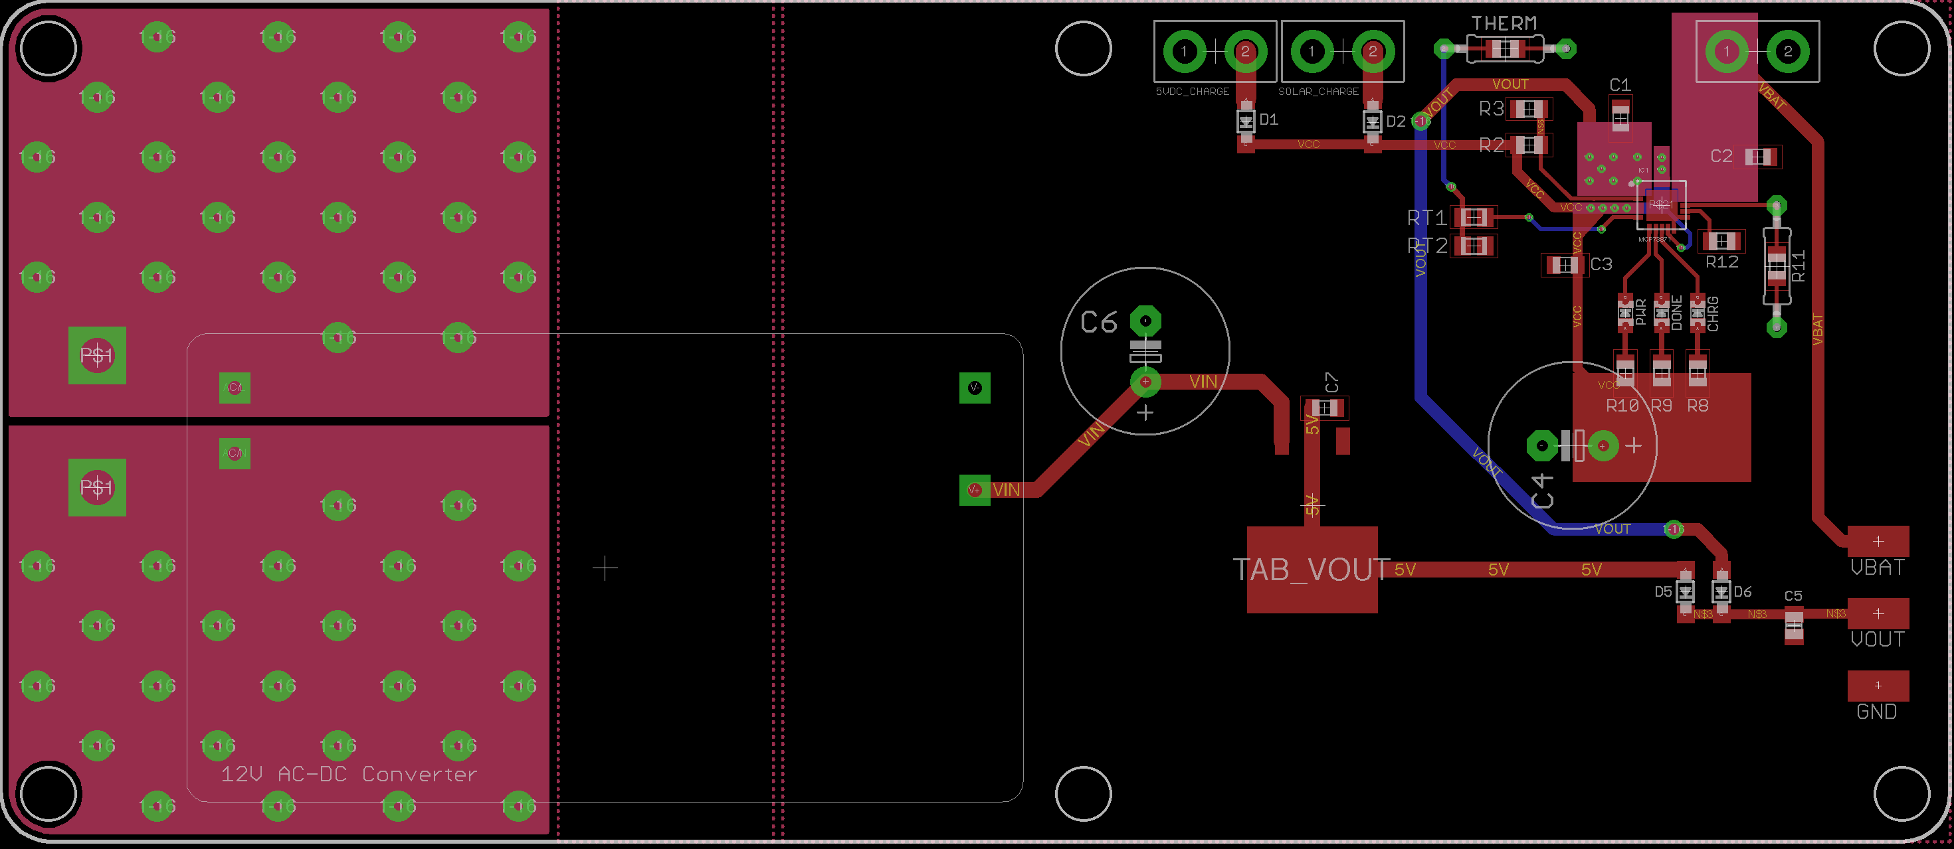
Power Board

Slide 13
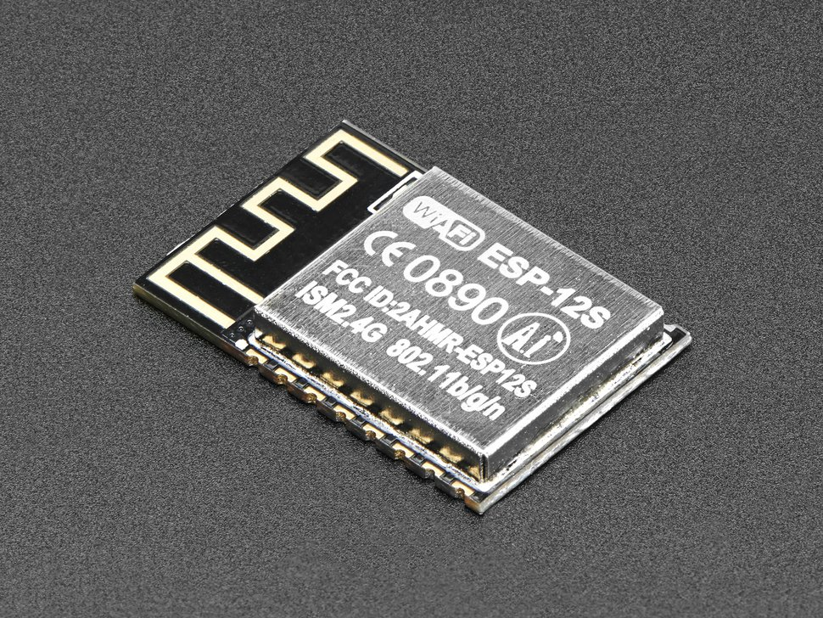
ESP-12S
System on Chip solution for WiFi and Microcontroller
Large Memory (4 MB)
Compatibility with Arduino
Inexpensive
Small
Vendor | Adafruit
Price | $6.95
Memory | 4 MB
I/O | 10

Slide 14
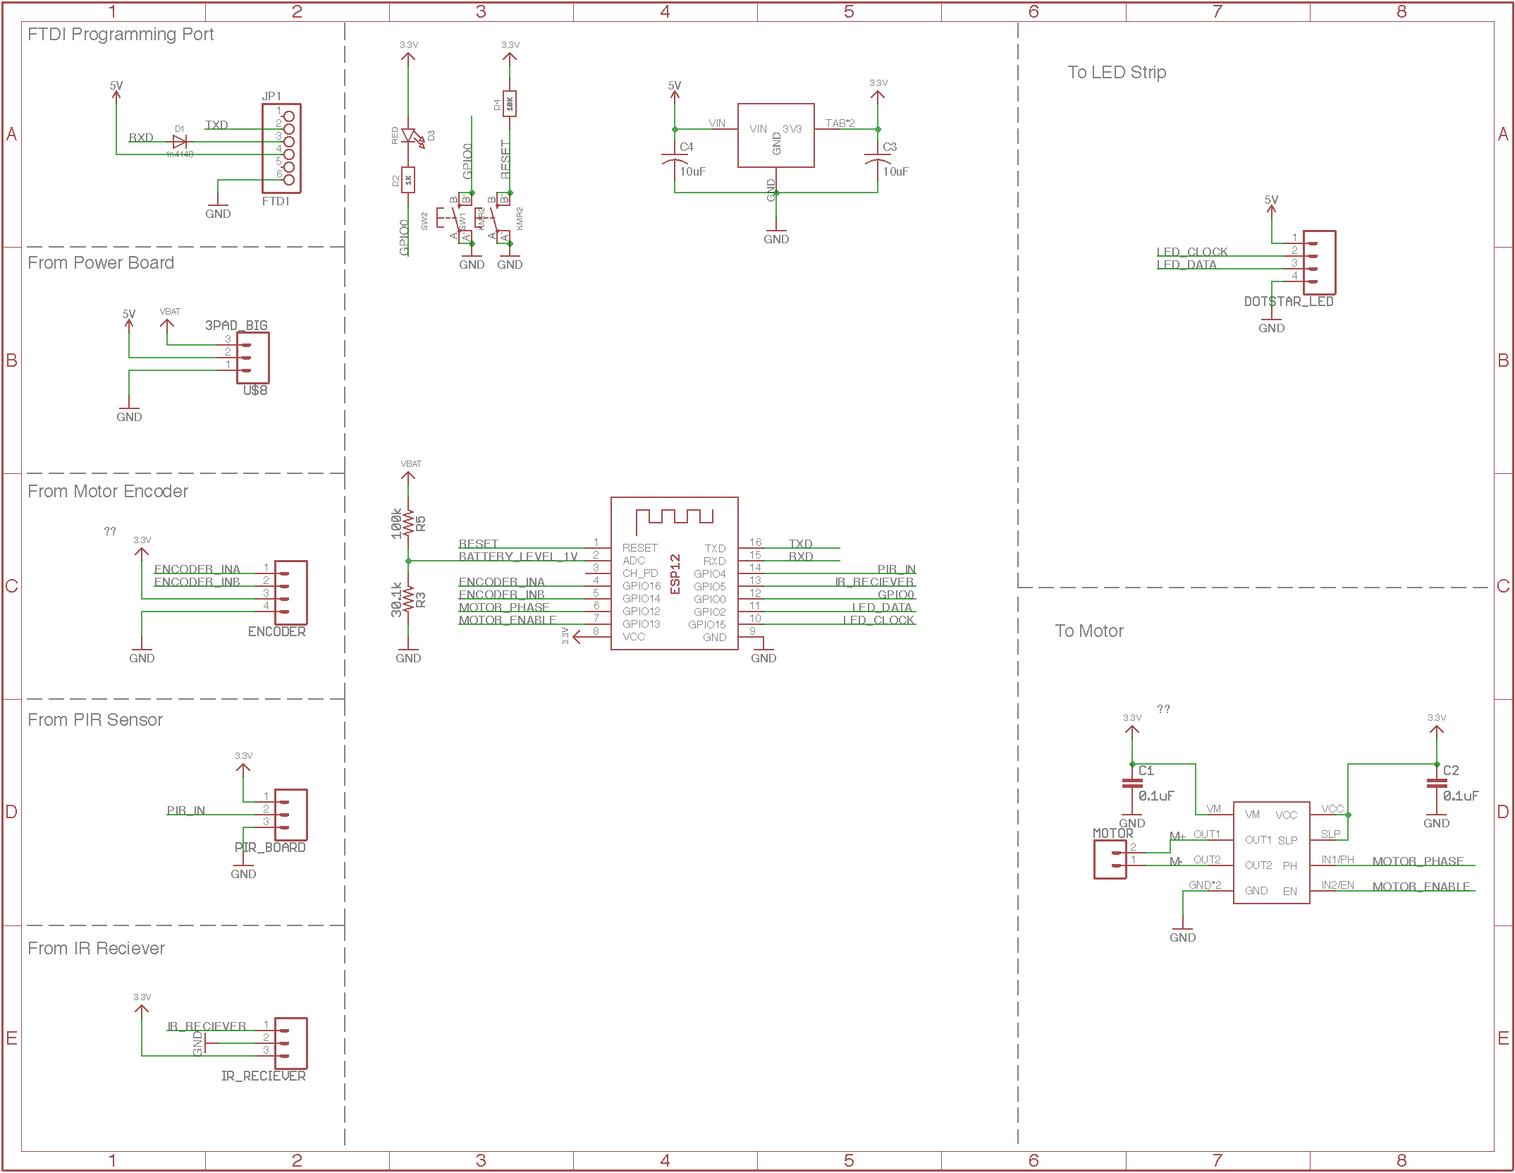
Control Board Schematic

Slide 15
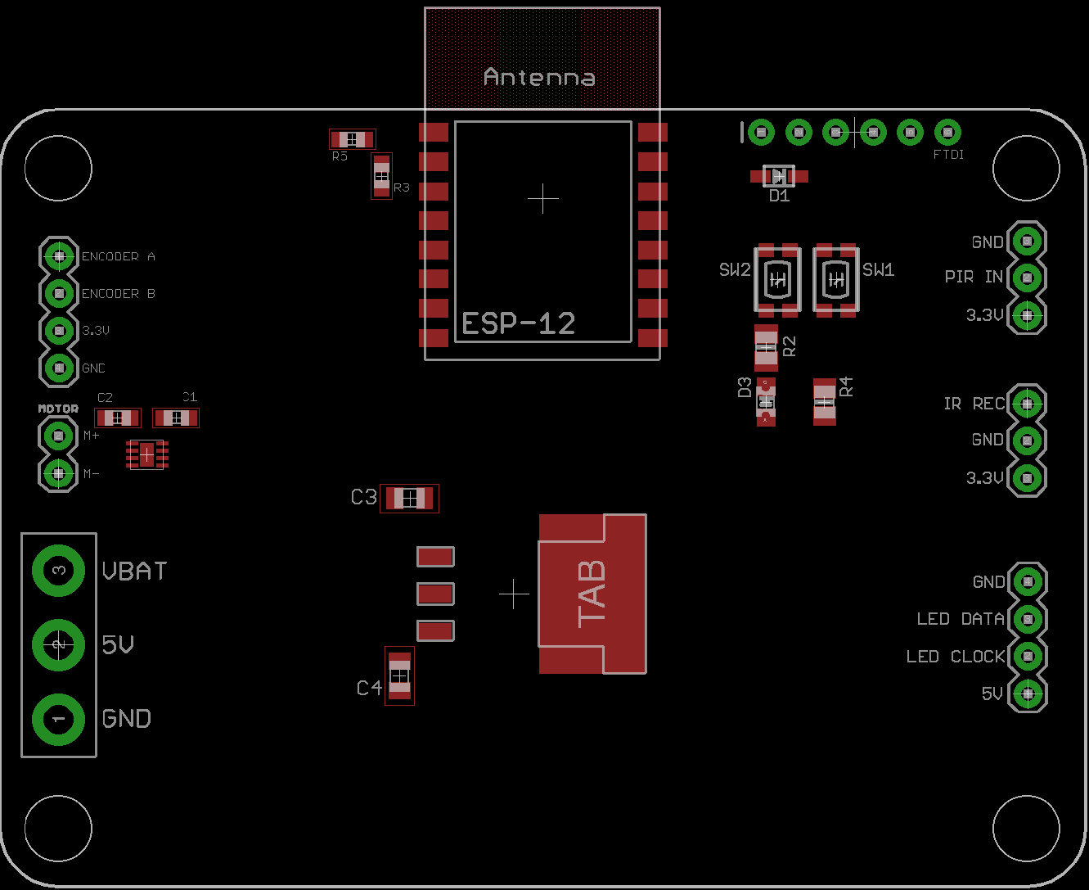
Control Board

Slide 16
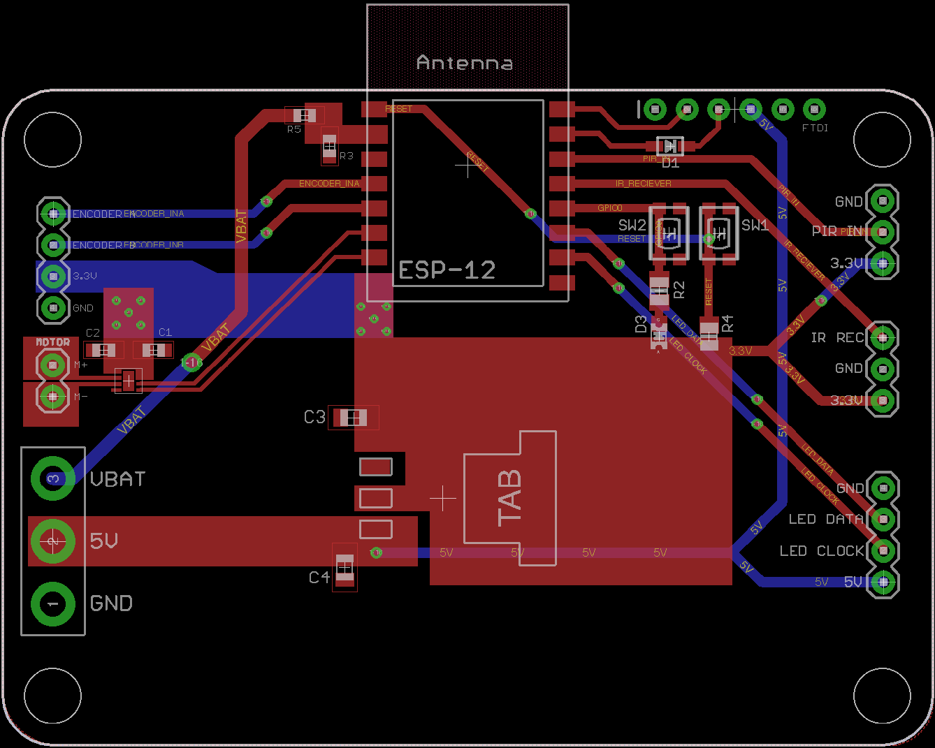
Control Board

Slide 17
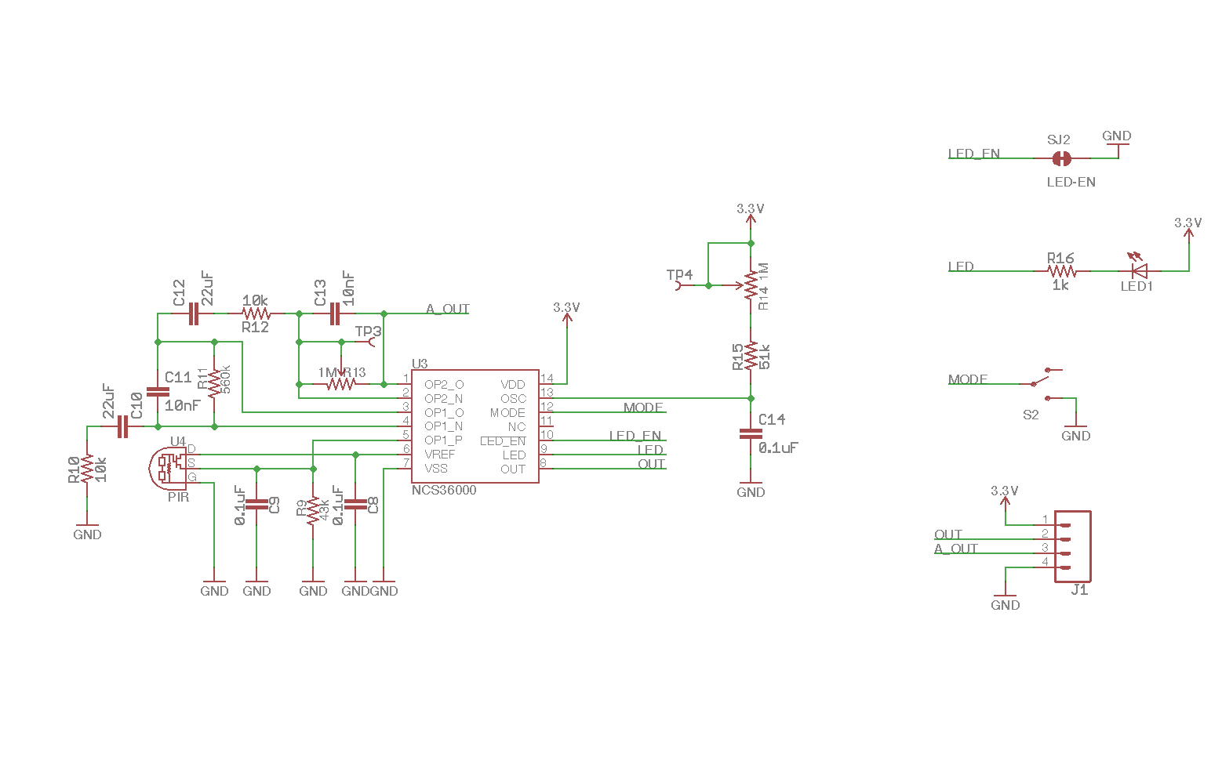
PIR Board Schematic

Slide 18
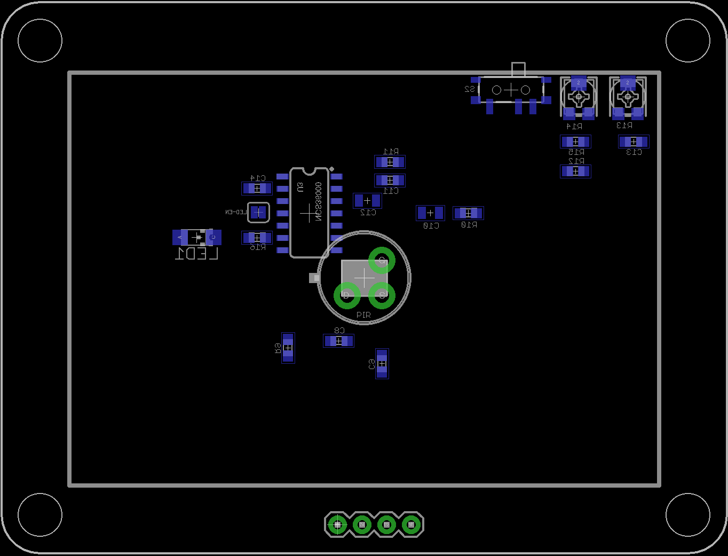
PIR Board

Slide 19
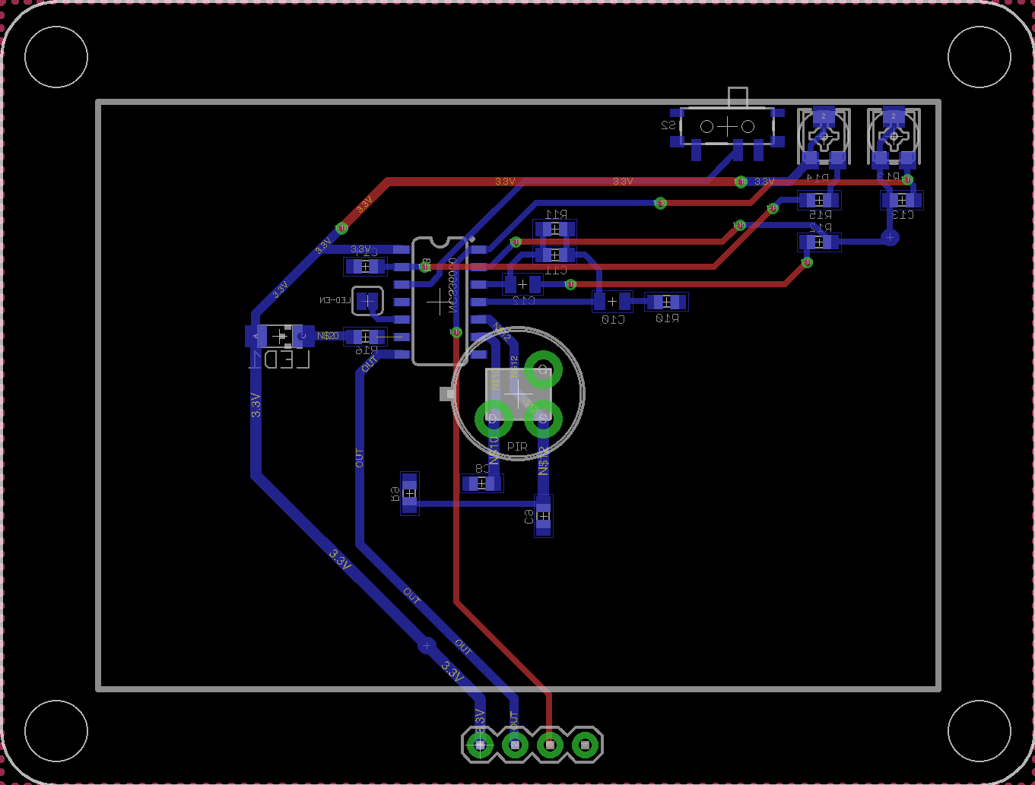
PIR Board

Slide 20
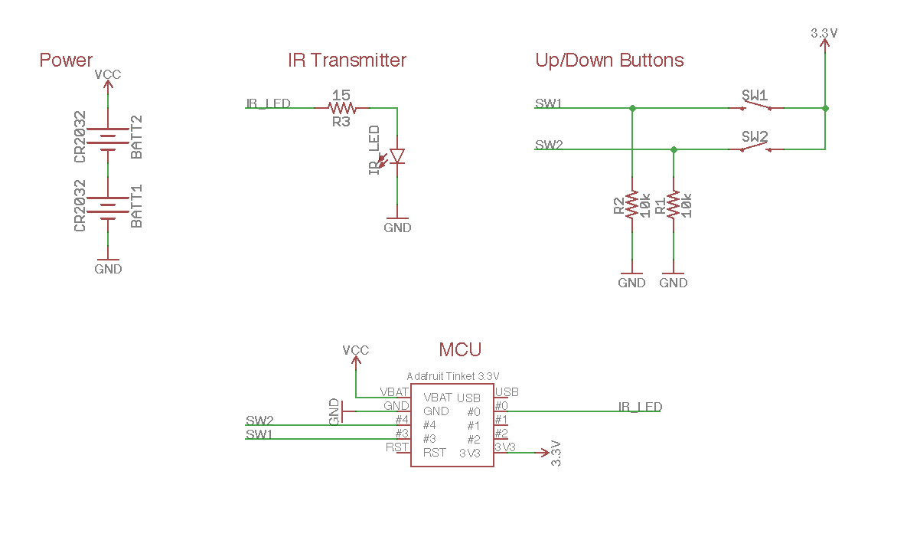
IR Remote Control Schematic

Slide 21
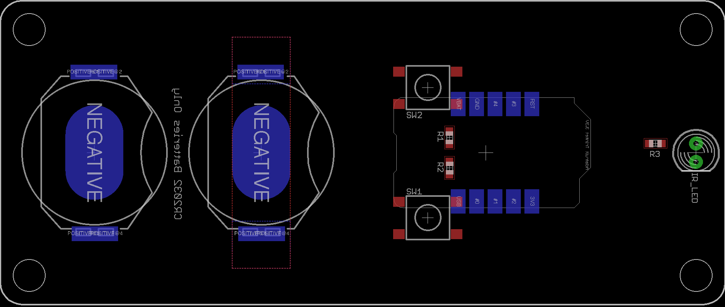
IR Remote Control

Slide 22
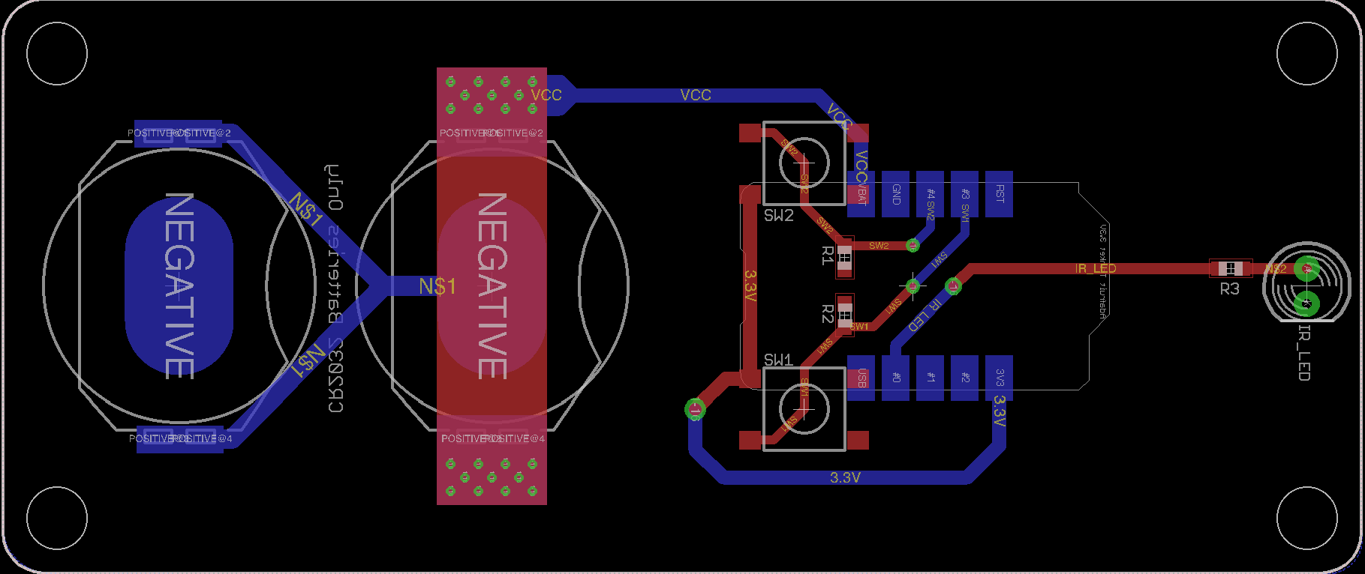
IR Remote Control

Slide 23
Software Design

Slide 24

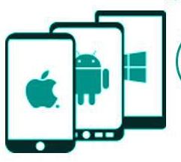

Web Application vs. Native Application
Native Apps | Web Application
Native Apps are built for particular platforms so that apps can take advantage of its operating system and device–specific hardware | Web Applications use web browsers and web technology
Native Apps offer great look and feel as well as also provides higher speed over web applications | Web Applications and responsive websites both satisfy the definition of mobile-friendly
Cost of maintenance of apps is higher. Also, developers usually have to create multiple apps on different platforms for every user | Hard to accommodate every user when many times users are using different web browsers
Both approaches requires both time and money for good products

Slide 25
Top-level Software Design
1) Web Application Functionality
Server Programming
Server will accept request from (1 and 2)
Server will process request
Server then communicates with PCB
PCB/MCU
PCB waits for input or command from either remote or server
Once input received, perform appropriate action
Our Web application and Amazon Echo will share or communicate directly with our web server to send/ Receive HTTP Requests.
Our Web Server then will accept the request. As well as process the appropriate the request and calls the appropriate Arduino method.
At this stage, appropriate Arduino methods will execute appropriate actions. (i.e. Roll-up Shades, Set Brightness, Change LED Color.)
2) Amazon Echo Functionality
3) Physical Remote Control

Slide 26
Web Application Core Modules
Wake
(Open)
Bedtime
(Close)
WiFi Settings
LED Color Change
LED Brightness Change
Remote Utility
Users are able to move shades up/down
Battery Indicator
Users are able to view real-time battery status
LEDs
Users can set preferred color
Users can set preferred brightness
Settings
Set Wake/bed time
Add/modify WiFi connection
Settings
LEDs
Web App
Battery Indicator
Remote Utility
Display Battery Level
Up
Down

Slide 27
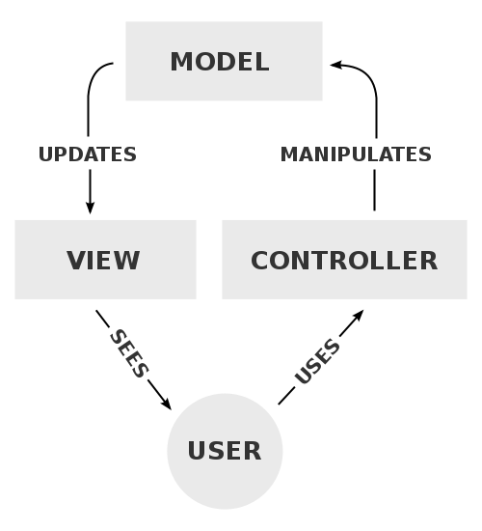
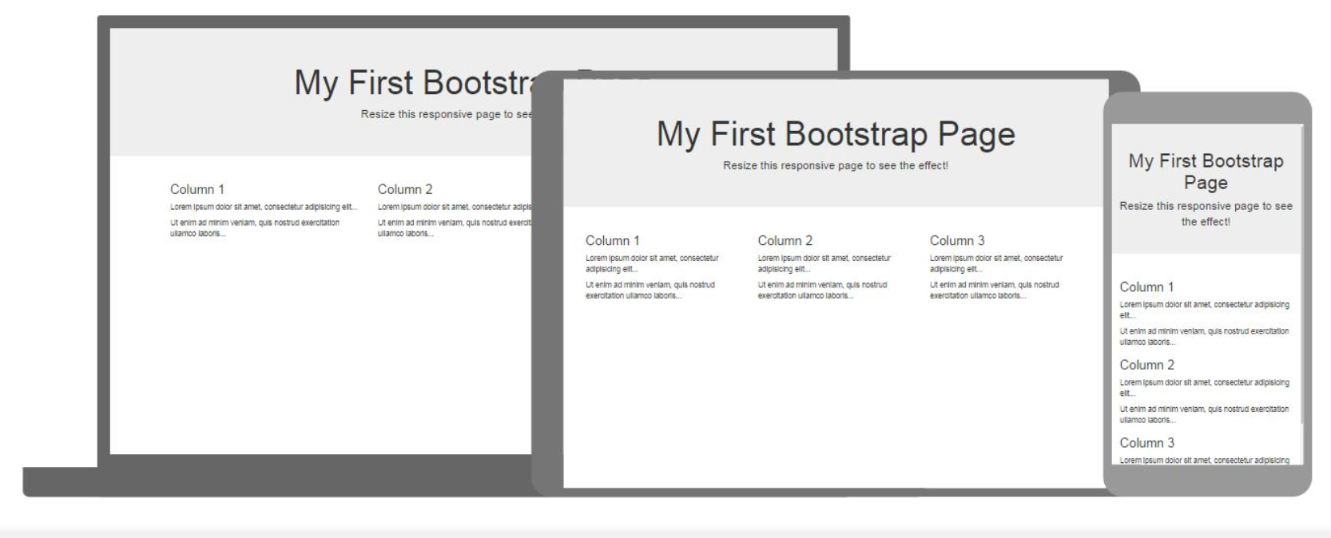

Software Tools
Model-View-Controller is a software architectural pattern commonly used for developing user interfaces that divides applications into three interconnected parts.
Bootstrap 3 libraries will be used to make the web application a responsive mobile-first website.
Jquery is a JavaScript library, and its syntax is designed to easily create animations and more.

Slide 28
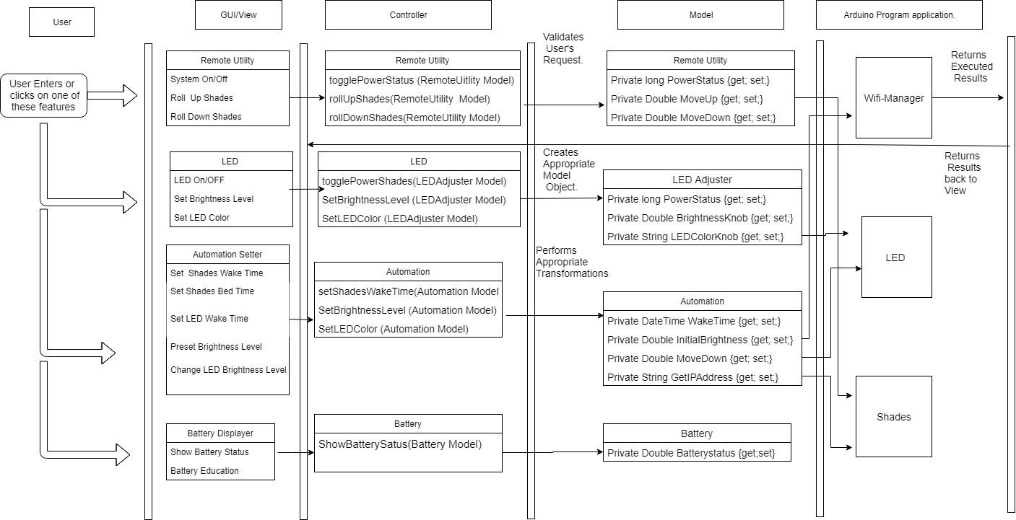
Class Diagram

Slide 29
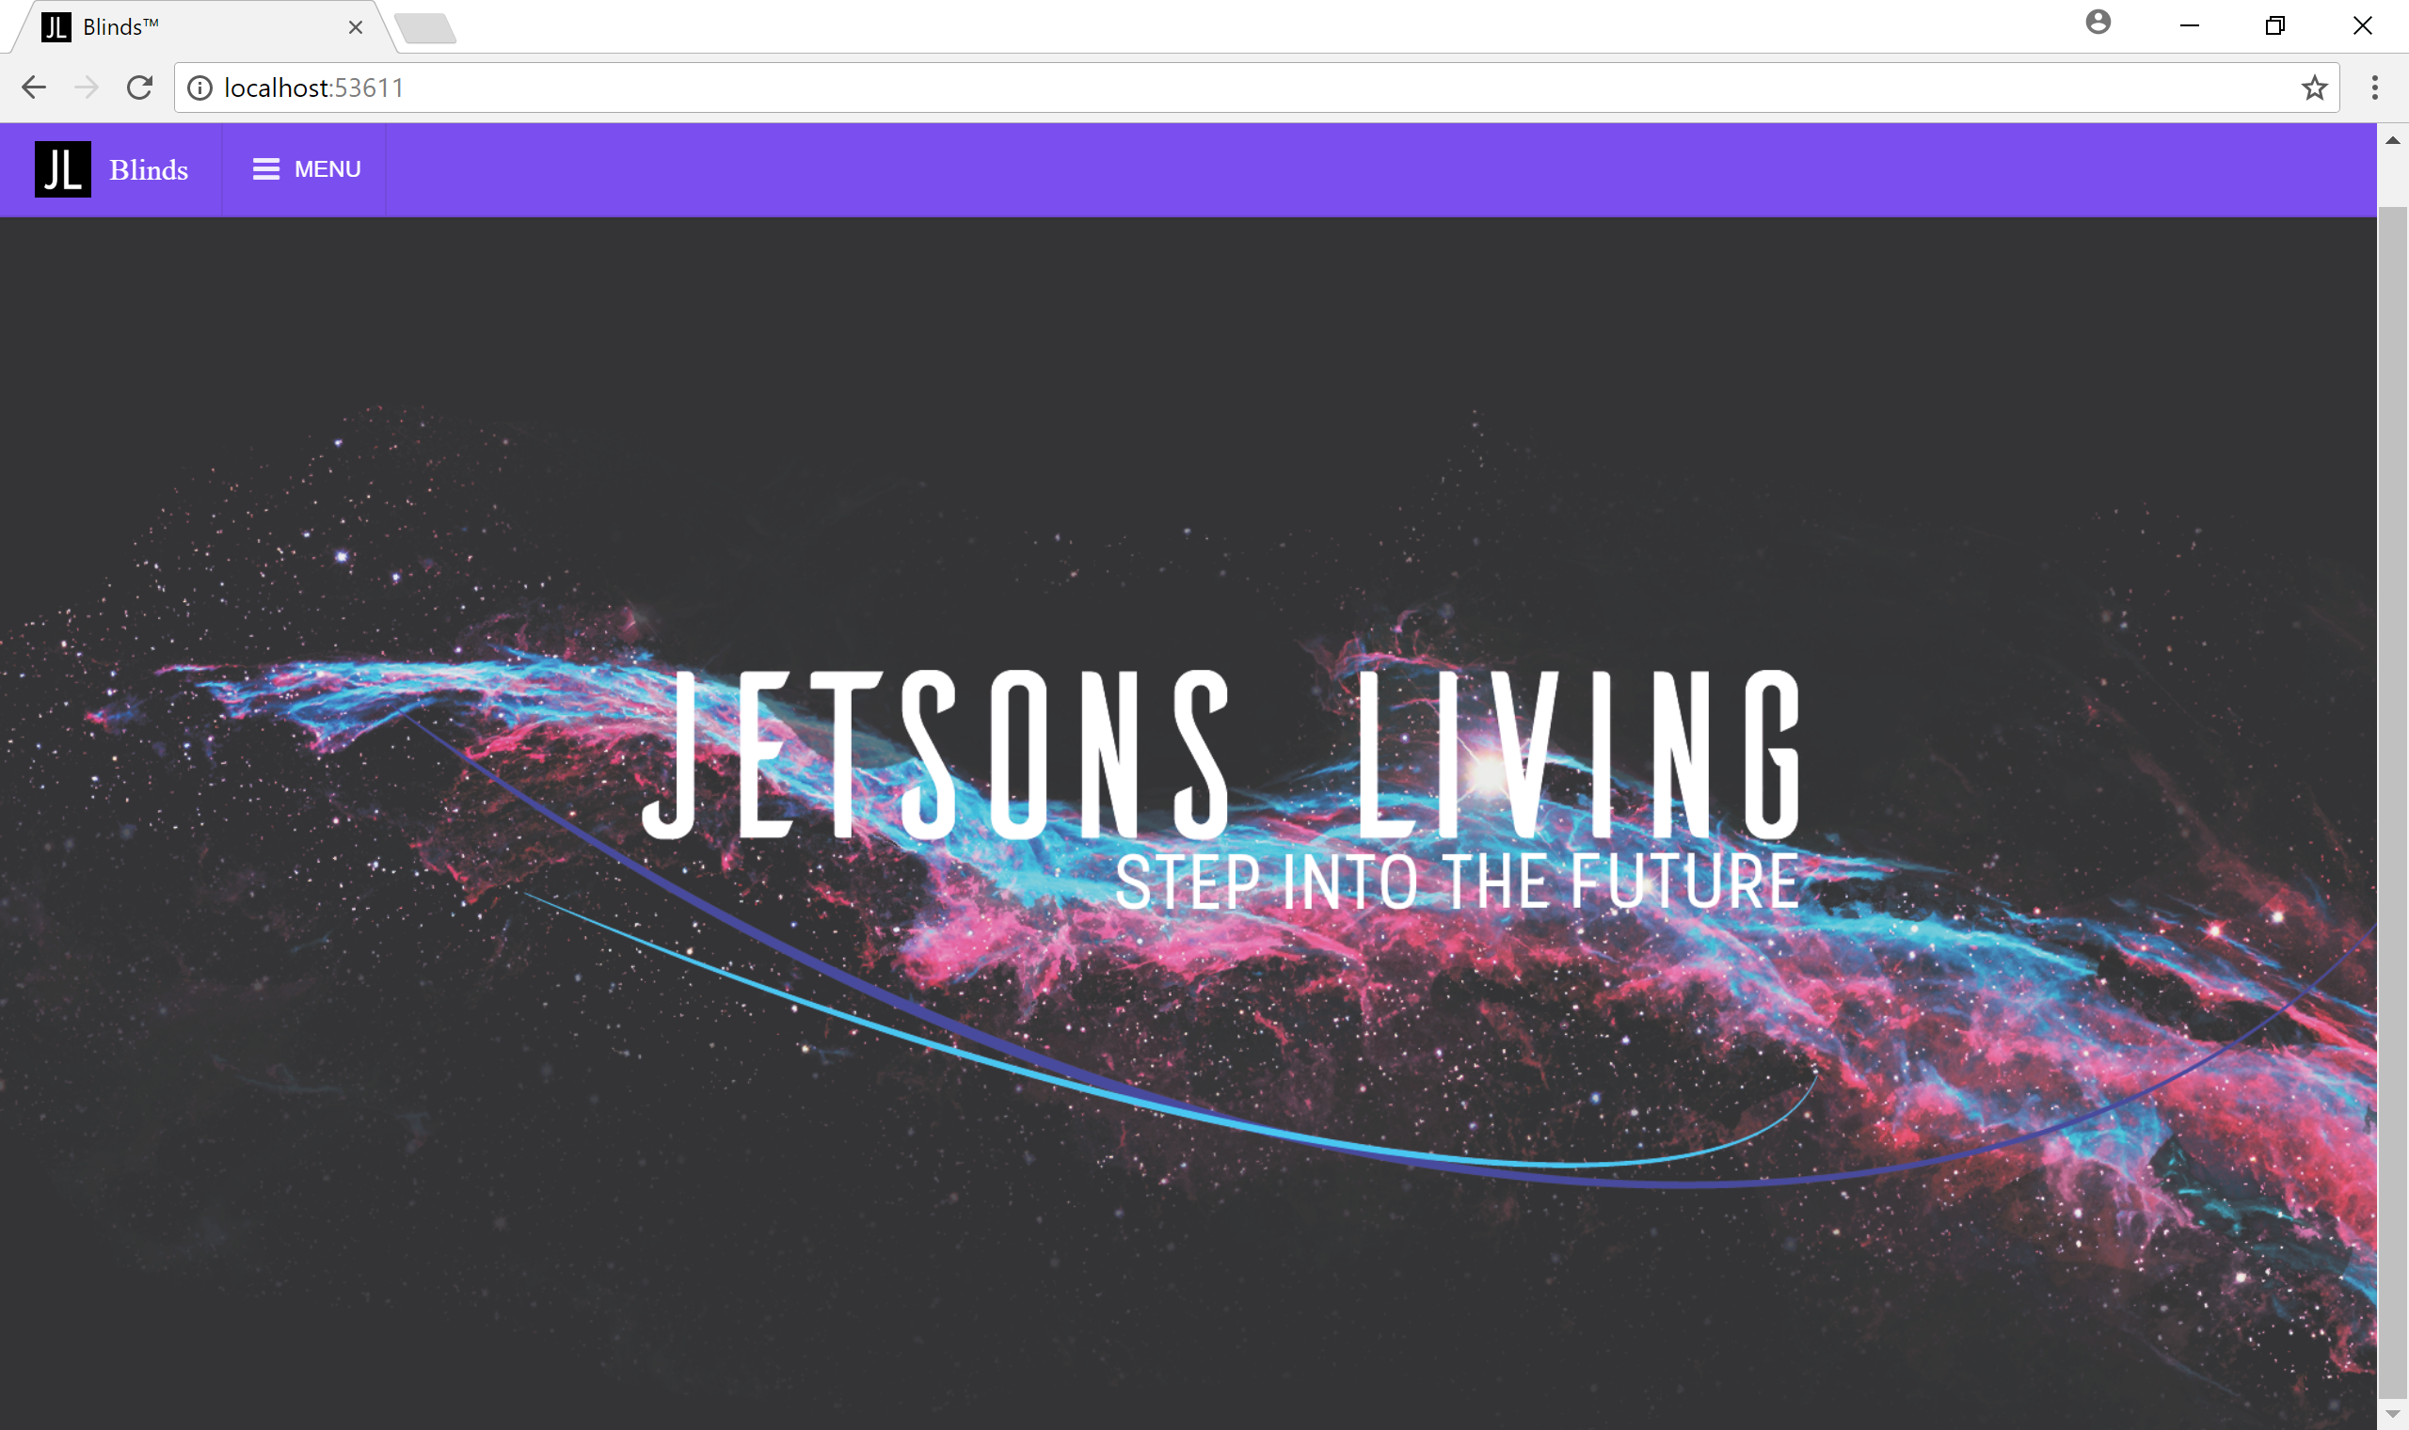
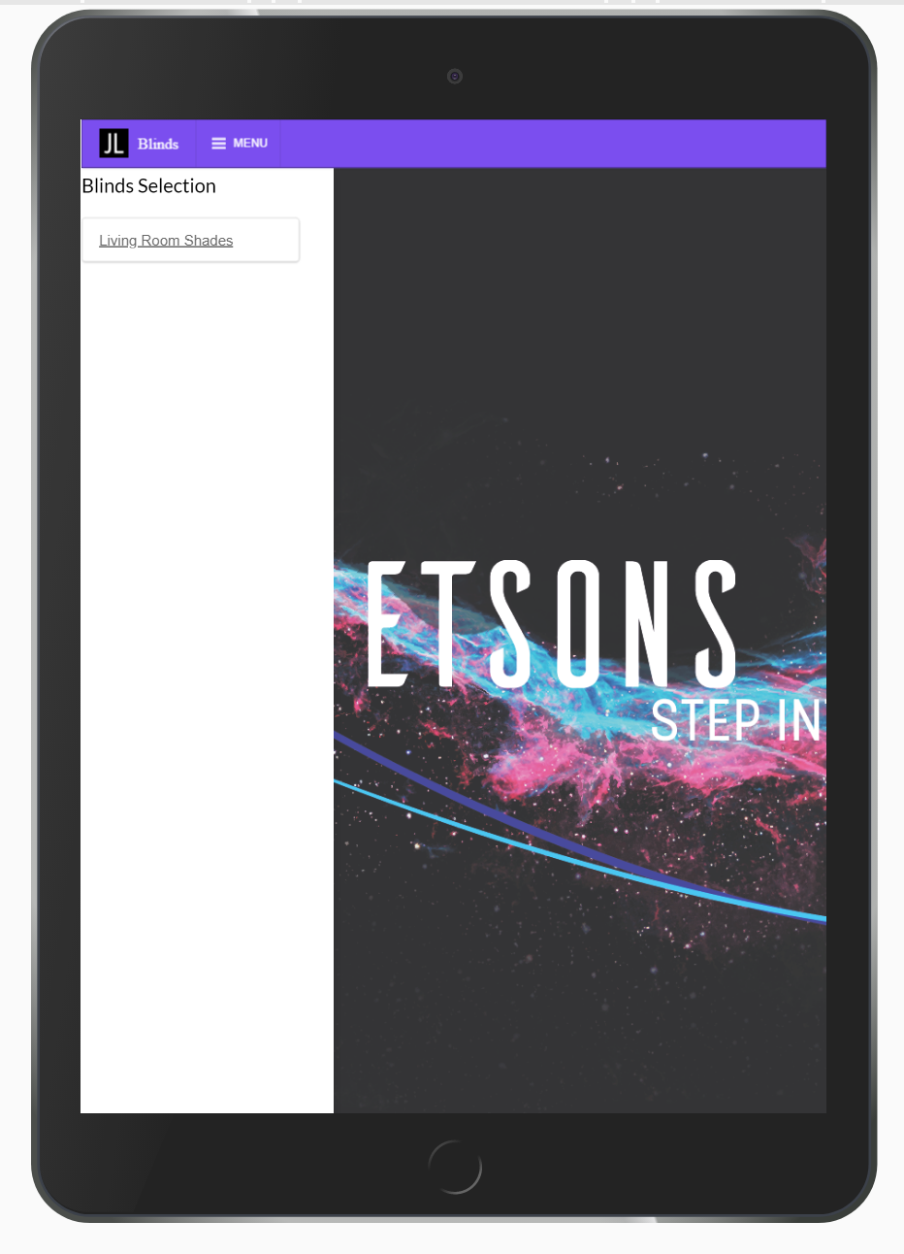
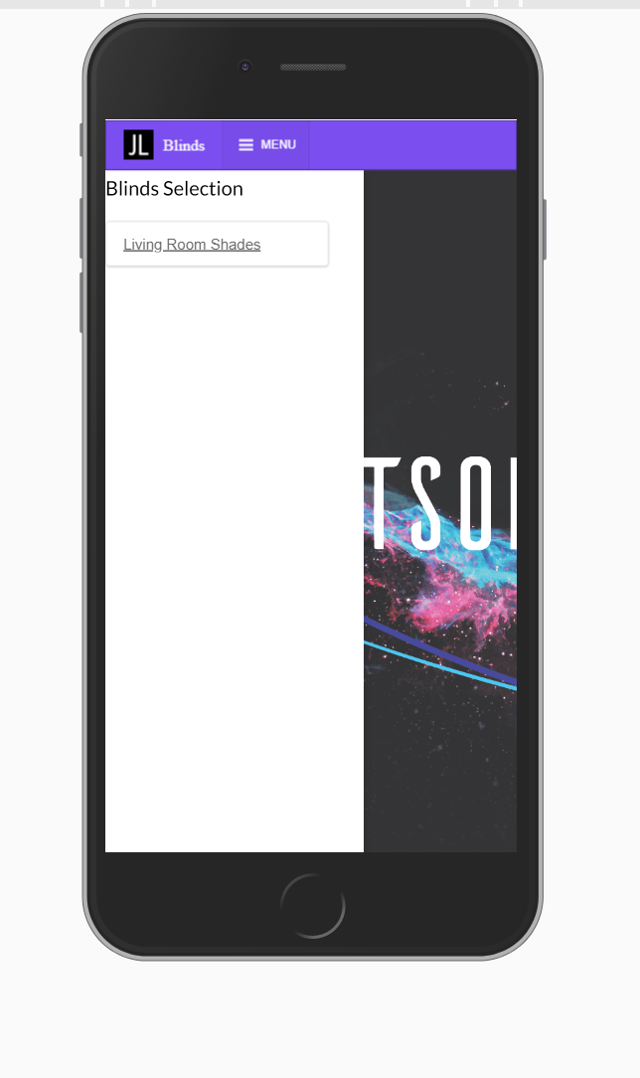
Web Application Progress

Slide 30
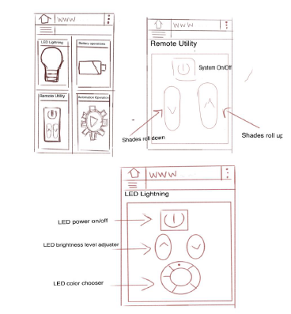
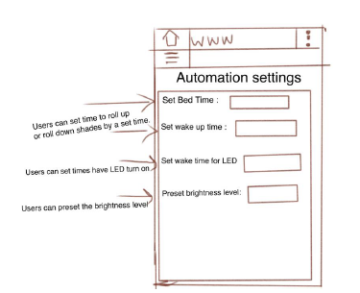
Web Application Mockups

Slide 31
Amazon Echo Integration
“Alexa, roll up blinds.”
Our product will also include integration with Amazon Echo.
Users are able to verbally communicate with our shades through Amazon Echo Virtual Assistant
Our hope is to create at least three commands that are coherent with our web application
“Alexa, change LEDs to red.”
“Alexa, lift blinds at 7:00am.”

Slide 32




Wireless Communications
Bluetooth:
Limited range
Multiple pairings
Not as fast
Zigbee/Z-Wave:
Not necessary to communicate to other smart home devices
Not as fast (about 0.25 Mbps)
Wi-Fi (IEEE 802.11 b/g/n):
Fast
Good range
Convenient to implement

Slide 33
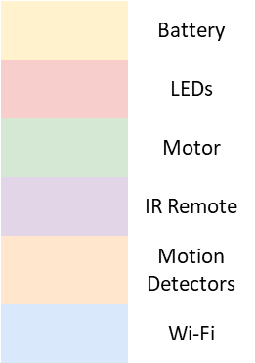
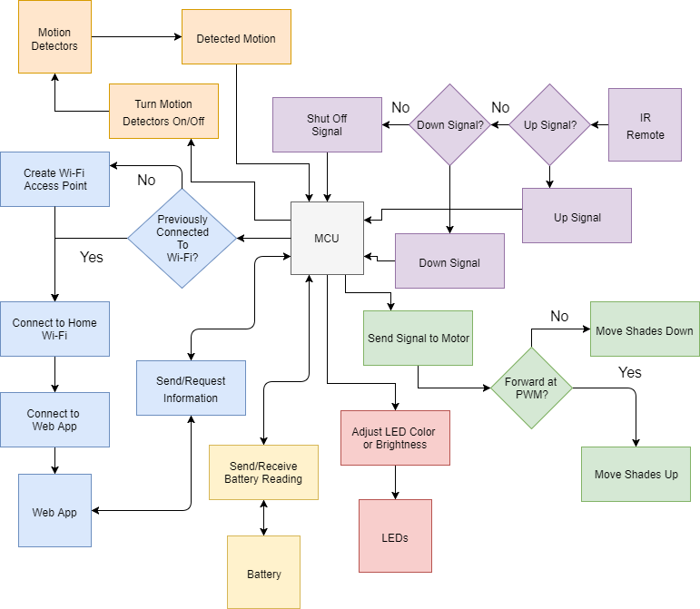
Flowchart

Slide 34
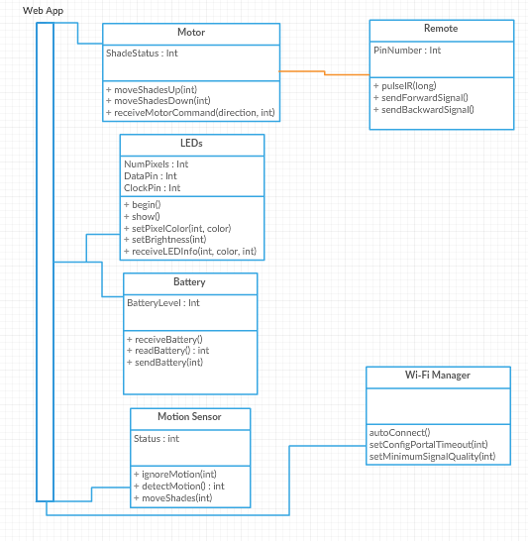
Function Diagram

Slide 35
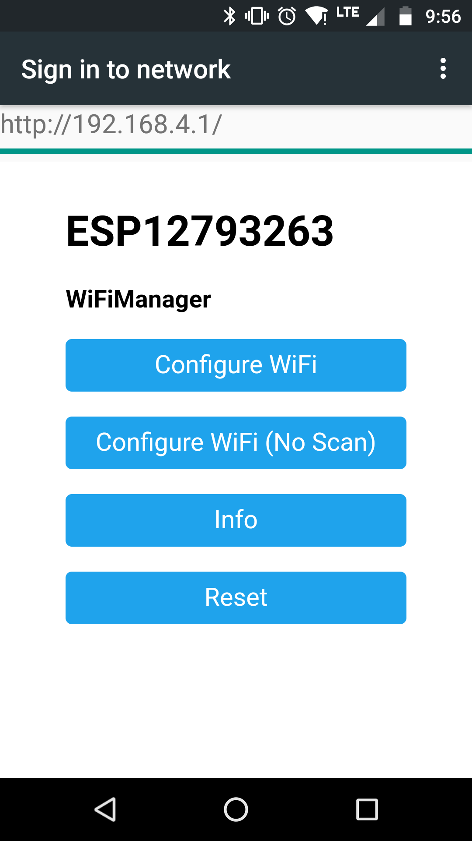
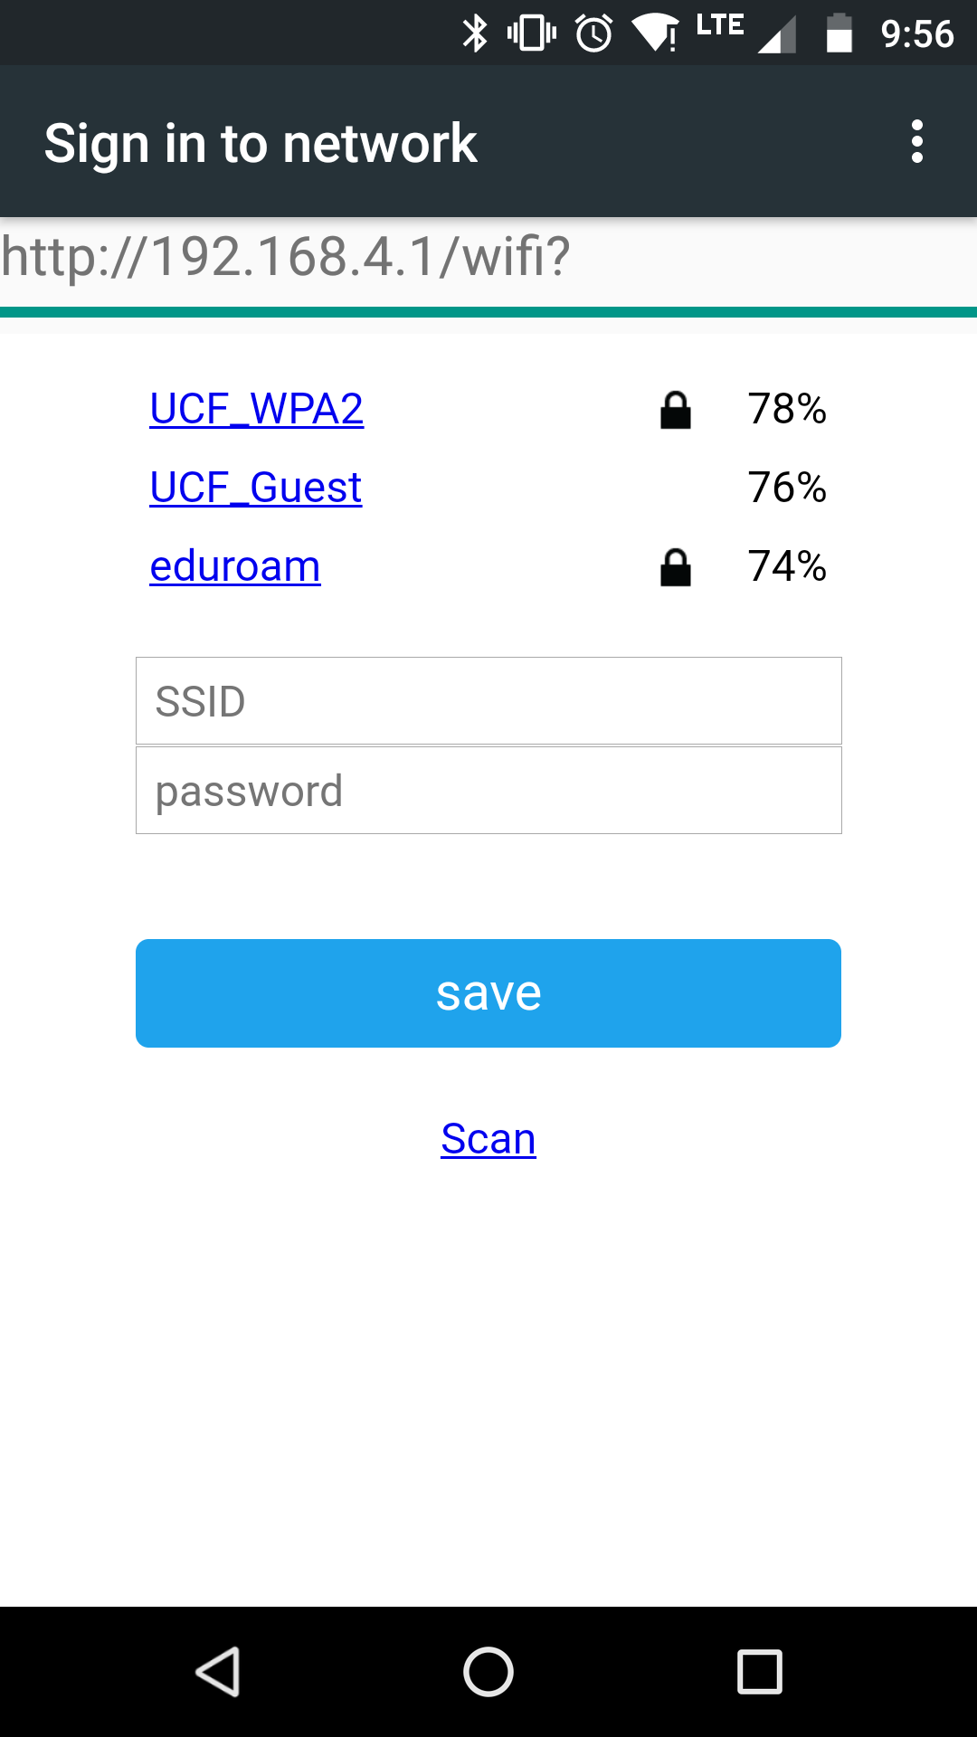
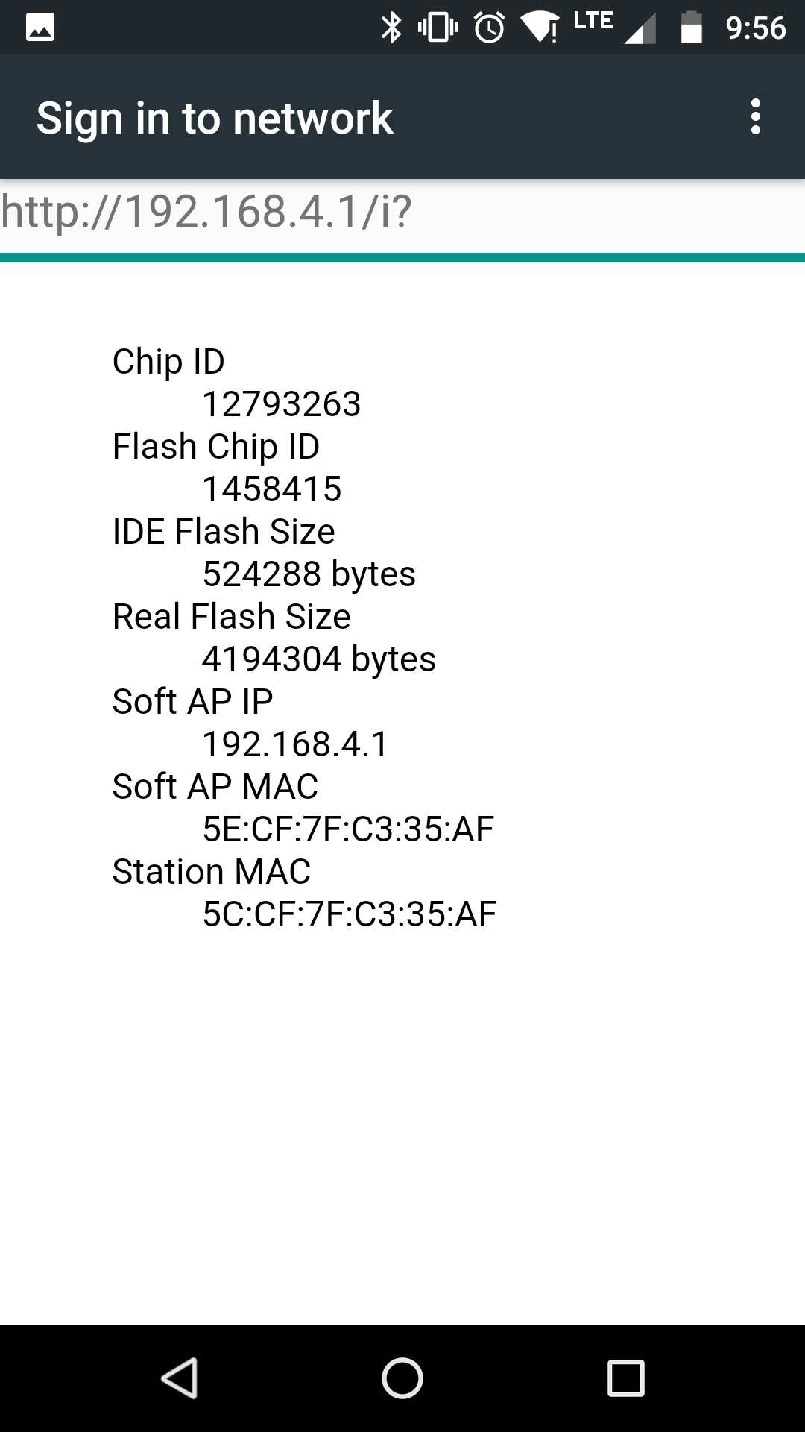
Wi-Fi API

Slide 36


IDEs
Arduino IDE benefits:
Default IDE
Support
Manage upload bit rate
Visual Studio + Visual Micro benefits:
Debug
Integrate with web app

Slide 37
Useful Libraries
Adafruit_DotStar
Controlling the LED
ESP8266WiFi
Wi-Fi Scanning
DNSServer
Helps implement a DNS server
ESP8266WebServer
Serves the configuration portal
WiFiManager
Use of the Captive Portal

Slide 38
Administrative Content

Slide 39
Work Distribution
 | Stephen Fryer (CpE) | Brian Mora (EE) | Priyank Patel (CpE) | John Rossi (EE)
Power |  | x
IR Remote |  | x
Control |  |  |  | x
Housing |  |  |  | x
Web Application |  |  | x
Amazon Echo |  |  | x
Microcontroller Programming | x

Slide 40
Financing
Item | Total Cost
Reimbursable Budget | $500
Total R&D Costs to Date | $88
Total Parts Cost to Date | $188.20
Remaining in Budget | $223.80

Slide 41
Budget
Item | Supplier | Price | # Units | Total Cost | Item | Supplier | Price | # Units | Total Cost
Power System |  |  |  |  | Control Board
AC-DC Converter | Jameco | $13.70 | 1 | $13.70 | ESP-12s MCU | Adafruit | $6.95 | 1 | $6.95
3.7V Li-Ion Battery Pack | All-Battery | $43.99 | 1 | $43.99 | DRV8838 Motor Driver IC | Digikey | $1.35 | 1 | $1.35
PV Panels | Amazon | $7.99 | 5 | $39.95 | LED Strip | Adafruit | $29.95 | 1 | $29.95
LM1085 5V Regulator | Digikey | $2.16 | 1 | $2.16 | IR Reciever | Adafruit | $1.95 | 1 | $1.95
LM1085 3.3V Regulator | Digikey | $2.16 | 1 | $2.16 | Low Noise 12VDC Motor | Digikey | $47.90 | 1 | $47.90
MCP73871 Solar Charger IC | Digikey | $1.90 | 1 | $1.90 | Other External Components | Digikey | $6.12 |  | $6.12
Other External Components | Digikey | $17.71 |  | $17.71 | IR Remote
PIR Board |  |  |  |  | Trinket MCU | Digikey | $6.95 | 1 | $6.95
NCS36000 PIR Driver IC | Mouser | $0.86 | 1 | $0.86 | IR LED | Digikey | $0.44 | 1 | $0.44
PIR Sensor RE200B-P | Mouser | $1.25 | 1 | $1.25 | Batteries/Holders (CR2032) | Sparkfun | $1.24 | 2 | $2.48
Fresnel Lens | Fresnel Factory | $1.55 | 1 | $1.55 | Other External Components | Digikey | $1.30 |  | $1.30
Other External Components | Digikey | $11.26 |  | $11.26 | All 4 PCB's | PCBWay | $55.00 |  | $55.00
 |  |  |  |  | Total |  |  |  | $296.88

Slide 42
Progress

Slide 43
Issues
Uncertain if motor will be able to move the shades assembly at a desirable speed at 3.3V

Slide 44
Questions?

