Slide 1

Smart Home Blackout Shades
Group 2
Stephen Fryer – CpE
Brian Mora – EE
Priyank Patel – CpE
John Rossi – EE
Sponsored by: Jetsons Living

Slide 2
Motivation
Smart home appliances are becoming very popular
Voice Assistant Speakers (e.g. Amazon Echo) are becoming very popular
Window shades operation lends itself well to automation
Sponsor wants a cheaper and more feature packed alternative to current available products

Slide 3
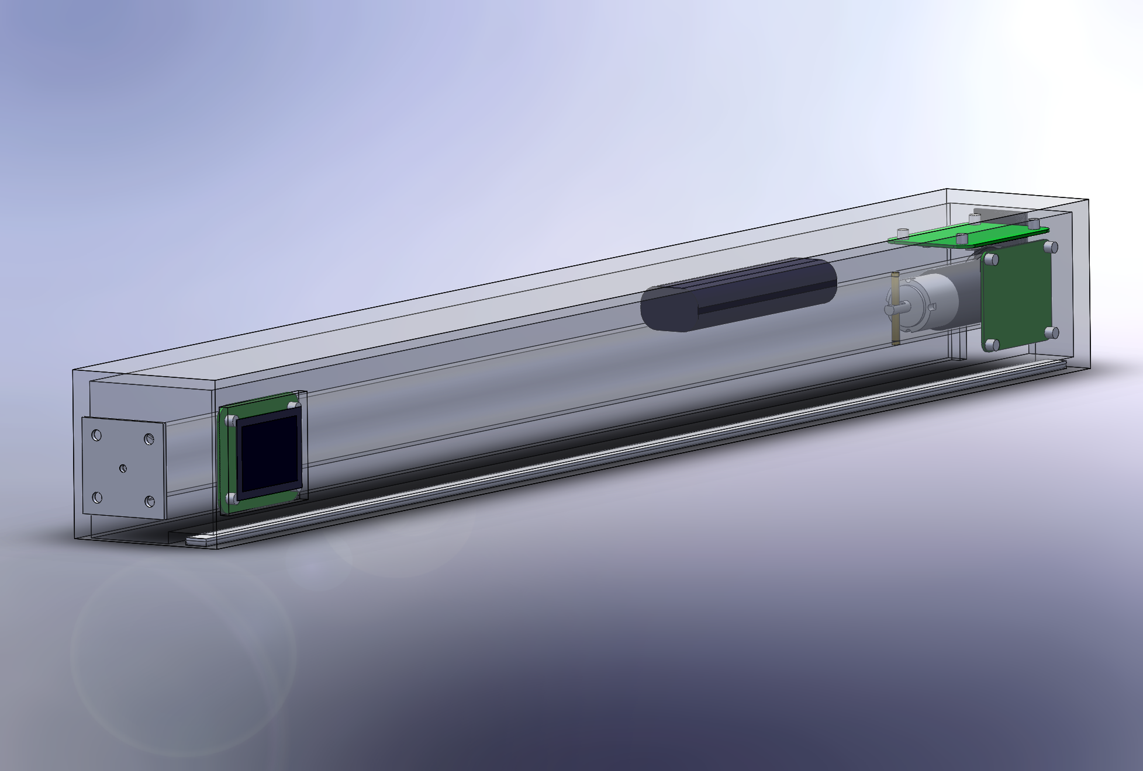
Goals and Objectives
Capable of operating completely wirelessly
Several modes of interaction
Remote control, web app, motion sensor
Solar powered
Capable of interfacing with Amazon Echo

Slide 4
Specifications
Parameter | Specification
Response Time | 1 S
Solar Panel Peak Output Power | 6 W
Motion Detection Range | > 3 m
Average Power Consumption | < 10 W
IR Receiver distance | > 15 m
Amazon Echo Skills | 3 skills
Shade Speed | At least 2 in/sec

Slide 5
Hardware Design

Slide 6
Block Diagram
PV Panels
120 Volt AC
MCU and WiFi
IR Remote
Motor
Battery Charger
AC-DC
Converter
Battery
LED strip
Motion Detector
5 Volt
Regulator
3.3 Volt
Regulator
Source Select
Power
I/O
Control Line
Power Line

Slide 7
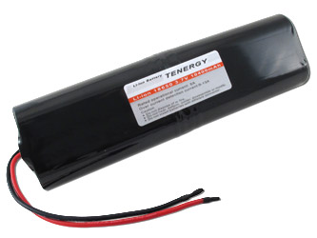
Battery
3.7V Li-Ion
Large capacity is most important factor
Simple to charge
Built-in charge protection
Vendor | All-Battery
Part Number | 31908-1
Capacity | 10,400 mAh
Dimensions | 133.5 x 38 x19 mm

Slide 8
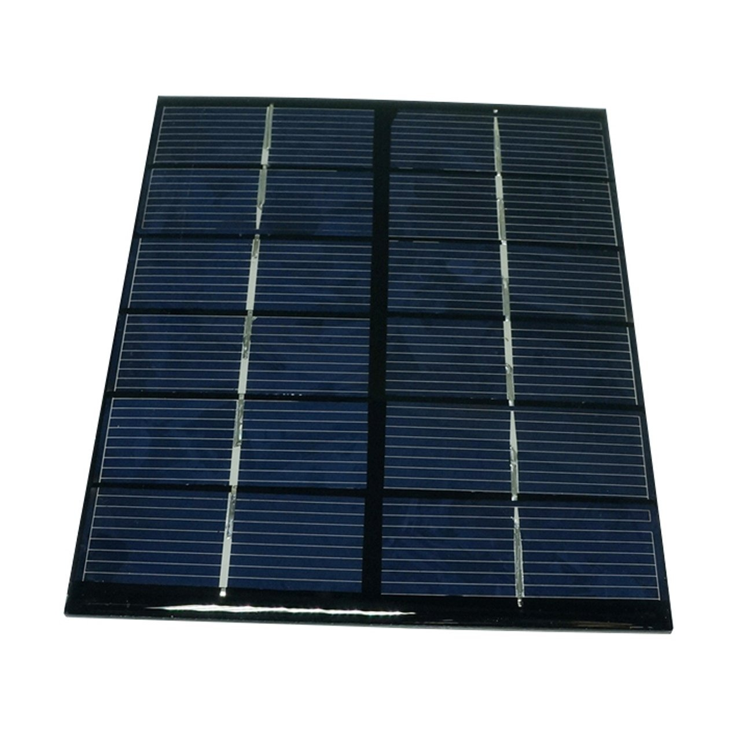
PV Panel
Available 10W panel footprints were too obtrusive
Opted for 5 2W panels in parallel to achieve more desirable footprint
Vendor | SunnyTech | Adafruit Colossal
Part Number | B00HQXQOIQ | 2747
Max power | 10 W | 9 W
Max voltage | 6 V | 6 V
Max current | 1.62 A | 1.5 A
Price | $40.00 | $78.95

Slide 9
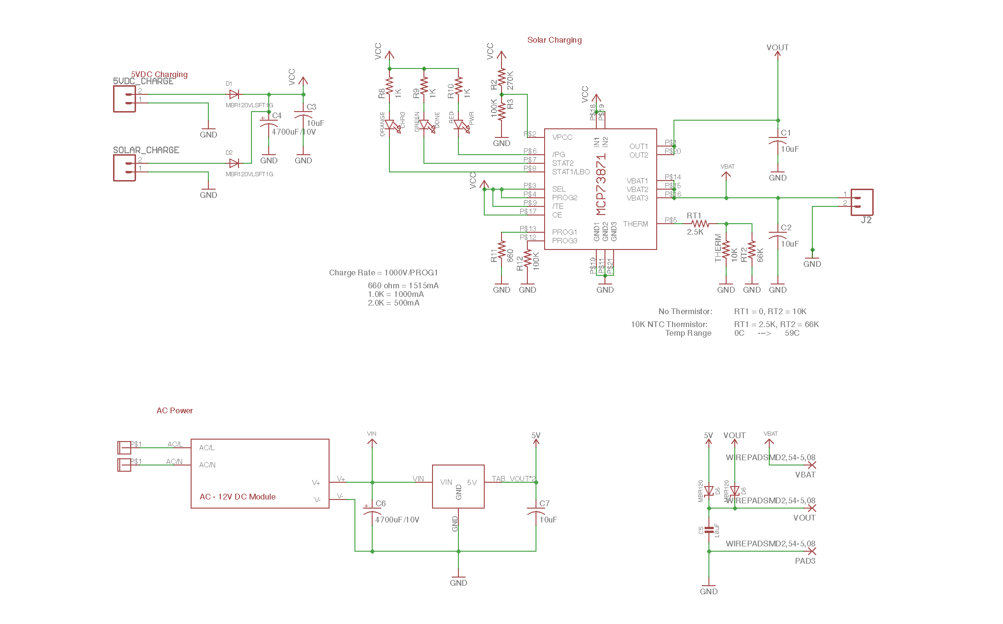
Power Board Schematic

Slide 10
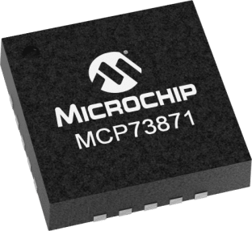
MCP73871
Battery charge management controller
Small footprint
Few external components are required for use
Over-temperature protection
Why not MPPT?
Application is low current and low voltage, which results in comparable efficiency
Comparable MPPT is twice as expensive
Vendor | Digikey
Part number | MCP73871-2AAI/ML-ND
Charge current max | 1.1A
Battery pack voltage | 4.2V

Slide 11
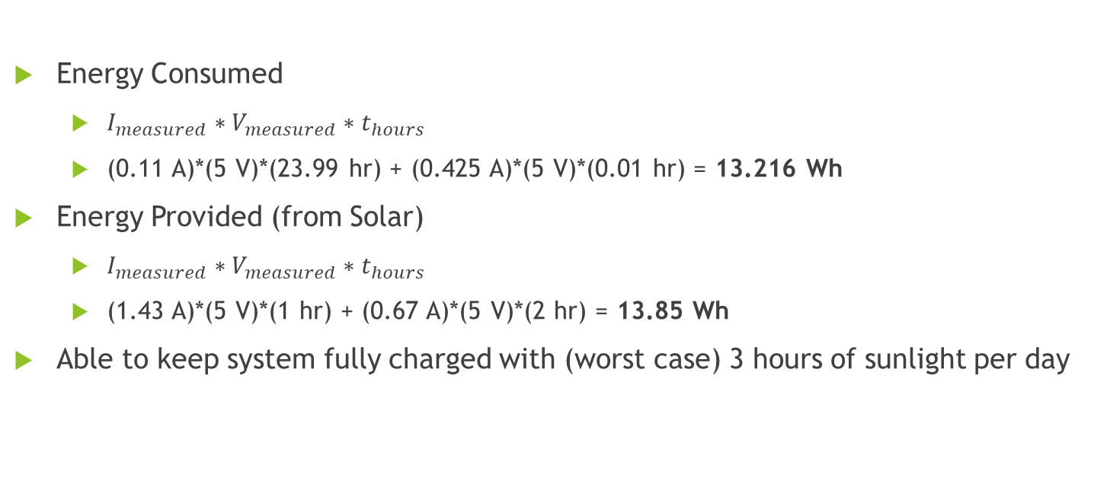
Energy Usage
Operation | Average Current at 5V (mA)
Standby | 110
Motor running | 425
LEDs on | 340 – 700
Energy Consumed
$I_{measured}∗V_{measured}∗t_{hours}$
(0.11 A)*(5 V)*(23.99 hr) + (0.425 A)*(5 V)*(0.01 hr) = 13.216 Wh
Energy Provided (from Solar)
$I_{measured}∗V_{measured}∗t_{hours}$
(1.43 A)*(5 V)*(1 hr) + (0.67 A)*(5 V)*(2 hr) = 13.85 Wh
Able to keep system fully charged with (worst case) 3 hours of sunlight per day

Slide 12
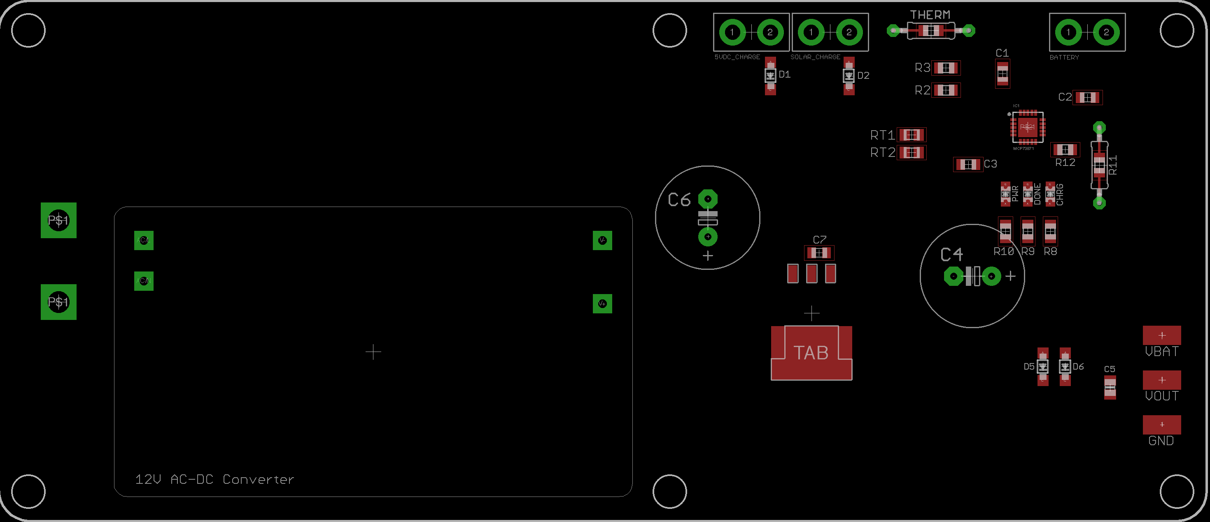
Power Board

Slide 13
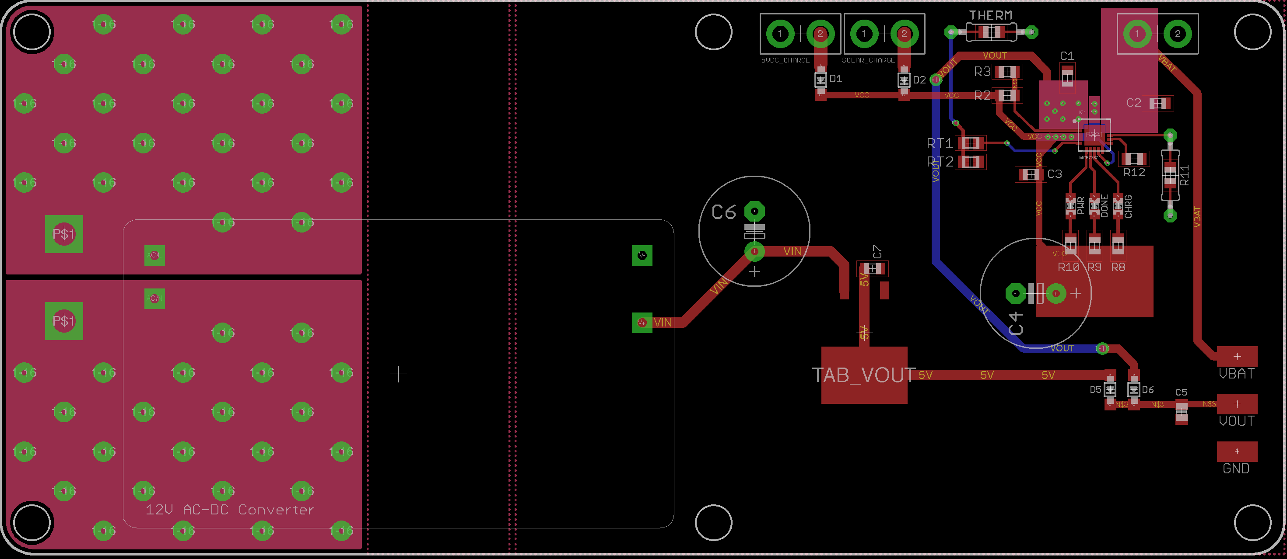
Power Board

Slide 14
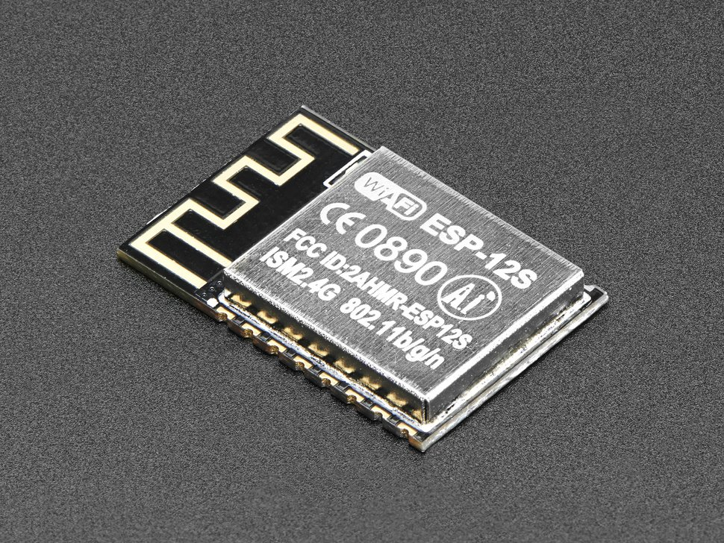
ESP-12S
System on Chip solution for WiFi and Microcontroller
Large Memory (4 MB)
Compatibility with Arduino
Inexpensive
Small
Part | ESP-12S | ATSAMW-25
Price | $6.95 | $18.92
Memory | 4 MB | 256 KB
I/O | 10 | 31

Slide 15
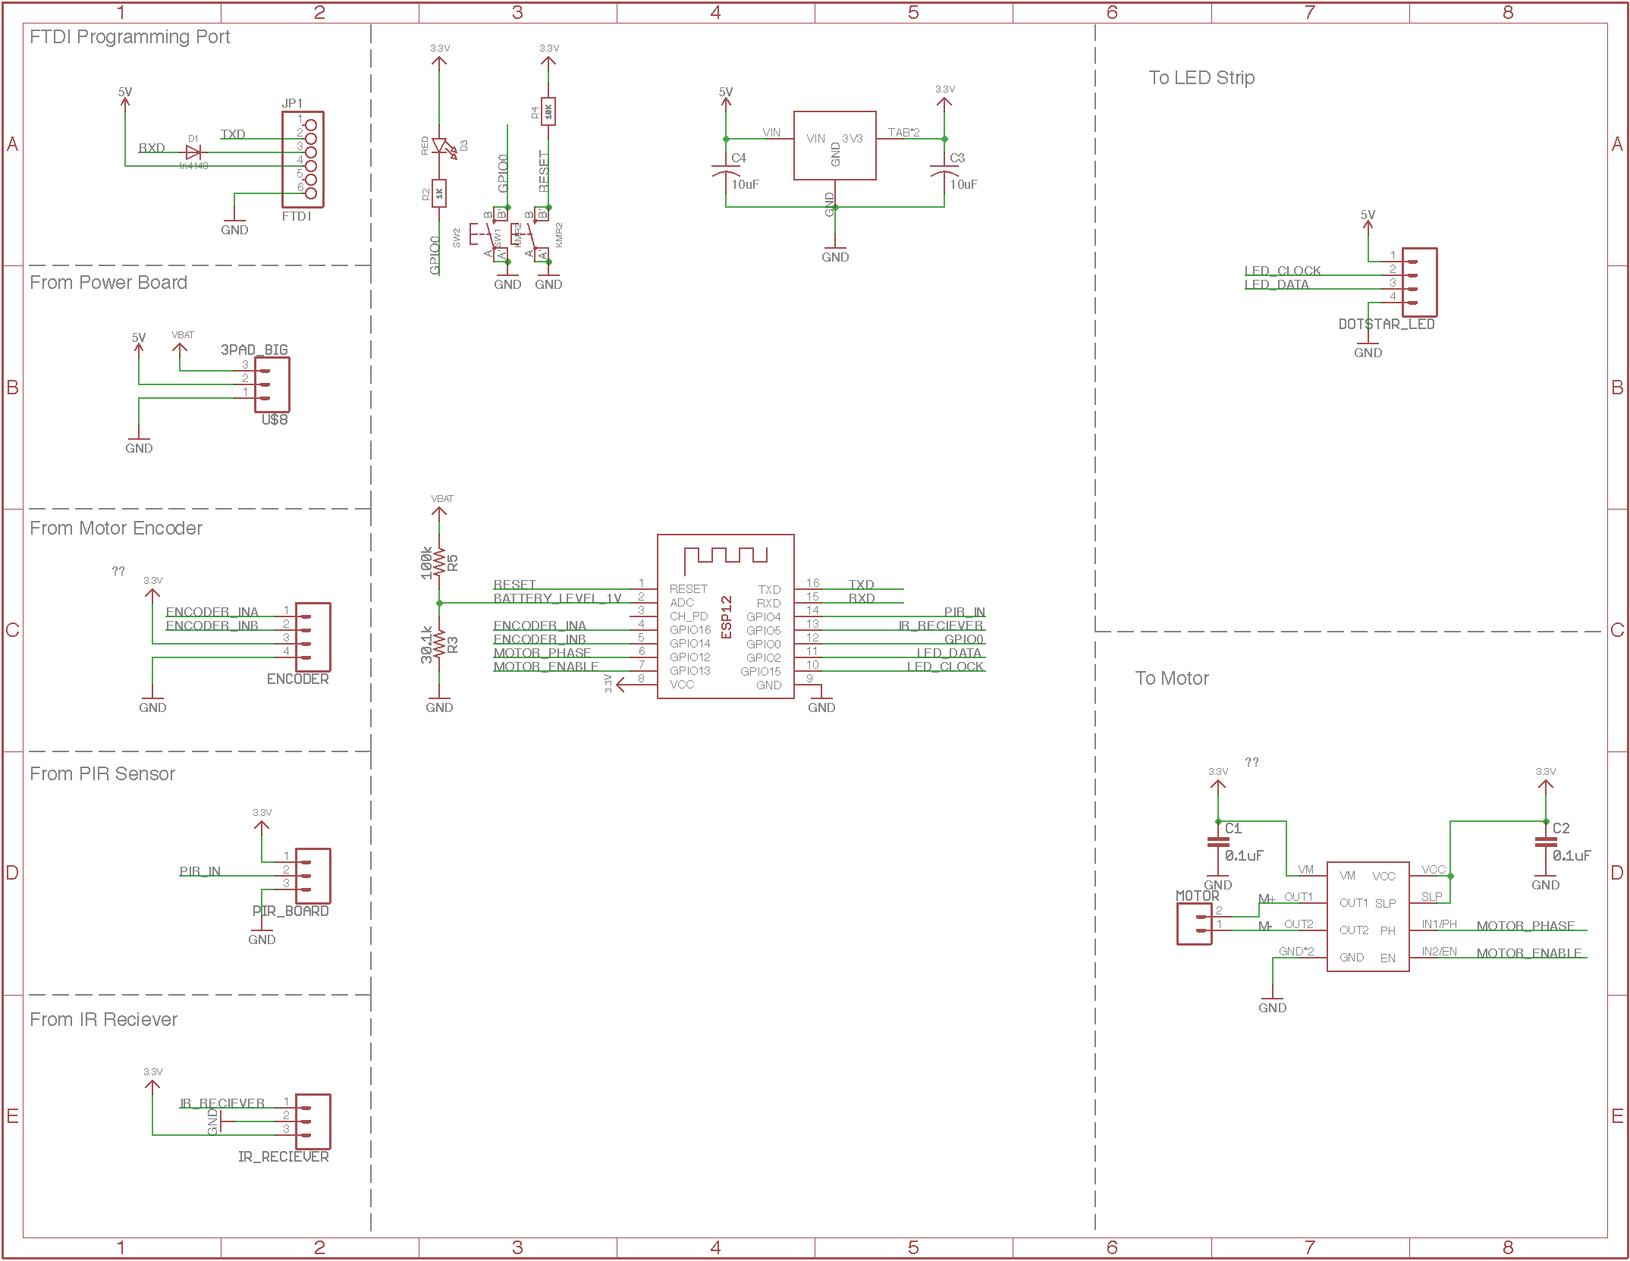
Control Board Schematic

Slide 16
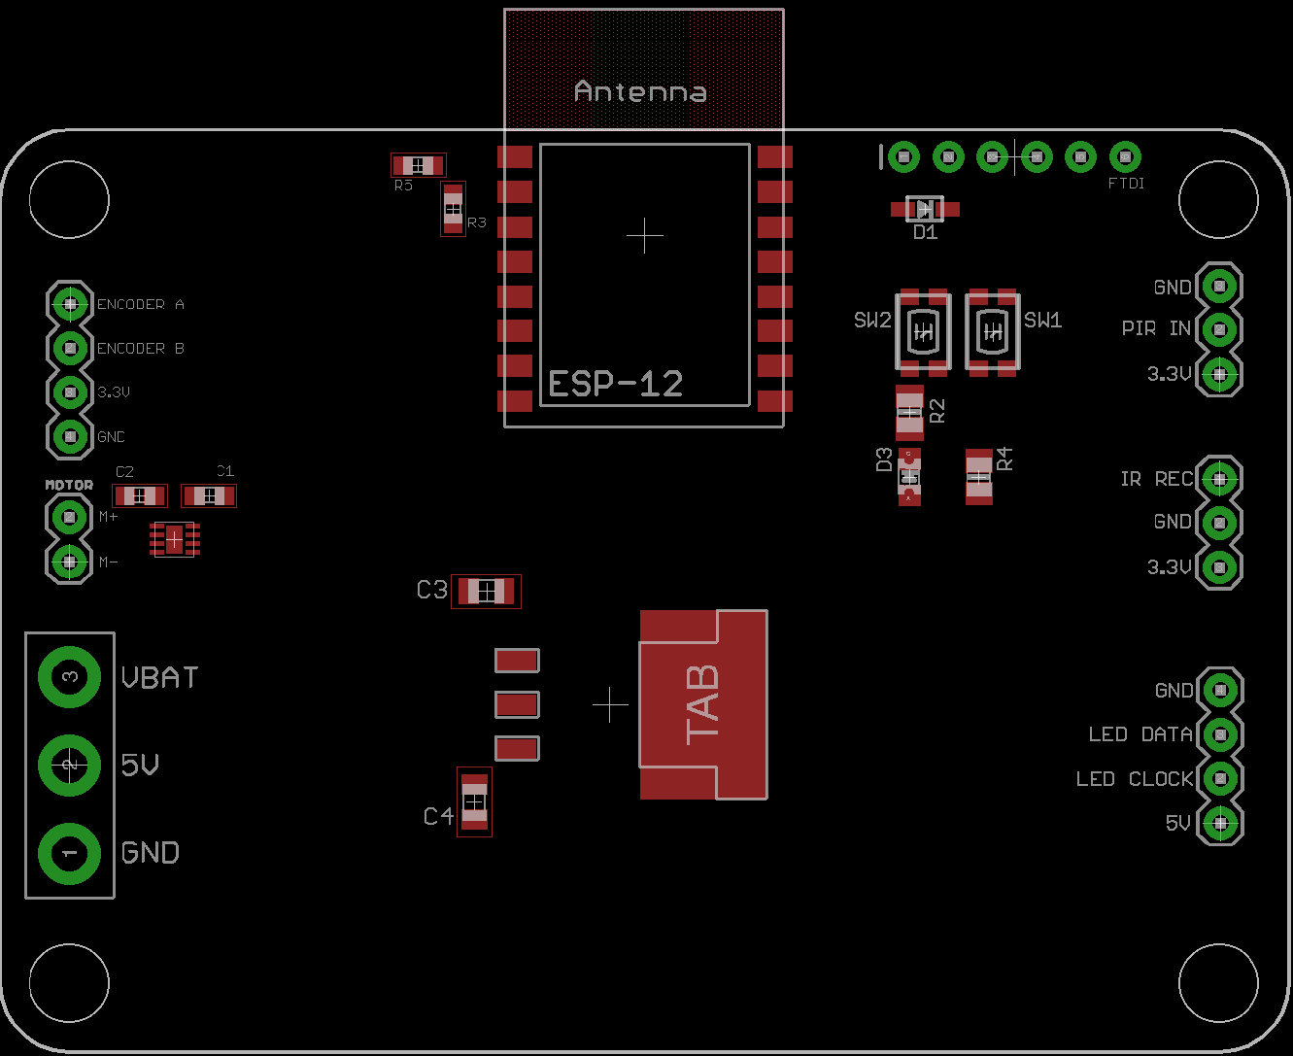
Control Board

Slide 17
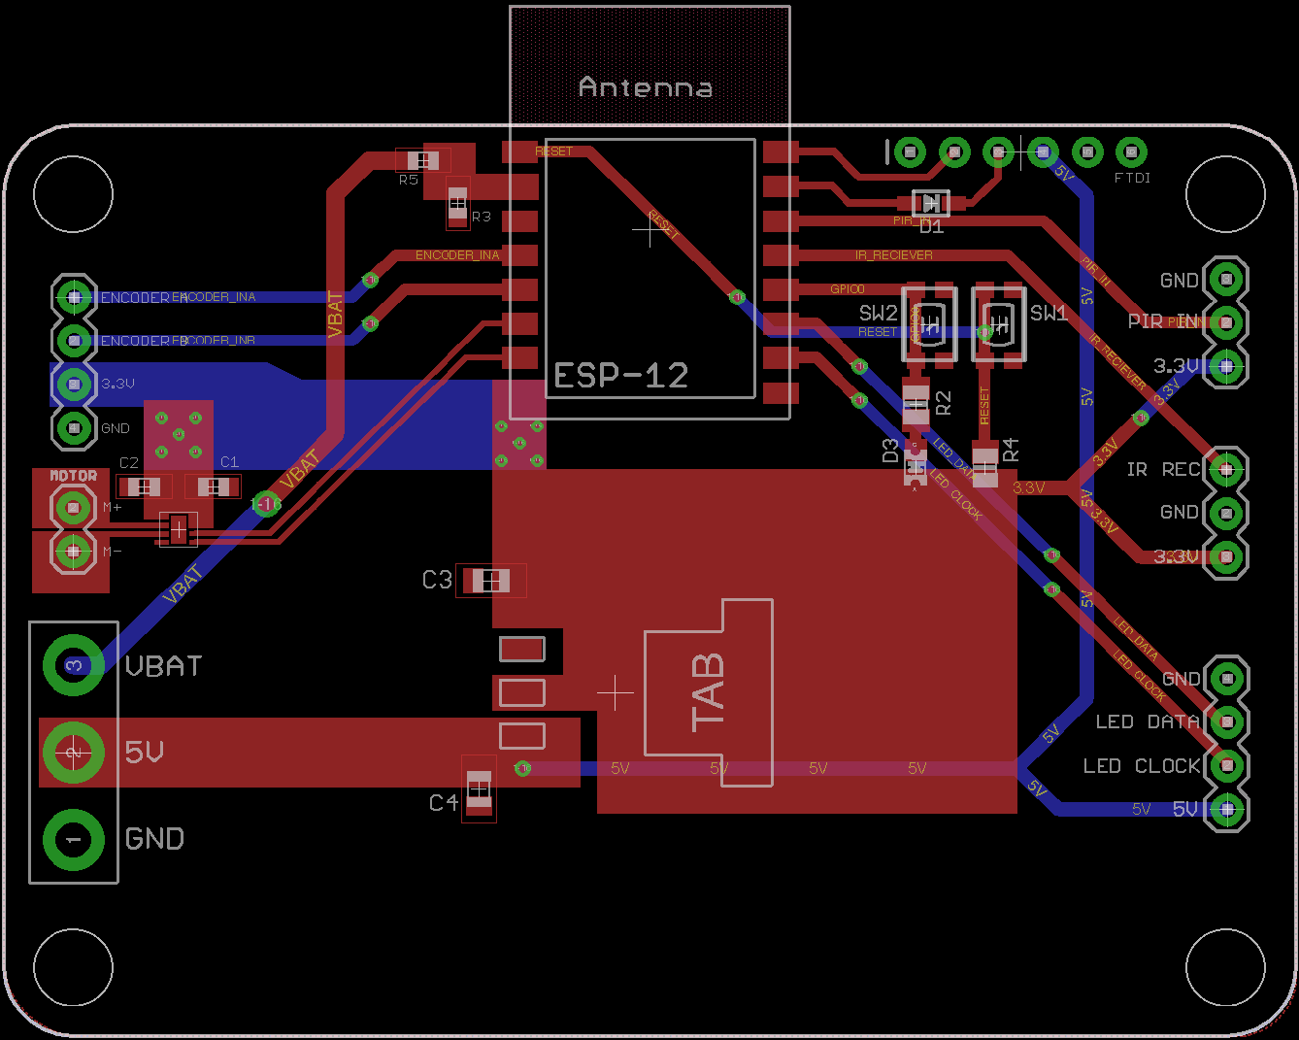
Control Board

Slide 18
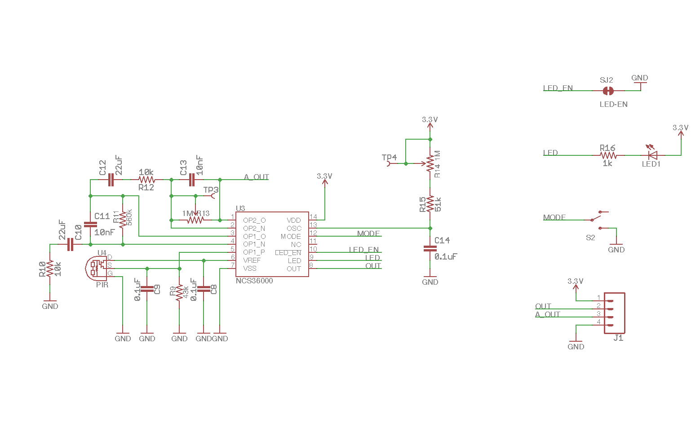
PIR Board Schematic

Slide 19
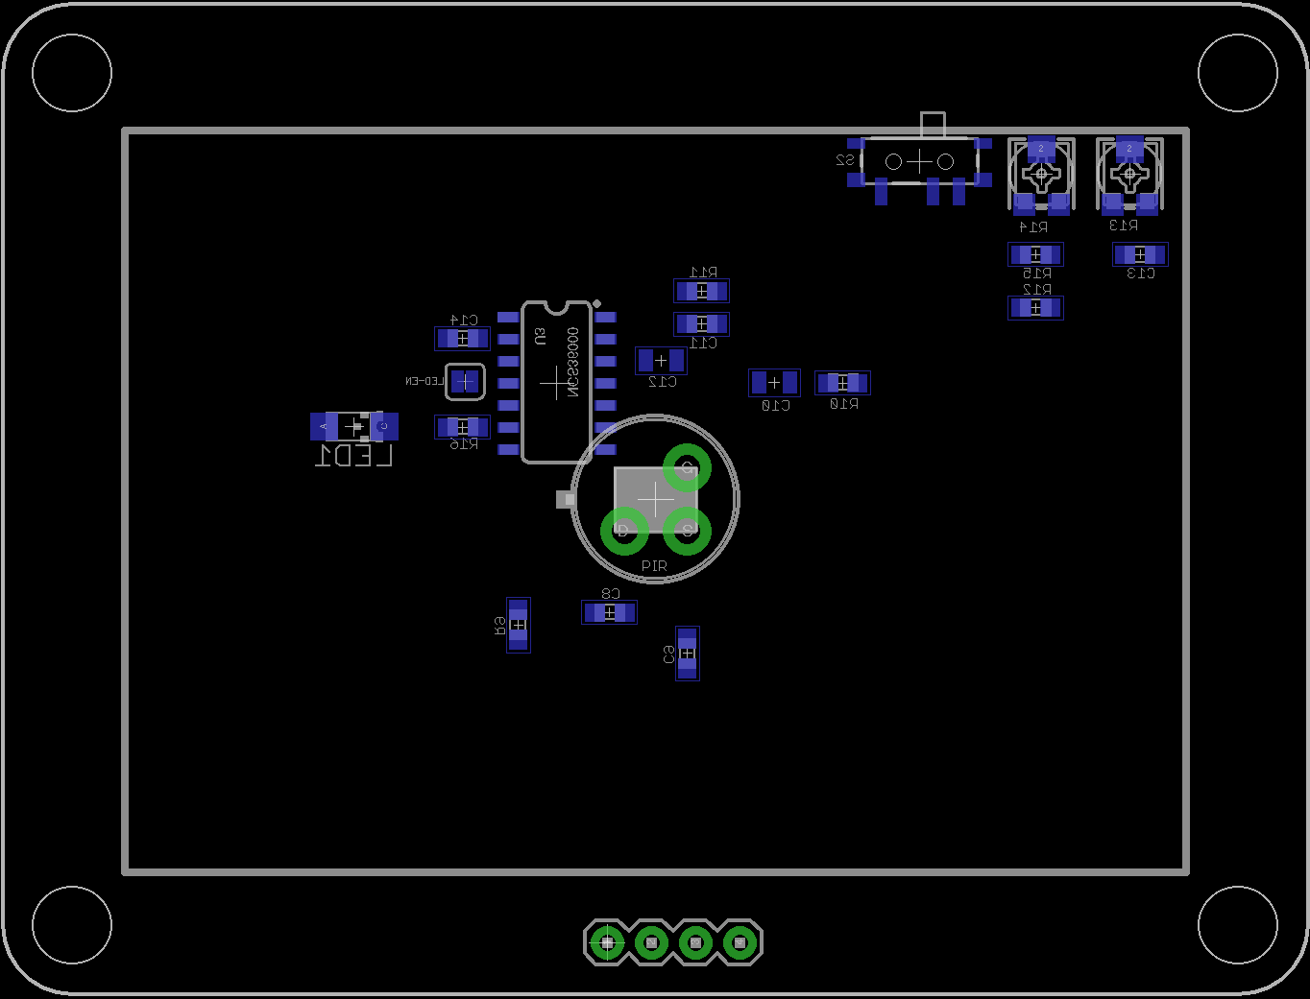
PIR Board

Slide 20
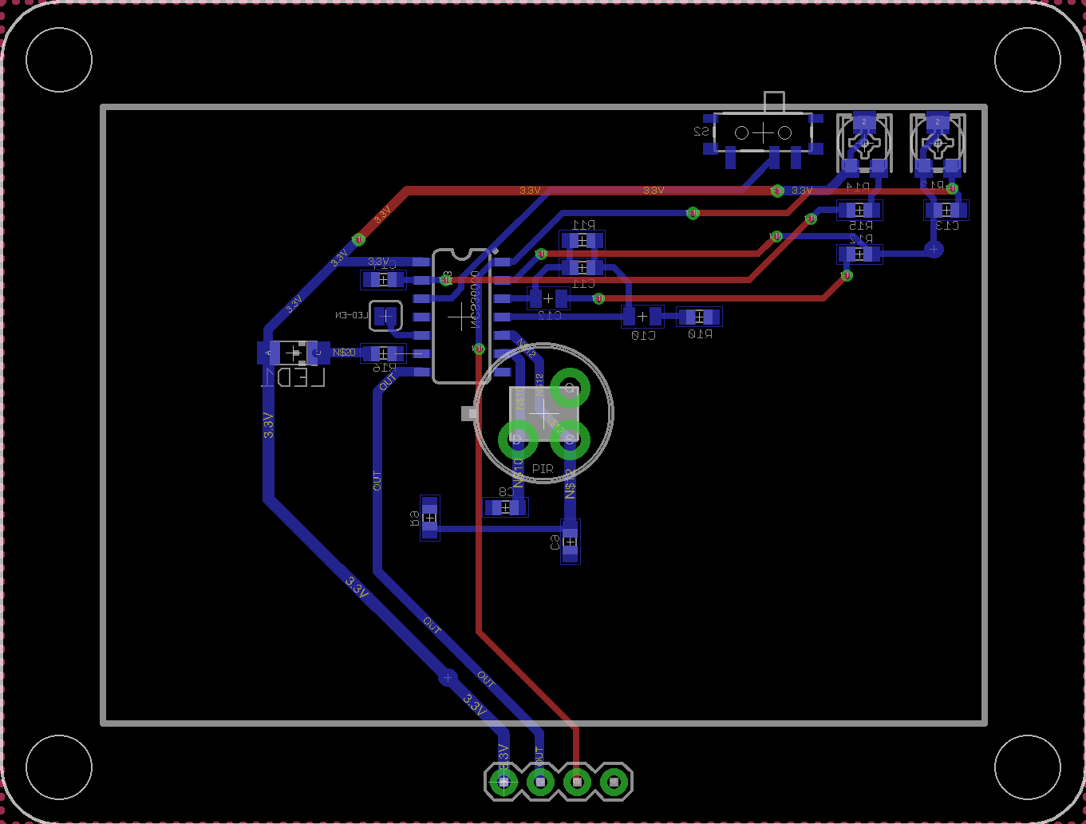
PIR Board

Slide 21
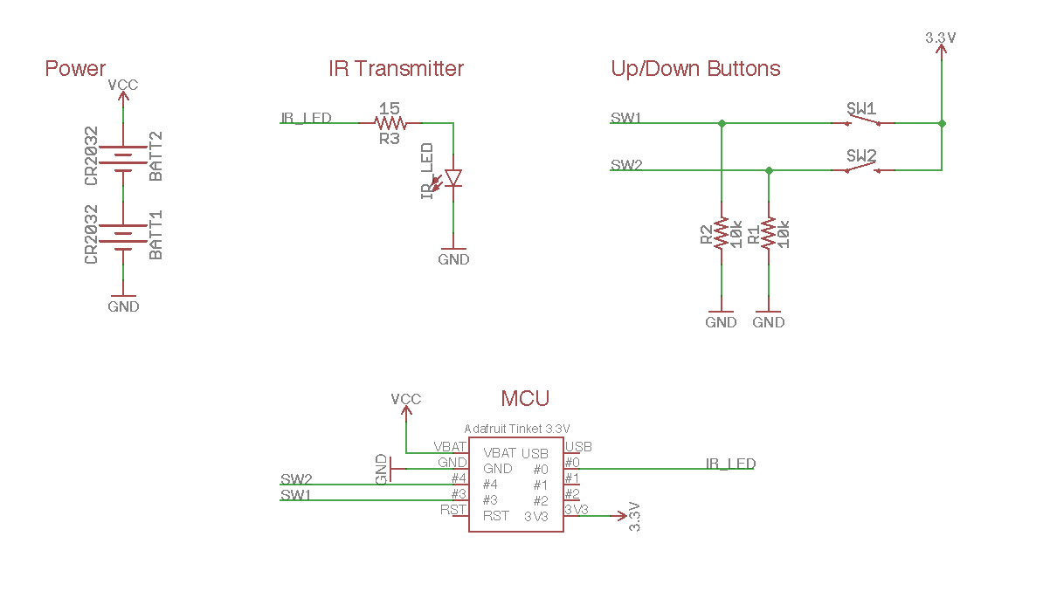
IR Remote Control Schematic

Slide 22
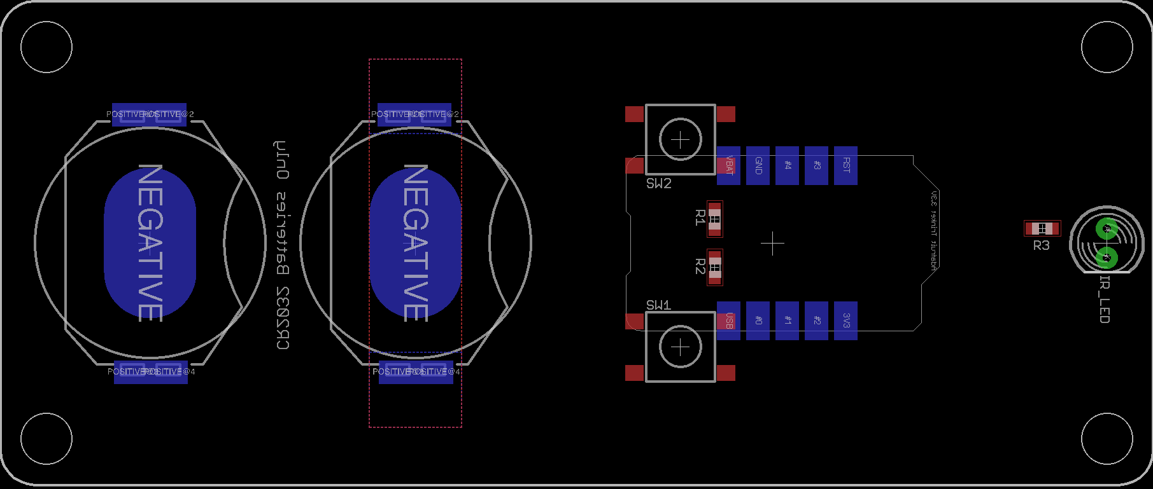
IR Remote Control

Slide 23
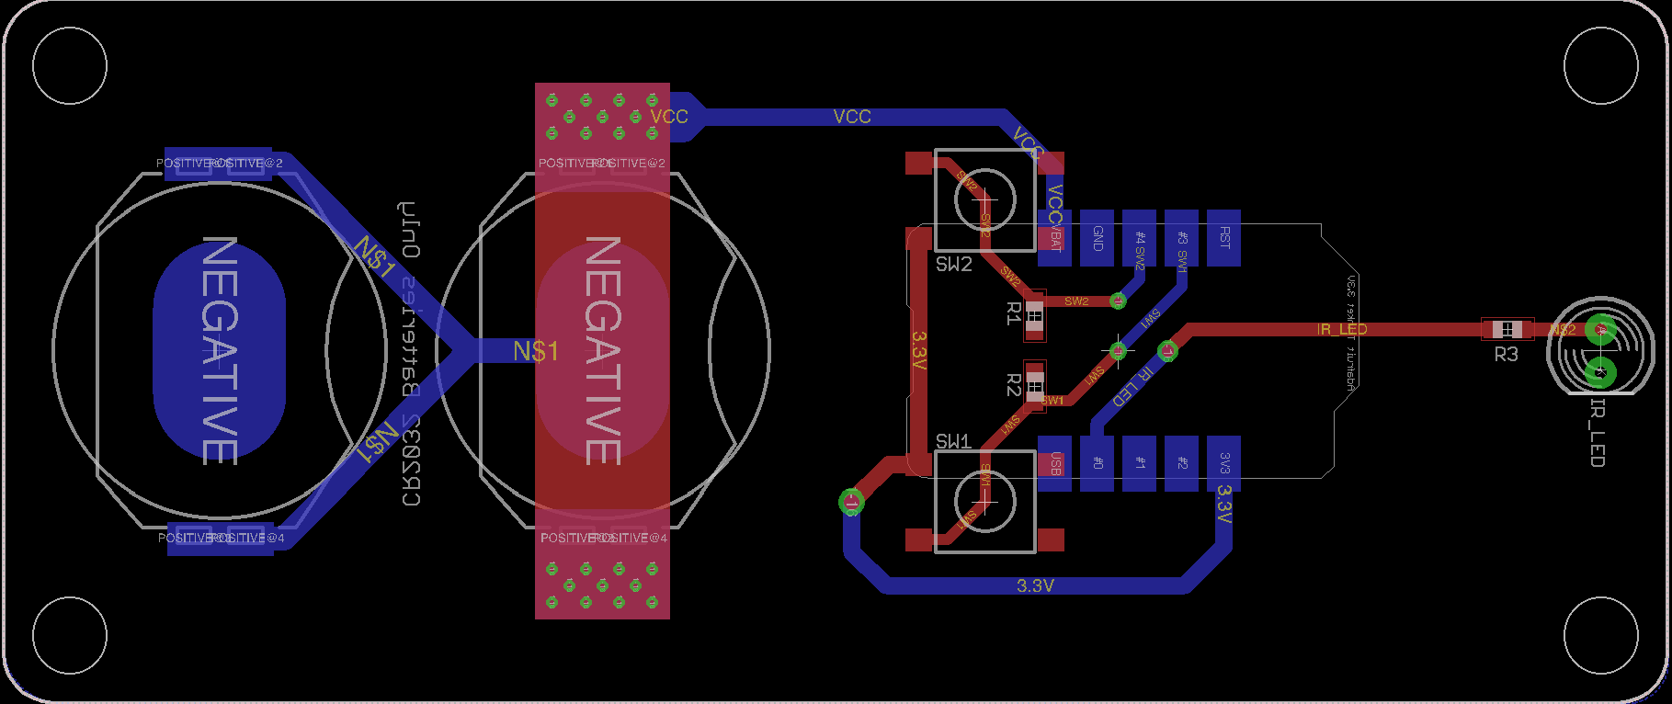
IR Remote Control

Slide 24
Software Design

Slide 25



Web Application vs. Native Application
Native Apps | Web Application
Native Apps are built for particular platforms so that apps can take advantage of its operating system and device–specific hardware | Web Applications use web browsers and web technology
Native Apps offer great look and also provide higher speed over web applications | Web Applications and responsive websites both satisfy the definition of mobile-friendly
Cost of maintenance of apps is higher. Developers usually have to create multiple apps on different platforms for every user | Hard to accommodate every user when many times users are using different web browsers
Both approaches requires both time and money for good products

Slide 26
Top-level Software Design
1) Web Application Functionality
Server Programming
Server will accept request from (1 and 2)
Server will process request
Server then communicates with PCB
PCB/MCU
PCB waits for input or command from either remote or server
Once input received, perform appropriate action
Our Web application and Amazon Echo will share or communicate directly with our web server, as well as Firebase to send/receive HTTP Requests.
Our Web Server then will accept the request. As well as process the appropriate request and call the appropriate Arduino method.
At this stage, appropriate Arduino methods will execute appropriate actions. (i.e. Roll-up Shades, Set Brightness, Change LED Color)
MCU will upload data to Firebase where the web application will then send HTTP requests to receive said data from Firebase
2) Amazon Echo Functionality
3) Physical Remote Control
Firebase

Slide 27
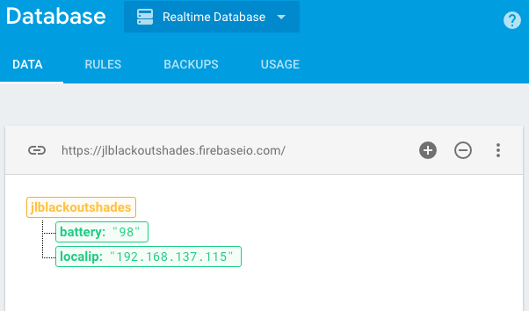
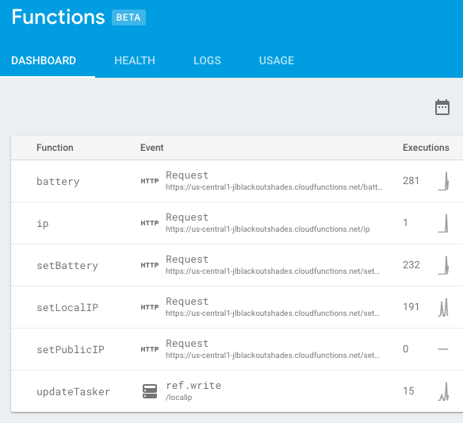
Firebase
Using Node.js to initialize Firebase functions
Firebase functions for microcontroller to send data to the web app
Battery
Local IP address

Slide 28
Web Application Core Modules
Wake
(Open)
Bedtime
(Close)
Nightlight
Alarm
LED Brightness Change
Remote Utility
Users are able to move shades up/down
Battery Indicator
Users are able to view current battery status
LEDs
Users can set preferred color
Users can set preferred brightness
Settings and Automation
Set Wake/bed time
Nightlight
Security Alarm
User Information
Add email
Settings
LEDs
LED Color Change
Web App
Add email
Battery Indicator
Remote Utility
Display Battery Level
Up
Down

Slide 29

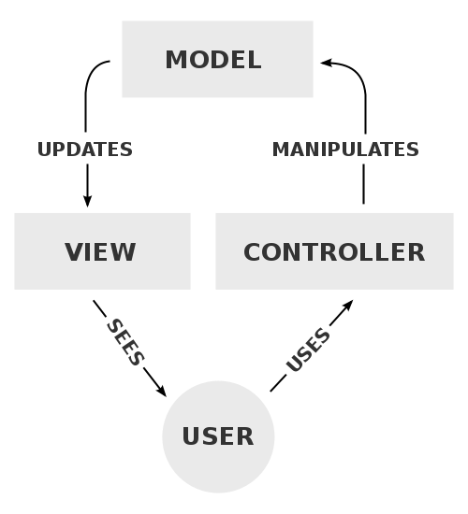

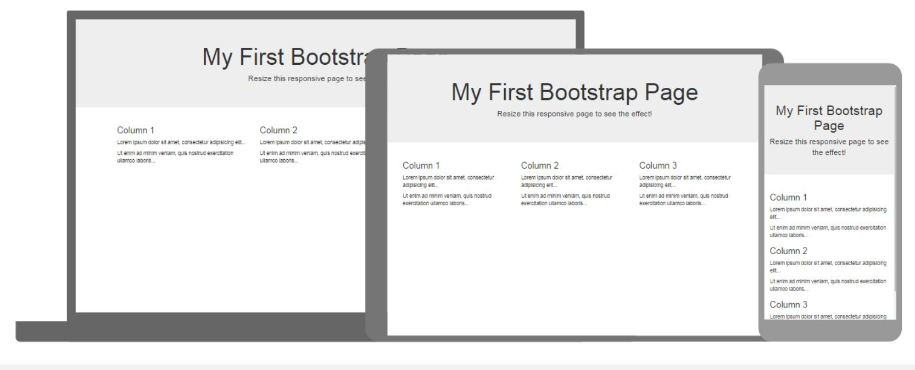

Software Tools
Model-View-Controller is a software architectural pattern commonly used for developing user interfaces that divides applications into three interconnected parts.
Bootstrap 3 libraries will be used to make the web application a responsive mobile-first website.
Jquery is a JavaScript library, and its syntax is designed to easily create animations and more.

Slide 30
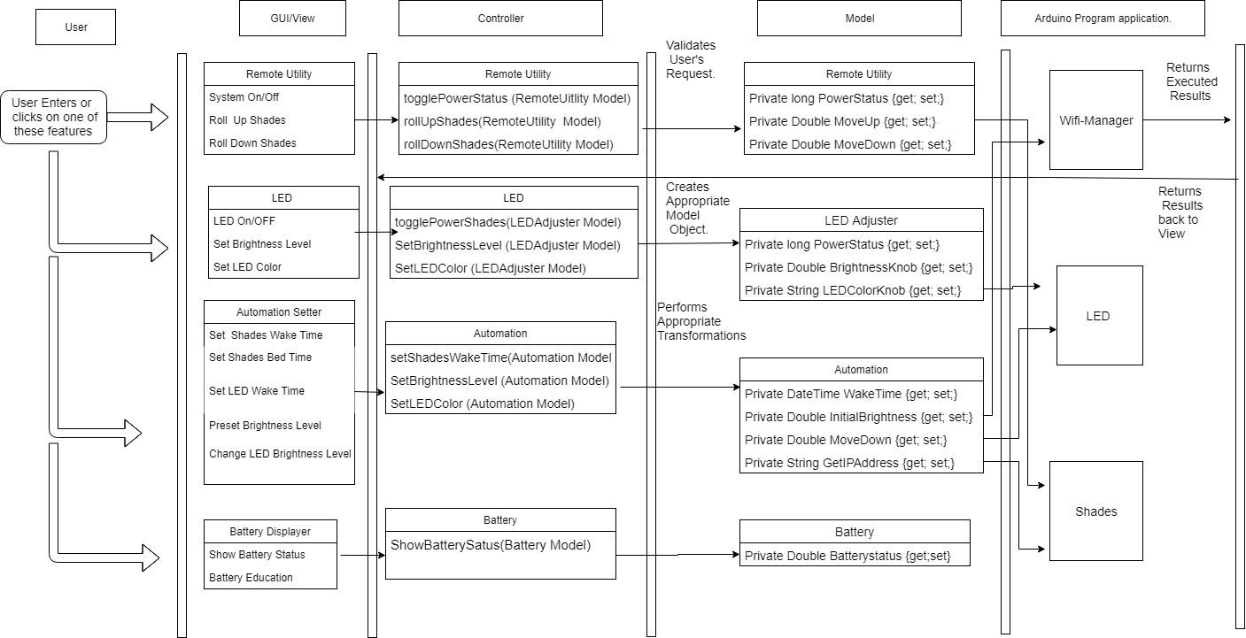
Class Diagram

Slide 31
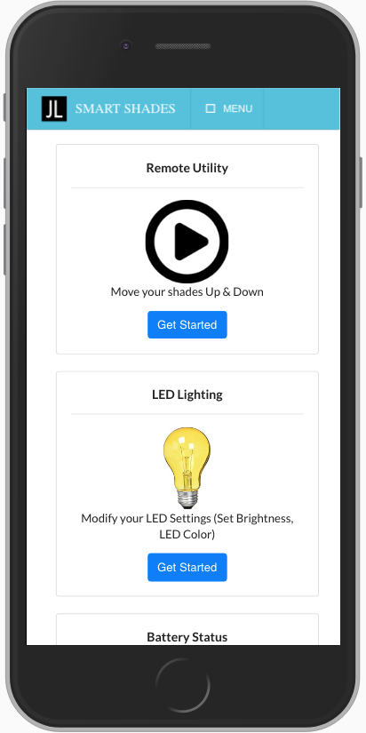
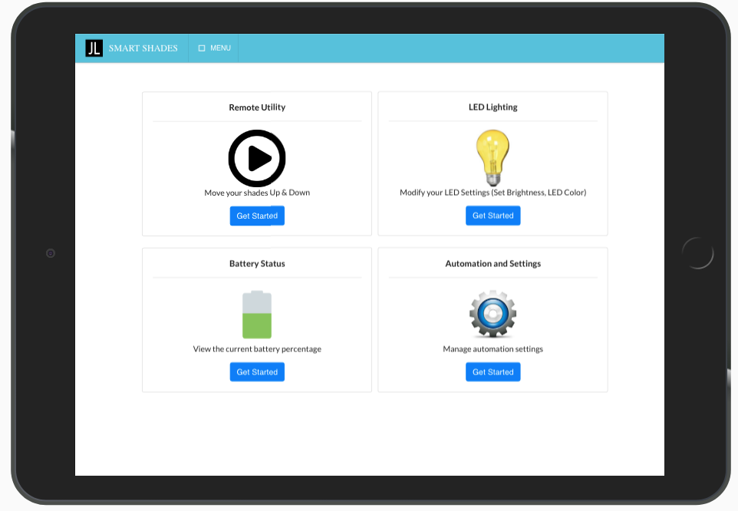
Web Application

Slide 32
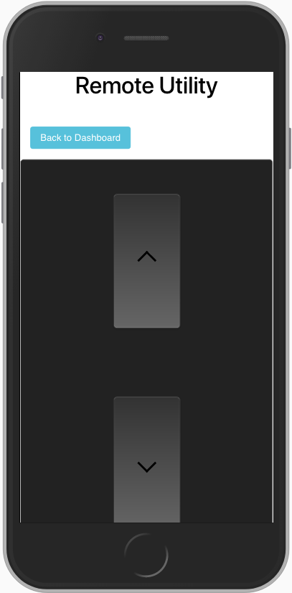
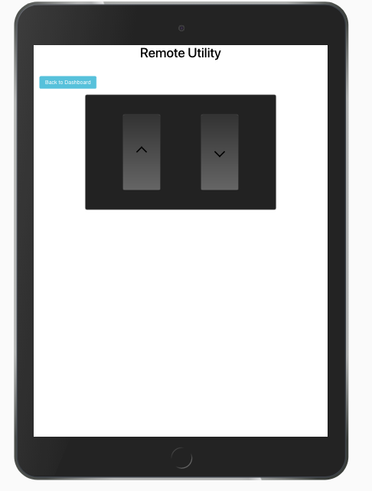
Web Application

Slide 33
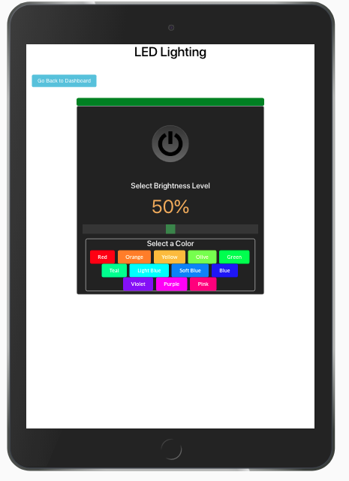
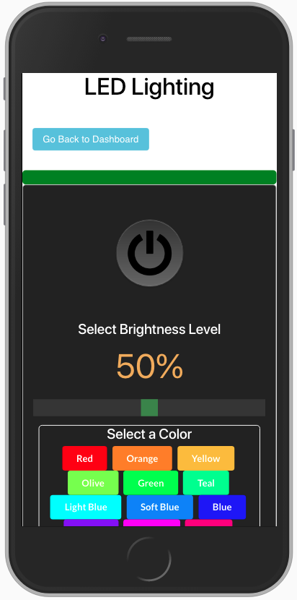
Web Application

Slide 34
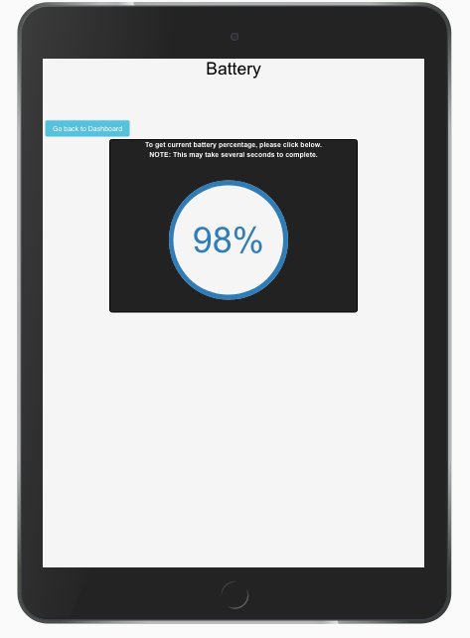
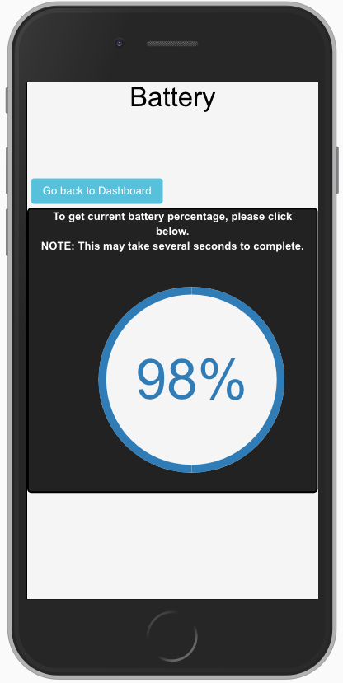
Web Application

Slide 35
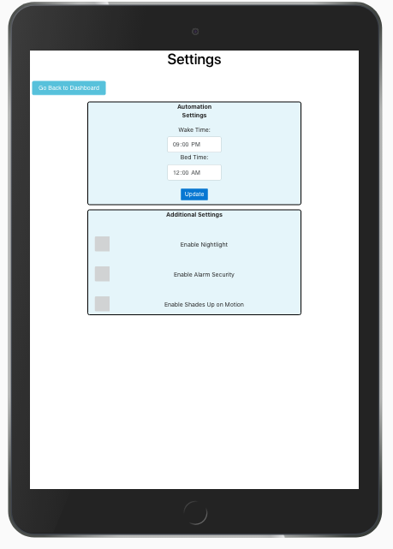
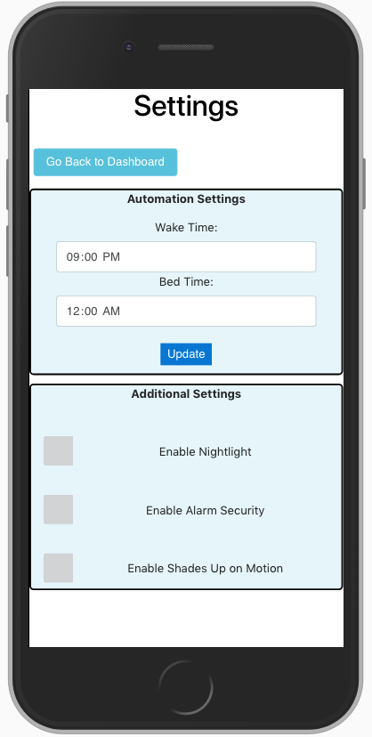
Web Application

Slide 36
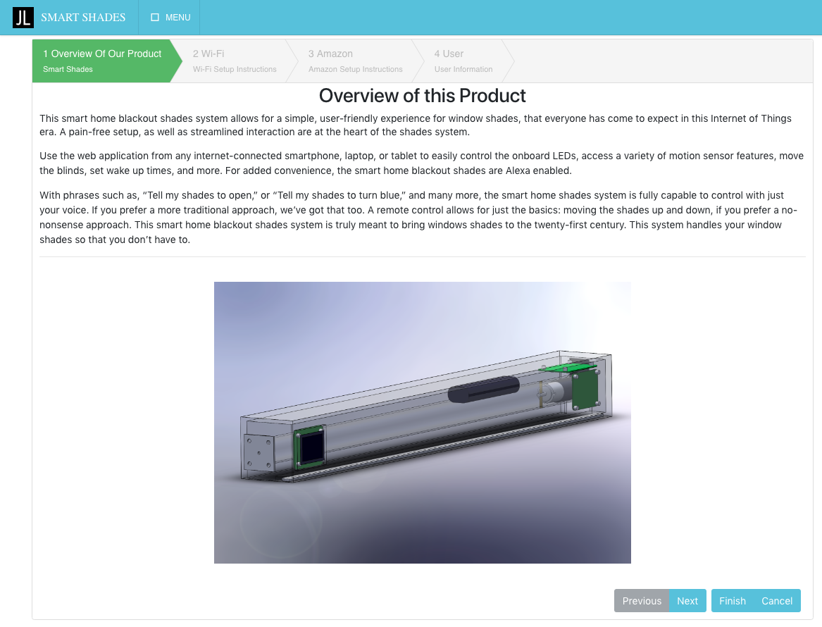
Web Application

Slide 37
Amazon Echo Integration
“Alexa, tell my shades to roll up.”
Our product will also include integration with Amazon Echo.
Users are able to verbally communicate with our shades through Amazon Echo Virtual Assistant
Making an Alexa Skill:
Using Amazon Developer console, developed Alexa skill
Using AWS Lambda to send custom HTTP requests from Alexa Skill
“Alexa, tell my shades to turn red.”
“Alexa, tell my shades to go down 25 percent.”

Slide 38




Wireless Communications
Bluetooth:
Limited range
Multiple pairings
Zigbee/Z-Wave:
No need to communicate to other smart home devices
Wi-Fi (IEEE 802.11 b/g/n):
Familiar
Good range
Convenient to implement

Slide 39
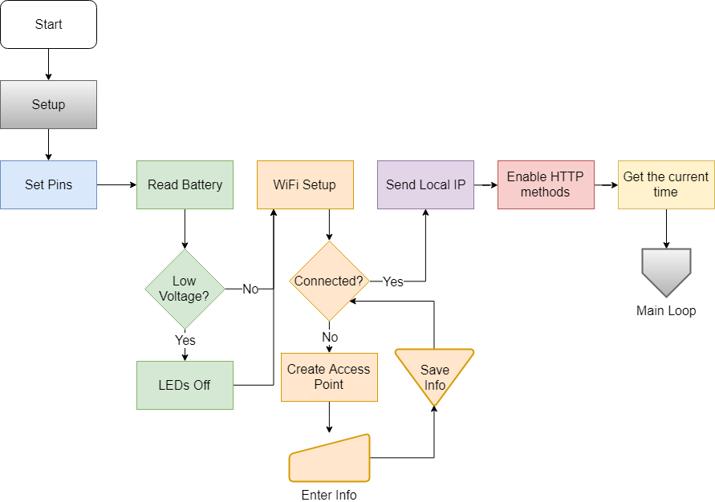
Setup Flowchart

Slide 40
Main Loop Flowchart

Slide 41
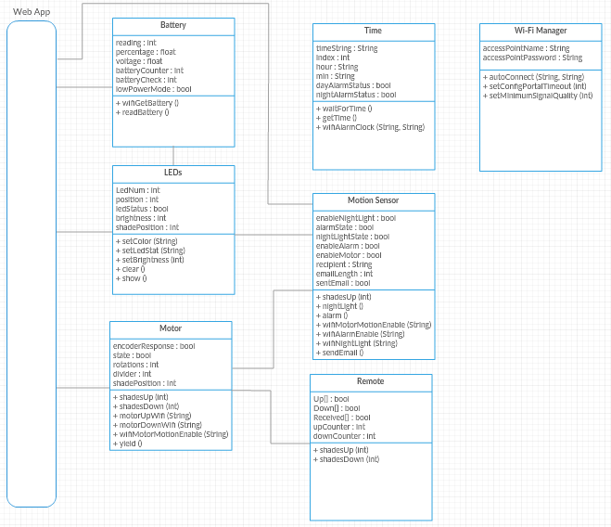
Function Diagram

Slide 42
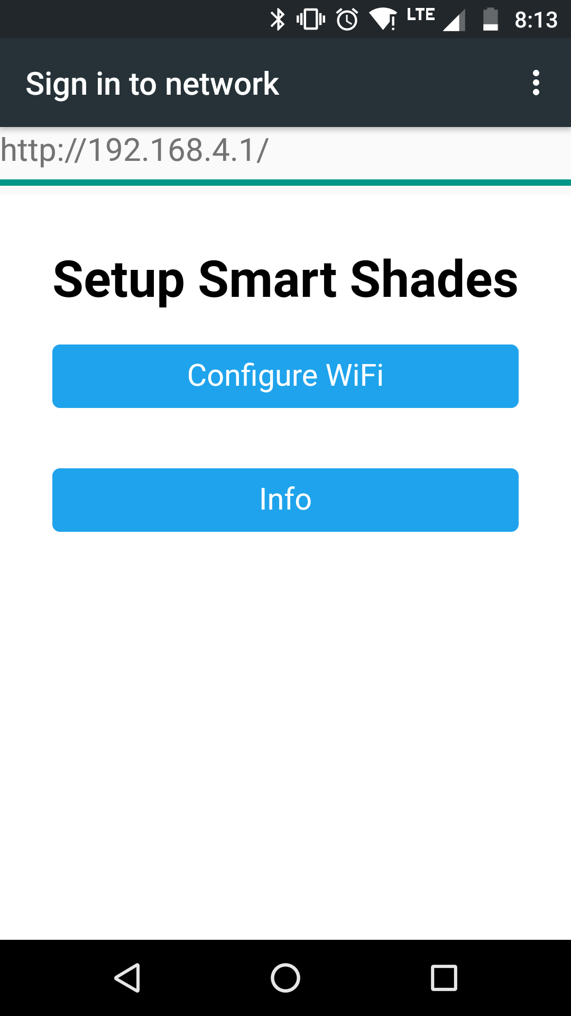
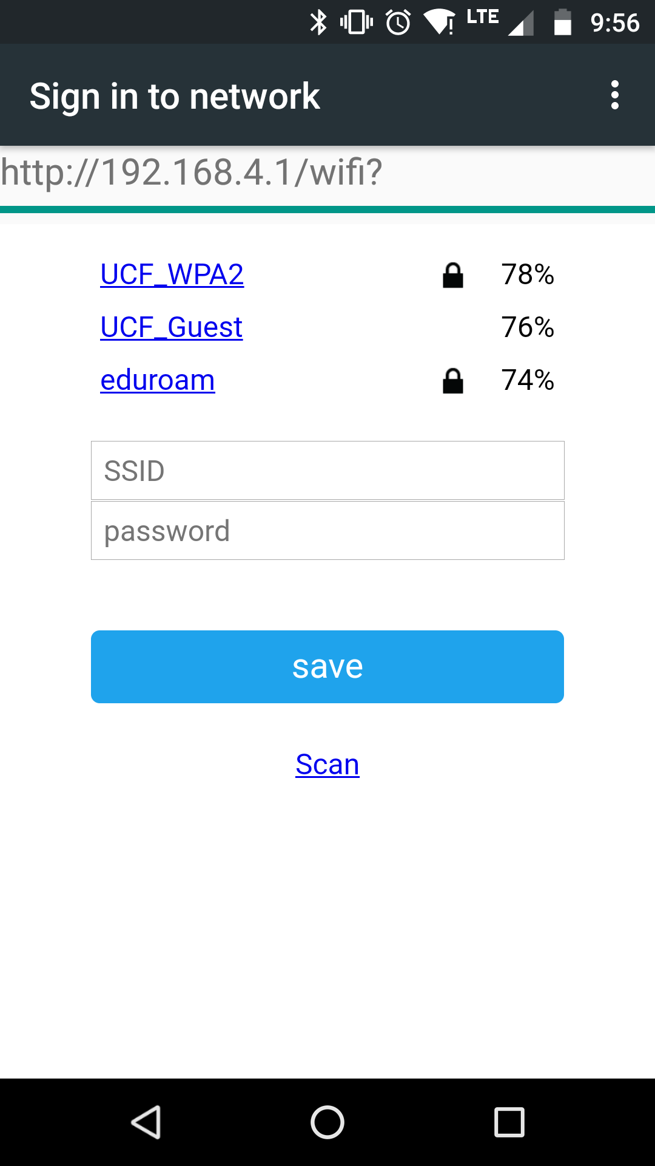
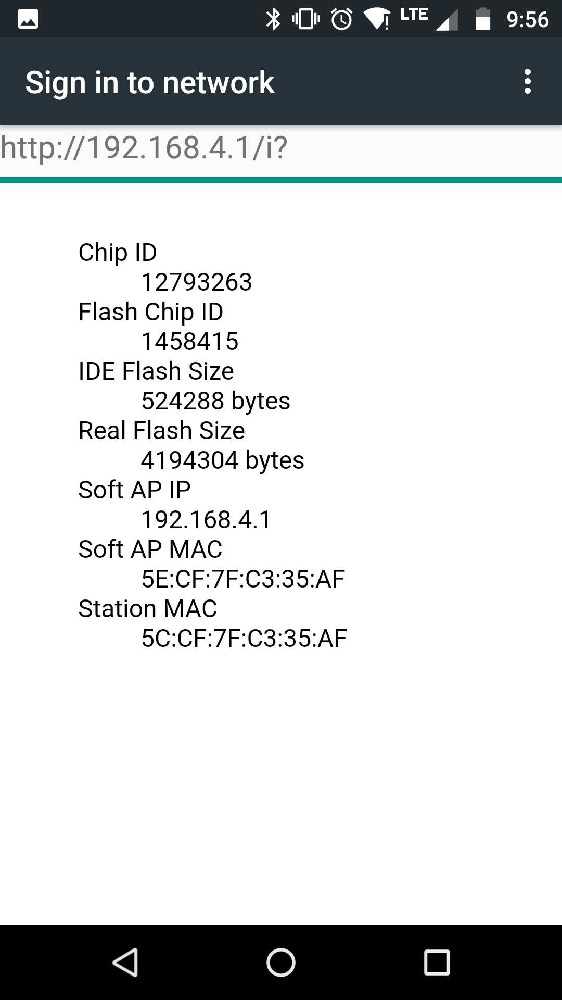
Wi-Fi API

Slide 43


IDEs
Arduino IDE benefits:
Default IDE
Support
Manage upload bit rate
Updates to board and libraries
Visual Studio + Visual Micro benefits:
Debug
Integrate with web app

Slide 44
Useful Libraries
Adafruit_DotStar
Controlling the LED
ESP8266WiFi
Wi-Fi Scanning
DNSServer
Helps implement a DNS server
ESP8266WebServer
Serves the configuration portal
WiFiManager
Use of the Captive Portal
Gsender
Helps send an Email through Gmail
Time
Helps configure the time
EEPROM
Allows information to be saved to the board

Slide 45
Administrative Content

Slide 46
Work Distribution
 | Stephen Fryer (CpE) | Brian Mora (EE) | Priyank Patel (CpE) | John Rossi (EE)
PCB Design |  | x |  | x
Housing |  |  |  | x
Web Application |  |  | x
Amazon Echo |  |  | x | x
Microcontroller Programming | x | x

Slide 47
Financing
Item | Total Cost
Reimbursable Budget | $ 500
Total R&D | $ 88
Total Per Unit | $ 300.60
Display & Extra Parts | $ 171.59
Total | $ 560.19

Slide 48
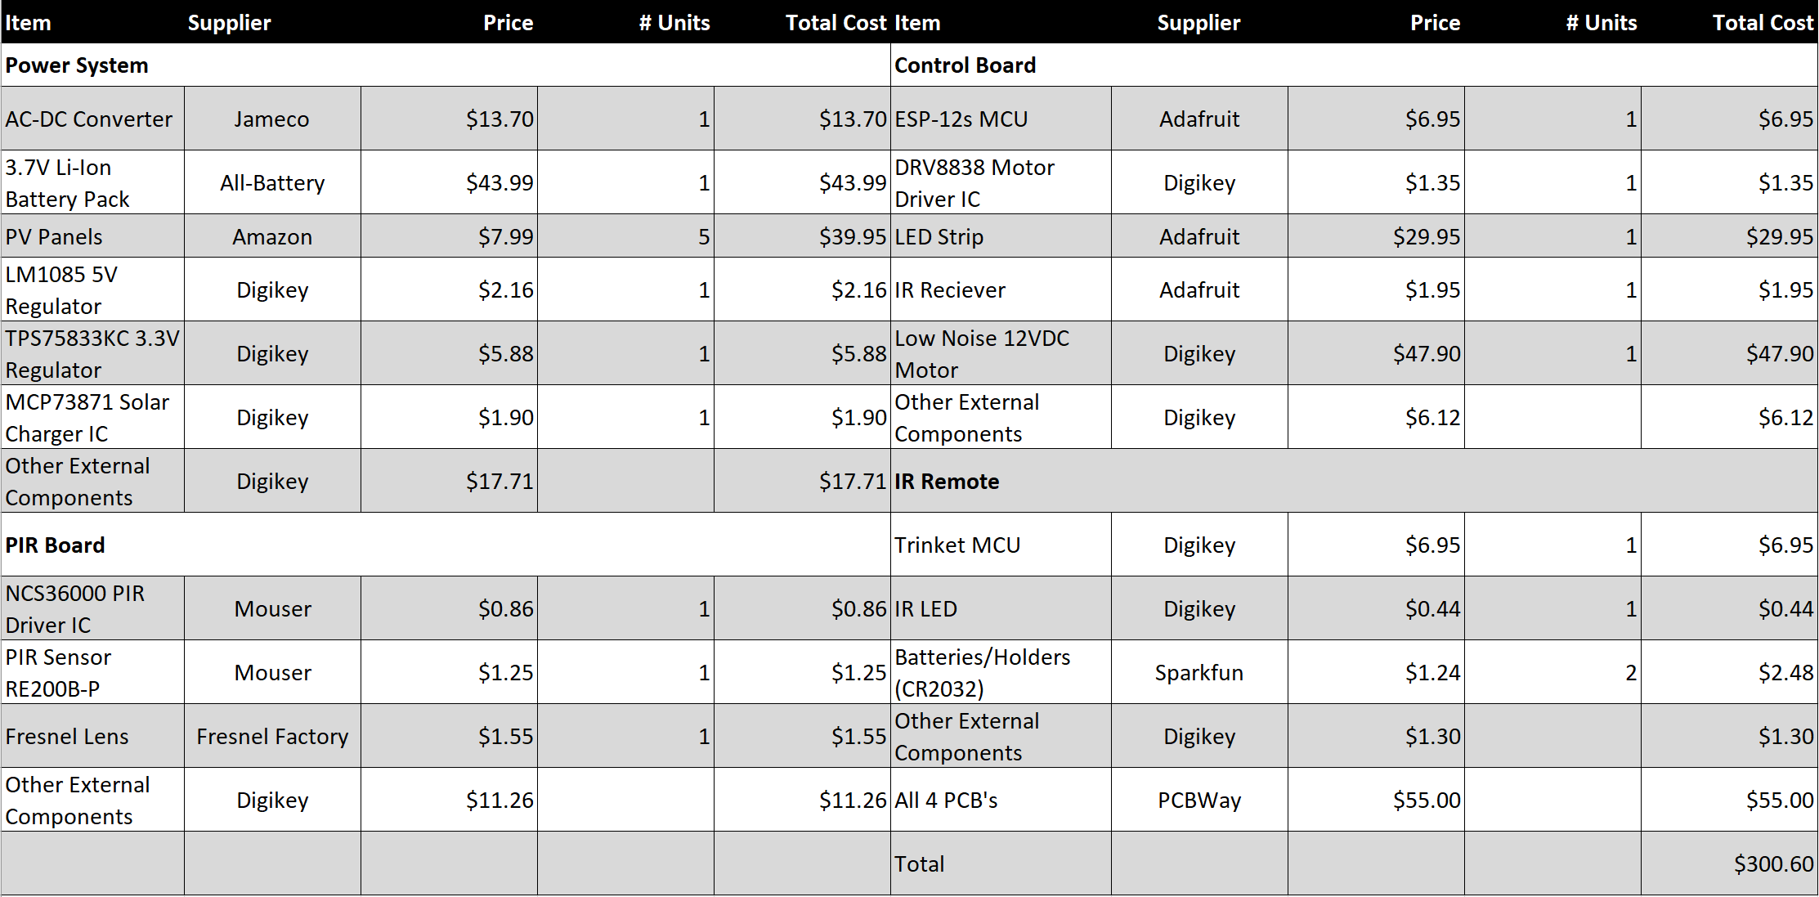
Per Unit Budget

Slide 49
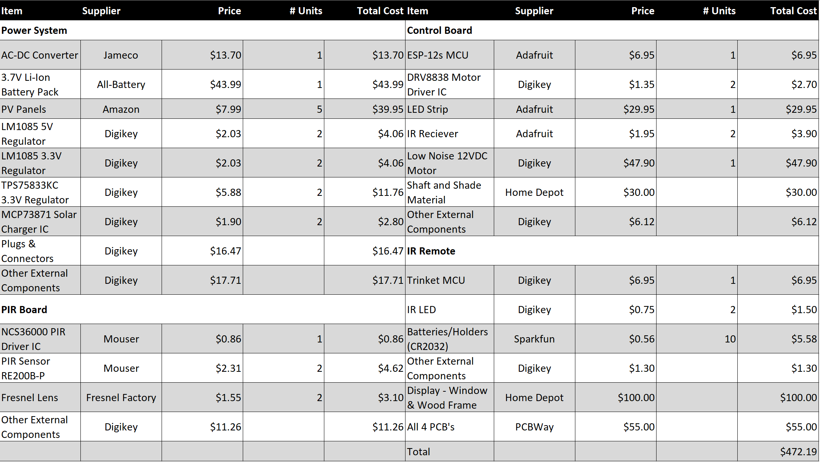
Total Budget

Slide 50
Thank you

Slide 51
Questions?

Slide 52
Demonstration
Parameter | Specification | Achieved
Response Time | 1 S | *
Solar Panel Peak Output Power | 6 W | 7.15 W
Motion Detection Range | > 3 m | 4 m
Average Power Consumption | < 10 W | 550 mW
IR Receiver distance | > 15 m | 16 m
Amazon Echo Skills | 3 skills | 4 skills
Shade Speed | At least 2 in/sec | 3.8 in/sec
Web Application
Installation Instructions
Remote Utility
LED Lighting
Battery Status
Automation and Settings
Amazon Echo
“My shades” Intro
Up/Down Intent
LED Color, Brightness, Power Intents
IR Remote
Backup Battery
* Due to UCF’s network, true response time cannot be shown, as we are forwarding through tasker

