Slide 1
3D Environment Modeler
Daniel Batista
Aaron Coville
Matthew Cummings
Sean Huskey

Slide 2
Motivation
No current cheap, room-proximity depth imaging
LIDAR is more accurate than ultrasound
  Ultrasound diverges quickly producing unwanted results
  Collimated light allows for better resolution
Has applications in
  Robot Vision
  Virtual/Augmented reality
  Area survey

Slide 3
Overall Project Goals
Render a 3D point cloud of the surroundings relative to the device
Wireless data transfer to a computer for rendering
Not too big or heavy
Fast enough for one scan to happen in a reasonable timeframe
Good resolution

Slide 4
Project Specifications
Metric | Value
Size | 1 ft³
Weight | <10lb
Scan Speed | <1h per total scan
Axial Resolution | ±1.5cm
Power | 12V
Range | 10m
Azimuth | 360°
Elevation | 90°
Final Cost | ≤ $400

Slide 5
Sections
Distance Measurement
Mechanical/Electronic Integration
PC Interface
Administrative Material

Slide 6
Optical Triangulation
Object 1 & 2 (close to laser)
Object 1 & 2 (far from laser)
Laser
Lens
Sensor
Bad resolution at far range
More complicated imaging

Slide 7
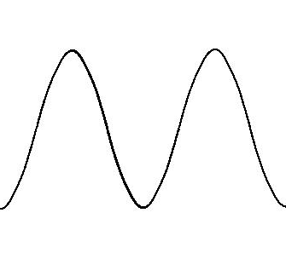

Continuous-Wave Intensity Modulation
Time-of-Flight
Outgoing Signal
Suffers from problems with phase-wrapping
Requires high-speed electronics
Laser
Returning Signal
Sensor

Slide 8
Pulse Time-of-Flight
Send out a laser pulse, the time it takes to get back can be used to determine distance travelled
Requires high-speed electronics

Slide 9
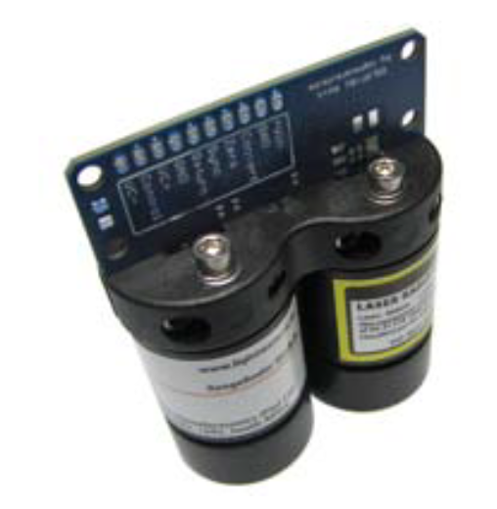
OSLRF-01
Uses pulsed TOF, but with sequential-equivalent-time-sampling (SETS) to allow for slow-speed LIDAR

Slide 10

Sequential-Equivalent-Time-Sampling (SETS)
Allows signals to be “slowed down” to speeds that cheaper electronics can process
Relies on taking individual samples of several pulses over a period of time and stitching them together.
Normal sampling:
Original Signal:
= sample
Reconstructed Signal:

Slide 11
Sequential-Equivalent-Time-Sampling (SETS)
Allows signals to be “slowed down” to speeds that cheaper electronics can process
Relies on taking individual samples of each signal over a period of time and stitching them together.
SETS sampling:
Original Signal:
= sample
Reconstructed Signal:

Slide 12
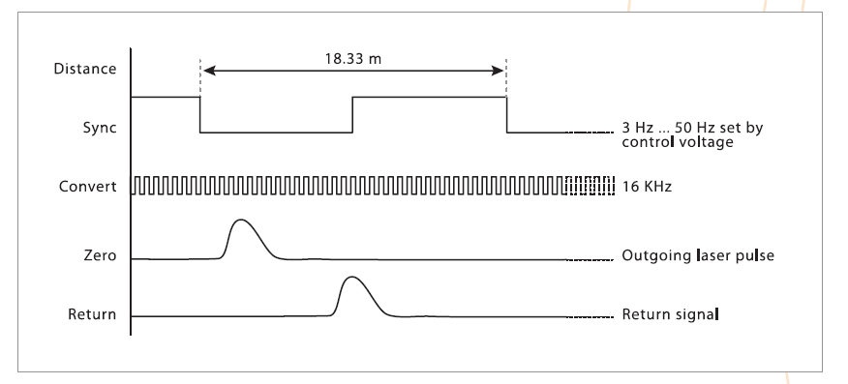
Sequential-Equivalent-Time-Sampling (SETS)

Slide 13
OSLRF-01 Architecture Benefits
We have control (within a range) of our resolution.
Accuracy within 1mm takes 4 hours to scan but accuracy within 15mm takes 15 minutes to scan.
Libraries also exist making interfacing with the device easier on the development end

Slide 14
Sections
Distance Measurement
Mechanical/Electronic Integration
PC Interface
Administrative Material

Slide 15
Rough Device Mockup
Top-down View
Side View
Field of
view
System Components
This layer would be the slip-ring that rotates the top-half of the device.
Slip-ring Rotation

Slide 16
Device Flow Chart
360° Stepper Motor
Target
180° Stepper Motor
Mirror
Beam Splitter
MCU
Laser System
Timing
Detection System
Power
Wireless Communication
Processing unit
3D Image

Slide 17
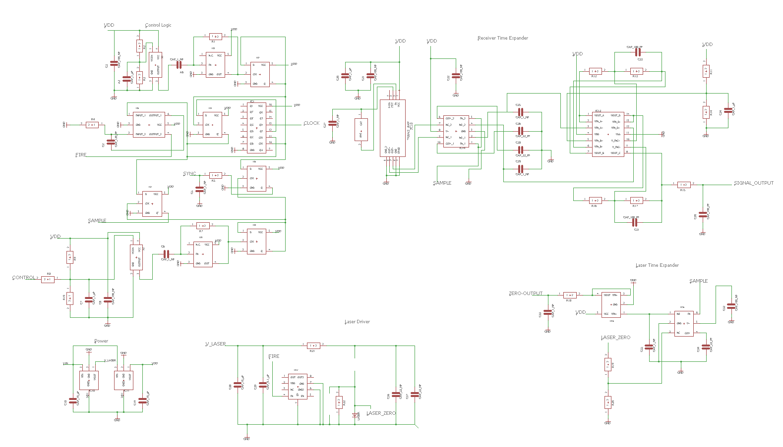
Electrical Schematic

Slide 18
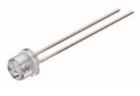
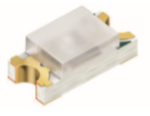
Laser Diode/Detector
Most important aspect of the system
System chosen was in the IR spectrum
  Reduction of noise
Laser output wavelength at 905 nm
  Peak power at 25W
  Rise/Fall time of 1 ns
Detector has 0.4 A/W sensitivity at 905 nm
  Rise/Fall time of 2ns
SPL PL 90 is manufactured to be pulsed
  Previously prototyped other lasers and failed to generate a clean pulse
SFH 2701 allows pulse to be detected fast enough
  Very quick rise time for $1
  Previously had a 10 ns detector for $15 that broke
SPL PL 90
SFH 2701

Slide 19
Integrating the Components
Integrations Lead : Sean Huskey
Stepper 180
Stepper 360
Stepper Drivers
Laser
Control
Switch
Laser System
3.3 v
Reg
Bluetooth
Module
12v
Battery
Supply
MCU

Slide 20
Choosing a Microcontroller
Stepper 180
Stepper 360
Stepper Drivers
Laser
Control
Switch
Laser System
3.3 v
Reg
Bluetooth
Module
12v
Battery
Supply
MCU

Slide 21
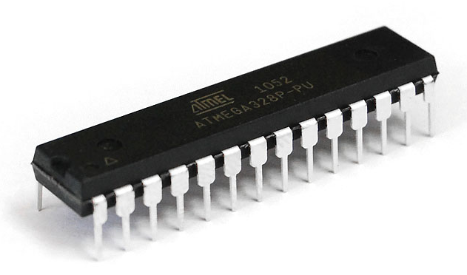
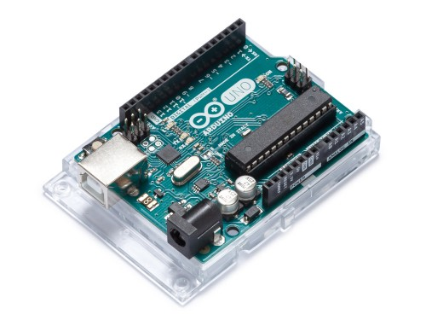
ATMEGA328P-PU
Just enough I/O Pins
Only 2 interrupt pins required
Cheap and available
Easy to install
Plentiful Documentation
16 MHz to process data
32 KHz sampling rate required

Slide 22
Required Processing from MCU
Read samples at 32 Khz
Keep a small buffer of sample data to find signal centers
32-bit floating point precision to calculate distance in millimeters
Direct the laser and keep track of its current direction
Stringify the point data and send it over Bluetooth

Slide 23
Directing the Laser
Stepper 180
Stepper 360
Stepper Drivers
Laser
Control
Switch
Laser System
3.3 v
Reg
Bluetooth
Module
12v
Battery
Supply
MCU

Slide 24
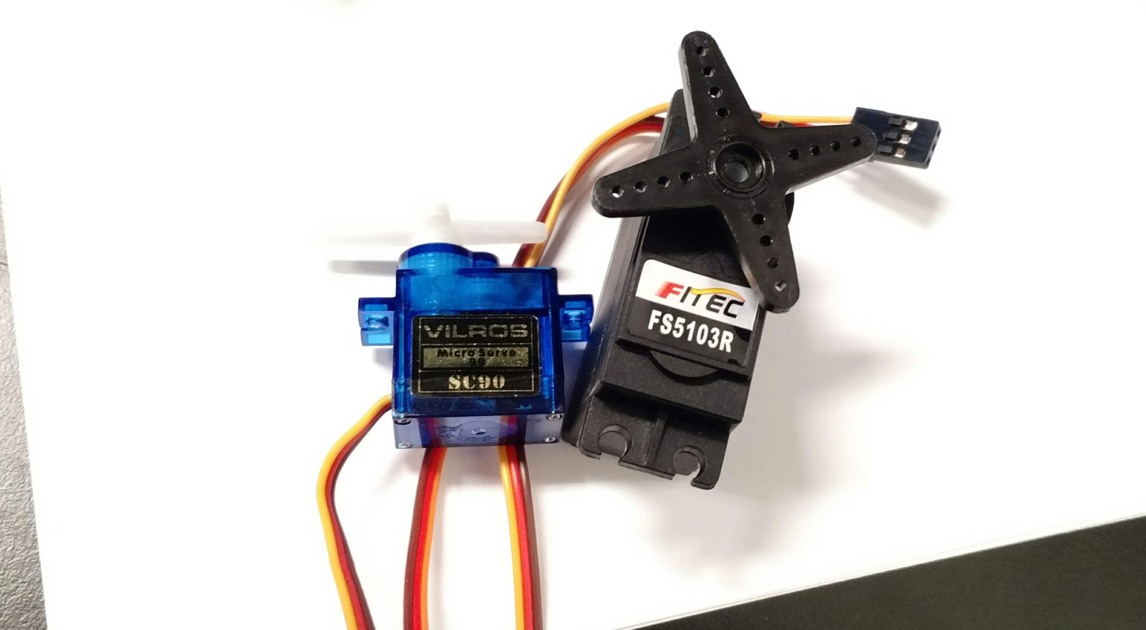
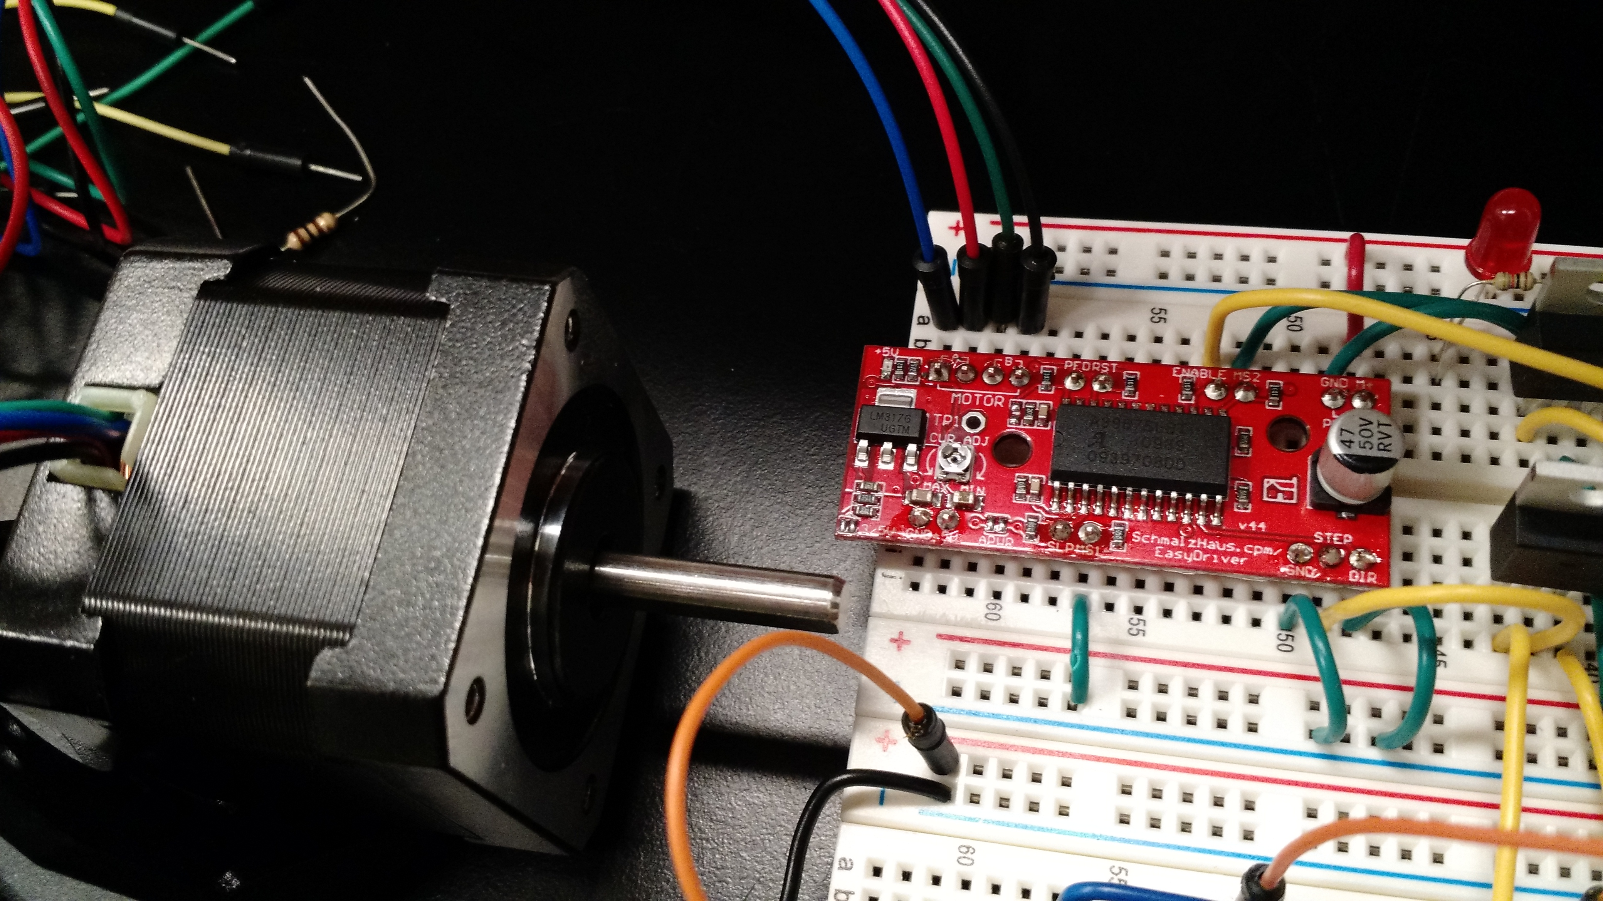
Servos vs Steppers
Servos can’t provide enough precision and control
Swapped servos for NEMA 17 and NEMA 8 stepper motors controlled by EZ Stepper Driver

Slide 25
Sending the Data
Stepper 180
Stepper 360
Stepper Drivers
Laser
Control
Switch
Laser System
3.3 v
Reg
Bluetooth
Module
12v
Battery
Supply
MCU

Slide 26
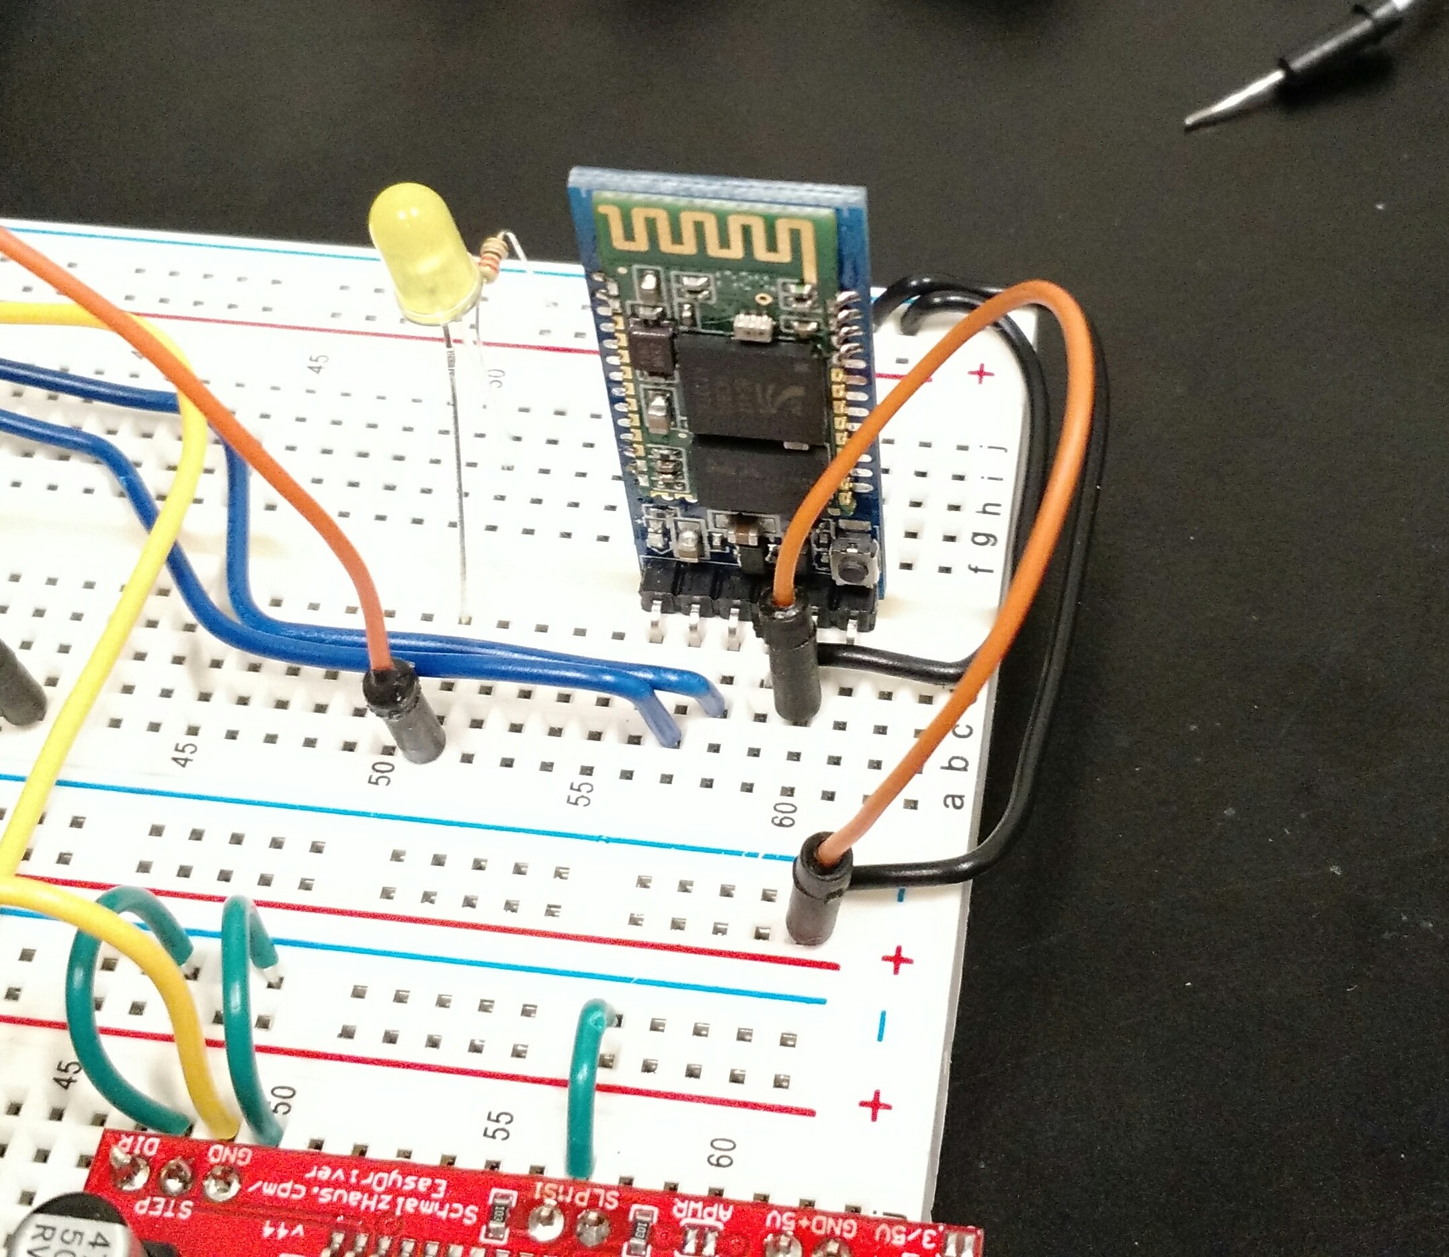
HC-05 Bluetooth Module
Standard Bluetooth protocol
Many online example projects to reference
Pybluez used to communicate with the module from a laptop (during development)
Watchdog timer used to recover from out of sync errors
Laptop repeatedly sends pats during idle state to prevent reset

Slide 27
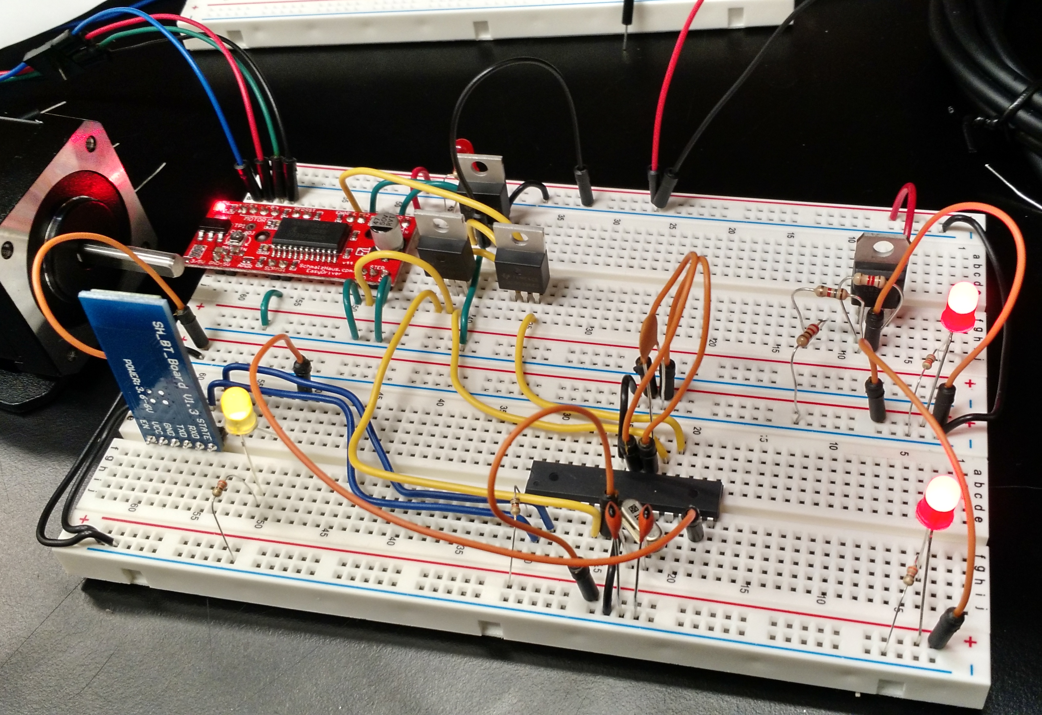
Integrations Progress So Far
The chip successfully working independently of the development board
Bluetooth messages are being passed reliably
Watchdog successfully preventing out of sync errors and power reset errors
MOSFET as a switch working to control 12V power supply to a load using only 3.3V control signal

Slide 28
What’s next for Integrations
Cleaning up the programming on both ends to prepare for version 1.0
Simulate operating requirements with final tests
  Drive both steppers at once
  Sample and read analog signal at 32 Khz
  Calculate mock distance values with boundary conditions
  Communicate to Laptop for a full test sweep
Measure final current requirements of the new stepper drivers during simulated operating conditions
Finalize PCB and begin assembly

Slide 29
Sections
Distance Measurement
Mechanical/Electronic Integration
PC Interface
Administrative Material

Slide 30
PC Interface Goals
Establish a wireless connection to embedded system for various purposes
Provide a visual output for laser data
Provide a sensible, usable interface for human operators to interact with

Slide 31
PC-Side Bluetooth
Uses BlueZ with C as the base
Primary purpose is to receive encoded data from the embedded system
Secondary purpose is to send a Begin signal to the embedded system to start the scan

Slide 32
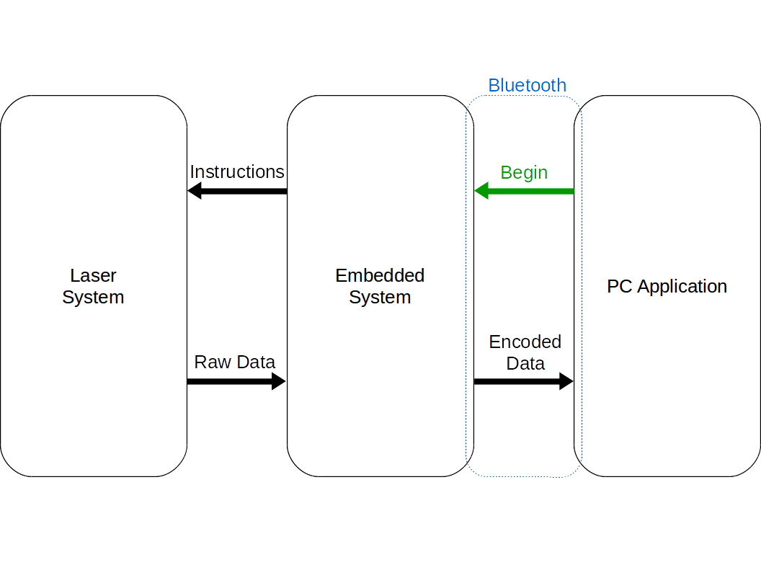
Network Diagram

Slide 33
PC App Overview
PC app will be made using Qt C++ as the base for the GUI
It will provide the means to start the scan as well as a canvas on which to render the point cloud
Overall is an event-driven architecture

Slide 34
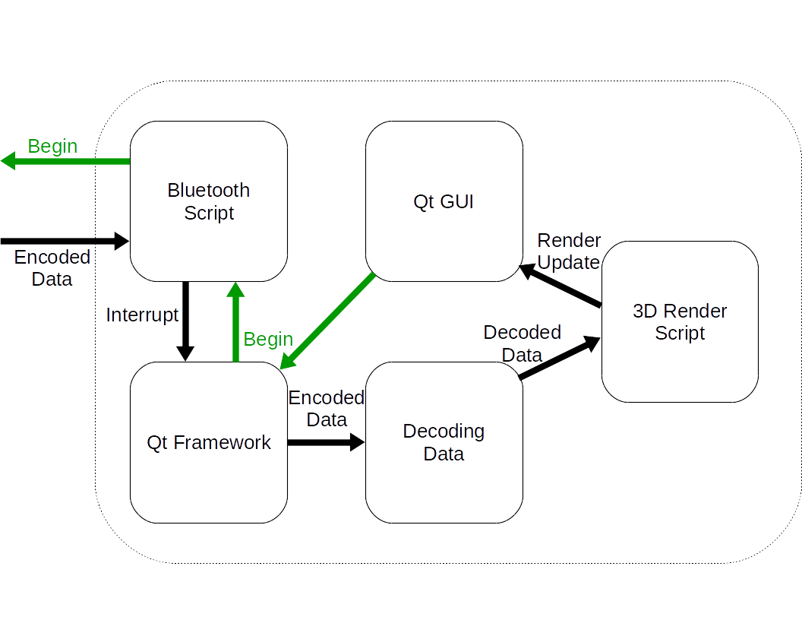
PC Application

Slide 35
Decoding The Data
Data is given in the form of a single stream of ASCII characters
Needs to be converted into three floating point numbers in order to render

Slide 36
Rendering The Data
Final render will be through an WebGL scene
It will be embedded in the application through a 3D canvas in the GUI
When a new point is received, its position is calculated, the point created, and an interrupt sent to the GUI to update the canvas

Slide 37
What’s Next For PC Interface
Test Bluetooth communications
Migrate existing render system onto Qt application
Do tests with the actual laser system when completed

Slide 38
Sections
Distance Measurement
Mechanical/Electronic Integration
PC Interface
Administrative Material

Slide 39
Budget

Slide 40
Budget Continued
Total Spent to Date | Unit cost
$580.44 | $108.69

Slide 41
Group Member Work
Name | Laser System | Detection System | Timing | Signal Analysis | Data Communication | Electrical Design | Mechanical Design | 3D Render | PC app
Daniel | ● | ● |  |  |  | ● | ●
Aaron |  | ○ | ● | ○ |  | ○ | ●
Matthew |  |  |  |  | ○ |  |  | ● | ●
Sean |  |  | ○ | ● | ● | ○ | ●
Primary Contributor | ●
Secondary Contributor | ○

Slide 42
Progress

Slide 43
Questions?

