Slide 1
3D Environment Modeler
Daniel Batista
Aaron Coville
Matthew Cummings
Sean Huskey

Slide 2
Motivation
No current cheap, room-proximity depth imaging
LIDAR is more accurate than ultrasound
Ultrasound diverges quickly producing unwanted results
Collimated light allows for better resolution
Has applications in
Robot Vision
Virtual/Augmented reality
Area survey

Slide 3
Overall Project Goals
Render a 3D point cloud of the surroundings relative to the device
Wireless data transfer to a computer for rendering
Not too big or heavy
Fast enough for one scan to happen in a reasonable timeframe
Good resolution

Slide 4
Project Specifications
Metric | Value
Size | 1 ft³
Weight | <10 lb
Scan Speed | <1 hour per total scan
Axial Resolution | ±1.5 cm
Voltage | 12 V
Range | 10 m
Azimuth | 360°
Elevation | 90°
Final Cost | ≤ $400

Slide 5
Device Block Diagram
360° Stepper Motor
Target
180° Stepper Motor
Mirror
Through-Hole Mirror
MCU
Laser System
Timing
Detection System
Power
Wireless Communication
Processing unit
3D Image

Slide 6
Sections
Distance Measurement
Mechanical/Electronic Integration
Embedded System
PC Interface
Administrative Material

Slide 7
Optical Triangulation
Object 1 & 2 (close to laser)
Object 1 & 2 (far from laser)
Laser
Lens
Sensor
Bad resolution at far range
More complicated imaging

Slide 8
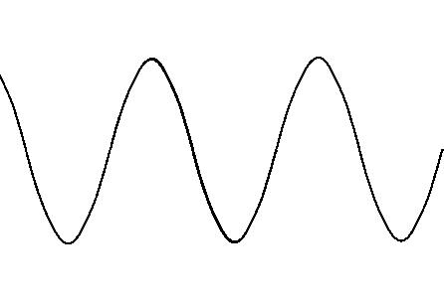
Continuous-Wave Intensity Modulation Time-of-Flight
Outgoing Signal
Suffers from problems with phase-wrapping
Requires high-speed electronics
Laser
Returning Signal
Sensor
$$φ=180°$$

Slide 9
Pulse Time-of-Flight
Send out a laser pulse, the time it takes to get back can be used to determine distance travelled
Requires high-speed electronics

Slide 10
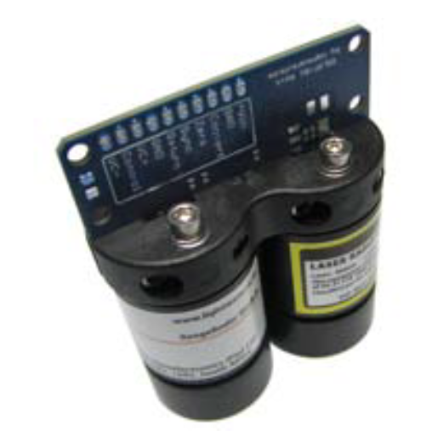
OSLRF-01
Uses pulsed TOF, but with sequential-equivalent-time-sampling (SETS) to allow for slow-speed LIDAR

Slide 11
Sequential-Equivalent-Time-Sampling (SETS)
Allows signals to be “slowed down” to speeds that cheaper electronics can process
Relies on taking individual samples of several pulses over a period of time and stitching them together.
Normal sampling:
Original Signal:
= sample
Reconstructed Signal:

Slide 12
Sequential-Equivalent-Time-Sampling (SETS)
Allows signals to be “slowed down” to speeds that cheaper electronics can process
Relies on taking individual samples of each signal over a period of time and stitching them together.
SETS sampling:
Original Signal:
= sample
Reconstructed Signal:

Slide 13
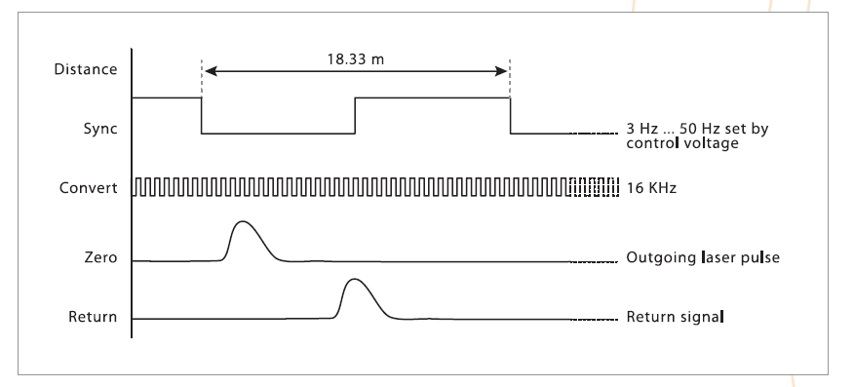
Sequential-Equivalent-Time-Sampling (SETS)

Slide 14
Sections
Distance Measurement
Mechanical/Electronic Integration
Embedded System
PC Interface
Administrative Material

Slide 15
Optical and Mechanical Design
Stepper Motor Rotation
Top-down View
Stepper motor
Mirror
Stepper Motor Rotation
Diffusive Surface
Gear
Gear
Stepper motor
Slip Ring
Focusing lens
Detector
Through-Hole Mirror
PCB
Cylindrical lens
Laser
Mirror
Slip-ring Rotation
Aspherical lens

Slide 16
Limitations
Parallax is an issue and will only see one point
Beam splitter
Original idea but, introduced a large loss being 50/50
Through-hole mirror
Design implemented with highest return signal but still introduce loss
Slip ring limits return signal irradiance
Beam collimation
A smaller beam may return more irradiance

Slide 17
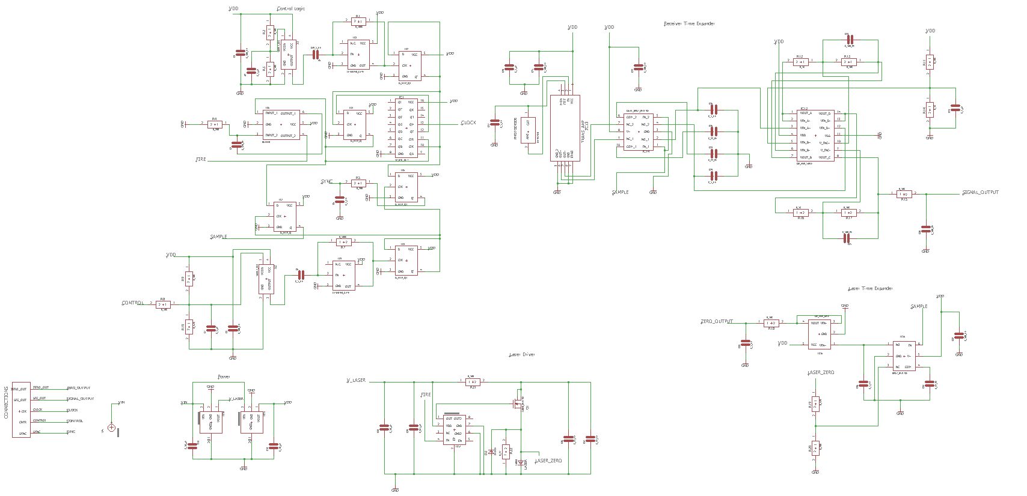
Range Finder Electrical Schematic

Slide 18
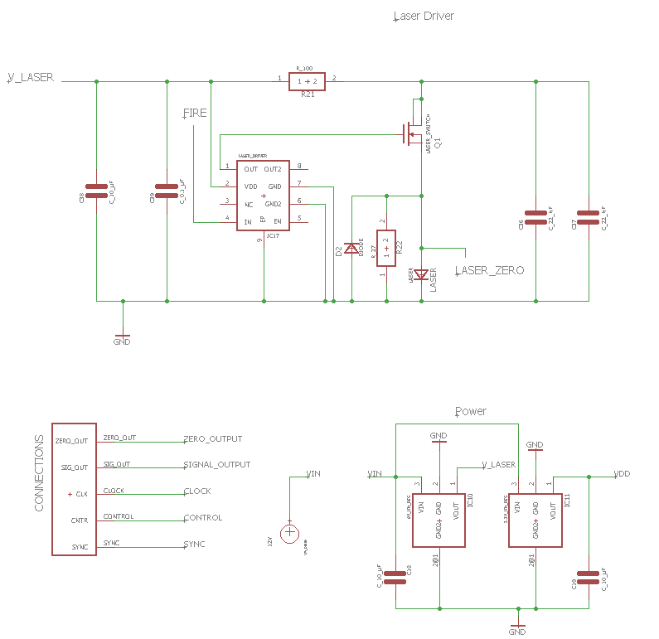
Connections, Power, Laser Driver

Slide 19
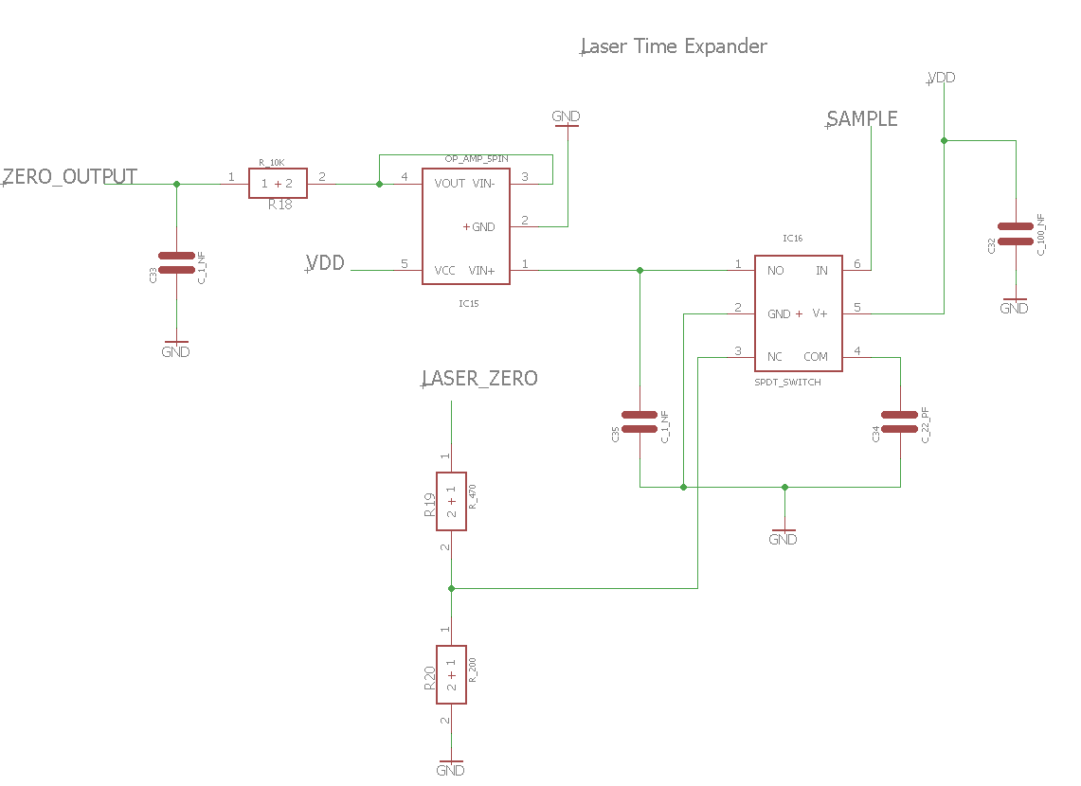
Laser Time Expander

Slide 20
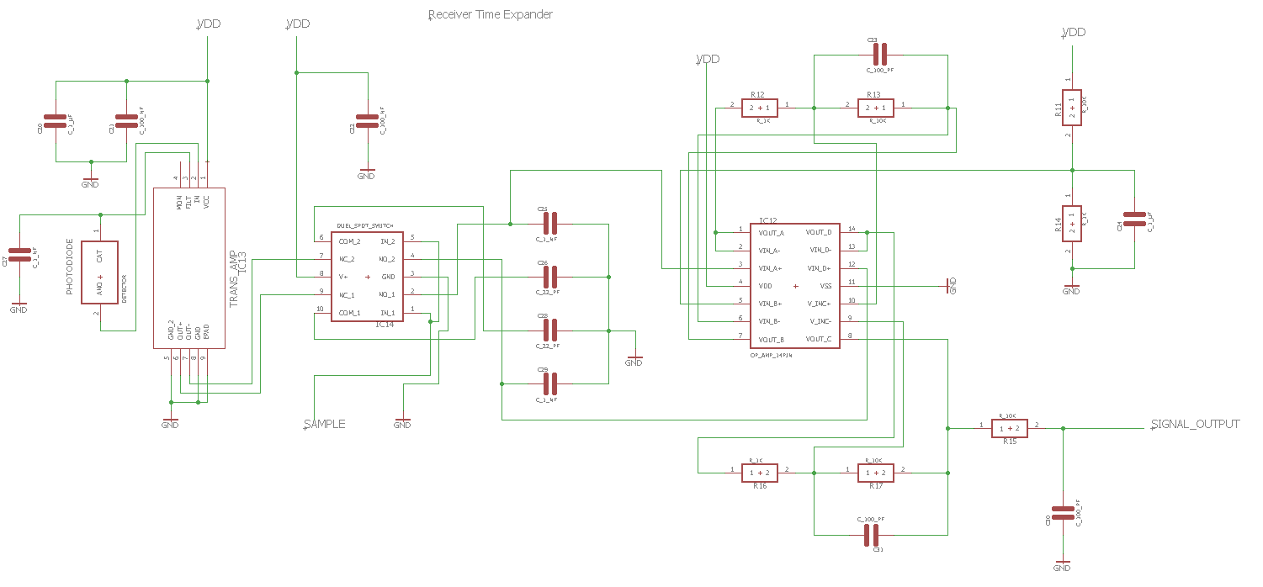
Receiver Time Expander and Amplifier

Slide 21
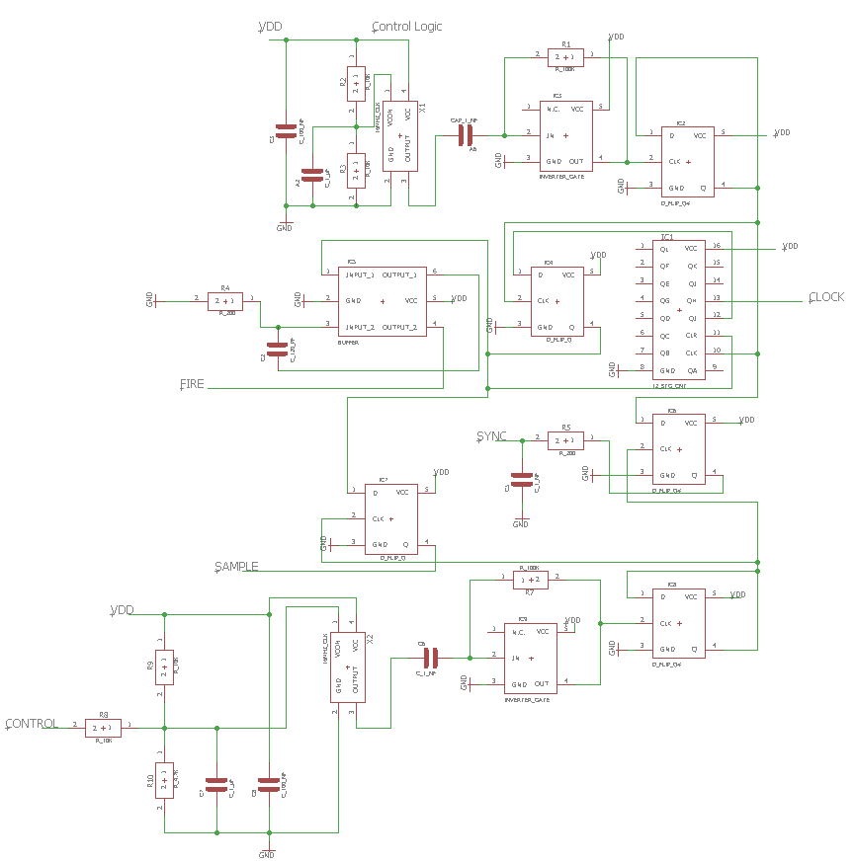
Master Timer

Slide 22
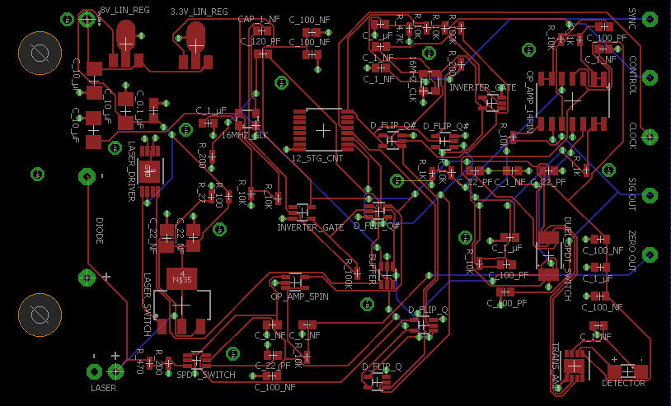
Range Finder PCB

Slide 23
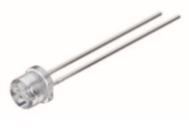
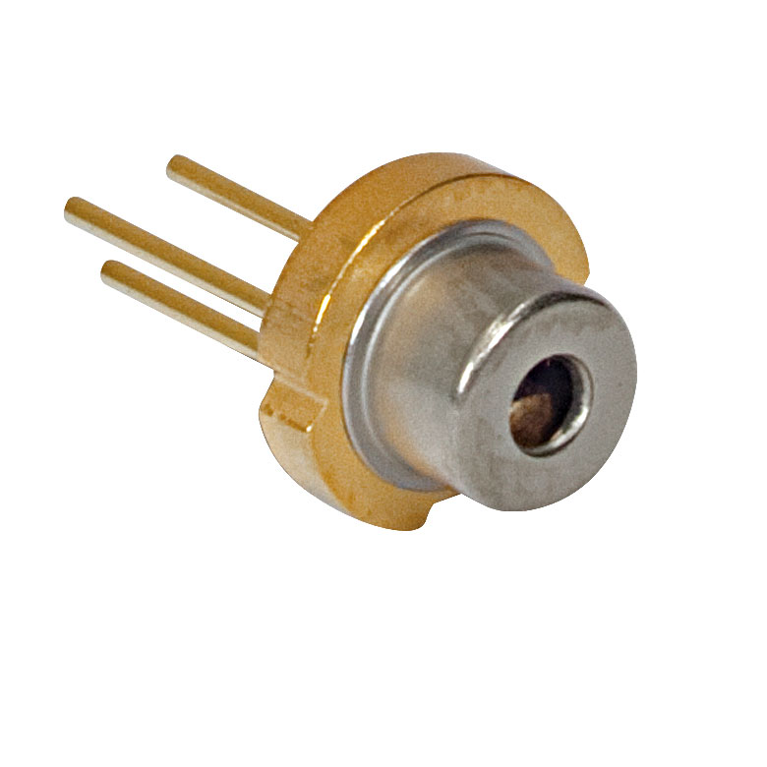
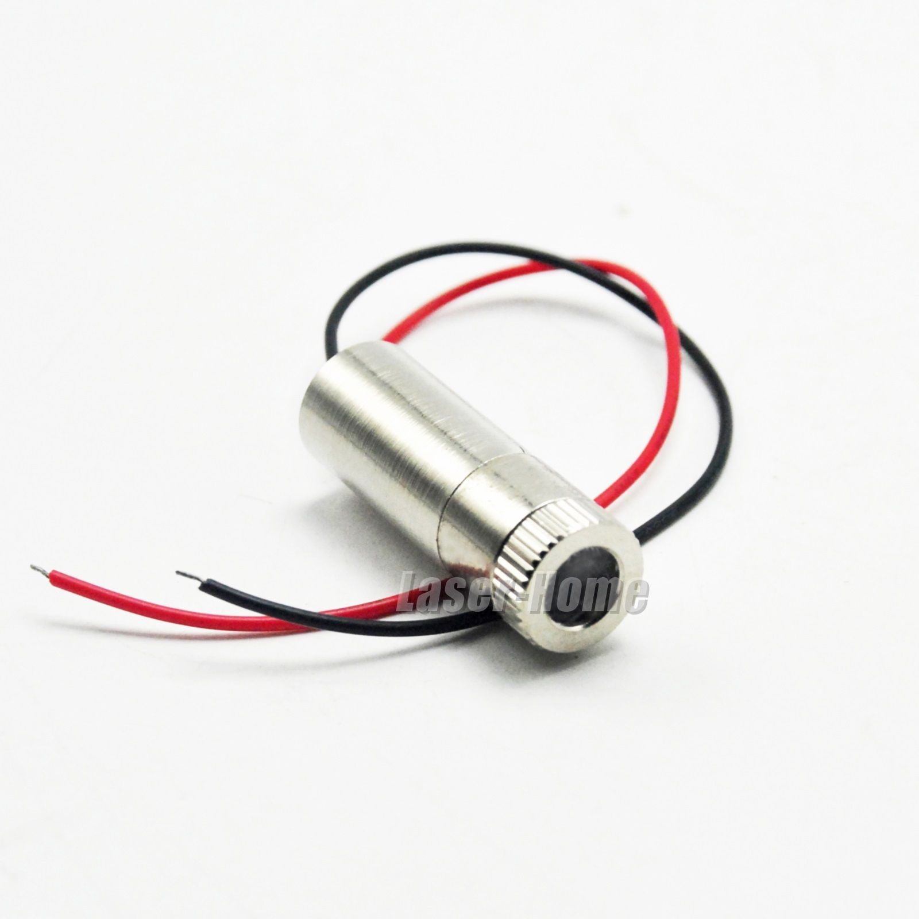
Laser Diodes
SPL PL 90
 | HLM6544FM | Laser Dot Diode Module w/ Driver | SPL PL90
Average Power | 50 mW | 30 mW | 0.5 mW
Peak Power | - | - | 25 W
Rise Time | - | - | 1 ns
Fall Time | - | - | 1 ns
Wavelength | 660 nm | 850 nm | 905 nm
Cost | $33.41 | $25.89 | $20.47
System chosen was in the IR spectrum
Reduction of noise
SPL PL 90 was chosen since it is manufactured to be pulsed
Previously prototyped lasers failed to generate a clean pulse

Slide 24
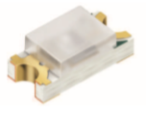
Detectors
 | PDV-P9007 | FDS100 | PD15-22C/TR8 | SFH 2701
Wavelength Range | 400-700 nm | 350 – 1100 nm | 400-1100 nm | 400-1050
Peak Wavelength | 570 nm | 980 nm | 940 nm | 820 nm
Responsivity | - | 0.65 A/W | - | 0.5 A/W
Active Area | - | 13 mm² | - | 0.36 mm²
Rise Time | 60 ms | 10 ns | 10 ns | 2 ns
Fall Time | 25 ms | 10 ns | 10 ns | 2 ns
Dark Current | - | 1 nA | 10 nA | 0.05 nA
Cost | $1.78 | $14.08 | $0.50 | $1.04
Chose SFH 2701 as detector
Detector has 0.4 A/W sensitivity at 905 nm
Rise/Fall time of 2ns
SFH 2701 allows pulse to be detected fast enough
Very quick rise time for $1
Previously used FDS100 detector for $15 that broke
SFH 2701

Slide 25
Sections
Distance Measurement
Mechanical/Electronic Integration
Embedded System
PC Interface
Administrative Material

Slide 26
Responsibilities of the Control PCB
Regulate the power supply to all components and laser system
Sample an analog signal at 32 kHz
Process the samples to calculate a distance
Communicate the calculated distance over Bluetooth
Direct the laser

Slide 27
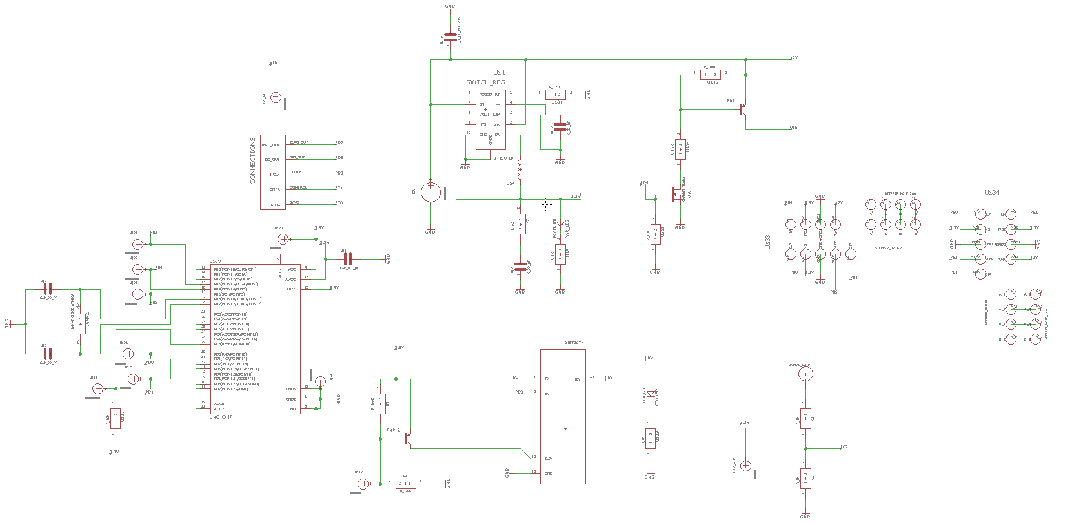
Control Schematic

Slide 28
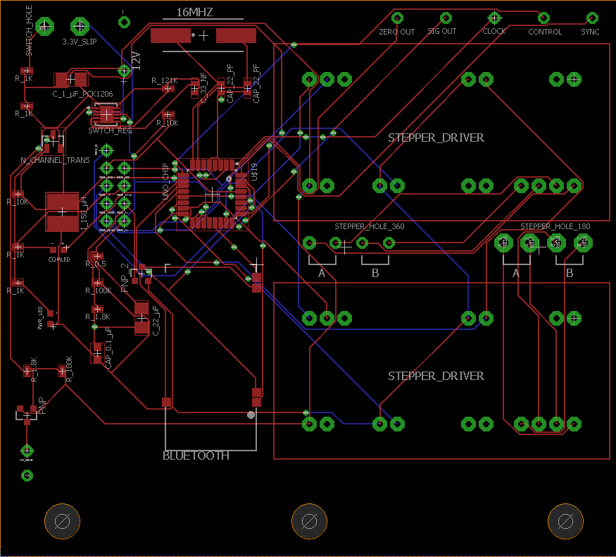
Control PCB

Slide 29
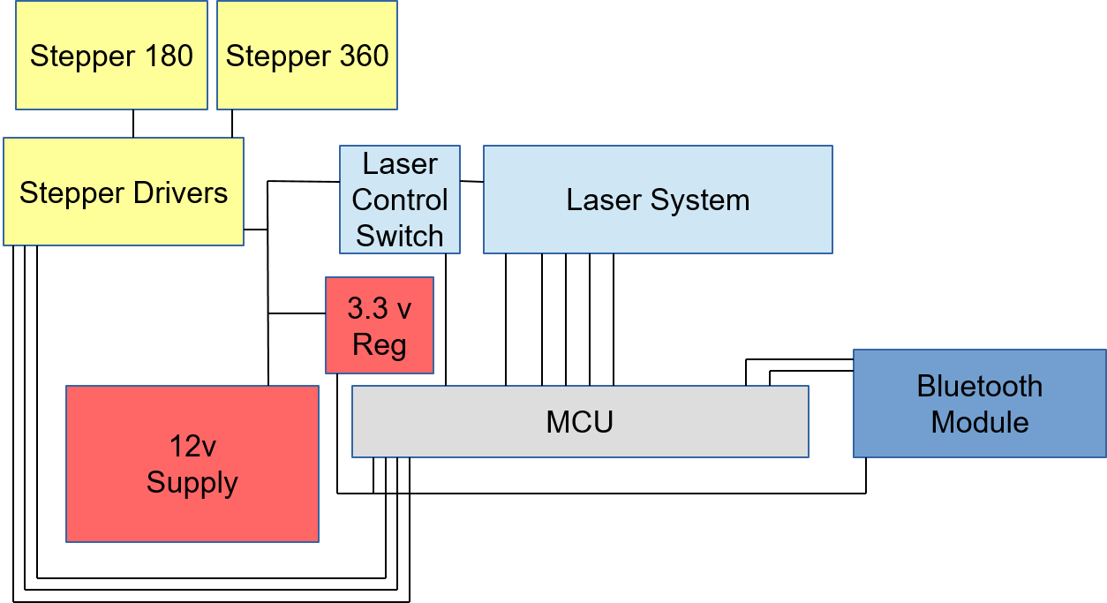
Control PCB Components and Design

Slide 30
Directing the Laser
Stepper 180
Stepper 360
Stepper Drivers
Laser
Control
Switch
Laser System
3.3 v
Reg
Bluetooth
Module
12v
Supply
MCU

Slide 31
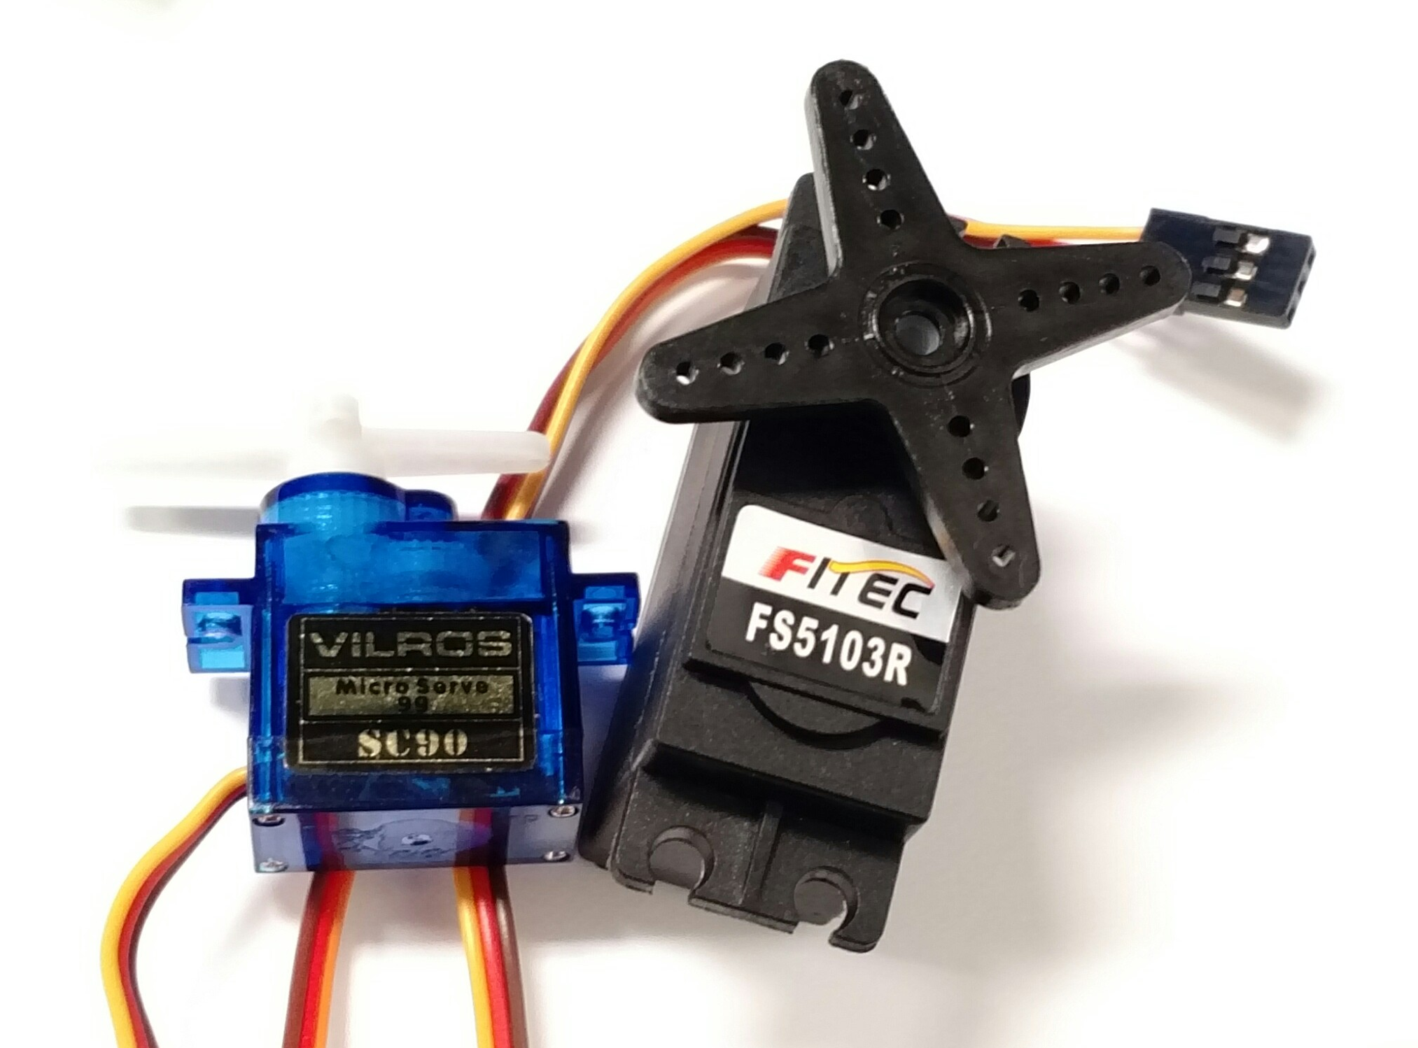
Servos vs Steppers
Servos can’t provide enough precision and control
Swapped servos for NEMA 17 and NEMA 8 stepper motors controlled by EZ Stepper Driver
Stepper Driver provides excellent current regulation and power saving modes

Slide 32
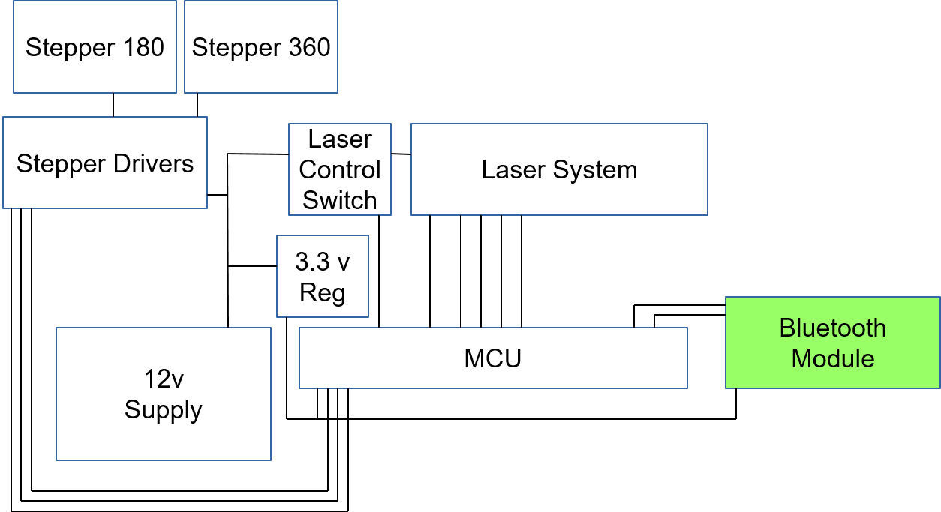
Sending the Data

Slide 33
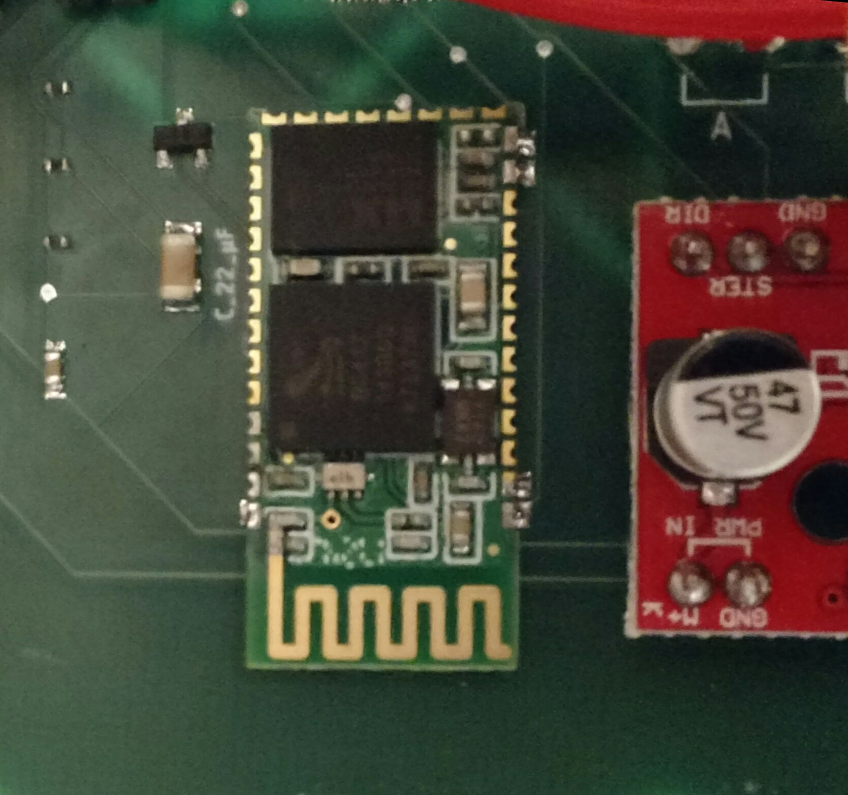
HC-05 Bluetooth Module
Standard Bluetooth protocol
Many online example projects to reference
Pybluez used during development. C++ with Bluez for the final application

Slide 34
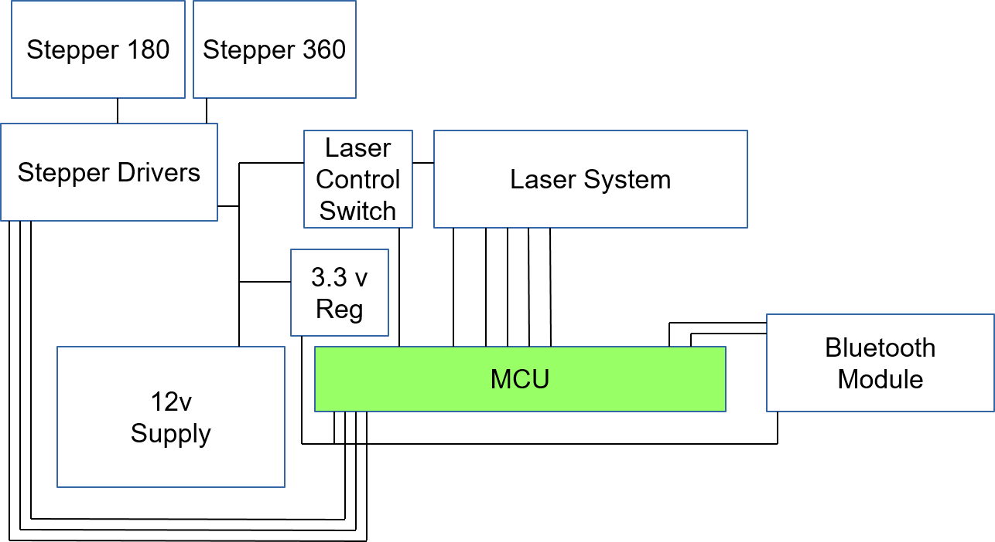
Choosing a Microcontroller

Slide 35
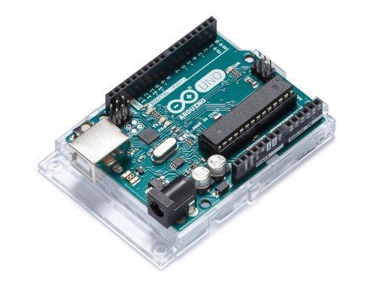
ATMEGA328P
Just enough I/O Pins
Only 2 interrupt pins required
Cheap and available
Plentiful Documentation
16 MHz to process data
32 KHz sampling rate required
ADC can be run at a rate of 12 uSec given the fastest configuration

Slide 36
Addressing Control PCB issues
Handling an unreliable user or wireless connection
Solved by implementing the Watchdog timer at its longest timeout interval
Issue of losing samples during scanning
Solved by setting the ADC to one of its fastest settings and calculating distances using signal maximums

Slide 37
Sections
Distance Measurement
Mechanical/Electronic Integration
Embedded System
PC Interface
Administrative Material

Slide 38
PC Interface Goals
Provide a sensible, usable interface for human operators to interact with
Establish a wireless connection to embedded system for various purposes
Provide a visual output for laser data

Slide 39
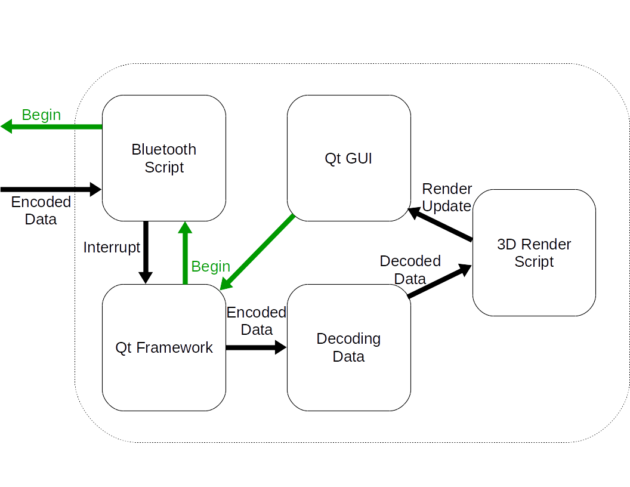
PC Interface Design Diagram

Slide 40
PC App Overview
PC app was designed in the Qt C++ framework
Provides native implementations for UI outlines, timing, debugging, and event handling
Additional feature implementations such as Bluetooth functionality and OpenGL rendering present less dependencies due to the C++ base

Slide 41
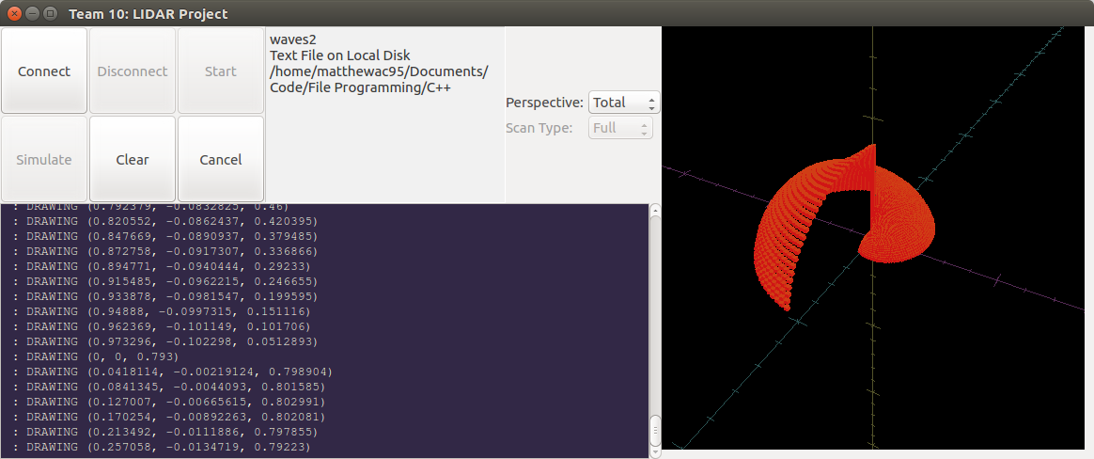
PC App – Simulating

Slide 42
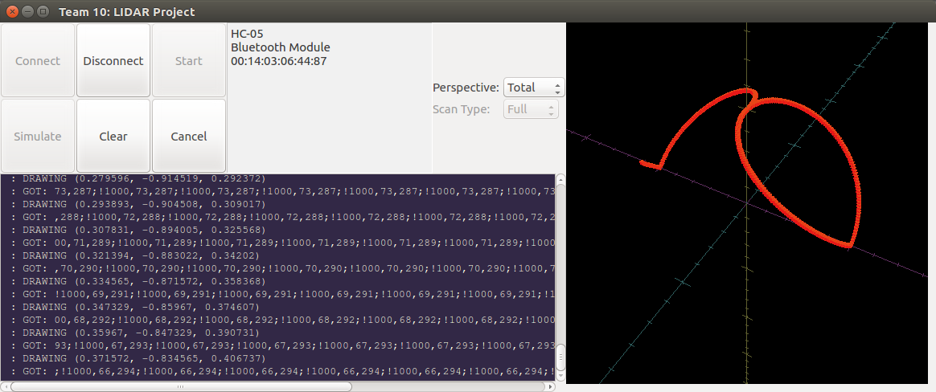
PC App – Talking to Bluetooth

Slide 43
Networking with Bluetooth
Done through a socket-based networking script embedded directly into the application
Module acts as a server while the laptop acts as the client
In order to communicate, laptop sends commands and requests messages from the module
To the embedded system, Bluetooth is just an I/O destination

Slide 44
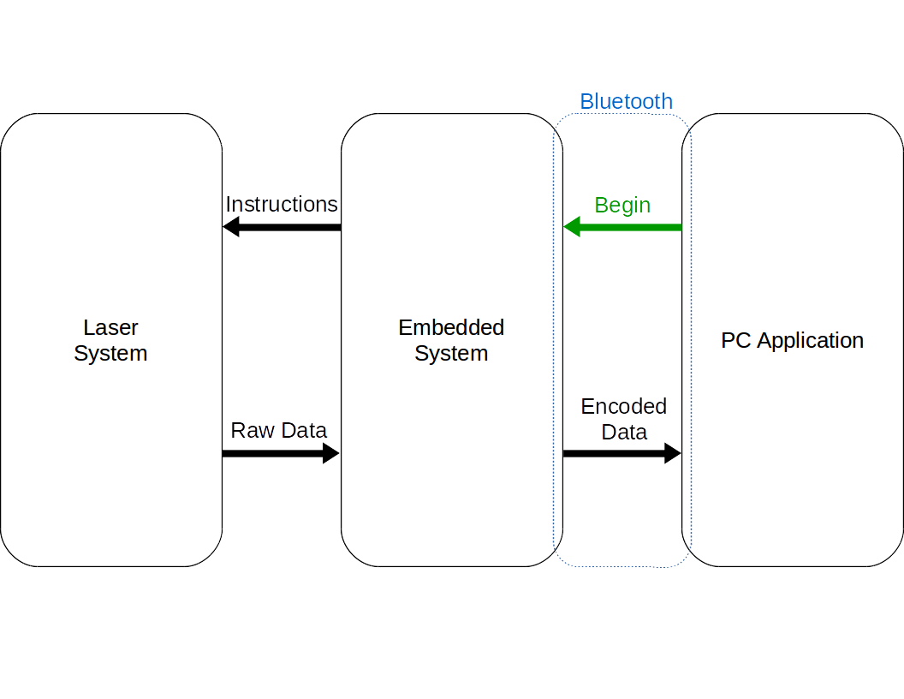
Network Diagram

Slide 45
Decoding The Data
Message from Bluetooth must first be confirmed as valid before being converted into 3D number
Done by moving through message one character at a time to find a matching format, accounting for partial messages, duplicate messages, and offset messages

Slide 46
Rendering The Data
Every primitive is rendered using glBegin() and glEnd(), data points are cubes made of GL_QUADS and axes are made of GL_LINES
glBegin and glEnd are used over vertex arrays and buffer objects
The former is easy to use and the others are more useful in apps which require high graphical performance

Slide 47
Sections
Distance Measurement
Mechanical/Electronic Integration
Embedded System
PC Interface
Administrative Material

Slide 48
Budget
Expenditure | Cost
Electronic Components | $282.37
Mechanical Components | $172.74
Prototyping Parts | $408.28
PCB Boards | $165.00
Shipping Costs | $156.66
Optics (In-House) | $1143.00
Optics (Out-of-House) | $103.13
Total Spent to Date | Unit cost (In-House) | Unit cost (Out-of-House)
$1,185.05 | $1,531.44 | $432.39

Slide 49
Electrical Components
Component | Number Bought in total | Number Used in final design | Unit Price | Total price we paid
8V linear regulator | 10 | 1 | 0.407 | $4.07
3.3V linear regulator | 10 | 1 | 0.382 | $3.82
3.3 V Buck Regulator (DRC) | 5 | 1 | 4.03 | Sample
3.3 V Buck Regulator (DGS) | 5 | 0 | 4.16 | Sample
Laser Driver | 8 | 1 | 1.02 | $8.16
Pulsed Laser Diode | 1 | 1 | 20.47 | $20.47
Laser Diode (NIU) | 2 | 0 | 25.89 | $51.78
Laser Switch | 4 | 1 | 0.69 | $2.76
Diode | 10 | 1 | 0.309 | $3.09
Transimpedance Amplifier | 4 | 1 | 5.84 | $23.36
Sampling Switch | 5 | 1 | 0.42 | $2.10
Sampling Switch | 5 | 1 | 0.32 | Sample
Duel Sampling Switch | 5 | 1 | 0.68 | Sample
Op-Amp Receiver | 5 | 1 | 0.42 | $2.10
Op-Amp Laser | 5 | 1 | 0.61 | $3.05
Photodiode | 10 | 1 | 0.806 | $8.06
Si Photodiode (NIU) | 2 | 0 | 13.8 | $27.60
12 Stage Counter | 5 | 1 | 0.63 | $3.15
D-Flip-Flop Q# (TI) | 5 | 0 | 0.18 | Sample
D-Flip-Flop Q# | 20 | 3 | 0.295 | $5.90
Inverter Gate | 5 | 2 | 0.36 | $1.80
Inverter Gate | 5 | 2 | 0.21 | Sample
D-Flip-Flop Q | 10 | 2 | 0.295 | $2.95
Dual Schmitt-Trigger Buffer | 5 | 1 | 0.42 | Sample
16.369 MHz Clock | 7 | 2 | 3.58 | $25.06
16 MHz Crystal | 4 | 1 | 0.25 | $1.00
Timing Chip (NIU) | 10 | 0 | 1.39 | Sample
Arduino Due Chip (NIU) | 2 | 0 | 9.68 | Sample
Arduino Uno Chip (NIU) | 5 | 0 | 2.2 | $11.00
Surface Mount Arduino Chips | 3 | 1 | 2.2 | $6.60
MOSFET Switch | 5 | 0 | 1.41 | Sample
NPN Transistors | 4 | 0 | 0.55 | $2.20
PNP Transistor | 5 | 2 | 0.21 | $1.05
N-Channel MOSFET | 3 | 1 | 0.36 | $1.08
Blue LED | 10 | 1 | 0.376 | $3.76
Red LED | 10 | 1 | 0.211 | $2.11
121 kΩ Resistor | 100 | 1 | 0.0056 | $0.56
100 kΩ Resistor | 100 | 4 | 0.0063 | $0.63
Component | Number Bought in total | Number Used in final design | Unit Price | Total price we paid
10 kΩ Resistor | 100 | 11 | 0.0063 | $0.63
1.8 kΩ Resistor | 100 | 4 | 0.0117 | $1.17
1 kΩ Resistor | 100 | 7 | 0.0063 | $0.63
4.7 kΩ Resistor | 100 | 1 | 0.0056 | $0.56
470 Ω Resistor | 100 | 1 | 0.0056 | $0.56
200 Ω Resistor | 100 | 4 | 0.0056 | $0.56
100 Ω Resistor | 100 | 1 | 0.0063 | $0.63
27 Ω Resistor | 100 | 1 | 0.0055 | $0.55
0.5 Ω Resistor | 4 | 1 | 0.45 | $1.80
22 µF Capacitor | 4 | 1 | 0.64 | $2.56
10 µF Capacitor | 12 | 3 | 0.215 | $2.58
1 µF Capacitor | 100 | 3 | 0.0688 | $6.88
1 µF Capacitor (alt.) | 4 | 1 | 0.45 | $1.80
0.1 µF Capacitor | 100 | 2 | 0.0446 | $4.46
100 nF Capacitor | 100 | 14 | 0.026 | $2.60
33 nF Capacitor | 10 | 1 | 0.046 | $0.46
22 nF Capacitor | 20 | 2 | 0.24 | $4.80
1 nF Capacitor | 100 | 8 | 0.0062 | $0.62
120 pF Capacitor | 100 | 1 | 0.0385 | $3.85
100 pF Capacitor | 100 | 3 | 0.0094 | $0.94
22pF Capacitor | 100 | 5 | 0.0223 | $2.23
150 µH Inductor | 4 | 1 | 0.87 | $3.48
Misc. Skycraft Elec. | 1 | 0 | 3.8 | $3.80
Slide Switch | 3 | 1 | 1.65 | $4.95
Total Spent to Date
$282.37

Slide 50
Mechanical Components
Component | Number Bought in total | Number Used in final design | Unit Price | Total price we paid
Slip Ring | 1 | 1 | 42.3 | $42.30
360° Servo | 1 | 0 | 29 | $29.00
Nema 17 Stepper Motor | 1 | 1 | 13.99 | $13.99
Nema 17 Mounting Bracket | 1 | 1 | 6.5 | $6.50
180° Servo | 1 | 0 | 10.89 | $10.89
Nema 8 Stepper Motor | 1 | 1 | 24.95 | $24.95
T50 Gear | 3 | 1 | 5.32 | $15.96
T90 Gear | 3 | 1 | 7.72 | $23.16
Delrin Sheet 0.25'x12'x12' | 1 | 1 | 52.1 | Sample
T50 Gear Mount | 1 | 1 | 5.99 | $5.99
Total Spent to Date
$172.74

Slide 51
Prototyping Parts
Component | Number Bought in total | Number Used in final design | Unit Price | Total price we paid
Male Pin Headers | 1 | 0 | 7.29 | $7.29
Female Pin Headers | 1 | 0 | 5.6 | $5.60
Flux Pen | 1 | 0 | 12.75 | $12.75
Solder Paste | 2 | 0 | 1.95 | $3.90
Solder Wick/Desoldering Pump | 1 | 0 | 7.99 | $7.99
MSSOP-14 Breakout Boards | 2 | 0 | 2.83 | $5.66
SC-70 Breakout Boards | 4 | 0 | 0.6 | $2.40
SC-70-6 Breakout Boards | 4 | 0 | 0.85 | $3.40
0.3 mm Solder | 1 | 0 | 9.99 | $9.99
Battery Holder | 8 | 1 | 0.6 | $4.80
Bluetooth BLE (NIU) | 1 | 0 | 7.99 | $7.99
Bluetooth | 5 | 1 | 9.99 | $49.95
Stepper Motor Driver Board | 3 | 1 | 9.99 | $29.97
IC Chip Socket Adaptors | 1 | 0 | 6.22 | $6.22
Protoboards | 1 | 0 | 9.99 | $9.99
Wires | 1 | 0 | 15.34 | $15.34
Switches (NIU) | 1 | 0 | 8.14 | $8.14
Arduino Due | 2 | 0 | 40.27 | $80.54
Batteries | 1 | 0.25 | 16 | $16.00
USBtinyISP | 1 | 0 | 12.95 | $12.95
Alligator Clips | 1 | 0 | 6.78 | $6.78
Multicolored Dupont Wire | 1 | 0 | 7.86 | $7.86
Nylon Screws/Spacers | 1 | 0 | 8.99 | $8.99
Superglue | 1 | 1 | 10.59 | $10.59
Giftcards | 2 | 0 | 25 | $50.00
Laser Heat Sink (NIU) | 1 | 0 | 6.69 | $6.69
Beamsplitting Cubes | 1 | 0 | 16.5 | $16.50
Total Spent to Date
$408.28

Slide 52
Optical Components
Component | Number Bought in total | Number Used in final design | Unit Price | Total price we paid
Aspherical Lens (In-House) | 1 | 1 | 124 | Sample
Cylindrical Lens (In-House) | 1 | 1 | 459 | Sample
Focusing Lens (In-House) | 1 | 1 | 210 | Sample
Mirrors (In-House) | 2 | 2 | 71 | Sample
Beamsplitter (In-House) | 1 | 1 | 279 | Sample
Aspherical Lens (Out-House) | 0 | 0 | 11.23 | $0.00
Cylindrical Lens (Out-House) | 0 | 0 | 39.31 | $0.00
Focusing Lens (Out-House) | 0 | 0 | 17.99 | $0.00
Mirrors (Out-House) | 0 | 0 | 11.82 | $0.00
Beamsplitter (Out-House) | 0 | 0 | 22.78 | $0.00
In-House Cost | Out-of-House Cost
$1143.00 | $103.13

Slide 53
Group Member Work
Name | Laser System | Detection System | Timing | Signal Analysis | Data Communication | Electrical Design | Mechanical Design | 3D Render | PC app
Daniel | ● | ● |  |  |  | ● | ●
Aaron |  | ○ | ● | ○ |  | ○ | ●
Matthew |  |  |  |  | ○ |  |  | ● | ●
Sean |  |  | ○ | ● | ● | ● | ●
Primary Contributor | ●
Secondary Contributor | ○

Slide 54
Final Assembly
Range of 1 meter to 2 meters
Due to power loss
Accurate within $±$10 cm in the axial direction
Due to noise in return signal
Added filters to reduce noise
Precision optics hindered ability to make chassis
Potential heating issue with stepper drivers
Application is unresponsive during device discovery

Slide 55
Questions?

Slide 56
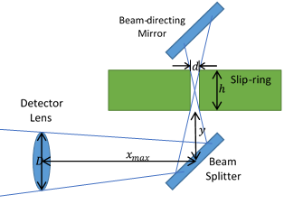
Power Loss Due to Slip-ring
$$x_{max}=\frac{\left(D−d\right)h}{2d}−y$$

Slide 57
Expected Axial-Resolution
$$Δd=\frac{T_{convert}}{T_{sync}}∗18.33m$$
$$T_{convert}=31.5 µs$$
$$T_{sync}≈22 ms$$
$$Δd≈2.6 cm$$

Slide 58
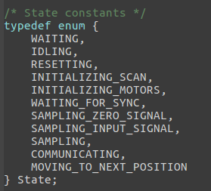
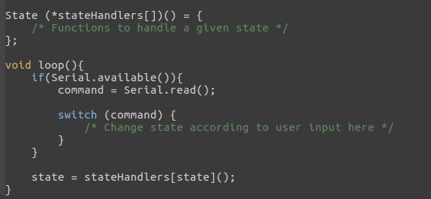
Programming the ATMega328P
Keeping the system responsive

Slide 59
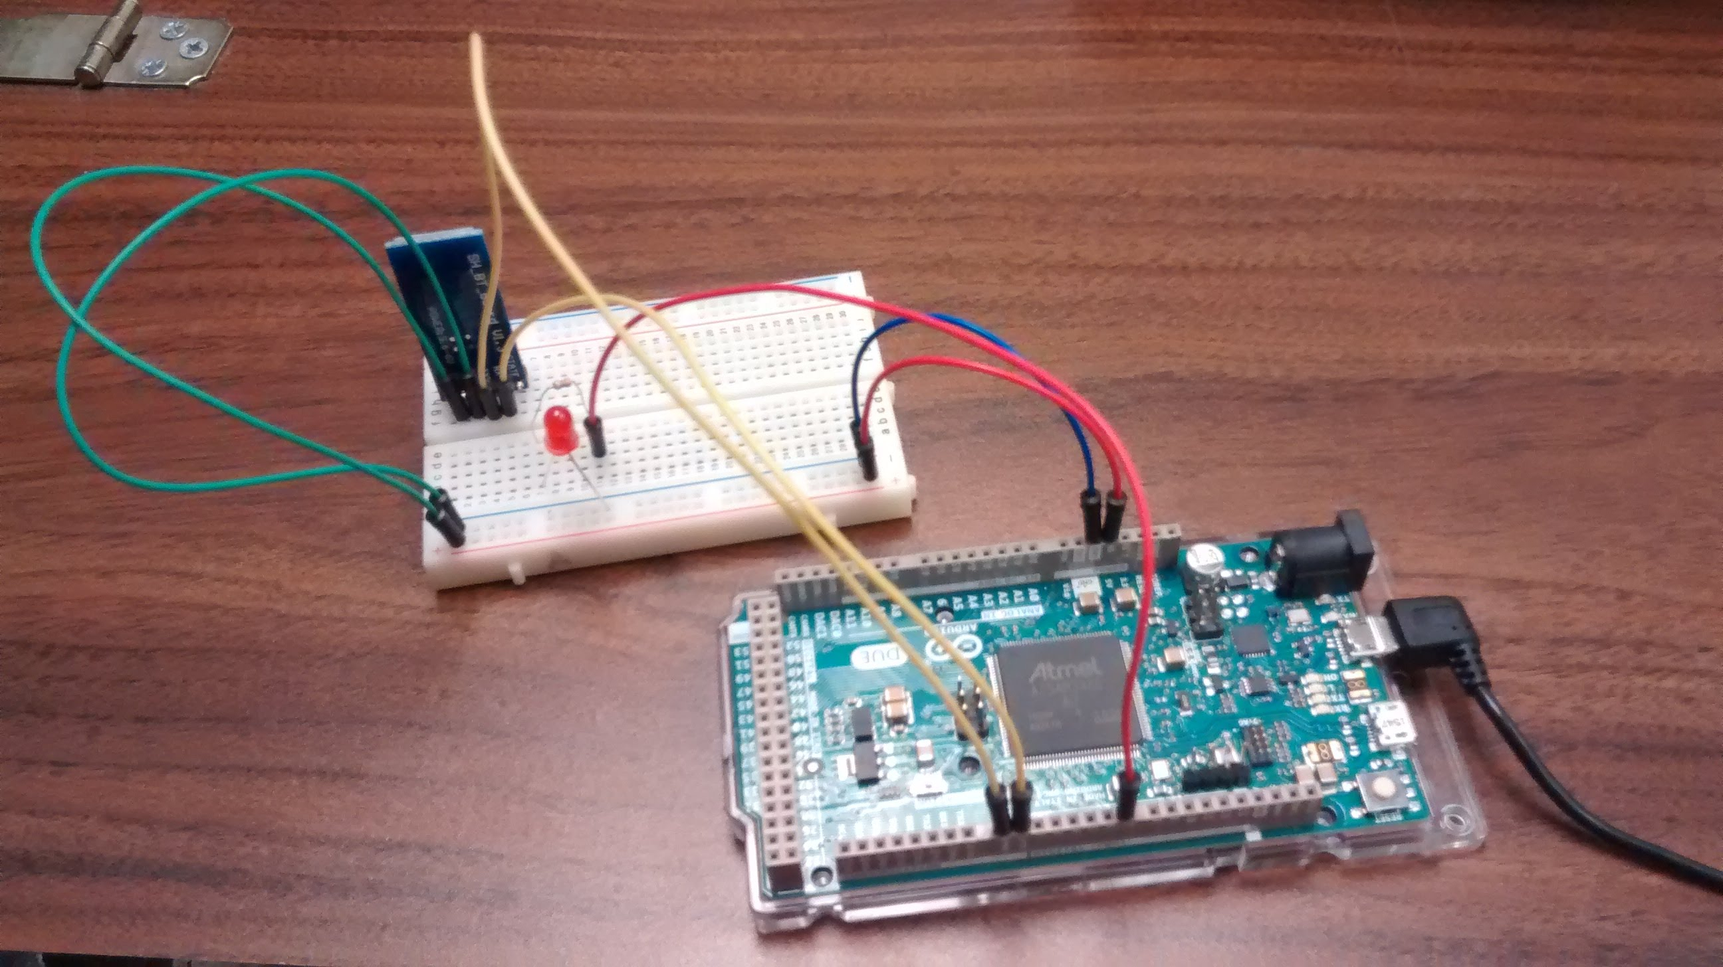
Dedicated Testing Circuit

Slide 60
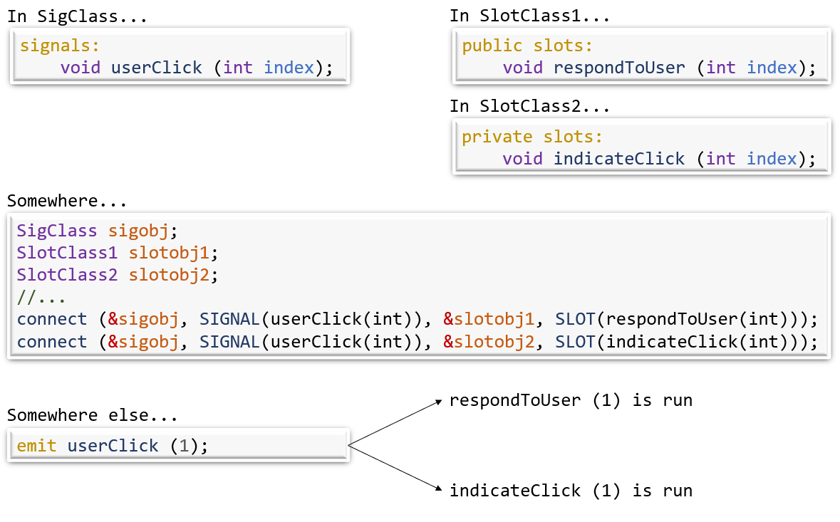
Qt – Signals and Slots

Slide 61
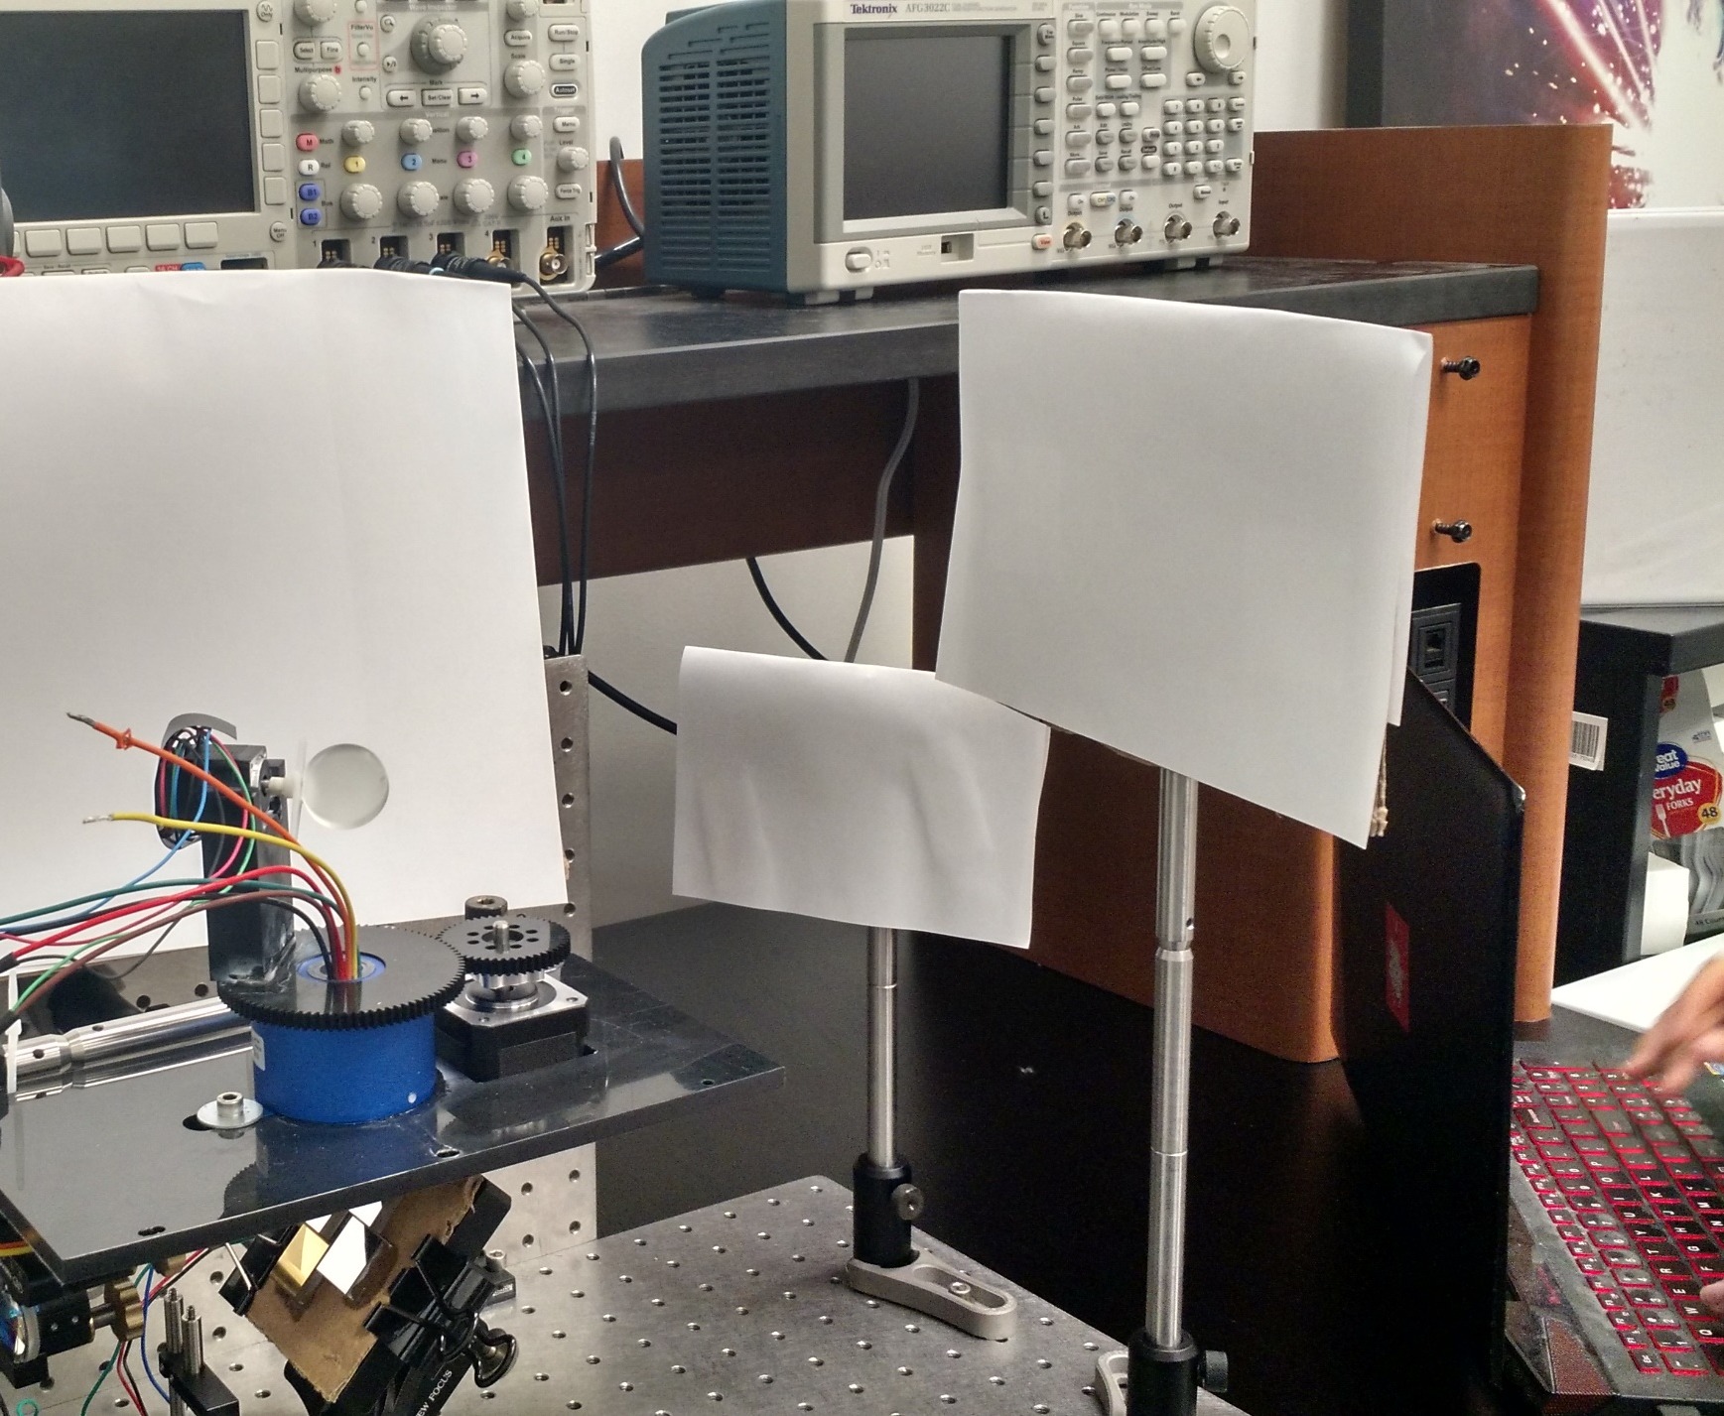
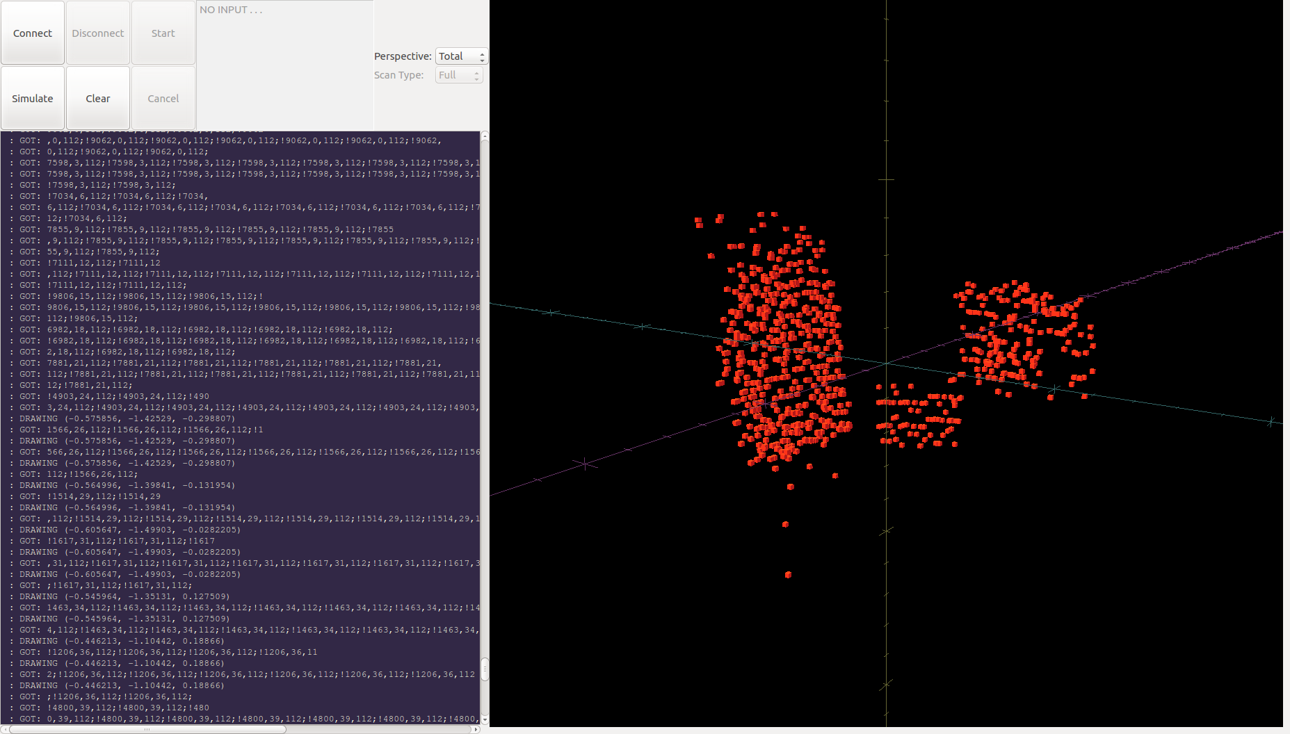
Test Results

