Slide 1


Group 19 Members
Landon Davis Electrical Engineer
Zack Foster Electrical Engineer
Christopher John Ison Computer Engineer
Michael Mosquera Computer Engineer

Slide 2

Motivation:
According to the U.S. Department of Justice there are approximately 1.03 million home invasions that occur each year
What are the typical hours that home invasion occur?
  Most invasion occur from 10:00AM – 3:00PM
Why?
  Thieves/ home invaders know that household members are not present during these hours

Slide 3
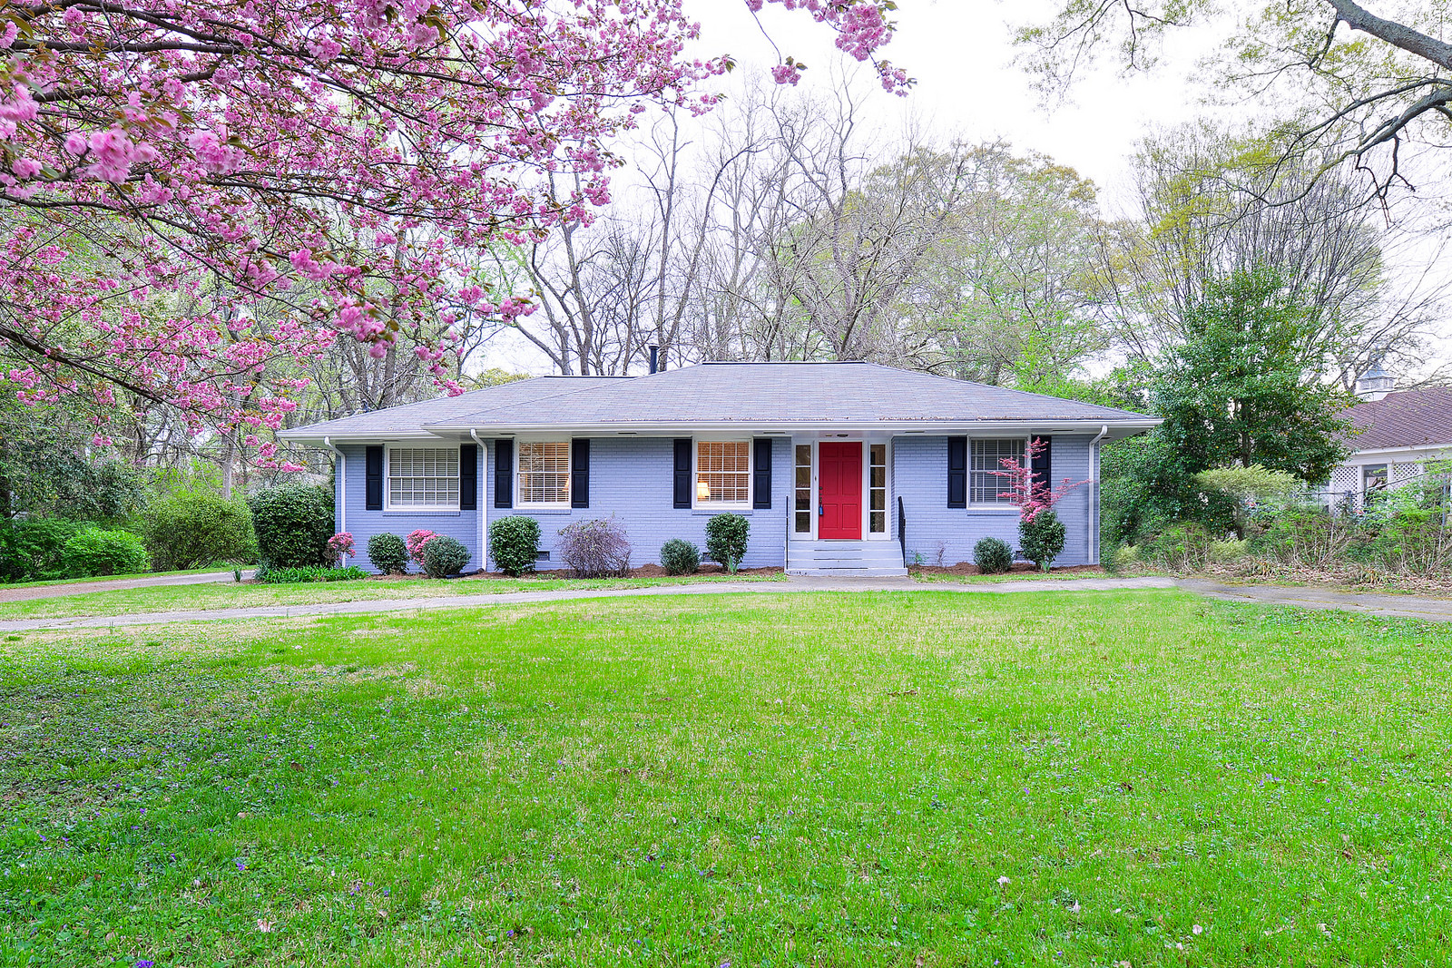

Slide 4

What is GuardMat
  An affordable and compact passive security system available to homeowners that can notify them of any presence at their door. Whether it be an expecting guest or an unwelcome person at your door.

Slide 5
How Does it Work
GuardMat works by sending a live video feed from the onsite
surveillance camera to the individual’s mobile device via SMS
(short messaging service).
What triggers the video feed
The system consists of a pressure sensitive mat that is capable of
detecting pressure. Once the mat detects the pressure, the system
proceeds to activate the camera which would be sent to the user’s
mobile device.

Slide 6

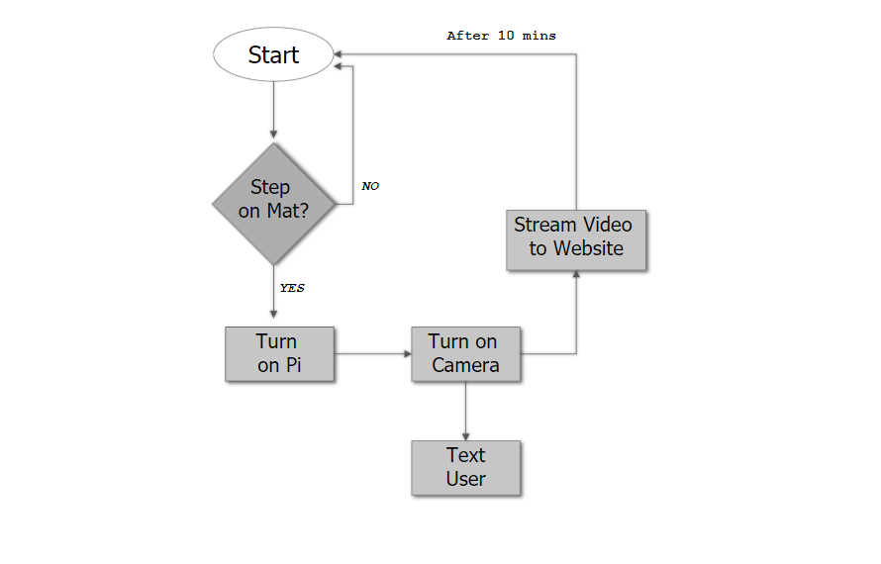

Slide 7
GOALS :
Provide a defensive measure for homeowners
Provide homeowners with a real time video feed of all integral entry points
Quick and simplistic access to HD video feed
Easy installation process
Give people peace of mind, anytime, anywhere

Slide 8

PROTECT YOUR HOME ANYWHERE
Your home

Slide 9

Technical Objectives
Pressure sensitive mat that will serve as the trigger for camera activation
Send video feed from the camera to the user’s mobile device via SMS
(Mobile App): containing a library of previous video feeds as well as accessibility of live video feeds
Moderate battery life for preservation and duration of the system

Slide 10
Technical Specifications
Mat size: 7” X 5” x 3” in
Total System Size: 900g or 2lbs.
PCB Design contains 3 ports:
  Analog Input
  Digital Output
  USB type b
Video Camera resolution of 720p @ 30 – 60fps
Response time from trigger to PCB to Pi: no more than 4 sec.
Camera FOV minimum of 120 degrees

Slide 11
Hardware Design

Slide 12
Pressure Sensing
Force Collector sensing uses a collector such as a diaphragm or piston to measure the force applied over the area.
Force collector sensors are made with varying technologies, such as:
    piezoresistive
    capacitive
    electromagnetic
    piezoelectric
    optical
    potentiometric

Slide 13

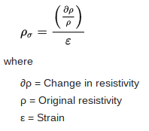
Piezoresistive devices have a linear change, within a range of applied pressure.
The piezoresistive coefficient is the change in electrical resistivity due to strain.
The piezoresistive coefficient can be found with the following formula.

Slide 14
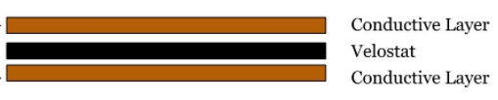
The Velostat material is made up of polymeric foil impregnated with carbon black.
The addition of carbon black is to increase the electrical conductivity and to give the material an antistatic effect.
Velostat

Slide 15
 | Velostat | Linqstat | Force Sensitive Resistor
Surface Resistivity | 31000 Ω/cm² | 40000 Ω/cm² | 124 kΩ/cm² - 250 Ω/cm²
Volume Conductivity | < 500 Ω-cm | < 500 Ω-cm | -
Range of Resistivity | - | - | 100 kΩ - 200 Ω
Max Force | 140.61 kg/cm² | 140.72 kg/cm² | 10 kg/cm²
Temp. Range | -45℃ to 65℃ | -45℃ to 65℃ | -30℃ to 70℃
Range of Size | 3 m² (sheets) | 42 m² - 420 m² (roll) | 0.25 cm² - 3111 cm²

Slide 16
 | Tape | Exposed Wire | Thread
Materials | Carbon (C) Carbon Nickel Nickel (N) Copper Foil (Cu) Aluminum Foil (Al) Silver (Ag) | Copper (Cu) Aluminum (Al) Gold (Au) | Copper (Cu) Silver (Ag) Stainless Steel
Size | 12-25mm x 5 m (C) 6.3-12.7mm x 16.5 m (Cu) 6.3-25.4mm x 16.5 m (Al) | 32 - 0000 AWG | 2-ply (SS) 3-ply (SS) 23 m spool
Resistance | 100 kΩ/sq. (C) 1 mΩ/sq. (Cu) | 164.1 Ω/kft (32) 0.05 Ω/kft (0000) | 16 Ω/ft (2-ply) 10 Ω/ft (3-ply)
Temp. Range | -20℃ to 70℃ | 0.00393/℃ (Cu) 0.00429/℃ (Al) | 0.00393/℃ (Cu) 0.0038/℃ (Ag)

Slide 17
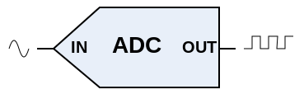
Analog to Digital Conversion Types
Conversion Type | Pros | Cons
Flash | Fast | Many Parts Expensive Power Consumption
Sigma-Delta | High resolution | Slow
Dual Slope | High accuracy Noise immunity | Slow
Successive Approximation | High speed capability Tradeoff of speed and cost | Higher resolution requires more time

Slide 18
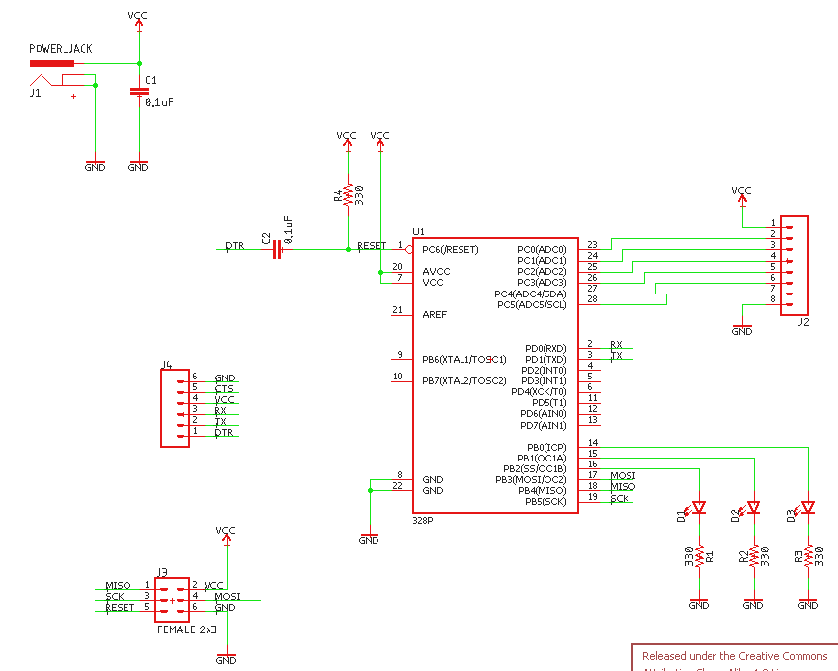

Slide 19

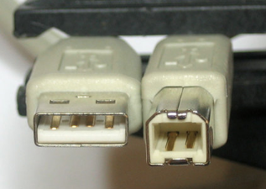
How do we Communicate?
R Pi uses the USB-C that supplies to USB-B connection to power and communicate with the PCB. R Pi is used as the master unit to run the signal processing code for the PCB to understand.
USB-C left / USB-B right
Notes:
5V USB-C
The PCB’s Atmege328P can utilize a 3.3V USB-B source

Slide 20
System Power Limitations
R Pi module requires a 3.3V operating voltage (~1.5AMax)
  The Camera will have use (~250mAMax)
While the Atmega328P requires 3.3V but 5V for increase performance (~500mAMax)
Summing these together we find that our load will use about ~2.25A max current draw
Solutions?
Notes:
Because the R Pi board will use a USB-C connector to provide power to the PCB we have recently determine that the entire system will

Slide 21
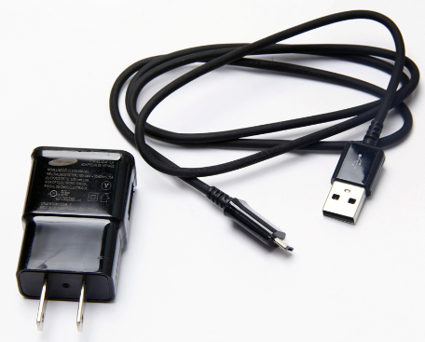
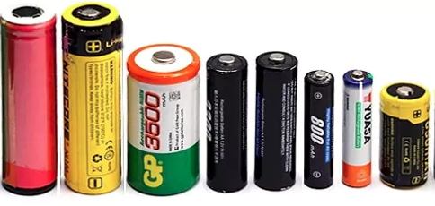
Source of Energy
AC to DC wall plug
Battery powered
Rechargeable or not?
Notes:
AC to DC is would be a good choice for this system, but doesn’t allow us to meet out mobile design specifications.
Battery powered will be our means of delivering power to this system. Give us a mobile and robust design required for our system.
Either rechargeable or not is an important question to be answered as well

Slide 22
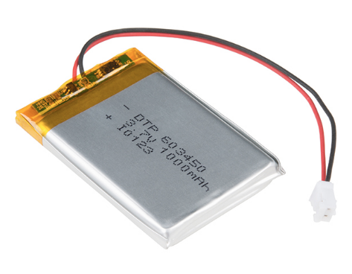
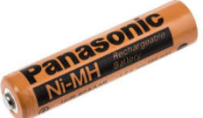
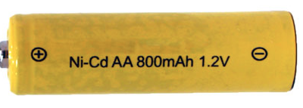
Battery types
Li-Ion (Lithium ion)
Ni-Cd (Nickle Cadium)
Ni-MH (Nickle-Metal Hydride)
Notes:
Of these batteries type. We choose Li-ion
Li-Ion = Even though explosive under heavy discharge and high charge rate conditions
- energy density by size with Li-ion batteries prove to be ideal for small to medium load systems
- Memory affect is far more superior to that of Ni based batteries
- Weight savings compared to the other 2 choices proves to be superior e
- The upside of the Li-ion batteries are self discharge rate
- On the negative side, the service life is lower compared to its counterparts (~500 charges)
NiCad = are toxic when not disposed properly
- With todays technology NiCad batteries have pretty much become obsolete
- they have less capacity the Both Others in all shapes and sizes
- best suited for applications to depletion (clocks, radio, flashlight)
Ni-MH = They are one of the most widely used batteries for modern electronic devices
- Provide high energy capacity and are easily chainable into larger “packs”
- Longest Service life of all these batteries ~1000 charges depending on capacity and metals used
- only down side is the weight of these batteries

Slide 23
Part of the Solution
Separate battery sources per board
  Rechargeable vs Non-Rechargeable
1 larger battery to support both boards
  Rechargeable vs Non-Rechargeable
Notes:
Just for testing purposes did the a non-rechargeable VDC battery serve its purpose. Even though testing is not done
1st - use 2 Li-ion batteries on each board to supply power
pros – less heat from power regulation
con – Cost
Rechargeable requires more circuitry for onboard charging and discharging but provides a more robust system required for this type of project
2nd – 1 larger battery
pros – less cost in the long run (not having to replace multiple batteries at the end of its life cycle), more
cons – requires a way to either step down the voltage or regulate the rate of drain depending on battery specs
Because the USB-C to B cable supports power as well as data transfer, we decided to use that as a means for the PCB to operate.
This in turn eliminates the need for an additional battery.

Slide 24
Battery Management
Battery Supply
PCB
R Pi
We need a way to distribute power to the R Pi and PCB safely we face these issues
  Charging the battery before depletion while in-use
  Depletion protection (no less then 2.7V)
  Over-Charge protection (no more then 4.2V)
Notes:
With realizing that we need only 1 battery, A larger voltage battery should serve well for this application.

Slide 25
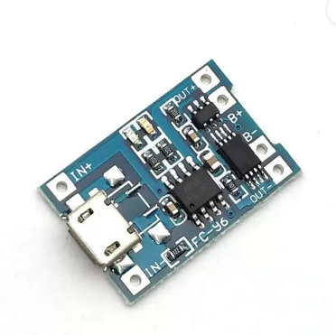
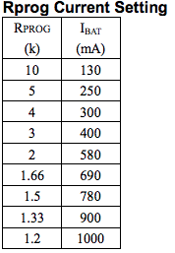
TP4056 Li-ion Battery Charger

Slide 26
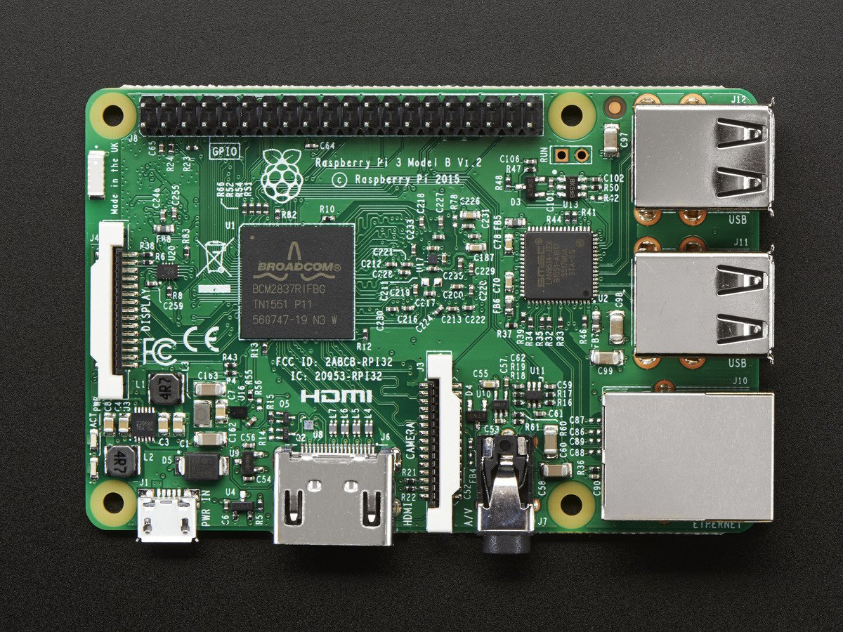
Board Computer Selection

Slide 27
Raspberry Pi 3 Specs
CPU: 4X ARM Corte-A53, 1.2GHZ
RAM: 1GB
Networking 10/100 Ethernet, 2.4GHz 802.11n wireless
Bluetooth: Bluetooth 4.1 Classic, Bluetooth Low Energy
Storage: microSD
GPIO: 40-pin header
Ports: (1) HDMI, (2) 4XUSB 2.0, (3) Camera Serial Interface, (4) Display Serial Interface
Supported Comm Protocol: SPI, I2C, UART

Slide 28
Camera Selection
NoIR Wide Angle FOV160° 5-Megapixel Camera Module
Sensor: 0V5647
Dimensions: .99 X .95 X .36
FOV: 160 degrees
Pixy (CMUcam5)
Dimensions: 2.1 X 2.0 X 1.4
Weight: 27g
Supports: SPI, I2C, Uart
FOV: 75 degrees

Slide 29

Software Design

Slide 30



Main Components
Raspberry Pi 3
Twilio

Slide 31


What Is Twilio?
Cloud platform that lets developers build real time communications into their software applications.
Over 40,000 businesses uses it including Lyft, Airbnb, Uber and Netflix.
SMS, Voice, Videos, etc.
Serverless environment

Slide 32
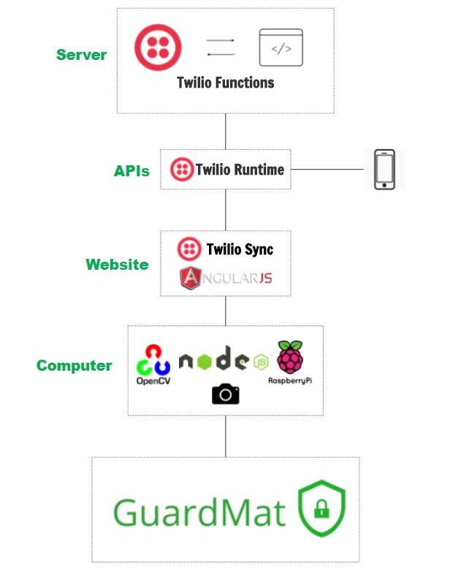
Software Overall Diagram

Slide 33
Software Overall Diagram
Twilio Functions
Stores the images, videos and codes.
Scales automatically when needed.

Slide 34
Software Overall Diagram
Twilio Runtime
Application Programming Interface that communicates with the database
Sends the SMS to user with URL link of the website

Slide 35
Software Overall Diagram
Twilio Sync
Manages permissions and access
Front-end website written in AngularJS

Slide 36
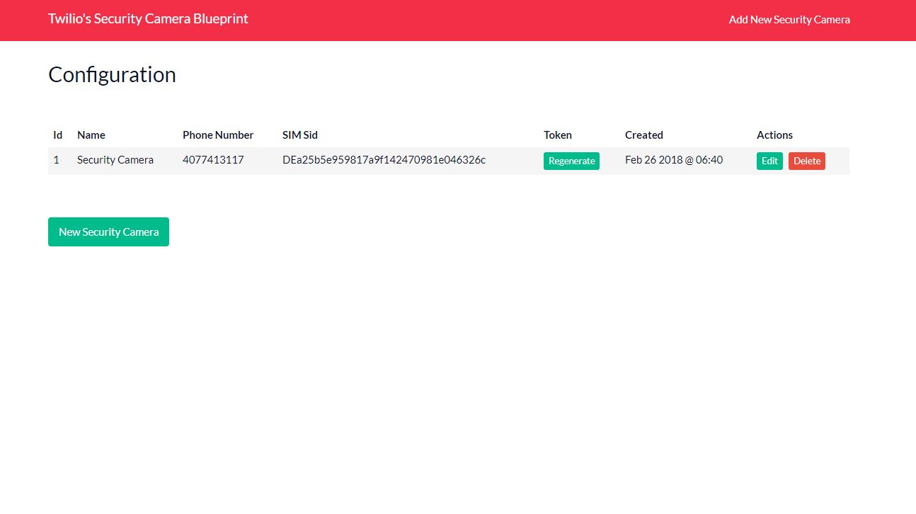

Slide 37
Software Overall Diagram
Computer (Raspberry Pi)
OpenCV - detect people and object in the video feed
NodeJS framework – uses npm to manage packages.

Slide 38
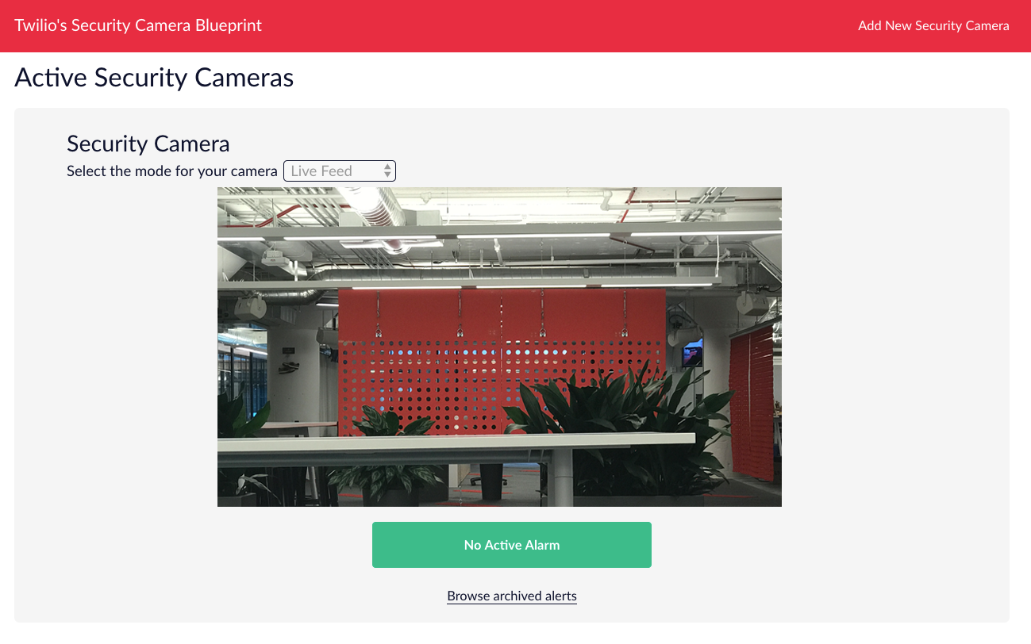
GuardMat Functionalities:
Access Anywhere ->
Live View
Security

Slide 39
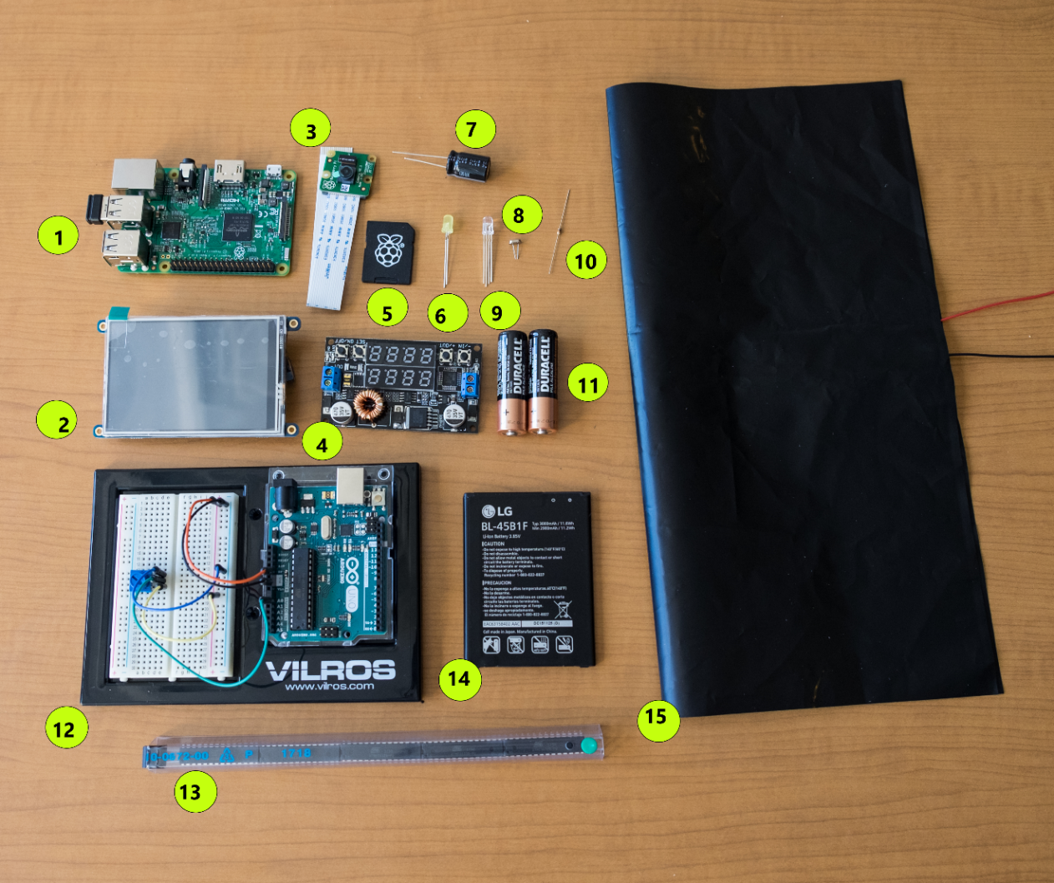
 | Item List
1 | Raspberry Pi 3 Model B
2 | Osoyoo LCD Display
3 | Wide Angle Camera
4 | Buck Converter
5 | NOOBS Preloaded SD card
6 | LED light
7 | Capacitor
8 | Crystal
9 | LED light
10 | Resistor
11 | AA Duracell Batteries
12 | Arduino Uno 3/ Breadboard
13 | ATmega328
14 | Battery
15 | Conductive Sheet
Place your screenshot here

Slide 40

BUDGET
 | Vendor | Price | Amount
Raspberry Pi 3 Model B | Urpi | $ 35.22 | 1
NOOBS Preloaded SD card | Viaboot | $10. 85 | 1
Raspberry Pi Camera | Raspberry Pi | $25.00 | 1
Arduino Uno 3 | Prestige Millano | $44.99 | 1
Pressure Sensitive Conductive Sheet | Ada-fruit | $9.09 | 1
Conductive Tape | Ted Pella, Inc. | $20.00 | 1
PCB | PCBWay | $3.00 | 1
ATmega328 | Digi-Key | $10.00 | 5
TOTAL PRICE |  | $158.15

Slide 41

THANKS!
Any questions?
You can find us at:
lan.da727@gmail.com
z.g.foster@gmail.com
johnison@knights.ucf.edu
mosquera@gmail.com

