Slide 1


The Smart Security Dash Camera
Matthew White
Timothy Deligero
Austin Sturm
Scott Levine
Joseph LaBauve
Group 25
Notes:
Matt

Slide 2
Roles
Matthew White - Sponsor / Lead Hardware Designer
Austin Sturm - Lead Software Developer
Joseph LaBauve - Hardware Designer
Scott Levine - Embedded Software Design
Timothy Deligero - Mobile App Development
Notes:
Matt

Slide 3
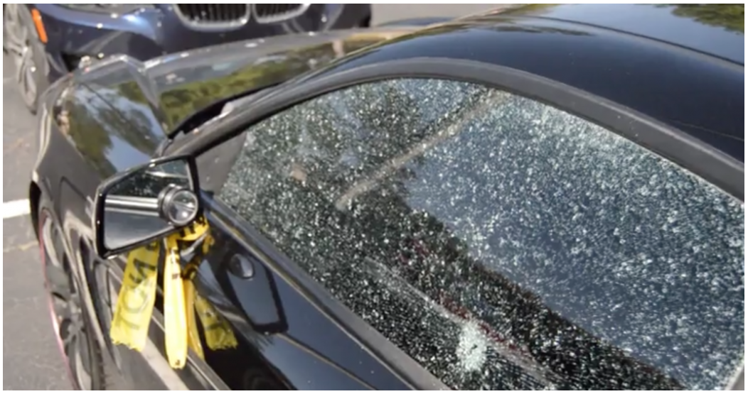
Introduction
According to the Department Of Transportation there were 765,484 reported car thefts in the US in 2016
In March 2017 there was 36 vehicle break-ins on the UCF campus. Costing students and parents hundreds to thousands in damages per vehicle
What if one car had a Smart Dash Cam?
The Smart Dash Camera will provide users with piece of mind and instant notification
Notes:
Matt

Slide 4


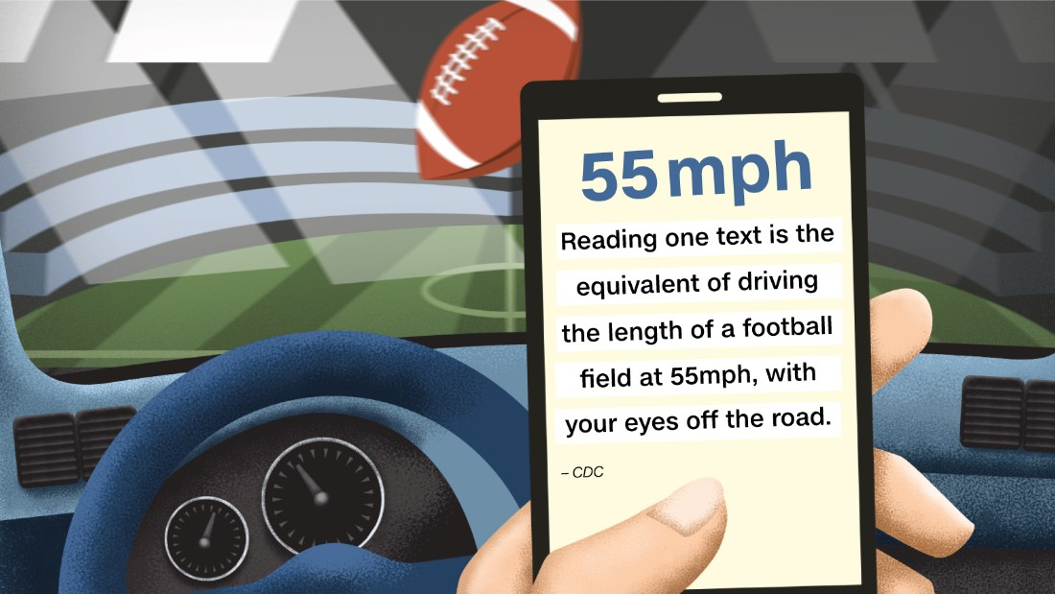
Goals and Objectives
Design and implement a Smart Dash Camera to send video data at 1080p 60fps when an incident occurs
The dash camera will provide a solution to the growing problem of vehicle damages, break ins, texting and driving, vehicle related deaths and overall vehicle thefts
The dash camera must be calibrated to be able to tell the difference between a true crisis and false positive
Notes:
Matt

Slide 5
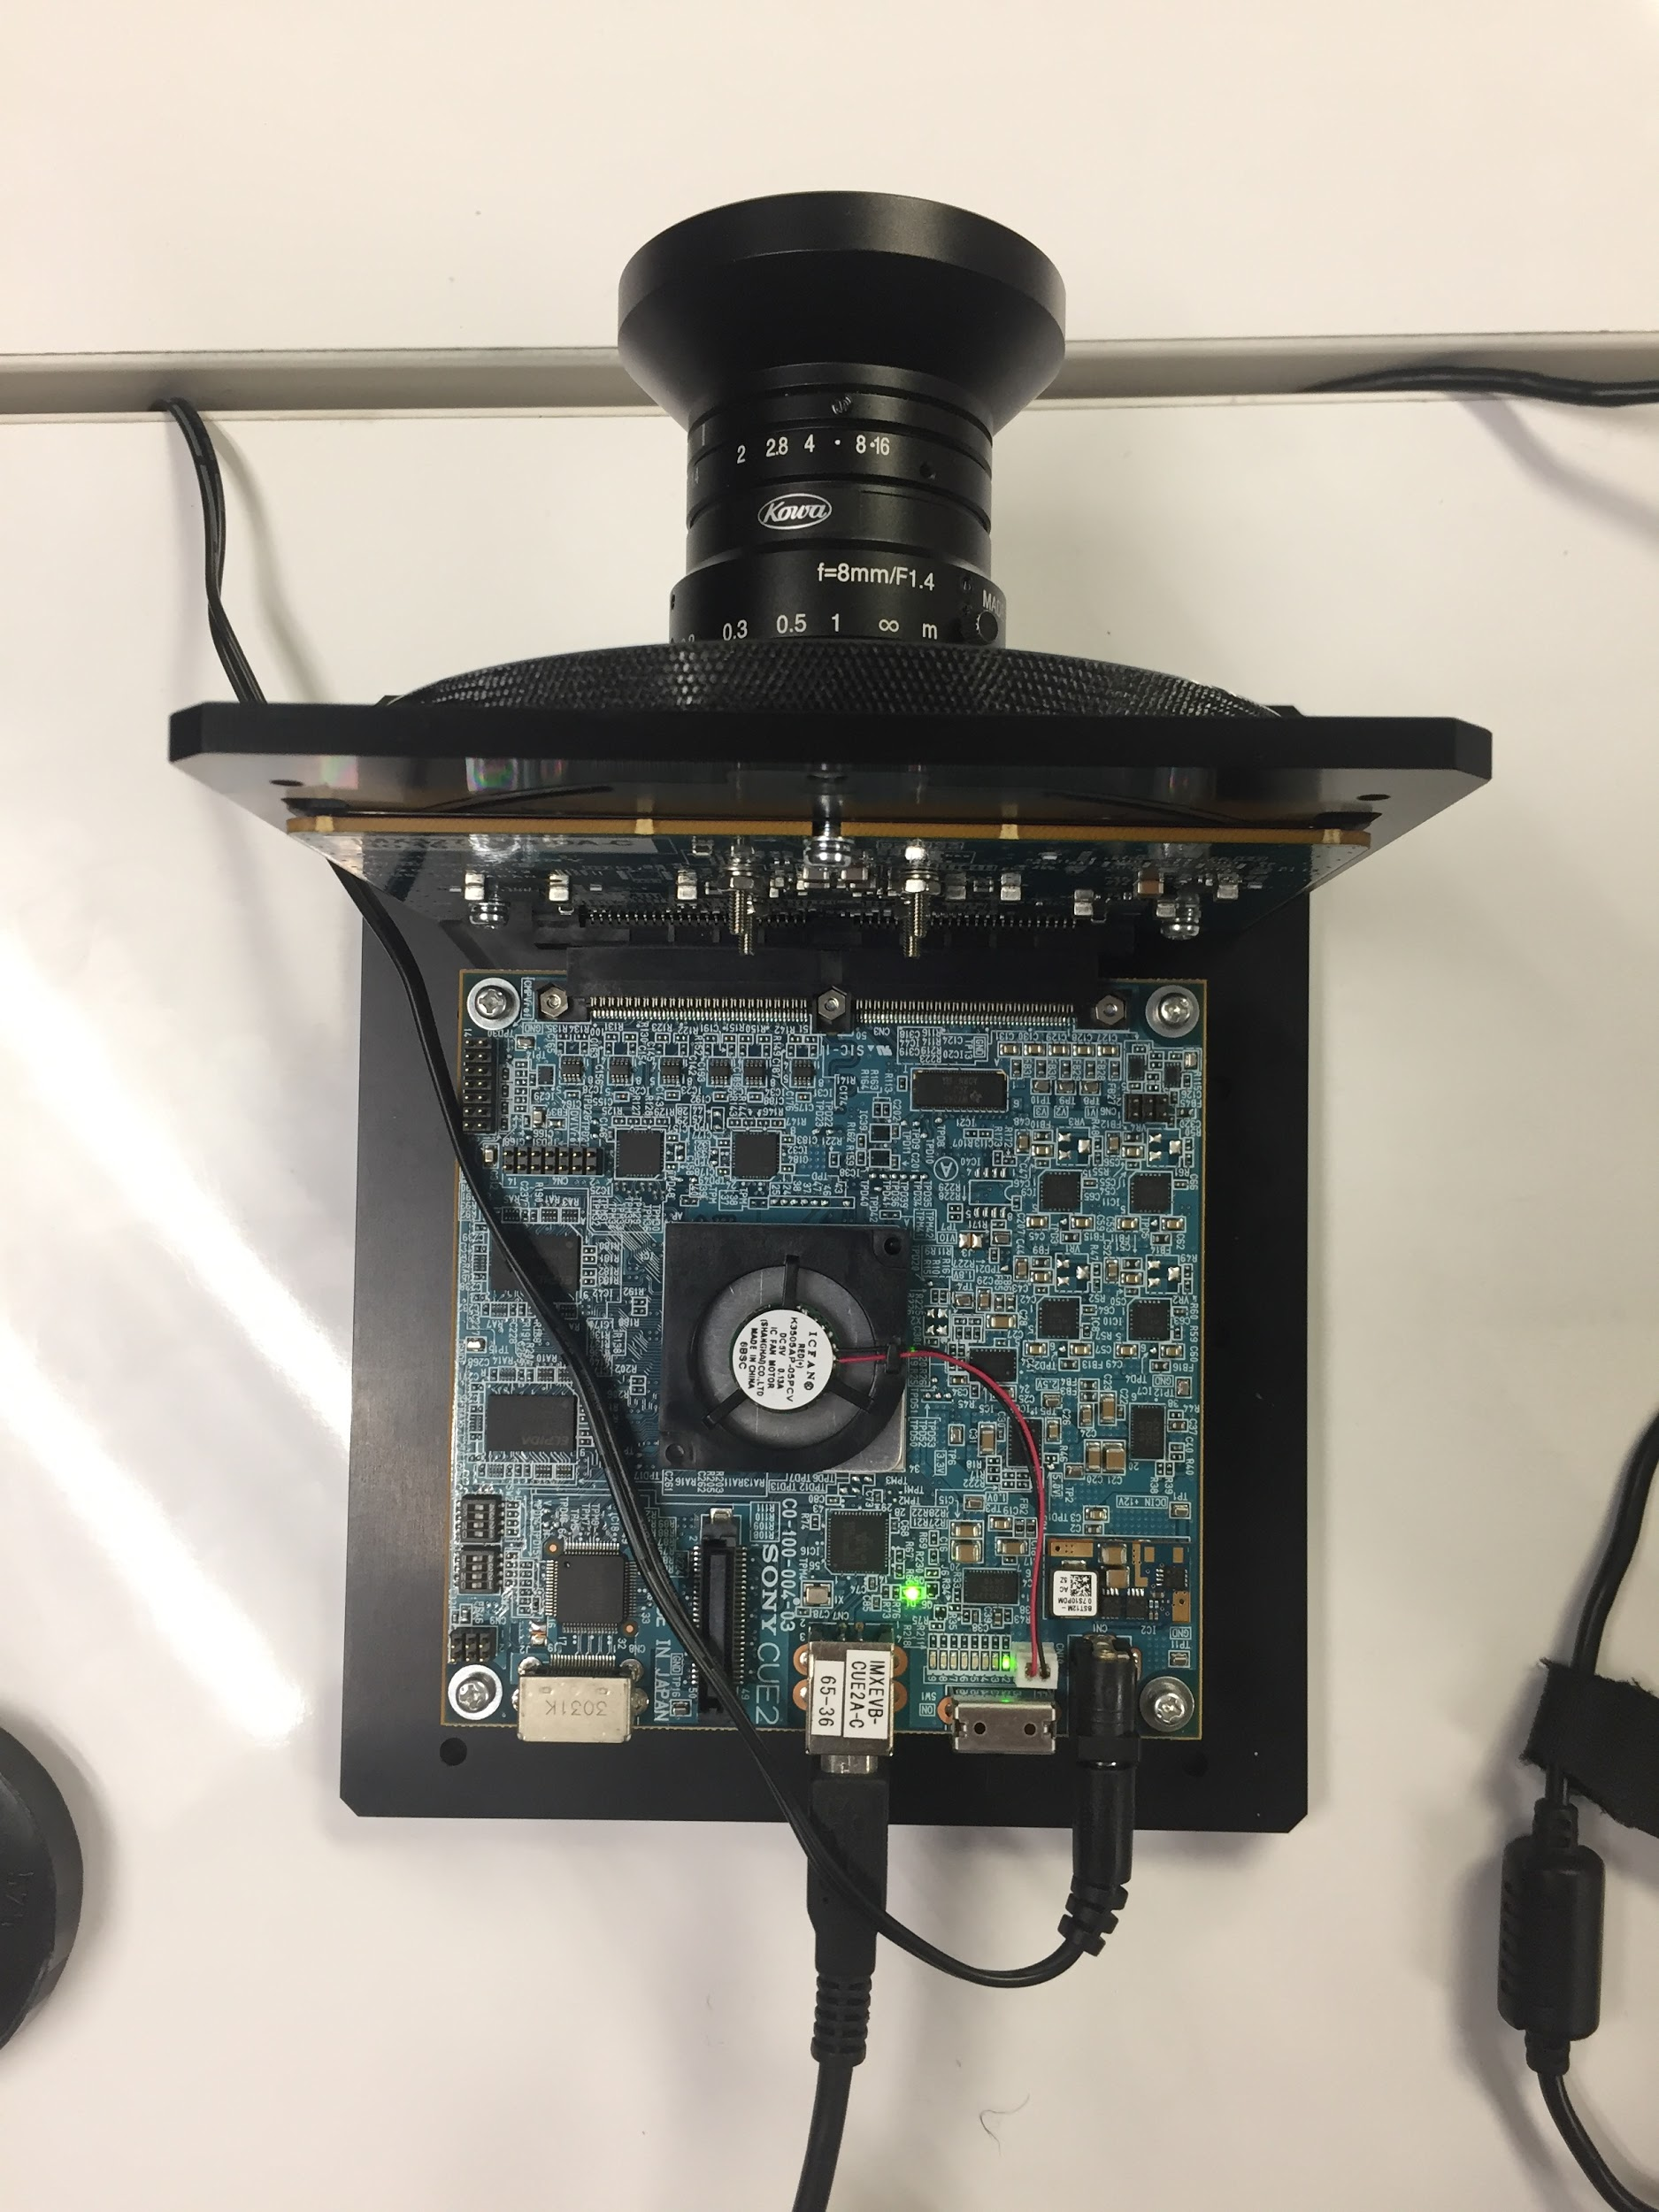
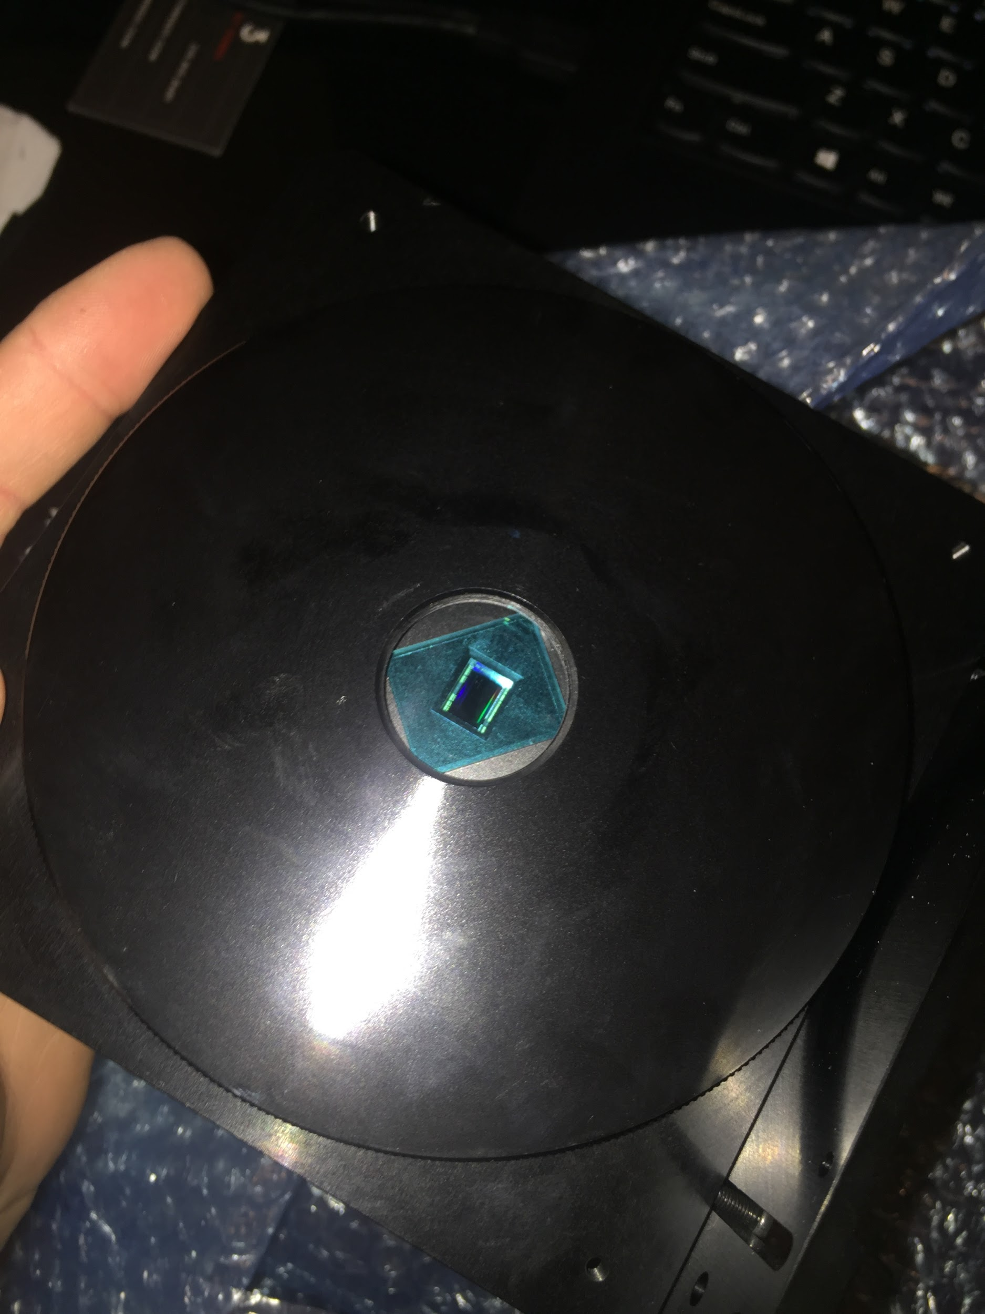
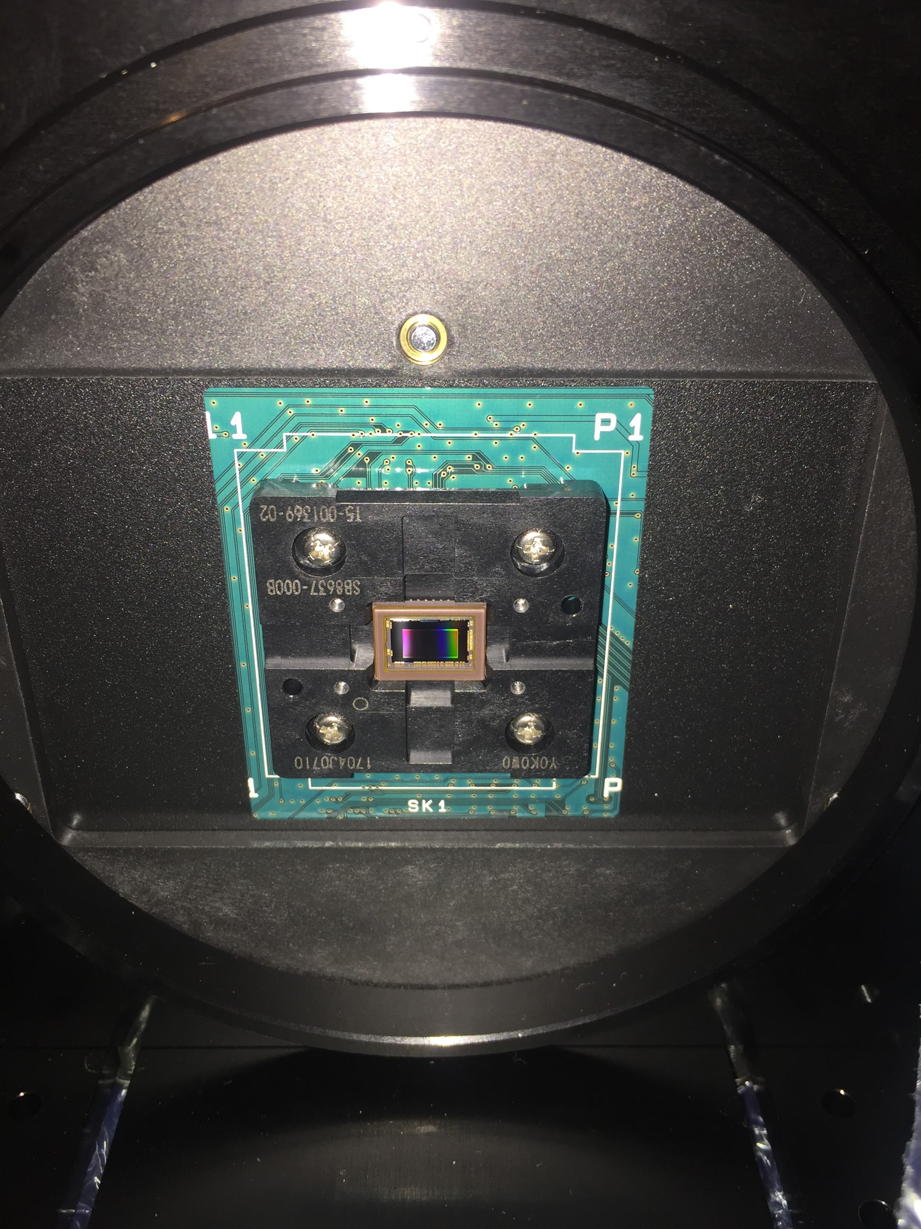
Optical Sensor Testing
Notes:
Matt

Slide 6
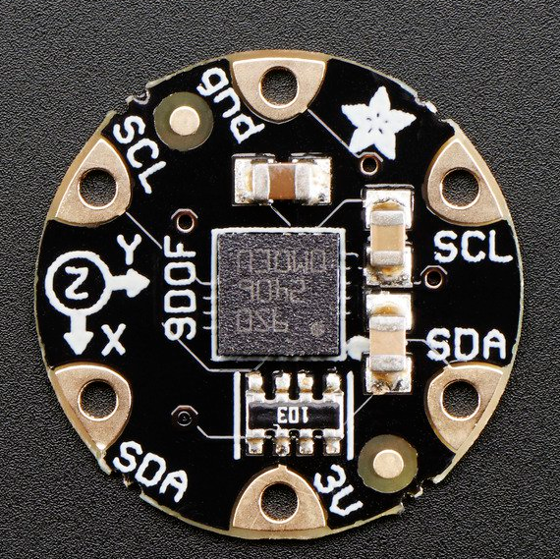
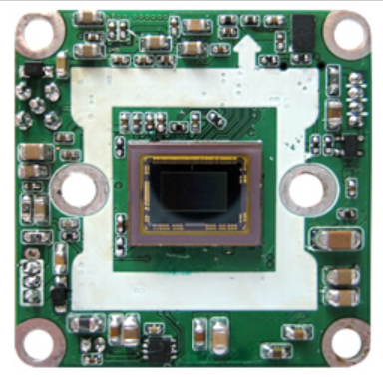
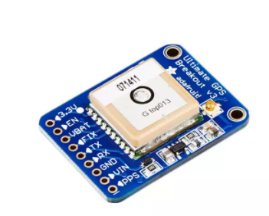
Specifications and Requirements
Cameras - Two wide angle cameras will be used to view both the front of the vehicle and the inside of the vehicle
Android Mobile Application - The mobile app will be used to receive notifications for the user during cases of car theft or car damage as well as view images and recorded footage
GPS Tracker - Must be able to detect current location of vehicle to assist in location of vehicle or track stolen vehicles
Accelerometer - Used to detect car movement when the car is off
Notes:
Matt

Slide 7
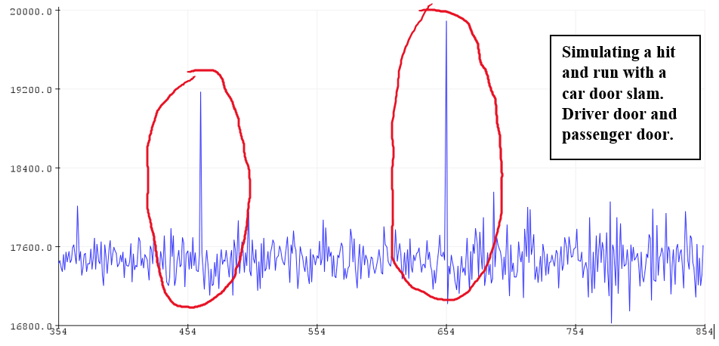
Accelerometer Test Data
Parking garage and car crash
Determine alert threshold
Alert when data abnormal from threshold
Notes:
Matt

Slide 8
Device Hardware

Slide 9
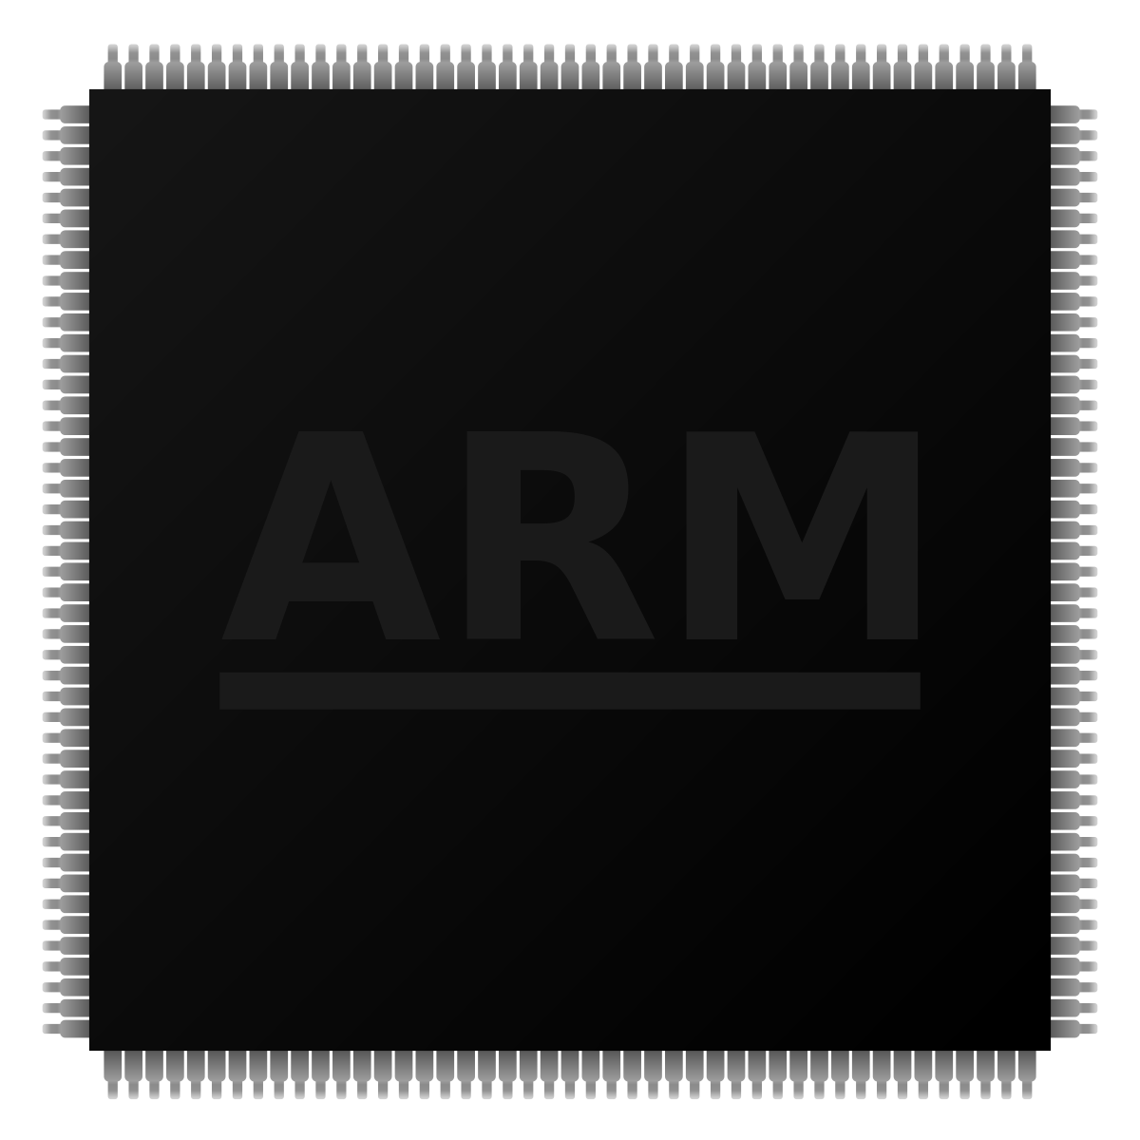
Parts Selection
Texas Instruments Video Processor
Atmel MCU
Texas Instruments WiFi Module
Sierra Wireless Cellular Chip
Notes:
scott

Slide 10
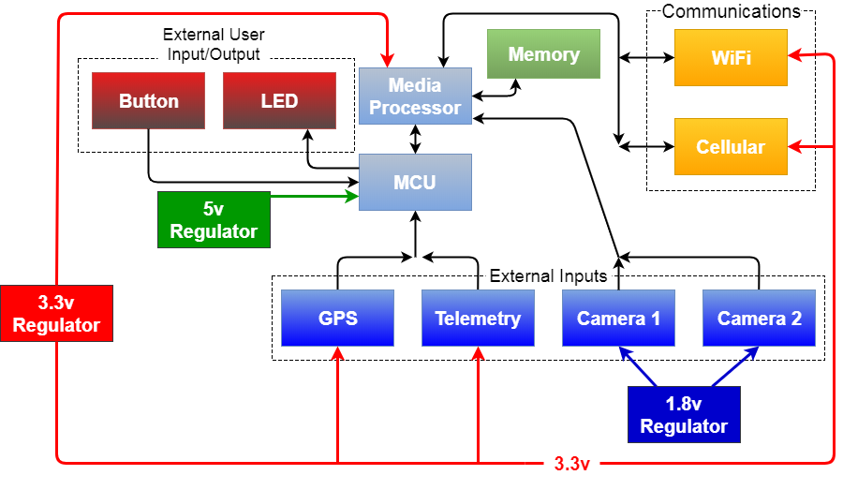
Hardware Block Diagram
Notes:
SCOTT
This is the abstracted hardware block diagram that depicts the interconnectivity of all of the subsystems
The black lines are data lines, the remainder lines are power lines.
As can be seen, there are three voltage regulators which drop down the 12v supply from the car’s battery to a usable 5v, 3.3v, and 1.8v rails.

Slide 11
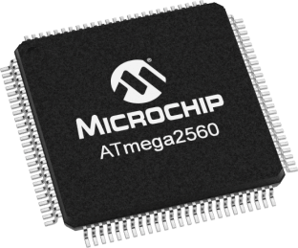
Microcontroller (MCU)
CPU Clock | 16 MHz
RAM | 8 KB
Program Memory | 256 KB
EEPROM | 4 KB
Communicates with GPS chip and sends coordinate data to data transmit
Analyzes telemetry sensor data to wake up system.
Notes:
SCOTT
We chose the Atmel 2560, which recently replaced another microcontroller which would be over engineered for this project.
Connects with GPS chip to receive and relay latitude and longitude coordinates to the media processor
Also responsible for sampling the telemetry data at a high rate which is used trigger an interrupt on the media processor.

Slide 12
Media Processing Unit (MPU)
Low power mode
Video processing/encoding
Server communication
Wireless
Cellular
TI-RTOS
Notes:
SCOTT
The interrupt disables the media processor’s low-power mode
Exiting low power mode enables the media processor to encode the raw camera data and store it on the onboard SD card.
It is also in charge with communication to the API server to determine updates, send video, as well as all other requests.
In order to send or receive this data, the system prioritizes the wireless network opposed to the cellular network based on connectivity to a WiFi access point
Due to all of these tasks, we chose a well specced processor that’s capable of running a stripped down version of Linux from TI called TI-RTOS. The operating system was highly necessary to properly utilize cameras as well as the cellular chip which required USB drivers.

Slide 13
Schematics
Digital media processor- media processor to process the data of the two cameras using two 6GB DDR RAM chips.
MCU- processor that controls interrupts, and sends stops commands to cameras
WiFi- talks through uart to wirelessly communicate with app
CDMA Cell Chip- cheaper than GSM, lots of info readily available
Notes:
Joe
talk about connection of ddr ram or how it creates a smoother flow of data

Slide 14
Camera
Requirements: 1080p 3Mp, 60FPS, near 180degree view, h.246
calculation of Mbps:
C(compression variable) x #(cameras) x Mp(Megapixels) x FPS
= 90Mbps
Notes:
Joe
discuss the compression 80% reduction in size of the raw data

Slide 15
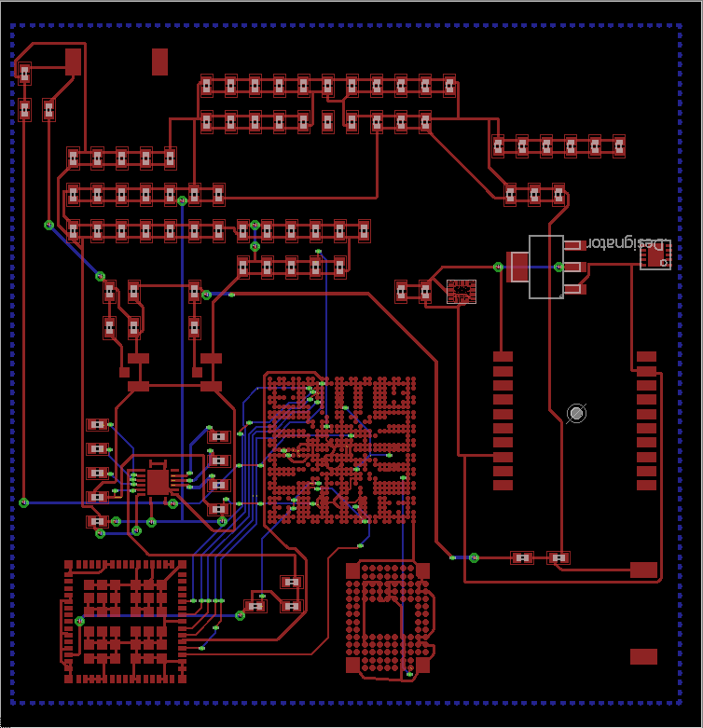
PCB Design
PCB design is very intensive
PCB design includes a Cat 4 modem connection, 80-100 Mbps WiFi chip, and TI MCU, GPS, and accelerometer chip
Notes:
JOE
certain parts were left off of this board design due to being proprietary
it is porjected for the PCB desgin to be 100% complete by

Slide 16
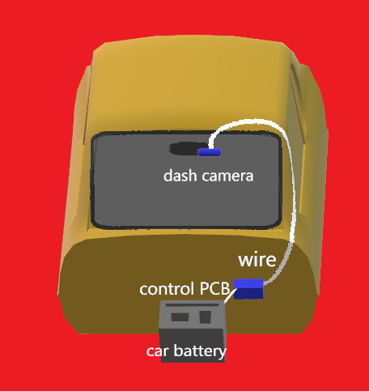
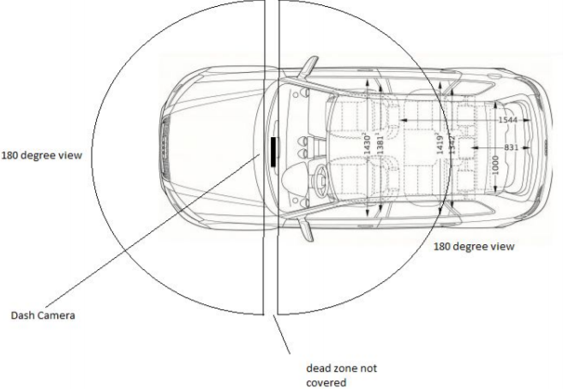
Design Diagrams
Notes:
JOE

Slide 17
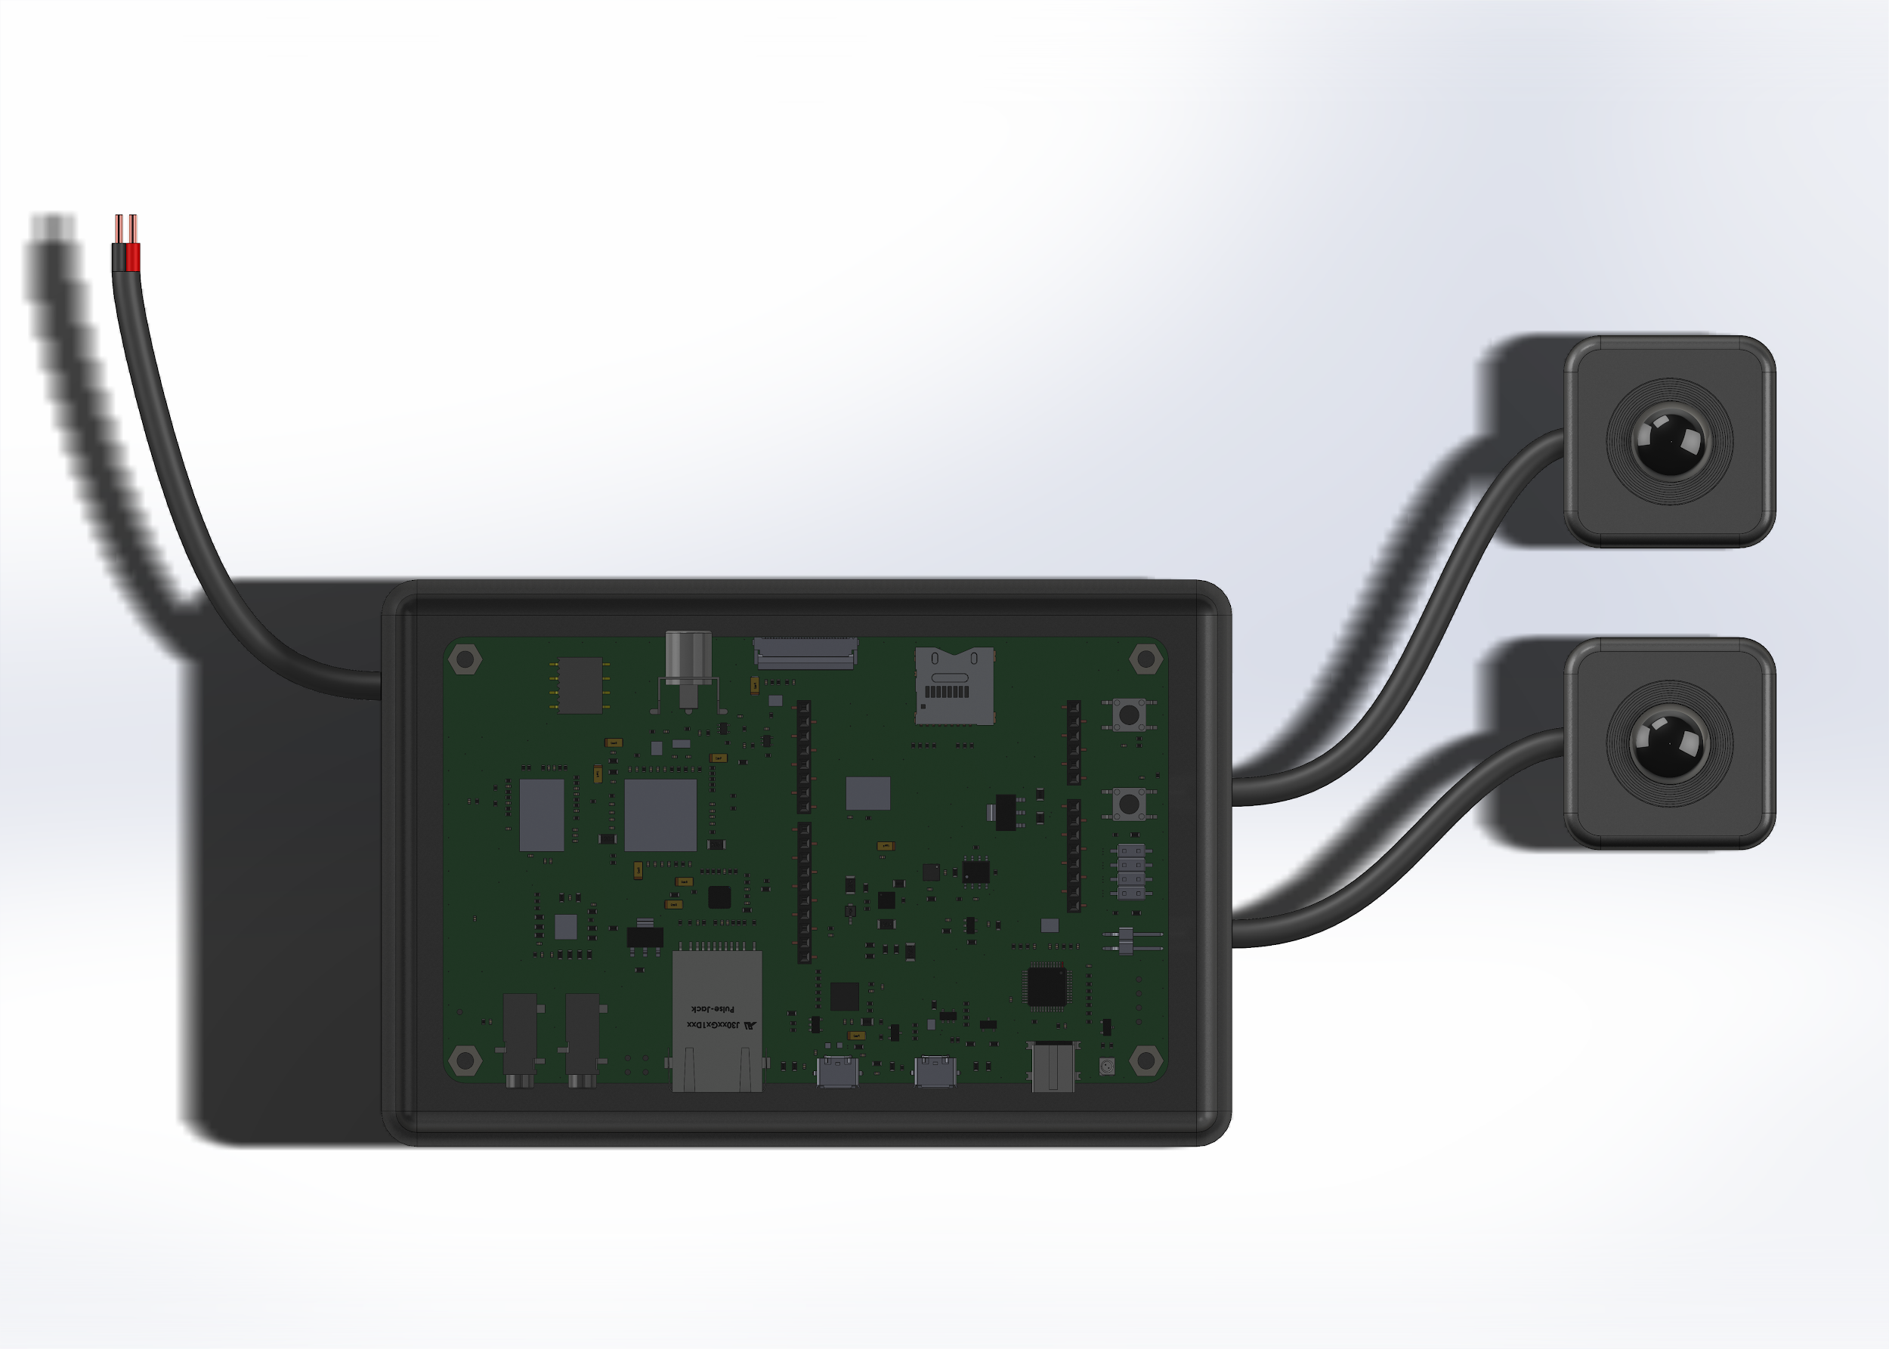
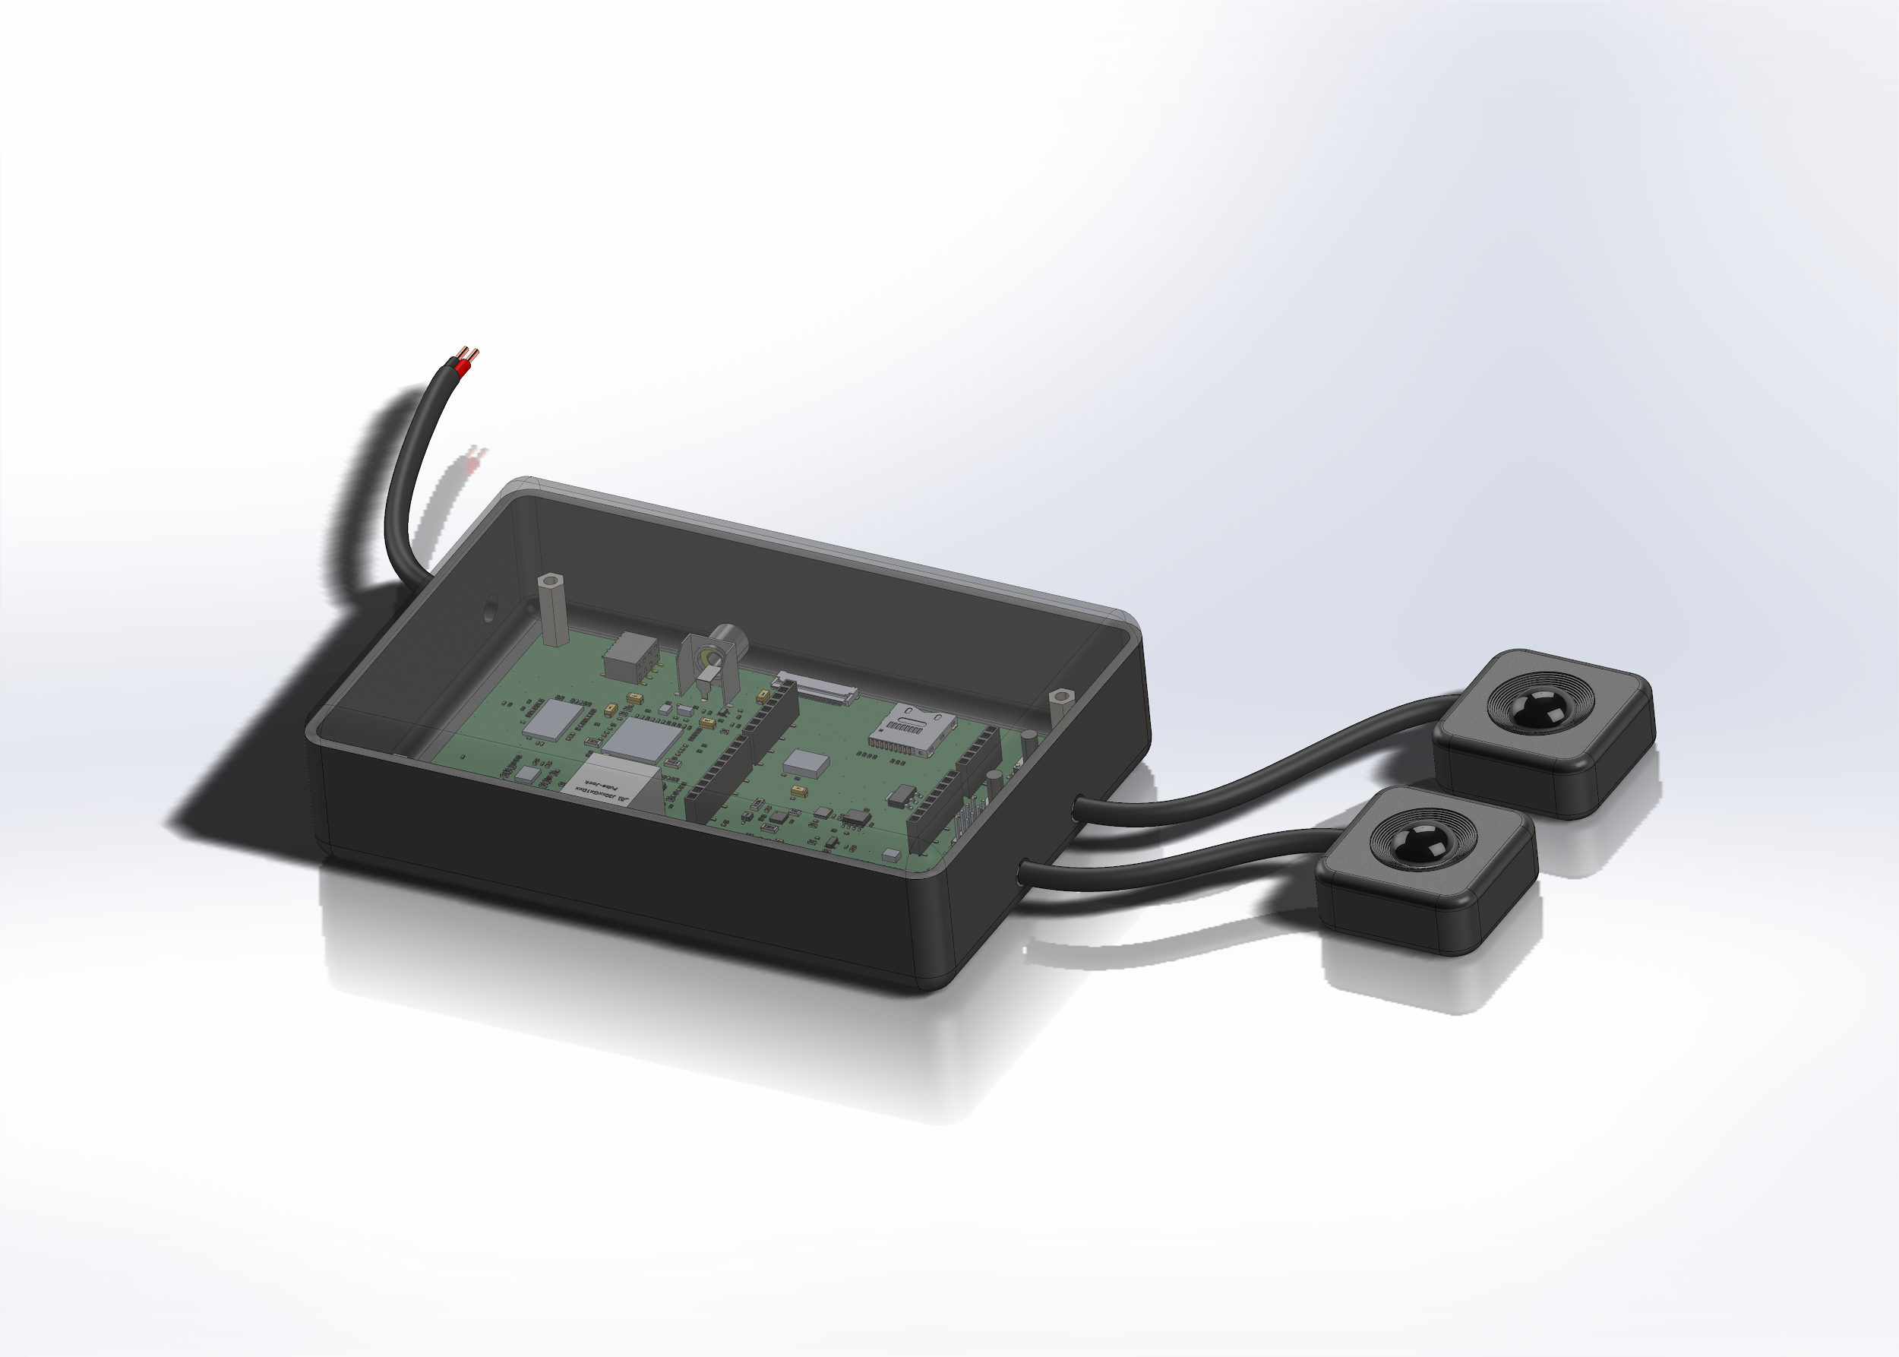
PCB and Camera Enclosures
Front View
Side View
Notes:
JOE
enclosure is minimized for viewing purposes

Slide 18
Server

Slide 19
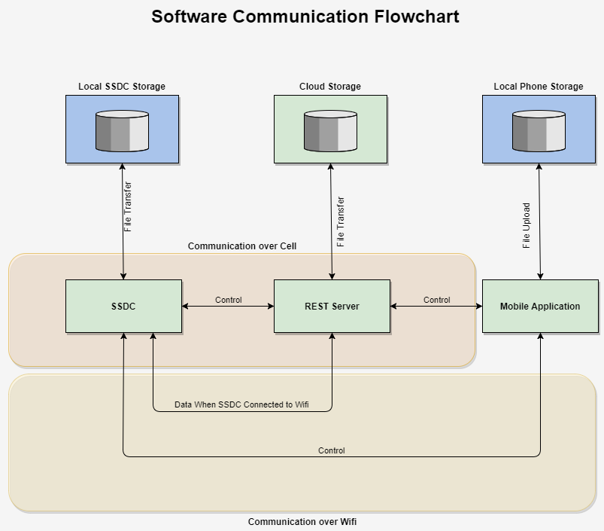
Software Communication
Django Rest Framework
AWS Hosting
Dev Environment: Local Server
Python 3
Java Mobile App
Notes:
Austin - There are three aspects to the software design for the dashboard camera: Embedded development, API server and the mobile application. The hardware development relies on utilizing C programming and shell scripts on the RTOS system. The API server developed utilizing Django alongside the Rest Framework provides the channel for communication between the hardware device and the mobile application. As we were unable to determine any method to facilitate remote direct connection to the two devices, the API must act as a sort of middle man to create the connection. All the while providing storage for the devices videos, eventually we would like to send the video to a cloud storage provider opposed to the current local storage solution. The mobile application provides the control for the hardware device by sending HTTP requests to the API server which in turn will relay the information to the hardware device. This is all done via polling from each device as without keeping a socket alive it is impossible to initiate the conversation between the two remote devices The diagram illustrates the channels of communication for the device under specific criteria. When the device is connected over wifi or cellular it sends the data straight the the API server, we would also like to have the device send the data straight to the mobile application when the cellular device is connected to the hardwares access point.

Slide 20

Security
TLS enabled on all endpoints
Encrypted video transfer
Hashed database credentials
Token Based Authentication
WPA2/PSK for access point
Notes:
Austin - IoT Devices are notoriously insecure and even IoT security products tend to provide a new attack surface for intruders. As our device is meant to be a car security product we hope to eliminate security flaws within our device and network. Thus we will be implementing TLS encryption on all API endpoints to ensure data is encrypted on transmit. Data at rest will be also hashed such as the database with the SHA-256 algorithm. A mistake we wanted avoid was the utilization of an insecure hashing function such as MD5. The API utilizes token based authorization, after login the user is provided a token to utilize in all subsequent requests. This token will lock the user in to only seeing information related to their device and account. Upon logout or token timeout the user will be required to relogin to obtain a new token. The previous token will thus be invalid and invoke an error.
As for the hardware device it will enforce WPA2 encryption on the device’s access point. As an accepted risk the device will have the ability to connect to open wireless networks and thus be unprotected from MiTM attacks.

Slide 21
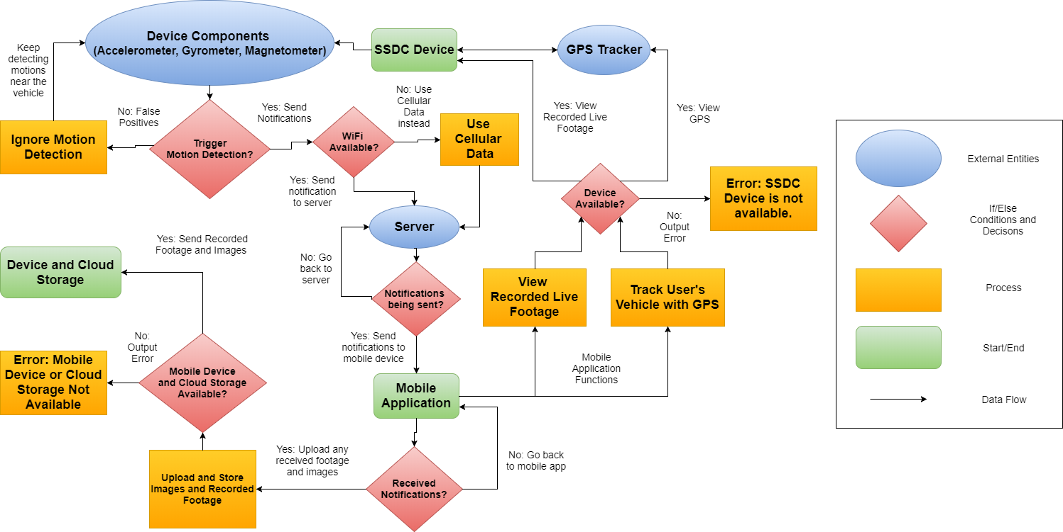
Data Flowchart
Notes:
austin - This diagram illustrates the intended flow of data for the device such as in the case of triggering an alert. in order to avoid data costs if it needs to trigger an alert it prioritizes wifi communication as the channel over cellular, if no communication can be made the device will store the alert in an event queue for later transmission.

Slide 22
Mobile Application

Slide 23

Android Studio
The mobile application will be made using the system software Android Studio
The software will be used to create the app with multiple activities/Java classes and xml files
An emulator will be used to test and debug the mobile application
Notes:
Tim

Slide 24
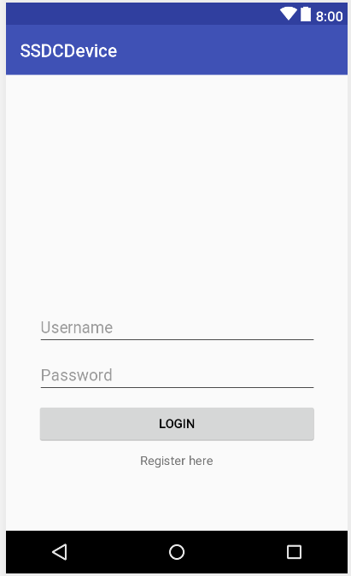
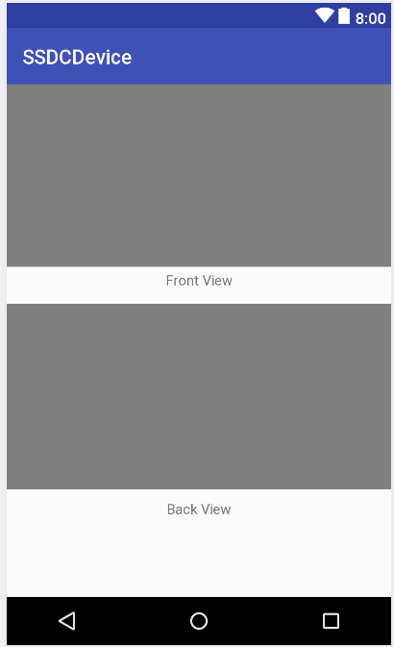
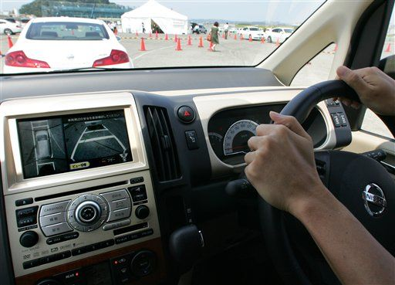
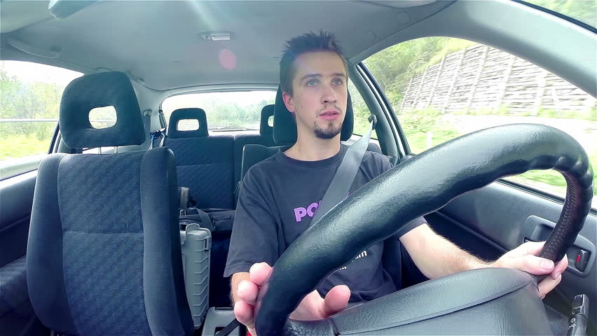
GUIs
Login/Register
Alerts
View Live Footage
GPS (Vehicle Location)
View Stored Footage and Images (Cloud Storage)
Manage Devices
Settings
Notes:
Tim
Login/Register - First GUI to see, used to login previously made information, or register a new account with unique information
Settings - Used to change username and email information
First mention Devices GUI and how it relates to the rest of the GUIs
Devices, list of devices add device, connect to a device, disconnect or remove a device from the list, clear alerts for device
View Live Footage - see front and back of the camera connected to the dashboard
GPS - locate vehicle’s location, used to track vehicle in case of car theft
Alerts and storage - alerts received from device and footage and images comes along with it

Slide 25
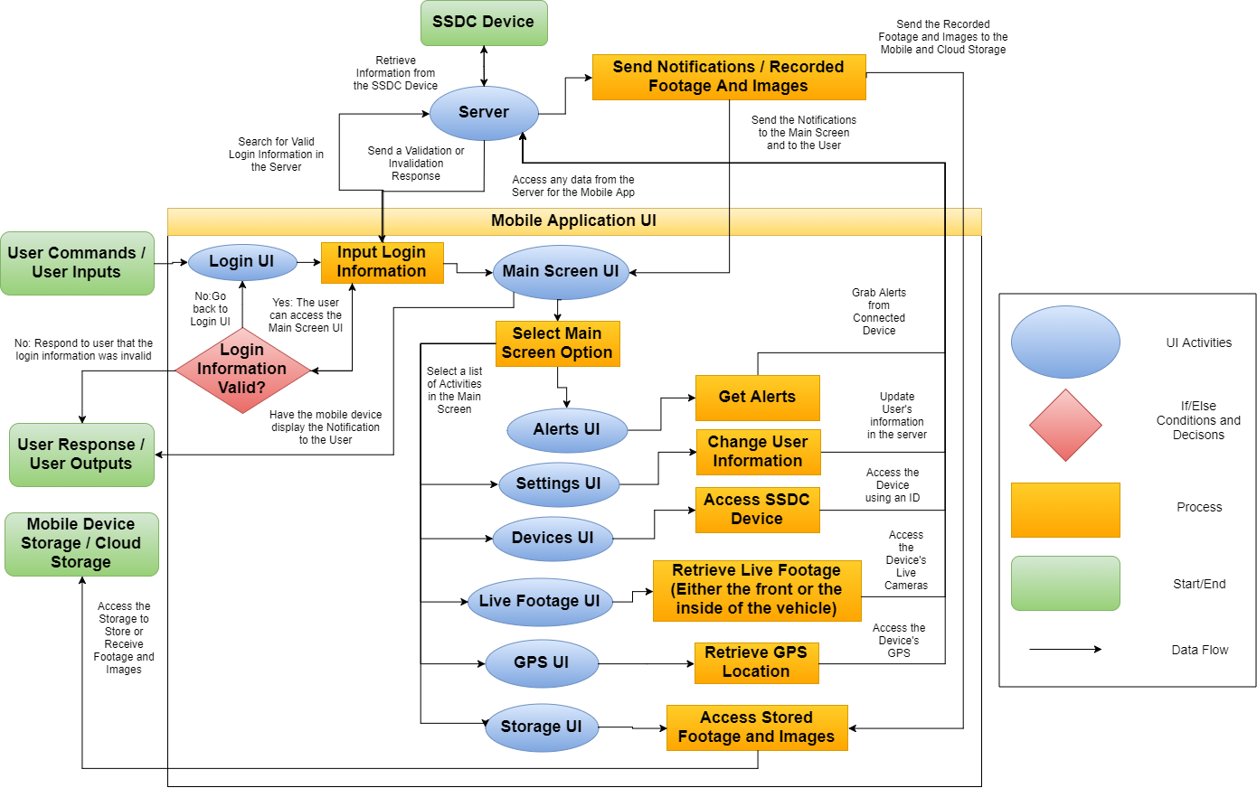
UI Diagram
Notes:
Tim
This represents the general data flow of user inputs and responses to GUIs
List what is necessary for the mobile app
Give an example, such as receiving an alert.

Slide 26
Adminstrative Content

Slide 27
Design Difficulties
Adjusting device triggers to account for false positives in Parking garages, subway stations, train stations and graphs explaining the scenarios unwanted vibration
Correct selection of parts that can properly communicate with one another
Size of unit and amount of data being transferred
Finding quality parts
Notes:
Matt

Slide 28
Budget and Financing
Development Costs
Item | Quantity | Cost
Atmel MCU Chip | 1 | $12.71
TI Video Processor Dev board | 1 | $412.00
Arduino | 1 | $44.99
Rental of Sony Sensors | 1 | $150.00
PCB | 2 | $800.00
Cameras | 2 | $200.00
Cell Dev Plan | 1 | $100.00
Sensors | 2 | Free
Sierra Wireless modem | 1 | $70.00
Total | 12 | $1729.70
Notes:
Matt

Slide 29
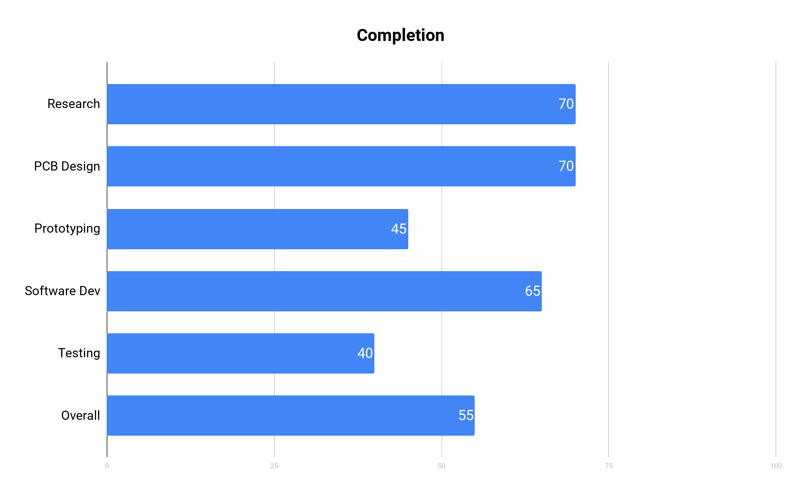
Current Progress
Notes:
Matt

Slide 30
Questions?
We’ve got answers
Notes:
Matt

