Slide 1

Daynight Panel
Group 2:
Andrew Haas – CpE
Jordan Larsen – EE
Ornella Ngalamulume – EE
Ricardo Rivera-Matos – EE

Slide 2
Administrative
Name | Schematic | PCB | Embedded Software | iOS App
Andrew |  |  | S | P
Jordan | S | P
Ornella | S |  | P | S
Ricardo | P | S
Legend
P: Primary
S: Secondary
Notes:
Add legend

Slide 3

Project Motivation
Overexposure to blue light can impact the human circadian rhythm.
This may cause a suppression in melatonin production and can affect sleep patterns.
Younger people are more sensitive to this affect than older people.

Slide 4




Project Motivation
The human circadian rhythm is maintained by a light–dark cycle.
Environmental cues (like sunlight color temperature) keep this cycle on track.
Lack of actual sunlight exposure may result in a disrupted circadian rhythm.

Slide 5
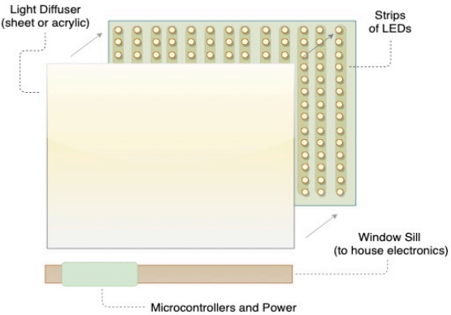
Project Description
Project Goals:
Create the effect of a window for “windowless” rooms
Provide the aesthetic and biological benefits of dynamic lighting based on real world data
Allow for intuitive user control and downloadable content through an iOS app
Project Objective:
To create consumer level lighting product that can create the visual effect of a window and natural light that can be controlled by an iOS app

Slide 6
Specifications and Requirements
Specifications
Requirements
Parameter | Specification
Bluetooth Range | 10 m
Autonomous Run Time | 12 hours
Product Weight | <50 lbs
Color Temperature | 2700K-6500K
Max Power Consumption | 120 W
Min Lumen Output | 1000 lm
Modern and appealing design
Must mimic daylight
Must be safe and easy to install
Must have sustainable lifespan
Affordable
Compatible with home/office power outlet
Good Bluetooth range

Slide 7
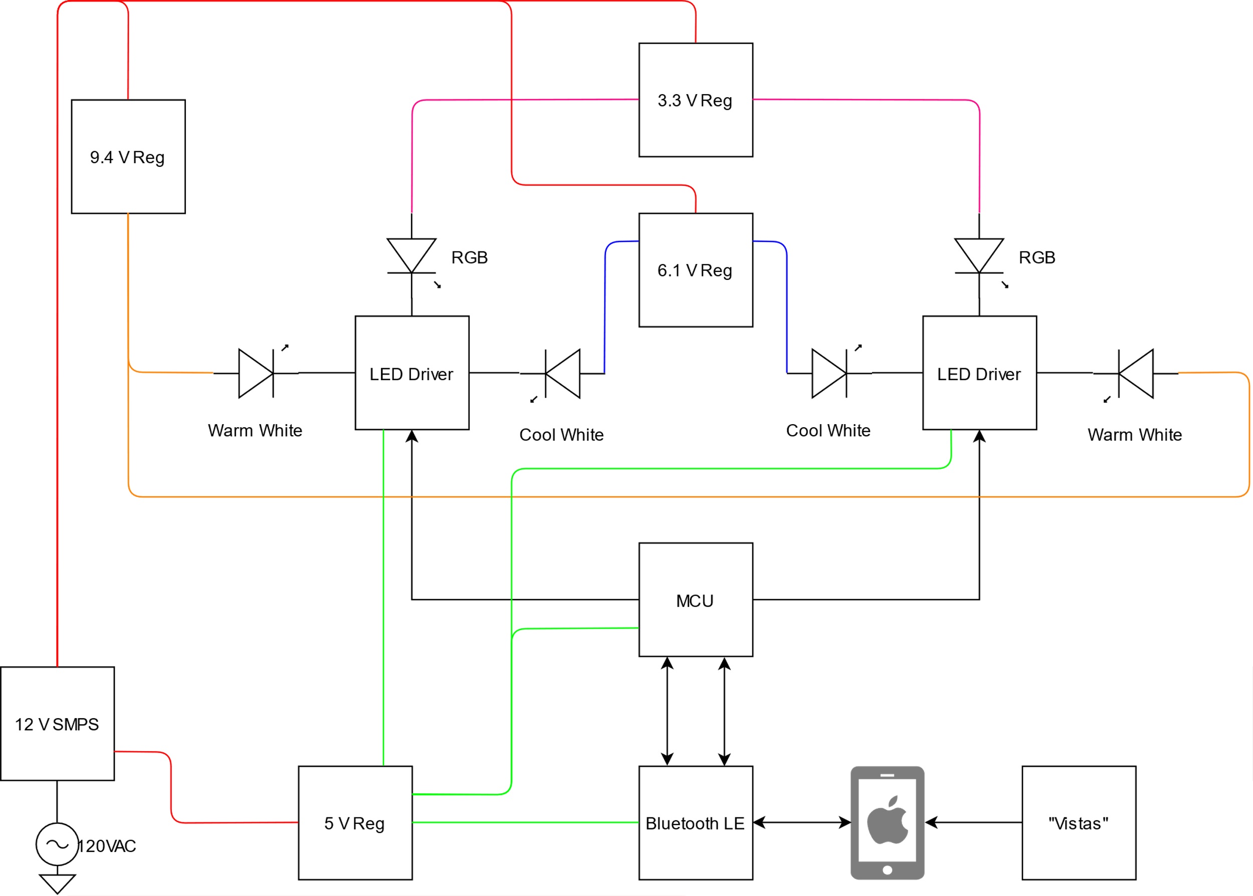
Daynight Panel Block Diagram

Slide 8
Daynight Panel Block Diagram

Slide 9
Daynight Panel Block Diagram

Slide 10
Daynight Panel Block Diagram

Slide 11
Daynight Panel Block Diagram

Slide 12
Project Design, Lighting Technology
 | Incandescent | CFL | LED
Heat Produced | High | Low | Very Low
Size | Large | Mid-Sized | Small
Integration Effort | Med-High | Med-High | Medium
Color Range | Low | Low | All color ranges
Run Time | Low | High | Very High
Lumens per Light | Low | Medium | Medium
Goal was to minimize size and heat and maximize run time
LEDs were chosen because they are both the smallest and generate the least amount of heat.

Slide 13
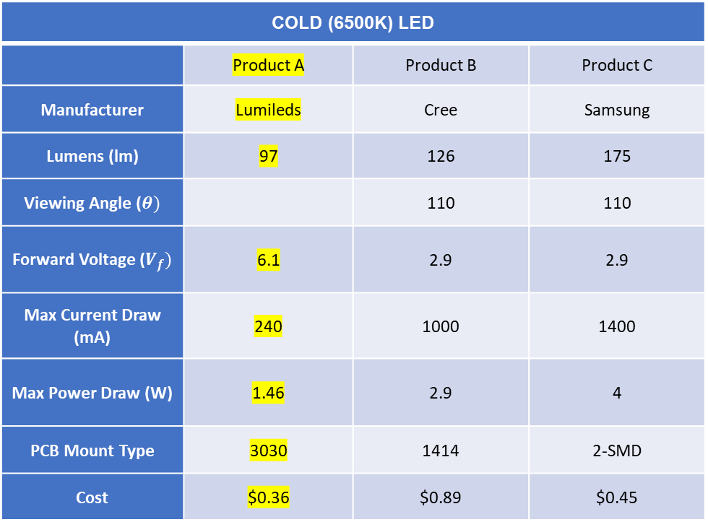
Project Design, LED Products
COLD (6500K) LED
 | Product A | Product B | Product C
Manufacturer | Lumileds | Cree | Samsung
Lumens (lm) | 97 | 126 | 175
Viewing Angle ($θ)$ |  | 110 | 110
Forward Voltage ($V_{f})$ | 6.1 | 2.9 | 2.9
Max Current Draw (mA) | 240 | 1000 | 1400
Max Power Draw (W) | 1.46 | 2.9 | 4
PCB Mount Type | 3030 | 1414 | 2-SMD
Cost | $0.36 | $0.89 | $0.45
LEDs must be capable of replicating daylight.
LEDs total lumen output must be approximately 1000 lumens to give sufficient lighting
In the case of the cold LED, product A was chosen for following specification and relative low current draw
Notes:
Could we add highlighting for product A?

Slide 14
Project Design, LED Testing
Tests were run on LEDs to ensure that they performing as expected
Curve created by LEDs matched data sheets
Lux on graph is relative to maximum lux output measured (same as datasheet)
LED1 and LED2 are same type
Notes:
add legend

Slide 15
Project Design, LED Color Balancing
LED Magnitudes for 3000K Temperature
Goal Temp | Theoretical Temp | Goal Lumen | Theoretical Lumens | Cold LED Step | Warm LED Step
3000 | 3016.7 | 5 | 4.5 | 1 | 11
3000 | 3016.7 | 10 | 9.1 | 2 | 22
3000 | 3000 | 15 | 14.4 | 3 | 35
3000 | 2998 | 20 | 19.3 | 4 | 47
3000 | 2996.9 | 25 | 24.2 | 5 | 59
3000 | 2996.1 | 30 | 29.1 | 6 | 71
3000 | 2995.6 | 35 | 34 | 7 | 83
3000 | 2992.3 | 40 | 39.3 | 8 | 96
3000 | 2992.3 | 45 | 44.3 | 9 | 108
3000 | 2992.3 | 50 | 49.2 | 10 | 120
3000 | 2992.3 | 55 | 54.1 | 11 | 132
3000 | 2992.3 | 60 | 59 | 12 | 144
3000 | 2990.6 | 65 | 64.3 | 13 | 157
3000 | 2990.7 | 70 | 69.2 | 14 | 169
3000 | 2971.4 | 75 | 74.2 | 14 | 182
3000 | 2972.7 | 80 | 79.1 | 15 | 194
3000 | 2973.9 | 85 | 84 | 16 | 206
3000 | 2973.7 | 90 | 89.3 | 17 | 219
The cold (6500K) and warm (2700K) LEDs must be balanced to achieve a goal temperature and lumen output
Due to the drivers stepping from 0-255 to control LED output, the goal values can not be perfectly reached
The desired temperature and lumen output is calculated every time the LED values are updated

Slide 16
Project Design, Diffusion
Diffuser Comparison Table
 | Product A | Product B | Product C | Product D
Manufacturer | Brightview | Brightview | Inventables | Inventables
Item Name | C-HE80 | E-1560 | 23114-04 | 23114-02
LED Luminaire Efficiency | 88-82% | 90-95% | 66% | 87%
Diffuser Strength |  | 15x60 | 2.25 | 1.5
Product Type | Panel | Panel | Film | Film
Cost | $160> | $160> | $19.49 | $22.49
LEDs must be diffused to prevent glare and create a semi-homogenous source.
Must be diffused enough to make base lighting blend but have a primary bright point to act like a sun.
Film diffuser will also require clear acrylic panels to attach to.
Notes:
add highlight

Slide 17
Project Design, MCU
 | Raspberry Pi 3B | MSP432 | ATmega328p
Flash Memory | - | 256KB | 32KB
PWM Pins | 1 | 16 | 6
Speed | 1.2GHz | 48MHz | 20MHz
Price | $35.00 | $1.69 | $1.46
Operating Voltage | 0-5V | 1.65V – 3.7V | 1.8V – 5.5V
Max Current (I/O) | 2A | 2mA | 40mA
I/O Pins | 40 | 40 | 23
Design approach will be modular.
Ensure thorough control through simple manipulation.
Ensure compatibility with iOS App.
Monitor status of hardware.

Slide 18

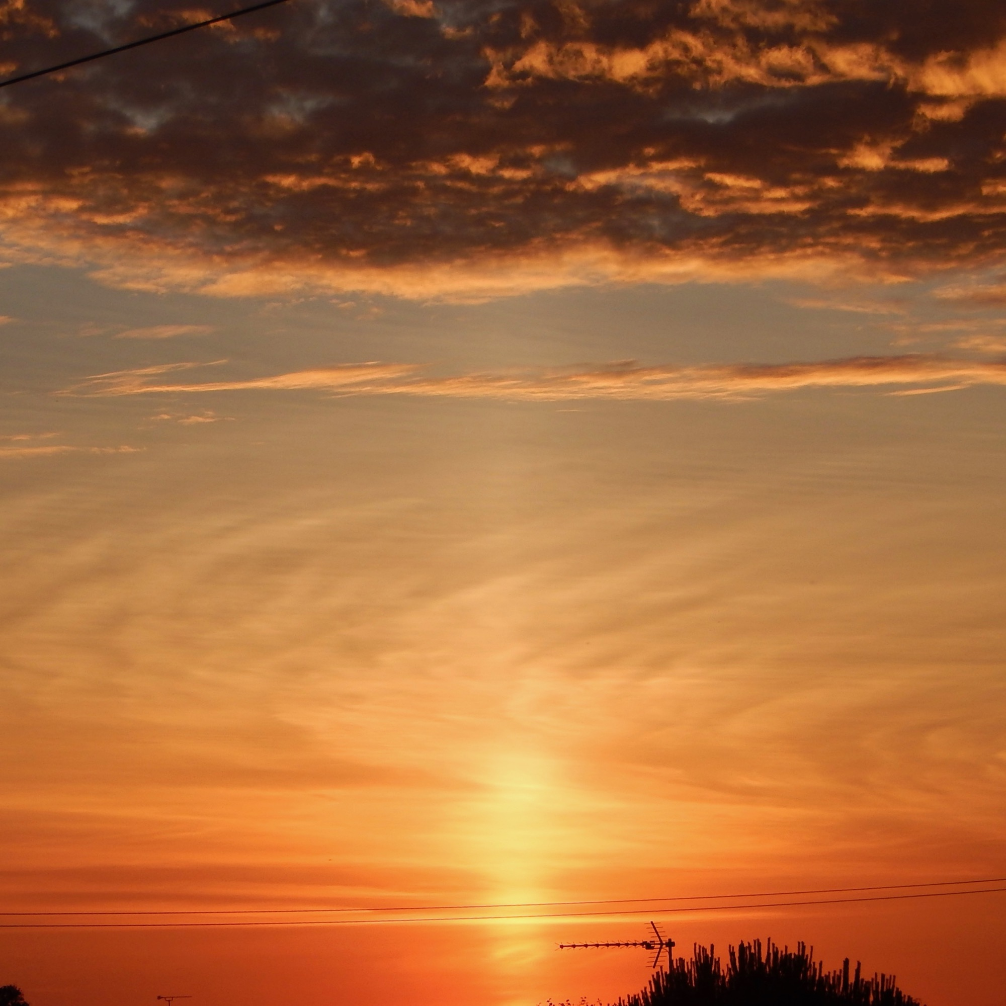
Overall Approach
Weather /Image data defines color temperature
Reduced Resolution RGB Data defines color and brightness or intensity.
Commands for motion
Commands for transitions
The design of the vistas will be modular.
All the driver functionalities have been separated into functions.
All the tools are present for testing to begin.

Slide 19
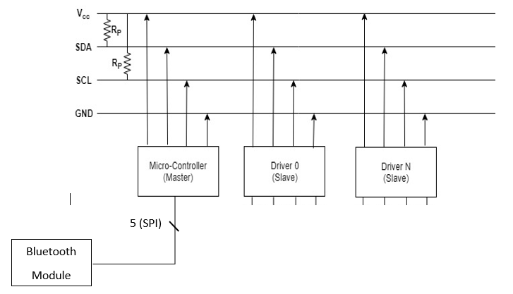
Controls Overview
Drivers Require I2C.
Each driver has a unique address and configuration registers.
Bluetooth module requires SPI.
Control is gained through a mix of AT and SPI commands.

Slide 20
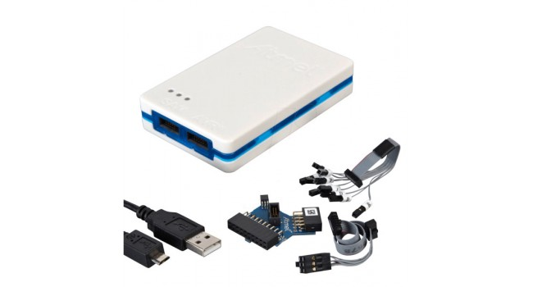
Thorough Control Through Simple Manipulation
Translating data sent from app to panel commands.
Defining how data is transferred through the app.
Ensuring all commands are executed in a timely manner.
Monitor Status of all Hardware
Failure analysis

Slide 21
Ensure compatibility with iOS App
Define the contents of messages.
Define what information will be stored where.
Test the different options to see which results in the smoothest operation.

Slide 22
Project Design, LED Driver
Part | # of channels | mA per channel | PWM Resolution [Steps] | Area [mm x mm]
TLC59116 | 16 | 120 | 256 | 5x5
TLC5955/7/8 | 48 | 25 | 65,536 | 8x8
LT8500 | 48 | 30 | 4096 | 6x6
An LED driver capable of meeting the following requirements was desired
Multichannel (reduce BOM)
Independent PWM dimming on each channel
Must be able to source high I_{F} (240mA) efficiently
The Texas Instruments, TLC59116, 16 channel LED driver
Group analog dimming via REXT
Individual dimming via PWM (256 steps)
Communication to MCU via I2C (Error detection)

Slide 23
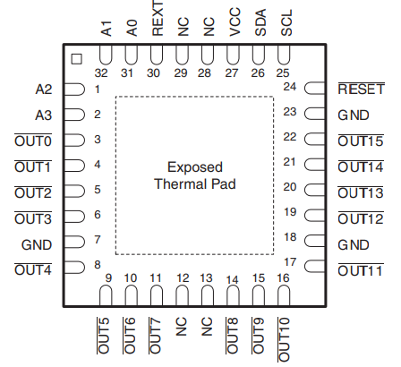
Project Design, LED Driver
Configuring the TLC59116
The sink current is set to ~100 mA using a 200Ω from pin 30 to GND
Connection to MCU via SDA, SCL, and Reset pins
I2C bus address is hardcoded using A0-A3
Each driver can control two “cells” of LEDs
A cell of LEDs is defined as one RGBW LED, one warm white LED, one cold white LED
LEDs are connected with cathode tied to output pin and anode tied to the appropriate voltage rail
5 mm
5 mm
Notes:
Fix reset pin

Slide 24
Project Design, Power
Rail | Voltage [V] | Max Current [A]
VCC | 5 | <1
RGBW | 3.3 | 4.8
Warm | 6.1 | 1.2
Cold | 9.4 | 2.88
Total |  | 9.88
The Daynight Panel receives 12V from an off the shelf internal AC/DC 120W power supply
From the 12 volt input four power rails must be produced for the onboard electronics (MCU and drivers) and various LED forward voltages
Due to the large current draw and higher regulation voltages, switching regulators will be used in this design

Slide 25
Project Design, Power Rail 1, 2
RGBW Power Rail 3.3V, 4.8A Rail
VCC Power Rail, 5V, 1A Rail
Part | Vin [V] | Vout [V] | Iout,max [A] | BOM Count
LTM4649 | 4.5 - 16 | 0.6 – 3.3 | 10 | 5
LMZ23605 | 6 – 36 | 0.8 – 6 | 5 | 5
Part | Vin [V] | Vout [V] | Iout,max [A] | BOM Count
LTM4623 | 4 – 20 | 0.6 – 5.5 | 3 | 5
LMZM23601 | 4 – 36 | 2.5 – 15 | 1 | 5*

Slide 26
Project Design, Power Rail 3, 4
COOL Power Rail 6.1V, 1.2A Rail
WARM Power Rail, 9.4V, 2.88A Rail
Part | Vin [V] | Vout [V] | Iout,max [A] | BOM Count
LTM8023 | 3.6 – 36 | 0.8 – 10 | 2 | 5
LMZ34202 | 4.5 - 42 | 2.5 – 7.5 | 2 | 4
Part | Vin [V] | Vout [V] | Iout,max [A] | BOM Count
LTM8033 | 3.6 – 36 | 0.8 – 24 | 3 | 6
LMZM33603 | 4 – 36 | 1 – 13.5 | 3 | 6

Slide 27
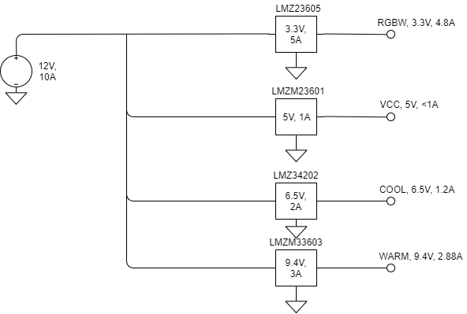
Project Design, Power
To simplify design and lower BOM cost for small scale production, switching regulators with as many integrated passive components were selected.
In mass production the regulators selected may not be the most effective design choices from a cost and efficiency perspective

Slide 28
Daynight App for iOS
Swift is compiled into native code which is optimized for modern hardware; this allows Swift to be a fast-performing language.
Safe memory management is abstracted in to the language, this prevents bad use of memory allocation.
Swift features a clean syntax and extensive documentation for developers.
Notes:
This project features an app for iOS that is developed using Swift. *slide contents*. This makes developing in Swift a very pleasant experience.

Slide 29
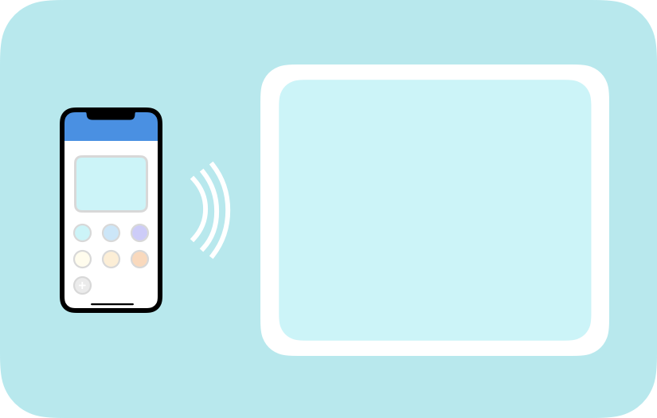
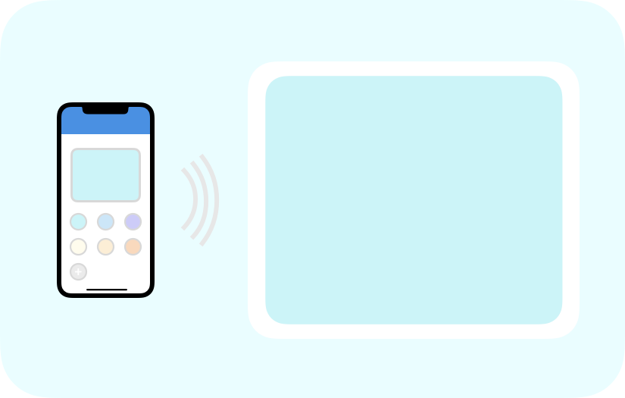
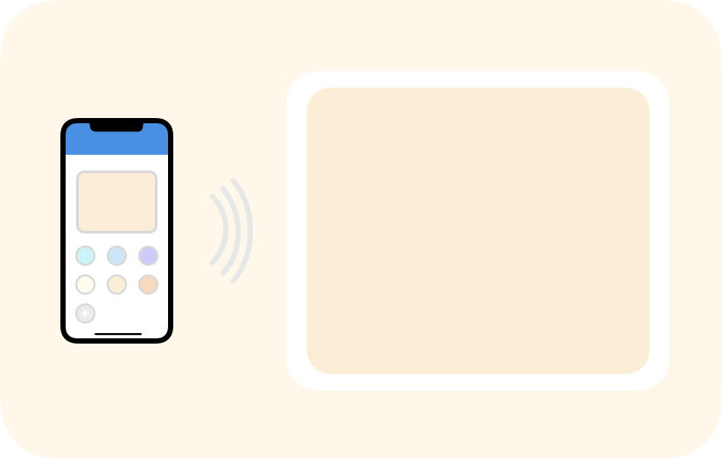
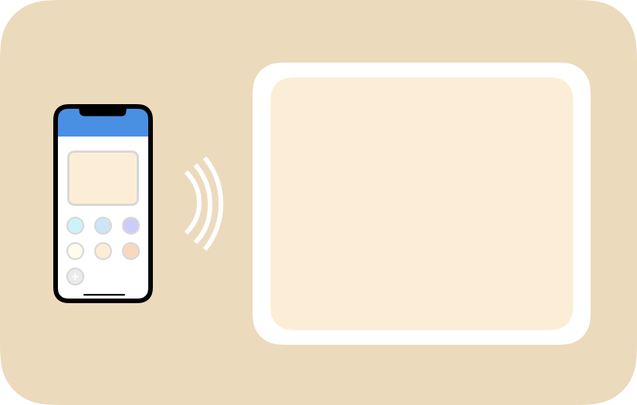
Daynight App for iOS
Schedule automatic color changes according to sunrise and sunset.
Take manual control of colors for preferred daylight effects or creative effects.
Notes:
Along with timed updates according to Sunrise and Sunset times, the Daynight App will provide users the ability to take manual control of the Daynight panel.

Slide 30
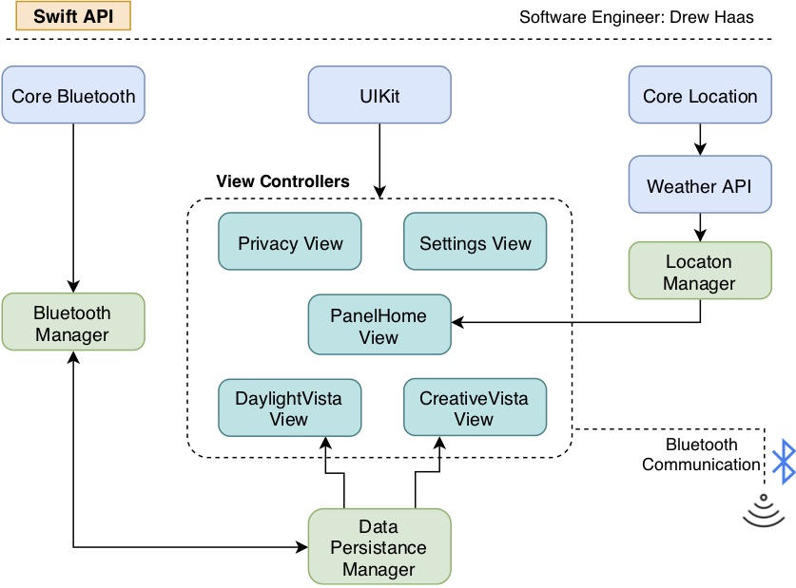
iOS Software Diagram
Notes:
In this software diagram, each of these blocks represents a class or framework that the app is comprised of.

Slide 31
iOS Software Diagram
Notes:
So we begin at the framework level. These three Swift frameworks provide the project with any extra functionality that will be necessary for the app. The Core Bluetooth framework, for example, allows me to read and transmit data using Bluetooth.

Slide 32
iOS Software Diagram
Notes:
The Managers classes are really the brains of the operation, here. These classes take information from the frameworks, like what the user’s current location is, and performs any logic here in order to get the information ready to be displayed to the user.

Slide 33
iOS Software Diagram
Notes:
Finally, the view controllers. This is where user interaction takes place. The manager classes provide data in a format that is ready to be interacted with. Any feedback from the user is sent backward through the chain to the manager classes.

Slide 34
Model – View – Controller Paradigm
Notes:
The software model this app uses is called Model-View-Controller. The ”Model” is represented by the frameworks, which notify the Controller, those manager classes, of any data that might be helpful. Finally, the view or view controllers are updated and are ready for user interaction. This cyclical process really represents the liveliness of the app.

Slide 35
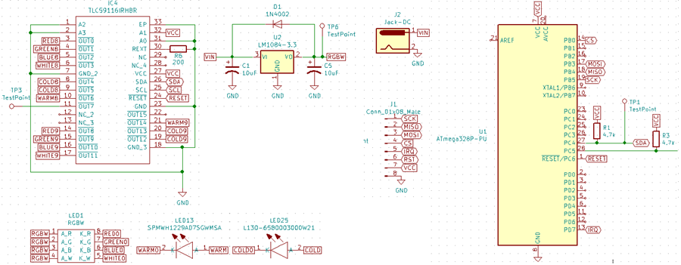
Schematic

Slide 36
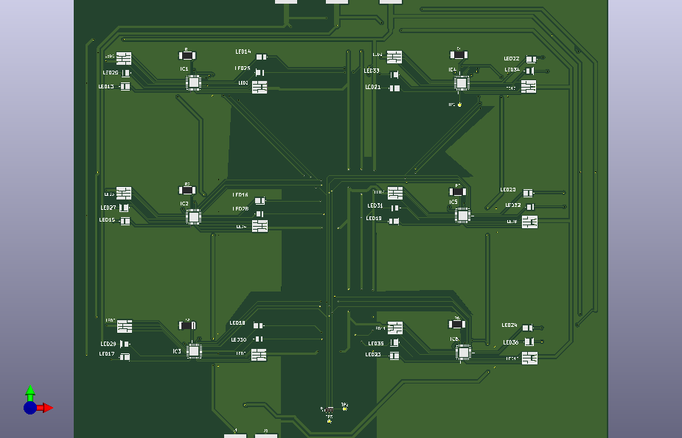
Project Design, LED PCB
PCB was ordered from JLCPCB
Ground plane eliminated near communication lines to reduce capacitance
Design maximized usage of top plane to make bottom layer a better heat sink
Minimize distance between each cells cold and warm light

Slide 37
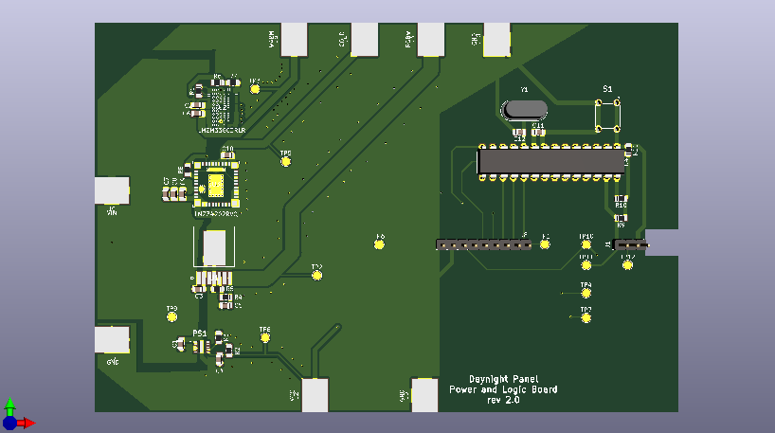
Project Design, Power/Logic PCB
The power and logic board will face opposite the LED PCB
This board contains the switching regulators and their respective external components on half of the board and the MCU and communications components on the other half
Again, notice that the ground plane has been eliminated near the communications traces
The soft reset push button on this board will pull the reset line “low” when pressed momentarily triggering a reset of all logic components

Slide 38
Budget
Item | Cost/Unit | Units | Total Price
RGB Sensor | $ 8.99 | 2 | $ 19.15
Light Sensor | $ 9.52 | 1 | $ 16.13
Power Resistors | $ 4.99 | 1 | $ 5.31
Warm LED | $ 0.21 | 40 | $ 8.83
Cold LED | $ 0.36 | 40 | $ 25.78
RGB LED | $ 0.72 | 40 | $ 28.88
Acrylic Panel | $ 11.96 | 1 | $ 12.74
Power PCB | $ 42.99 | 1 | $ 42.99
Adafruit 32u4 | $ 33.50 | 1 | $ 35.85
Adafruit SPI Friend | $ 18.15 | 3 | $ 57.72
Spiral-bound Paper | $ 42.34 | 1 | $ 45.30
Apple Developer Program | $ 99.00 | 1 | $ 99.00
Aiposen PSU | $ 17.99 | 1 | $ 17.99
Solder Paste and Flux Paste | $ 26.90 | 1 | $ 27.61
PCB and Stencil and Frame Rev1 | $ 85.95 | 1 | $ 124.88
Mouser Order 10 Jan 19 | $ 26.48 | 1 | $ 34.47
QFN DIP Adapters | $ 8.74 | 1 | $ 9.31
Atmel Ice Debugger | $ 160.00 | 1 | $ 160.00
Atmega328P-PU Chips | $ 2.00 | 4 | $ 8.00
 |  |  | $ 779.94

Slide 39
Progress by Subsystem

Slide 40
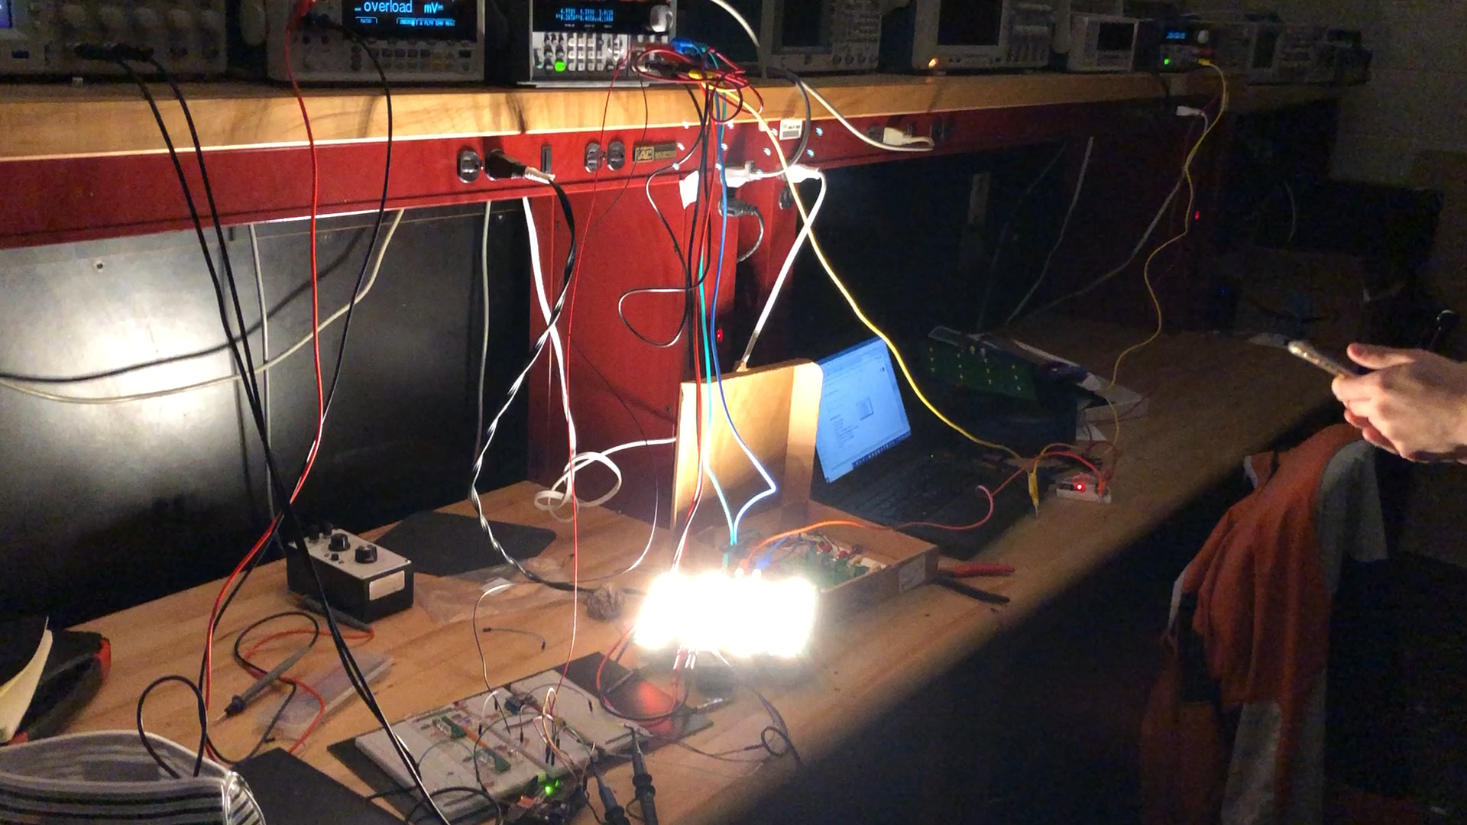
Demonstration Video

Slide 41
Next Steps/Questions
Test power PCB revision and determine changes necessary for final revision
Begin design and construction of the Daynight Panel housing and frame
Test color balancing
Expand existing iOS functionality.
Create a visual in-app setup / demo experience for first-time users.
Defining data packets and commands.
Refining control.

Slide 42
Citations
https://www.robotics.org.za/ATMEL-ICE (Atmel ICE Image)
https://developer.apple.com/swift/ (Swift Icon)
http://www.ti.com/lit/ds/symlink/lmzm33603.pdf (LMZM33603 Datasheet)
http://www.ti.com/lit/ds/symlink/lmz34202.pdf (LMZ34202 Datasheet)
https://www.analog.com/media/en/technical-documentation/data-sheets/8023fj.pdf (LTM8023 Datasheet)
https://www.analog.com/media/en/technical-documentation/data-sheets/8033fb.pdf (LTM8033 Datasheet)
https://www.analog.com/media/en/technical-documentation/data-sheets/4649fc.pdf (LTM4649 Datasheet)
https://www.analog.com/media/en/technical-documentation/data-sheets/4642fb.pdf (LTM4642 Datasheet)
http://www.ti.com/lit/ds/symlink/tlc59116.pdf (TLC59116 Datasheet)

