Slide 1
Let’s Have A Blast!
Laser Tag
Group 10
Marco Montero - Electrical Engineering
Anuj Yamdagni - Computer Engineering
Shannon Fies - Electrical Engineering
Karlie Brinthaupt - Electrical Engineering

Slide 2
Motivation
New inventions are always in demand to capture the interest of today’s youth and to get them away from addictive technology (cell phones, televisions, etc…)
Lack of innovation within the laser tag game system
Polished product that is easy to replicate
Wanted to enjoy Senior Design and make a project that is enjoyable to use
Notes:
Shannon

Slide 3
Goals and Objectives
To produce a low cost laser tag system
To keep 90% of the hardware on one PCB as to minimize the size of the device
To implement multiple game modes
To have a built in user interface
To use an internal, independent power system that is easily chargeable
Notes:
Shannon

Slide 4
Specifications and Requirements
Category | Metric | Requirement
Dimension | Volume | < 3"x8"x12"
Cost | USD | < 50
Battery Life | Hour | > 1
IR range | Feet | > 20
IR accuracy | Percentage | > 95
Game Modes | Selections | ⩾ 2
Notes:
Shannon

Slide 5
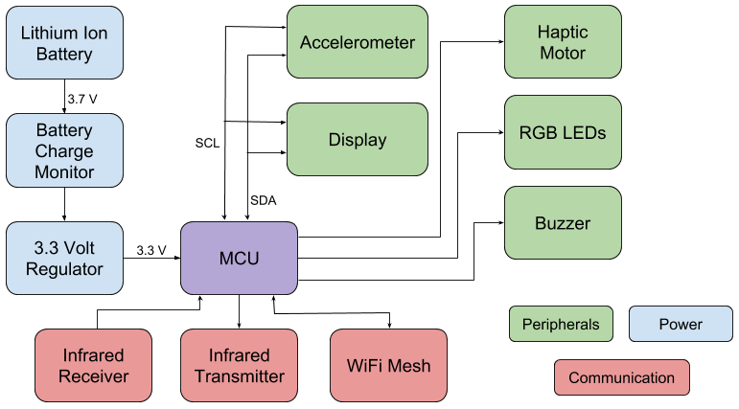
Block Diagram
Notes:
Anuj

Slide 6
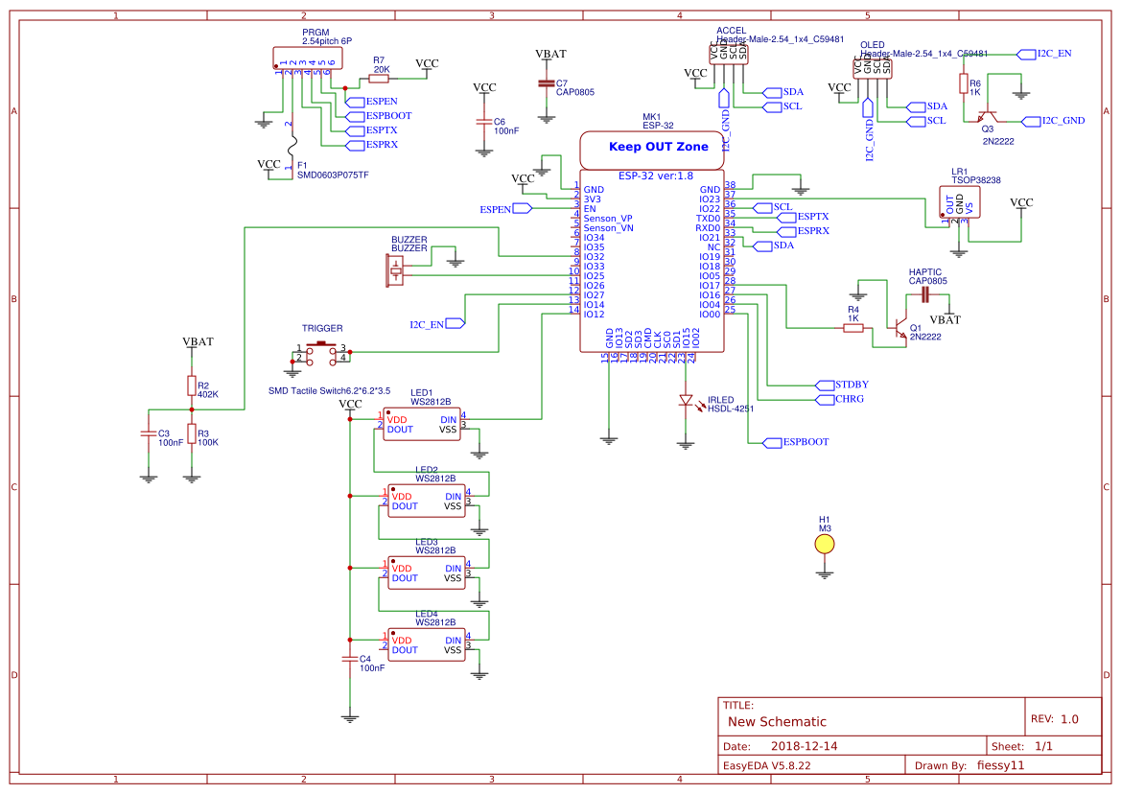
PCB Diagram (Main)

Slide 7
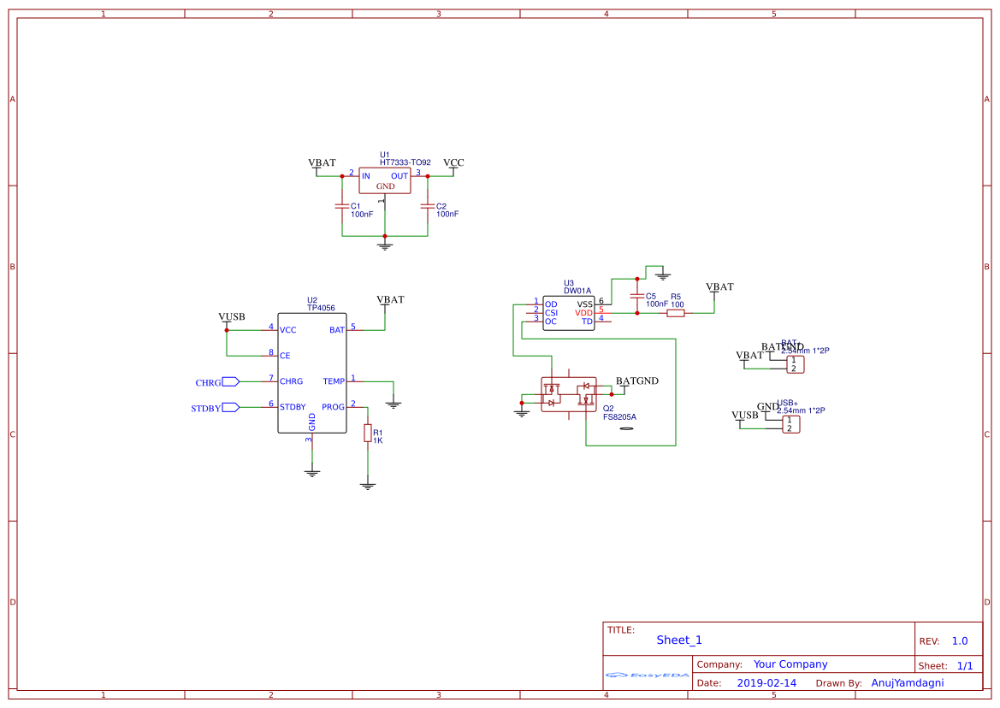
PCB Diagram (Power)

Slide 8
Processor Considerations

Slide 9
Microcontroller vs. FPGA
 | MCU | FPGA
Programming Learning Curve | Some learning curve to understand interrupts and threads among other concepts | Large learning curve to understand hardware description language
Flexibility | Software reprogrammable | Software and hardware reprogrammable
Development Length | Easily can recompile software or add a patch which is fairly quick | Have to place and route hardware all over again which take much longer
Speed | 80/240 MHz | ~100 MHz
Price | $5 | $15

Slide 10
Microcontroller Comparison
MCU: | ATMega328p (Arduino Nano) | ESP32 | MSP430G2553
Speed | 16MHz | 80/240 MHz | 16MHz
RAM | 2kb | 328kb | 512 bytes
Cost | $2 | $5 | $1.98
Pros | Cheapest module of all options, and has the most amount of open source support for libraries. | In built wifi and bluetooth controller. Significant amount of available RAM and Flash memory. Fastest CPU speed of all MCUs. | Cheapest option, lowest power usage amongst all the MCUs

Slide 11
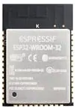
Microcontroller
ESP32-WROOM
Plenty of GPIO, Flash and SRAM
Onboard WiFi and Bluetooth Radio
Affordable and Small
UART and WiFi firmware updates
18mm
25.5mm
Notes:
Anuj

Slide 12
IDE Software Comparison
IDE | Language | Pros | Cons
Espressif IDE | C++ | Precise control over each subsystem | Newer tech, less support/open sources available
Espressif Lua | Custom | Lightweight language | Simple language is more error prone, harder to optimize
Arduino IDE | C++ | IO port management broken into functions, many open sources available | Abstraction can hinder performance

Slide 13
IDE Software
ESP32 is programmed using the Arduino IDE
Several open source libraries available for implementing various sensors
Arduino IDE supports flashing the microcontroller over a serial port and exporting firmware for wirelessly uploading as well.
Includes a serial terminal for debugging purposes.
Notes:
Anuj

Slide 14
Network Considerations

Slide 15
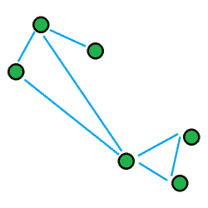
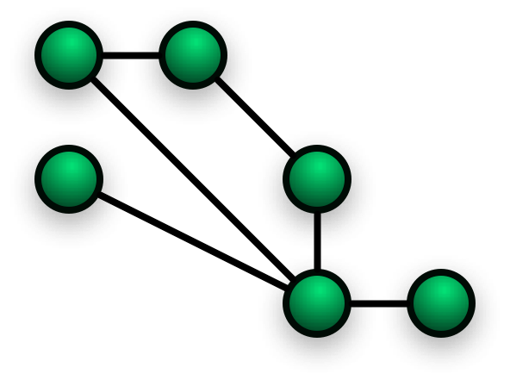
WIFI Mesh Networking
Each system will communicate to each other using mesh networking to keep track of game participants, scorekeeping and the game timer.
Modules can use multihop which allows two guns that are out of range of each other to talk via intermediate nodes.
Notes:
Juna

Slide 16
Peripherals

Slide 17
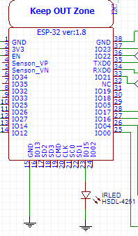
IR LED Communication
Each gun sends out a 32 bit packet “bullet” encoded as an infrared beam using NEC Standard
The packet is comprised of the team ID, player ID, damage value and checksum
Notes:
Anuj

Slide 18
Inter-component Communication Comparison
Name of Protocol | Advantages | Disadvantages
UART (Universal Asynchronous Receiver Transmitter) | - Only two wires needed (TX and RX) - Parity bit checks data integrity | - Slower than I2C and SPI - Predetermined baud rate needed - Start, stop and optional parity bits not sending useful data - Only two devices can communicate at a time - Most complex hardware
I2C (Inter-Integrated Circuit) | - Only two wires needed (SCK and SDA) - Faster than UART - Supports multiple masters - Supports multiple slaves - ACK checks data successfully received by slave | - Slower than SPI - More complex hardware than SPI
SPI (Serial Peripheral Interface) | - Faster than UART and I2C - Supports multiple slaves - Simpler hardware than UART and I2C | - Needs minimum of 4 wires for two devices, one more for each added device. - Supports only one master. Slaves cannot talk to each other on their own - Communication must be well defined beforehand
Notes:
Marco

Slide 19
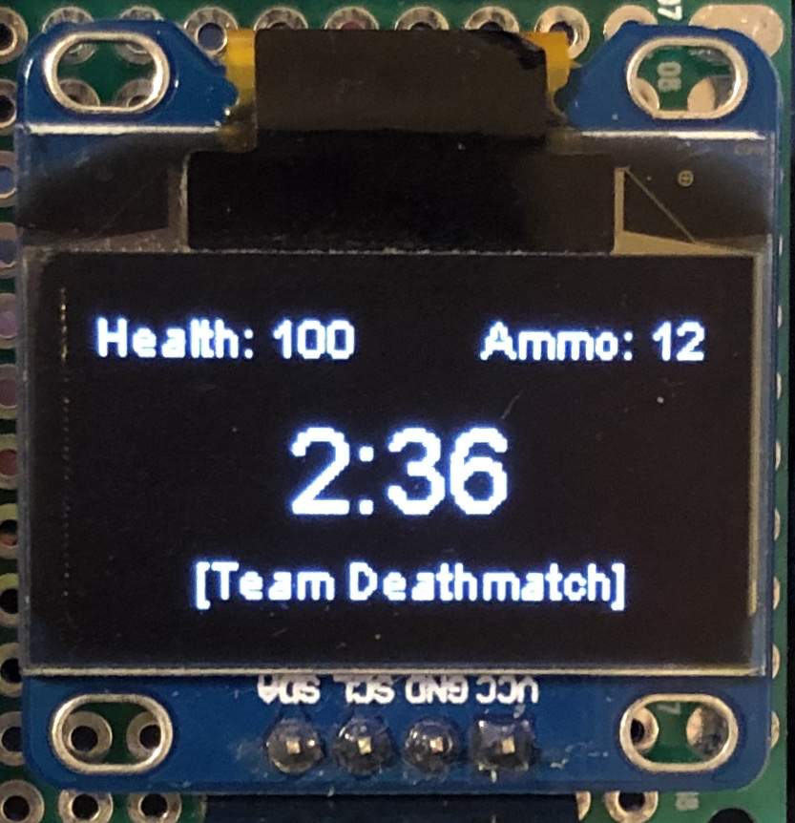
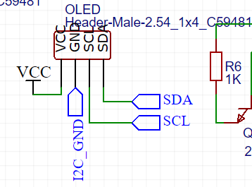
User Interface
The gun will interact with the OLED display, trigger, accelerometer, speaker, haptic motor, LEDs and display.
The onboard wifi module can be used to connect to a smartphone to complete the rest of the set up.
Notes:
Marco

Slide 20
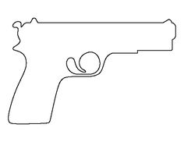
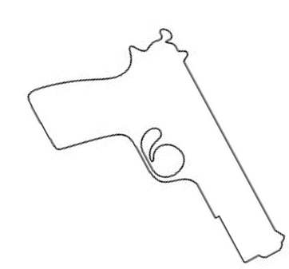
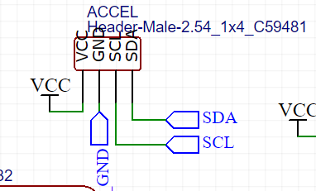
Accelerometer
Accelerometer + Gyro: MPU6050
Used to determine orientation of the gun as part of the user interface.
User can point gun downwards during the game to “reload.”
The data can also be monitored for a lack of motion, indicating that the gun has been put down and the system can be put into sleep mode for power conservation
Normal Use
Reloading
Notes:
Get specific part #

Slide 21
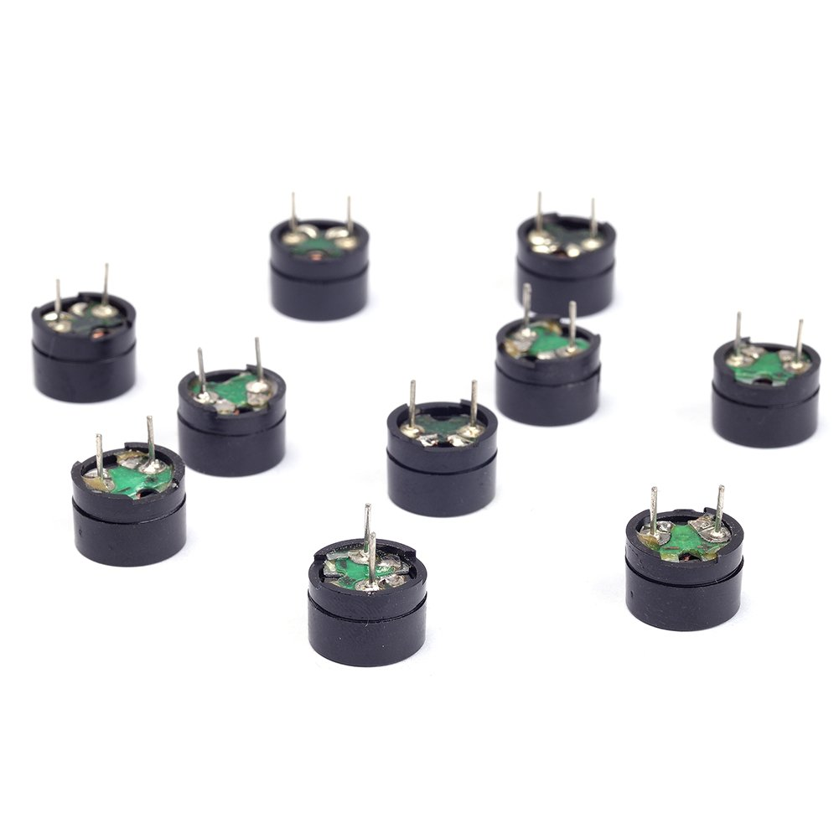
Speaker
Gives the gun the ability to make sounds
Sound effects for firing and being hit and when a game is being started
ESP32 has onboard DAC for controlling buzzer
Pew!
Pew!
Notes:
Get specific part #

Slide 22
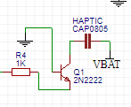
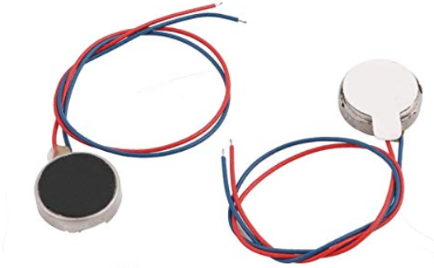
Vibration Motor
Allows the gun to vibrate
Used to alert the player when firing and being hit
Silent alternative to buzzer
Notes:
Get specific part #

Slide 23
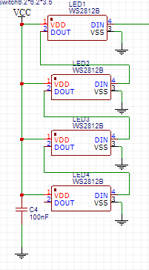
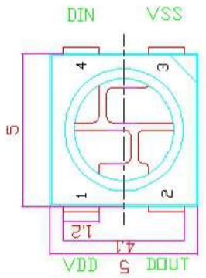
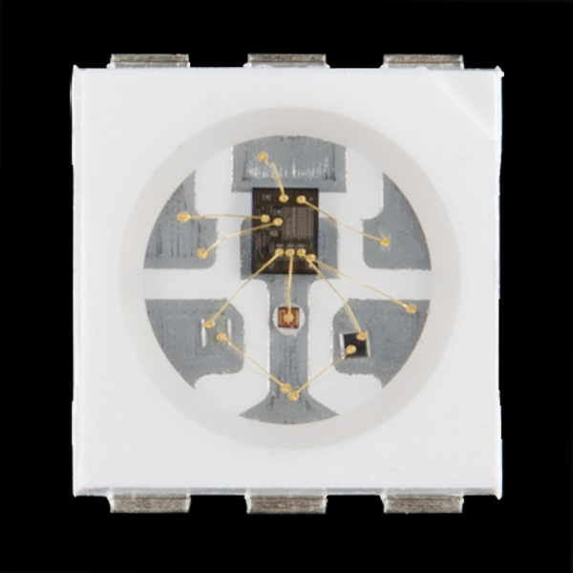
RGB LEDs (WS2812B)
Set of four RGB LEDs in each gun
Gives the ability for the gun to change colors
Used to show team/game mode
Individually addressable for animations
Notes:
Get specific part #

Slide 24
Game Play

Slide 25
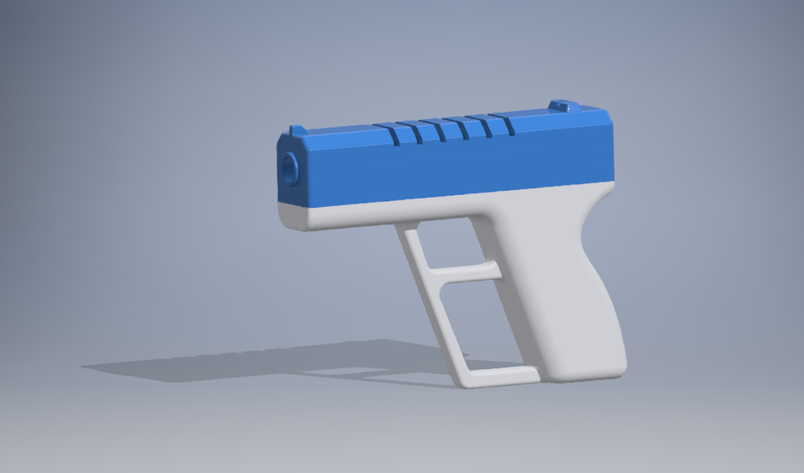
System Housing
Notes:
Marco

Slide 26
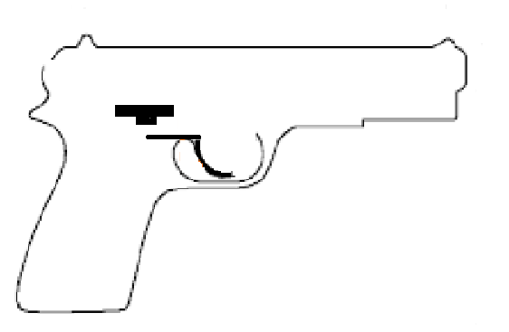
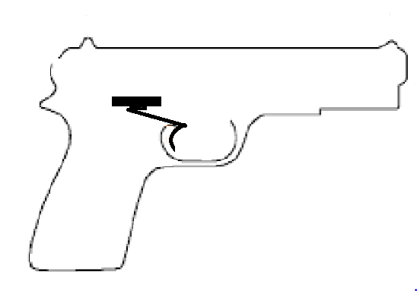
Trigger Mechanism
Tactile switch will be placed at the bottom of the PCB
Mechanical arm will be used to connect trigger to switch -> 3D printed in place
Button will connect to interrupt pin to wake MCU from sleep mode
Notes:
Marco

Slide 27
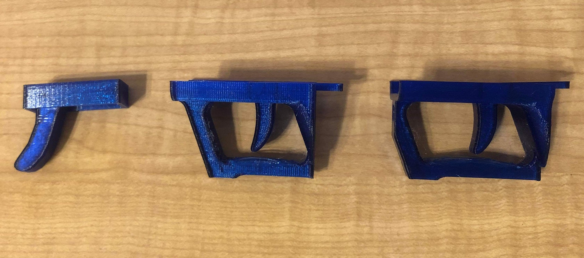

Slide 28
Game Play
Individual players (free for all)
Each “hit” from IR beam registers a predetermined amount of damage (encoded in IR beam) and briefly disable “gun”
Damage is totalled and displayed on OLED screen to user
Predetermined damage limit, a player loses when they reach this limit
Remaining player after all others reach maximum damage limit is the winner
Feedback for shot fired, hit registered, reloading (vibration, LED flash, speaker)
Notes:
18-27 for Karlie

Slide 29
Power

Slide 30
Battery Type Comparison (rechargeable)
Battery Type | Pros | Cons
Lithium-Ion | Most energy dense, light weight, lowest self discharge rate, no memory effect | Sensitive to high temp, sensitive to over charging/over discharging
Lithium-Polymer (LiPo) | Most energy dense, light weight, low self discharge, no memory effect | Sensitive to over charging/over discharging, electrolyte may expand and damage battery life
Nickel-Cadmium (NiCad) | Durability, long lifetime, resistance to over charging/over discharging | Expensive (cadmium), heavy, sensitive to memory effect

Slide 31
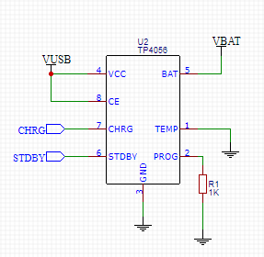
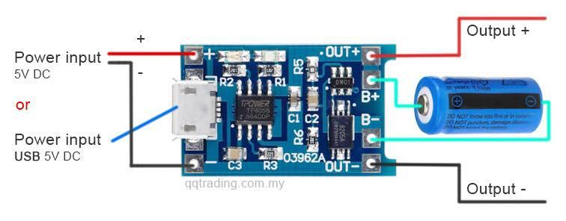
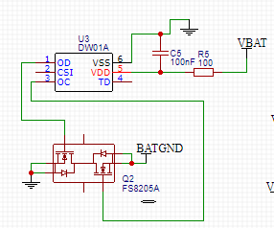
Battery Management
TP4056
DW10A

Slide 32
Linear Regulator Comparison
Regulator | Output Voltage (V) | Dropout Voltage (V) | Output Current (mA) | Quiescent Current (uA) | Unit Cost ($)
Holtek HT7333 | 3.3 | 0.09 | 250 | 7 | 0.23
TI UA78M33CKVURG3 | 3.3 | 2 | 500 | N/A | 0.67
Analog Devices ADP124ACPZ-3.3-R7 | 3.3 | 0.13 | 500 | 45 | 1.33

Slide 33
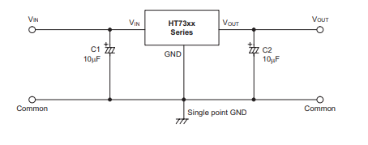
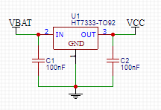
Holtek HT7333 Linear Regulator

Slide 34
Testing

Slide 35
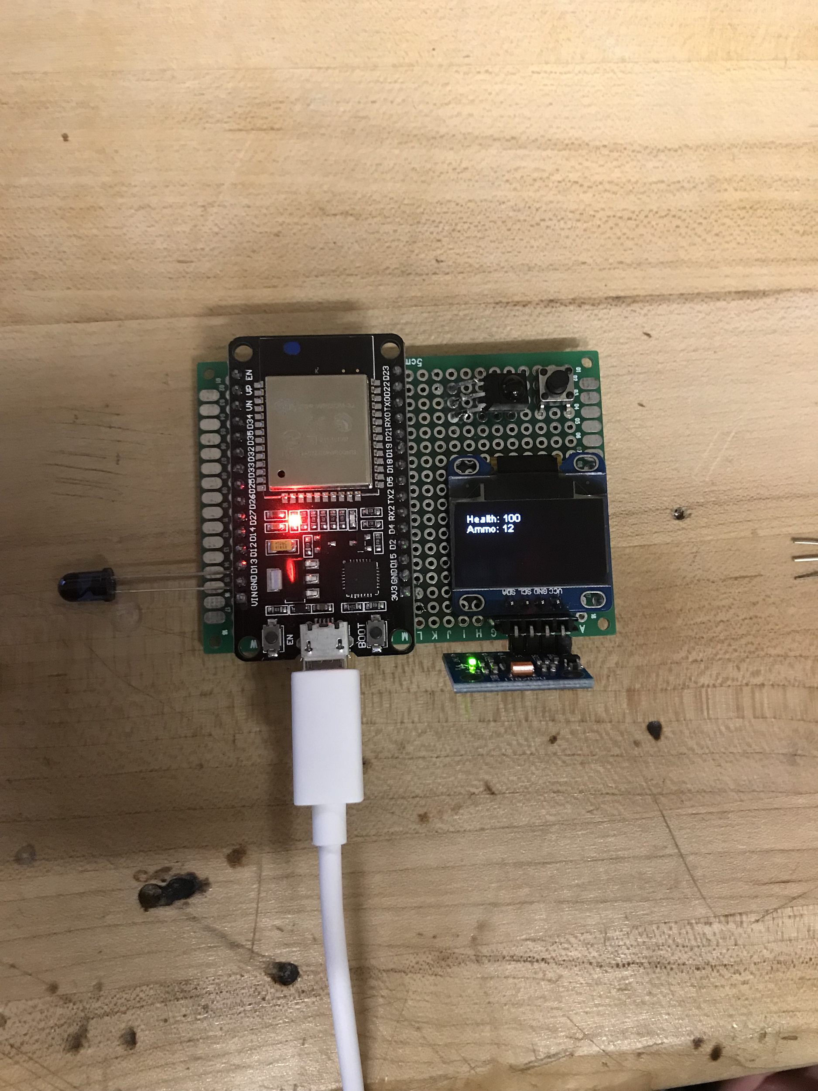
Notes:
Updated pics, updated issues

Slide 36
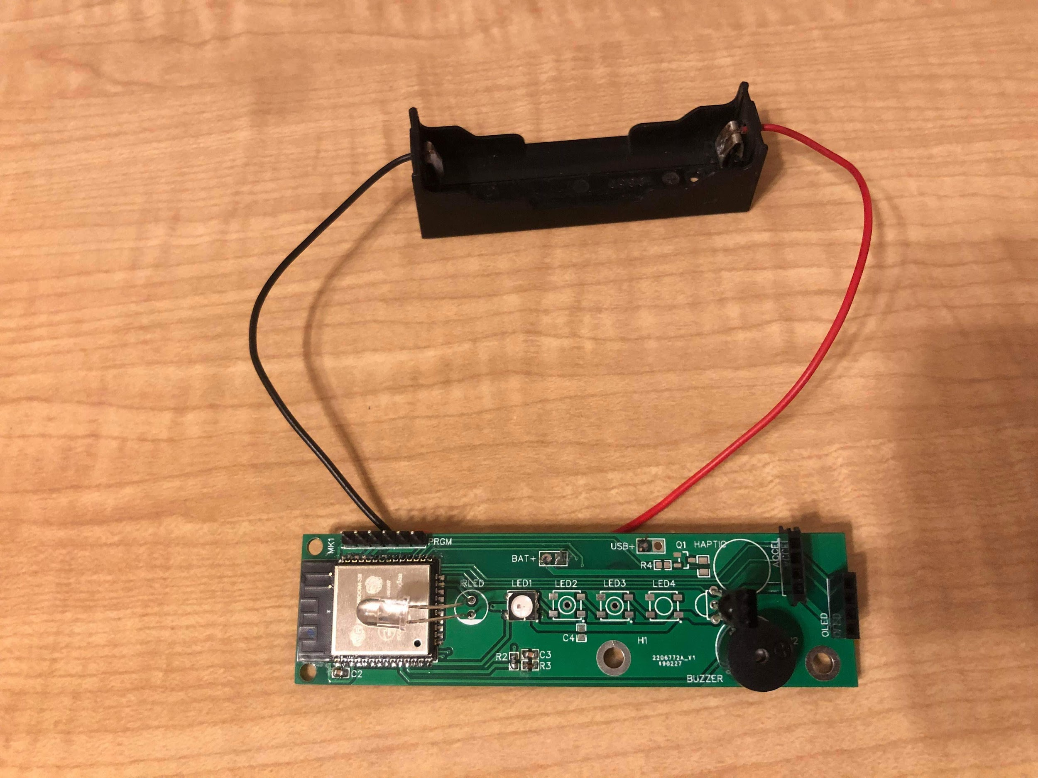

Slide 37
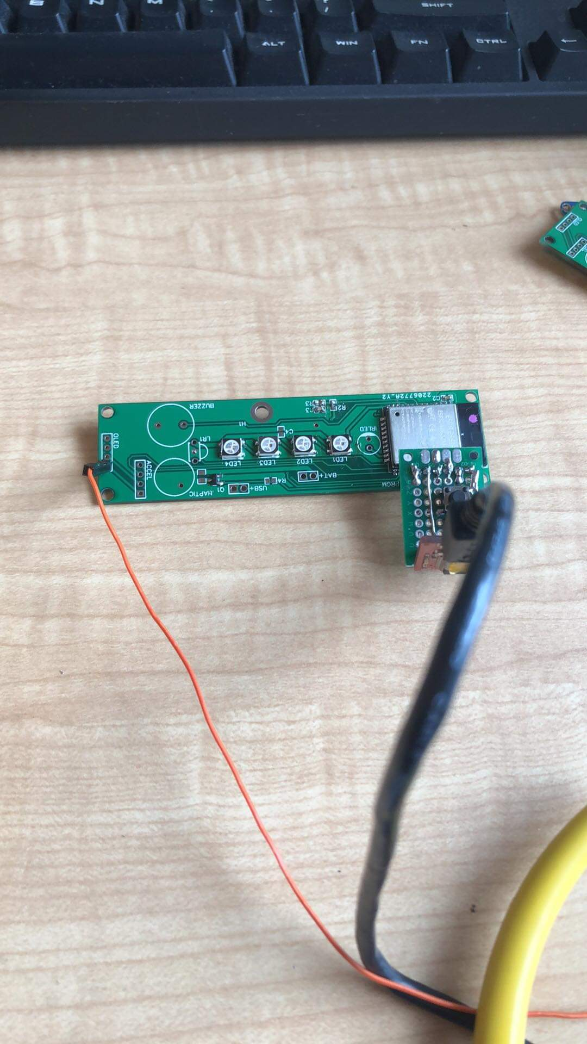

Slide 38
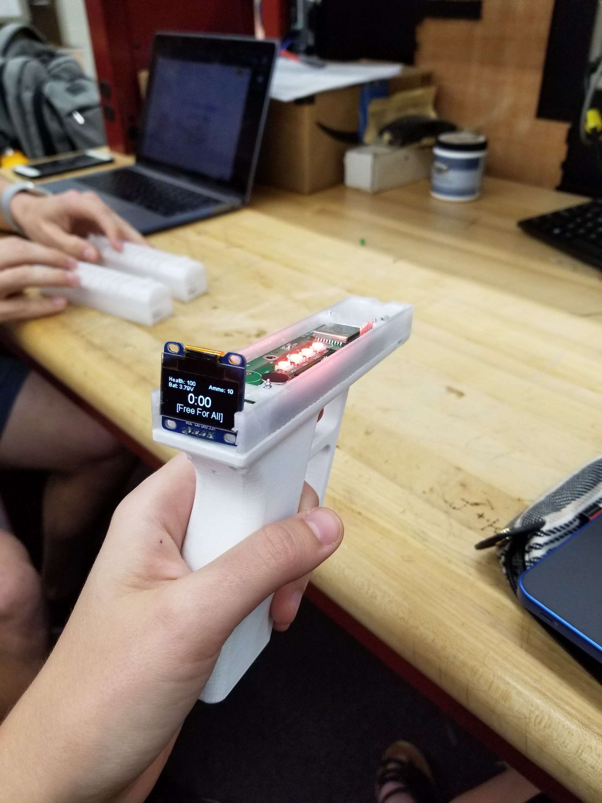

Slide 39
Issues
Standard first PCB attempt mishaps
Standard PCB assembly mishaps
Pull-up resistor on ESP32 reset
Battery charging hardware jitter required capacitor
Notes:
Marco

Slide 40
Administrative Content

Slide 41
Relevant Constraints and Standards
IEEE Policies, Section 7: Code of Ethics
IEEE STD 1625-2004: Standards for Rechargeable Batteries for Portable Computing
IPC-J-STD-001ES: Soldering Standards
RoHS certified products will be used when possible to comply with environmental and health and safety standards (2011/65/eu)
The constraints that most affects our project are social and political

Slide 42
Relevant Social and Political Standards
Title 15 of the Code of Federal Regulations: guidelines for an imitation firearm
Bright orange cap at the end of the muzzle, bright/translucent body to clearly mark it as a toy
Desired colors are available in ABS/PETG filament
LEDs on top of the gun also identify it as a toy

Slide 43
Division of Work
 | Project Area | Software | Peripherals | Power | PCB Design
Group Member
Karlie Brinthaupt |  |  | Secondary | Primary
Shannon Fies |  | Secondary |  |  | Primary
Marco Montero |  |  | Primary | Secondary
Anuj Yamdagni |  | Primary |  |  | Secondary

Slide 44
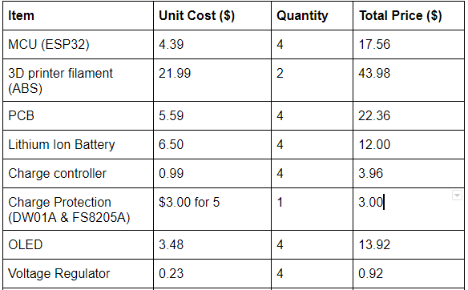
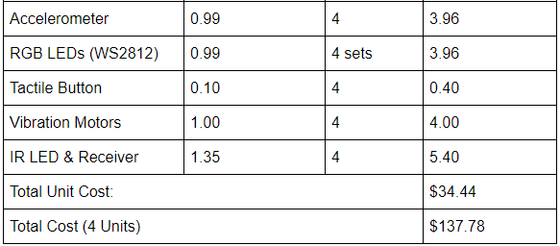
Budget/Bill of Materials

Slide 45
Financing
Self Funded!
Most parts are inexpensive to begin with
Some prototyping components are already owned
Allows us more creative freedom and less stress

Slide 46
Questions?

