Slide 1
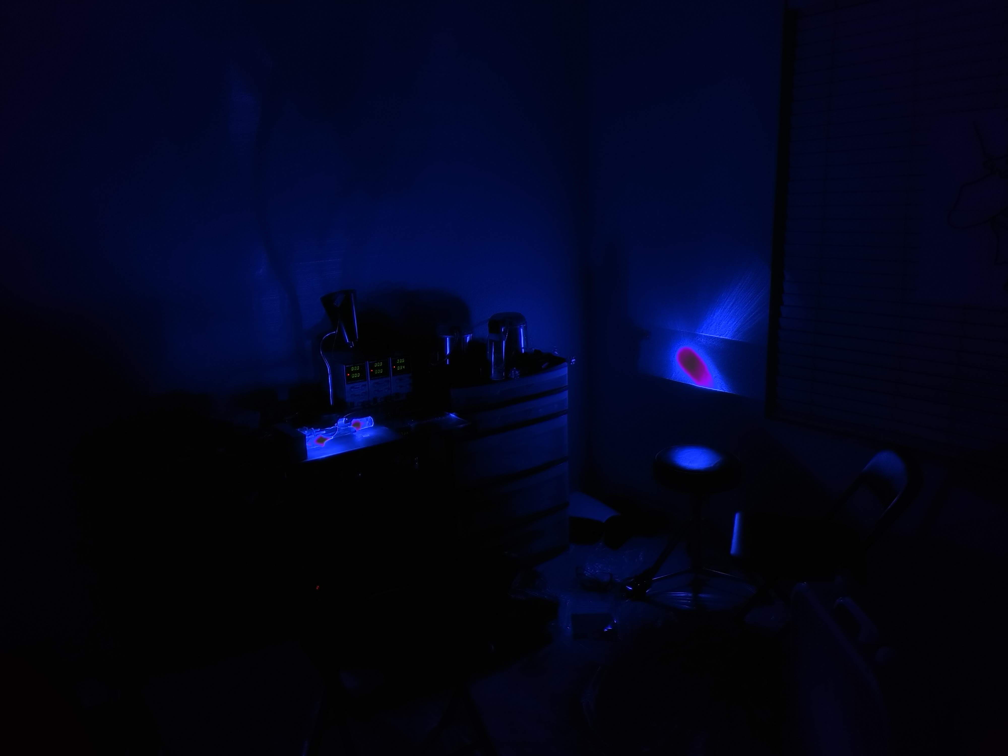

Mixed and Distributed Laser Illumination System (MADLIS)
Group 26
Hunter Cohen (BSPSE)
Derek Daniels (BSPSE)
Melvin Ramos (BSCpE)
Ian Shearer (BSEE)
Patent pending, Eternal Photonics LLC

Slide 2
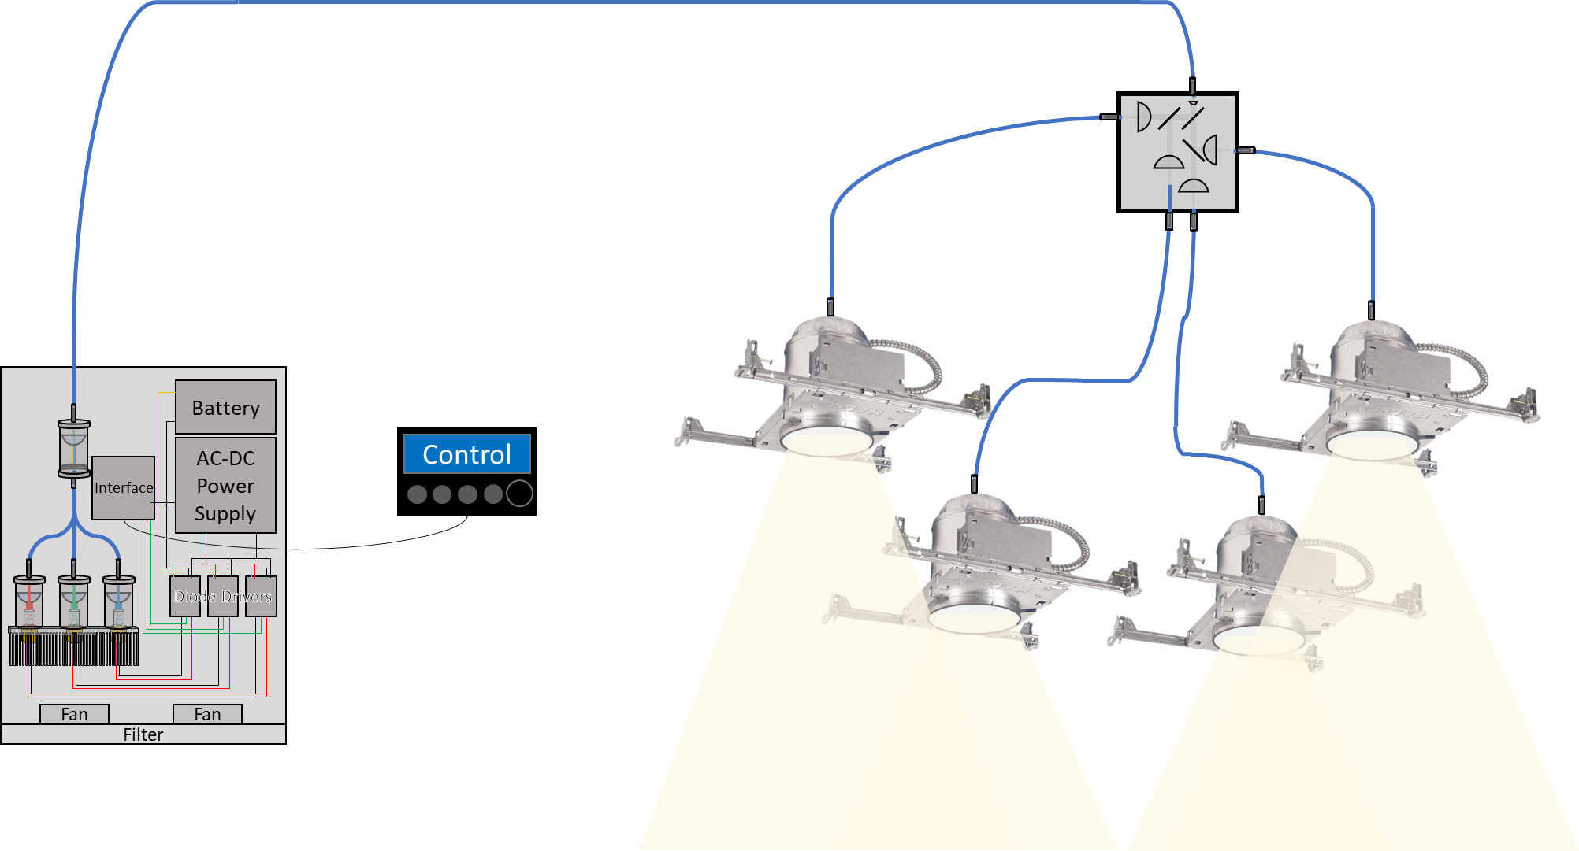
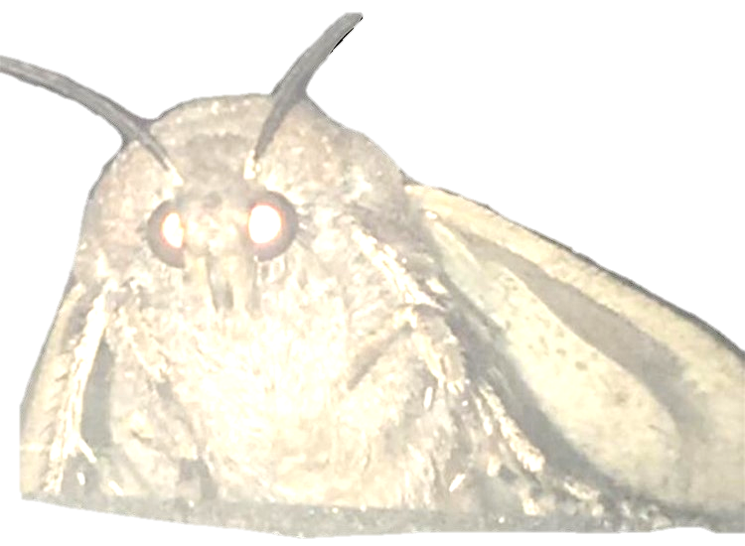
System Diagram
(Not to Scale)

Slide 3

Block Diagram
Legend
Melvin Ramos Area of Responsibility
Ian Shearer Area of Responsibility
Derek Daniels Area of Responsibility
Hunter Cohen Area of Responsibility
DC Power
Regulated DC Power
Control Signal
Power Monitoring Signal
Uncoupled Light
Fiber Optic Cable
Controller
Laser Diode Driver
Red Laser Diode
Diffuser
Interface
Fiber Combiner
Fiber Splitter
Laser Diode Driver
Green Laser Diode
Diffuser
Blue Laser Diode
Diffuser
DC Power Supply
Laser Diode Driver
Diffuser

Slide 4

Specifications
>5 lux/sqft, >200sqft room
>100 lux output/watt to laser diodes
At least 4-bit color/intensity control
>80% diode driver efficiency
<10% variation between outputs
Maintain 25°C +20°C/-10°C

Slide 5
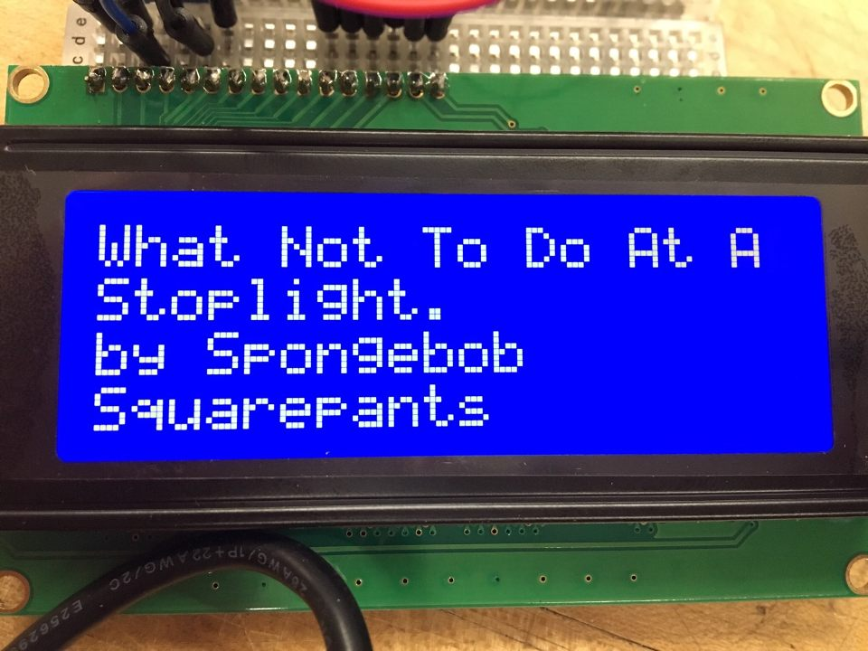
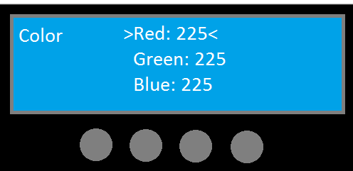
The User Interface
Output: Screen/Display
-LCD 4x20 Character display
Input: Buttons/dials
-4 push buttons
Menu System
-Setting sub-menus

Slide 6
Choosing a Microcontroller
Specs | ATmega328 | MSP430G2553 | ATmega32U4 | PIC16F877A
Non-volatile Memory | 2KB SRAM | 16KB | 2.56KB | 256B
Memory | 32KB | RAM 0.5KB | 32KB | RAM 368B
I/O Pins | 28 | 24 | 26 | 33
Clocks/Timers | 8-bit timer 16-bit timer Oscillator | 32 kHz Crystal 2 16-bit timers | 8-bit timer 16-bit timer Oscillator | 8-bit prescaler 8-bit timer 16-bit timer
Serial Port Communication | USART | UART | USART | USART
SPI | 2 | 2 | 2 | 1
Cost (USD) | $0.90 | $2.20 | $2.89 | $5.09

Slide 7
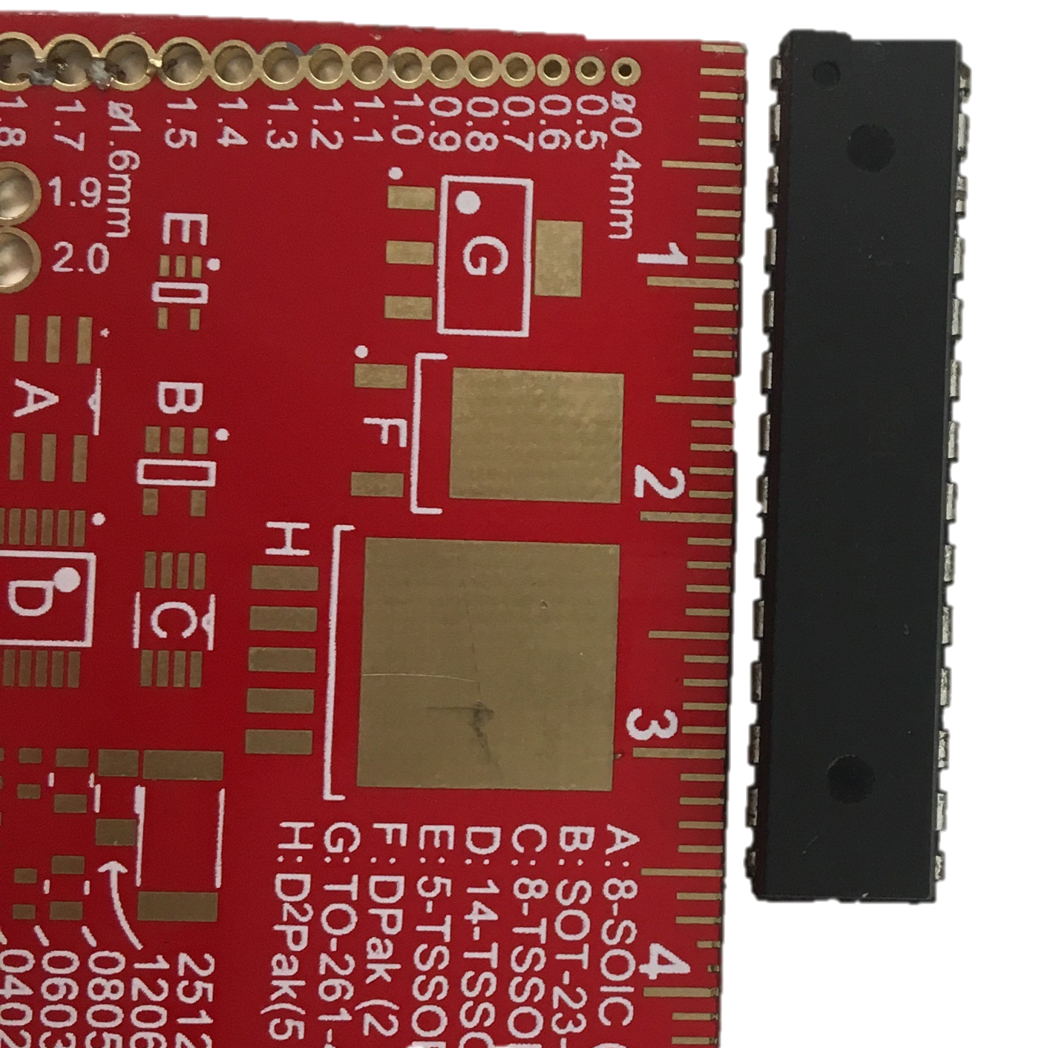
The Microcontroller ATmega328
Dimensions: 37.4 x 6.76 x 3.28mm

Slide 8
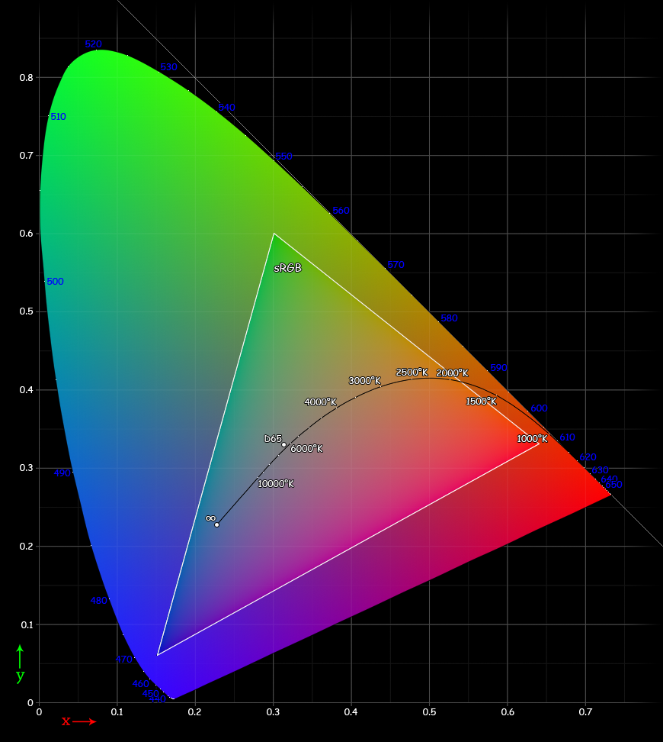
Control Software Features
Color control RGB values
Luminosity value
Custom Color profiles
Predefined color profiles
Schedule times to use color profiles

Slide 9
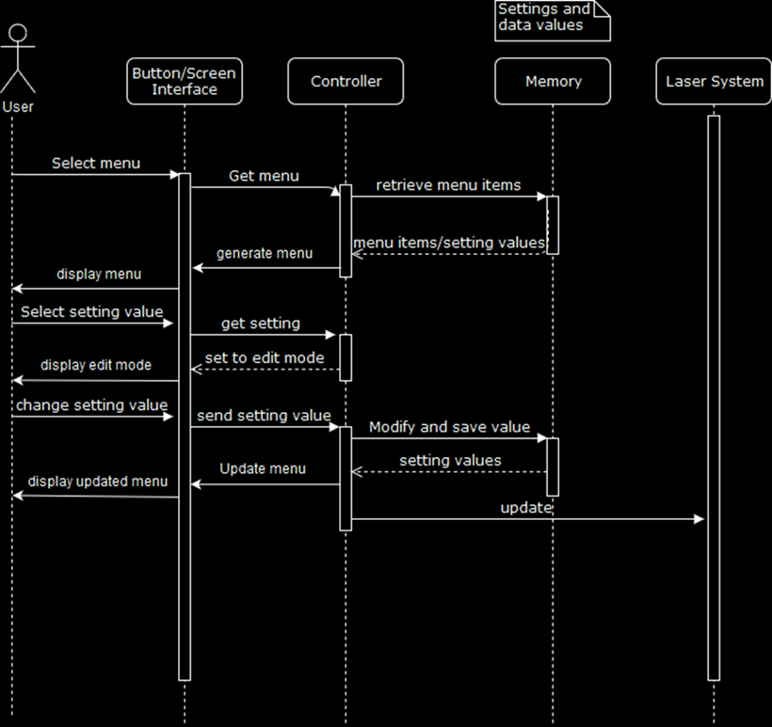
UI Design Implementation

Slide 10
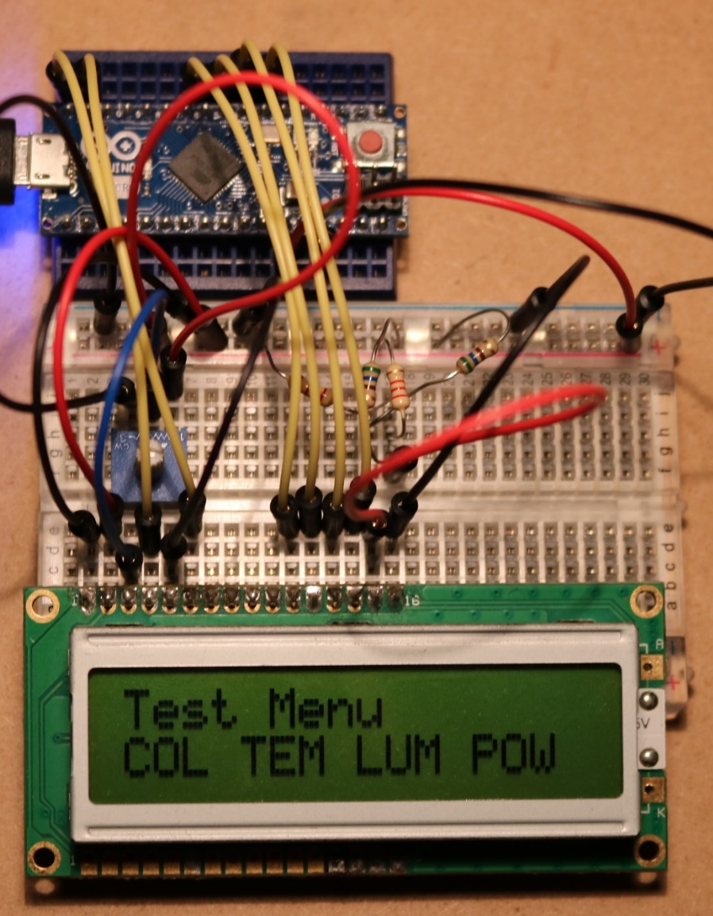
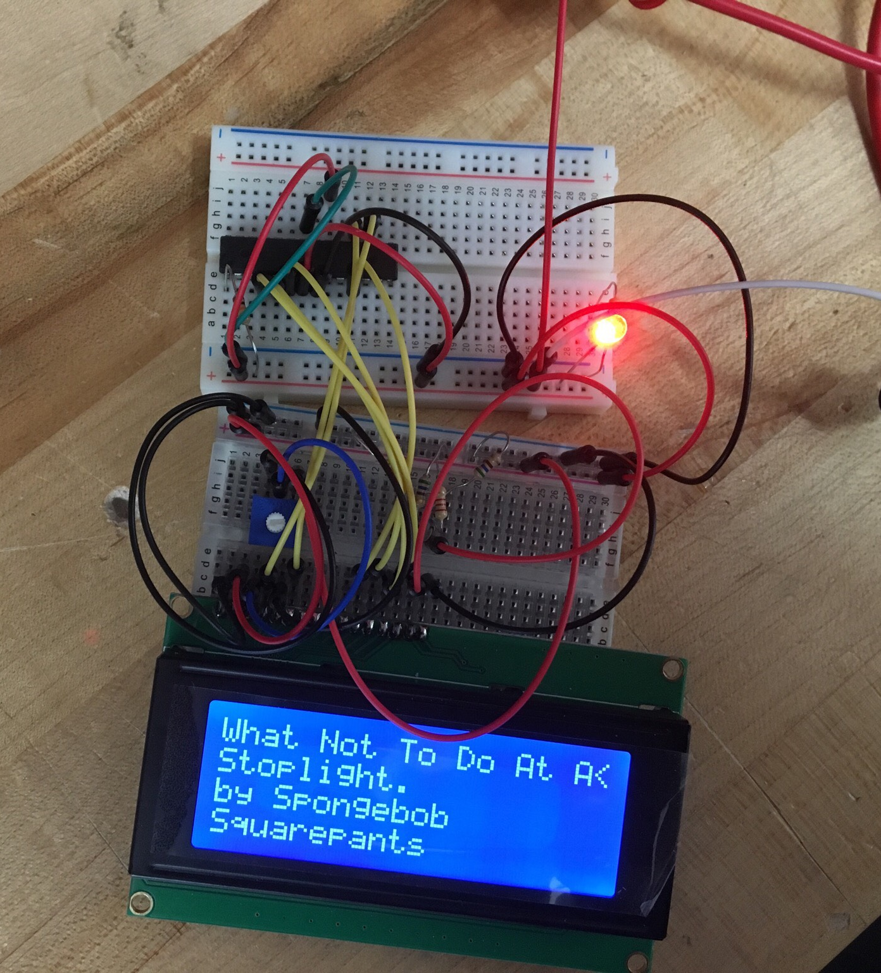
UI Testing

Slide 11
Electronics Goals
Supply around 50-70 W of power for the whole system
  Three Diode Drivers (~20-30 W)
  Logic/Power Distribution Board (~10-20 W)
High Supply to Diode efficiency
  70%
  Stretch goal = 80%
Easy control with microcontroller

Slide 12
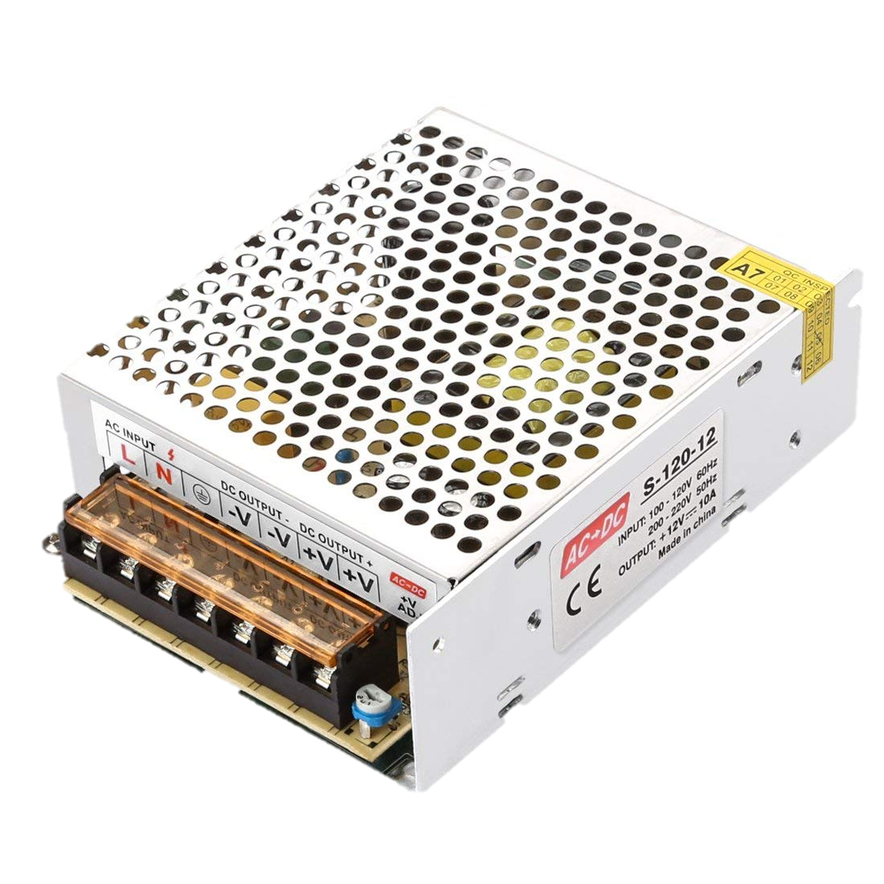
120VAC –> 12VDC Power Supply
120VAC mains input
12VDC output
Up to 20A output

Slide 13
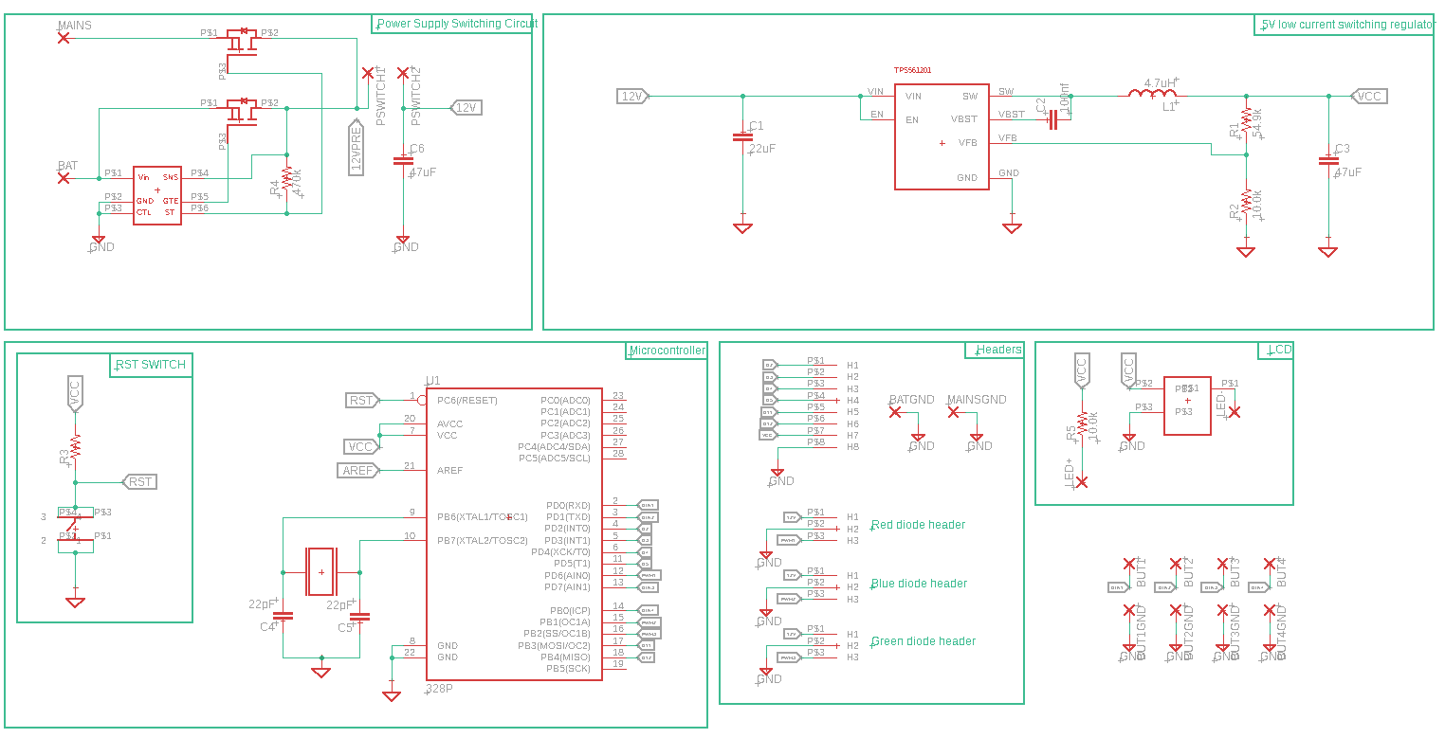
Logic Board Schematic

Slide 14
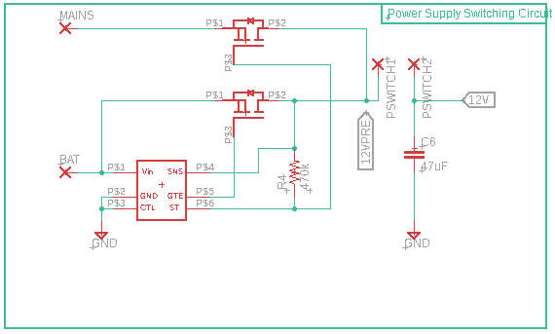
Power Supply Switching Circuit

Slide 15
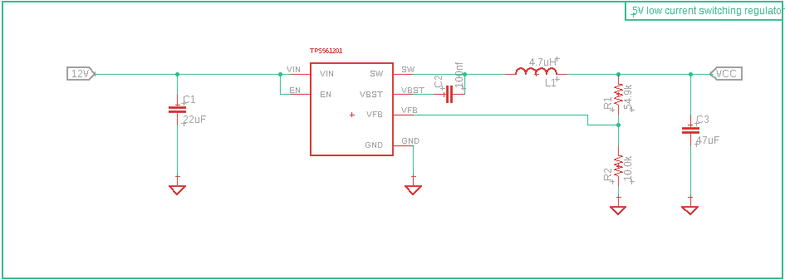
Microcontroller Power

Slide 16
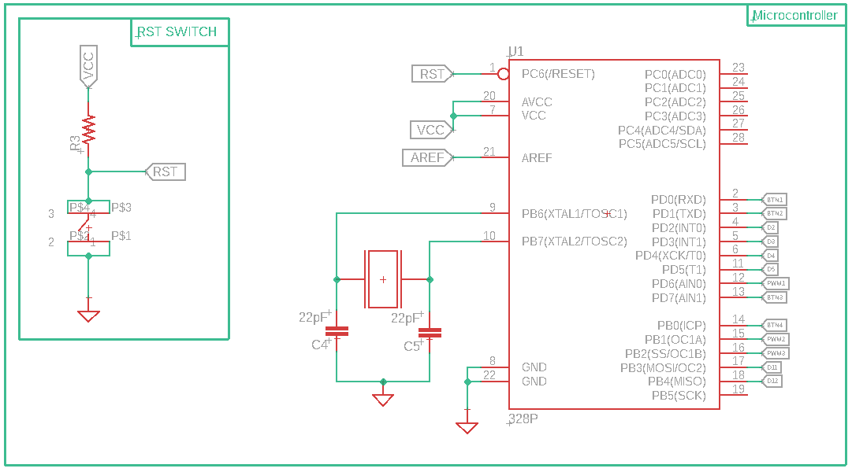
Microcontroller

Slide 17
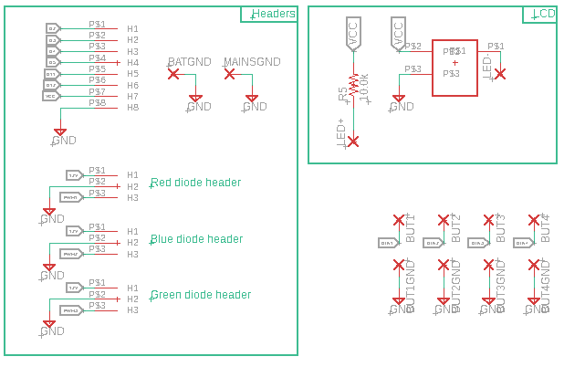
Headers/Control

Slide 18
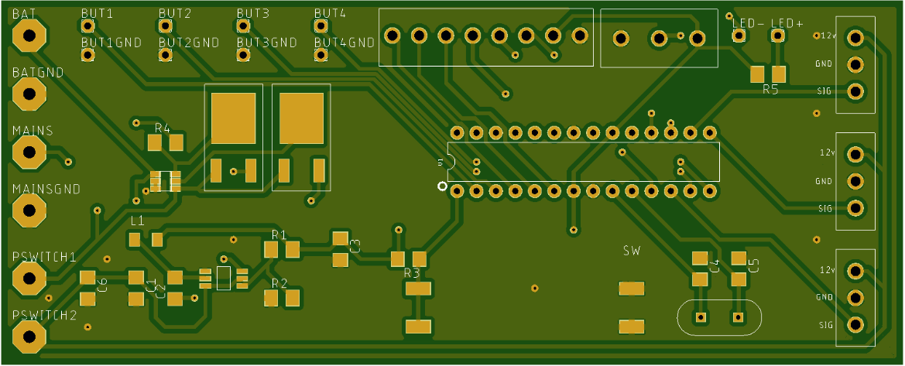
Logic/Power PCB

Slide 19
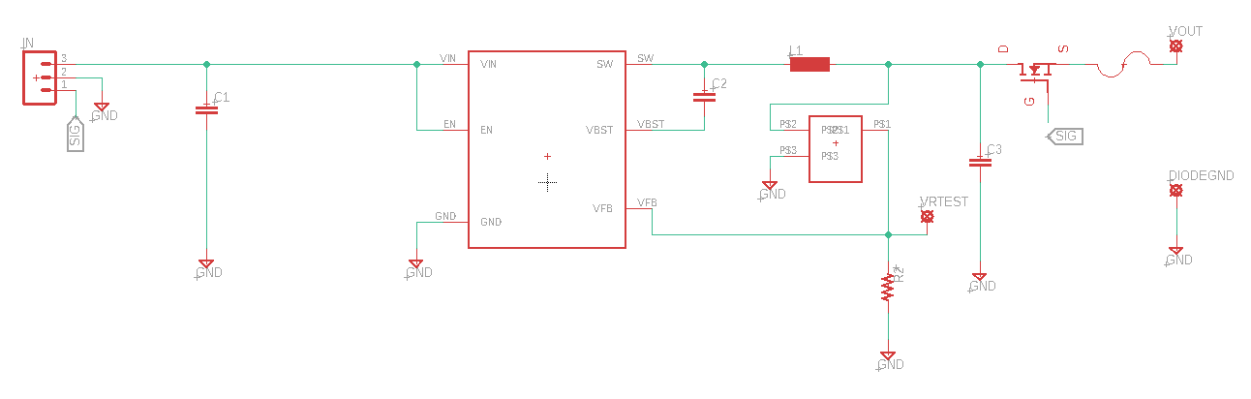
Diode Driver

Slide 20
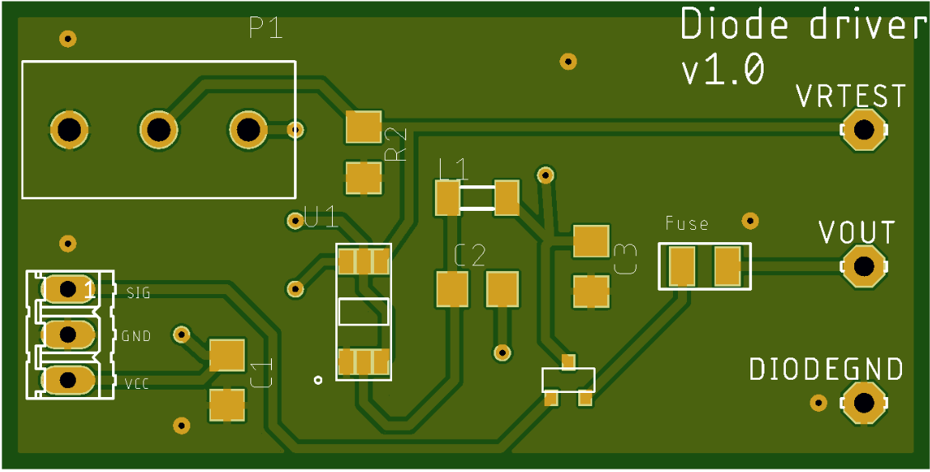
Diode Driver PCB

Slide 21

Software/Suppliers
Schematic/CAD
  Eagle CAD
    Free for students
    Simple/Powerful
    Large Userbase
PCB Manufacturer
  JLCPCB
    Cheap and Quality products
Component purchases
  Mouser
    Consistent delivery
diyaudiocircuits.com/eagle-cad-pcb-design-software-tutorials-way/

Slide 22
Possible/Known Issues
MOSFET driving with PWM signal
Heat
Accuracy of potentiometers
Footprints incorrect

Slide 23
Electronics Costs
$144.02 : Components
$13.79 : PCB
$18.69 : 120VAC -> 12VDC Power Supply

Slide 24
Component Selection
Material | Rigidity | Durability | Transparency | Consistency | Cost/ft.
Steel Pipe | High | High | None | High | $15
Aluminum Pipe | Medium | Medium | None | High | $10
Acrylic | Low | Low | High | Medium | $20
PVC | Medium | Medium | None | High | $3
Polycarbonate | High | High | High | High | $7
Material | Thermal Conductivity (W/mK) | Density (g/cm³) | Mohs Hardness
Aluminum | 205 | 2.7 | 2.75
Copper | 401 | 8.96 | 3
Carbon Steel | 54 | 7.85 | 4.25
Diamond | 1000 | 3.5 | 10
Gold | 310 | 19.3 | 2.5
Silver | 429 | 10.49 | 2.5
Description | Source | λ (nm) | Power (W) | Price
Oclaro HL63193MG | DTR's Laser Shop | 638 | 0.7 | $26.00
Ushio HL63290HD | OE-Company | 638 | 2.2 | $165.00
Ushio HL63290HD | Worldstar Tech | 638 | 2.2 | $98.00
Nichia NUGM02 | DTR's Laser Shop | 520 | 0.9 | $95.00
Nichia NUGM02 | Ebay: laserlandaustrailia2016 | 520 | 0.9 | $127.05
Nichia NDG7475 | DTR's Laser Shop | 520 | 1.0 | $175.00
Nichia NDG7475 | Ebay: techhood | 520 | 1.0 | $130.41
Nichia NUBM44-81 | DTR's Laser Shop | 450 | 7.0 | $80.00
Nichia NUBM44-81 | Opt Lasers | 450 | 7.0 | $197.00
Nichia NUBM08 | DTR's Laser Shop | 455 | 4.3 | $50.00

Slide 25
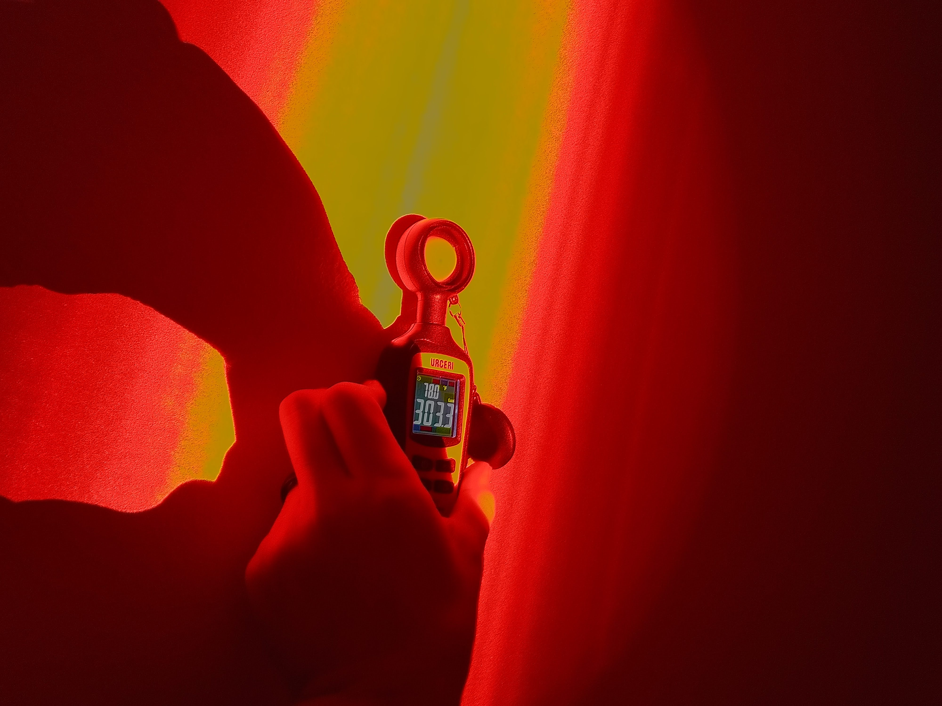
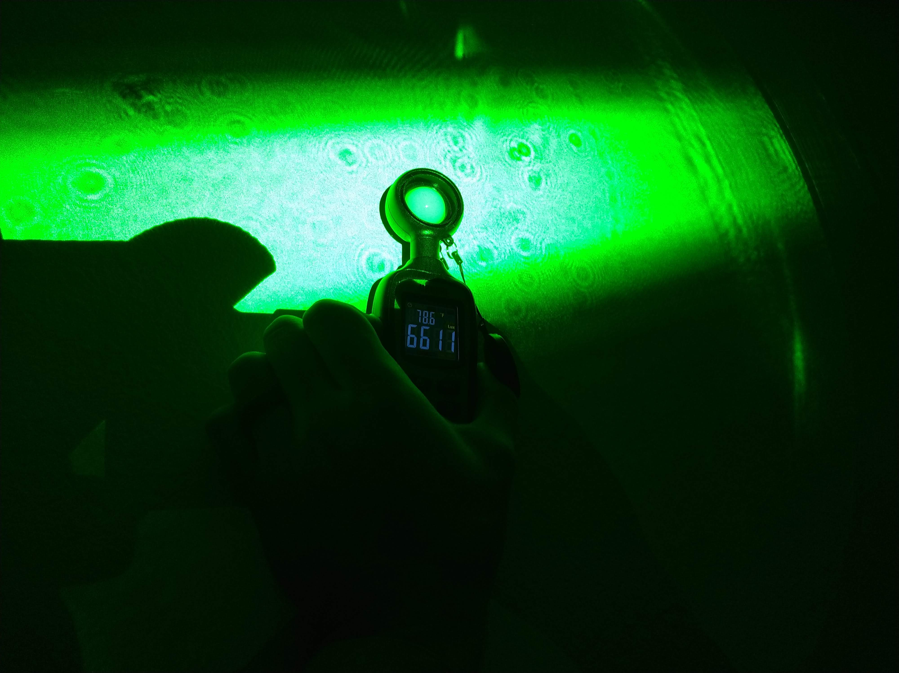
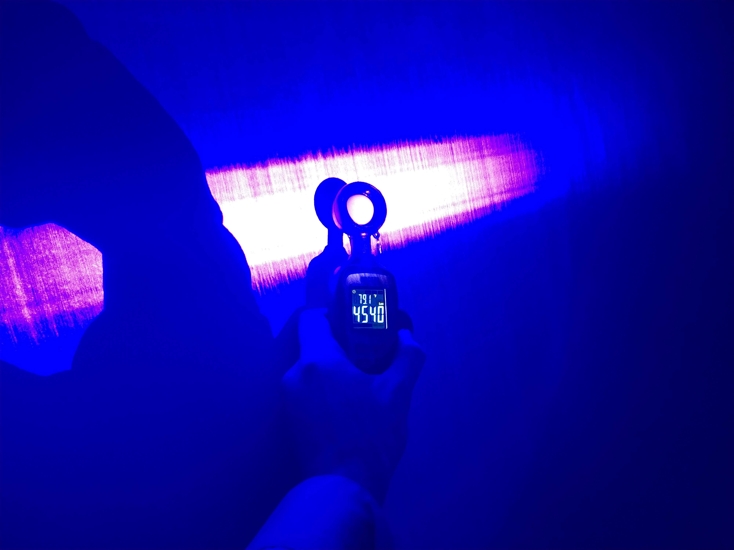
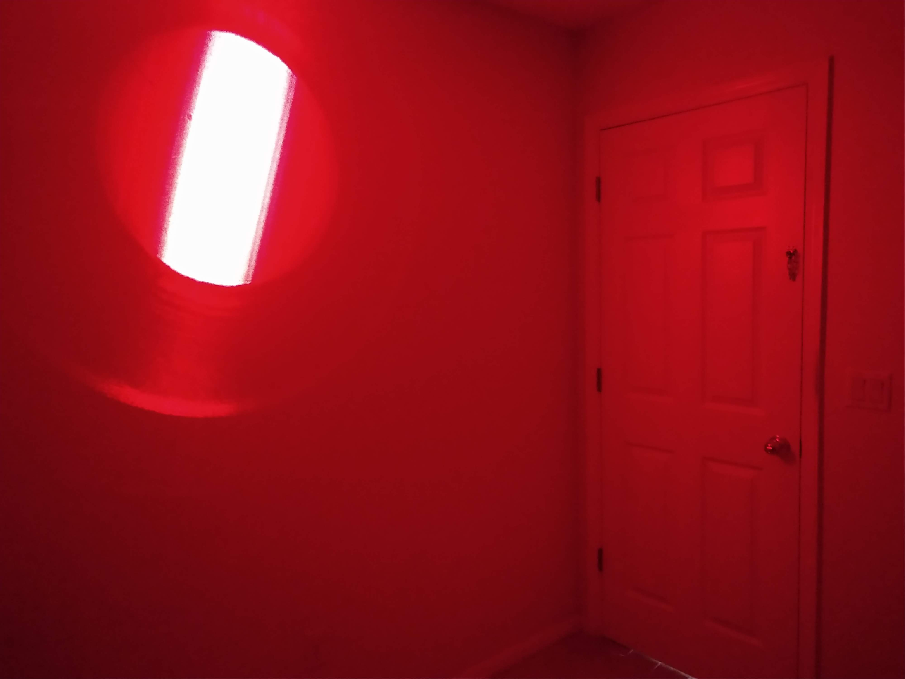
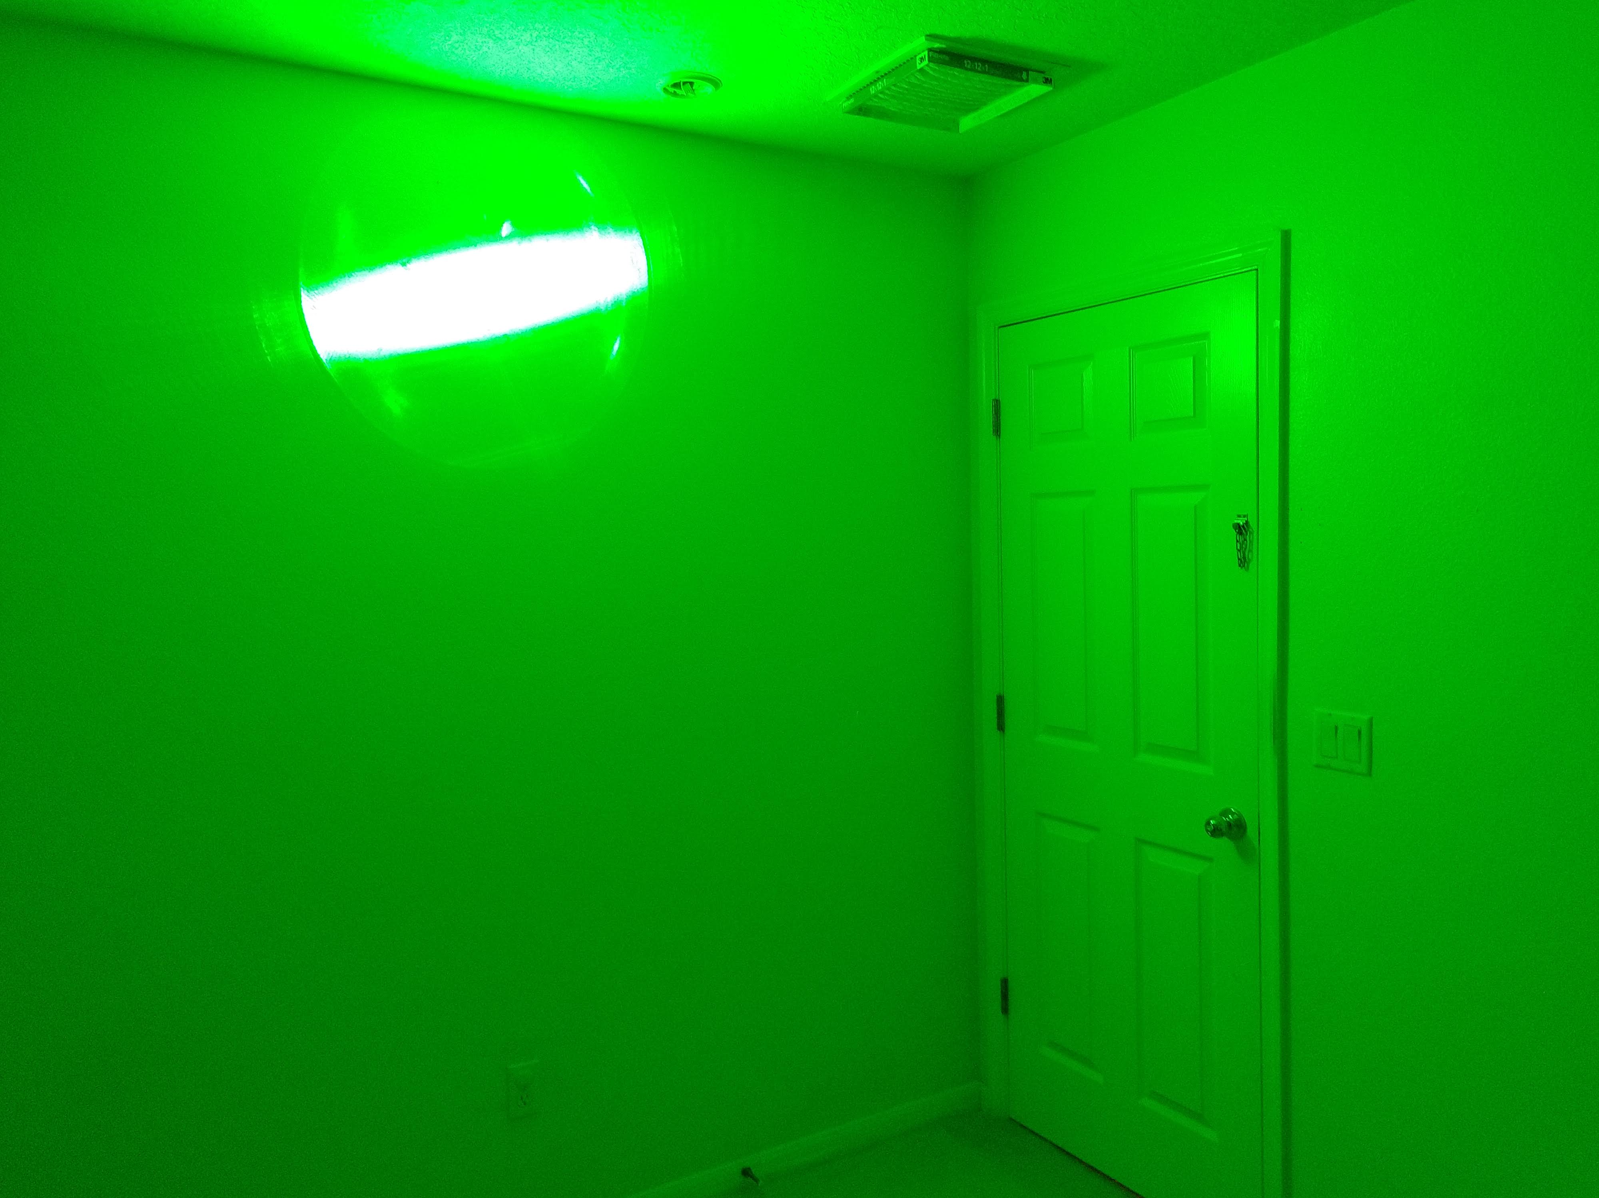
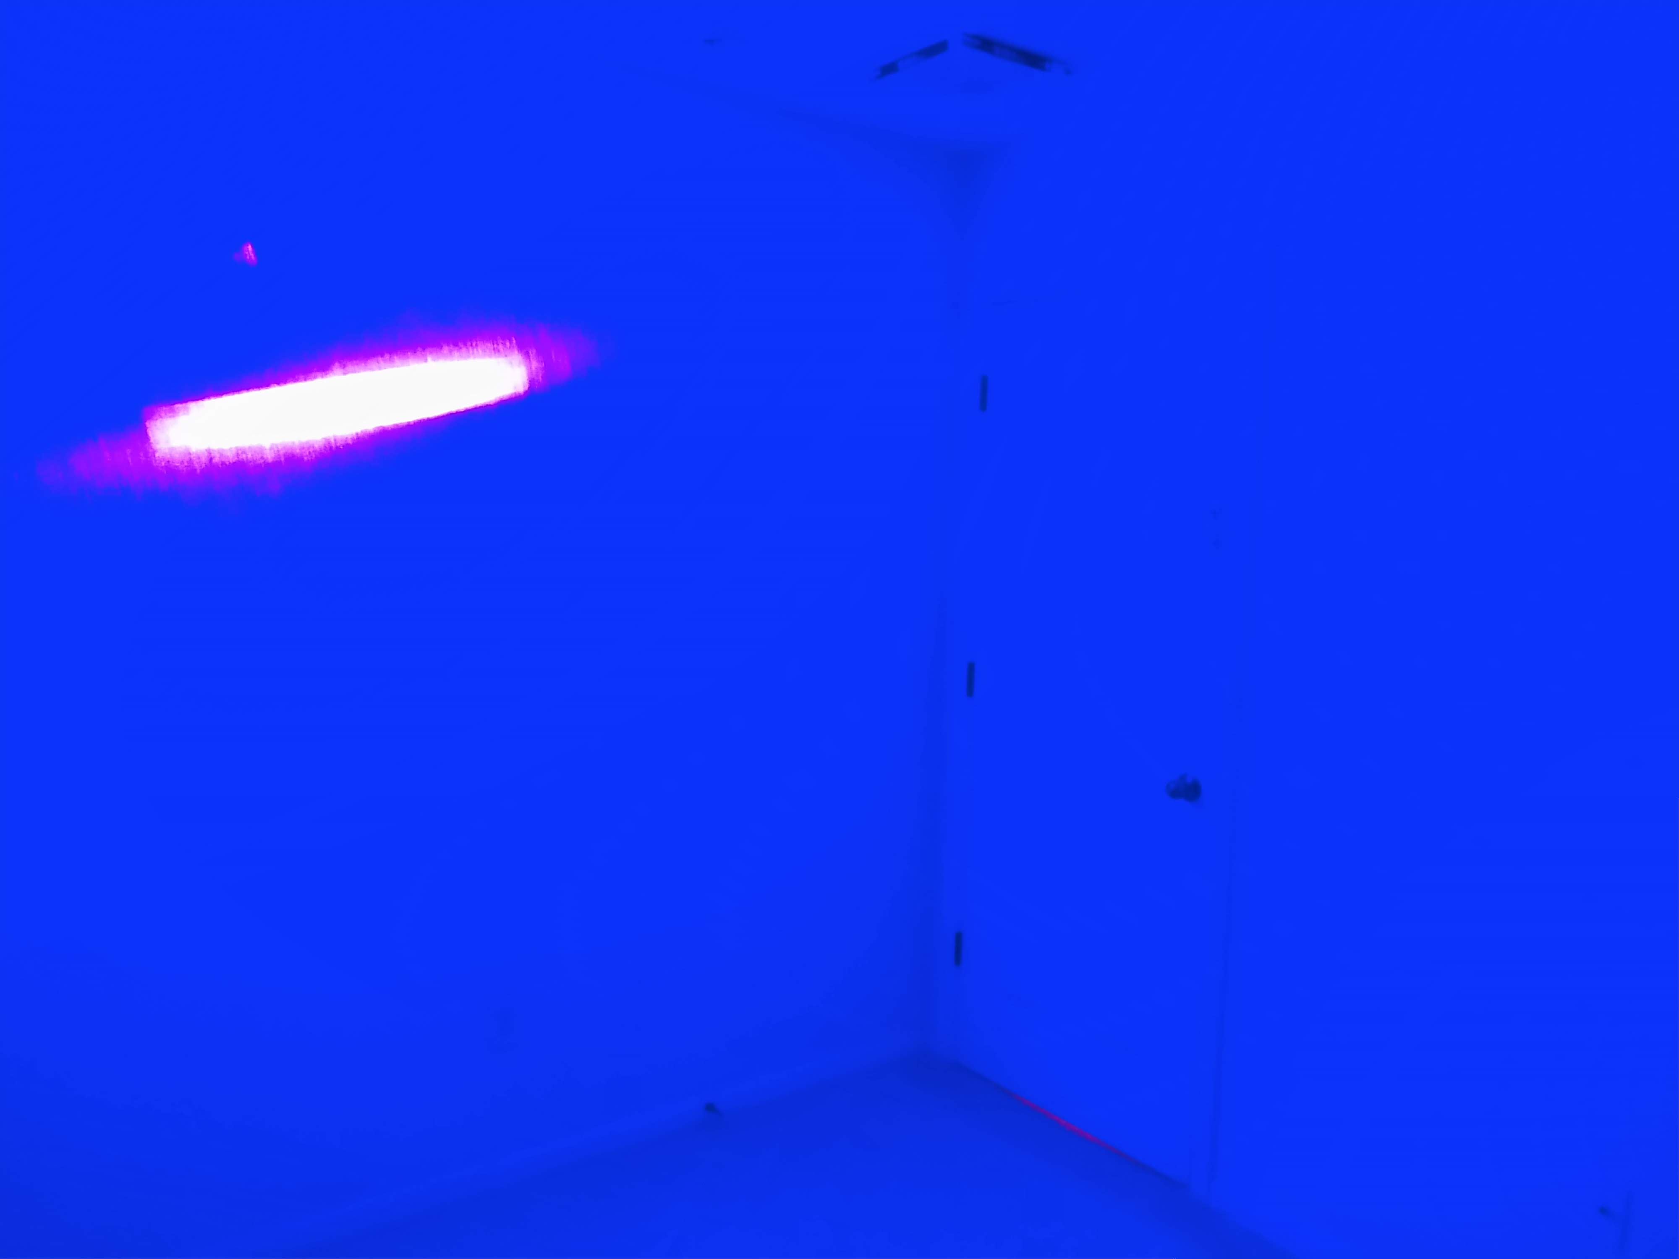
Diode Testing

Slide 26
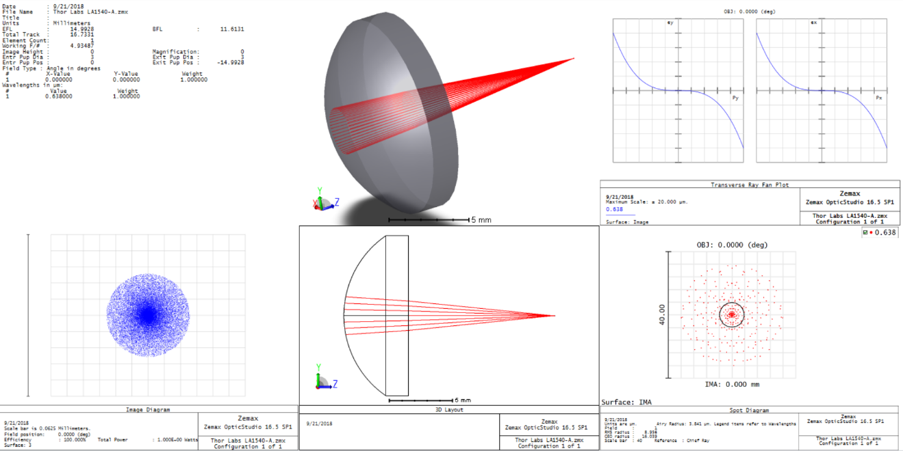
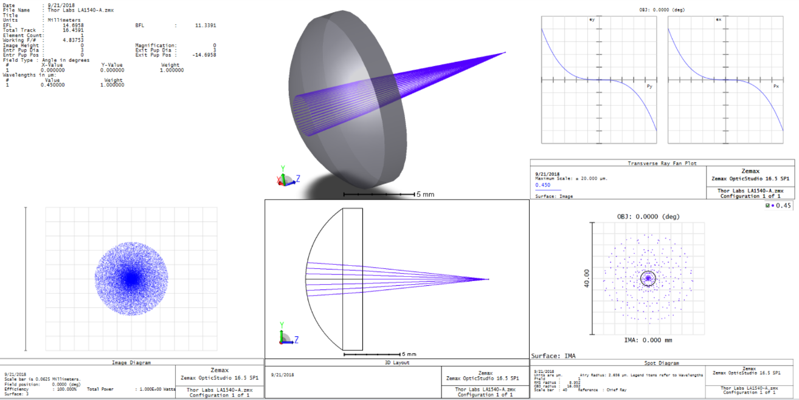
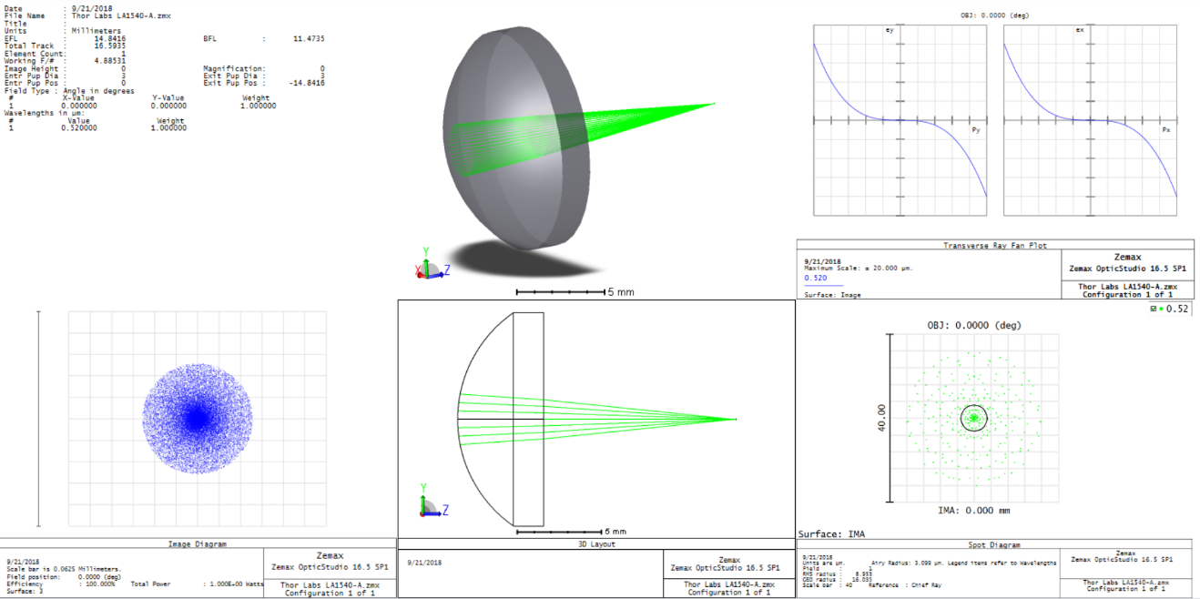
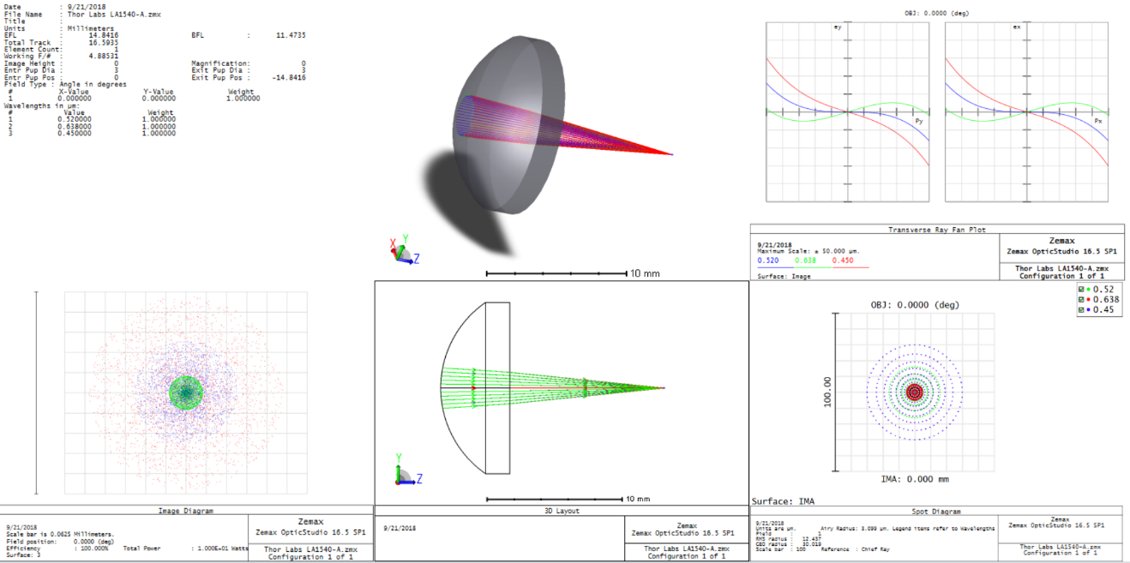
Optic Simulation

Slide 27
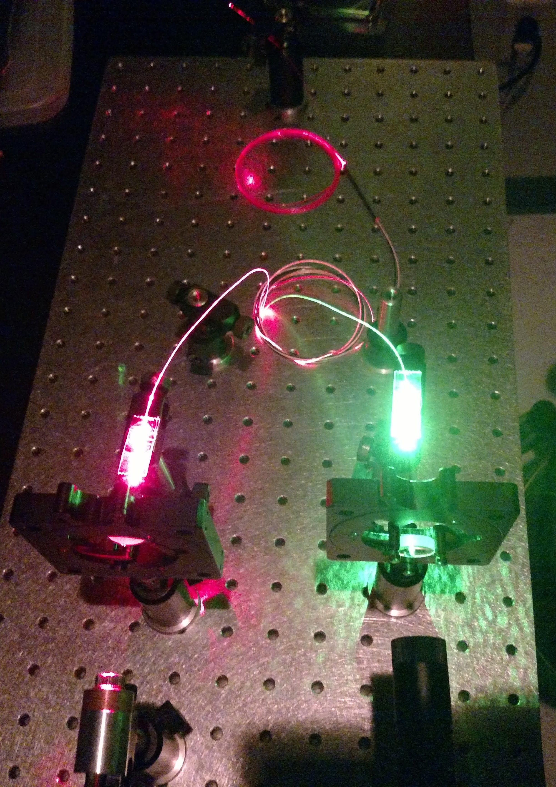
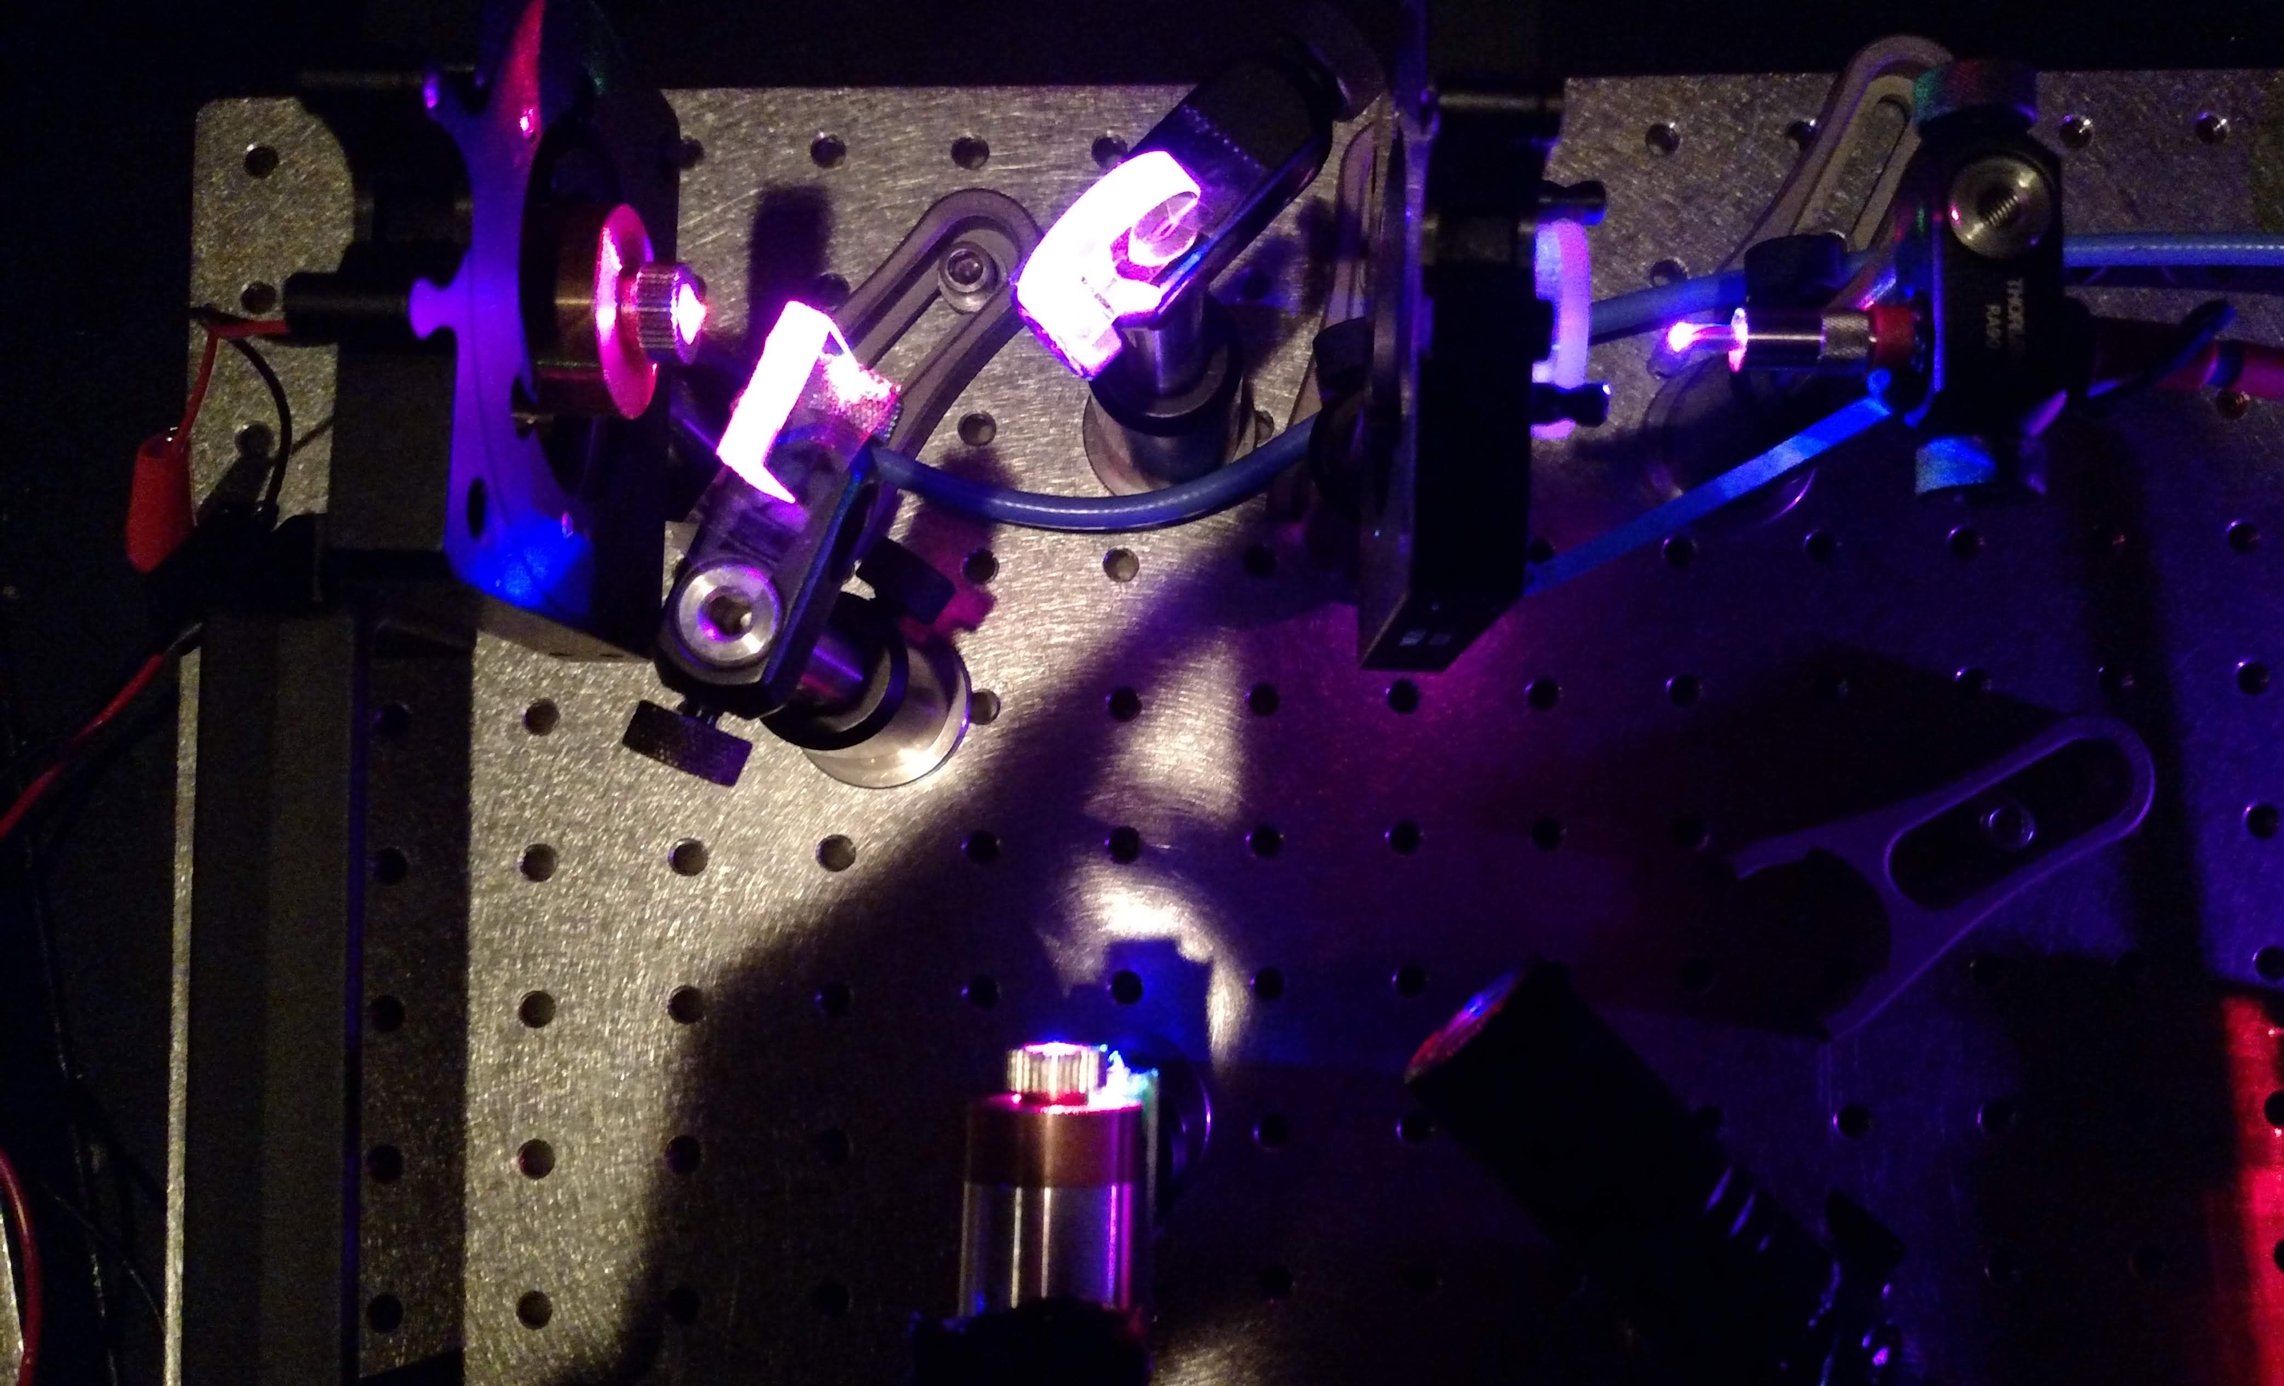
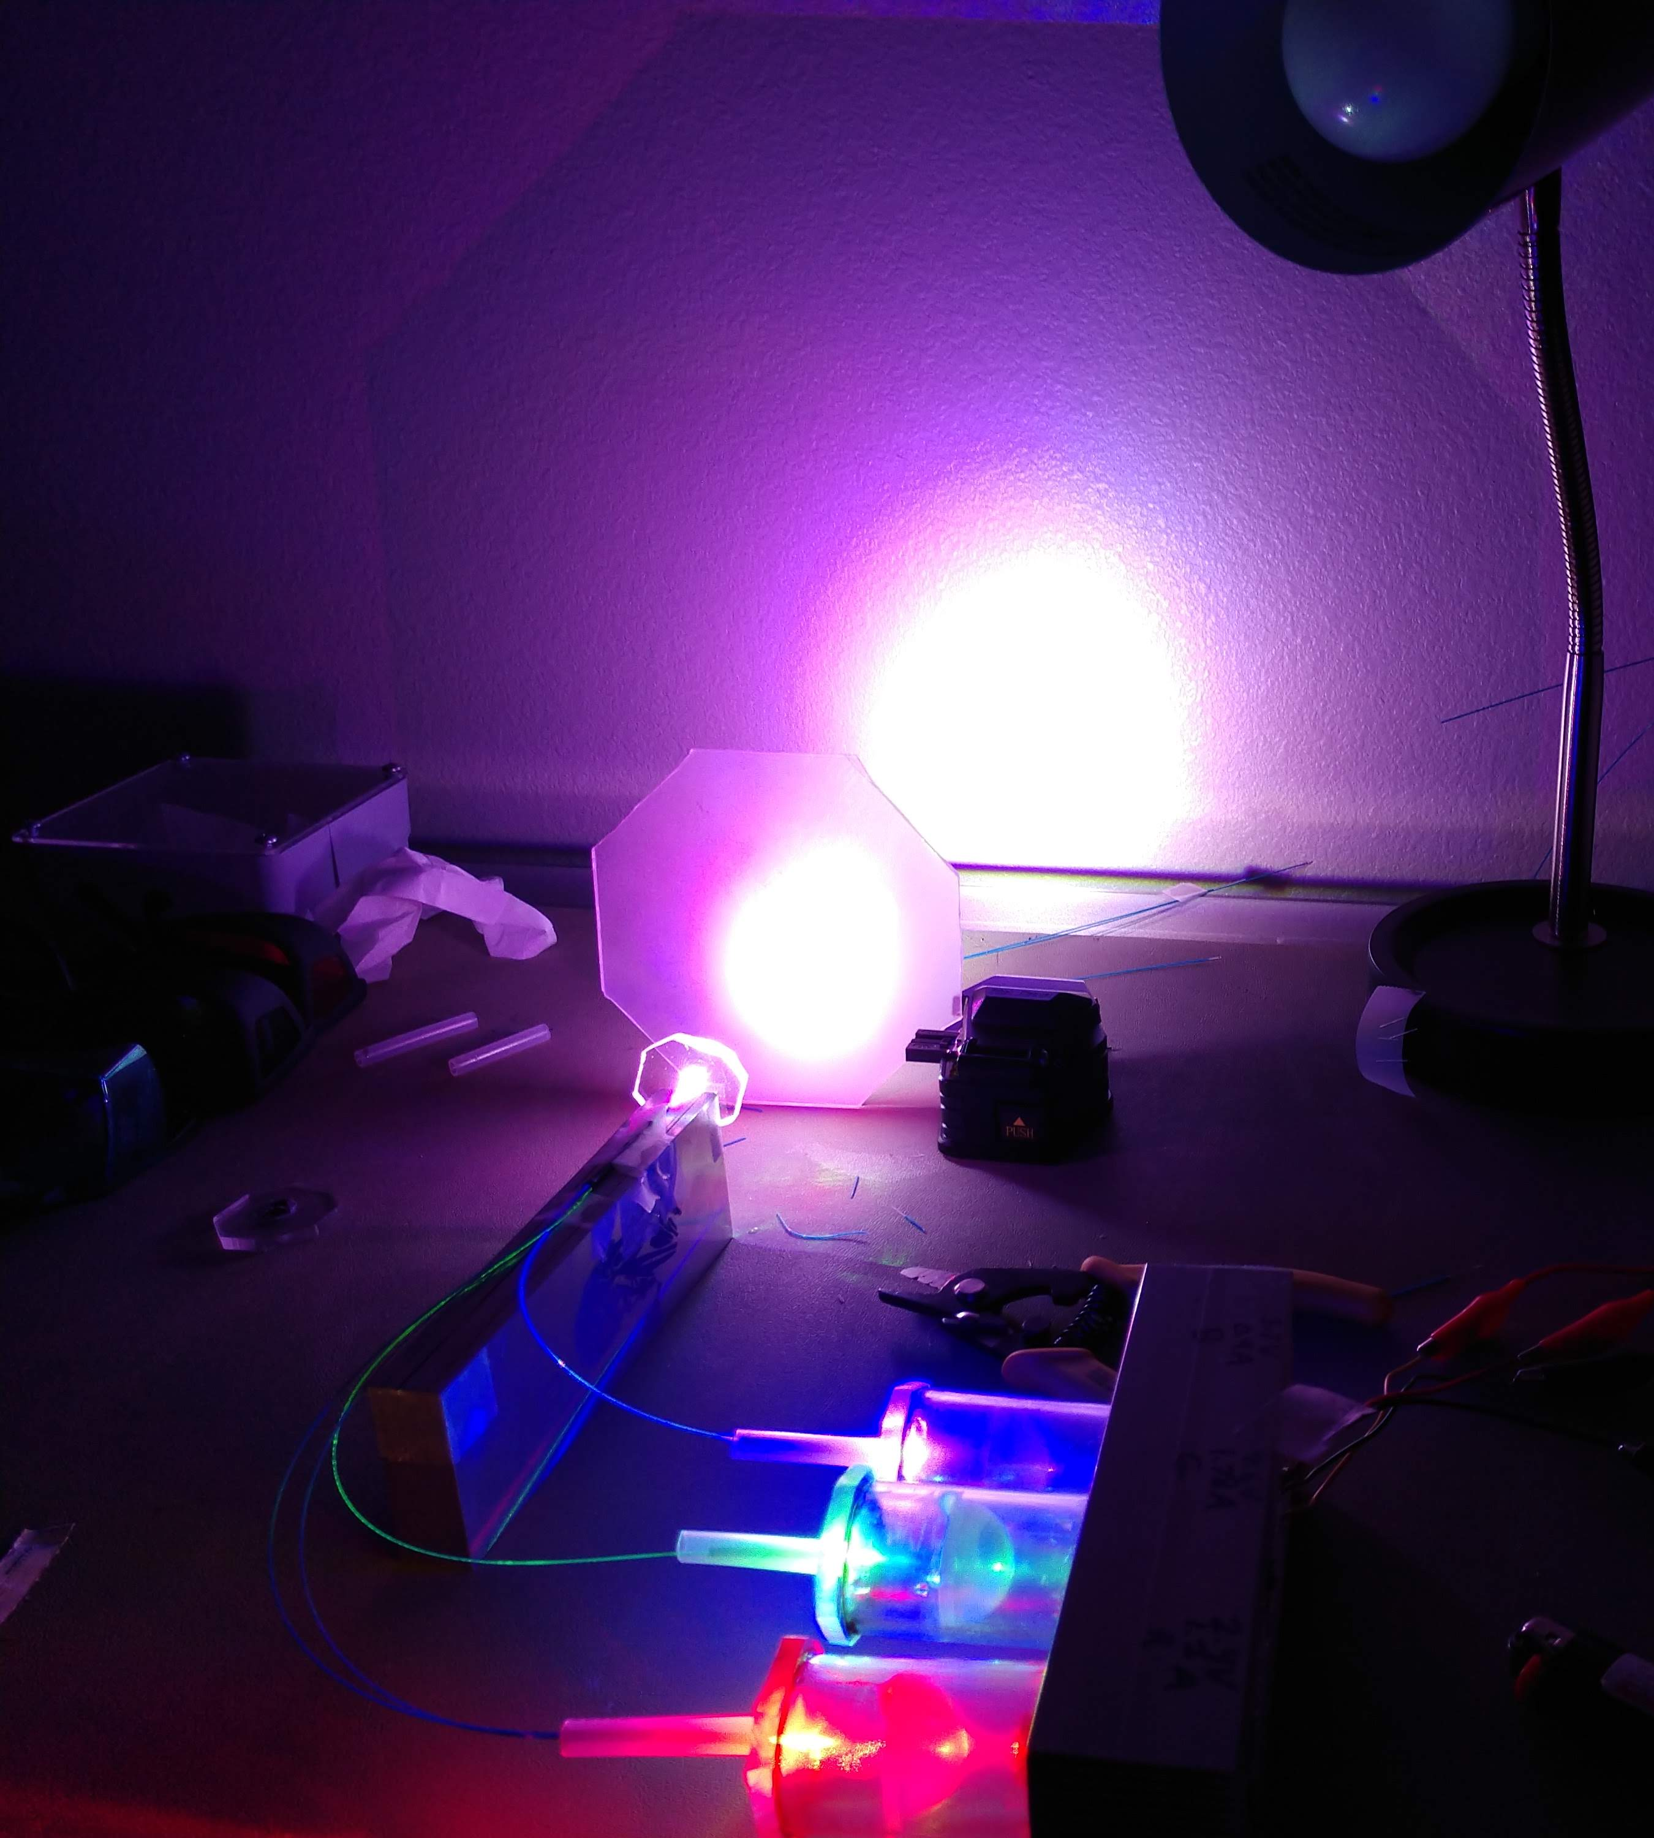

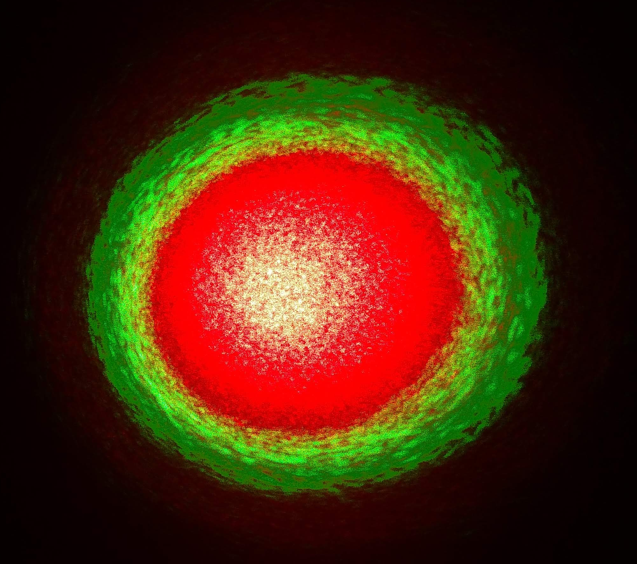
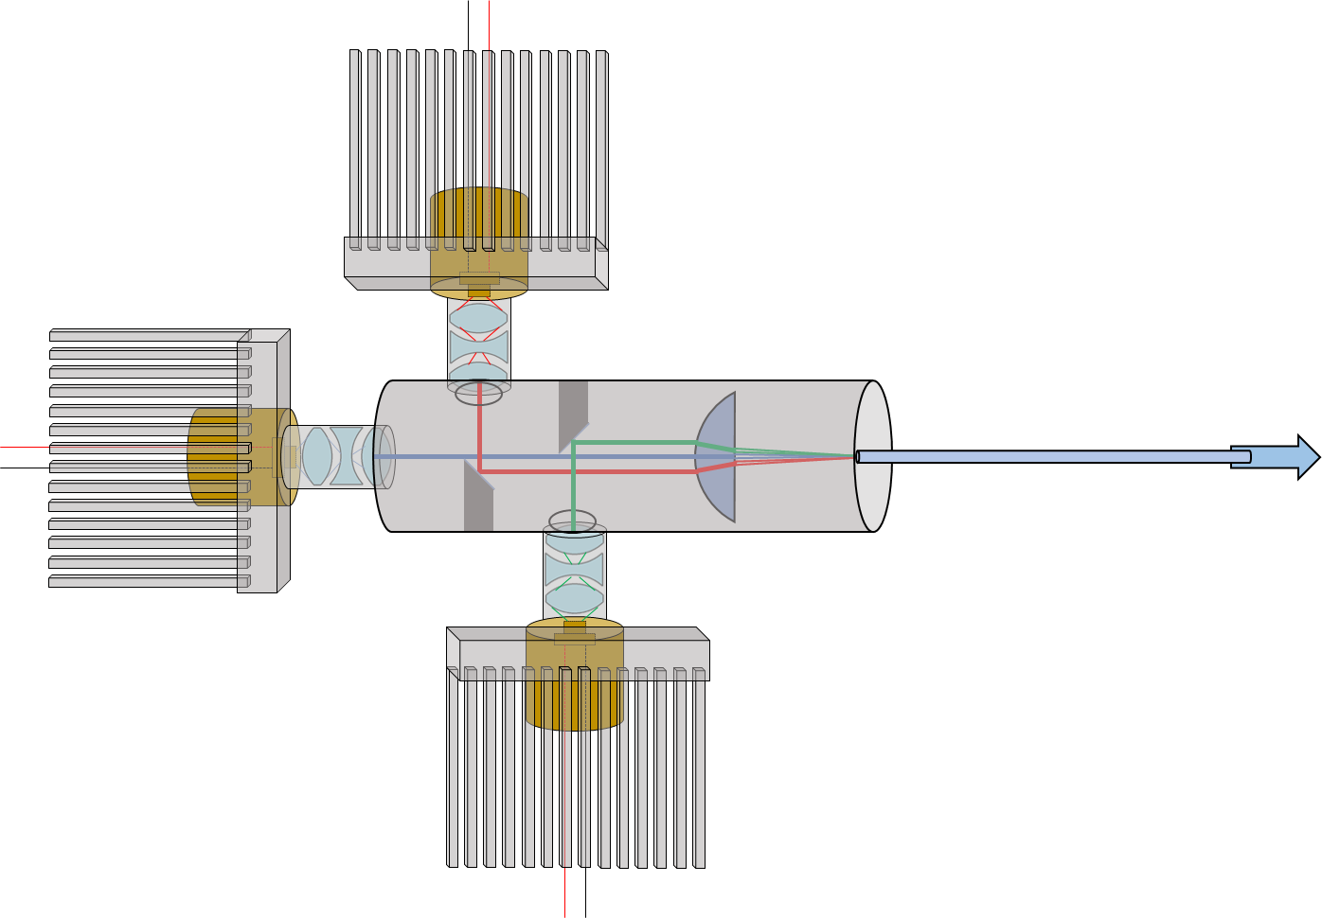
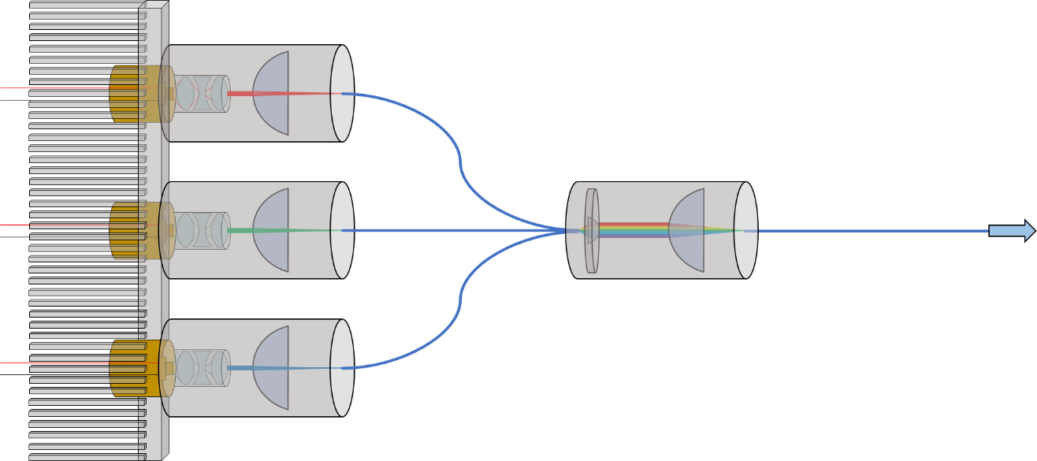
Improvise, Adapt, Overcome

Slide 28
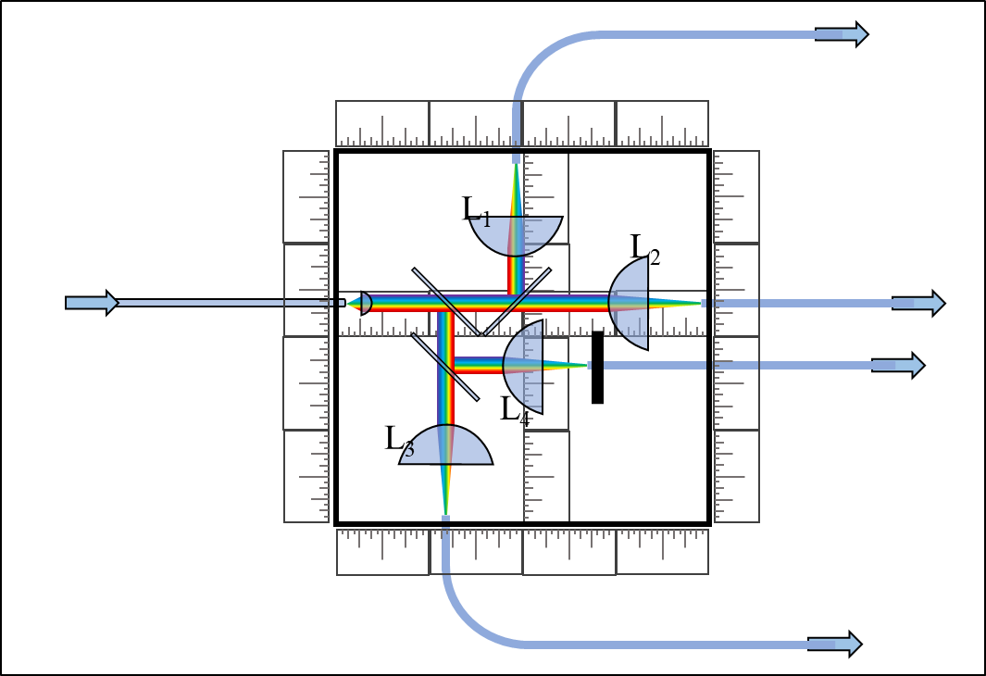
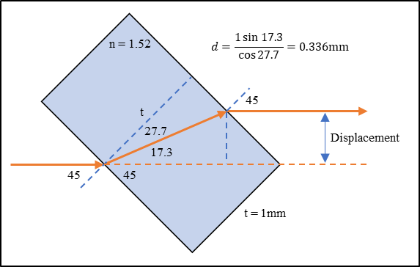
Fiber Splitter
Distribution of mixed light
PPP displacement
Four output pathways
P _{λ} (W) | λ (nm) | % T | % R
4.4 | 638 | 45.73301 | 50.56379
1 | 520 | 47.11318 | 49.60828
7 | 450 | 45.65878 | 50.60305
Outputs: | 1 (W) | 2 (W) | 3 (W) | 4 (W) | Loss (W)
638nm | 1.0167872 | 0.921350144 | 1.12211 | 1.0167872 | 0.322965456
520nm | 0.23371271 | 0.22193521 | 0.24611521 | 0.23371271 | 0.06452416
450nm | 1.617373086 | 1.45938492 | 1.792464526 | 1.617373086 | 0.513404382
White | 2.867872996 | 2.602670274 | 3.160689736 | 2.867872996 | 0.900893998
 |  |  |  | Efficiency: | 92.73%
 |  |  |  | Total Power: | 11.499106
 |  |  |  | Per Output | 2.874776501
 |  |  |  | Standard Dev: | 0.227949917

Slide 29
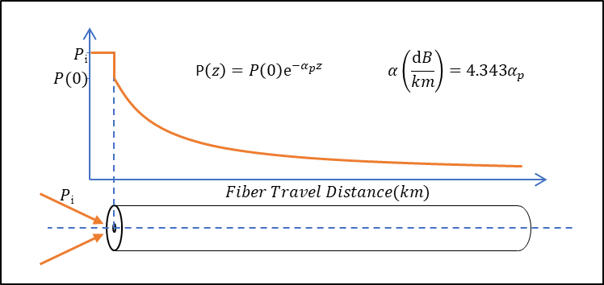
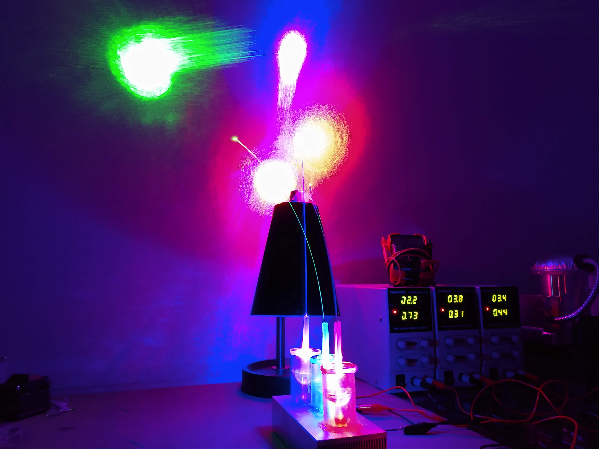
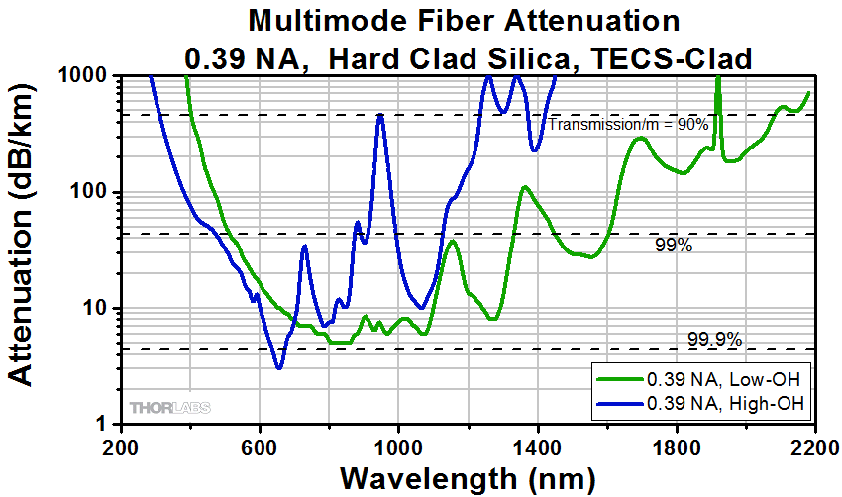
Fiber Losses
End interfaces
  Angled or notched cleave
  No AR coating
Attenuation over distance
  Low wavelengths - less loss in high-OH

Slide 30
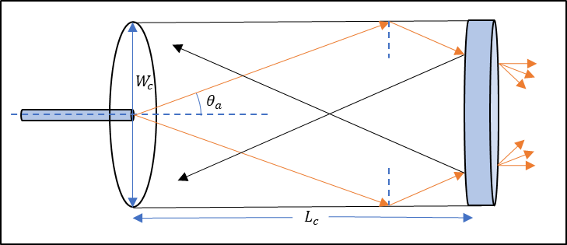
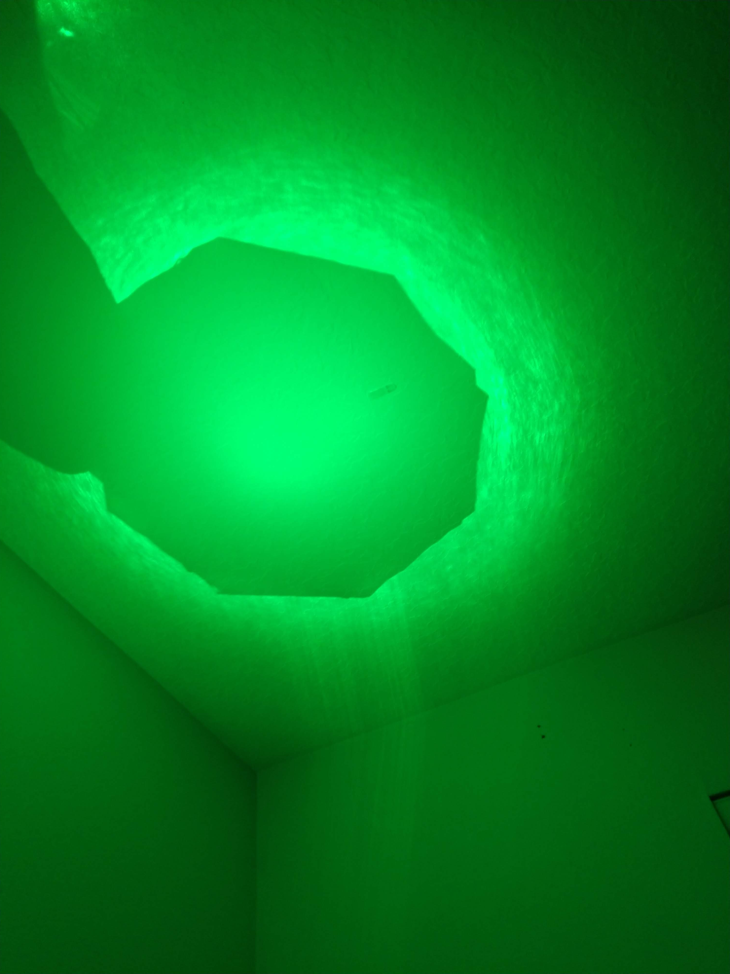
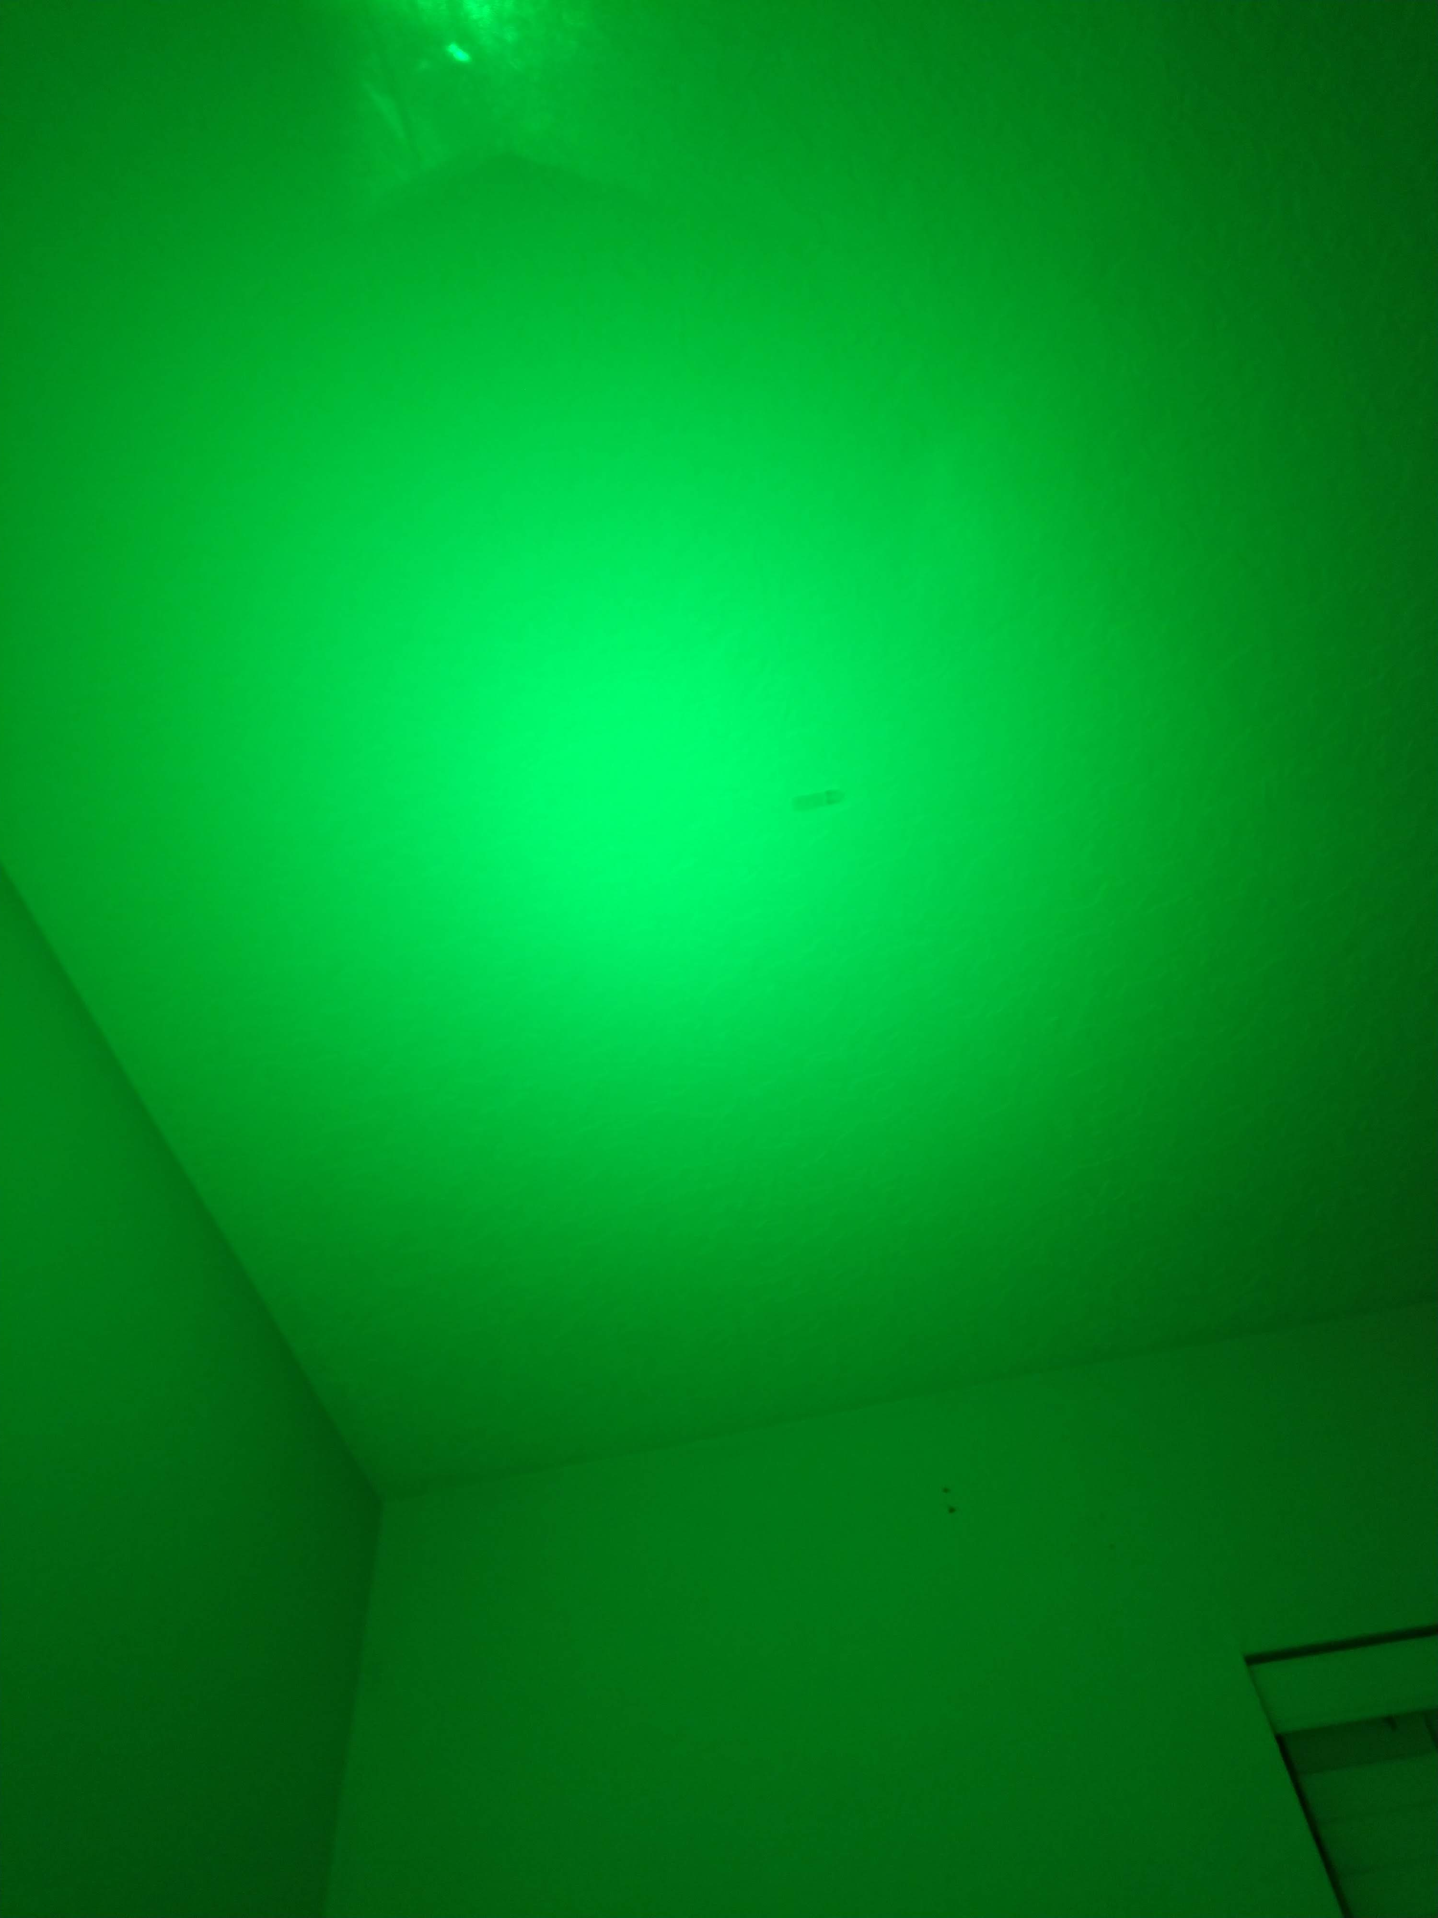
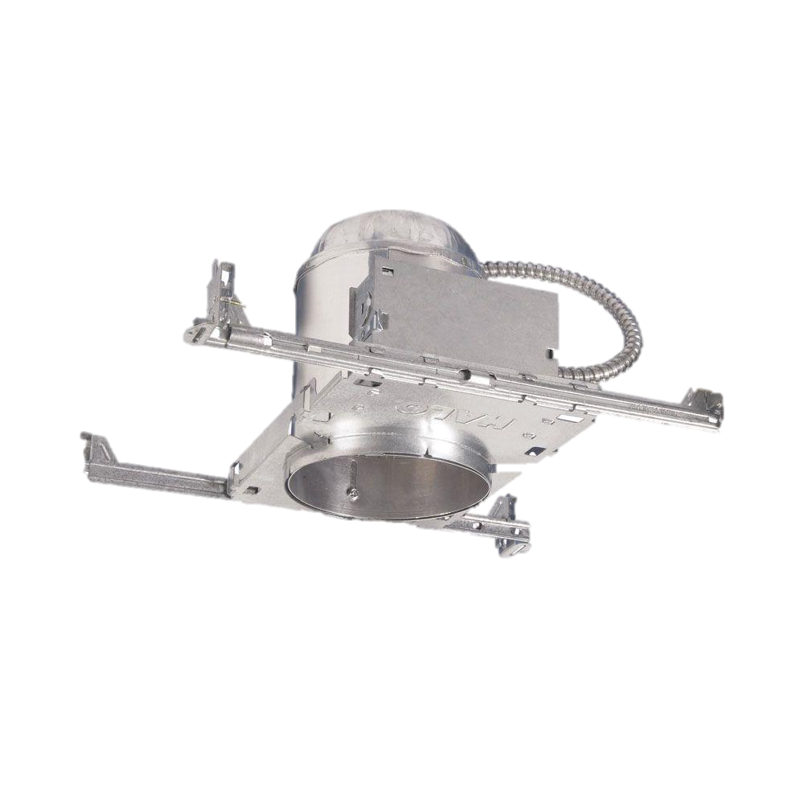
Light Output Points
Can lighting fixture
Solar tubing for back reflections
  Circular piece with hole for the top

Slide 31
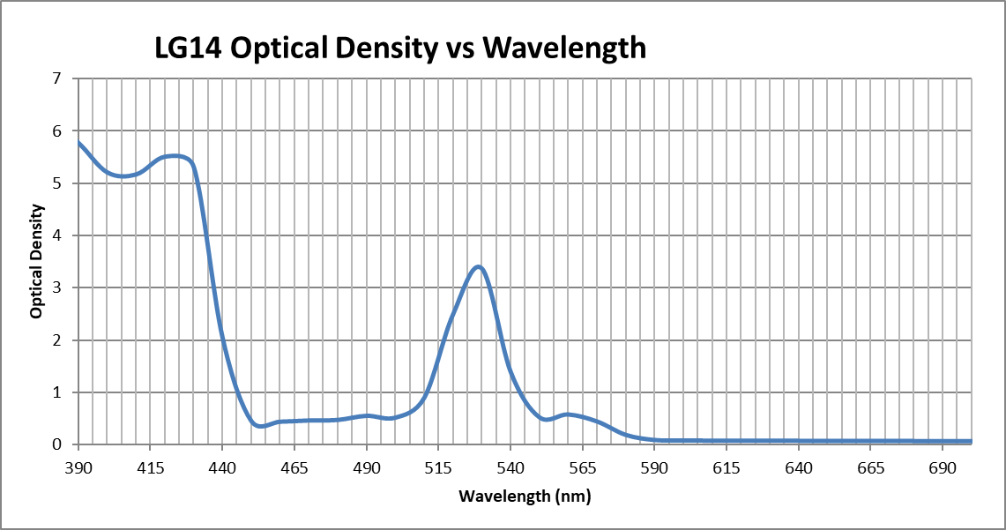
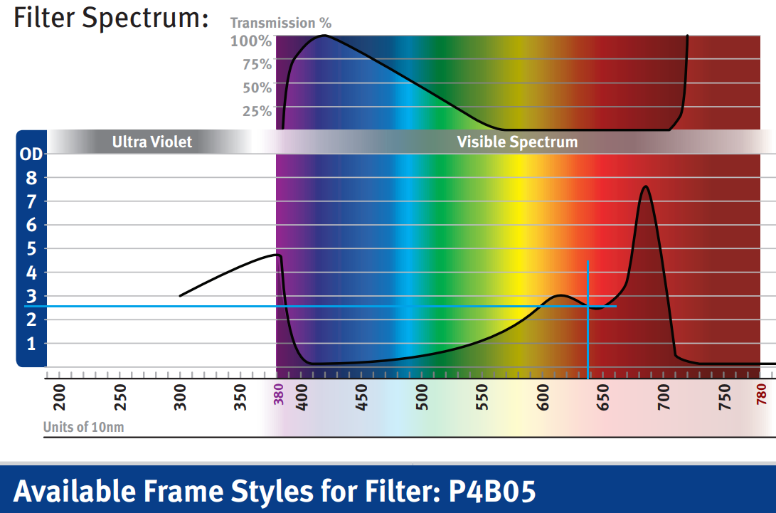
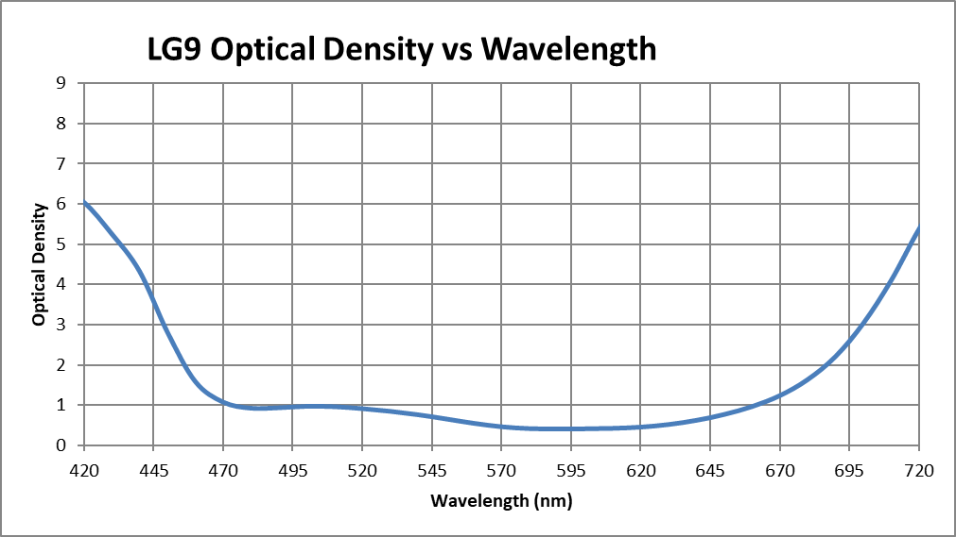
Safety First
Classification
Safety Gear for Production
Description | Price Each | Quantity | Total Price | Wavelength λ (nm) | Laser Power (W) | Glasses OD at λ | Transmittance (%) | Final Laser Power (W) | Final Laser Power (mW)
Newport LV-F22.P4B05 | 208 | 2 | 416 | 638 | 1.8 | 2.6 | 0.251188643 | 0.004521396 | 4.521395577
ThorLabs LG14 Glasses | 211 | 2 | 422 | 520 | 1 | 2.48036 | 0.33085675 | 0.003308568 | 3.308567505
ThorLabs LG9 Glasses | 200 | 2 | 400 | 450 | 3 | 2.81894 | 0.151725997 | 0.00455178 | 4.551779911

Slide 32
Description | Source | Quantity | Price Each | Price Total
Ushio HL63290HD 2.2W 638nm Laser Diode | Worldstar Tech | 1 | $98.00 | $98.00
Nichia NUGM02 900mW 520nm Laser Diode | DTR's Laser Shop | 1 | $95.00 | $95.00
Nichia NUBM44-81 7W 450nm Laser Diode | DTR's Laser Shop | 1 | $80.00 | $80.00
1" ID Polycarbonate Tube | Amazon | 1 | $14.53 | $14.53
Plano-Convex Lens, 6.35mm Dia., 6.4mm EFL, AR | Newport Corporation | 2 | $53.00 | $106.00
Plano-Convex Lens, 25.4mm Dia., 25.4mm EFL, AR | Newport Corporation | 8 | $27.00 | $216.00
Multimode Fiber, 0.39 NA, High OH, 300μm Core | Thorlabs Inc. | 50 | $1.68 | $84.00
EBS1 Economy 50:50 Beamsplitter | Thorlabs Inc. | 3 | $32.90 | $98.70
JB Weld Plastic Bonder, Black | Walmart | 1 | $5.88 | $5.88
JB Weld MinuteWeld, Clear | Walmart | 2 | $4.84 | $9.68
PVC Junction Box, 4x4x2 in. | Home Depot | 1 | $7.09 | $7.09
Silverstone ML05B Computer Case | Amazon | 1 | $45.79 | $45.79
Lexan 10"x8" Polycarbonate Sheet | Home Depot | 1 | $4.98 | $4.98
Optix 20"x32" Acrylic Sheet | Home Depot | 1 | $17.98 | $17.98
31/32" High Speed Steel Drill Bit | Victor Machinery | 1 | $18.42 | $18.42
Aluminum Heatsink, 150x69x37mm | Amazon | 2 | $14.39 | $28.78
ATmega328 Microcontroller | Digi-Key | 1 | $1.96 | $1.96
Arctic Silver Thermal Paste | PXT Store | 1 | $6.67 | $6.67
URCERI Handheld Digital LUX Meter | URCERI | 1 | $19.99 | $19.99
Wire Spool, 18AWG, 35 ft., Black | Home Depot | 1 | $8.70 | $8.70
3/32" Heat Shrink Tubing, 8-Pack | Home Depot | 1 | $1.99 | $1.99
0.170" ID x 10' PVC Clear Vinyl Tube | Home Depot | 1 | $2.82 | $2.82
Halo 6" Aluminum Lighting Housing | Home Depot | 4 | $7.49 | $29.96
MOSFET CSD17318Q2T | Digi-Key | 4 | $0.47 | $1.88
0.1uF Ceramic Capacitor | Digi-Key | 10 | $0.06 | $0.61
22uF Ceramic Capacitor | Digi-Key | 2 | $0.51 | $1.02
47uF Ceramic Capacitor | Digi-Key | 2 | $0.49 | $0.98
3.3uH Inductor | Digi-Key | 2 | $0.48 | $0.96
10kΩ Resistor | Digi-Key | 2 | $0.52 | $1.04
Step Down Switching DC-DC converter | Digi-Key | 2 | $0.00 | $0.00
56.2kΩ Resistor | Digi-Key | 2 | $0.26 | $0.52
LCD Character Display | Amazon | 1 | $7.99 | $7.99
Budget
Planned: $2,000
Current: $1,017.92

Slide 33
Project Progress

Slide 34

Outlook/Final Thoughts
Light source complete
Merging of sections soon
Fiber optimization still in progress
Company started due to product
  Commercialization research in progress

Slide 35
Thank you!
Questions

