Slide 1
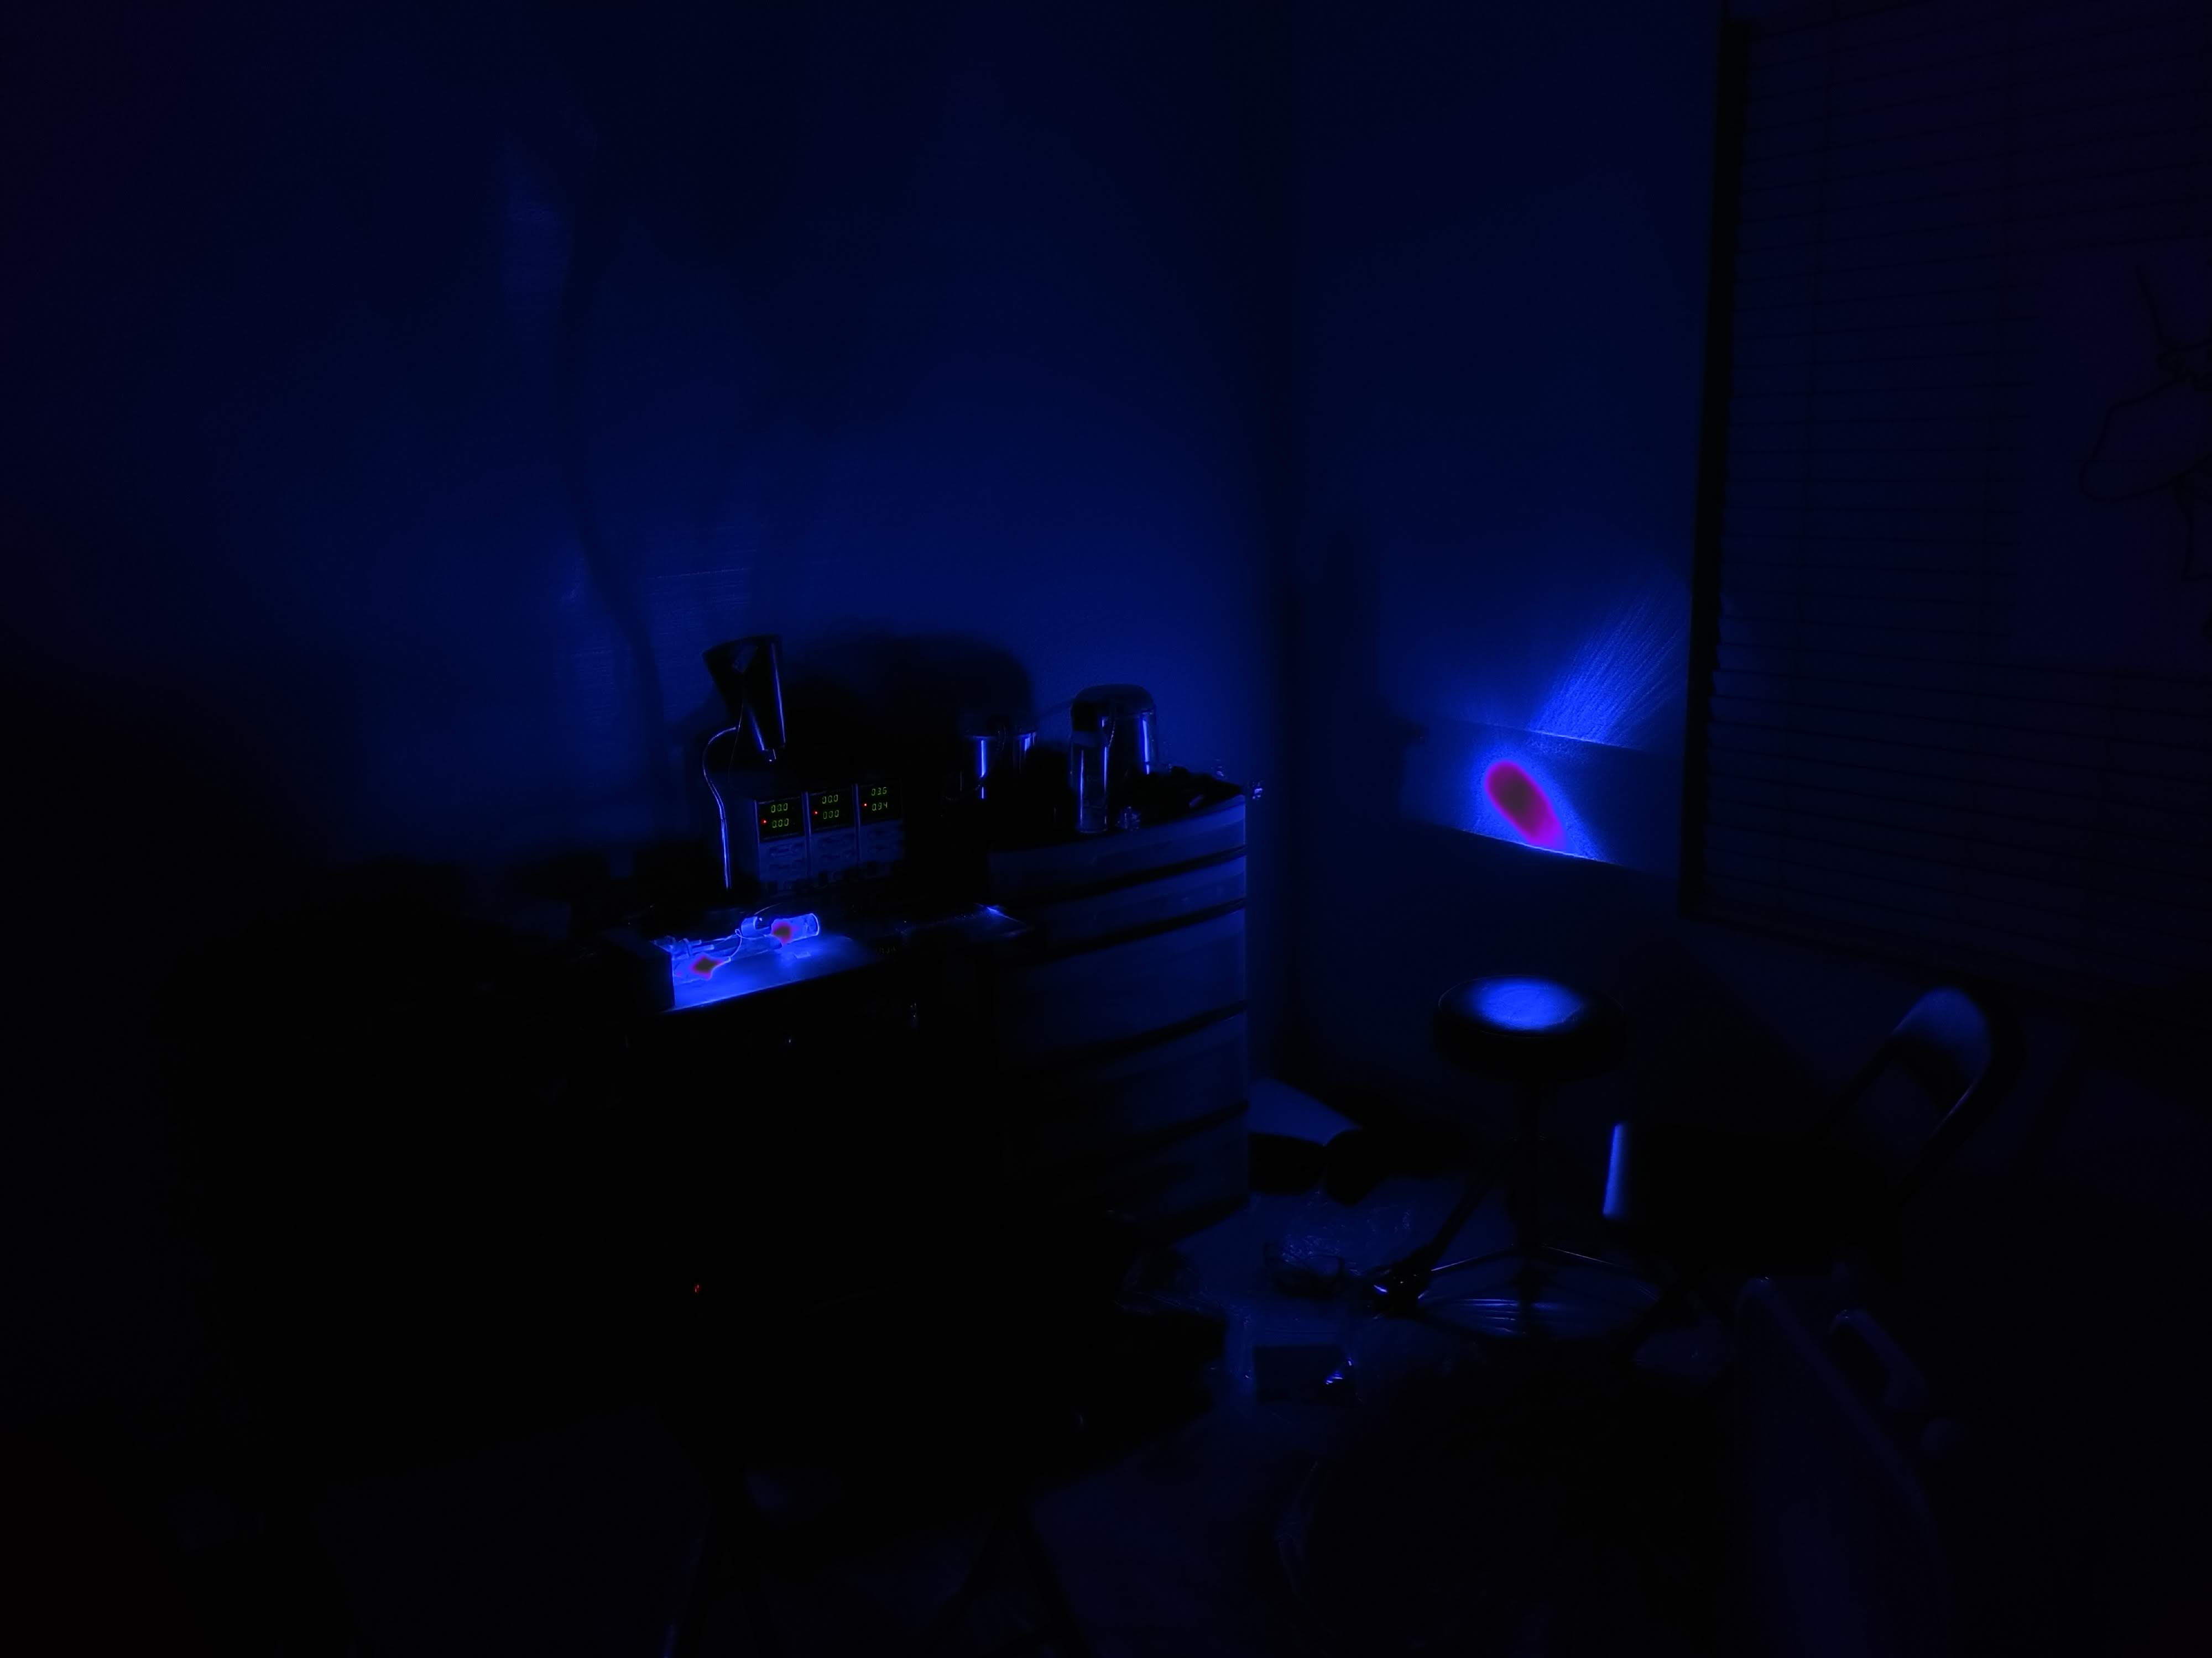

Mixed and Distributed Laser Illumination System (MADLIS)
Group 26
Hunter Cohen (BSPSE)
Derek Daniels (BSPSE)
Melvin Ramos (BSCpE)
Ian Shearer (BSEE)
Patent pending, Eternal Photonics LLC

Slide 2
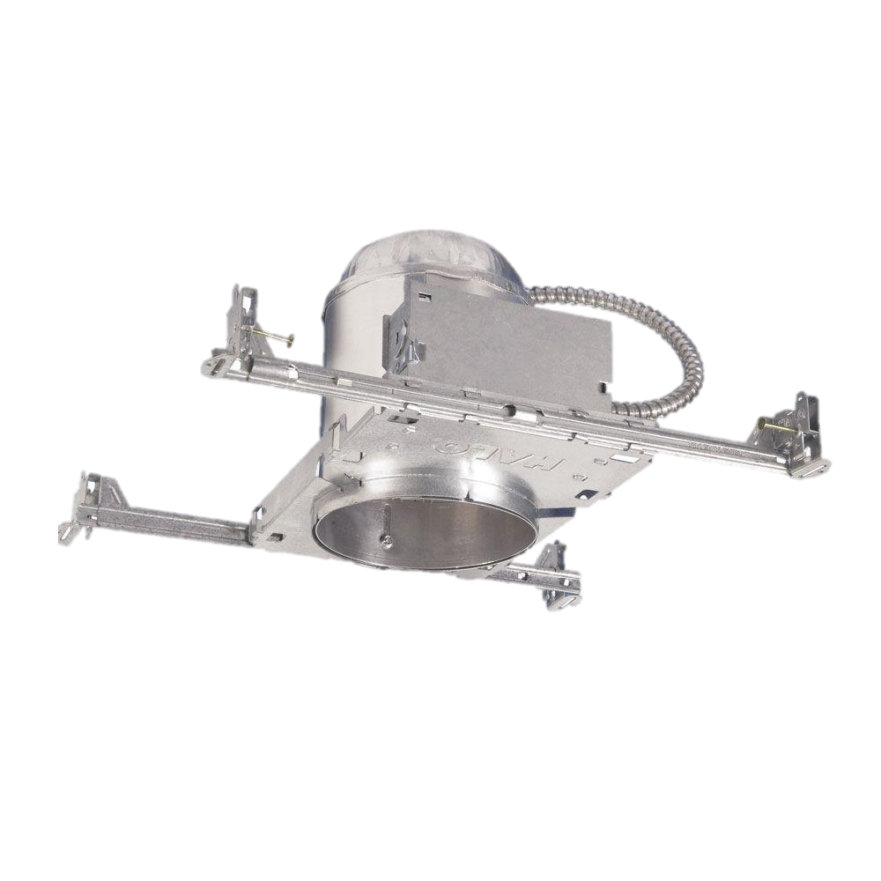


System Diagram
(Not to Scale)
Battery
AC-DC Power Supply
Control
Interface
Diode Drivers
Fan
Fan
Filter

Slide 3

Block Diagram
Legend
Melvin Ramos Area of Responsibility
Ian Shearer Area of Responsibility
Derek Daniels Area of Responsibility
Hunter Cohen Area of Responsibility
DC Power
Regulated DC Power
Control Signal
Power Monitoring Signal
Uncoupled Light
Fiber Optic Cable
Controller
Laser Diode Driver
Red Laser Diode
Diffuser
Interface
Fiber Combiner
Fiber Splitter
Laser Diode Driver
Green Laser Diode
Diffuser
Blue Laser Diode
Diffuser
DC Power Supply
Laser Diode Driver
Diffuser

Slide 4

General Specifications
>5 lux/sqft, >200sqft room: Marginally met
>100 lux output/watt to laser diodes: Well met
At least 4-bit color/intensity control: Well met
>80% diode driver efficiency: Well met
<10% variation between outputs: Marginally met
Maintain 25°C +20°C/-10°C: Well met

Slide 5
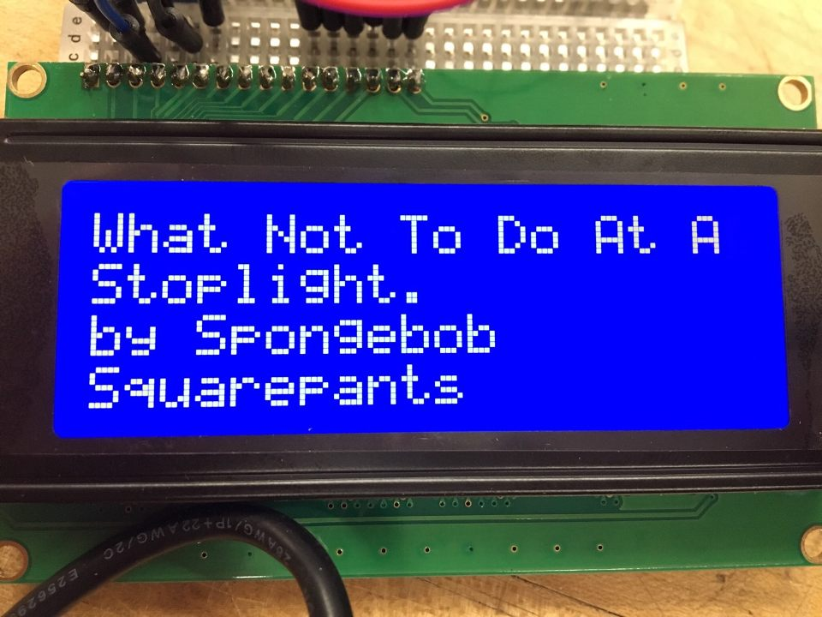
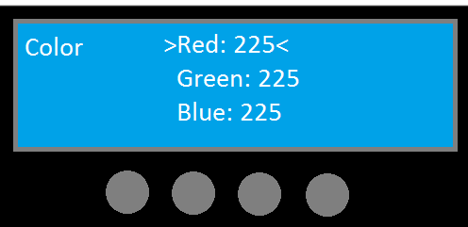
The User Interface
Output: Screen/Display -LCD 4x20 Character display
Input: Buttons/dials -4 push buttons
Menu System -Setting sub-menus

Slide 6
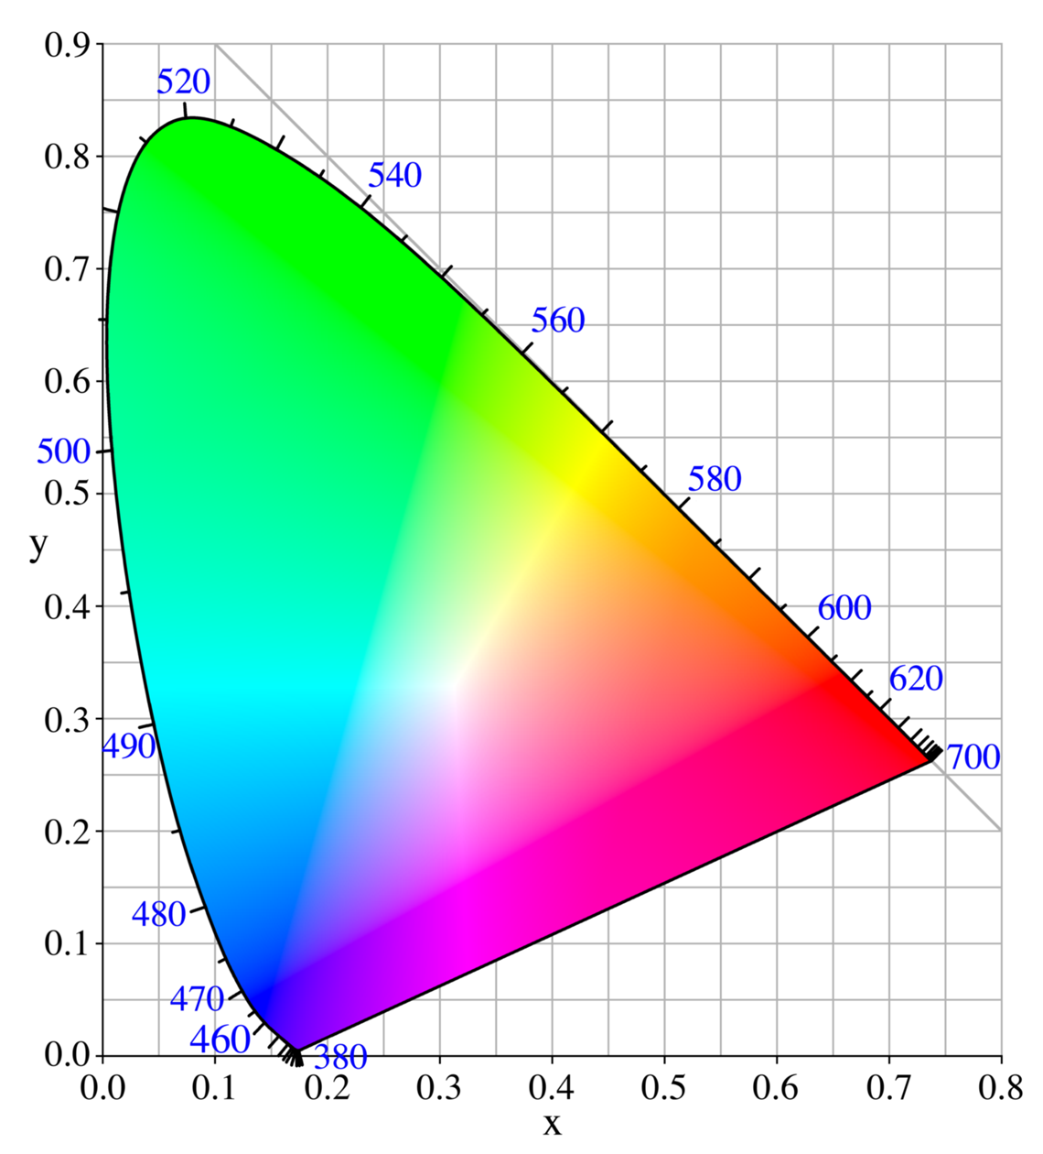
Control Software Features
Color control RGB values
Luminosity value
Custom Color profiles
Predefined color profiles
Schedule times to use color profiles

Slide 7
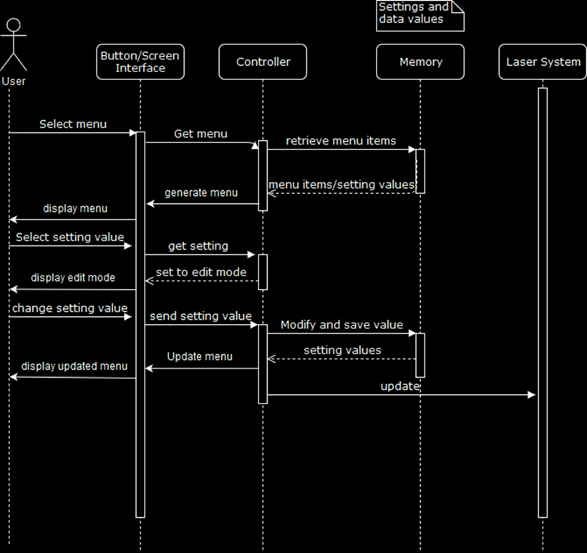
UI Design
Implementation

Slide 8
Electronics Goals
Supply around 50-70 W of power for the whole system: Well met
Three Diode Drivers (~20-30 W): Well met
Logic/Power Distribution Board (~10-20 W): Well met
High Supply to Diode efficiency: Well met
70%: Well met
Stretch goal = 80%: Well met
Easy control with microcontroller: Well met

Slide 9
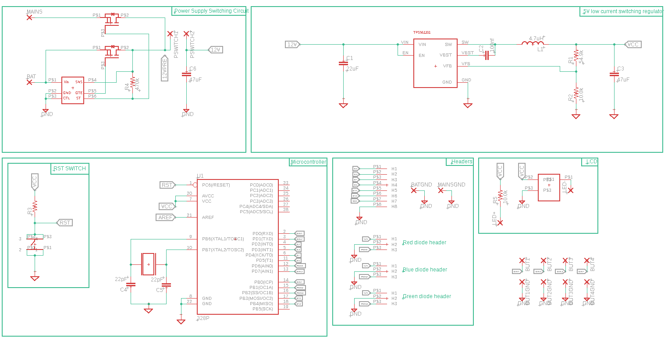
Logic Board Schematic

Slide 10
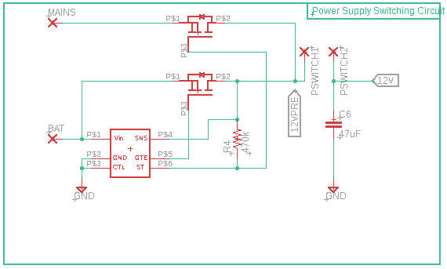
Power Supply Switching Circuit

Slide 11
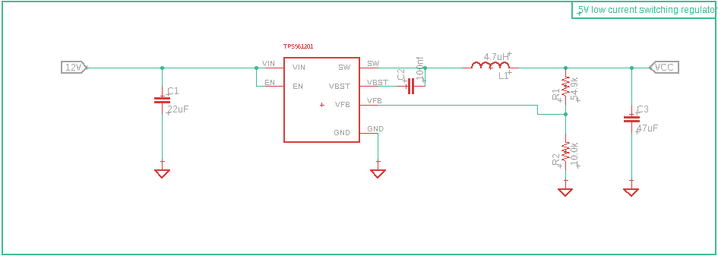
Microcontroller Power

Slide 12
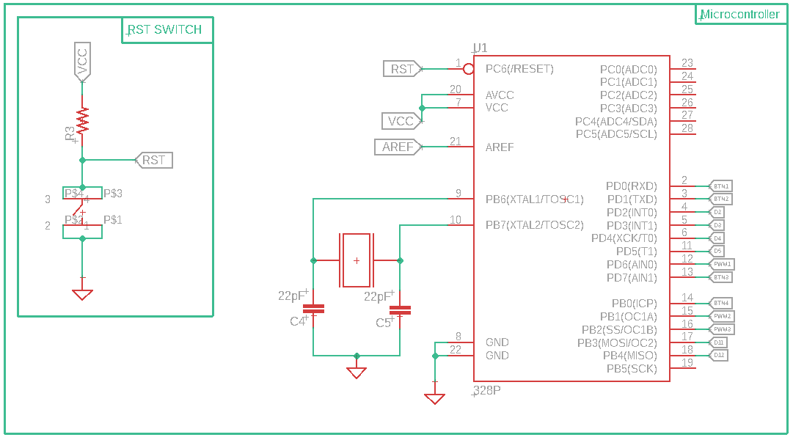
Microcontroller

Slide 13
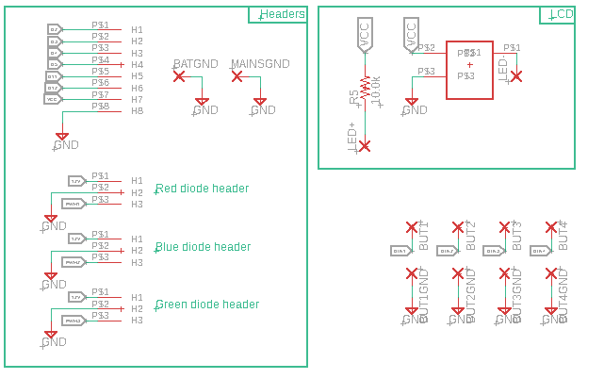
Headers/Control

Slide 14
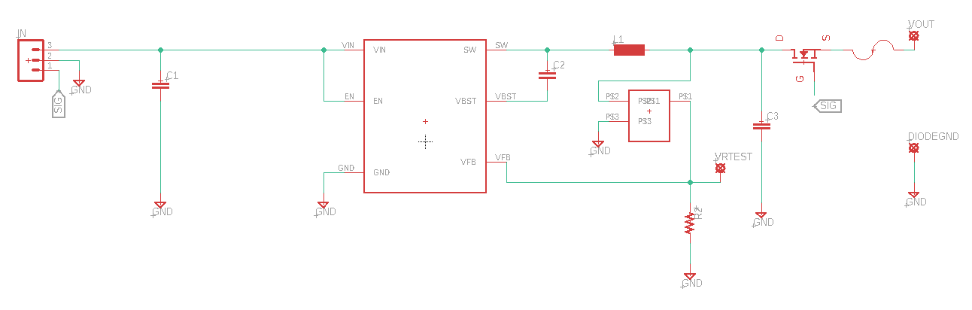
Diode Driver

Slide 15

Software/Suppliers
Schematic/CAD
Eagle CAD
Free for students
Simple/Powerful
Large Userbase
PCB Manufacturer
JLCPCB
Cheap and Quality products
Component purchases
Mouser
Consistent delivery
diyaudiocircuits.com/eagle-cad-pcb-design-software-tutorials-way/

Slide 16
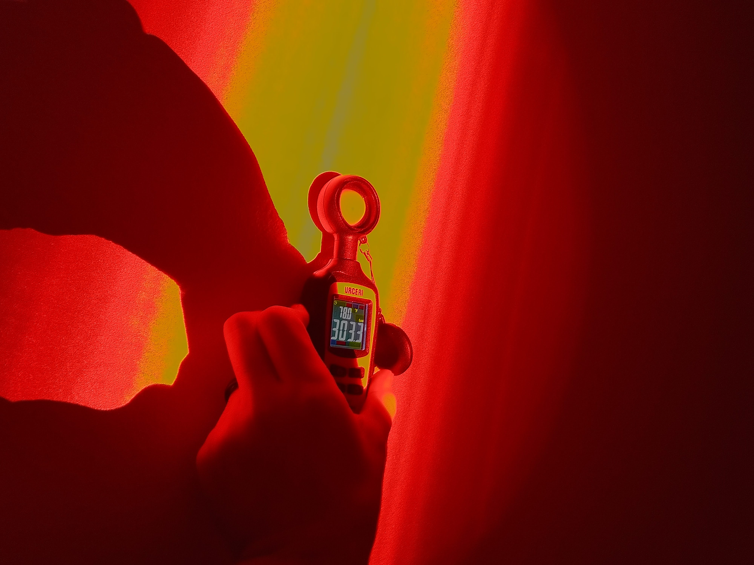
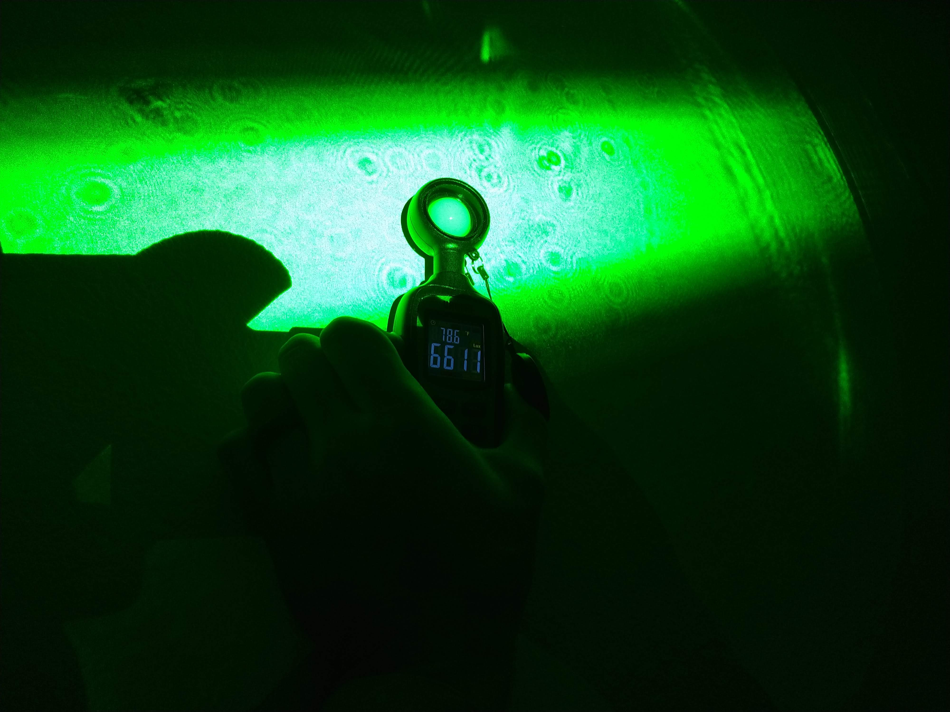
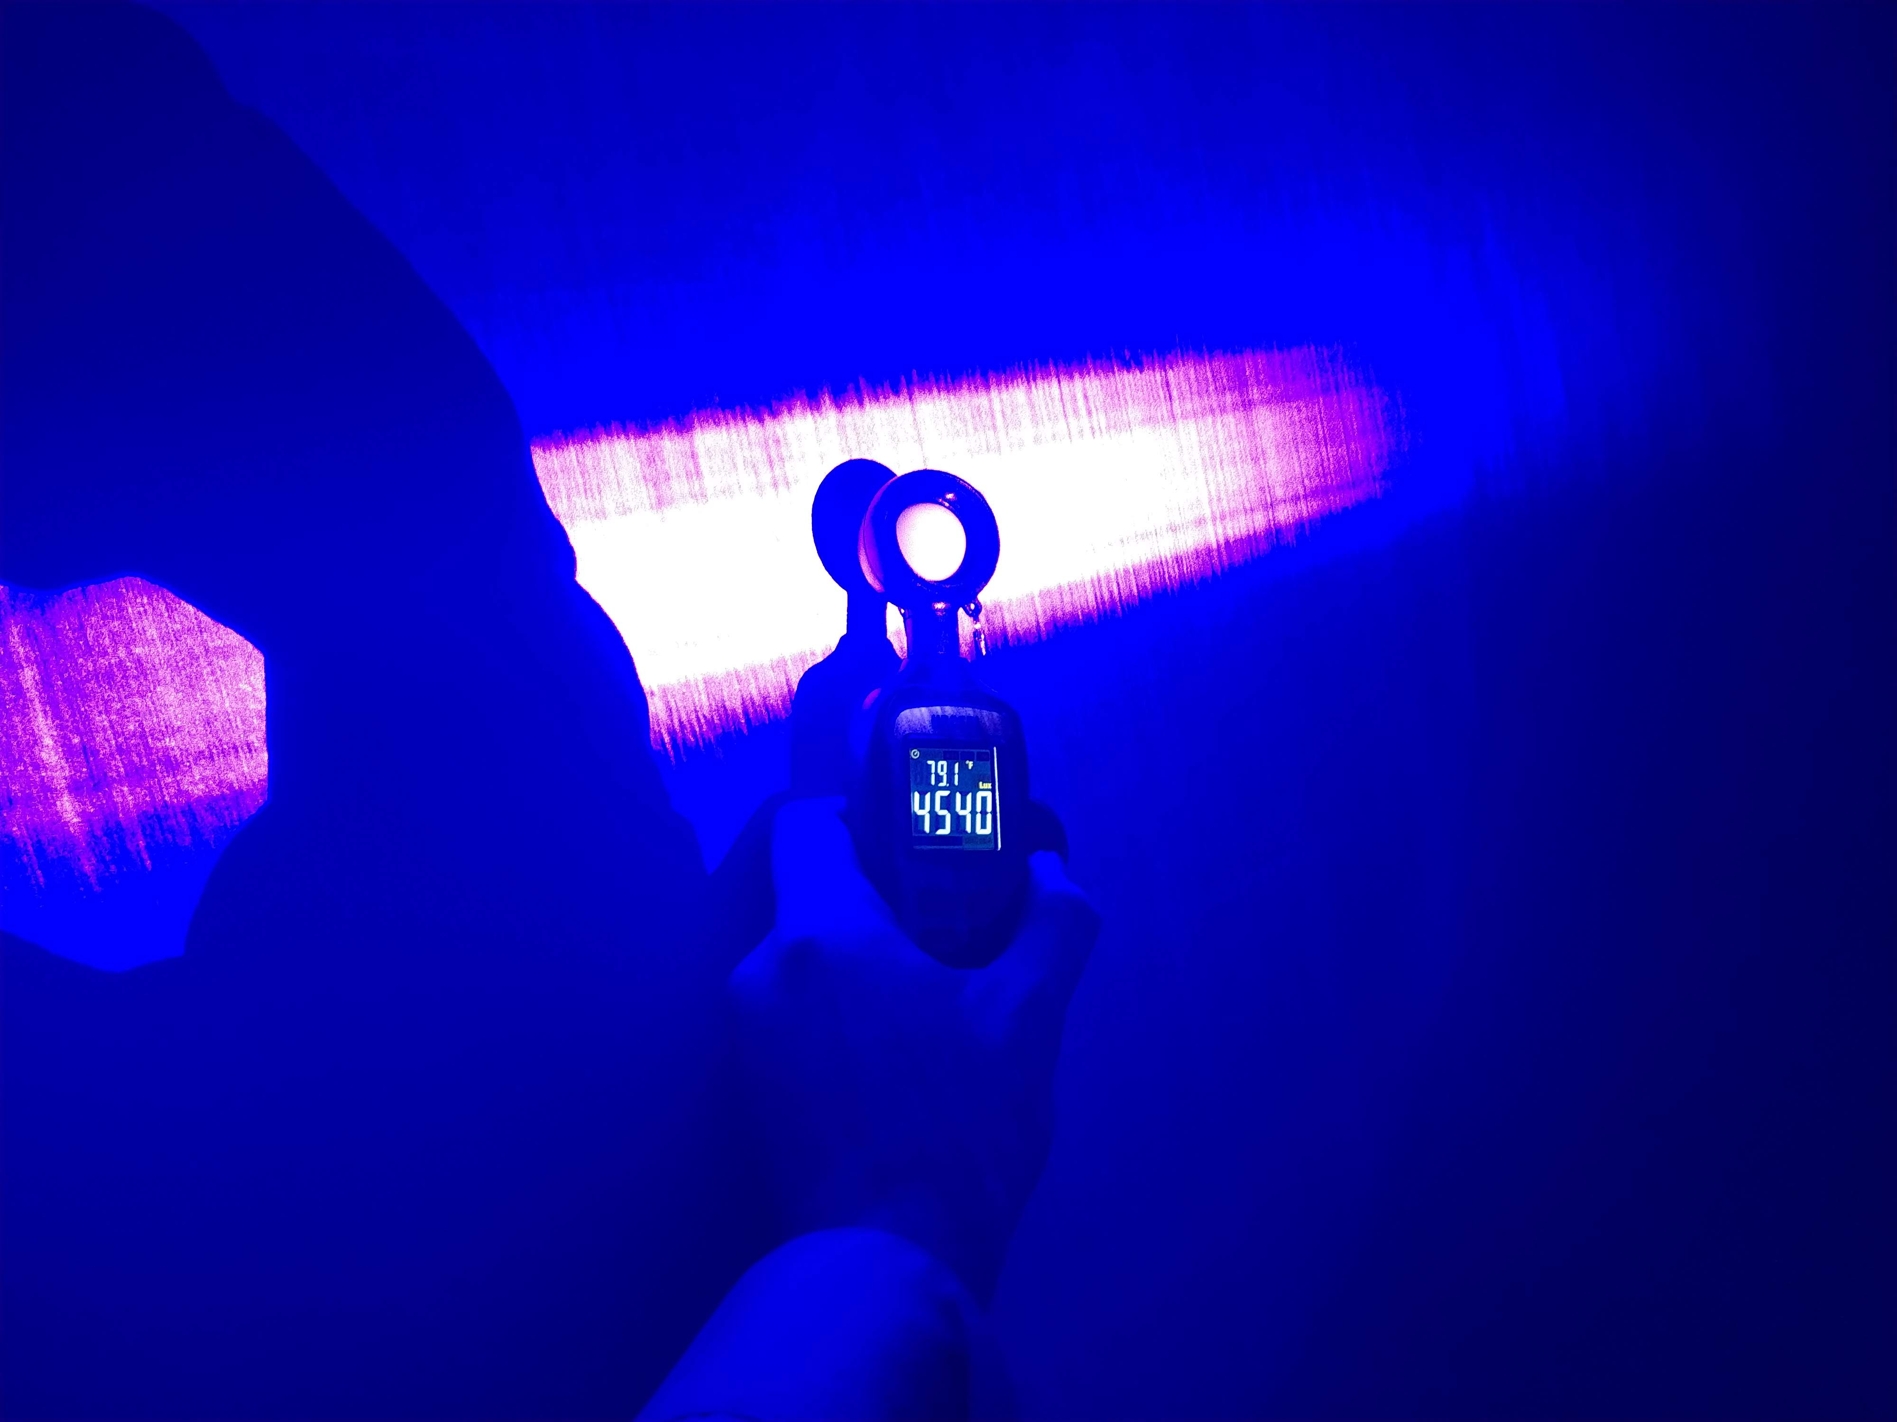
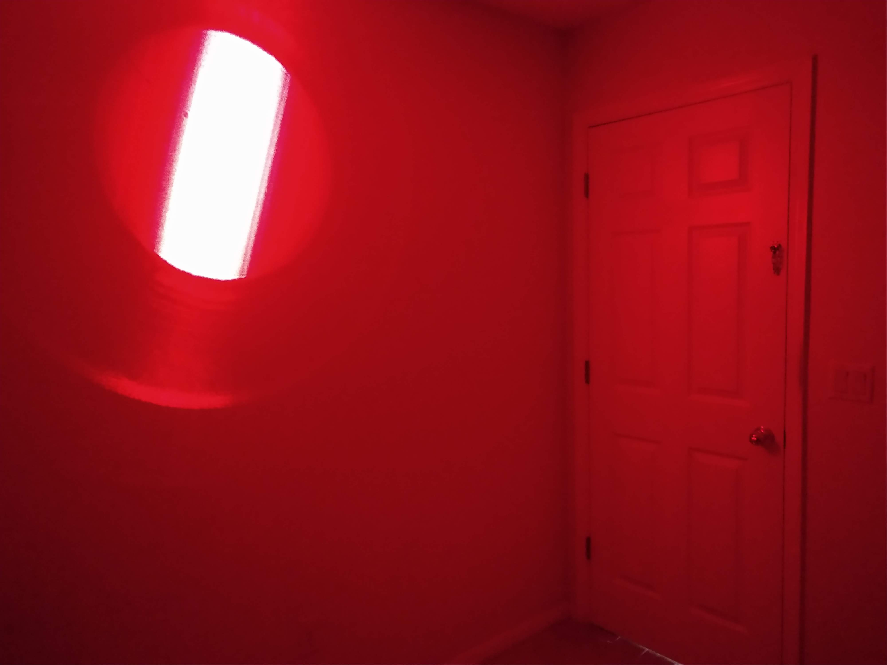
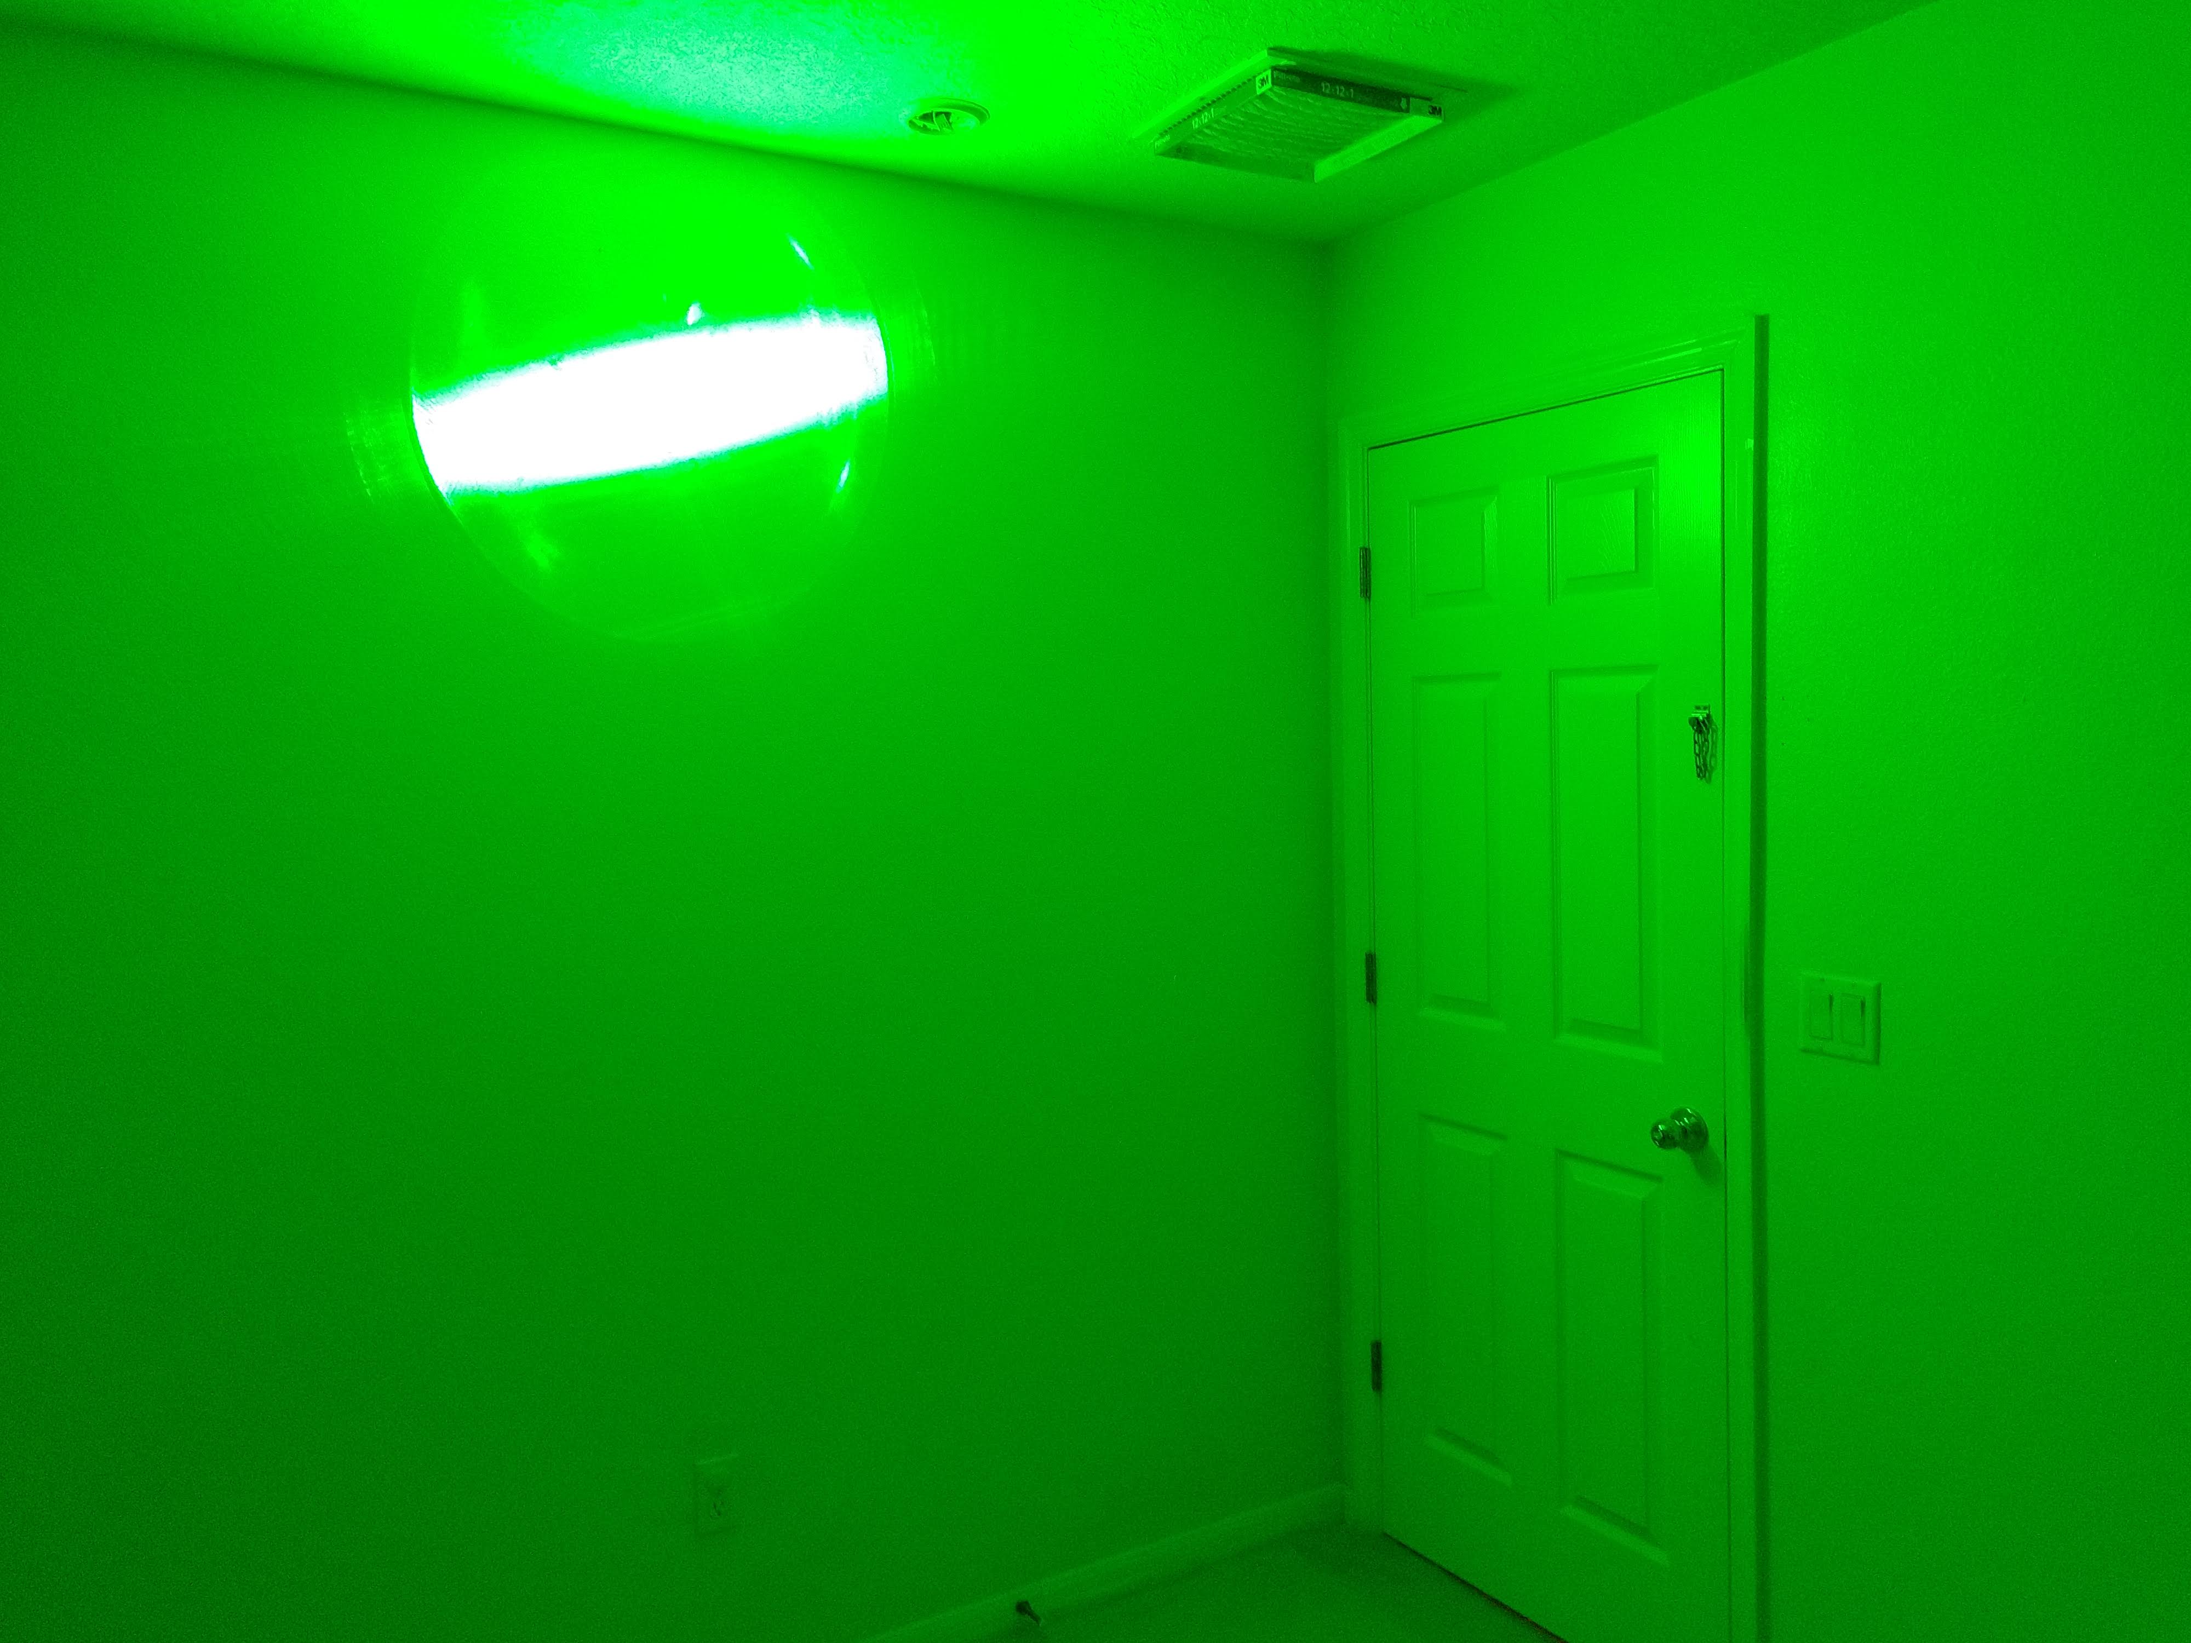
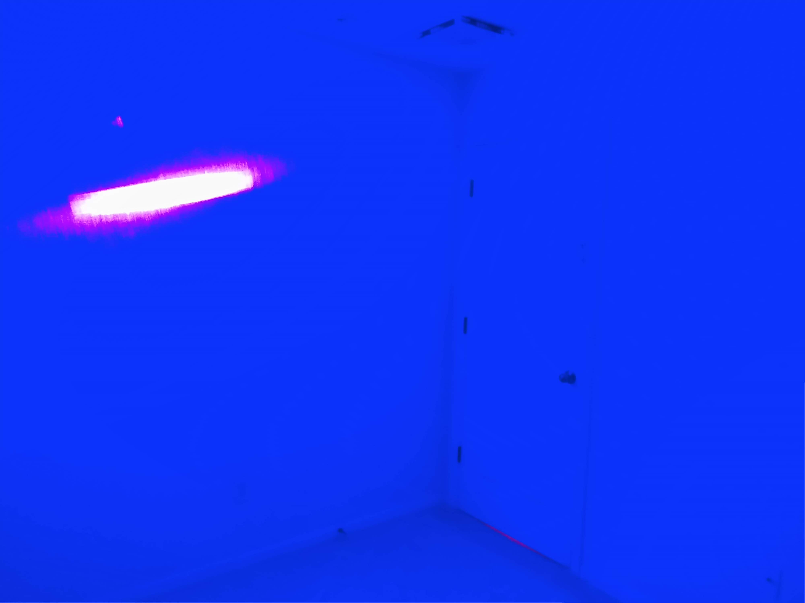
Diode Testing
Incorrect theory for generating white light

Slide 17
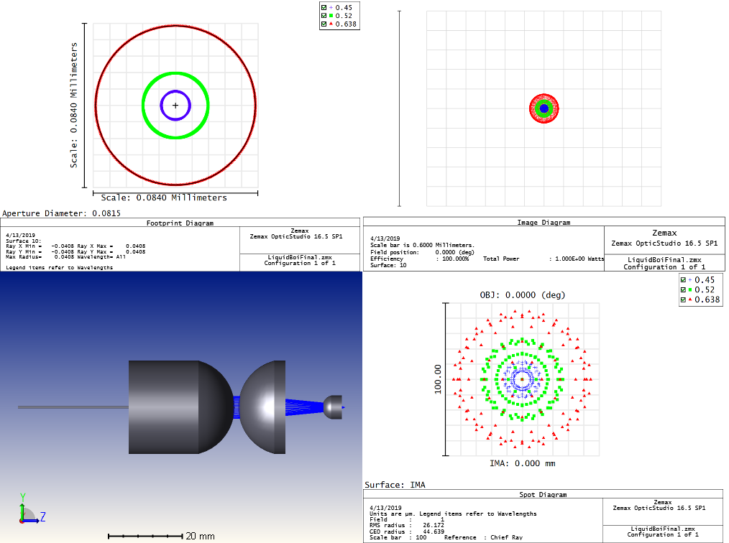
Optic
Simulation

Slide 18
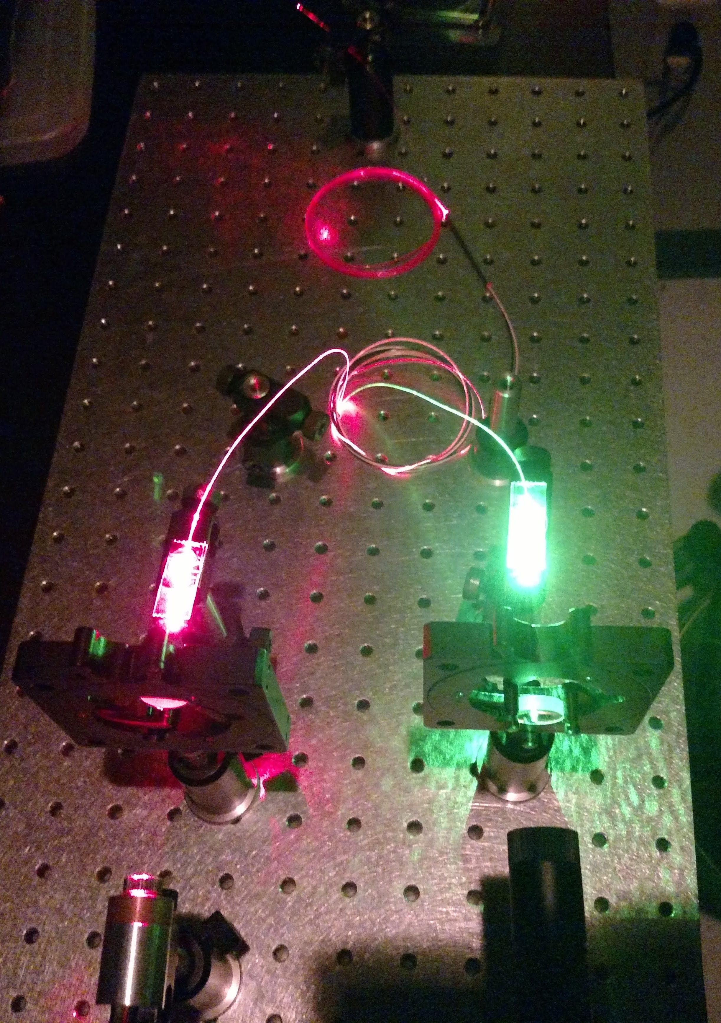
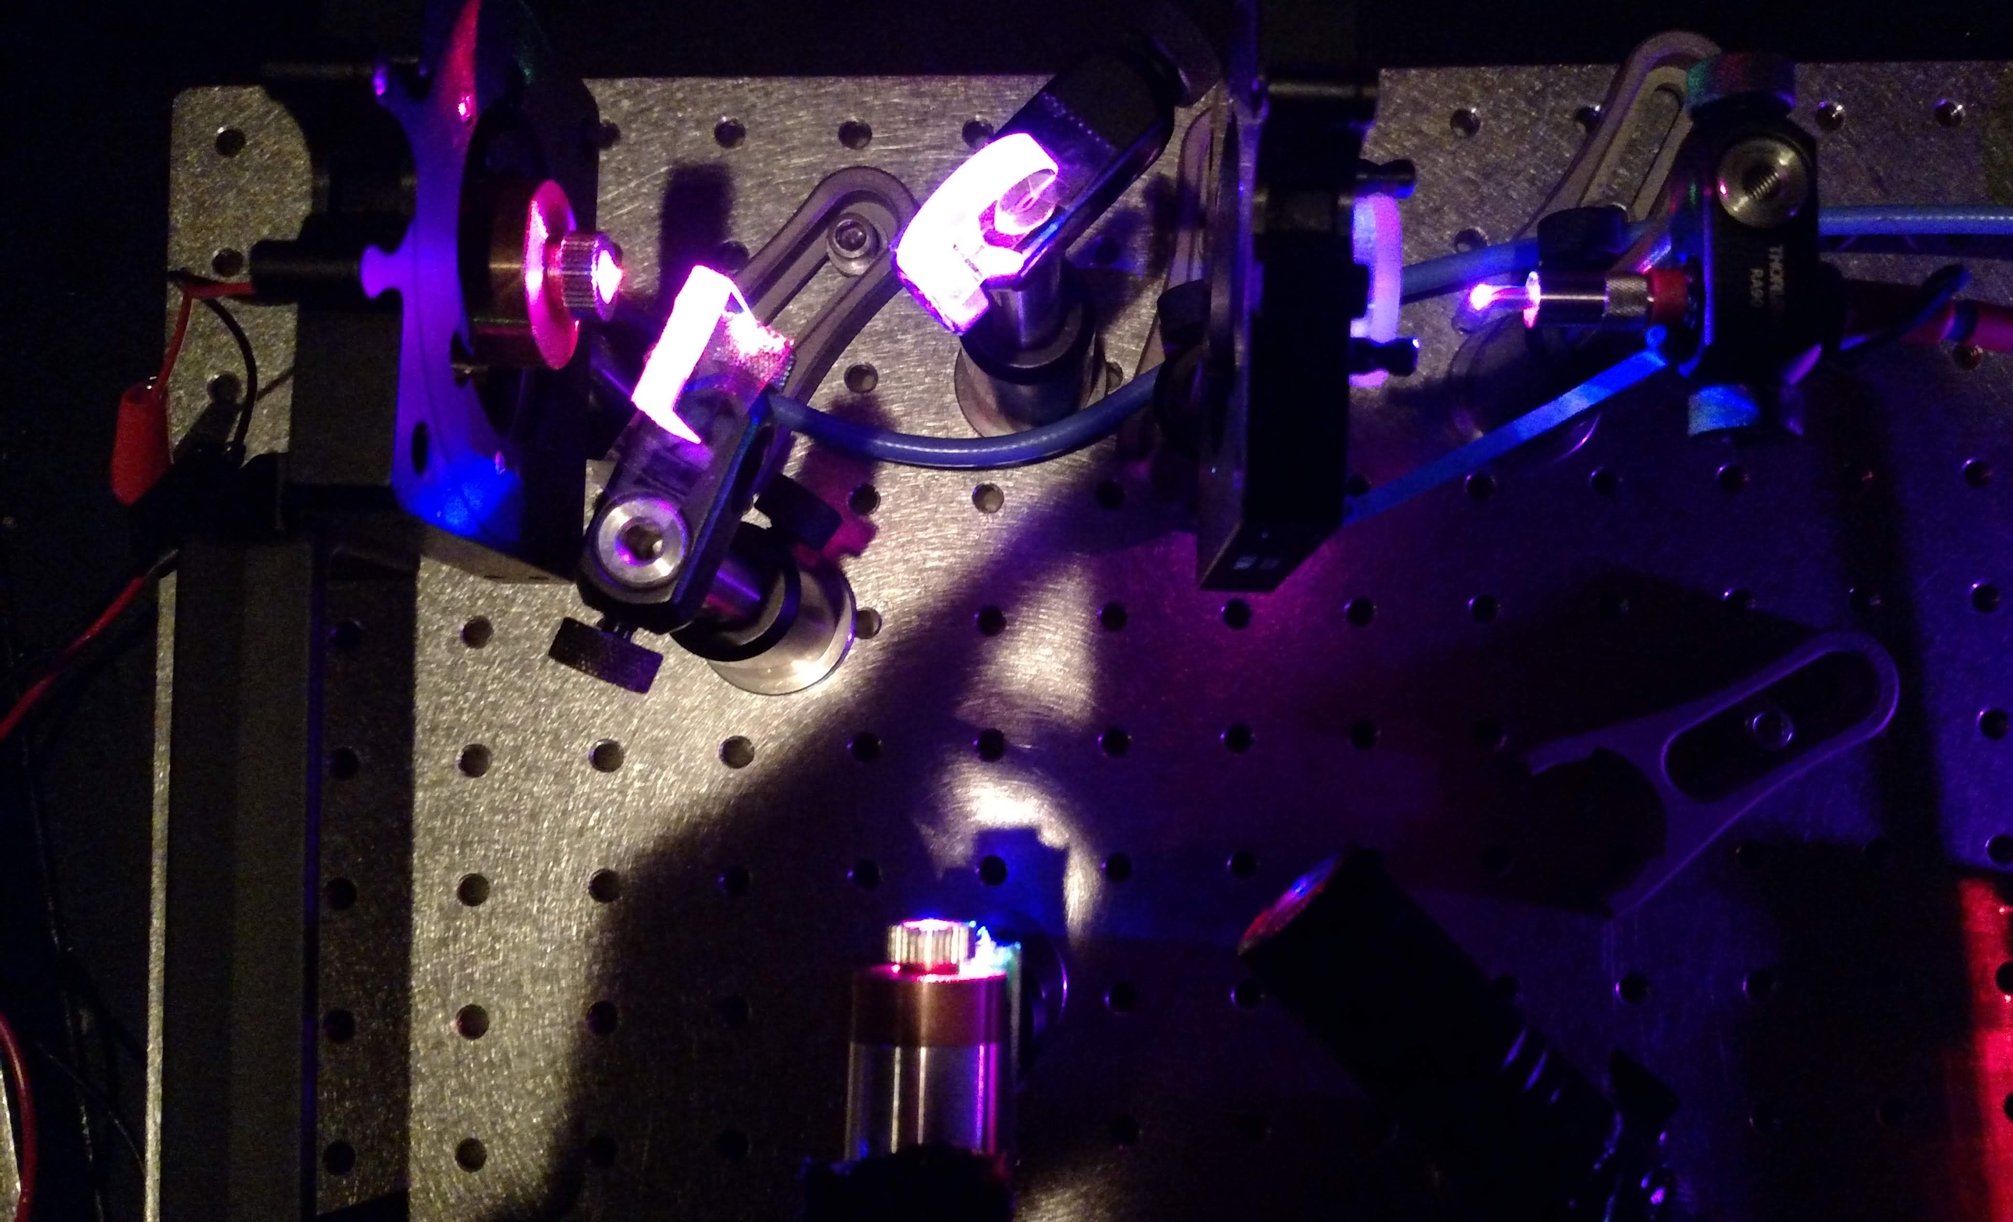
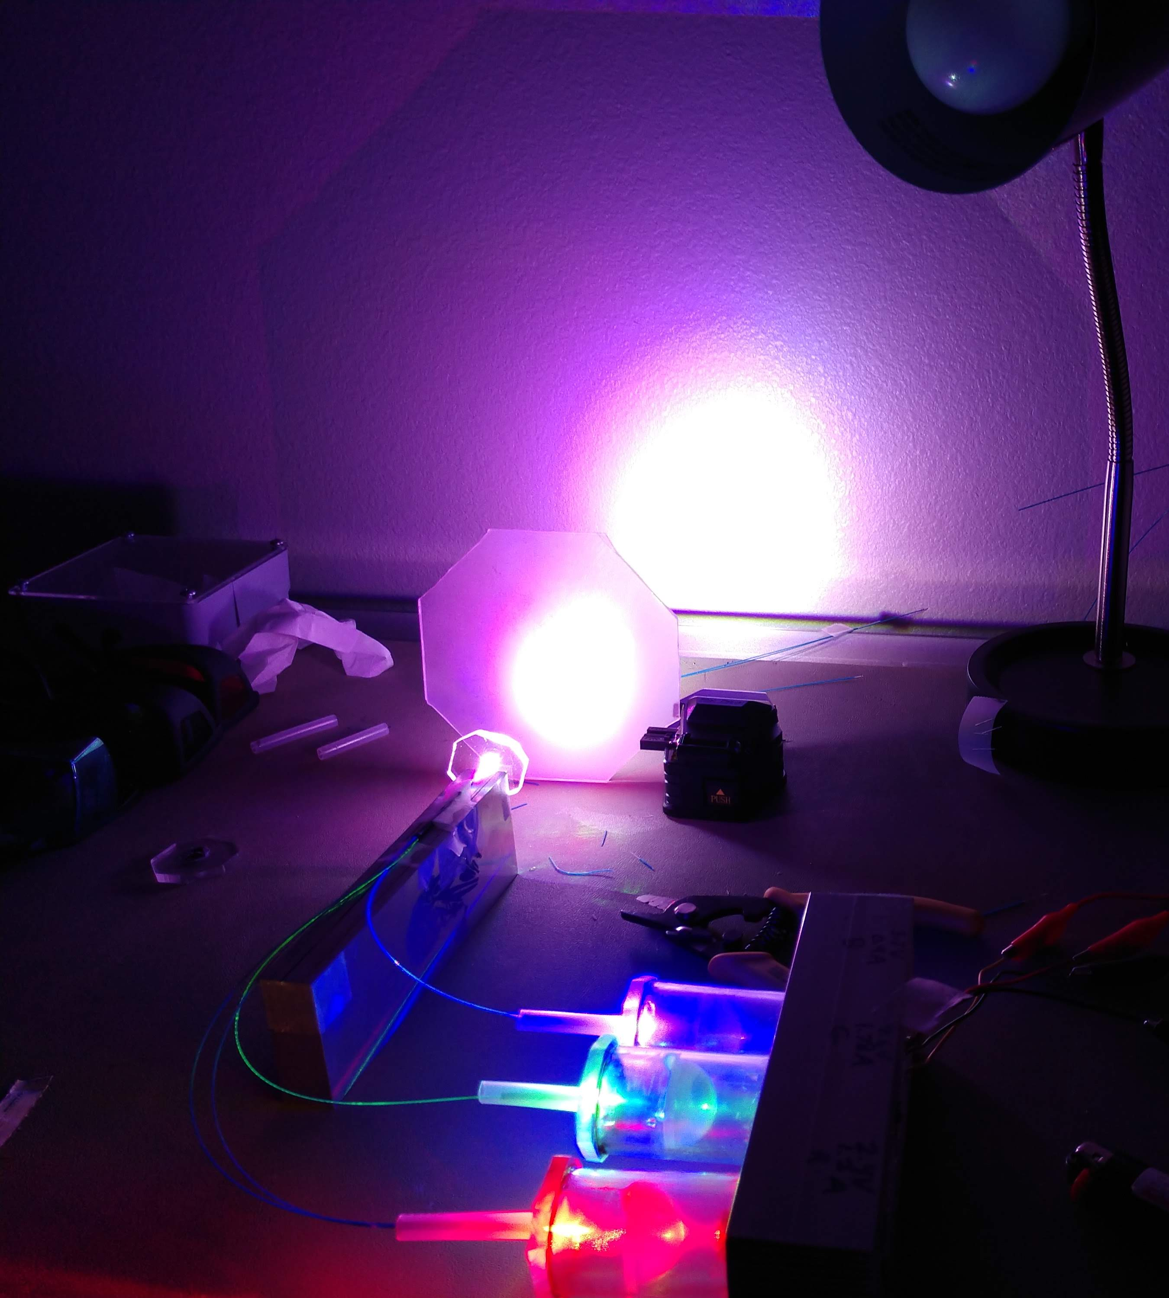
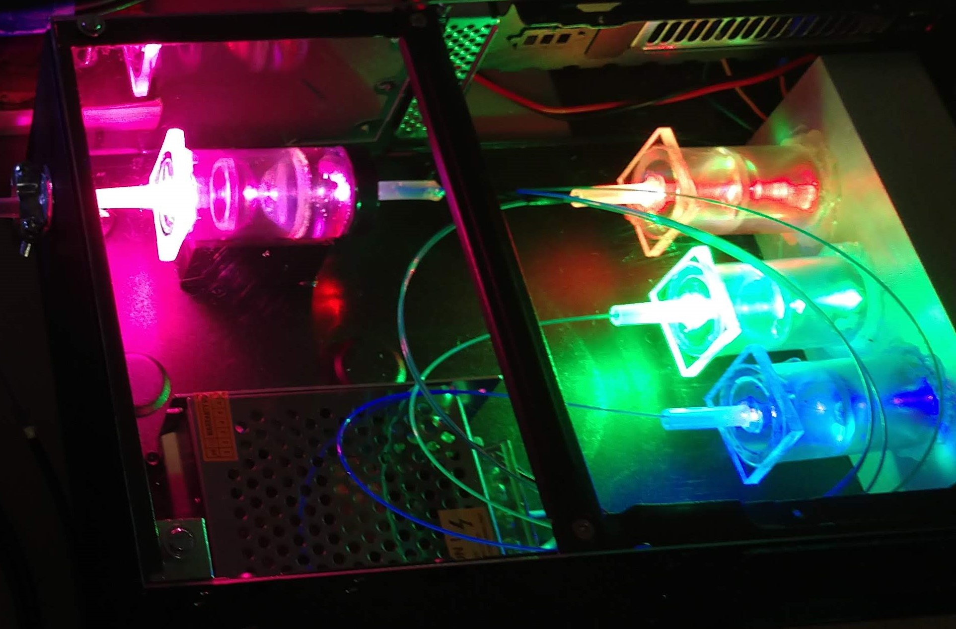

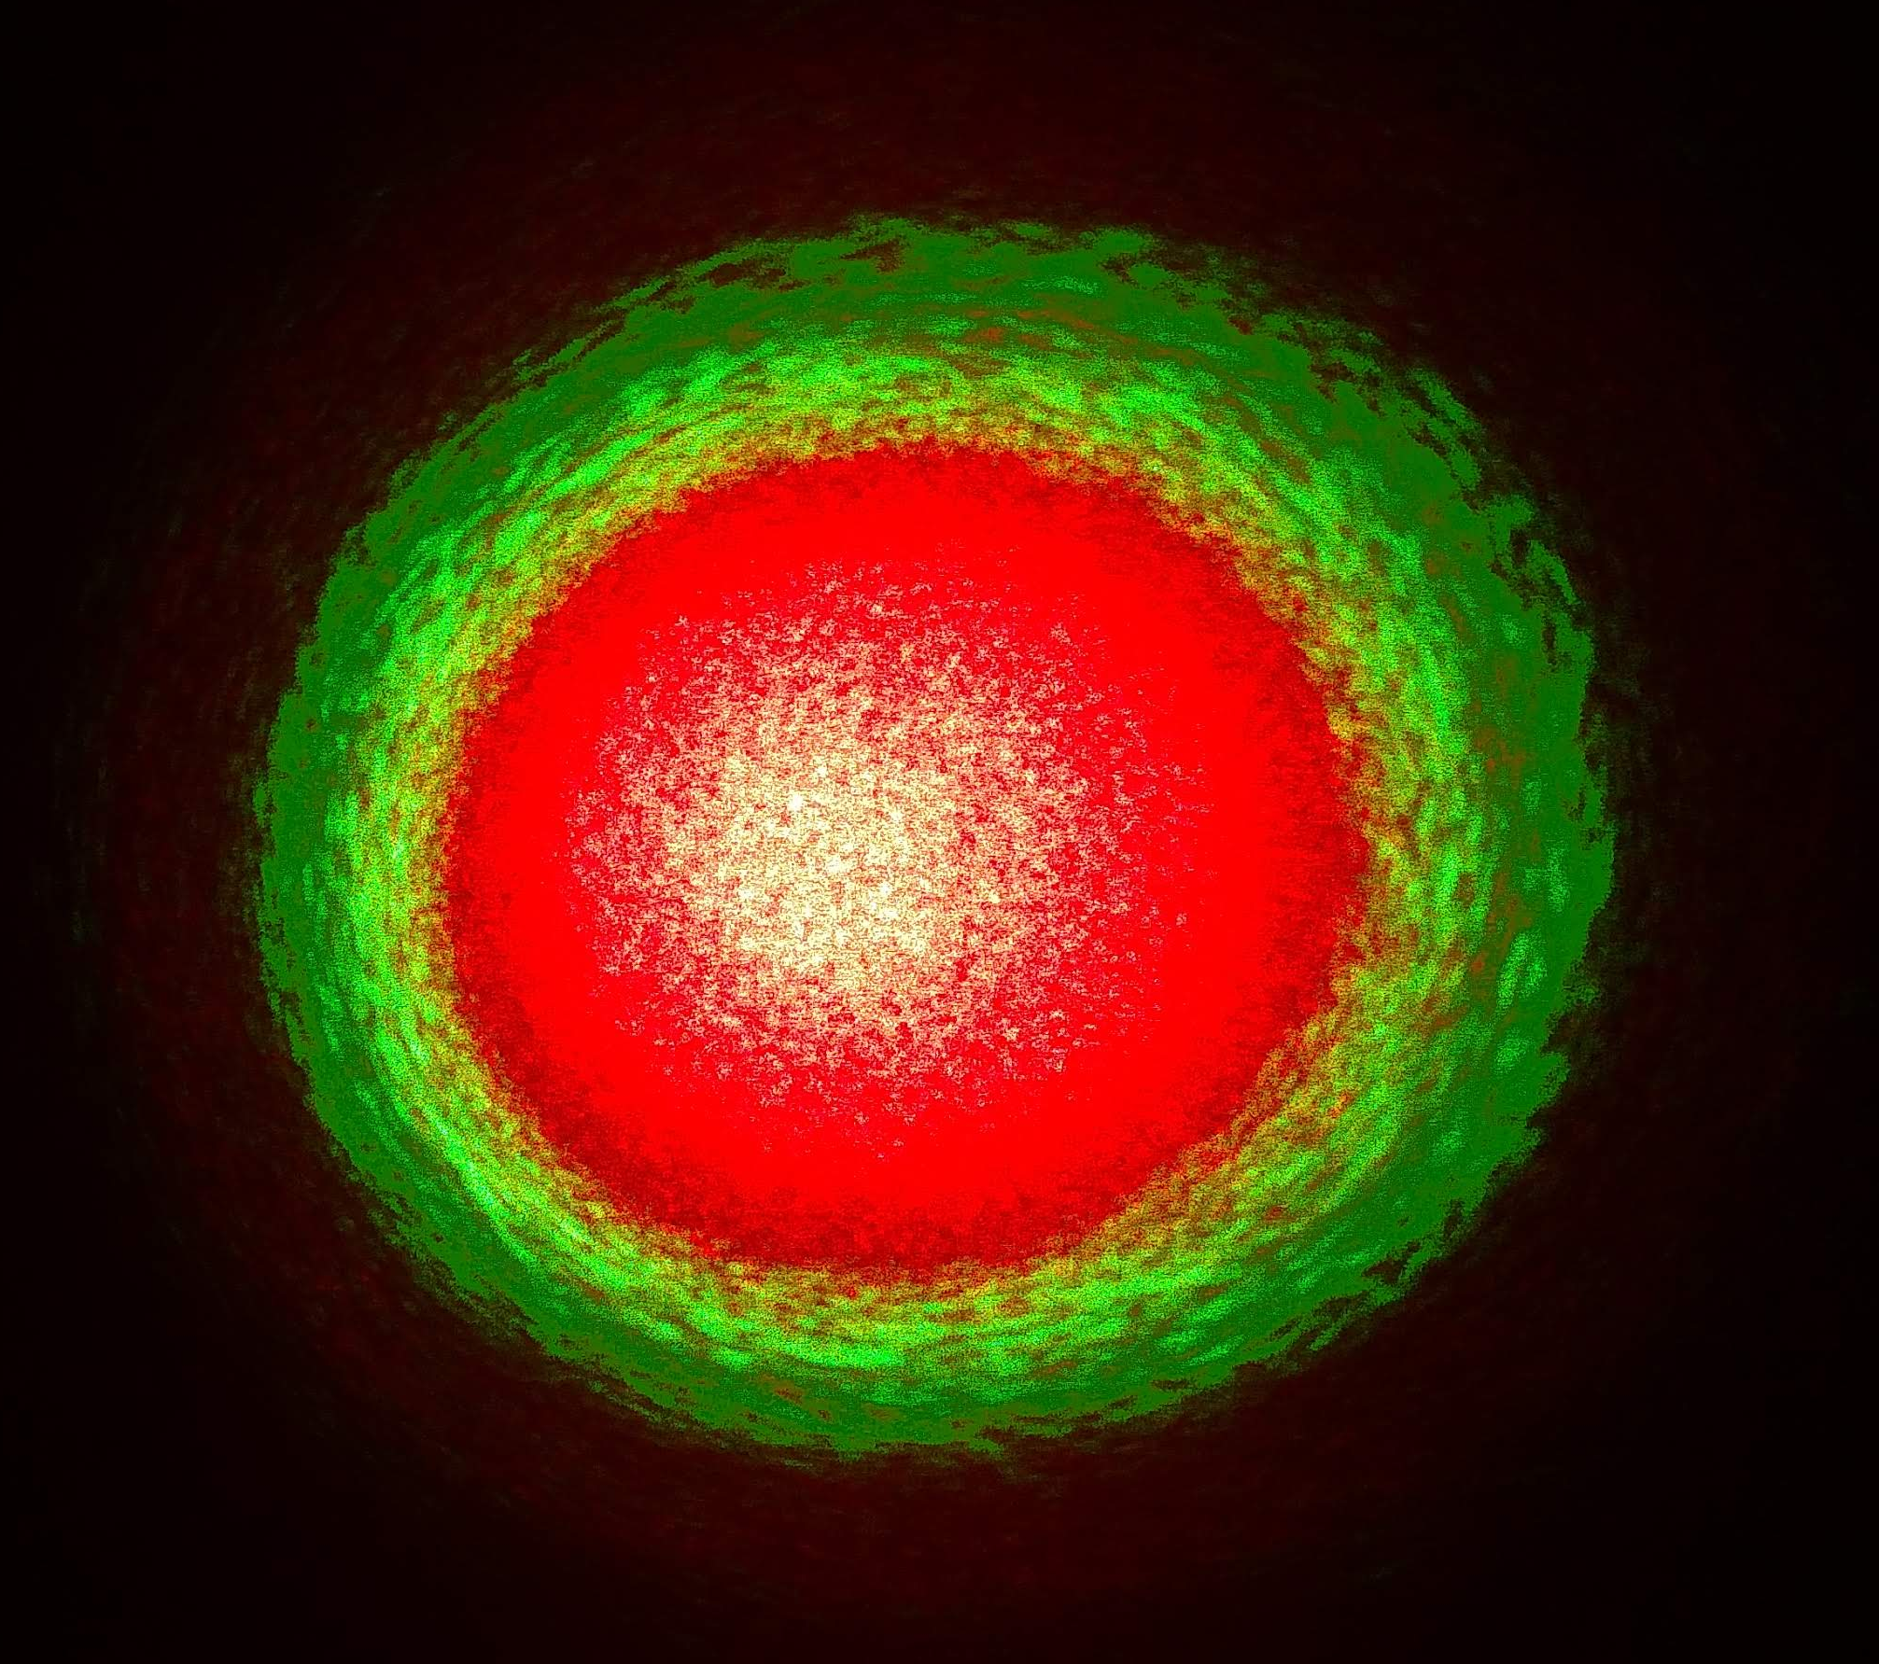
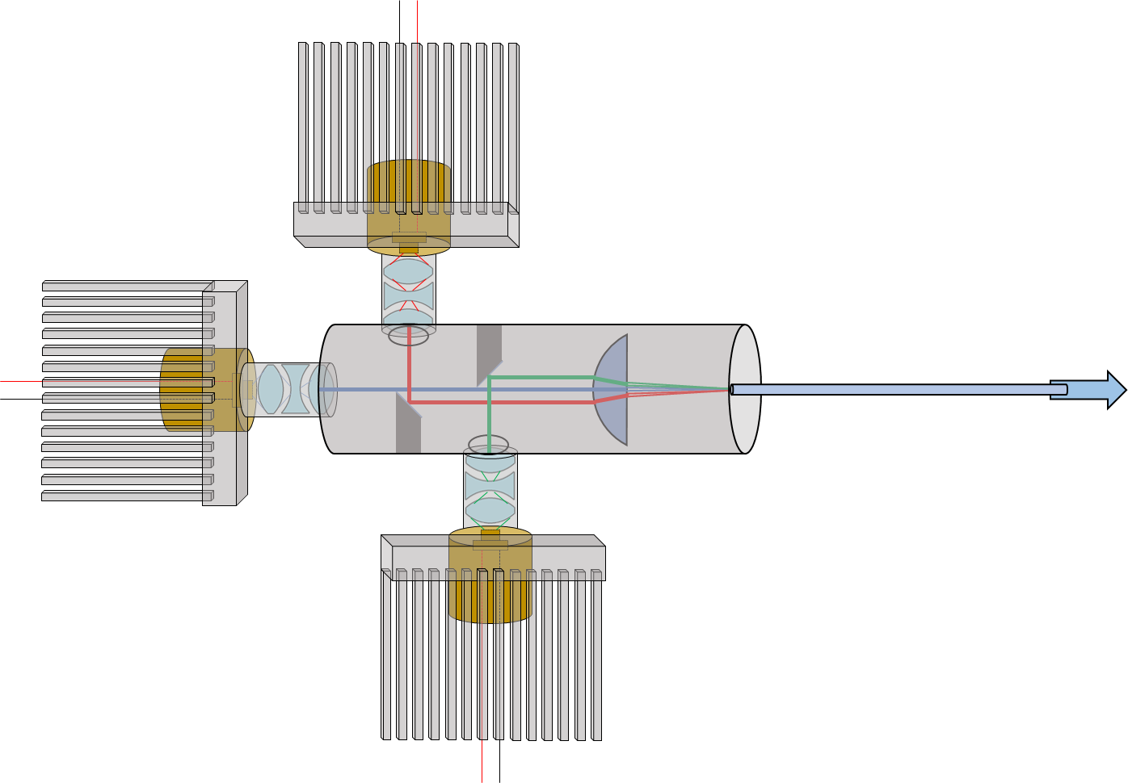
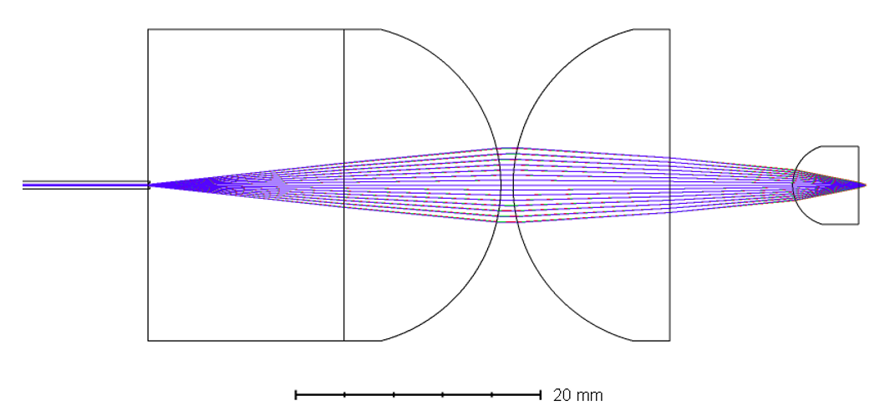
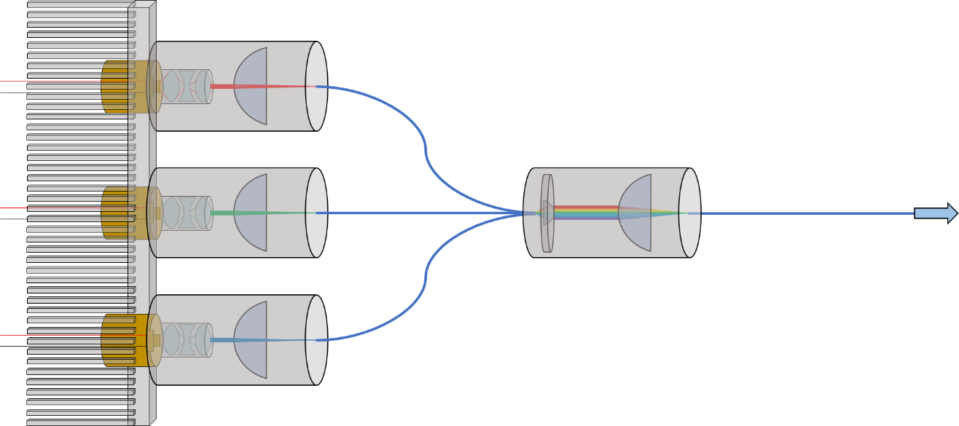
Improvise, Adapt, Overcome

Slide 19
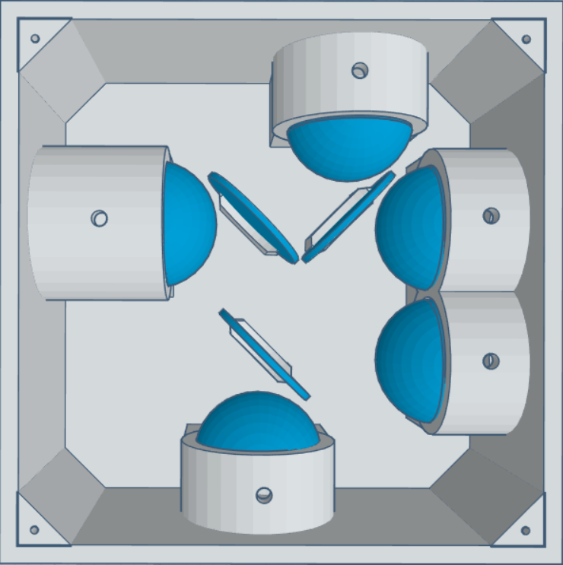
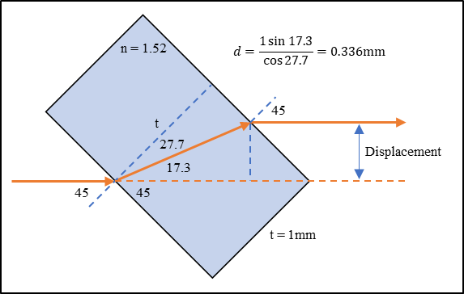
Fiber Splitter
Distribution of mixed light
PPP displacement
Four output pathways
P _{λ} (W) | λ (nm) | % T | % R
4.4 | 638 | 45.73301 | 50.56379
1 | 520 | 47.11318 | 49.60828
7 | 450 | 45.65878 | 50.60305
Outputs: | 1 (W) | 2 (W) | 3 (W) | 4 (W) | Loss (W)
638nm | 1.0167872 | 0.921350144 | 1.12211 | 1.0167872 | 0.322965456
520nm | 0.23371271 | 0.22193521 | 0.24611521 | 0.23371271 | 0.06452416
450nm | 1.617373086 | 1.45938492 | 1.792464526 | 1.617373086 | 0.513404382
White | 2.867872996 | 2.602670274 | 3.160689736 | 2.867872996 | 0.900893998
 |  |  |  | Efficiency: | 92.73%
 |  |  |  | Total Power: | 11.499106
 |  |  |  | Per Output | 2.874776501
 |  |  |  | Standard Dev: | 0.227949917

Slide 20
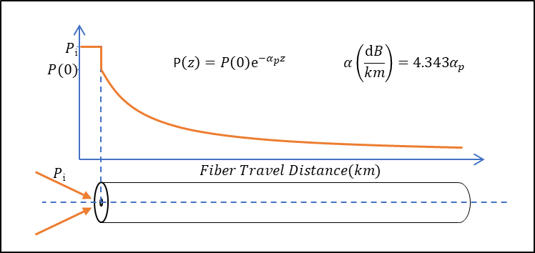
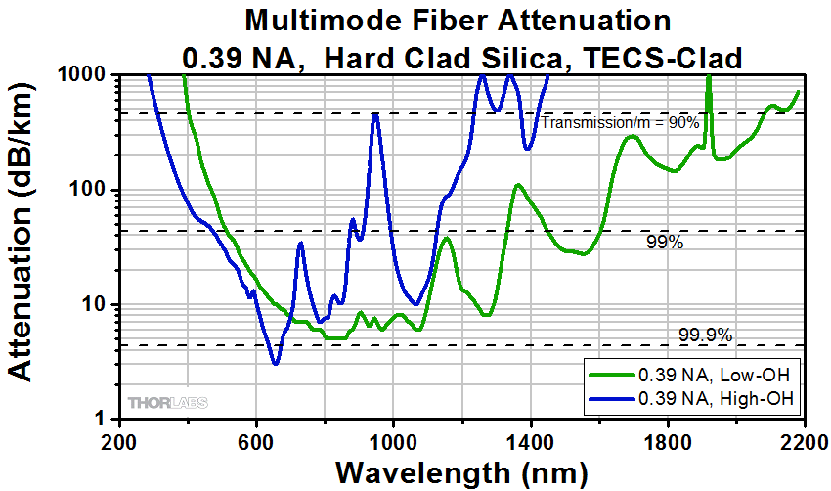
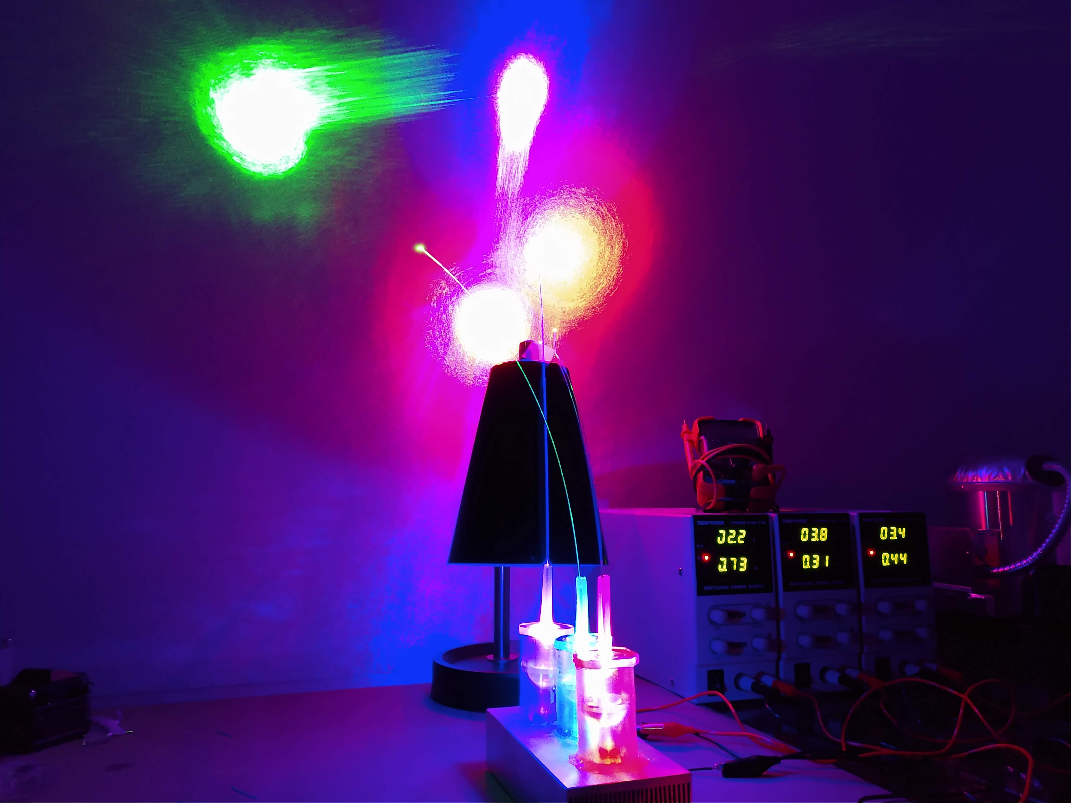
Fiber Losses
End interfaces
Angled or notched cleave
No AR coating
Attenuation over distance
Low wavelengths - less loss in high-OH
https://www.thorlabs.com/newgrouppage9.cfm?objectgroup_id=6845

Slide 21
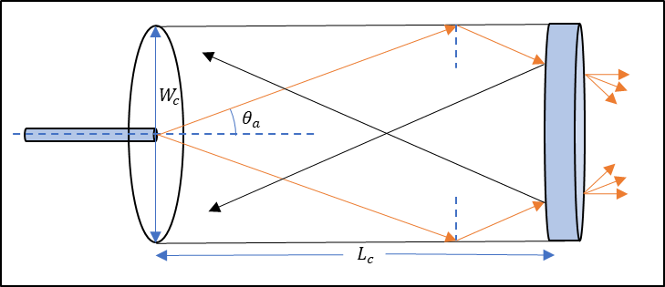
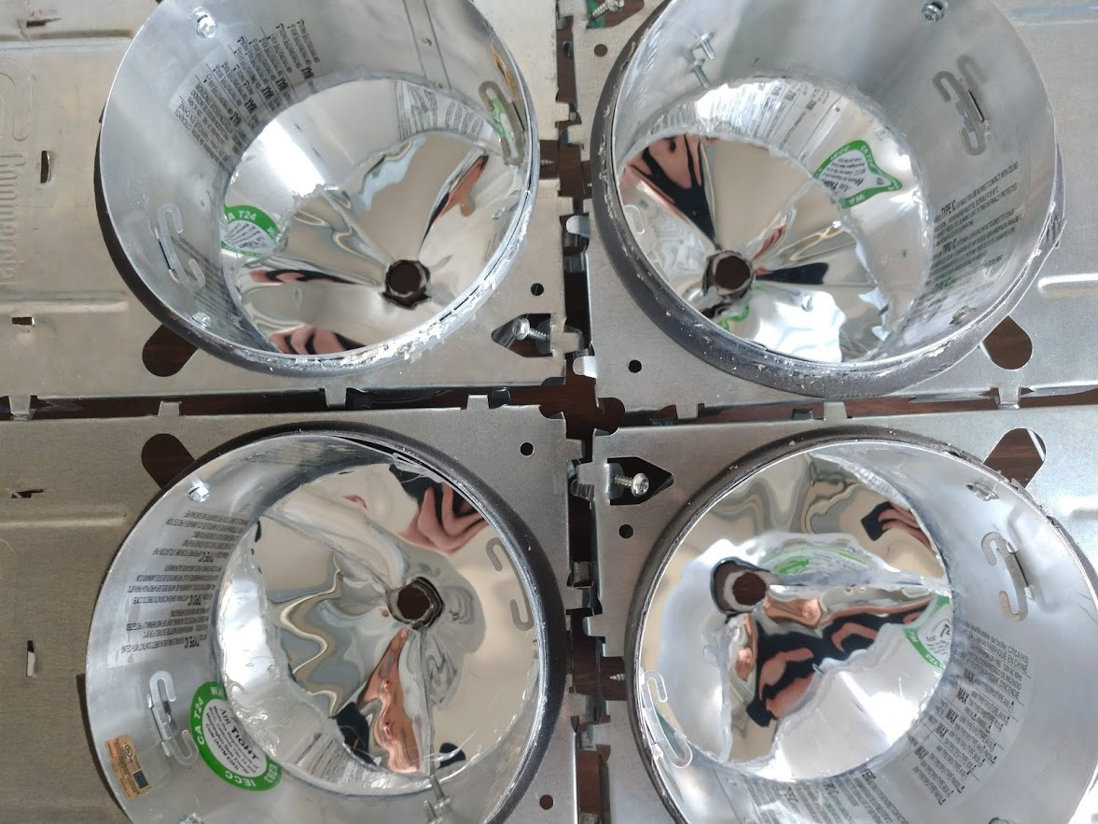
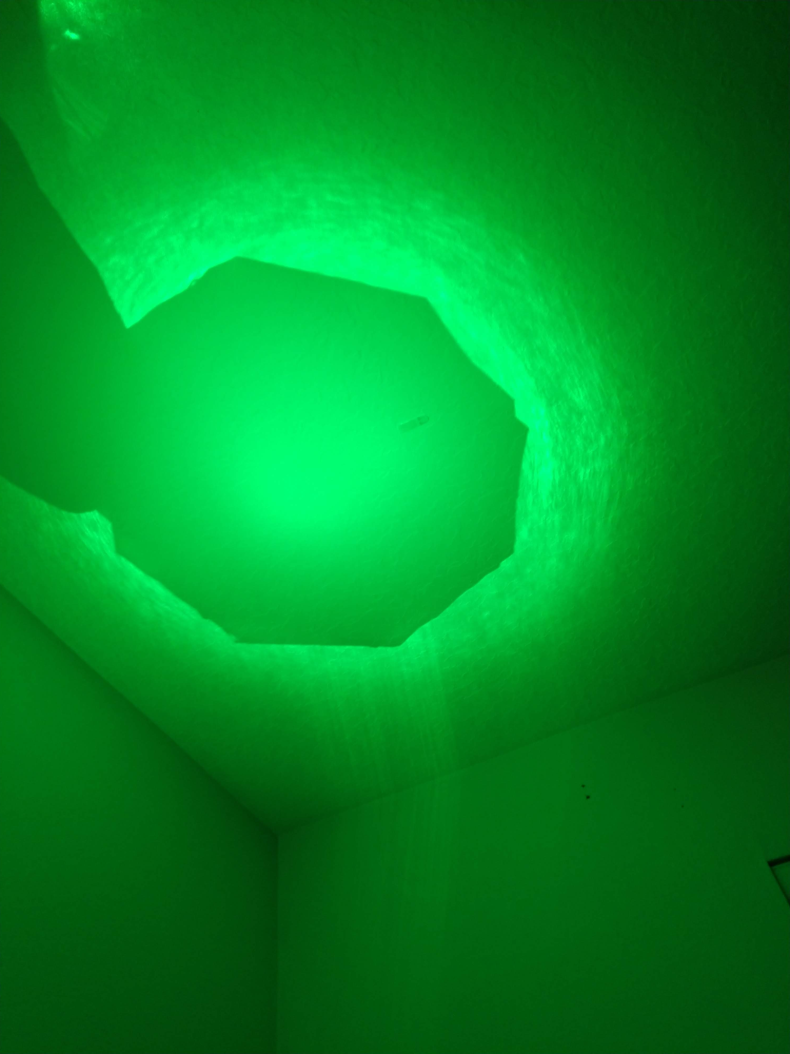
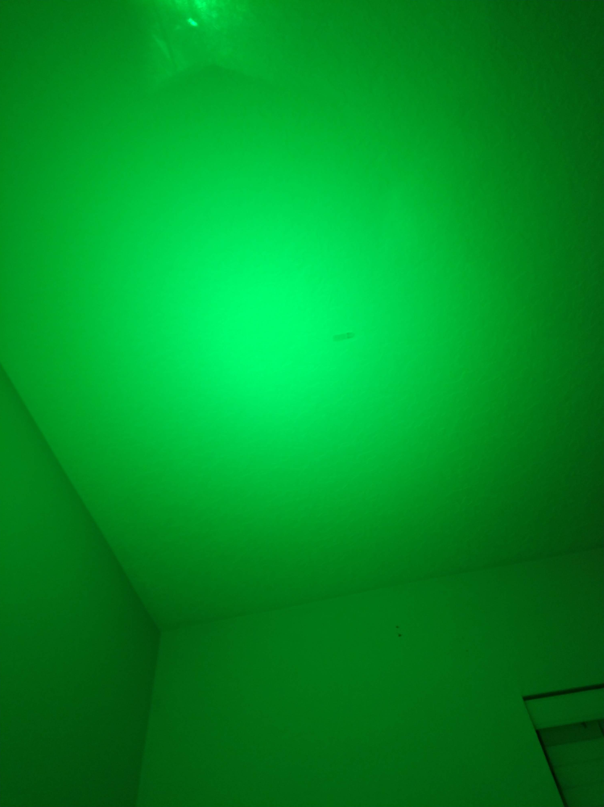
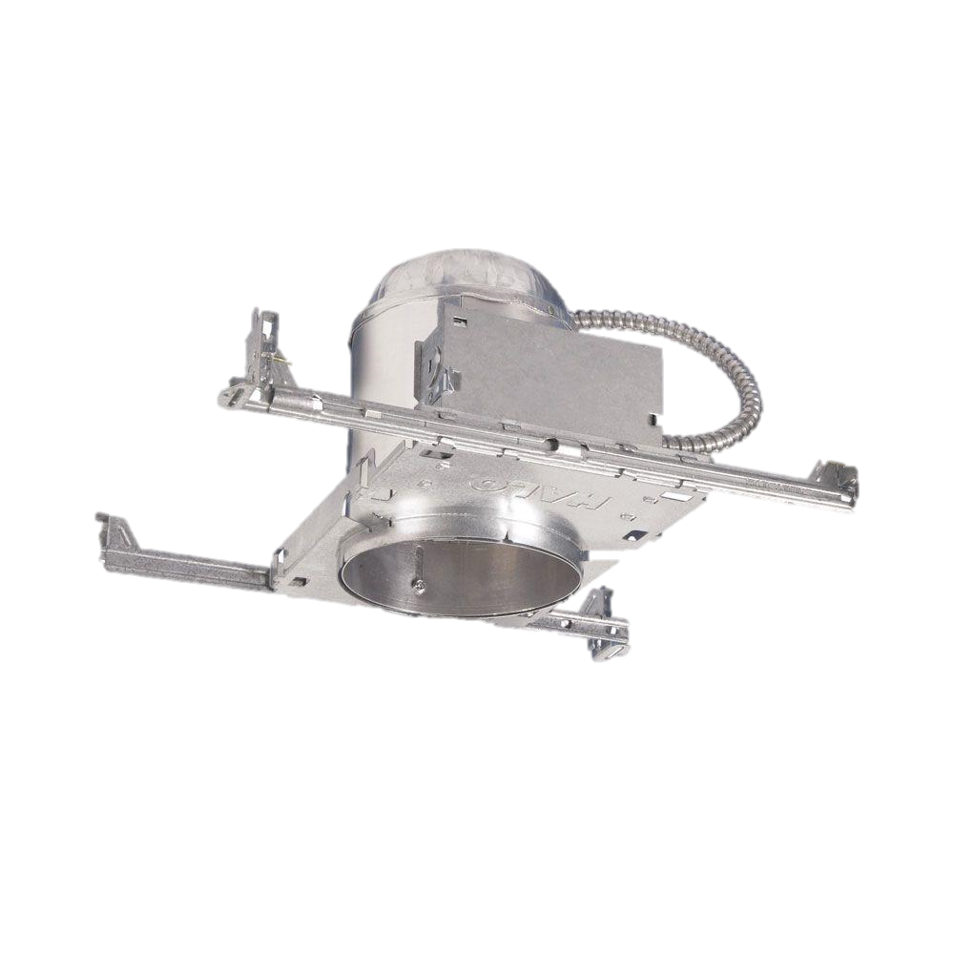
Light Outputs
Can lighting fixture
Solar tubing for back reflections
Circular piece with hole for the top

Slide 22
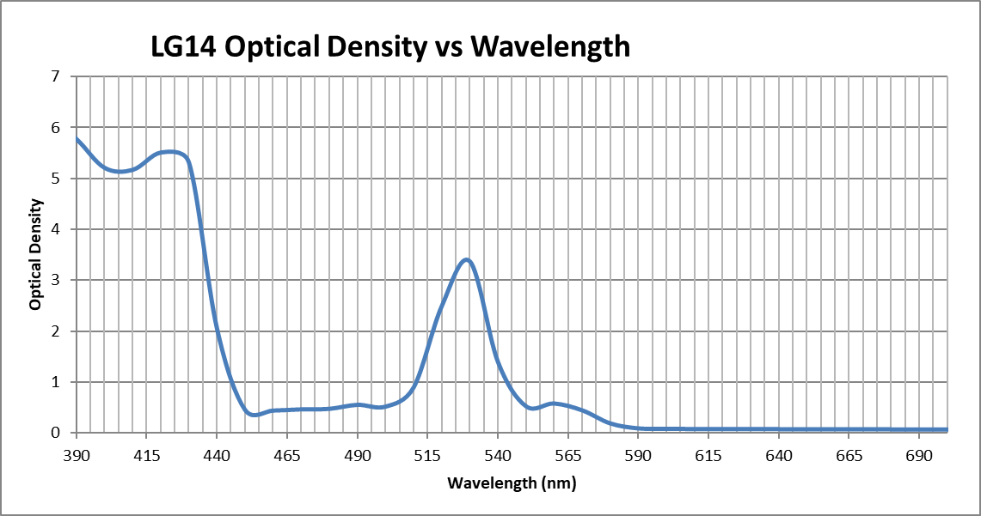
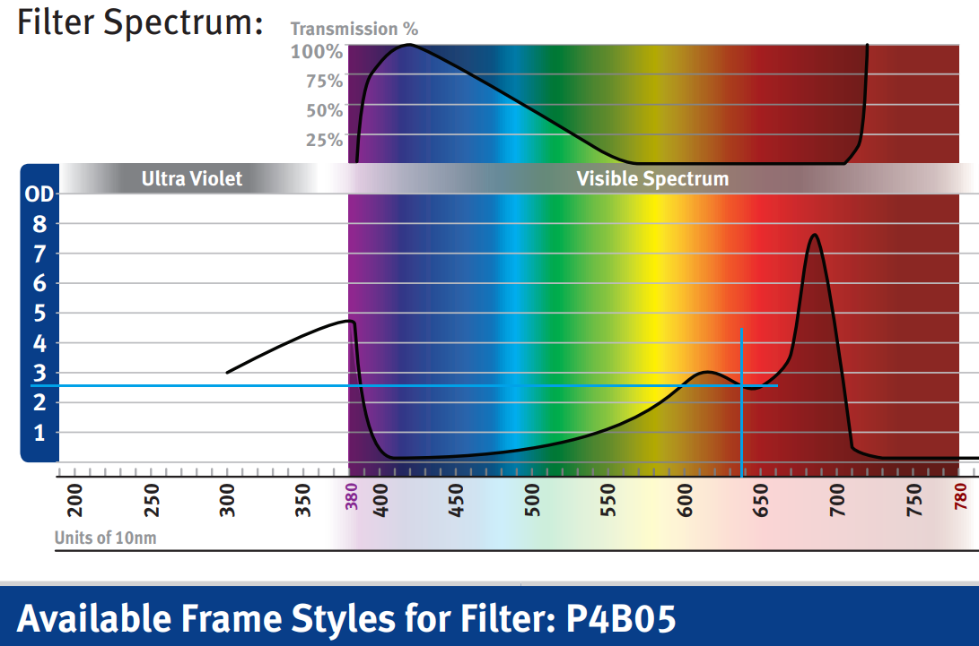
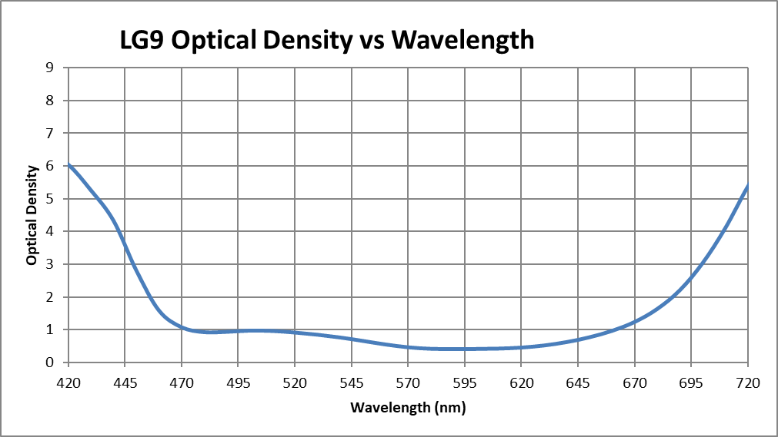
Safety First
Laser safety goggles during assembly/alignment
Description | Price Each | Quantity | Total Price | Wavelength λ (nm) | Laser Power (W) | Glasses OD at λ | Transmittance (%) | Final Laser Power (W) | Final Laser Power (mW)
Newport LV-F22.P4B05 | 208 | 2 | 416 | 638 | 1.8 | 2.6 | 0.251188643 | 0.004521396 | 4.521395577
ThorLabs LG14 Glasses | 211 | 2 | 422 | 520 | 1 | 2.48036 | 0.33085675 | 0.003308568 | 3.308567505
ThorLabs LG9 Glasses | 200 | 2 | 400 | 450 | 3 | 2.81894 | 0.151725997 | 0.00455178 | 4.551779911

Slide 23

Outlook/Final Thoughts
Many small details of the optical design changed due to experimental results
Multiple footprint/assembly issues delayed electronic completion
Company started due to product
Commercialization research in progress
Non-provisional patent draft in progress
Several improvements could be implemented on the next prototype

Slide 24
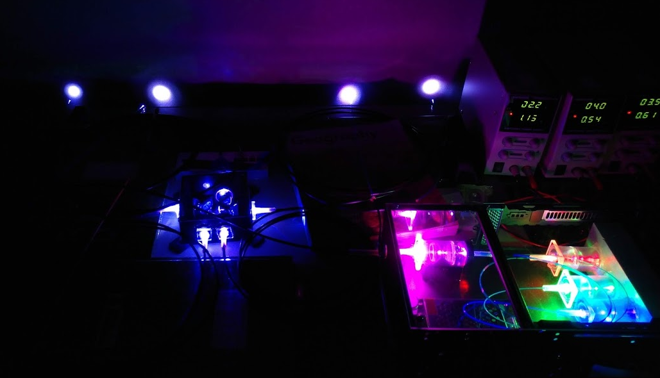
Thank you!
Questions

