Slide 1
A.I.R.E.
Autonomous Intelligent Roof Enclosure
UCF Senior Design 2 - Group 8
Sarah Riseden – Electrical Engineering
Lauren Miller – Computer Engineering
Ron Acevedo – Electrical Engineering
Christopher Smith – Electrical Engineering
Sponsor: Open Aire - Retractable Roofs and Skylights

Slide 2
Motivation
Unpredictable weather can affect many outdoor businesses
Retractable roof enclosures allow for the outdoors to be enjoyed indoors
Smart system allows for enclosure to predict weather before it happens not as it happens
Energy efficient system has been shown to save customers up to 30% a year in energy costs. *
* Statistic taken from our sponsor, Open Aire’s, website.
Notes:
RON
Build upon what is already there
Open Aire brings the outdoors to be enjoyed indoors
Open Aire has limited sensors and capabilities

Slide 3
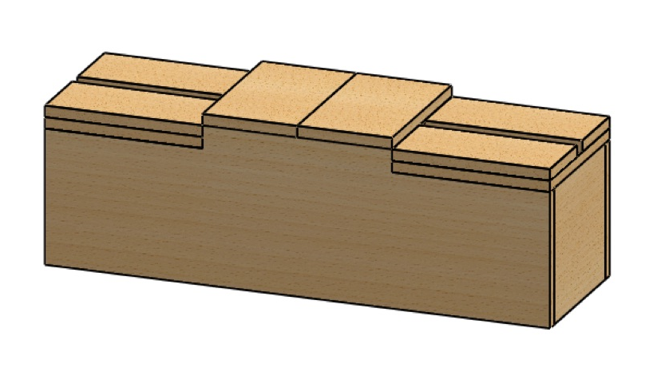
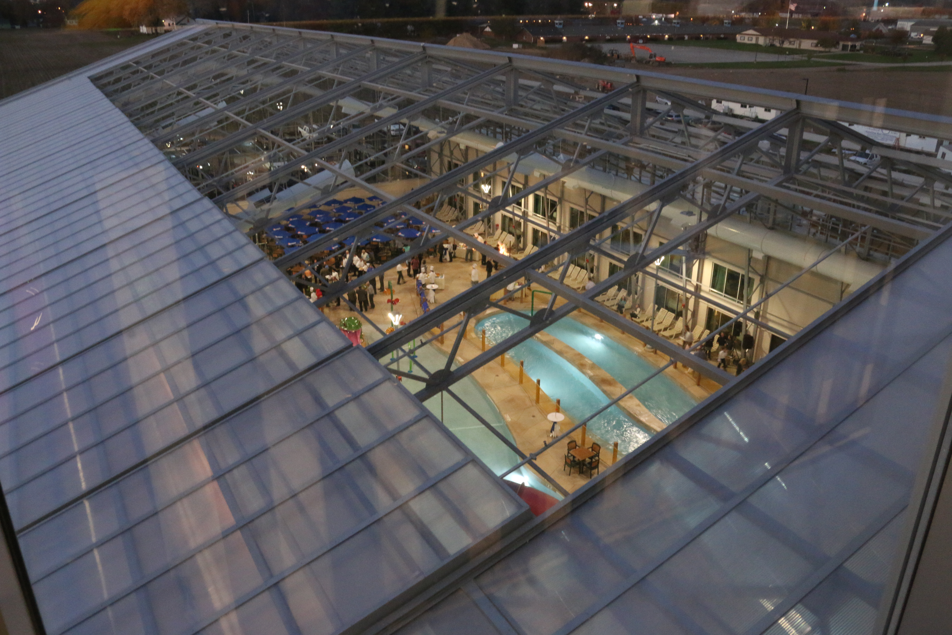
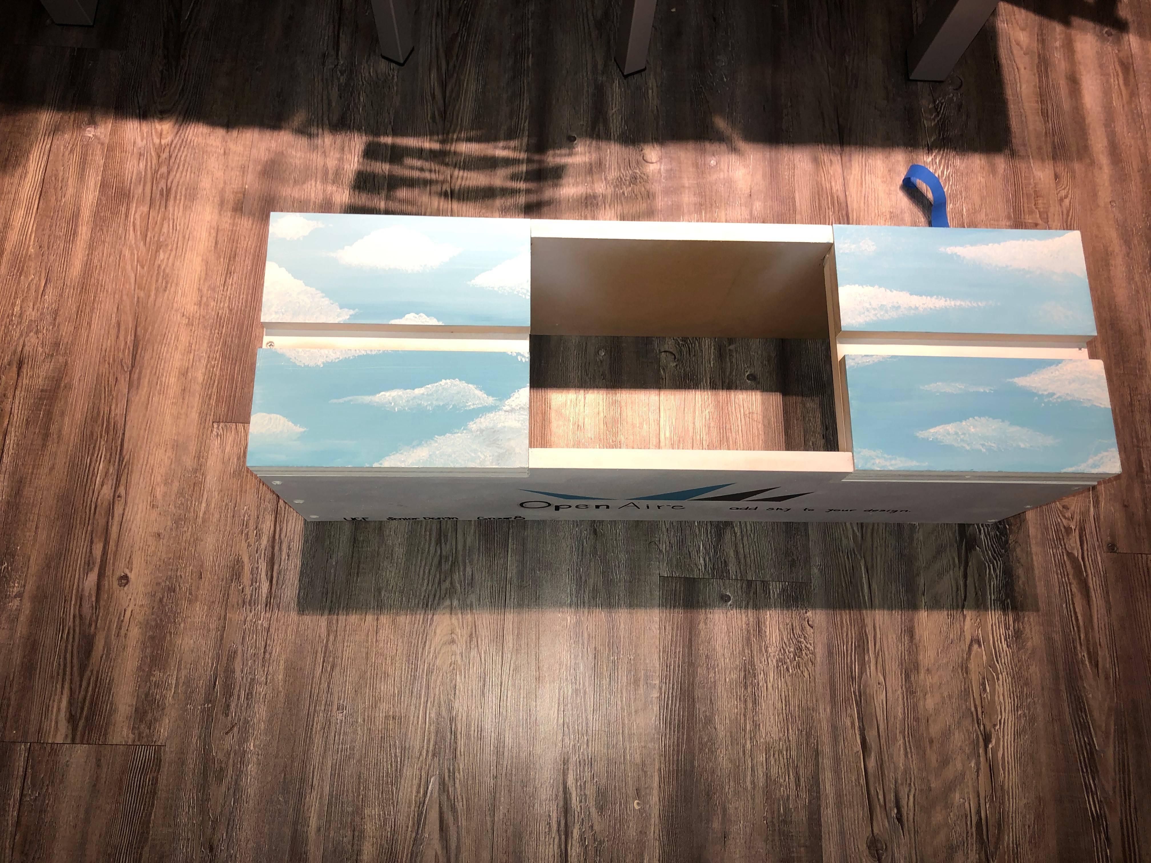
Design and Inspiration
Sponsor’s current design
Our design
Notes:
Sarah
Our inspiration for this project is to make the current design into a smart system
Here are some designs that our sponsor has done recently on the left, and on the right is our final design. As you can see, the roof is made up of glass panels which slide along a track. In order to update this, we are leaving the physical design a lone but adding more sensors to make it a "smart" system

Slide 4
Goals
Wanted to update our sponsor’s current semiautomated design, which includes only a few sensors to detect weather.
Addition of sensors for the 6 main characteristics of weather
Addition of app for weather updates and user control of the roof system
Waterproof protection for all electronic components
Battery management and voltage regulation modules
Notes:
Ron - Increase predictability and reliability
Add a few more sensors and a phone application

Slide 5
System Requirements Specifications
Specification Number | Specification
1 | The system shall have one retractable roof with two glass panels
2 | The system shall have one 16-bit 10-channel microcontroller capable of handling weather sensing data and signal processing
3 | The system shall have one solar panel system not exceeding 8 cubic feet
4 | The system shall have 3 lithium battery packs for back-up power, to be charged by one 5W solar panel system
5 | The system shall have three regulators providing +12V, +5V, and +3.3V power lines
Notes:
RON
Here are the system requirement specifications. The underlined specifications are the ones that drove a lot of the choices for the different hardware we selected for this project. Those specifically are 6 & 7
Needed proper voltage for the vast array of sensors, and needed a microcontroller that would be able to handle the high number of input and output signlas

Slide 6
Enclosure Specifications
Specification Number | Specification | Value | Unit
7 | Dimensions | 32x11x10 | inches
8 | Weight | < 30 | lbs
9 | Retractable Roof | 1
Notes:
Lauren
The enclosure is very simple, a 32 inches long 11 inches wide and 10 inches tall,
The building strucute, roof, and sensor kit will not exceed 30 lbs
The building will have one retractable roof

Slide 7
Power Module Specifications
Specification Number | Submodule | Specification | Value | Units
11 | Solar Panels | Power Delivery | 1 – 5 | Watts / Panel
12 | Lithium Ion Battery | Package | 18650
13 | Reverse Polarity | MOSFET Rds(on) | < 0.05 | Ohms
14 | 12 V Regulator | Input Voltage Range | 3.2 – 12.6 | Volts
15 | 5 V Regulator | Input Voltage Range | 11 – 13 | Volts
16 | 3.3V Regulator | Input Voltage Range | 5 – 3 | Volts
17 | Battery Management System | Supply/Output Voltage Range | 3.2 – 12.6 | Volts
18 | Battery Management System | Fault Protection | Overcurrent Protection
19 | Battery Management System | Fault Protection | Overvoltage Protection
Notes:
Chris
Wanted to make sure we had enough power
The corrct regulation required and adequate battery management to protect our system

Slide 8
Sensor Module Specifications
Specification Number | Module | Specification | Value | Unit
20 | Anemometer | Resolution | < 10 | meters/second
21 | Barometric Pressure Sensor | Accuracy | +/- 5 | millibar
22 | Temperature Sensor | Accuracy | +/-1% | ºCelsius
23 | Humidity Sensor | Accuracy | +/3% | Relative Humidity
24 | Rain Sensor | Response Time | < 240 | seconds
25 | Light Sensor | Spectral Range | 1500 | nanometer
26 | Bluetooth | Range | 50 | meters
Notes:
Sarah – wanted to highlight accuracy for the price we could get

Slide 9
Microcontroller Unit Specifications
Specification Number | Specification | Value | Unit
27 | Microcontroller will be hard coded with an identification number | 8 | Bits
28 | For specific sensors, their status will be polled | 60 | seconds
29 | The Weather API will be polled for predictions | 60 | seconds
30 | Microcontroller will signal a roof reaction when deemed necessary in an appropriate time frame from receiving measurements | 30 | seconds
31 | Code will only require half of the microcontroller’s available storage | 128 | kiloBytes
32 | Weather API prediction data will be stored on the microcontroller | 32 | kiloBytes
Notes:
Lauren –
Here is the breakdown for our micro controller unit specifications
A lot of these specfications drove the decsison making process for specifc unit we selected
Since there are quite a few I am going to highlight the more imporatnt ones.
Each unit will have a unique ID encoded,
the MCU needs to be able to handle the communication with all 6 sensors.
And leave half or more than half of the available storage for holding weather statistics and prediction data

Slide 10
Mobile Application Specifications
Specification Number | Specification
33 | Application shall provide exact parameters for Microcontroller to signal roof enclosure
34 | Application shall support iOS 9.0 and above
35 | Application shall support iPhone 6s Models and above
36 | Application shall support Bluetooth 4.0 and above
37 | Application shall decode sensor data in a human readable manner
38 | Application shall show sensor data from last minute of reading
39 | Application shall follow security protocol for storing Username Password information in the database.
Notes:
Ron –
Read the highlighted specifications, as well as summary specification numbers 34-36

Slide 11
Standards
Standard Name | Description
Bluetooth 5.1 | To ensure best security and speed with Bluetooth connectivity
RoHS 3 Directive 2015/863 | To ensure environmental safety and promote greener product manufacturing
AES/SS IEEE 307-1969 | To ensure accurate and viable sensor performance parameter definitions
USB 3.0 | To ensure reliable connection with any industry-standard USB connector
ANSI C | To ensure code is readable for reproductivity
Notes:
Chris – BT, RoHS, Sensor standards to make sure we're up to date

Slide 12
Engineering Constraints
Constraint Type | Constraint Description
Financial | Total project must be under $2000 USD
Sensor Hardware | Sensors must be capable of either digital output via UART, I2C, or SPI, or analog input via voltage or current in order to interface reliably with ATmega1280 microcontroller
Manufacturability | Passive components must be in packages 1206 or larger for hand-solderability
Mobile Software | Must be compatible with latest generation of iOS
Bluetooth | Bluetooth module CYBT-423028-02 will need to be programmed within Wiced IDE
Environmental | To comply with RoHS standards, components must be free of lead and PCB material must be environmentally sustainable
Notes:
Chris
*** Should be at 3 minutes max ***

Slide 13
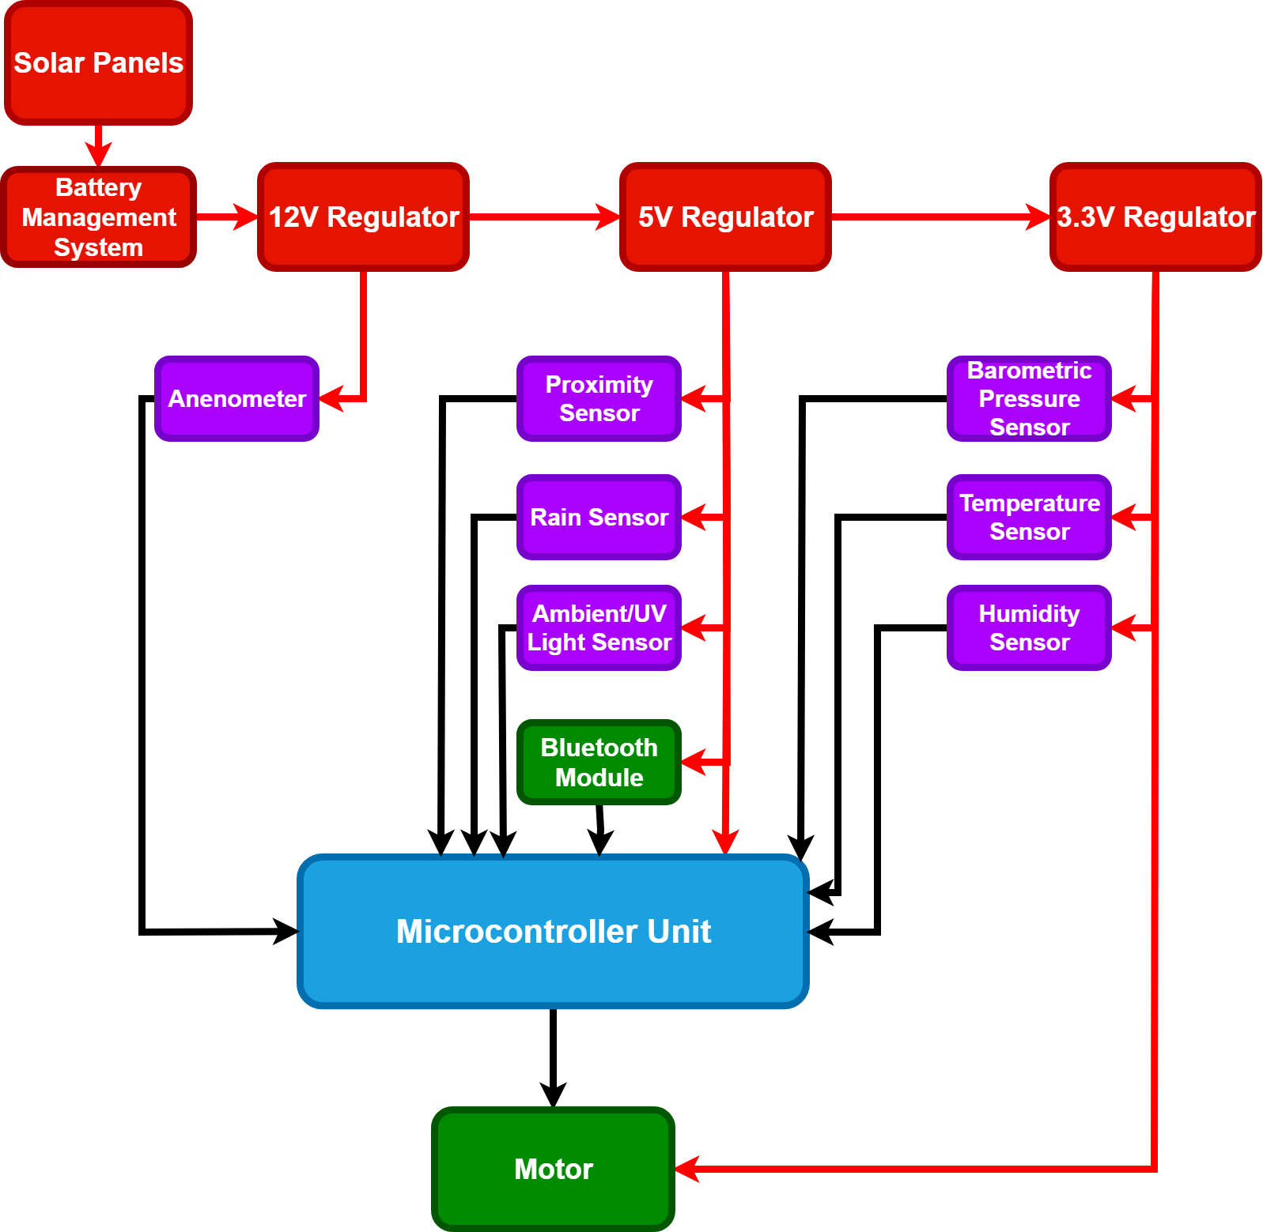
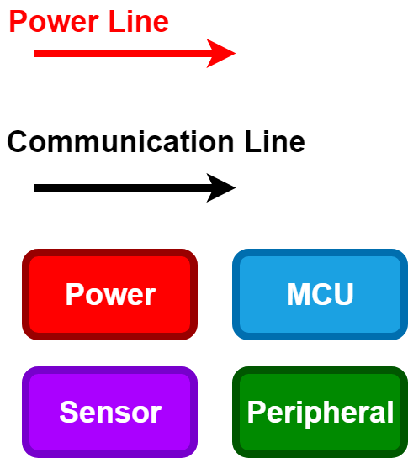
Overall block diagram (CHRIS)
System
Overview
Notes:
Chris (Start)
Start with hardware, go into MCU, sensors, and power

Slide 14
HARDWARE

Slide 15
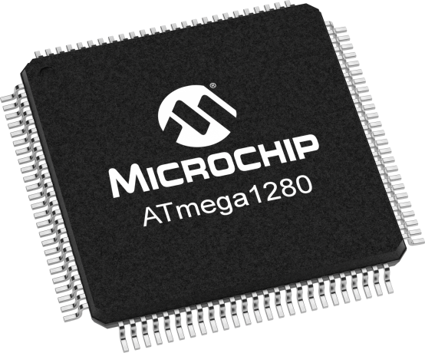

Microcontroller Unit
ATmega1280
128 KB flash memory size
16-channel, 10-bit ADC converter
Lots of documentation on Arduino for easy programming
Notes:
Chris

Slide 16
Development Board – Bluno Mega 1280
Due to COVID-19 issues we were unable to finish the ordering of our proposed microcontroller PCB
We have decided to implement the Bluno Mega 1280 development board with the ATMega 1280 MCU
the use of the development board limits the number of Inter-Integrated communication (I2C) devices the team can use since the board is only equipped with two I2C ports.
Notes:
CHRIS

Slide 17
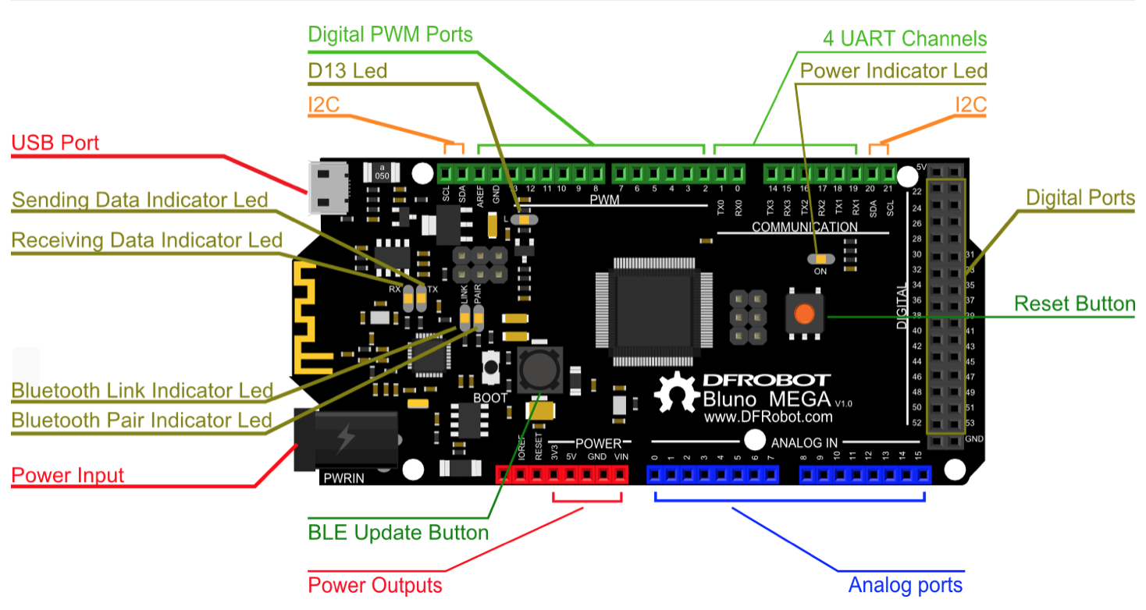
Bluno Mega 1280 Pin Layout
Notes:
Chris

Slide 18
Sensor Module
The following sensors will be used for weather prediction. All sensors are RoHS compliant, and were chosen to be inexpensive, and small enough to fit on our model building.
Proximity* (Not used due to COVID-19)
Wind/Anemometry* (Not used due to COVID-19)
Rain*
Barometric Pressure (Not used due to COVID-19)
Humidity
Temperature
Light and UV
*Sensors already implemented by sponsor
Notes:
SARAH
Aside from the sensors that are currently included by OpenAire, the team is adding a barometric pressure, humidity……

Slide 19
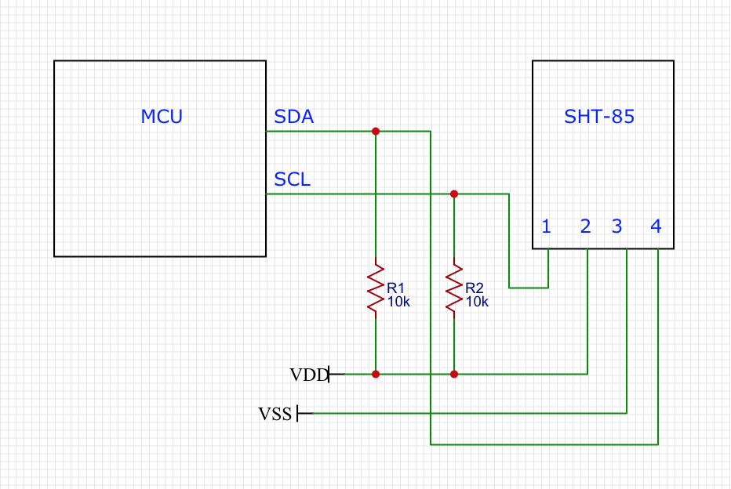
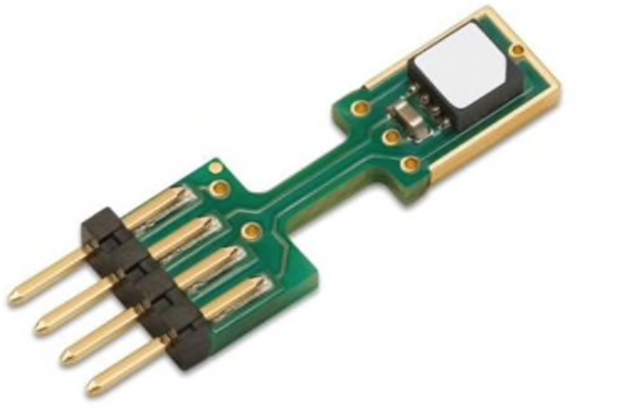
Humidity Sensor – SHT-85
Capacitive humidity sensor measures changes in capacitance of a material as moisture comes into contact with it
Operating Parameters: 0-100% humidity with +/-1.5% RH accuracy
Operating Voltage: 3.3V
I2C communication with A/D converter built-in
Cost: $29.22
Notes:
Humidity sensor uses the changing capacitance of a material to sense the presence of moisture, it also has a temperature sensor built in for back up. I2c with ac to dc conversion built in

Slide 20
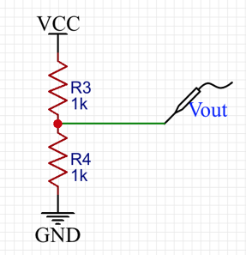


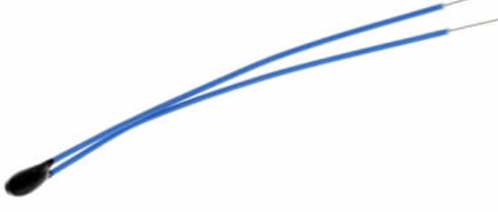
Temperature Sensor – B57863S
Bead thermistor design makes it small and easy to implement in our system
Tolerance: +/-1%
Operating Temperature: –55 – 105 degrees Celsius
Output voltage can be converted to a temperature value
Cost: $2.93
Notes:
Temperature sensor is a small thermistor, which is super easy to implement, and easy to calculate a temperature reading from the change in resistance of the sensor.

Slide 21
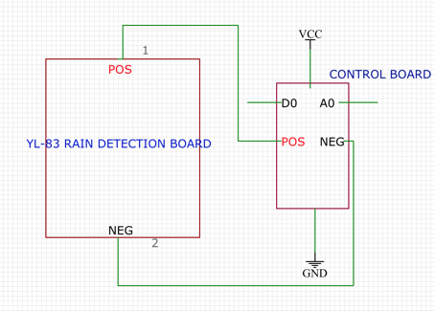
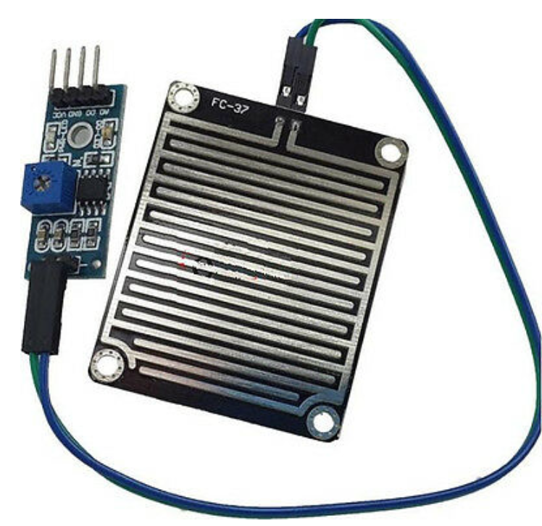
Rain Sensor – YL-83
Conductive rain sensor
Operating Voltage: 5V
Includes regulating circuitry with A/D converter
Output: high/low voltage signals to indicate rain versus no rain
Response time: 1sec
Cost: $7.81
Notes:
Conductive rain sensor works similarly to capacitive humidity sensor. This sensor includes regulating circuitry and an ac/dc converter so it is easy to place on our pcb.

Slide 22
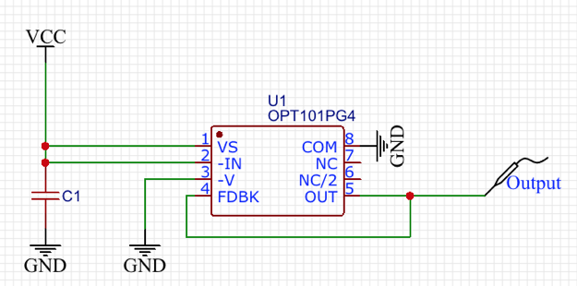
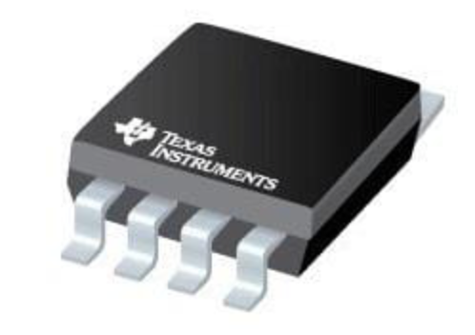
Visible Light Sensor - OPT101
Integrated photodiode and transimpedance amplifier
8-pin integrated circuit with leakage current error, noise, and gain peak protection
Operating Voltage: 2.7-36V
Spectral Range: 400-1000nm
Cost: $8.80
Notes:
Chris – for ambient light

Slide 23
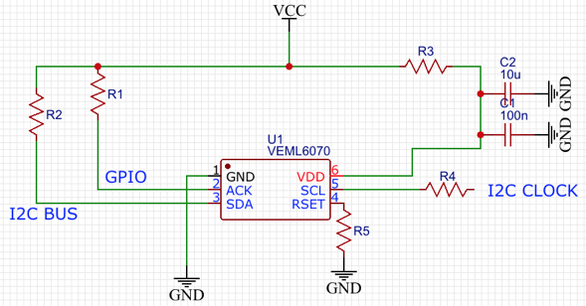
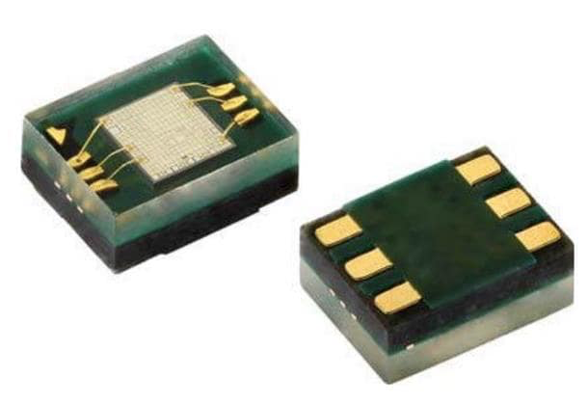
UV Light Sensor - VEML6070
Digital output photodiode with I2C supported circuitry
Integrated circuit containing photodiode, low pass filter, and I2C interface
Maximum Operating Voltage: 5.5V
Spectral Range: 280-400nm
Cost: $2.77
Notes:
Chris – UV light

Slide 24
Sensor Module PCB Design
For this, we needed all sensors outside while the important circuitry must be kept inside away from harsh weather
We went with a design that includes one PCB with all sensors, that connects to the MCU and Power Module PCB, which is kept inside the enclosure
All sensors needed to be outside to ensure accurate readings, away from any noise that could be introduced by being close to the main circuitry and the MCU.
Notes:
Sarah
Our pcb design for the sensors is a dual pcb design. On pcb will be outside with all of our sensors on it as they need to be out in the elements for the most accurate readings, and the sensitive circuitry will be kept inside out of the weather.

Slide 25
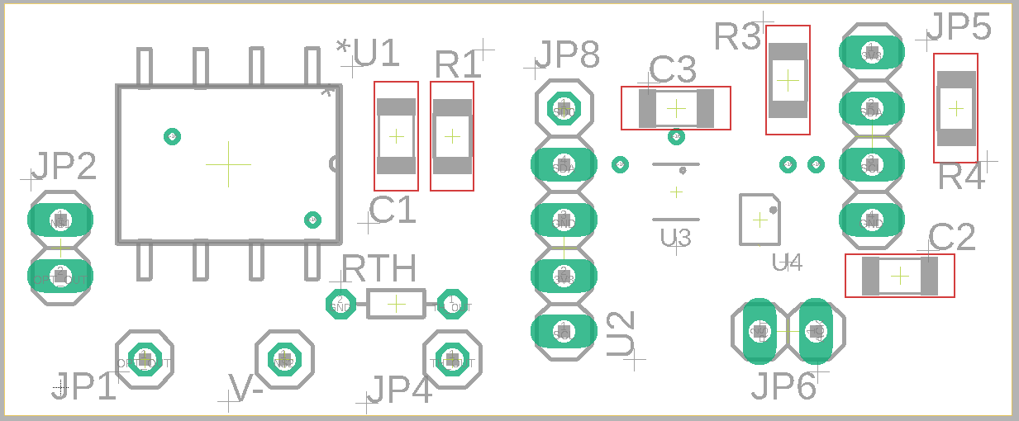
Sensor Module PCB Design cont.
Notes:
Sarah (Stop) - outside pcb connects via jumpers to inside pcb

Slide 26
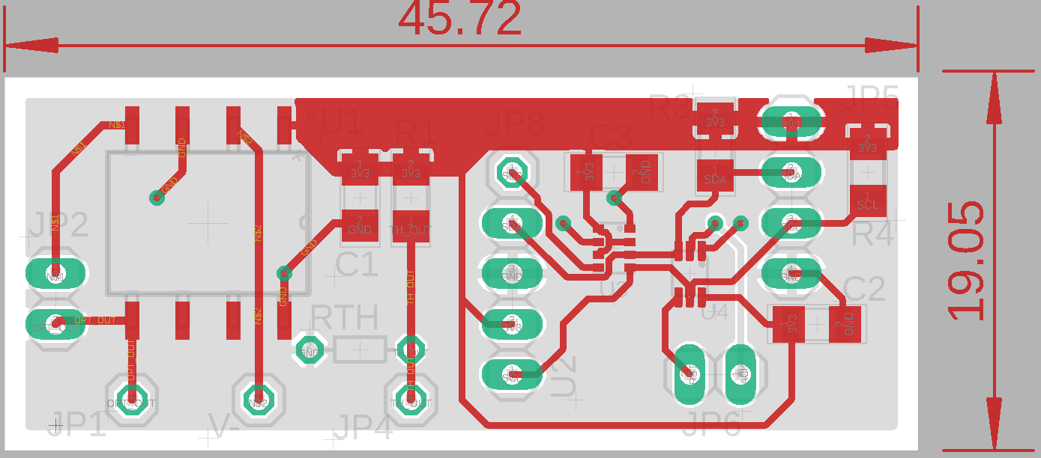
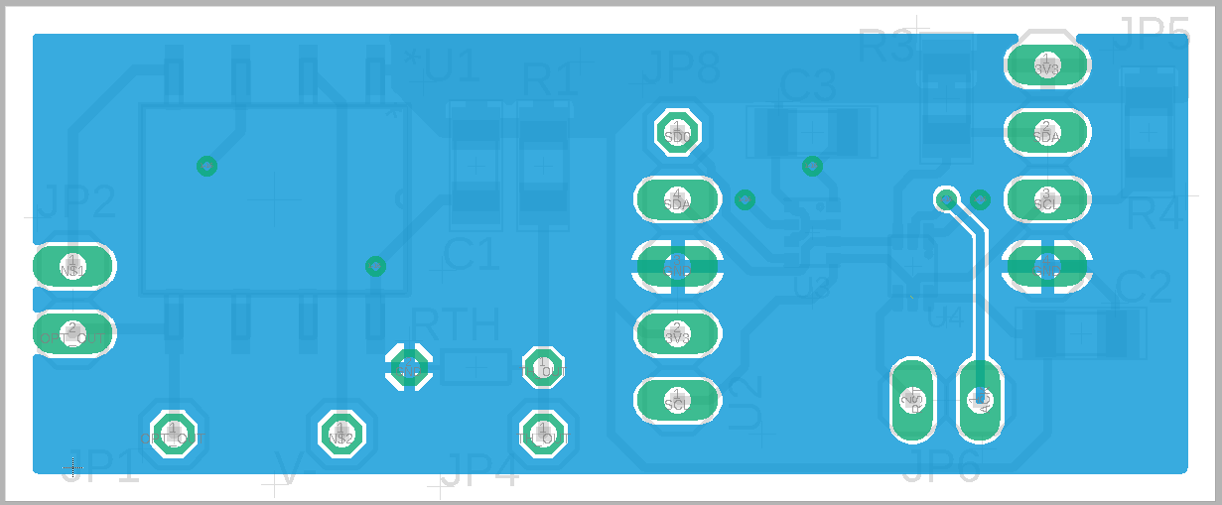

Slide 27
Sensor Test Plan
Sensor | Test
Temperature | Sensor will be exposed to four different temperatures, two of which will be at the extremes of the range, in order to check for the validity of the measurement and the relay of the data to the microcontroller.
Humidity | Sensor will be exposed to four different humidities in order to check for the validity of the measurement and the relay of the data to the microcontroller.
Wind | Sensor will be exposed to different wind speeds from different directions to check that the wind is detected and the speed measured accurately.
Rain | Sensor will be exposed to different rates and volumes of water to check that the signal to the microcontroller is accurate and timely.
Light | Sensor will be exposed to different light levels and UV indexes to check accuracy. Verify that the signal to change interior lights is sent when light lumination changes.
Notes:
Lauren
In order to check the functionality and accuracy of the sensors once implemented we tested
Each sensor for their communication and measurement accuracy and repeatability. Each sensor was exposed to 4 different measurements, two at the extremes, and two in the middle. The exceptions to this is the rain sensor since it only returns a boolean for if it is raining or not, so for the rain sensor, different amounts of water were placed on the sensory and the threshold value for the voltage for raining was adjusted

Slide 28
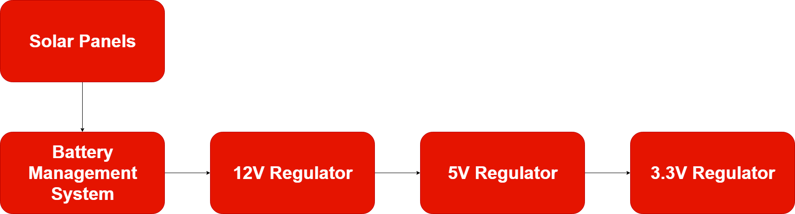
Power Module
The power module will be charged with safely and efficiently providing power to all subsystems and components of the AIRE system
Geared towards high efficiency and low cost, the power module contains five (5) sections that will work together to harness energy from the environment, protect itself from user error, and provide power to the AIRE system
Notes:
Chris

Slide 29
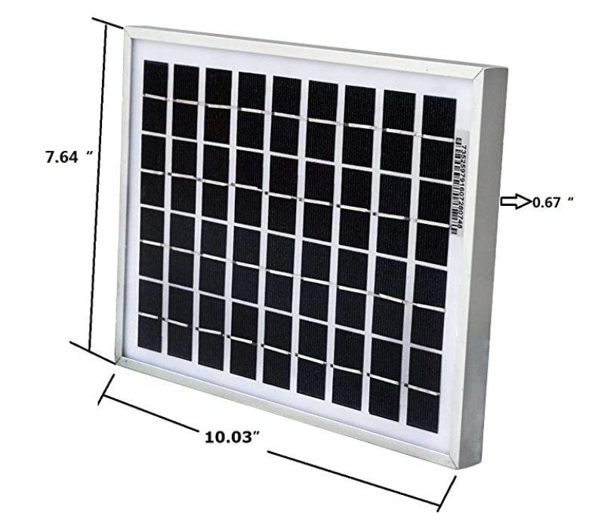
Solar Panels
Allows autonomy and limited self-sufficiency while also being environmentally friendly
ECO-Worthy brand provides 5 Watts of power generation purchasable from Amazon and includes a 5-year warranty
Reference:
[Untitled illustration of a solar panel system]. Retrieved January 22, 2020 from https://www.specialized.net/zamp-solar-usp1005-portable-45-watt-single-solar-panel-kit.html
Notes:
CHRIS

Slide 30
Battery Management System
This subsystem includes a lithium ion battery pack, battery charger controller, and reverse polarity protection
Lithium ion battery back includes a 3-series configuration of 18650 cells. These cells have an impressively high energy density that allows efficient storage of power.
The charge/discharge cycle of this battery pack is controlled by multiple battery charge controllers, which balance each individual cell to ensure they maintain their health throughout the lifetime of the AIRE system
To ensure the power system is not vulnerable to user error when replacing the battery, reverse polarity protection circuitry is implemented as well
Notes:
CHRIS

Slide 31
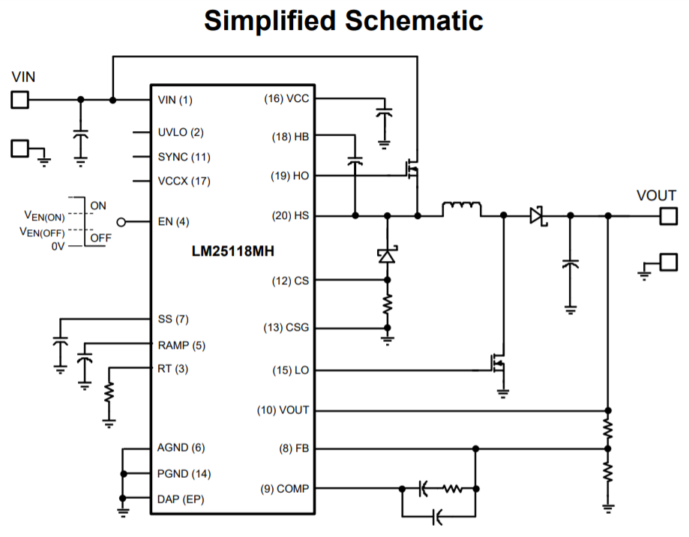
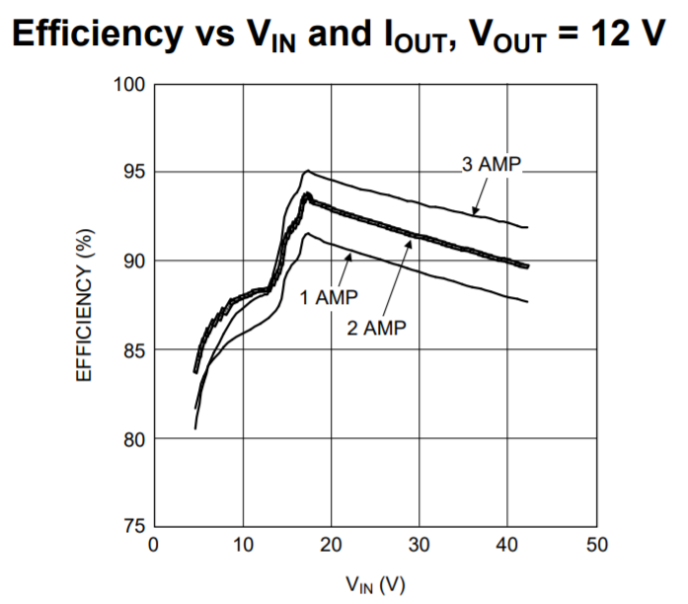
12V Buck-Boost Controller
The 3-S battery back will have a voltage range of 9V when discharged, up to 12.6V when fully charged, and a nominal voltage of 10.8V.
To accommodate, the 12V regulator will need to have both buck and boost capability
Reference:
Texas Instruments, "LM25118 Wide Voltage Range Buck-Boost Controller ," LM25118 datasheet, July 2011 [Revised Mar. 2018].
Notes:
CHRIS

Slide 32
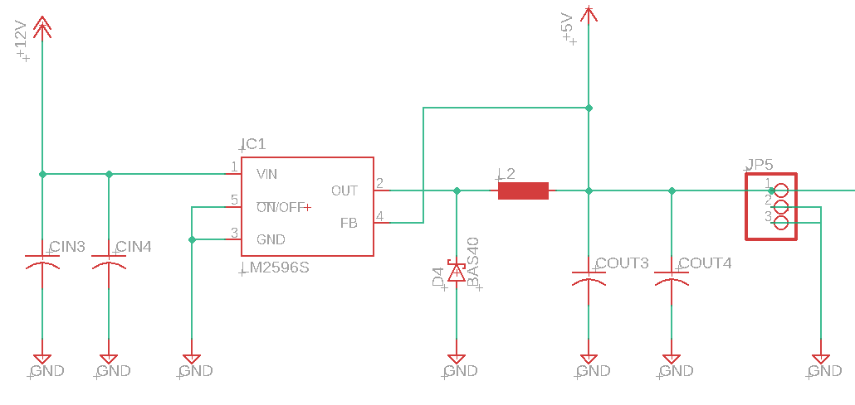
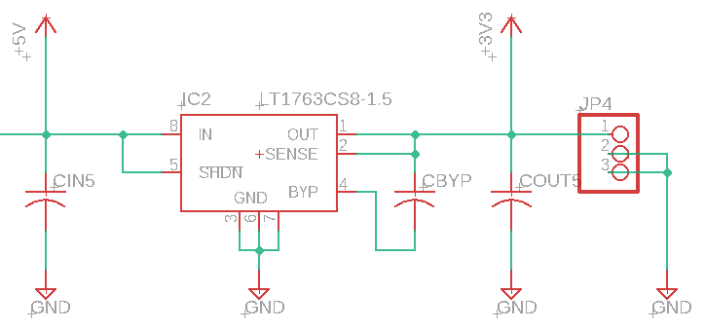
5V Buck Converter
LM2596
Team is familiar with IC, low external component count
Only need buck functionality since input is +12V
3.3V Voltage Regulator
LT1763 Low Dropout Regulator
82.5% efficiency for only $5 per unit
Notes:
CHRIS

Slide 33
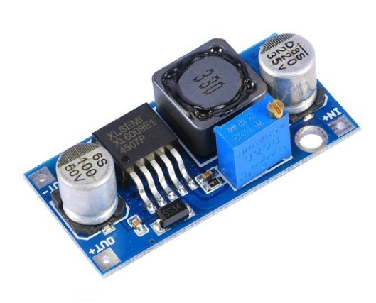
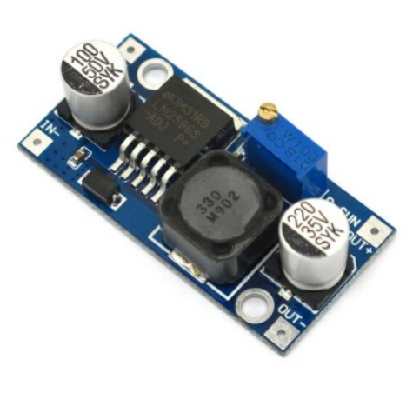
XL6009 (Boost) LM2596 (Buck)

Slide 34
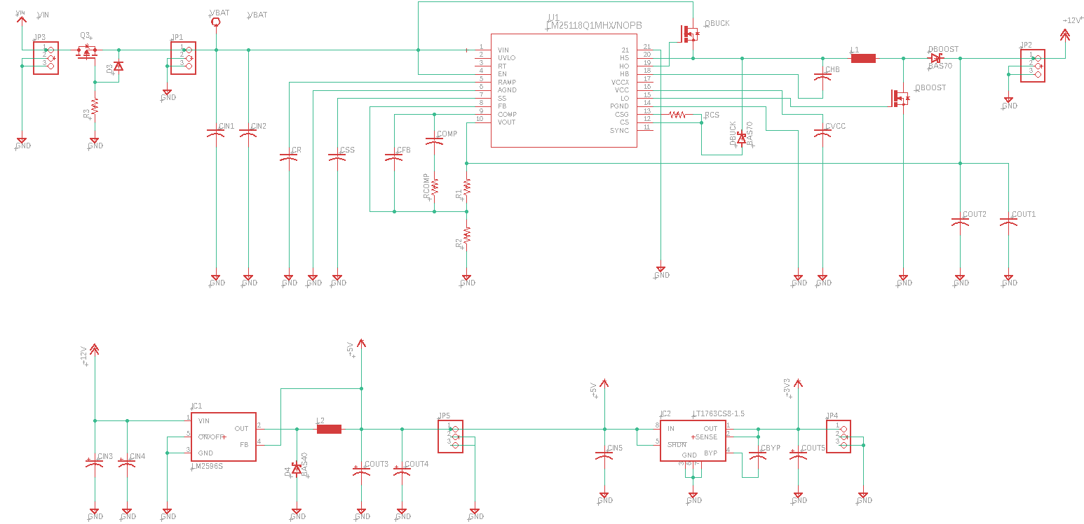
Voltage Regulator PCB Schematic
Notes:
CHRIS

Slide 35
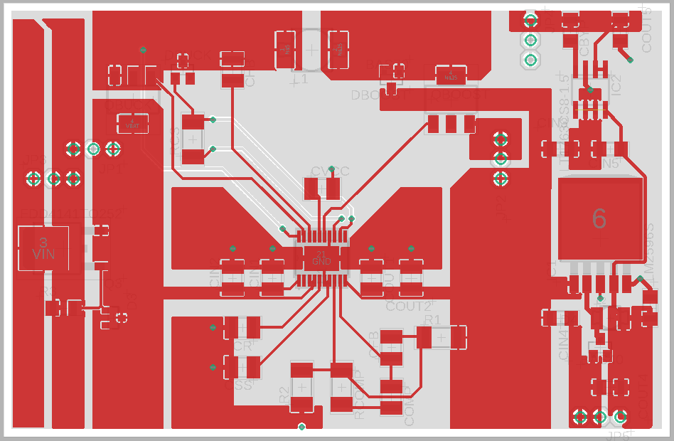
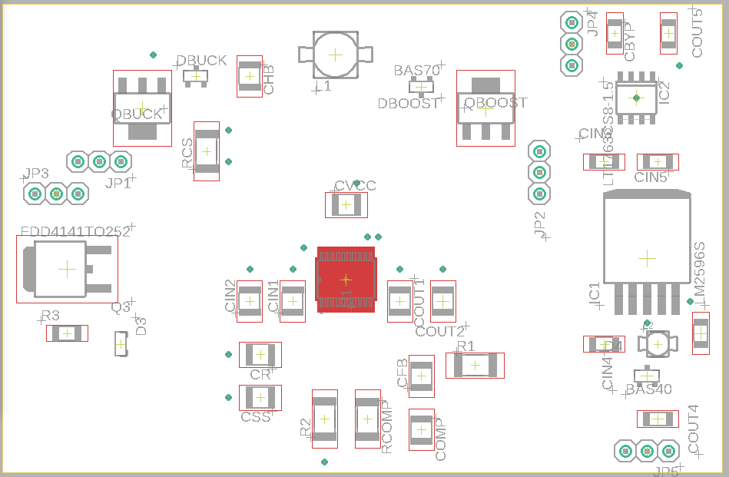
Voltage Regulator PCB Layout
Notes:
CHRIS

Slide 36
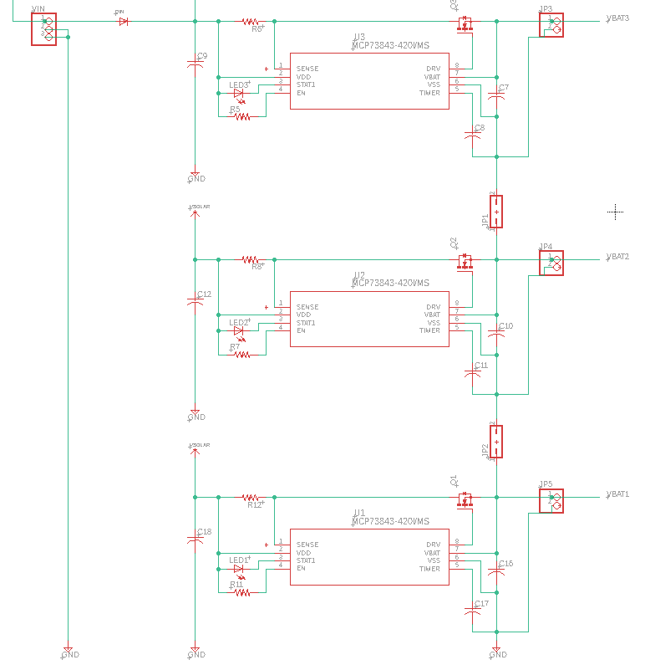
Battery Management PCB Schematic
Notes:
CHRIS

Slide 37
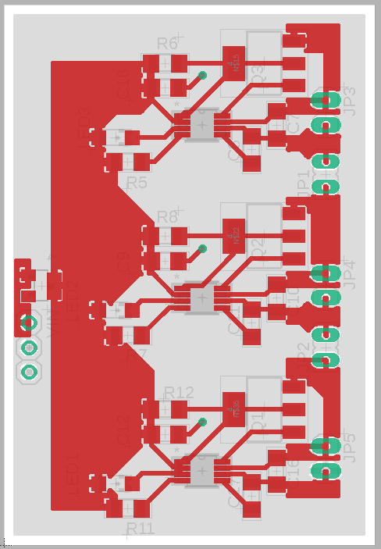
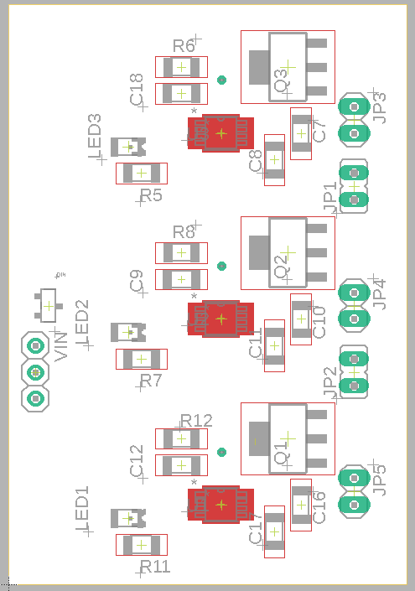
Battery Management PCB Layout
Notes:
CHRIS

Slide 38
SOFTWARE
Notes:
Lauren
Now we are going to dive more into the software side of our project, highlighting different aspects for both the firmware and IOS application

Slide 39
Firmware Basics
The basics of the main code is based around three different interrupts
  UART Receive Complete
  Timer Interrupt
  External Interrupt
Bluetooth commands to change thresholds
Sensor measurements are recorded every 30 seconds
  Requires I2C, ADC, External Interrupts
  Follow the logic for the measurements
Notes:
Lauren
The base of the firmware code is around 3 interrupts
UART Receive Complete
Timer Inteerupt
And External Interrupts for polling a sensor
The UART Rx C is used for new bluetooth commands to change threshold values or the roof status
When a new Bluetooth command is sent, an interrupt is executed to read in the command and any sub command that could follow
The timer interrupt is used to poll the sensors for new measurements to see the current weather conditions every 30 seconds, the sensors use different protocols to record the measurements, and one of the sensors uses an external interrupt
Once new measurements are recorded the values are put through a logic flow to determine if action needs to be taken

Slide 40
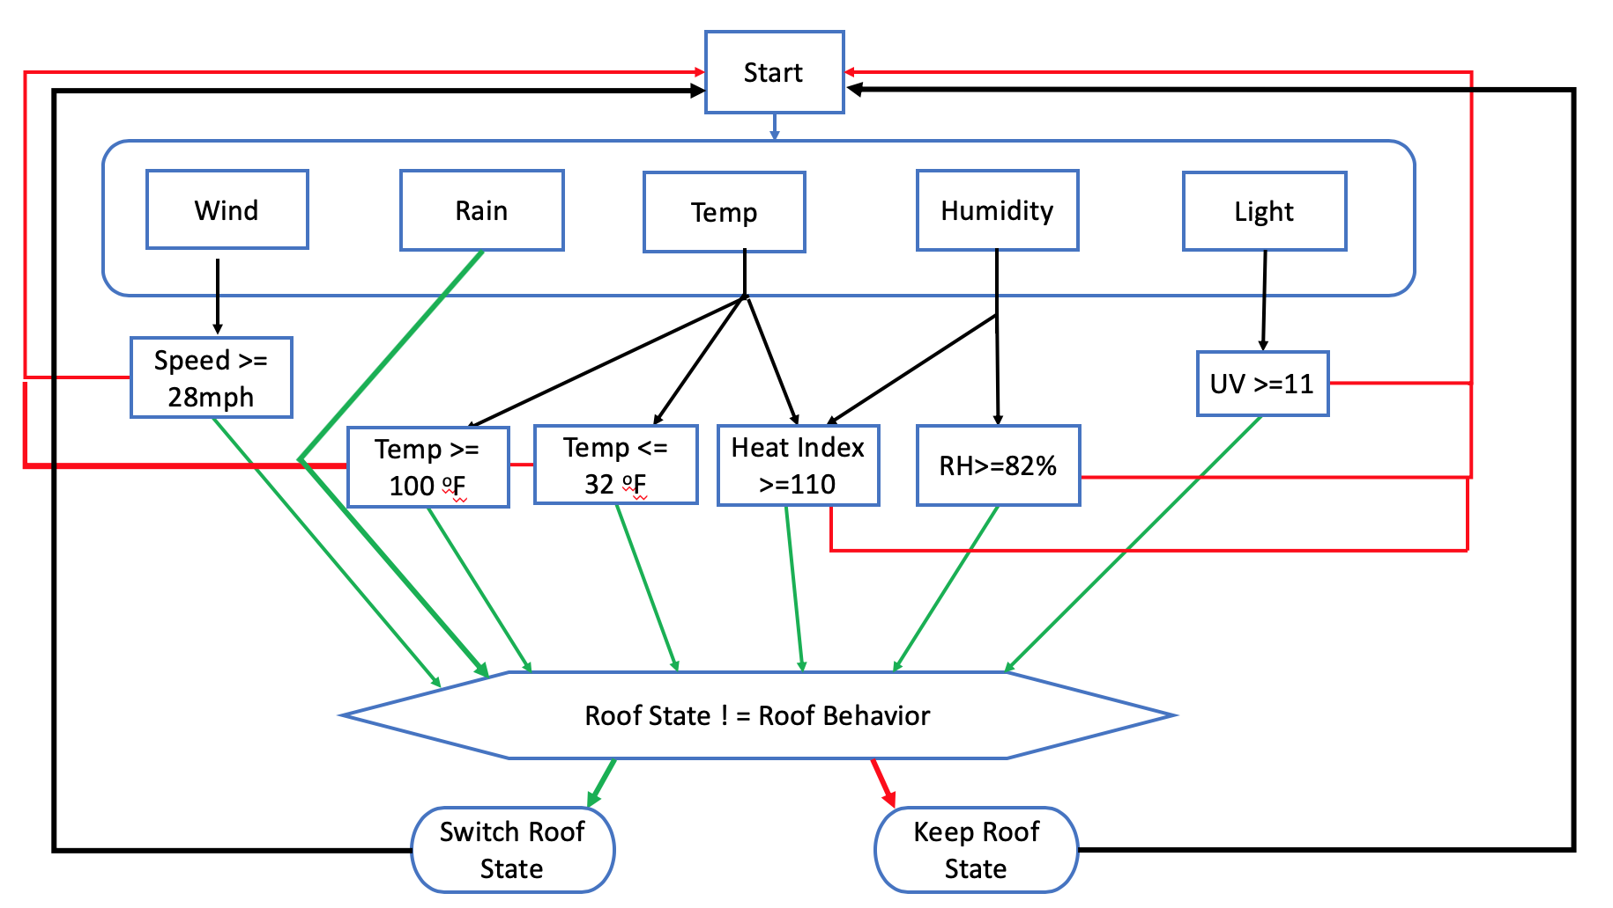
Software Block Diagram
Notes:
LAUREN
This is the high level overview of the software logic implemented in our project
Includes a lot of conditionals to find out if certain inclement weather is active
Some measurements are used for multiple conditions and states, such as temperature it is used for both maximum and minimum temperature alone with relative humidity.
If inclement weather is sensed, the current roof state (open or closed) is checked, and if the desired behavior is different then the roof will open or close based

Slide 41
Sensor Algorithms
Default values for the extremes for each sensor, these can be changed during each kits set up
Values for each kit are stored within a table in the database, with the unique kit id
Measurement/Condition | Value | Unit
Windy | 28 | Miles per Hour
Raining | NA | NA
Temperature (Maximum) | 100 | Degrees Fahrenheit
Temperature (Minimum) | 32 | Degrees Fahrenheit
Relative Humidity | 82 | %
Heat Index | 110 | Degrees Fahrenheit
Barometric Pressure | 101.325 | KiloPascals
UV | 11 | UV Index
Notes:
Lauren (Start)
The values for the if conditionals are based off the sensor thresholds
We have chosen these default values to for the thresholds based off of research from the National weather service and average measurements for averages in here in FL
These can be changed during the initial set up of the sensor kit by the user and throughout operation in the IOS application
Values for each kit are stored within a table in the database with the uinque kit id

Slide 42
Sensor Algorithms Continued
Most values come directly from sensor measurements, however heat index and pressure extremes comes from unique equations based on other measurements/characteristics
Heat index is calculated from both relative humidity and temperature:
Heat Index = 42.379 + 2.04901523 ∙T + 10.1433127 ∙RH - 0.22475541 ∙T ∙RH - 0.00683783 ∙T²- 0.05481717 ∙RH²+ 0.0012287 ∙T²∙RH ∙0.00085282 ∙T ∙RH²- 0.00000199 ∙T²∙RH²
Notes:
LAUREN
Most of the weather conditions' measurements come straight from the sensors, but some weather conditions require a sensor's measurement to be used in a calculation. As you can see Heat Index, which is important for the amount of time and exertion a human can spend outside, is calculated using both temperature and relative humidity.
This equation is hardcoded as used a function to determine new heat index levels when new temperature and humidity measurements are recorded

Slide 43
Sensor Measurements
Sensor measurements recorded via I2C:
  Humidity
  UV Index
Sensor measurements recorded via ADC:
  Temperature
  Rain
Sensor measurement recorded via External Interrupt:
  Wind
Notes:
LAUREN
To obtain each sensor measurement during the 30 second interrupt we use a mixture of I2C commnication, ADC, and external interrupts to poll the sensors. The Humidity sensor and the light sensor for UV communicate via I2C. They are both initialized during the setup portion of the microntroller when it is first powered on. This allows us just send a single write command for a new measurement followed by the read command.
The temperature sensor and the rain sensor measurements are obtained via ADC. The reference voltage for the ADC is 3.3V
The wind speed is calculated based on the falling edge external interrupt. Wind is the only measurement that is not polled, as it just updates the value itself.
All the current measurements are stored in a strucutre, whenever new measurements are polled they are added to another strucuter that is the average measurement strcuture that sent to the iOS application via bluetooth when a new bluetooth connection is made

Slide 44
Roof Algorithm/Behaviors
Default actions will be in response to the measurements/conditions the sensors report, along with the data that will be pulled in from the Weather API
Default behaviors can be changed during kit set up
Depends on structure type
Measurement/Condition Changes | Roof Behavior for Pool Structure | Roof Behavior for Greenhouse Structure
Windy | Close | Close
Raining | Close | Open
Temperature (Maximum) | Open | Open
Temperature (Minimum) | Close | Close
Relative Humidity | Close | Open
Heat Index | Close | Close
Barometric Pressure | Close | Open
UV | Close | Open
Notes:
Lauren
Whenever inclement weather is sensed, whatever action that the roof needs to take will be based off of the defined roof behaviors. Just like the sensor defined values, these behaviors can be changed during the initial setup and throughout the roof's operation in the IOS application. Different structure types care about different weather conditions, so here are two example of default values for different strucutre types. For example, a structure over a pool would probably want the roof to closed when it is raining, but a roof over a greenhouse may want to be open to allow for the extra rain fall on the plants

Slide 45
Bluetooth Commands
The main data that is sent to the microcontroller are the new thresholds for the sensor measurements along with the main open and close command for the roof.
Each command is formatted in similar fashion, but all commands start with a single character to represent the sensor the new threshold is for, or the command to change the status of the roof.
Command Character | Decimal Value | Hexadecimal Value | Sensor/Threshold or Command | Command Format
W | 87 | 0x57 | Wind | [0xXX , 0xXX , 0x2E , 0xXX , 0xXX , 0x(4F/43) ]
U | 85 | 0x55 | UV Index | [0xXX , 0xXX , 0x2E , 0xXX , 0xXX , 0x(4F/43) ]
L | 76 | 0x4C | Temperature Min | [0xXX , 0xXX , 0x2E , 0xXX , 0xXX , 0x(4F/43) ]
H | 72 | 0x48 | Temperature Max | [0xXX , 0xXX , 0x2E , 0xXX , 0xXX , 0x(4F/43) ]
R | 82 | 0x52 | Rain Sensor | [ 0x(4F/43) ]
S | 83 | 0x53 | Open/Close | N/A
Notes:
Lauren
o communicate between the iOS application and the microcontroller specific commands are sent via Bluetooth. The main data that is sent to the microcontroller are the new thresholds and behavior for the sensor measurements along with the main open and close command for the roof. Each command is formatted in similar fashion, but all commands start with a single character to represent the sensor the new threshold is for, or the command to change the status of the roof.
For commands that change new threshold values the starting character is followed by four sub commands representing the float value itself, with the whole number, the decimal point, and the decimal value of the threshold. The value is converted from the four int vlaues back to a float on the microcontroller side. The sixth sub command is the representation of the roof behavior for the given threshold. The value is either “C” or “O”, representing closed or open.
One of these commmands is sent whenever a threshold or behavior is set in the app and the phone is connected to the controller
The rain sensor is slightly unique compared to the other sensors as it does not have a threshold, only a boolean if it is raining or not raining. For the rain sensor, only the roof behavior command can be changed for the preference of the roof when it is raining.
The only other command sent to the microcontroller is the open and close roof command. This command is denoted by the character “S’. And it is not followed by any sub commands

Slide 46

IOS Application
Swift Based Application
Capabilities:
  Open/close roof
  Change default attributes
  Modify accesses and such based on account permissions
  Access weather metrics collected by system
Notes:
Ron :
Summarize powerpoint above

Slide 47
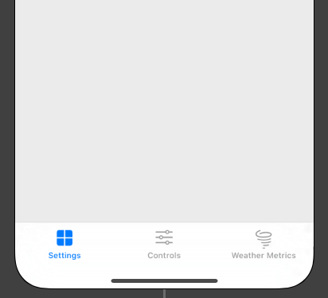
IOS Application GUI
The application will begin with a login screen
Authentication leads to tab-based interface
Views
  Login
  Settings
    User Authorizations
    Roof Settings
  Controls
  Weather Metrics
Notes:
RON

Slide 48
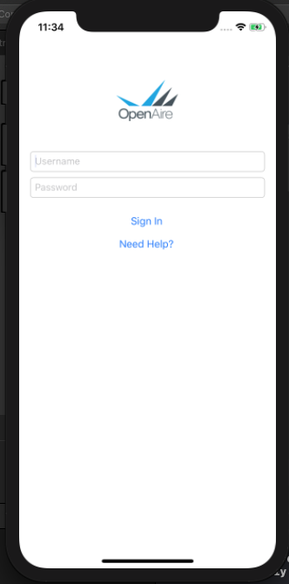
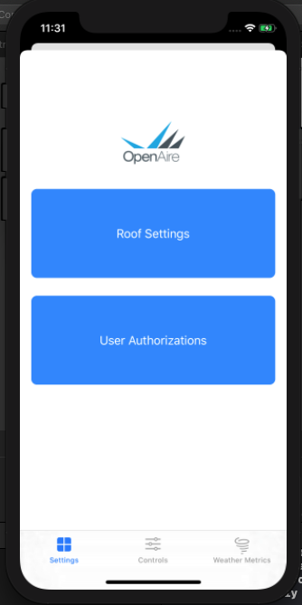
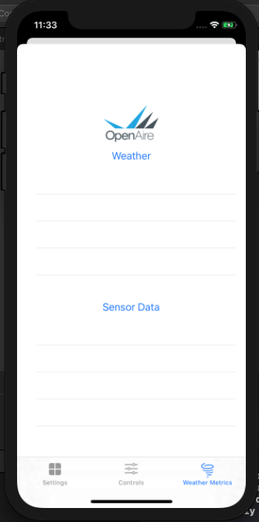
IOS Application GUI
Notes:
Ron:
Mention 3D touch

Slide 49
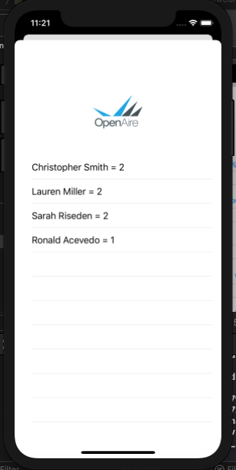
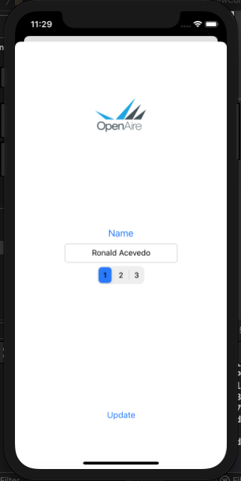
iOS Application GUI
Notes:
RON

Slide 50
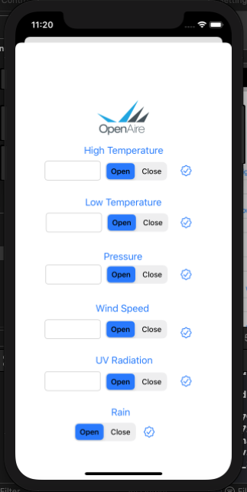
iOS Application GUI

Slide 51
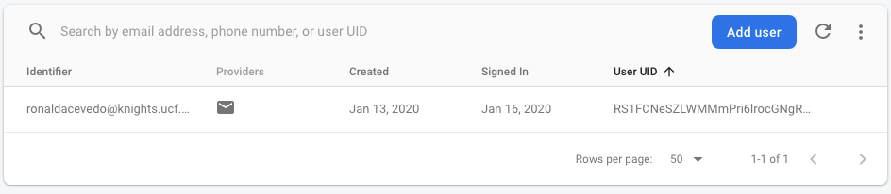
IOS Application security
Email and Password based authentication
  Credentials provided by OpenAire
  ‘Firebase SDK Authentication’ based
Notes:
Ron

Slide 52

Weather API
Utilizing a weather API to give user additional information in order to make decisions on roof behavior
Required data from API: temperature, windspeed, precipitation probability, lightning strikes, and weather warnings
Increases system's reliability and functionality
Dark Sky API
  Allows limited free calls
Polling of the API will take place in Google Firebase’s cloud function hosting platform, which will then be inserted into the database for the application to pull from
Notes:
RON

Slide 53
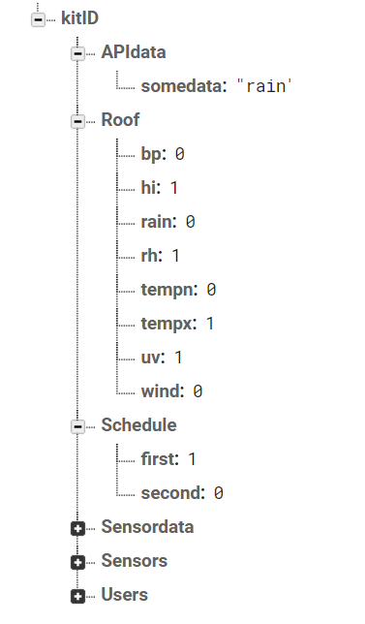
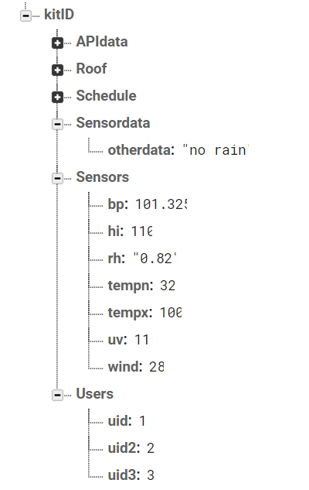
Database
Google's Firebase
Google's test lab and real time hosting and debugging
Firebase uses JSON pairs rather than the normal tables found in regular database
Main branch is off of the Kit identification number
Notes:
Lauren
To hold all the user settings and weather predicition and collected measurement data for each kit, we are implementing a database. Specifically we are suing google's firebase. We chose firebase because of its easy connecting to swift applications. You also get a ton of buillt in storage and security features from google
6 main json token pairs that will be used to hold all the data for each sensor system.
Users – hold hard coded kit ID number and the unique customer user id
Permissions - different user ids and and permissions for each for a given kit
Preferences – holds all the defined sensor values we talked about earlier
Behaviors – all the roof behaviors that are defined for each kit
Sensors Collection – average data collected by the sensors for each kit
API Predictions – collected API polled data for predicitons for a given kit

Slide 54
Administration
Notes:
Sarah (Start)

Slide 55
Group Roles
Job | Christopher S. | Lauren M. | Ron A. | Sarah R.
Sensor Module | S |  |  | P
Motor Module |  |  | P | S
Solar Panel | P |  |  | S
Batteries/Battery Management | P |  |  | S
Voltage Regulation | P |  |  | S
Mechanical Design | S | S | P | P
iOS Application |  | S | P
Sensor Algorithms |  | P | S
Bluetooth |  | P | S
Database |  | P | S
Weather API |  | P | S
Administrative |  | S |  | P
Notes:
SARAH
Group roles: sarah and chris mostly hardware. Ron and lauren mostly software

Slide 56
Milestones
IOS Application Front-End interface finalized
Database tables finalized
All active components and modules ordered and tested
PCBs soldered and tested
Final design implemented
Hardware Progress: 100%
Software Progress: 100%
Overall Completion: 100%
Notes:
Chris

Slide 57
Finances and Budget
The members of this group would like to thank our sponsor, Open Aire, for inspiring and funding this project. Special thanks to Deborah Baker and Donie Riseden for coordinating with us throughout the duration of this project.
Notes:
Sarah

Slide 58
Module | Item | Qty | Item Price | Cost Estimate
Microcontroller | Microcontroller | 2 | 50 | 100
Power | Power Module | 1 | 20 | 20
 | Battery Management System | 1 | 20 | 20
 | PV panels | 2 | 15 | 30
Sensors | Temperature Sensor | 1 | 10 | 10
 | Barometric Pressure Sensor | 1 | 50 | 50
 | Pressure Plate Sensor | 1 | 15 | 15
 | Humidity Sensor | 1 | 25 | 25
 | Anemometer (Wind speedometer) | 1 | 50 | 50
 | Adaptive light sensor | 1 | 10 | 10
Wireless | Wi-Fi Module | 1 | 20 | 20
 | Bluetooth Module | 1 | 20 | 20
Peripherals and Drivers | Motor Driver | 1 | 10 | 10
 | Fan Driver | 1 | 10 | 10
 | Stepper Motor | 1 | 20 | 20
 | Fan | 1 | 10 | 10
Miscellaneous | Miscellaneous Passives | 1 | 50 | 50
 | PCB Design and Fabrication | 5 | 5 | 25
 | Glass Tinting | 1 | 100 | 100
 | Waterproof Enclosure | 1 | 200 | 200
Total Cost |  |  |  | $735
Notes:
SARAH
Budget was an estimated $1000, spent a little over $1200, received $2000. Parts selection was based soley on being able to stay within budget, but with COVID-19 we had to switch some of our designs and buy new parts and extra supplies such as two voltmeteres

Slide 59
Issues and Concerns
Anemometer was initially delayed and did not receive it until late February
Initial delay on funds
COVID-19 pandemic causing major requirement and design changes
  Lack of lab resources such as oscilliscope prevented a lot of necessary debugging which resulted in having to remove the barometric pressure sensor from implementation
Notes:
Lauren

Slide 60
References
[a] ZF Electronics, “Magnetic Proximity Sensors (Hall Effect),” MP1021 datahseet, June 2017.
[b] Jacksking, “Jacksking Anemometer, 360 12V-24V DC Pulse Signal Output Aluminum Alloyed Wind Speed Direction Sensor Measurement Tool,” B07SN1V427, Oct. 2019.
[c] Sensirion “Datasheet SHT-85”, SHT-85 datasheet, 2017 [Revised July 2017]
[d] Little Fuse, “Leaded Thermistors”, PR103J2 datasheet, 2018 [Revised Feb. 26 2018]
[e] Texas Instruments, “OPT101 Monolithic Photodiode and Single-Supply Transimpedance Amplifier”, Opt101 datasheet, Jan. 1994 [Revised Jan. 2015]
[f] Vishay, “UVA Light Sensor With I2C Interface”, VEML6070 datasheet, 2019 [Revised Sept 12, 2019]
[g] ECO-Worthy, “Polycrystalline Solar Panels”, ECO-Worthy datasheet 2019
[h] Great Power, “Lithium Ion Battery”, PRT-13189 datasheet, July 7, 1028
[i] Microchip, “Advanced Single or Dual Cell Lithium-Ion/ Lithium-Polymer Charge Management Controllers”, MCP73842 datahseet, 2013
[j] Texas Instruments, “LM25118 Wide Voltage Range Buck-Boost Controller”, LM25118 datasheet, July 2011 [Revised Mar. 2018]
[lk] Texas Instruments, “LM2596 SIMPLE SWITCHER® Power Converter 150-kHz 3-A Step-Down Voltage Regulator”, LM2596 datasheet, Nov. 1999 [Revised May 2016]
[l] Linear Technology, “500mA, Low Noise, LDO Micropower Regulators”, LT1763 datasheet, 2019
[m] Atmel, “8-bit Atmel Microcontroller with 16/32/64KB In-System Programmable Flash”, ATMEGA 1280 datasheet, 2014
[n] Texas Instruments, "CC2460 SimpleLink Bluetooth Wireless MCU", CC2460 datasheet, 2015 [Revised June 2017]
Notes:
CHRIS OR RON IDC

Slide 61
Questions?
Notes:
CHRIS TEAM LEADER FINISH STRONG

