Slide 1

ROBOTIC SOLAR FARM GRASS CUTTING SYSTEM DESIGN CHALLENGE (EGOAT)
Daniel Corbellini, EE
Tyler Bradley, EE
Joseph Morelli, EE
Nathaniel McKain, CpE
Team 23, Gold Team
Sponsors: Orlando Utilities Commission (OUC) and Duke Energy

Slide 2




MOTIVATION
Cheaper alternative for solar farm landscape maintenance
Demonstrate knowledge gain from years of studying engineering
Project provides the opportunity to work with engineers of other disciplines
Wanted to have work experience with an autonomous project

Slide 3




PROBLEMS
Expenses from paying workers to cut the grass around and under the solar panels
No need to use chemicals to kill grass directly under the panels
We don’t need goats...
More consistent maintenance of the landscape rather than monthly

Slide 4






GOALS AND OBJECTIVES
Main goal was to design and build an autonomous rover-based robot to guide electric weed whackers
Object detection using input sensor
Return to sender
Efficient power supply
Precision, to cut as close to pillars of solar panels
As cost efficient as possible

Slide 5
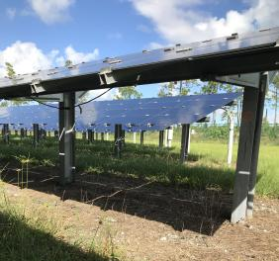
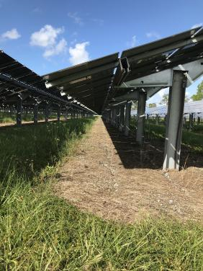
PICTURES OF COURSE

Slide 6
COMPETITION REQUIREMENTS
Navigation and Mobility
  Needs to be able to move autonomously
  The ability to traverse over uneven terrain.
Speed and Accuracy
  Needs to move fast enough to cut a 50’x10’ area of grass in 15 minutes
  Cut grass at a uniform height

Slide 7
ELECTRICAL SPECIFICATIONS
Component | Parameter | Design Specification
Battery | Discharge | 1hr
Remote Kill Switch | Distance | 50ft
Kill switch | Quick acting | < 1 second
Drive Controller | Speed | ~2mph
GPS | Location | 10ft
Fencing | Perimeter | 50x10ft

Slide 8
MECHANICAL SPECIFICATIONS
Component | Parameter | Design Specification
Dimensions | Size | 24x24x20in
Trimmer | Material | String based
Trimmer | Grass Length | 3 to 6in
Notes:
Joseph

Slide 9
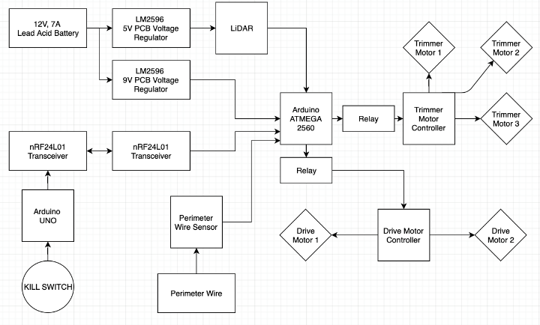
OVERALL CONTROL SYSTEM DESIGN
Blue: Daniel
Red: Nathan
Green: Tyler
Gold: Joseph
Notes:
Joseph

Slide 10
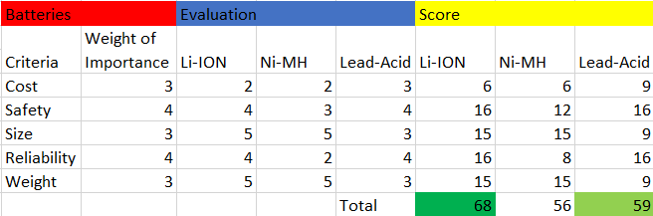
Battery Comparison
Lithium ION battery has highest score
Lead-Acid second highest score
Used both types

Slide 11
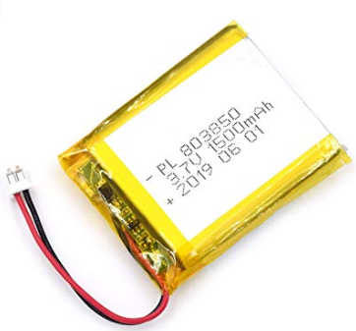
Lithium-Ion
High energy density
High charge efficiency
3.7 V
1500mAh
Height: 7 mm
Length: 60 mm
Width: 36 mm
Powers the remote kill switch

Slide 12
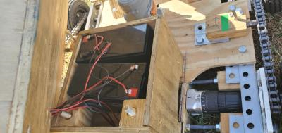
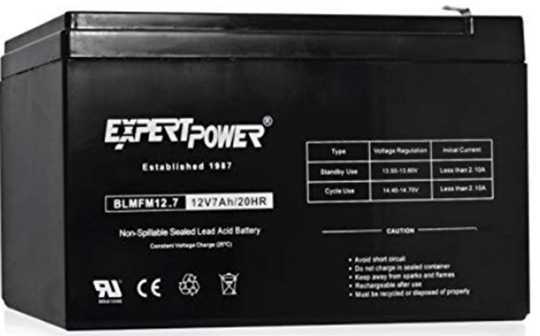
Lead-Acid
Large power-to-weight ratio
Low cost
12 V
7 Ah
Height: 3.7 inches
Length: 5.9 inches
Width: 2.5 inches
Powers the drive motors one battery per motor

Slide 13
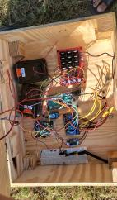
TRIMMER BATTERY
Batteries that came with the store bought weed whackers
One powers the trimmers
Other powers the electronics.
20 V /battery
1.5 Ah /battery

Slide 14
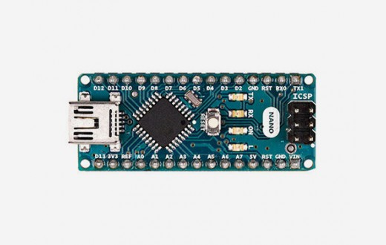
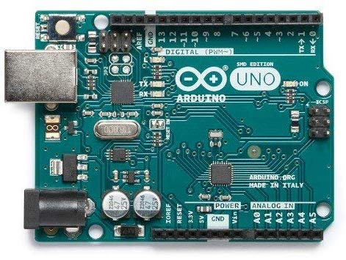
PROCESSOR
Arduino Nano
Clock speed 16MHz
Operating Voltage 5V
Input Voltage 7-12V
22 digital input/output pins
SPI support
Arduino Uno
32 KB Flash memory
Clock Speed 16Mhz
14 digital Input/output pins
SPI support

Slide 15
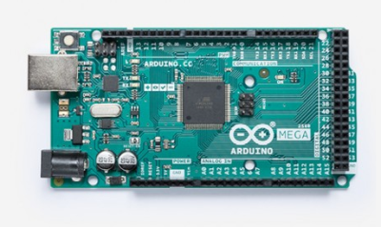
PROCESSOR
Arduino Mega 2560
256 KB Flash Memory
Clock speed 16MHz
Operating Voltage 5V
Input Voltage 7-12V
54 digital input/output pins

Slide 16
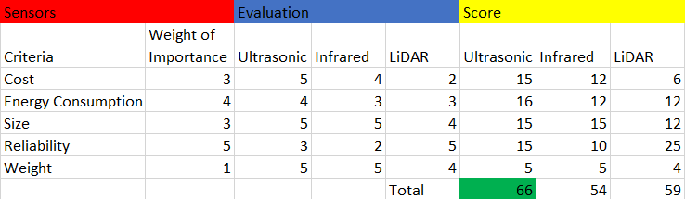
Sensor Comparison
Larger the number the better the product is in that category

Slide 17

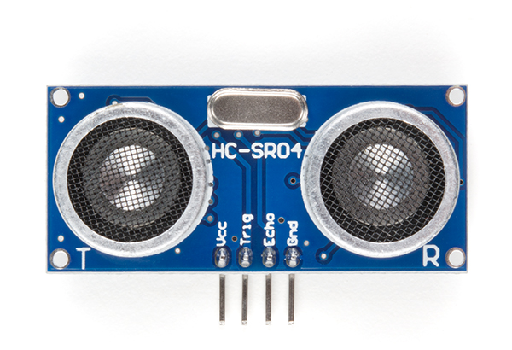
SENSORS
RPLidar A1M8
360 degree omnidirectional laser scanner
12 meter range
8000 times sample rate
Configurable Scan Rate from 2-10Hz
Ultrasonic HC-SR04
4 meter range
Positioned on top of servo

Slide 18
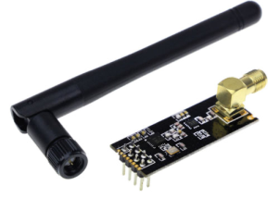
COMMUNICATION
nRF24L01+-RF 2.4GHz Wireless Transceiver Module
Max operating speed 2Mbps
Built-in CRC error detection
Optional add-on voltage regulator for more stability
Low power (1.9-3.6V), only 1uA on Power-down mode

Slide 19
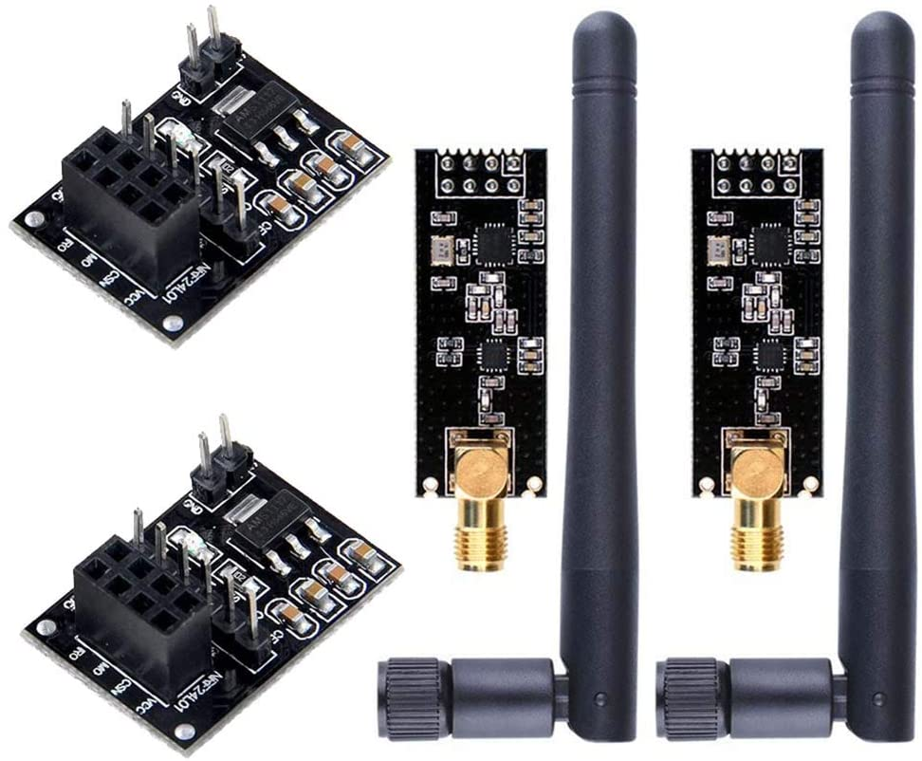
WHY WE CHOSE nRF24L01+
Easy to use
Low power consumption
High Range
Small and compact

Slide 20
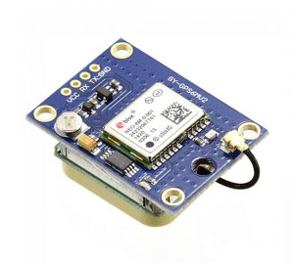
GPS
NEO-6M GPS Module
On board memory chip
Backup battery
Integrates with a broad range of microcontrollers
Cost effective

Slide 21

FENCING
Perimeter around entire course to ensure we stay in bounds
Wire Generator – 555 Timer based circuit to a desired frequency
Frequency Sensor – LC tank circuit will resonate with generated frequency
Multiple sensors around eGoat
Signal detection will allow us to calculate orientation or wire
Notes:
Audio Clip - 1:32

Slide 22
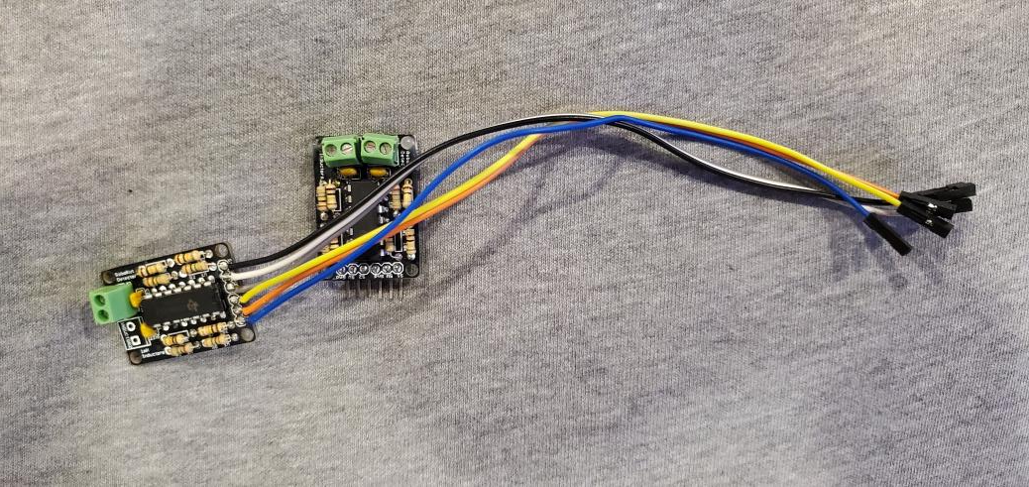
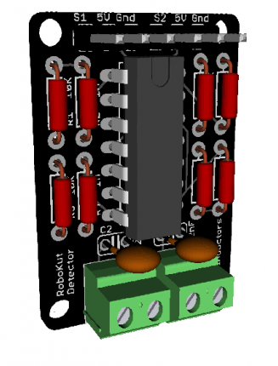
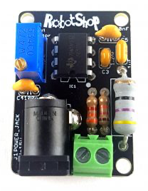
FENCING
Generator Board
Sensor
Board
Soldered
Boards
Notes:
Audio Clip 0:55

Slide 23
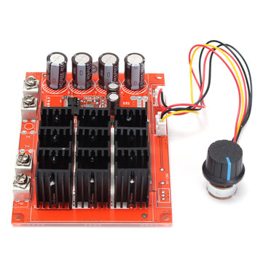
DRIVE MOTOR CONTROLLER
10-50V 60A DC Motor Speed Control PWM
Easily Compatible with 4 channel relay
3000W Limit
Modified to be interfaced with an Arduino
Notes:
Audio Clip - 0:55

Slide 24
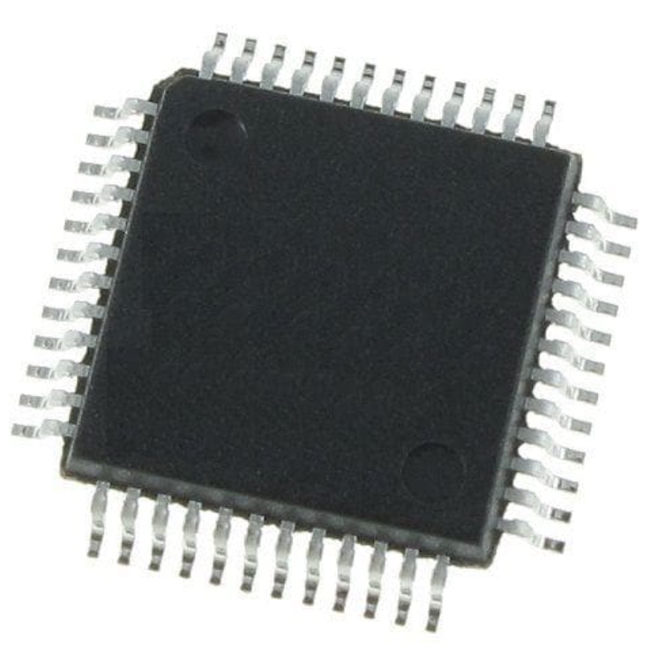
STM32
72 MHz frequency performance
128 Kbytes of Flash memory
26 I/O pins
9 communication interfaces
Low power mode
Notes:
Audio Clip - 0:44

Slide 25
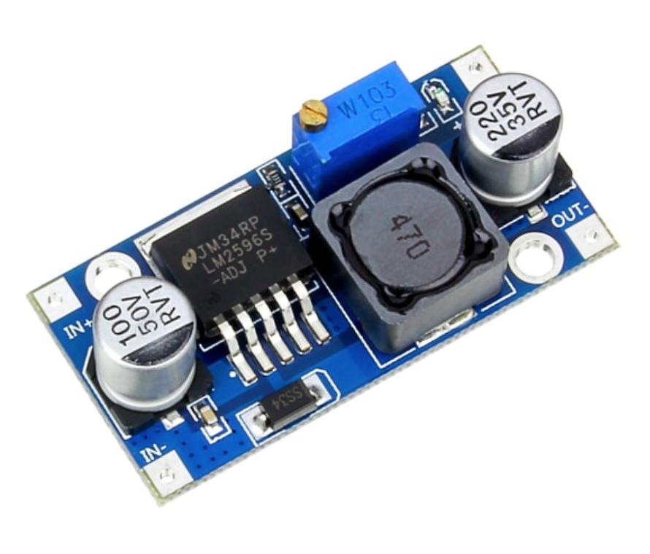
LM2596
Switching voltage regulator
High current load with adjustable output voltage
Highly efficient and simple
Thermal shutdown and current limit protection
Notes:
Audio Clip - 0:33

Slide 26
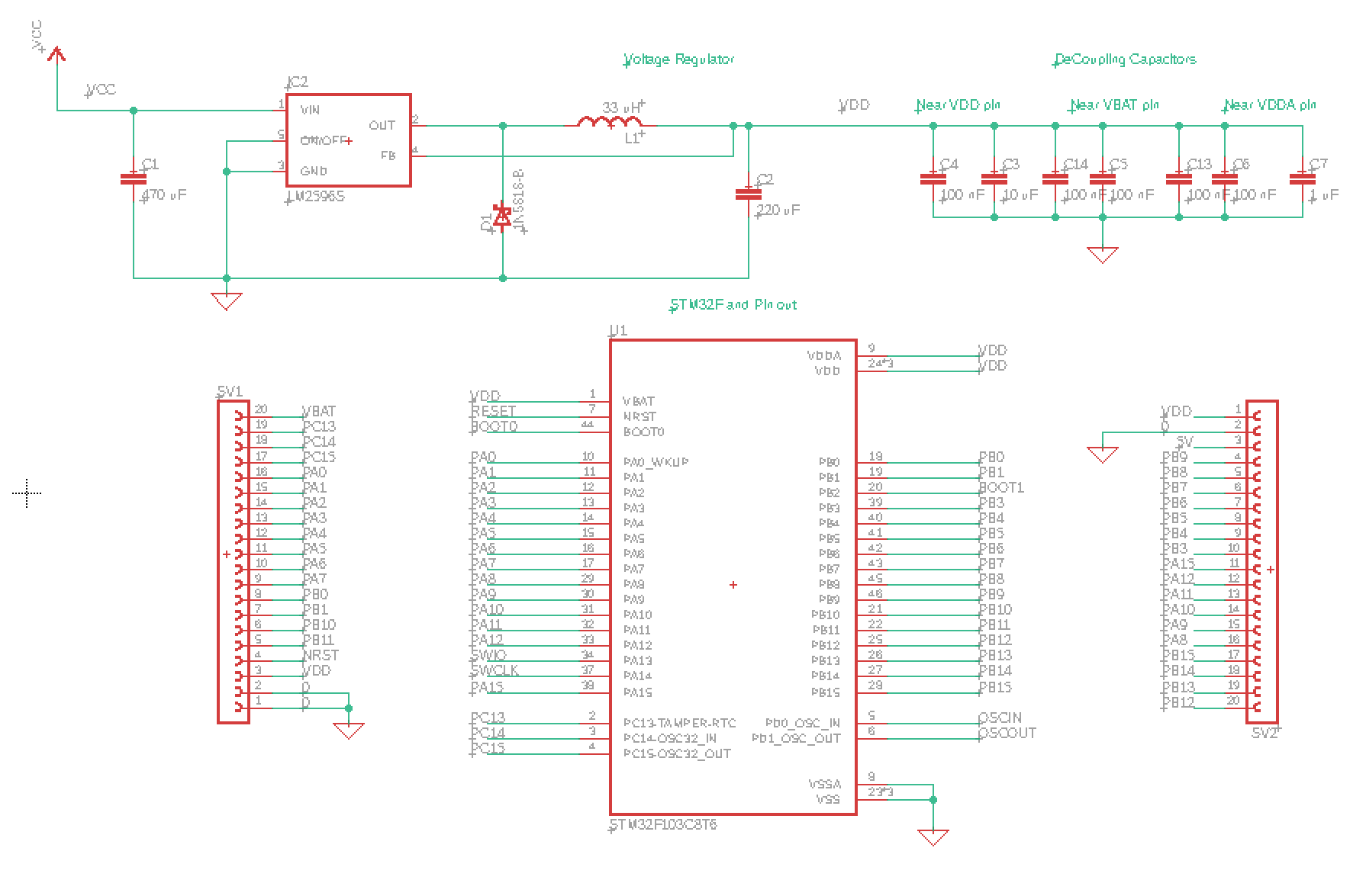
PCB SCHEMATIC
Notes:
Audio Clip - 0:40

Slide 27
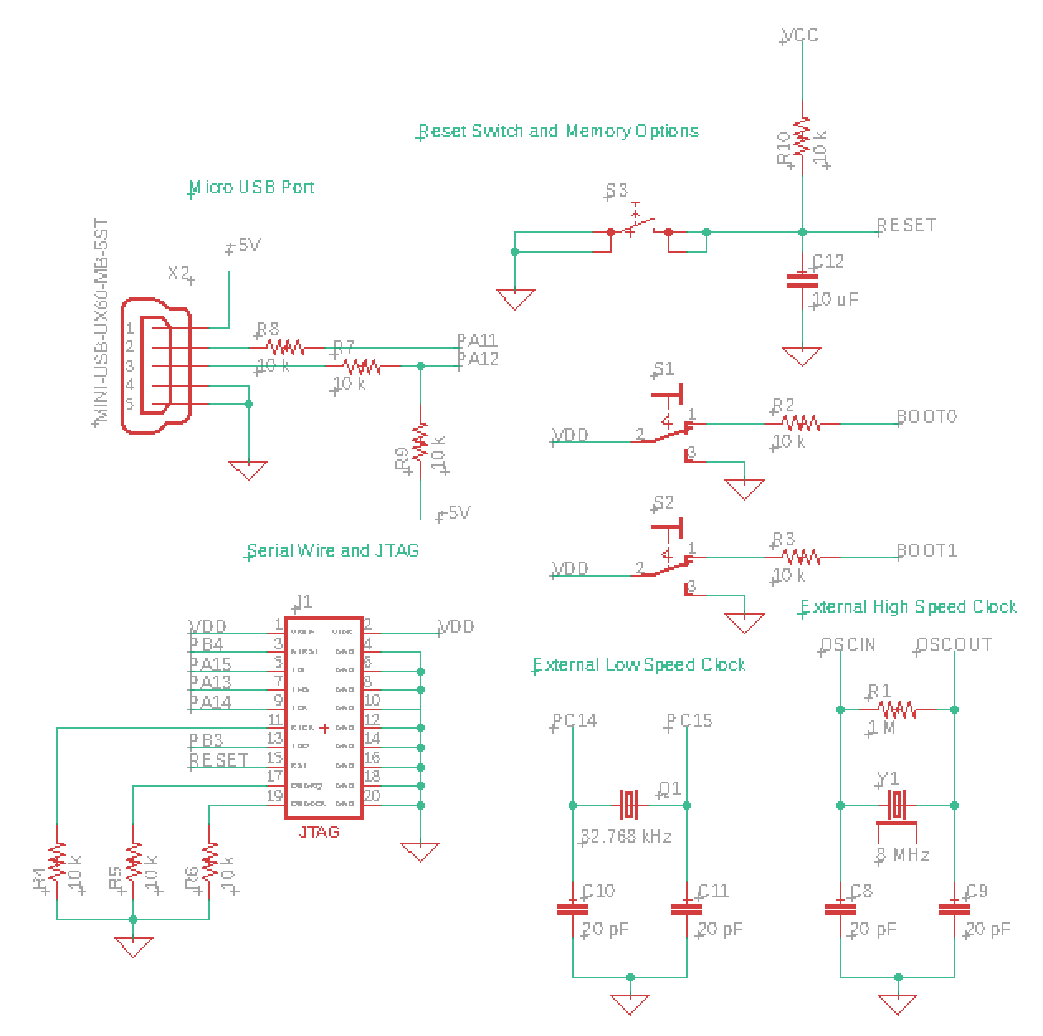
PCB SCHEMATIC
Notes:
Audio Clip 1:04

Slide 28
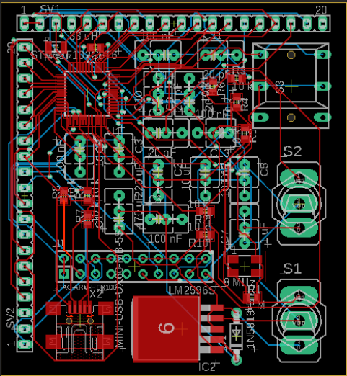
PCB LAYOUT
Notes:
Audio Clip - 0:44

Slide 29
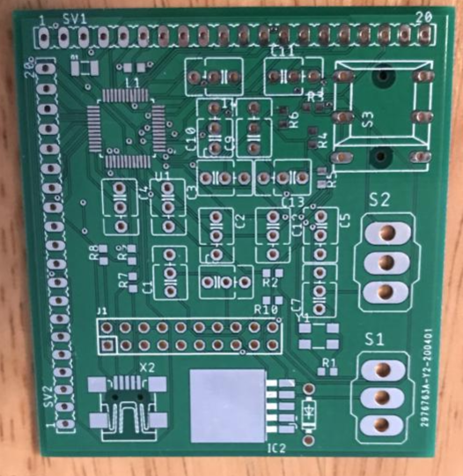
PCB LAYOUT
Notes:
Audio Clip 0:26

Slide 30
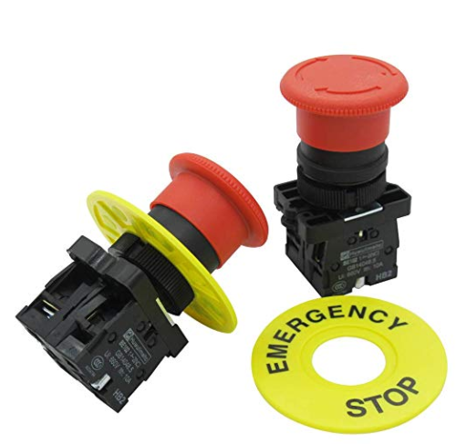
SAFETY FEATURES
Kill switch on robot and RF kill switch
On board kill switches are Red Mushroom Emergency Stop Push Button Switch
Required to have both types of switches by employers
Kill switch on robot needs to be easily accessible
Perimeter fencing

Slide 31
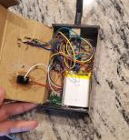
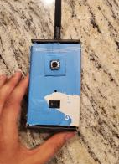
REMOTE KILL SWITCH
The remote kill switch activates in less than .1 seconds
Uses the Arduino Nano
Powered by the 3.7V Lithium-Ion battery
nRF24L01 transceiver
Battery capacity sensor
On/Off switch for remote and kill switch toggle button
Can be recharged with a microUSB

Slide 32
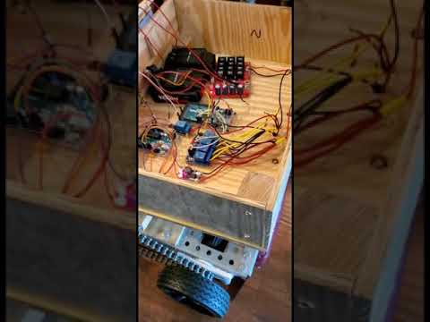
Kill Switch Demo

Slide 33
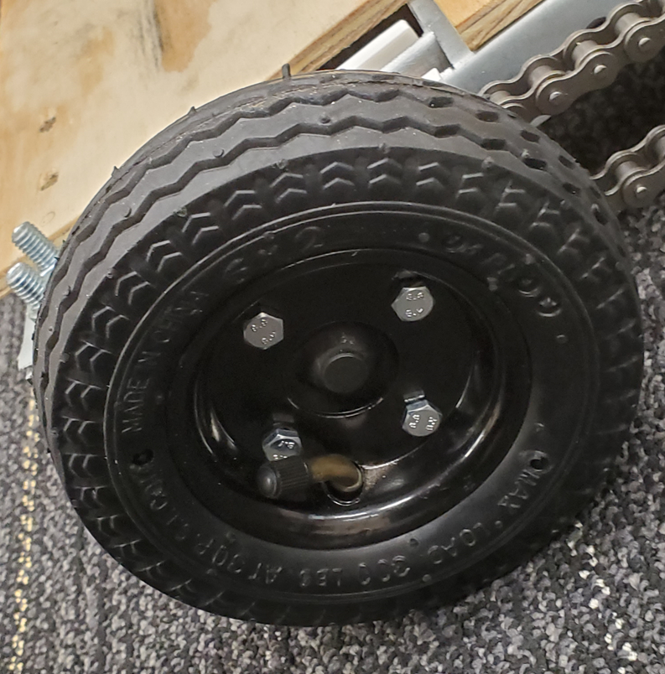
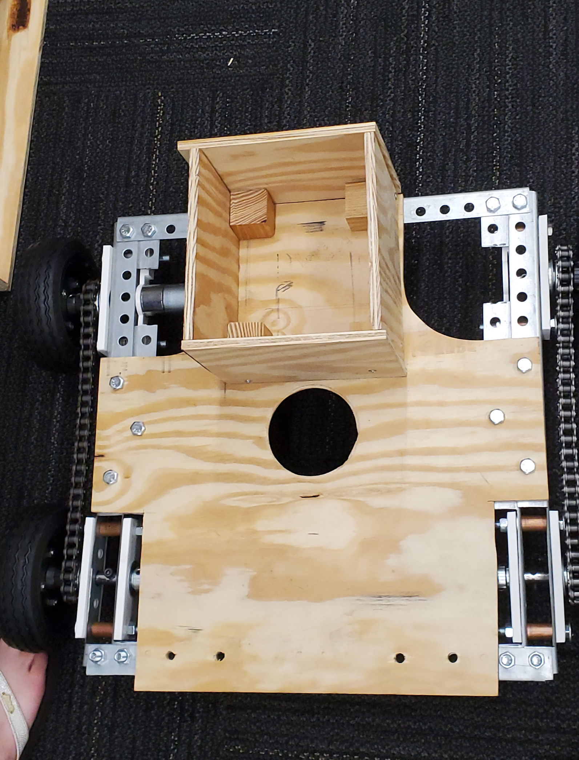
MECHANICAL OVERVIEW
Frame made out of aluminum
Plywood used for surface structures
3 Trimmers- 2 in the front, one in the middle
Small box is for batteries
Large Box houses the electronics
4-Wheels, 6in diameter
Each side connected with a chain.
Treaded rubber wheels

Slide 34
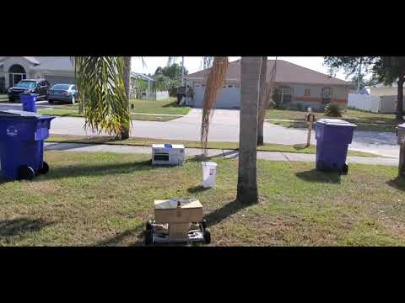
Demo of turning and obstacle avoidance

Slide 35
BUDGET
Item | Quantity | Unit Price | Total Price
Arduino Mega 25600 R3 | 1 | $38.50 | $38.50
Arduino Uno R3 | 1 | $22.00 | $22.00
Arduino Motor Shield R3 | 1 | $22.00 | $22.00
Emergency Stop Button | 1 | $11.99 | $11.99
3.7V Li-Ion battery | 2 | $7.99 | $15.58
12V 7Ah Lead-Acid Battery | 2 | $17.75 | $35.50
DC-DC Voltage Regulator | 1 | $5.99 | $5.99
Transceiver Module | 1 | $9.99 | $9.99
DC Motor Controller | 1 | $34.95 | $34.95
GPS Module | 1 | $16.99 | $16.99
RPLiDAR | 1 | $99.99 | $99.99
Total Electronic |  |  | $313.48
Total Spent |  |  | $1,059.02

Slide 36
WORK DISTRIBUTION
Name | Power | Sensors | Software | PCB
Daniel | P |  |  | S
Tyler |  |  | S | P
Joseph | S | P
Nathan |  | S | P

Slide 37
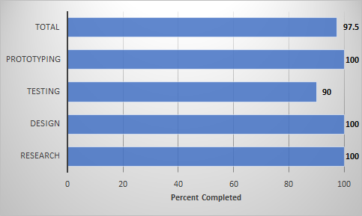
PROJECT PROGRESS

Slide 38
ISSUES
1
2
3
4
5
Interdisciplinary
PCB Design
Ordering Process
Late Start
Quarantine

Slide 39

QUESTIONS?

