Slide 1


Solar powered Water Filtration System
Group 24

Slide 2




Project Motivation
-Help underdeveloped countries
-Make a difference in someone’s life
-Decrease the number of deaths

Slide 3
Goals and Objectives
Create a simple, efficient water filtration system with low power consumption
    -Solar panels
Make it portable
  -Small in size and lightweight
Build an Android app
  -Shows sensors data (pH, turbidity, and
  temperature)

Slide 4
Component | Design Specification
Case | < 5 lbs
Solar Panels (4) | Open: 34.4 x 9.6 x 0.1 in Folded: 7.6 x 9.6 x 0.8 in Weight: 1.7 lbs
Solar Panels Output | 19.8 W
Microcontroller | 2.7 in X 2.1 in
Water precision | ± 5 degrees Fahrenheit
Water tank | At least ½ a gallon of H20
Water pump | 4 L/min
Water pump | < 12V to power save on battery power
UV lamp | < 12 W
Bluetooth | < 6V
Specifications

Slide 5

Block Diagram
Sediment Filter
Pre-Carbon Filter
Solar Panels
UF Filtration Membrane
Battery
Water Pump
Water Flow Sensor
Water Flow Sensor
Purified Water Outlet
UV - Chamber
pH/Temperature Sensor
MCU
MCU
Power
Turbidity Sensor
MicroSD Card Module
Filtration System
Peripherals
LCD Display
Bluetooth Transmitter

Slide 6
Filtration System
Sediment Filter
Pre-Carbon Filter
Solar Panels
UF Filtration Membrane
Battery
Water Pump
Water Flow Sensor
Water Flow Sensor
Purified Water Outlet
UV - Chamber
pH/Temperature Sensor
MCU
MCU
Power
Turbidity Sensor
MicroSD Card Module
Filtration System
Peripherals
LCD Display
Bluetooth Transmitter

Slide 7
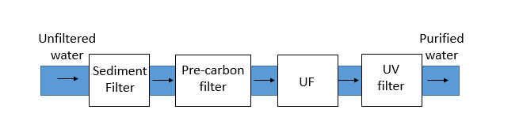
Water Filtration System
Consist in four different types of filters:
  Sediment filter
  Pre-carbon filter
  Ultrafiltration membrane
  Ultraviolet water purifier
Combination of these filters ensures purified water meets all required standards
For convenience of the user the filters selected have minimum lifetime of 12 months

Slide 8
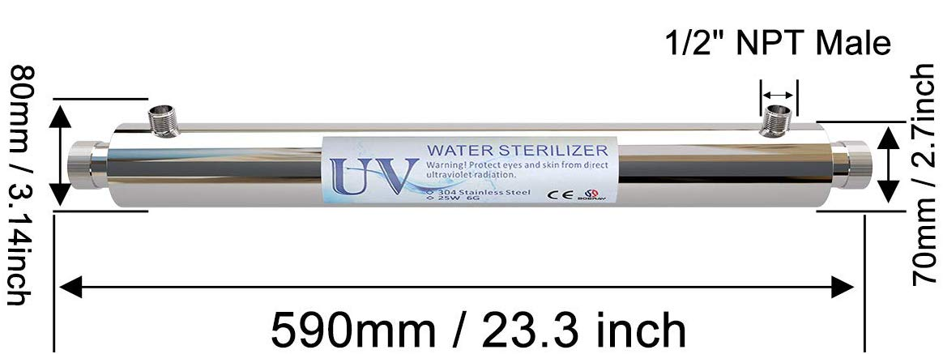
Ultraviolet filter
Selection criteria:
Large lifetime
Low power consumption
Cheap to reduce overall cost
Overall effectiveness
Ultraviolet water purifier | Size | Cost | Lifetime | Power consumption
Express Water – Ultraviolet Water Filter | 16 x 4.5 x 3.6 inches | $69.99 | 6 months | 12 W
Boeray Ultraviolet Light Water Purifier | 17.8 x 4.9 x 3.9 inches | $53.99 | 12 months | 6W

Slide 9
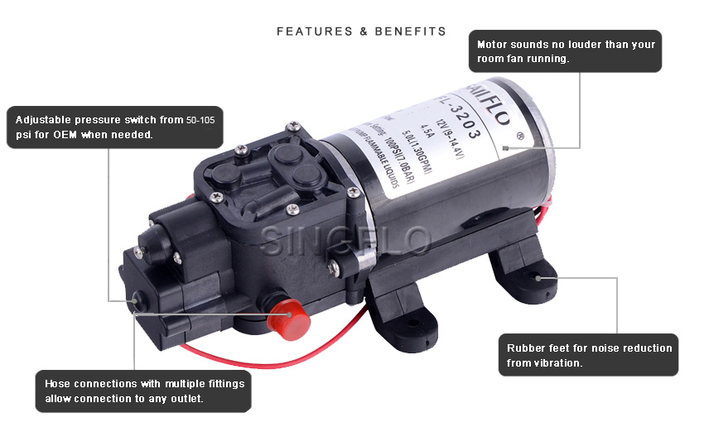
Water Pump
Comparison of 2 types of water Pump:
Transfer water pump easy to maintain, more efficient, large use of energy
Submersible water pump not portable, less efficient, conserve energy
Specifications:
Voltage: 6-12 volts
Current Drawn: 1.7 Amp
Liters per minute: 4.3 L/min
Cost: $16.48
17cm x 10cm x 67cm

Slide 10
MCU
Sediment Filter
Pre-Carbon Filter
Solar Panels
UF Filtration Membrane
Battery
Water Pump
Water Flow Sensor
Water Flow Sensor
Purified Water Outlet
UV - Chamber
pH/Temperature Sensor
MCU
MCU
Power
Turbidity Sensor
MicroSD Card Module
Filtration System
Peripherals
LCD Display
Bluetooth Transmitter

Slide 11
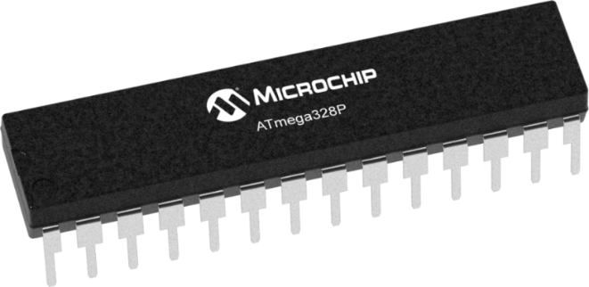
Microcontroller
 | ATSAMG51 | MSP430FR6989 | Atmega328P
Memory | 256 KB | 128 KB | 32 KB
RAM | 64 KB | 2 KB | 2 KB
Pin Size | 38 | 83 | 23
Communication Protocols | UART, I2C, SPI | UART, I2C, SPI | UART, I2C, SPI
Low-Power Mode | 103 uA/MHz | 101.25 uA/MHz | 0.75 uA/MHz
Selection Criteria:
Cheap to reduce overall cost
Enough number of pins for multiple peripherals
Low power consumption to optimize battery lifetime
Easy to mount on PCB
Compatibility with different types of sensors

Slide 12
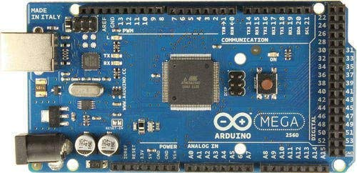
ATmega328p
• Arduino bootloader
• Compatible with multiple types of sensors
• Programmable in C
•Extensive list of hardware libraries
• Simple layout and easy to use
• Large support community
• Open source

Slide 13
Peripherals
Sediment Filter
Pre-Carbon Filter
Solar Panels
UF Filtration Membrane
Battery
Water Pump
Water Flow Sensor
Water Flow Sensor
Purified Water Outlet
UV - Chamber
pH/Temperature Sensor
MCU
MCU
Power
Turbidity Sensor
MicroSD Card Module
Filtration System
Peripherals
LCD Display
Bluetooth Transmitter

Slide 14
Wireless Technology Selection
In order for the microcontroller to send the information received from the sensors to a mobile device a wireless communication is needed
Selection criteria:
Easy to connect to devices
Low power consumption
No need of internet connection
Easier to implement in microcontroller environment
Connection | Power Consumption | Range | Interference | Bandwidth
Bluetooth | 100 mW | 10 meters | Minimum of 2.4 GHz | 1 Mb/s
Wi-Fi | 750 mW | 100 meters | 2.4 GHz -5 GHz | 54 Mb/s

Slide 15
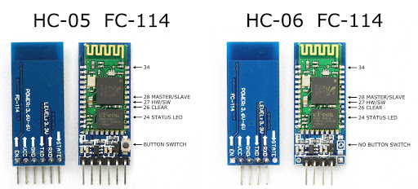
Bluetooth module comparison
 | HC-05 | HC-06
Dimension | 26.9mm x 13mm x 2.2 mm | 26.9mm x 13mm x 2.2 mm
Operating Voltage | +3.3V to +6V | +3.3V to +6V
Security | Authentication and encryption | Authentication and encryption
Operating temperature range | -20 ~ +75Centigrade | -20ºC to +55ºC
Bluetooth protocol | Bluetooth Specification v2.0 | Bluetooth V2.0 protocol standard
Pins | 6 | 4
Modes | Master or slave | Slave

Slide 16
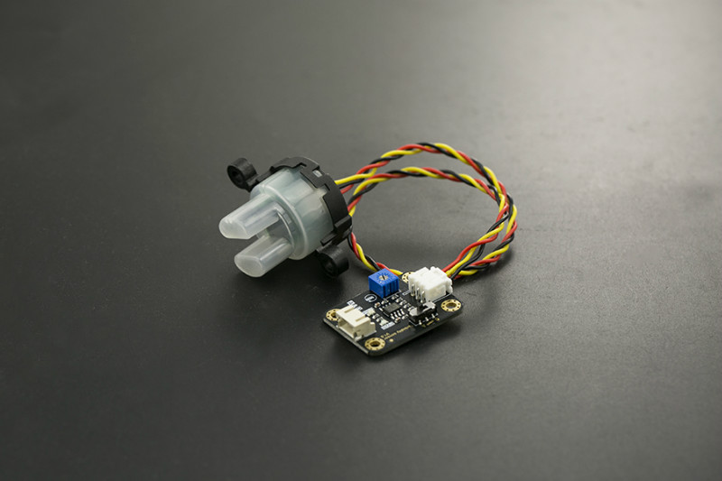
Turbidity Sensor
Selection Criteria:
Low power consumption
Low price
Turbidity Sensor Model | DFRobot Gravity SEN0189 | Thermometrics TSD - 10 | Thermometrics TSW – 10
Operating Voltage | 5V | 5V | 5V
Operating Current | 40mA (max) | 30mA (max) | 30mA (max)
Insulation Resistance | 100MΩ (min) | 100MΩ (min) | 100MΩ (min)
Operating Temperature | 5°C – 90°C | -10°C – 90°C | -30°C – 80°C
Storage Temperature | -10°C – 90°C | -20°C – 90°C | -10°C – 80°C

Slide 17
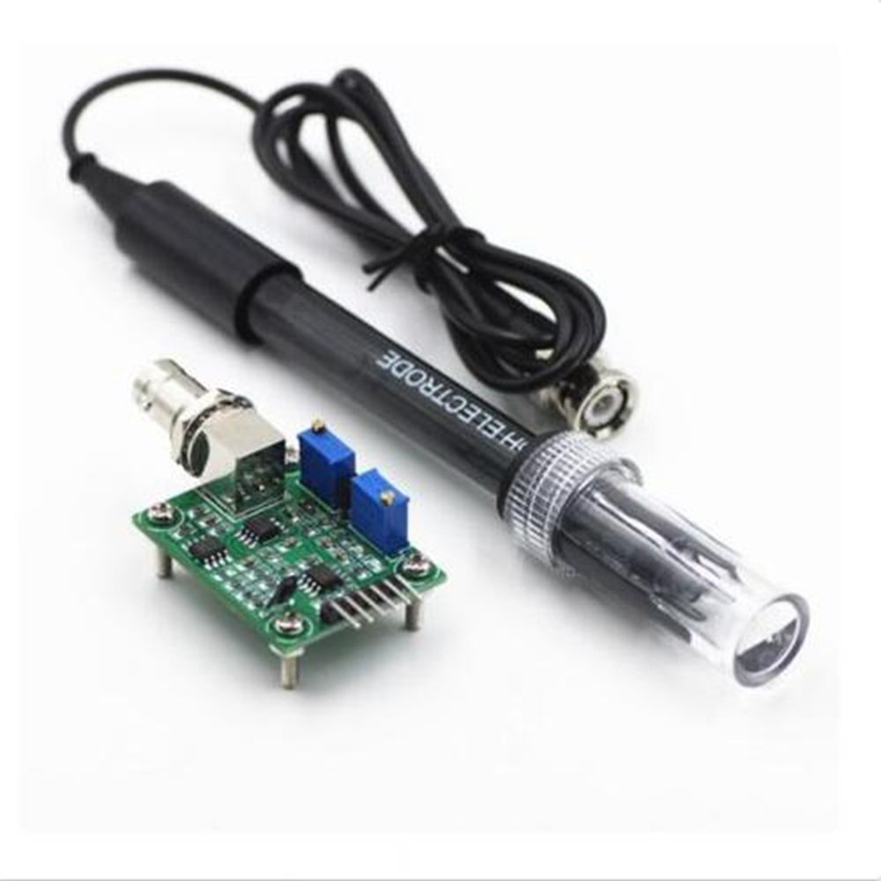
pH / Temperature Sensor
Selection Criteria:
Low power consumption
Low price
Waterproof
Wide temperature range
pH sensor model | pH Measuring Range | Temperature Measuring Range | Response Time | Waterproof | Operating Voltage
DFRobot Gravity SEN0161 | 0 – 14 pH | 0 – 60 ◦C | < 1 min | Only the tip | 5 V
DFRobot Gravity SEN0169 | 0 – 14 pH | 0 – 60 ◦C | < 1 min | Yes | 5 V
GAOHOU Probe BNC | 0 – 14 pH | 0 – 80 ◦C | < 6 sec | Yes | 5 V

Slide 18
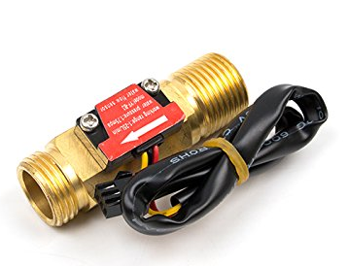
Water Flow Sensor
Selection Criteria:
Low power consumption
Low price
Durability
Water flow rate measuring capacity
Water flow sensor model | Water Flow Rate Measuring Range | Material | Working Temperature | Operating Voltage
Seeed Flow Sensor YF-B3 | 1 – 25 L/min | Cooper | < 120 ◦ C | 5 V
Seed M11 water flow sensor | 0.3 – 6 L/min | Plastic | < 80 ◦ C | 5 V
Seed G3/4 water flow sensor | 1 – 60 L/min | Plastic | < 80 ◦ C | 5 V

Slide 19
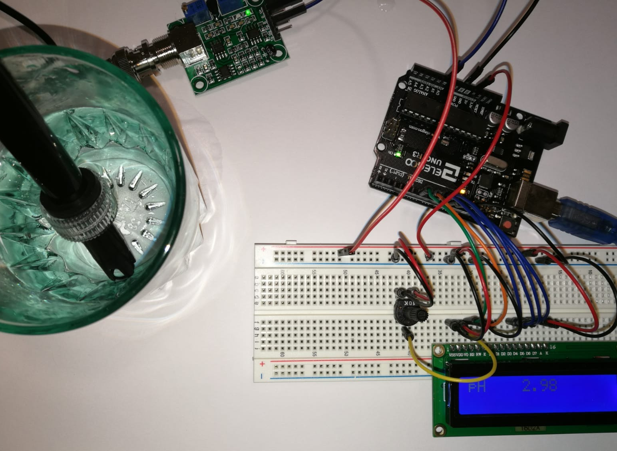
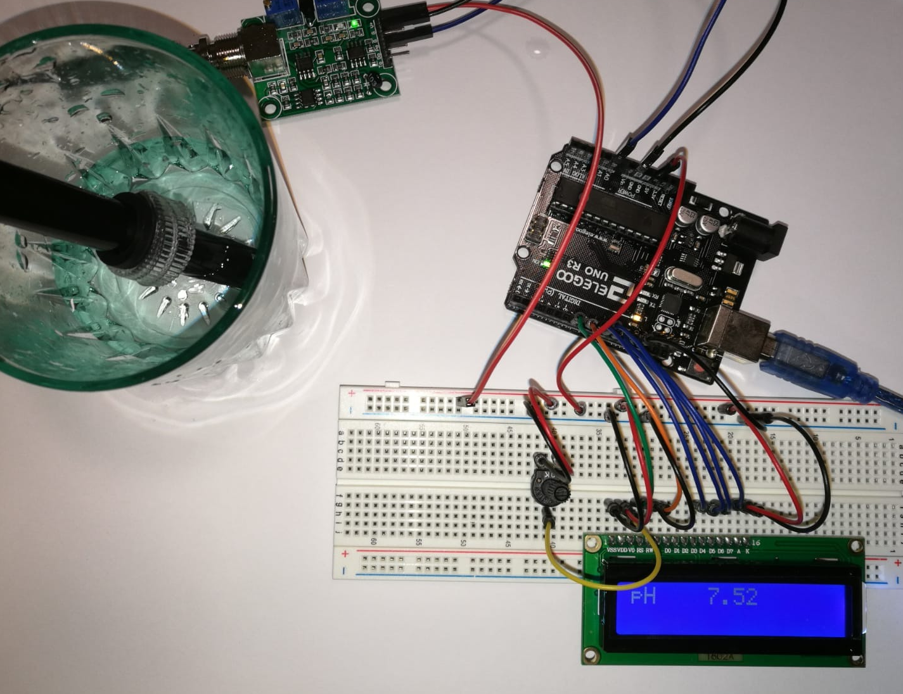
Sensor Testing
The pH sensor is tested by measuring the pH in liquids with know pH concentrations.
We used vinegar, distilled water and salted water for our tests.
Measured Subtance | pH Reading | Expected pH
Vinegar | 2.98 | 2.4-3.4
Distilled Water | 7.52 | 7
Salted Water | 8.53 | ~8

Slide 20
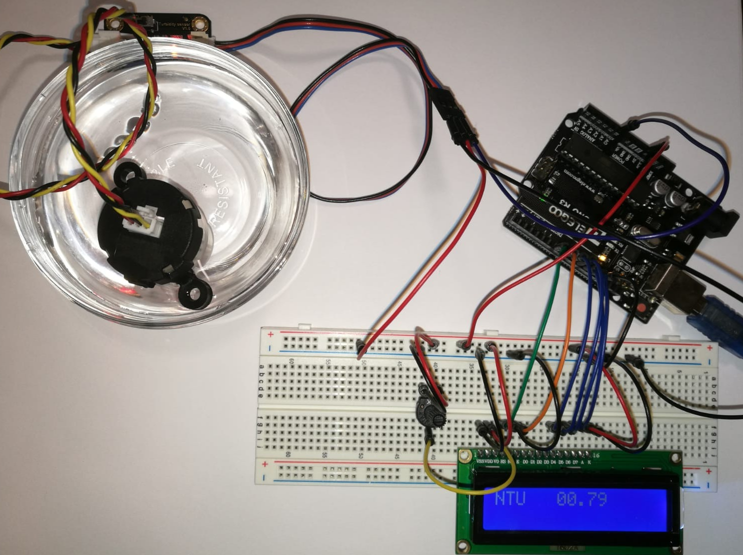
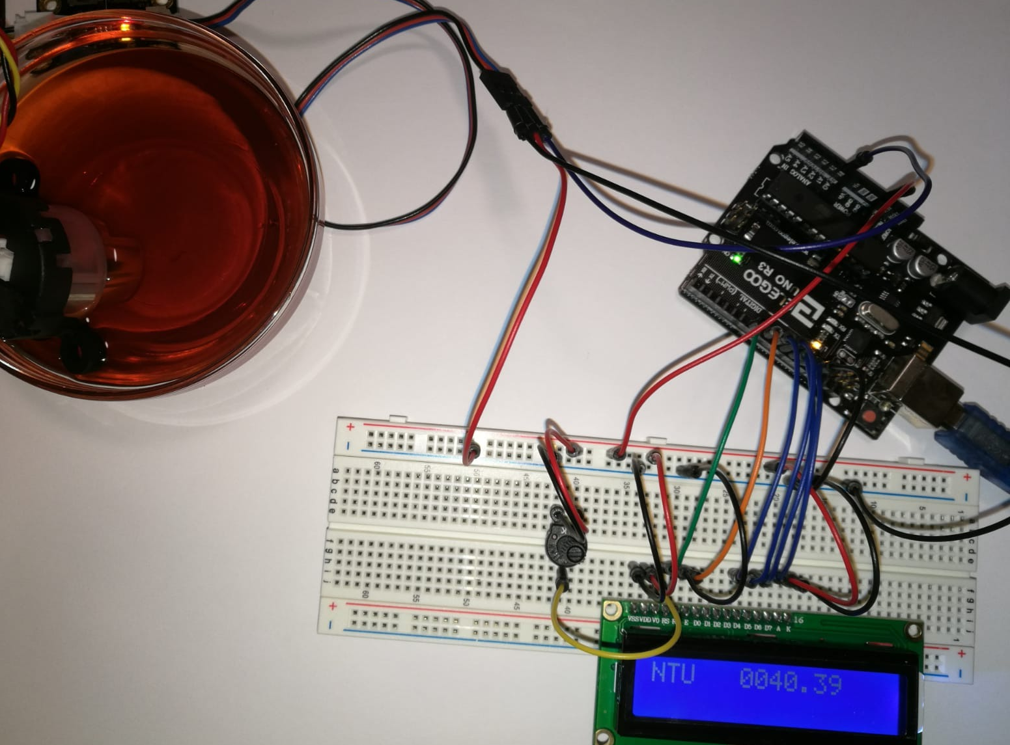
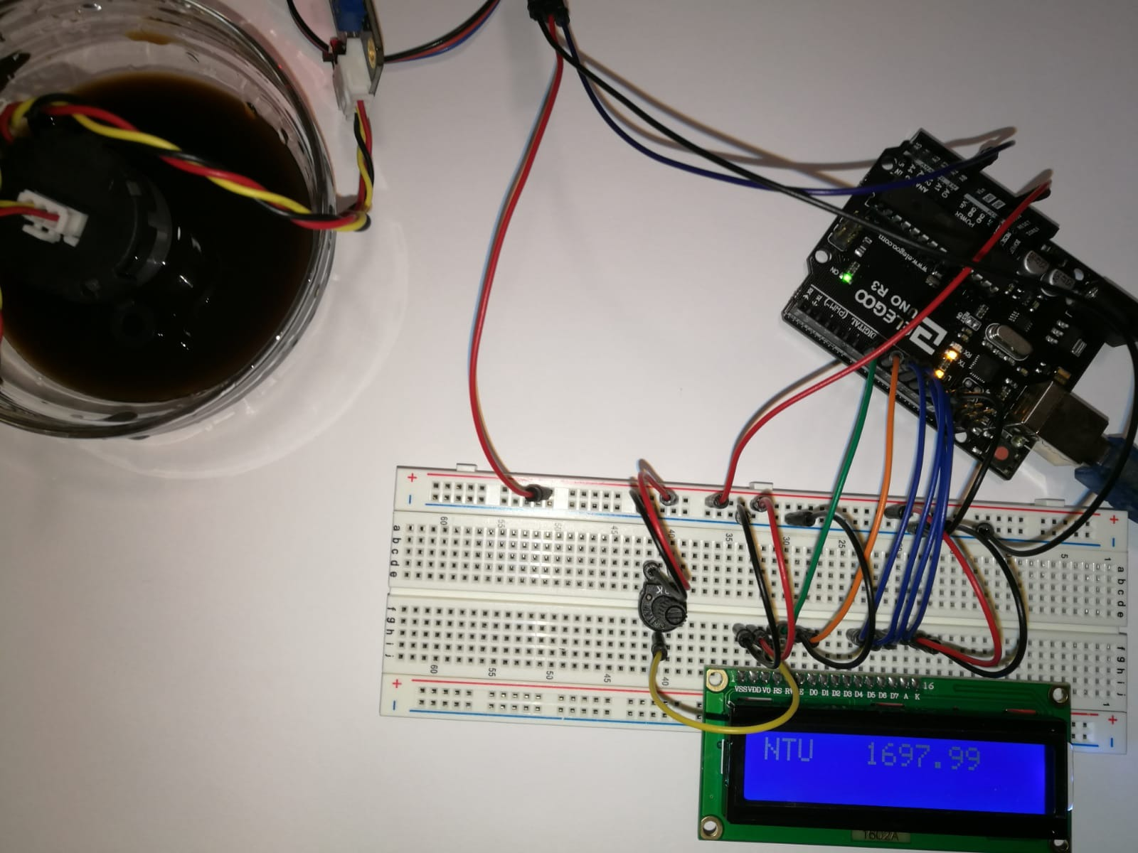
Sensor Testing
The turbidity sensor measures the amount of particles suspended in the water.
The unit for turbidity measurement is called NTU.
The higher amount of particles in the water, the higher the NTU value.
Subtance | Turbidity (NTU) Reading
Liquid #1 | 0.79
Liquid #2 | 40.39
Liquid #3 | 1697.99

Slide 21
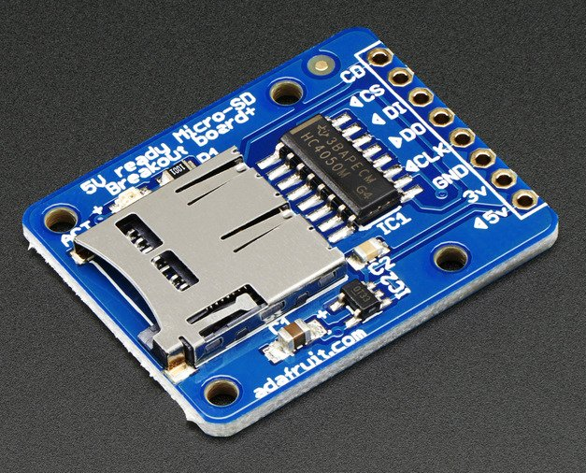
MicroSD Card Module
Adafruit MicroSD Card Breakout Board+
Onboard 5V → 3V regulator
Use 3 or 4 digital pins to read and write 2Gb+ of storage
Activity LED lights up when the SD card is being read or written

Slide 22
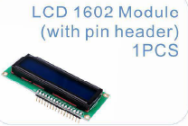
LCD Screen
LCD 16x02 screen module
System is designed so it can be operated without the application.
The LCD screen will display the readings from the sensors and alert the user in case there is a problem with the system.

Slide 23
Power
Sediment Filter
Pre-Carbon Filter
Solar Panels
UF Filtration Membrane
Battery
Water Pump
Water Flow Sensor
Water Flow Sensor
Purified Water Outlet
UV - Chamber
pH/Temperature Sensor
MCU
MCU
Power
Turbidity Sensor
MicroSD Card Module
Filtration System
Peripherals
LCD Display
Bluetooth Transmitter

Slide 24
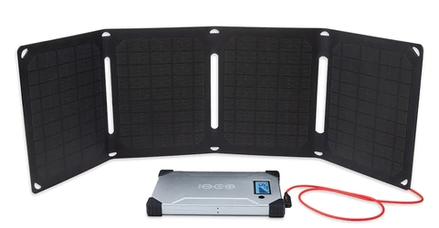
Solar
Panels
Comparison of 3 types of solar panels:
Monocrystalline Cells- Small, highest efficiency, very portable
Polycrystalline Cells-Large in size (heavy), less efficient, not portable
Thin Film Cells-Large in size, less efficient, not portable
Specifications:
19 % efficiency rates, 16V output, peak current of 1.1 A, and peak power of 19.8 W
Has a built-in USB port

Slide 25
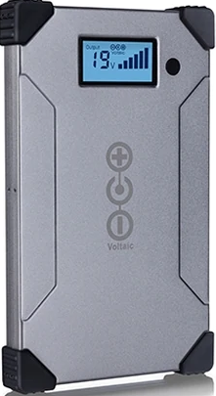
Battery
Battery Features | Lead-acid | Akaline | Li - polymer
Weight
Energy density
Discharge stability
Cost

Slide 26
Battery
V-88 USB-C Power Delivery
Portable Battery
Voltaic
Specification
Capacity : 24,000 mAh / 88.8 Watt Hours
Output: 12V/6A, 16V/5A, 19V/4.5A, 24V/3.5A
USB QC: 5V/3A, 3.6V-12V, 18W Max
Battery Type: Li-Polymer
DC Input: 18-25V/3A
Dimensions
Size : 8.6 x 5.4 x 0.9 in.(21.8 x 13.7 x 2.2 cm)
Weight : 1.57 pounds (714g)

Slide 27
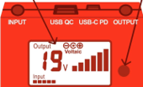
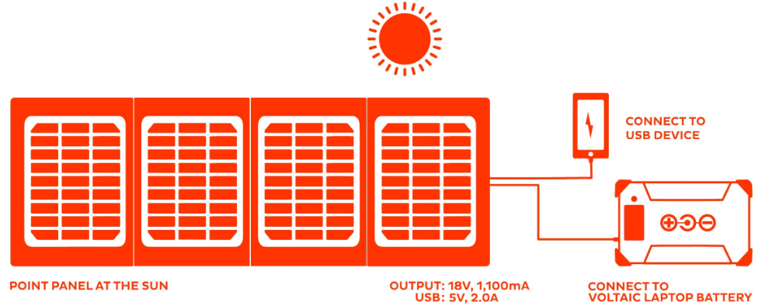
Advantages
Protection: Short Circuit, Over Charge, Over Discharge, Over Current, Over Temperature
Very light weight 1.57 pounds
2.5-3 hours from included additional AC charger
Safe for air travel
No need for charge controller (MPPT).
Battery features always ON mode

Slide 28
PCB
Printed Circuit Board

Slide 29
PCB
Printed Circuit Board

Slide 30
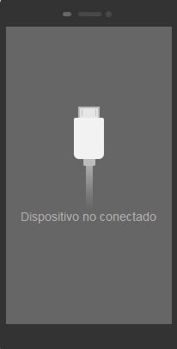
App Front End
Device Connected
Water Temp Turbidity
15◦C /59◦F 0 NTU
Water Flow 1 Water Flow 2
2.5 L/min 2.5 L/min
pH
7.8
Alerts:
No current alerts.
Device Connected
Water Temp Turbidity
15◦C /59◦F 0 NTU
Water Flow 1 Water Flow 2
2.5 L/min 2.5 L/min
pH
13.5
Device Connected
pH
13.5
Alerts:
Current pH is too high.
Suggested actions:
Test system in different water source.
If pH remains outside acceptable values, filters may need replacement. For a pH alert first replace pre-Carbon filter and/or UF membrane and test the system again.
Alerts:
Current pH is too high.
Click for suggested actions.
View/ Update Filter Replacement Dates
View/ Update Filter Replacement Dates
Show pH History
Show turbidity History
Show pH History
Show turbidity History
Show temp History
Show water flow History
Show temp History
Show water flow History

Slide 31
App Front End
Device Connected
Water Temp Turbidity
15◦C /59◦F 0 NTU
Water Flow 1 Water Flow 2
2.5 L/min 2.5 L/min
pH
7.8
Alerts:
No current alerts.
Device Connected
Ph History Graph
View/ Update Filter Replacement Dates
Show pH History
Show turbidity History
Show temp History
Show Water flow History

Slide 32
Work Distribution
Task | Primary | Secondary
Wireless Communication | Gabriel | Alejandro
Mobile Application | Alejandro | Gabriel
Microcontroller | Gabriel | Henok
Power Supply | Henok | Alejandro
Rechargeable Battery | Henok | Cecile
Sensor Integration | Alejandro | Cecile
Water filtration Module | Gabriel | Henok
User Interface | Cecile | Gabriel
PCB Design | Henok | Alejandro
Solar Panel Integration | Cecile | Alejandro

Slide 33
Project constraints
Lead Acid battery
Bulky and heavy
Size constraint
UV- Filter
Powers from Ac – 120V
Need for additional circuitry

Slide 34
Project Expenses
Number | Component name | Price
1 | Arc 20W Solar charger kit | 229.00
2 | UV filter | 130.0
3 | case | 50
4 | Microcontroller | 7
5 | PCB
6 | Water pump | 15.48
7 | Sediment filter | 7.99
8 | Turbidity sensor | 15
9 | Ph/temperature sensor | 38
10 | Water flow sensor (X2) | 22
11 | Ultrafiltration membrane | 19.00
12 | Pre-carbon filter | 15
13 | Bluetooth module | 8
14 | LCD | 8
15
Total

Slide 35
Progress …

Slide 36
Any Questions… ?

