Slide 1
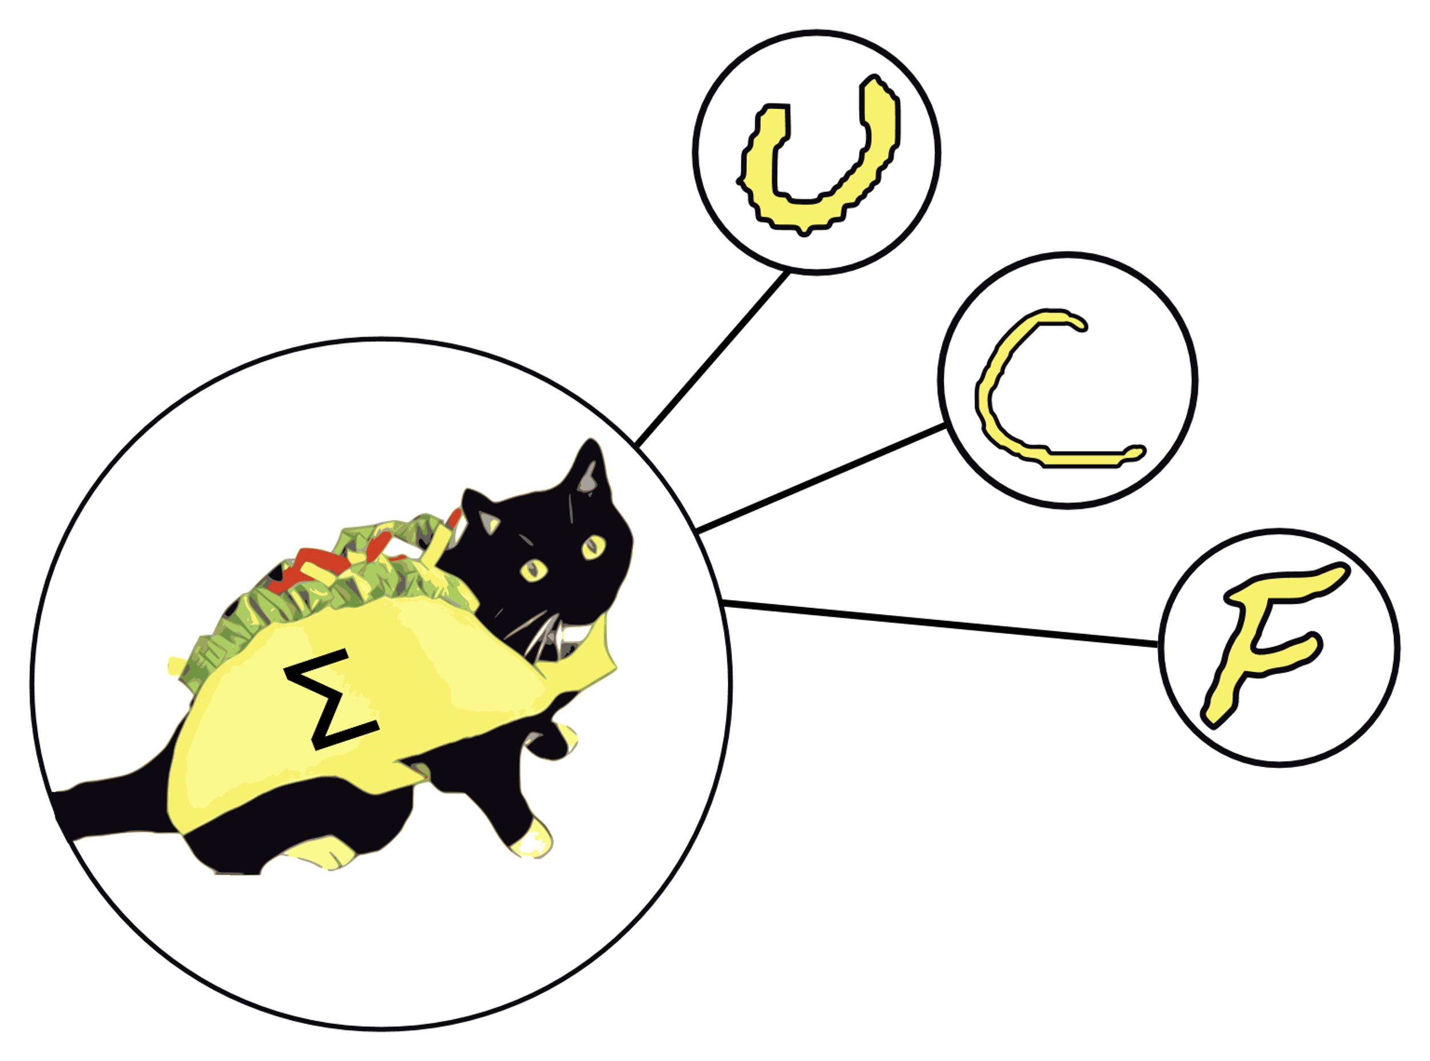
Trainable Acceleration of Classification Operations via Commonly Available Technology
German Romero Castro, EE
Luke Minks, EE
Deven Morone, EE
Justin Sapp, CpE
Notes:
Justin
Everyone
Good morning. We’re Group 31, and our project is called “TACOCAT”, which stands for Trainable Acceleration of Classification Operations via Commonly Available Technology.
I’m Justin Sapp and I’m a Computer Engineering Major.
German, Luke, and Deven introduce themselves.

Slide 2
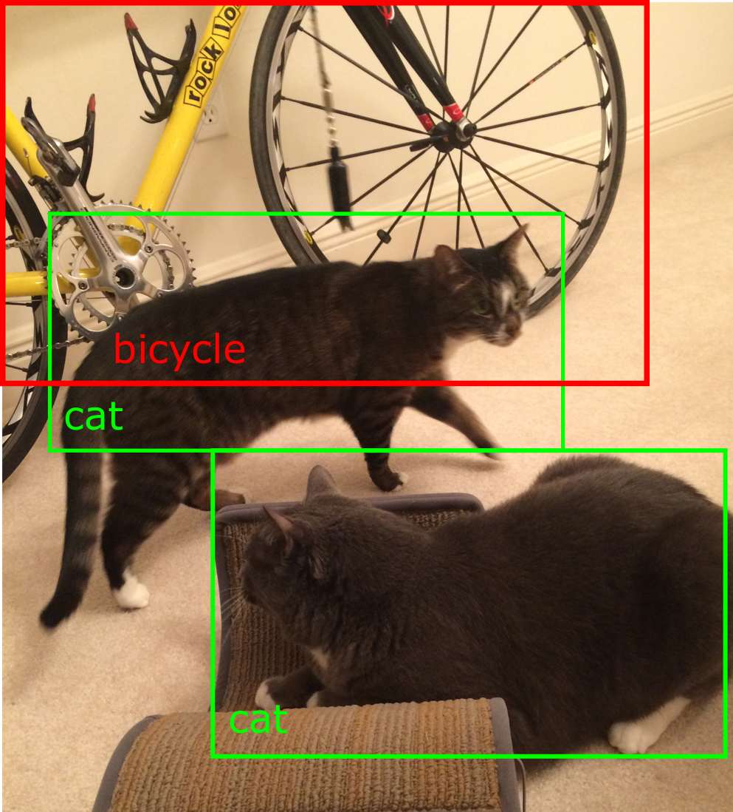
Motivation
Modern neural networks are capable of helping us in many ways, especially through sound and image recognition.
However, many software-based neural network models are too large and slow to be implemented on mobile devices.
Hardware-based neural networks may allow mobile devices to perform complex recognition tasks without sending data out to the cloud.
Notes:
Justin
So speech-to-text and image recognition are really helpful machine-learning applications, but a lot of times they’re too complex to run on mobile devices or small computers, and we have to send data out to the cloud to be processed.
While a lot of today’s software-based neural networks are impractical to run on small processors, hardware-based neural networks are a new technology that could provide huge increases in performance and efficiency for applications like speech and image recognition.

Slide 3
Motivation
A neural network that is capable of recognizing 10+ handwritten characters is too large to practically implement in hardware without the use of custom VLSI fabrication.
However, a demonstration-sized network that can recognize a limited set of 3 handwritten characters should be manageable using off-the-shelf components.
Notes:
Justin
Most of the current research in hardware-based neural networks focuses on large systems that depend on emerging devices like memristors, and they use custom VLSI fabrication to make large, efficient networks.
For TACOCAT, we wanted to see if we could build a small-scale neural network using only components that are readily available off-the-shelf.
Instead of trying to recognize any handwritten character, we’ve chosen to recognize 3 handwritten characters.

Slide 4
Goals & Objectives
Build
Build a hardware-based neural network that can recognize 3 different handwritten characters with at least 75% accuracy.
Innovate
Use only mass-produced, readily available components.
Learn
Gain experience in hardware and software design for neuromorphic circuits.
Notes:
Justin
So, our objectives for TACOCAT are to build a hardware-based neural network that can recognize three different handwritten characters with reasonably accuracy, to use only commercially-available components, and finally we hope to gain experience in designing hardware-based neural networks.
In the next two slides, I’ll give a quick overview of how TACOCAT works, and then we’ll talk more about the details of the design.

Slide 5
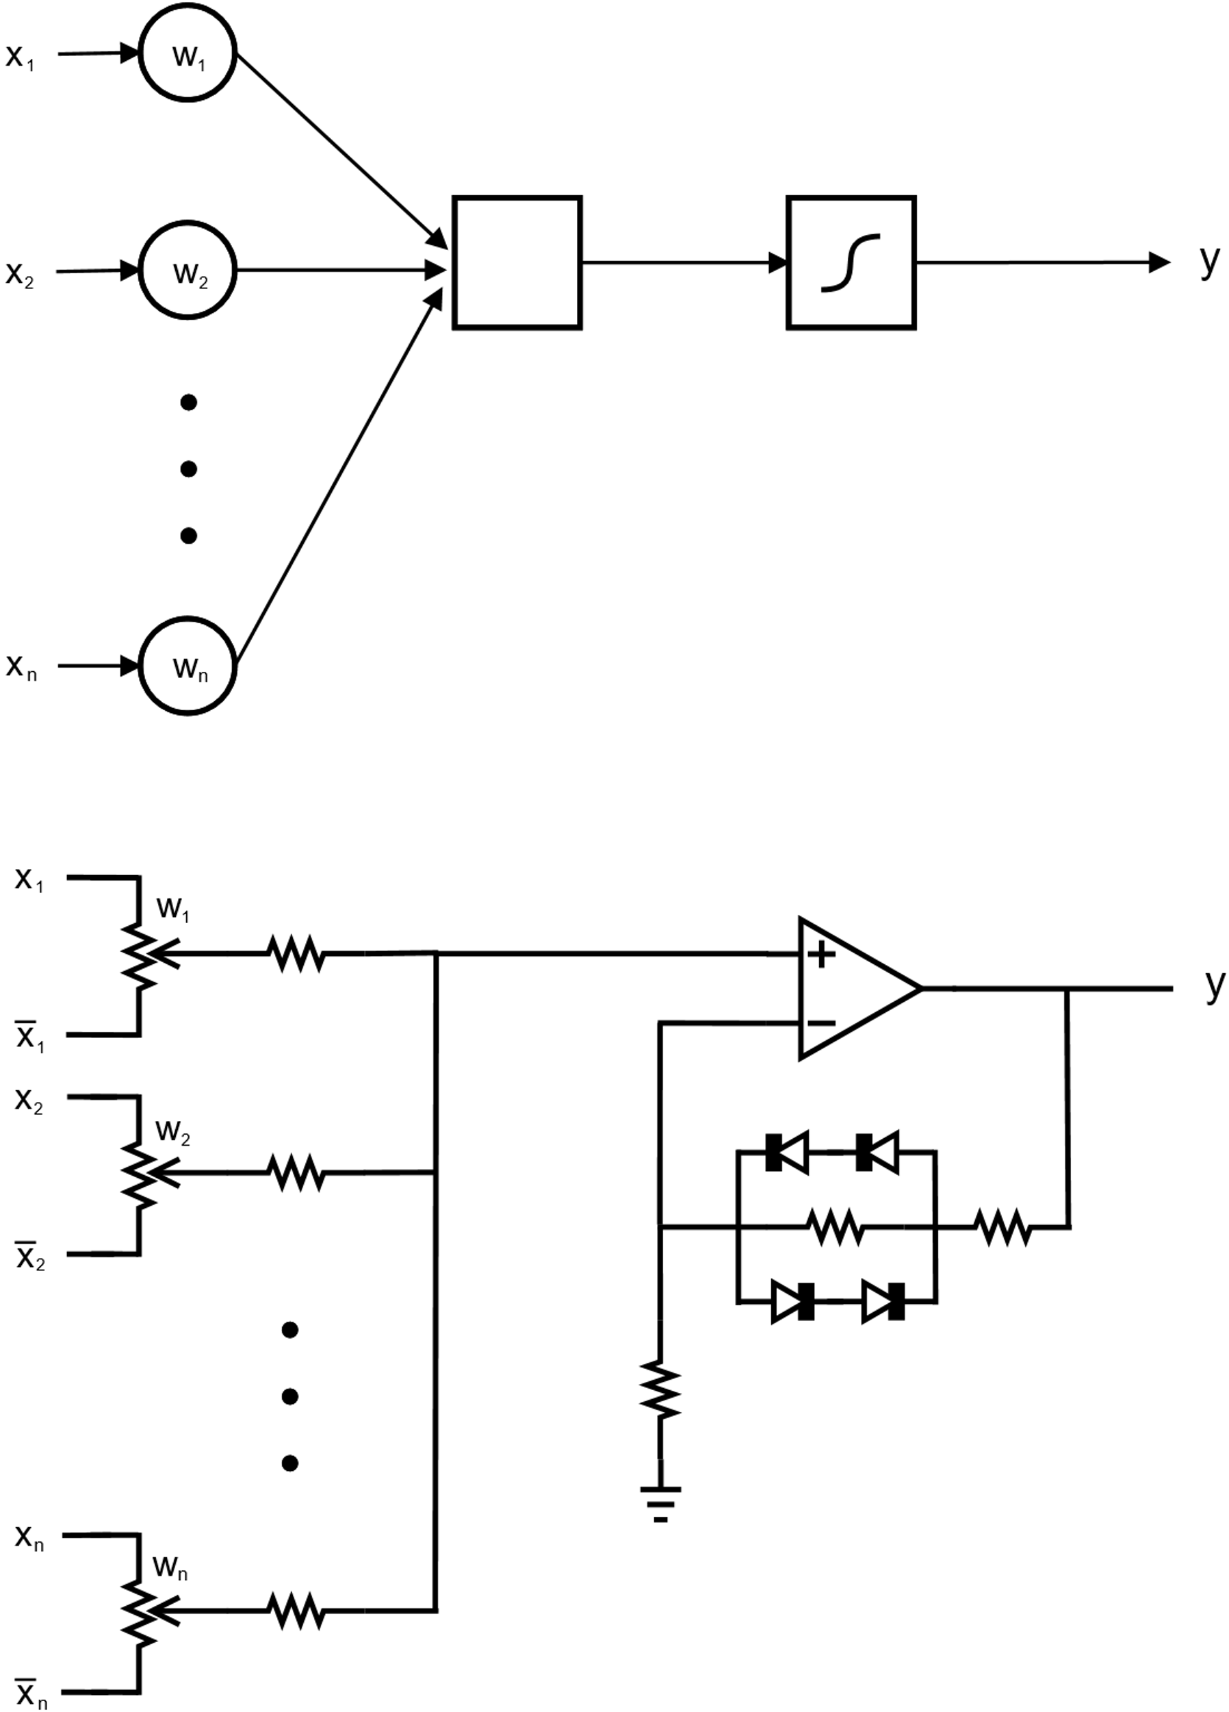
Neural Network Overview
Equation
TACOCAT’s hardware design in based on the perceptron, which is an artificial neuron.
Each of the perceptron’s “synapse” inputs (x) is multiplied by a distinct weight coefficient (w).
The weighted inputs are summed together, and then an activation function is applied to the sum to calculate the neuron’s output.
TACOCAT uses a hyperbolic tangent activation function, which is differentiable at all points and nonlinear.
Abstract
Model
i₁
i∑
>
>
i₂
>
Circuit
i_{n}
>
Notes:
Justin
So TACOCAT’s hardware is based on a mathematical model called the perceptron, which represents an artificial neuron.
The perceptron can have any number of input “synapses”, and its output is determined by multiplying each input value (which are shown as x-values in the diagram) by a weight coefficient (the w-values in the diagram).
The perceptron takes the sum of the weighted inputs and passes it to an “activation function” that determines the neuron’s actual output.
The TACOCAT perceptron uses one digital potentiometer per synapse to represent the weight coefficients, and the summing and activation functions are implemented using a single op-amp stage.
While software implementations need multiple processor cores in order to speed up the calculations for the perceptron, the hardware implementation that we are using can easily perform most of these operations in parallel without any complex computing architecture.
We use a software algorithm and microcontroller interface to train the network by adjusting its weight values based on its responses to data samples, but the TACOCAT network can operate on its own once that training process has been completed.

Slide 6
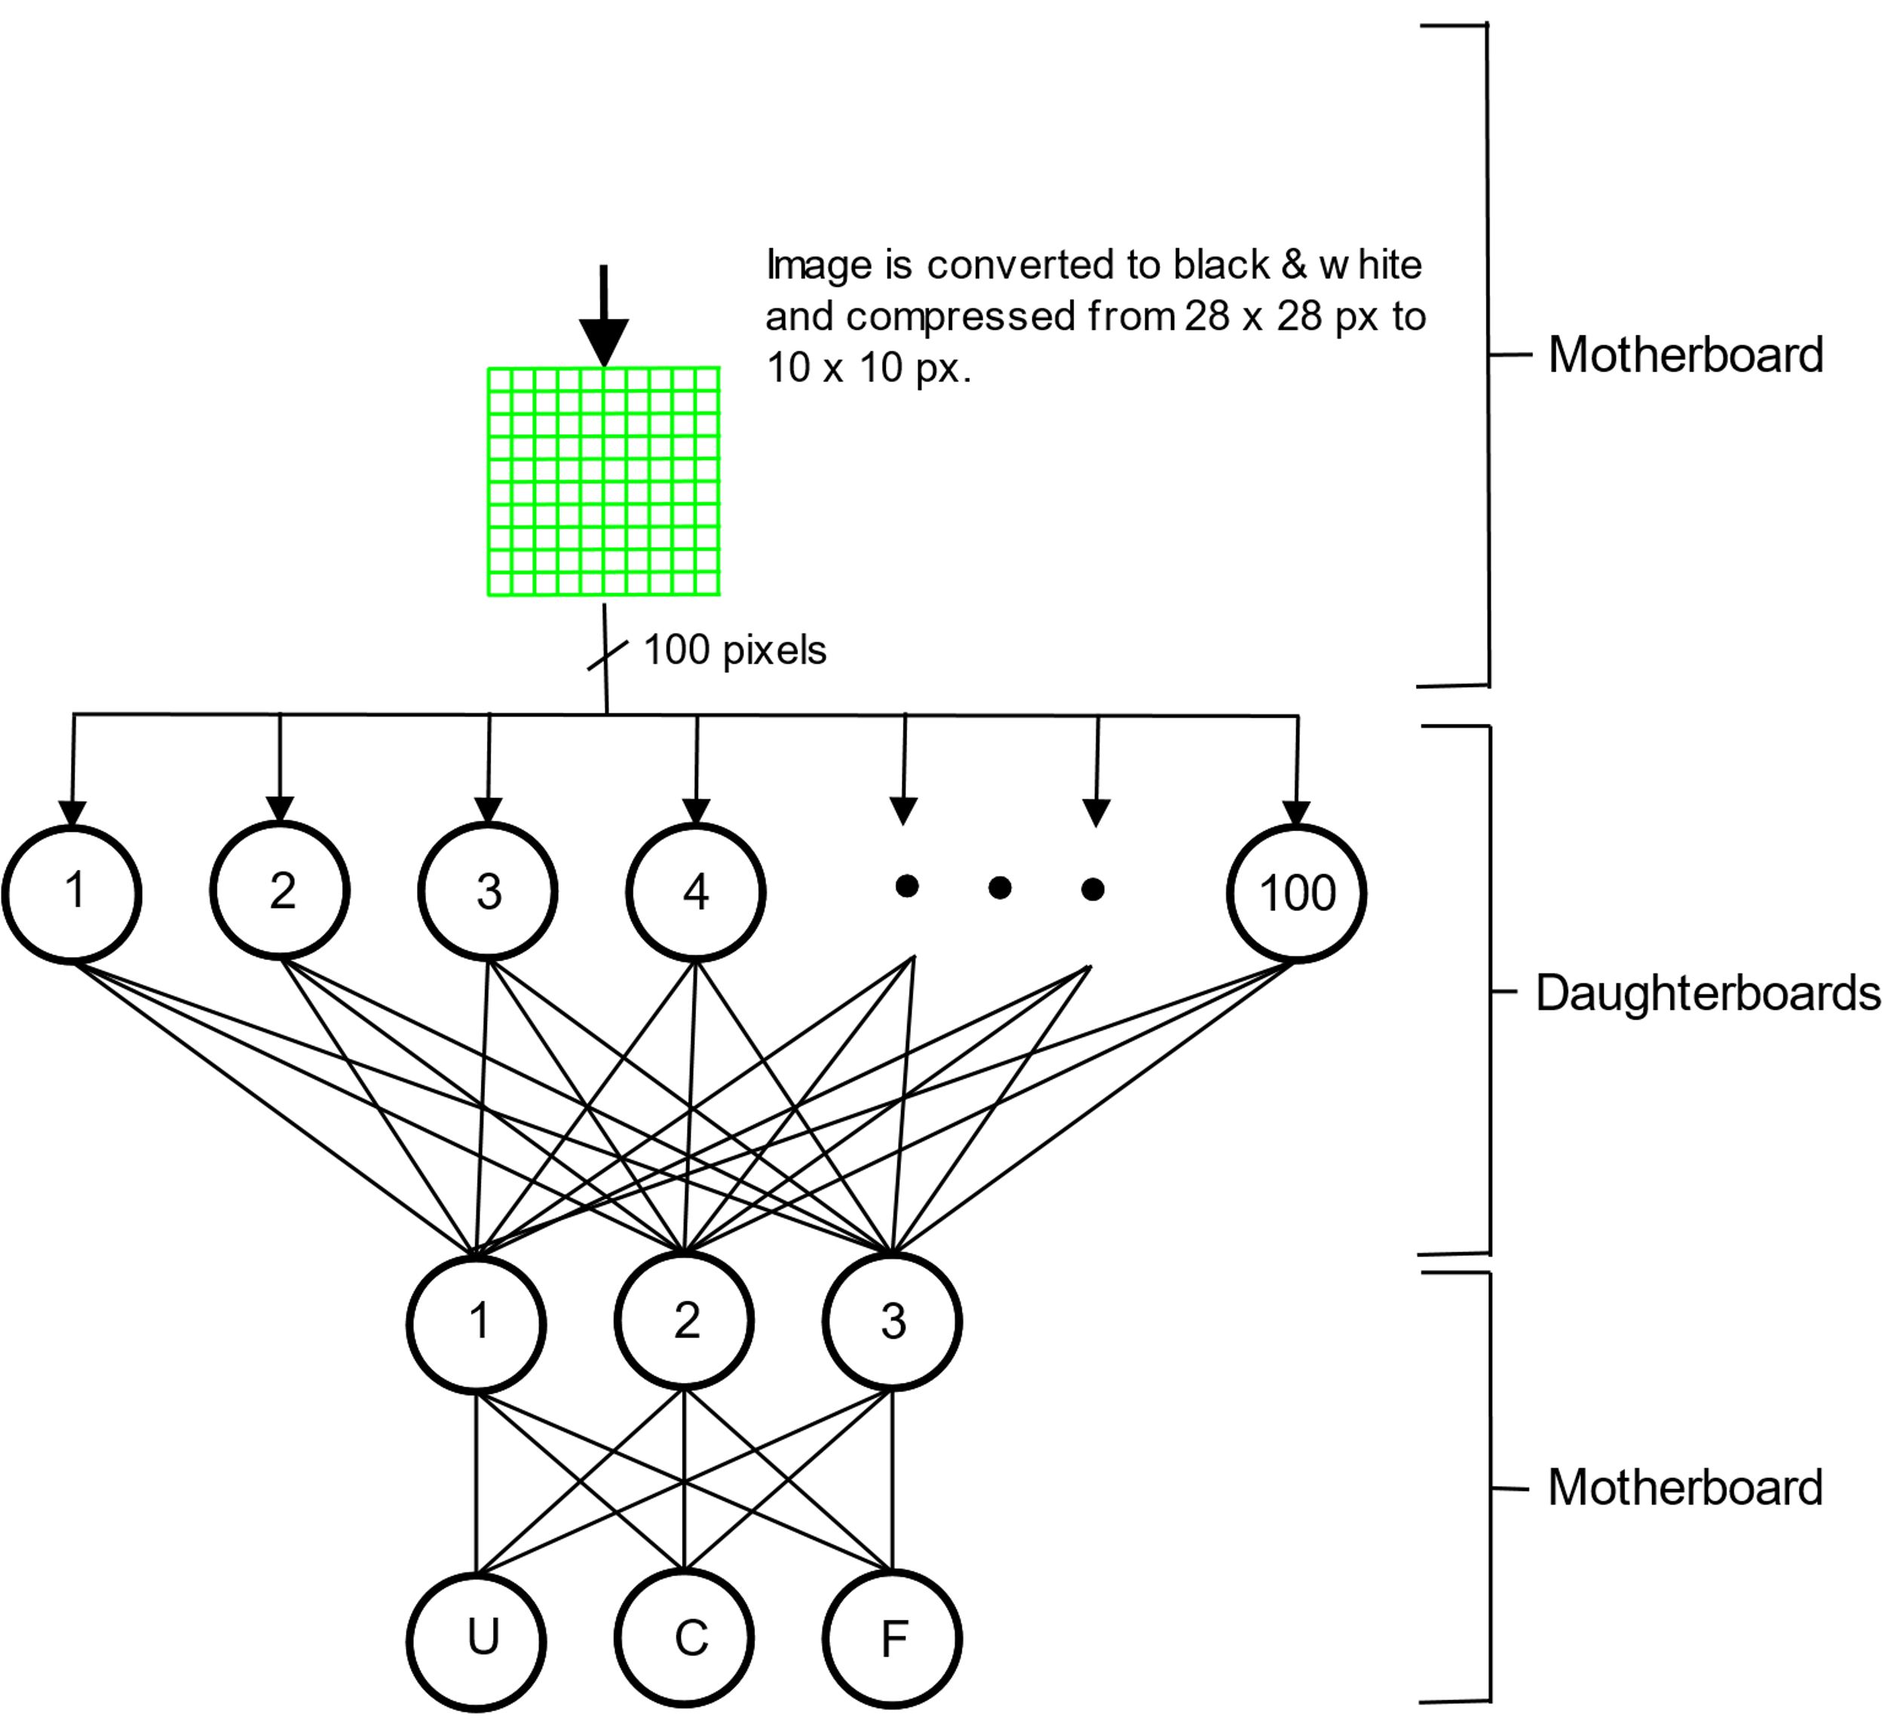
Neural Network Overview
TACOCAT is based on a Multilayer Perceptron (MLP) architecture that uses three fully-connected synapse/neuron layers.
Character recognition is performed by dividing a sample image into 100 pixel-values and applying corresponding voltages to the input synapses.
The output neuron with the highest voltage indicates the network’s prediction.
Notes:
Justin
This diagram shows TACOCAT’s three-layer architecture, which consists of 100 input neurons, 3 “hidden” neurons, and 3 output neurons. In total, there are 309 hardware synapses.
To classify a sample image, we start by using software to down-sample the character image (if needed) to 100 black and white pixels.
We then apply a voltage to each input synapse based on its corresponding pixel value, with zero volts representing black and 1.8 volts representing white.
Once the network has reached a steady state, the output neuron with the highest voltage indicates the network’s prediction, so in this example, we would expect the ‘U’ neuron to have the highest output voltage.
Right now, our software simulations for this design show an accuracy of around 92% for the character set of U, C, and F.

Slide 7
Neural Network Architecture
Neural Network Architecture chosen is the Multi-layer Perceptron (MLP).
Architecture that consists of 3 or more layers; an input layer, output layer, and at least 1 hidden layer.
Requires the design of analog circuitry to weigh the neuron synaptic inputs, sum them, and apply non-linearity via an activation function.
Notes:
German
Neural Network architecture that was chosen was the MLP NN for its simplicity in its layer count and complexity, when compared to other more complex NN architectures like RNN or CNN. Our circuit design and layer density would need to be larger and more complex to implement these other architectures.
MLP NN architecture is made up of 3 or more layers of neurons. It needs an input layer, an output layer, and at least 1 hidden layer.
The analog circuitry that will be used to realize this architecture will need to be designed to perform the 3 necessary functions of a synapse and neuron of a neural network, which are:
Weigh the synaptic inputs
Sum the weighted inputs
Apply non-linearity via an activation function (hyperbolic tangent for this design)

Slide 8
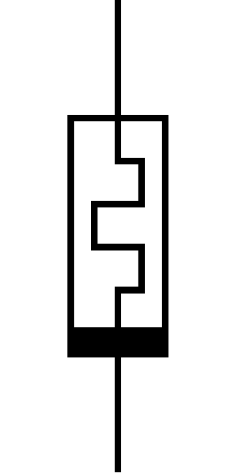
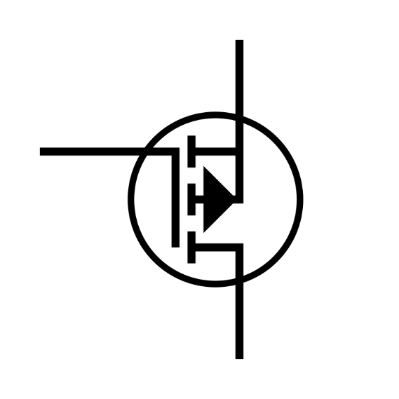
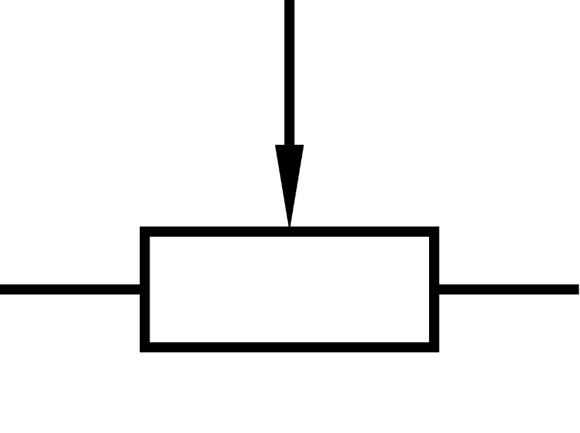
Neuromorphic Weight Implementation
Inputs to our artificial neurons need to be weighted using some sort of adjustable analog resistance.
Some examples of devices used to implement neuromorphic weights include: Memristors, variable channel resistors (transistors), potentiometers, etc.
Digital potentiometers were chosen as a commonly available adjustable resistance device.
Notes:
German
To achieve the weighing of the synaptic input, some analog device with variable resistance needs to be used. This will allow the circuit to vary the input voltages to the summing circuit to vary during training.
Some examples of possible devices that would be used for this task are:
Memristors (current-controlled resistance)
Transistors (voltage-controlled channel resistance)
Digital Potentiometer (voltage-controlled analog resistance)
Digital Potentiometers were chosen as they are commonly available and reliable adjustable resistance devices, with low-enough tolerance.

Slide 9
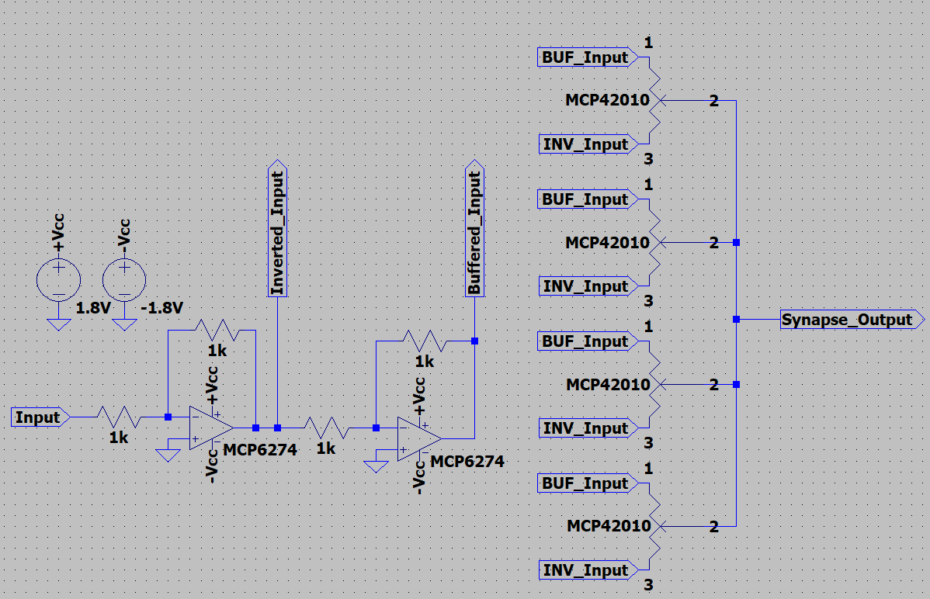
Synapse Circuit Design
Buffer/Inverter pairs used to isolate individual neurons to effectively separate network layers.
Buffer and inverter pair is implemented using two unity gain inverter op. amp circuits.
Notes:
German
This circuit is responsible for weighing the inputs to our artificial neurons. In our input layer, they receive the digital inputs that correspond to the pixel data of the input image. On subsequent layers, they are the outputs of the previous layer’s neurons.
Circuit is designed as a simple pair of unity-gain inverting amplifiers in series. The output of the first amplifiers applies the opposite polarity of the input voltage, while the second amplifier provides the buffered voltage level.
Both voltage levels provided by our buffer/inverter pair are connected to the ends of the digital potentiometers to achieve the desired weighing, as the position of the wiper will be adjusting the weight. These weighted inputs are then taken to the neuron circuit.

Slide 10
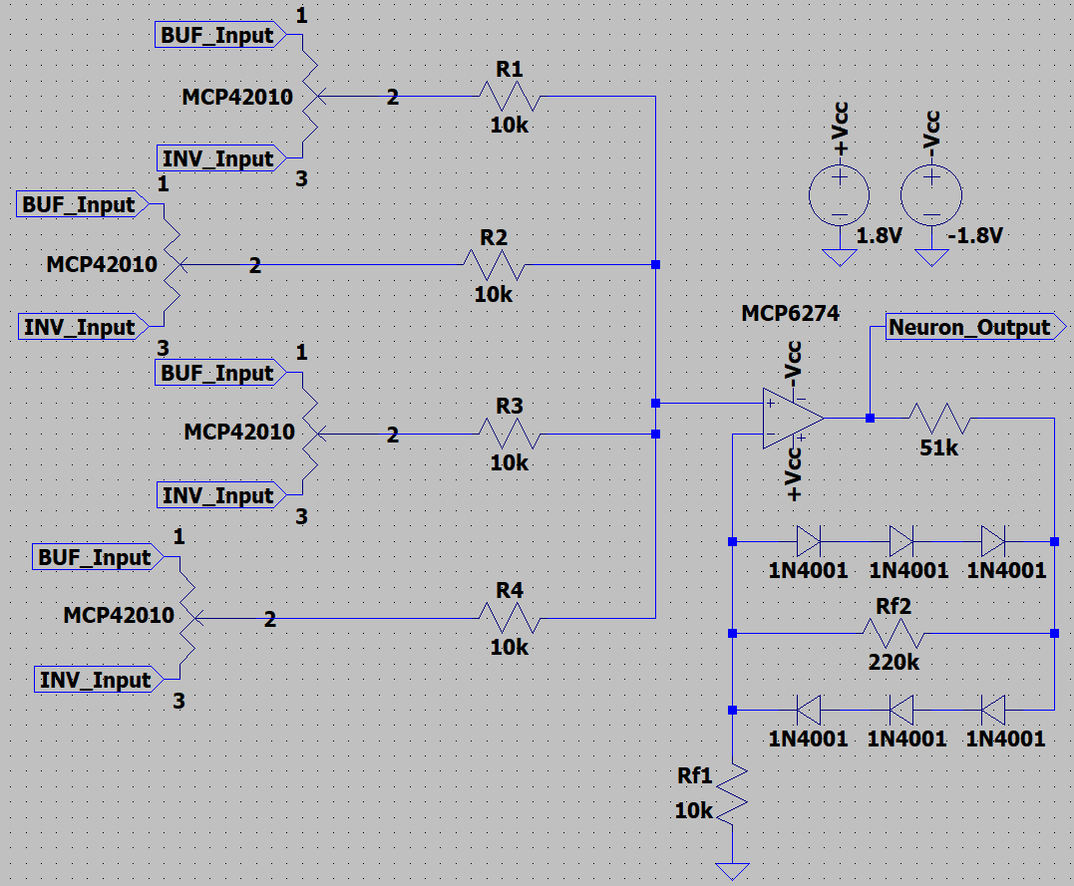
Neuron Circuit Design
Non-inverting summing amplifier design chosen to sum the weighted inputs to the neuron.
Designed with a maximum gain of about 5.6 when the diodes are not conducting.
Diodes on the feedback network achieve the non-linearity needed for the activation function.
The hyperbolic tangent activation function is achieved in the transfer characteristics of the neuron.
Notes:
German
To implement the summing of weighted synaptic inputs, a non-inverting summing amplifier circuit was designed. The outputs from the previously shown synaptic circuit are taken from the wipers of the potentiometers to the non-inverting terminal of an op amp through some resistors.
The feedback network of the op amp circuit includes forward and reverse biased diodes to provide non-linearity in the transfer function of the neuron circuit. While the diodes are not conducting, the gain of the circuit is about 5.6, giving us a steep slope in the transfer curve. While the diodes are being biased, the transfer curve shows a more exponential curve before being driven to the rails of the op amp.

Slide 11
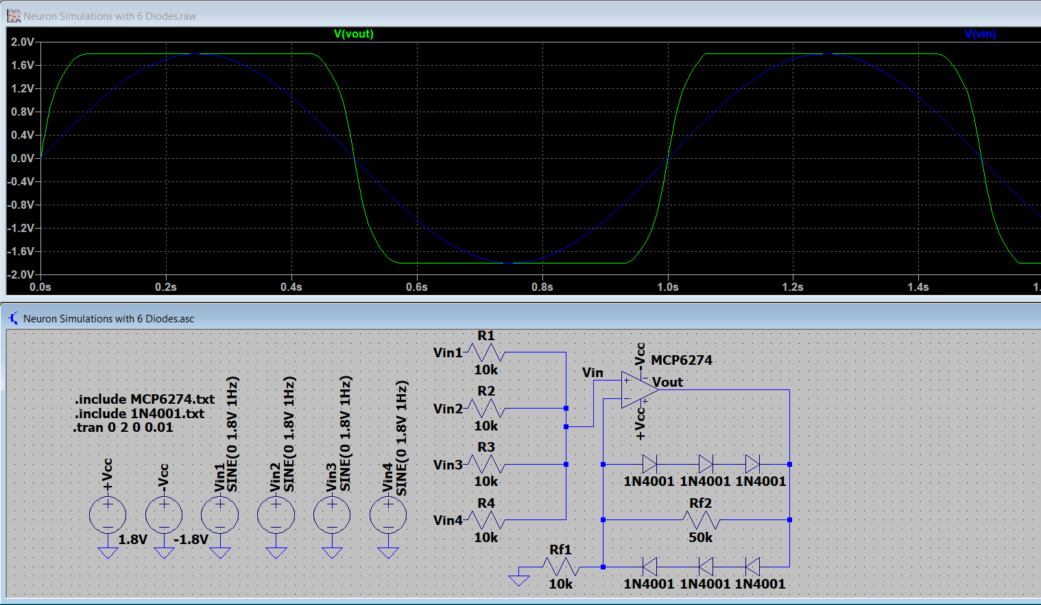
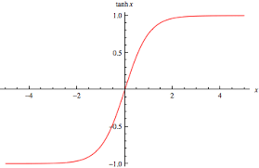
Hyperbolic Tangent Transfer Characteristic
Notes:
German
The overall transfer characteristic that this neuron circuit models is the hyperbolic tangent function, for the activation function requirement of the neural network.
The model of the ideal tanh(x) is shown on the left while the right shows a simulation of the neuron circuit, displaying the transfer characteristic of a tanh activation function that we want. There is a resistor missing from this circuit compared to the previously shown, but all that changes is with the resistor, there would be a steeper output curve.

Slide 12
Output Comparator Circuit Design
To distinguish which of the 3 possible output voltages is highest, a differential amplifier to comparator network was designed.
This achieves voltage sorting purely with analog circuitry, and avoids the need for software interpretation, with the ADC on our MCU.
Very high gain on the difference amplifier allows for high sensitivity.
Output of the amplifier compares with 0V reference to classify whether the voltage being tested is greater or smaller.
Notes:
German
To stay on the theme of avoiding software to do any of the neural network computations in this project, we wanted to design a circuit that would be used to distinguish which of the 3 neurons in the output layer of our network had the highest voltage. (Highest output voltage signifies the prediction that the neural network has made)
To achieve this, a differential amplifier to comparator network was designed.
First, a very high gain differential amplifier was made with a gain of about 10k, to give us a sensitivity of about 10mV. It will take the difference from the input voltages and amplify it. A negative difference would mean that the voltage being tested is greater, while a positive voltage means it is smaller.
This difference is then taken to an inverting comparator circuit that compares it to a reference voltage of about 0V.
Both difference-amplified and compared voltages are taken to an AND gate. The AND gate will go high, if and only if the voltage being tested is indeed higher than the other two.

Slide 13
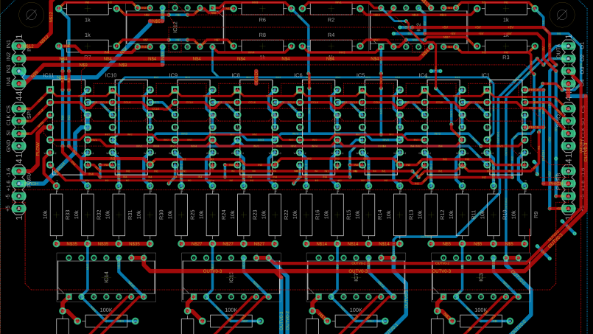
Prototype
Notes:
German
Introduce prototype network

Slide 14
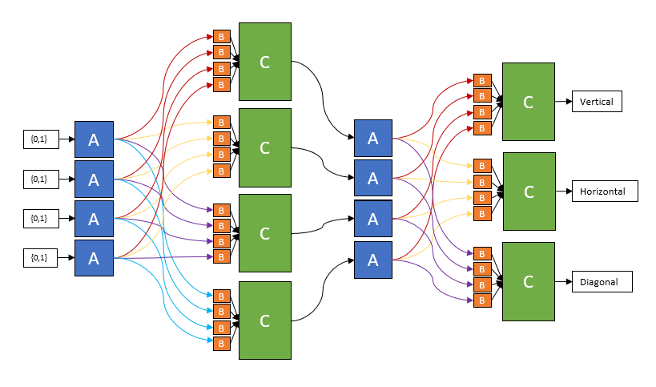
Prototype Neural Network
This Neural Network is designed to recognize line orientations (vertical, horizontal, or diagonal)
A blocks: input drivers
B blocks: synaptic weights
C blocks: neuron circuit
Notes:
German
This Prototype Neural Network is a 4 neuron inpu layer, hidden layer, and 3 neuron output layer
Network is desgined to be trained to recognize line orientations from input images
The blocks shown in the diagram will be composed of the basic circuit designs previously shown; Explain what each block in the diagram is

Slide 15
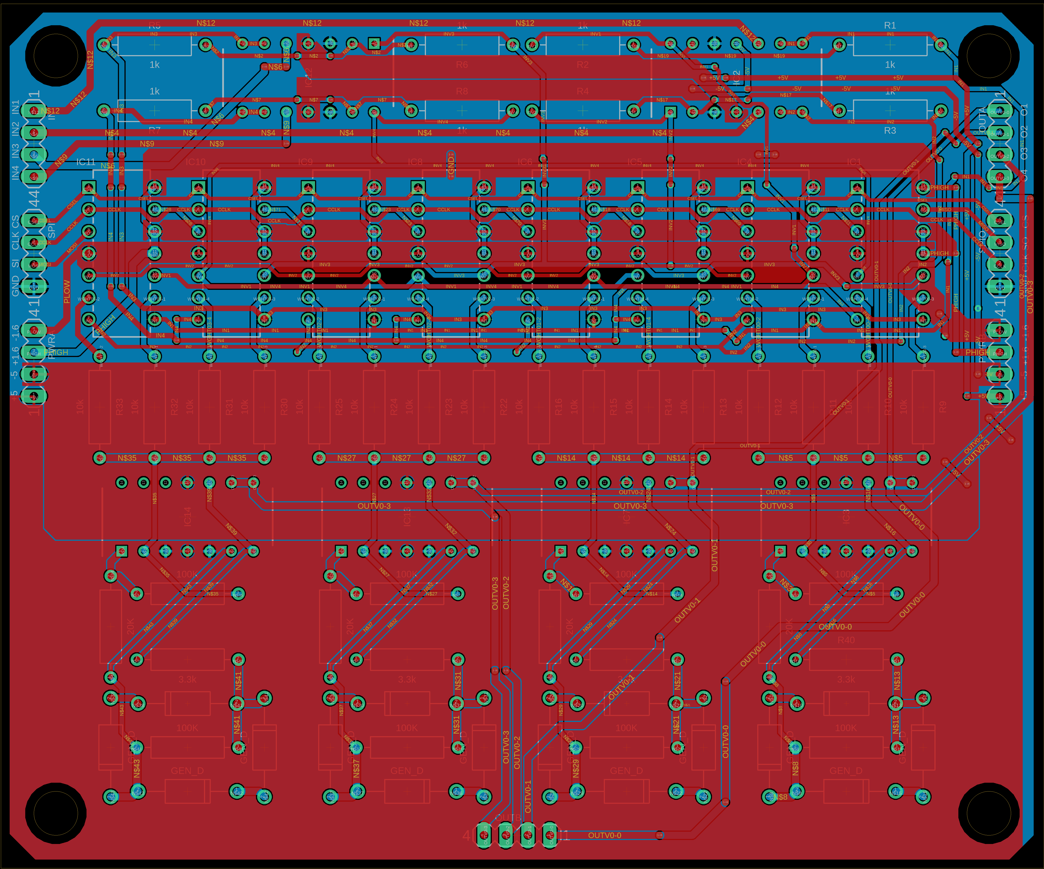
Prototype Network PCB Design
4 inputs, 4 outputs
Ability to be daisy-chained to arbitrary extent
2 layers
3.9" x 4.75"
2 sets of power pins
2 sets of output pins
1 set each of input pins, SPI in, SPI out
Notes:
Luke
breadboarding insufficient, better test/prototyping platform necessary
desired flexible platform to test multiple amplifier and potentiometer chips
separate voltage rails for amps and pots to allow both rtr op amps and tl084s
2 sets of voltage pins, 2 sets of output pins, signal input pins, spi in and spi out to allow arbitrary daisychaining

Slide 16
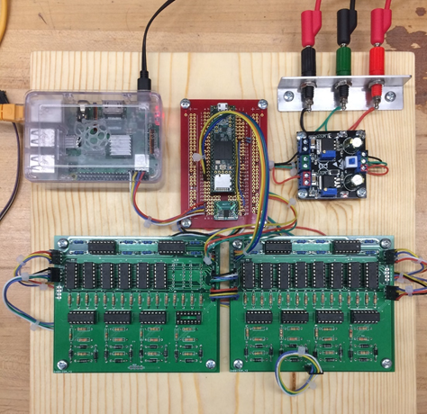
Prototype Network
4 pixel input network
Recognize patterns of pixels in 2x2 grid (horizontal, vertical, diagonal)
Scaled down version of 10x10 final network design
Notes:
Luke
first layer bottom right, output layer bottom left; note missing components
teensy on red perfboard, voltage supply devboard on upper right, pi on upper left
buffers on top, potentiometers below, neuron amplifiers at bottom

Slide 17
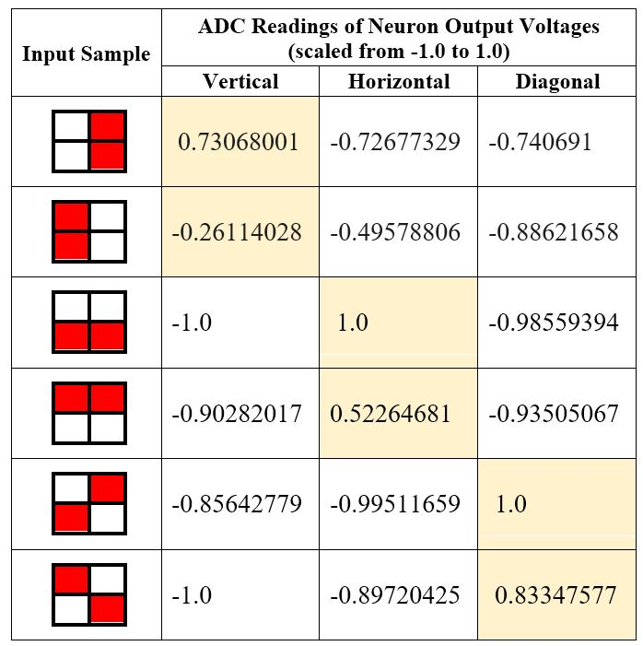
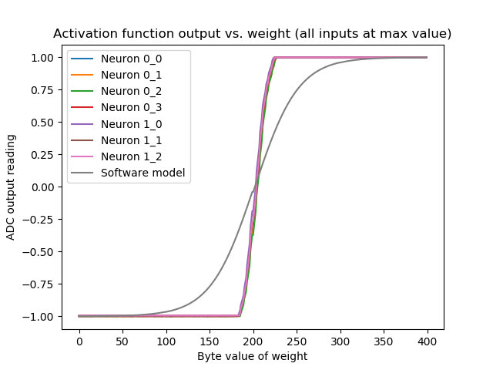
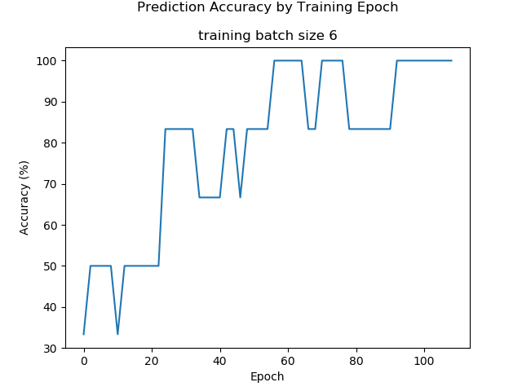
Prototype Network Results
Notes:
Justin
When we built our prototype, we honestly didn’t know if it would work or not, but we were really encouraged by the test results.
Activation functions worked properly, and we were able to train the network to 100% accuracy by going over the training data set roughly 100 times, which takes less than a minute. I should mention that the data set for this network is tiny, with only 6 sample images, which is why the training history graph looks a bit jumpy.
The chart on the right shows neuron output readings for each input sample, and as you can see, the ‘vertical’, ‘horizontal’, and ‘diagonal’ neurons each had the highest output voltages for the appropriate inputs.
Now we just need to scale this network up from 4 pixels to 100 pixels.

Slide 18
Component
Selection
Notes:
Luke

Slide 19
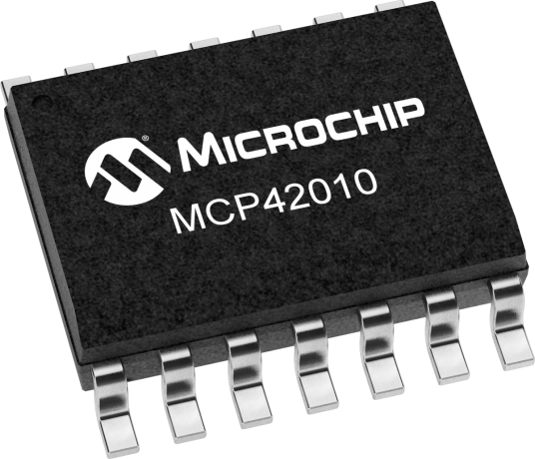
Digital Potentiometers
Device | Pots./chip | Price/pot. | Protocol | SPI daisy chaining? | # of Taps
MCP44XX | 4 | $.30 | I2C | N/A | 129/257
MCP43XX | 4 | $.40 | SPI | No | 129/257
MCP42XXX | 2 | $.86 | SPI | Yes | 257
TPL0202 | 2 | $.78 | SPI | No | 257
AD5204 | 4 | $.94 | SPI | Yes | 257
Prototype
Final Design
Notes:
Deven

Slide 20
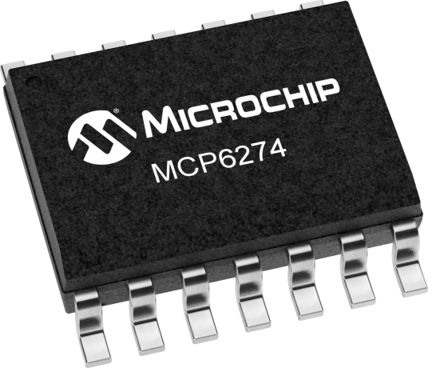
Op Amps
Device | Distributor | Price | Input Impedance | RRIO? | Input bias current | Input offset voltage | Type
TL084 | Texas Instruments | $1.10 | 10¹² Ω | No | 30 pA | 3 mV | Quad JFET
MCP6274 | Microchip | $1.01 | 10¹³ Ω | Yes | 1 pA | 5 mV | Quad JFET
TL974 | Texas Instruments | $0.89 | 10¹⁰ Ω | Yes | 200 nA | 1 mV | Quad BJT
MCP6294 | Texas Instruments | $1.84 | 10¹³ Ω | Yes | 1 pA | 0.3 mV | Dual JFET
Prototype
Final Design
Notes:
Deven

Slide 21
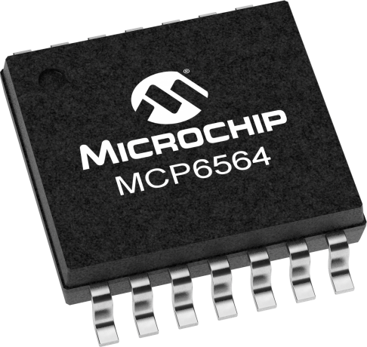
Comparator & AND Gate
Function | Part Number | Price | Min. Hysterisis | Supply Voltage (rail-to-rail) | Manufacturer
Comparator | MCP6564 | $1.44 | 1 mV | 1.8 to 5.5 V | TI
Comparator | LMX93 | $0.08 | 100 mV | 3 to 36 V | TI
AND Gate | SN74HC08N | $0.45 | N/A | 2 to 6 V | TI
AND Gate | SN74HCS11 | $0.07 | N/A | 2 to 6 V | TI
Final Design
Final Design
Notes:
Deven

Slide 22
Microcontroller Selection
Device | Manufacturer | GPIOs | Clock Rate | Price
PIC32MZ0512EFE | Microchip | 120 | 200 MHz | $9.62
LPC4353JBD208E | NXP | 142 | 204 MHz | $14.55
STM32H743IIT6 | STMicroelectronics | 140 | 400 MHz | $10.96
Final Design
Notes:
Justin
For the full-sized network, we wanted an MCU with a minimum of 120 GPIO pins and we chose to avoid chips with ball-grid-array packages, since they complicated our 2-layer PCB design.
We found the best candidate to be the STM32H743 from ST Microelectronics. It has a fast ARM core, with a clock rate of 400 MHz, plenty of GPIO pins, and it’s priced competitively at just under eleven dollars.

Slide 23
Software/ Firmware Overview
Graphical user interface module
Dataloader module
Dataset
I2C Link
MCU control interface
Core module
Linux PC
STM32H7
Python module
Text file
C++ firmware
Notes:
Justin
Our software for this project is written in Python3, and we are running it on a small Linux PC. The firmware package is written in C++, and it runs of the STM32H7.
The two systems communicate using an I2C interface.

Slide 24
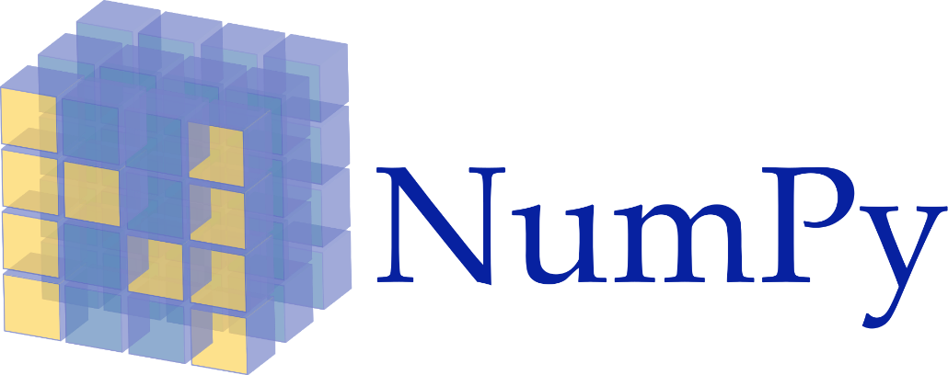
Software Package
A custom-coded machine learning model that can be trained using interchangeable hardware- or software-based neural networks.
The training algorithm uses backpropagation by gradient descent, and it can be applied to a software model, a SPICE circuit simulation, or the TACOCAT microcontroller interface, without any changes to the code.
Notes:
Justin
The core module of our software package is a hand-coded machine learning model written in Python3. Our training algorithm is based on backpropagation by gradient descent, and it is designed to be compatible with three different interchangeable Python modules: one for a pure software model, another for a SPICE simulation of the TACOCAT hardware, and another for the actual TACOCAT microcontroller interface.

Slide 25
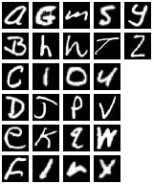
Dataset
The Extended MNIST (EMNIST) dataset contains samples of handwritten numbers (0-9) and letters (a-z, A-Z).
Samples follow MNIST formatting (28 x 28 pixel 8-bit grayscale images).
The dataset includes separate data subsets for training and testing.
Notes:
Justin
Our data samples come from the Extended MNIST dataset, which is provided by the National Institute of Standards and Technology. The Extended MNIST set includes handwritten letters and numbers, and it follows the organization and formatting standards used in the MNIST dataset, which is a widely-used machine-learning benchmark.

Slide 26
Firmware Package
Microcontroller initialization code and header files with custom pin names are generated automatically using STM32CubeMX software.
Firmware receives commands from Python model and programs synaptic weights, toggles input pixel values, or reads output voltages according to the instructions it receives.
Notes:
Justin
Our firmware code is written in C++, with initialization code and pin assignment header files automatically generated by the free STM32CubeMX software tool.
The firmware receives commands from the software package via I2C link, and these commands include setting synaptic weights, configuring pixel inputs, and reading neuron output voltages.

Slide 27
Touchscreen Interface
User interface for demonstration purposes.
Written in Python3 and Tk.
Runs on a Raspberry Pi touchscreen display.
Notes:
Justin
We plan to develop a touchscreen user interface for demonstration purposes, with code written in Python3 and Tk. The interface module will run on a Raspberry Pi touchscreen display.

Slide 28
Final Neural Network Design Changes
Summing Amplifier Design will be adjusted such that a 100-input neural network can be achieved.
Intermediate summing amplifiers with attenuating gain will be used to avoid driving the output of a neuron to the rails with just 1 input.
Motherboard-daughterboard set up used to simplify SPI communications and efficiently use PCB area.
Notes:
German
To implement the final design of the network, the one capable of distinguishing between 3 handwritten characters, a 100-input neural network needed to be designed.
The prototype network was scaled up while considering the input density of each neuron circuit.
Since each summing amplifier cannot have 100 inputs without running into bias current problems, intermediate summing amplifiers with attenuating gain were used to sum weighted inputs in groups of 10 and a final amplifier sums the 10 groups with high gain.
Motherboard-daughterboard set up is used to simplify serial communications, trace layout, and efficiently use PCB area.
The final neuron design is then changed to a single non-inverting summing amplifier circuit, with the same diode feedback network, that receives the input from the summing amplifier that sums the weighted inputs to realize the overall hyperbolic tangent transfer function.

Slide 29
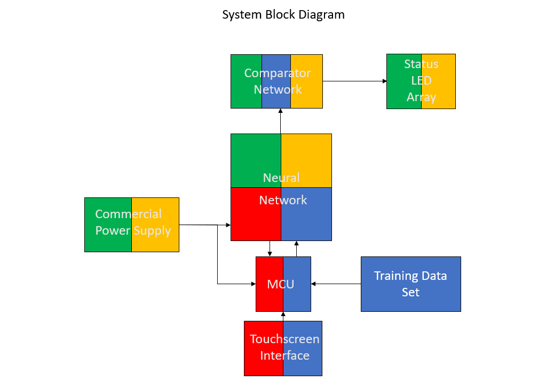
Work Distribution
Person(s) Responsible
Deven
German
Justin
Luke
+/- 1.8V DC Power Supply
MCU: STM32H7
Daughterboard Summing Stage
Motherboard communications
Training Algorithm
Touchscreen Interface
Output Comparator
Output Status LED
Notes:
Deven
* Need to update power supply to +/- 1.65V and MCU to STM32H7 ←---- was wrong about the voltage. Changing back to 1.8V -JS

Slide 30
Final Network Daughterboard PCB Design
100 inputs, 1 output
Designed with 90-degree double-row pins to allow for socketing in motherboard
2 layers
6.6" x 7.5"
25 quad-potentiometer ICs
28 quad-amplifier ICs
346 resistors
Notes:
Luke
purely a weighting and summing circuit; no neuron hardware on daughterboard
spi clock and chip select split into 3 signals and buffered individually to avoid signal attenuation
too complicated for significant, coherent voltage planes; large, redundant rails used instead (8h 6v)

Slide 31
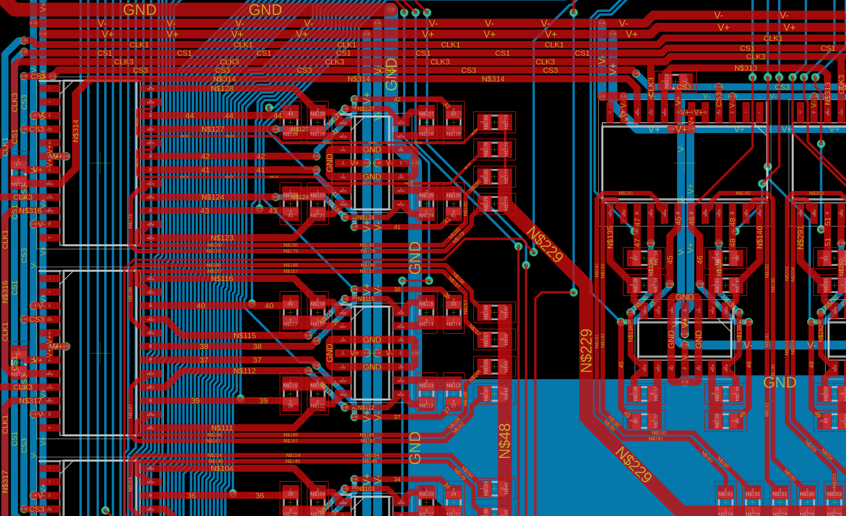
Daughterboard
Notes:
Luke
magnified view of a few of the pot/inverting amp modules; pot on left, summing amp on right
note heavy trace density on both layers

Slide 32
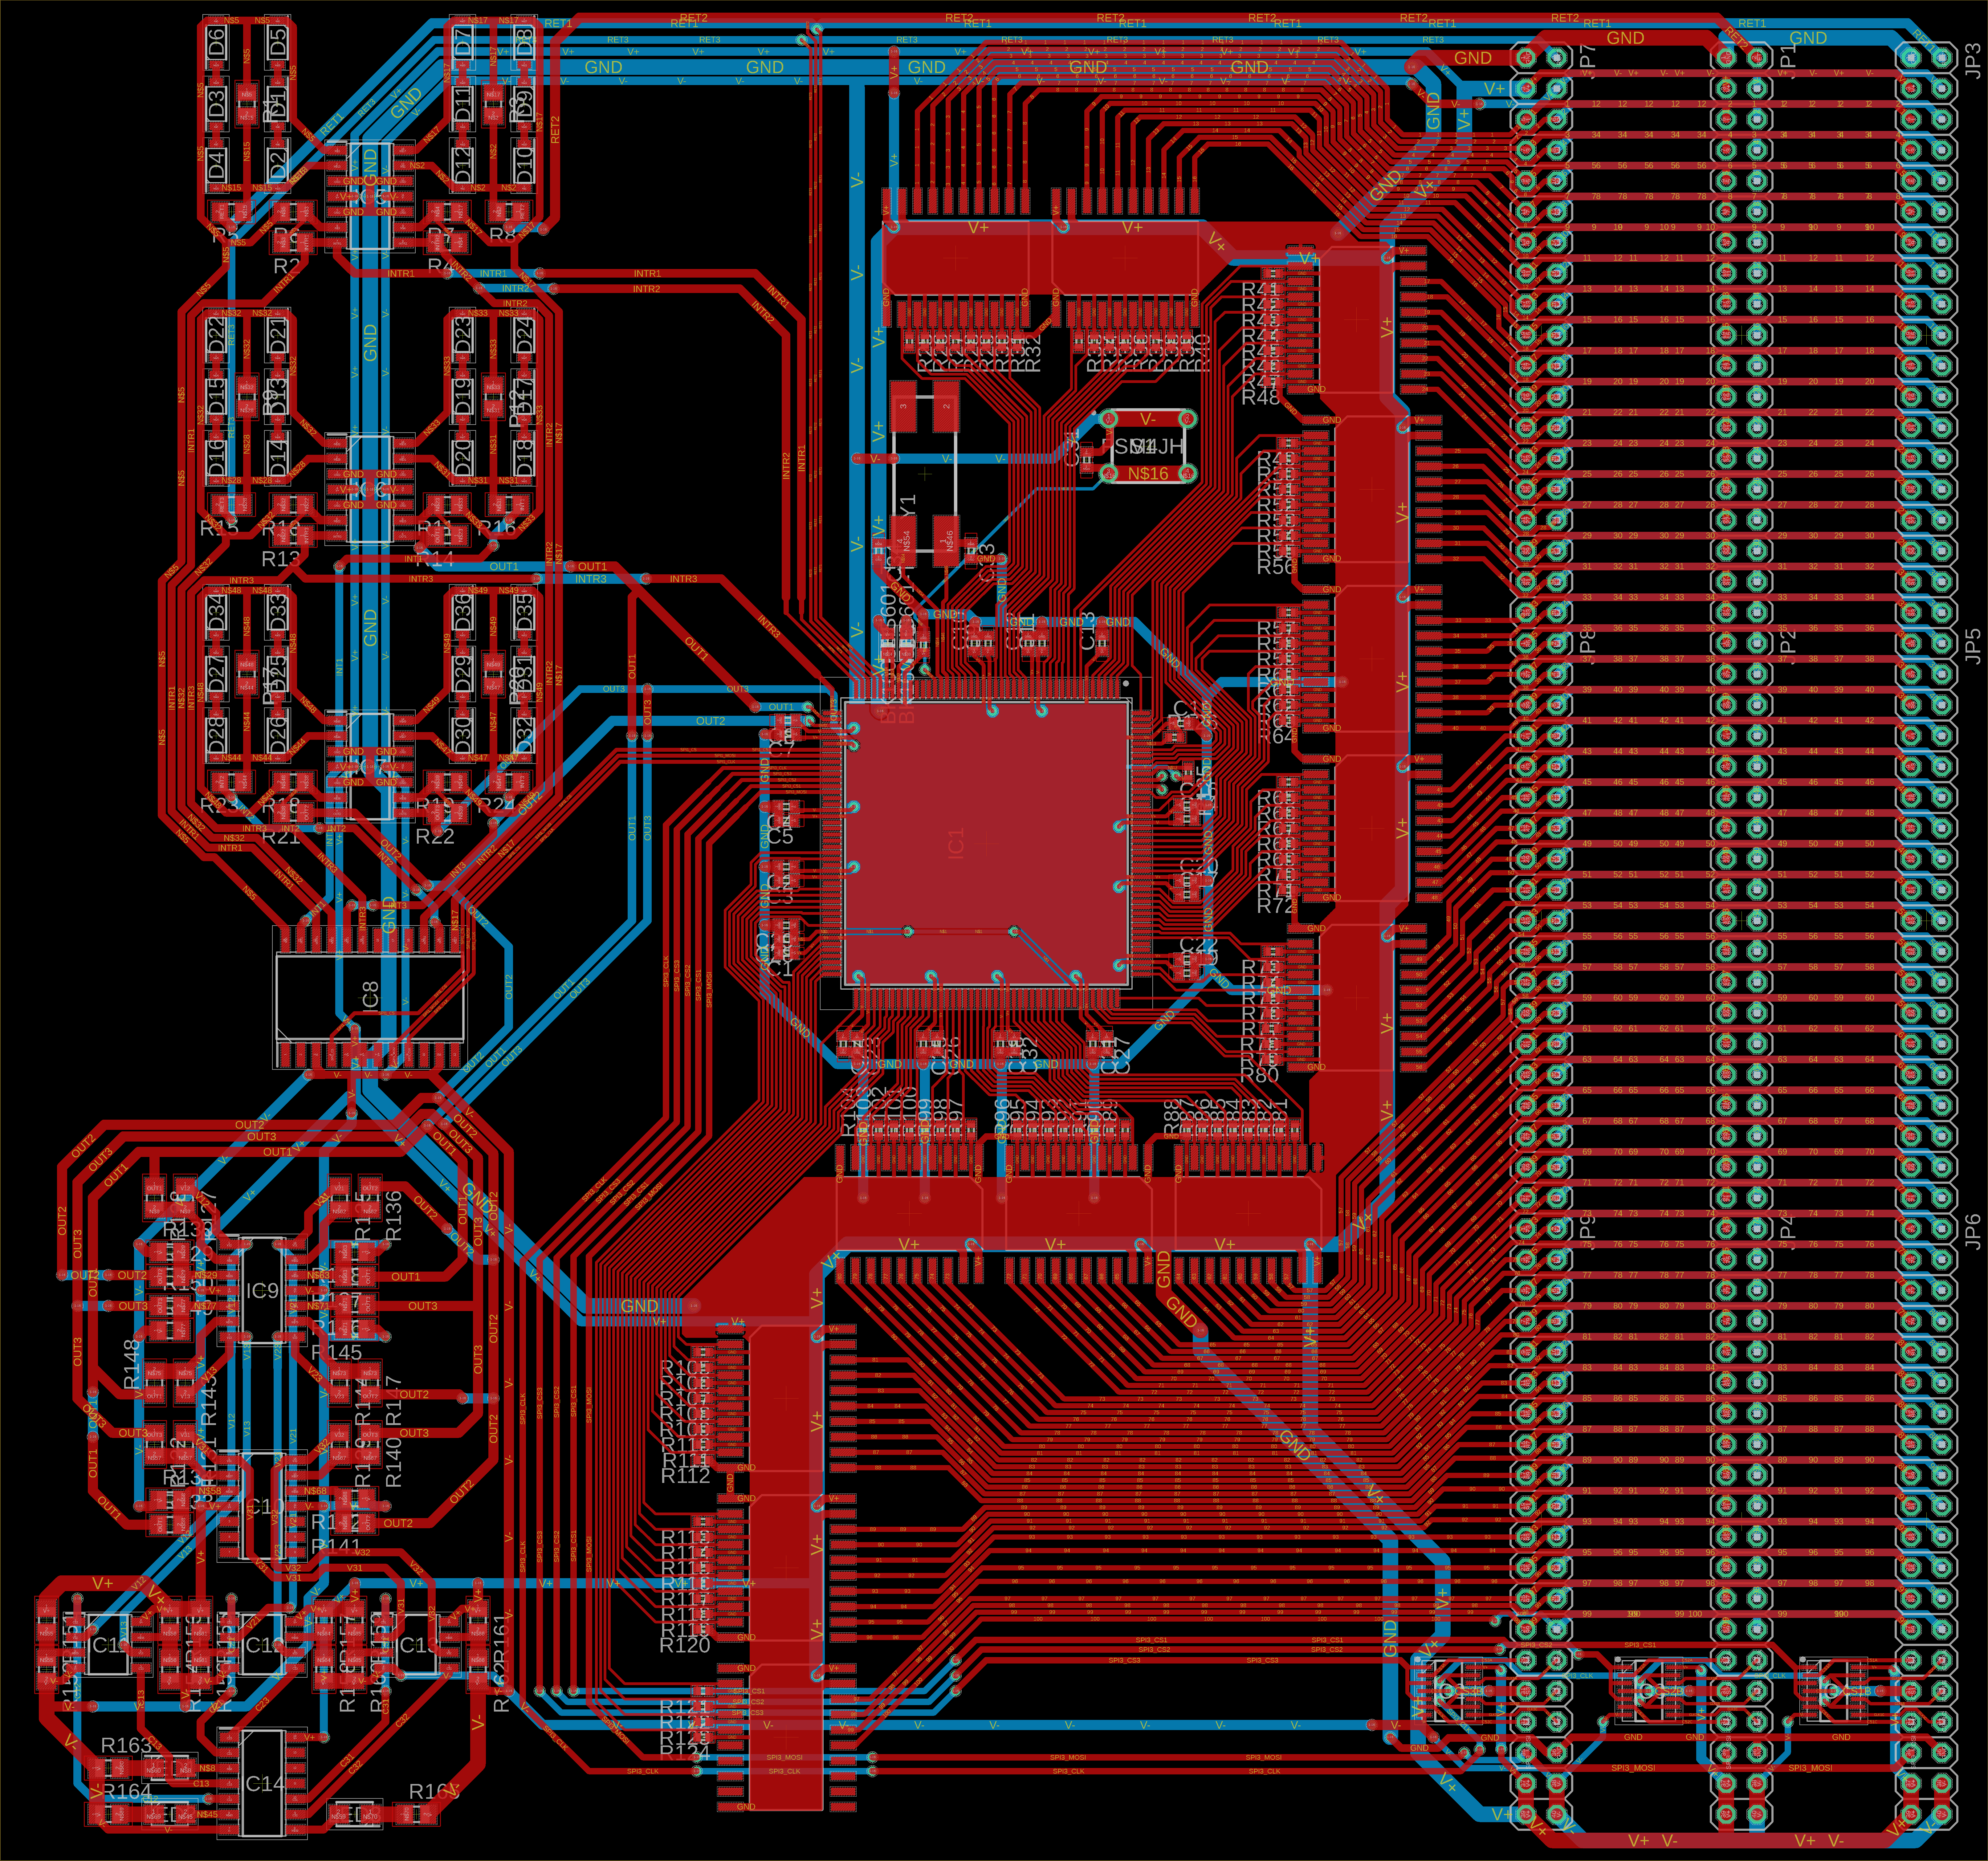
Final Network Motherboard PCB Design
100 outputs chained to each daughterboard; all buffered
Able to accommodate up to 3 daughterboards
2 layers
6.05" x 7.85"
Over 1,000 traces
Hidden layer and output layer
Comparator output array
Notes:
Luke
STM in center of board; outputs buffered by snake-looking octal buffers above, to right of, and below stm
neurons on upper left, comparator output on bottom left
note 3 sets of outputs for 3 daughterboards total

Slide 33
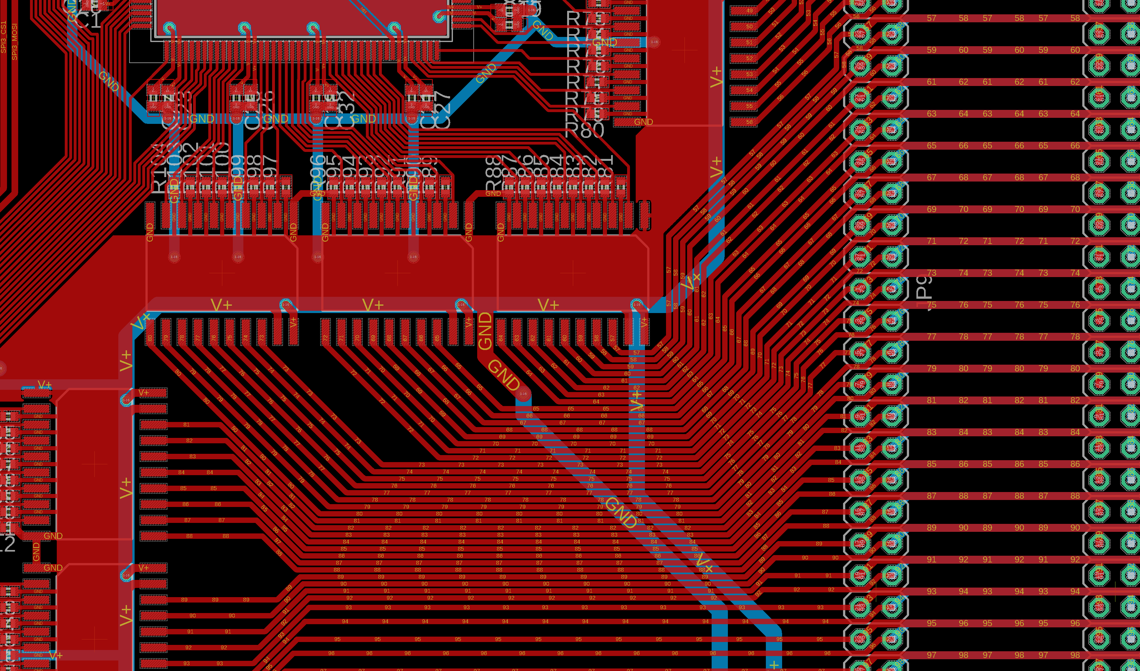
Motherboard
Notes:
Luke
magnified view of trace density near chip; note buffers with ground plane underneath and pulldown resistors between input pins to pull from 1.8v to 0v

Slide 34
Administrative
Notes:
Luke

Slide 35
Parameter | Value
Weight | 2kg
Footprint Area | 1m x 1m
Supply Voltage | 3.6 Volts rail-to-rail
Power Consumption | 1-2 Watts
External Temperature | 50° C
Number of input neurons | 100
Number of output neurons | 3
Input data resolution | 1 bit
Output latency | 10 ms
Throughput | 100 recognition operations per second
Accuracy | 75%
Specifications

Slide 36
Budget
Budget item | Allocated funds | Predicted spending
Prototyping development boards | $50 | $26
PCBs | $150 | $150
Network microcontrollers | $50 | $11
Potentiometers | $250 | $250
Operational amplifiers | $75 | $80
Resistors, capacitors, diodes, ferrite beads | $50 | $15
Sample collection camera/pad | $100 | $80
Total | $725 | $612
Notes:
Luke
Fill in missing boxes

Slide 37
Motherboard Cost Breakdown
Component | Price ($/unit) | # of units | Total cost ($)
MCP6274 | $1.01 | 5 | $5.05
AD5204 | $3.23 | 1 | $3.23
STM32H743IIT6 | $10.96 | 1 | $10.96
MCP6562 | $.71 | 3 | $2.13
74AHCV17APWJ | $.48 | 3 | $1.44
SN74HC08DR | $.40 | 1 | $.40
CD74AC541M | $.71 | 13 | $9.23
Resistors | $.023 | 165 | $3.80
Capacitors | $.022 | 33 | $.73
Ferrite Beads | $.10 | 2 | $.20
LEDs | $.17 | 3 | $.51
Pin sockets | $.075 | 350 | $26.25
Diodes | $.166 | 36 | $5.98
Miscellaneous |  |  | $2
Total (minus PCB) |  | 1 | $71.98
Notes:
Luke

Slide 38
Daughterboard Cost Breakdown
Component | Price ($/unit) | # of units | Total cost ($)
AD5204 | $3.23 | 25 | $80.75
MCP6274 | $1.01 | 28 | $28.28
Resistors | $.01 | 346 | $3.46
Pin Sockets | $.075 | 116 | $8.70
Total (minus PCB) |  | 3 | $121.19 (x3)
Notes:
Luke

Slide 39
Financing
Complimentary samples from manufacturers
Self-funded
Notes:
German
Our project has been primarily funded by ourselves, both financially and with some hardware we had prior to starting the project.
Luckily, we also were able to place many sample orders for ICs from several manufacturers during our prototyping stage.

Slide 40
Progress
Notes:
German
Most of the legwork for our project has been completed as we were able to get an early start since last summer.
Research and prototyping have all been completed.
The majority of the work left to do is finishing the PCB layout while troubleshooting any problems we most likely will encounter with the final neural network design.
We also have to finish the integration of our demo setup with the neural network, with a touch screen input for users to try, and an output LED array to show the final prediction of the neural network.

Slide 41
Problems Encountered
Finding good alternative to Memristors for synaptic weights
Different power requirements for chips on the same board
Modeling software activation stage curve with analog components
Confusion over SPI programming sequence and device naming scheme.
Switching from logistic sigmoid activation function to hyperbolic tangent due to incorrect translations between output voltages and software values.
Notes:
German
Some of the most successful implementations of hardware neural networks have used discrete memristor devices for the synaptic weights. Commercially available memristors are expensive and hard to come by so we had to come up with a good alternative device for this application.
To simplify the power layers of our PCB, we had to research for op amps that could be operated at the same power rails as our MCU and DigiPots, so we found a good RRIO +/- 1.8V op amp.
Modeling software activation stage curve with analog components
The biggest challenge that we had, in my opinion, was matching the software activation stage curve with the transfer characteristics of the neuron circuit. Lots of tweaking resistor values and re-designing/testing of the circuit before we obtained good results.
When programing the DigiPots on our prototype neural network, we had not taken into account the programming sequence of SPI protocol. The last chip in the daisy chain was programmed first, which caused some confusion when obtained ADC measurements during testing.
Switching from logistic sigmoid activation function to hyperbolic tangent due to incorrect translations between output voltages and software values.

Slide 42
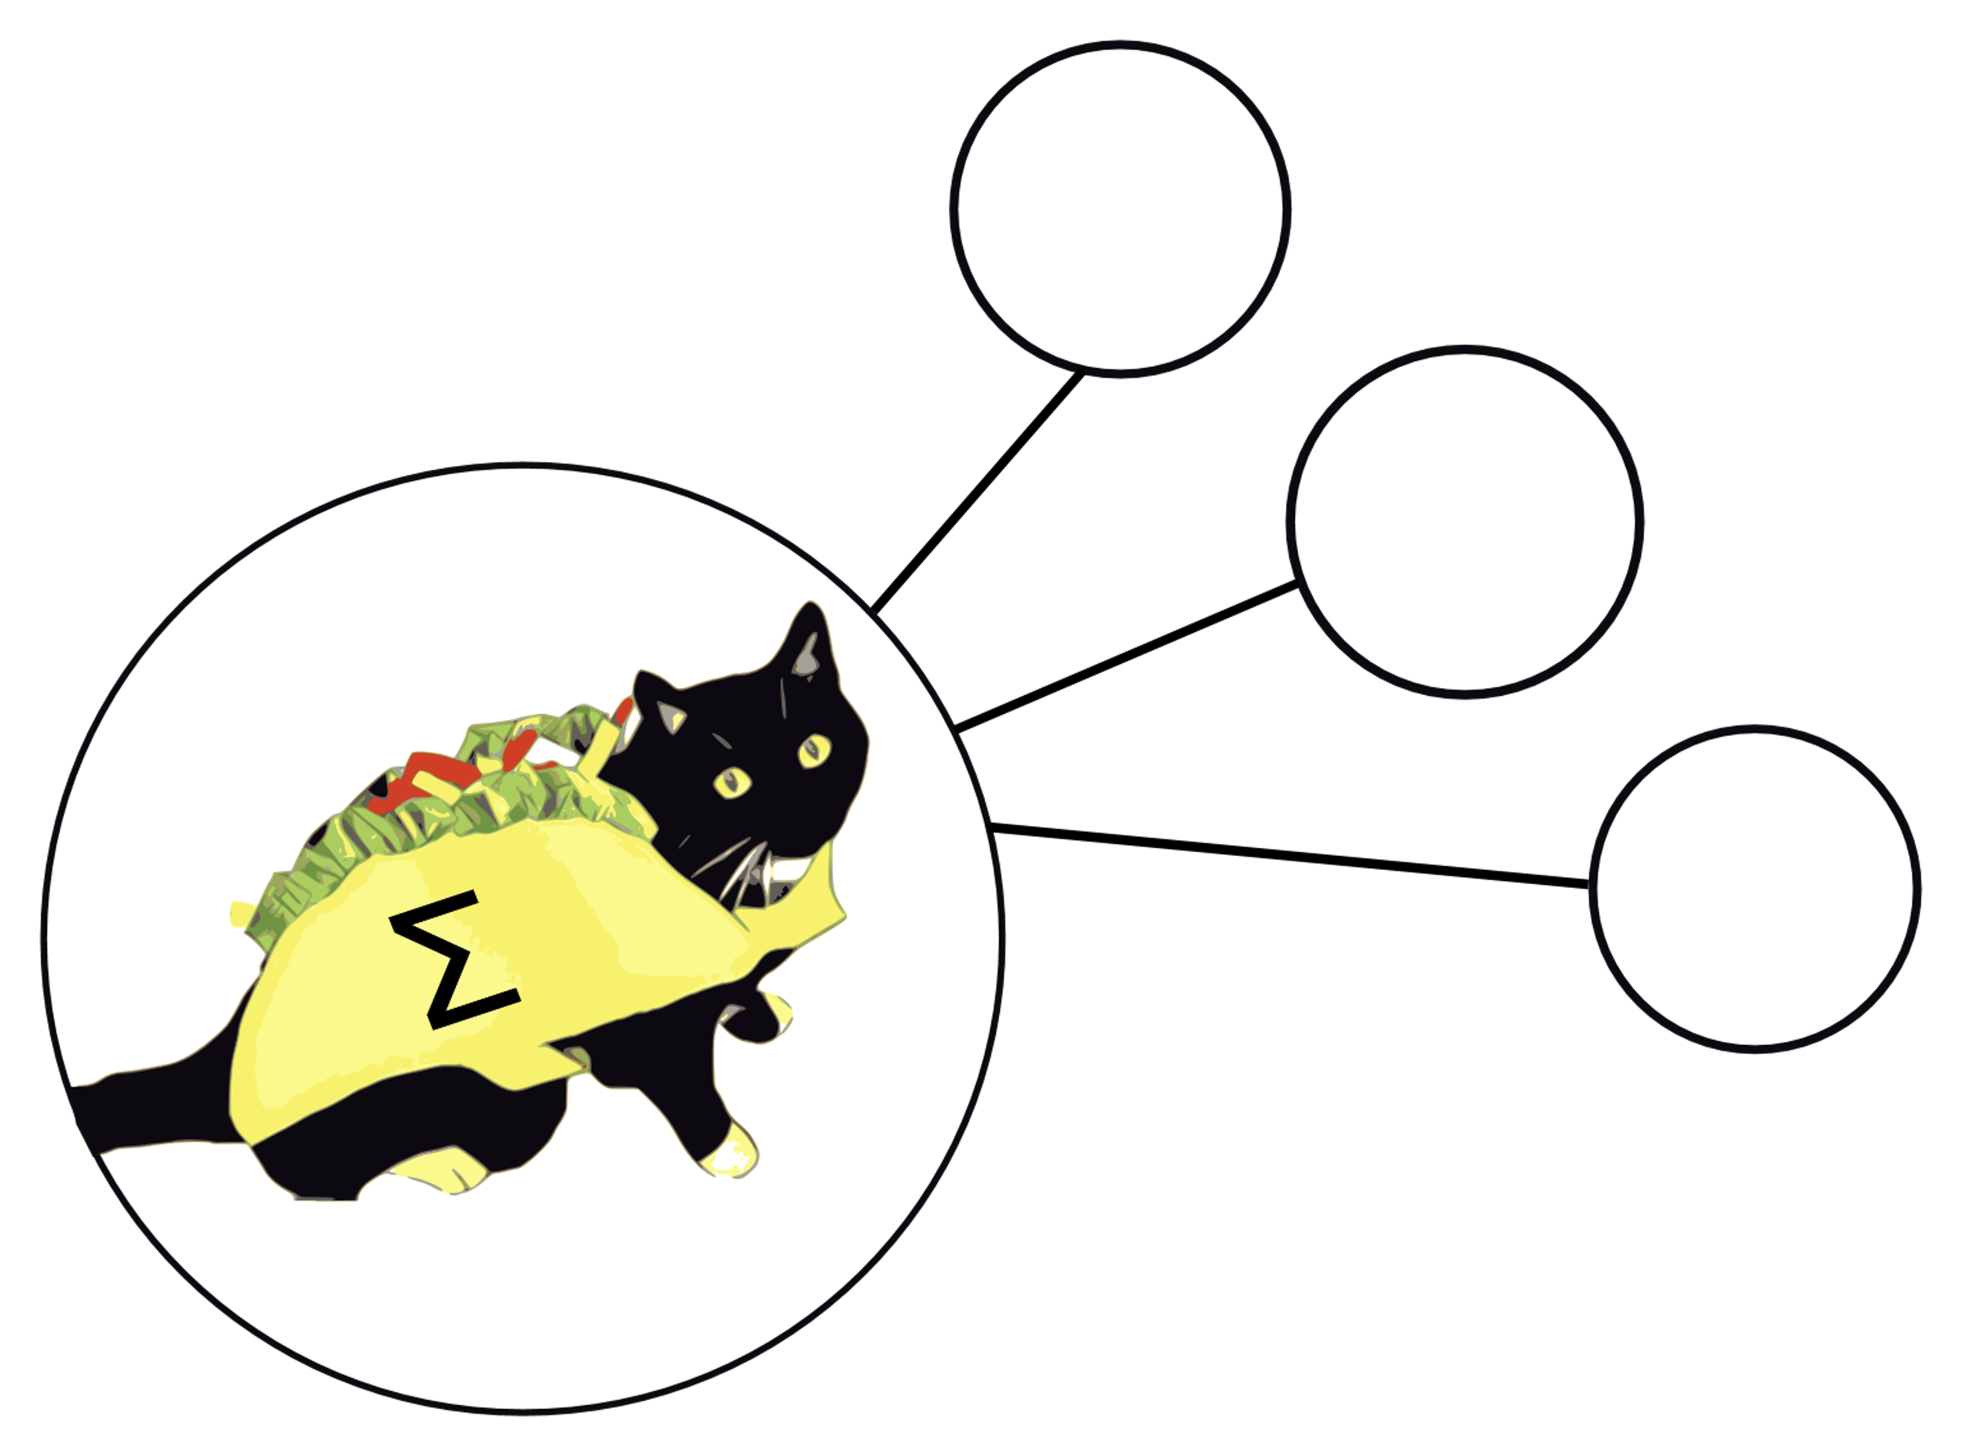
?
Questions?
?
?

