Slide 1






Autonomous Pet Entertainment System (A.P.E.S.)
Group 8
Nathan Anthony
Naim El-Nil
Ricardo Serrano
Cameron Alexander
Notes:
we are group 8 and our project is the Autonomous pet entertainment system or APES for short.

Slide 2

Motivation
We’re all home a lot now
Still have other obligations
Pets still want attention
Nathan
Notes:
Everyone likes to play with their pets when they’re at home. But there are times when you really need to get something done and just don’t have time to spare entertaining them. Especially these days with many people working virtually from home, our furry friends expect a lot of attention from us while we’re stuck in staff meetings. This is where the APES comes into play.

Slide 3
Description
Automated Laser Pointer
Roams the room
Specifications
Specification | Value | Unit
Speed | 1.5 | fps
Obstacle Distance | 8 | in
Radius | 13.5 | in
Height (peak) | 8-10 | in
Development Cost | ~600 | $
Laser Rangefinder Detection Range | 3-30 | ft
Side view
Height
Radius
Nathan
Notes:
The APES is designed to offer dynamic entertainment for pets without you needing to do more than just turn it on. The APES will be able to see your pet with an onboard camera and actively keep a laser pointer away from it as well as be able to move itself around a room while avoiding obstacles using a laser rangefinder and multiple IR sensors. It will have a similar speed and radius to a Roomba with a clear dome on top. The infrared sensors will not allow the device to get any closer than about 8 inches to any obstacle and the plan is to develop the APES for less than $600.

Slide 4
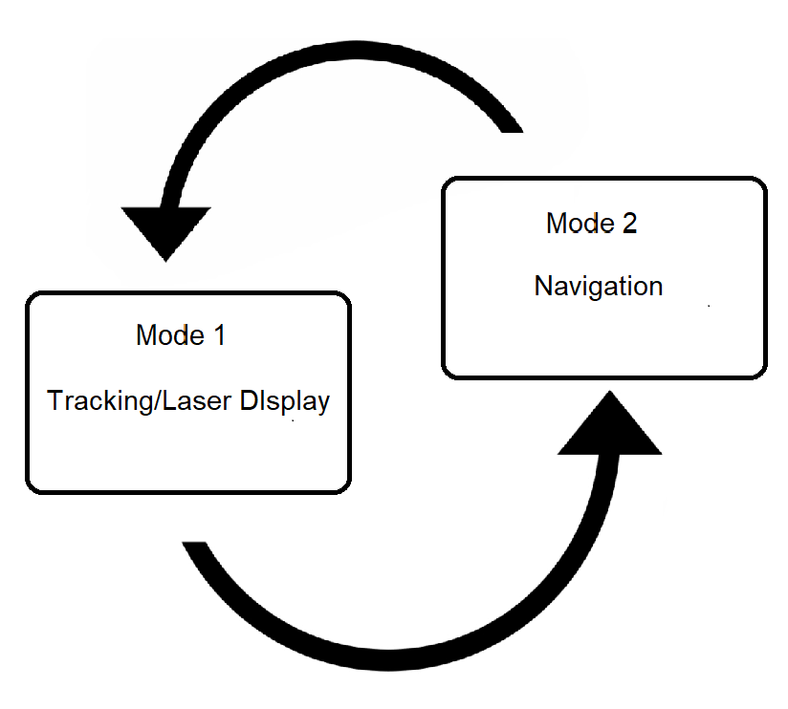
Operation overview
Two modes of operation
Mode 1: Tracking/Laser Display
Mode 2: Navigation
Autonomously switches between modes
Cameron
Notes:
The APES is an autonomous robot with two modes of operation
Mode 1 is scanning
Mode 2 is movement
The Apes is capable of switching between modes automatically

Slide 5
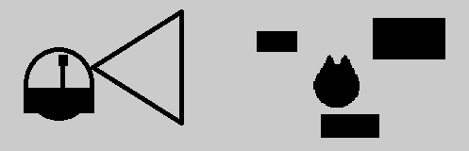
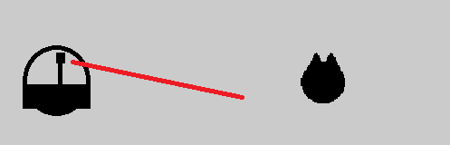
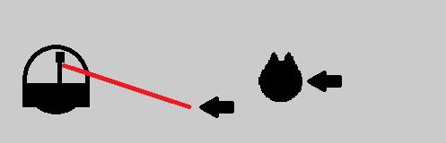
Operation overview - tracking/Display
After powering on APES scans the room for the subject
If the subject is detected it displays the show laser
It will attempt to keep the laser away from the subject
If the subject is not found it will switch to navigation
Cameron
Notes:
The APES begin in mode 1 and scans the room for subject
If the subject is detected it will display the show laser
it will attempt to keep the show laser away from the subject

Slide 6
Operation overview - Navigation
The APES will navigate its environment to find a new area to scan for the subject
It will use sensory inputs to avoid collision with obstacles
After time has passed it will switch modes again and attempt another scan for the subject
Cameron
Notes:
If the apes is unable to detect the subject it goes into mode 2
in mode 2 the APES will attempt to navigate its environment
It will take in input from sensors determine any obstacles in its path and navigate away from them
during both modes it will observe its orientation and shut off if knocked over

Slide 7
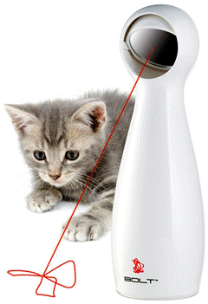
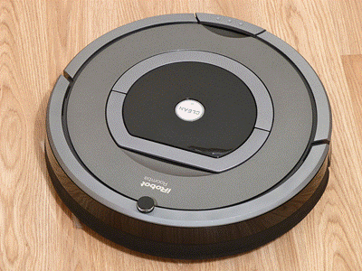
Design
A.P.E.S.
Nathan
Notes:
Now moving on to some of the design aspects of the APES. Many of these were inspired by existing robot vacuum cleaners and automatic cat toys.

Slide 8
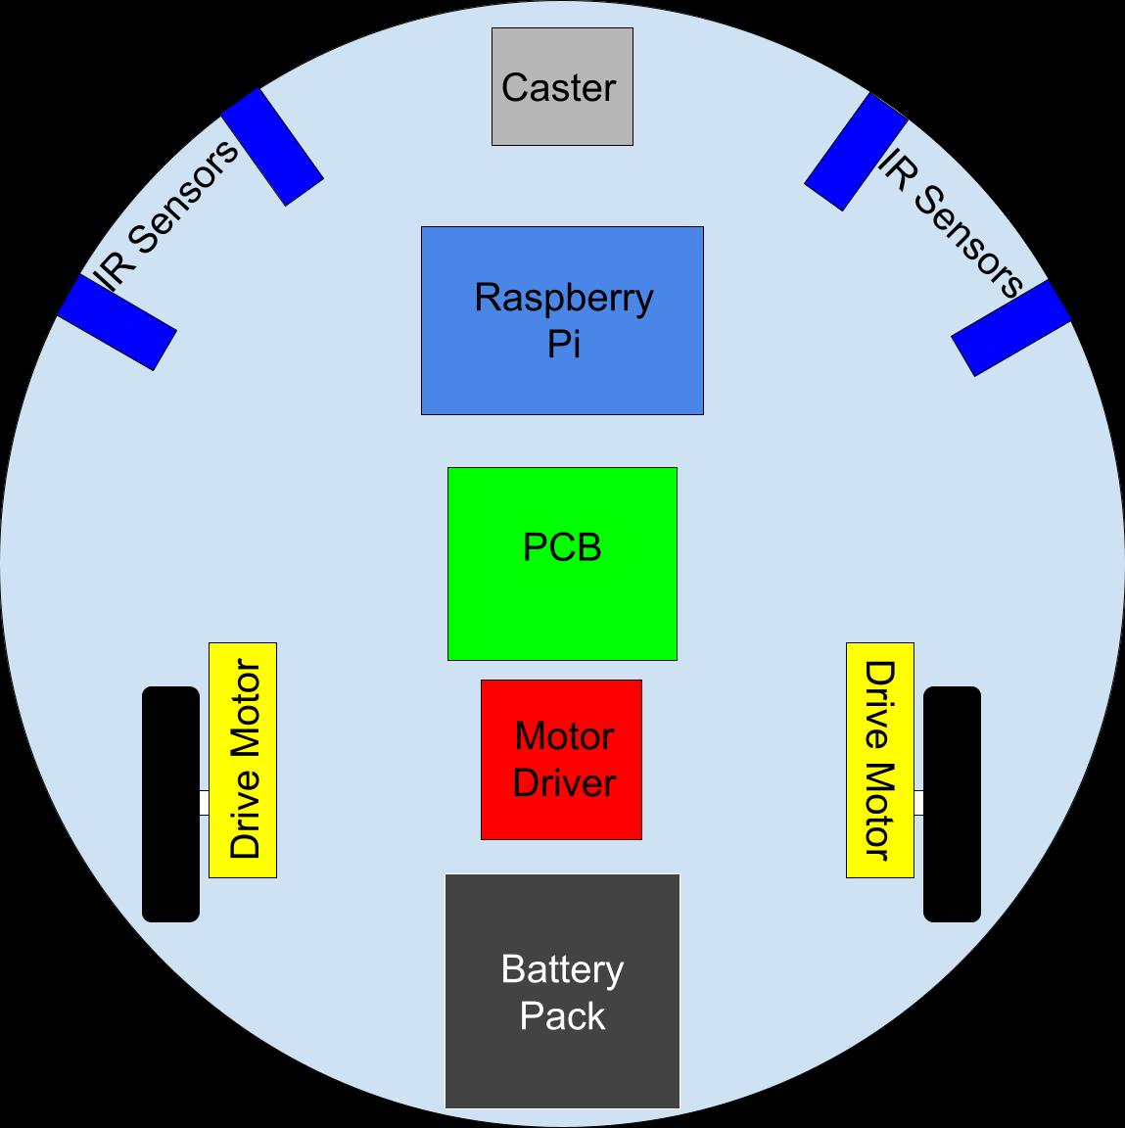
Propulsion
Front
Top-down View
Scaled Components
12”
Nathan
Notes:
The APES will use the three wheeled design shown here with two, fixed drive wheels that operate independently. The front wheel is a free spinning caster. This arrangement allows for minimal complexity, zero-radius turns, and a wide, stable base on which to mount the various other components. Also included on this level of the device is the printed circuit board containing the Atmega328, a raspberry pi board, the main motor driver, and all four IR navigational sensors.

Slide 9
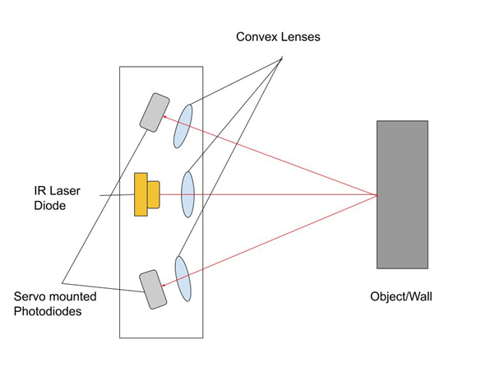
Laser rangefinder Overview
The Rangefinder is meant as a navigational tool
Uses laser output and photodetectors to find exact distance
Infrared light used instead of visible
Both Photodiodes swept for each measurement
Ricardo

Slide 10
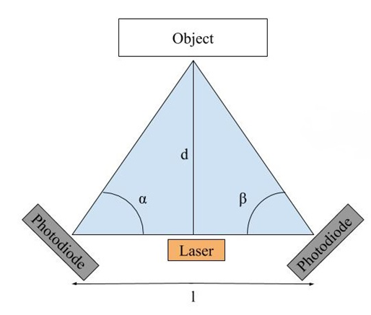

Rangefinder method
After analyzing various methods, Triangulation was chosen
Hardware needed for Time-of-Flight not feasible
Ricardo

Slide 11
Rangefinder Current Status
In the process of individual component testing
Components gathered for assembly
Finalizing Rangefinder Chassis design
Ricardo

Slide 12
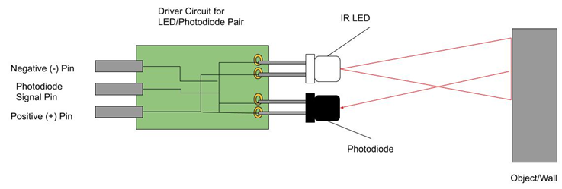
LED IR sensors
Utilized as additional navigation aid to rangefinder
Detects relative range, not exact
Individual units tested and working
Ricardo

Slide 13
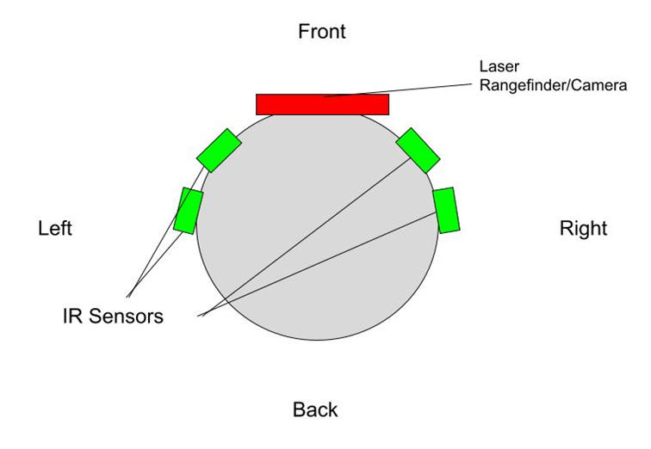
Location of rangefinders
Ricardo

Slide 14
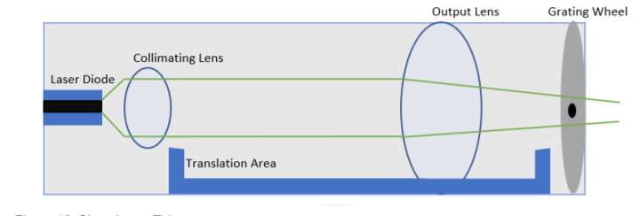
Laser tube overview
Show Laser
Telescopic Lens System
Diffracting Grating Wheel
Stability and Alignment
Attached to Servos
Laser Tube in APES Dome
Naim
Notes:
Hello my name is naim and I am going to be speaking about another subsystem of our project called the laser tube. The laser tube will be placed at the apex of our device to allow for the most degrees of freedom to rotate its beam vertically and horizontally around a room, and its purpose is to house 3 main optical components which the first is the show laser to generate a beam that will pass through the next two components, a telescopic lens system for magnification of the beam and a diffraction grating to change the pattern and shape of the beam.
Inside the laser tube, the components will all be optically aligned so the laser beam output will not be obstructed in anyway and will not move around as the laser tube rotates. The purpose of the laser tube is to bring the show laser, the lens system and diffraction wheel together so they could be rotated and maneuvered all together by the servos and keep the alignment steady.

Slide 15
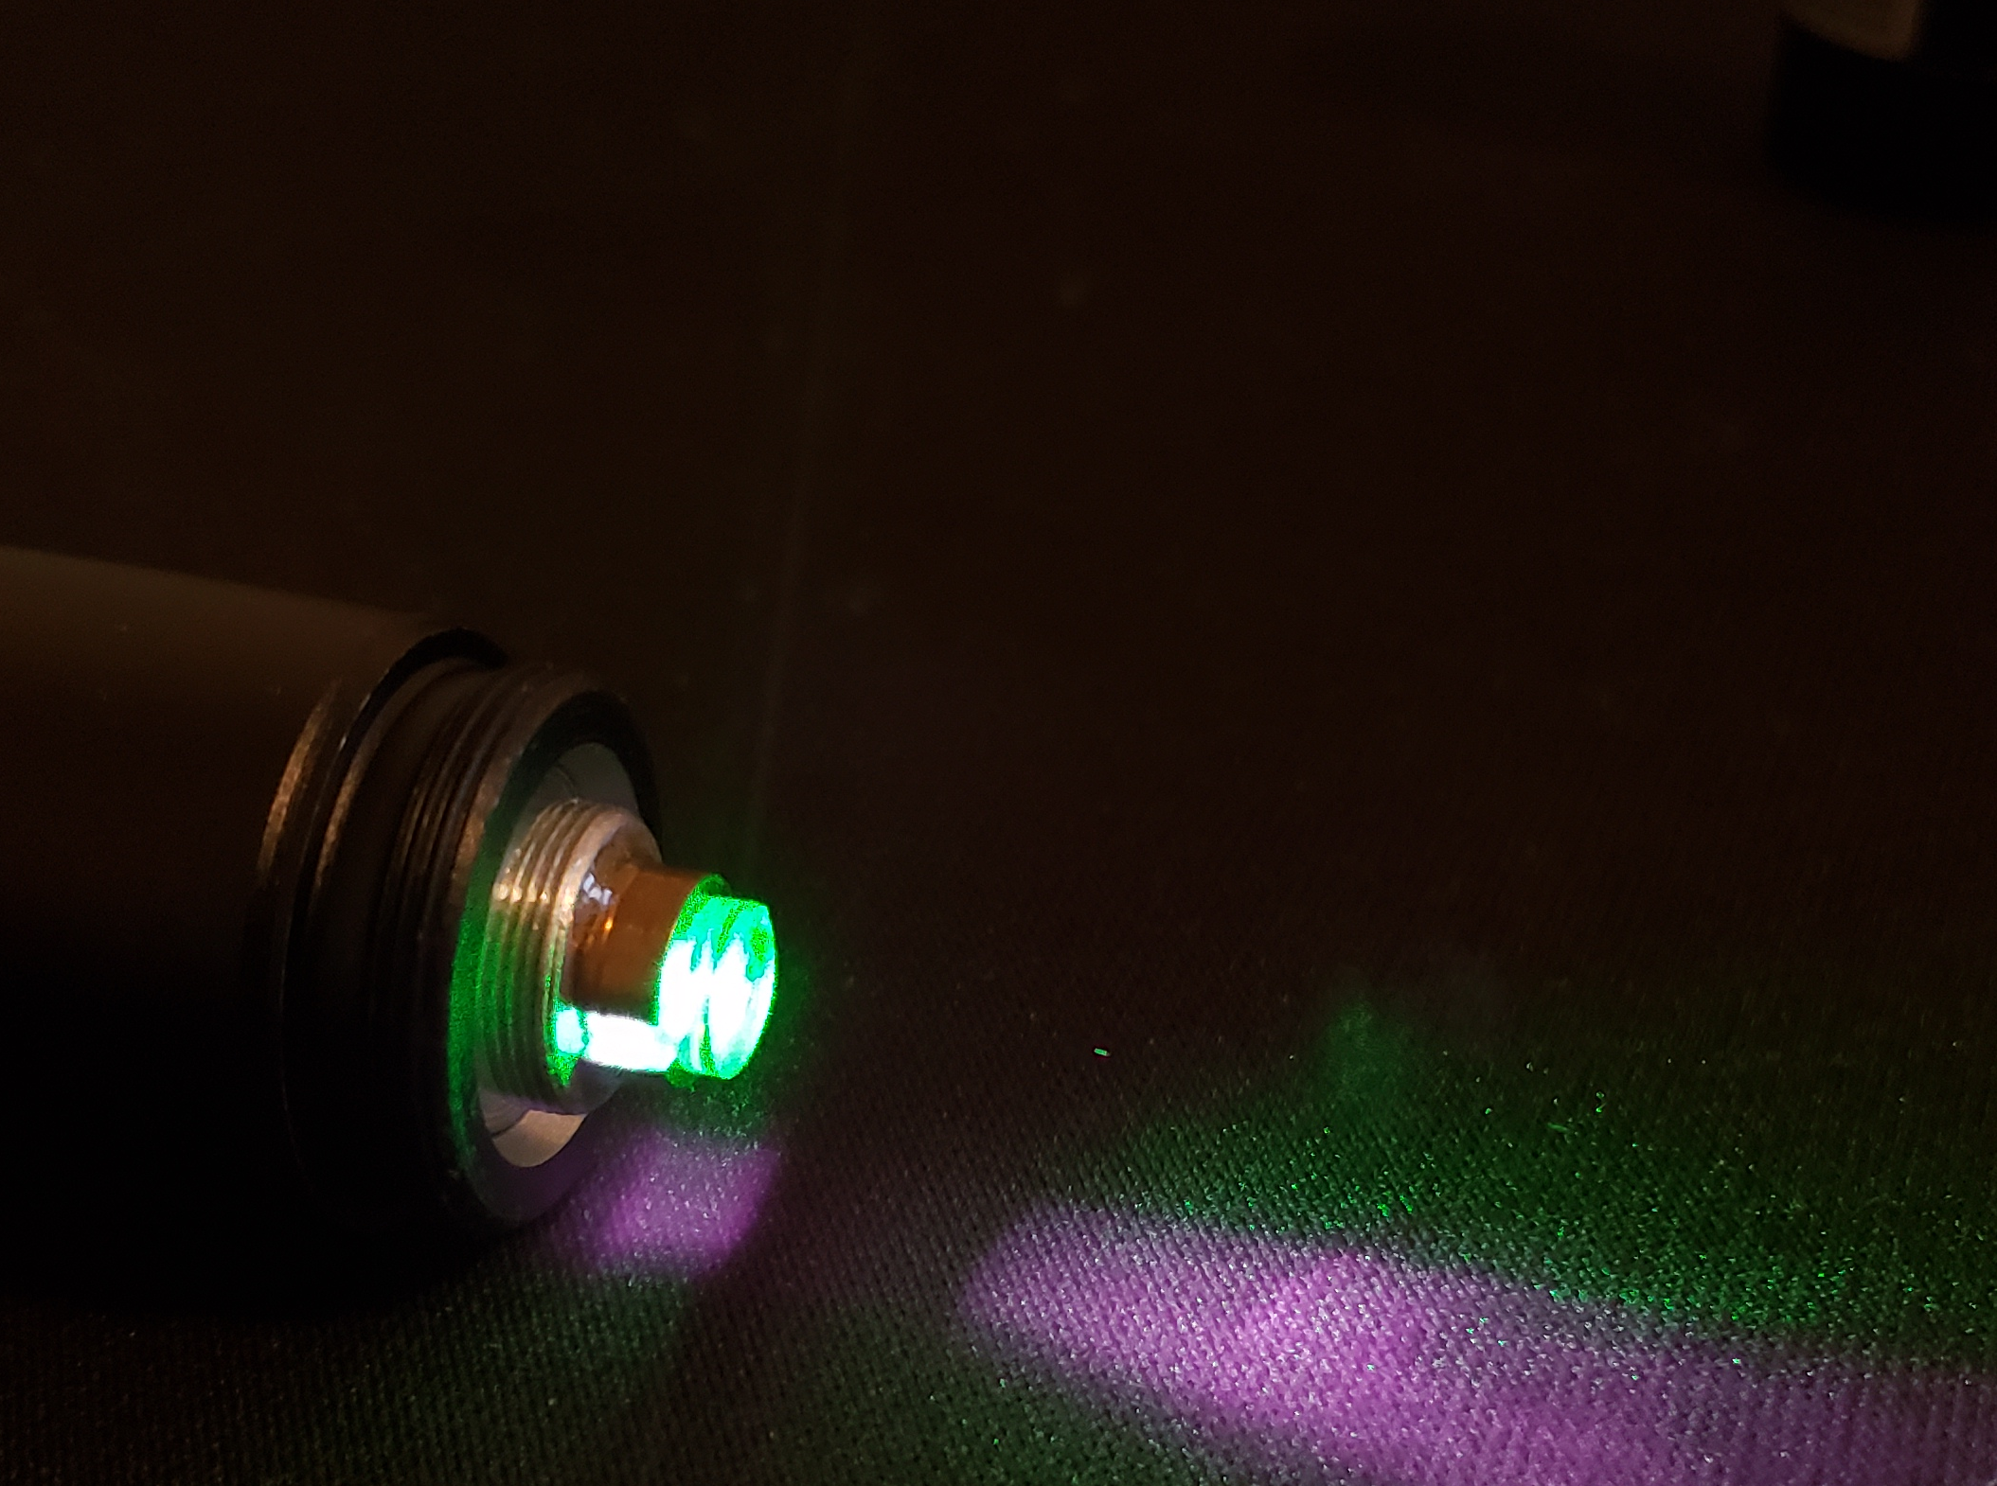
Laser Tube Components – Show laser
Green Laser Diode
Compact
Stable
Class 3
Naim
Notes:
The first component of the laser tube is the show laser.
The show laser is a green laser diode that will be pointed around to distract the cat and its output beam will be distorted by the lens system and diffraction gratings to create special visual effects unique to our project.
We chose a laser diode for our device due to its simplicity and compactness compared to a normal laser. A normal laser usually has its cavity still and is very prone to stop lasing when the cavity is disturbed. The laser tube is one of the most mobile parts of the APES so choosing to build a normal laser is less than ideal. The laser diode deals with this problem since its cavity is semiconductors fused together and will never be disturbed.
The laser diode is also primary choice for its size. This small laser will easily be able to fit inside the laser tube with plenty of room to spare for the other optical components. The laser tube needs to be small to fit inside the plastic dome and the lens system will need the most space in the tube.
Another factor of the laser diode’s compactness is its power supply as it only needs to connect a voltage source rather than a bulky power unit. that would not fit on the device.
Our laser is a class 3 laser according to international laser safety standards since it is in the visible spectrum and has an output power less than 5 mW. This makes it very dangerous to the naked eye and to ensure safety, the show laser will primarily point its beam towards the floor and polarizers will be added to reduce the output power. The maximum angle the show laser can point is parallel to the floor and since thei device is fairly short there is little concern that it can reach a human’s eyes

Slide 16
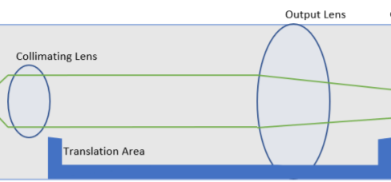
Laser tube components – lens system
Changes Size
2 convex lenses
1 Lens moves along axis
5x Magnification
Naim
Notes:
The main purpose for the lens system and diffraction grating is to create special and unique effects on the output beams size and shape, and this is a design decision to add more optical elements to the project and more discrepancy to other laser pet toys.
The telescopic lens system includes two convex lenses where one has a short focal length and the other has a longer focal length. When the two lenses are placed a distance of their focal lengths combined, The ratio of their focal lengths is equal to the amount of magnification. variable magnification is introduced when one of the lenses is moved along the optical axis and the other lens is fixed. The maximum distance will be the focal lengths combined and the minimum distance will be approximately zero and there will be increment distances with distinct magnifications. For example if the maximum magnification is 5x, then variable magnifications will in 2x, 3.5x, etc. A motor will be connected to a stage that will translate the movable lens along the optical axis to the incremented distances.

Slide 17
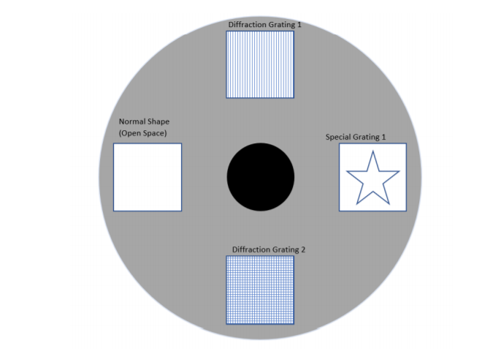
Laser tube components – grating wheel
Changes shape
Creates 4 unique patterns
No Grating
Single Axis
Double Axis
Special Grating
Naim
Notes:
The diffraction grating is one of the simplest ways to change the shape of an output lasers beam in the field of optics. Our project does not worry about the intensity distribution, but only its shape and the diffraction grating fits this criteria perfectly.
The grating wheel is a thin disk with multiple different types of diffraction gratings embedded into it and it will be able to rotate with a motor to change to only one grating for the beam to pass through. The diffraction wheel will have atleast 4 different types of gratings: No grating (normal beam), single axis grating, double axis grating, and special grating. The importance of choosing these types of gratings is that they are distinct. The special gratings includes any gratings that will display a shape such as a star, crosshairs, etc.

Slide 18
Laser tube Successes and difficulties
Components gathered
Size
Laser Alignment and Obstruction
Servos Mount
Stability and Assembly
Naim
Notes:
Moving on to the discussion of successes and difficulties for this subsystem, all of the components have been gathered.
For size, As mentioned before the tube needs to be small enough to fit inside the plastic dome and have fredoom to rotate vertically
For the show laser, difficulty for the laser tube will include optical alignment and to make sure the beam does not get obstructed.
For the servos, the stability of the mounted laser tube is a large potential difficulty as there is a lot of motion and it could become unstable. Additional components may be needed to increase stability.
Lastly, Assembly is in progress to determine the correct sizes for all the pieces and to create the laser tube.

Slide 19
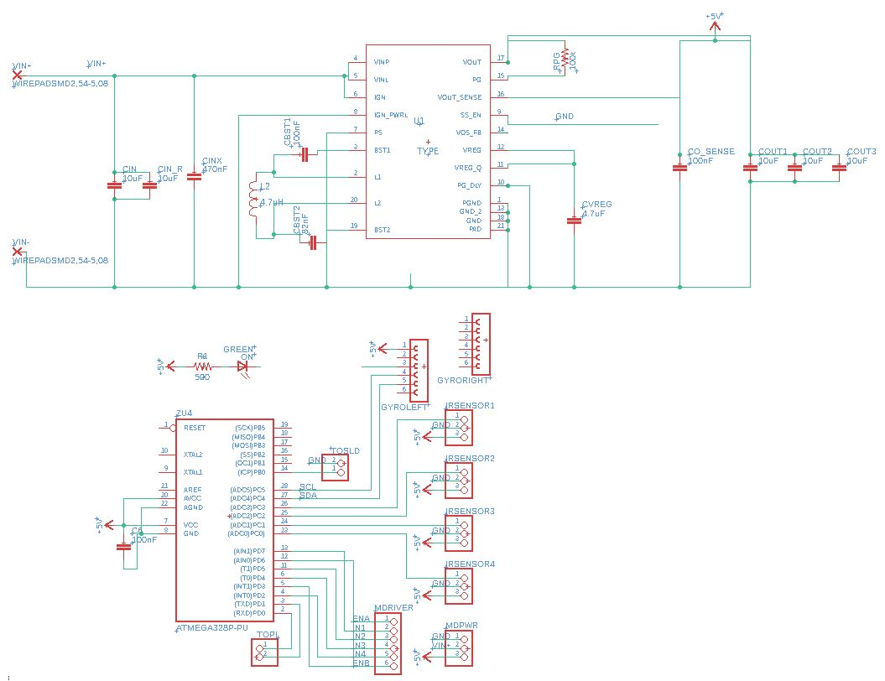
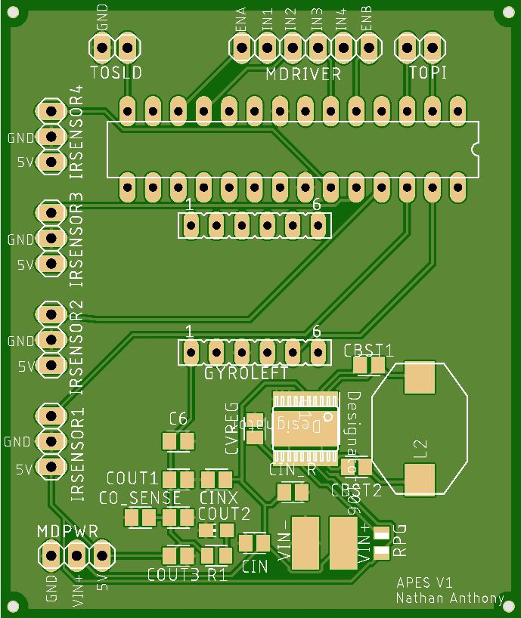
PCB Design
Nathan
Notes:
Now we move on to the design of the printed circuit board which was done in both Eagle and Fusion360.

Slide 20
PCB Schematic - What it’s controlling
Nathan
Notes:
This PCB will act as a hub for the powering and control over the majority of the sensors and propulsion systems of the APES. These connections are represented by the pin headers highlighted on the schematic. The components to be connected to the PCB include the four IR sensors, motor driver, gyroscope, show laser, and two communication pins. With the exception of the gyroscope, these components will be connected to the board via external wires to allow for ease of positioning within the actual device. The gyroscope will be mounted to the center of the circuit board to ensure that it gets the best reading about overall device orientation.

Slide 21
PCB Schematic – atmega328
Nathan
Notes:
In order to accommodate these components and their necessary connections, an appropriate microcontroller needed to be selected. The two main options are the ATmega328 and the MSP430G2553. These two chips are very similar in their features and our team is familiar with working with both. The deciding factor ended up being the number of PWM capable pins. This rules out the MSP since the motor driver we are using requires 4 PWM signals while the MSP only has 3 capable pins. On top of having a usable set of pins, the ATmega also has a faster clock, more memory, a wider operating voltage range, and lower power consumption. These will be useful for ensuring safe and lasting operation of the toy.

Slide 22
PCB Schematic – voltage regulator
Nathan
Notes:
The APES is to be powered by four AA batteries whose output varies from 6.6V (fully charged) to 4.8V (depleted). Thus, to enable the toy to use the greatest amount of power from our battery supply, a voltage regulator is needed that can produce a steady 5V from an input both greater and smaller than 5V. This type of regulator is called a buck-boost regulator.
The original design had the highest efficiency and lowest part count that could be created using the TI WEBENCH power designer tool and was selected mid last semester. Unfortunately this regulator has since been sold out at every retailer I could find with no estimate as to when more could be stocked. Since our deadline is considerably sooner than “indefinite”, a different design had to be selected.
The current voltage regulator is shown in the top section of the schematic. A compromise had to be made between the number of parts in the circuit and the efficiency. While this design does have a relatively low number of components, the efficiency is only about 87% which should be acceptable for our application.

Slide 23
PCB Layout
Image Via JLCPCB
Nathan
Notes:
The printed circuit board itself was ordered through JLC PCB.com. The components were sourced from various vendors. All parts and boards have been received and assembly has begun.

Slide 24
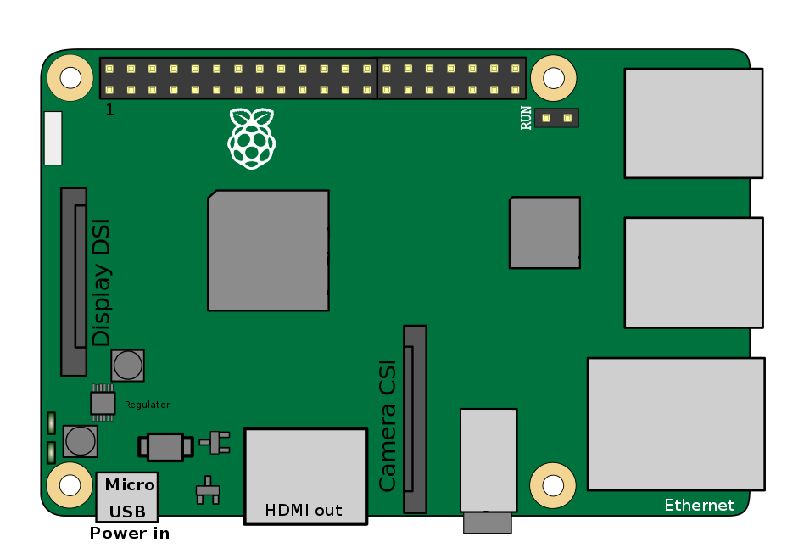
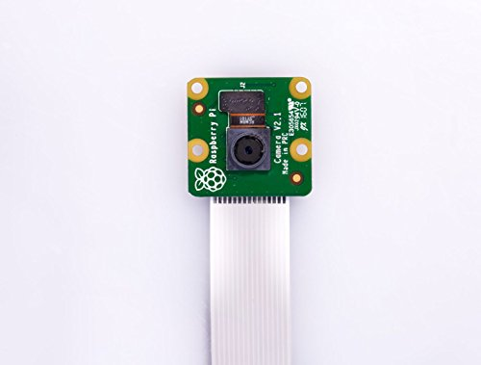
Raspberry Pi 3B and Camera Module
Cameron
Notes:
Pi3B
Primarily used for vision and show laser movement, while also relaying range finder information during movement
Pi is a more powerful than other microcontrollers at a similar price
Allows for us to run complex vision calculations necessary for the APES to meet its design goals
Includes a dedicated camera port that allows for faster video communication between the program and our webcam
Large repository of information regarding other projects with the pi, python libraries for computer vision makes research and implementation easier
RPI-CAM-V2
Camera module specifically designed to be used by the raspberry pi
has special connection directly to the board which allows for faster communication while freeing up space for other peripheral attatchments
60 frames per second at 720p resolution allows for capturing of the data we need to track the motion of the subject

Slide 25
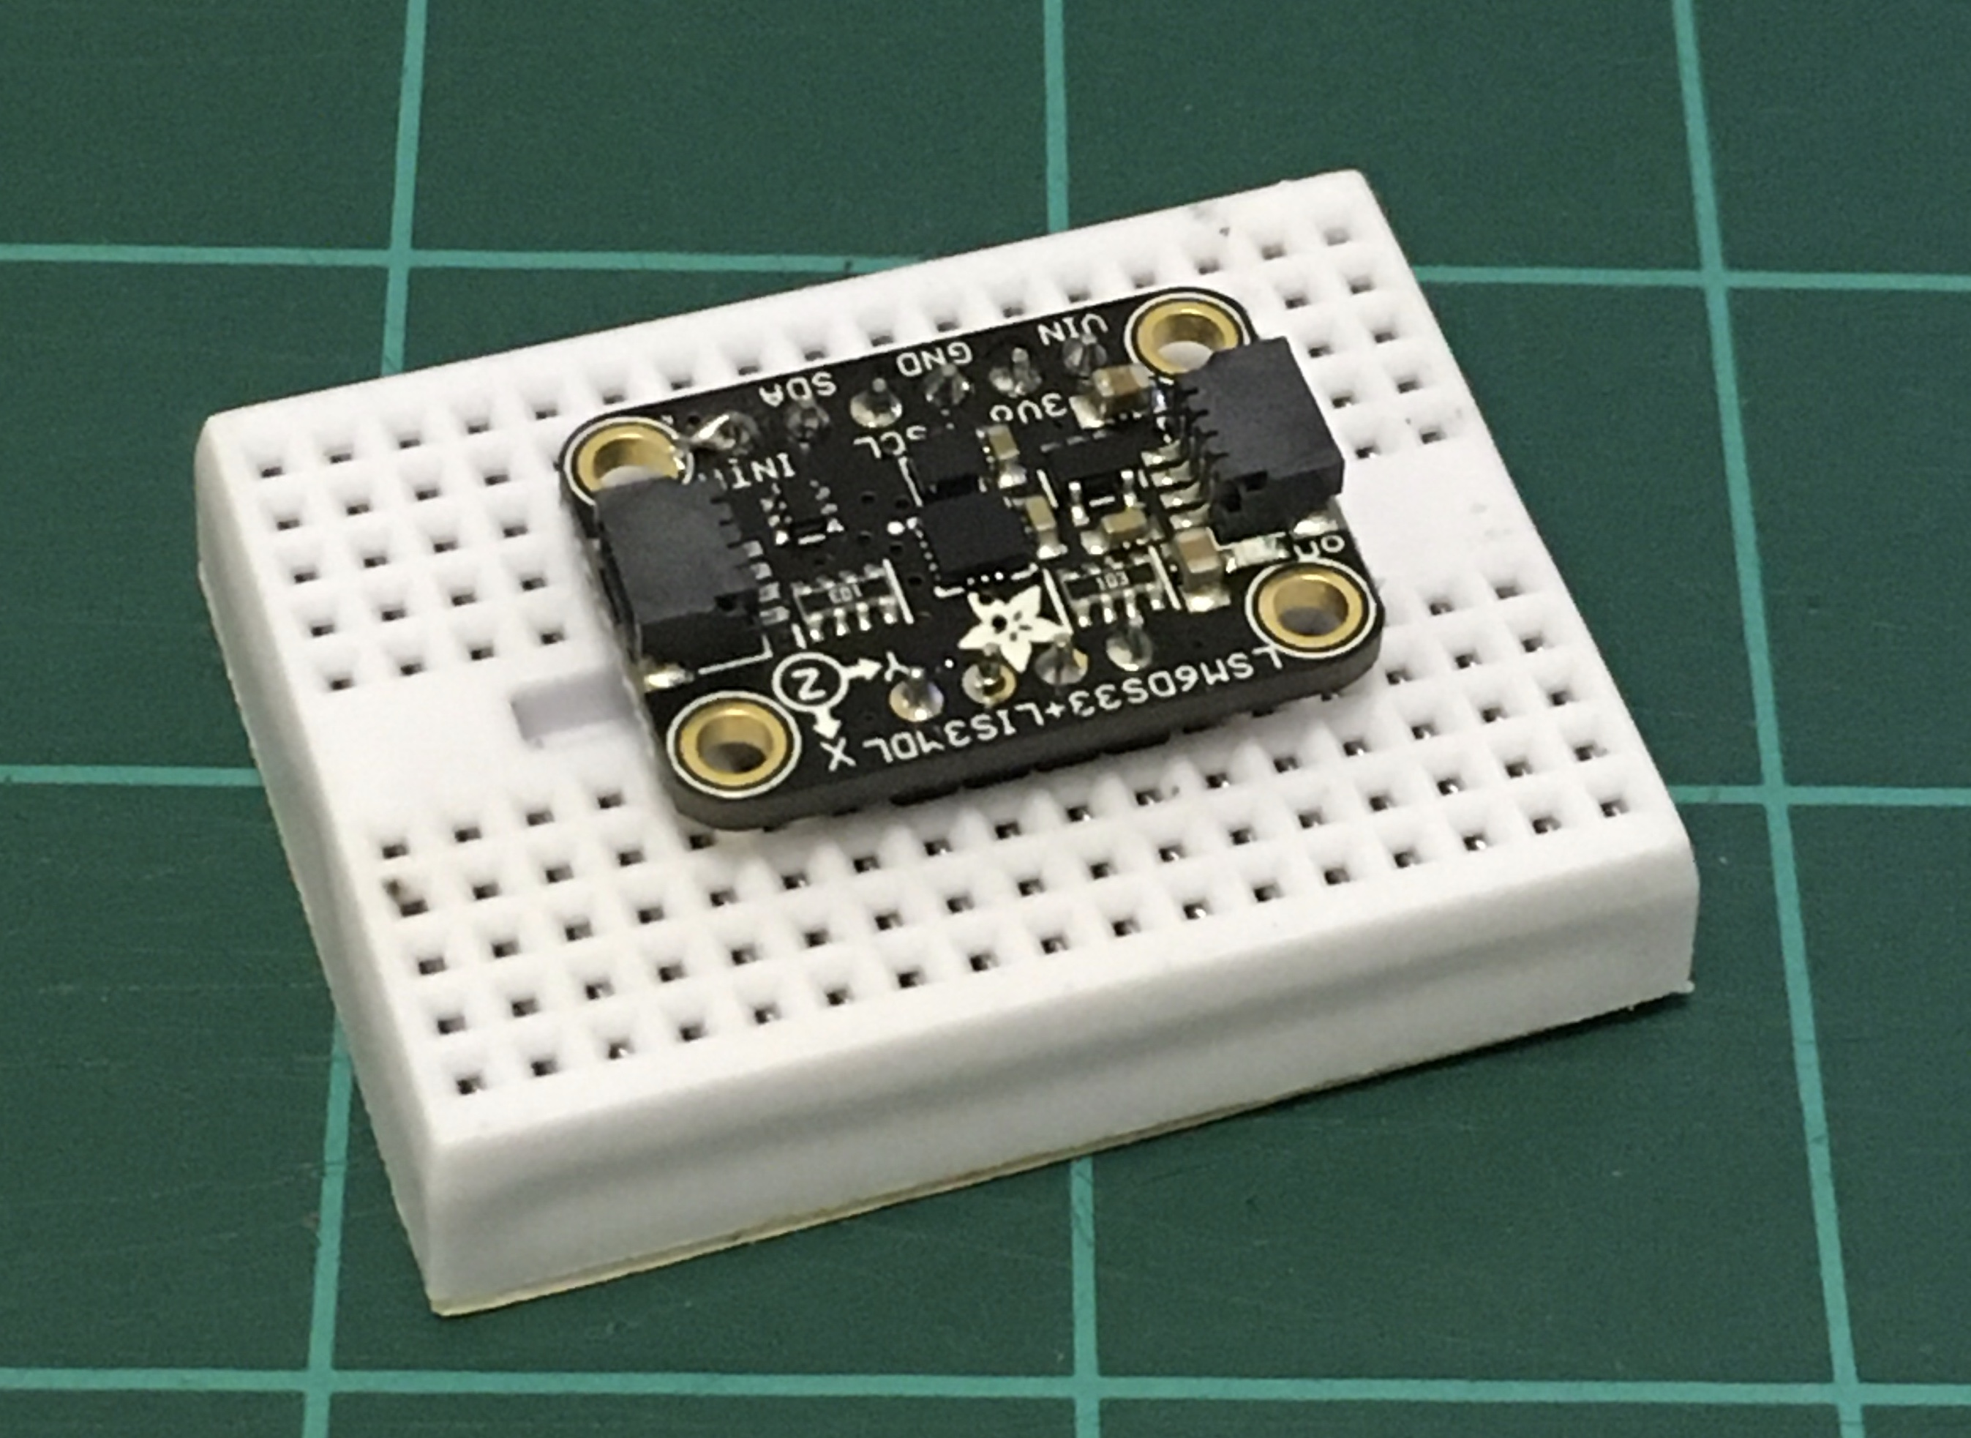
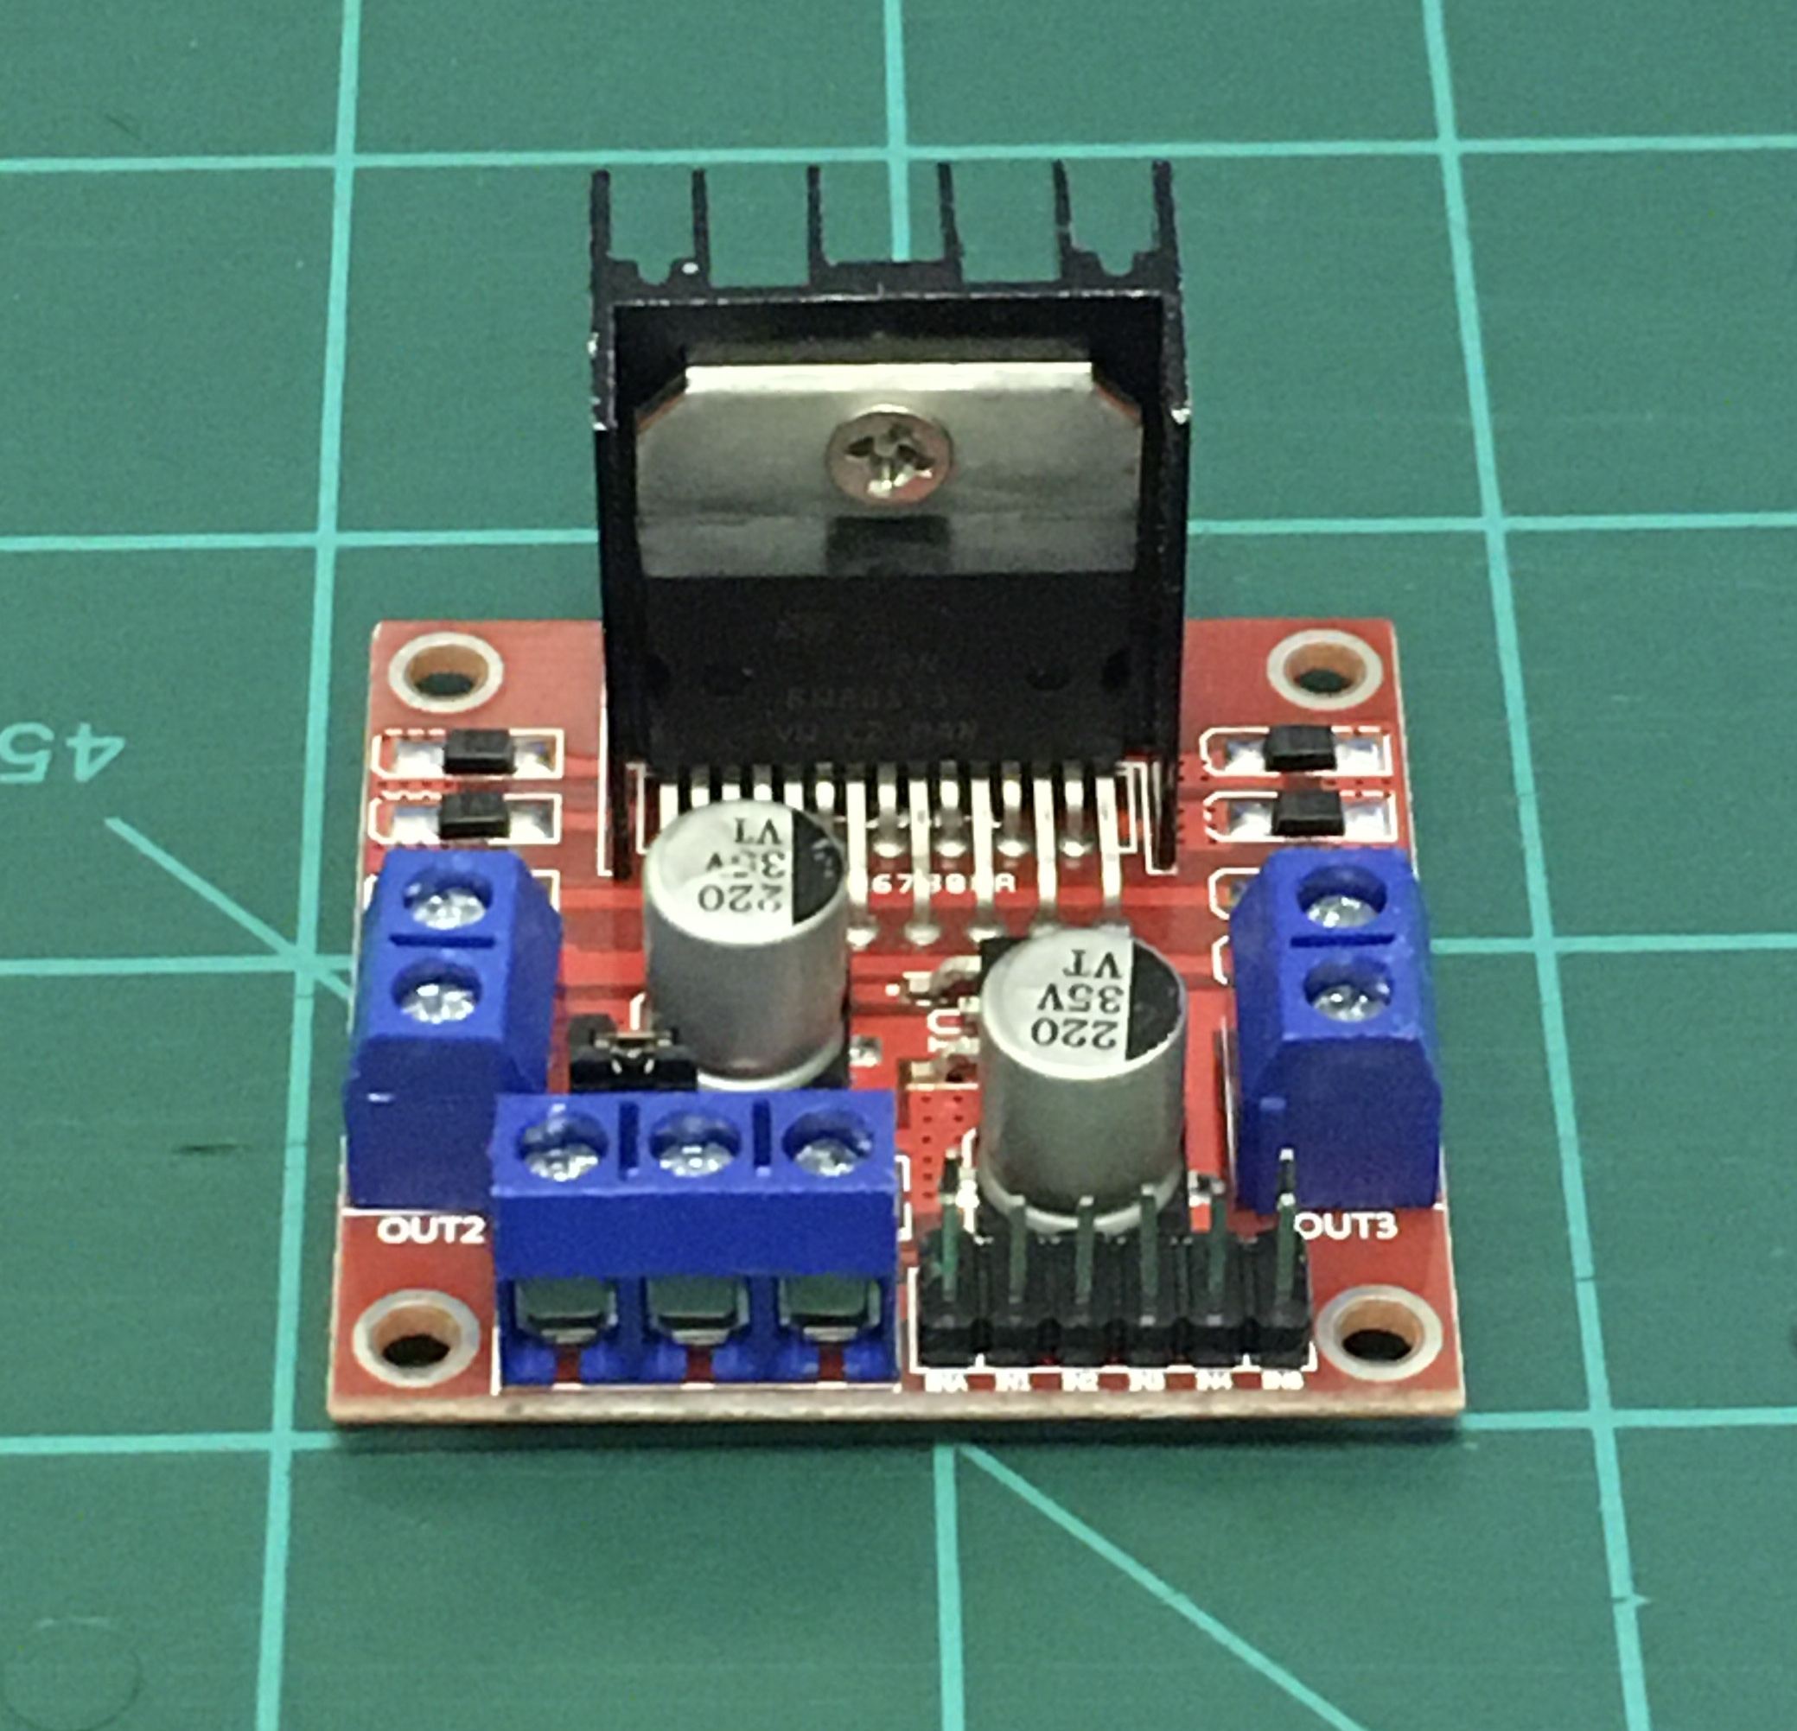
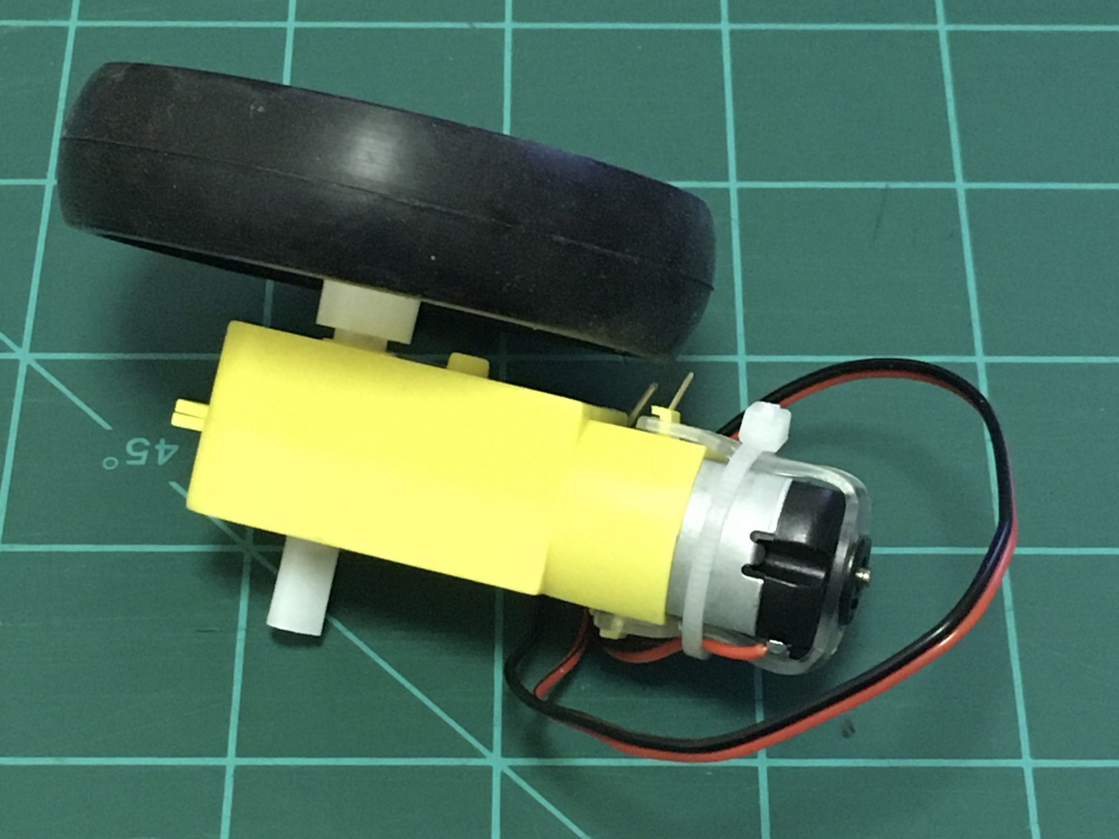
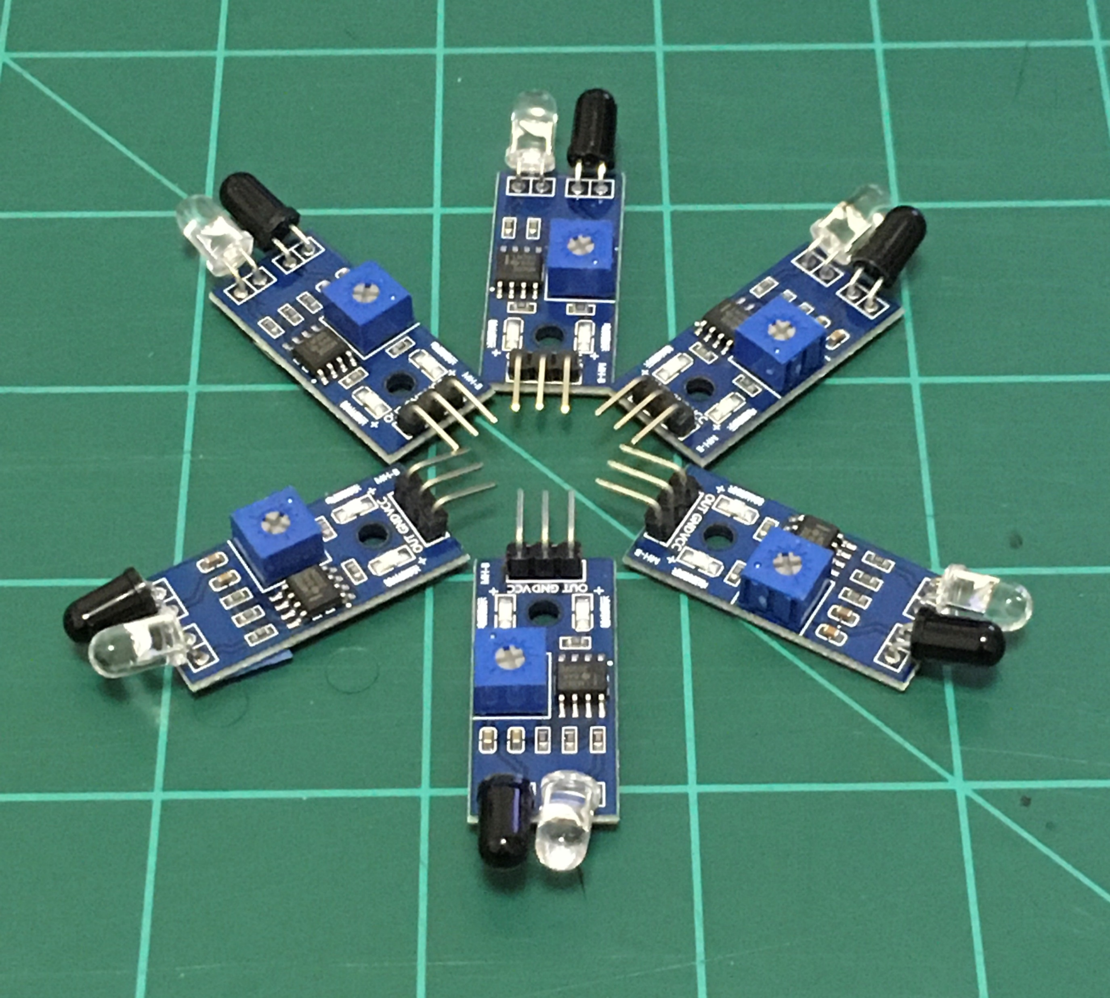
Hardware Testing
LSM6DS33 Gyroscope
L298N Motor Driver
TT Motor and Wheel
Nathan
IR Sensors
Notes:
Thus far, hardware testing is largely proceeding as planned. Each component was tested individually with either an Arduino UNO or raspberry pi 3 driving them to ensure they all work as needed.

Slide 26
Hardware Testing – IR Sensors
Nathan
Notes:
The infrared sensors being used in navigation are tuneable to detect different distances via a potentiometer. In order to determine the effective detection ranges of each sensor, the potentiometer was adjusted to its minimum and maximum settings until an object was no longer detected. These values were recorded and four sensors will be chosen for use on the prototype. The intended range for the prototype is around 3 to 6 inches which falls within the effective range of all the sensors tested.

Slide 27
Hardware Testing - Gyroscope
Nathan
Notes:
The purpose of testing the gyroscope is to ensure that the calculations can be made in a fast, efficient manner to determine the current angle of the device along either the X or Y direction. Only these two axes are required because they represent the planes parallel to the floor, which this angle is relative to. This data is crucial to the safe operation of the toy because in the event that the toy is inverted, the show laser must immediately be deactivated to keep it from pointing at an upward angle.
Testing has revealed that the simple filtering algorithm that is currently being used is not adequate to account for the device drift. Some options for better filtering include continuing to fine tune the current algorithm or to move to Kalman filtering. More research is required on filtering techniques.

Slide 28
Hardware Testing – Motors & motor drivers
Nathan
Notes:
Both the motor drivers and the drive motors were tested together. For each motor driver, different PWM speed values were sent to the motor for a set amount of time. Based on how many rotations the attached wheel completed in that time, a value for the motor’s RPM could be calculated. Upon analysis, motor B tended to be slower and driver A was the most consistent. The slowness of motor B can be addressed in programming to ensure the motors rotate at a consistent speed.

Slide 29
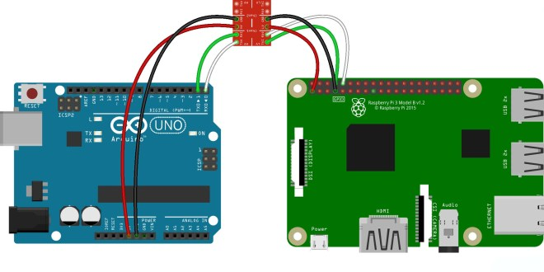
Software Overview - Initialization
Power on device
Check Sensors
Check Communication
Report errors
Cameron
Notes:
Initialization
Power on the device providing power to the microcontrollers
all sensors are checked and communication between the microcontrollers determined to be successful
This allows us to shut down in case any part is malfunctioning so that there are no malfunctions during runtime

Slide 30
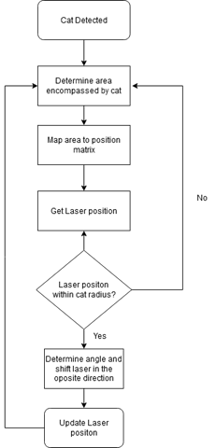
Software Overview - Scanning
Driven by the Pi3B
Using OpenCV Python Library
Cameron
Notes:
Scanning
Mode 1 is always the first mode initialized
In this mode the ATmega is put to rest and the APES remains stationary except for a hardware interrupt connected to the gyroscope
It begins by scanning the operation area using the rpi-cam to determine if the subject is in view
this is done via a cascade classifier algorithm that is trained to spot the subject amongst other objects
if the subject is spotted, the show laser is initialized and pointed in the direction of the subject using servos
Using the position data of the subject in the frame we calculate the angles to relay to the servos such that the laser is close but not on top of the subject
if the position of the subject is changed we recalculate the new position and readjust the laser
We continue this process until the unit is powered off or view of the subject is lost completely for a long enough period

Slide 31
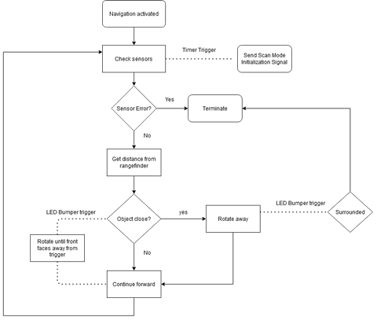
Software Overview - Motion
Driven by ATmega328
Assisted by Pi3B
Programmed in APL
Cameron
Notes:
Navigation
If Mode 1 is not initialized due to not finding the subject, or comes to an end due to the subject being lost Mode 2 is initialized
In Mode 2 the ATmega328 is awakened and initializes itself gathering data from the ir sensors and range finder
the Pi3B begins another program in which it deactivates the show laser and activates the laser range finder
In this mode the Pi3B only relays data from the rangefinder to the ATmega328
Once it determines it is in a position to move forward it will begin navigating by turning on the wheel motors
Navigation is done via a loop that checks the sensors to determine if there is any obstruction and adjust the motor speed and wheel direction accordingly
This loops runs for around 15-20 seconds
Once navigation is complete the ATmega328 will signal to the 3B to switch back to Mode 1 and then put itself back to sleep
In the case the system is drastically disturbed by crashing or flipping, the gyroscope will trigger a hardware interrupt on the ATmega328 that will initiate a shutdown routine and instruct the Pi3B to do the same

Slide 32
Administrative Cost
Part | Quantity | Vendor | Cost
Raspberry Pi 3B | 1 | Amazon.com | $32
ATmega328 | 1 | N/A | N/A
Raspberry Pi Cam Module V2 | 1 | Amazon.com | $24.99
DC Gearbox TT Motor | 2 | Adafruit.com | $5.90
L298N Motor Drive Controller | 1 | Amazon.com | $8.69
SG90S 9g Micro Servo | 2 | Amazon.com | $9.99
Adafruit LSM6DS33 | 1 | Adafruit.com | $9.95
GHH PT Pan/Tilt Camera Platform | 1 | Amazon.com | $8.49
6pc Optical Lens Set | 1 | Amazon.com | $15.43
Diffraction Grating Slide- Linear 1000 Lines/mm 2x2 | 1 | Amazon.com | $12.95
Cameron

Slide 33
Labor division
Team Member | Show Laser | Sensing | Movement | Camera | Code/Algorithms
Nathan |  | S | P |  | S
Naim | P | CP | S |  | S
Cameron |  | S | CP | P | P
Ricardo | CP | P | S |  | S
Key: P = Primary Contributor CP = Co-Primary Contributor S = Secondary Contributor
Ricardo

Slide 34
Project progress
Ricardo

