Slide 1
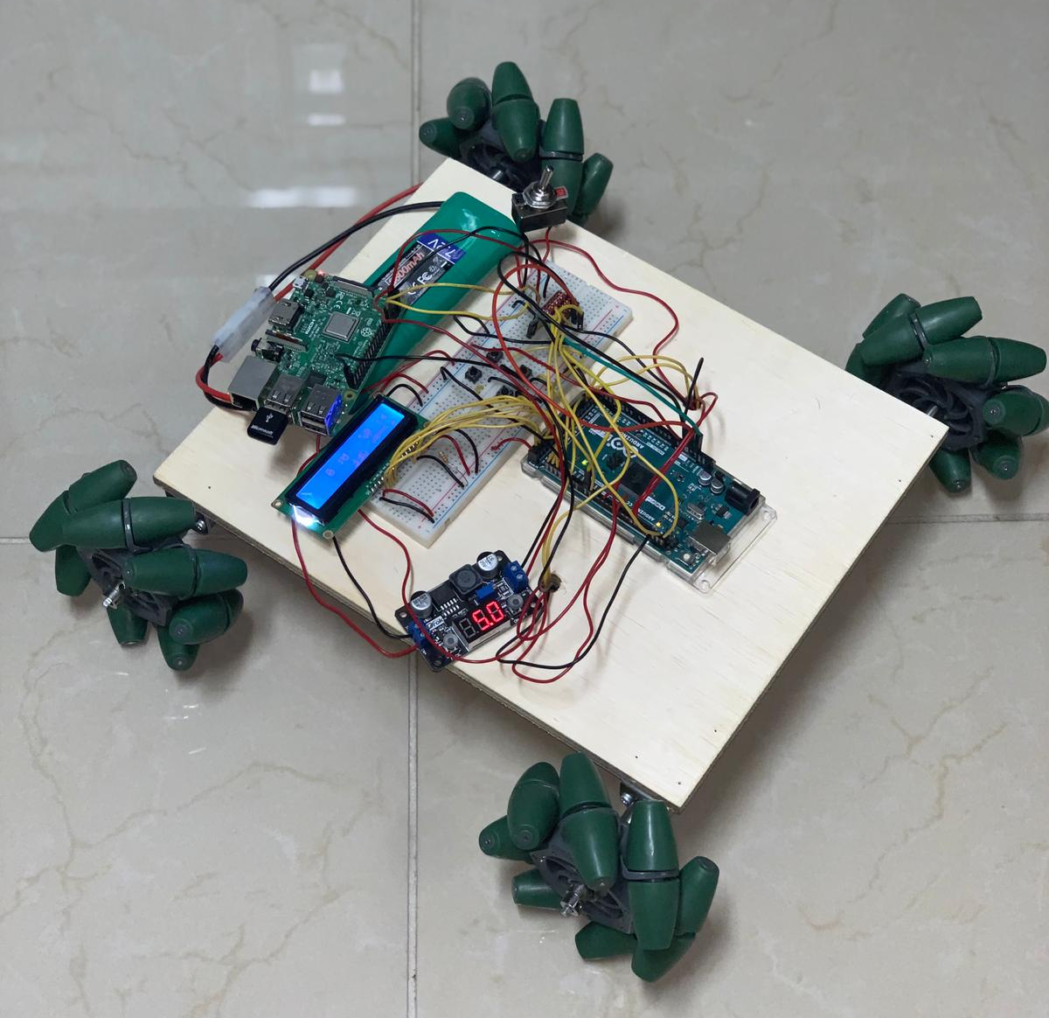
All Wheel Find
Elias Jucevicius
Adriana McCabe
Luiz Rocco

Slide 2
Our Project
Robotic vehicle
Can search through a given unknown search area
Identifies obstacles and maps the terrain
Identifies target and pins location in map
Uses mapped area to find its way back to its original starting location

Slide 3
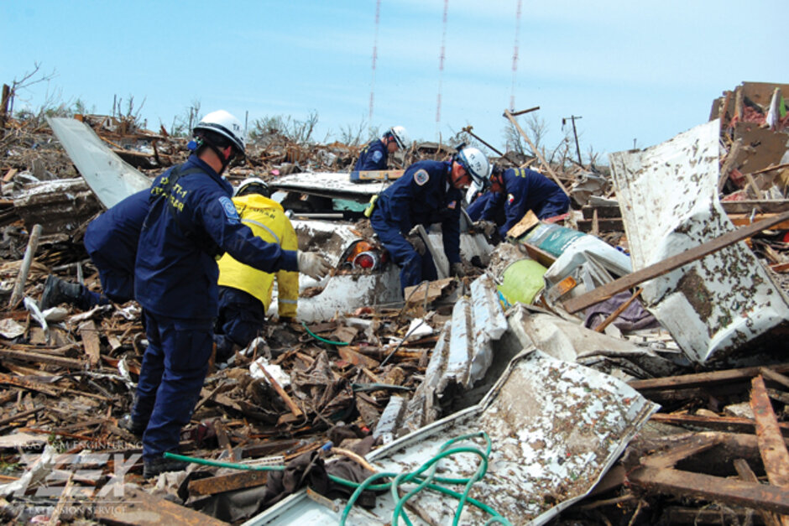
Motivation
Wanted something versatile
  Military
  Search and Rescue
  Recreational
  Research
Search and rescue
  Can be used by search and rescue teams
    Help identify location of people
    Map an unknown search area into a known search area

Slide 4
Goals & Objectives
The robotic system shall be equipped with an obstacle avoidance algorithm, and have the ability to autonomously locate a specific object using its robotic vision search algorithm
Ability to travel through various terrains
After locating the object, the robot will return back to its starting position and display whether the object was found
Manual override feature in the event that the robotic vehicle gets stuck

Slide 5
Project Design : Hardware

Slide 6
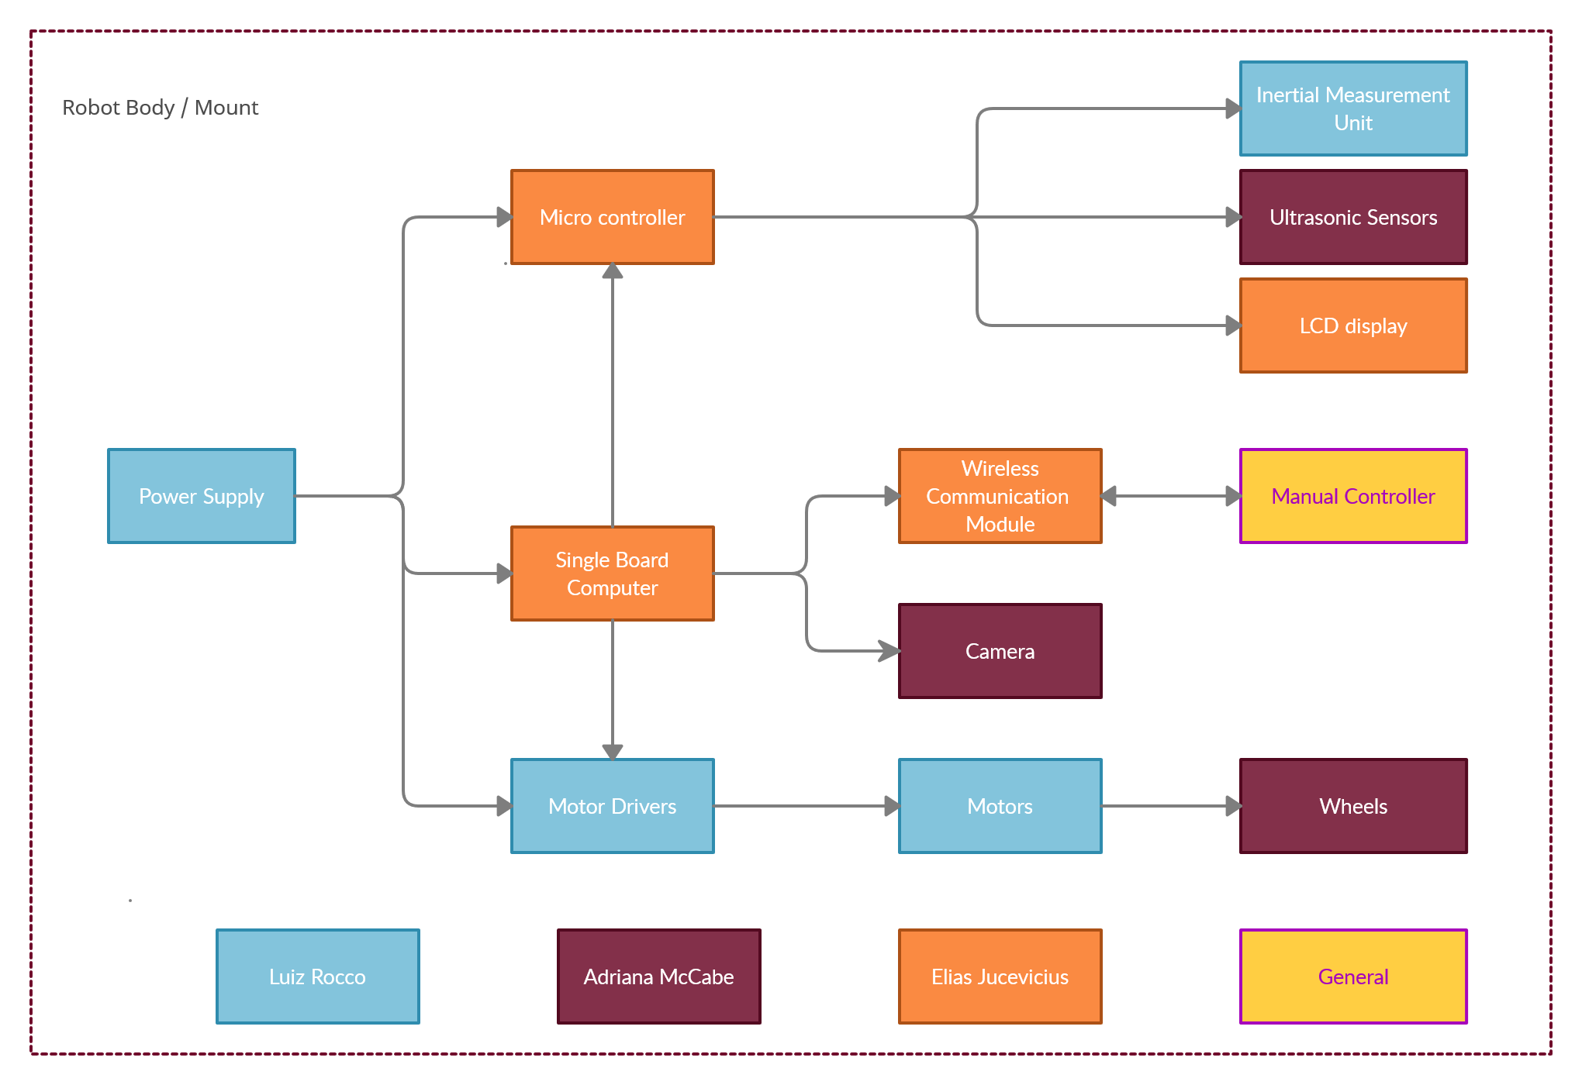
Hardware Block Diagram

Slide 7
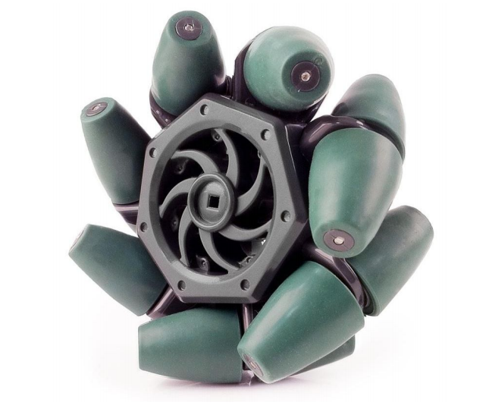
Wheels - Mecanum
Mecanum wheels are an
omnidirectional wheel design
that allows for movement in
any direction
Widely used in robotics to eliminate
the need of turning of the wheels

Slide 8
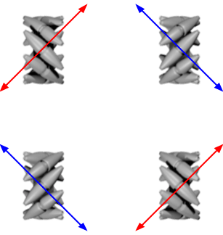
Wheels - Mecanum
Each wheel contributes movement
at a 45 degree angle
The vector sum of all moving wheels
determines final direction of
Movement
Allows for rotation in place

Slide 9
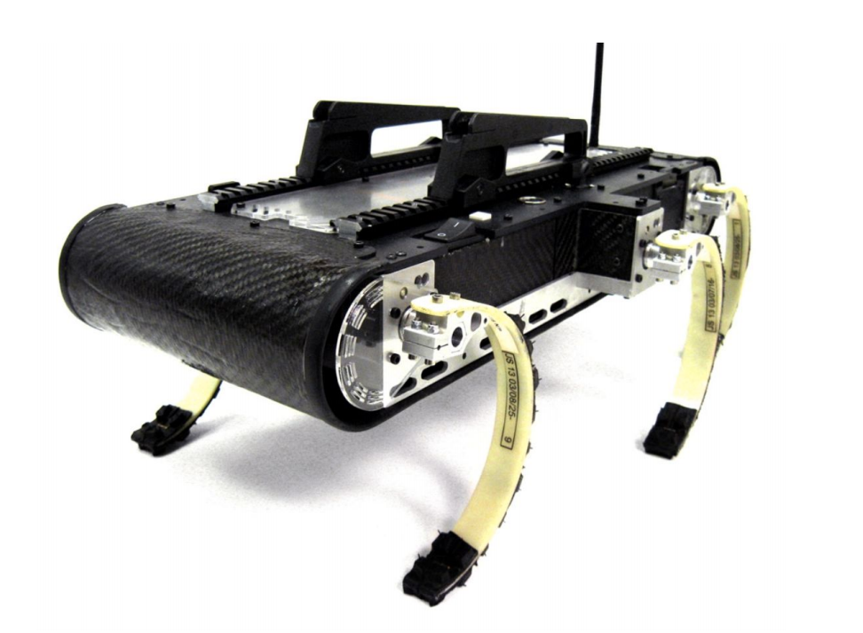
Paddle-Like Legs
Stretch goal
Inspired by the RHex Robot
Ability to traverse through more difficult terrain
Ability to flip itself back over to its correct orientation

Slide 10
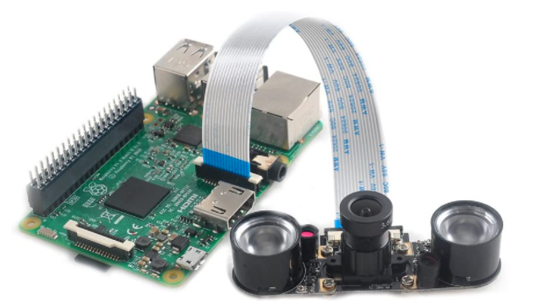
Camera
MakerFocus Pi Camera
Used in conjunction with robotic vision algorithm
Raspberry Pi 3 compatible
Adjustable Focus
Resolution: 1080p
Supports night vision (stretch goal)

Slide 11
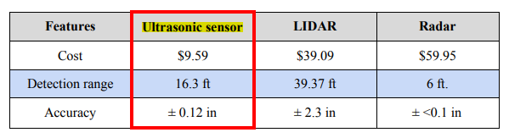
Ultrasonic Sensor
Used in conjunction with Find Target Algorithm
Accuracy, Detection range, and Cost best fit the needs of our system
4 Ultrasonic sensors

Slide 12
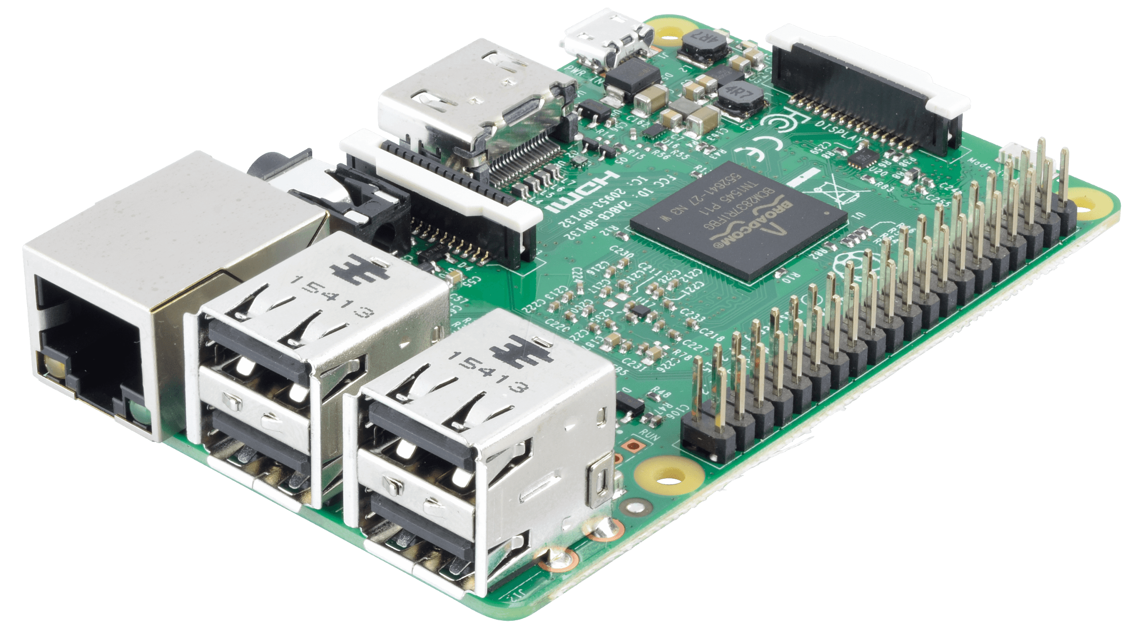
Raspberry Pi 3 Model B
The choice of microcomputer is the Raspberry Pi 3 Model B because the project needed a powerful enough board to be able to perform object detection using YoloV3 on live videos

Slide 13
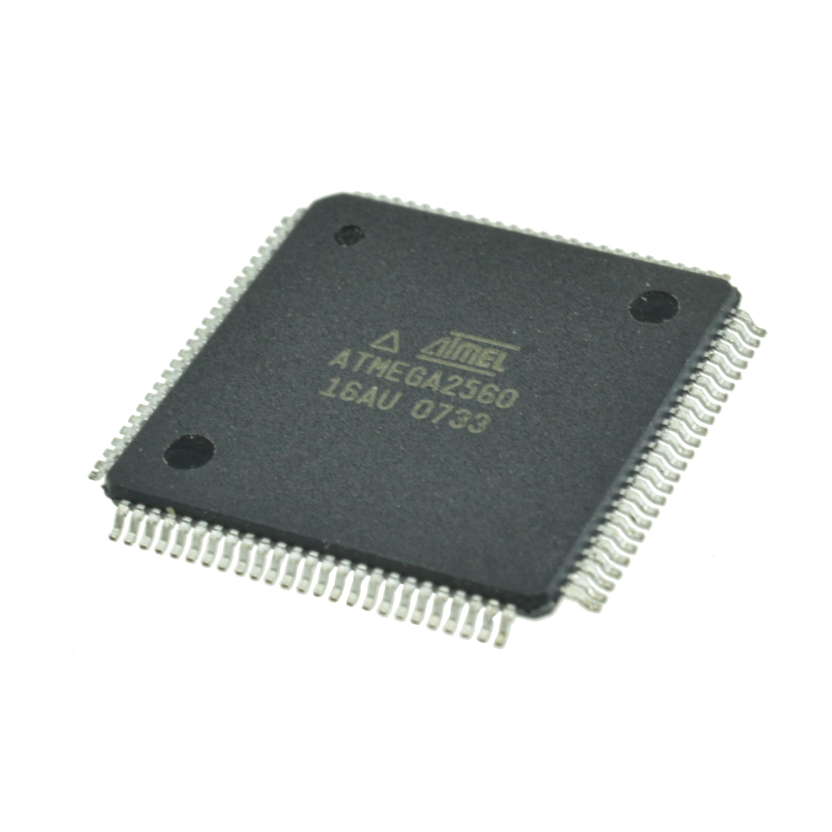
ATmega2560
The ATmega2560 was chosen because it is one of the more powerful models from the ATmega family of microprocessors, which is needed to handle the communication received from the microcomputer and it is cheap due to its high supply in the market since it is used in many development boards such as the Arduino boards

Slide 14
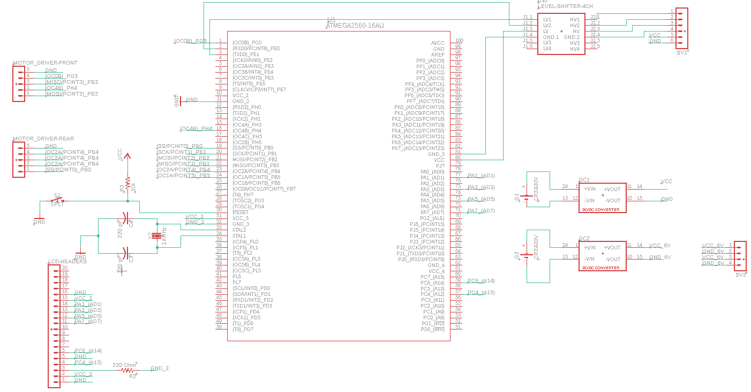
PCB Schematic

Slide 15
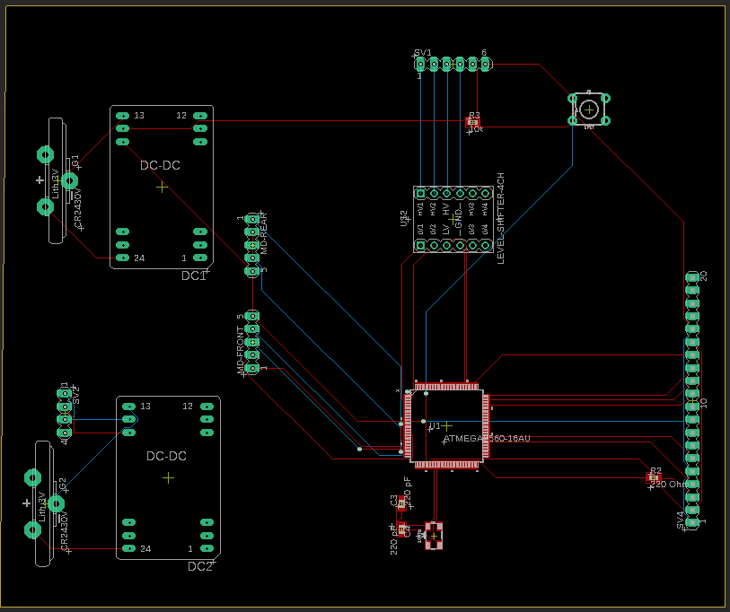
PCB Layout
75% Complete
Expected Completion Date: 2/14
Expected Arrival Date: 3/5

Slide 16
Project Design : Software

Slide 17
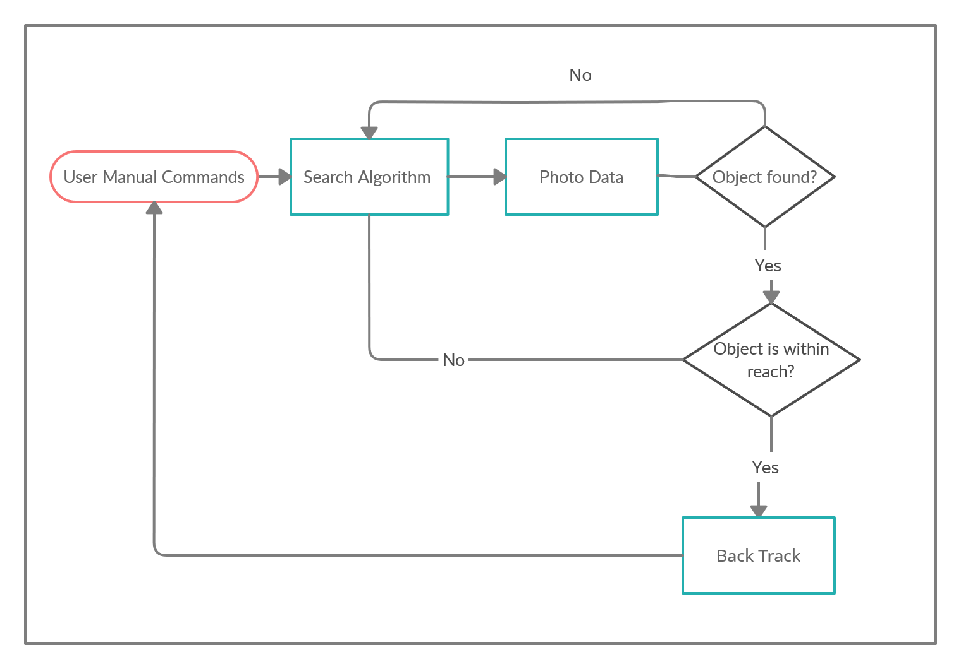
Software Block Diagram

Slide 18
Project Design : Software
We will have 3 main algorithms:
Computer vision algorithm
  Identify the target
Find Target Algorithm
  Search algorithm to efficiently search the given unknown area
Go Back Home Algorithm
  To return back to the original starting point of the robot and quickly as possible

Slide 19
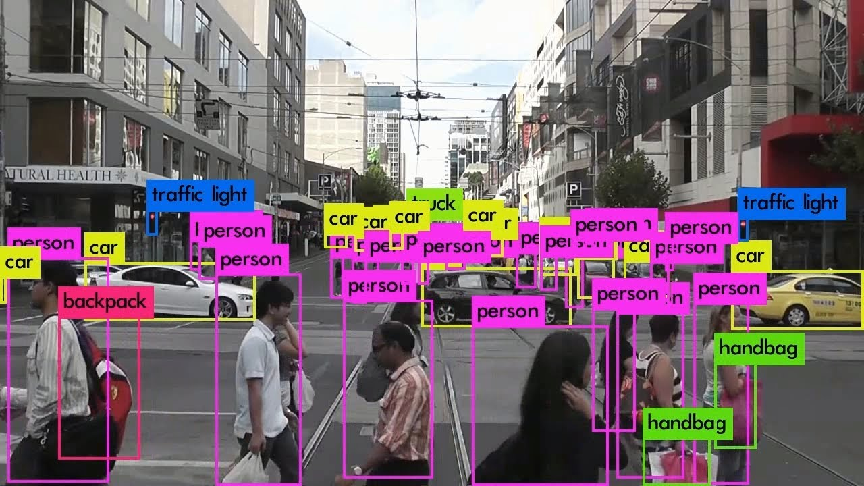
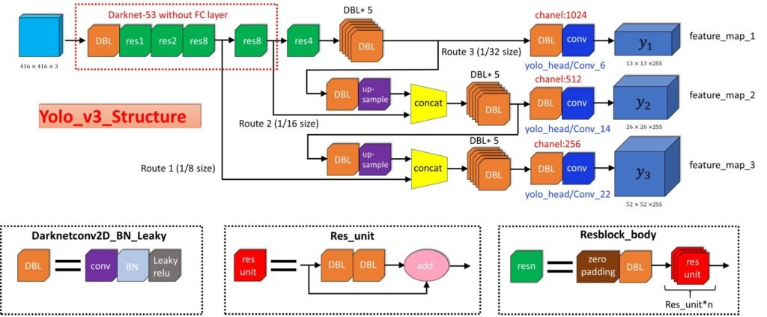
Computer Vision Algorithm
YOLO framework used to recognize a target ball
Training target is generalizable, which includes but is not limited to missing people in natural disasters, stray dog, etc
Yolo V3 uses an interesting mix of computer vision techniques and deep learning to handle videos of up to 40 FPS

Slide 20
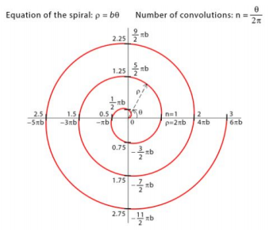
Find Target Algorithm
Archimedean Spiral

Slide 21
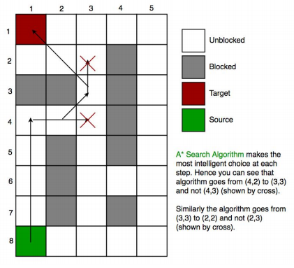
Go Back Home Algorithm
A* Algorithm
  Euclidean distance approximation heuristic
Will use the explored portion of the given search area
Speed is now priority instead of efficiency

Slide 22


Website
At its early stages but completely
functional for prototyping.
Flask used as the backend technology
Basic HTML, CSS and Javascript used in the frontend

Slide 23
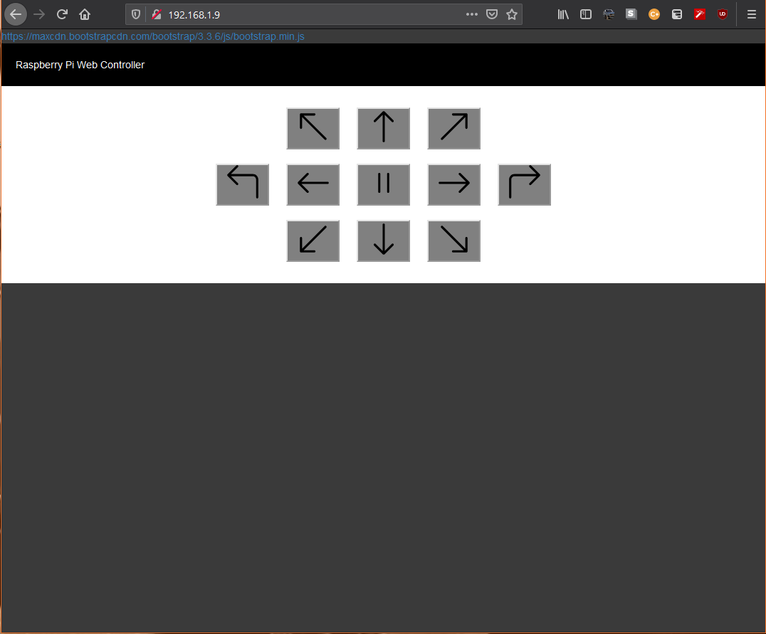
Website
Press and hold buttons that control the robot’s movement over a wifi connection
Could host the website and control the robot via the Internet easily
More functionalities to come

Slide 24
Design Constraints
Economic and Time
  Lack of Funding
  Two semester time frame
Ethical
  Spying
  Could limit search area or require a license for use
Health and Safety
  Accuracy rate of 90%
  Waterproof structure
Manufacturability and Sustainability
  Simple, easy to manufacture design
  Waterproof design

Slide 25



Standards
IEEE STD 1872-2015
  Standard Ontologies for Robotics and Automation
IPC-A-600
  Acceptability of Printed Boards
IPC J-STD-001E-2010
  Requirements for Soldered Electrical & Electronic Assemblies
ANSI/IEEE STD 1008
  Standard for Software Unit Testing

Slide 26
Work Distribution
 | PCB Design/Soldering | Website Design/WiFi Implementation | Training Robot to Identify Specific Object | Enclosure Design | Obstacle Avoidance Algorithm | Search Algorithm | Go-Back-Home Algorithm | Hardware Implementation
Elias Jucevicius | ✓ |  | ✓ | ✓ | ✓ | ✓ |  | ✓
Adriana McCabe |  |  |  |  | ✓ | ✓ | ✓ | ✓
Luiz Rocco | ✓ | ✓ | ✓ |  | ✓ | ✓ | ✓ | ✓

Slide 27
Budget
ITEM | Qty. | TOTAL PRICE
Raspberry Pi 4 | 1 | $60
Smart Vision Camera | 1 | $60
Robot Chassis | 1 | $100
Ultrasonic Sensor | 1 | $10
PCB | 5 | $50
LCD Display | 1 | $10
6-Cell NiMH Battery Packs | 2 | $36
Motors | 4 | $140
Motor Drivers | 2 | $40
Mecanum Wheels | 4 | $35
Misc. Parts | - | $200
Due to the nature of this being a self-funded project among our group, maintaining cost efficiency is a crucial factor to the success of our project
≈ $741 total budget
All major components have been purchased

Slide 28
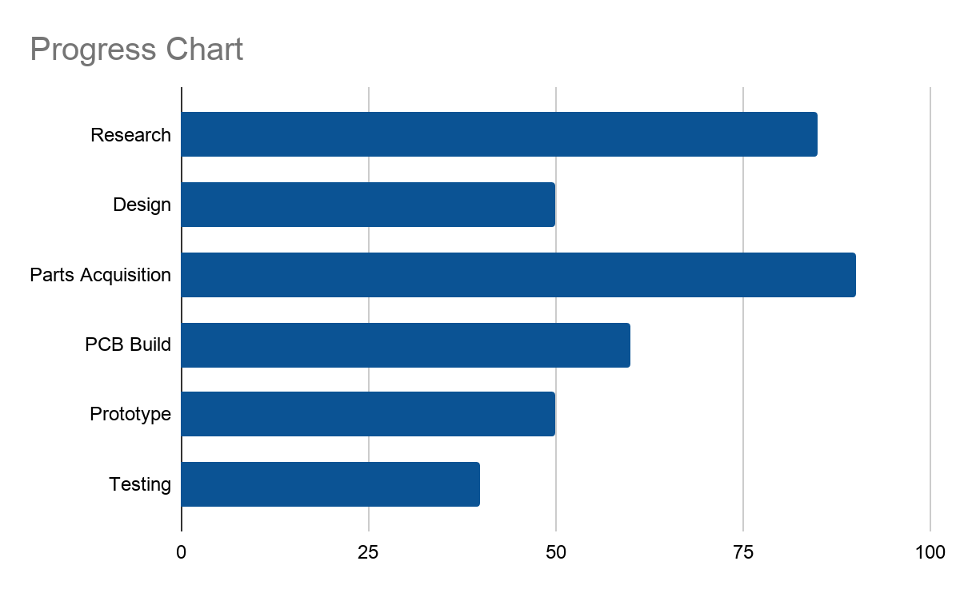

Slide 29
Questions?

