Slide 1
BikeSystem
Final Presentation
Group 21
Keegan Van Wyk – EE
Daniel Birath – EE
Benjamin Tamayo – EE
Sandhya Singh – CpE

Slide 2
Motivation
Alternative to expensive bikes
Make locking a bike more convenient
Provide useful metrics to the user
Appeal to a niche in the market
Notes:
Keegan

Slide 3
Goals & Objectives
Basic Goals | Advanced Goals | Stretch Goals
RFID module as the main locking/unlocking method | Fingerprint locking/unlocking methods as failsafe | Generate power/charge from the bicycle itself instead of replaceable batteries
Lights added to frame as safety measure | Temperature Sensor added to measure ambient temperature | Creating of the mobile to connect via Bluetooth
Mounted LCD on handlebars | - | GPS tracking module for location purposes
Sensors attached to wheels to measure distance and speed | - | -
- | - | -
Notes:
Ben

Slide 4
Specifications
Inclusive bike locking system that can be attached to a pre-existing bike frame
Main marketed method of locking/unlocking via RFID module
Alternate unlocking mechanism in the case of low power
Measure revolutions of wheel and tire assembly
Notes:
Danny

Slide 5
Specifications Cont’d
Additional lights mounted on bicycle frame as a safety measure
A DC power generator with drive pulley will be fixed to the frame of the bike to charge the battery
Creation of a mobile app to save the metrics (health data, ambient temperature, distance, and average speed) from each trip
Notes:
Danny

Slide 6
3 Demonstratable Specifications
Specification #1:
  LED Brightness greater than 50 lux
Specification #2:
  Measured distance is accurate within +/- one foot
Specification #3:
  RFID unlocks within less than 5 seconds
Notes:
Danny

Slide 7
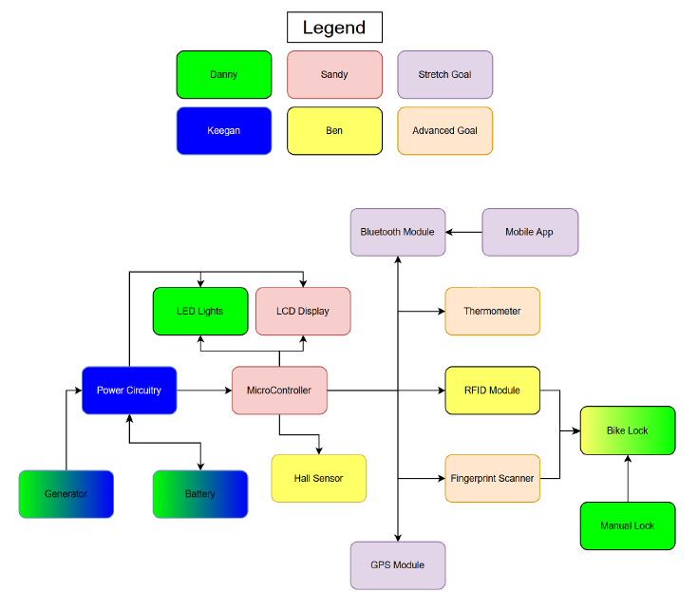
Block Diagram
Notes:
Keegan

Slide 8
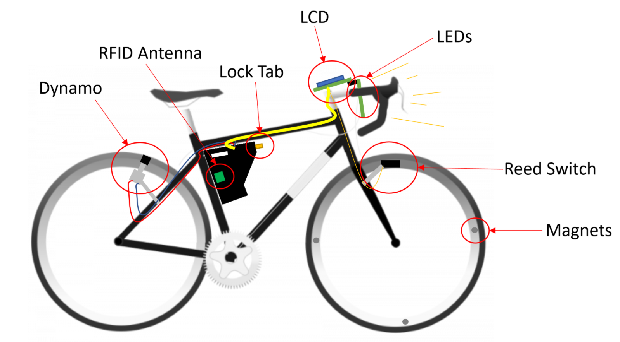
Bike System
Notes:
Keegan

Slide 9
Related Standards
JESB8C.01 3.3V Standard
ISO/IEC/IEEE 29119 – Life Cycle of Software Development
ISO/IEC standard 18000-3:2008
OSHA standard 1915.82 General Requirements for Lighting
Notes:
Keegan/Sandy/Ben/Danny

Slide 10
Constraints
Economic
  Lack of funding – the BikeSystem is entirely self-funded
Microcontroller and relating sensors were confined to the power design (3.3V)
Time
  Shipping and manufacturing delays due to the pandemic
Notes:
Danny

Slide 11
Power Subsystem
Power provided by battery and dynamo
Rectifies and regulates power generated by dynamo
Switches between sourcing power from dynamo and battery
Automatic switching between power sources
Indicates when battery is in use
Charges the battery when the battery is not in use
Regulates selected source to 3.3V output
Notes:
Keegan

Slide 12
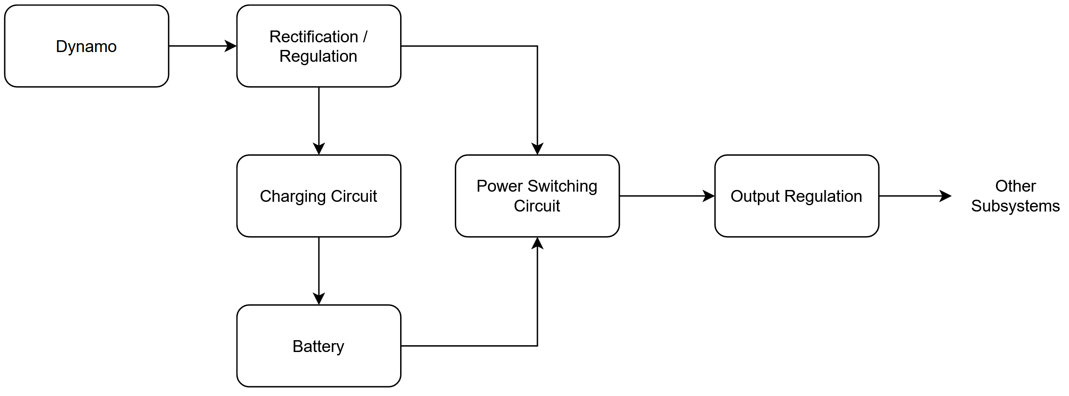
Power Subsystem Block Diagram
Notes:
Keegan

Slide 13
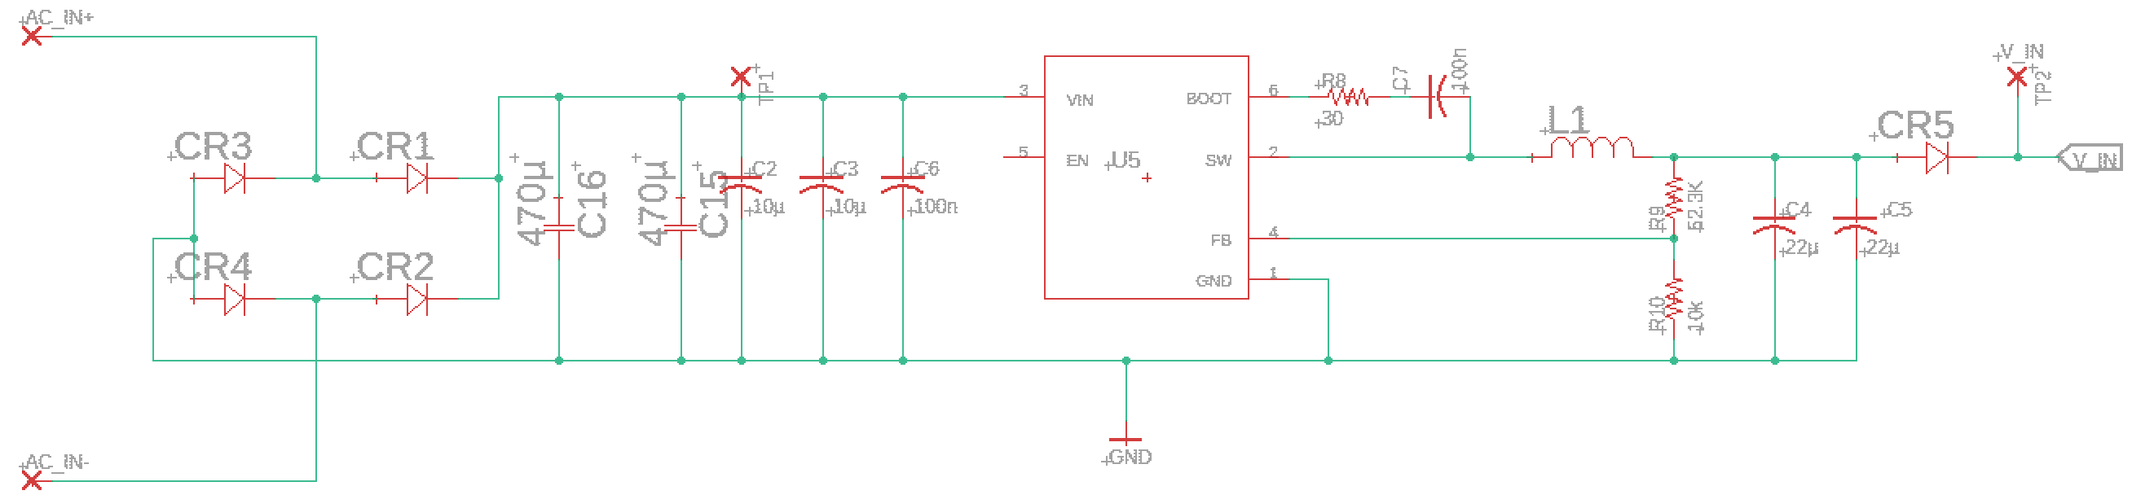
Input Rectification and Regulation
Rectification and Filtering
Voltage Regulation IC
Dynamo Input
Notes:
Keegan

Slide 14
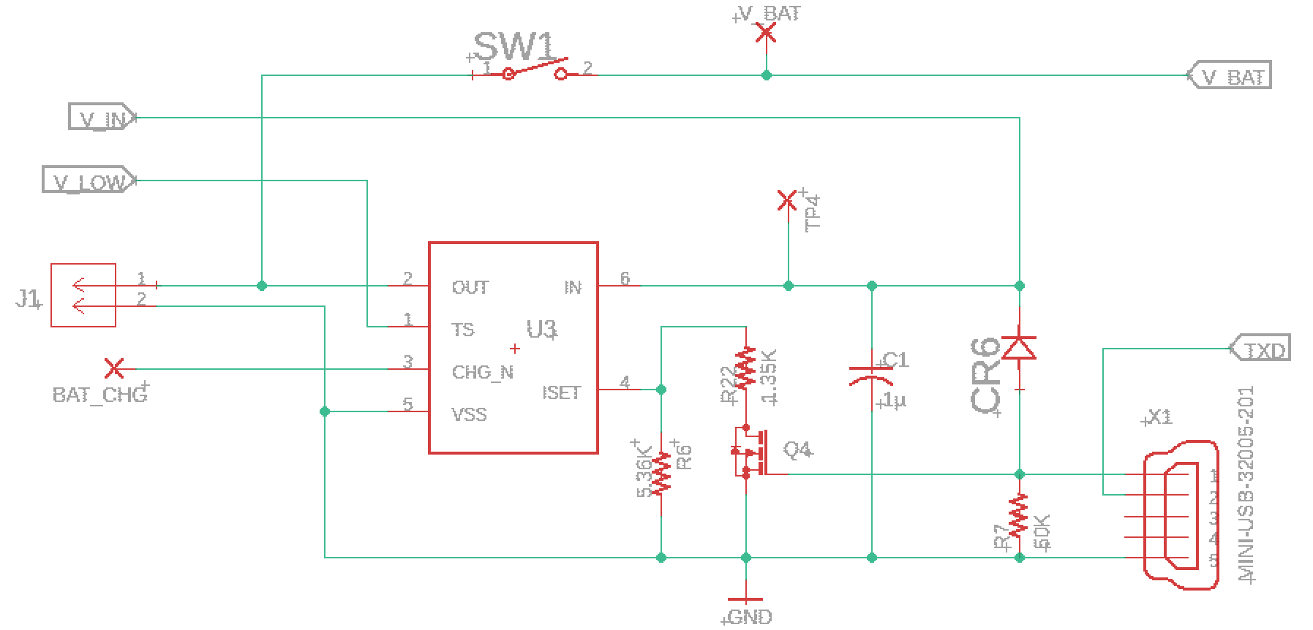
Battery and Charging Circuit
Charging IC
Battery Connection
For External Charging
Notes:
Keegan

Slide 15
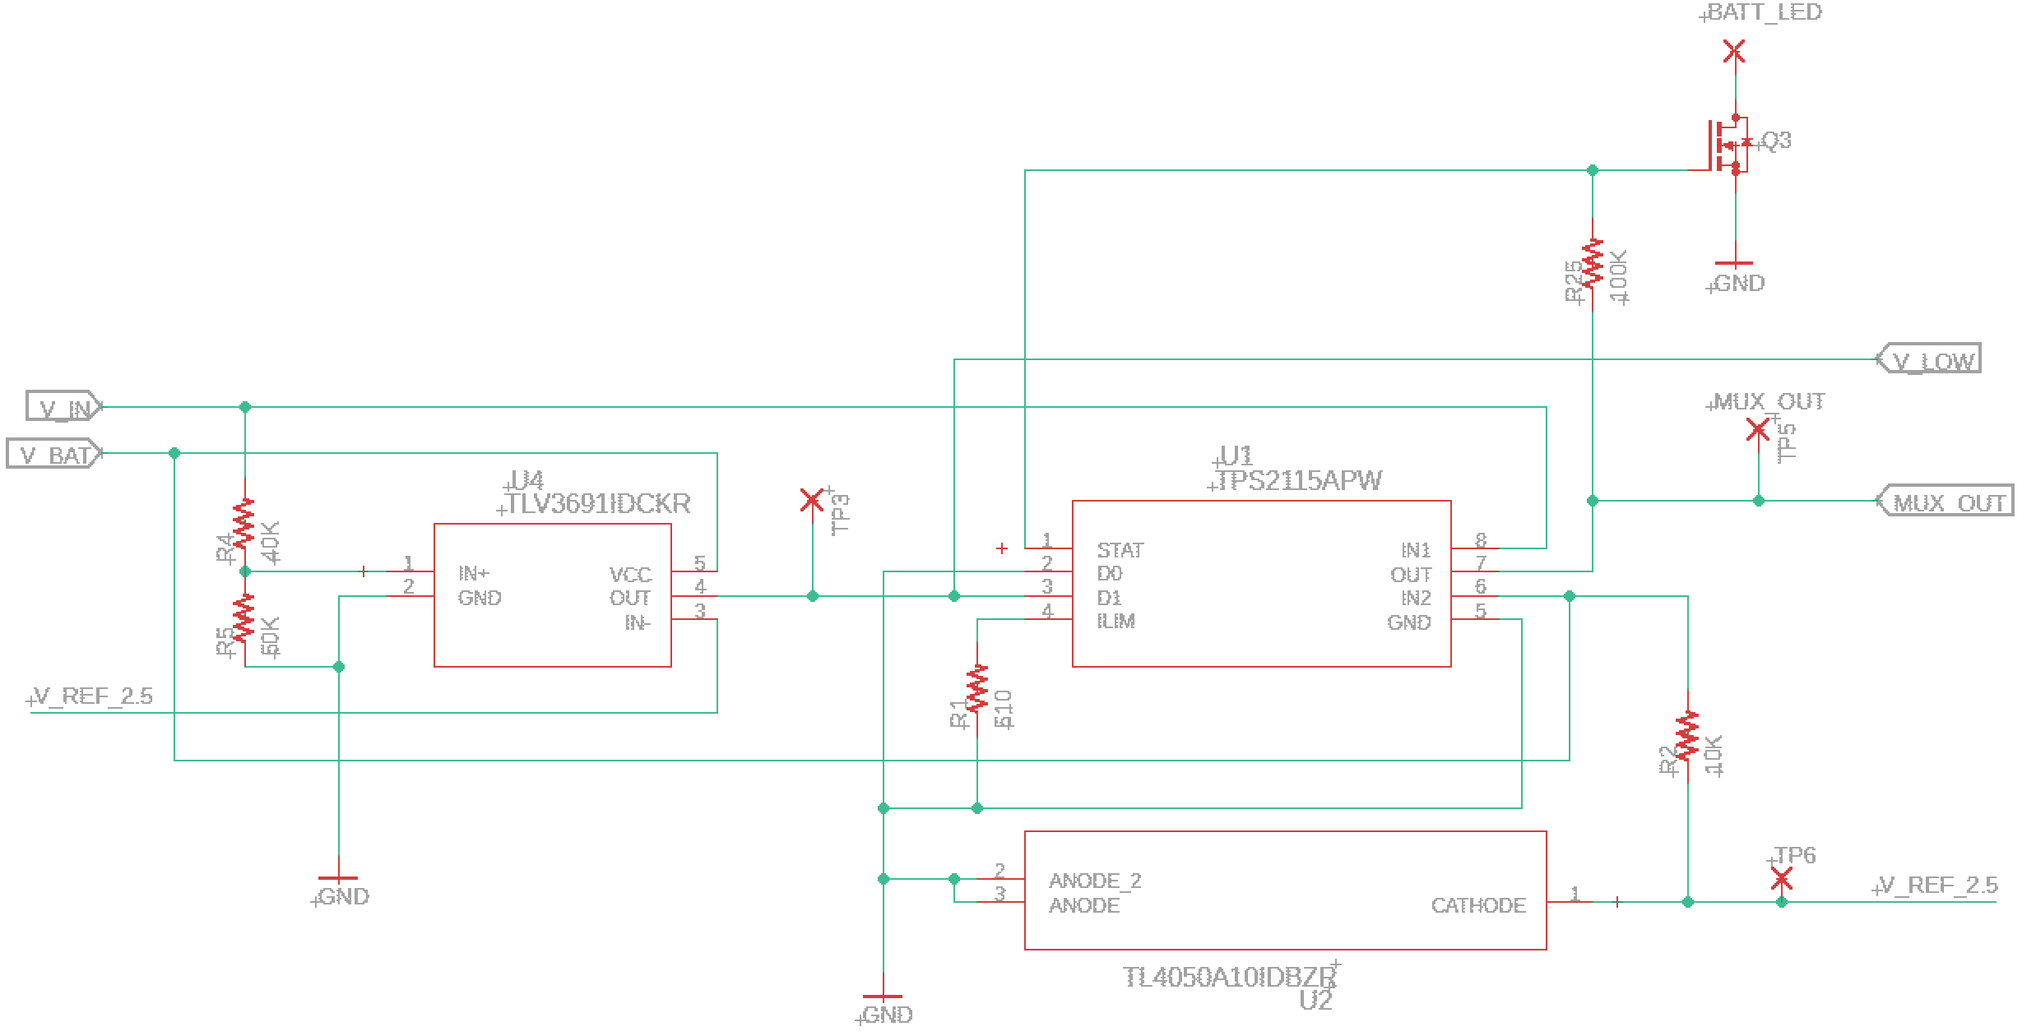
Power Circuit Switch
Power Switching IC
Comparator
Voltage Reference
Notes:
Keegan

Slide 16
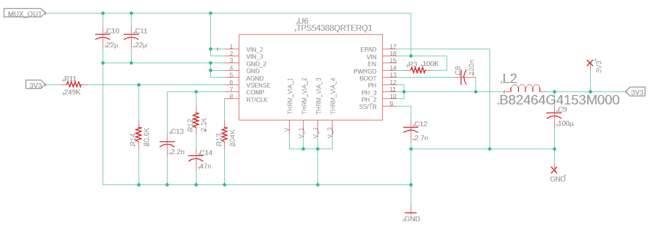
Output Regulation
Voltage Regulation IC
Notes:
Keegan

Slide 17
Methods for Unlocking the Bicycle
Potential Components
Reasons for Selected Component
Fingerprint Scanner
Cell Phone Application (App)
RFID System
Due to limited coding experience among the three EE’s in the group, the cell phone application was ruled out.
The fingerprint scanner proved more difficult to implement, and more expensive, during the research phase of the project when compared to the RFID System.
The RFID System had relevant libraries to rely upon when debugging code and was the cheapest of three options in terms of time and effort.
Notes:
Ben

Slide 18
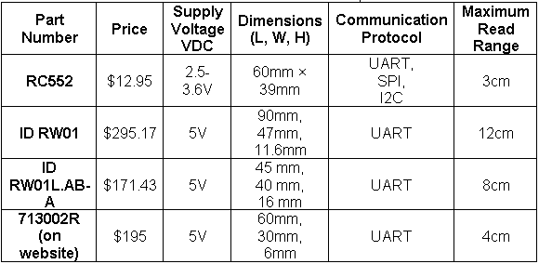
RFID Module
Only complete RFID modules were considered.
RC522 was chosen because of stark difference in price and freedom of communication protocol.
Notes:
Ben

Slide 19
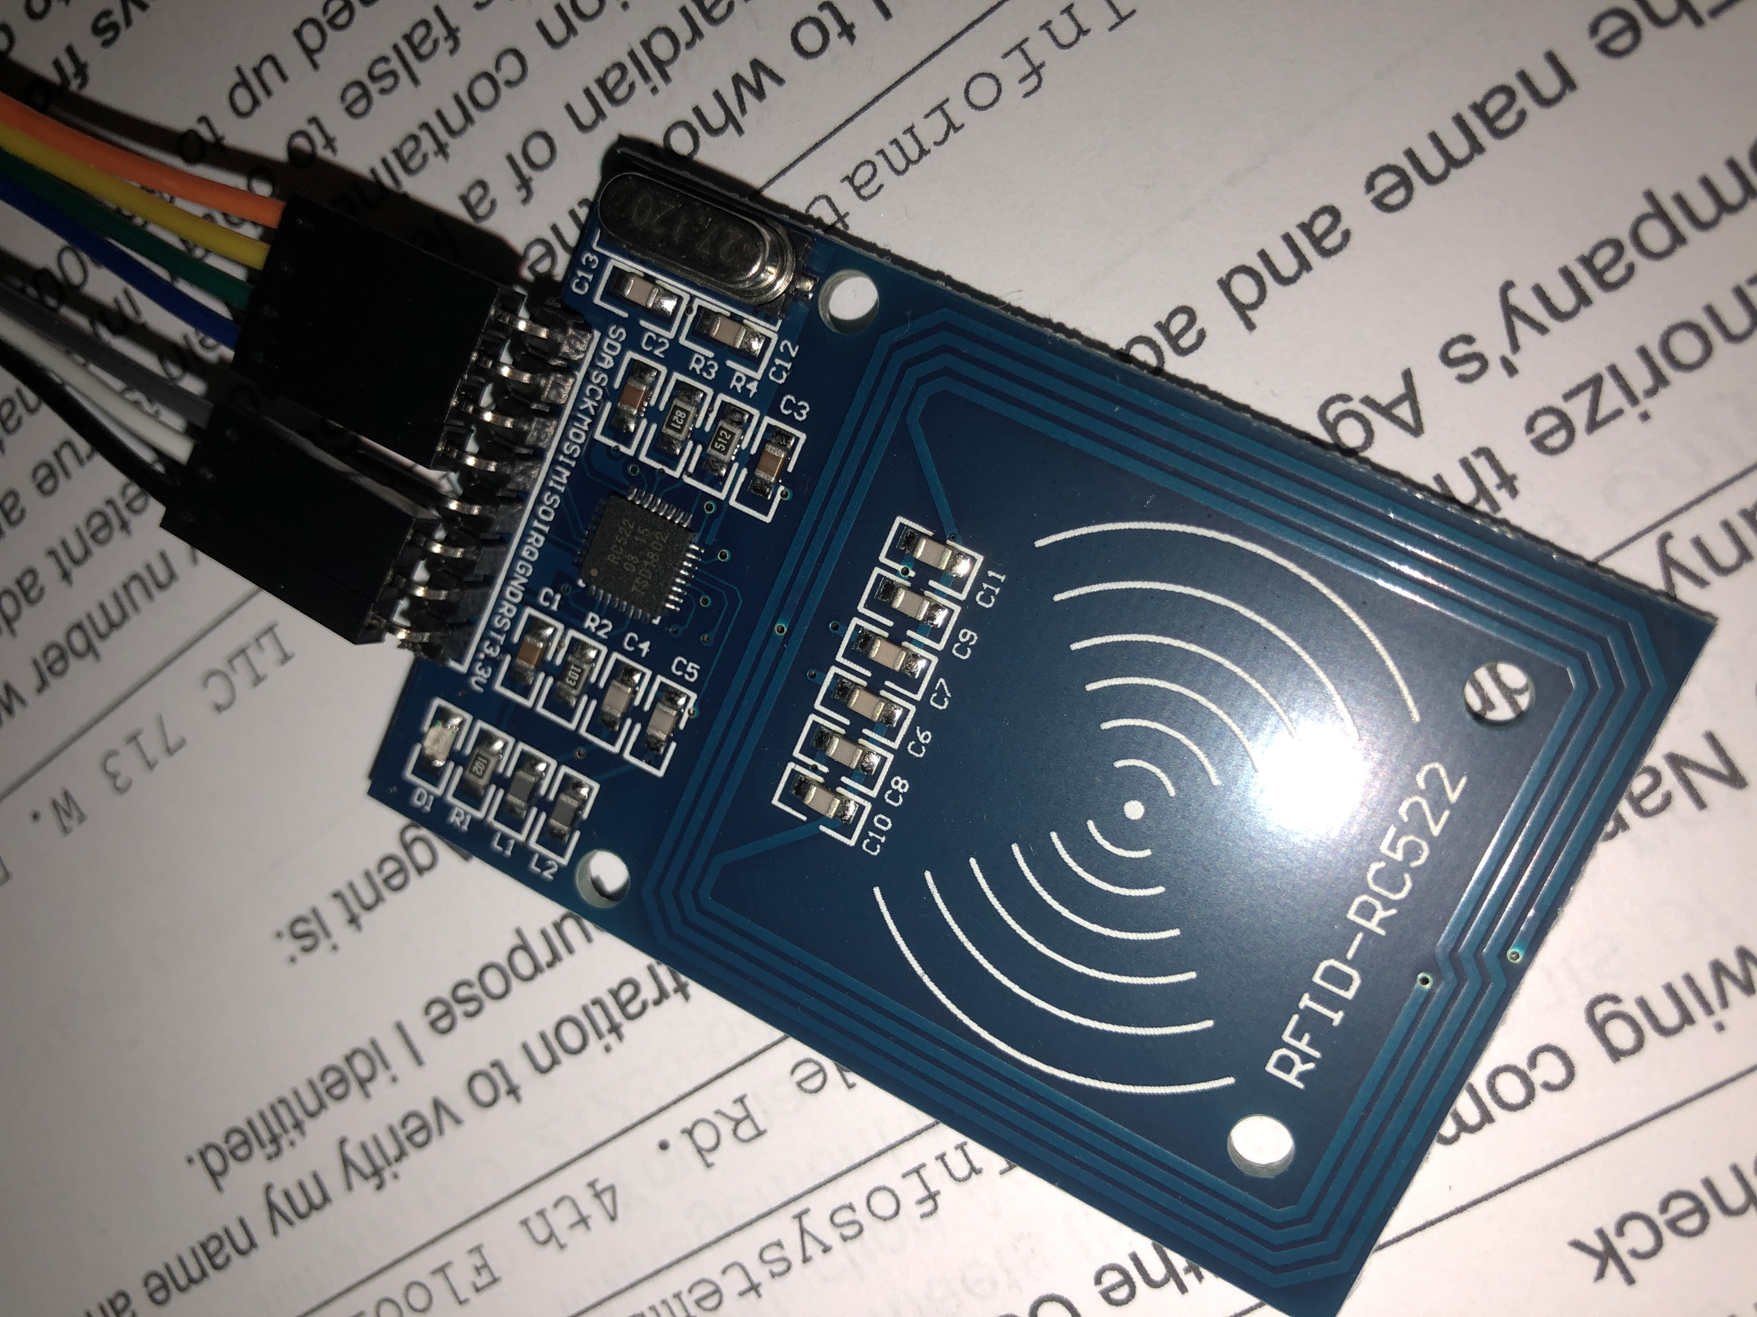
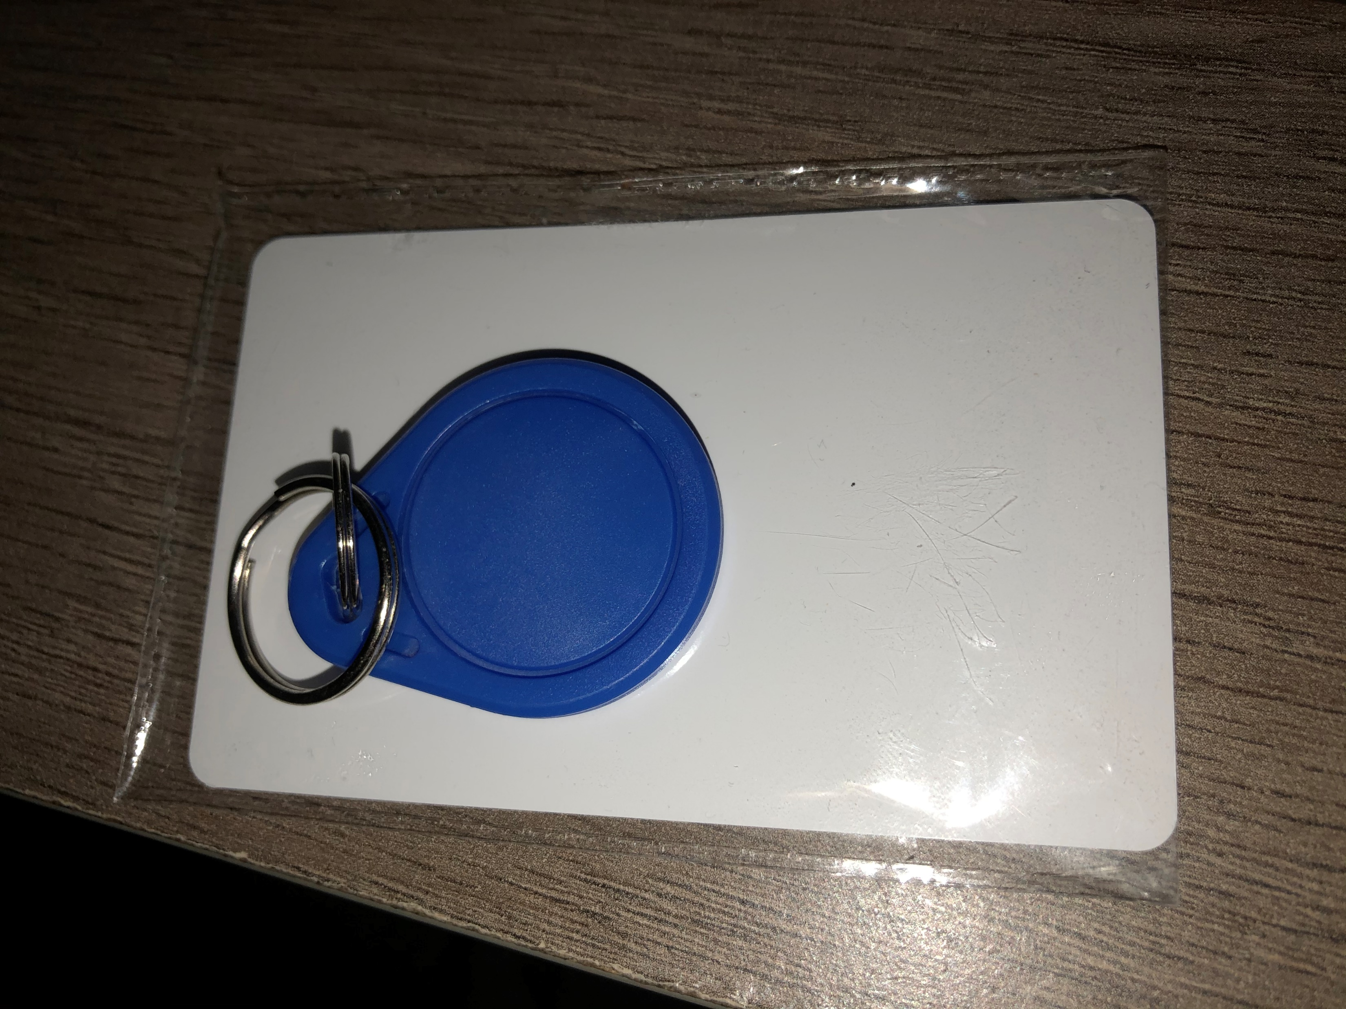
RFID Module
Benefits to using the RC522 RFID module include:
  Proof of concept and code with an existing embedded antenna and impedance matching network.
  Proof of schematic for specific communication standard (SPI).
Notes:
Ben

Slide 20
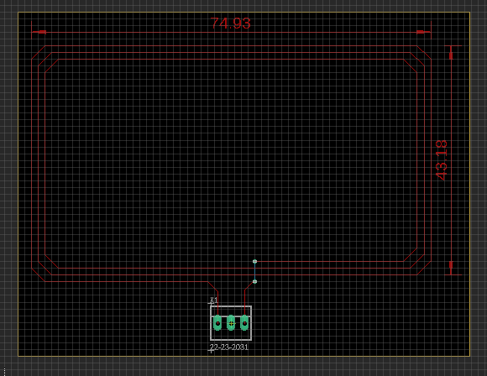
Integrating RFID Module
The IC that drives the RC522 RFID module is called the MFRC522 IC. This IC is responsible for communicating with the chosen microcontroller and RFID card.
The two primary steps to integrate the RFID module into the final PCB is to design an antenna with a known inductance and then design an impedance matching network that connects the antenna to the MFRC522.
Notes:
Ben

Slide 21
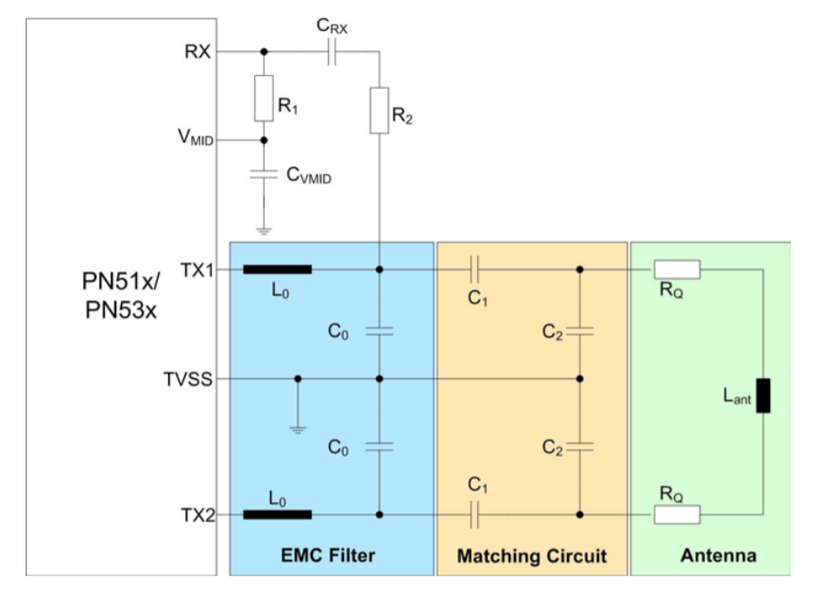
RFID Subcircuits

Slide 22
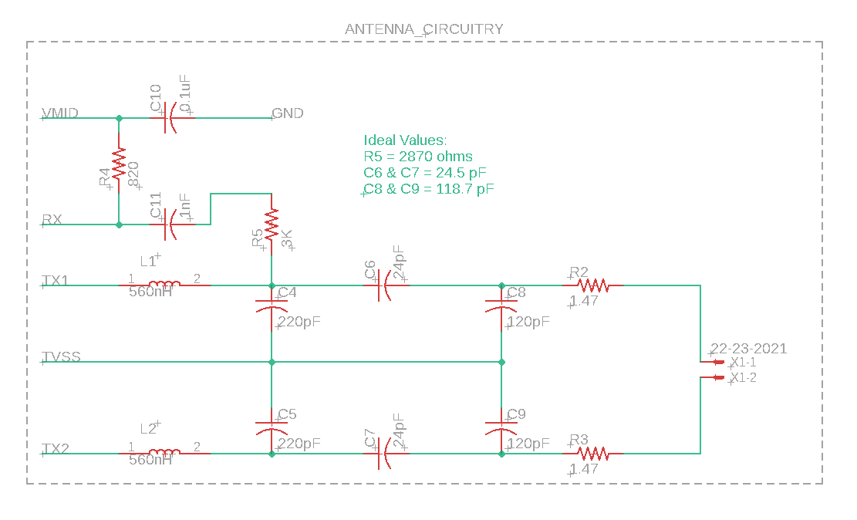
RFID Matching Network
Notes:
Ben

Slide 23
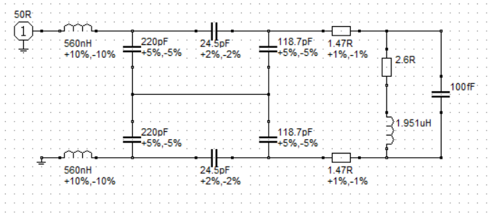
RFID Circuit Simulation Schematic

Slide 24
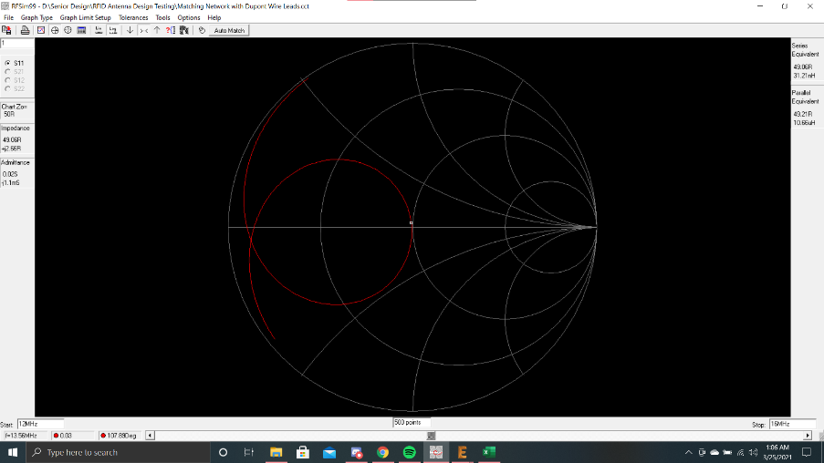
RFID Smith Chart Simulation

Slide 25
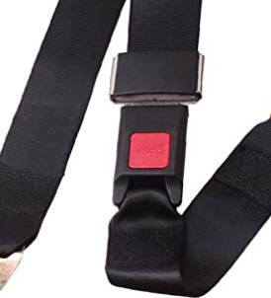
Locking Mechanism
Provide user with a better alternative to traditional bike locks
Convenience
Efficiency
Notes:
Danny

Slide 26
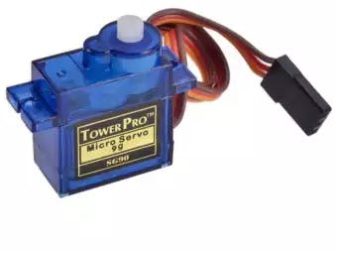
Locking Mechanism
Key Features:
Automatic locking/unlocking of the bike system
Lock assembly mechanics
Rotating arm driven by a servo motor
Set Backs:
Redesign of device used for locking
Comparison of Electromagnet and servo motor
Notes:
Danny

Slide 27
Speed and Distance Calculation
Potential Components
Reason for Selected Component
Accelerometer
Hall Sensor
Reed Switch
The Reed Switch offers the relevant information, for example the revolutions of the bicycle tire per unit time, while the other two options offer information that will not be used for the purpose of speed and distance calculation.
Reed Switch requires the least pins of all the options aforementioned.
Reed Switch is the less expensive option when compared to the accelerometer.
Notes:
Ben

Slide 28
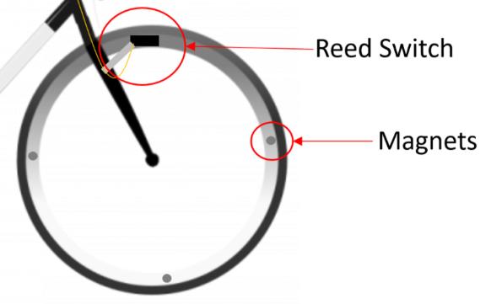
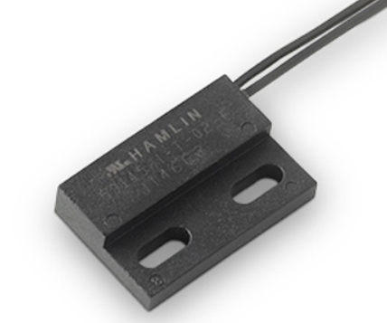
Reed Sensor
The Littelfuse 59145 Reed Sensor was chosen because of its mounting style and sensitivity.
Normally-open configuration will be used.
Notes:
Ben

Slide 29
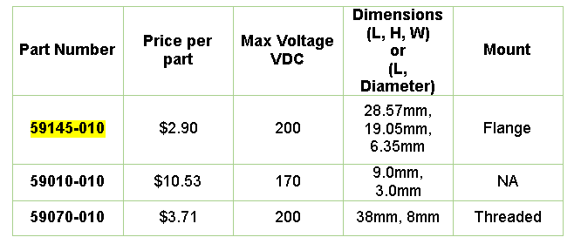
Reed Sensor
Reed Sensor is basically a switch that is actuated by an electromagnetic field.
Output of reed sensor will be used to calculate speed and distance traveled by the system.
Notes:
Ben

Slide 30
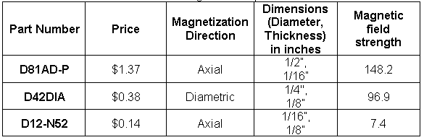
Magnet for Reed Sensor Actuation
Magnet needs to be able to actuate the Reed Sensor from at least 0.5 inches away.
D81AD-P magnet was chosen, although it was the most expensive per part of all magnets considered, because it has the highest magnetic field strength when considered from 0.5 inches away.
D81AP-P also comes with adhesive pad, which will be needed to secure magnets to the rim of the bicycle tire.
Notes:
Ben

Slide 31
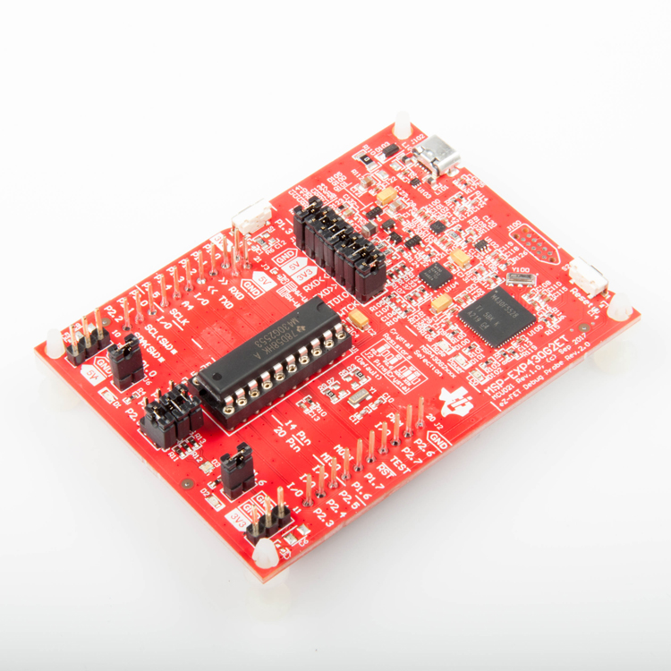
Microcontroller
MSP430G2553
3.3 v
Low power consumption
Notes:
Sandy

Slide 32
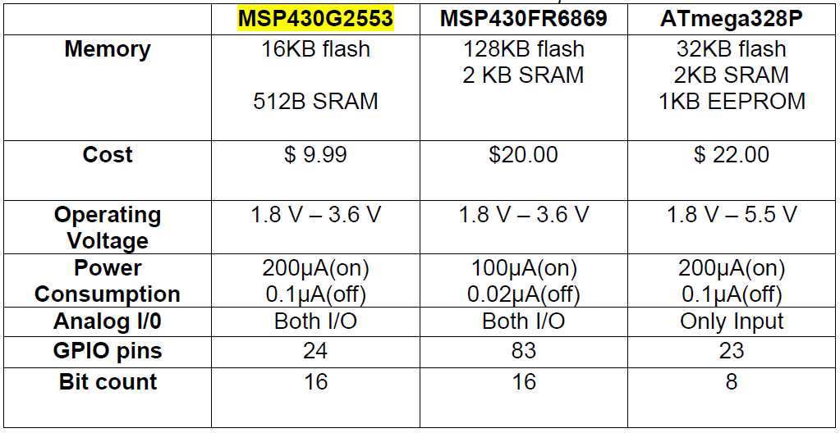
Microcontroller Comparison

Slide 33
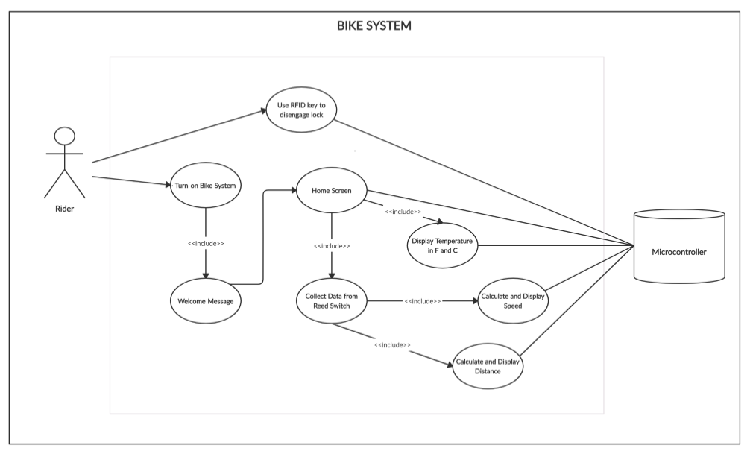
Use Case Diagram
Notes:
Sandy

Slide 34
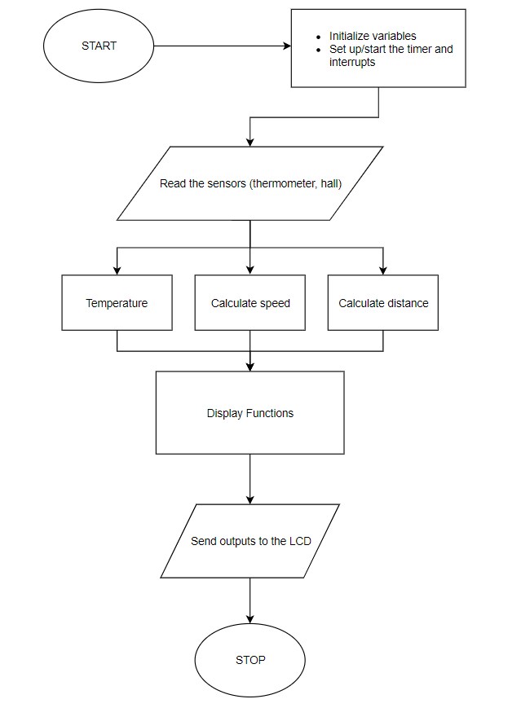
Software Functionality
Input from:
    Reed Sensor
    TMP 235 Temperature Sensor
    RFID Module
    Lights
Code written in the C language
Developed and tested within Code Composter Studio (CCS) environment
Notes:
Sandy

Slide 35
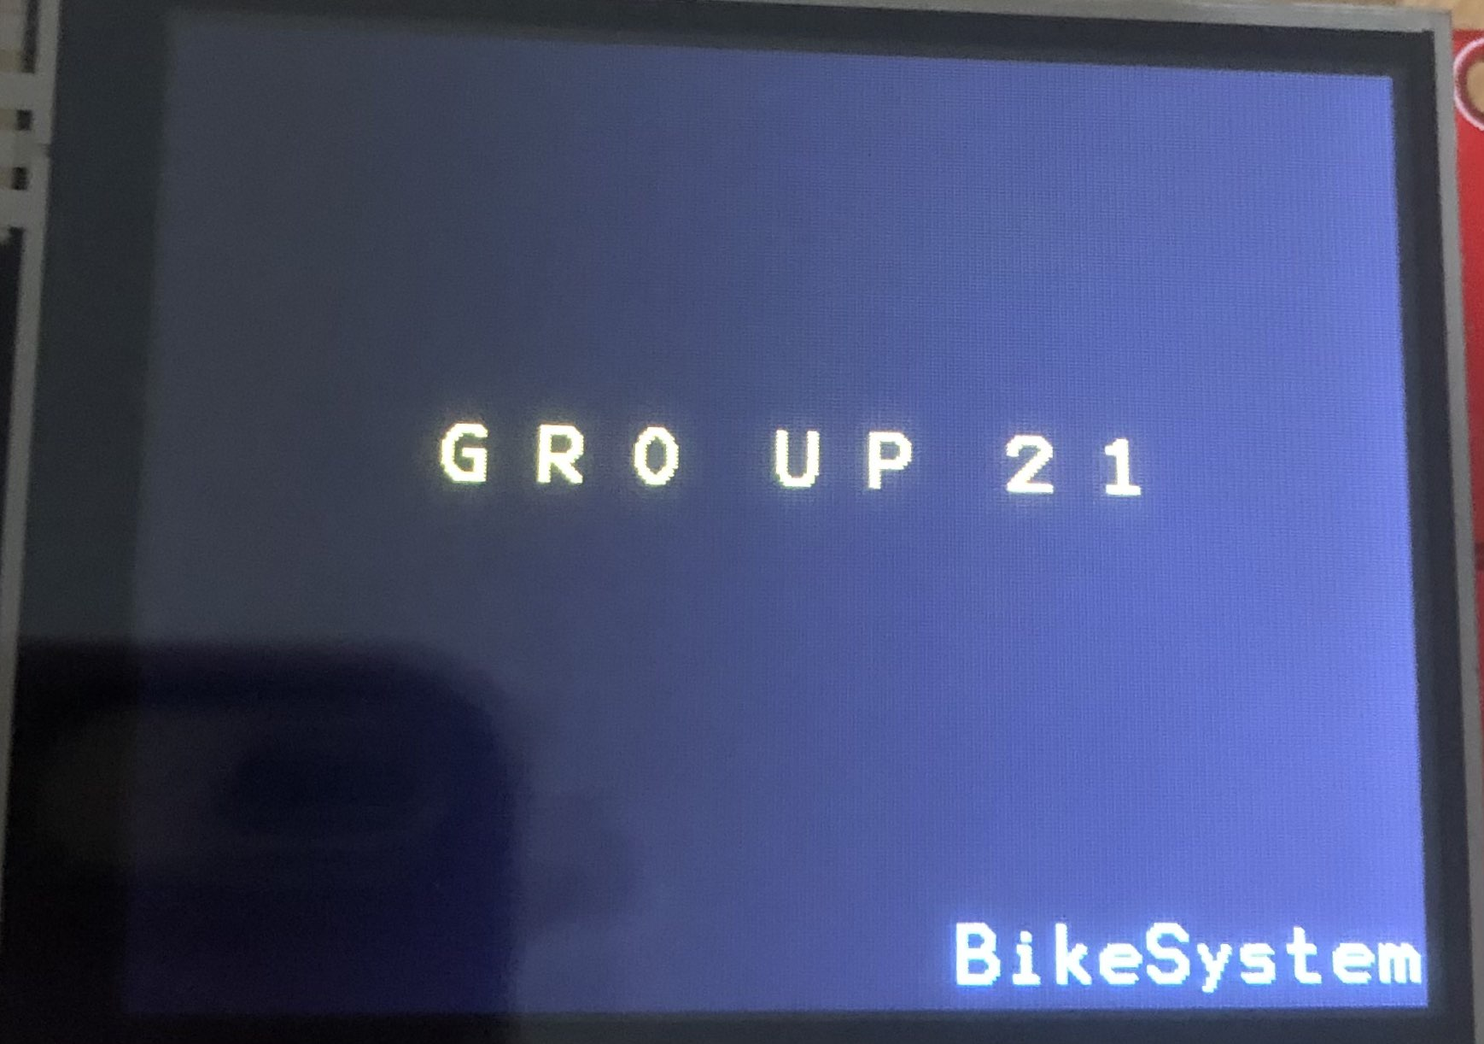
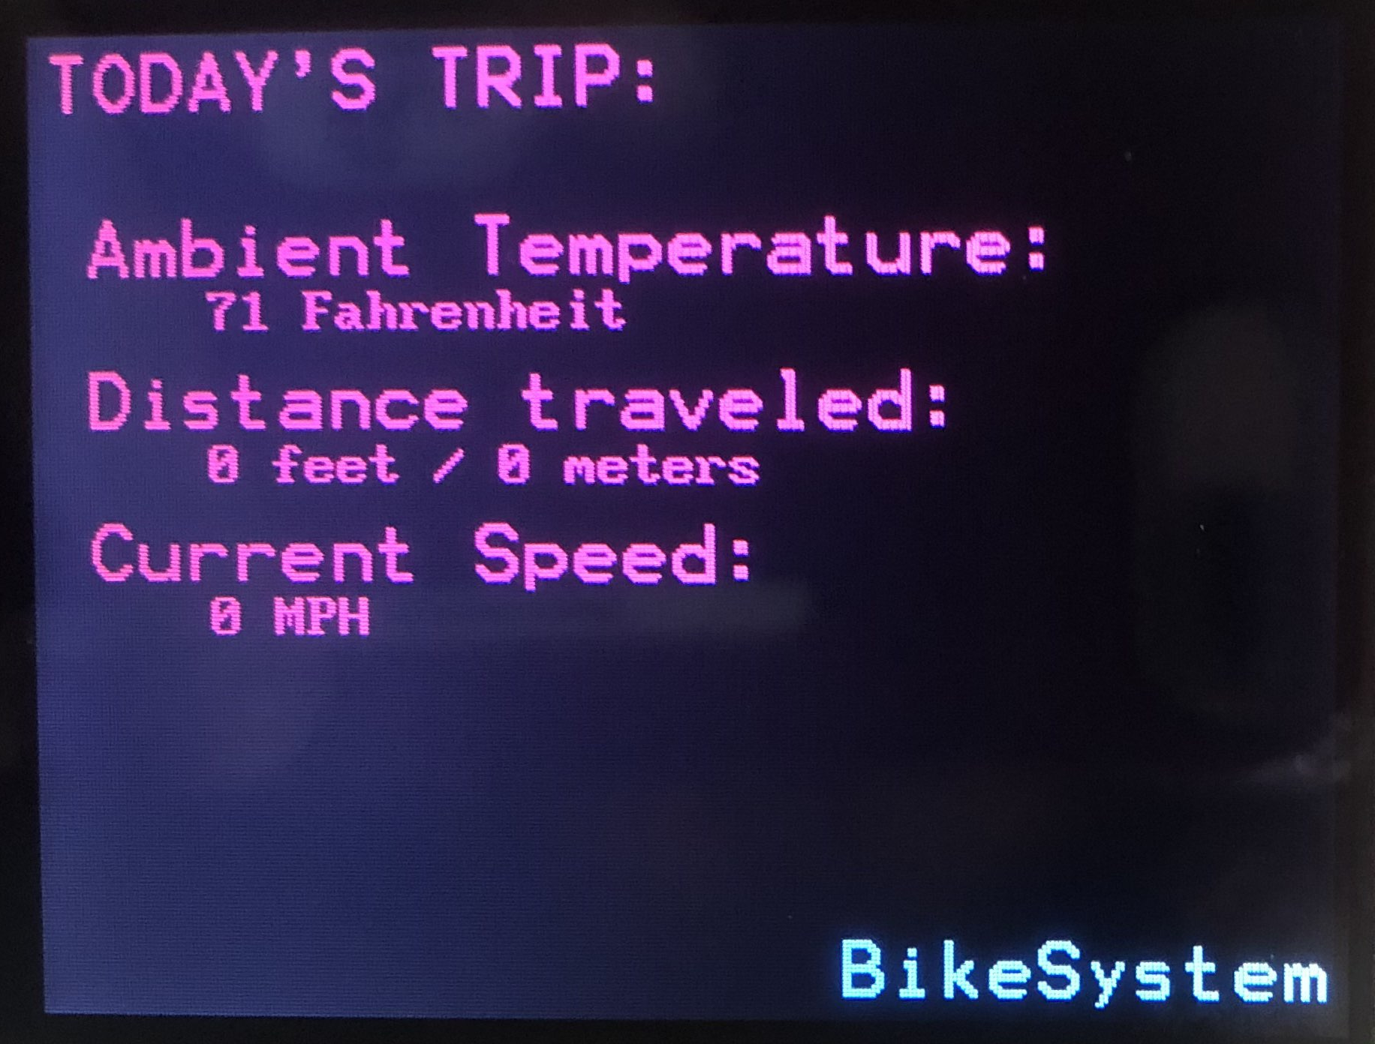
User Interface
Simple design to avoid user/rider distraction
Metrics such as the temperature, current trip distance and current trip average speed are constantly updated and displayed on the LCD
Notes:
Sandy

Slide 36
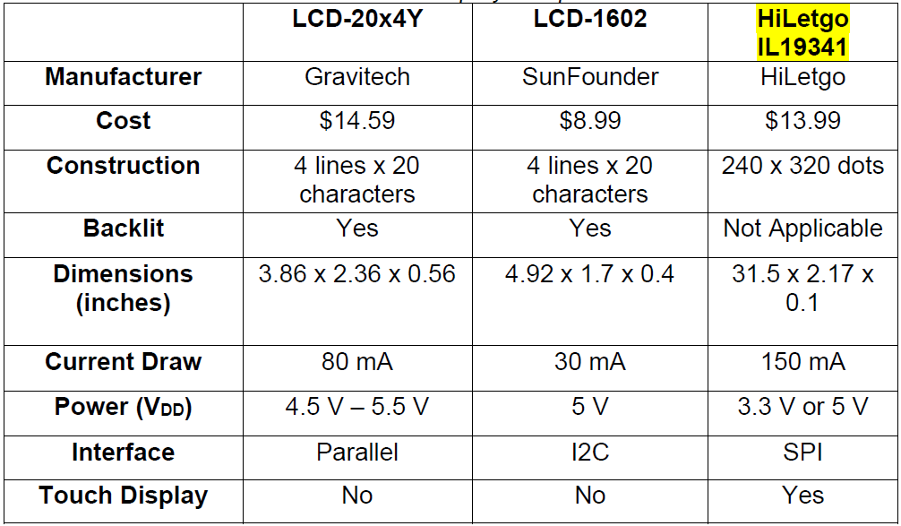
LCD Comparison

Slide 37
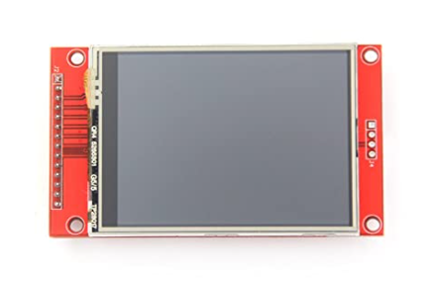
LCD
HiLetGo IL19341
3.3 V operating voltage
Resolution: 240 x 320
Dimensions: 43.2 mm x 57.6 mm
Notes:
Sandy

Slide 38
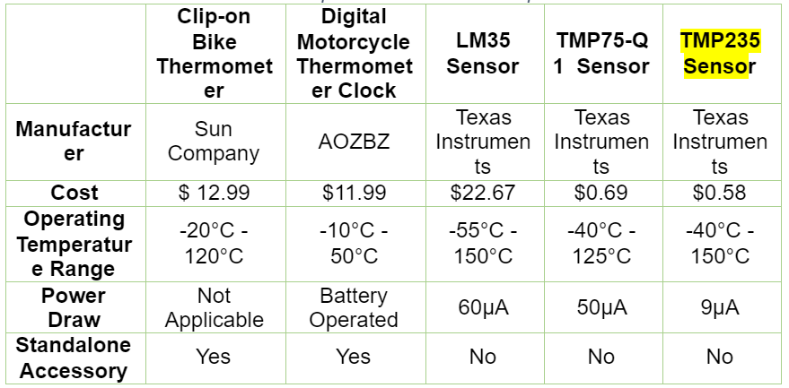
Temperature Sensor Comparison

Slide 39
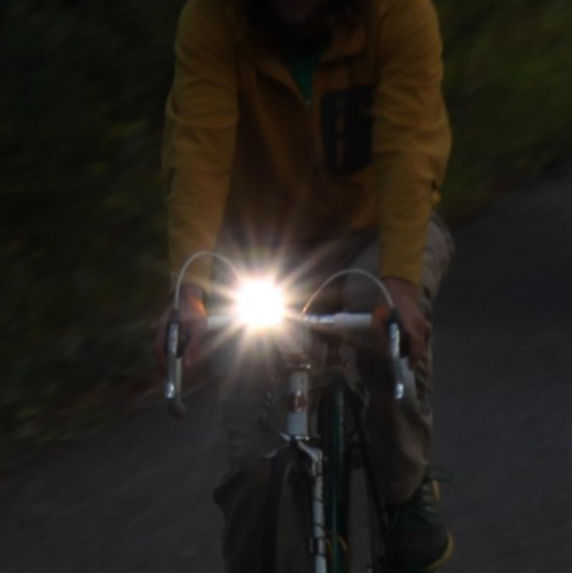
LED Lights
Provide a deterrent from motor vehicles
Provide light for the rider
Efficiently use power resources
Notes:
Danny

Slide 40
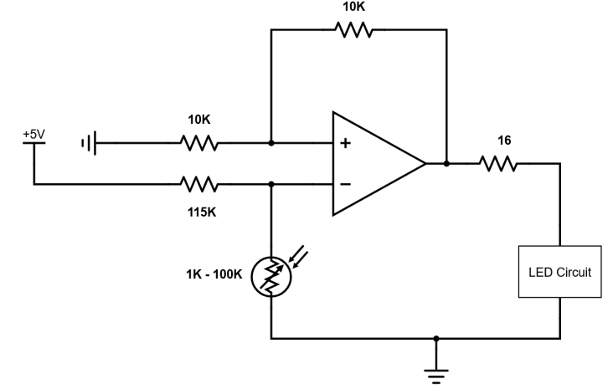
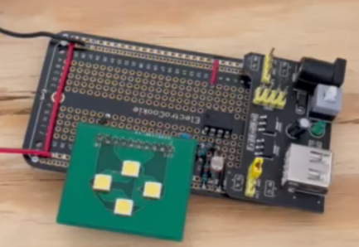
LED Lights Features
Auto dimming
Driver for LED’s
Manual On/Off switch
Notes:
Danny

Slide 41
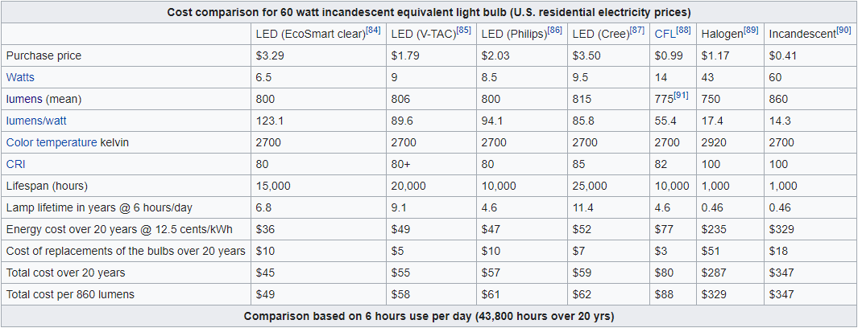
Light Comparison
Incandescent VS LED Lighting
Power
Lifespan
Image provided from Wiki.com

Slide 42
System Integration
Each subsystem was integrated together to form the Bike System
Split up amongst three interconnected PCBs
System Testing
Notes:
Keegan

Slide 43
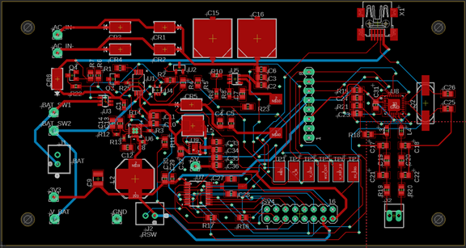
Layout
Notes:
Keegan

Slide 44
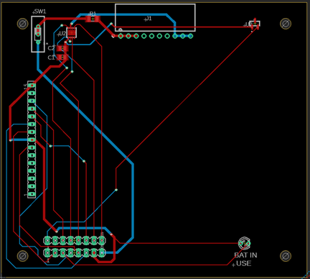
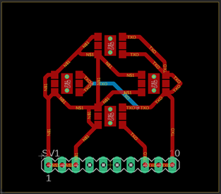
Layout
Notes:
Keegan

Slide 45
Administrative Content

Slide 46
Work Distribution
Group Member | Power Circuitry | Locking Mechanism | Temperature Sensor | Code | UI Design | RFID | Reed Sensor | Lighting | PCB Schematics
Keegan | Primary |  |  |  |  |  | Secondary | Secondary | Primary
Daniel | Secondary | Primary | Secondary | Primary |  | Secondary |  | Primary | Secondary
Benjamin |  | Secondary |  | Secondary |  | Primary | Primary |  | Secondary
Sandhya |  |  | Primary | Primary | Primary | Secondary
Notes:
Sandy

Slide 47
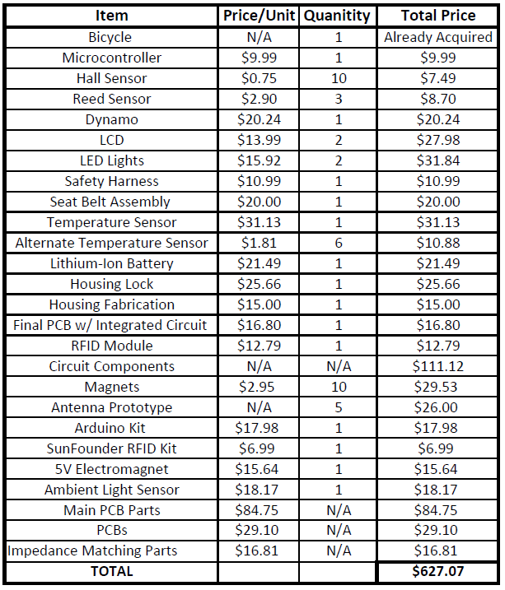
Budget
Self-funded
Initial budget of $ 600
Notes:
Sandy

Slide 48
Thank you

