Slide 1


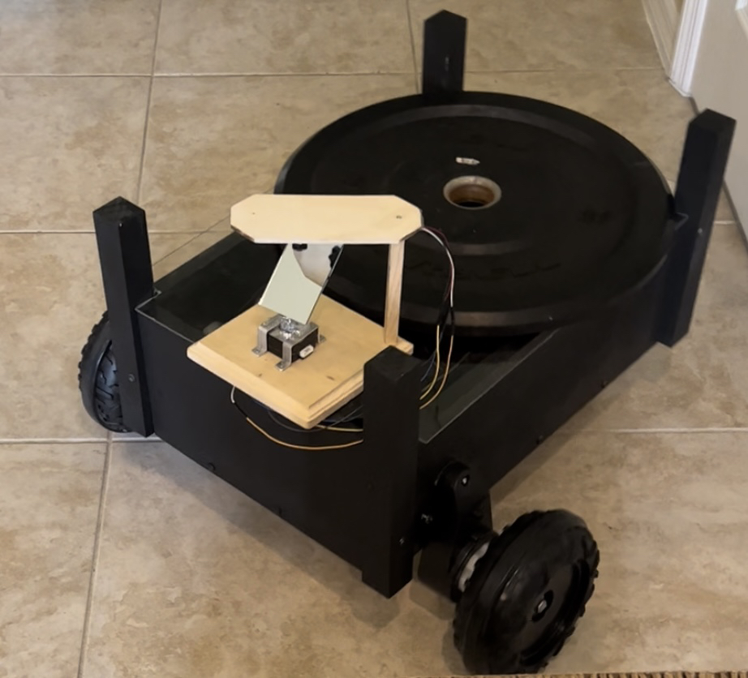
Solar-powered Path-finding Carrier (S.P.C) Robot
Group 8
Deborah Campbell - Computer Engineering
Brianna Chavira - Optics and Photonics Engineering
Ularislao Cordova - Electrical Engineering
Tommy Rodriguez - Electrical Engineering

Slide 2

Overview
Deborah
Motivation
Project goals & objectives
Specifications
Block diagram
Overall design
Power Supply
PCB design
Budget
Notes:
This is an overview of what we’re going to present to you today. We’re presenting the PCB, the budget, the distribution of work, goals for the project, requirement specification

Slide 3
Motivation
Deborah
Create a robot that assists in day-to-day activities
Provide a solar powered robot to further assist the user
Ability to carry objects while moving
Notes:
The motivation of this project is to create a robot that can assist the user with heavy objects of about 25lbs with the ability to follow and evade obstacles along the way.

Slide 4
Goals and Objectives
Tommy
Primary Goals
To have the S.P.C. robot follow the user autonomously
Create a mobile application to control the robot
Secondary Goals
Ensure the robot can evade obstructions in its path
Ensure the mobile app is user friendly to help the user control the S.P.C
The S.P.C will carry items for the user to the different Waypoints.
One of the priorities is to assist the user in carrying objects of a certain weight

Slide 5
Specifications
Tommy
Specifications | Target
The carrier robot should be able to detect and avoid obstacles within 1m | 1m
The carrier robot should be able to run autonomously for up to 1 hour | 1 hour
The solar panels should be able to charge the carrier robot’s battery to a useable level | ~12.5V (for a 12V Battery)
The carrier robot must follow the user within 3m behind them | 3m
The carrier robot should be able to travel between 1-5 miles an hour autonomously | 2 miles/hr
The carrier robot must be able to keep up with the user up to 5 miles/hour | 2 miles/hr
The carrier robot should be able to carry up to 25lbs | 25 lbs
Total system and assembly cost must be under $1000 | $1000

Slide 6
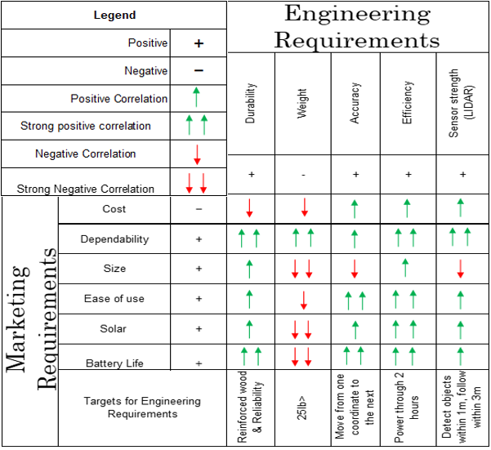
Tommy
House
of
Quality

Slide 7
Project Design
Notes:
Nick

Slide 8
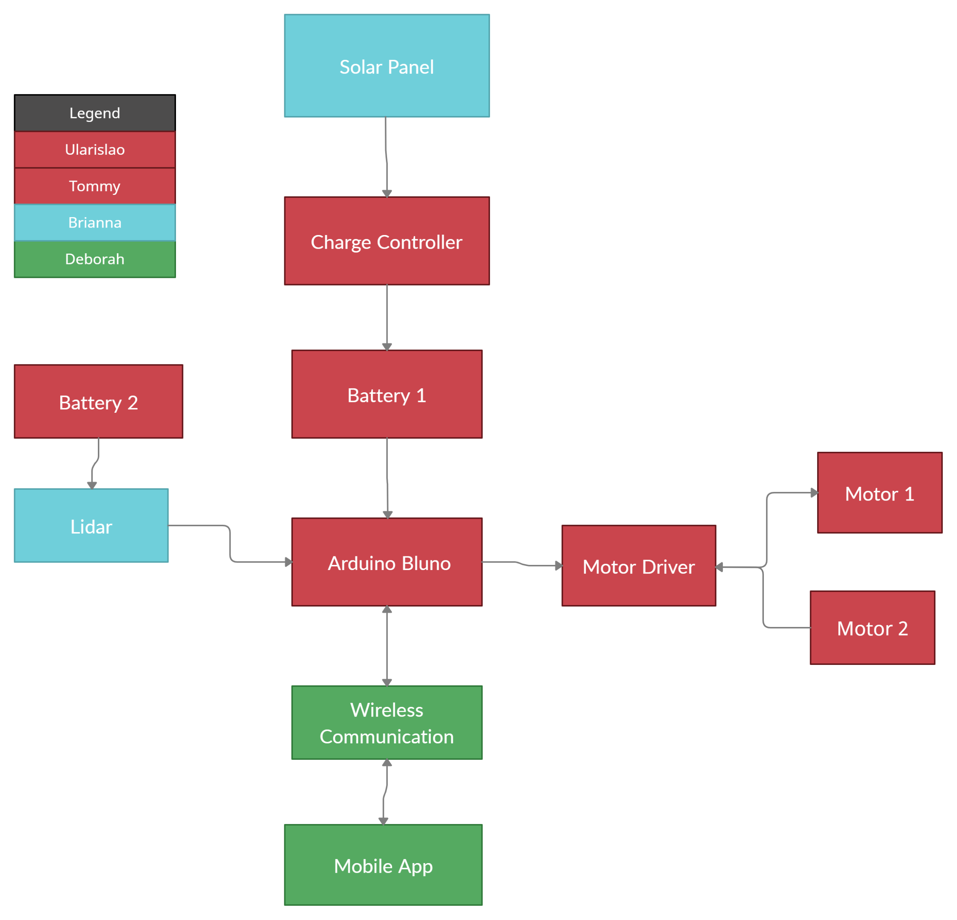
Block Diagram
Tommy

Slide 9

Recommended MCU's
Ularislao
Development Board | Arduino Uno (ATmega328) | MSP430F5132IDA | STM32F303CBT6
Operating Voltage(v) | 7-12V | 1.8V - 3.6V | 2 - 3.6V
Main Board | Uno | Charge Controller | LiDar
Applications | Autonomous Systems | Motor Controls Power Optimization | Signal processing, complex algorithm execution.
Pins | 28 | 38 | 48
Price | $24.90 | $2.44 | $7.75

Slide 10
Coding Implementations
Deborah
Many code resources exists due to the popularity of using the Arduino
To reach the desire specification for the project, an edit of existing codes is required
The coding languages used are:
Java for IDE, C++ for the programming
Android IDE is used to for the programming of the project.
Notes:
Coding with Arduino, the IDE is written in JAVA while the coding is implemented using C++, which is the language the group preferred. Due to the popularity and resources, many code already exists and we just had to tweak the existing code that pertains to what we’re doing to fit our project.

Slide 11
Bluetooth
Deborah
Majority have access to Bluetooth
Bluetooth allows 30 feet of proximity
Energy Efficient
Notes:
When the connection for the communication between the phone and the Arduino uno was discussed, we decided to use Bluetooth instead of WiFi connection. The Bluetooth was chosen due to its operating range. With the Blynk app, connection to the Arduino via Bluetooth was made possible.

Slide 12
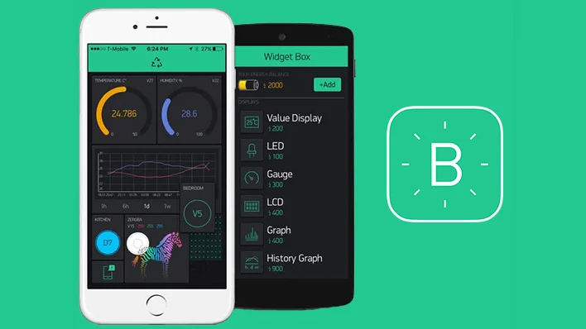

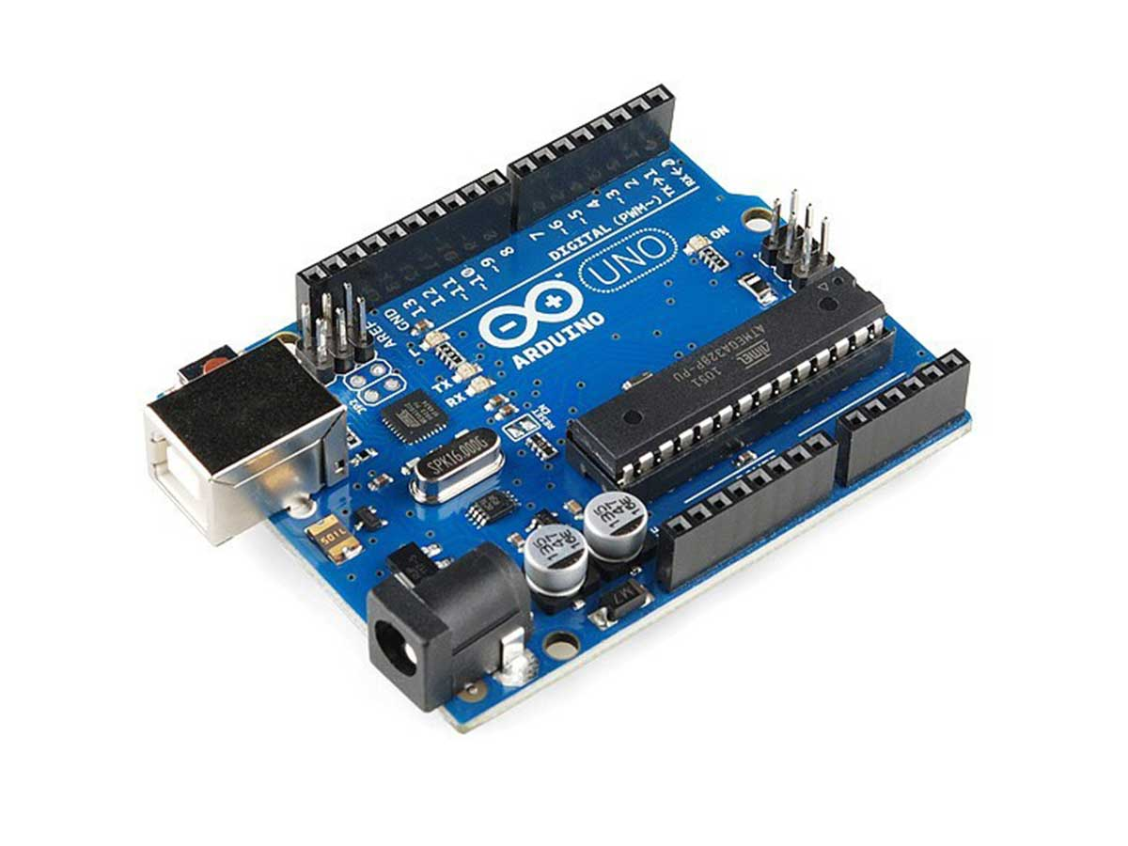
Blynk Mobile Application
Deborah
Notes:
The mobile application we are using is called the blynk mobile app which is a commonly used application when programming with the microcontrollers. It also helps that it is user friendly. Well will be controlling the robot by using the blynk mobile app to connect to the Arduino uno.

Slide 13
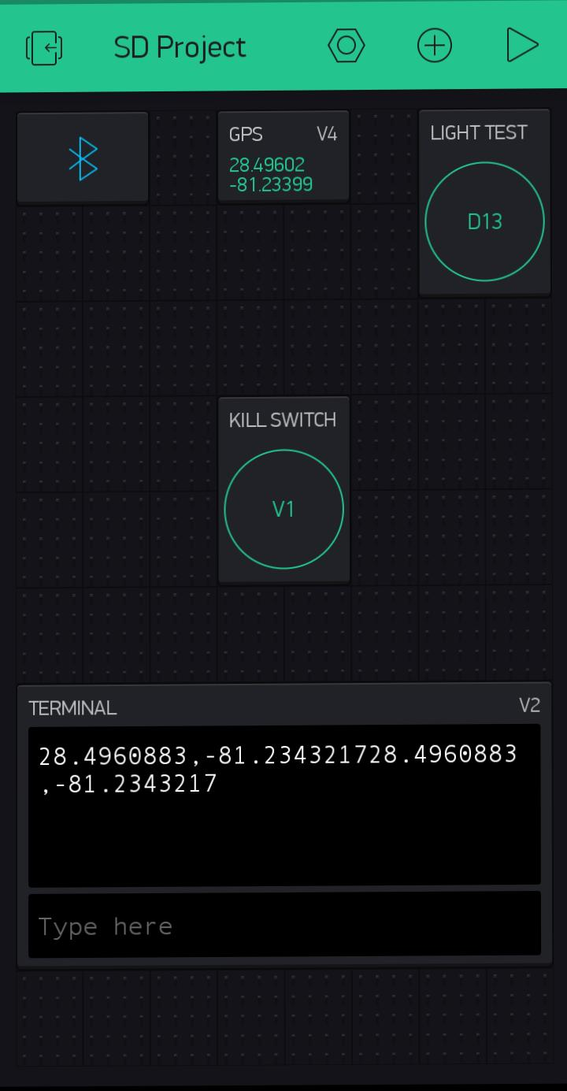
Blynk App
Deborah
Allows switch from cellphone tower accuracy to GPS accuracy
Displays the Waypoints, add new Waypoints
Gets periodic location updates:
- Turn the service on/off
- Configure how often it runs
Notes:
For the mobile application, we used the blynk mobile app which is a commonly used application when one needs a mobile communication tool. How blynk works is that you can add buttons, terminals, joysticks, and various things. They are programmed to virtual pins and when it comes to the Arduino code those virtual pins add these functions. And in those functions, we can make it do various of things such as streaming the phones' location since it has a gps streaming module. Gps coordinates were also added to calculate the waypoints.

Slide 14
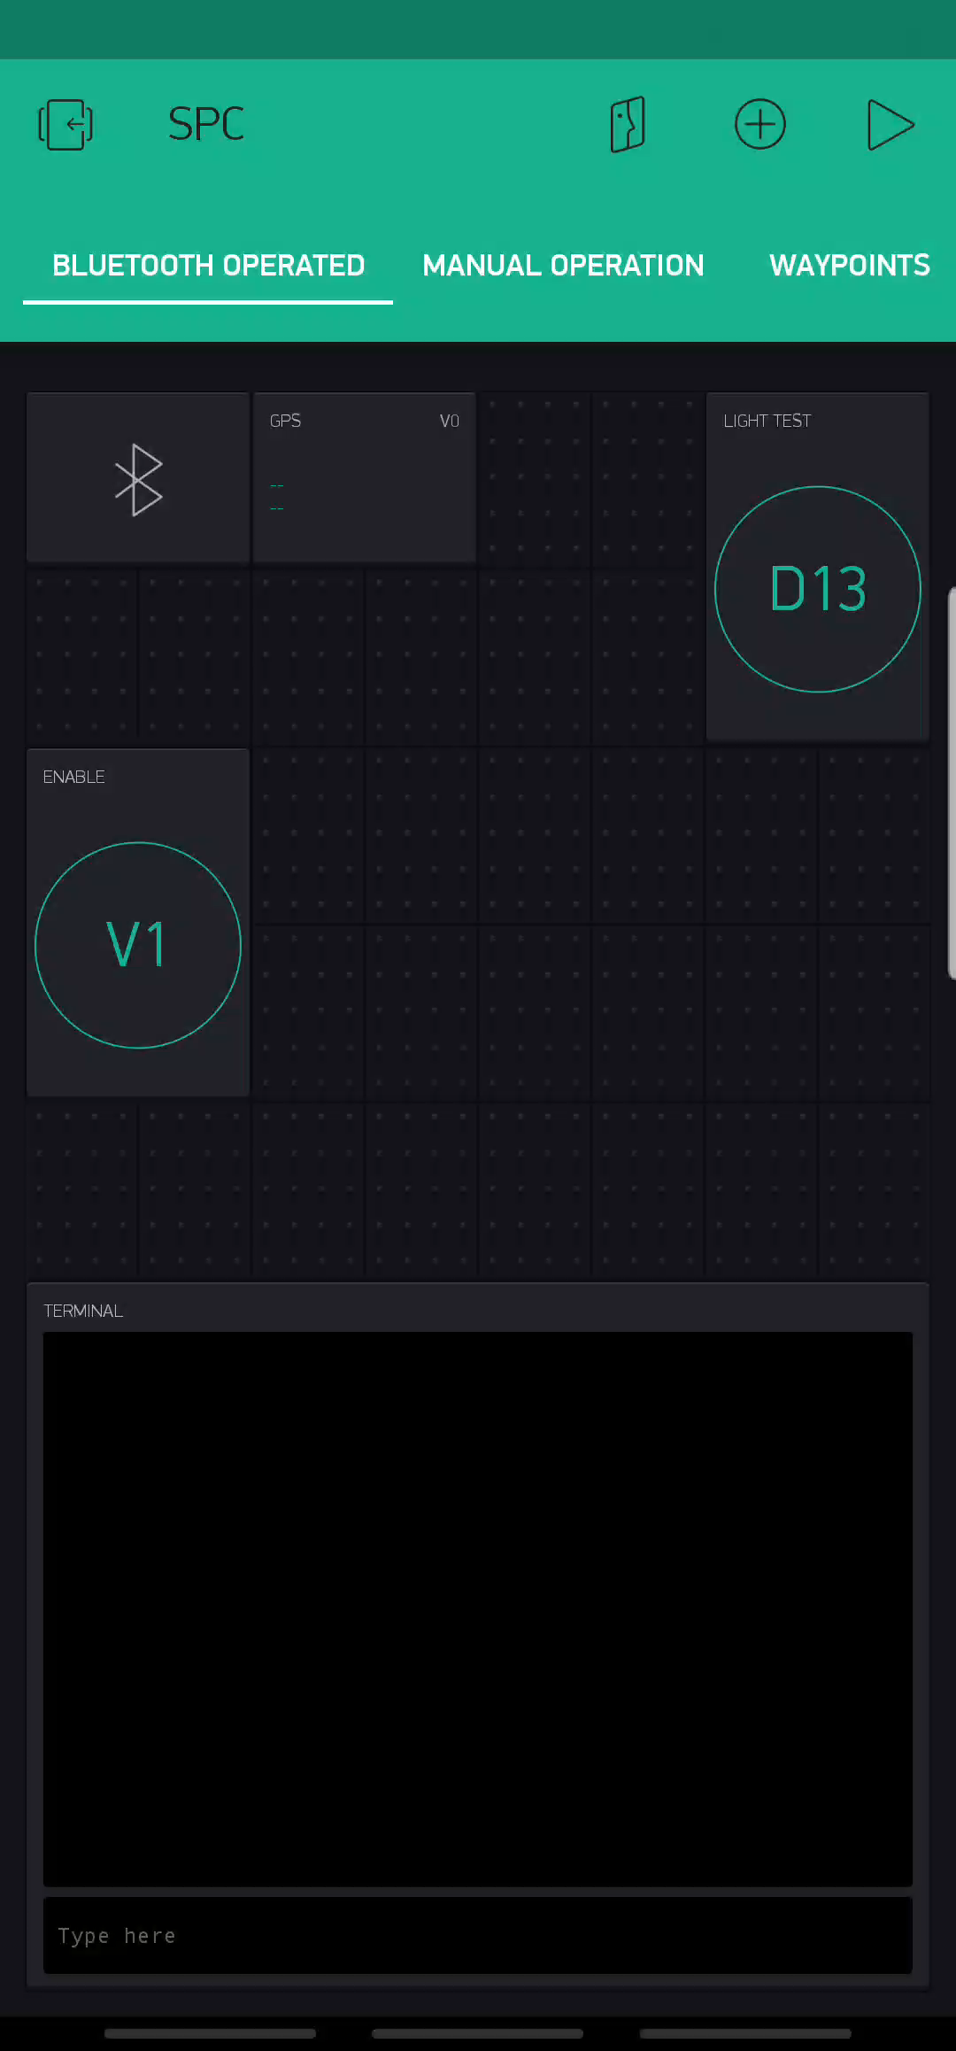
Blynk App Demo
Deborah
Features
Bluetooth module
GPS streaming module
Control to get the waypoints
Joystick to manually control the movement of the robot.
GPS Streaming Range is 5-20 seconds (Specified by user)

Slide 15
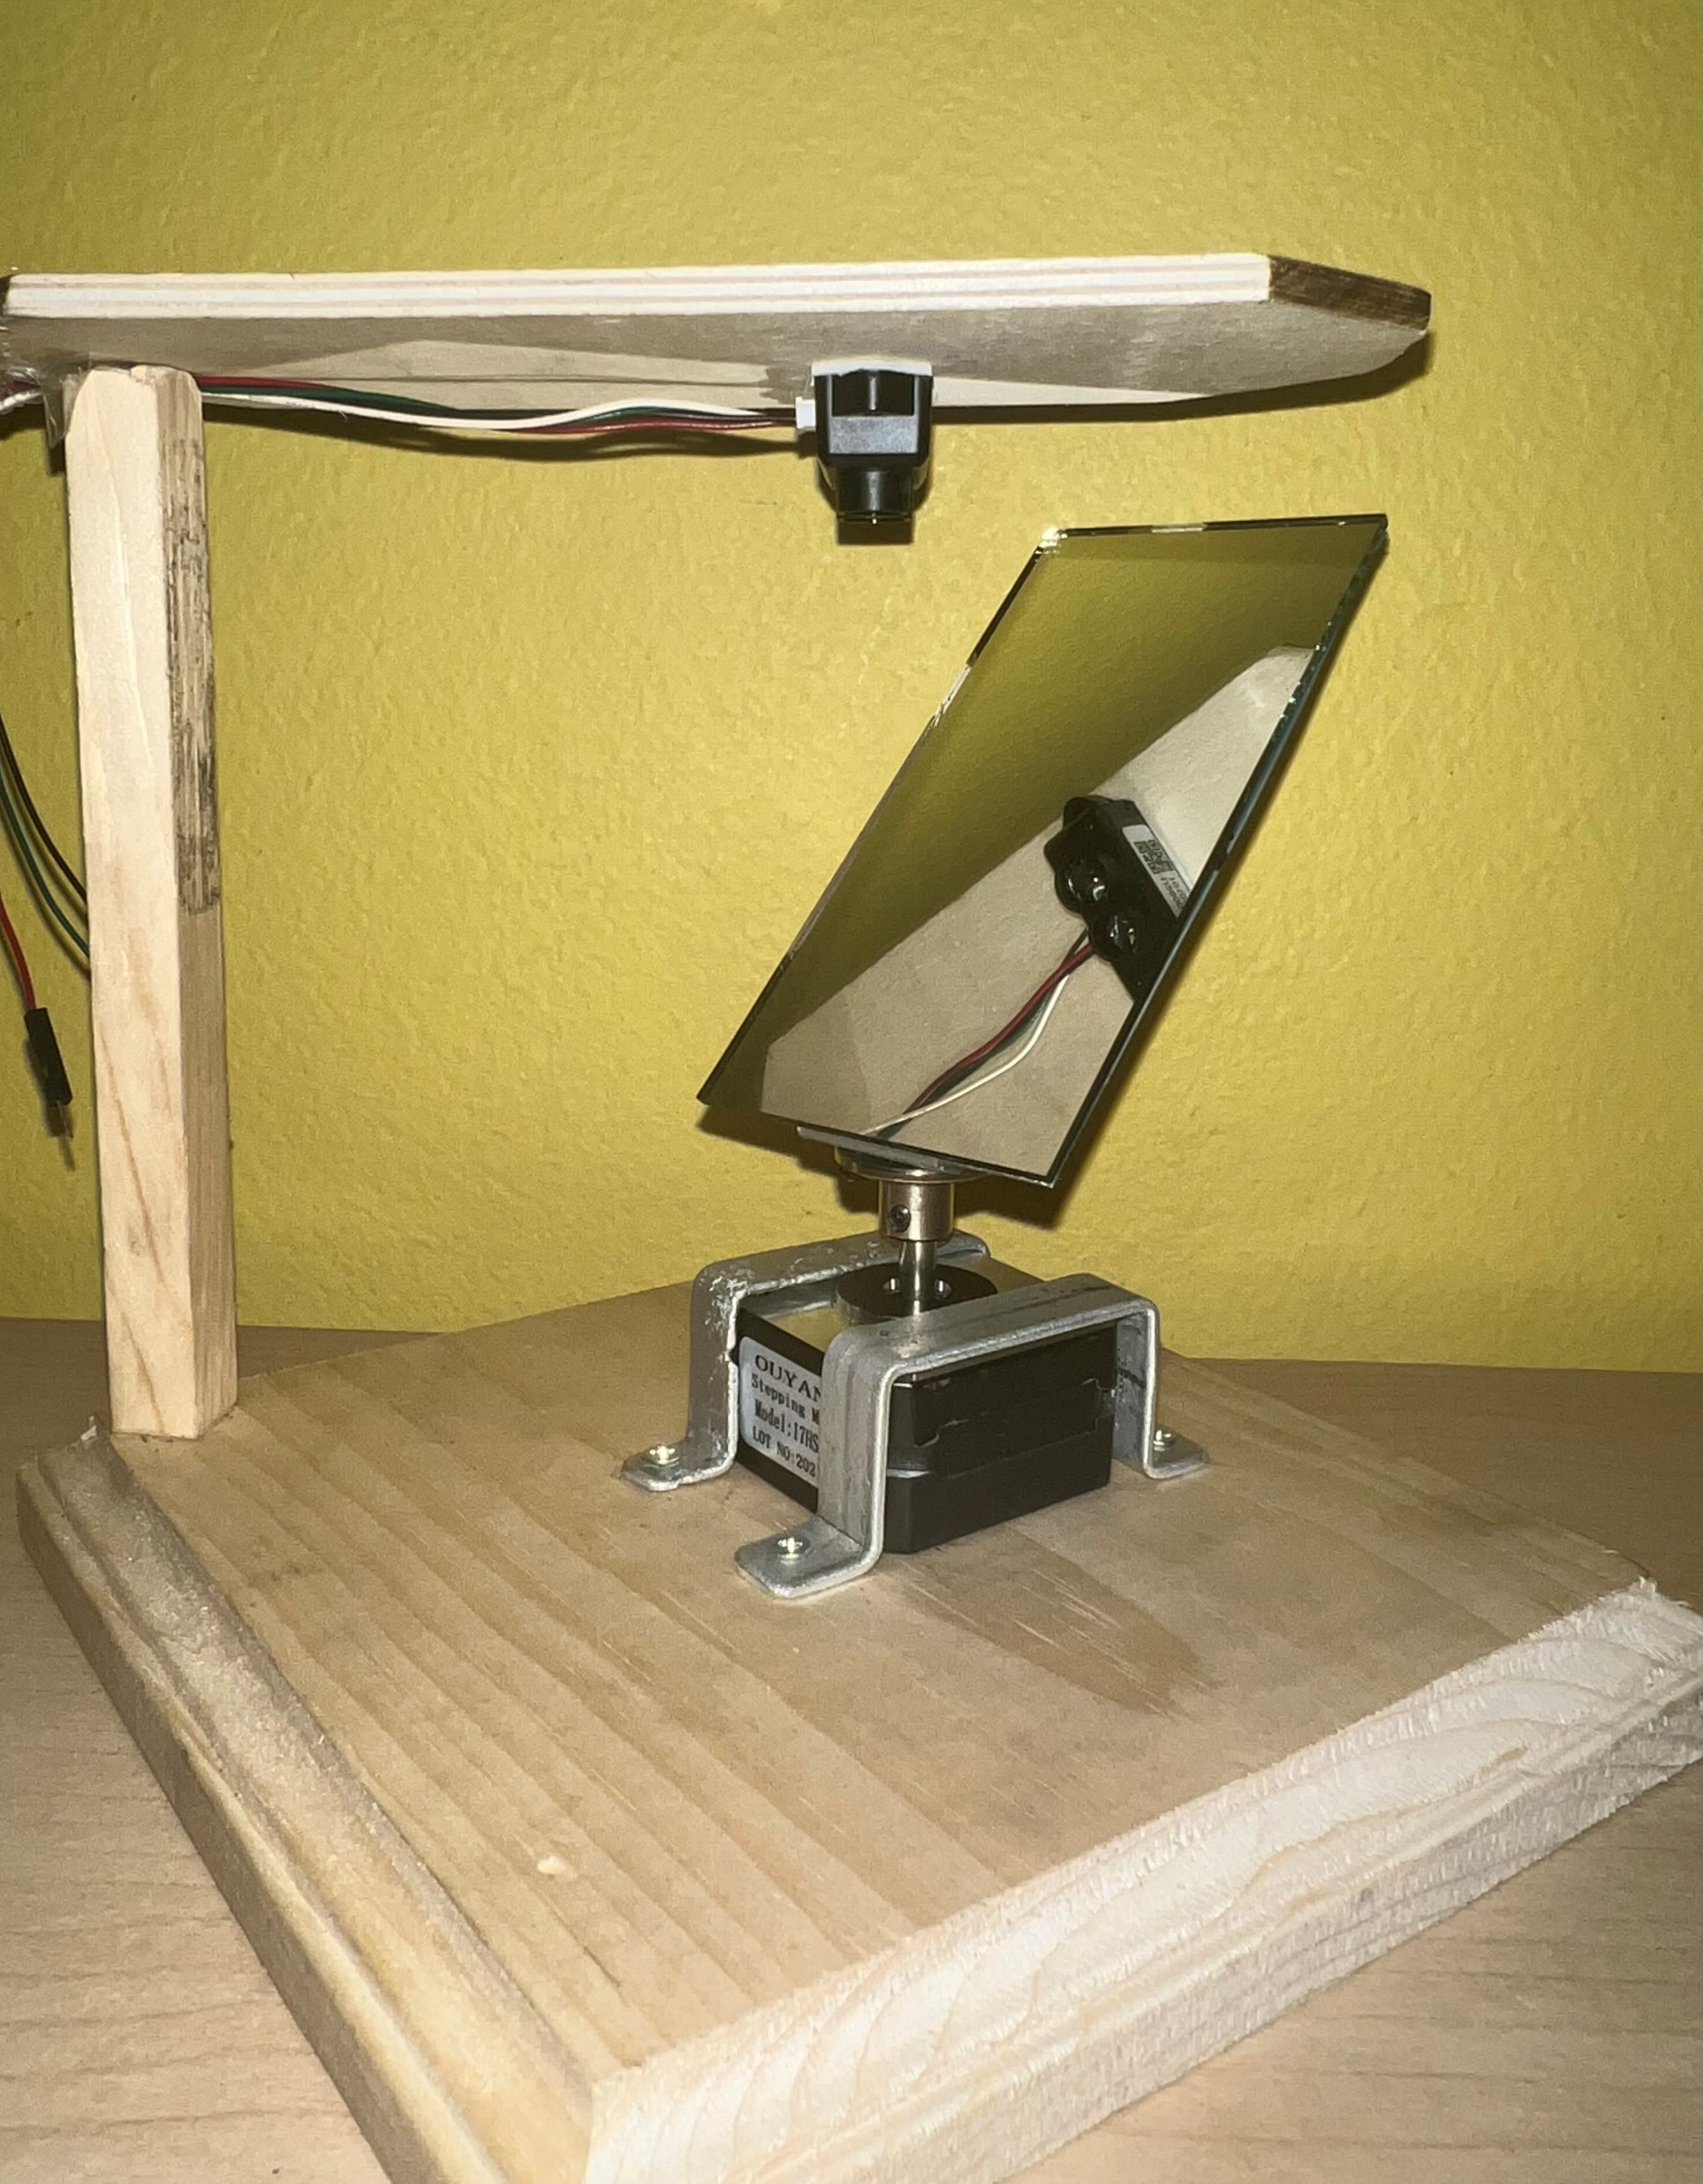
Lidar Design
Time of flight principle
360-degree scan of environment
Wavelength : 905 nm
Adjustable stepper motor

Slide 16
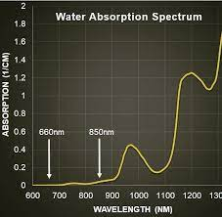

Wavelength
Outdoor conditions
Lower power, higher efficiency
Availability & cost
Safety

Slide 17
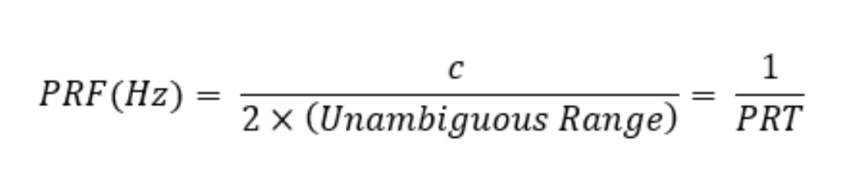
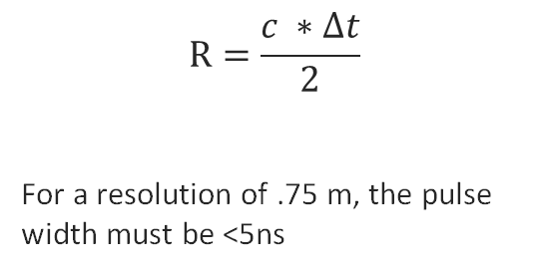
Calculations
Resolution
Range
$$R=\frac{c ∗∆t}{2}$$
For a resolution of .75 m, the pulse width must be <5ns
For a range of 25m, the pulse repetition frequency must be less than 6MHz
Response time
If the robot is moving at 5mph and the Lidar has a range of 25m, then the detection and the response time must be less than 55 seconds.

Slide 18
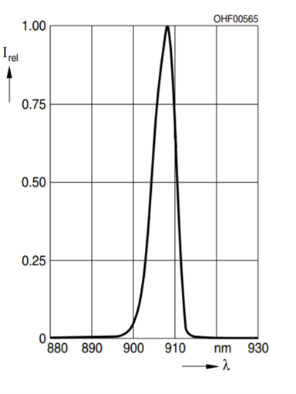
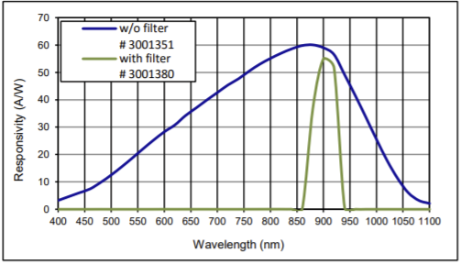
Laser diode & Photodiode selection
Laser Diode :
SPL PL90_3
Wavelength = 905 (nm)
Pulse Width = 1-100 (ns)
Peak Power = 90 (W)
Photodiode : AD500-9
Peak Wavelength Sensitivity = 905nm(λ)
Rise/Fall Time = .55 (ns)
Responsivity = 49 (A/W)
Spectral response of AD500-9
Relative spectral emission of SPL PL90_3

Slide 19
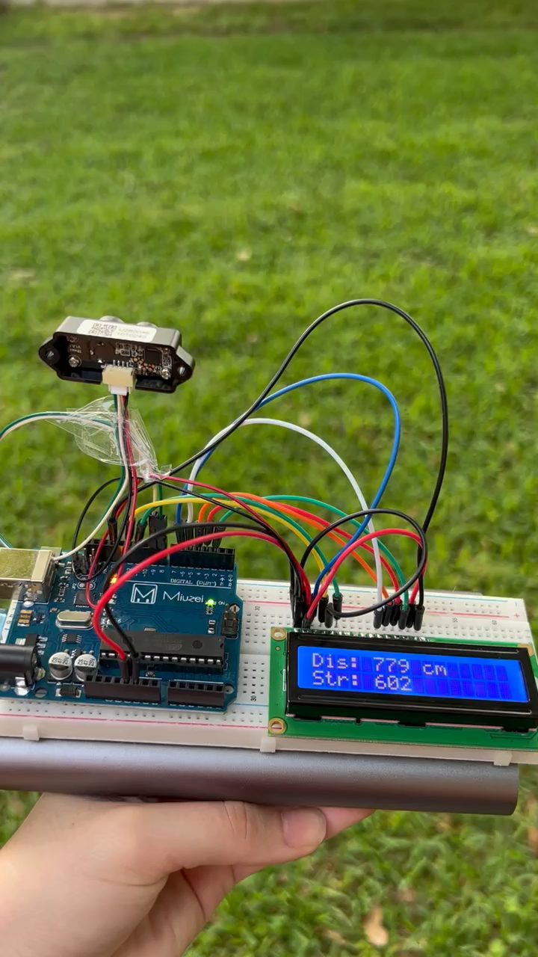
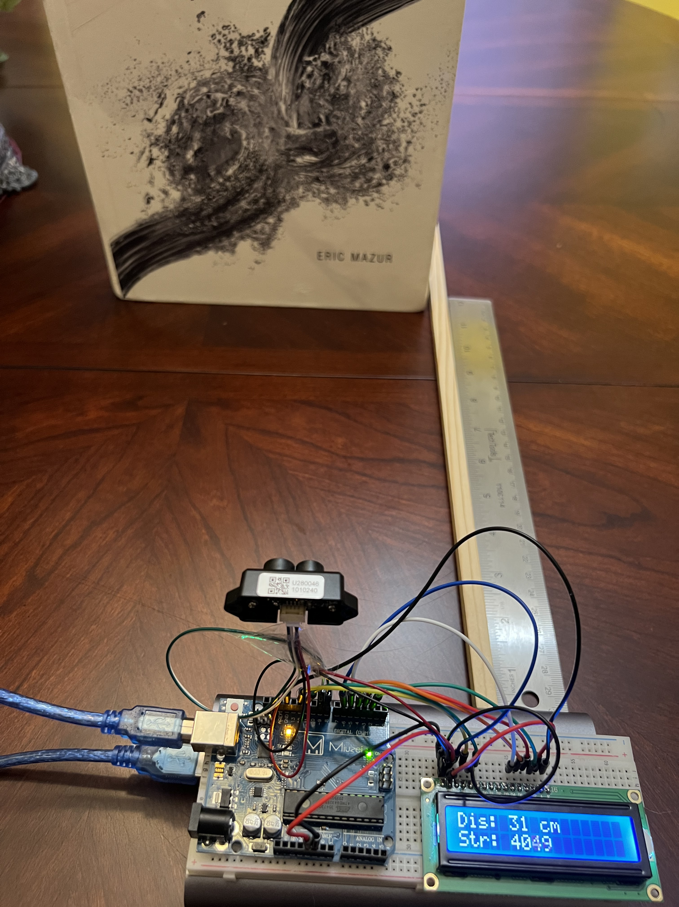
TFMini Testing
Range
Accuracy

Slide 20
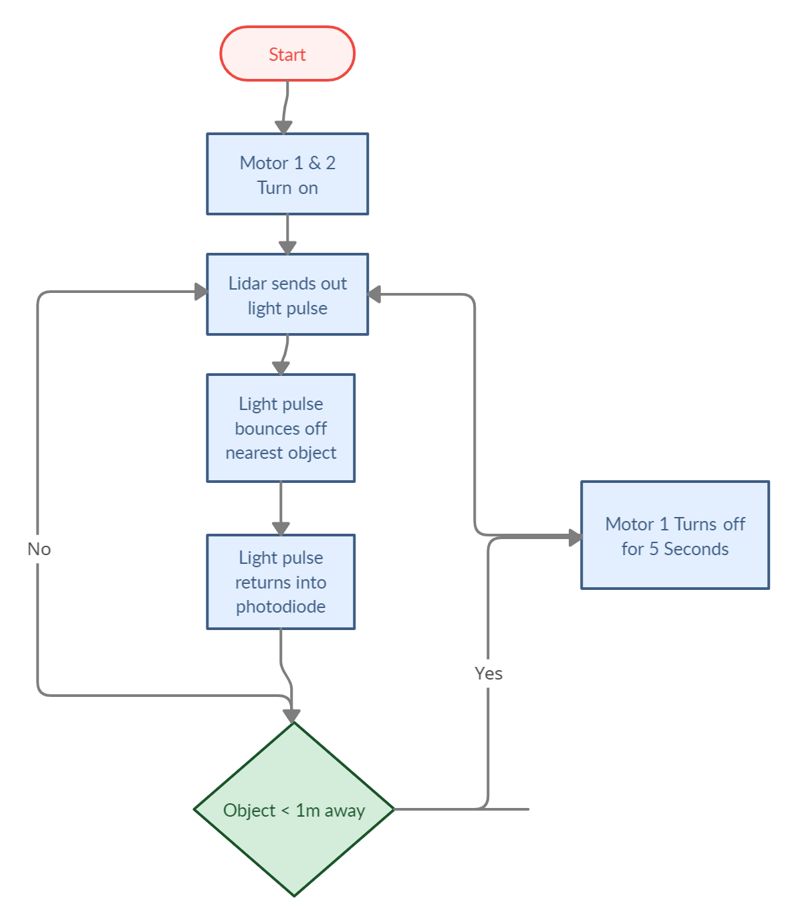
Obstacle Avoidance

Slide 21
Mechanical Design Overview
Tommy
Frame made from accessible parts
Plywood used for structure
Built to withstand vibrations due to terrain
Ability for sharp turns
Removable solar panel
Component Accessibility

Slide 22
Power supply

Slide 23
DC Power Supply
Tommy
Keep electronics running under all conditions
Is powered DC to DC by the Solar Panel
DC power source must continue to function after disconnection of Solar Panel
Operational voltage range 6V-12V

Slide 24
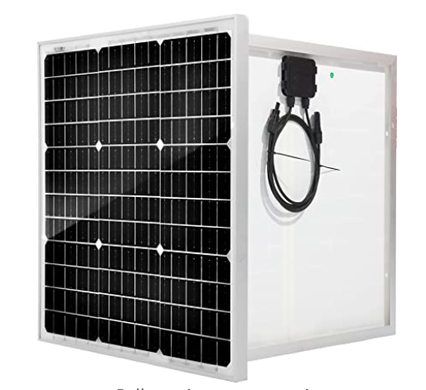
Solar Panel
Ularislao
SUNSUL 50-Watt 12 Volt
Dimensions: 21in x 21 in x 0.98 in
Open Circuit Voltage (Voc): 22.4V
Max Power Voltage (Vpm): 18.2V
Short Circuit Current (Isc): 2.94A
Operating Current (Imp): 2.75A
Mainly used for smaller power systems
Temperature Range：-40°F to +176°F

Slide 25
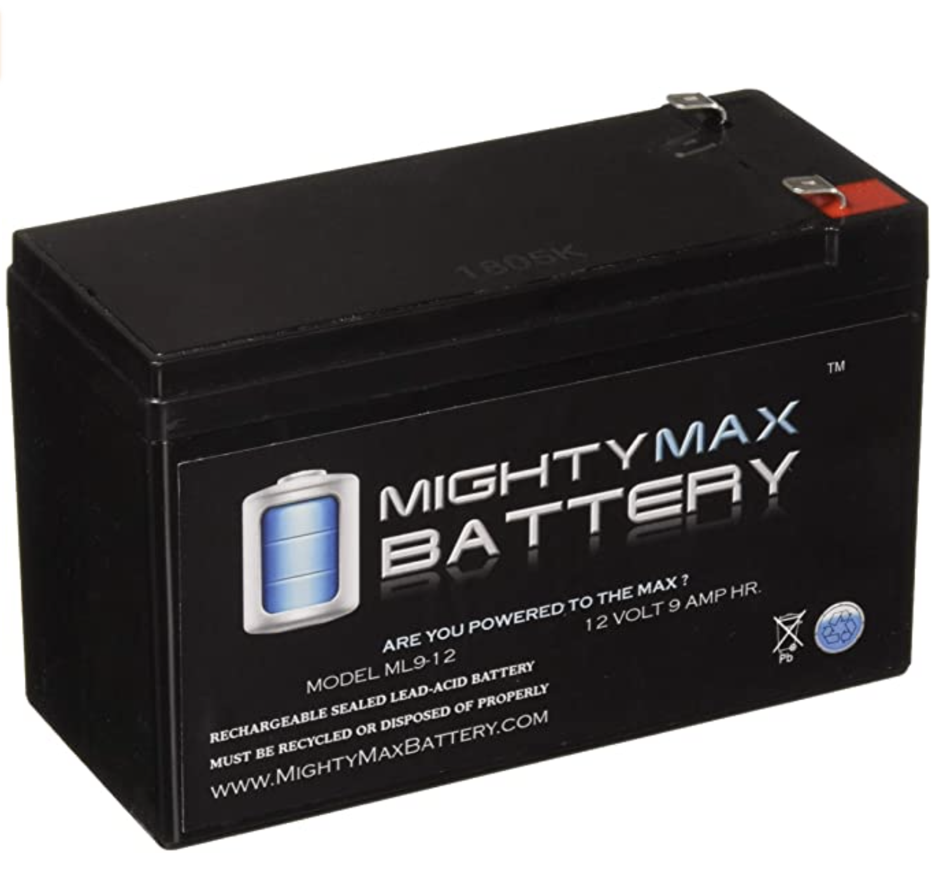
Battery
Ularislao
12 V, 9 Ah Rating
Sealed Lead Acid
Large Power-to-Weight Ratio
Rechargeable
5lbs
Mighty Max Battery

Slide 26

PCB Boards

Slide 27
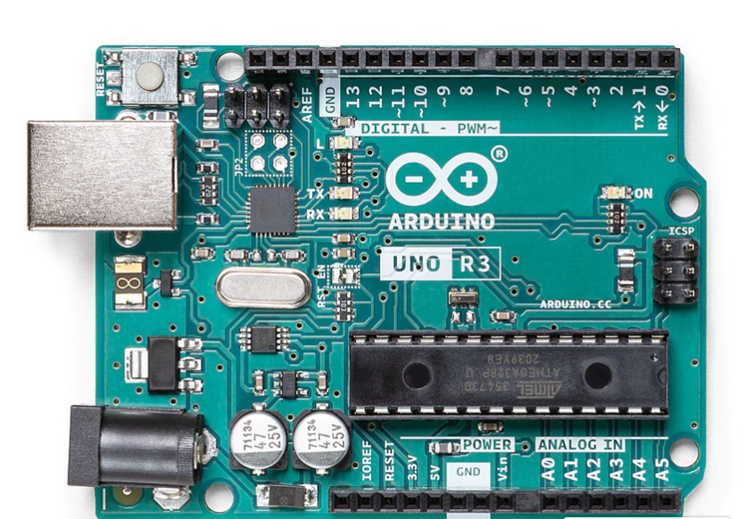
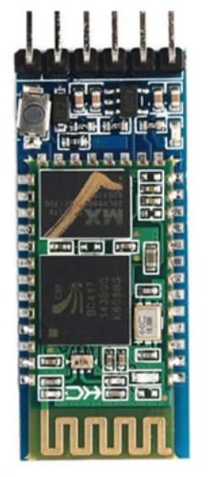
HC-05 Bluetooth
Tommy
Arduino Uno R3
Added HC-05 Bluetooth Receiver
Facilitates communication with the mobile device
Range is about 10 meters

Slide 28
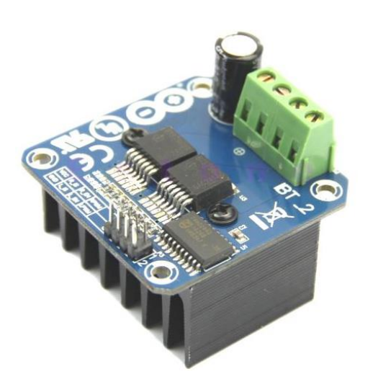
Motor Drive Controller
Ularislao
BTS7960 H-Bridge Motor Driver
Single H-bridge Driver
Better for Higher Currents
Bidirectional Control
Uses 4 Control Pins
Cost ~ $7 Each

Slide 29
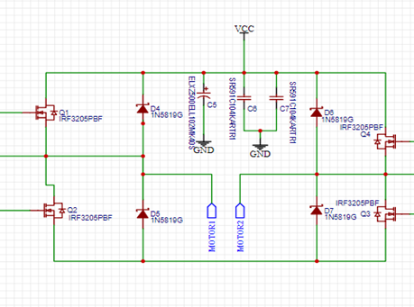
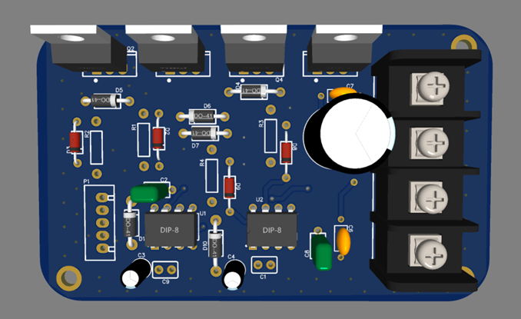
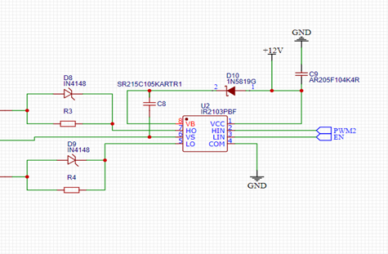
Suggested H Bridge
Ularislao

Slide 30
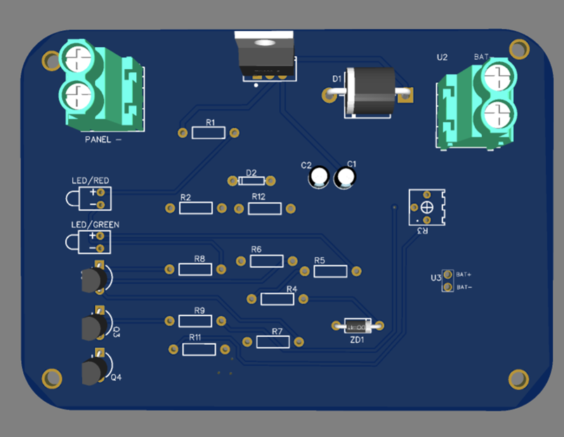
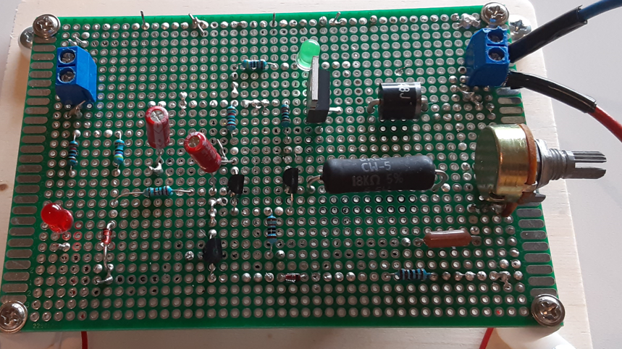
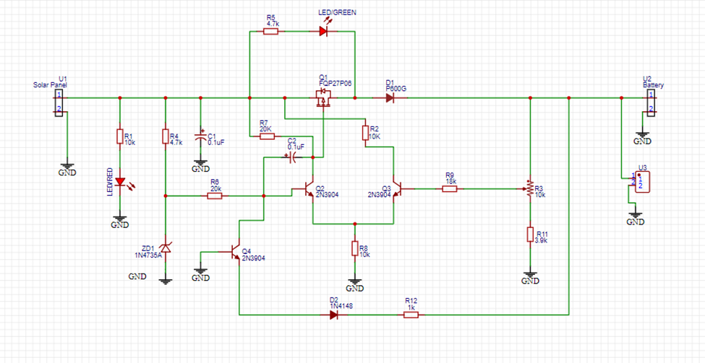
Charge Controllers (LDO)
Ularislao​

Slide 31
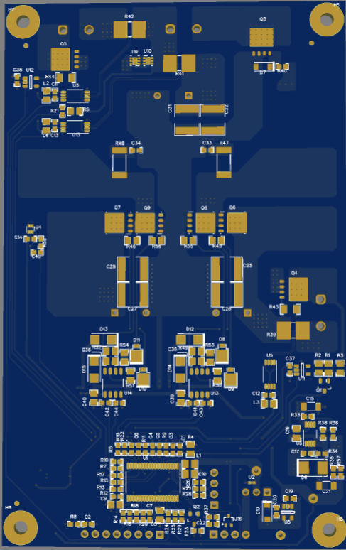
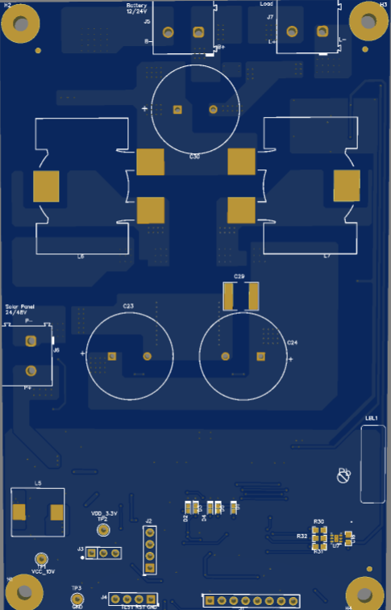
Charge Controller (MPPT Controller)
Ularislao

Slide 32
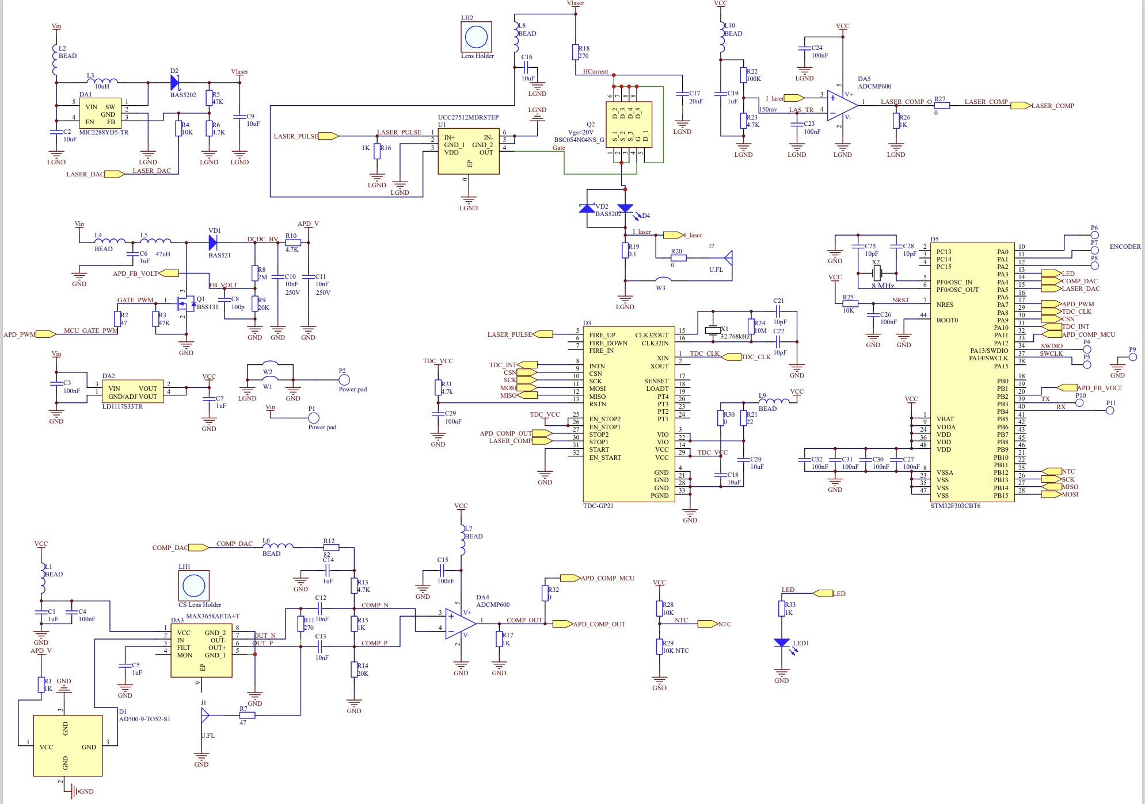
Lidar PCB Schematic

Slide 33
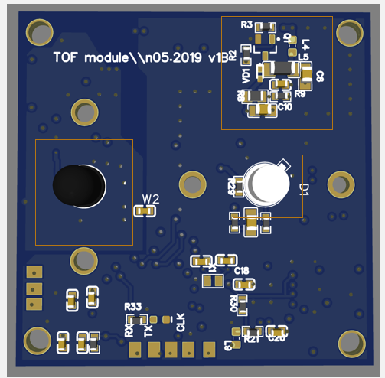
Lidar PCB - Top
Pulsed laser diode, 50 watt pulses. Light wavelength is 905 nm
Avalanche photodiode
Step-up converter module. It produces regulated high voltage for the APD.
3
2
1

Slide 34
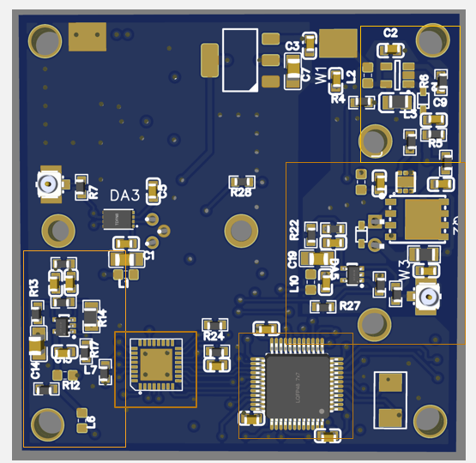
Lidar PCB – Bottom
Brianna
5
1.Pulsed laser driver. Including MOSFET and driver, Current sensing resistor and Comparator.
2.TIA comparator, converts analog signal into a digital form
3.TDC: time-to-digital-converter. It is used for measuring time of flight of the light pulse. It is capable of measuring intervals with 90 ps resolution.
4.Microcontroller used to control the LIDAR.
5.Step-up converter for laser circuits produces regulated voltage.
1
2
4
3

Slide 35
Communication Protocols

Slide 36
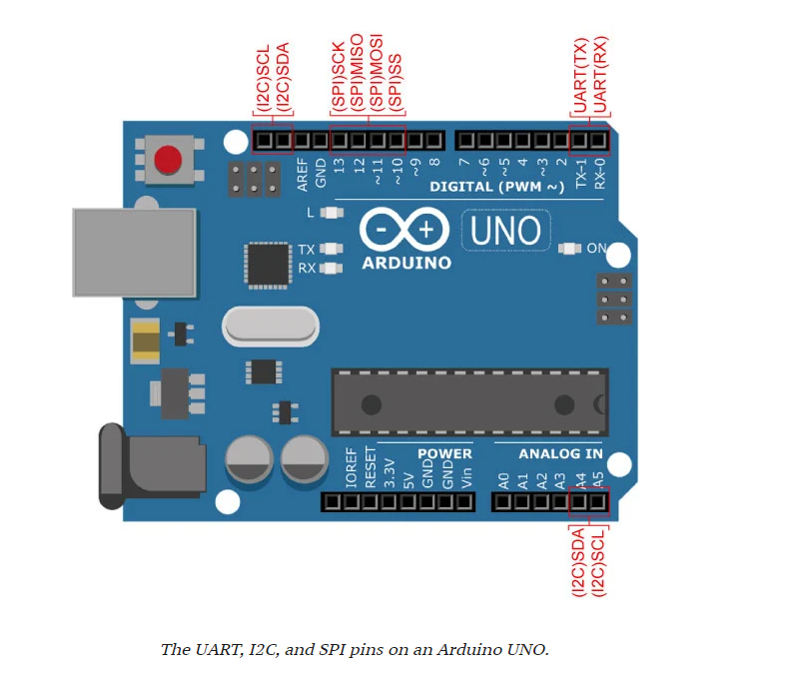
Communication
Protocols
Tommy
UART via RX and TX
I2C with the use of SDA and SCL including the analog pins
SPI included on board but never used in project

Slide 37
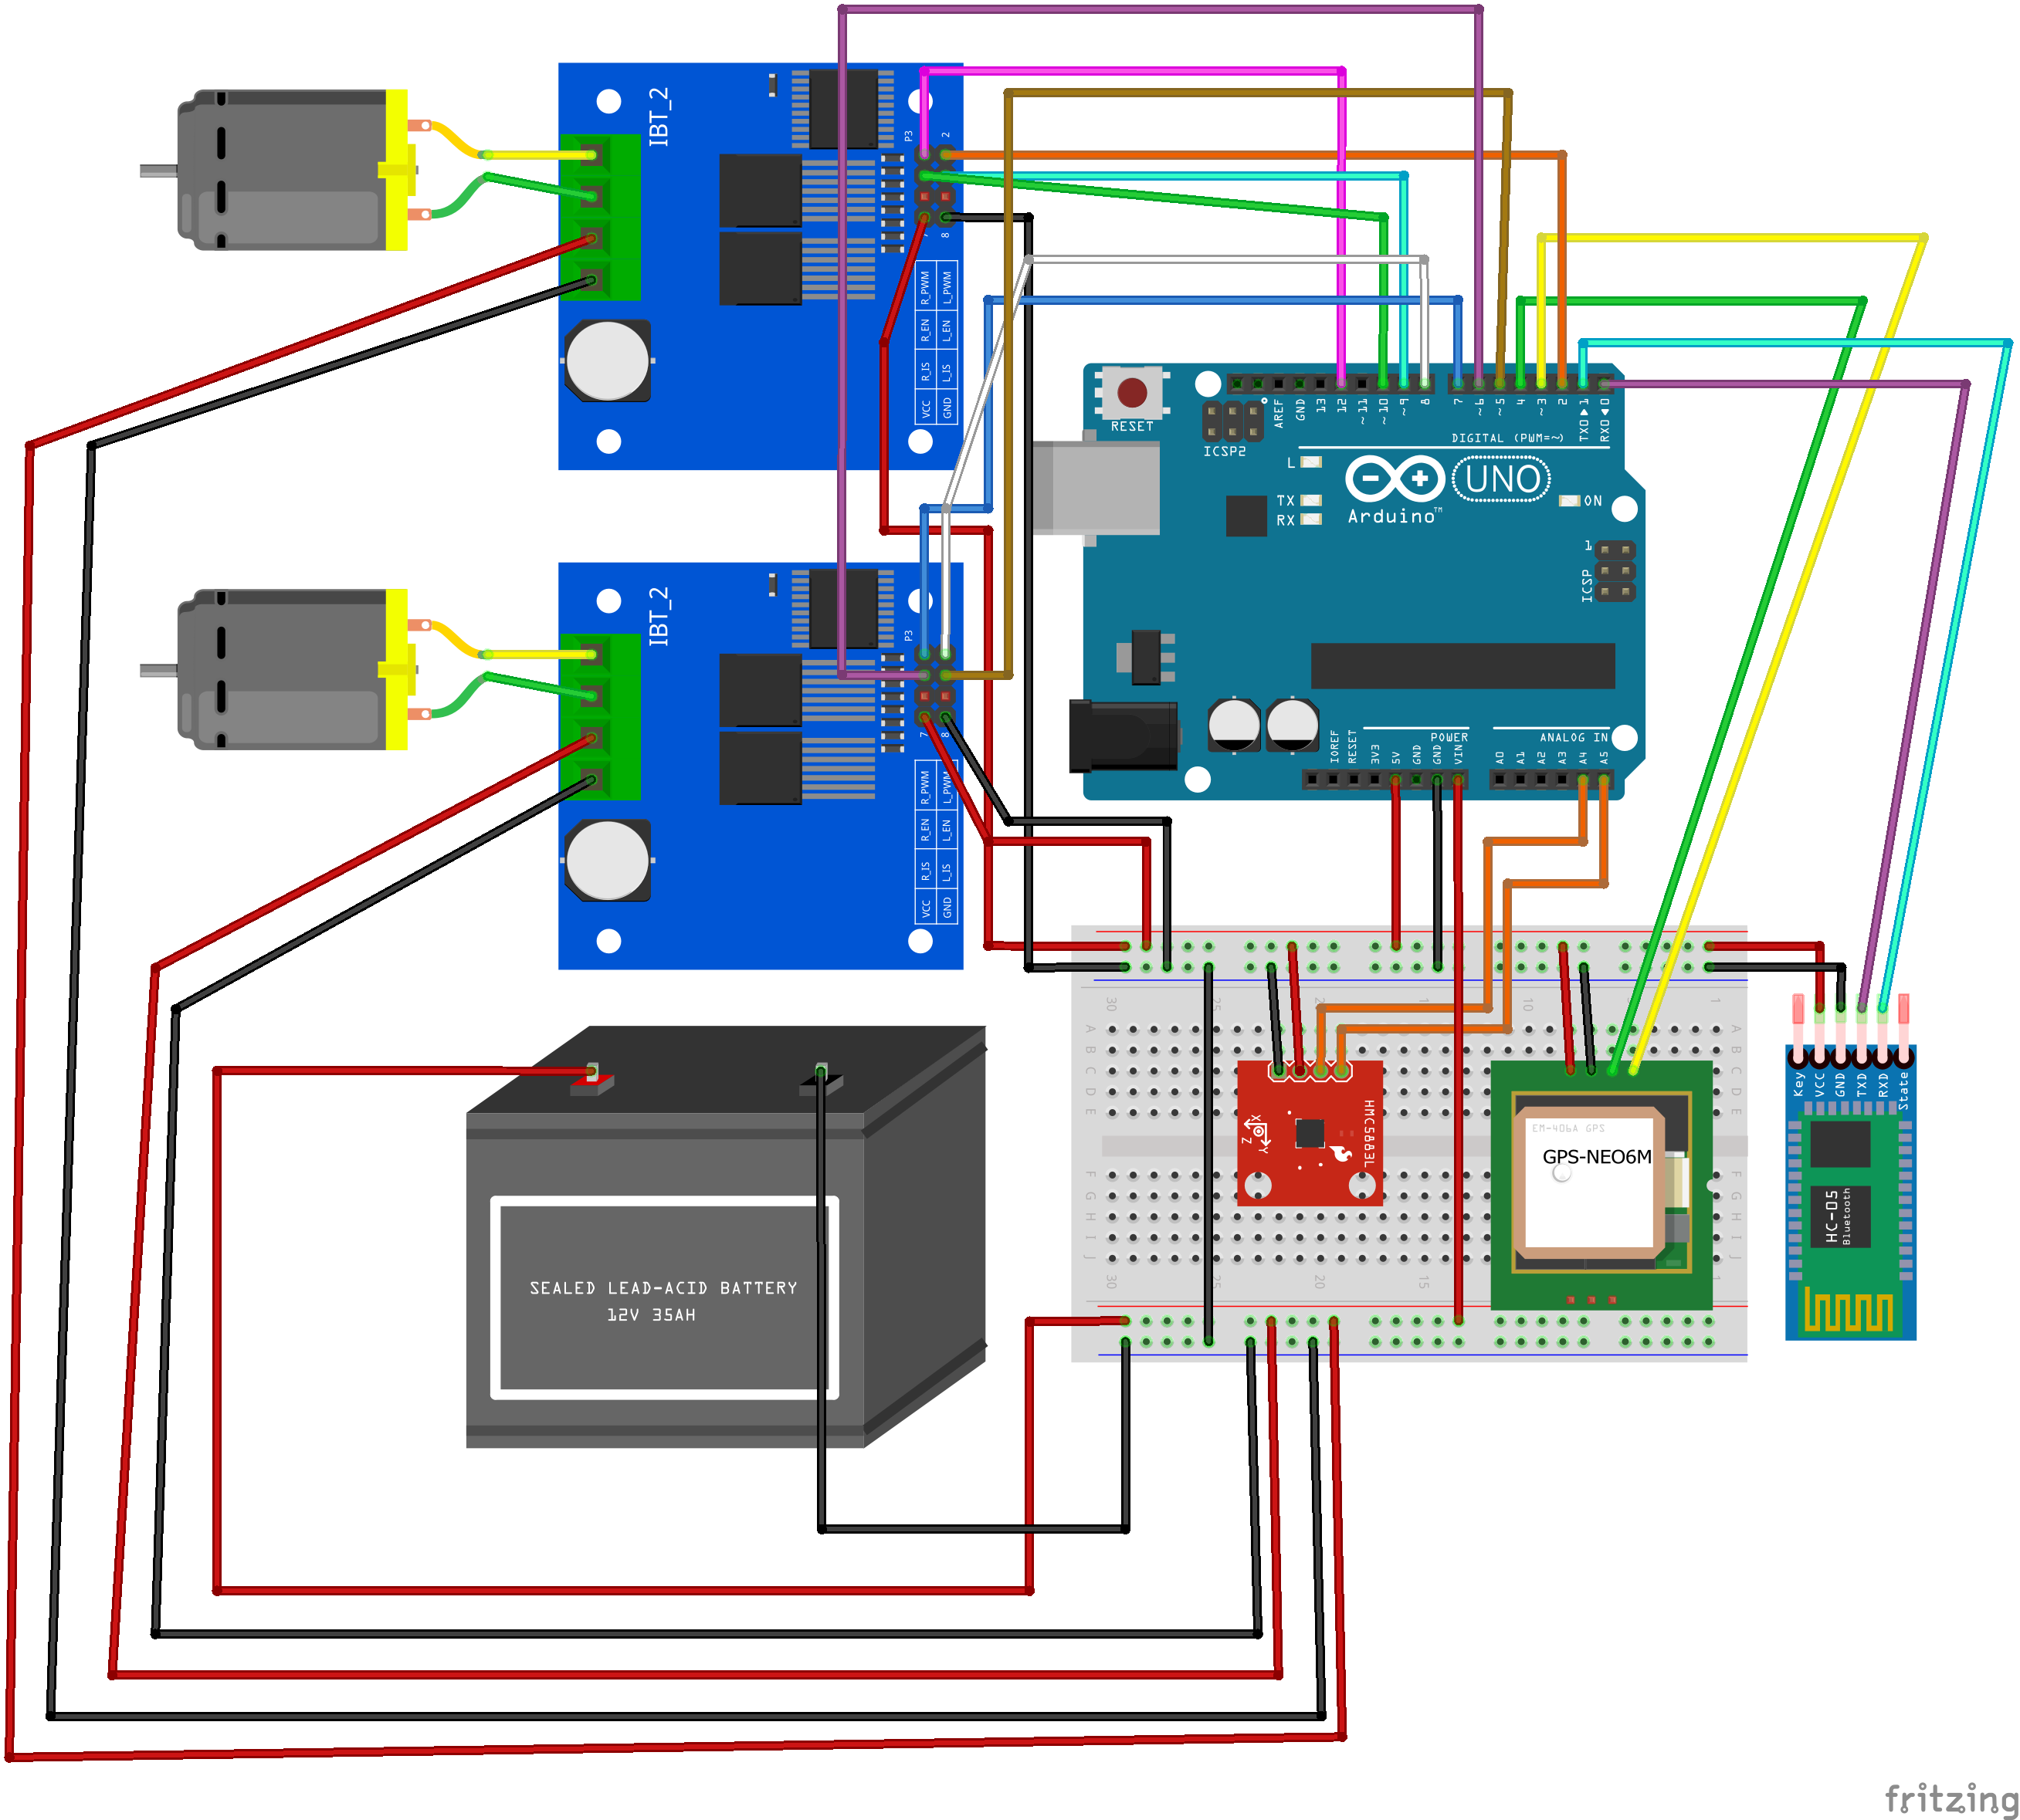
WIRING SCHEMATIC
Tommy
Notes:
PWM (Pulse Width Modulation). USED analogWrite() to generate PWM signal.

Slide 38
Administrative Content

Slide 39
Work Distribution
Ularislao
Name/Section | Ularislao | Tommy | Deborah | Brianna
Electrical Component Selection | Primary | Secondary
Lidar/Sensors | Secondary |  | Secondary | Primary
Wireless Communications, Mobile Application & GPS |  | Primary | Secondary
PCB Designs | Primary | Secondary |  | Secondary
Power System Design | Primary | Secondary |  | Secondary
Programming |  | Primary | Secondary | Secondary
Structure Design | Primary | Secondary |  | Secondary
Administrative Content |  |  | Primary

Slide 40
Design Constraints Faced
Ularislao
Inability to move design around easily
Selecting components for maintain low price
Weather, most of the testing required to be outside
Shortage of Component.
Some important components did not arrive on time
Websites did not have an updated inventory count

Slide 41
Budget
Brianna
Quantity | Description | Price
1 | GPS Module | $12.00
1 | Arduino Uno Board | $24.90
1 | Charge Controller (parts and assembly) | $200.00
1 | CS Lens | $19.67
1 | CS Lens Mount | $4.96
1 | M12 Lens | $9.23
1 | M12 Lens Mount | $3.12
1 | Lidar PCB and Components | $90.00
1 | Mirror | $8.00
1 | Mirror Mount | $20.00
2 | Stepper Motor | $8.00
1 | 12V Power Wheel Gearbox Motor | $30.86
1 | Rechargeable Battery | $22.99
2 | Motors | $23.00
2 | Motor Controller | $7.44
1 | PV Solar | $80.00
1 | Frame and Body | $50.00
 | Total | $549.17

Slide 42
Questions and Comments

