Slide 1

IoT Smart Doggy Door
Group 15 - Dr. Chan
Jordan Carraway - EE
Hunter Herrold - EE
Alexis Quintana - CpE/EE
Logan Waln - CpE

Slide 2

Goals and Objectives
Create a doggy door that is rich with features, easy to use and capable of implementing new ideas
Enable remote user control with a mobile application
Have long lasting, affordable, and easy to replace collars
Make the door as compact as possible
Supply the door with two power sources
Allow offline operation
Create a responsive system
Add an auditory cue for the dog to learn from
Notes:
-While budget for this project was a concern, our goal was to focus on a system that had many features
-We wanted the system to be easy to use, such that after installation, the user can start using the door right away with as little hassle as possible
-Due to the system’s reliance on software, it would be easy to modify or even add additional features for future updates. These features could include changes to the either firmware or on the mobile application itself
-Another objective was to provide a way that the user could actually control the system remotely by adding an interface that most people have quick and easy access to
-A goal that was important for us was to make collars to be as cheap as possible. Many animal collars can be expensive and tend to break with little use, however, we want our system to work easily not only with multiple animals but without cost being a concern to the consumer as well
-The door was powered from an AC power source. However, despite power loss, we wanted our system to still operate. Therefore, the system was made able to operate with the assistance of an external battery for an additional period of time
-Finally, to assist with dog training, we provided an auditory cue that will notify the dog if it can successfully pass through the door. If the cue does not play, then it is presumed that the dog cannot pass through

Slide 3
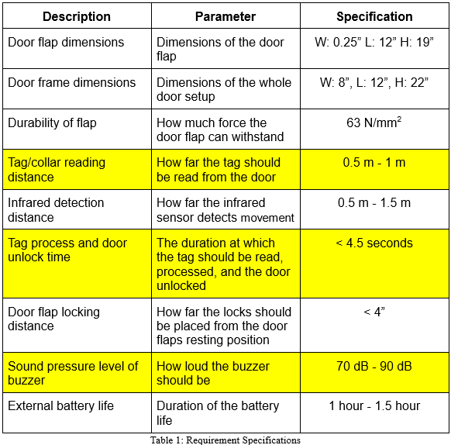
Requirement Specifications
Door dimensions (flap and overall size)
Strength of flap
Detection/reading distance
System processing time
Door flap locking distance
Buzzer noise level
Duration of external battery life
Notes:
For our system to support a variety of animal sizes, we required the inner part of the door to be a dimension that would fit most medium sized dogs. To ensure that the system is compact, some technologies had to be disregarded. Even though the door could have been implemented in other ways, it would have been constructed at the expense of doubling the height or length of the current dimensions. While the length and height are only slightly larger than the flap dimensions, the width is substantially larger which ensured that all components could fit in the door. The flap had to be able to withstand a force of 63 N/mm^2 so it would not only be secure, but it would also be durable as well. When a dog approaches the door to go either inside or outside, the collar had to be read by the system from up to a meter away. The time at which the tag is read, the database must be queried and the door must be unlocked in under 4.5 seconds. The infrared sensors, which activates the camera and detects dog movement, had to be able to sense up to a meter and a half. To prevent the door flap from swinging loosely, it needed to be locked no more than 4” from its default closed position. The buzzer also needed to be loud enough for both humans and animals to hear, but not loud enough to cause damage. For this reason, we chose the sound pressure level to be between 70dB to 90dB. Lastly, the external battery had to be able to power the system for an additional hour if the power goes out.

Slide 4

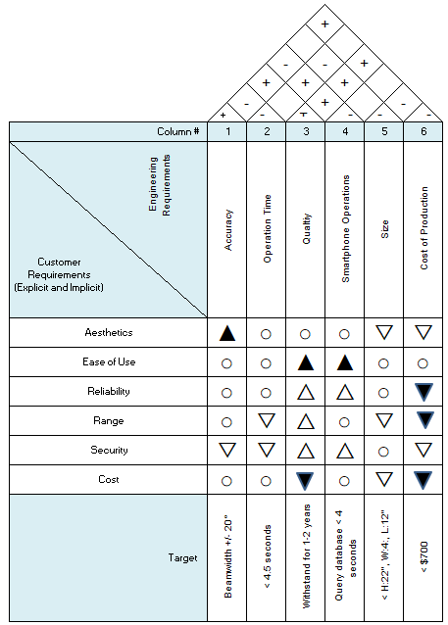
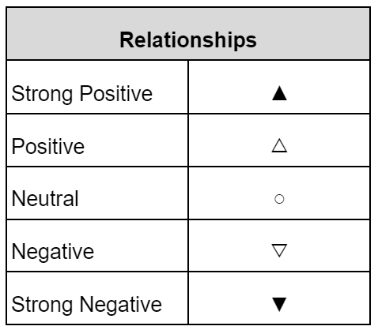
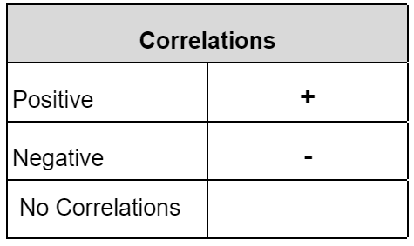
House of Quality
Strived for ease of use and reliability
Willing to compromise on aesthetics and cost to create a better product overall
Notes:
· For our project, our group strived for our IoT Smart Doggy Door to be easy to use and be reliable while also making the door as secure as possible
· To achieve this, our group had to make some compromises which consist of the cost to create the product as well as the aesthetic of the doggy door.
· While the cost of production being high is a concern, this can cause the overall product to have higher quality and accuracy.

Slide 5


Plan of Approach
Compartmentalize the system into individual parts
Mechanical
Precise measurements
Electrical
PCB
Software
System Controller
Database
Mobile Application
Notes:
Our plan of approach for this project was to break up all the required components to help compartmentalize our goals and objectives. Breaking up the project allowed us to easily direct our attention to individual tasks rather than tackling the project as a whole. This allowed for clear and defined tasks to be created as well as having the work distributed evenly. Because we knew that both the mechanical and electrical aspects would take a lot of time, both in precise measurements and acquiring components, we wanted to focus on those two parts first. For the mechanical aspect, the door had to be carefully constructed so that it could be easily installed and operated smoothly. For the electrical aspect of the project, due to the extended lead times when ordering components, we made sure to focus on our PCB right away so orders for parts could be placed as soon as possible. Providing ourselves with this cushion allowed us to test our electrical components and place any additional orders. For the software, we had to focus on setting up the back end first which is like the glue to the system that holds the other parts together. This allowed us to test our embedded software on the system controllers and our software on the mobile application throughout its development lifecycle.

Slide 6

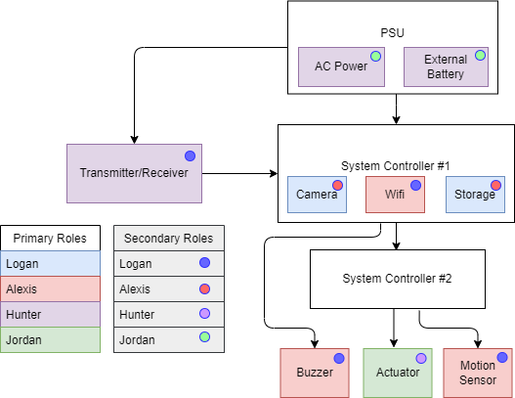
Hardware Diagram
Switching module for external battery and wall adapter
Each assigned primaries and secondaries
Notes:
This is our hardware block diagram. For our project we have a transmitter and receiver that will be communicating to a system controller that contains a camera, wifi, and a means of storage. From there, appropriate communication will be made to a buzzer to indicate status, some type of actuation to facilitate the locking and unlocking of the door, as well as a motion sensor that will be included for detecting the presence of a dog. A second system controller was needed in order to initiate the actuation as well as activate the sensors. All of this will be powered by an AC wall adapter, with an external battery backup in the event of a power outage. There is also a switching module that will initiate the change of power. Each member was assigned primaries along with secondaries.

Slide 7
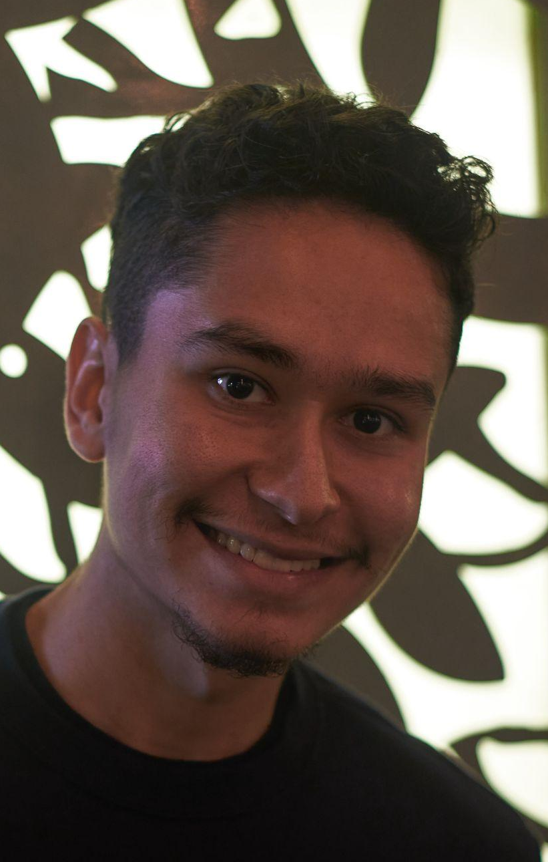
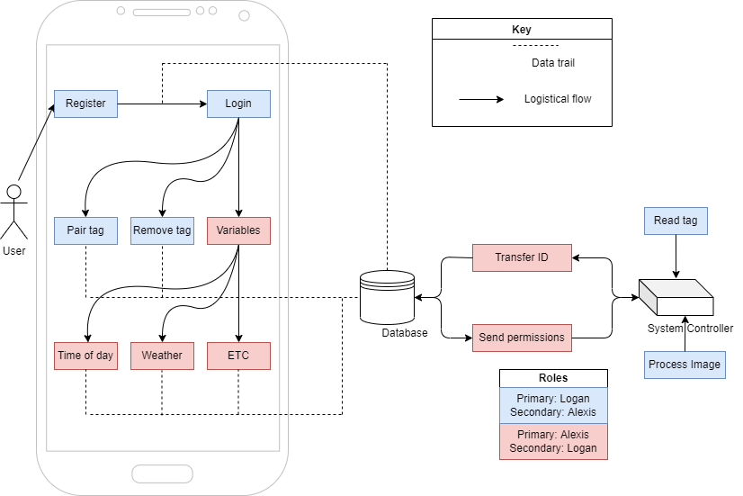
Software Diagram
Software setup using database and mobile app for IoT integration
Workload split between front end and back end tasks
Notes:
BP1: Here we have the software diagram for our project. Our software setup begins with a user creating an account on the mobile app. Once they have done this they can register their door using the serial number found on it, and add animals that will interact with the door along with sets of permissions for each individual animal
BP2: As can be seen in our diagram these things all happen in an order on the app but every step of the way is being recorded by the database. The workload split was decided in a way that both the front end and the back end were worked on individually with just enough cross over to ensure both ends are communicating without issues.

Slide 8
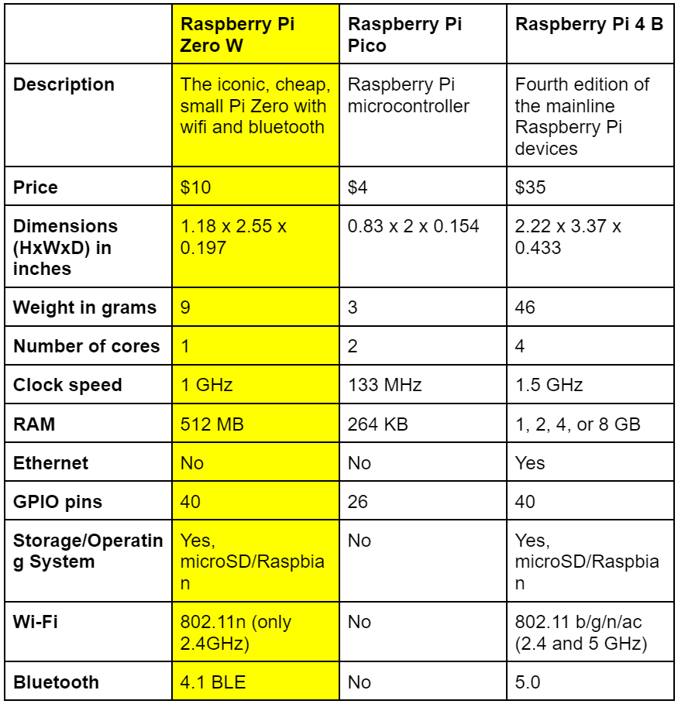
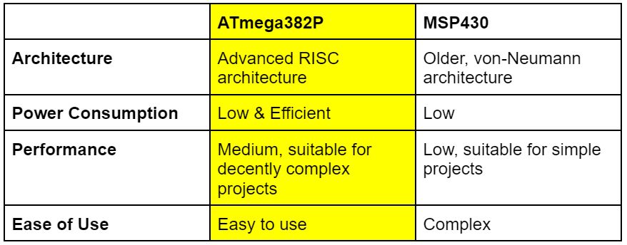
System Controllers
Notes:
Table 1: To communicate with our solenoid driver circuit, we constructed a PCB that used a microcontroller to bridge the gap between our solenoids and the main system controller. The Arduino ATmega looked to be the perfect option for our project in every regard. The advanced architecture combined with ease of use along with the efficient power consumption and decent performance for its size, made it the clear winner for our team
Table 2: For our main system controller we went with a microprocessor as we knew our project had a lot of concurrent tasks to be handling with some of them being as performance heavy as capturing images with a camera and immediately uploading them to a database through an internet connection. When deciding on just which one to use, The Pico was very quickly ruled out for it’s underwhelming power. The Pi 4 while appealing was more expensive and might have been beginning to reach unnecessary levels of power.
Why we chose RPi (had enough GPIO pins, on board storage, camera support, UART communication, wifi capability, and sufficient processing power)

Slide 9
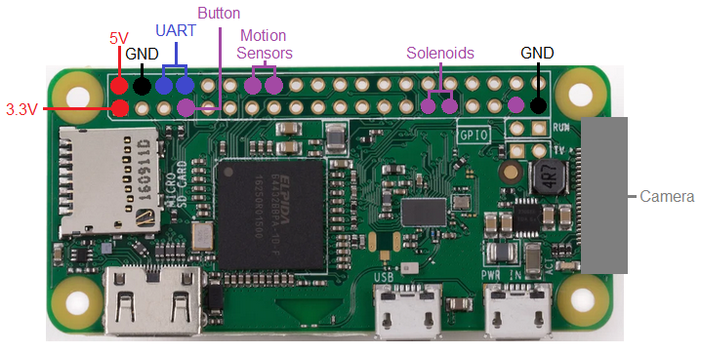
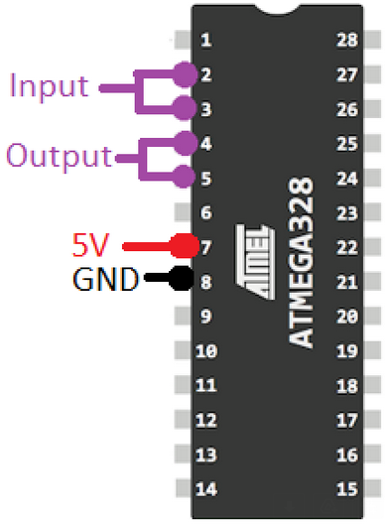
Pinout Diagrams
Notes:
This is the pinout configuration for both the Raspberry Pi and ATmega328P. Most peripherals were controlled by the GPIO pins located on the raspberry Pi, however, the Pi had to communicate with the ATmega to control our solenoid driver circuit. The ATmega would actively listen to two GPIO pins on the Pi. Both devices were powered by 5V. The 3.3V on the Pi was used in conjunction with a GPIO pin to detect a button press. The Pi used UART communication to communicate with the reader. The motion sensor pins were actively listened to on the Pi, to advance the running script. Lastly, the camera was attached to the Pi via a ribbon cable.

Slide 10
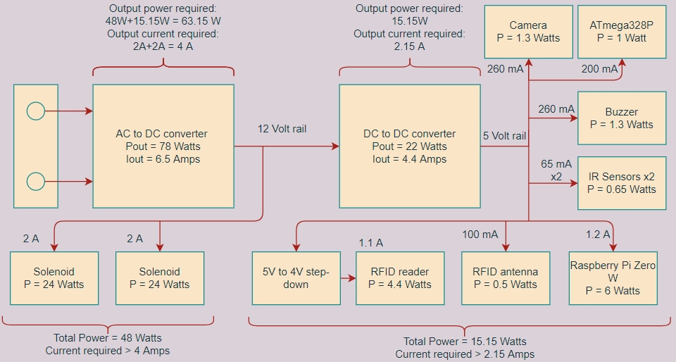
Power Requirements
System power requirements
Two voltage rails: 12 VDC and 5 VDC
AC/DC converter posed more interesting of a PCB
DC/DC converter module therefore bought instead
All current values are maximum ratings
Notes:
In order to create a design to power our project, we needed to consider the power requirements from each device. Our system has two voltage rails: 12V and 5V. The 12 volt rail will be powering the solenoids facilitating the locking mechanism. The 5 volt rail will be powering the rest of the project hardware. Regarding the PCB design, there was the choice between the AC/DC converter and the DC/DC converter. Ultimately, the AC/DC converter posed an interesting and involved design, allowing us to demonstrate a more impressive PCB than the DC/DC converter. Therefore, a 12V to 5V module was purchased for our DC/DC. All currents on this diagram are the maximum ratings, ensuring that our design would be able to supply the power required.

Slide 11
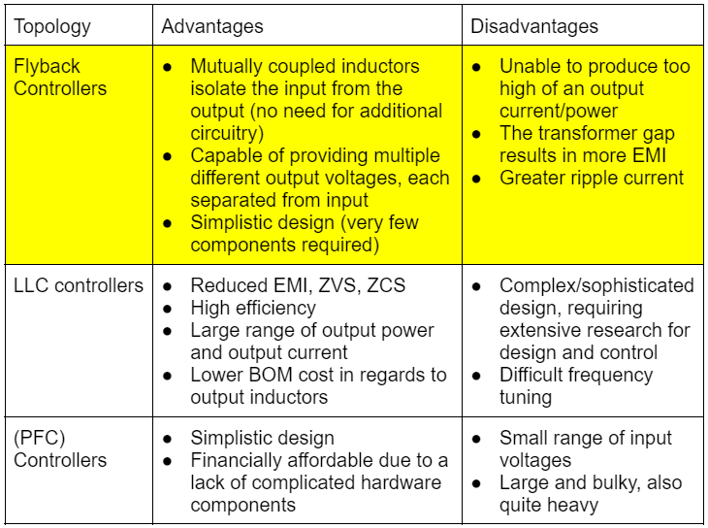
Significant PCB Design
PSU AC/DC converter topologies
Tradeoffs between efficiency and simplicity
LLC controllers introduced many luxuries, but the complexity was unnecessary
PFC controllers’ disadvantages outweighed the simplicity
Flyback was an acceptable compromise between what we were looking for
Notes:
For our design, we chose the power supply unit to be our PCB, an AC/DC or DC/DC converter. In order to design a PSU, we first needed to establish what topology we wanted to use. We looked at three different controller topologies: flyback, LLC, and PFC. There were certain tradeoffs that needed to be made in order to find the best fitting design, making the balance between simplicity and efficiency difficult to find. LLC controllers had many advantages. Reduced electromagnetic interference, zero voltage switching, and zero current switching allowed for this topology to have a high efficiency. However, the complexity mixed with the extremely high efficiency deemed this controller to ultimately be excessive for our design. Power Factor Correction controllers had a simplistic design, which offered an affordable PCB, but it’s small range of input voltages as well as it’s large and bulky design outweighed its simplicity. Flyback controllers therefore posed the best compromise between its advantages and disadvantages, with its simplistic design achieving sufficient efficiency from mutually coupled inductors.

Slide 12
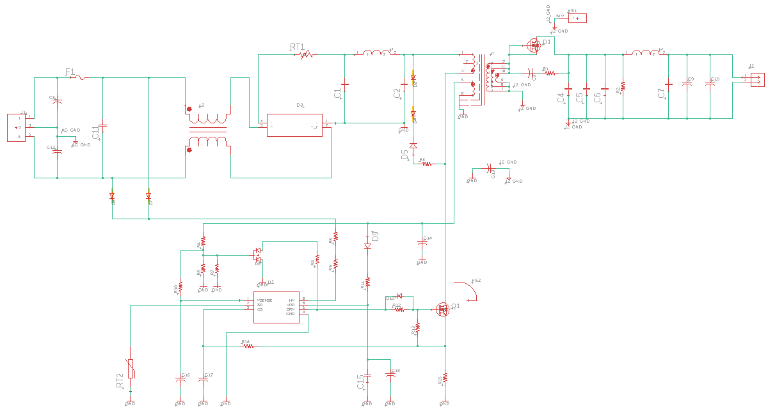
PCB Design
PCB was chosen to be the PSU
Notes:
Here is the PCB design for the AC/12VDC converter. The converter inspired by Texas Instruments reference designs is a flyback controller with quasi-resonance to increase the efficiency. The AC input is introduced on the left-hand side, followed by a mutually coupled inductor. A full wave diode rectifier allows for positive cycles of the AC input to be passed through. Once the rectified voltage is smoothened out through an inductor and capacitors, a thermistor monitors the thermal properties at the rectifiers output. On the bottom is the high power MOSFET controlled by the PWM driver chip located beneath it, responsible for delivering current to the transformer, whose auxiliary winding powers the IC chip through the VDD pin, which will be discussed in more detail on the next slide. At the output of the transformer, the signal is smoothed out, leading to the 12V output jumper that delivers a maximum current rating of 6.5 Amps.”

Slide 13
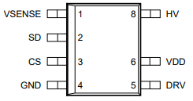
Significant PCB Design Cont.
Pulse Width Modulation (PWM) controller
Primary-side regulated (PSR) flyback controller
VDD pin; powered through auxiliary winding
HV pin; high voltage input,
DRV output pin; high power MOSFET control
VSENSE pin monitoring; VDD input voltage, DRV output voltage
CS pin; current sensing
SD pin; safety fault mode
GND pin; connecting IC’s ground
Notes:
“As mentioned, the Auxiliary winding of the transformer powers the IC chip through the VDD pin. Included is a hold-up capacitor that ensures proper operation of the chip in the event of a loss of power from the auxiliary winding. The HV pin stands for high voltage; it is an input pin that takes the high voltages from the AC input in order to initiate an efficient start-up current. The output of the driver, the DRV pin, controls the gate of the high power MOSFET located here. The VSENSE pin is able to monitor the input voltage from the transformer to the VDD pin as well as the output voltage from the DRV pin. The CS pin senses the current delivered through the mosfet, while the SD pin is connected to a thermistor. The SD pin is pulled high by default. When the thermistor’s temperature increases, the resistance decreases. Once the SD pin is pulled low, a safety fault mode is activated. The ground pin is for connecting the ground of the circuit to the IC’s ground.”

Slide 14
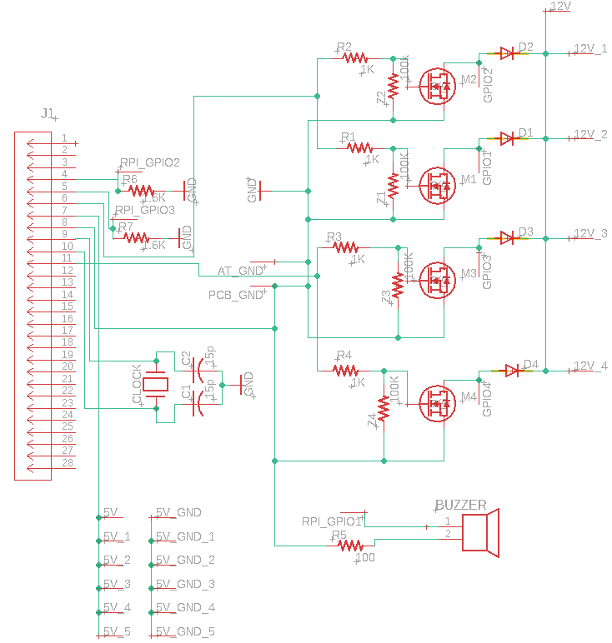
Significant PCB Design Cont.
Additional PCB with a programmable microcontroller
Actuation: Solenoid Driver
ATmega328P communicating to the Raspberry Pi
Includes I/O ports for 5V rail and 12V rail
Notes:
This circuit is a solenoid driver, responsible for the actuation of the locking mechanism. The circuit consists of four MOSFETS whose gates are connected to the ATmega328P. In order to unlock the door, two solenoids lift up on either side, allowing for entry inside or outside. One pin of the ATmega connects to the gate of two MOSFETs that provide power to the solenoids. A diode is inserted in parallel with the solenoids to allow the solenoids to discharge. We needed to include the crystal oscillator clock in order for the microcontroller to operate properly. This circuit also acts as our wire management center. It has 6 I/O pins for a 5V rail. The I/O pins located at the top left are for 12V power as well as solenoid connections and Raspberry Pi GPIO pins. One of the Pi pins will activate the buzzer when necessary, and the other two Pi GPIO pins will be for communication to the ATmega with respect to the activation of the inside and outside solenoid MOSFETs.

Slide 15
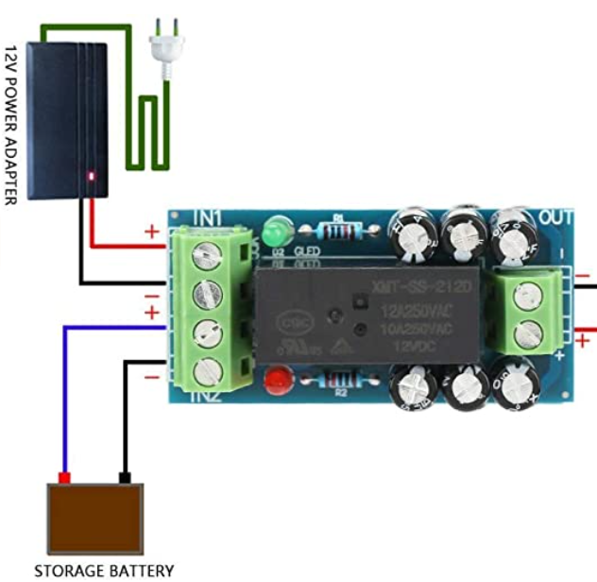
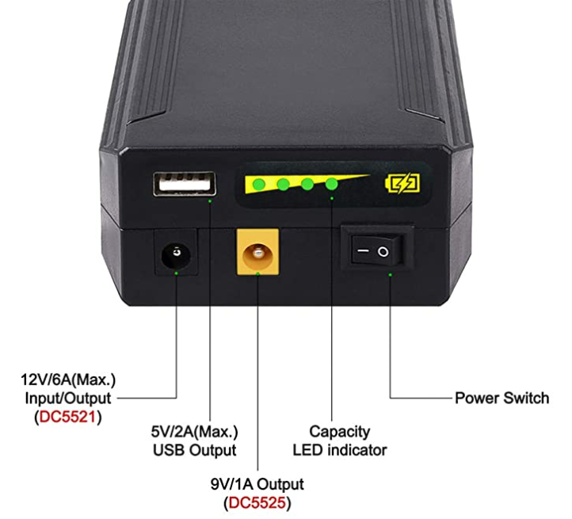
Battery Bank and Switching Module
Battery bank in case of power outage
Rechargeable 12V 8300mAh Lithium ion Battery Pack
12V/6A barrel jack input/output
9V/1A barrel jack output
5V/2A USB output
Switching module for battery bank and wall adapter
Outputs input 1 by default, unless input 1 drops below a certain voltage, then switches to input 2
Notes:
The power supply for the project is meant to switch between a wall adapter and a battery bank in the case of a power outage. The power bank that we chose as our backup was a rechargeable, 12V lithium ion battery pack with 8300 mA per hour. The battery has a 12V/6A barrel jack I/O port, 9V/1A output, and a 5V/2A USB output. For our application, we will be using the 12V barrel jack. In order to switch the source of power between the battery bank and the wall adaptor, the switching module will output the voltage of input 1 by default. Once the voltage drops below a certain level, input 2 will be switched on.

Slide 16
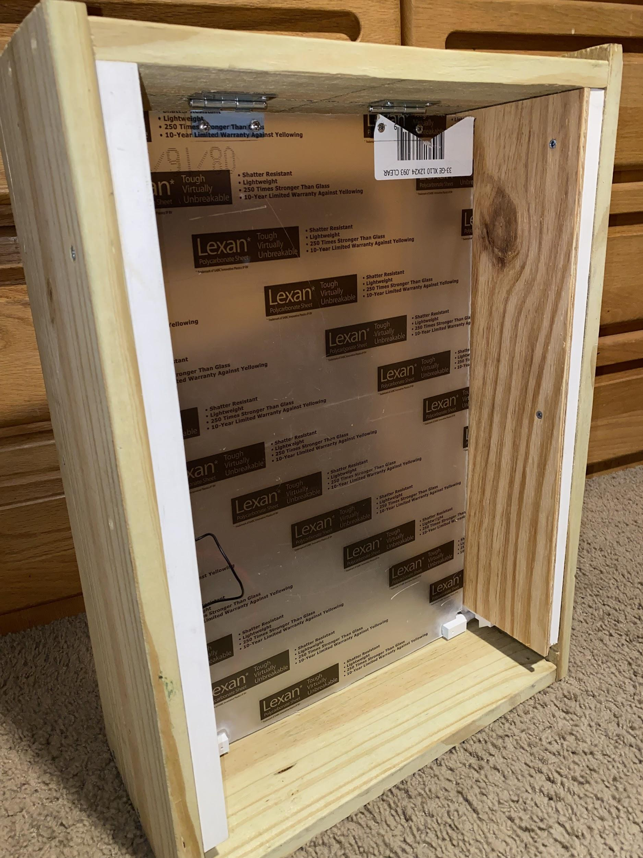
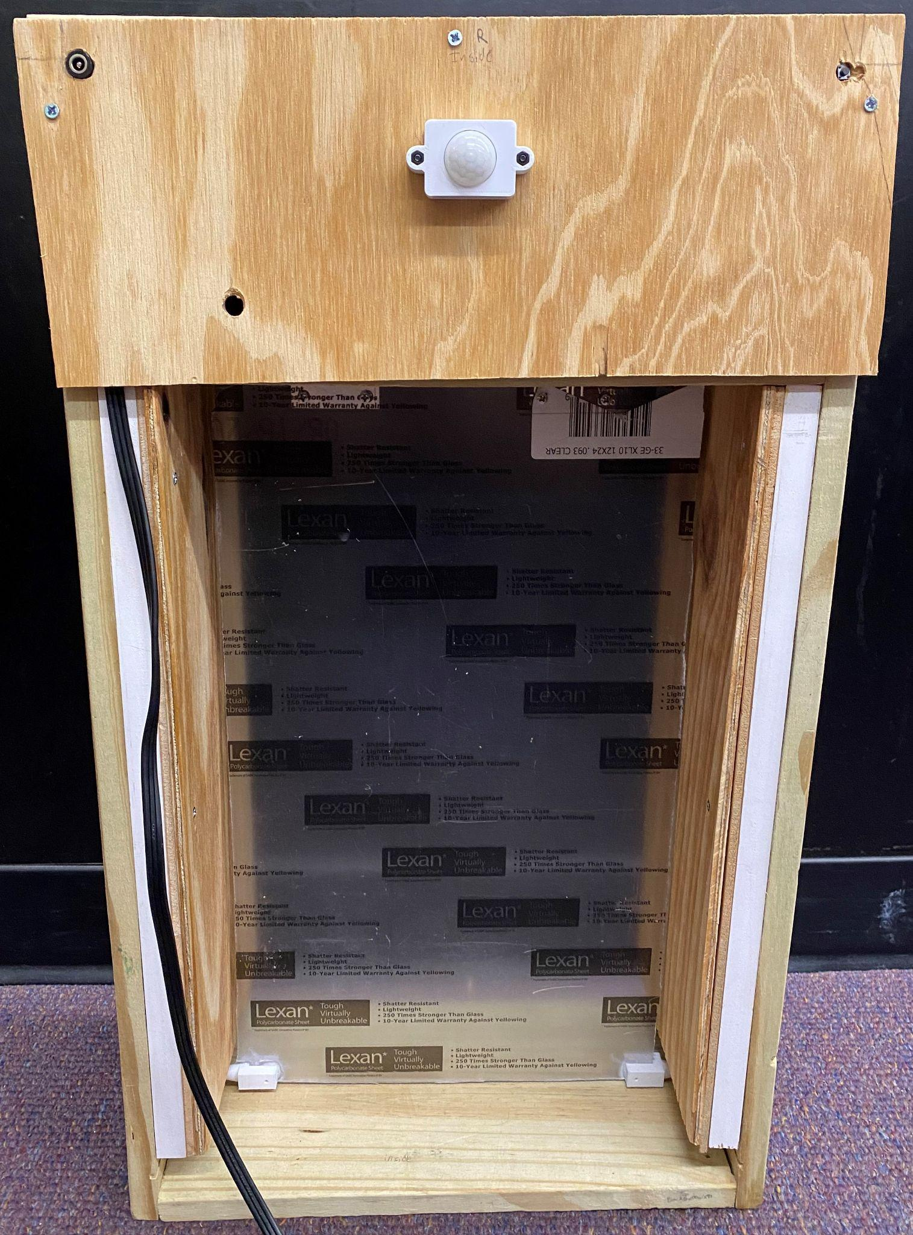
Doggy Door Materials and Construction
The doggy door is constructed using wooden planks 8” wide and ¾” thick
Space on each side of the door to house the locking mechanism and solenoids
Flap is made of a polycarbonate sheet to increase durability
Top portion houses the remaining hardware components
Notes:
· The majority of the doggy door is constructed using 8 inches by ¾ inch wood planks.
· This consists of the outer walls, the floor, ceiling, as well as the box on top which will house all the hardware components.
· The inner walls of the doggy door is made of quarter-inch wooden sheet and has a gap in between the larger wood planks to house the locking mechanism
· Additional wood was placed in between the two types of wood to close off the gap between them to protect the locking mechanism from weather and being tampered with.
· The door flap is made from a polycarbonate sheet and was chosen because it is lightweight, has an impact-resistant surface, is shatter-resistant, and has UV protection for long term weathering
· On top of the door contains a compartment that is used to house the remaining hardware components that consist of both PCBs, antenna, RFID reader, external battery, etc.
· The front of the door has a port that, that is located in the top left part of the door, that can be used to charge the external battery that is housed in the top compartment.
· Each side of the door has a motion sensor and when motion is detected and the tag is within range, it will query the database and retrieve the corresponding information and unlock the door accordingly.
· The front side of the doggy door also contains a button in the top right corner and is used to register new tags. This is done by holding the tag within range of the reader and holding down the button down for three seconds.
· A camera is also on the backside of the doggy door above the motion sensor and is not shown in this picture. When motion is detected outside, regardless of whether or not the tag is within range, the camera will take pictures and send them to the doggy door application. This is done to provide a picture of the owner’s dogs as they exit through the door as well as a security precaution in case there are wild animals or intruders outside of the door so the owners can then take the necessary precautions.

Slide 17
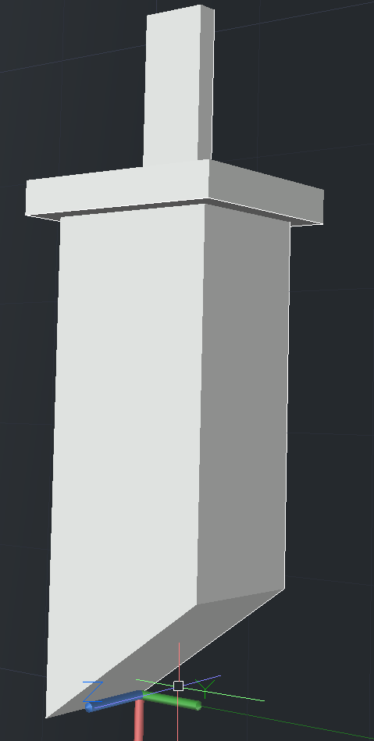
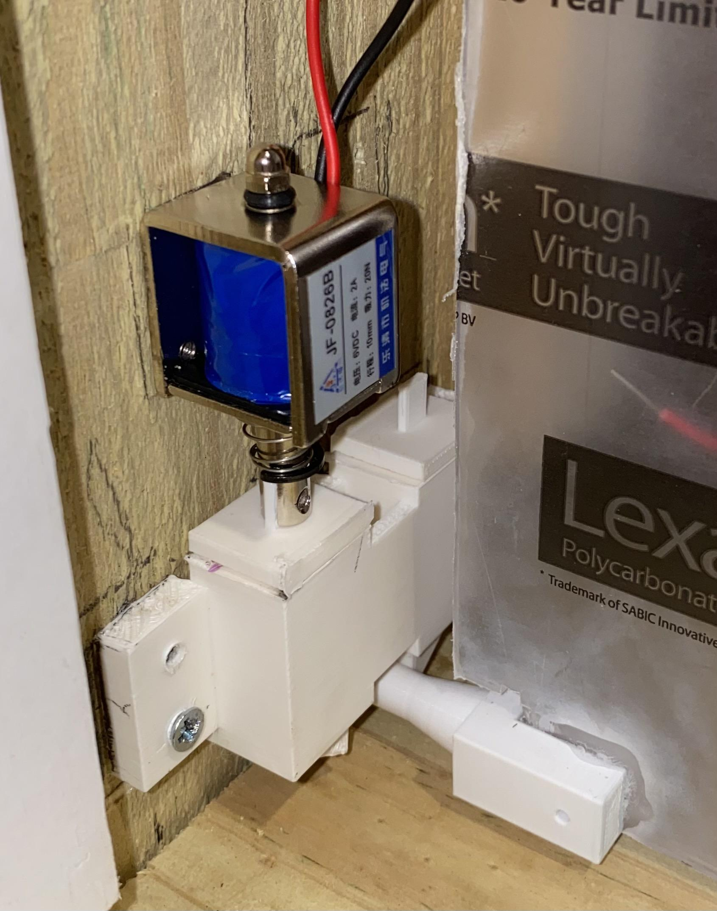
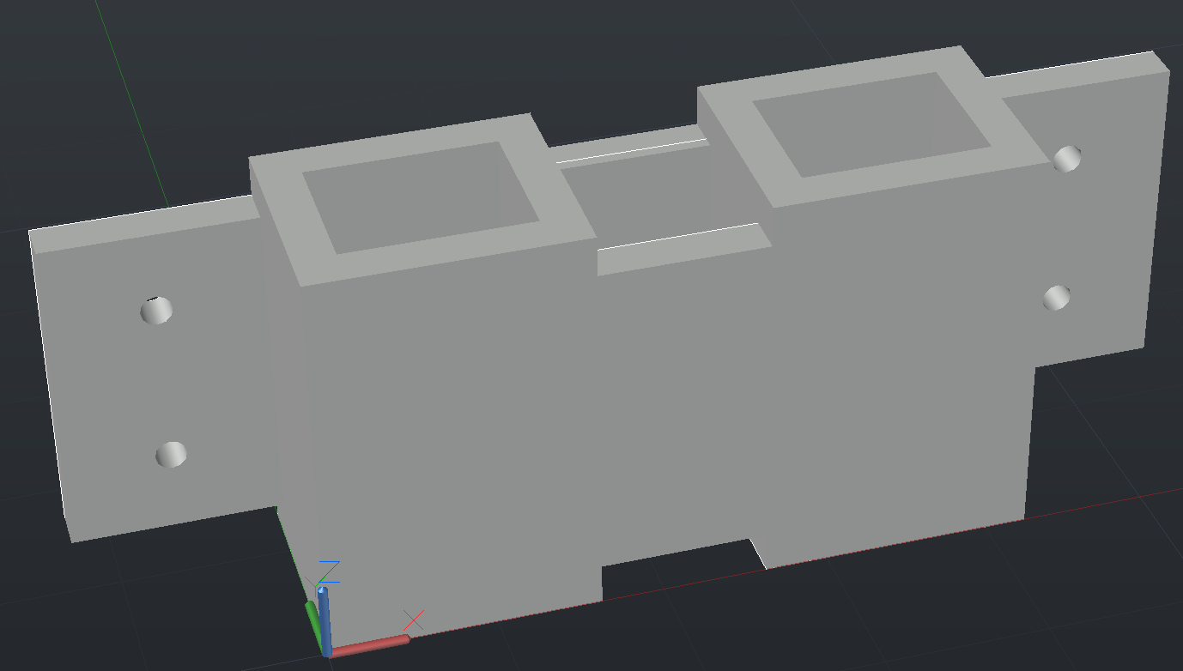
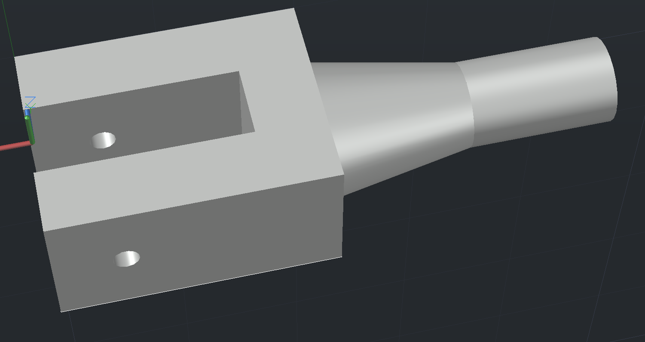
Doggy Door Locking Mechanism
3 pieces locking mechanism consisting of the locking pins, knobs, and shaft
The design of the pins allow for the flap to work unidirectional at any given time.
Solenoids will be used to push the pins up to allow for the door to be opened.
(Knob)
(Shaft)
(Pin)
Notes:
· The locking mechanism consists of three pieces that were designed using AutoCAD and then 3-D printed.
· It also contains four solenoids that will be used to unlock the door.
· These three pieces consist of four locking pins, two knobs that are attached to the end of the door flap, and two shafts that house the pins.
· Each pin has a slant on it, that faces outward on each side.
· This allows for the knob to push up the pin, and once this happens it will be stopped by the next pin and be locked in between the two pins
· A solenoid will be attached to each pin, which will allow the pin to be pushed up to allow the DOG to exit through the door.
· This process is triggered by the dog’s tag being read by the RFID reader.
· The locking pins are also set up to only allow the door to work in one direction at any given time
· This prevents the dog from exiting through the door and other animals coming in right after.

Slide 18
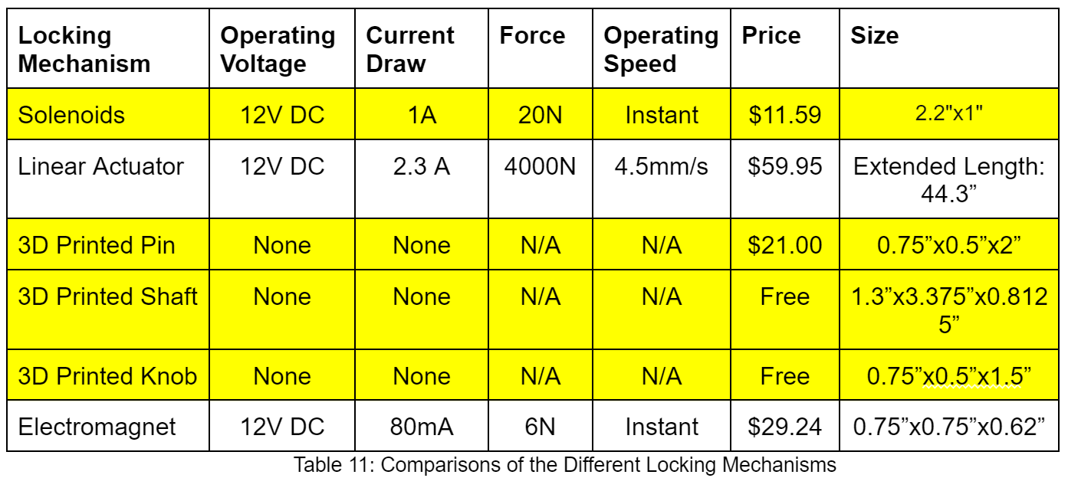
Doggy Door Locking Mechanism Comparisons
Notes:
· While researching different methods to lock and unlock the doggy door, a few different things were considered.
· One of them was the 3-D printed locking mechanism as well as the solenoids that our group decided to use for the final prototype.
· The other consisted of a linear actuator which would be placed above the door that would open the door vertically.
· We decided to not use this approach because it was costly and the movement speed was only 4.5 mm/sec
· The other device considered was an electromagnet, but this was not chosen since it could interfere with the RFID reader and Antenna.

Slide 19
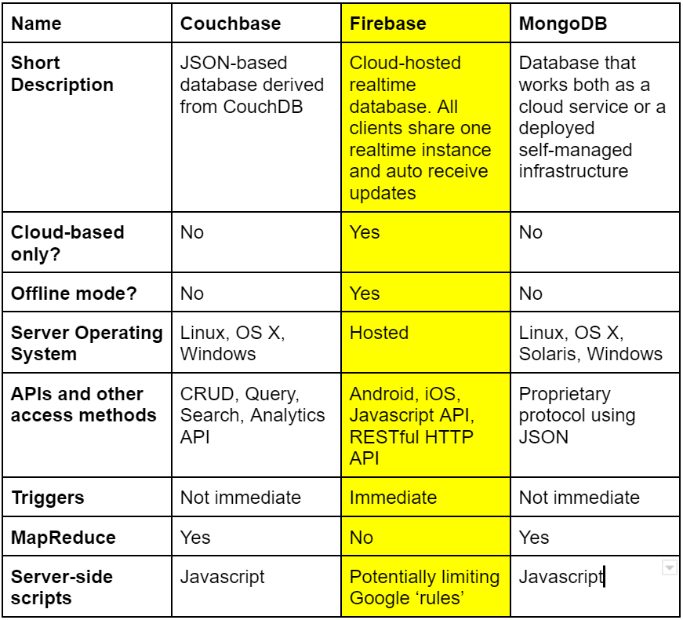
Databases
Foundation for IoT integration
Accessible by the mobile application anywhere, at any time
Decision to go with Firebase
Notes:
BP1: IoT projects utilize a database to store all information that will be accessed by users. Good set ups allow for customer support and easy way of sending out updates
BP2: In contrast to storing everything locally only, users can access their system through the mobile app from wherever they are and make whatever changes they like
BP3: With firebase we can give our users real time updates to whatever changes they are making while also having everything being watched and noted if the systems go offline

Slide 20
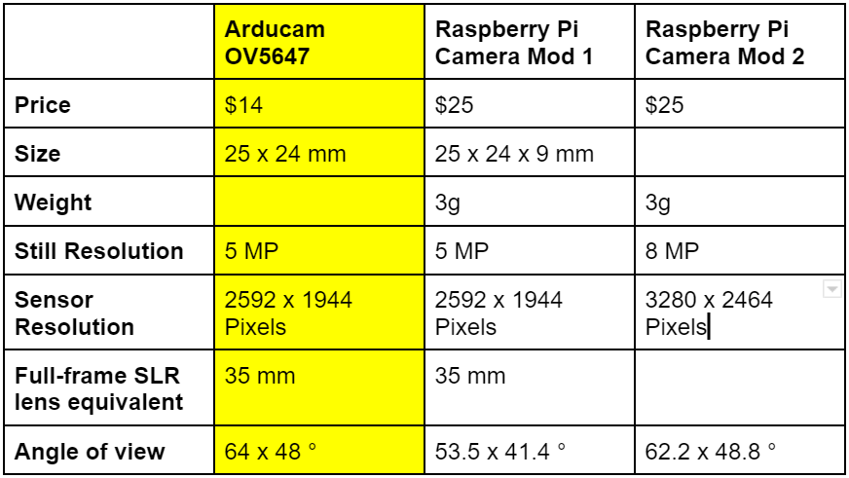
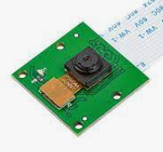
Camera
Used for capturing images of anything that might be in front of the door
Decision to go with the Arducam
Notes:
BP1: In the early brainstorming stages of our project, we realized that sometimes on the outside section of the door, you may have unwanted guests. Putting the peace of mind of our consumers first, we decided to add a camera that could capture any critter that might pay your door a visit. Our camera works in conjunction with a motion sensor. Images are taken when any motion is detected and then they are sent to database storage which allows them to be displayed on the users mobile app.
BP2: When deciding on which camera to go with, the options we were looking at weren’t too different from one another. The one we ended up with was cheaper while also having a good angle of view. The low image quality was not of our concern as we aren’t using the camera for our user to have new pictures to post on instagram

Slide 21
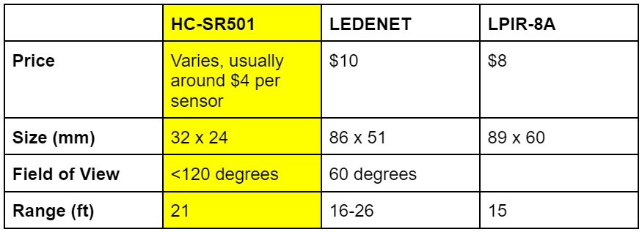
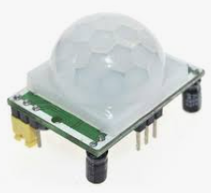
Passive Infrared Sensor
Used to detect any living presence at the door using infrared technology
Works in conjunction with camera and reader
Second sensor on inside
Decision to go with HC-SR501
Notes:
BP1: Passive Infrared Sensors were selected for our project because sometimes inanimate objects might be placed by the door and we do not want to send out a signal when such is the case
BP2: The outside sensor picks up motion and alerts the camera when it knows that it is a moving, living thing. It then alerts the reader to begin to scan for any tags in the area so that the system checks the permissions of any nearby registered pet
BP3: We use a combination of two motion sensors along with local data to keep track of whether each animal is inside or outside
BP4: With the range, good field of view, small form factor and low price, this decision was a no brainer

Slide 22
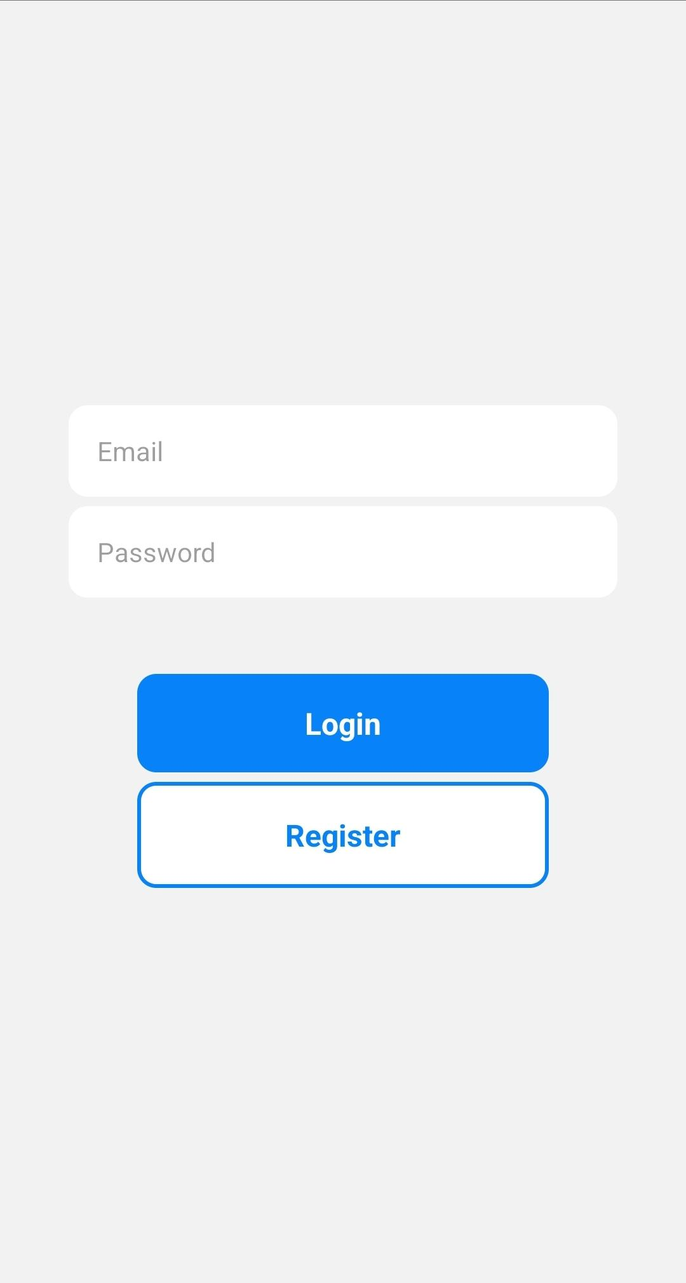
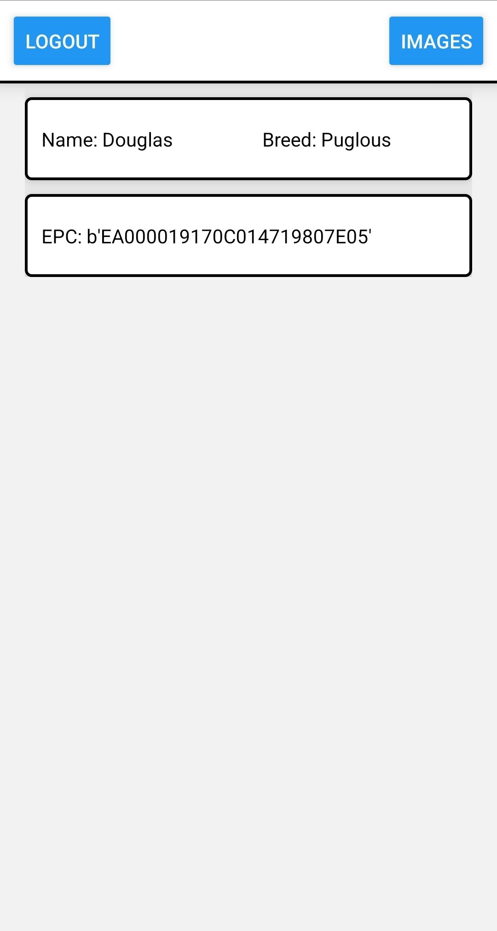
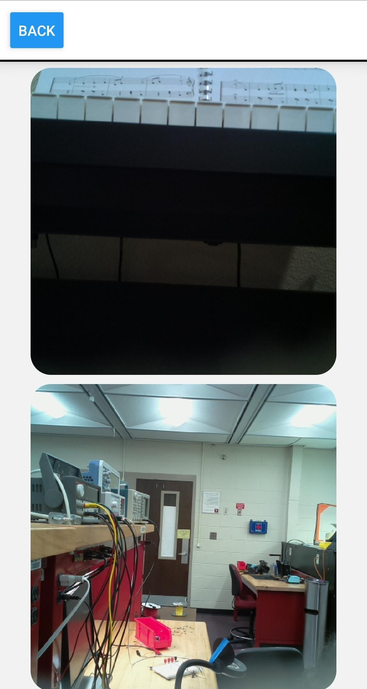
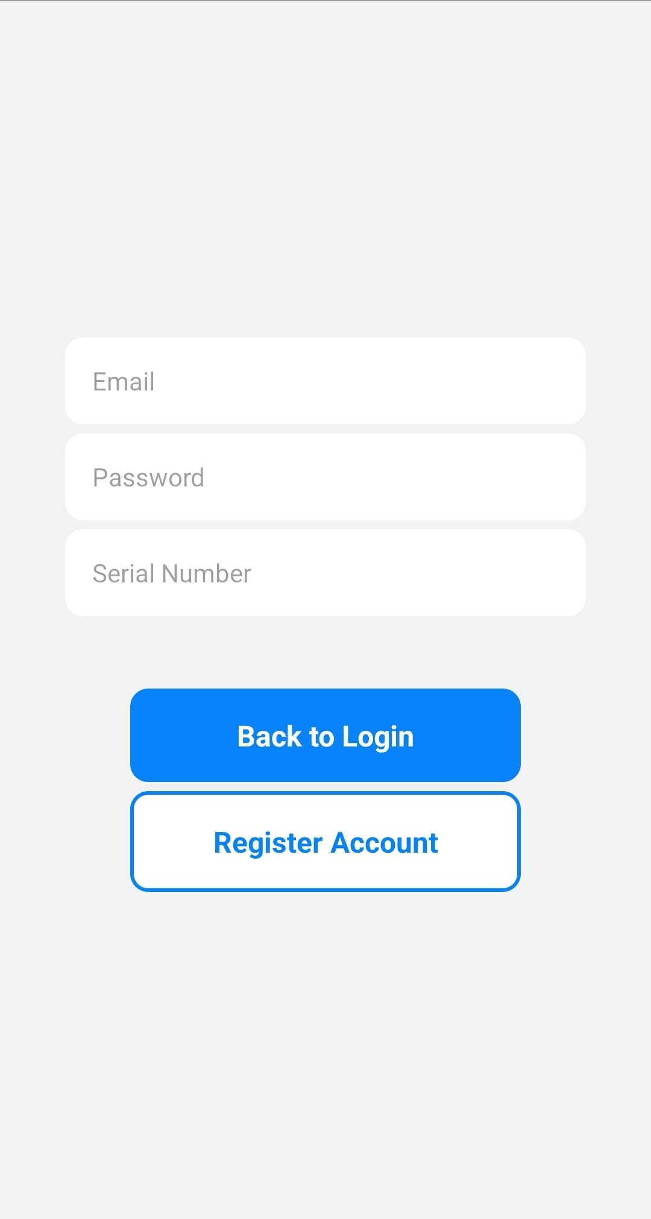
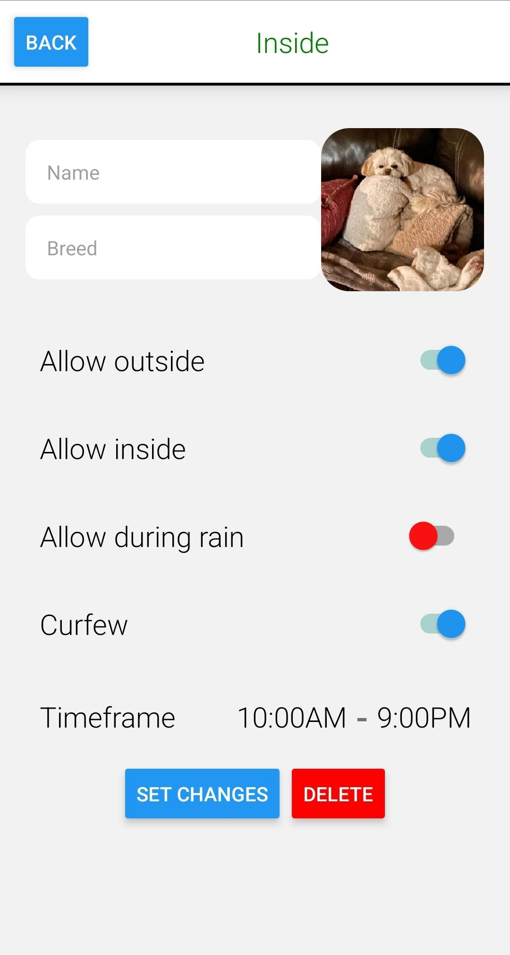
Mobile Application
Software
React Native CLI
Functionality
Registration
Edit and delete animals
Change animal permissions
View photos taken by camera
Notes:
For the mobile application, we decided to use the React Native command line interface, which allowed for cross platform development. Due to our previous experience with React Native, this allowed for faster development and allowed us to focus more on the features of the application. The purpose of the application is to allow the user to interface with the door and to control it remotely. When the user first opens the app, they are prompted to either login or register an account. When you register an account, you need to provide a valid email, password, and the serial number of the door. The serial number is given to the user and is required because this will allow the door and the mobile application to be linked together through the database. Initially, the home screen of the app is empty until you register an animal by scanning a tag via a physical button on the door. Animals registered can have the following changes made to its profile: name, breed, profile image, state, passage permissions, allow during rain, as well as curfew. Finally, an animal’s profile can also be deleted. Also from the home page, images can be viewed that were taken by the system within the last 24 hours. Anything over that timeframe is automatically deleted.

Slide 23
RFID Tags and Frequencies
Frequency ranges:
LF: 125 - 134 kHz, 1 - 10 cm
Low susceptibility to EM disturbance, but slow data processing speeds
HF: Typically 13.56 MHz (NFC), 1 - 100 cm
Faster transmission and relatively low EM disturbances, but too short of a read range
UHF: 865 - 960 MHz, reaching over 30 m
Higher read range, but higher interference from certain materials
Active versus passive tags:
Active tags
Initiator: requires battery, introducing a lifetime
More expensive
Longer read distances
Passive tags:
Waits for incoming signals: no internal source of power (no battery)
Relatively cheap in comparison
Shorter read distances
Notes:
We decided to choose RFID as our wireless technology as opposed to Bluetooth, GPS, and ultrasonic sensing. This is because RFID has fast read rates, consistent communication, and can allow for collars without batteries. RFID offers three different operating frequency bands: low frequency, high frequency, and ultra high frequency. Low frequencies are capable of reading from distances of up to 10cm. High frequencies are capable of reading up to 100cm and ultra high frequencies can read up to 30m or more. Low frequency has the advantage of its low susceptibility to electromagnetic disturbance, but unfortunately it has slow data processing, as well as too short of a read range for our application. High frequency transmits information faster, with low EM interference as well, but still it’s read range is too short. Therefore, UHF was the frequency range we settled on. However, we needed to be careful with its interference susceptibility. Luckily, we are enclosing our reader in a wooden design, which does not pose any issues. Next, the type of tag needed to be discussed. Active and passive are the two main types of tags, where active tags initiate communication between itself and other devices, requiring a battery to be powered. Because of this, these tags tend to be more expensive, but they do have longer read distances for the same reason. Passive tags on the other hand do not initiate communication, but rather wait for incoming signals, requiring no internal source of power. Due to the cheaper price, no battery, and sufficient read range for our application, we decided to utilize passive tags.

Slide 24
RFID Tag Classes; ISO 18000-6C
Tag Class | Frequencies | Active or Passive | Description
Class 0 | UHF | Passive | Read-only, need to write at least once
Class 1 | UHF or HF | Passive and Active | Write-once, read-many
Class 2 | Unspecified | Passive | Indefinite read-write
Notes:
The tags must adhere to the ISO 18000-6C protocol standard. Within this standard there are 6 classes. Class 0 is a read-only, passive UHF protocol. Having the tag as read only prevents the ability to add additional information that can assist with animal to owner identification. Class 1 is a write-once, read-many UHF or HF protocol, which is perfect for our design, considering we only need to write once and it falls within our frequency range. Class 2 has an indefinite read-write operation with passive tags, but we only needed to write once, making this class unnecessary. Ultimately class 1 was the category that our project fell under.

Slide 25
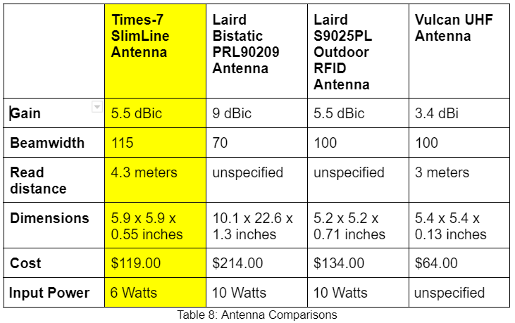
RFID Reader and Antenna
Desired parameters
Polarization:
Circular
Beamwidth:
Around 120 degrees
Read distance:
Over 1 meter (antenna can be operated at less power to lower the read distance)
Cost:
As low as possible…
Operation frequency:
UHF (865 - 960 MHz)
Notes:
For our reader and antenna, there were some important parameters we needed to consider. For the reader, it needed to support an external antenna, UHF, and budget friendly. The only reader we found that fit this description was the M6e-nano. For the antenna, we know that we needed circular polarization, which allows for the antenna to read tags at any orientation. We needed a beamwidth of around 120 degrees in order to have an appropriate reading area. The read distance we wanted was over 1 meter, but this variable was flexible, where the power delivered to the antenna could be lessened in order to achieve a lower read distance. As far as the cost goes, of course as low as possible. The frequency range was established earlier as UHF. The chart shows a few antennas we considered. The Times-7 SlimLine antenna seemed to be the best fit, seeing as its beamwidth was the closest to what we were aiming for.

Slide 26
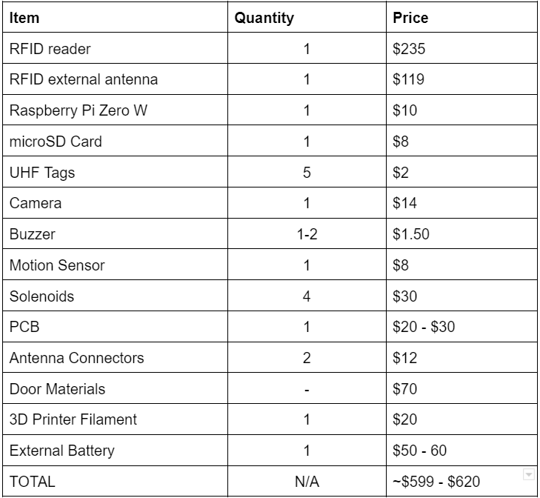
Budget (Proposed/Current)
Notes:
This is our proposed budget for the project. We knew that the RFID was going to be the most expensive component, making up for the majority of our expenses. Other components, like the sensors, cameras, and battery add up over time. Around $600 was estimated for our project.

Slide 27
Division of Work
Logan:
Project manager
Camera research
Storage
Mobile application
Embedded software
Alexis:
Wifi
Buzzer
Motion sensor
Database
Embedded software
Jordan:
Door research/design
Enclosure/door construction
Locking mechanism
Hunter:
RFID (reader, antenna, tag) research/design
PSU (PCB and battery bank) design
PCB research and construction
Notes:
Here’s the division of work. Logan and Alexis were in charge a lot of the software side of things, with storage, wifi, database, and so on. Jordan was mainly responsible for the construction of the door and designing/building the locking mechanism. I was responsible for the RFID research, as well as the designing and constructing the PCB and PSU.

