Slide 1

IoT Smart Doggy Door
Group 15 - Dr. Chan
Jordan Carraway - EE
Hunter Herrold - EE
Alexis Quintana - CpE/EE
Logan Waln - CpE

Slide 2

Goals and Objectives
Create a doggy door that is rich with features, easy to use and capable of implementing new ideas
Enable remote user control with a mobile application
Have long lasting, affordable, and easy to replace collars
Make the door as compact as possible
Supply the door with two power sources
Allow offline operation
Create a responsive system
Add an auditory cue for the dog to learn from
Notes:
While budget for this project was a concern, our goal was to focus on a system that had many features
Wanted the system to be easy to use, such that after installation, the user can start using the door right away with as little hassle as possible
Due to the system’s reliance on software, it is easy to modify or even add additional features for future updates. These features could include changes to the either firmware or on the mobile application itself
Another objective was to provide a way that the user could actually control the system remotely by adding an interface that most people have quick and easy access to
A goal that was important for us was to make collars to be as cheap as possible. Many animal collars can be expensive and tend to break with little use, however, we want our system to work easily not only with multiple animals but without cost being a concern to the consumer as well
The door will be powered from an AC power source (such as plugging the system into the wall). However, despite power loss, we want our system to still operate. Therefore, the system must be able to continue running with the assistance of an external battery for an additional period of time
Dogs are very capable of learning patterns, therefore, when the dog approaches the door, either from inside or outside, we want to provide an auditory cue that will notify the dog if it can successfully pass through the door. If the cue does not play, then it is presumed that the dog cannot pass through

Slide 3
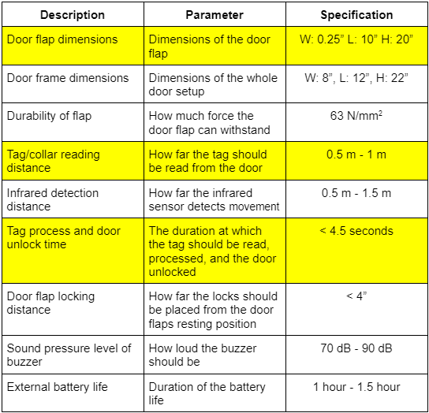
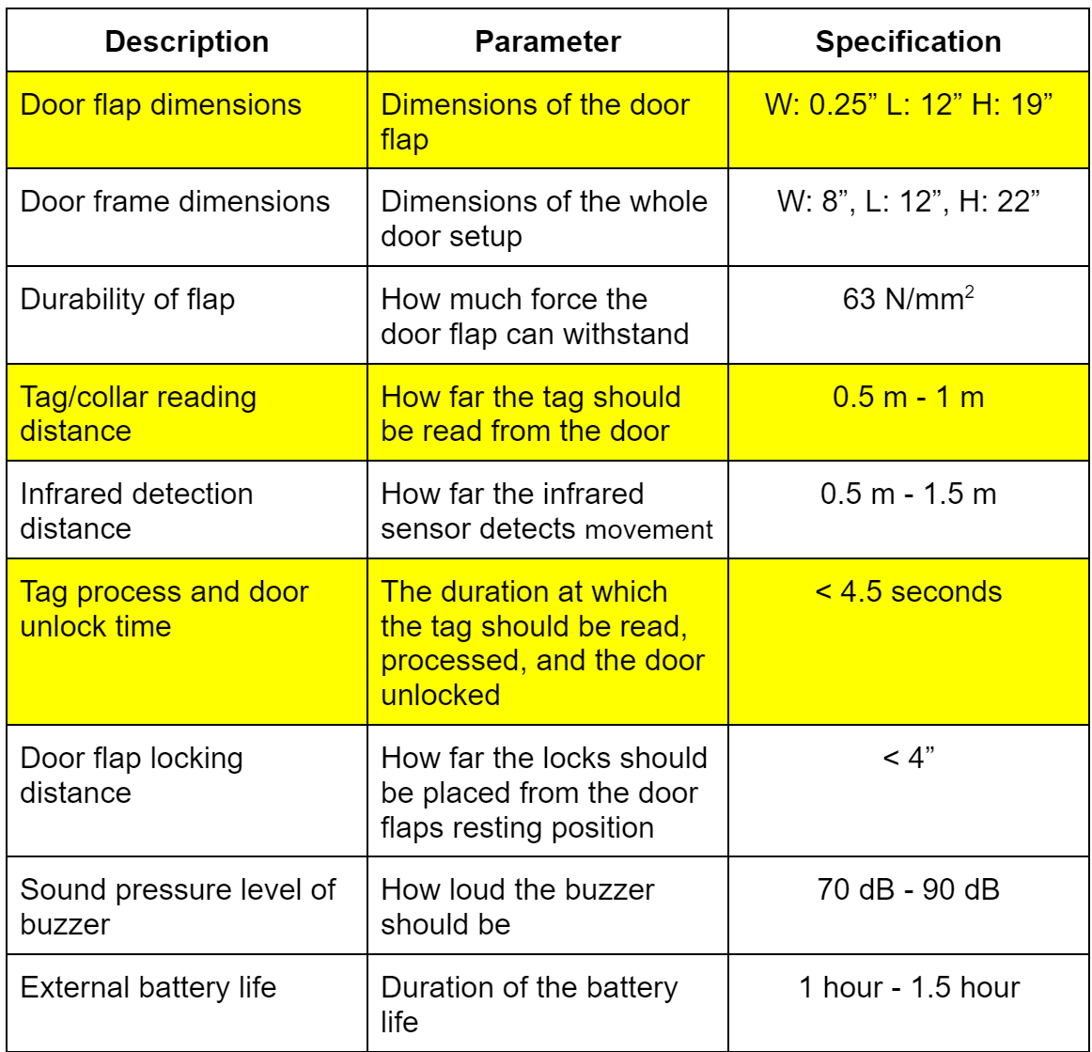
Requirement Specifications
Door dimensions (flap and overall size)
Strength of flap
Detection/reading distance
System processing time
Door flap locking distance
Buzzer noise level
Duration of external battery life
Notes:
For our system to support a variety of animal sizes, we required the inner part of the door, where the door flap is located, to be 0.25”W x 12”L x 19”H. This will allow for small, medium, and even some large sized dogs to pass through. To ensure that the system is compact, some technologies had to be disregarded. So even though the door could have been implemented in other ways, it would have been constructed at the expense of doubling the height or length of the current dimensions. While the length and height are only slightly larger than the flap dimensions, the width is substantially larger to ensure that all components could fit in the door. The flap must be able to withstand a force of 63 N/mm^2 so it would not only be secure, but it would also be durable as well. When the dog approaches the door to go either inside or outside, the collar must be read by the system from up to a meter away. The time at which the tag is read, the database must be queried and the door must be unlocked in under 5 seconds. The infrared sensors, which will activate the camera and detect dog movement, must be able to sense up to a meter and a half. To prevent the door flap from swinging loosely, it must be locked no more than 4” from its default closed position. The buzzer must also be loud enough for both humans and animals to hear, but not loud enough to cause damage. Lastly, the external battery must be able to power the system for an additional hour if the power goes out.

Slide 4

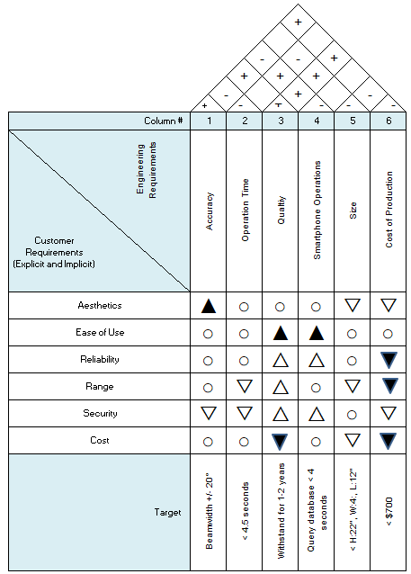
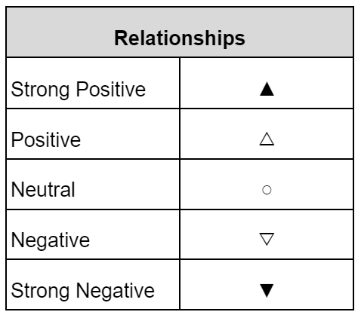
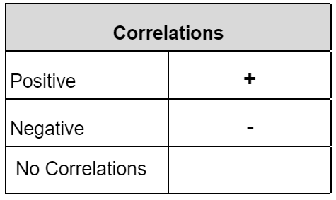
House of Quality
Strived for ease of use and reliability
Willing to compromise on aesthetics and cost to create a better product overall

Slide 5



Plan of Approach
Compartmentalize the system into individual parts
Mechanical
Precise measurements
Electrical
PCB
Software
Raspberry Pi
Database
Mobile Application
Notes:
Our plan of approach for this project was to break up all the required components to help compartmentalize our goals and objectives. Breaking up the project allowed us to easily direct our attention to individual tasks rather than tackling the project as a whole. This allowed for clear and defined tasks to be created as well as having the work distributed evenly. Because we knew that both the mechanical and electrical aspects would take a lot of time, both in precise measurements and acquiring components, we wanted to focus on those two parts first. For the mechanical aspect, the door had to be carefully constructed so that it could be installed easily and operated smoothly. For the electrical aspect of the project, due to the extended lead times when ordering components, we made sure to focus on our PCB right away so orders for parts could be placed as soon as possible. Providing ourselves with this cushion also allows us to test our electrical components and place any additional orders. For the software, we had to focus on setting up the back end first which is like the glue to the system that holds the other parts together. This allowed us to test our embedded software on the raspberry pi and our software on the mobile application throughout its development lifecycle.

Slide 6

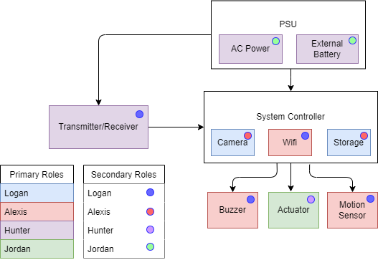
Hardware Diagram
Switching module for external battery and wall adapter
Each assigned primaries and secondaries
Notes:
This is our hardware block diagram. For our project we have a transmitter and receiver that will be communicating to a system controller that contains a camera, wifi, and a means of storage. From there, appropriate communication will be made to a buzzer to indicate status, some type of actuation to facilitate the locking and unlocking of the door, as well as a motion sensor that will be included for detecting the presence of a dog. All of this will be powered by an AC wall adapter, with an external battery backup in the event of a power outage. There is also a switching module that will initiate the change of power. Each member was assigned primaries along with secondaries.

Slide 7
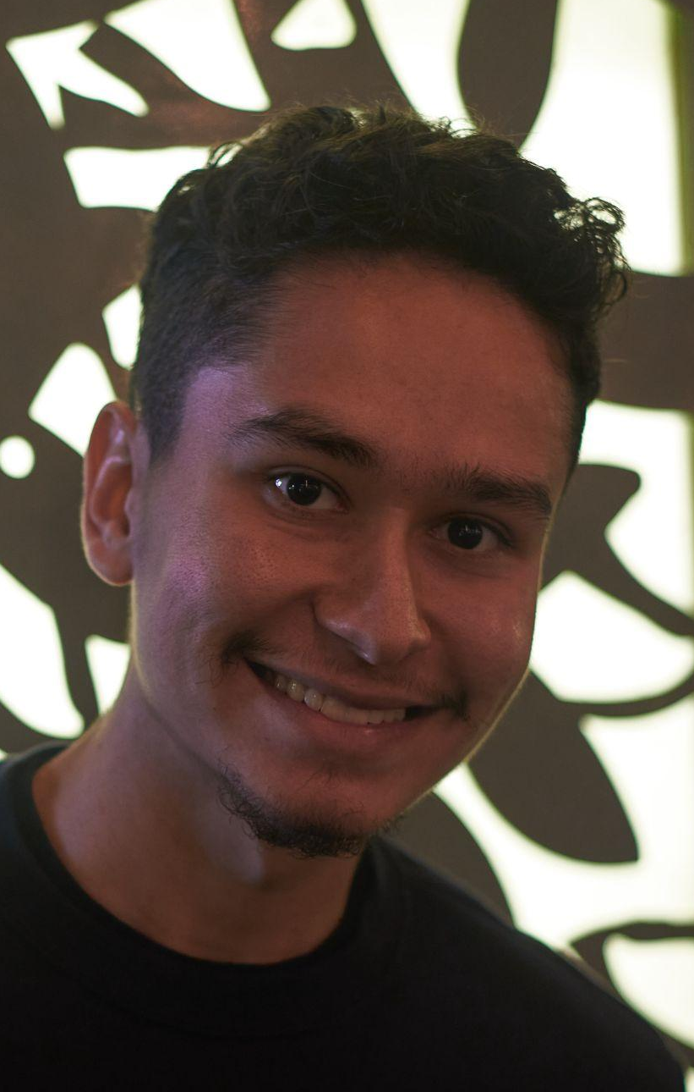
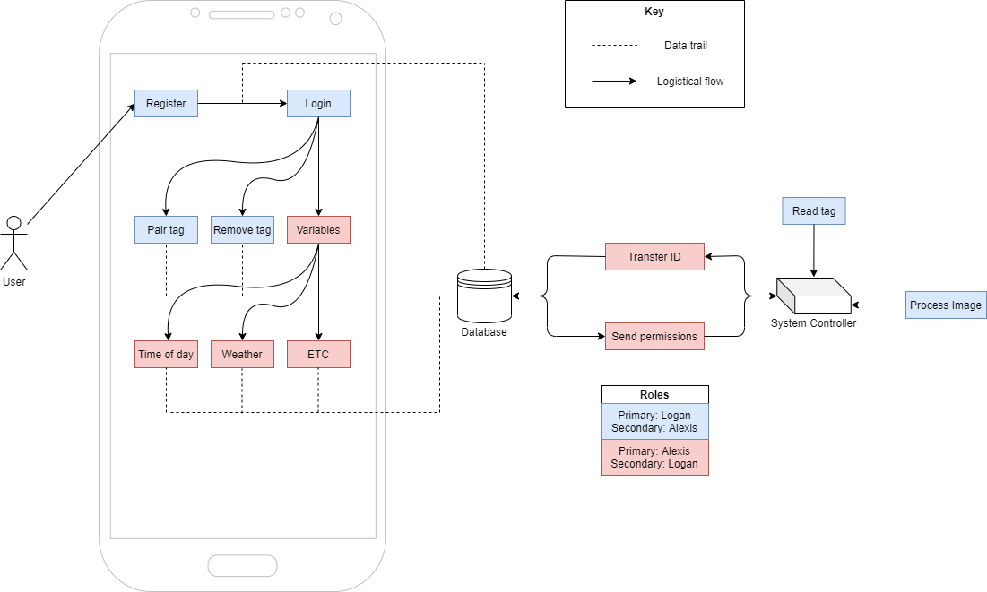
Software Diagram
Software setup using database and mobile app for IoT integration
Workload split between front end and back end tasks
Notes:
BP1: User on mobile application creates account, registers door with serial number, adds animals that will interact with the door, sets permissions for each individual animal
BP2: Logan will be focusing on the mobile application and most of the front end work. Alexis will be working with the Raspberry Pi and the database to set up the back end and send the front end whatever information it may need

Slide 8
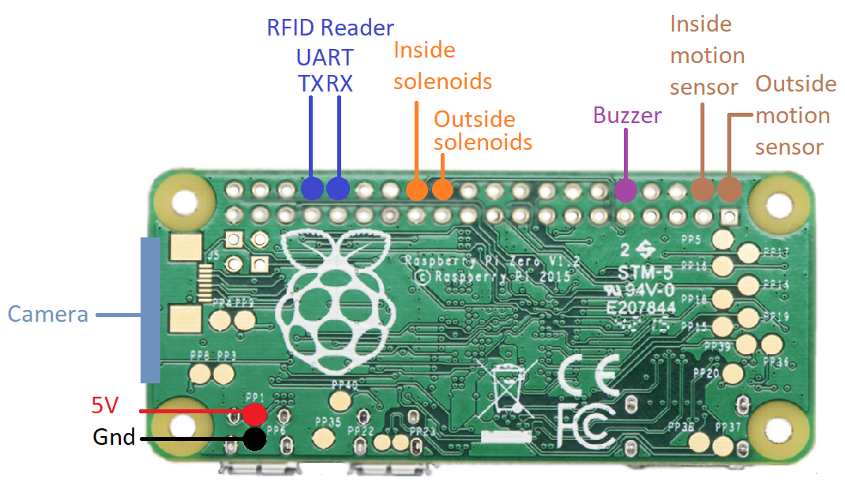
Raspberry Pi Pinout
Notes:
This is the pinout configuration for the Raspberry Pi. The motion sensors and the solenoids will be controlled by a few of the many GPIO pins. To control the sound level of the buzzer, the connected pin must be capable of pulse width modulation. Both the TX and RX pins used for UART communication, however, must utilize the two pins shown. The camera will be connected to the camera port on the board via ribbon cable. Lastly, the board can be powered through specific pins or through a micro usb connection.

Slide 9
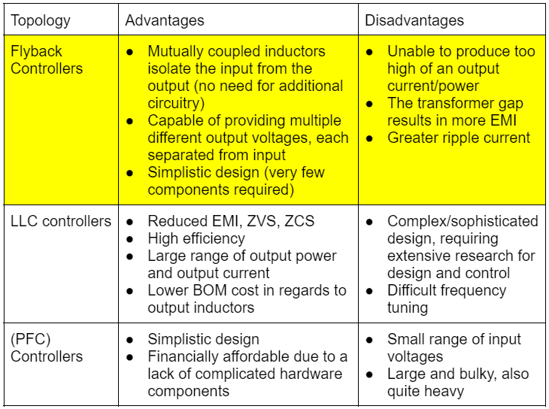
Significant PCB Design
PSU AC/DC converter topologies
Tradeoffs between efficiency and simplicity
LLC controllers introduced many luxuries, but the complexity was unnecessary
PFC controllers’ disadvantages outweighed the simplicity
Flyback was an acceptable compromise between what we were looking for
Notes:
For our design, we chose the power supply unit to be our PCB, an AC/DC or DC/DC converter. In order to design a PSU, we first needed to establish what topology we wanted to use. We looked at three different controller topologies: flyback, LLC, and PFC. There were certain tradeoffs that needed to be made in order to find the best fitting design, making the balance between simplicity and efficiency difficult to find. LLC controllers had many advantages. Reduced electromagnetic interference, zero voltage switching, and zero current switching allowed for this topology to have a high efficiency. However, the complexity mixed with the extremely high efficiency deemed this controller to ultimately be excessive for our design. Power Factor Correction controllers had a simplistic design, which offered an affordable PCB, but it’s small range of input voltages as well as it’s large and bulky design outweighed its simplicity. Flyback controllers therefore posed the best compromise between its advantages and disadvantages, with its simplistic design achieving sufficient efficiency from mutually coupled inductors.

Slide 10
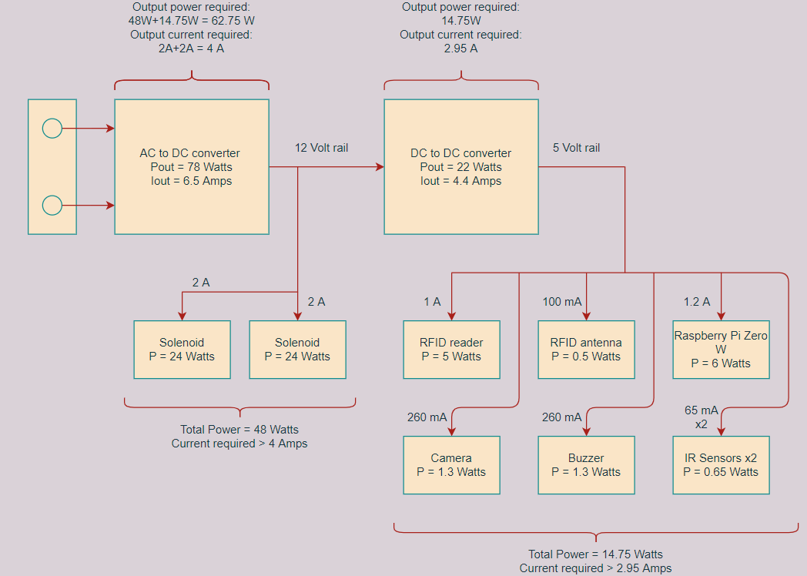
Significant PCB Design Cont’d
System power requirements
Two voltage rails: 12 VDC and 5 VDC
AC/DC converter posed more interesting of a PCB
DC/DC converter module therefore bought instead
All current values are maximum ratings
Notes:
In order to create a design to power our project, we needed to consider the power requirements from each device. Our system has two voltage rails: 12V and 5V. The 12 volt rail will be powering the solenoids facilitating the locking mechanism. The 5 volt rail will be powering the rest of the project hardware. Regarding the PCB design, there was the choice between the AC/DC converter and the DC/DC converter. Ultimately, the AC/DC converter posed an interesting and involved design, allowing us to demonstrate a more impressive PCB than the DC/DC converter. Therefore, a 12V to 5V module was purchased for our DC/DC. All currents on this diagram are the maximum ratings, ensuring that our design would be able to supply the power required.

Slide 11
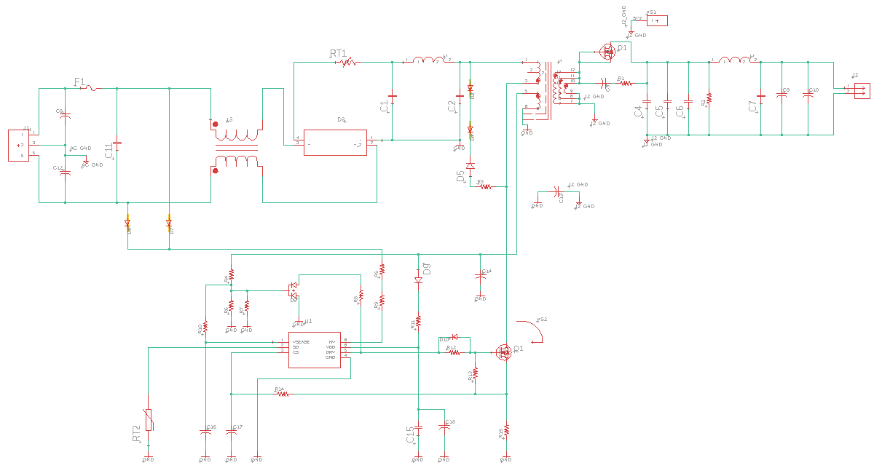
PCB Design
PCB was chosen to be the PSU
Notes:
Here is the PCB design for the AC/12VDC converter. It is a flyback controller with quasi-resonance to increase the efficiency. On the left is the AC input, and on the right there is the 12VDC output. There is a mutually coupled inductor, as discussed in the flyback table in a previous slide, next the the rectifier, a transformer, and a PWM.

Slide 12
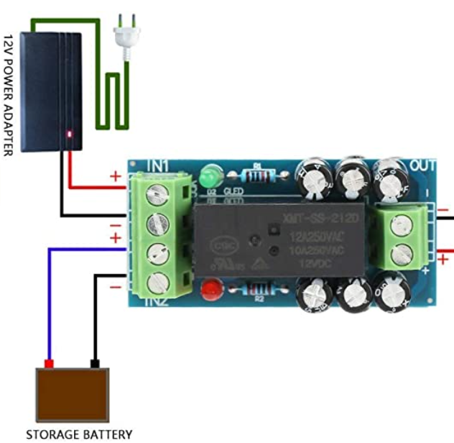
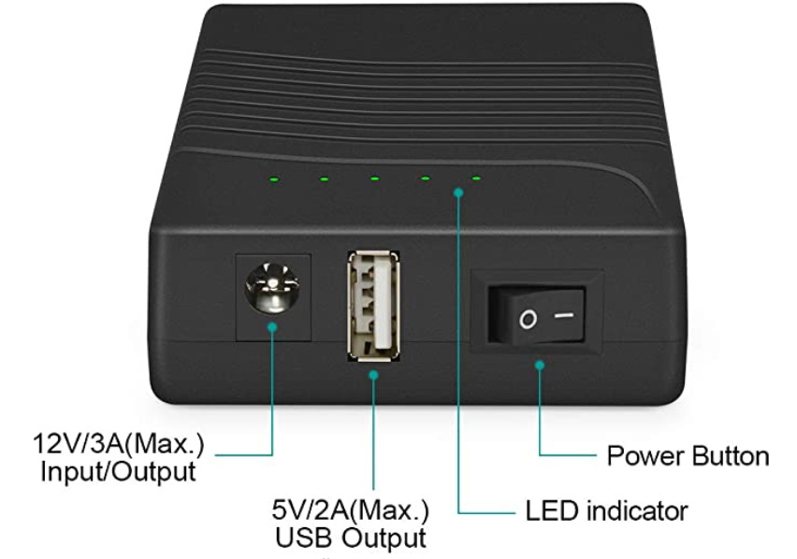
Battery Bank and Switching Module
Battery bank in case of power outage
Rechargeable 12V 3000mAh Lithium ion Battery Pack
12V/3A barrel jack output
5V/2A USB output
Switching module for battery bank and wall adapter
Outputs input 1 by default, unless input 1 drops below a certain voltage, then switches to input 2
Notes:
The power supply for the project is meant to switch between a wall adapter and a battery bank in the case of a power outage. The power bank that we chose as our backup was a rechargeable, 12V lithium ion battery pack with 3000 mA per hour. The battery has a 12V/3A barrel jack output, as well as a 5V/2A USB output. For our application, we will be using the barrel jack. In order to switch the source of power between the battery bank and the wall adaptor, the switching module will output the voltage of input 1 by default. Once the voltage drops below a certain level, input 2 will be switched on.

Slide 13
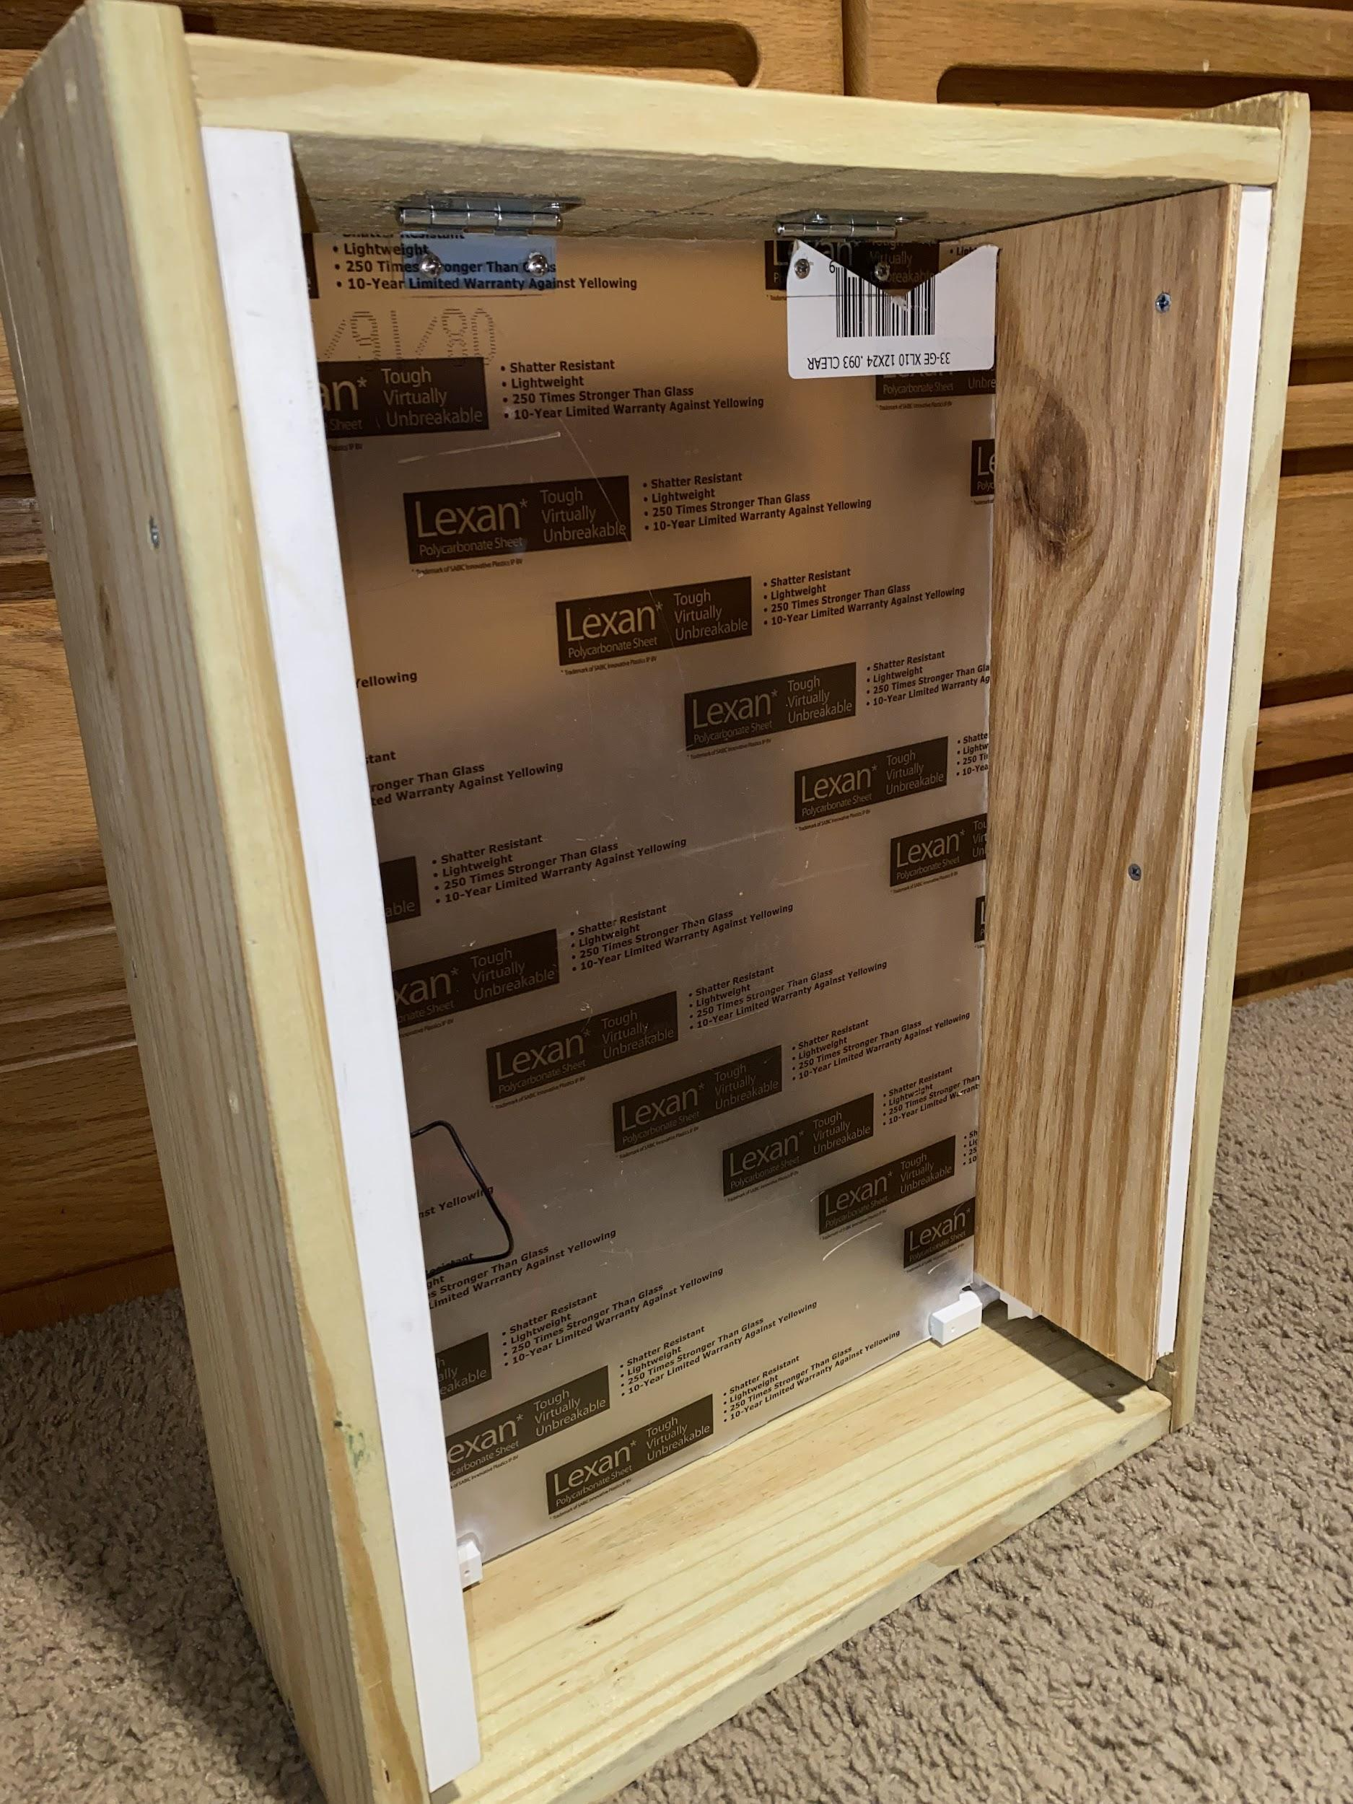
Doggy Door Materials and Construction
The doggy door is constructed using wooden planks 8” wide and ¾” thick
Space on each side of the door to house the locking mechanism and solenoids
Flap is made of a polycarbonate sheet to increase durability

Slide 14
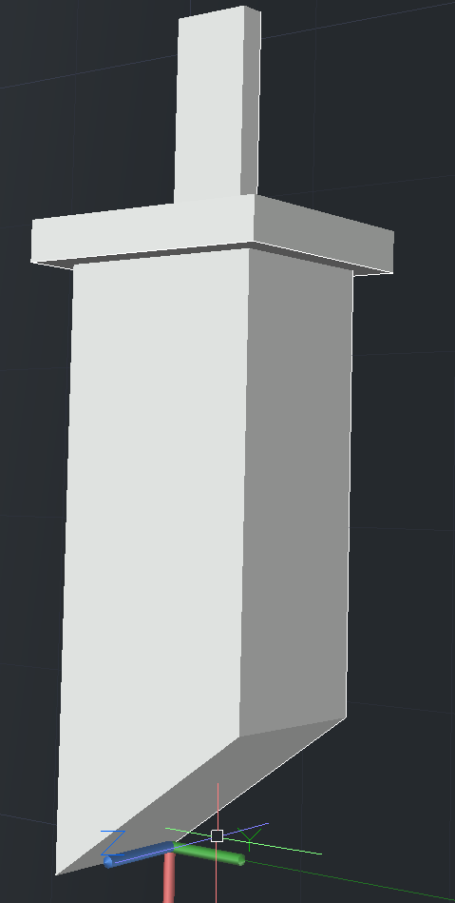
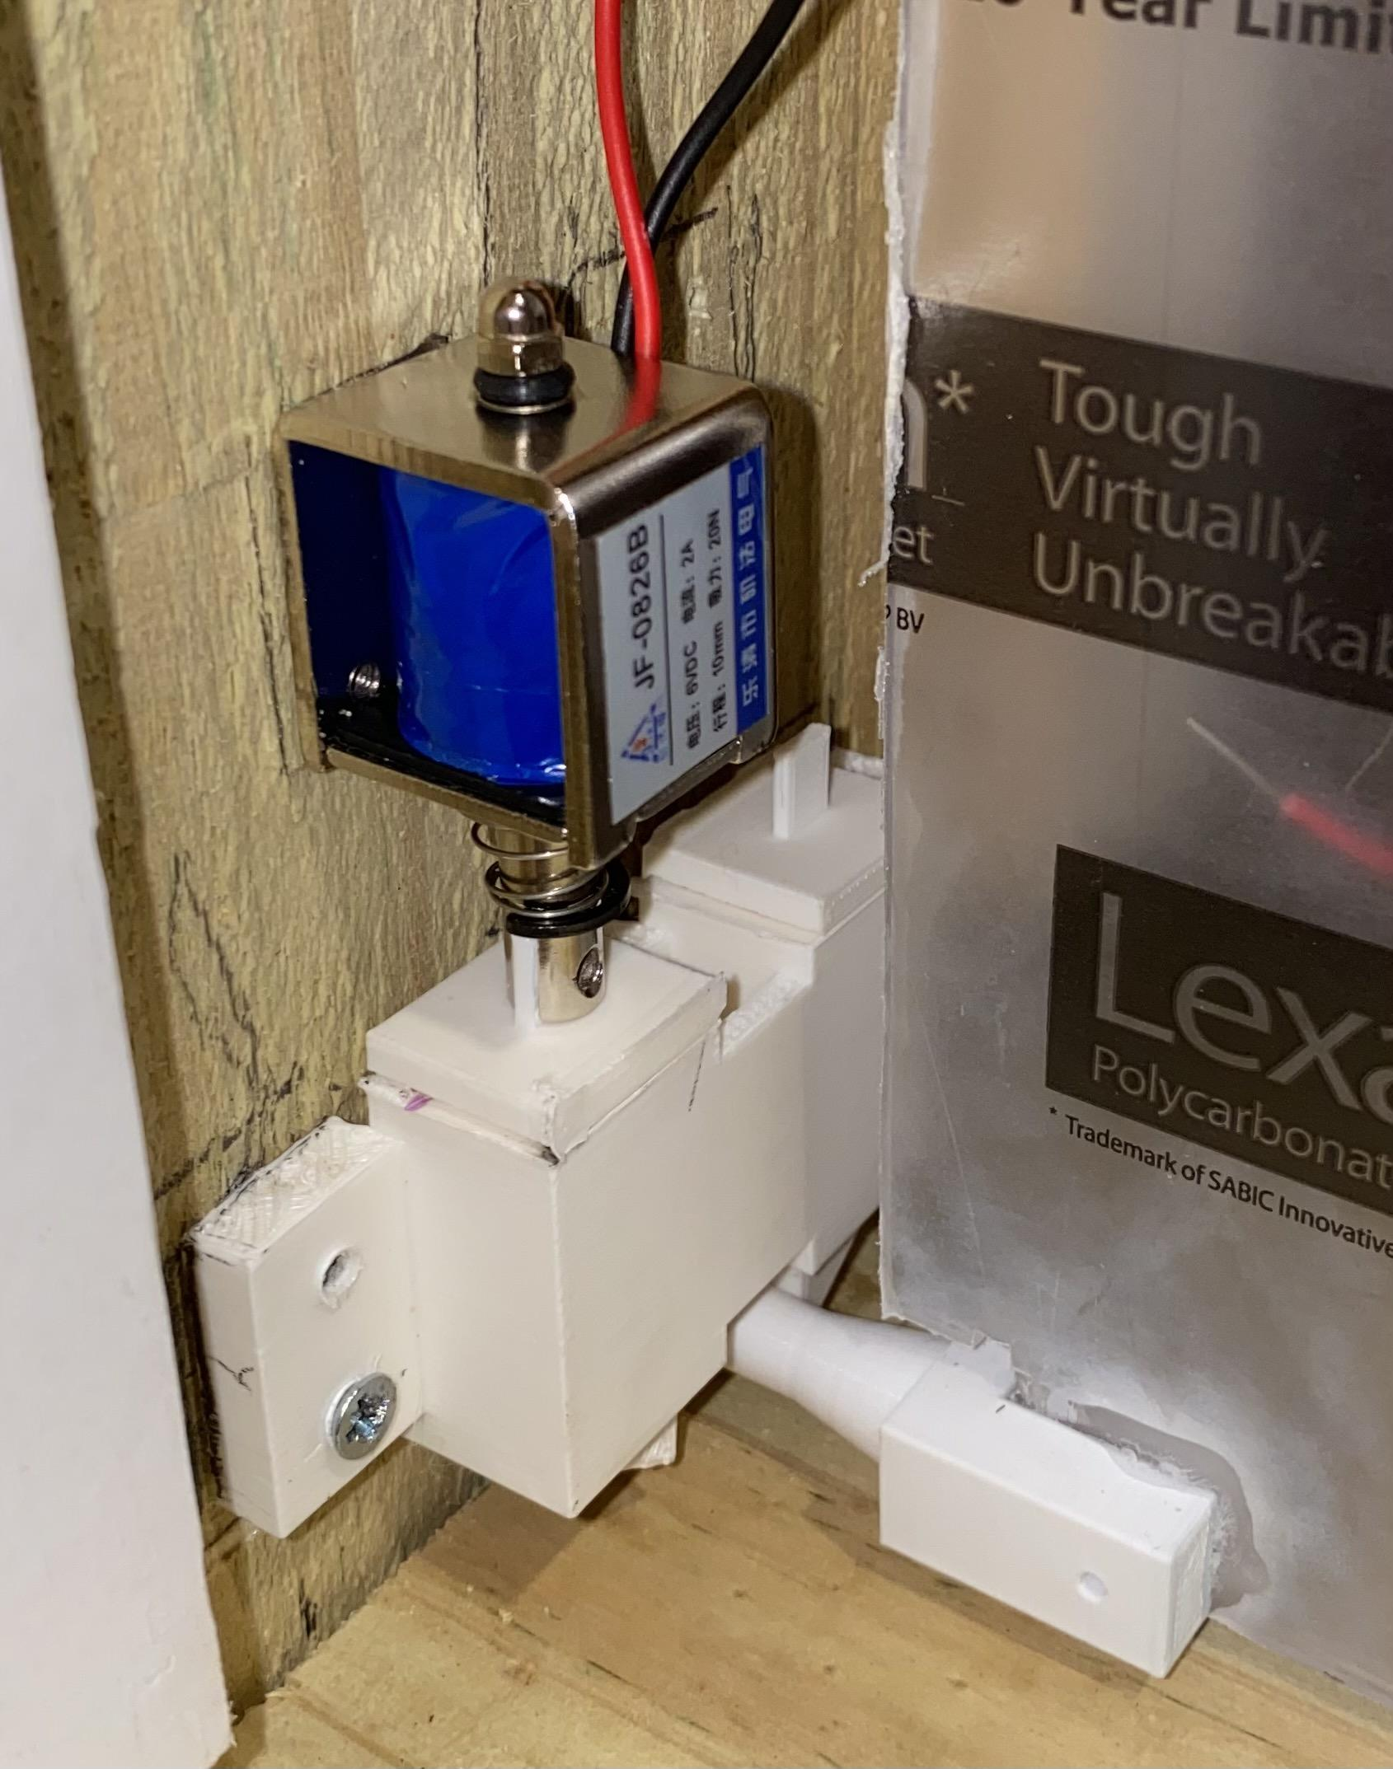
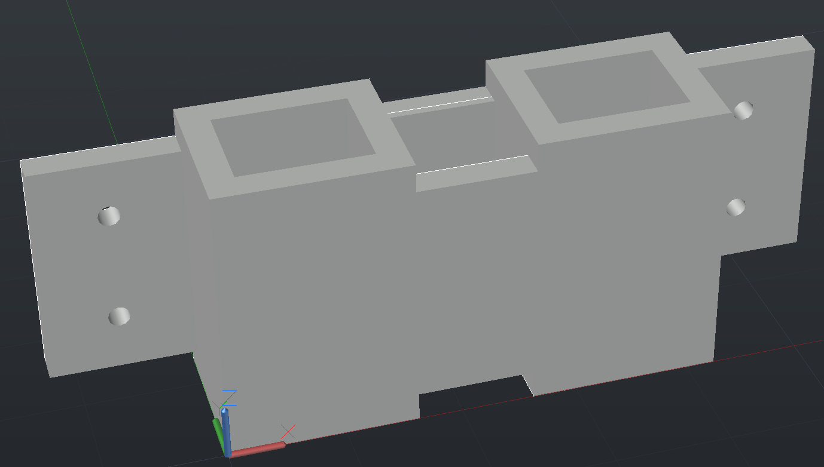
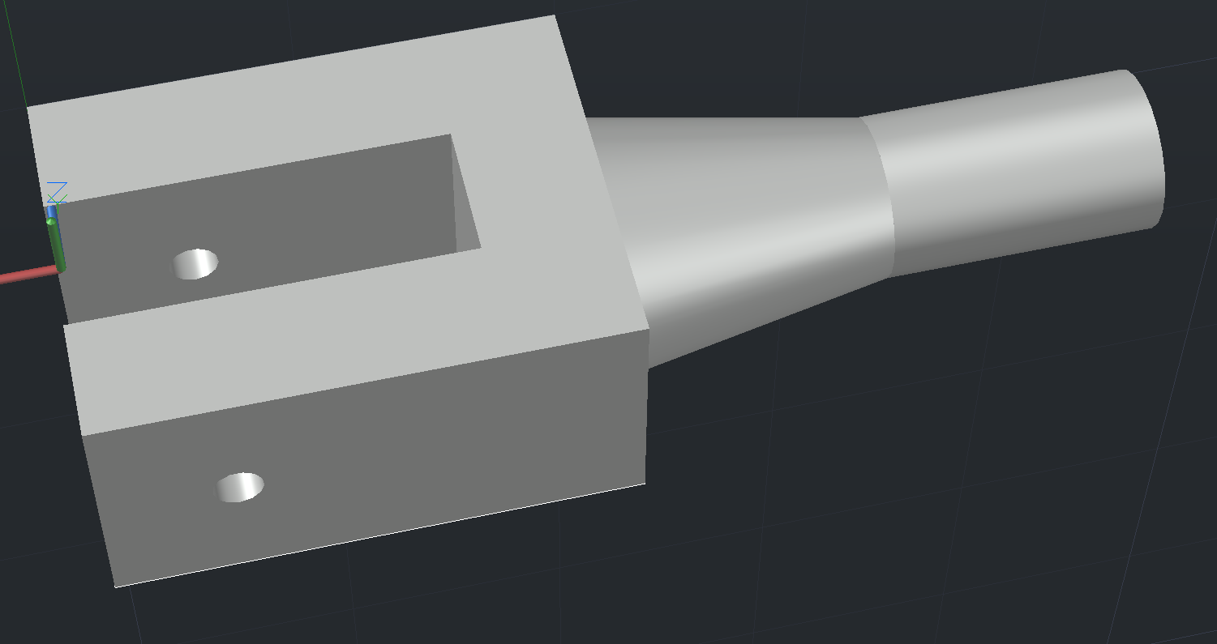
Doggy Door Locking Mechanism
3 pieces locking mechanism consisting of the locking pins, knobs, and shaft
The design of the pins allows for the flap to work unidirectionally at any given time.
Solenoids will be used to push the pins up to allow for the door to be opened.
(Knob)
(Shaft)
(Pin)

Slide 15
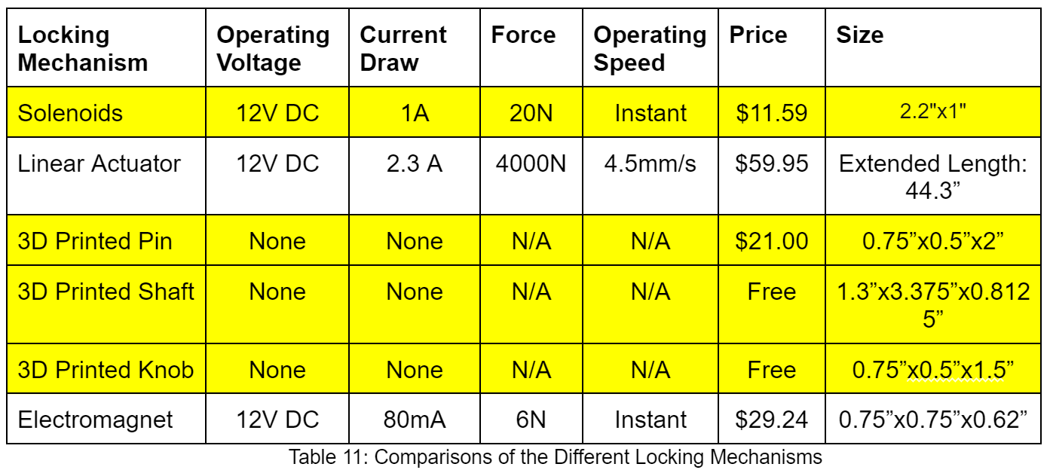
Doggy Door Locking Mechanism Comparisons

Slide 16
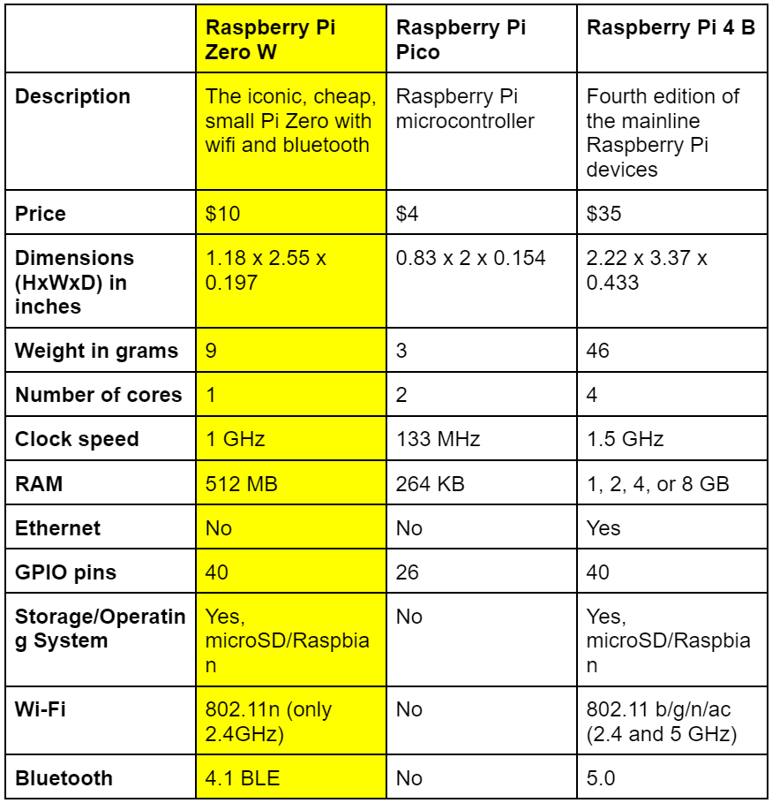
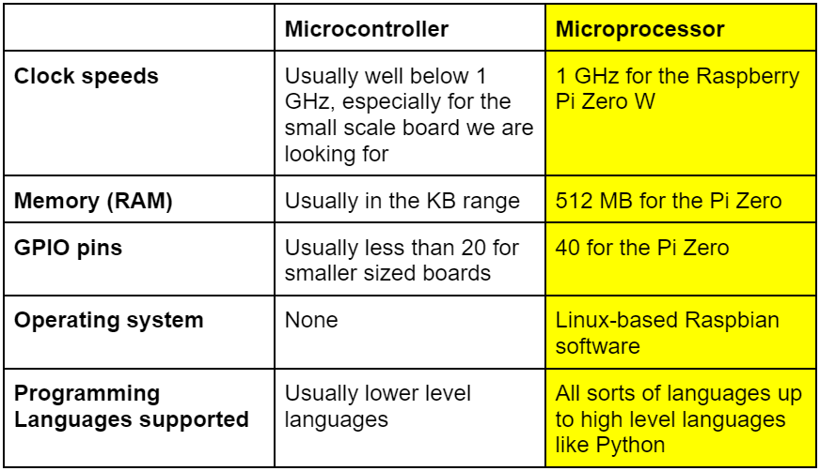
System Controller
Notes:
Table 1: Knowing that we would be capturing images, while recording sensor data, while recording data from the reader, we needed something that could handle everything we were going to throw at it. Comparing the first two fields we see that going with a microprocessor, even if it was the least powerful of the bunch, would still be heaps above the microcontroller alternative. As we knew we would have to write quite a bit of code to integrate all our parts and get them communicating with the system controller correctly, and we knew everything could be programmed in python, the linux operating system with easy python integration was also a plus.
Table 2: Here we put the option we were already looking at against its two polar opposites. The Pico was very quickly ruled out for it’s underwhelming power. The Pi 4 while appealing was more expensive and might have been beginning to reach unnecessary levels of power.
Why we chose RPi (had enough GPIO pins, on board storage, camera support, UART communication, wifi capability, and sufficient processing power)

Slide 17
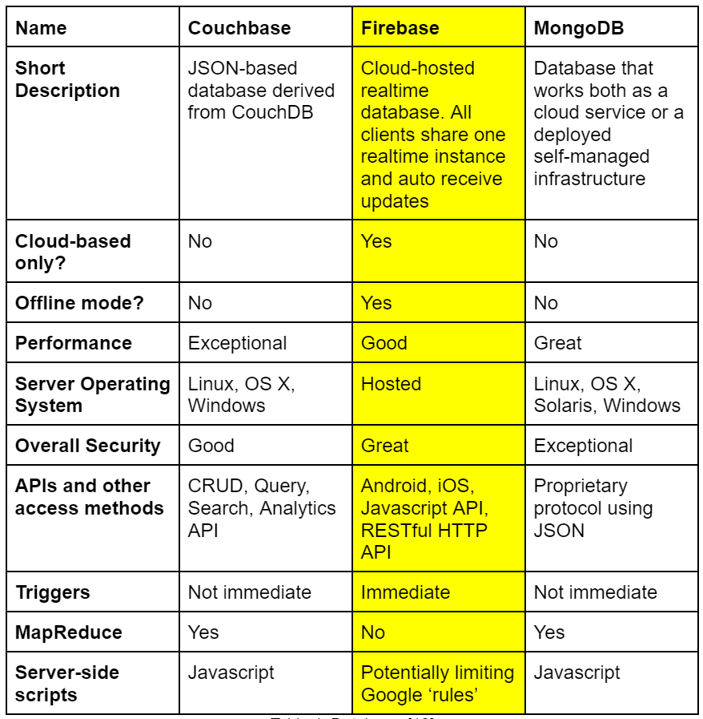
Databases
Foundation for IoT integration
Accessible by the mobile application anywhere, at any time
Decision to go with Firebase
Notes:
BP1: IoT projects utilize a database to store all information that will be accessed by users. Good set ups allow for customer support and easy way of sending out updates
BP2: In contrast to storing everything locally only, users can access their system through the mobile app from wherever they are and make whatever changes they like
BP3: With firebase we can give our users real time updates to whatever changes they are making while also having everything being watched and noted if the systems go offline

Slide 18
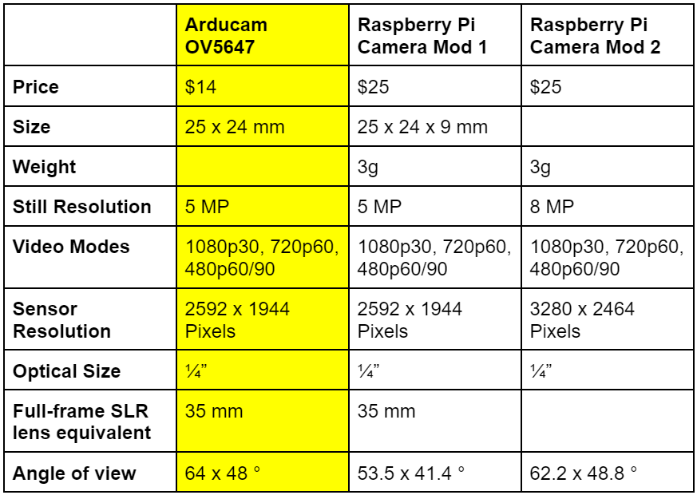
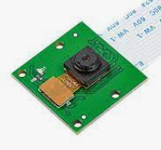
Camera
Used for capturing images of anything that might be in front of the door
Decision to go with the Arducam
Notes:
BP1: Images taken when motion sensor detects, sent to database and therefore users mobile app. Can talk about security and peace of mind for user
BP2: Not too many differences, more affordable with good angle of view is a plus. Not greatest image quality but we are not going for that
What the camera is supposed to do and how it will work with our system

Slide 19
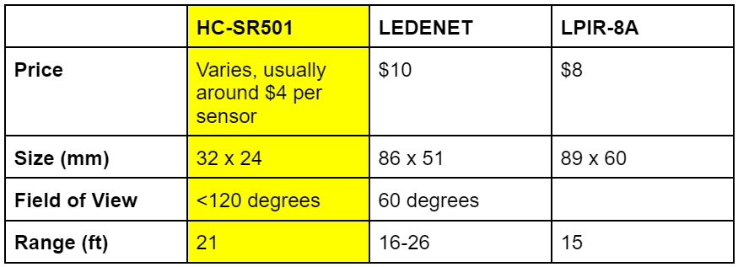
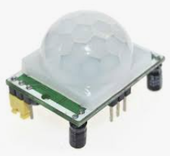
Passive Infrared Sensor
Used to detect any living presence at the door using infrared technology
Works in conjunction with camera and reader
Second sensor on inside
Decision to go with HC-SR501
Notes:
BP1: Passive Infrared Sensors were selected for our project because of the fact that sometimes inanimate objects might be placed by the door and we do not want to send out a signal when such is the case
BP2: The sensor picks up motion and alerts the camera when it knows that it is a moving, living thing. But at the same time it will know not to alert the camera if the reader picked up a tag at the same time motion was detected.
BP3: In the case that an animal sticks it head through the door but doesn’t commit to going outside, we plan on using data pulled from both sensors to keep an accurate representation of whether that animal is currently inside or outside
BP4: With the range, good field of view, small form factor and low price, this decision was a no brainer

Slide 20
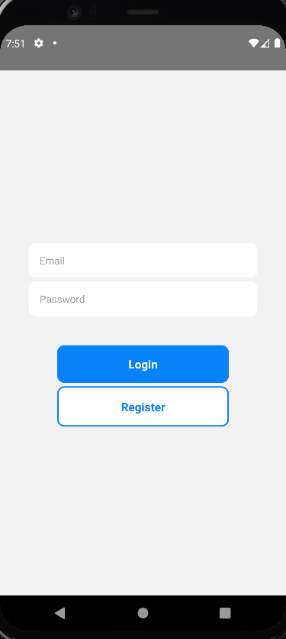
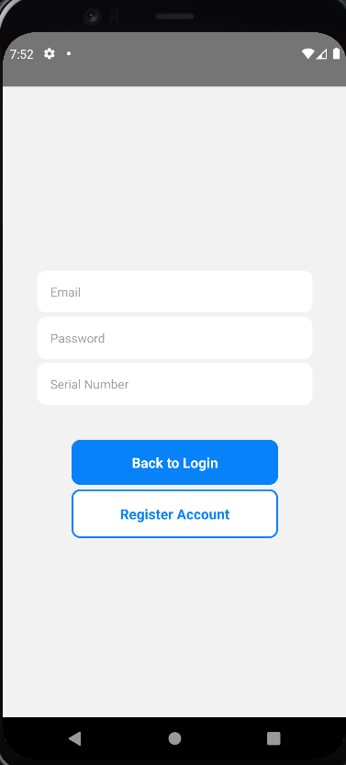
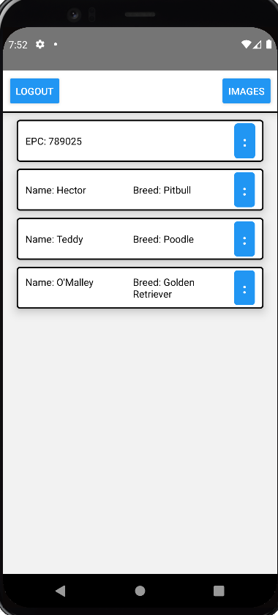
Mobile Application
Software
React Native CLI
Android Studio
Functionality
Registration
Edit and delete animals
Change animal permissions
View photos taken by camera
Notes:
To create the mobile application, we had several options to choose from, such as using Java, Kotlin, Flutter, Swift, and more. We decided to end up going with using the React Native Command Line Interface as our choice. Not only have we had previous experience with React Native, the documentation was also well-written, and both Android and Apple are easily supported. Therefore, we did not have to create an app for each operating system. To help with the development process, we used Android Studio to emulate the app on the computer. This allowed for us to view our changes live and make adjustments quickly. The purpose of the application is to allow the user to interface with the door and to control it remotely. When the user first opens the app, they are prompted to either login or register an account. When you register an account, you need to provide a valid email, password, and the serial number of your door. The serial number would actually be given to the user if this was a product they could buy. The reason the serial number is required is because this will allow the door and the mobile application to be linked together. Without this, the door would not be able to understand who is has access to the door and it would not be able to query the user’s information. After the user is logged in, all the dogs connected with this system and registered account will automatically be loaded. If no dogs are registered, the home screen will be empty. When an animal is added to the system, the list will update in real time and display the EPC of the collar. The user can then press on the three dots on the animal’s card to display the name and breed of the animal instead. Alternatively, from this same screen, the animal could be deleted from the system as well. If the user presses on the card itself, this is where they have the ability to change the permissions for each animal registered. For example, a permission may permit one animal to enter or exit, while another animal cannot. Additionally, if it is raining, you can set the permission for one or more dogs to not be allowed outside or even inside if they are already outside and are wet. One of the more unique permissions we have is to set a curfew for each animal. Therefore, you can set a timeframe at which the animal can use the door. For example, if you do not want your animal to go outside at night time or while you are away at the store, you can set the curfew accordingly to deny the animal permission. At any point however, this can be changed due to the remote nature of this application. Also from the front page, you can access all the images taken by the system within the last 24 hours. This will not only let you see which animals are at the door, but this will also provide an additional layer of security from intruders.

Slide 21
RFID Tags and Frequencies
Frequency ranges:
LF: 125 - 134 kHz, 1 - 10 cm
Low susceptibility to EM disturbance, but slow data processing speeds
HF: Typically 13.56 MHz (NFC), 1 - 100 cm
Faster transmission and relatively low EM disturbances, but too short of a read range
UHF: 865 - 960 MHz, reaching over 30 m
Higher read range, but higher interference from certain materials
Active versus passive tags:
Active tags
Initiator: requires battery, introducing a lifetime
More expensive
Longer read distances
Passive tags:
Waits for incoming signals: no internal source of power (no battery)
Relatively cheap in comparison
Shorter read distances
Notes:
We decided to choose RFID as our wireless technology as opposed to Bluetooth, GPS, and ultrasonic sensing. This is because RFID has fast read rates, consistent communication, and can allow for collars without batteries. RFID offers three different operating frequency bands: low frequency, high frequency, and ultra high frequency. Low frequencies are capable of reading from distances of up to 10cm. High frequencies are capable of reading up to 100cm and ultra high frequencies can read up to 30m or more. Low frequency has the advantage of its low susceptibility to electromagnetic disturbance, but unfortunately it has slow data processing, as well as too short of a read range for our application. High frequency transmits information faster, with low EM interference as well, but still it’s read range is too short. Therefore, UHF was the frequency range we settled on. However, we needed to be careful with its interference susceptibility. Luckily, we are enclosing our reader in a wooden design, which does not pose any issues. Next, the type of tag needed to be discussed. Active and passive are the two main types of tags, where active tags initiate communication between itself and other devices, requiring a battery to be powered. Because of this, these tags tend to be more expensive, but they do have longer read distances for the same reason. Passive tags on the other hand do not initiate communication, but rather wait for incoming signals, requiring no internal source of power. Due to the cheaper price, no battery, and sufficient read range for our application, we decided to utilize passive tags.

Slide 22
RFID Tag Classes
Tag classes: ISO 18000-6C protocol standard
Class 0: A read-only, passive UHF protocol
Need to write at least once
Class 1: A write-once, read-many UHF or HF protocol
Perfect for our application
Class 2: Indefinite read-write operational passive RFID tag
Unnecessary writing times
Class 3: Provides read-write operations for various sensors (temperature, pressure, acceleration, etc)
Unnecessary sensor implementations
Class 4: An integrated transmitter allowing for active tags to communicate with other tags and readers
Unnecessary and not applicable to our design
Class 5: Active tags capable of delivering power to other tags as well as communicating to devices other than readers
Unnecessary and not applicable to our design
Notes:
The tags must adhere to the ISO 18000-6C protocol standard. Within this standard there are 6 classes. Class 0 is a read-only, passive UHF protocol. Having the tag as read only prevents the ability to add additional information that can assist with animal to owner identification. Class 1 is a write-once, read-many UHF or HF protocol, which is perfect for our design, considering we only need to write once and it falls within our frequency range. Class 2 has an indefinite read-write operation with passive tags, but we only needed to write once, making this class unnecessary. Class 3 is read-write operations for devices with various sensors, such as temperature and pressure. This was definitely unnecessary, considering we aren’t measuring any of these phenomena. Class 4 has an integrated transmitter where active tags communicate with other receivers, however due to the nature of our application, class 4 is unnecessary. Class 5 is practically the same story, with active tags being able to power other devices. Ultimately class 1 was the category that our project fell under.

Slide 23
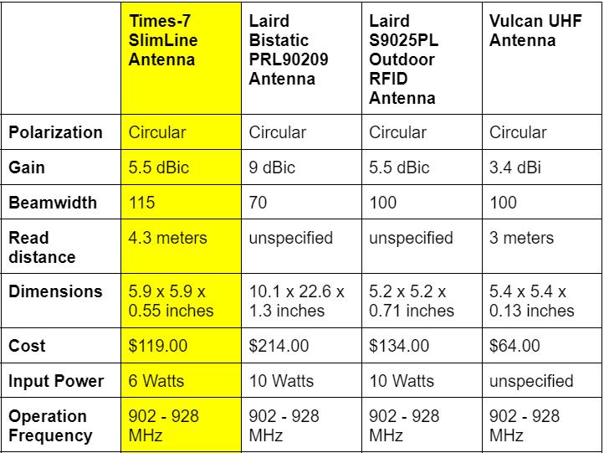
RFID Reader and Antenna
Desired parameters
Polarization:
Circular
Beamwidth:
Around 120 degrees
Read distance:
Over 1 meter (antenna can be operated at less power to lower the read distance)
Cost:
As low as possible…
Operation frequency:
UHF (865 - 960 MHz)
Notes:
For our reader and antenna, there were some important parameters we needed to consider. For the reader, it needed to support an external antenna, UHF, and budget friendly. The only reader we found that fit this description was the M6e-nano. For the antenna, we know that we needed circular polarization, which allows for the antenna to read tags at any orientation. We needed a beamwidth of around 120 degrees in order to have an appropriate reading area. The read distance we wanted was over 1 meter, but this variable was flexible, where the power delivered to the antenna could be lessened in order to achieve a lower read distance. As far as the cost goes, of course as low as possible. The frequency range was established earlier as UHF. The chart shows a few antennas we considered. The Times-7 SlimLine antenna seemed to be the best fit, seeing as its beamwidth was the closest to what we were aiming for.

Slide 24
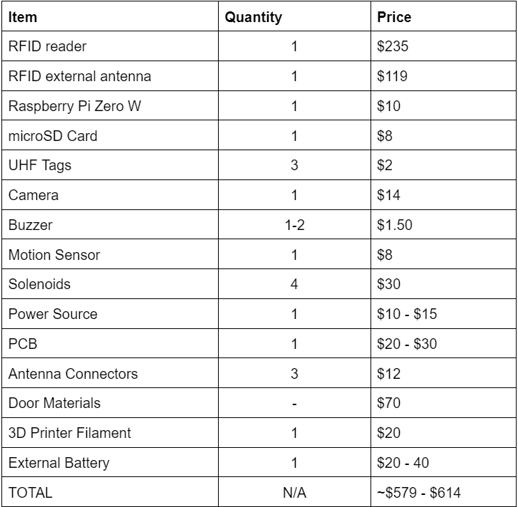
Budget (Proposed/Current)
Notes:
This is our proposed budget. We knew that the RFID was going to be the most expensive components, making up for the majority of our expenses. Other components, like the sensors, cameras, and battery add up over time. We estimate around $600, but realistically it will likely be a bit more.

Slide 25
Division of Work
Logan:
Project manager
Camera research
Storage
Mobile application
Embedded software
Alexis:
Wifi
Buzzer
Motion sensor
Database
Embedded software
Jordan:
Door research/design
Enclosure/door construction
Locking mechanism
Hunter:
RFID (reader, antenna, tag) research/design
PSU (PCB and battery bank) design
PCB research and construction
Notes:
Here’s the division of work. Logan and Alexis were in charge a lot of the software side of things, with storage, wifi, database, and so on. Jordan was mainly responsible for the construction of the door and designing/building the locking mechanism. I was responsible for the RFID research, as well as the designing and constructing the PCB and PSU.

Slide 26
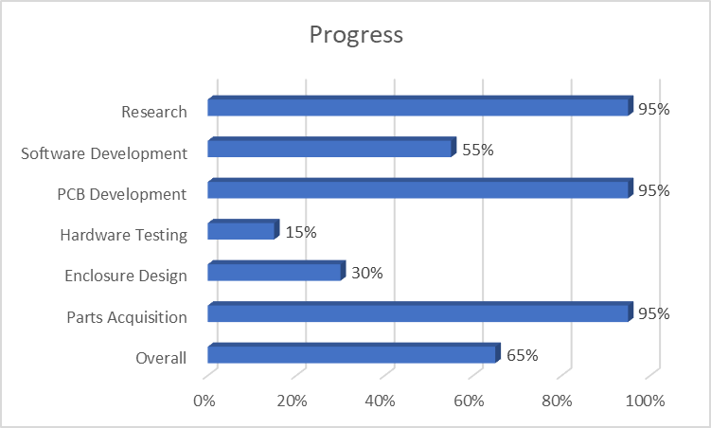
Notes:
The research, PCB design, and parts acquisition for this project are almost done. We have a bit of progress to make on the software, testing the hardware, and designing the enclosure for the door. All in all, we are about 65% done with this project.

Slide 27
Next Steps
Tasks | 2/18 | 2/25 | 3/4 | 3/11 | 3/18 | 3/25 | 4/1 | 4/8 | 4/15
Place Hardware on Door
Test PCB/switching circuit
RPi reading from database
RPi integrated with camera and RFID reader
Finish mobile application
RPi communicating with mobile application through database
Integration and testing
Finishing touches and preparing for demo
Notes:
The next steps for our project is to integrate components together, placing the hardware on the door, testing the PCB and switching module, and reading the raspberry pi from the database by next friday. The week after that, we would like to integrate the camera and the RFID reader. The following week, we would like to have the raspberry pi communicating with the mobile app through the database.

