Slide 1

Robodog
Group 29
Jonathan Hernandez
Anthony Coniglio
Esteban Arguello
Adrian Lopez

Slide 2
Motivation
Alternative to live animal emotional support
Support for loneliness, anxiety, and stress
Usage of AI assistants are rapidly increasing with 4 billion voice assistant devices being sold in 2020*
AI Assistant would allow the dog to be useful for common tasks/questions
Companionship without need for continuous monetary and time expense
*Statistics taken from Statista 2020 statistical study

Slide 3
Goals & Objectives
Google Assistant/Amazon Alexa capable
Expressive and emotional capable of analog motor and digital eyes expression
  Capable of moving with four independent legs
  Able to assume different positions
Reacts to its name and other voice commands
Touch-sensitive
Able to recognize color and objects in front of it

Slide 4
Specifications
Requirements | Specifications
Weight | < 15 lbs.
Response Time | < 3 sec.
Articulation* | 180-degree rotation
Touch Response | < 500 ms delay
Audio Quality | at least 50dB at 3ft.
Audio Recognition* | 80% of words understood
Display Size | 10cm x 8cm
Standby Mode | 5% of full load energy consumption
Dimensions | 30cm x 45cm x 25cm
Battery life | 3 hours idle, 1 1/2 hours active
Video Quality | at least 240*240 resolution 8-bit full color
Facial Detection* | < 500 ms delay in response
Camera Quality | > 1 megapixel quality Works with regular indoor and outdoor lighting

Slide 5
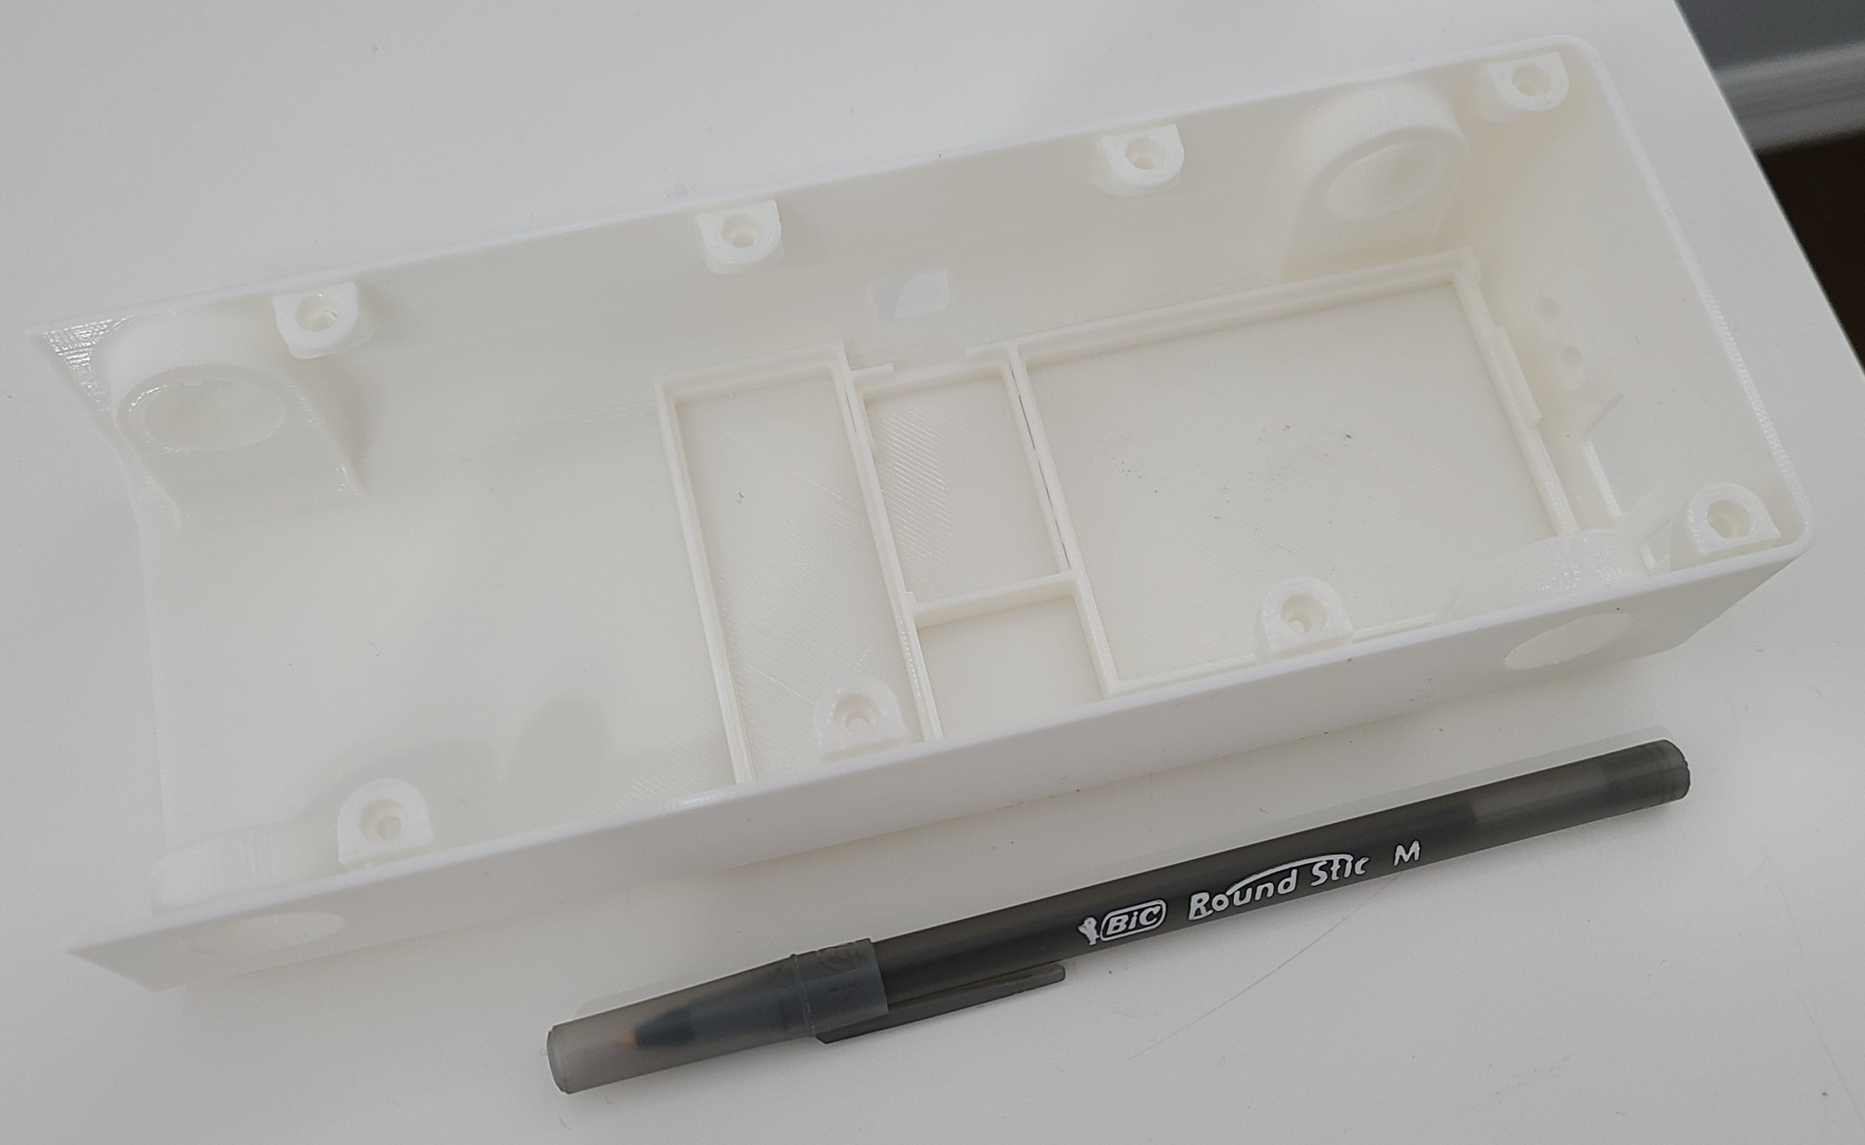
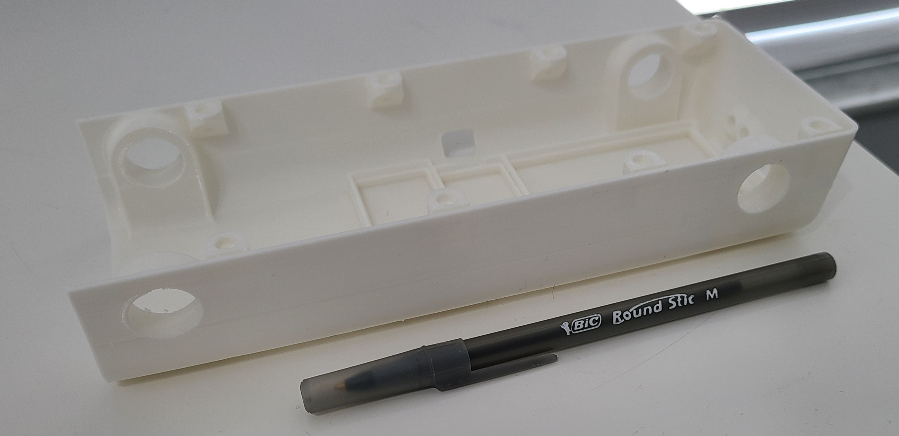
Chassis
3D printed in PLA+
207.6mm x 38mm x 80mm
Lightweight/Durable
Slotted for battery holder, PCB, Raspberry Pi
Included slots for I/O ports

Slide 6
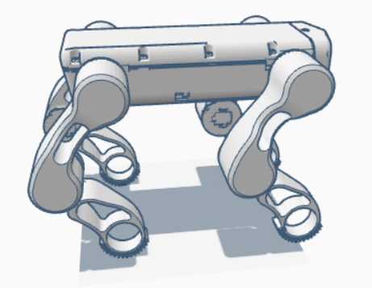
Model
Prototype design render
Embedded electrical cables for cableless design
Space for 2 servo motors per arm
Friction fit design
Only required hardware 8 standard bolts

Slide 7

Slicing
Slicing by Ultimaker Cura
Three dimensional gyroid infill pattern for equal strength in every direction
5% infill for chassis components keeps robodog within weight spec
Designed to be printed at home with minimal complex support structures

Slide 8
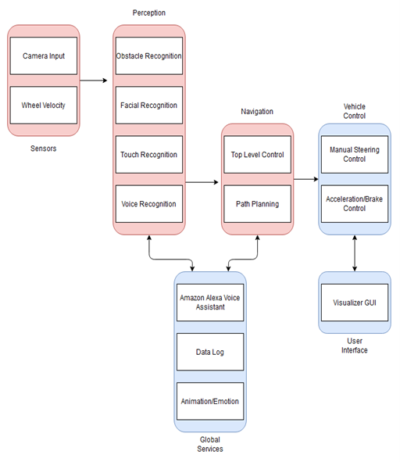
Software Block Diagram

Slide 9
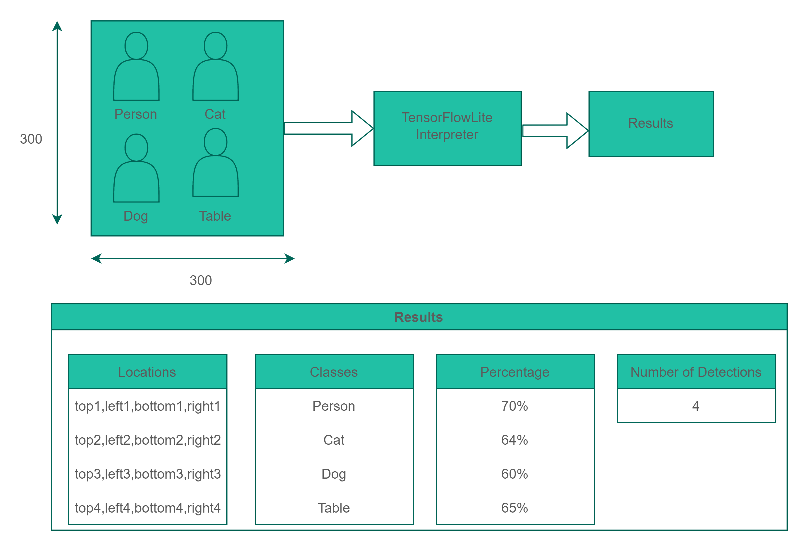
AI Assistant

Slide 10
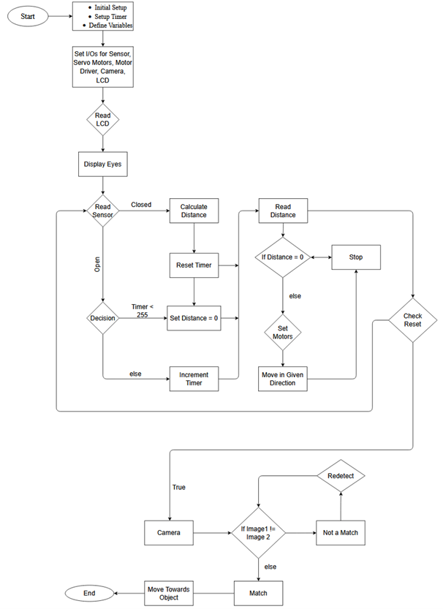
Movement Flow Chart

Slide 11
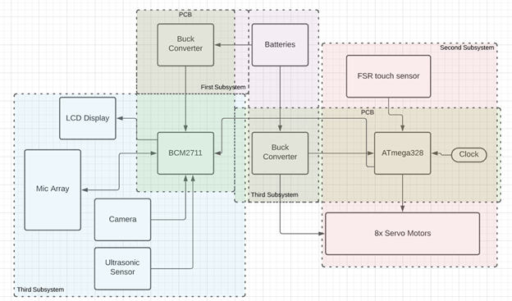
Hardware Block Diagram

Slide 12
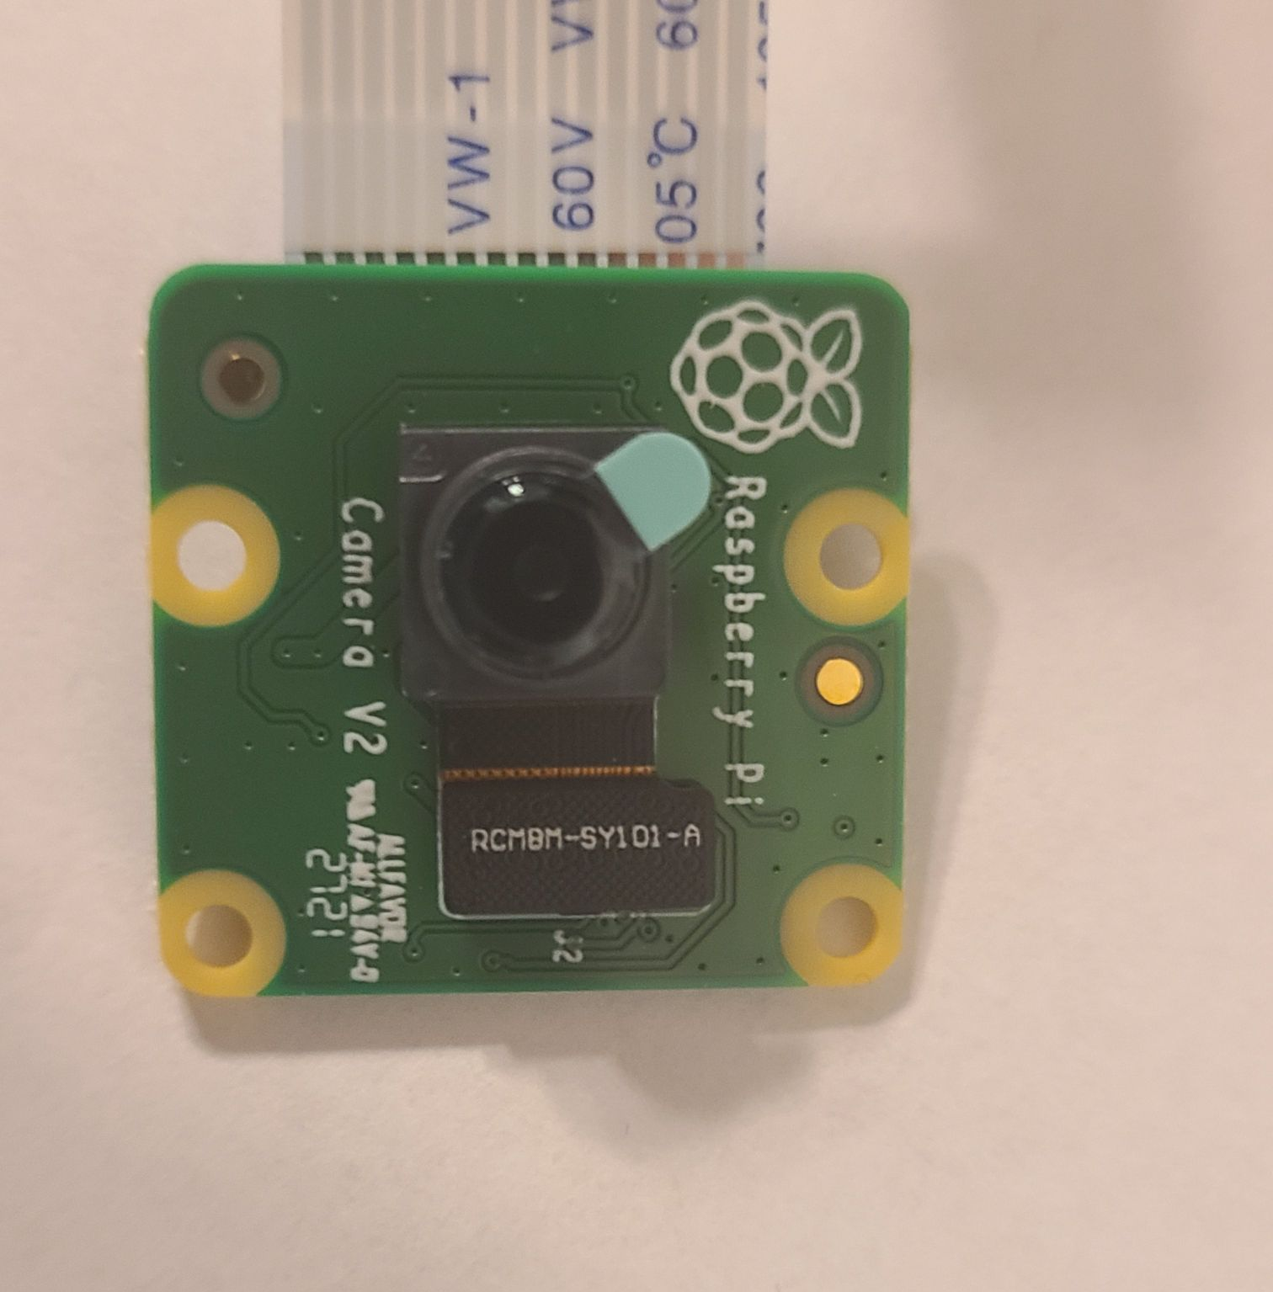
Camera
The Raspberry Pi Camera Module 2
The v2 Camera Module has a Sony IMX219 8-megapixel sensor
Supports 1080p30, 720p60 and VGA90 video modes, as well as still capture.
It attaches via a 15cm ribbon cable to the CSI port on the Raspberry Pi.

Slide 13
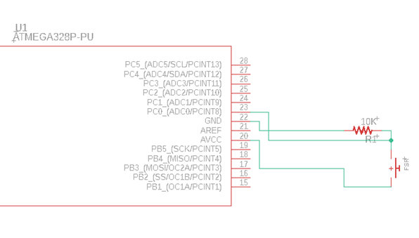
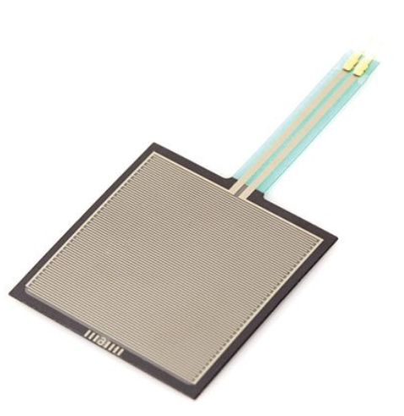
Touch Sensor
 | Capacitive Touch Sensor (AT42QT1012 or TPS65-201A-s) | Resistive Touch Sensor (Pololu FSR)
Price | $16.00 | $17.00
Size | 40mm x 40mm | 40mm x 40mm
Differences | Requires bare finger for detection Must be directly touched Multi-touch input technology | Pressure Dependent Can be hidden under the body Cannot detect multiple inputs Readily available in multiple sizes

Slide 14
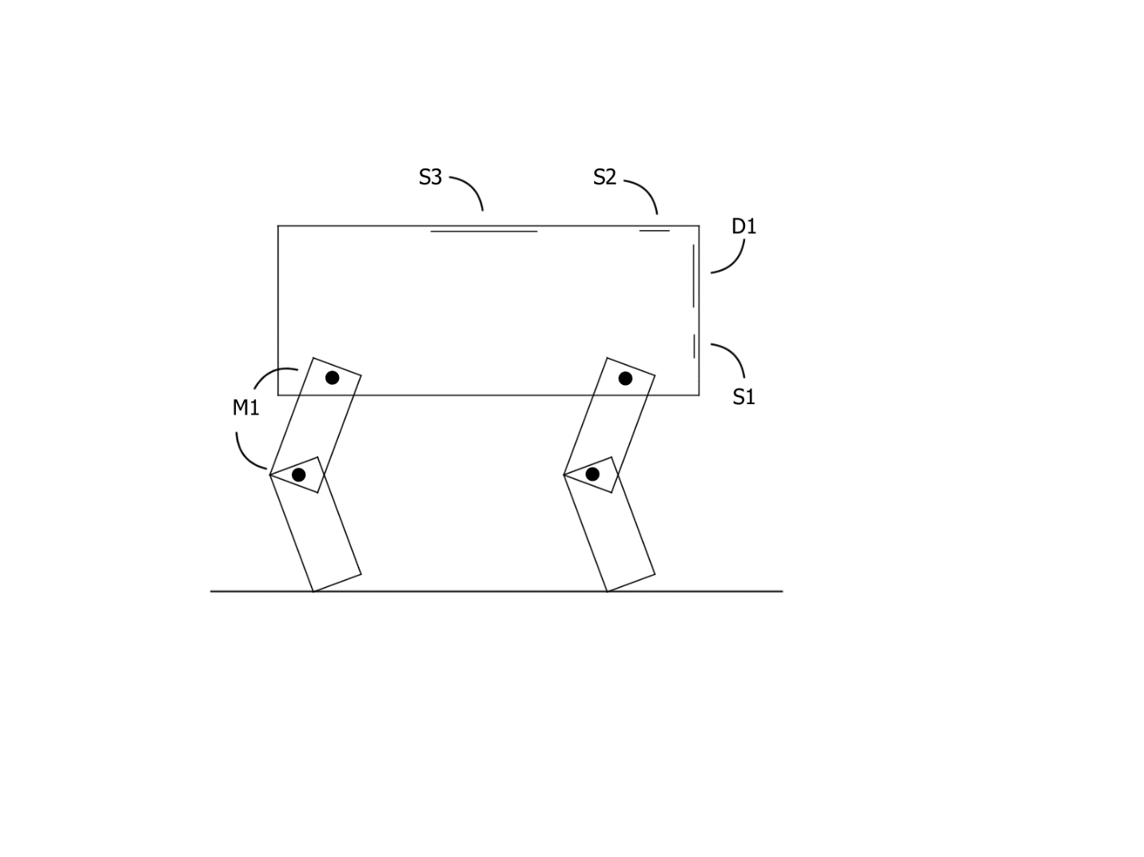
Movement and Motor Design
Cables of motors are located inside the leg
All motors are controlled by the Atmega328p
Servo motor feedback system
Series articulated
2 servo motors used for each leg
Allows for simple movement commands
Creates difficulties with balancing
Resemble the most to dog articulations
While idle, the motors have little to no strain
Notes:
Leightweight allows motors to wits

Slide 15
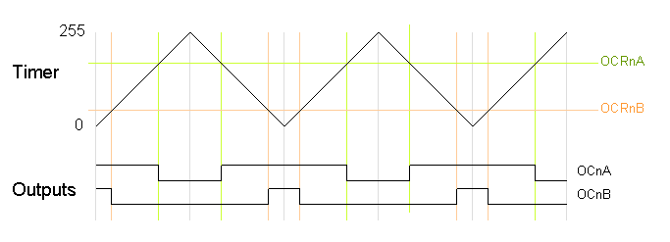
Using Digital Pins for PWM functionality
Bit-Banging not useful since the MCU is needed for the FSR touch sensor
PWM registers are modified directly
Phase-Correct PWM Mode
Output frequency calculation:
(16 Mhz /64) / (255/2) = 490.16 Hz
OCRnA = 180 (70.6% duty cycle)
OCRnB = 50 (19.6% duty cycle)

Slide 16
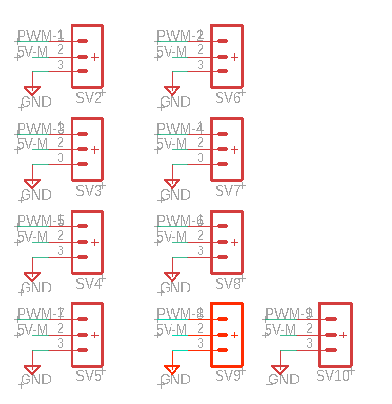
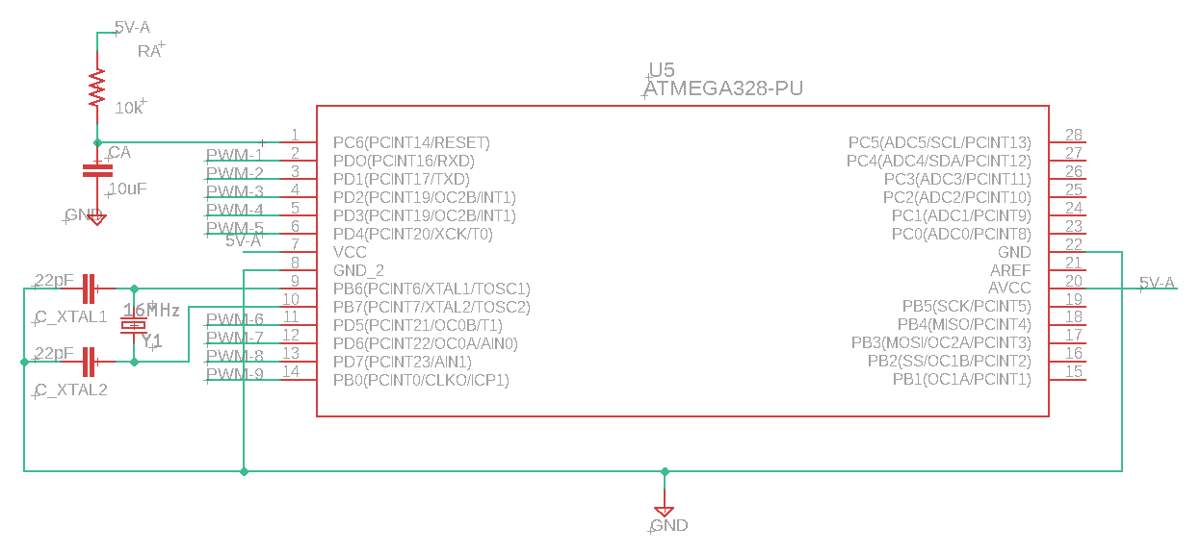
Servo Motor Schematic

Slide 17
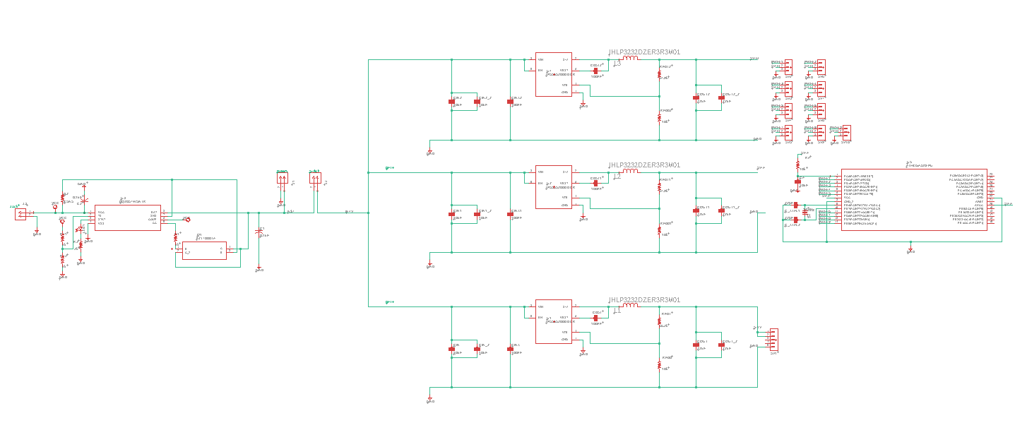

Slide 18
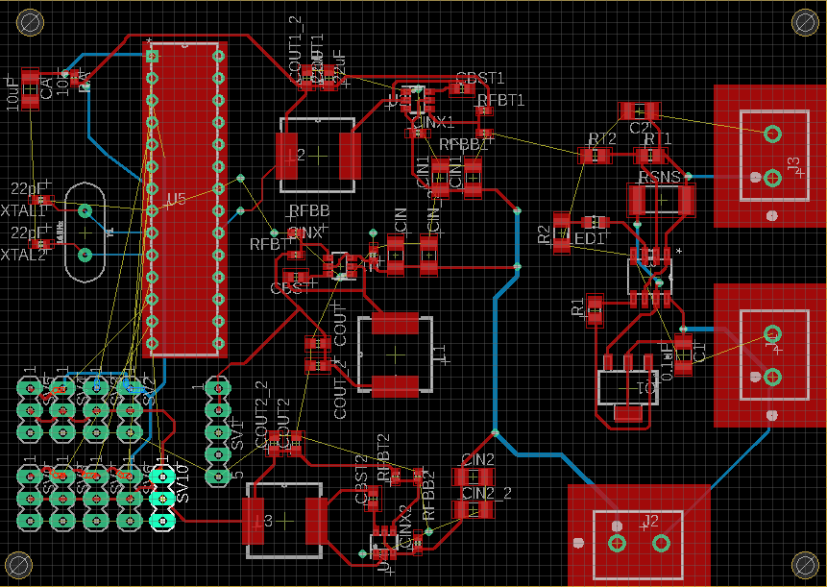
Overall PCB
Motor PCB

Slide 19
Power Delivery
The power delivery for each subsystem has its own power supply unit. The power supply design process was facilitated by the Texas Instruments Webench tool.
The TI TPS565208 buck convertor was chosen based on factors such as its high efficiency as well as the low footprint and bill-of-materials cost for the overall design.
Supply constraints also contributed to the design decisions regarding power supplies. Using a buck convertor does benefit efficiency but complicates the design process as it necessitates the use of more than one battery cell in series.
A 2S battery configuration with the standard nominal voltage of 7.4V was used to limit further complications.
The subsystems required a 5.1V, 3A supply for the Raspberry Pi, and a 5V, 3A supply for the ATMEGA328P MCU and motor power. This was accommodated with a slight change between the two designs.

Slide 20
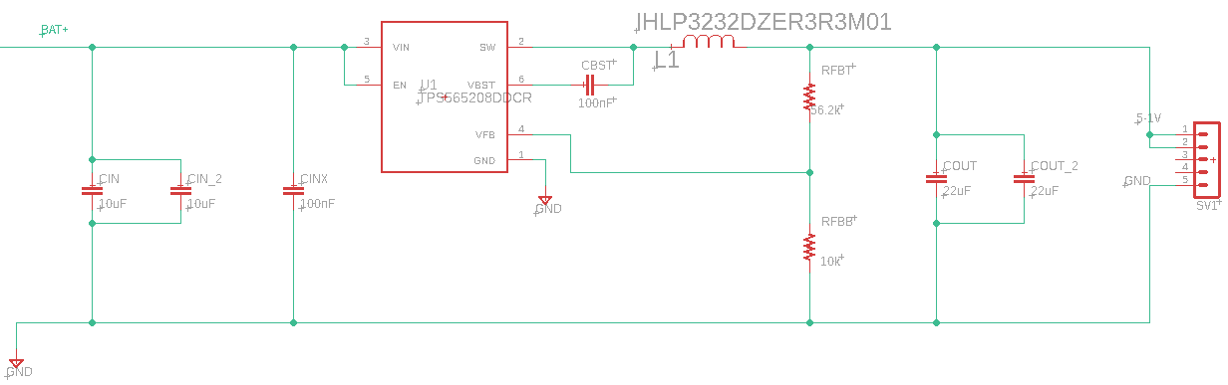
Raspberry Pi Power Supply

Slide 21
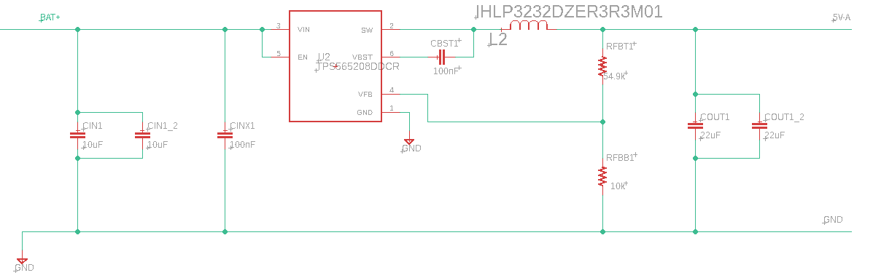
MCU and motor power supply

Slide 22
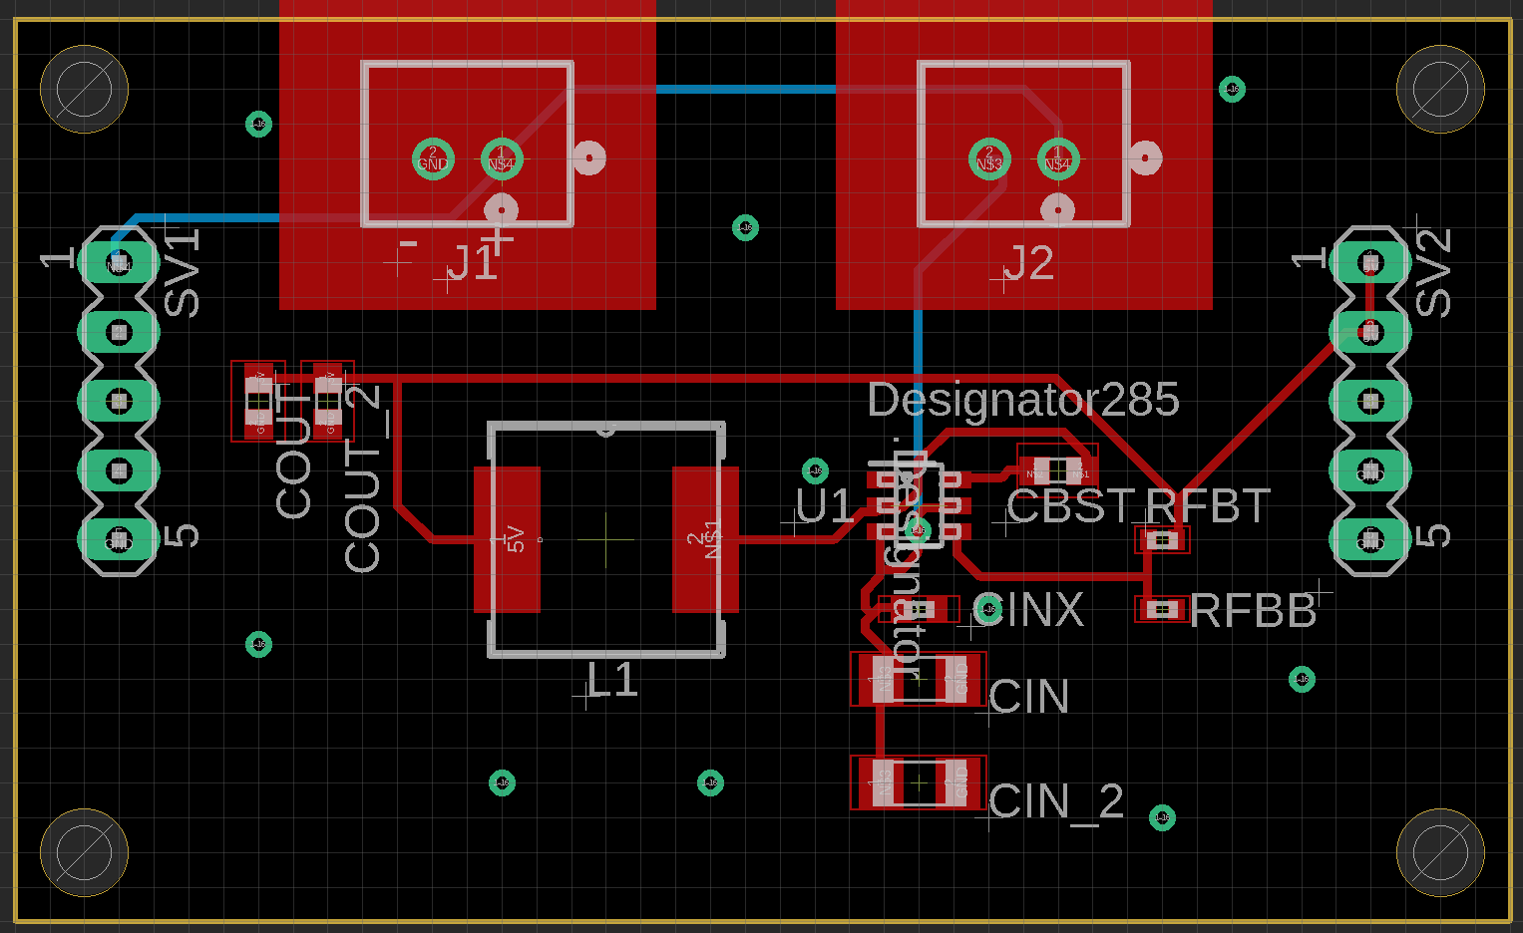
Power Supply PCB

Slide 23
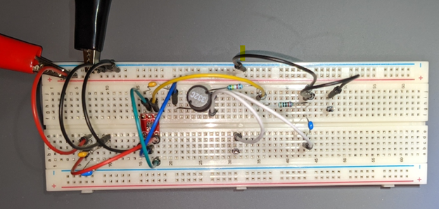
Power Supply Testing

Slide 24
Batteries and Charger
One of the desired outcomes of this project is to have a portable and convenient experience using the robot. Therefore, it was necessary for the robot to be battery powered and easily rechargeable.
Lithium-ion batteries were selected for light weight, power, and ubiquity.
To achieve proper integration into the overall design, a charger circuit was designed for use in our custom PCB.
The IC used for this charging circuit is the BQ2057W by Texas Instruments, for use with 2-cell li-ion batteries.

Slide 25
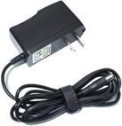
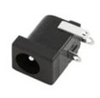
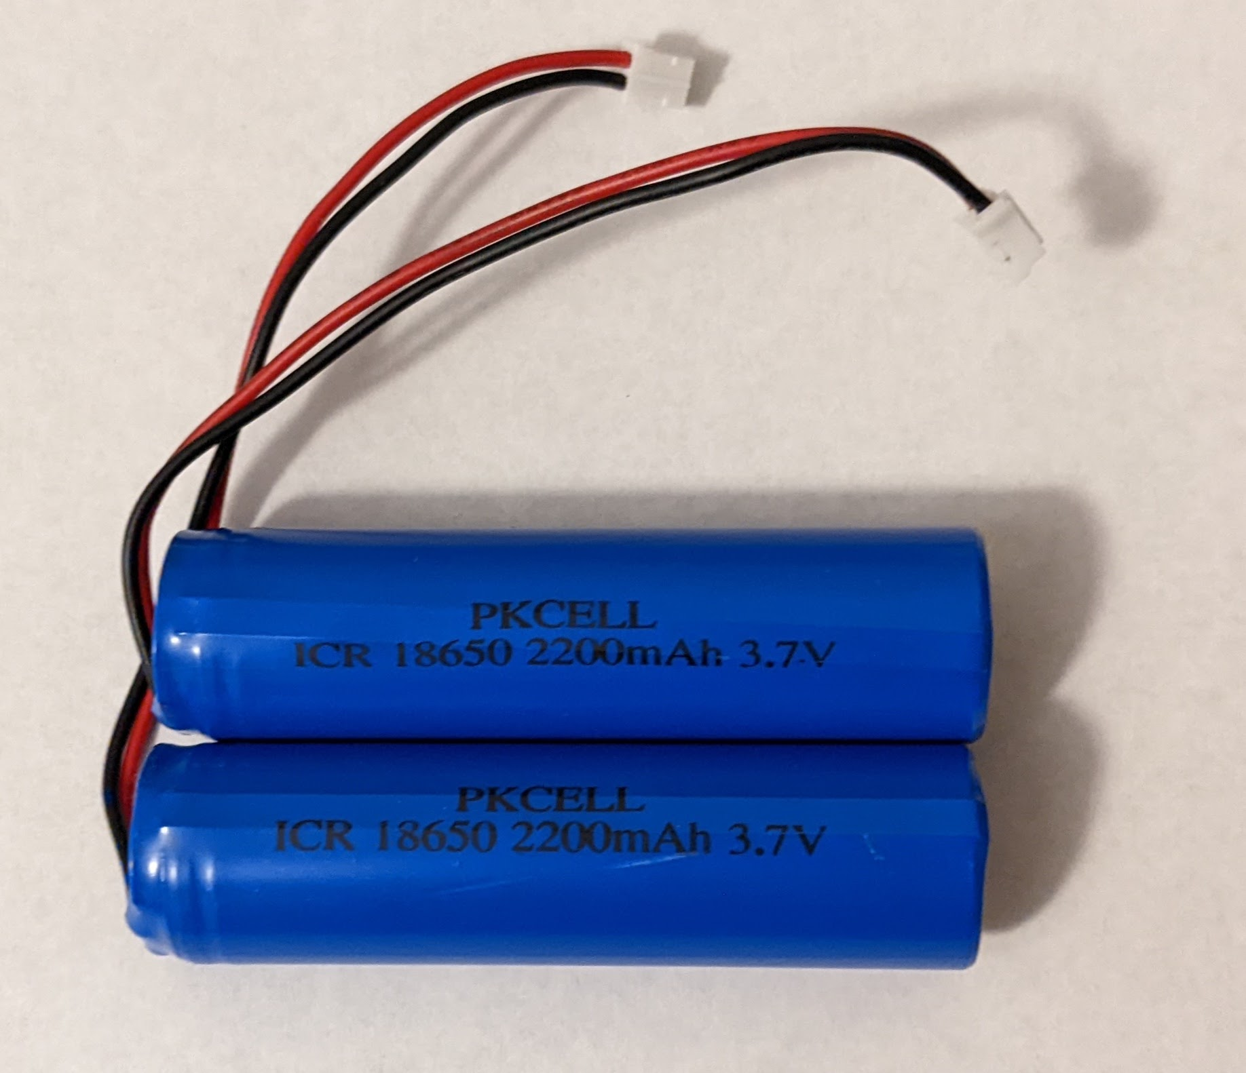
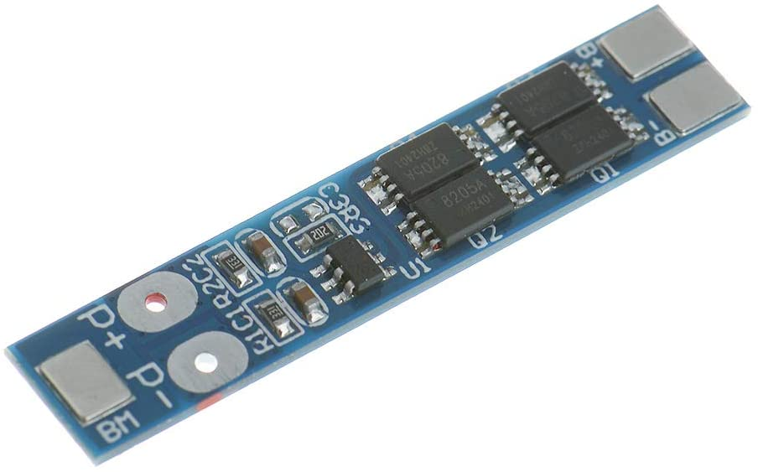
Batteries
Two 18650 Li-Ion batteries will be wired in series
1.1 A Discharge Rate
3.7 V nominal voltage increased to 7.4 V
2200 mAh, 16.28 Wh
The overcurrent, overdischarge, and overcharge protection will be handled by an off-the-shelf Battery Management System solution.

Slide 26
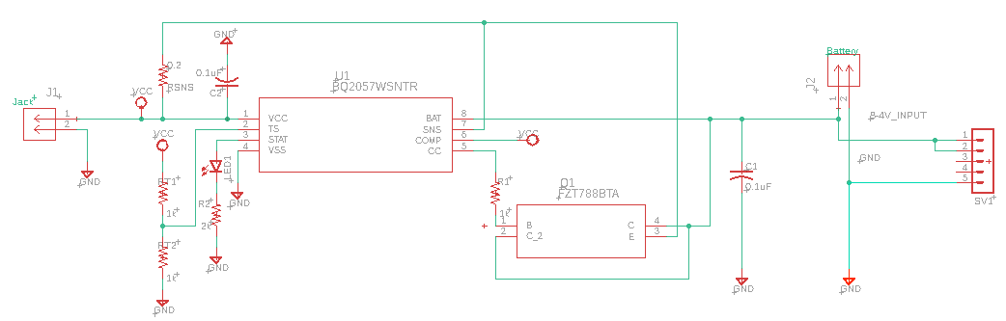
Charger Schematic

Slide 27
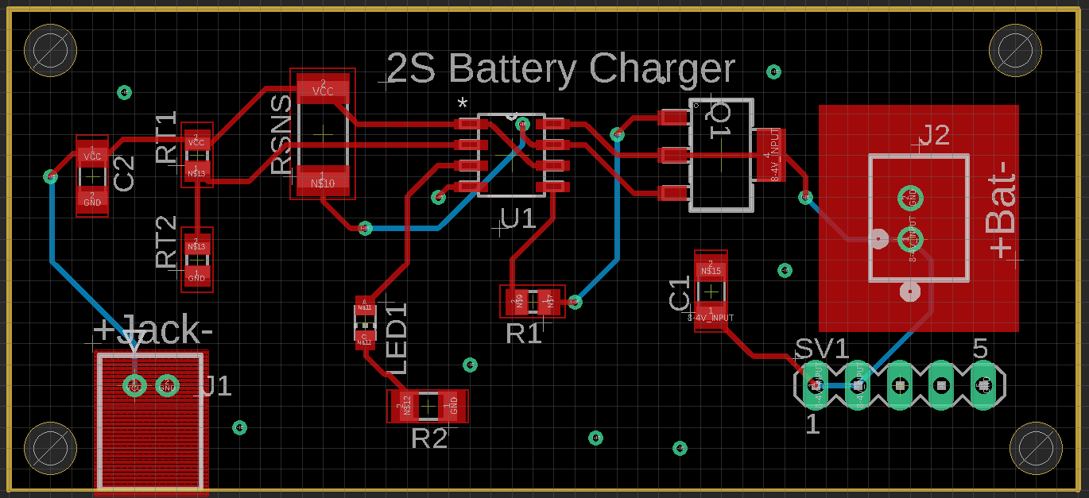
Charger PCB

Slide 28
Prototyping and Testing
Breakout board used for custom PCB
Testing points are set on multiple sections of the PCB
PWM is tested using oscilloscope

Slide 29
MCU Comparison
Features | Arduino UNO | Raspberry Pi 4 | Jetson Nano
Operating Voltage | 1.8 – 5.5V | 4.7V – 5.25V | 4.75V – 5V
GPU | N/A | Broadcom VideoCore VI | 128-core NVIDIA Maxwell
CPU | ATmega328P | Broadcom BCM2711, Quad core Cortex-A72 | Quad-core ARM A57
Max Clock Frequency | 16 MHz | 1.5GHz | 1.43 GHz
Memory | 32 KB | 8GB LPDDR4- 3200 SDRAM | 4 Gb LPDDR4
Storage | N/A | Expandable | Expandable
Bit-Count | 8-bit | 64-bit | 64-bit
Power Usage | 200µA@1MHz | 3.8W to 5.5W | 5W minimum
Dimensions | 68.6 mm x 53.4 mm | 68.6 mm x 53.4 mm | 100 mm x 80 mm x 29 mm
Price | $22 | $75 | $99

Slide 30
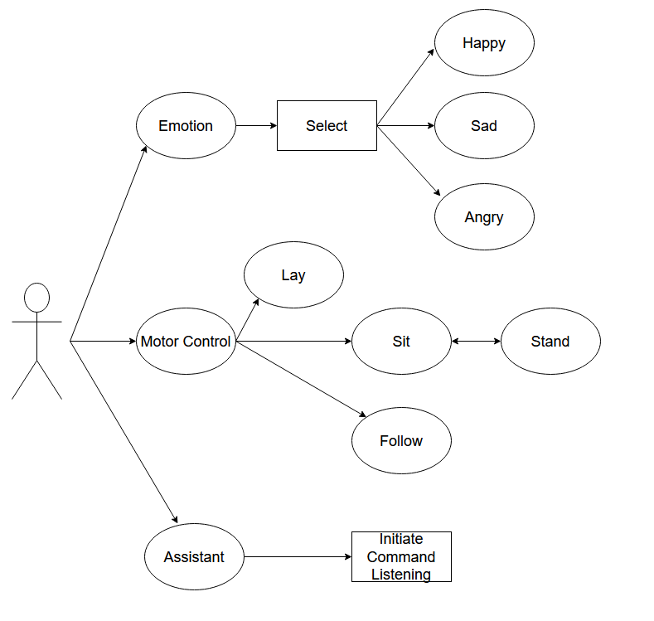
Use Case Diagram

Slide 31
Administrative Content

Slide 32
Budget
Part name | Description | Possible numbers | Cost
18v DC Motor Drill RS-550 D-Shaft 1/8in / 3.175mm Shaft - Fan Cooled High Torque 20K RPM Power Tool Replacement Upgrade 18 Volt (12v - 24v DC) DIY Electric Projects Robots Remote Controlled Car | Motors will be used for the legs, neck, and joints. | 8 | 8 x $15.45 = $123.60
0.3 Megapixels USB Camera for Raspberry Pi and NVIDIA Jetson Nano | The camera will be integrated near the eyes for use of AI vision. | 2 | 2 x $8.50 = $17.00
Adafruit Animated Eyes Bonnet for Raspberry Pi Pack | Screen will replace eye sockets and used to display information | 1 rectangle | $49.95
Respeaker Pi HAT 2 mic-array | Used to receive audio input for commands. Also includes a simple speaker for audio output | 1 | $9.95
Gravity Digital Speaker Module | Located where the ears would be. Gives output audio. These are optional and used if the 2 mic-array speaker is not good enough. | 1 or 2 | 2 x $6.00 - $12.00
PCB components and parts | Used to replace microcontrollers in final build | several | Estimated $53.80
Arduino Uno R3 Microcontroller Board. | Goes inside and controls peripherals such as motors, touch sensors, etc. | 1 | $44.90
LAMPVPATH (Pack of 2) 4 AA Battery Holder, 4 AA Battery Holder with Leads, 4 AA Battery Holder with Wires | Battery holder to satisfy battery standards. Used to facilitate robot design. | 1 | $5.98
2S Li-ion battery charger BOM | Connected to battery. | 1 | $6.74
Raspberry Pi | “Brain” of the robot; most likely located where the brain normally goes. | 1 | $39.99
Plastic Casing (3d printed) | 3D printed body |  | Cost of raw materials
Gravity Gesture/Touch Sensor | In the back for “petting detection” | 1 | $9.90
Total Amount |  |  | $380.07
Total: 380.07

Slide 33
Progress

Slide 34
Issues
Parts are getting delayed
Some motors are not performing to their specifcations
No availability of desired MCU
Need to create PWM with digital pins (using software)

Slide 35
Work Distribution
Name | Power | AI Recognition | Assistant | Systems
Jonathan |  |  | X
Adrian | X
Esteban |  |  |  | X
Anthony |  | X

Slide 36
Questions?

