Slide 1
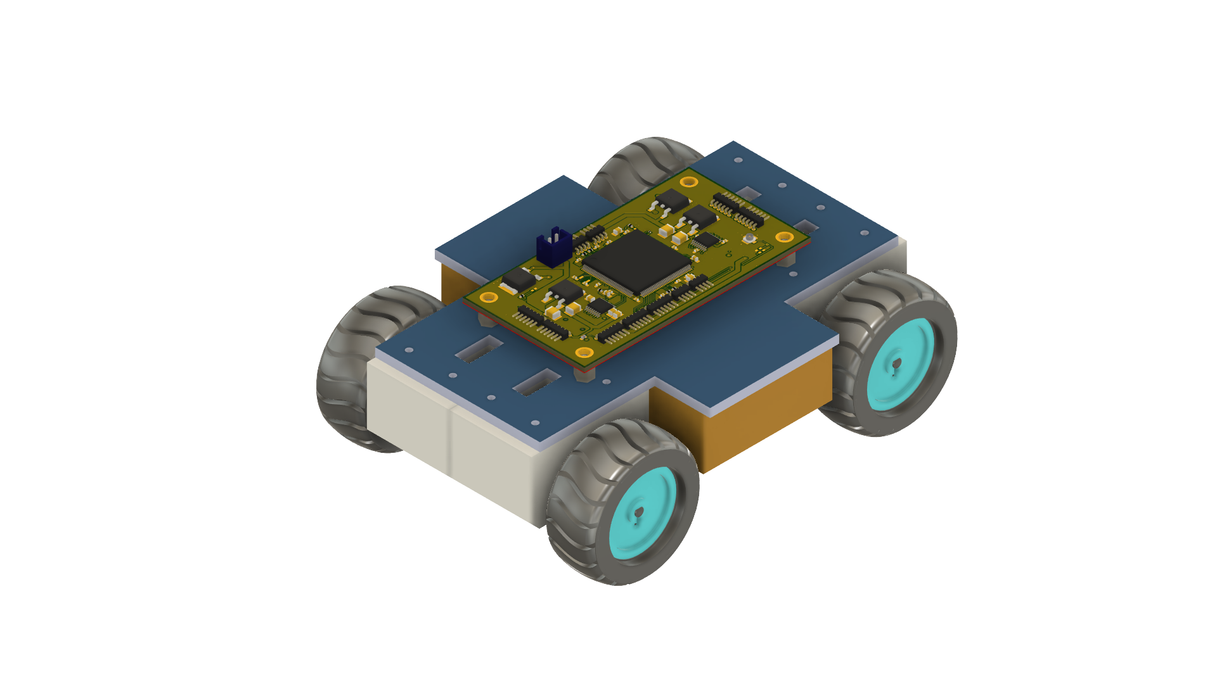



Autonomous Rover
“ The Processor on Wheels ”
Presented by Group 35:
Adriano Gussoni (Electrical eng.)
Brett Parker (computer eng.) – Team liaison
Michael Schumacher (Computer eng.) - Team representative
Group Advisor: Dr. Félix Soto Toro
Sponsored by:
Speaker: Michael Schumacher

Slide 2
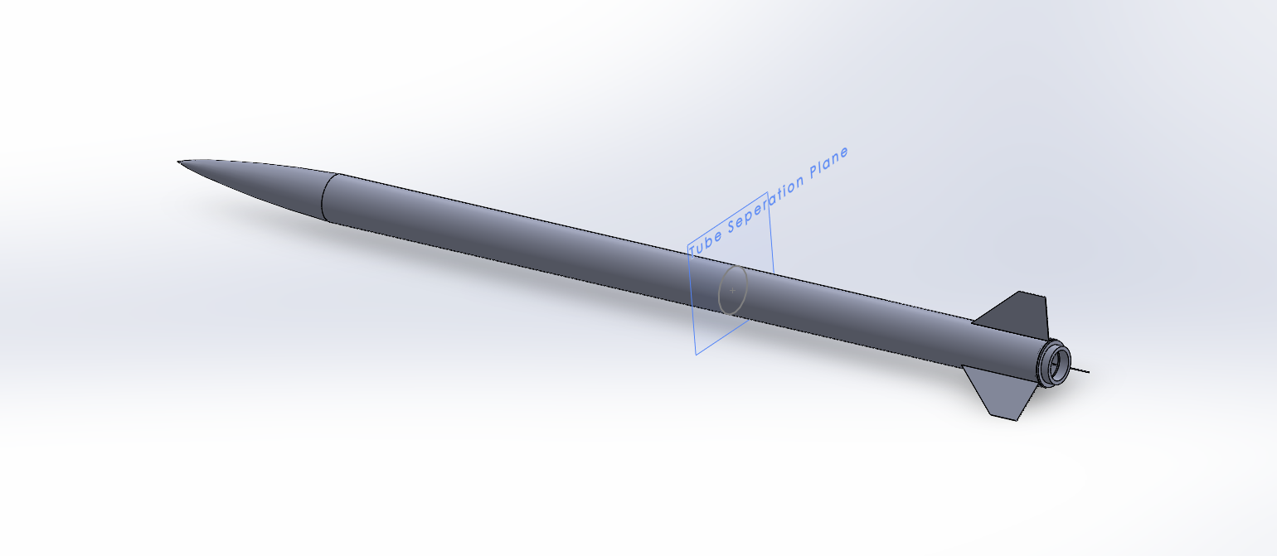
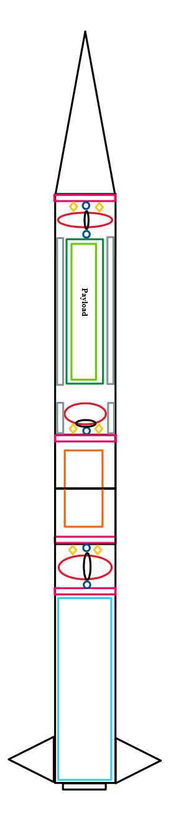
Project Description
Overview (FAR 1030)
High Powered Rocket(ry) [HPR]
10,000 ft and 30,000 ft competition
Rocket designed by UCF MAE Senior Design Group
UCF MAE Rocket entering competition – named ‘Arcturus’
FAR competition requires payload integration, 3 options:
Autonomous rover
Remote controlled rover
Drone or glider
Our team choose option 1
Requirements that apply to us
Rover must return autonomously to designated launch pad
Must transmit live video from payload touchdown
Other requirements that are decided by the rocket design team
Speaker: Michael Schumacher
Notes:
Our senior design project has the opportunity to take place in the FAR 1030 competition.
The mechanical, aerospace engineering senior design group; has designed a High powered rocket that will take place in the 10k competition
Our project is implemented as the autonomous rover in the required payload section for the FAR competition. Our main requirements are that the rover returns to the launch pad without human aid or interaction, and that live video must transmit from the time of payload touchdown to the successful return to the launch pad. Size and weight requerments were also put onto us by the UCF rocket design team

Slide 3
Project Description
Project Main Goals and Objectives
The goal of our project is to create a payload that follows the constraints given to us by the MAE team and FAR guidelines while also delivering a functional autonomous rover.
Goal: Low power usage / Maximum runtime:
Objective: Design the rover to save power where possible and choosing parts that min-max power usage.
Goal: Continuous Video Transmission:
Objective: Implement a standalone video transmission circuit capable of transmitting less than 1320 ft (~450 ft required).
Goal: Precision Motor Control:
Objective: Elimination potential error build up over time for drive systems by selecting motors with output shaft position feedback (encoders).
Speaker: Adriano Gussoni
Notes:
Obj/goals
In following the rocket team’s constraints and the competition guidelines, our main goals in designing an autonomous rover were
creating a system that could maximize the active runtime of rover
Implementing a video transmission system that has enough range to cover the possible distance from the rover to the receiver module
Finally, being able to precisely control the motors to ensure that the rover is moving as expected

Slide 4
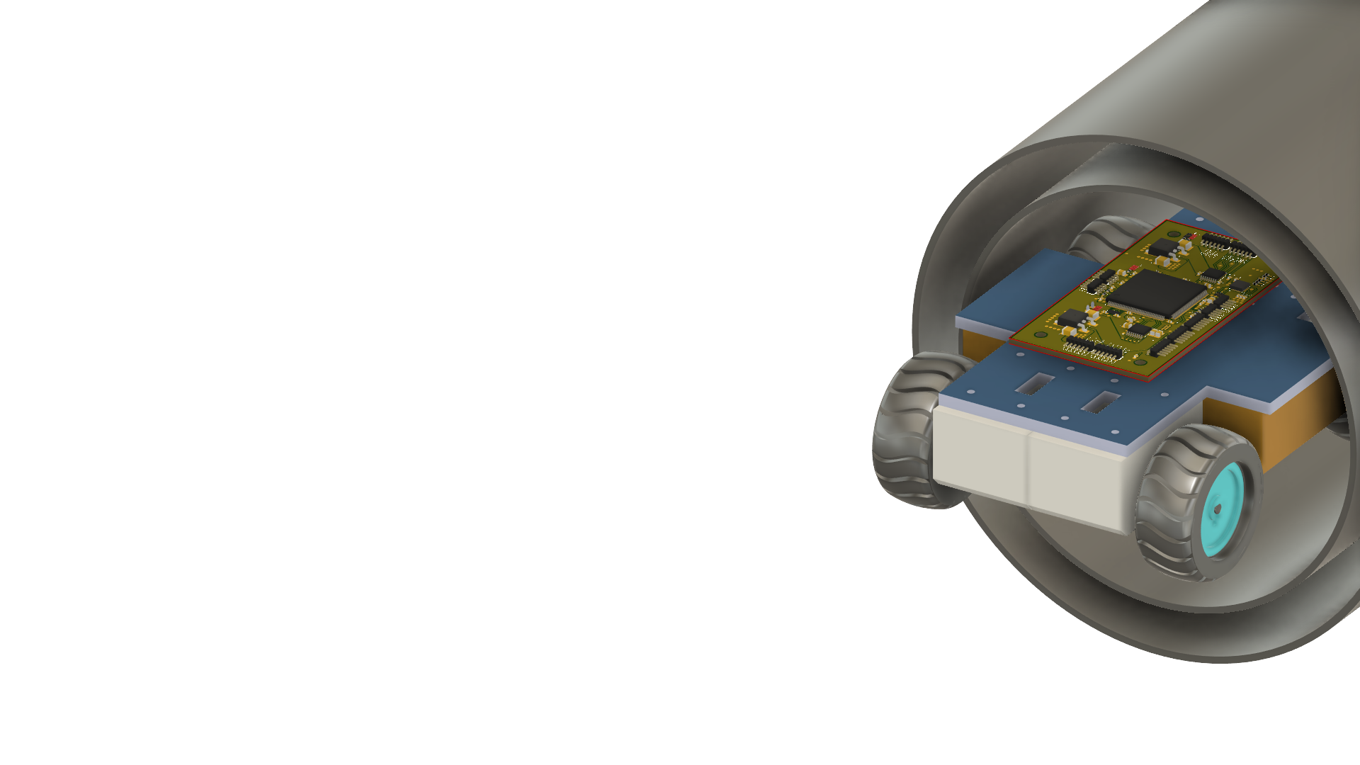
Engineering Requirements
Specifications and Requirements
Speaker: Michael Schumacher
Notes:
Reqs and specs misc

Slide 5
System Distribution by Member
Hardware, Integration, & Control Systems Lead – Michael Schumacher
Backup – Control Systems: Adriano Gussoni
Backup – Integration: Brett Parker
Software & Sensing Lead – Brett Parker
Backup – Michael Schumacher
Power & Thermal Lead – Adriano Gussoni
Backup – Michael Schumacher
Speaker: Michael Schumacher

Slide 6
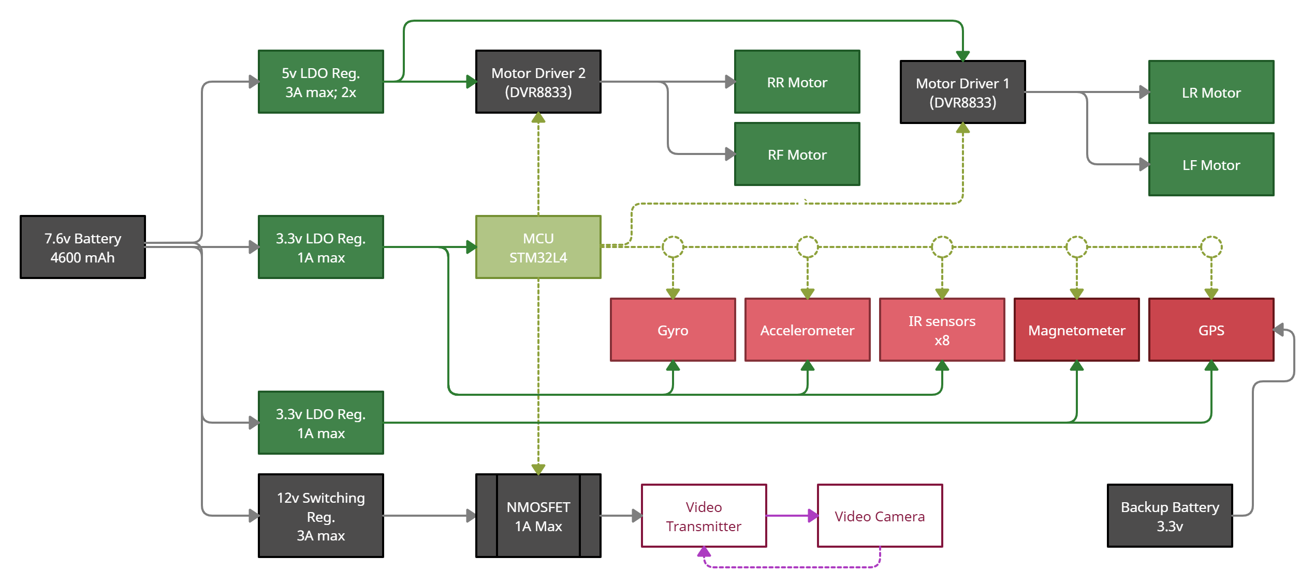
Hardware Block Level Overview
+5v
PWM
PWM
Control
Logic
Control Logic
I2C Data
+3v3
Digital
Switch
+1v5
+3v3
+12v
8.4v-7.6v
+5v
* Design has updated since Senior Design 1
Speaker: Michael Schumacher

Slide 7
Design Constraints
Economic:
Limited out of pocket expenses,
Thankful for our sponsor: Aerojet Rocketdyne, Coleman Aerospace
Environmental:
“No part left behind” – All parts will be recovered, No launch site pollution
Launch Site is in the desert. Build location and testing in humid Florida.
Health and Safety:
We have 2 main constraints for heath and safety.
In case of emergency, Logic loop detected autonomous shutdown
IR sensor placement – Minimize possible eye damage at all cost
Manufacturability and Sustainability:
Global IC shortage
JLC PCB does not support Blind or Buried Vias.
JLC PCB does not support fine trace sizes to accommodate WFBGA chips.
Speaker: Adriano Gussoni
Notes:
Some of our design constraints are
Financial – our sponsors gave us a budget of 500 dollars and anything else is out of pocket from us group members
Environmental – we need a design that is full self contained or recoverable as to not leave any parts out on the field.
Our design also needs to be able to function under the weather conditions of the desert launch site

Slide 8




Standards
Software:
(ISO/ IEC 9899): - C Programming
(IEEE 29119) : - Software Testing
(De Facto): - NTSC / PAL
(IEEE 754) : - Floating Point Arithmetic
(De Facto): - ASCII
Hardware:
(IEEE 149): - Antenna Distances
(IPC 2221): - PCB design
(IEEE 2700): - Sensor Performance
(ICECCPCE 6998764): - IR Sensor and Camera-Based Monitoring Systems
(IEEE 1625): - Rechargeable Batteries
Miscellaneous:
(De Facto): - SPI / I2C
(IPC 7801): - Reflow Oven Process Control
(IEE 188881): - IT Green Community Management
(Government): - RoHS Compliance
Speaker: Adriano Gussoni

Slide 9
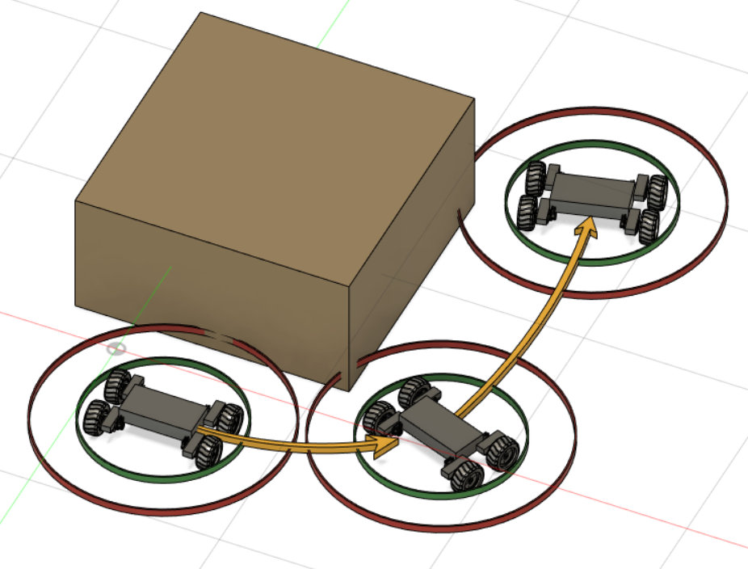
Significant Project Decisions TECHNOLOGIES
Object detection
We decided to create our own object avoidance algorithm for the project. There was two main reasons for this.
For the rover to feel like our own
Light-weight algorithm in terms of processor and memory
Scalable, not dependent on rover size
* Sensing ring distances and rover size not to scale
Speaker: Brett Parker
Notes:
Design Decisions

Slide 10
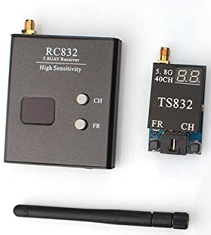
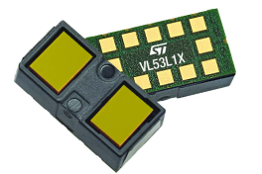
Significant Project Decisions TECHNOLOGIES
Live video
Range of transmission
Power consumption
Size
IR sensors
Size
Accuracy
Flexibility
Speaker: Brett Parker
Notes:
Bullets not paragraphs
Component Decisions

Slide 11
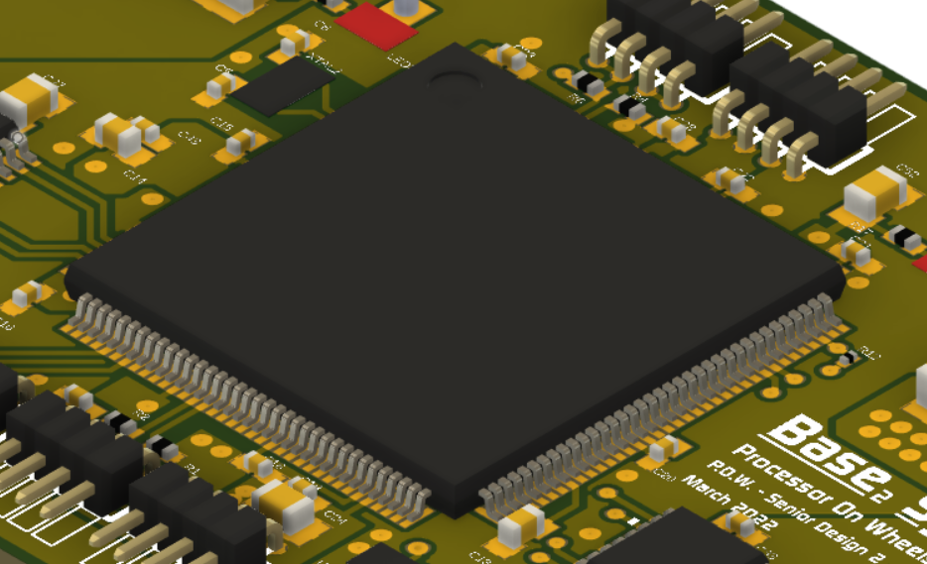
Part Selection – CPU
Microcontroller - STM32L4S9ZIT6
ARM Based Processor – 32-bit Cortex M4 series
144 LQFP package
16 timers
2 MB program size
120 MHz Clock
Why this processor?
Original MCU did not have enough PWM lines (Cortex M0)
The follow up, 100 LQPF Cortex M4 ran out of stock
This processor was next in line. Also had enough pins to add on components if needed.
Anything can happen. The more options available results in increased flexibility
Speaker: Michael Schumacher

Slide 12
Part Selection – Video TX/RX System
Video Transmitter
Speaker: Michael Schumacher

Slide 13
Part Selection – Video TX/RX System
Video Transmitter
Speaker: Michael Schumacher

Slide 14
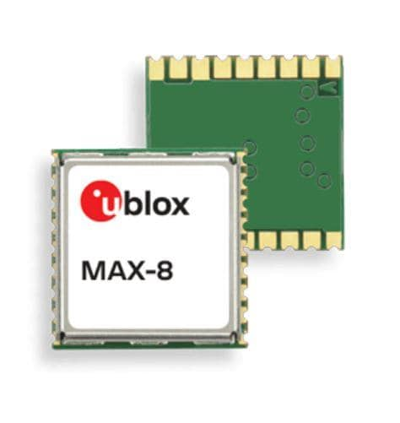
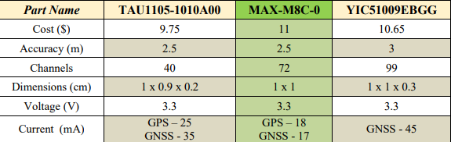
Part Selection – Orientation Sensors (GPS)
GPS – Passive gain layout
Connects via I2C
Available as base chip
Speaker: Brett Parker

Slide 15
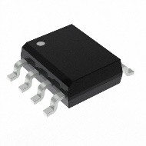
Part Selection – Orientation Sensors (IMU)
Magnetometer
Part # MLX90395KDC
SOIC-8 package
“The digital compass”
Hall effect sensing
Speaker: Brett Parker
Notes:
Accelerometer- speed
Gyroscope – rotation
Magnetometer – direction
Looked for parts that connected via i2c and all components are 3axis components
Not sure how well this will work so we worked in the option to use a off the shelf module if we can't get the IMU working

Slide 16
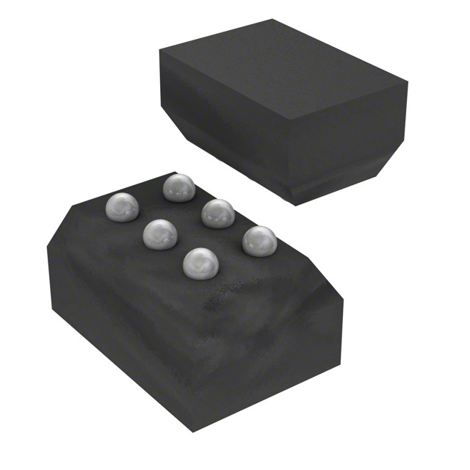
Part Selection – Orientation Sensors (IMU)
Accelerometer
Part # MXC4005XC
6-TFBGA package
3-axis
X, Y, Z acceleration sensing
Speaker: Brett Parker
Notes:
Accelerometer- speed
Gyroscope – rotation
Magnetometer – direction
Looked for parts that connected via i2c and all components are 3axis components
Not sure how well this will work so we worked in the option to use a off the shelf module if we can't get the IMU working

Slide 17
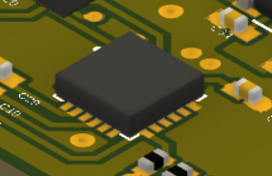
Part Selection – Orientation Sensors (IMU)
Gyroscope
Part # MPU-3050
24-VFQFN package
3-axis
Pitch, Roll, Yaw sensing
Speaker: Brett Parker
Notes:
Accelerometer- speed
Gyroscope – rotation
Magnetometer – direction
Looked for parts that connected via i2c and all components are 3axis components
Not sure how well this will work so we worked in the option to use a off the shelf module if we can't get the IMU working

Slide 18
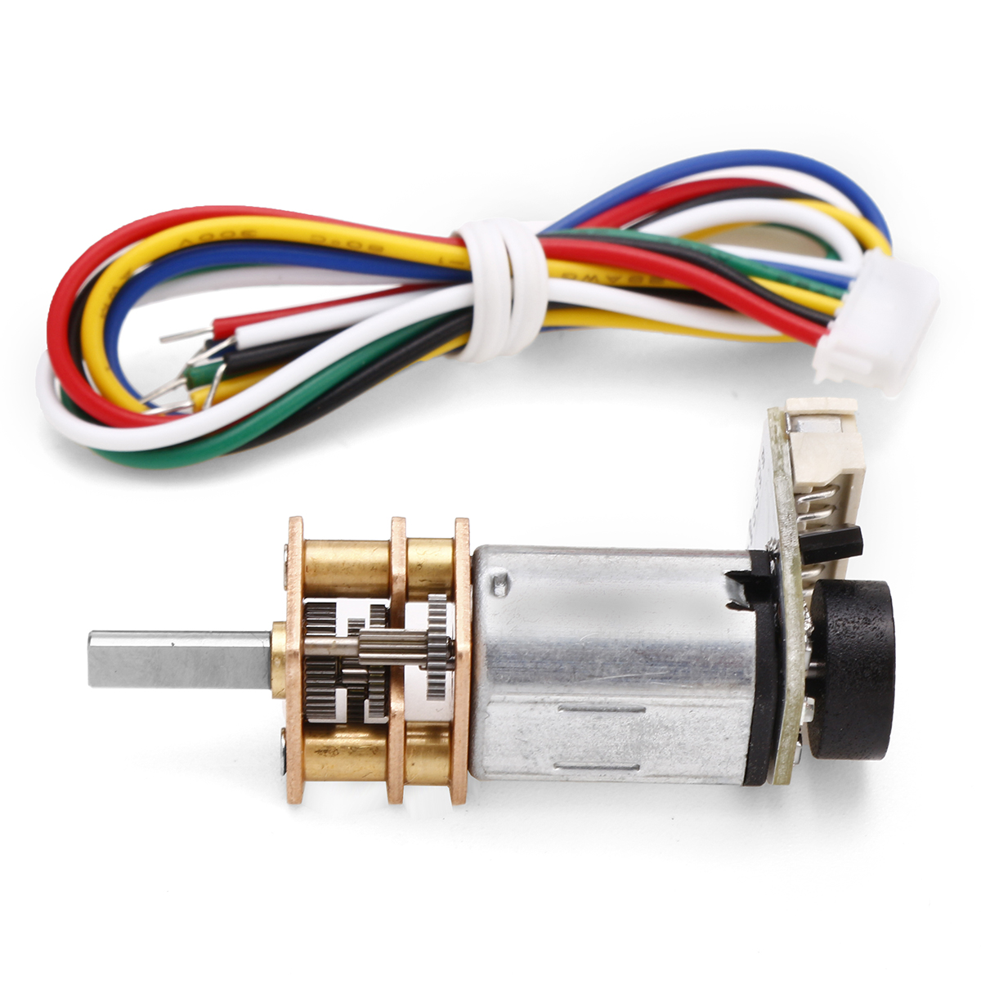
Part Selection – Drive System
N20 Micro Metal Gear Motor (x4)
One of the smallest EM motors on the market
High torque
Low stall current
Low no load current
Optimal drive current subject to rover mass
Optional encoders on drive shaft
Speaker: Adriano Gussoni
Notes:
Our motors of choice are the N20 Micro metal gear motors which are one of the smallest motors available
They have support for an encoder module which aids in our motor precision specification and a fairly small current at just under half an amp each when running at maximum efficiency
Using 4 of the motors in an AWD configuration should give us enough torque move the rover assuming it weighs around 1kg
The motor drivers we chose are the DRV8833 which were our second choice as our original choice, the DRV8835 ran out of stock starting our second semester
Each driver supports 2 DC motors and we implemented 2 driver chips to cover all 4 wheels.
The drivers provide enough current draw to run both motors with some overhead incase the rover needs extra torque

Slide 19
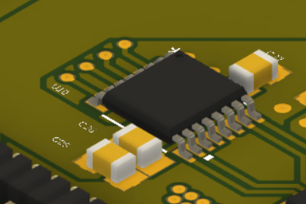
Part Selection – Drive System
Motor Driver (x2)
Part # DRV8833
Dual H-Bridge Motor Driver
1.5 Amp max (2 channels)
Supports PWM
Two modes – Fast decay & Slow decay
Speaker: Adriano Gussoni
Notes:
Our motors of choice are the N20 Micro metal gear motors which are one of the smallest motors available
They have support for an encoder module which aids in our motor precision specification and a fairly small current at just under half an amp each when running at maximum efficiency
Using 4 of the motors in an AWD configuration should give us enough torque move the rover assuming it weighs around 1kg
The motor drivers we chose are the DRV8833 which were our second choice as our original choice, the DRV8835 ran out of stock starting our second semester
Each driver supports 2 DC motors and we implemented 2 driver chips to cover all 4 wheels.
The drivers provide enough current draw to run both motors with some overhead incase the rover needs extra torque

Slide 20
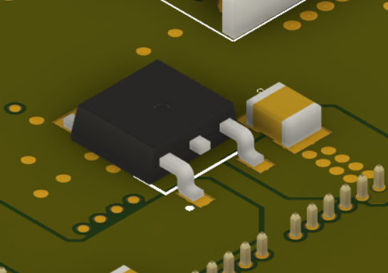
Part Selection – Power System
3.3v Regulator (x2)
Part # LP38690DT-3.3
1 Amp maximum
Small package (TO-252-3)
1 Independent – MCU / IR sensor bank 1
1 Independent – Orientation / IR sensor bank 2
Speaker: Adriano Gussoni
Notes:
To ensure our board had consistent power, we had to implement 3.3v and 5v regulators.
The 3.3V regulator has a maximum of 1 amp current draw.
We implemented 2 of these regulators,
1 dedicated for the MCU and half of the IR sensors and another for the IMU and second half of the sensors
The 5 volt regulators have a maximum current draw of 1.5 A each which is enough to cover 1 motor driver.
So each motor driver has dedicated voltage regulator in case they both need overhead power draw
And we use a third voltage regulator for any other IC’s or GPIO out pins that would need that 5V.

Slide 21
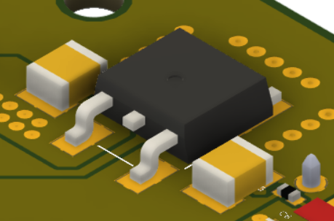
Part Selection – Power System
5v Regulator (x3)
Part # LD29150DT50R
1.5 Amp maximum
Small package (TO-252-3)
2 Independent for motor drivers
1 independent 5v GPIO out
Speaker: Adriano Gussoni
Notes:
To ensure our board had consistent power, we had to implement 3.3v and 5v regulators.
The 3.3V regulator has a maximum of 1 amp current draw.
We implemented 2 of these regulators,
1 dedicated for the MCU and half of the IR sensors and another for the IMU and second half of the sensors
The 5 volt regulators have a maximum current draw of 1.5 A each which is enough to cover 1 motor driver.
So each motor driver has dedicated voltage regulator in case they both need overhead power draw
And we use a third voltage regulator for any other IC’s or GPIO out pins that would need that 5V.

Slide 22
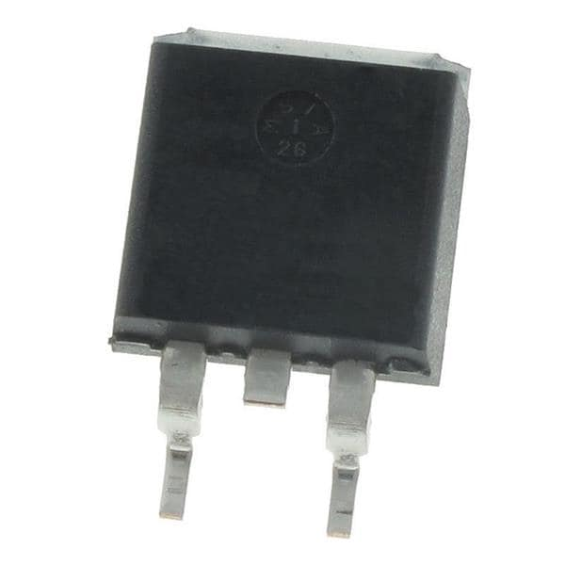
Part Selection – Power System
N-MOSFET (RF switch)
Part#: IPB65R230CFD7
4V Gate-Source Threshold
>1A Continuous Current
Small package (TO-263-3)
Used to cut video feed during launch
Speaker: Adriano Gussoni
Notes:
We use a NMOS transistor as a switch from the battery power to the video transmission system.
It is controlled by the MCU so we can tell it when to turn on to start transmitting our video feed.
We needed a FET that could draw at least 1A of current to power the transmission module.
Finally, our battery of choice was the ProTek RC Si-Graphene LiPo battery with a capacity of 4600mAh at 7.6V nominal
This battery back is high voltage which means it can be charged to 8.7V but we will keep it at a standard 8.4V giving us 4000mAh capacity.
We chose this battery because it was one of the smallest packages we could find while also being incredibly light due to its highly energy dense si-graphene battery technology.

Slide 23
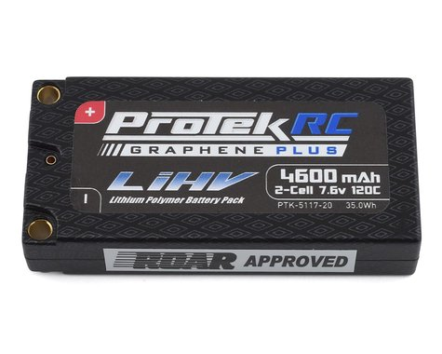
Part Selection – Power System
Battery
Part: ProTek RC 2S 120C
7.6v nominal
4600 mAh capacity (supports >30 min uptime)
LiPo (Si-Graphene)
Small battery package (high energy density)
Speaker: Adriano Gussoni
Notes:
We use a NMOS transistor as a switch from the battery power to the video transmission system.
It is controlled by the MCU so we can tell it when to turn on to start transmitting our video feed.
We needed a FET that could draw at least 1A of current to power the transmission module.
Finally, our battery of choice was the ProTek RC Si-Graphene LiPo battery with a capacity of 4600mAh at 7.6V nominal
This battery back is high voltage which means it can be charged to 8.7V but we will keep it at a standard 8.4V giving us 4000mAh capacity.
We chose this battery because it was one of the smallest packages we could find while also being incredibly light due to its highly energy dense si-graphene battery technology.

Slide 24
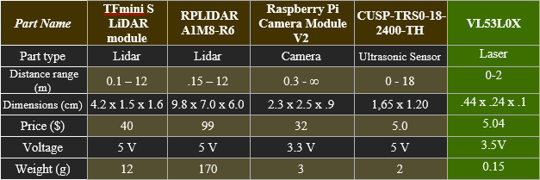
Part Selection – Obstacle Avoidance
IR Sensor (x8)
Key attributes:
Small as possible
Range >= 0.6m ~2ft
Reliable outside
Speaker: Brett Parker

Slide 25
PCB DESIGN

Slide 26
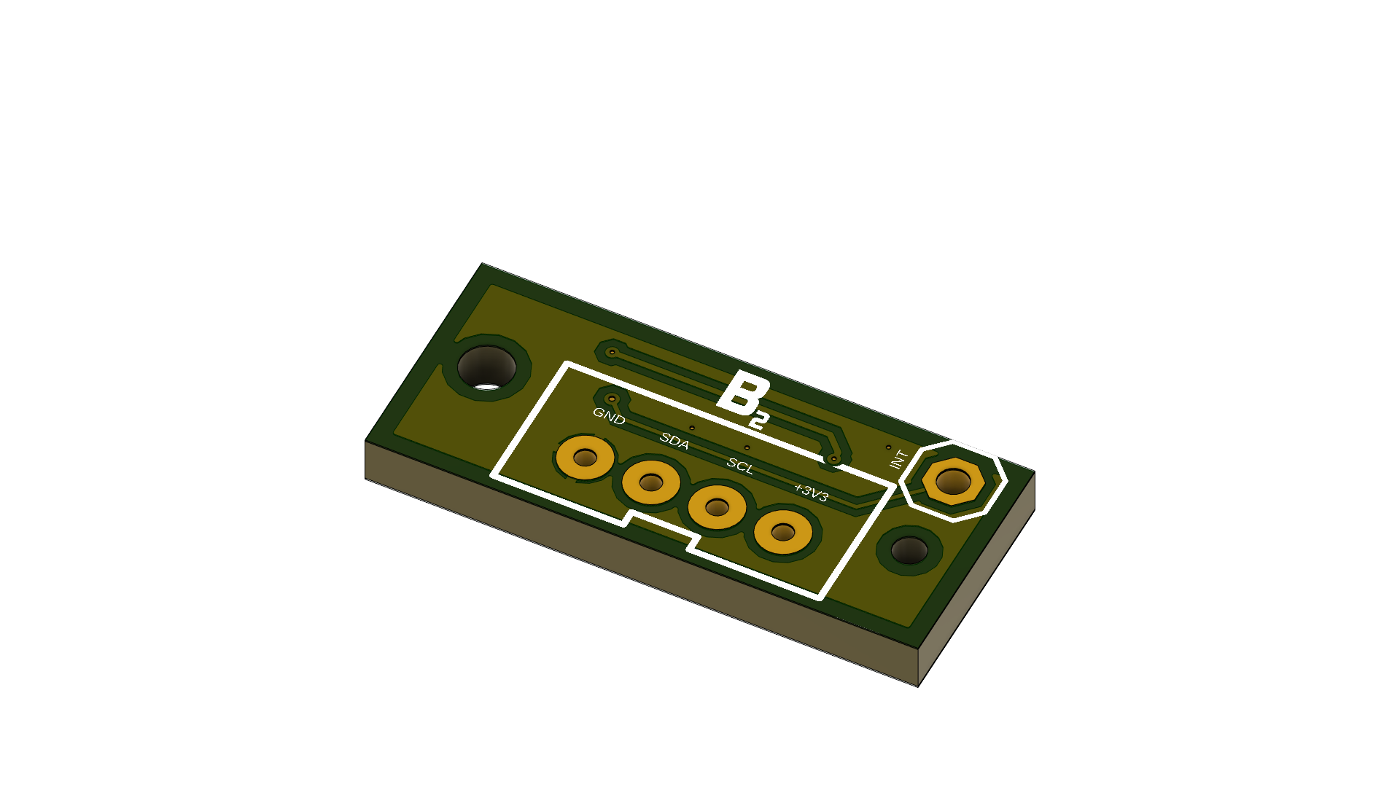
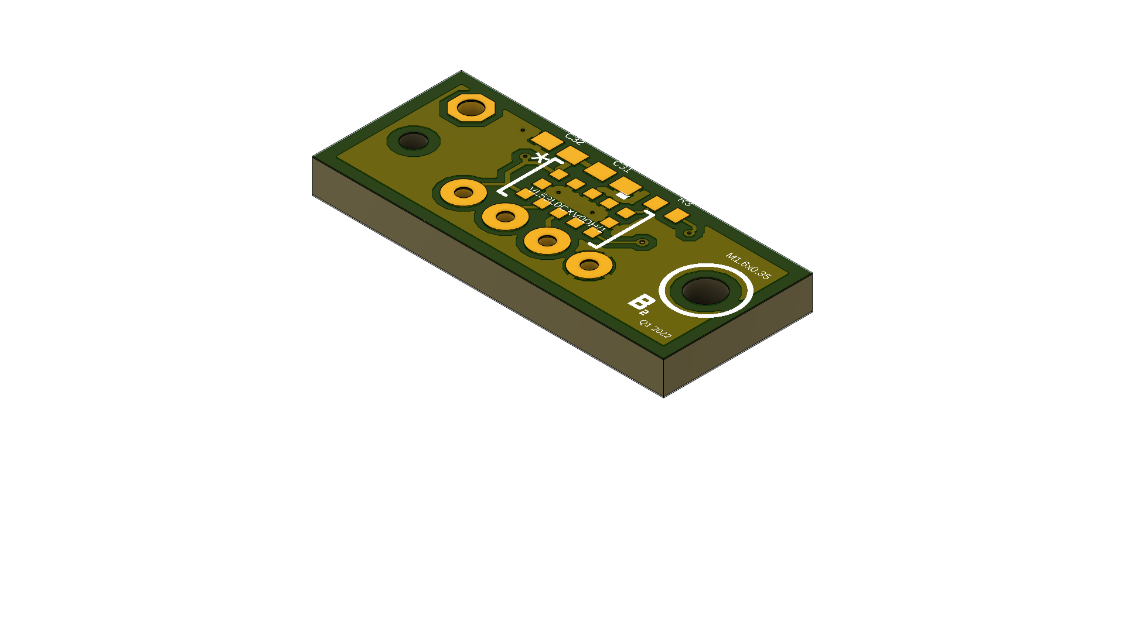
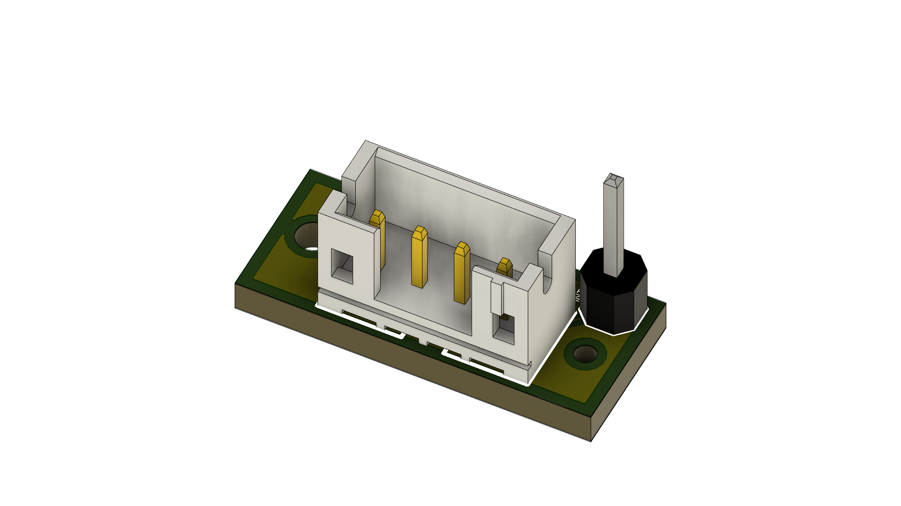
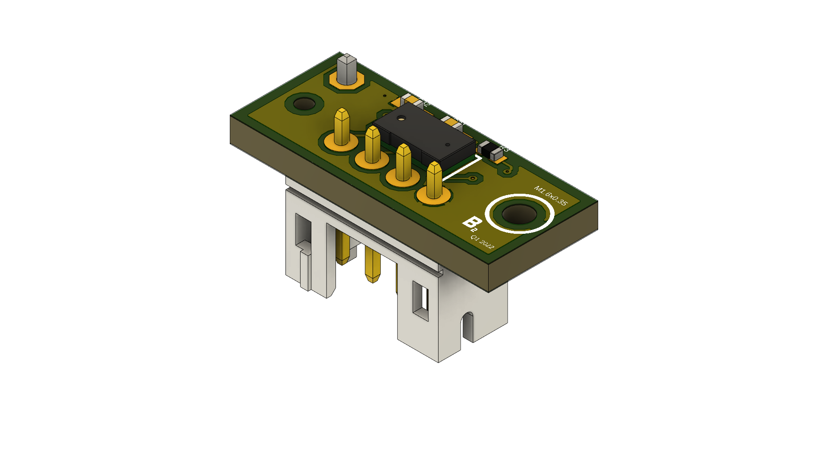
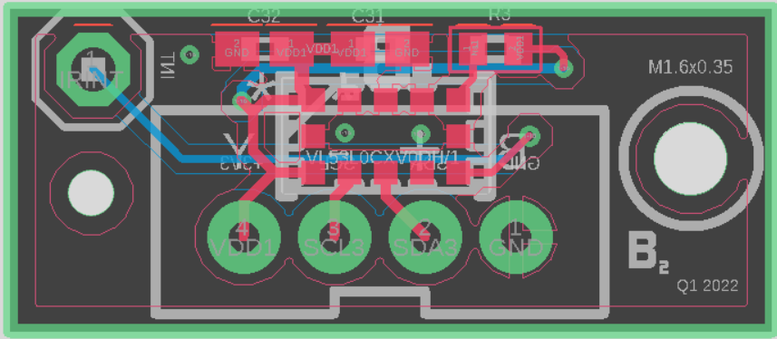
IR Sensor Board Layout
IR Board Overall Features
2-layer PCB
0.66-inch length
0.27-inch depth
6 Elements
4 Elements on the top
2 Elements on the bottom
GPIO uses JST 4 pin 2.54 pitch header
Optional single pin for interrupt
* Ground planes not shown
Speaker: Michael Schumacher
Notes:
15

Slide 27
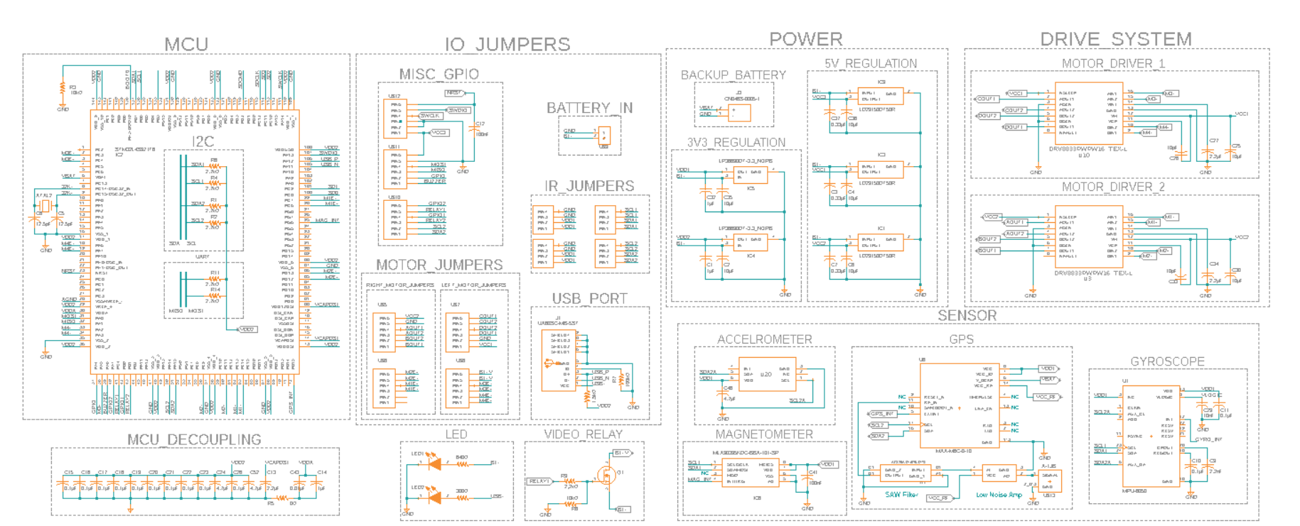
Main Board Schematic
* Design has updated since Senior Design 1
Speaker: Michael Schumacher
Notes:
15 seconds

Slide 28
Main Board Schematic
* Design has updated since Senior Design 1
Speaker: Michael Schumacher
Notes:
15 seconds

Slide 29
Main Board Schematic
* Design has updated since Senior Design 1
Speaker: Michael Schumacher
Notes:
15 seconds

Slide 30
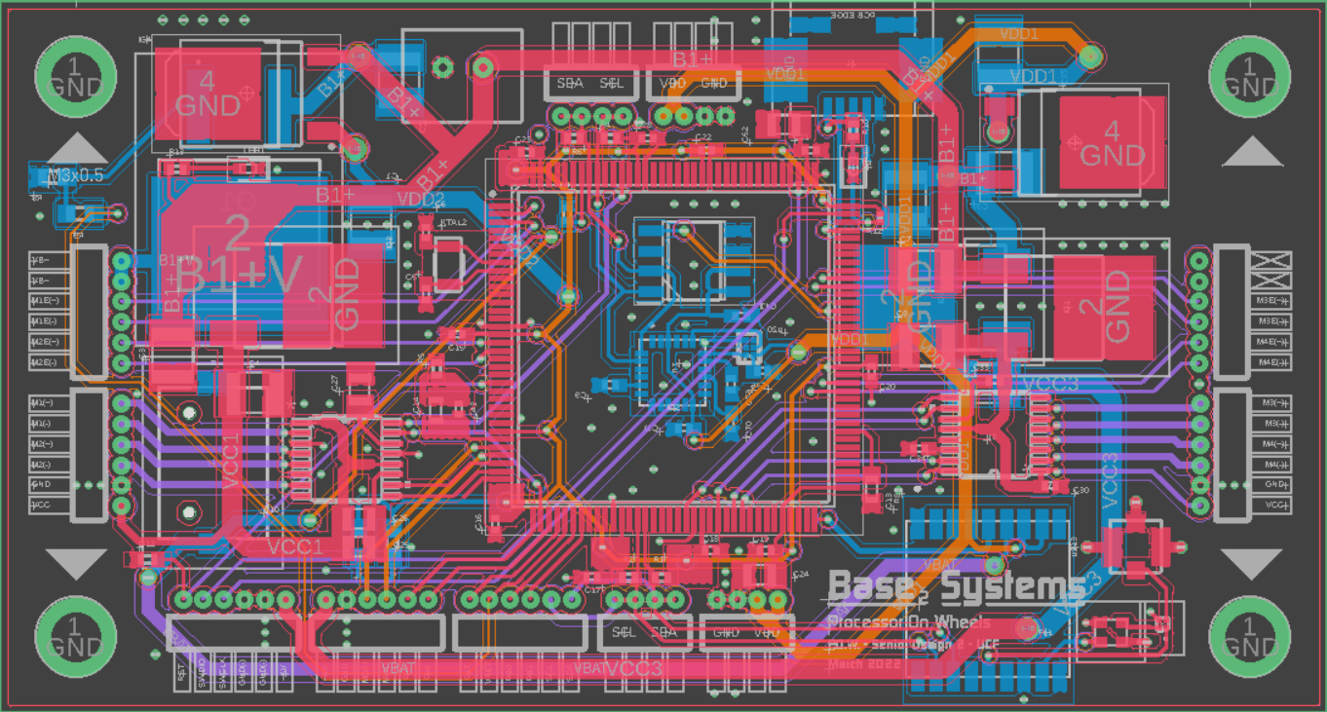
Main Board Layout
* Ground planes not shown
Speaker: Michael Schumacher
Notes:
Pictured below is the board layout for the main control board. More information about the main PCB is on the following slide. Please pause the presentation if you need more time to analize the layout

Slide 31
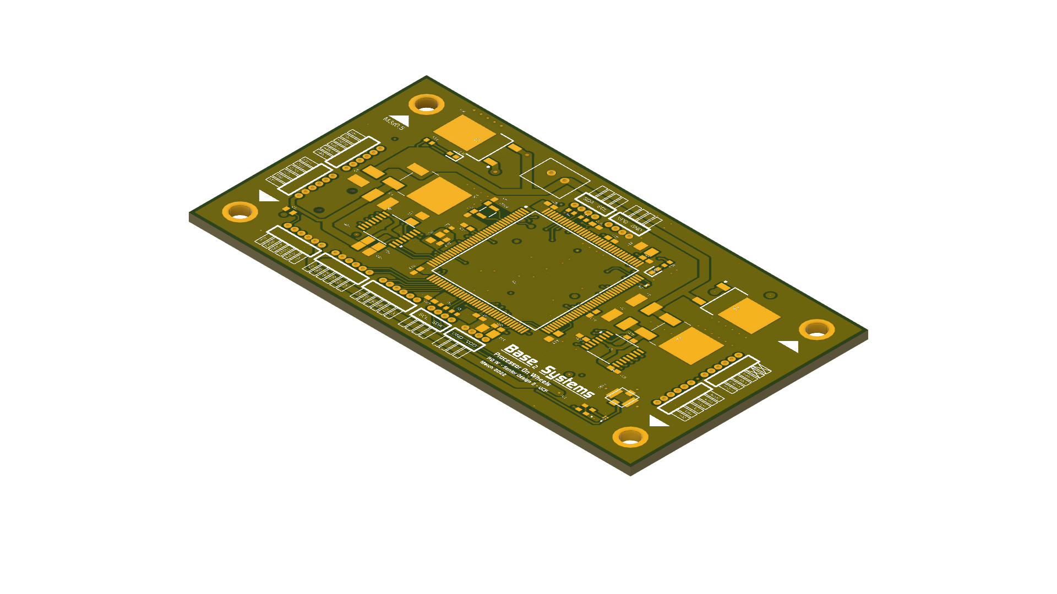
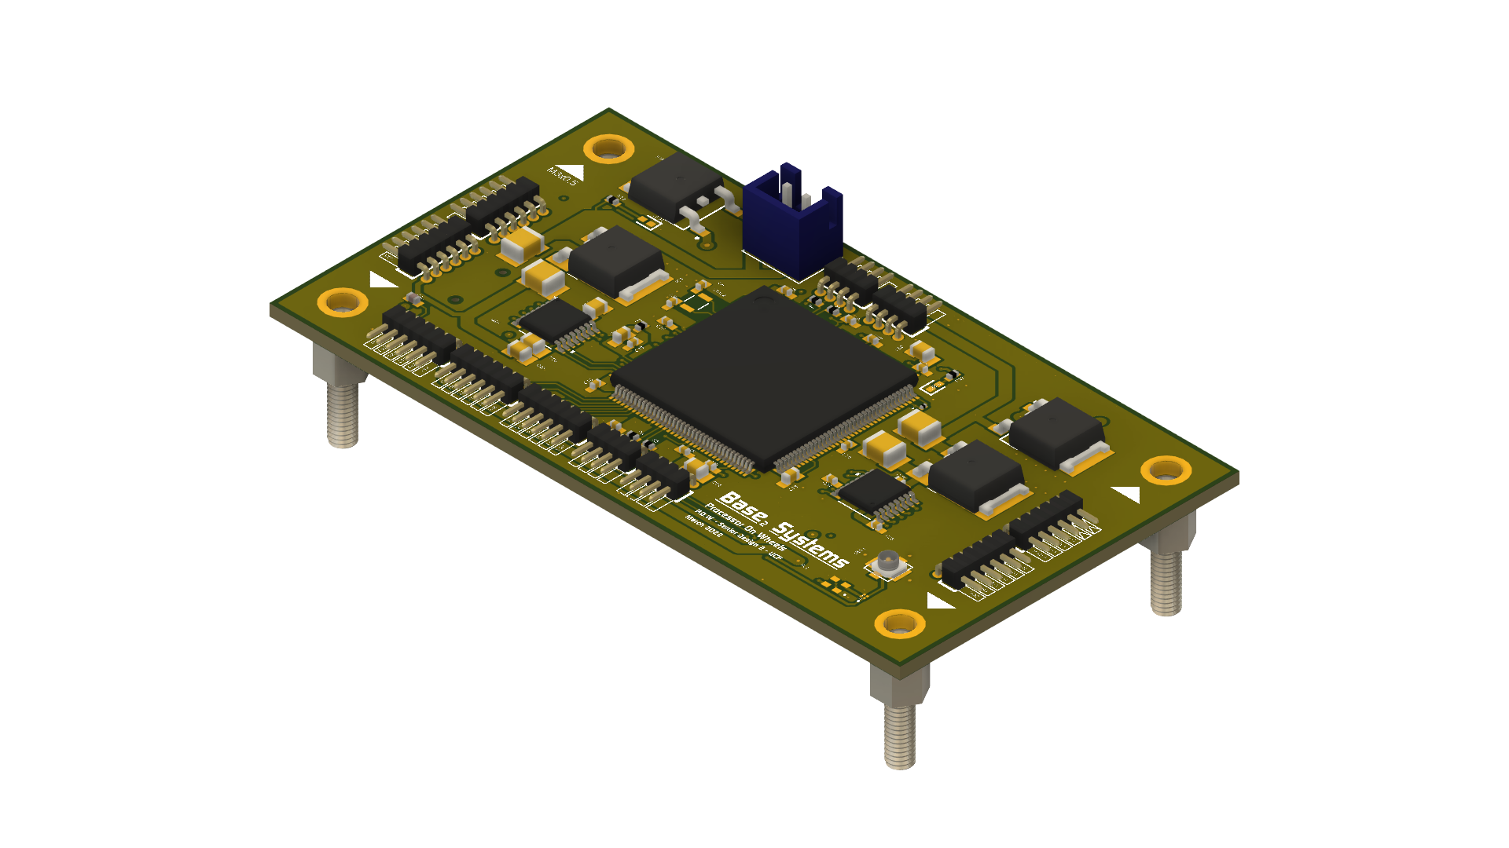
Main Board Layout
PCB Overall Features
4-layer PCB
3.622-inch length
2.182-inch depth
87 Elements
61 Elements on the top
GPIO uses 1.0 pitch solder cups
Speaker: Michael Schumacher
Notes:
15

Slide 32
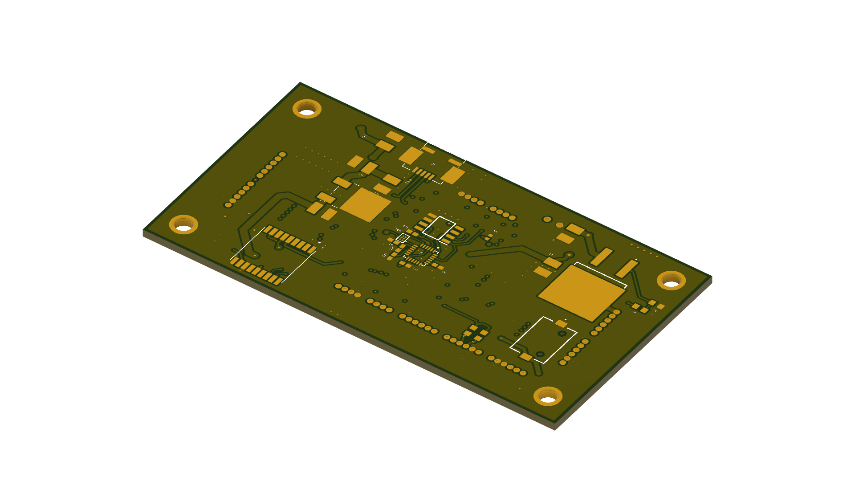
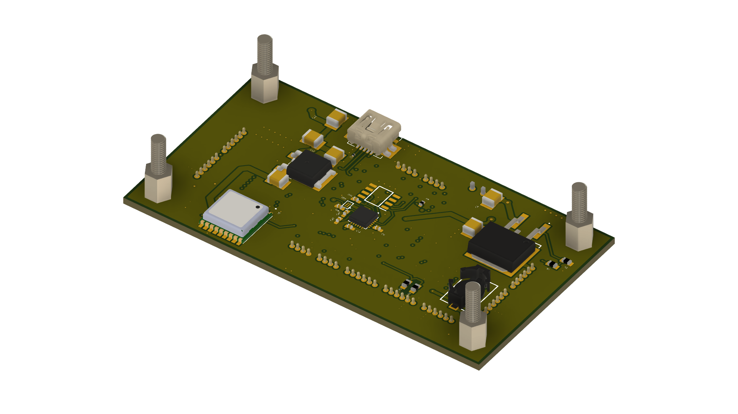
Main Board Layout
PCB bottom side
26 Elements on the bottom
IMU sensors mounted in the middle
Features 377, 1.5v backup battery for the GPS
Speaker: Michael Schumacher
Notes:
15

Slide 33
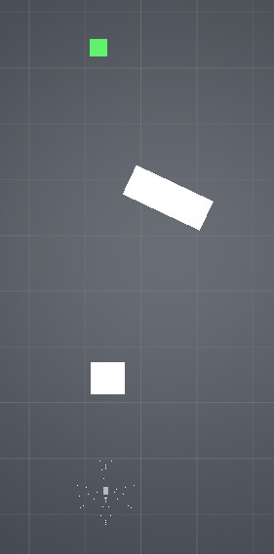
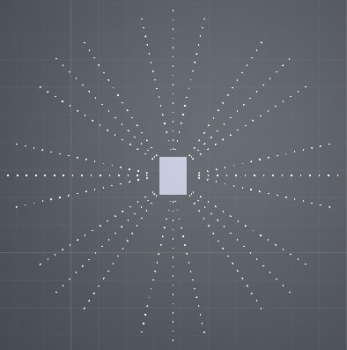
Simulation Explanation
View of the IR sensors
View of the simulation field
Speaker: Brett Parker

Slide 34
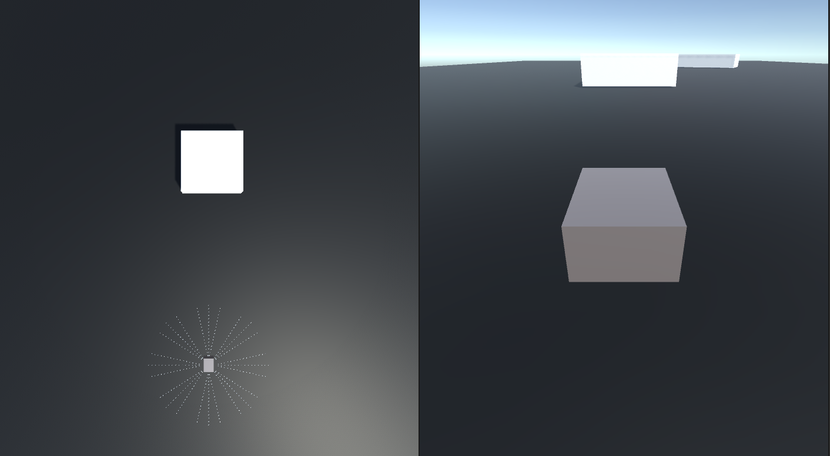
Simulation View
Speaker: Brett Parker

Slide 35
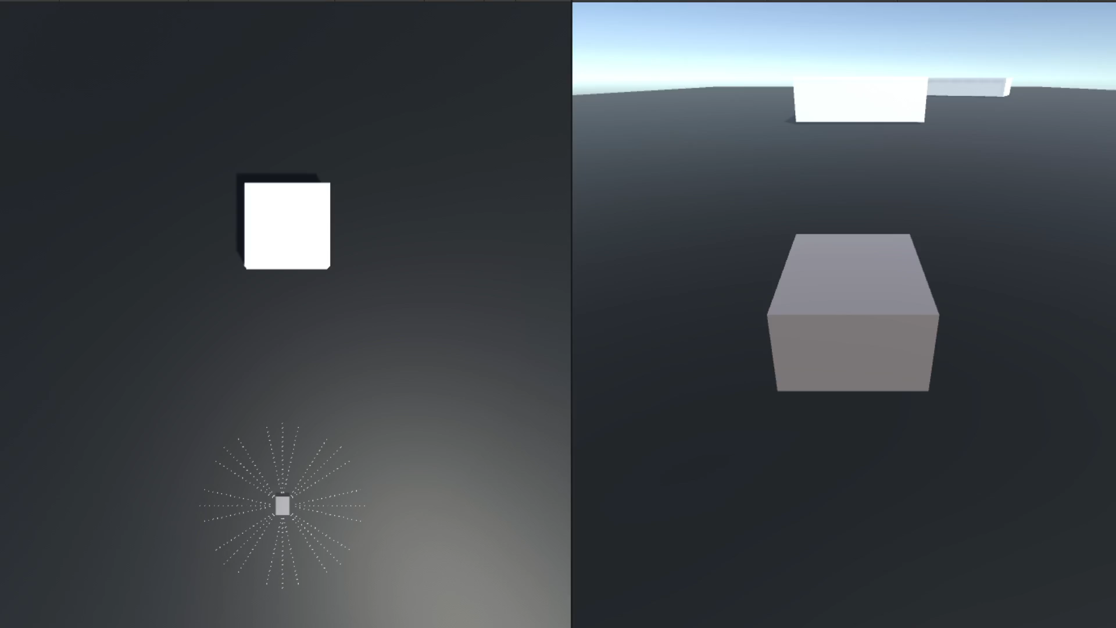
Object Detection Simulation
Speaker: Brett Parker

Slide 36
Project Devoted Budget
Project original estimate / distribution
Processing / PCB Fabrication | Up to $ 60
Video System | $ 50-100
Power System | ~$ 80
Sensing | $ 70
Drive System | ~$ 90
Frame / Structural | 50
TOTAL | $ 450
Less sponsor contribution | -$ 500
Rover team total | $0
Speaker: Michael Schumacher
Notes:
Our project original budget distribution and be placed into two main categories: Electrical and drive systems; and structural and frame. About 550 dollars was distributed for the electrical portion of our rover for a fully capable project about 200 dollars was distributed to ensure the rover be mechanically sound during its journey currently. We a underbudger with a combined total of roughly 400 dollars spent thus far. We anticipate to spend another 100 dollars in the competeion of this project

Slide 37
Bill of Materials
Bill of materials per project system
Processing
PCB Fabrication
Video System
Power System
Sensing
Drive System
Frame / Structural
TOTAL | $392.85
Less sponsor contribution | -$500.00
Rover team total
Speaker: Michael Schumacher
Notes:
15

Slide 38
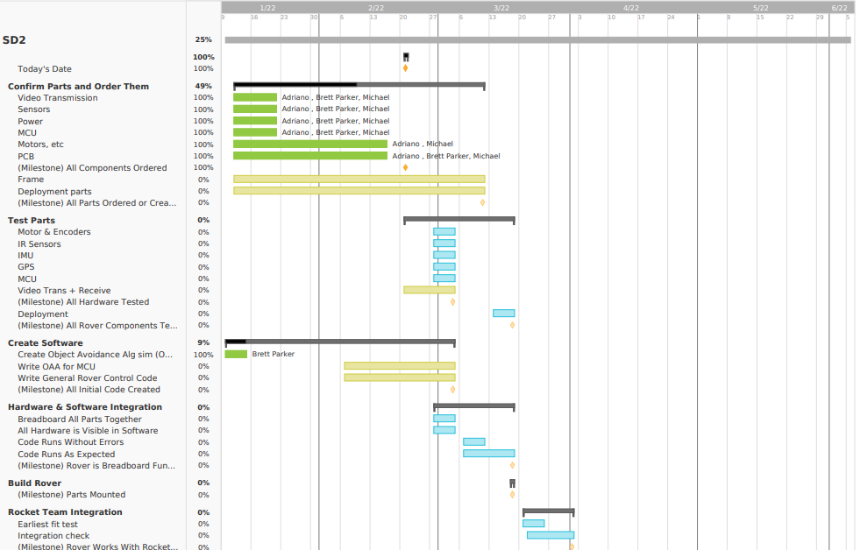
Administrative – Gantt Chart
Green- Completed
Yellow- Started
Blue - Yet to Start
Speaker: Adriano Gussoni
Notes:
discuss the group's immediate plans for the successful completion of the project
With our PCB design completed, all our needed components for testing have been submitted for ordering.
In the coming weeks, as we get the last of purchases, we will be testing our components and working to implement and integrate them.
Near the end of march, we want to have a functioning physical prototype for interfacing with the rocket teams payload deployment.

Slide 39
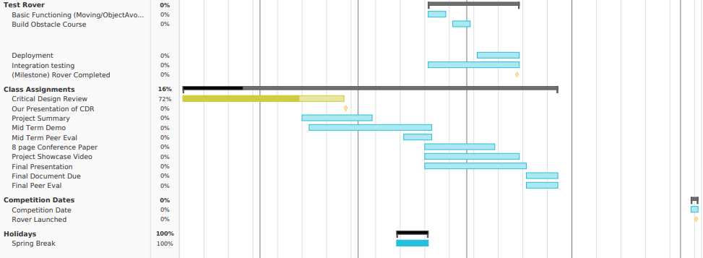
Administrative – Gantt Chart Continued
Green- Completed
Yellow- Started
Blue - Yet to Start
Speaker: Adriano Gussoni
Notes:
15
The plan for the rocket teams testing is to have test launches with the integrated payload by early April.
We will meet with rocket team from around mid march to mid april to test our deployment from the rocket and our rover’s performance after deployment.
The final competition date starts June 4th.

Slide 40
Administrative – Current Progress
Speaker: Adriano Gussoni
Notes:
clear statement of current progress made by the group (% done by category)
Our current progress is sitting at around 53% with all our research and design being completed.
We have purchased nearly everything we need, but we can start testing as soon as we get the rest of our components.
Within the next weeks we’ll make significant progress to our hardware and software testing and reach integration testing.

Slide 41
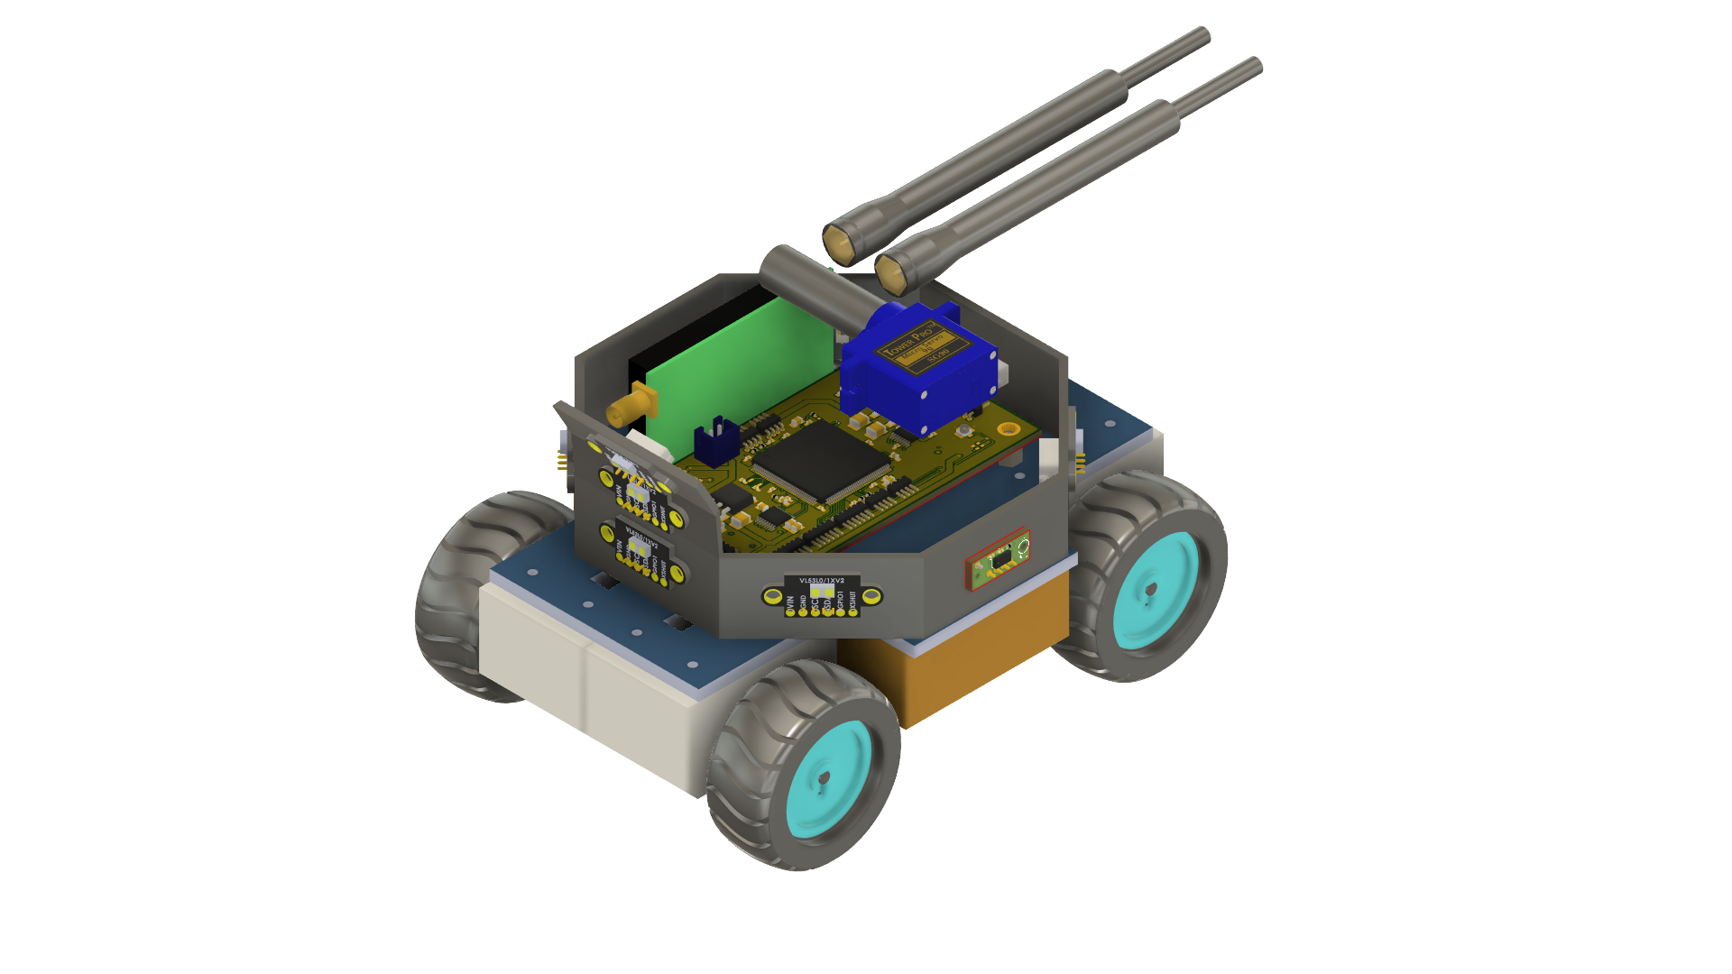

The end GROUP 35
“It is a great profession. There is the satisfaction of watching a figment of the imagination emerge through the aid of science to a plan on paper. Then it moves to realization in stone or metal or energy. Then it brings jobs and homes to men. Then it elevates the standards of living and adds to the comforts of life. That is the engineer's high privilege.”
- Herbert Hoover
Adriano Gussoni
Michael Schumacher
Brett Parker

