Slide 1
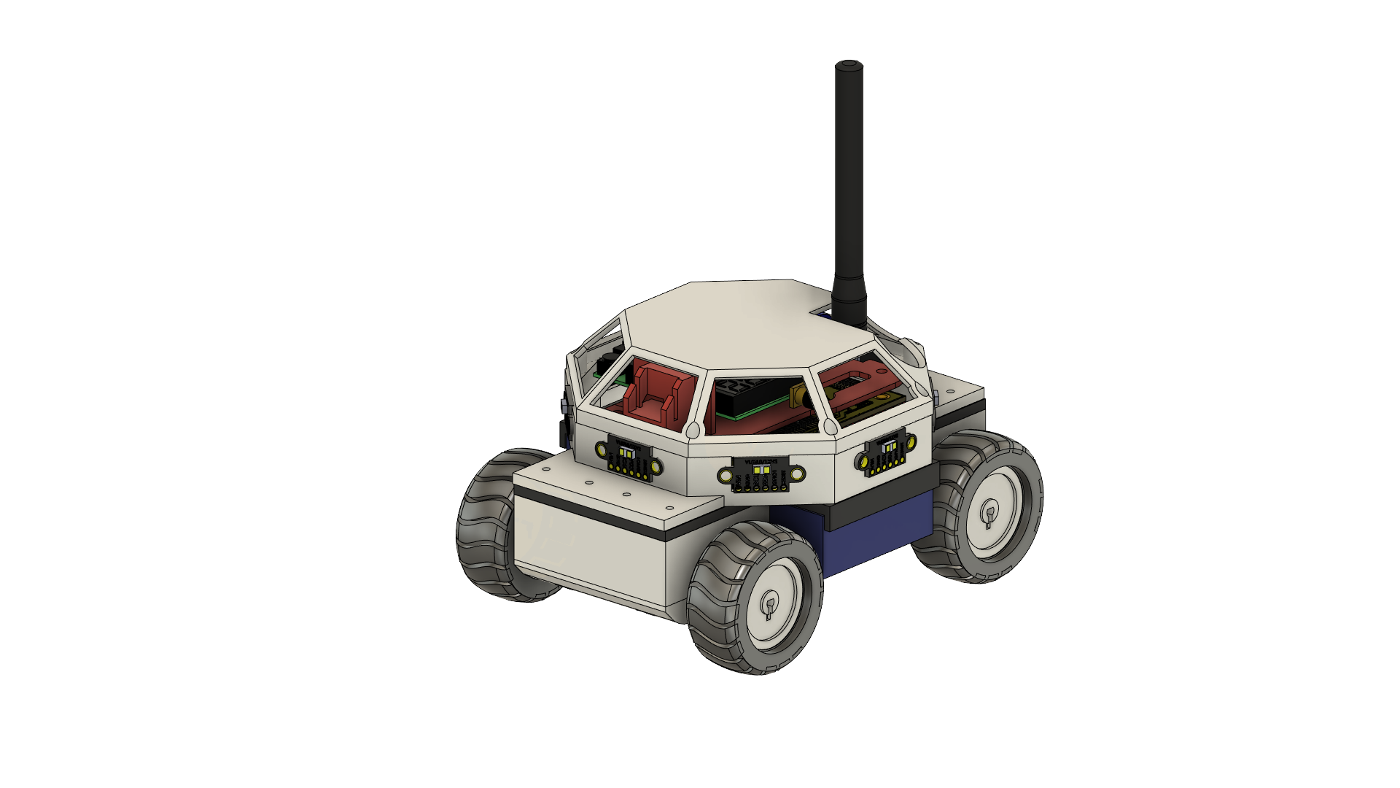
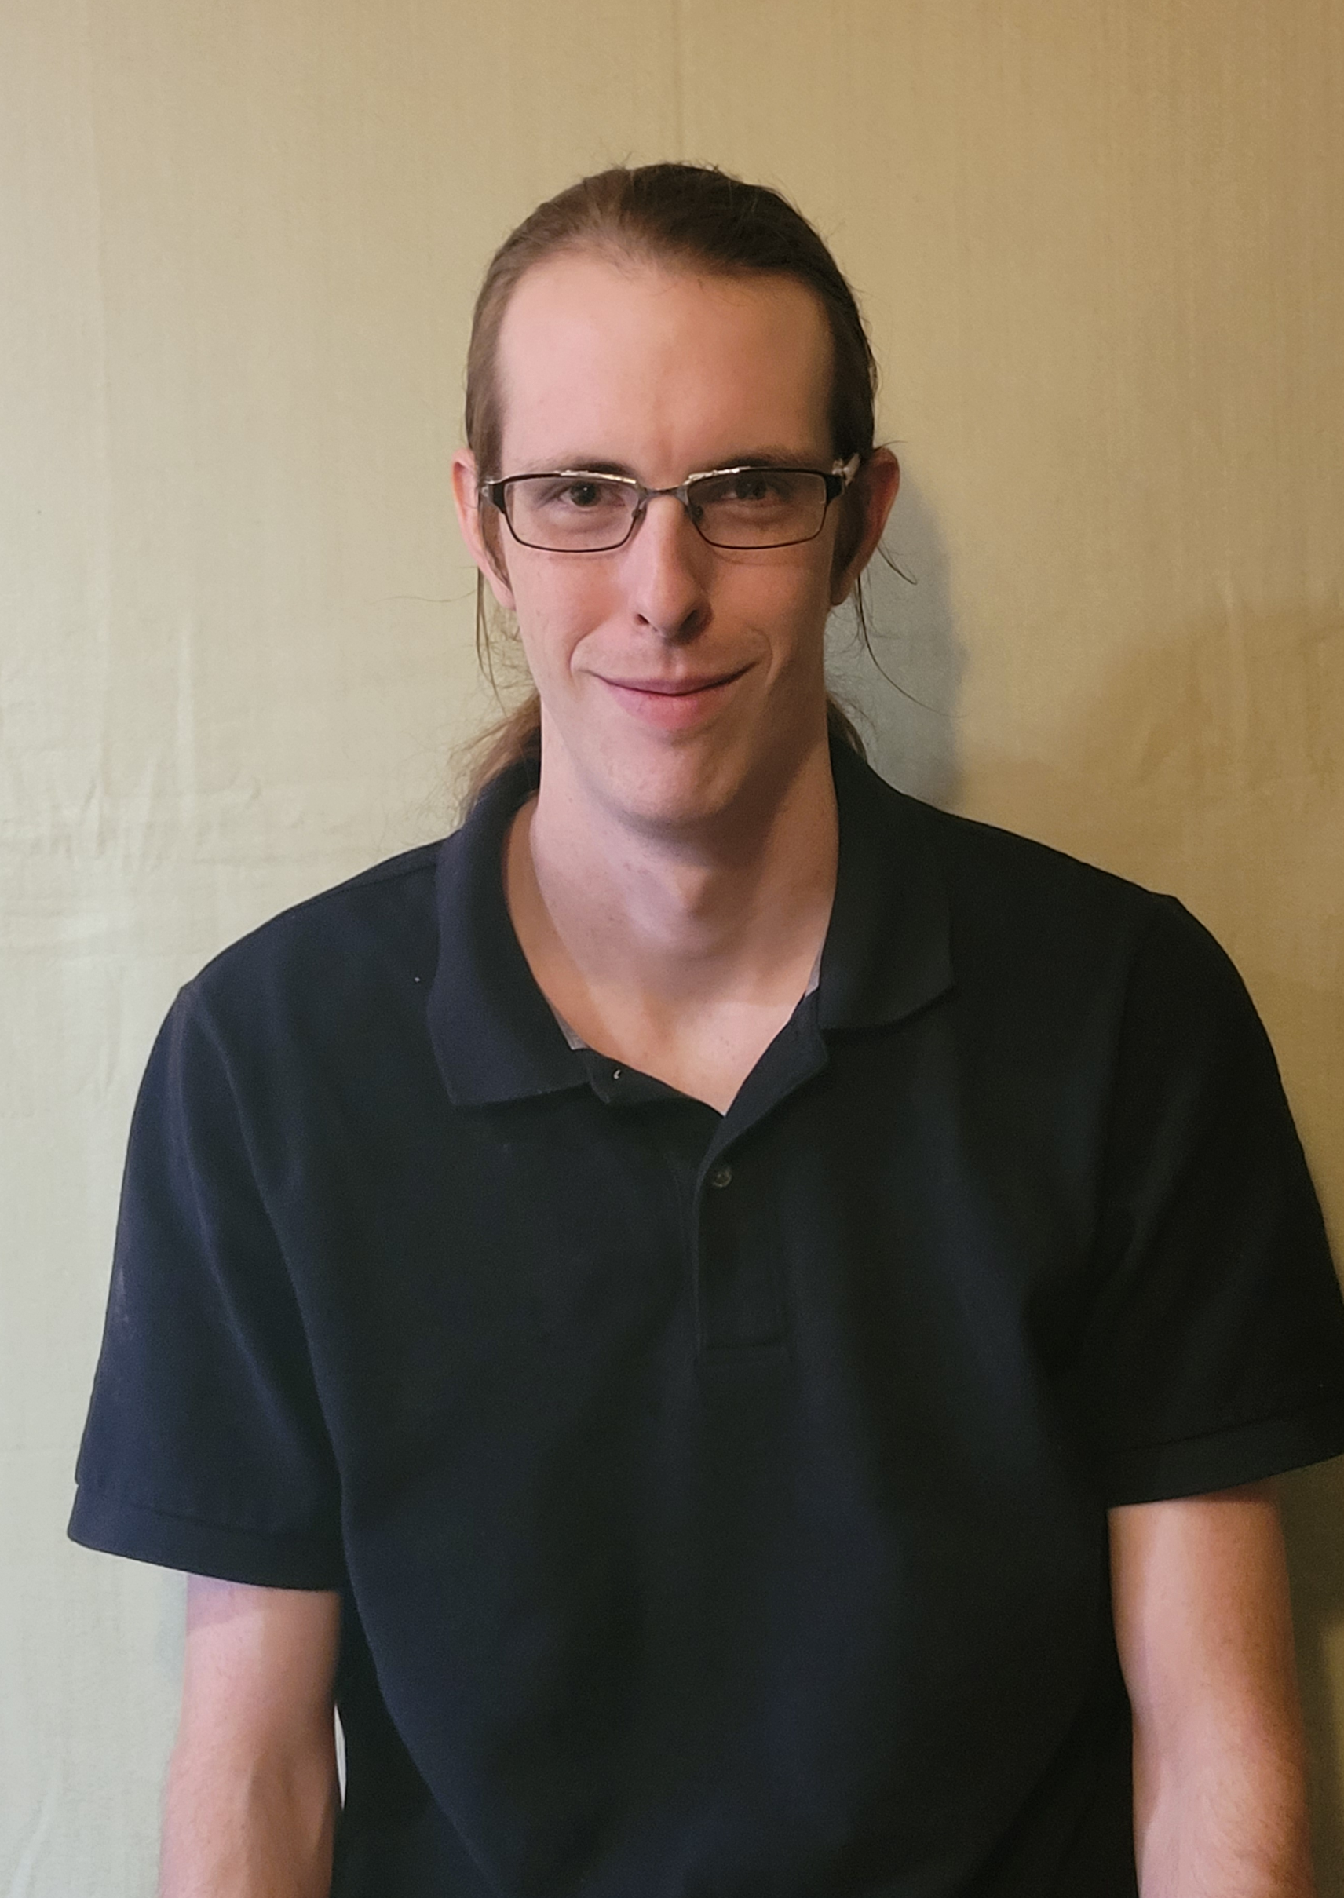


Autonomous Rover
“ The Processor on Wheels ”
Presented by Group 35:
Adriano Gussoni (Electrical eng.)
Brett Parker (computer eng.) – Team liaison
Michael Schumacher (Computer eng.) - Team representative
Group Advisor: Dr. Félix Soto Toro
Sponsored by: Aerojet Rocketdyne Coleman Aerospace
Speaker: Michael Schumacher
Speaker: Michael Schumacher

Slide 2
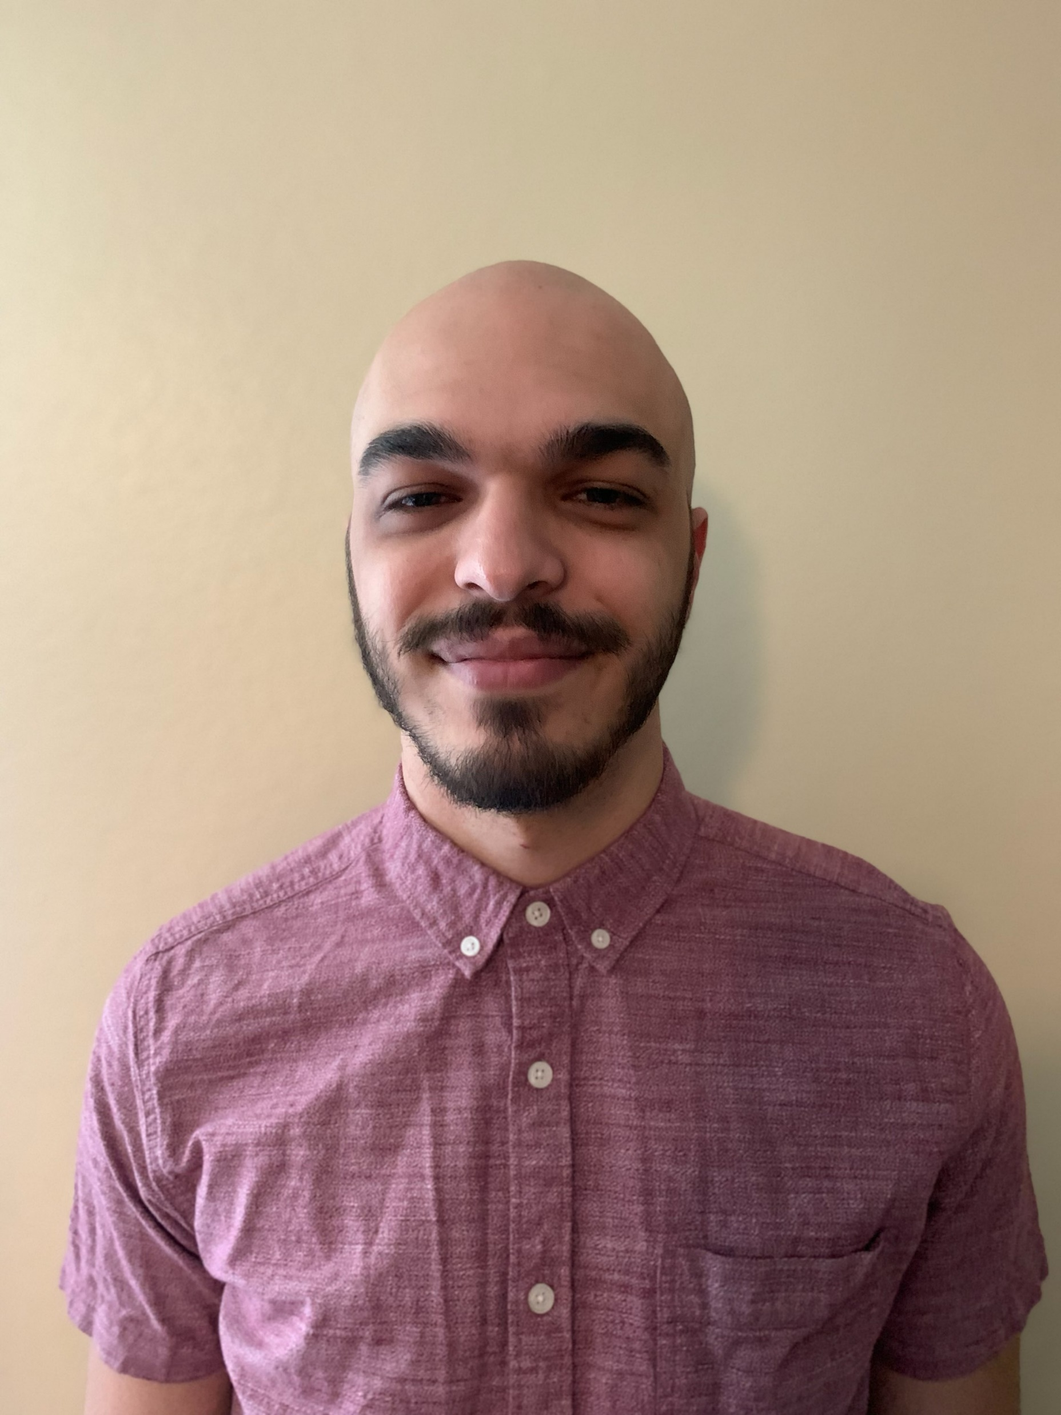
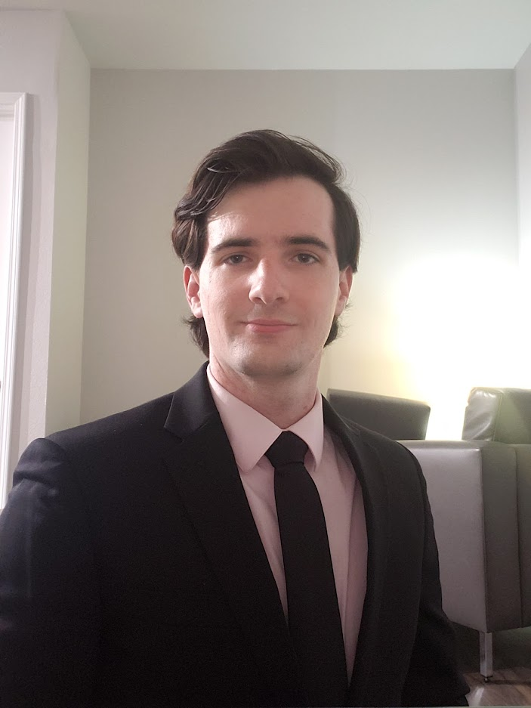
The Team
Power & Thermal Lead – Adriano Gussoni
Backup – Michael Schumacher
Software & Sensing Lead – Brett Parker
Backup – Michael Schumacher
Hardware, Integration, & Chassis Lead – Michael Schumacher
Backup – Integration: Brett Parker
Adriano
Brett
Michael Schumacher
Speaker: Michael Schumacher

Slide 3
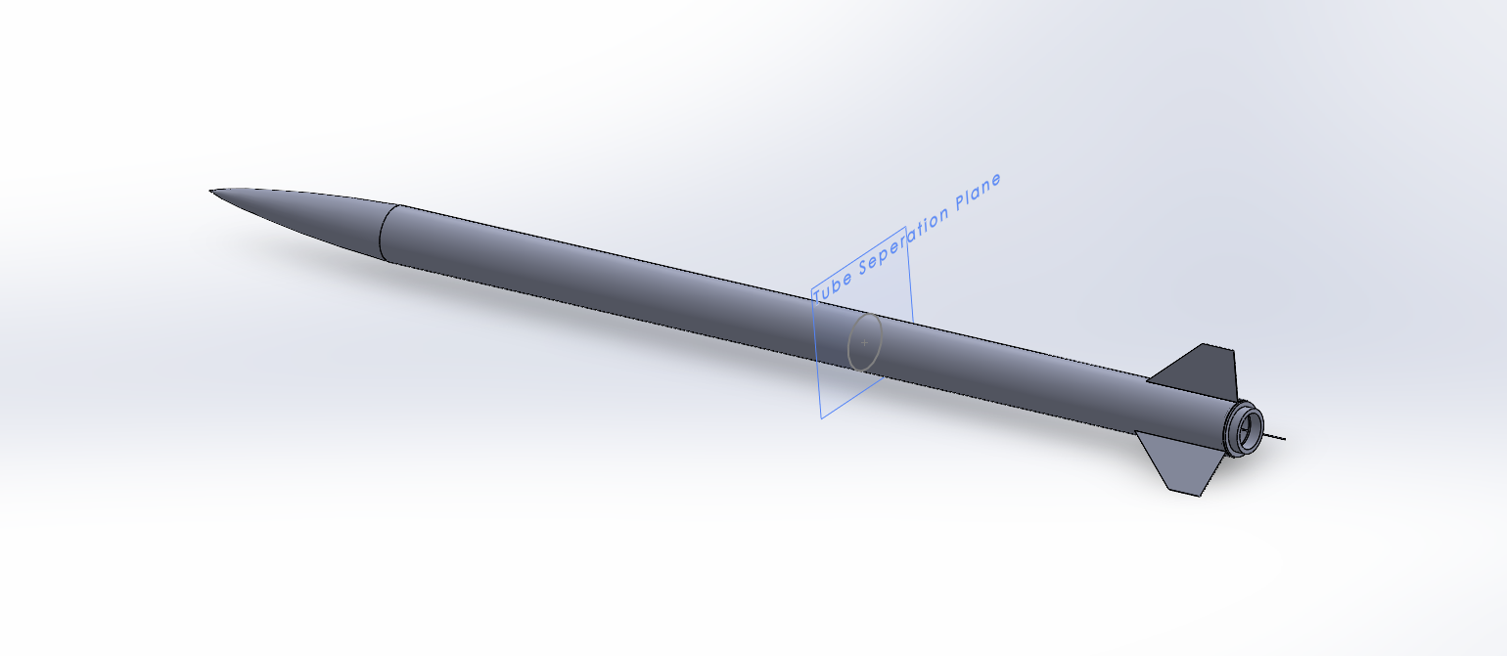
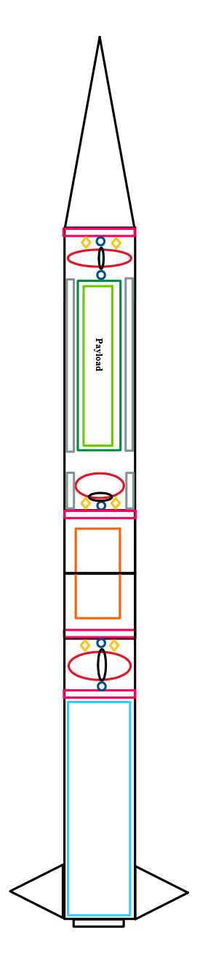
Project Description
Overview (FAR 1030)
High Powered Rocket(ry) [HPR]
10,000 ft and 30,000 ft competition
Rocket designed by UCF MAE Senior Design Group
UCF MAE Rocket entering competition – named ‘Arcturus’
FAR competition requires payload integration, 3 options:
Autonomous rover
Remote controlled rover
Drone or glider
Requirements that apply to us
Must transmit live video from payload touchdown.
Other requirements that are decided by the rocket design team.
Speaker: Michael Schumacher
Notes:
Our senior design project has the opportunity to take place in the FAR 1030 competition.
The mechanical, aerospace engineering senior design group; has designed a High powered rocket that will take place in the 10k competition
Our project is implemented as the autonomous rover in the required payload section for the FAR competition. Our main requirements are that the rover returns to the launch pad without human aid or interaction, and that live video must transmit from the time of payload touchdown to the successful return to the launch pad. Size and weight requirements were also put onto us by the UCF rocket design team

Slide 4
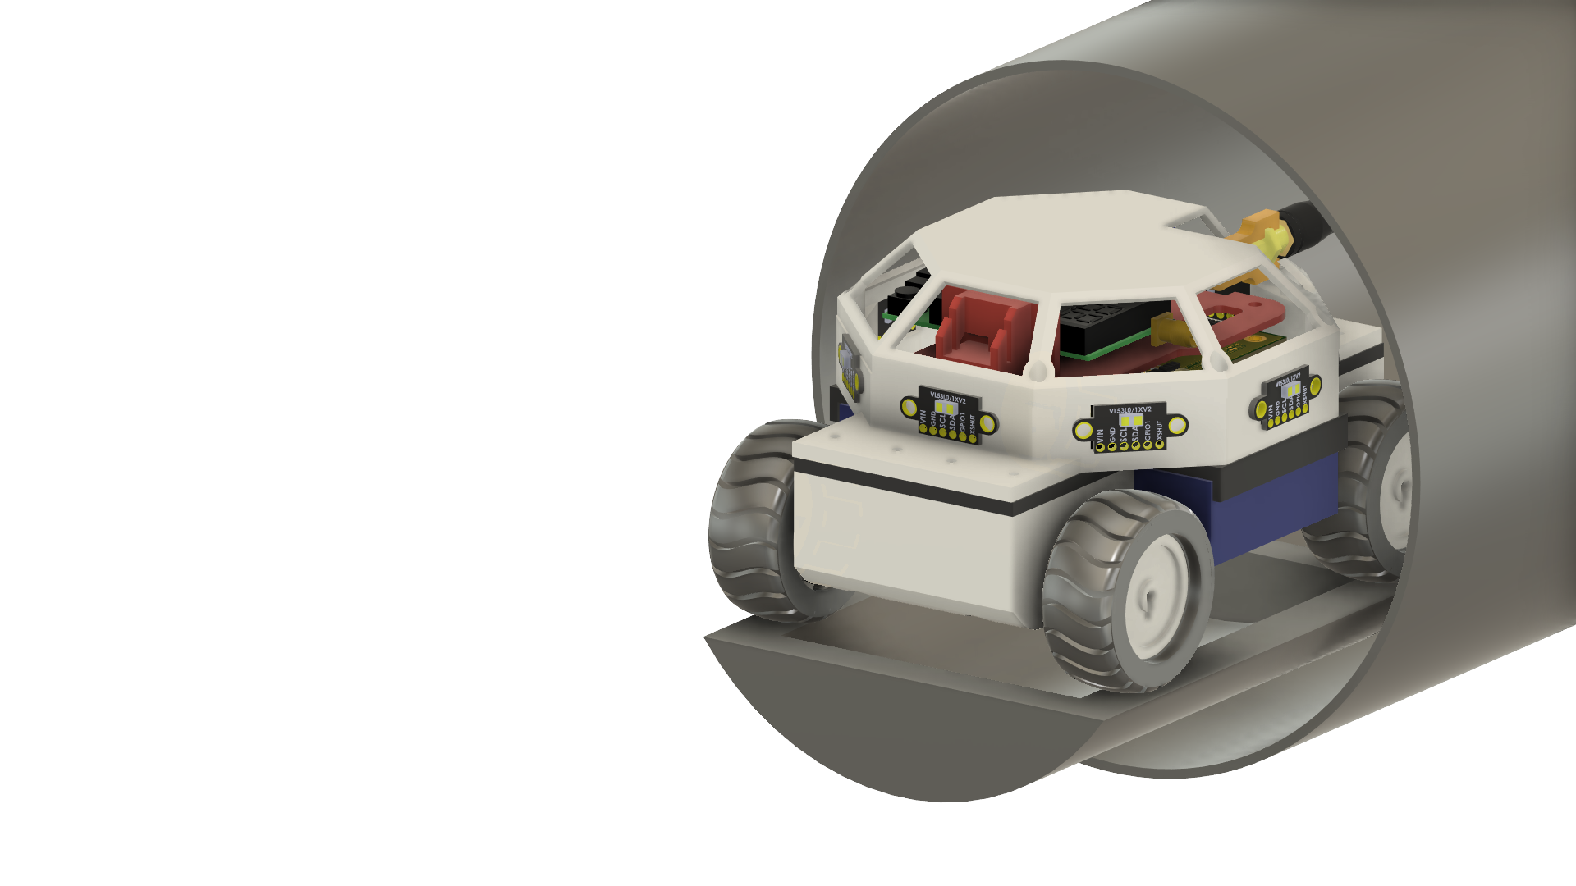
Engineering Requirements
Specifications and Requirements
Rover Specifications Table
Parameter | Value
Obstacle Detection
1. Detected Object Minimum Size 2. Detection Minimum Distance | 1x1 ft 2 ft ~609mm
Live Video Transmission
Continuous video transmission Transmission minimum distance | Yes ☑ No ❑ 400ft
Rover Moving Weight
5. Maximum weight rover must be able to move as | At 750g
Maximum mass
Combined sled, canister, and rover Rover | 9.5-lb, 2.2-lb, | 4.3 kg 1 kg | 4.3 kg 1 kg
Maximum size
Canister Length Inner canister diameter (width) Outer canister diameter | 16 in 6 in 6.169 in |  | 40.64 cm 15.24 cm 15.67 cm
Video capturing and transmission
Resolution Data Rate | 480i minimum, 1920 x1080p maximum 12 Mbps (720i), 22 Mbps (1080p)
Green Highlight = Key Engineering Requirements
Speaker: Michael Schumacher
Notes:
Reqs and specs misc

Slide 5
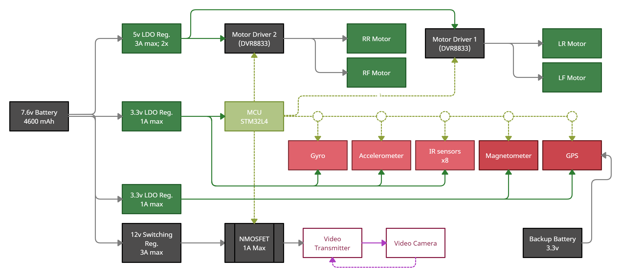

Hardware Block Level Overview
Project Work Distribution
Michael Schumacher
Adriano Gussoni
+5v
PWM
PWM
Brett Parker
Control
Logic
Control Logic
I2C Data
+3v3
Digital
Switch
+1v5
+3v3
8.4v-7.6v
+5v
1.5v
Speaker: Adriano Gussoni
Notes:
In this hardware block level over view we can see all the parts that go to making this rover function
we have two systems working together, the power systems and control system
The battery is the main power supply for the power system and that powers both the control systems and the motors drivers and motors.
The motor drivers are what allow us to connect the power systems and control systems.
The motor drivers are controlled by the MCU which holds our object avoidance algorithm
The control system consists of various sensors including an accelerometer, magnetometer, gyroscope, multiple ir sensors and a gps
These sensors give the rover information about its surrounding and tells it how and when to move and turn
Finally, we have a video transmission model to send live video of the rover so we can track its progress when completing its mission.

Slide 6
Design Constraints
Economic:
Limited out of pocket expenses,
Thankful for our sponsor: Aerojet Rocketdyne, Coleman Aerospace
Environmental:
“No part left behind” – All parts will be recovered, No launch site pollution
Launch Site is in the desert. Build location and testing in humid Florida.
Health and Safety:
We have 2 main constraints for heath and safety.
In case of emergency, Logic loop detected autonomous shutdown
IR sensor placement – Minimize possible eye damage at all cost
Manufacturability and Sustainability:
Global IC shortage
JLC PCB does not support Blind or Buried Vias.
JLC PCB does not support fine trace sizes to accommodate WFBGA chips.
Speaker: Adriano Gussoni
Notes:
Some of our design constraints are
Financial – our sponsors gave us a budget of 500 dollars and anything else is out of pocket from us group members
Environmental – we need a design that is full self contained or recoverable as to not leave any parts out on the field.
Our design also needs to be able to function under the weather conditions of the desert launch site

Slide 7




Standards
Software:
(ISO/ IEC 9899): - C Programming
(IEEE 29119) : - Software Testing
(De Facto): - NTSC / PAL
(IEEE 754) : - Floating Point Arithmetic
(De Facto): - ASCII
Hardware:
(IEEE 149): - Antenna Distances
(IPC 2221): - PCB design
(IEEE 2700): - Sensor Performance
(ICECCPCE 6998764): - IR Sensor and Camera-Based Monitoring Systems
(IEEE 1625): - Rechargeable Batteries
Miscellaneous:
(De Facto): - SPI / I2C
(IPC 7801): - Reflow Oven Process Control
(IEE 188881): - IT Green Community Management
(Government): - RoHS Compliance
Speaker: Adriano Gussoni

Slide 8
TECHNOLOGY COMPARISONS
Speaker: Michael Schumacher

Slide 9
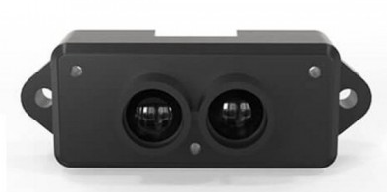
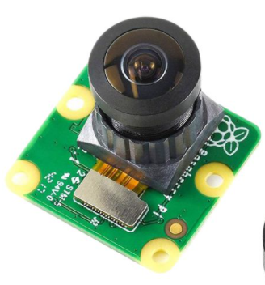
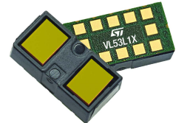
Object Detection
Technology Comparisons
Object Detection Solutions | Object Detection Solutions
Importance | Characteristics | Weighting | Lidar |  | AI / Camera |  | Basic Sensing
(1/10) |  |  | Raw | Weight | Raw | Weight | Raw | Weight
8 | Price | 0.15 | 1 | 0.15 | 3 | 0.45 | 2 | 0.30
6 | Weight | 0.11 | 1 | 0.15 | 2 | 0.22 | 3 | 0.33
7 | Size | 0.13 | 1 | 0.13 | 2 | 0.26 | 3 | 0.39
7 | Reliability | 0.13 | 3 | 0.39 | 1 | 0.13 | 2 | 0.26
10 | Ease of use | 0.19 | 2 | 0.38 | 1 | 0.19 | 3 | 0.57
6 | Conveniency | 0.11 | 1 | 0.11 | 3 | 0.33 | 2 | 0.22
9 | Flexibility | 0.17 | 1 | 0.17 | 2 | 0.34 | 3 | 0.51
 | Score |  |  | 1.48 |  | 1.92 |  | 2.58
Speaker: Brett Parker
Notes:
Design Decisions

Slide 10
Processing
Technology Comparisons
Processing Solutions |  |  | Object Detection Solutions
Importance | Characteristics | Weighting | FPGA |  | Microprocessor |  | Microcontroller
(1/10) |  |  | Raw | Weight | Raw | Weight | Raw | Weight
2 | Clock Speed | 0.07 | 10 | 0.7 | 7 | 0.49 | 7 | 0.49
3 | IOPS | 0.15 | 10 | 1.5 | 7 | 1.05 | 5 | 0.75
6 | Low Cost | 0.25 | 2 | 0.5 | 5 | 1.25 | 8 | 2
7 | Ease of use | 0.33 | 3 | 0.99 | 5 | 1.65 | 7 | 2.31
8 | # of Timers | 0.10 | 8 | 0.8 | 7 | 0.7 | 6 | 0.6
9 | Conveniency | 0.10 | 3 | 0.3 | 3 | 0.3 | 3 | 0.3
 | Score |  |  | 4.79 |  | 5.44 |  | 6.45
Speaker: Michael Schumacher
Notes:
Design Decisions

Slide 11
Motors
Technology Comparisons
Motor Technology Solutions |  |  | Object Detection Solutions
Importance | Characteristics | Weighting | Stepper |  | Servo |  | DC
(1/10) |  |  | Raw | Weight | Raw | Weight | Raw | Weight
7 | Price | 0.14 | 3 | 0.42 | 5 | 0.7 | 4 | 0.56
10 | Torque | 0.2 | 8 | 1.6 | 4 | 0.8 | 5 | 1.0
5 | Speed | 0.1 | 1 | 0.1 | 2 | 0.2 | 6 | 0.6
7 | Precision | 0.14 | 9 | 1.26 | 8 | 1.12 | 7 | 0.96
4 | Weight | 0.08 | 3 | 0.24 | 7 | 0.56 | 6 | 0.48
9 | Size | 0.18 | 5 | 0.8 | 6 | 1.08 | 7 | 1.26
8 | Efficiency | 0.16 | 2 | 0.32 | 7 | 1.12 | 8 | 1.28
 | Score |  |  | 4.74 |  | 5.58 |  | 6.14
Speaker: Adriano Gussoni
Notes:
Design Decisions
For our motors, our main concern was finding a motor that had a great size to torque ratio.
The speed of the motor was not as important as consistency was better than high top speed for our pathfinding and object avoidance program.
The stepper motors were very inefficient and heavy compared to all the other motors but in terms of pure torque output, they were the best.
The servo motors were the most expensive motors we could find and had a good amount of torque output as well and were fairly precise but the size was still an issue.
The DC motor was best when taking overall torque and size into consideration. It doesn’t have the best torque output but size and efficiency were important factors that it covered fairly well.
This was how we landed on the idea to use DC motors for our rover

Slide 12
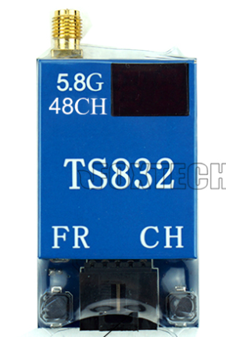
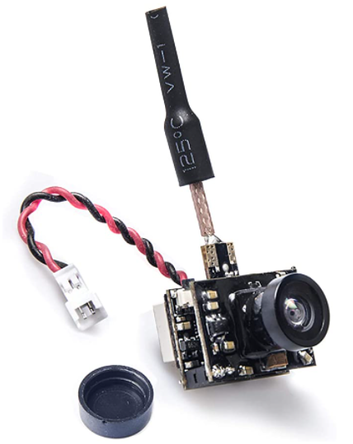
Live Video
Technology Comparisons
Live Video Solutions | Live Video Solutions
Importance | Characteristics | Weighting | Separate Modules | Purely Control Based | Pre-built Module
(1-10) |  |  | Raw | Weighted | Raw | Weighted
4 | Weight | 0.11 | 1 | 0.11 | 2 | 0.22
6 | Price | 0.17 | 1 | 0.17 | 2 | 0.34
7 | Size | 0.20 | 2 | 0.40 | 2 | 0.4
8 | Reliability | 0.23 | 2 | 0.46 | 1 | 0.23
10 | Flexibility | 0.29 | 2 | 0.58 | 1 | 0.29
 | Score |  |  | 1.72 |  | 1.48
Speaker: Brett Parker
Notes:
We had many internal discussions on if we should just get a fully built kit or buy our own camera and antenna, we decided on the latter for the flexibility it gave.

Slide 13
PART SELECTION COMPARISON
Speaker: Michael Schumacher

Slide 14
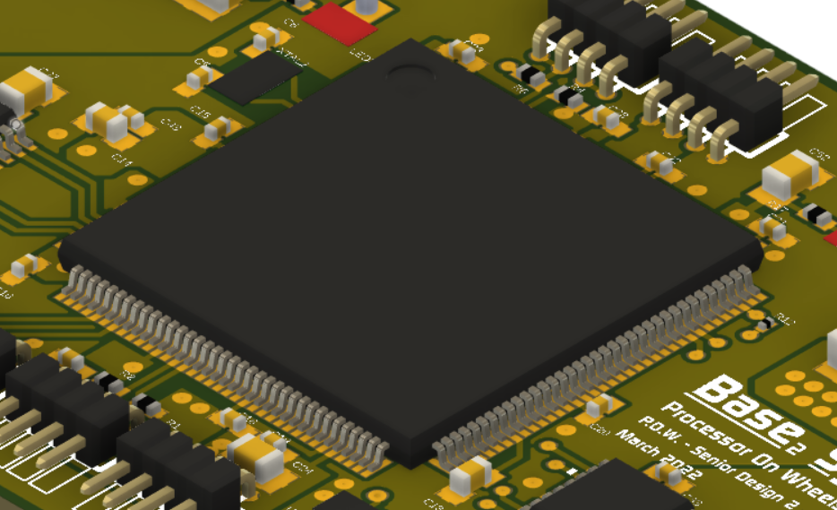
CPU
Part Selection
Microcontroller - STM32L4S9ZIT6
Part Name | ATmega2560 | STM32L4S9ZIT6 | MSP430FR6989
Cost ($) | 6 | 20 | 12
Clock Speed (MHz) | 16 | 120 | 16
Total GPIO | 54 | 112 | 83
Program Memory | 256 KB | 2 MB | 128 KB
Operating Voltage (v) | 5 | 3.3 | 3.3
ARM Based Processor –
32-bit Cortex M4 series
144 LQFP package
16 timers
Speaker: Michael Schumacher

Slide 15
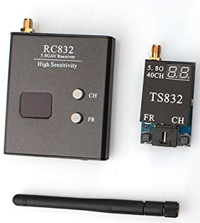
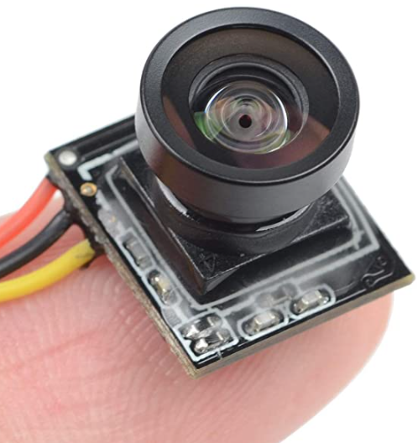
Video TX/RX System
Part Selection
Live Video
Key attributes:
Range of transmission
Power consumption
Size
Flexibility
Part Name | TS832 600mw Transmitter | Wirelessan 250-2kmW Transmitter | AKK 200mW kit
Price ($) | 33 | 50 | 18
Weight (g) | 22 | 20 | 5
Size (mm) | 54 x 32 x 10 | 30 x 30 | 91 x 60 x 40
Range (km) | 5 | up to 10 | 0.2
Voltage (V) | 7 - 16 | 7 - 26 | 3.3 - 5.5
Speaker: Brett Parker
Notes:
After researching different transmitters, we settled on wanting something in the 5.8GHz area. Lower frequency transmitters had lower bandwidths so lower quality video
We also found that power output made a significant difference in distance with these FPV cameras, so we decided to get something in the middle, in this case 600mW, since the datasheet, and reviews, report 1-2km distance for transmission.
We had many internal discussions on if we should just get a fully built kit or buy our own camera and antenna, we decided on the latter for the flexibility it gave.

Slide 16
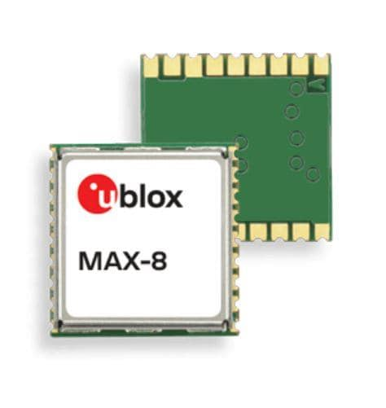
Orientation Sensors (GPS)
Part Selection
GPS
key attributes:
Decent Accuracy
Minimal Power consumption
High Availability
Part Name | TAU1105-1010A00 | MAX-M8C-0 | YIC51009EBGG
Cost ($) | 9.75 | 11 | 10.65
Accuracy (m) | 2.5 | 2.5 | 3
Channels | 40 | 72 | 99
Dimensions (cm) | 1 x 0.9 x 0.2 | 1 x 1 | 1 x 1 x 0.3
Voltage (V) | 3.3 | 3.3 | 3.3
Current (mA) | GPS – 25 GNSS - 35 | GPS – 18 GNSS - 17 | GNSS - 45
Speaker: Brett Parker

Slide 17
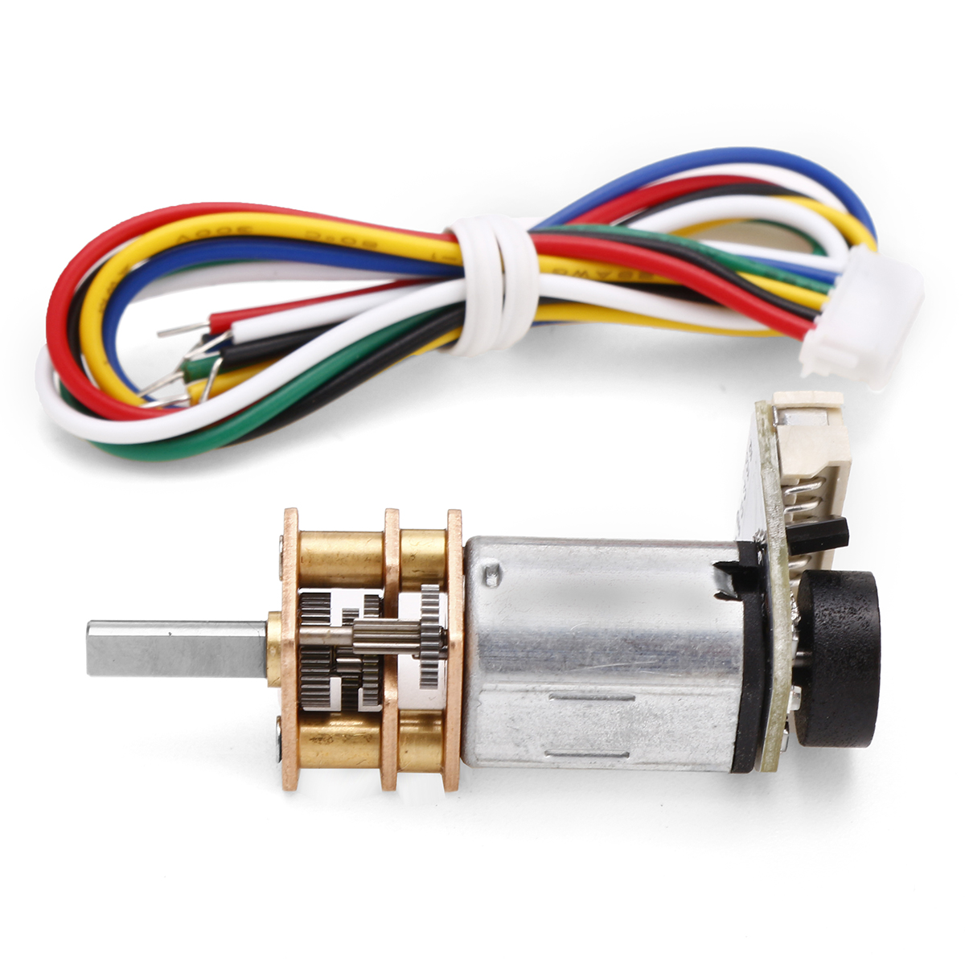
Drive System
Part Selection
N20 Micro Metal Gear Motor (x4)
One of the smallest EM motors on the market
High torque
Low stall current
Low no load current
Optimal drive current subject to rover mass
Optional encoders on drive shaft
Speaker: Adriano Gussoni
Notes:
Our motors of choice are the N20 Micro metal gear motors which are one of the smallest motors available
They have support for an encoder module which aids in our motor precision specification and a fairly small current at just under half an amp each when running at maximum efficiency
Using 4 of the motors in an AWD configuration should give us enough torque move the rover assuming it weighs around 1kg
The motor drivers we chose are the DRV8833 which were our second choice as our original choice, the DRV8835 ran out of stock starting our second semester
Each driver supports 2 DC motors and we implemented 2 driver chips to cover all 4 wheels.
The drivers provide enough current draw to run both motors with some overhead incase the rover needs extra torque

Slide 18
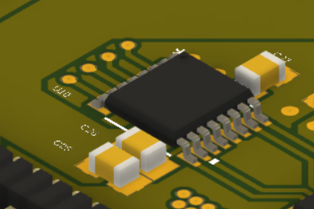
Drive System
Part Selection
Motor Driver (x2)
Part Name | TI L293D IC | TI DRV8833
Device Supply Voltage (Vcc) (V) | 4.5 – 36 | 0 – 7
Input Voltage (V) | 0 – 7 | -0.5 – (Vcc + 0.5)
Output Voltage (V) | -3 – (Vcc +3) | 0 – 12
Channels | 2 | 2
Cont. Output Current (A) | ±0.6 | ±1.5
Part # DRV8833
Dual H-Bridge Motor Driver
1.5 Amp max (2 channels)
Supports PWM
Two modes – Fast decay & Slow decay
Speaker: Adriano Gussoni
Notes:
Our motors of choice are the N20 Micro metal gear motors which are one of the smallest motors available
They have support for an encoder module which aids in our motor precision specification and a fairly small current at just under half an amp each when running at maximum efficiency
Using 4 of the motors in an AWD configuration should give us enough torque move the rover assuming it weighs around 1kg
The motor drivers we chose are the DRV8833 which were our second choice as our original choice, the DRV8835 ran out of stock starting our second semester
Each driver supports 2 DC motors and we implemented 2 driver chips to cover all 4 wheels.
The drivers provide enough current draw to run both motors with some overhead incase the rover needs extra torque

Slide 19
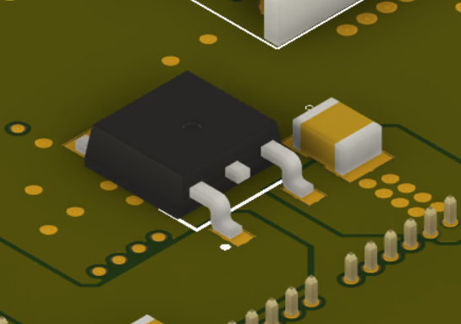
Power System
Part Selection
3.3v Regulator (x2)
Part Name | TLV2217 | LM1085IS-3.3 | LP38690DT-3.3
Max Output Current (A) | 0.5 | 3 | 1
Input Voltage (V) | 3 – 12 | 2.6 – 27.5 | 2.7 – 10
Operating Temp. (°C) | 0 – 125 | -40 – 125 | -40 – 125
Price ($) | 1.42 | 3.01 | 1.89
Part # LP38690DT-3.3
1 Amp maximum
Small package (TO-252-3)
1 Independent – MCU / IR sensor bank 1
1 Independent – Orientation / IR sensor bank 2
Speaker: Adriano Gussoni
Notes:
To ensure our board had consistent power, we had to implement 3.3v and 5v regulators.
The 3.3V regulator has a maximum of 1 amp current draw.
We implemented 2 of these regulators,
1 dedicated for the MCU and half of the IR sensors and another for the IMU and second half of the sensors
The 5 volt regulators have a maximum current draw of 1.5 A each which is enough to cover 1 motor driver.
So each motor driver has dedicated voltage regulator in case they both need overhead power draw
And we use a third voltage regulator for any other IC’s or GPIO out pins that would need that 5V.

Slide 20
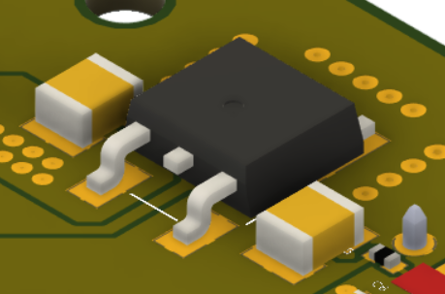
Power System
Part Selection
5v Regulator (x3)
Part Name | LP38690DT-5.0 | LM1085IS-5.0 | LD29150DT50R
Max Output Current (A) | 1 | 3 | 1.5
Input Voltage (V) | 2.7 – 10 | 2.6 – 27.5 | 3 – 14
Operating Temp. (°C) | -40 – 125 | -40 – 125 | -40 – 125
Price ($) | 1.71 | 3.01 | 1.45
Part # LD29150DT50R
1.5 Amp maximum
Small package (TO-252-3)
2 Independent for motor drivers
1 independent 5v GPIO out
Speaker: Adriano Gussoni
Notes:
To ensure our board had consistent power, we had to implement 3.3v and 5v regulators.
The 3.3V regulator has a maximum of 1 amp current draw.
We implemented 2 of these regulators,
1 dedicated for the MCU and half of the IR sensors and another for the IMU and second half of the sensors
The 5 volt regulators have a maximum current draw of 1.5 A each which is enough to cover 1 motor driver.
So each motor driver has dedicated voltage regulator in case they both need overhead power draw
And we use a third voltage regulator for any other IC’s or GPIO out pins that would need that 5V.

Slide 21
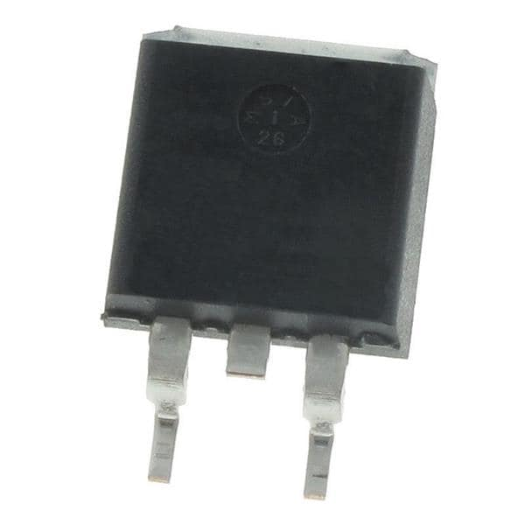
Power System
Part Selection
N-MOSFET (RF switch)
Part Name | SIHB24N65EFT1 | IPB65R230CFD7
Gate-Source Threshold Voltage (V) | 4 | 4
Cont. Output Current Limit (A) | 24 | 11
Rds (ON) (mOhms) | 156 | 230
Power Diss. (W) | 250 | 64
Price | 5.72 | 3.76
Part#: IPB65R230CFD7AATMA1
4V Gate-Source Threshold
>1A Continuous Current
Small package (TO-263-3)
Used to cut video feed during launch
** These FETs are overkill for their use-case, but they were the lowest price, highest stock we could find for the parameters chosen on Mouser
Speaker: Adriano Gussoni
Notes:
We use a NMOS transistor as a switch from the battery power to the video transmission system.
It is controlled by the MCU so we can tell it when to turn on to start transmitting our video feed.
We needed a FET that could draw at least 1A of current to power the transmission module.
Finally, our battery of choice was the ProTek RC Si-Graphene LiPo battery with a capacity of 4600mAh at 7.6V nominal
This battery back is high voltage which means it can be charged to 8.7V but we will keep it at a standard 8.4V giving us 4000mAh capacity.
We chose this battery because it was one of the smallest packages we could find while also being incredibly light due to its highly energy dense si-graphene battery technology.

Slide 22
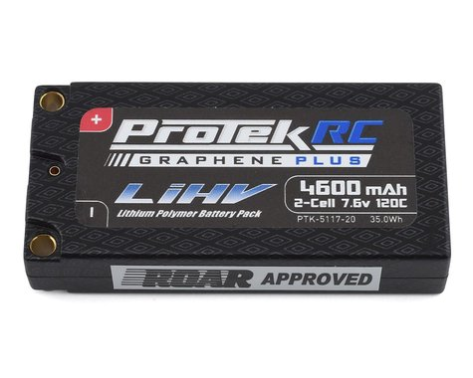
Power System
Part Selection
Battery
Part: ProTek RC 2S 120C
7.6v nominal
4600 mAh capacity (supports >30 min uptime)
LiPo (Si-Graphene)
Small battery package (high energy density)
Part Name | Tenergy Li-ion Rechargeable Battery Pack | EcoPower "Trail" Hard Case LiPo Battery | ProTek RC Low IR Si-Graphene LiPo Battery
Cost ($) | 29.49 | 37.99 | 59.99
Nominal Voltage (V) | 7.4 | 7.4 | 7.6
Dimensions (cm) | 3.8 x 7.2 x 1.95 | 4.6 x 13.85 x 2.5 | 4.7 x 9.55 x 1.95
Capacity (mAh) | 2600 | 5000 | 4600
Weight (g) | 99 | 309 | 165
Speaker: Adriano Gussoni
Notes:
We use a NMOS transistor as a switch from the battery power to the video transmission system.
It is controlled by the MCU so we can tell it when to turn on to start transmitting our video feed.
We needed a FET that could draw at least 1A of current to power the transmission module.
Finally, our battery of choice was the ProTek RC Si-Graphene LiPo battery with a capacity of 4600mAh at 7.6V nominal
This battery back is high voltage which means it can be charged to 8.7V but we will keep it at a standard 8.4V giving us 4000mAh capacity.
We chose this battery because it was one of the smallest packages we could find while also being incredibly light due to its highly energy dense si-graphene battery technology.

Slide 23
Obstacle Avoidance
Part Selection
IR Sensor
Key attributes:
Small as possible
Range >= 0.6m ~2ft
Reliable outdoors
Part Name | CUSP-TRS0-18-2400-TH | VL53L0X | APDS-9190
Part type | Ultrasonic Sensor | Laser Sensor | Laser Sensor
Distance range (m) | 0 - 18 | 0 - 2 | 0 - 0.1
Dimensions (cm) | 1,65 x 1.20 | .44 x .24 x .1 | .4 x .24 x .14
Price ($) | 5.0 | 5.04 | 5.21
Voltage (V) | 5 | 3.5 | 3.8 max
Weight (g) | 2 | 0.15 | 0.15
Speaker: Brett Parker

Slide 24
PCB DESIGN
(Board Layout & Schematic Capture)
Speaker: Michael Schumacher

Slide 25
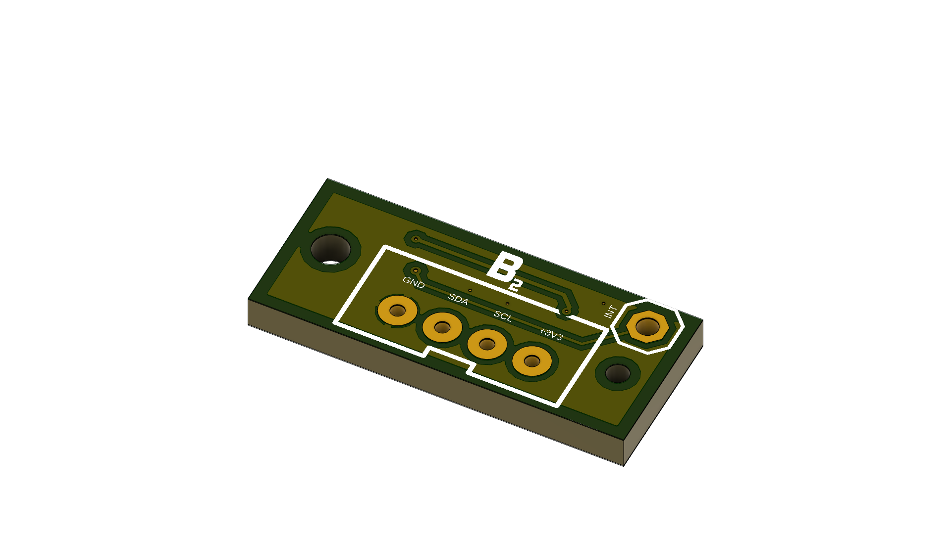
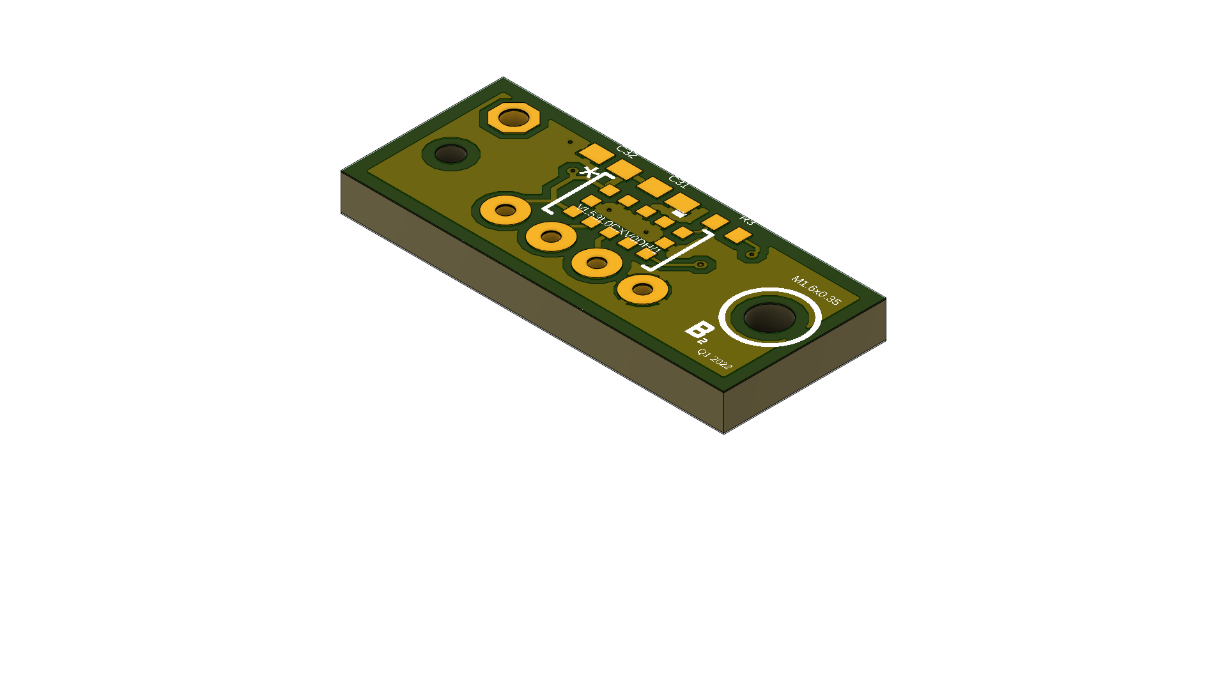
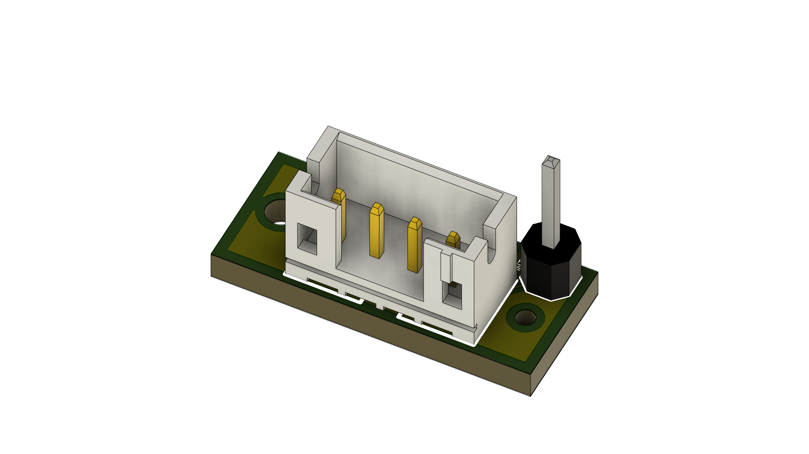
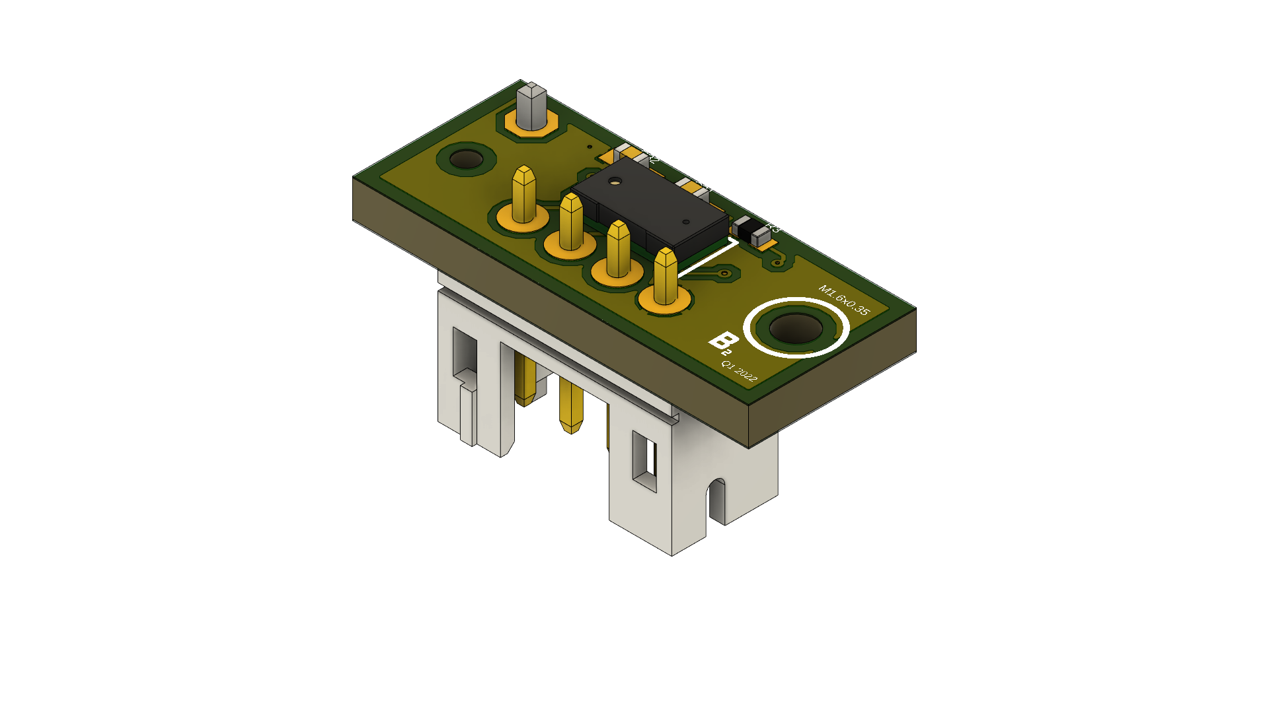
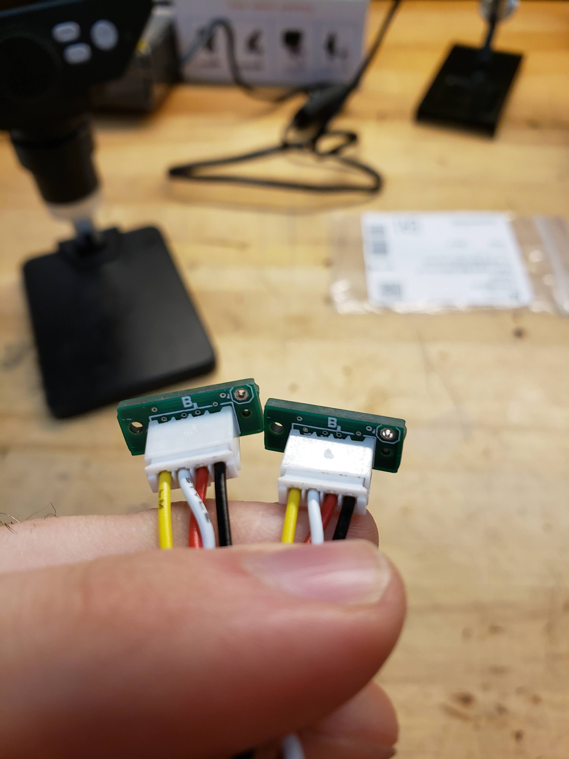
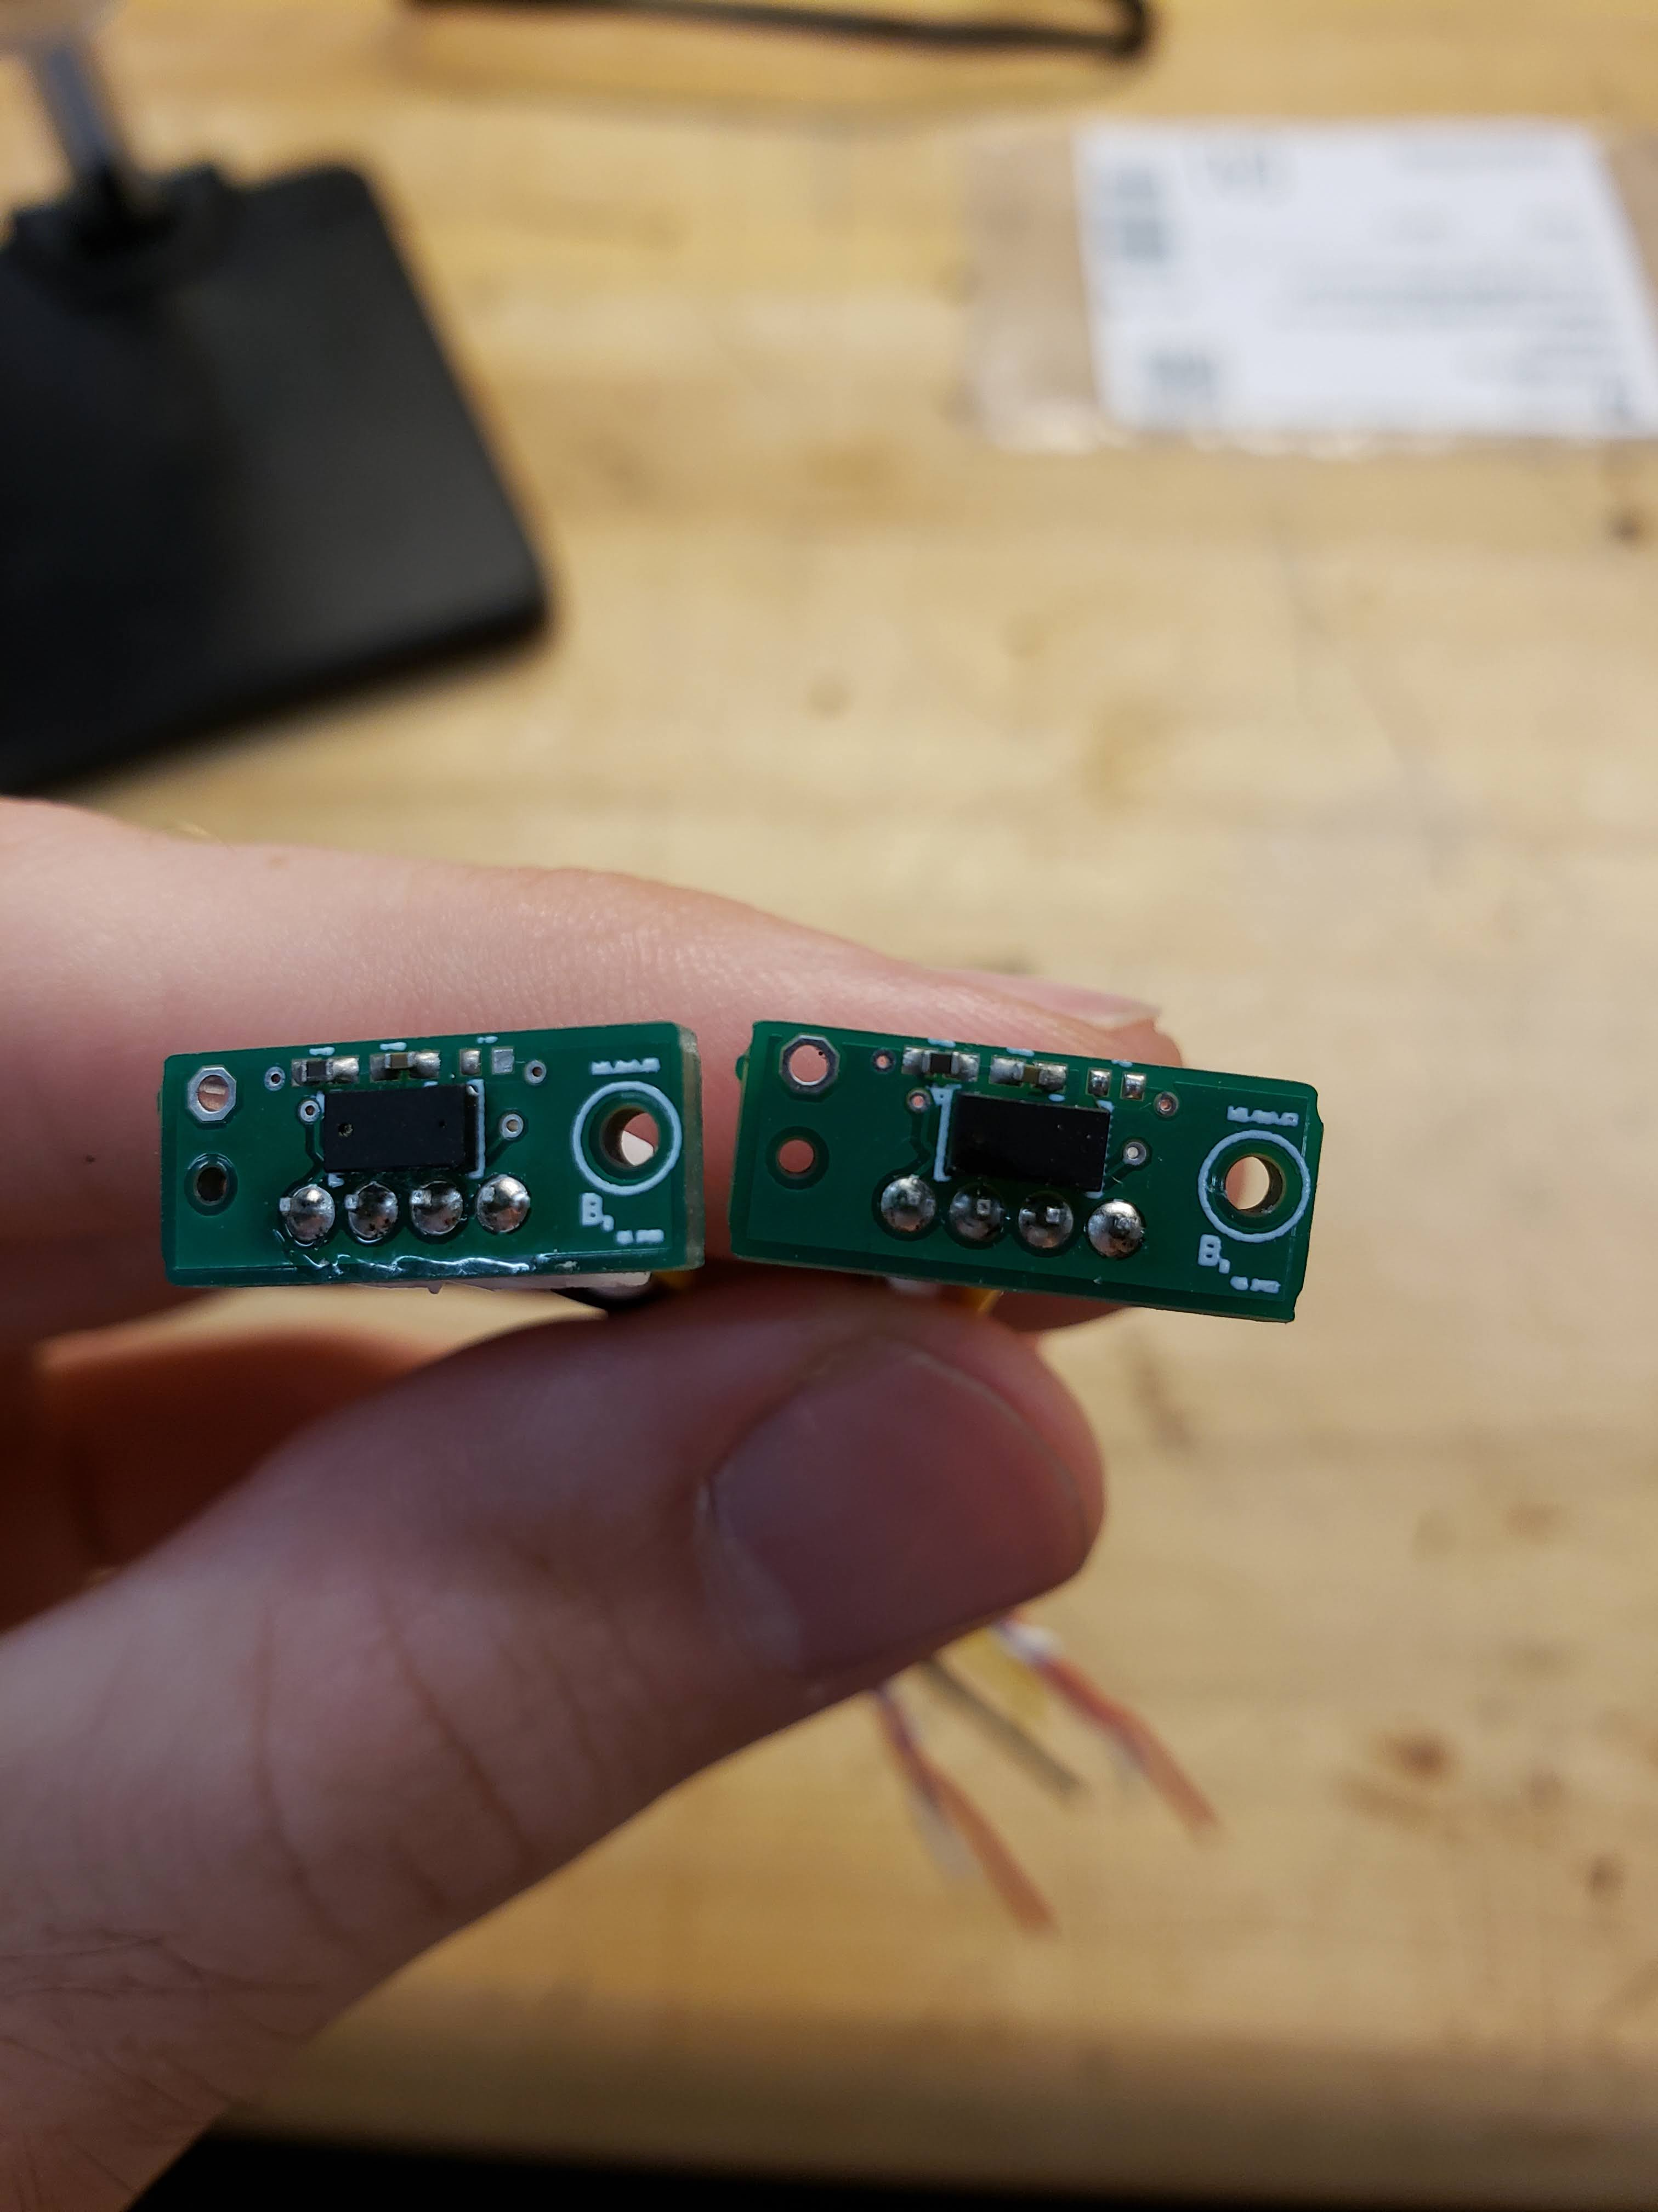
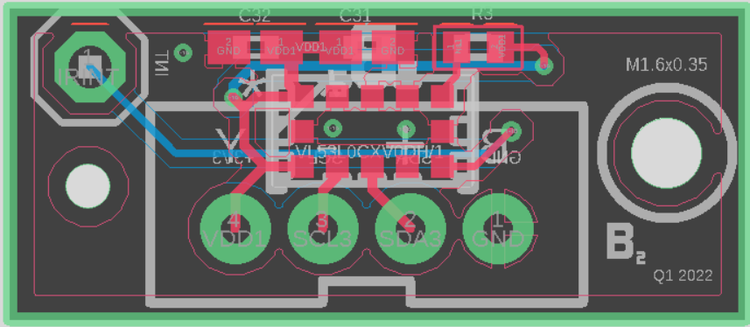
IR Sensor Board Layout
Aspect | Value
Layers | 2
Length | 0.66 in
Width | 0.27 in
Total Elements | 6
Total Elements on Top Layer | 4
Total Elements on Bottom Layer | 2
Features | 4 pin JST Optional Pin for Interrupt
* Ground planes not shown
Speaker: Michael Schumacher
Notes:
15

Slide 26
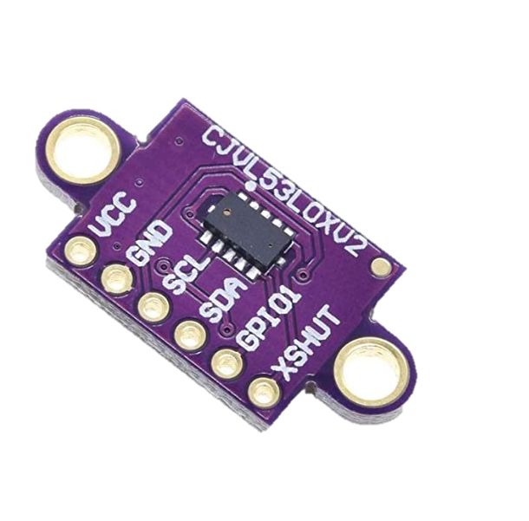
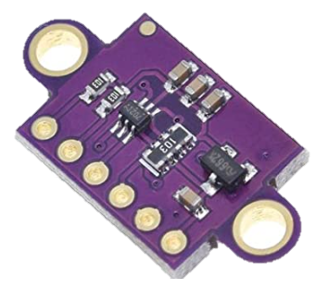
IR Module Used
Reasoning:
Access to XSHUT pin for multi – sensor purposes
Why this module?
Used in our breadboarding phase
Fit into our build without much change
Speaker: Brett Parker
Notes:
15

Slide 27
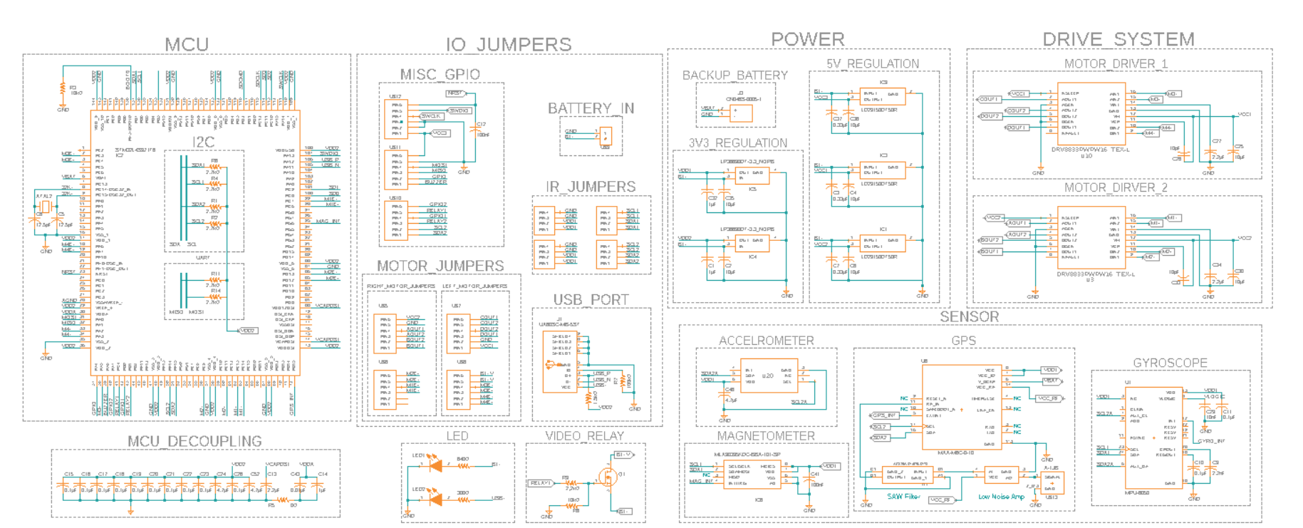
Main Board Schematic
Speaker: Michael Schumacher
Notes:
15 seconds

Slide 28
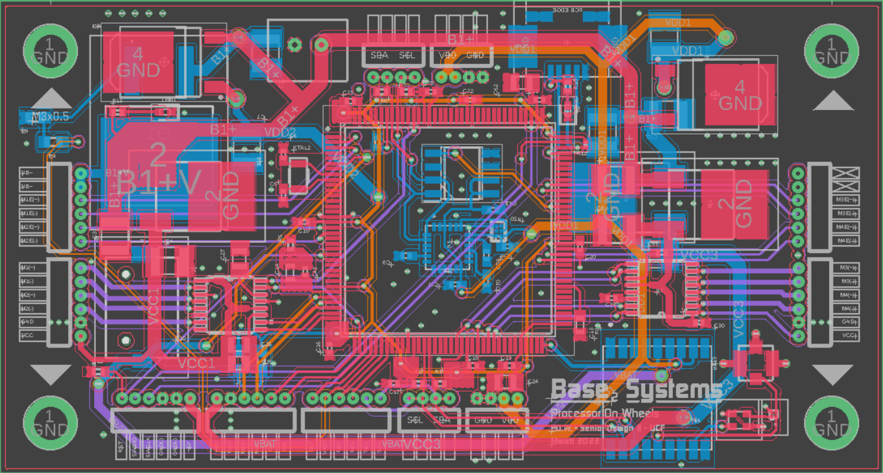
Main Board Layout
* Ground planes not shown
Speaker: Michael Schumacher
Notes:
Pictured below is the board layout for the main control board. More information about the main PCB is on the following slide. Please pause the presentation if you need more time to analize the layout

Slide 29
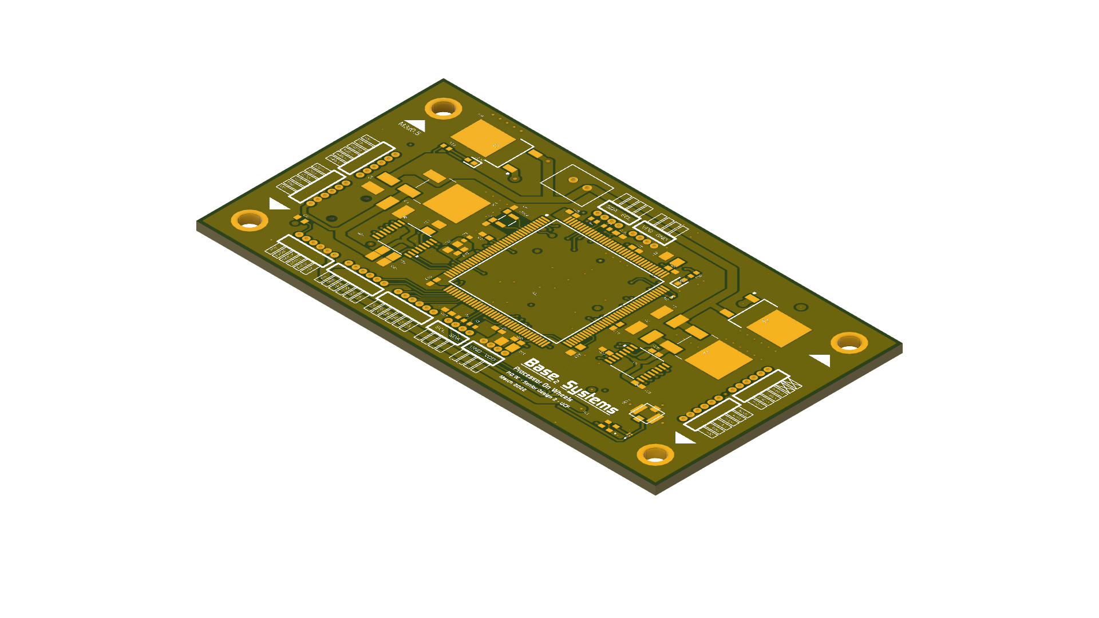
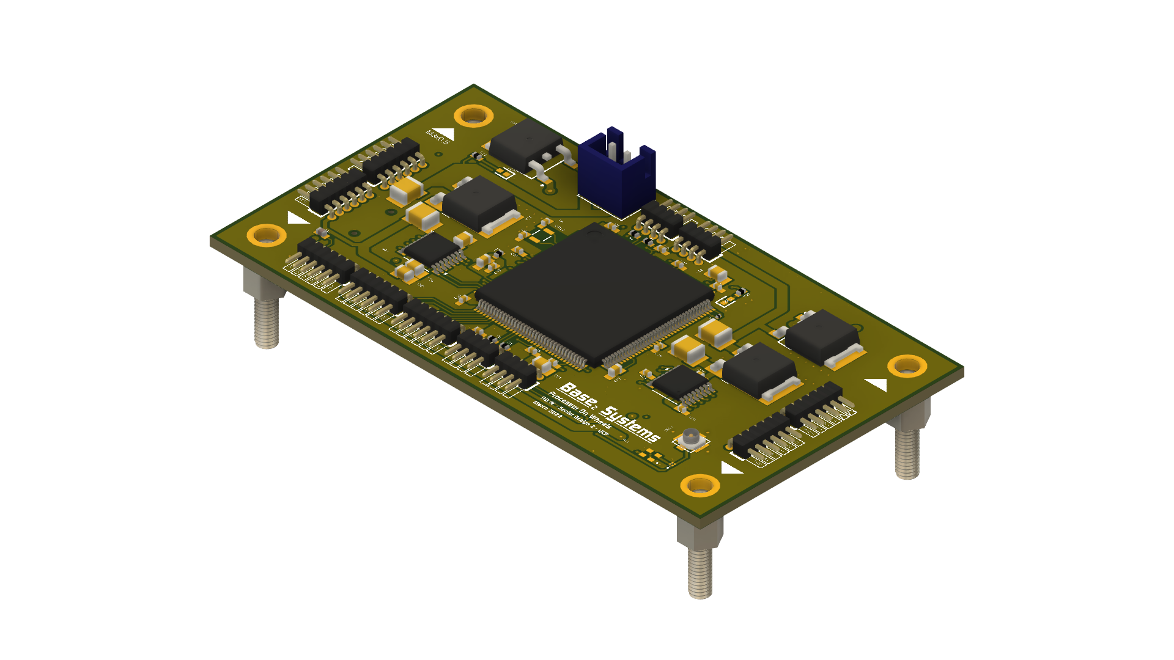
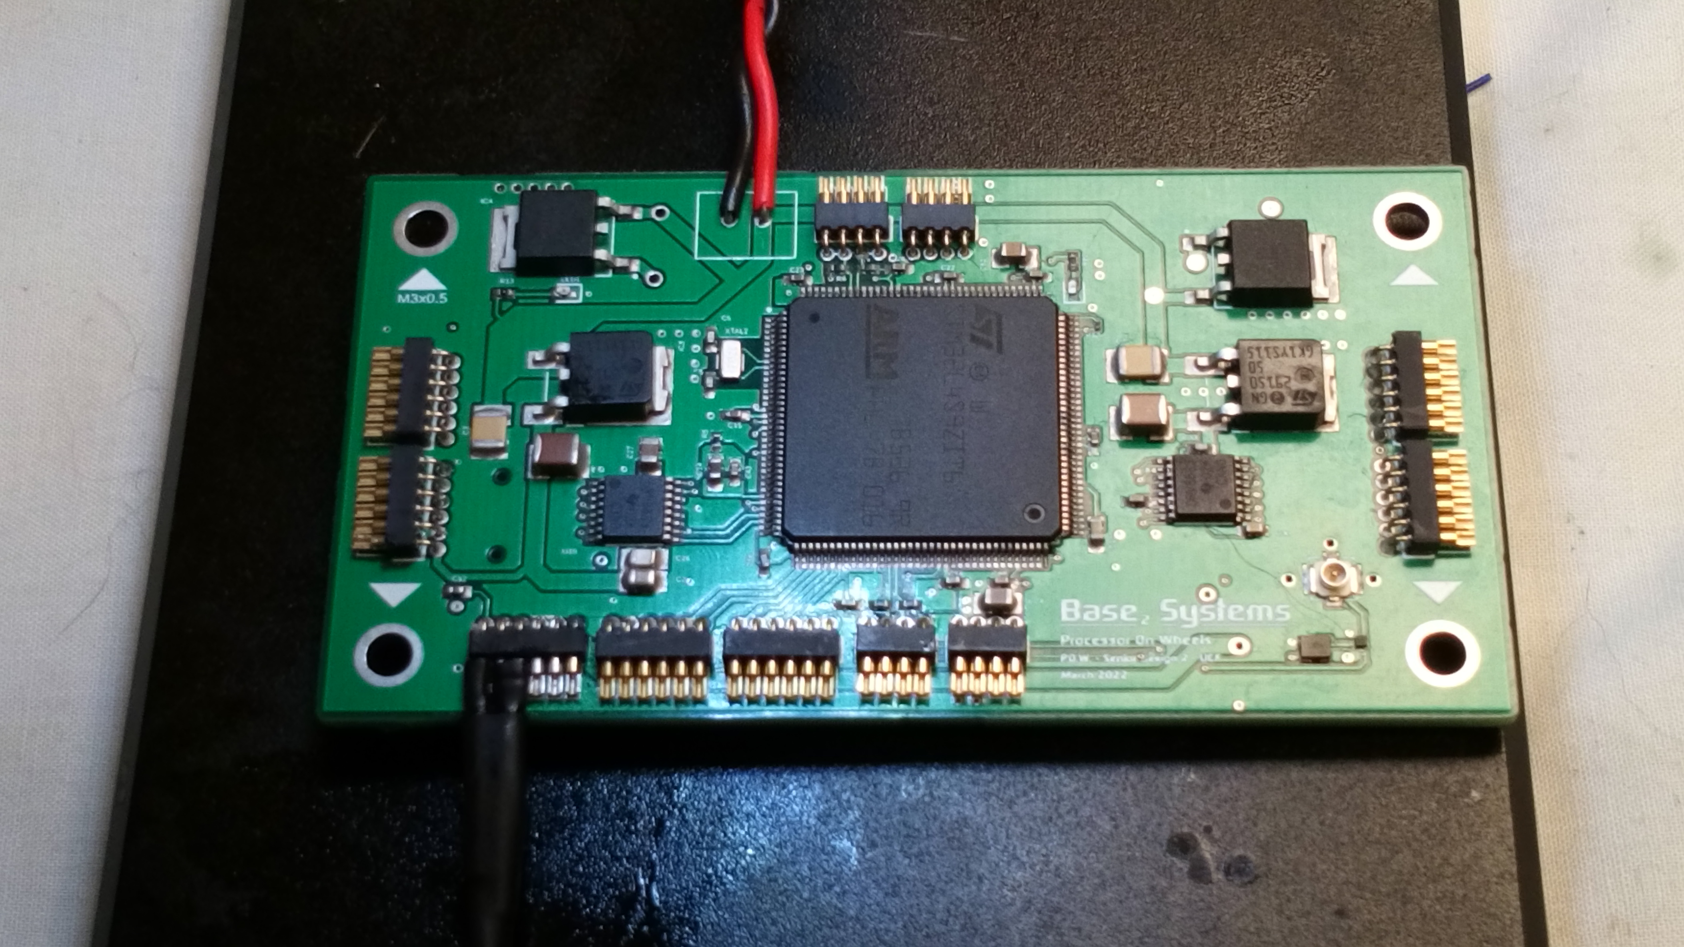
Main Board Layout
Aspect | Value
Layers | 4
Length | 3.625 in
Width | 2.2 in
Total Elements | 87
Total Elements on Top Layer | 61
Features | GPIO uses 1.0 mm pitch solder-cups
Speaker: Michael Schumacher
Notes:
15

Slide 30
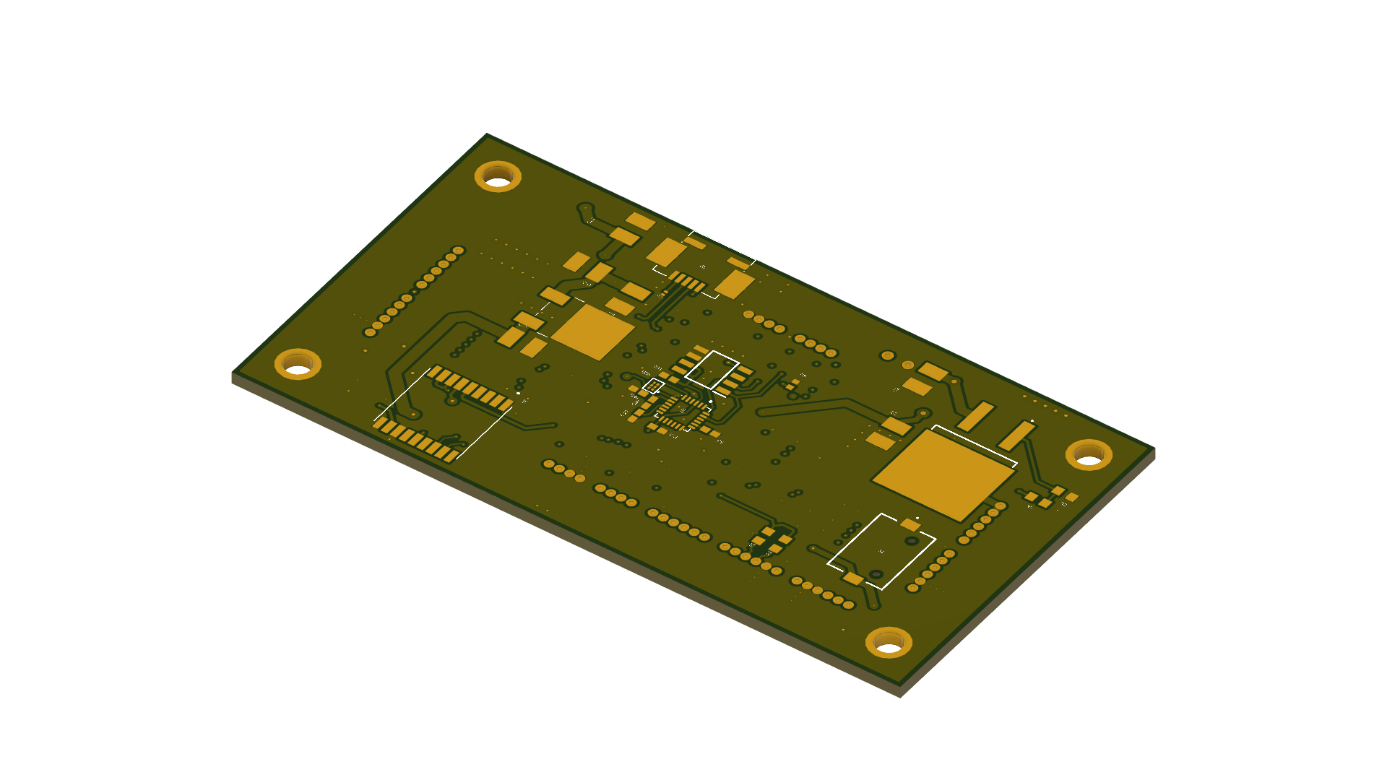
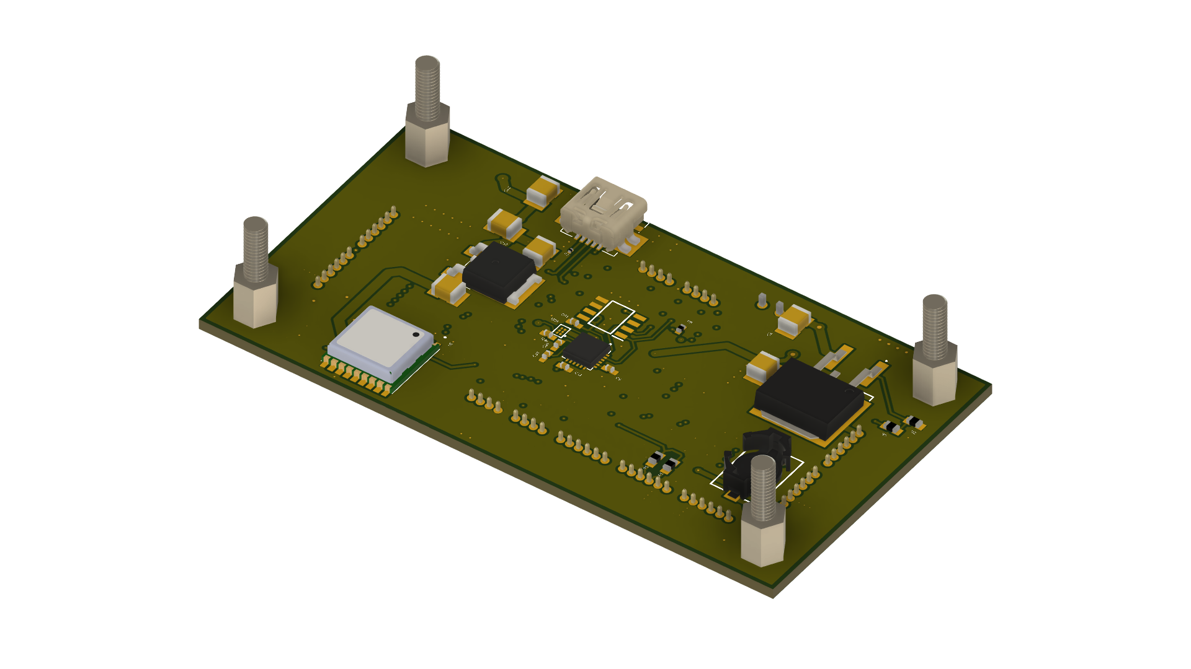
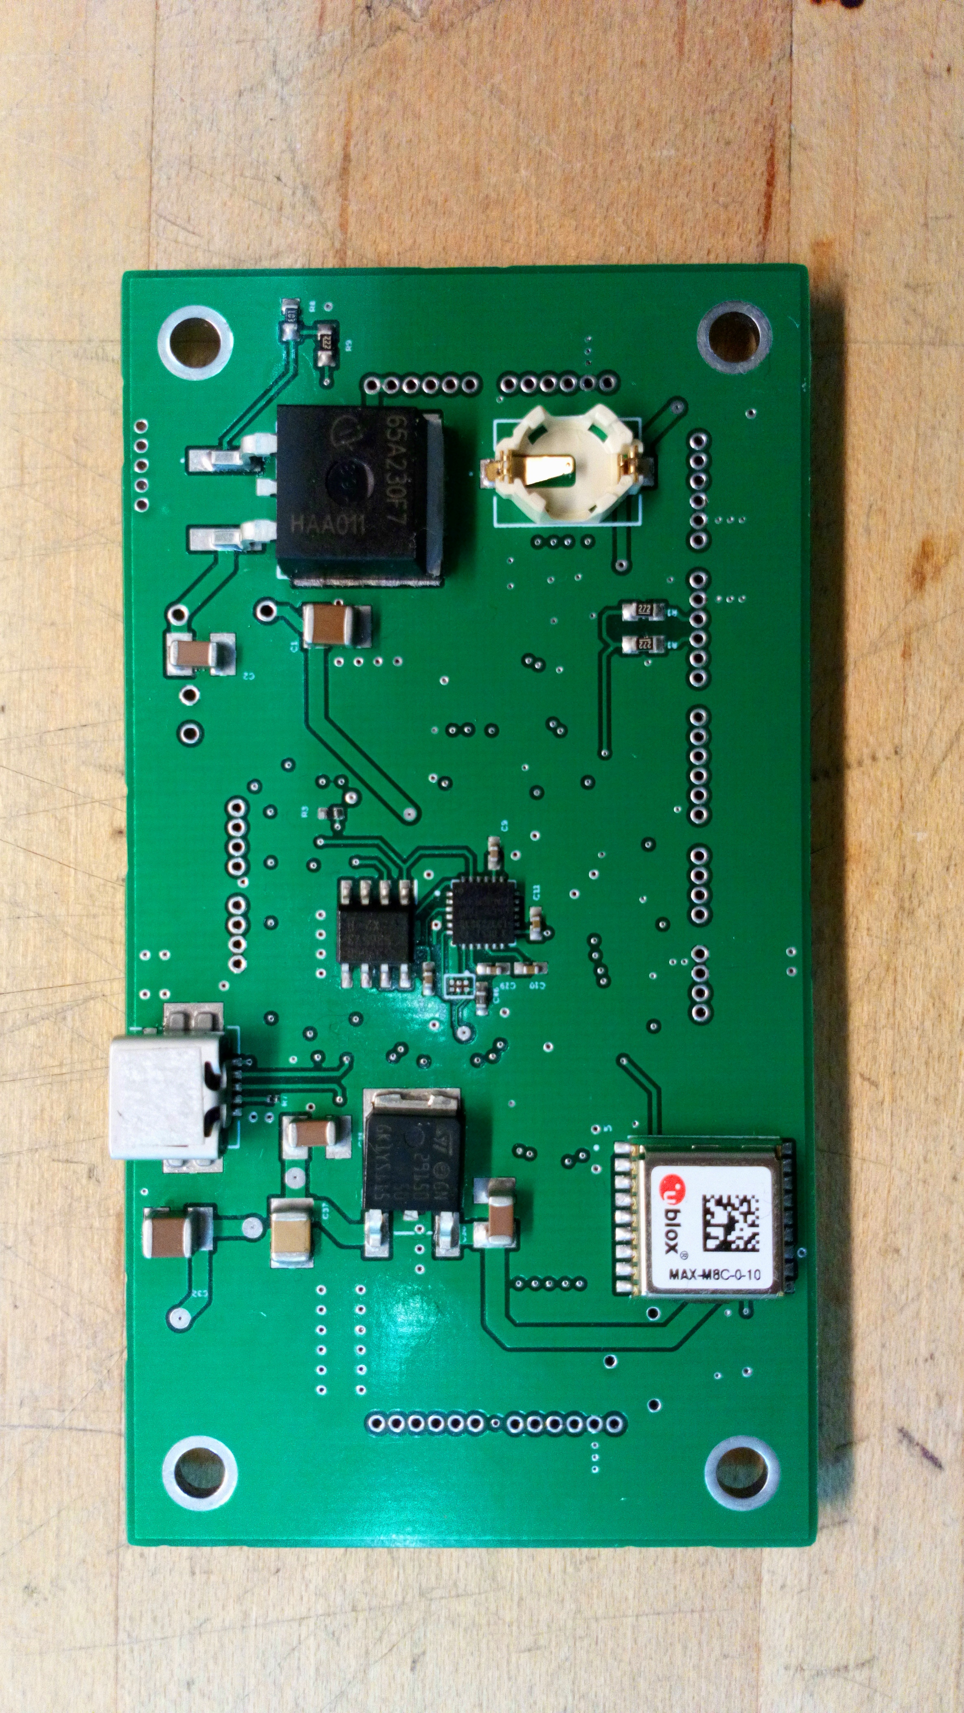
Main Board Layout
Aspect | Value
Layers | 4
Length | 3.625 in
Width | 2.2 in
Total Elements | 87
Total Elements on Bottom Layer | 26
Features | IMU Center Placement 377, 1.5v Backup Battery
Speaker: Michael Schumacher
Notes:
15

Slide 31
OBSTACLE AVOIDANCE
( Simulation Overview )
Speaker: Michael Schumacher

Slide 32
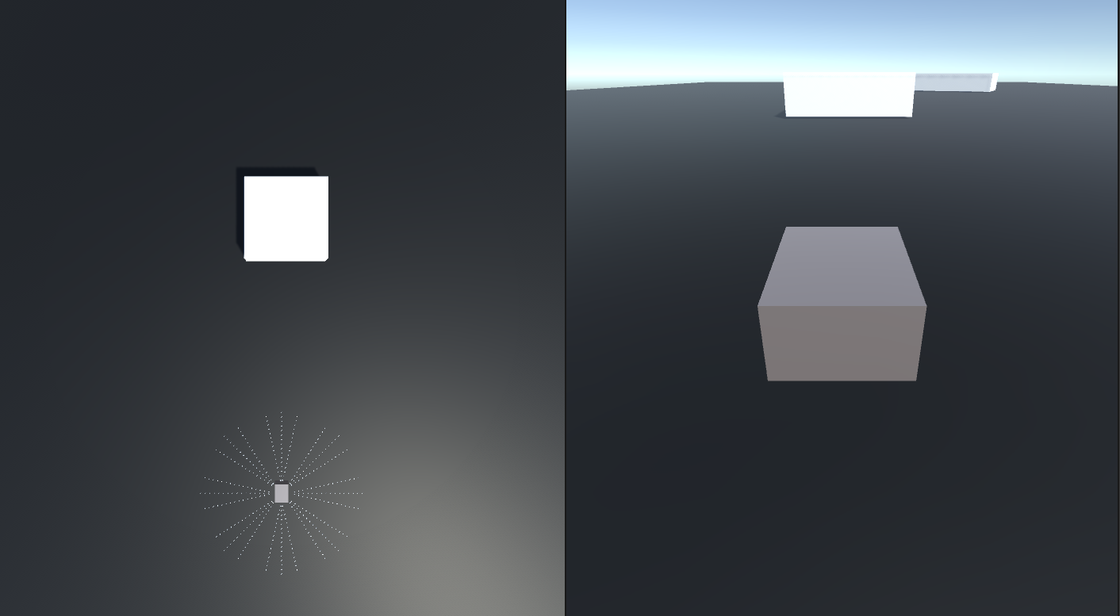
Simulation View
Speaker: Brett Parker

Slide 33
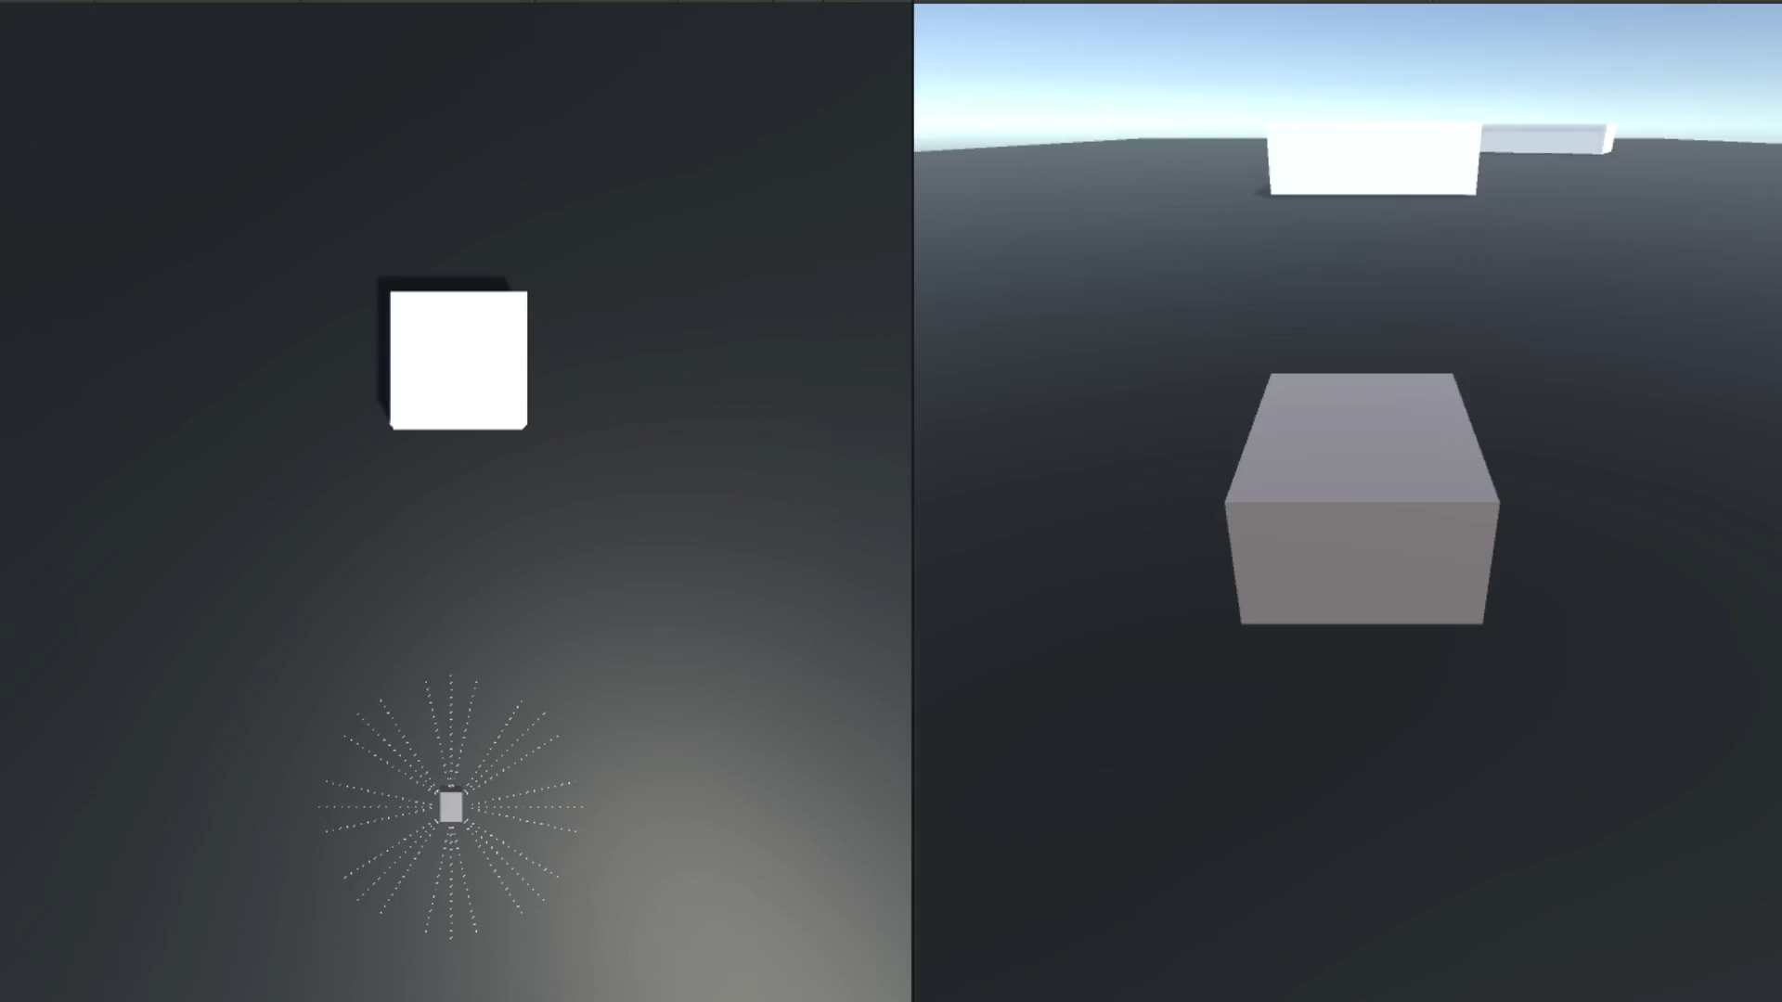
Object Detection Simulation
Speaker: Brett Parker

Slide 34
FRAME DESIGN
Speaker: Michael Schumacher

Slide 35
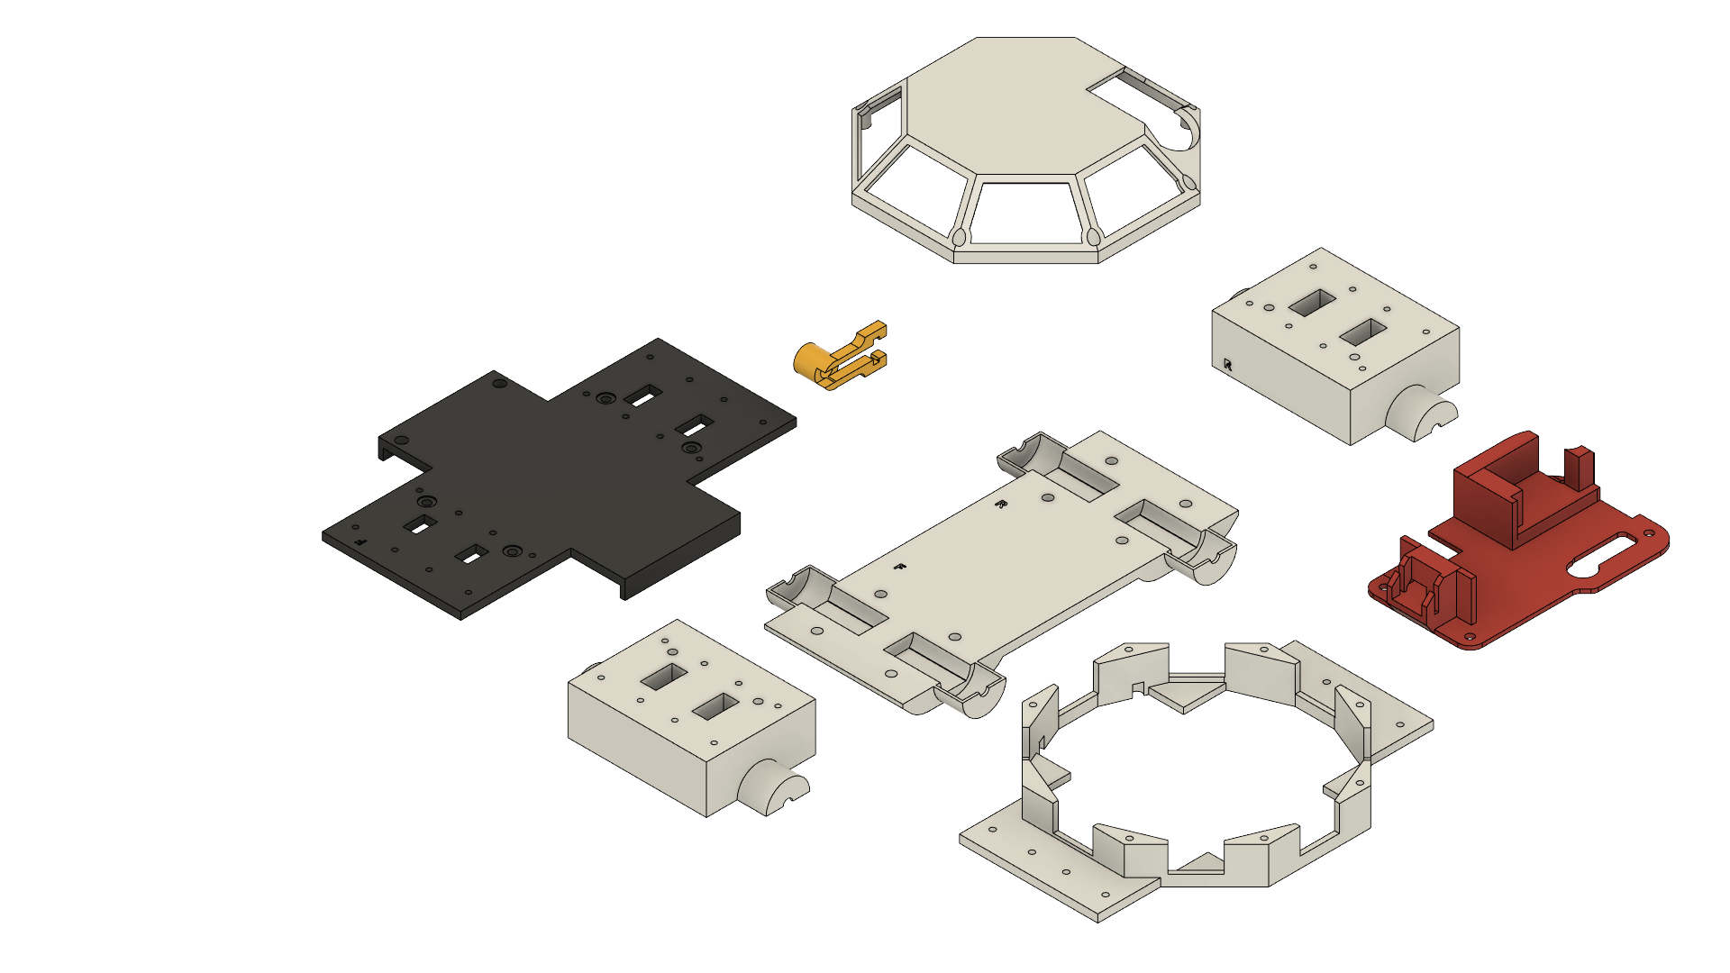
Rover Frame Design
Aspect | Value
Materials | PLA
Tolerances | 0.1mm
Total Pieces | 8
Fasteners | -M4 Screws for bottom plate -M2 Screws for top housing
Yellow Component | Antenna Holder
Red Component | Video TX System
Black Component | Middle plate / Battery Brace
Speaker: Michael Schumacher
Notes:
15

Slide 36
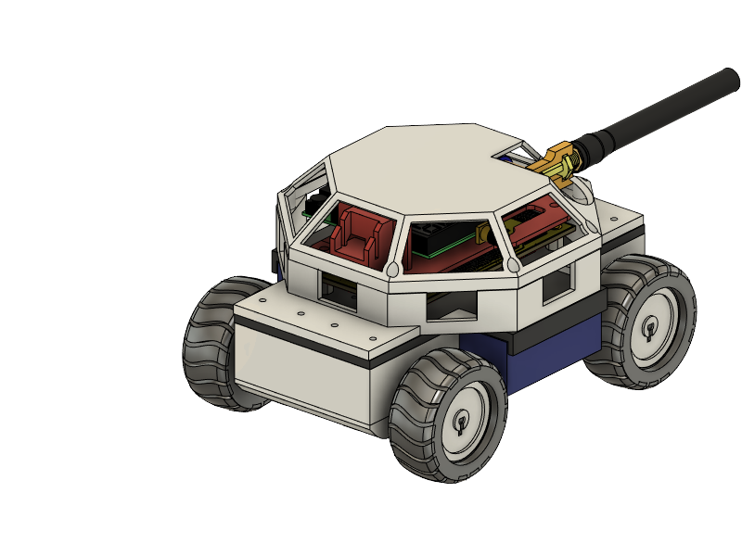
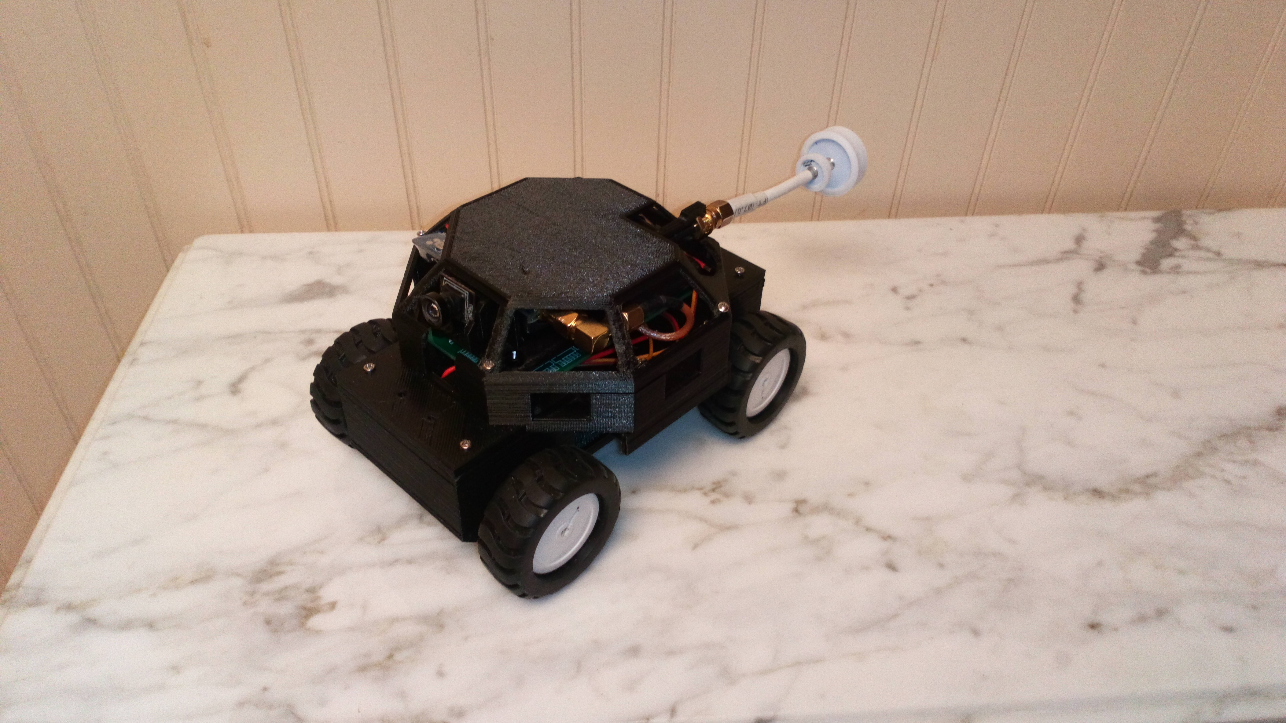
From Concept to Prototype
Speaker: Michael Schumacher

Slide 37
ADMINISTRATIVE
( BUDGET & WORKFLOW )
Speaker: Michael Schumacher

Slide 38

Bill of Materials
Bill of materials per project system
System | Actual Cost | Over/under Budget | Allocated Budget
Processing | $ 74.36 | - | $ 80.00
PCB Fabrication | $ 33.94 | + | $ 20.00
Video System | $ 44.98 | - | $ 50-100
Power System | $ 93.40 | + | $ 80.00
Sensing | $ 123.99 | + | $ 70.00
Drive System | $ 109.60 | - | $ 90.00
Miscellaneous | $46.68 |  | $100.00
Tools | $100.00 | + | $0.00
Testing Devs/Modules | $122.60 | + | $0.00
Mistakes | $13.00 | + | $0.00
TOTAL | $ 762.55 |  | $ 800.00
Sponsor contribution | -$500.00 |  | $ 500.00
Team contribution | -$262.55 |  | $ 300.00
Speaker: Michael Schumacher
Notes:
15

Slide 39
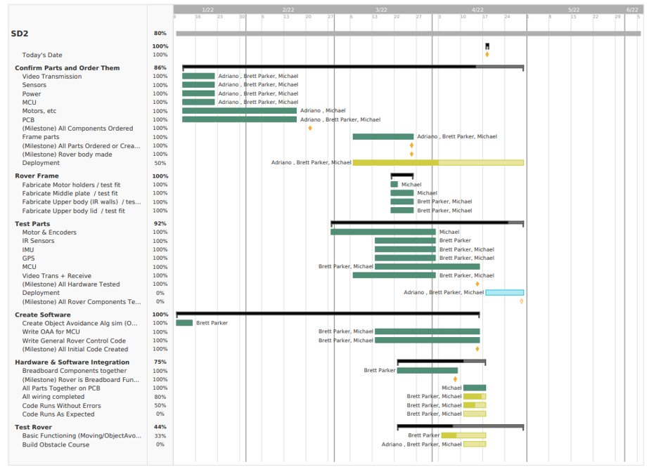
Gantt Chart
Green- Completed
Yellow- Started
Blue - Yet to Start
Speaker: Adriano Gussoni
Notes:
In this gantt chart we can see the overall progress of the rover in terms of its completion to current day.
All the parts were order, shipped and assembled to the basic frame of the rover.
The final steps for this rover was to test all our different systems but we ran into some trouble and bugs that took more time to iron out than we had expected.
We will cover the challenges we faced later, but these delays meant pushing back the deployment system we had worked on for the payload integration.
As wouldn’t be testing integration in April we decided to focus on getting the other systems functional first.

Slide 40
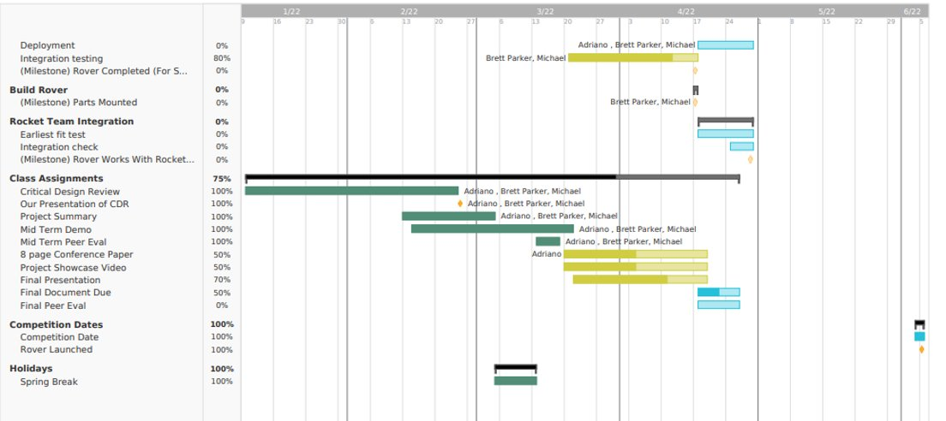
Gantt Chart Continued
Green- Completed
Yellow- Started
Blue - Yet to Start
Speaker: Adriano Gussoni
Notes:
15
The plan for the rocket teams testing is to have test launches with the integrated payload by early April.
We will meet with rocket team from around mid march to mid april to test our deployment from the rocket and our rover’s performance after deployment.
The final competition date starts June 4th.

Slide 41
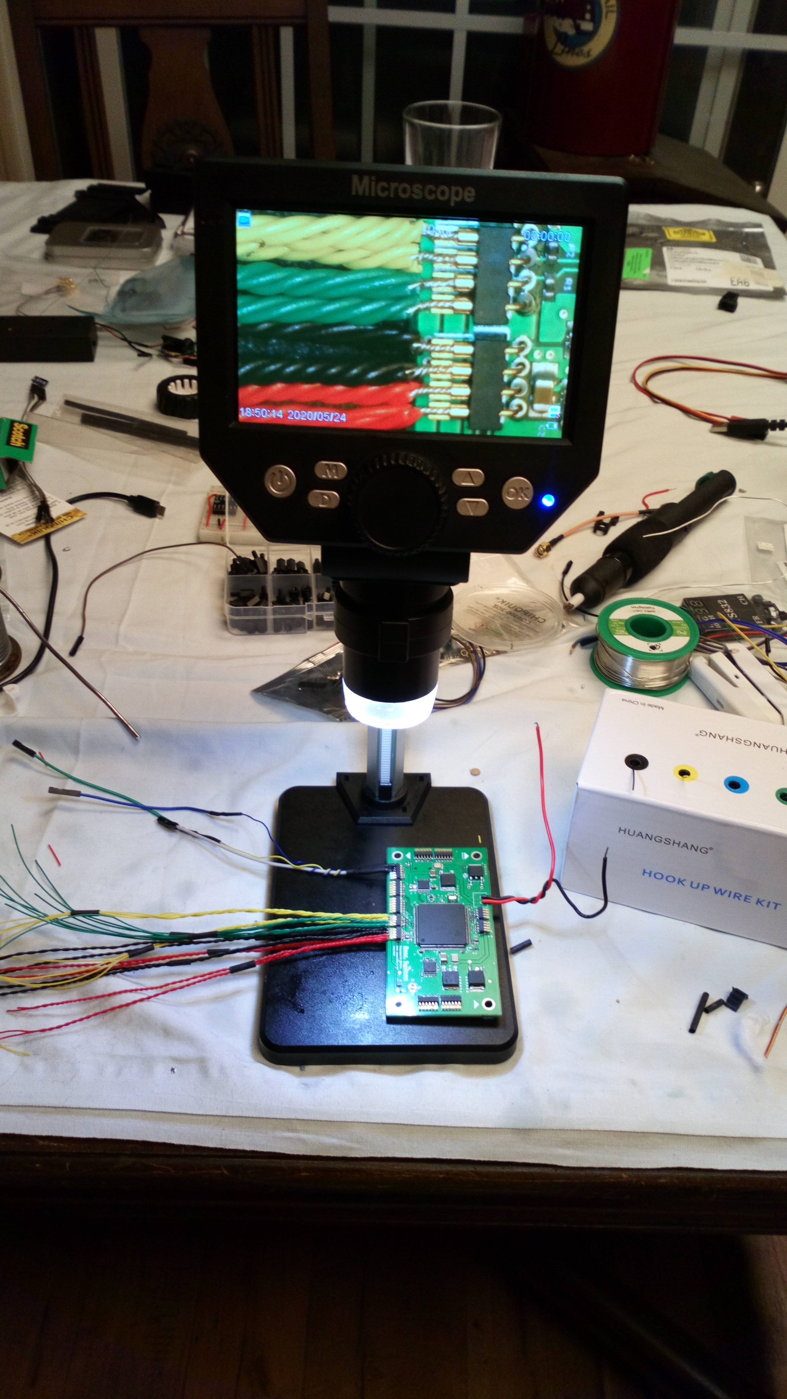
Project Challenges/Solutions
PCB assembly was top priority, with small components (mainly 0402 resistors and capacitors). Without the solder stencil, this project would cease to be.
Reduced stock of primary chosen components in original design required early purchase of said components.
Wiring external sensors and soldering 1mm pitch solder cups required patience.
Reverse engineering existing sensor drivers and modifying them to meet our project needs.
The group is composed of EECE, the project involved working on mechanical drive systems, varying sets of motors were purchased because of miscalculations of friction and overall load force when attempting the “skid steer”
Speaker: Adriano Gussoni
Speaker: Brett Parker
Notes:
discuss the group's immediate plans for the successful completion of the project
With our PCB design completed, all our needed components for testing have been submitted for ordering.
In the coming weeks, as we get the last of purchases, we will be testing our components and working to implement and integrate them.
Near the end of march, we want to have a functioning physical prototype for interfacing with the rocket teams payload deployment.

Slide 42
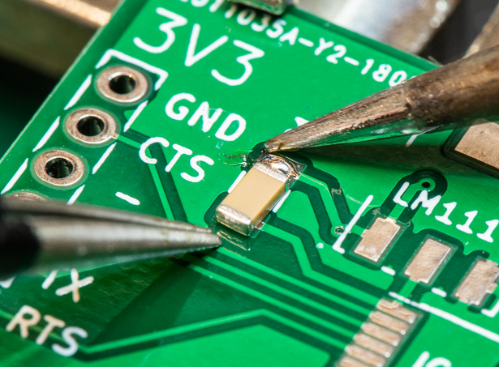


Skills Gained / Learned
Adriano Gussoni:
Working in as team within a larger, interdisciplinary project
Complex circuit board design and development
More in-depth understanding of design programs like Eagle and Fusion 360
Direct experience with SMD/SMT soldering
Speaker: Adriano Gussoni
Notes:
Being able to work side by side with other disciplines of engineering towards a common goal is an invaluable skill in the industry.
Learning how to work with other departments to integrate a product will surely be helpful later in my career.
I also learned complex circuit board design and development while working with Michael on the motherboard.
This expanded my experience and understanding in design programs like eagle and fusion 360
Finally, being able to work with small footprint surface mount technologies was a challenge but worth the experience.

Slide 43
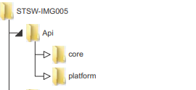


Skills Gained / Learned
Brett Parker:
First-hand experience using drivers/API for specific equipment
Having systems in the project that I didn’t personally build
Developing test code/sim code that converts to project code nicely
Speaker: Adriano Gussoni
Speaker: Brett Parker
Notes:
discuss the group's immediate plans for the successful completion of the project
With our PCB design completed, all our needed components for testing have been submitted for ordering.
In the coming weeks, as we get the last of purchases, we will be testing our components and working to implement and integrate them.
Near the end of march, we want to have a functioning physical prototype for interfacing with the rocket teams payload deployment.

Slide 44




Skills Gained / Learned
Michael Schumacher:
From schematic to prototype design.
4-Layer, compact PCB design.
Placing and reflow of 0201-0402 package size components and BGA Integrated circuits on PCB.
Programming a STM32 Cortex M4 Processor via SWD.
Practical CAD design to prototype for our project
Collaboration on an Interdisciplinary project over Microsoft Teams and Zoom
Speaker: Adriano Gussoni
Speaker: Michael Schumacher
Notes:
discuss the group's immediate plans for the successful completion of the project
With our PCB design completed, all our needed components for testing have been submitted for ordering.
In the coming weeks, as we get the last of purchases, we will be testing our components and working to implement and integrate them.
Near the end of march, we want to have a functioning physical prototype for interfacing with the rocket teams payload deployment.

Slide 45

The end GROUP 35
“It is a great profession. There is the satisfaction of watching a figment of the imagination emerge through the aid of science to a plan on paper. Then it moves to realization in stone or metal or energy. Then it brings jobs and homes to [families]. Then it elevates the standards of living and adds to the comforts of life. That is the engineer's high privilege.”
- Herbert Hoover
Big thank you to our sponsor
Aerojet Rocketdyne Coleman Aerospace
Adriano Gussoni
Michael Schumacher
Brett Parker

