Slide 1


FoodieRover CDR
Group 29

Slide 2



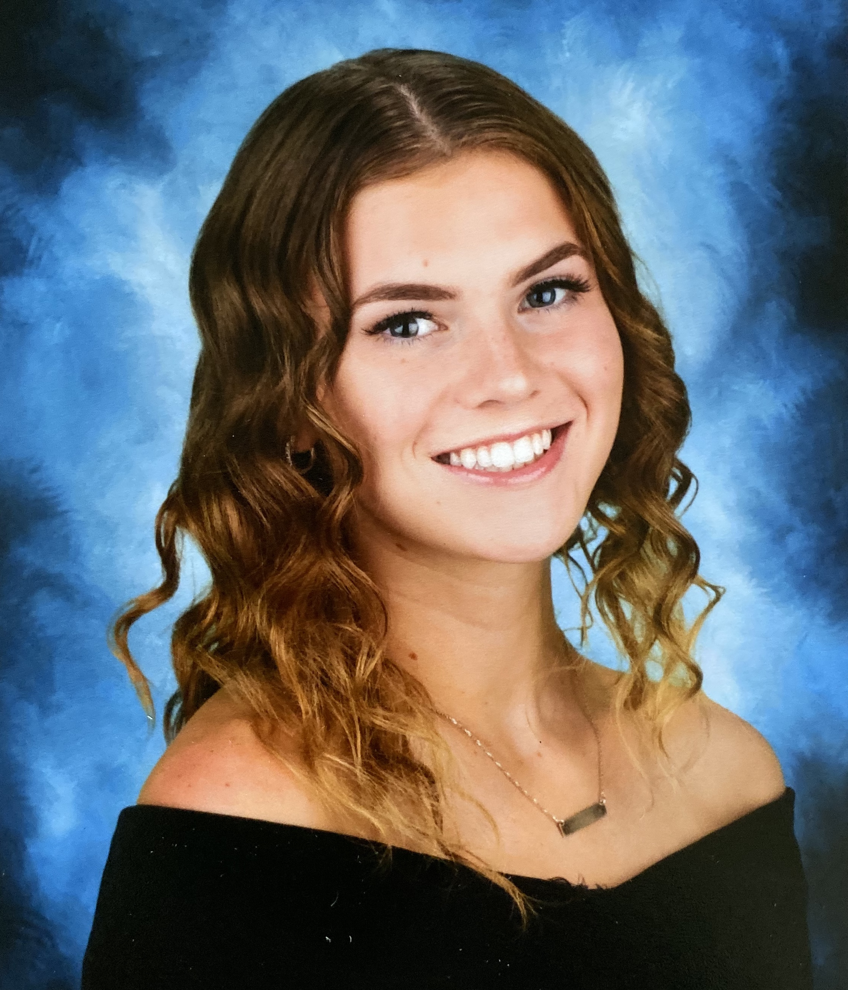
Team Members
Mauricio Ferrari
Computer Engineer
Chidoziri Maghiro
Electrical Engineer
Antonia Soto
Electrical Engineer
Alexis Gyselinck
Electrical Engineer

Slide 3
Motivation & Description
Reduce time wasted waiting for orders from busy campus restaurants.
Provide full-time students with a more efficient lunch break.
Enhance productivity by eliminating the need to leave workspaces for meals.
Autonomous ground vehicle that doubles as a food convoy.
Integrates Google Maps’ Directions API for path planning.
Companion mobile application for user interactivity.

Slide 4
Goals
Basic Goals
Path planning done remotely
Food is safely stored with a magnetic lock
Companion app can communicate arrival and passcode
Detect static objects
Advanced Goals
Detect dynamic objects
Obstacle avoidance (rerouting)
Track FoodieRover from app
Implement neural network to identify objects

Slide 5
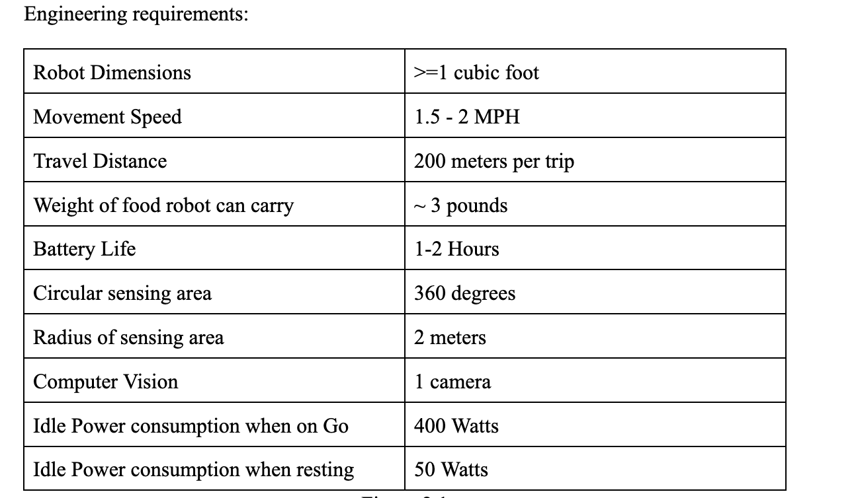
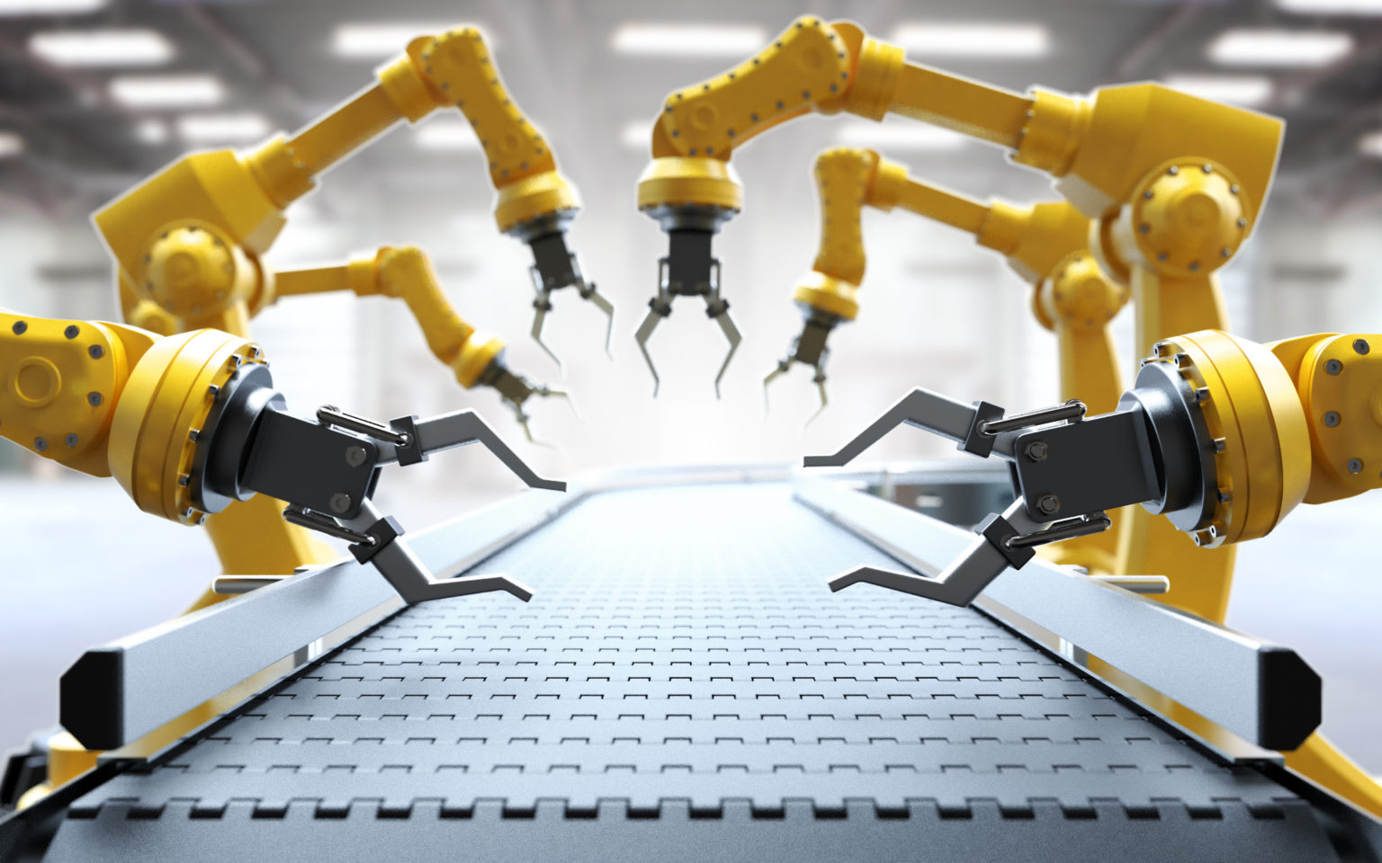

Engineering Specifications:

Slide 6

Obstacle Detection
FoodieRover will adapt to the different conditions it will encounter while delivering food. Its hardware design will accommodate for the non-ideal scenarios it may encounter.
We are providing FoodieRover with 8 ultrasonic sensors:
  One for each side (front/back/left/right) and then one for each shoulder.
In addition to this, we are also looking into implementing cameras and using computer vision to aid in obstacle detection and routing.
  Ideally, we would have one wide-angle camera.

Slide 7
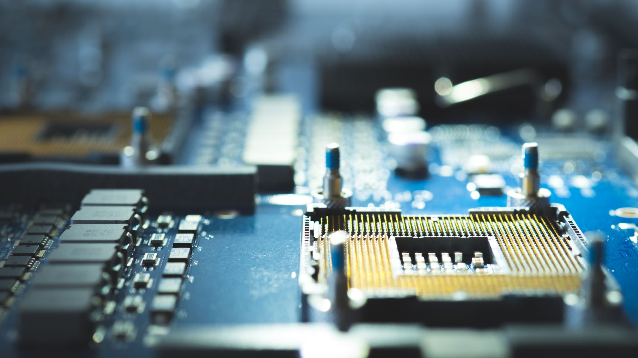
User Interface
The application will support two types of users:
  Consumer
    The consumer interface needs to have options to put in orders, enter drop-off locations, and unlock the container.
  Producer
    The producer side needs to be able to support commands to deliver food, return to base, and post food items

Slide 8
Engineering Specifications: API
A key component of the software is its API capabilities.
  This would require FoodieRover to have a wifi-chip so that it can make the API calls.
  As of now, the two servers we’re looking to contact is Google Maps and the eventual server of the application.

Slide 9
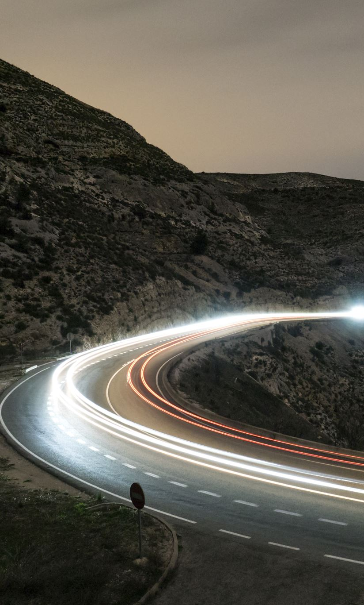
Performance
FoodieRover will be expected to travel distances over 200 meters per trip at a speed of 1.5 to 2 miles per hour.
It will carry around 3 pounds of food kept fresh by insulating material.
While delivering food the power consumption will be kept under 400 Watts.
When not moving, the bot ideally will reduce its power consumption to under 50 Watts.
The battery capacity will correspond to 1 to 2 hours of runtime with a battery that can be replaced and recharged.

Slide 10
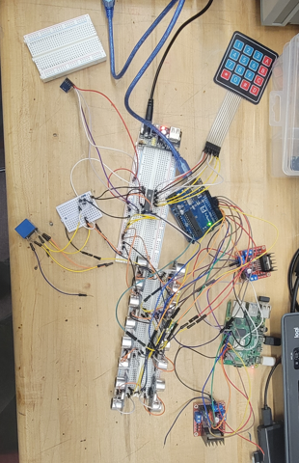

Hardware
Microprocessor & Microcontroller
  GPIO Expander
  Bi-Directional Logic Level Converter
Motor Drivers
  DC motors
Sensor array: Ultrasonic Ranging Module
Navigation hardware: Magnetometer & GPS module
Locking Mechanism: Magnetic lock, Keypad & Relay
Battery
  Fuses
  LiPro Balance charger

Slide 11
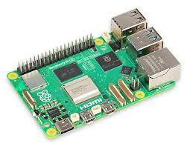
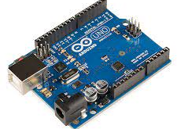
Raspberry Pi 4 Model B & Arduino Uno
Using an MPU:
Full operating system
Network connectivity
Using an MCU:
Real time communications
Connectivity (GPIOs)
They are complementary in their application for FoodieRover

Slide 12
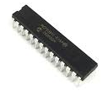
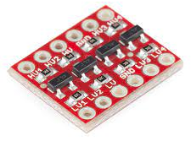
GPIO Expander & Level Shifter
To accommodate the extensive connectivity requirements for sensors and peripherals on the Arduino Uno, we employ an MCP23017 GPIO expander.
16 additional I/O ports
I2C interface
To ensure safe and reliable communication between the 3.3V Raspberry Pi board and the 5V Arduino Uno, we employ the BOB-12009 level shifter.
Voltage compatibility with bi-directional communication
High speed data transmission
Both offer cost-effective solutions with ease of integration to the system

Slide 13
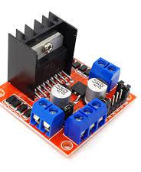
Motor Drivers
The FoodieRover chassis comes with four 12V DC motors. There is the need to control the direction and speed for each of the motors by a controller for effective maneuvering.
We are using two L298N Dual H-Bridge Motor Drivers
Dual bidirectional control of two motors
Up to 2A output per motor
Power LED indicators for operational monitoring
Compatible with microcontrollers and manual control setups

Slide 14
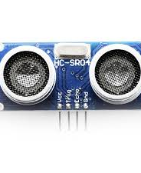
Ultrasonic Ranging Module
To provide FoodieRover with the ability to sense object within two meters of distance and provide comprehensive spatial detection. We are implementing the Ultrasonic Ranging Module HC - SR04.
Ultrasonic: widely used for automotive applications
Accurate readings from 2cm to 400cm
Cone shape measuring angle of approx. 15 degrees
Digital I/O communication
Cost-effective and easy of integration
Implementing 8 sensors for each face and corner of the bot.

Slide 15
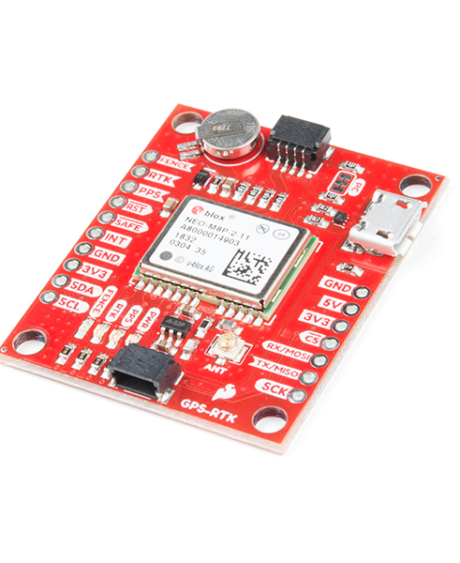
GPS Module
SparkFun GPS-RTK Board - NEO-M8P-2
Enables the application of real time kinematics
Accuracy: 0.025 m (w/ RTK)
Moving baseline RTK - 4 Hz
Price: $179.95
Requires RTCM correction stream:
  Florida DOT
  Polaris

Slide 16
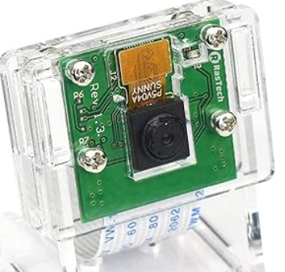
Rasp Pi Camera Module
This camera module is popular in Raspberry Pi projects and implements well with TensorFlow Lite applications.
5 MP
1080p @ 30 fps
720p @ 60 fps
Field of View: 2.0 x 1.33m at 2 m
15-pin MIPI camera serial interface

Slide 17
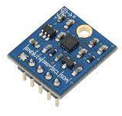
Magnetometer
To give FoodieRover a sense of direction for navigation we are incorporating the Compass Module 3-Axis HMC5883L to leverage the Earth’s magnetic field.
3-Axis magnetoresistive sensor
1 to 2 degree compass heading accuracy
I2C communication interface
Low power consumption and compact

Slide 18
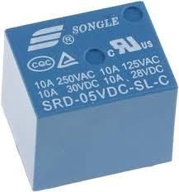
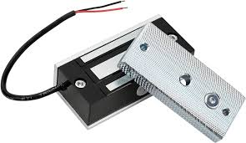
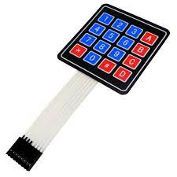
Magnetic lock, Keypad & Relay
FoodierRover’s lock mechanism to keep the food stored safely consists of the following components:
AGPtek® 60kg 130LBs Holding Force Electric Magnetic Lock
Relay: SRD-05VDC-SL-C
4x4 KeyPad

Slide 19
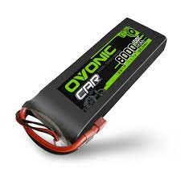
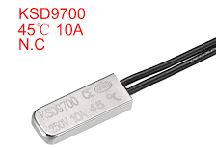
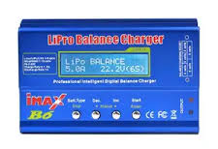
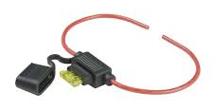
Battery
Ovonic 100C 11.1V 8000mAh 3S LiPo Battery
High energy density
Lightweight and compact
Fast Recharge Times
Low Self-Discharge Rate
Safety: current fuse (10A), thermal switch (45C), and LiPro Balance charger.

Slide 20
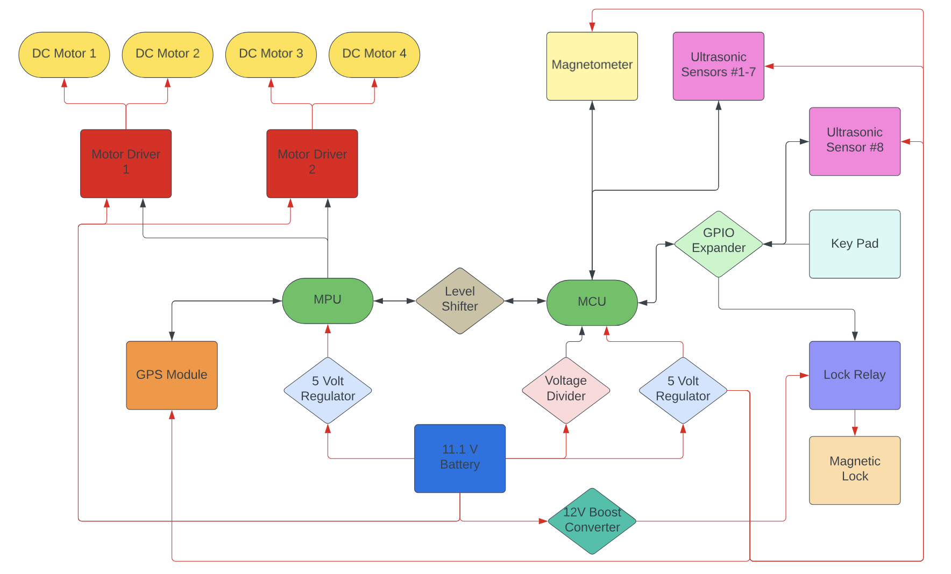
Hardware Design - Global Block Diagram
Red connections: Power transfer
Black connections: Data transfer

Slide 21
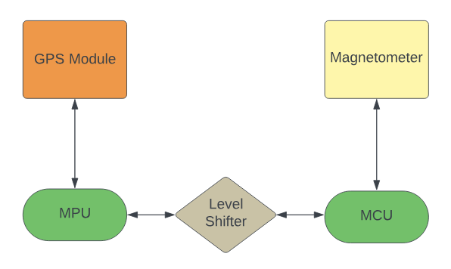
Hardware Design - Navigation System

Slide 22
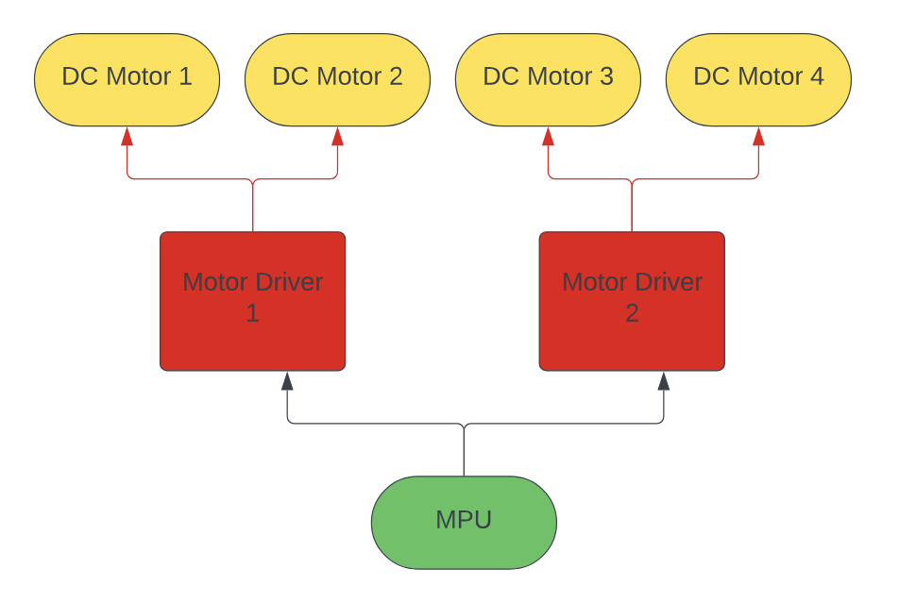
Hardware Design - Motor System

Slide 23
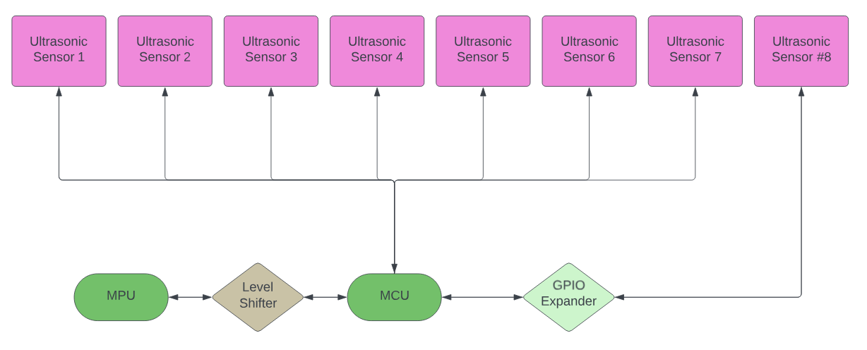
Hardware Design - Sensor System

Slide 24
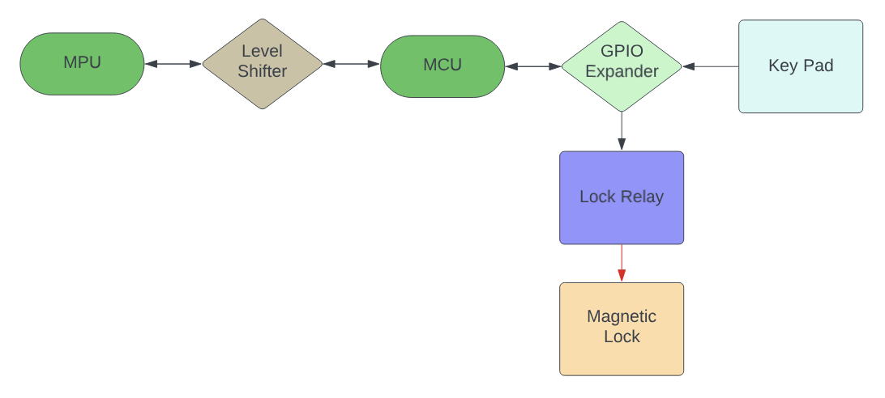
Hardware Design - Locking System

Slide 25
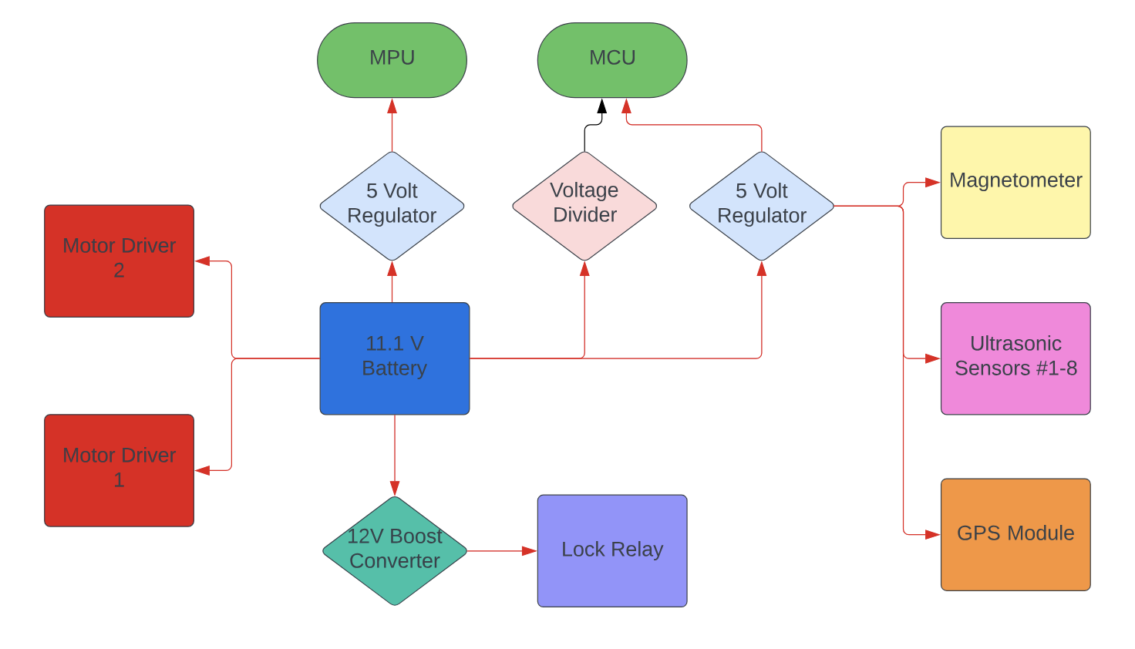
Hardware Design - Power System

Slide 26
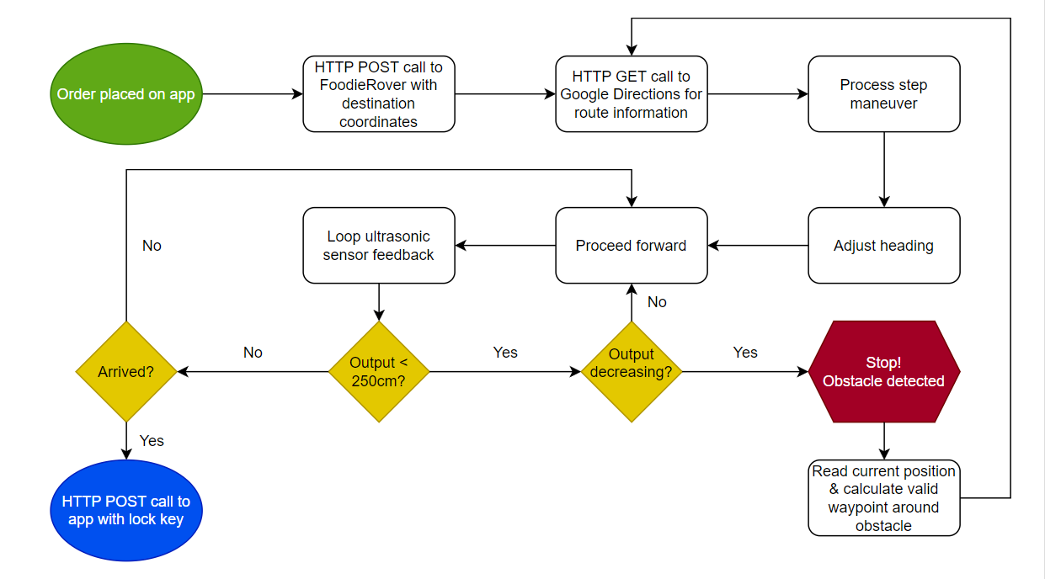

Software Design

Slide 27
Comparison of Software
Python
ROS
Automatic Memory Management
Slower due to interpretation and dynamic typing
OpenCV, TensorFlow
C++
Arduino IDE
Manual Memory Management
Faster thanks to compilation to native machine code
JavaScript
React Native
Automatic Memory Management
Supports server-side scripting

Slide 28
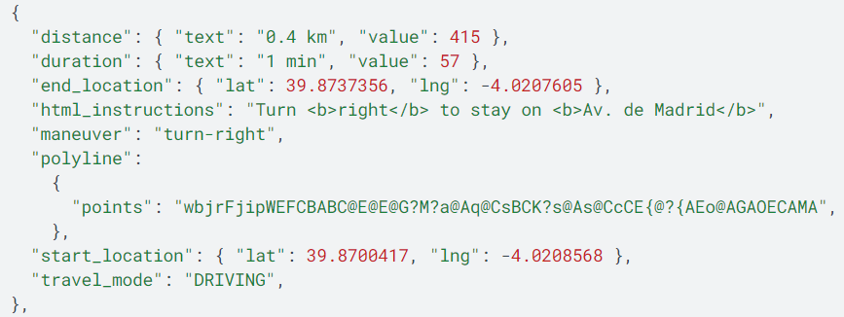
Google Maps Directions

Slide 29
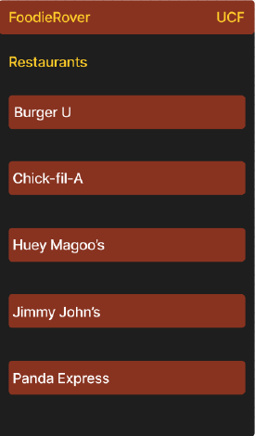
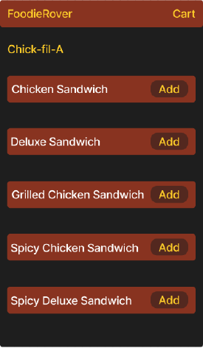
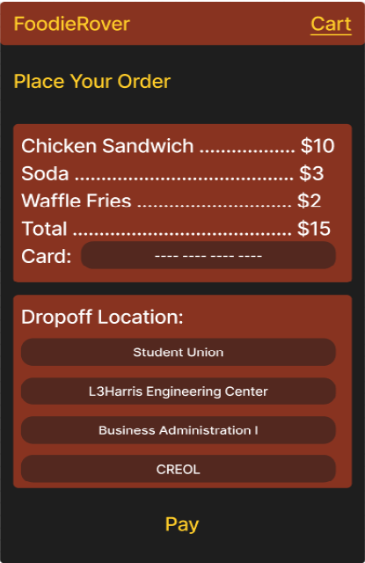
Mobile App

Slide 30
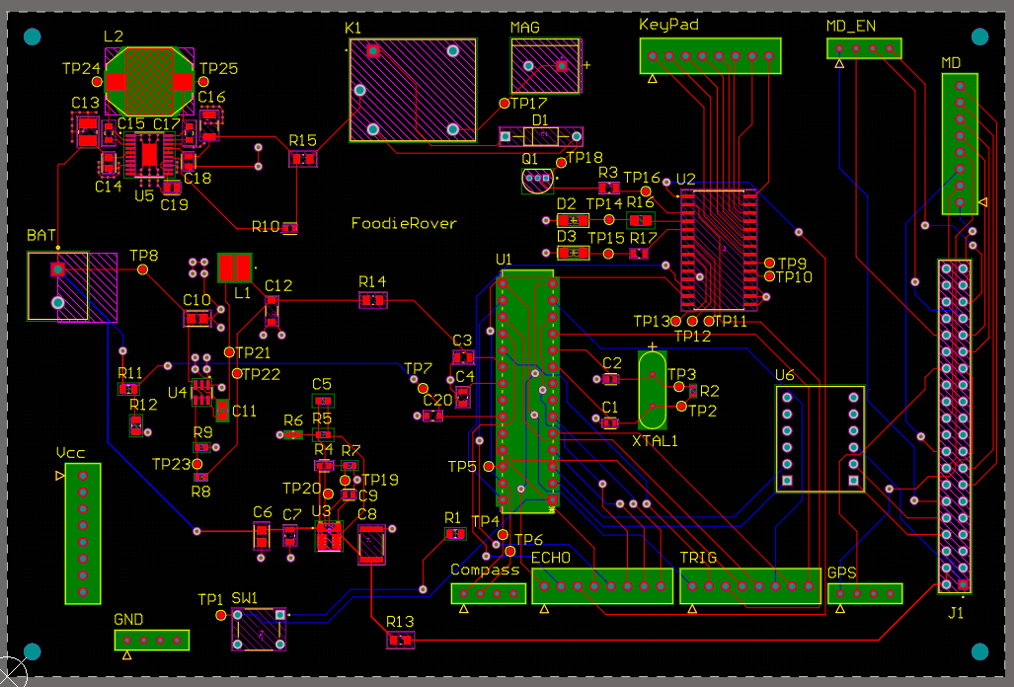
PCB Design
Microcontroller: ATMEGA328P
Level Shifter: BOB-12009
GPIO Expander: MCP23017
Relay: SRD-05VDC-SL-C
Voltage Regulators
  tps561201 (5V1A)
  tpsm863252 (5V3A)
  tps55165-q1 (12V1A)
Connectors & Connector to Raspberry Pi

Slide 31
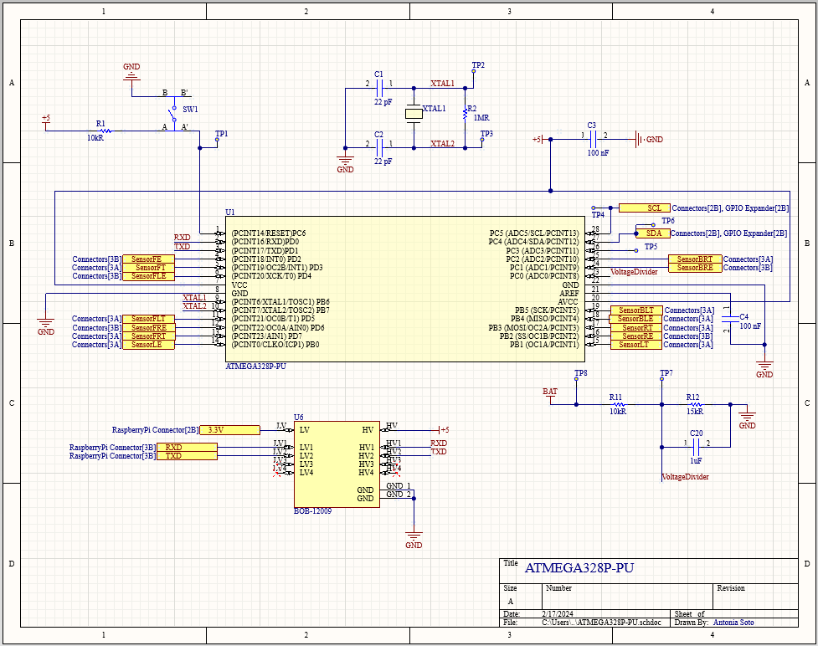
Microcontroller: ATMEGA328P
Voltage Divider
Level Shifter: BOB-12009

Slide 32
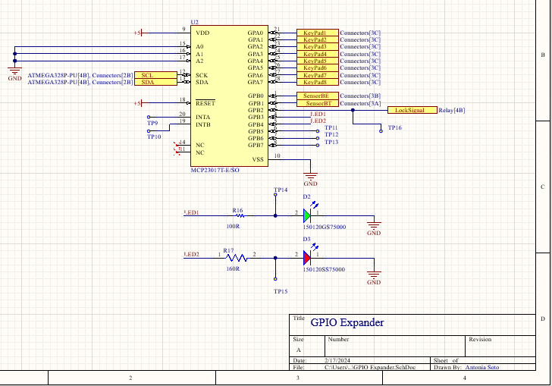
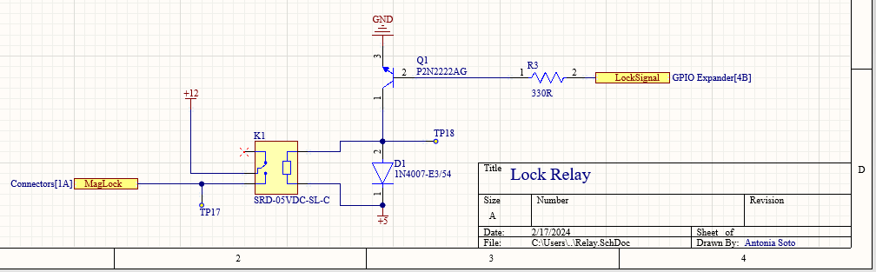
GPIO Expander: MCP23017
Relay: SRD-05VDC-SL-C

Slide 33
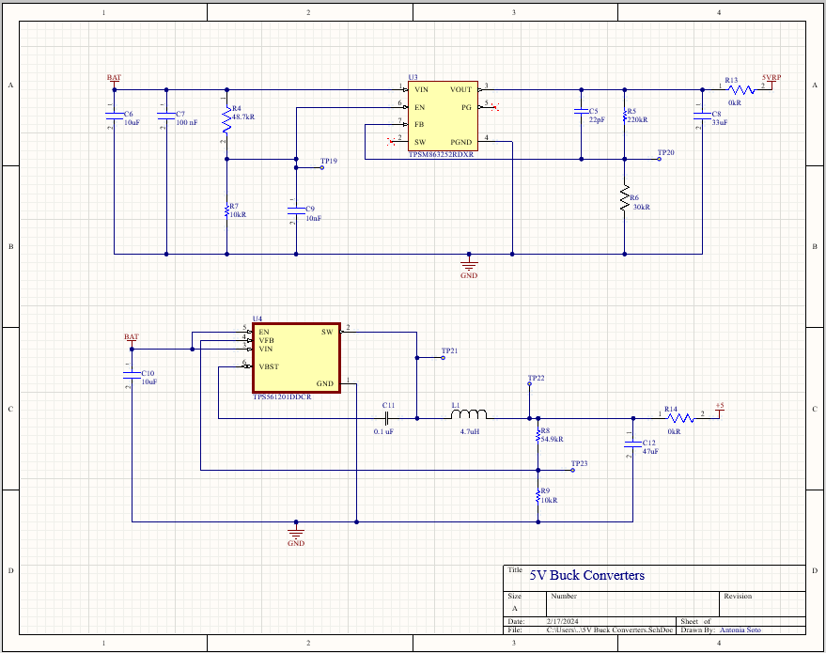
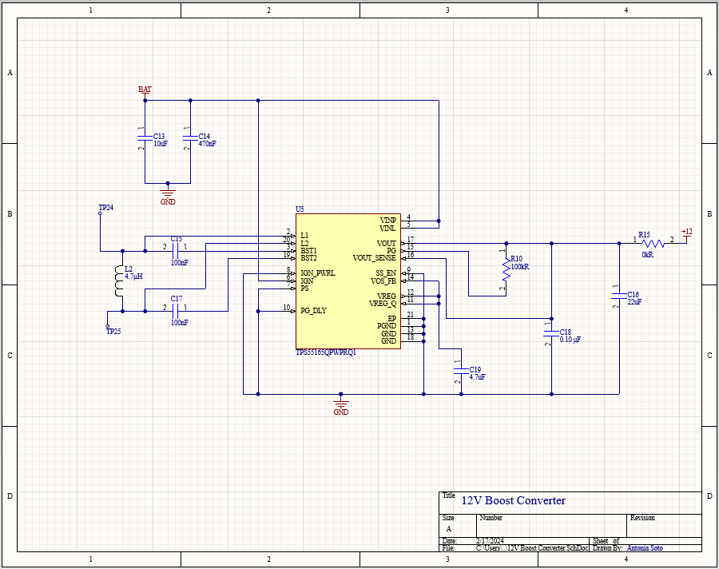
5V Buck Converters
  tpsm863252 (5V3A)
  tps561201 (5V1A)
12V Boost Converter
  tps55165-q1 (12V1A)

Slide 34
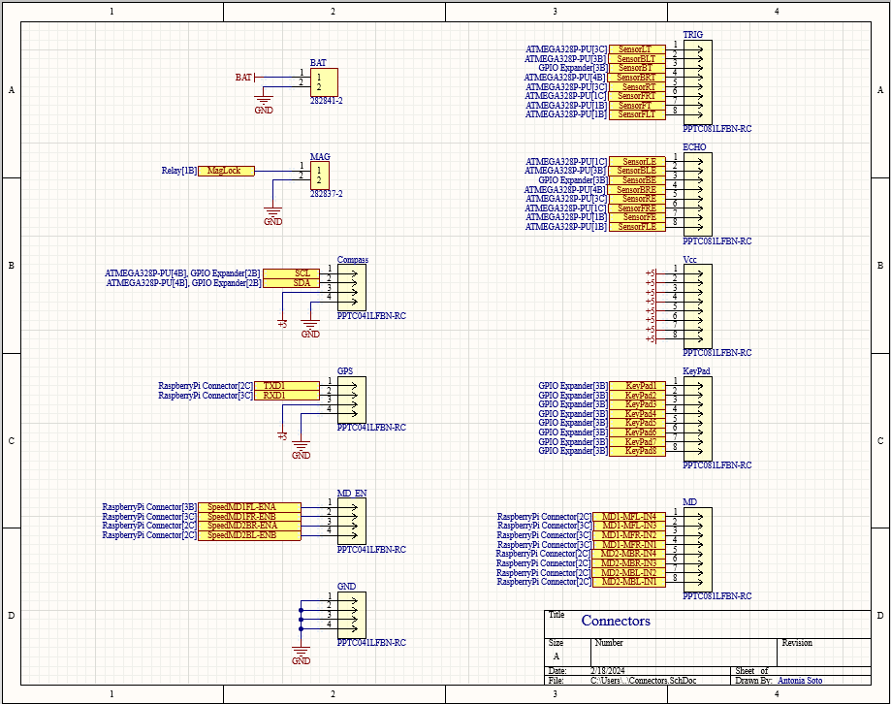
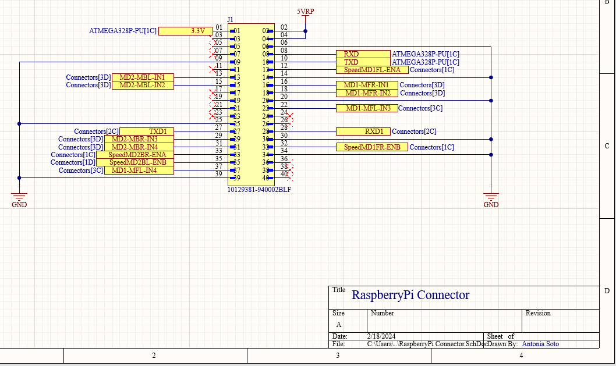
Connectors to Peripherals
Connector to Raspberry Pi

Slide 35
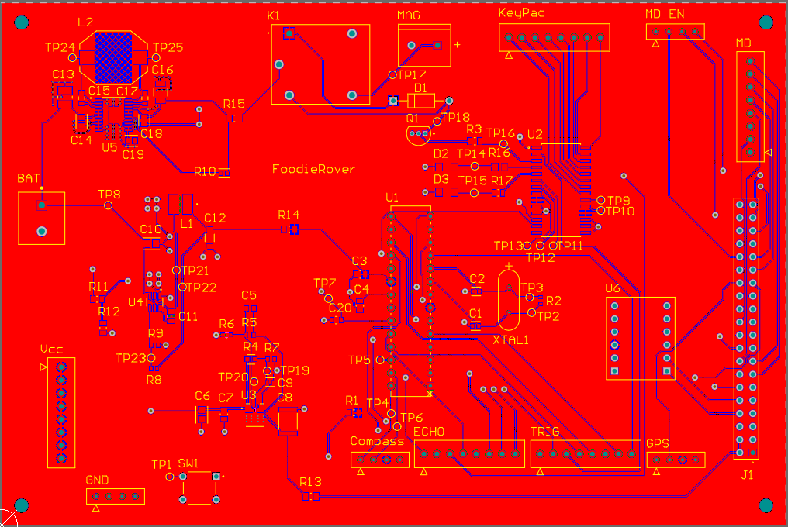
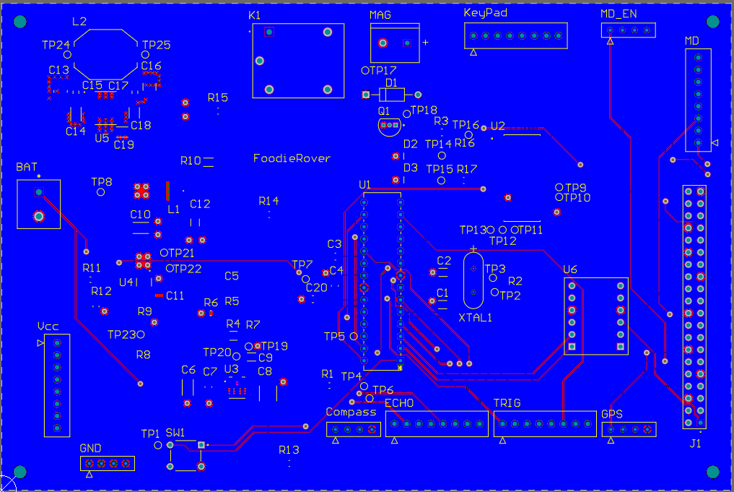
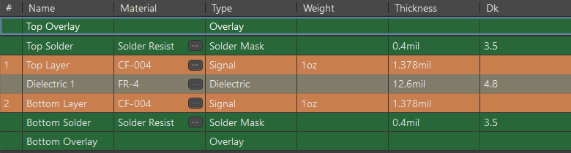
Top Layer
Bottom Layer
Layer Stack Manager

Slide 36
Budget
ITEM | QUANTITY | PRICE | TOTAL COST
Magnetometer | 1 | $11 | $11
GPS Module | 1 | $25 | $25
Motors | 2 | $26 | $52
Robot Chassis | 1 | $170 | $170
MPU | 1 | $32 | $32
Motor Drivers | 2 | $15 | $30
Ultrasonic Sensors | 8 | $9 for 5 | $18
Keypad | 1 | Previously owned | -
Battery | 1 | $43 | $43
GPIO Expander | 1 | $9 | $9
Level Shifter | 1 | $4 | $4
Lock Relay | 1 | $4 | $4
Magnetic Lock | 1 | $21 | $21
Cooler | 1 | $34 | $34
API | 1 | $30 | $30
PCB & Associated Components | 5 | - | $102
TOTAL |  |  | $585

Slide 37
Work Distribution
Component | Primary Member | Secondary Member
Communication Module | Mauricio | Alexis
Software | Mauricio | All
Motor System | Chidoziri | Alexis
Magnetometer | Chidoziri | Alexis
Ultrasonic Sensors | Chidoziri | Antonia
Microprocessor | Antonia | Mauricio
PCB | Antonia | All
Navigation Module | Antonia | Mauricio
Locking System | Alexis | Chidoziri
Power System | Alexis | Chidoziri

Slide 38
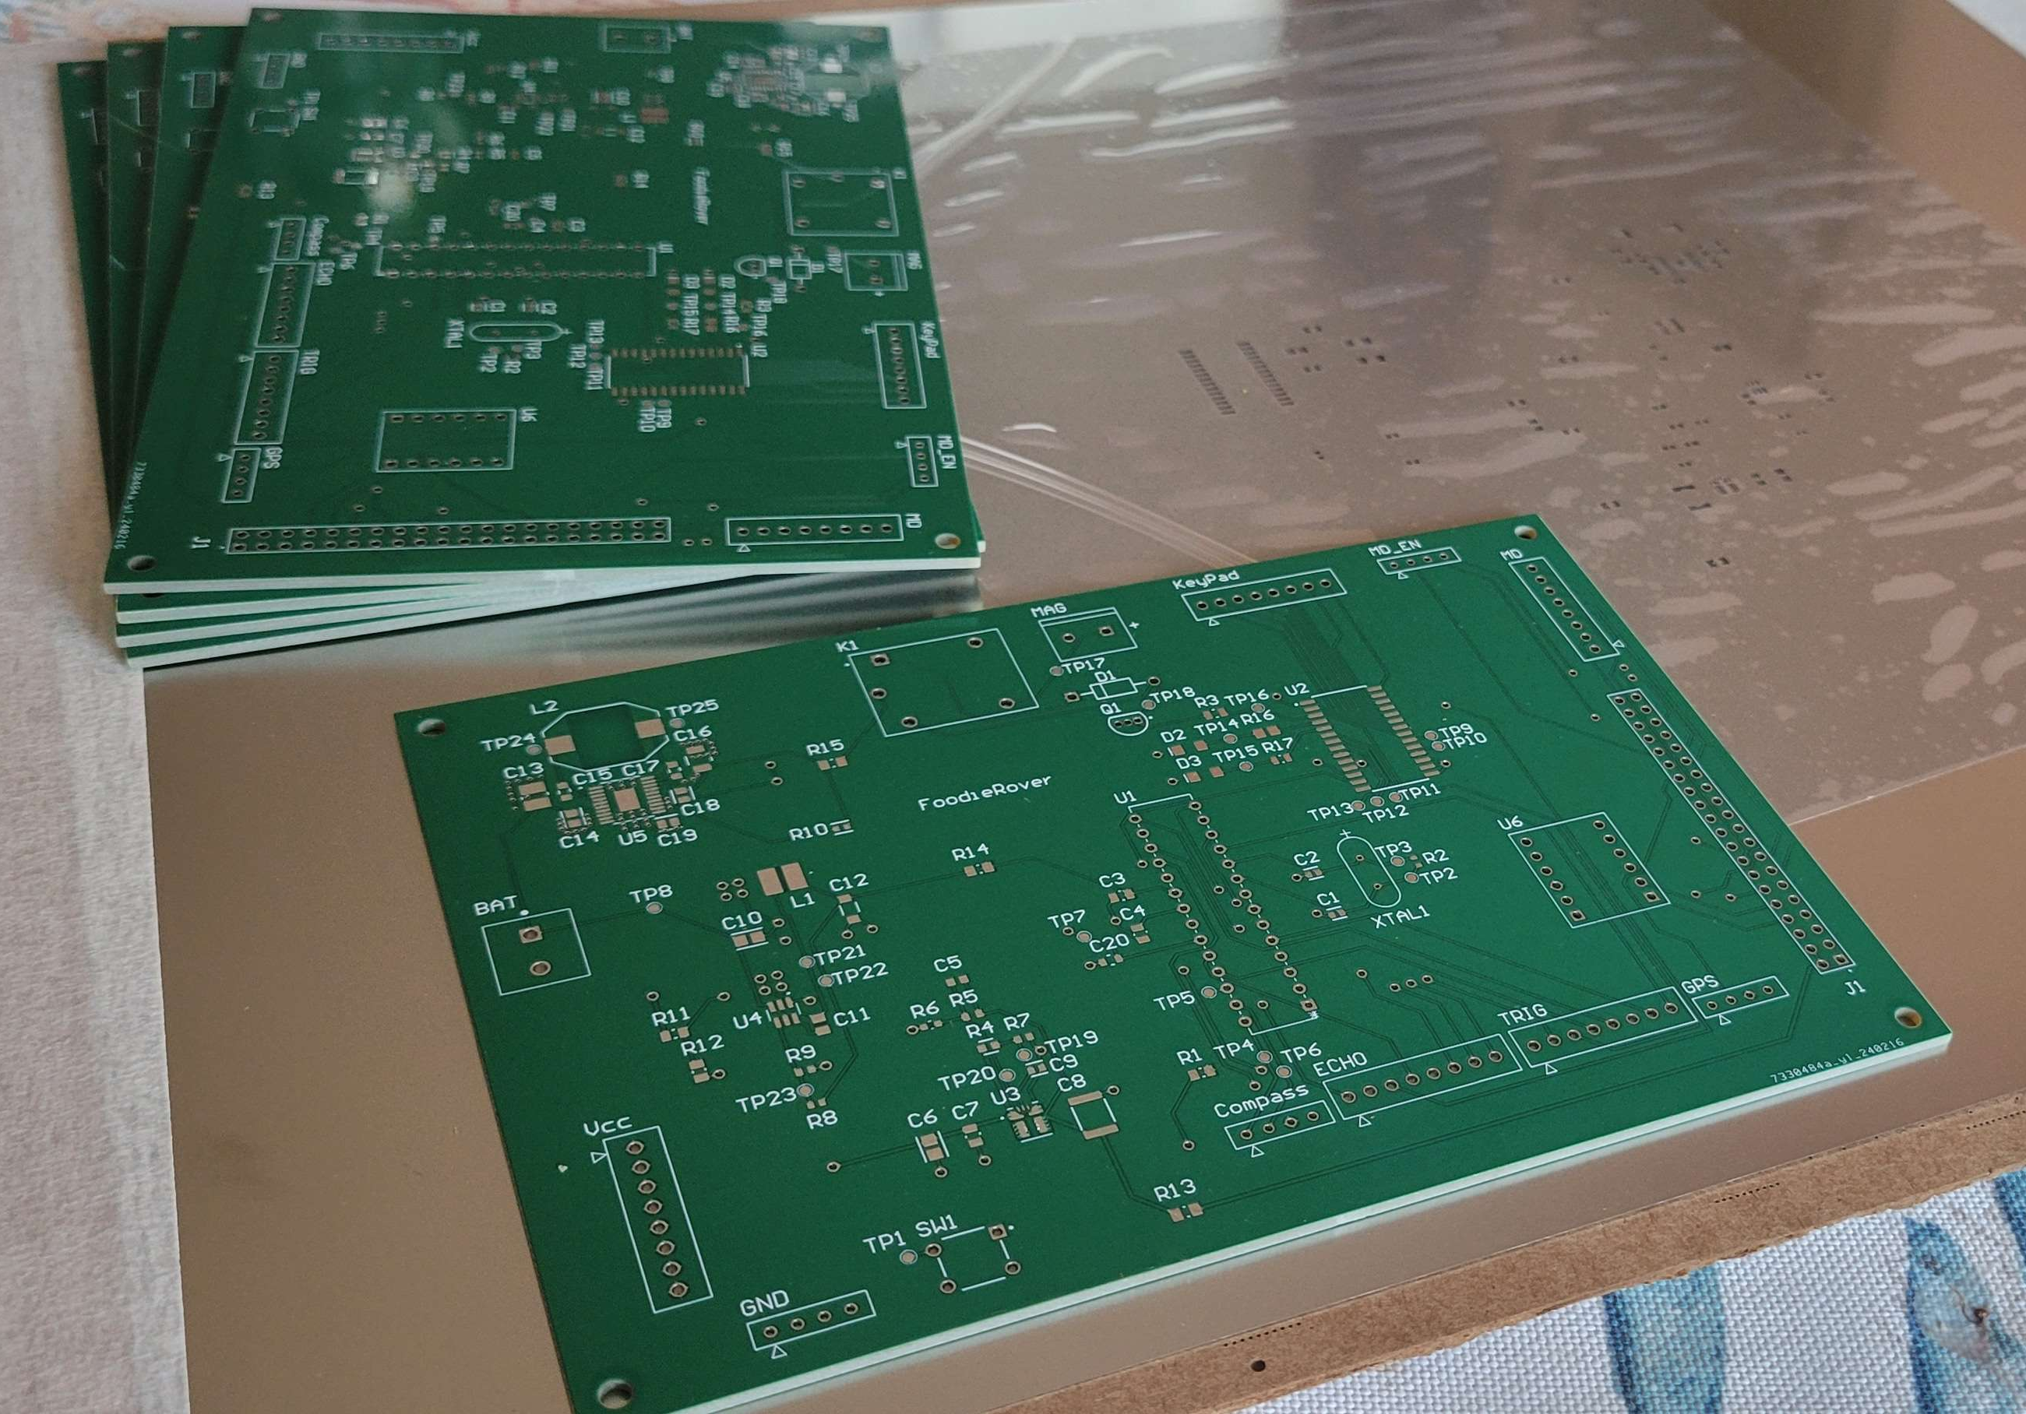
Progress
Major hardware components have been tested individually and subsystems have been tested while interfaced.
The PCB recently arrived and further testing will begin shortly.
Embedded stack is underway while mobile app development and server is taking precedence.

