Slide 1

Shell-Blocked
Programming Education Aid
Group 37

Slide 2




Team Members
Renso
Computer Engineering
Gabriel
Computer Engineering
Anthony
Computer Engineering
Noel
Electrical Engineering

Slide 3
Project Overview
Overview
Our project introduces a four-wheel robotic car with high maneuverability, designed to captivate and educate users through interactive play and engagement.
In order to interact with the robot, slots on the body of the car allow placements of up to fifteen command blocks, giving a high potential of possible movements and actions.
Additional supporting features including proximity sensors, lights, and speakers contribute to the main functionality and provide additional stimulus.
The robot itself possesses a turtle themed design and colors, along with a shell to access the slots and block placement.
Main Components
Mecanum wheels provide movement in eight directions
Cardinal and intercardinal.
RFID reader array provides a simple way to slot blocks and provide functionality to robot.
Speakers, lights, and proximity sensors add interactive elements.

Slide 4

Motivation and Background
MOTIVATION
The rising need for technology competence even in younger children.
Online exams
Online homework
Looking for resources on the internet
Limiting screen usage during education of younger students.
Removing the barrier of entry for technology education that computers or tablets may pose.
BACKGROUND
Group members have had years of experience teaching young children how to code and understand how difficult it can be.
Most children associate tablets or computer primarily with gaming or consuming content.
Since we are not using any screens in our project, there needed to be some visual feedback to the students, which is why we chose a robotic car.

Slide 5
Goals and Objectives
Basic Goals
Build a codeable robot with 15 RFID sensors
Design several code blocks that will instruct the robot what to do and in what order
Allow for omnidirectional movement using mecanum wheels
Implement simple obstacle detection to avoid dangerous scenarios
Provide a fun and interactive, but safe experience for our users
Create an aid for education and experimentation
Advanced Goals
Add customizability to the robot to increase engagement
Add different “modes” with fun objectives for our users to accomplish
Implement more complicated blocks that teach if-statements and other coding concepts

Slide 6
Engineering Specifications
 | Specification
1.0 | The robot will be able to operate continuously for at least 2 hours on a single charge.
2.0 | The robot will be able to detect any obstacles within a foot of its range in its motion of direction and be able to stop and avoid a collision.
3.0 | The robot will be able to control all four of its motors independently and be able to coordinate their movements.
4.0 | The robot will accurately be able to turn 90 degrees in any direction and also be able to chain multiple turn commands in a row.
5.0 | The robot will accept any combination of code block commands and execute them with a maximum 3 second delay.
6.0 | Users of the coding blocks and robot should be able to learn 75% of its functionality within an hour of use.

Slide 7
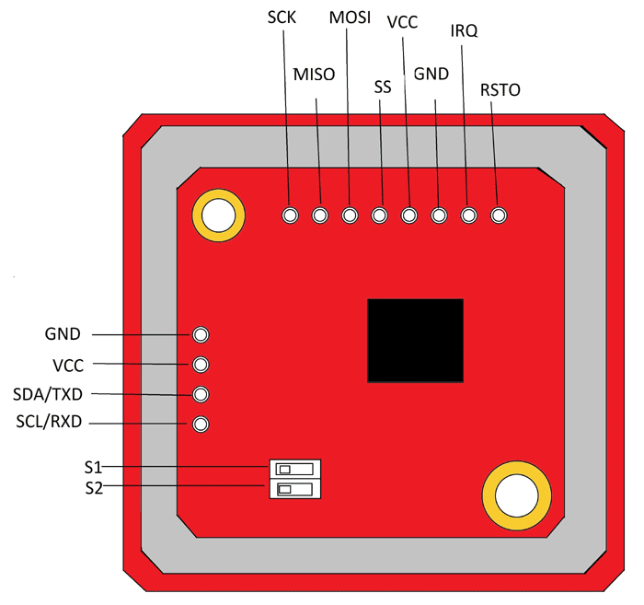
Communication Technology Comparison
Method | RFID (Radio Frequency Identification) | Resistance Detection | BLE (Bluetooth Low Energy)
Power Consumption | 0.1 - 0.26 Watt | 0.125 - 1 Watt | 0.01 - 0.5 Watt
Cost | $9 per module (need 15) | $8-$10 | $10-$12 per module (need 15)
Previous Experience | Most team members have experience | Extensive experience | No experience
Ease of Use | Moderately simple | Advanced | Moderately simple

Slide 8
Communication Part Comparison
RFID Module | Communication Interface | Operating Frequency | Range | Price Range
RC522 / MFRC522 | I2C, SPI | 13.56 MHz | Short (a few cm to a few meters) | $2 - $5
PN532 | I2C, SPI, HSU | 13.56 MHz | Short to Medium | $5 - $10
RDM6300 | UART | 125 kHz | Short | $5 - $10
SL030 | I2C | 13.56 MHz | Short to Medium | $5 - $15
EM-18 | Wiegand, UART | 125 kHz | Short | $5 - $10
ID-20 | UART | 125 kHz | Short | $15 - $20
DFRobot SEN0188 | UART | 125 kHz | Short | $5 - $10
UHF RFID Modules | Various | Ultra-High Frequency | Long | $50 - $200 (or more)
ESP8266/ESP32 with RFID | SPI, I2C, UART | Varies | Varies | $5 - $15 + RFID module

Slide 9
Motor Technology Comparison
Type | DC Motor w/ Gearbox | Stepper Motor | Servo Motor
Specialization | Speed | Motion Control | Positioning
Efficiency | 75-80% Efficient | 50% Efficient | 90% Efficient
Noise | Quiet | Loud | Loud
Ease of Use | Simple | Slightly Complex | Slightly Complex

Slide 10
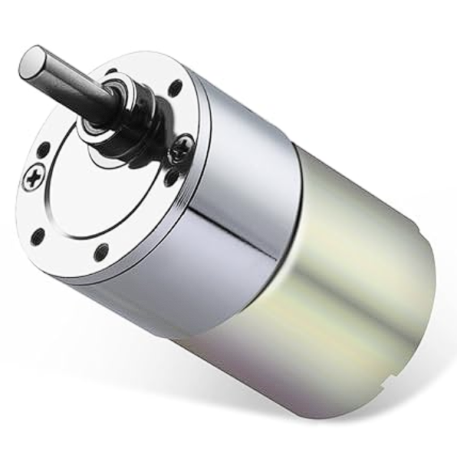
Motor Part Comparison
Motor Name | Rated Current | RPM | Stall Torque | Weight | Price | Diameter
Pololu 25D Metal Gearmotor | .5A | 300 | 1.58 kg-cm | 133g | $30 | 25 mm
Greartisan DC Gear Motor | .06A | 60 | 6.5 Kg.cm | 224g | $14.99 | 37 mm
Traxxas 775 Titan | 3.2A | 10,000 | 9.34 - 10.06 kg-cm | 300g | $40.95 | 39.4 mm
Bemonoc Encoder Metal Gearmotor | .15A | 60 | 4.8 kg.cm | 137g | $14.88 | 25mm
Bringsmart JGB37-520X | .6A | 200 | .58 kg-cm | 270g | $19.99 | 37mm
Pangyoo PYouo-DC Motor Z | 1.1A | 100 | 4.5 kg-cm | 499g | $32.56 | 37mm

Slide 11
Motor Driver Technology Comparison
Motor Driver | Direction Control | Speed control | Complexity | Price
H-Bridge | Yes | Yes | Easy to implement | $6.99
PWM | No | Yes | Easy to implement | $6
Relay Driver | No | No | Hard to implement | $7.49
Transistor | No | No | Hard to implement | $0.5

Slide 12
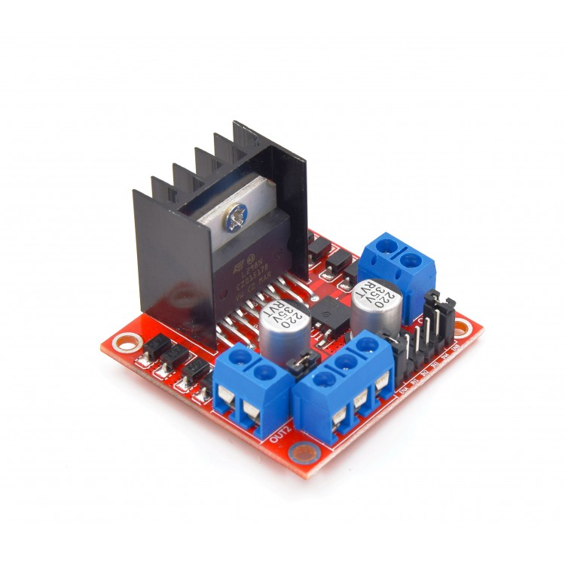
Motor Driver Part Comparison
 | Voltage (V) | Current (mA) | Size (cm) | Price
HiLetgo L298N | 5-35 | 36 | 6 x 6 x 3 | $3
L9110S | 2.5-12 | 800 | 10 x 8 x 1 | $1.20
L293D | 4.5 - 36 | 1000 | 2 x 2 x 3 | $1.56
BTS7960 43A | 5 - 27 | 4300 | 13 x 13 x 13 | $11.99

Slide 13
Battery Technology Comparison
Parameters | NiMH | LiPo | Li-Ion | NiCd | Lead Acid
Energy Density | 45 Wh/kg | 100 Wh/kg | 150 Wh/kg | 40 Wh/kg | 30 Wh/kg
Weight | 350g | 250g | 200g | 400g | 2000g
Memory Effect | None | None | None | Yes | None
Self Discharge (Per Month) | 15% | 3% | 2% | 20% | 6%
Life Cycle | 1000 | 500 | 1500 | 2000 | 1200
Size | Medium | Small | Small | Medium | Large

Slide 14
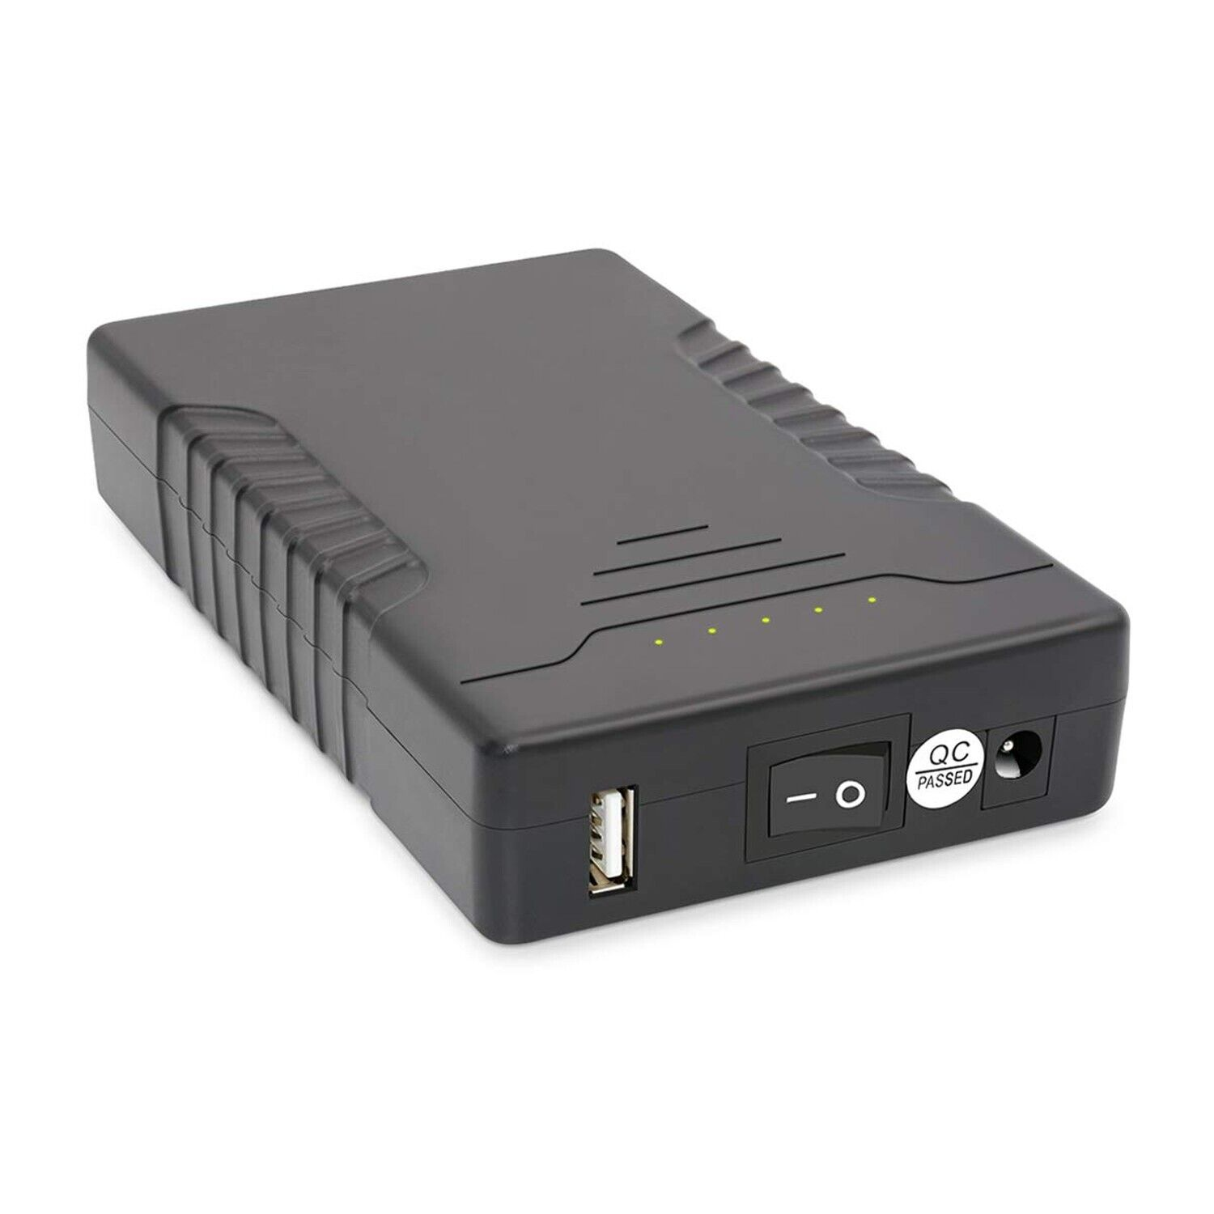
Battery Part Comparison
Battery | ABENIC DC | AA NI-MH Battery Pack | KBT Rechargeable Battery | Talentcell Rechargeable Battery Pack | Turnigy 5000mAh 3S 20C LiPo Pack
Capacity (mAh) | 4000 | 2400 | 5200 | 6000 | 5000
Weight (g) | 222 | 230 | 295 | 360 | 360
Dimensions (mm) | 98 x 57 x 21 | 115 x 106 x 32 | 70 x 55 x 40 | 28 x 85 x 145 | 143 x 51 x 23
Material | Li-ion | NiMH | Li-ion | Li-ion | LiPo
Price | $36.99 | $19.99 | $32.99 | $39.99 | $24.99

Slide 15
Object Detection Technology Comparison
Object Detection Method
Method | Ultrasonic | Infrared (IR) Proximity | LIDAR
Power Consumption | 0.1 Watt | .05 Watt | 1 Watt
Cost | $2 | $10 | $100
Ease of Use | Simple | Slightly Complex | Slightly Complex
Interference | Noise, soft surfaces | External light, color | Reflective and Transparent objects

Slide 16
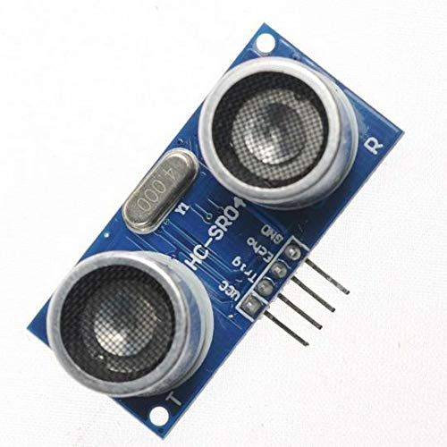
Object Detection Part Comparison
Sensor Module | Range (cm) | Accuracy (cm) | Voltage (V) | Sensor Type | Price
HC-SR04 | 2 - 400 | ±1 | 5 | Ultrasonic | $2.00
Sharp GP2Y0A21YK0F | 10 - 80 | ±8 | 4.5 - 5.5 | Infrared Proximity Sensor | $9.99
VL53L0X | 0 - 200 | ±6 | 2.6 - 5.5 | LIDAR | $4.99
Parallax PING | 2 - 300 | ±3 | 5 | Ultrasonic | $34.99
VL53L1X | 400 | ±12 | 2.6 - 3.5 | LIDAR | $8.99
GP2Y0A02YK0F | 20 - 150 | ±8 | 4.5 - 5.5 | Infrared Proximity Sensor | $9.99

Slide 17
Hardware Comparison - Microcontroller
Microcontrollers
MCU | Arduino Mega | Raspberry Pi | ESP8266 | PIC
Clock speed | 16 MHz | 2.3 GHz | 80 MHz | 100 MHz
Weight (g) | 37 | 45-50 | 2-5 | 1-5
Input Voltage (V) | 7-12 | 5 | 3.3 | 3.3-5
I/O Pins | 54 | 40 | 17 | 12-100

Slide 18
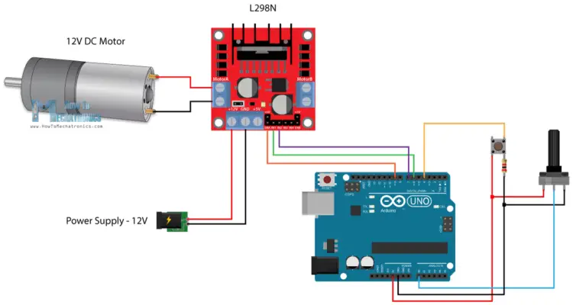
Hardware Design

Slide 19
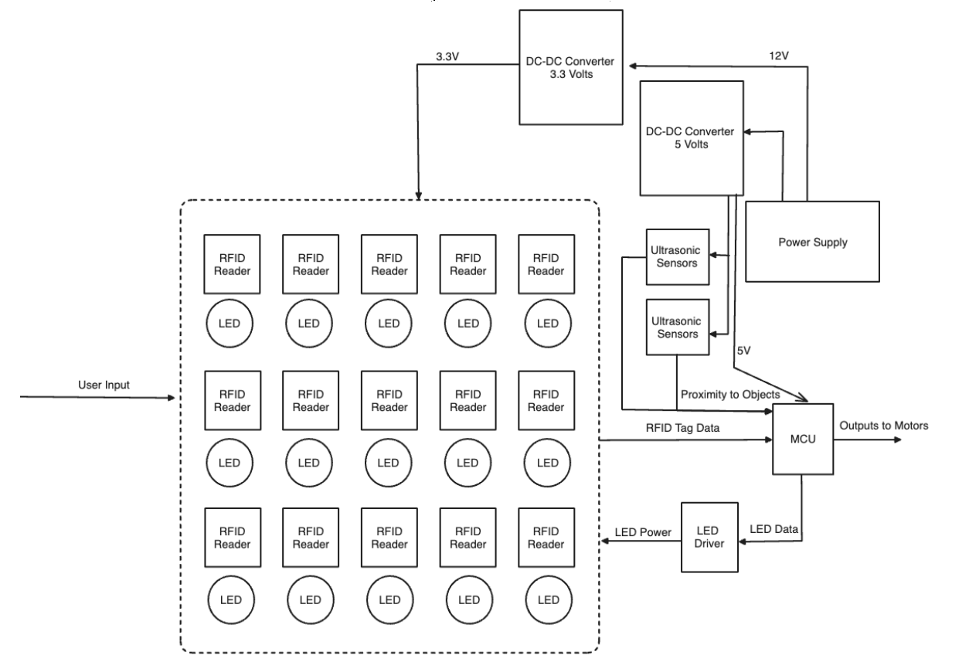
Hardware Block Diagram - Sensor Subsystem

Slide 20
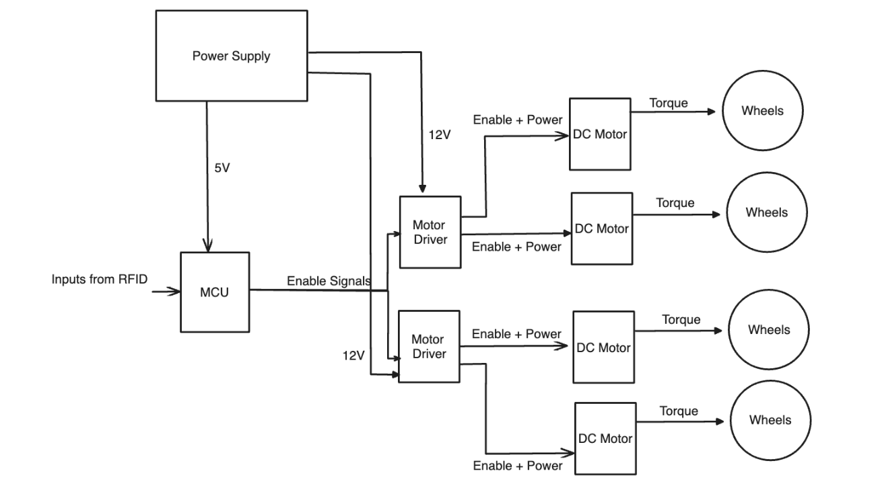
Hardware Block Diagram - Drive Subsystem

Slide 21
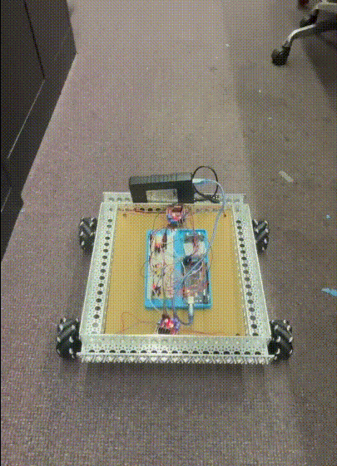
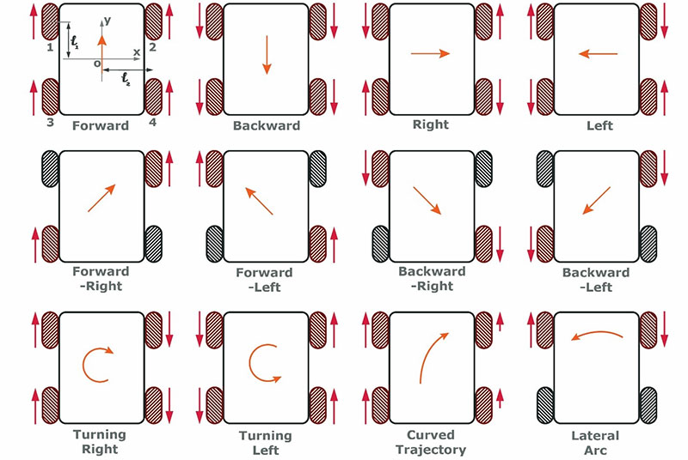
Mechanical Design
Mecanum wheels were chosen to remove the need for axles or an extra mechanism for turning.
Increases movement accuracy
Software implementation was simple as all that was needed was to tell each individual motor a direction depending on the instruction.

Slide 22
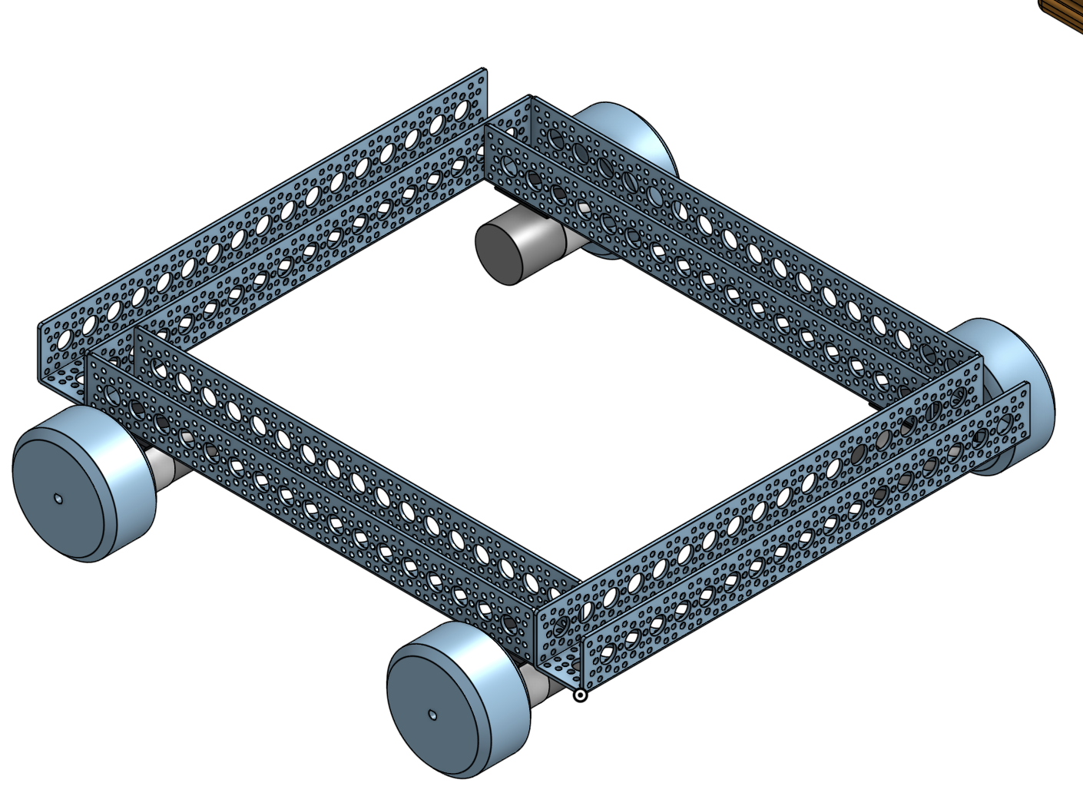
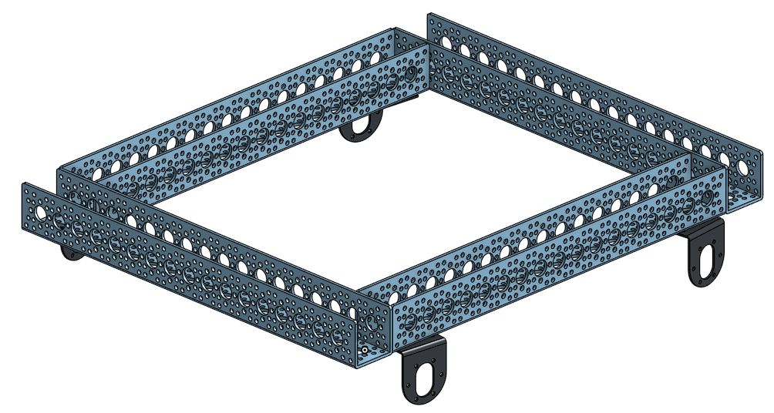
3D Models

Slide 23
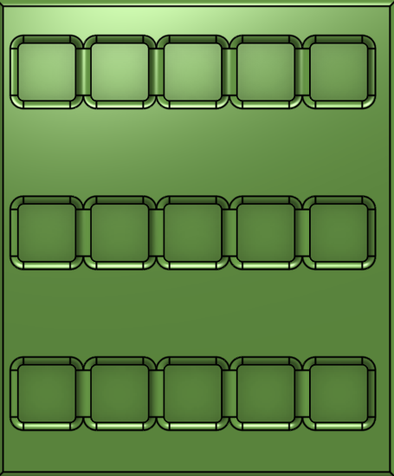
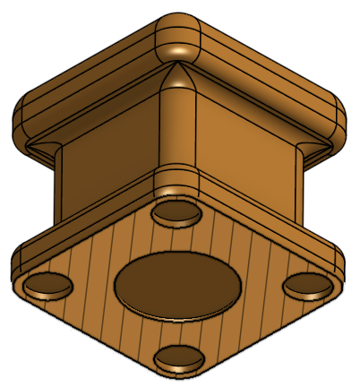
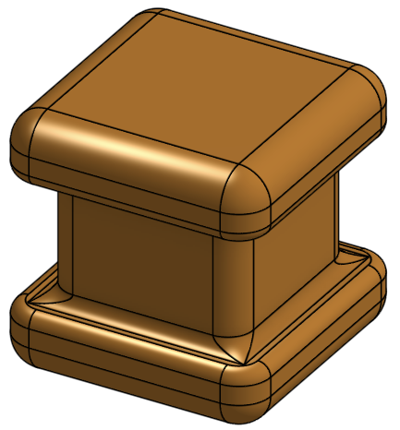
3D Models

Slide 24
Software Comparison - Language
Coding Language
Language | C++ | Python | Assembly
Compatibility with Hardware | Arduino MCs and TI architecture | Raspberry Pi, and Ada Fruit MCs | 8051, PIC, and ATiny and ATmega MCs
Previous Experience | Extensive | Extensive | Very little to none
Ease of Use | User-friendly and well documented | User-friendly | Additional research would be required

Slide 25
Software Comparison - Data Protocol
Data Protocols
Type | UART | SPI | I2C
Supports multiple devices | No support | Supports multiple devices via slave select | Supports multiple device addressing with only 2 wires
Pin usage | Two lines per device | Three shared lines, one SS line per device | Two lines, many devices
Complexity | Low | Medium; Requires Slave Select wire per device | Medium; Complexity increases with more devices

Slide 26
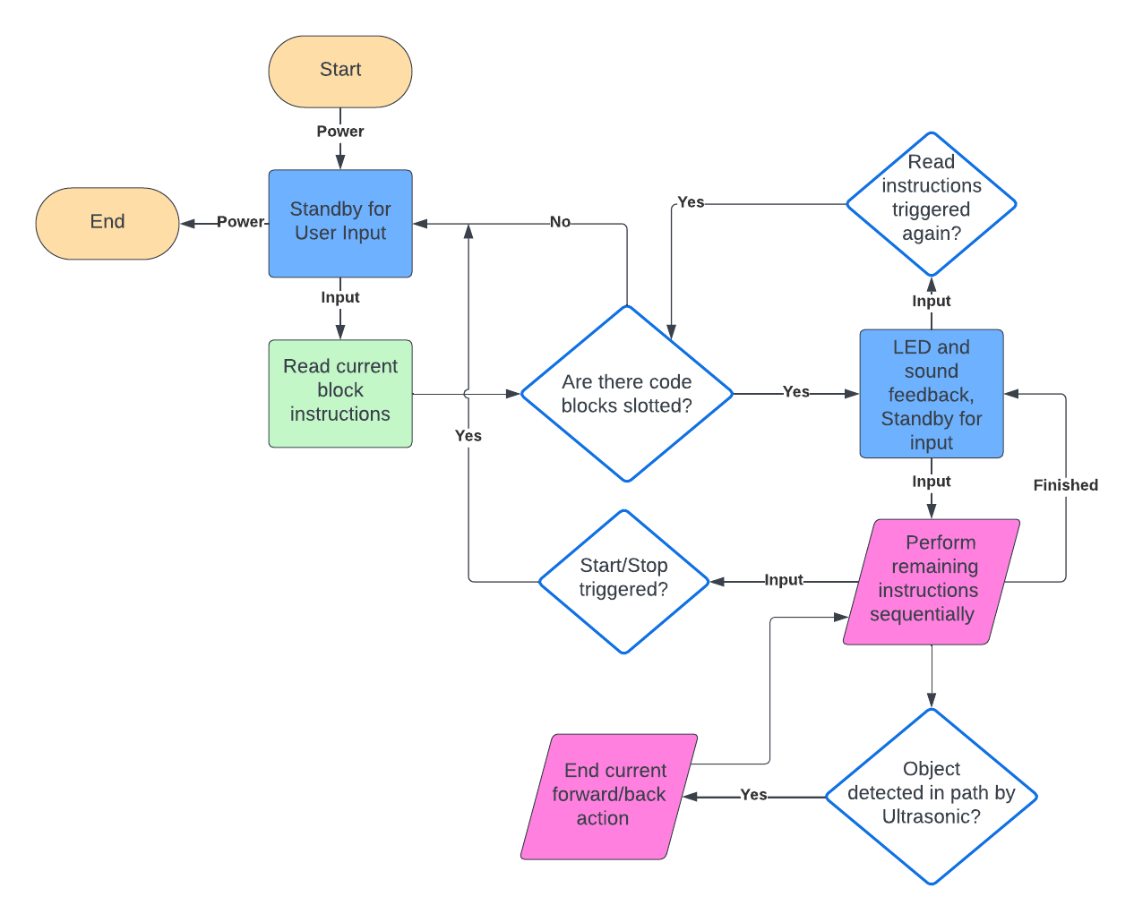
Software Design

Slide 27
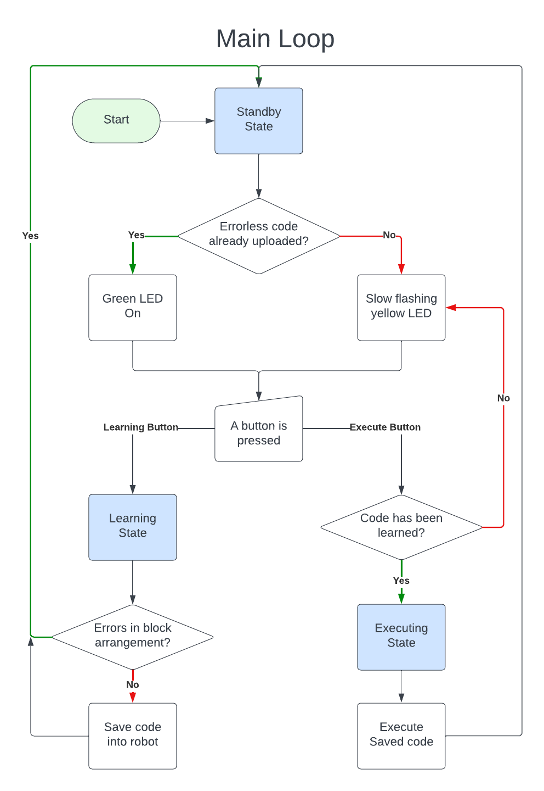
Software State Diagram

Slide 28
Code Block Functions
Move_Forward
Move the robot forward for one second; turn all wheels forward
Move_Backward
Move the robot backward for one second; turn all wheels backward
Turn_Clockwise
Turn the robot clockwise for one second; turn left wheels forward and right wheels backward
Turn_Counterclockwise
Turn the robot counterclockwise for one second; turn the right wheels forward and the left wheels backward
Turn_180Degrees
Turn the robot so it is facing the opposite direction
Play_Sound
Play sound
Change_Light_Color
Change headlight color to set color
Repeat_Last
Repeat last block that many times
Repeat_All
Repeat all instructions executed so far

Slide 29
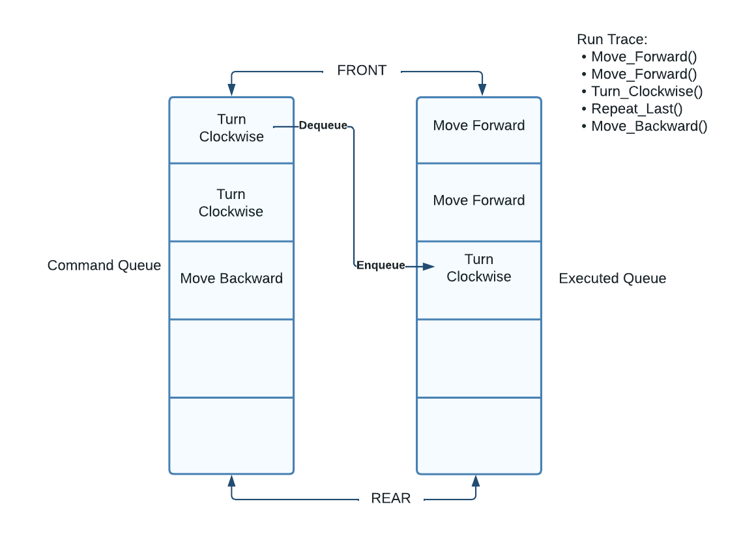
Learning State Processes

Slide 30
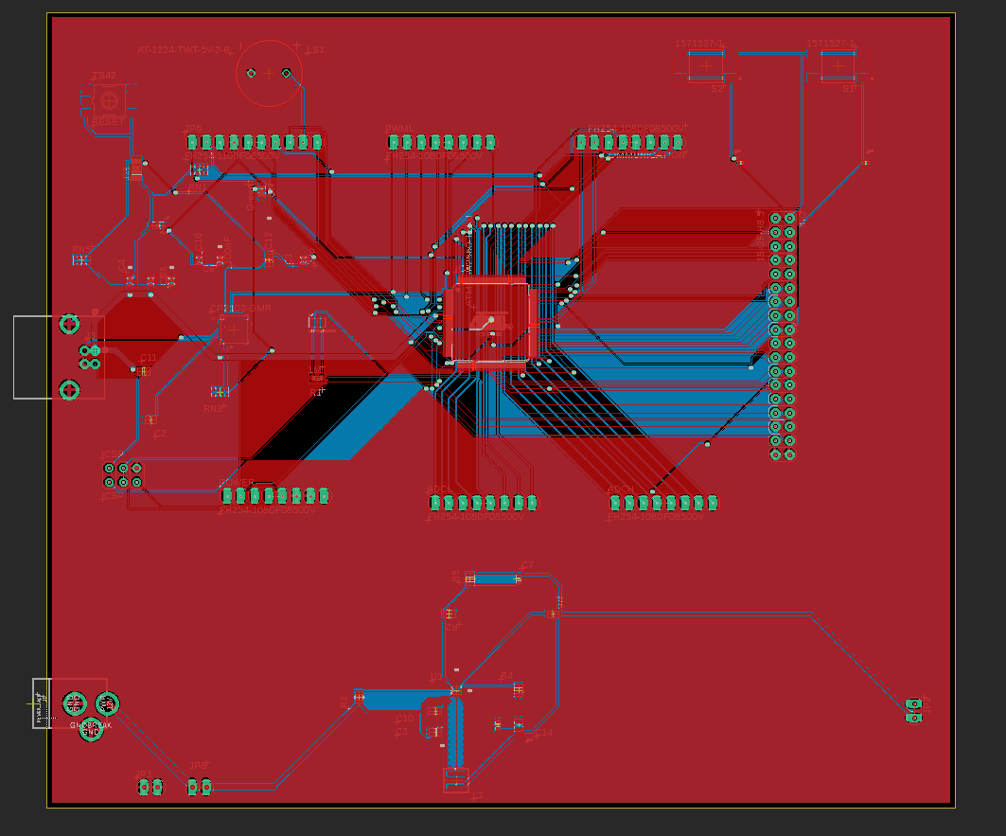
PCB Design
MCU: ATMEGA2560
USB to serial communication: CP2102
Voltage regulator: TPS56425(5V@ 2A) Buck Converter
Piezoelectric Buzzard
Header pins to connect peripherals

Slide 31
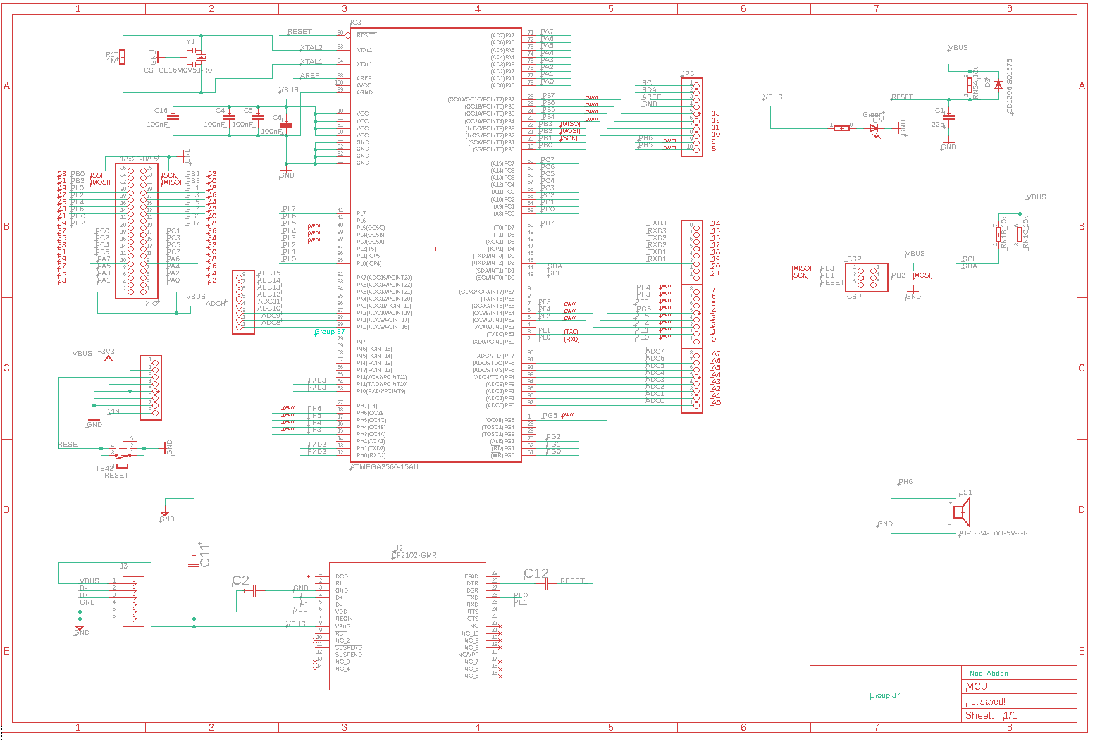
Schematic of MCU
Header pins for connecting peripherals
16Mhz crystal for clock signal
Reset button
Decoupling capacitors
CP2102 for usb to serial communication
Reset button

Slide 32
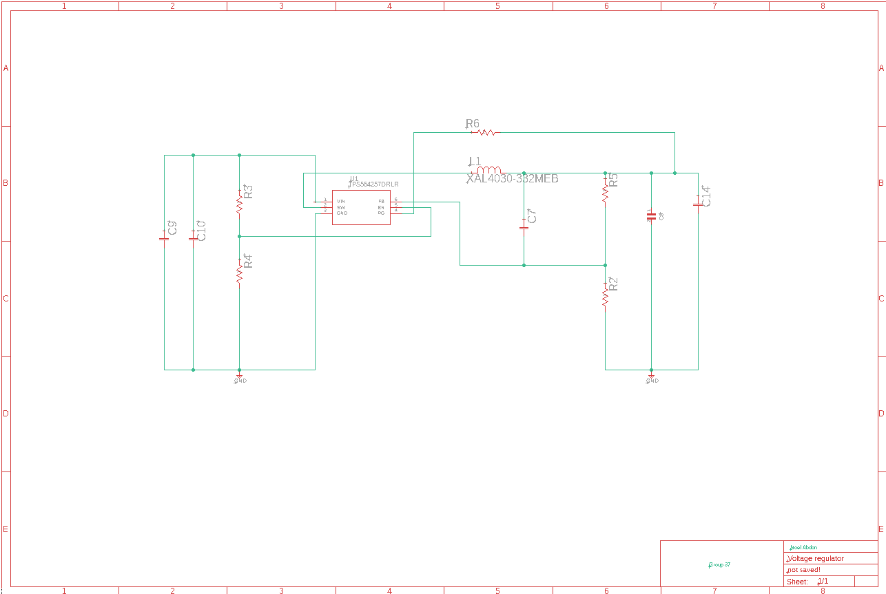
Voltage Regulator
TPS56425 Buck Converter:
95% Efficiency
Small footprint size
Continuous output of 5V at 2 amps
DC Barrel Jack will be used to connect our battery to the PCB. As well as a USB port to power the arduino with 5 volt output from our battery.

Slide 33
Work Distribution
 | Software | Hardware (Sensors and Interface) | Hardware (Mechanical Components | PCB Design
Primary | Anthony | Renso | Gabe | Noel
Secondary | Renso | Anthony | Noel | Gabe

Slide 34
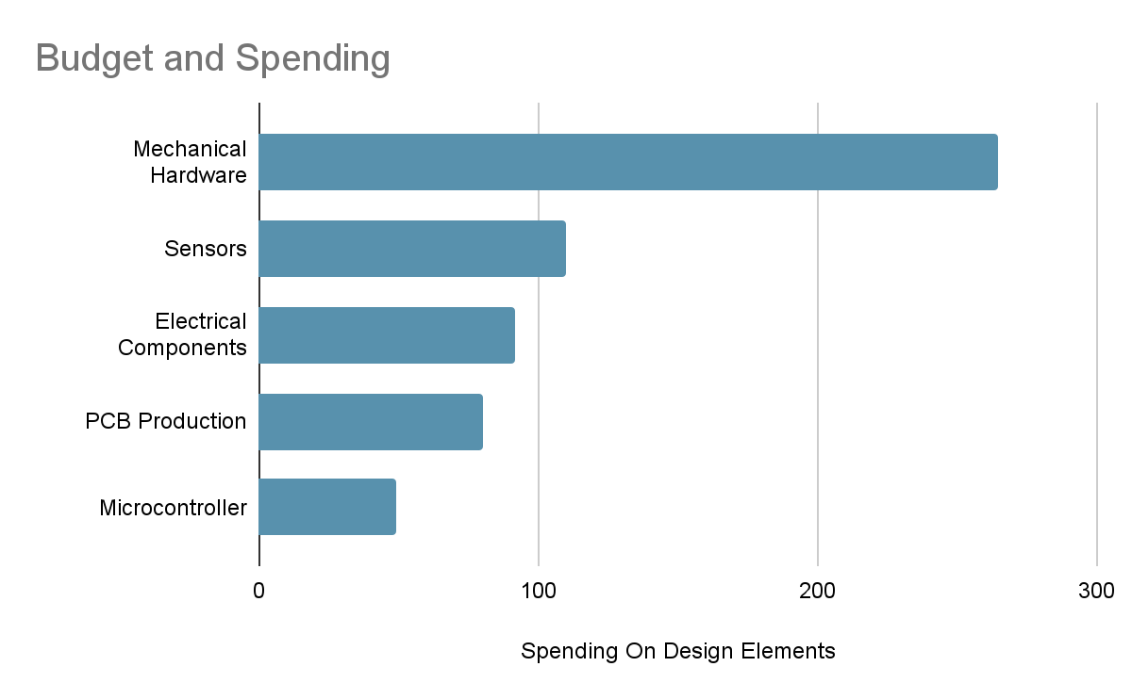
Budget
Total: $595.161

Slide 35
Current Progress
Design Step | Research | Hardware Design | Software Design | Prototype Testing | PCB Design | Final Build
Status | Complete | Complete | Complete | In progress | In progress | Incomplete

