Slide 1
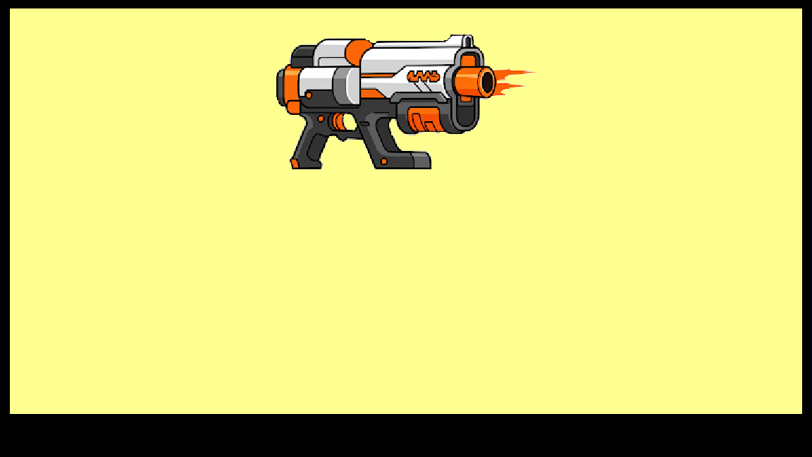
ALT-F4 using NERF
Automatic Light Turret For Focused Firing Feedback
Group 3

Slide 2
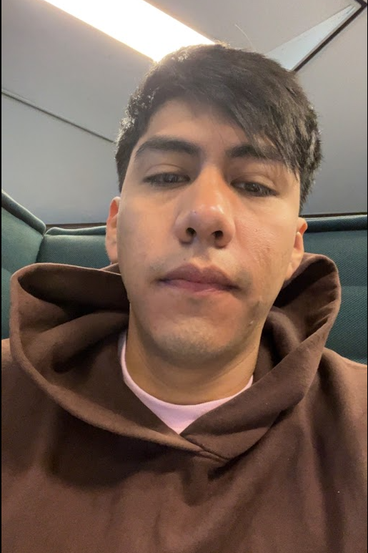
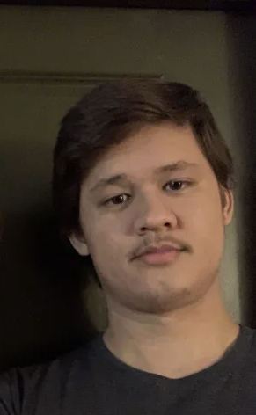
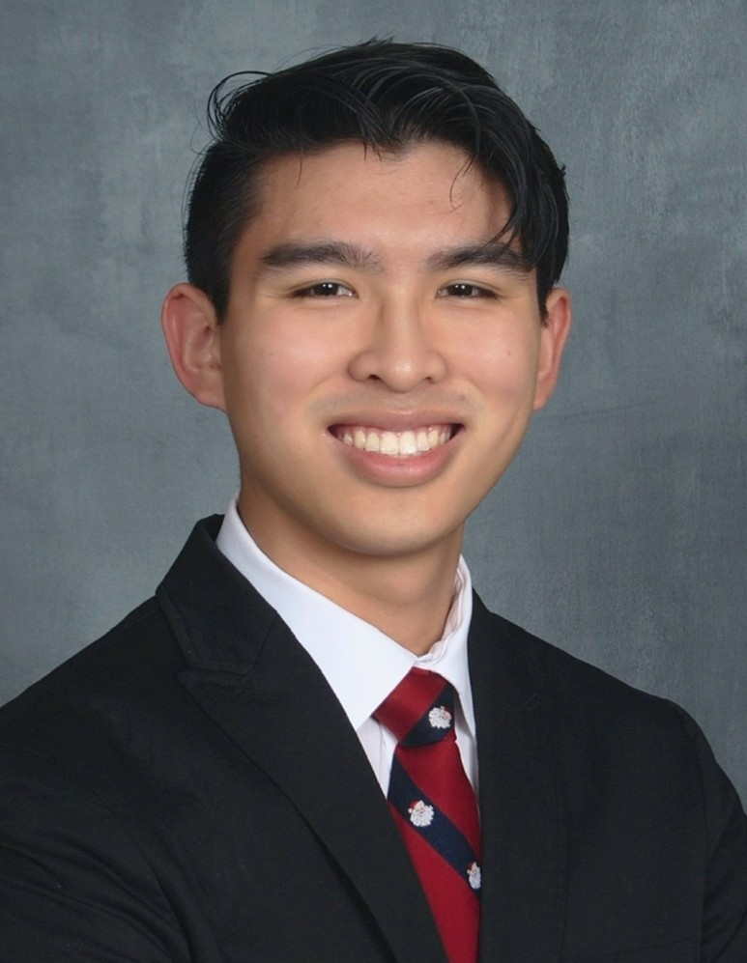
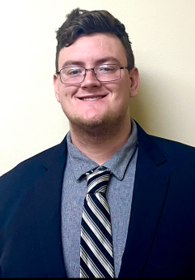
Meet The Team
Jose Castaneda
Electrical Engineering
Gabriel Taylor
Photonic Science and Engineering
Joshua Nguyen
Computer Engineering
Andrew Herbert
Computer Engineering

Slide 3
Motivation
Gabriel Taylor PSE
Security of large areas requires manpower
Guards cannot lose focus for extended periods of time
Guards are also at risk in case of an attack
ALT-F4 would defend an area with minimal manpower
ALT-F4 can remain attentive for as long as there is power

Slide 4
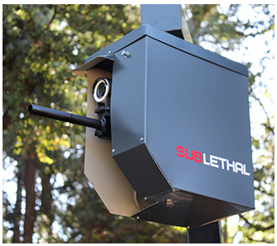
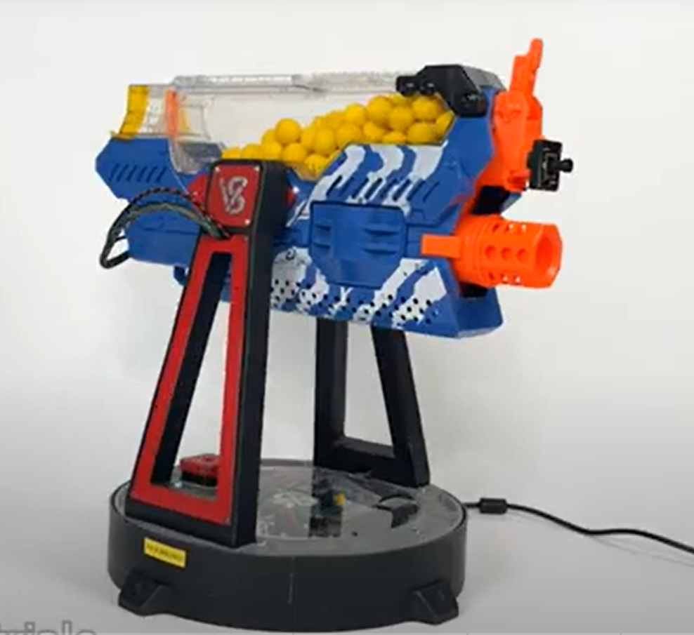
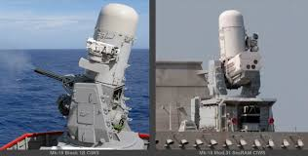
Similar Products
Gabriel Taylor PSE
Boomslang 2
Sublethal turret
No motion sensors
Nerf Turret
Shoots constantly or doesn’t shoot at all
Short effective range
Phalanx Close-In Weapon System (CIWS)
Very advanced tracking
Expensive to create and shoot rounds

Slide 5
Goals
Gabriel Taylor PSE
Basic
Accurately calculate the trajectory of NERF blasters using photodetector grids
Detect objects in an image
Advanced
Determine how far away an object is through Stereopsis
The capability to detect more than one kind of object based on input
Stretch
Implement different NERF blasters or armaments
Live tracking for moving targets

Slide 6
Objectives
Gabriel Taylor PSE
Basic
Create circuitry capable of detecting a projectile travelling through the grid
Process videos using COCO object detection
Advanced
Image processing that determines where the object is in both images and code to turn that information into distance from the turret
Webpage object input and including that when the turret runs
Stretch
We need ways to activate the motors and fire on a NERF blasters
Higher quality components to handle the processing needed to aim based on distance

Slide 7
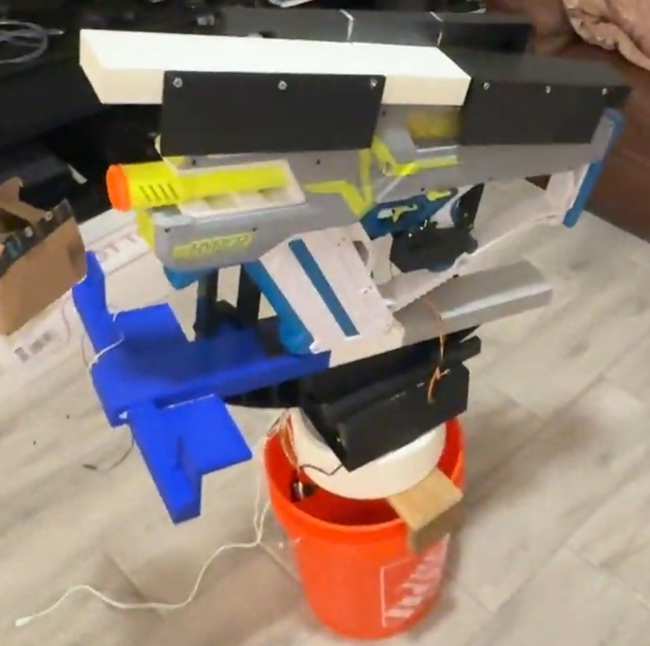
Prototype of ALT-F4

Slide 8
Engineering Specifications
Gabriel Taylor PSE
Requirement | Requirement Specification | Units
Once the turret begins spinning it will find the object and stop the motors | ≤10 | Seconds
After finding the object the turret will aim at the target | ≤10 | Seconds
Inputs from the photodetector grids will determine the velocity and therefore trajectory of the projectile | ≤15
Calculate the distance the object is from the turret | ≤10 | %
The turret should remain active for extended periods of time | ≥3 | hours
The turret should be able to turn horizontally | =360 | Degrees
%

Slide 9
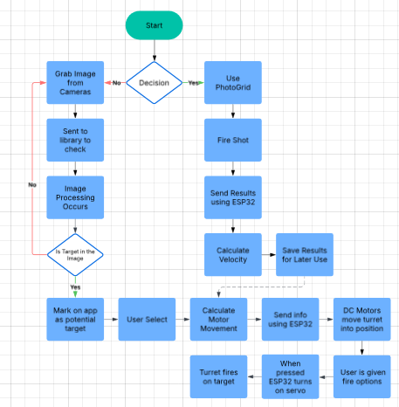
Software Block Diagram
Andrew Herbert CPE

Slide 10
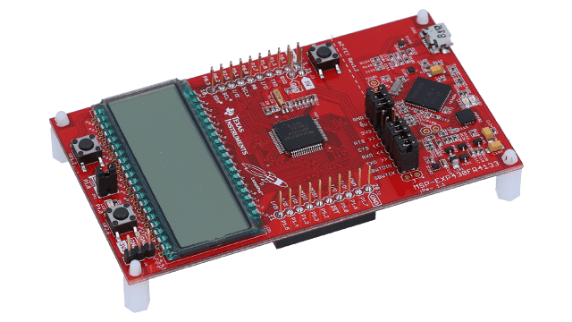
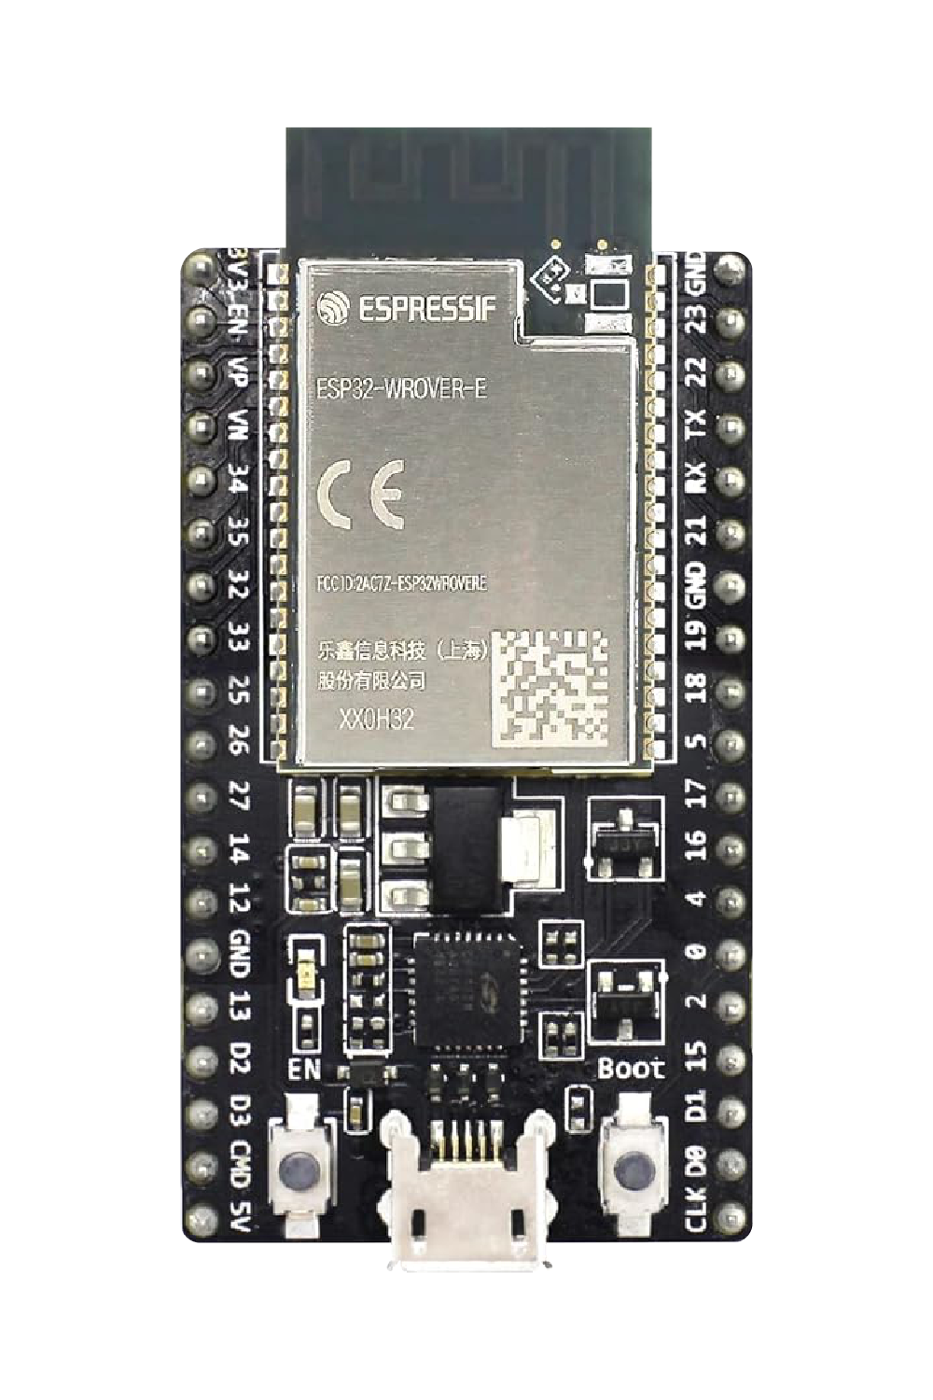
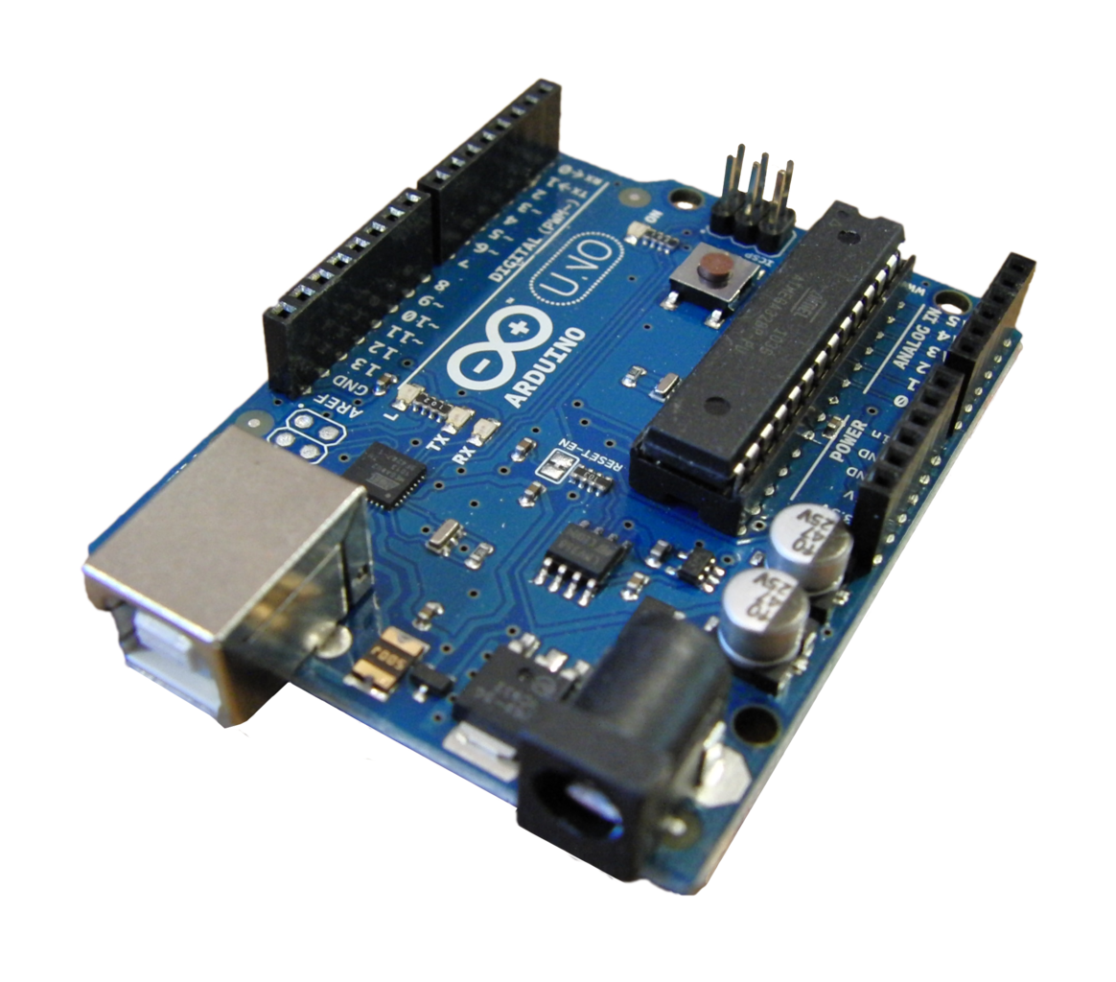
Microcontroller Selection
Andrew Herbert CPE
Choices: | MSP430FR6989 | Arduino Uno | ESP32 WROOM
Frequency | 16Mhz | 16MHZ | 80MHZ
Wifi & Bluetooth | No | No | Yes
Cost | 10.05 | 1.52 | 9.99
The ESP32 is a powerful piece of hardware that integrates WiFi and Bluetooth capabilities with a wide array of peripherals and pins. It also comes with two cores, making it a dual-core processor based on the Xtensa LX6 architecture and runs at clock speeds up to 240 MHz.

Slide 11
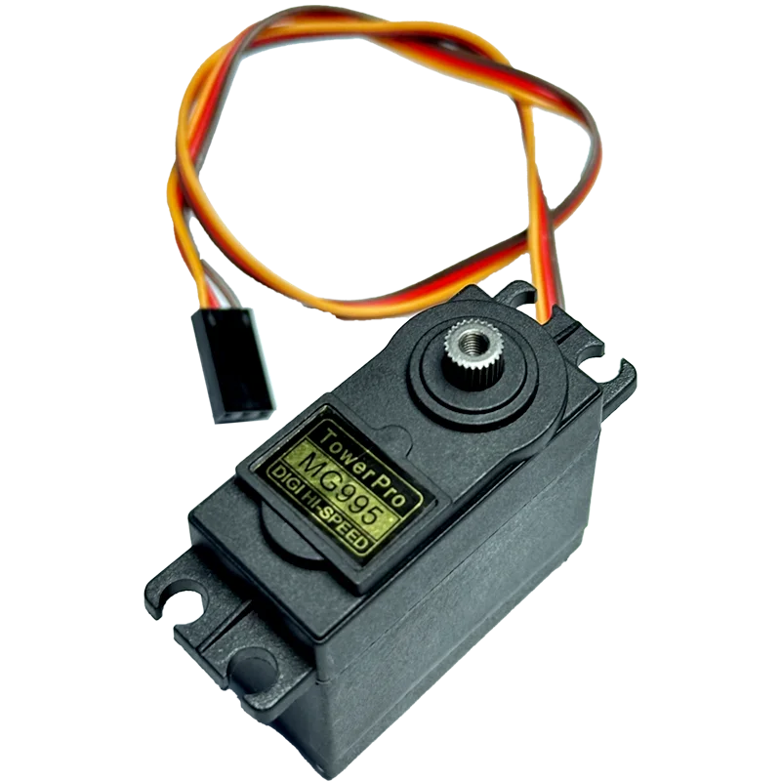
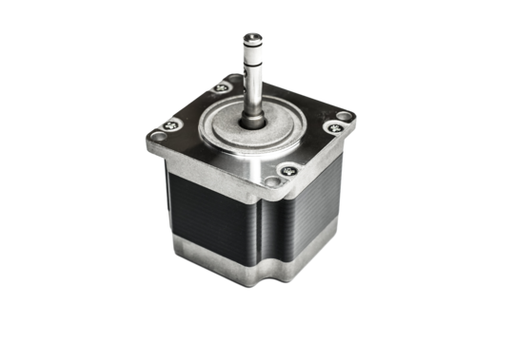
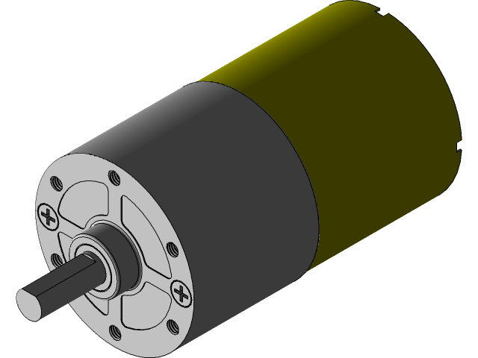
Servo and DC Motors
Andrew Herbert CPE
Motor Choices: | DC Motors | Servo Motors | Stepper Motors
Torque | High | Low | Moderate
Precision | Moderate | High | High
Cost | Moderate | Low | Moderate
Purpose:
Greartisan High Torque Motor: These two DC motors will be responsible for the horizontal and vertical movement of out turret system.
MS995 Servo Motor: The two positional servo motors will be responsible for emulating human trigger pulls on the NERF armament. (Prev: SG90)

Slide 12
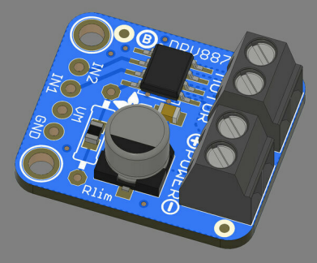
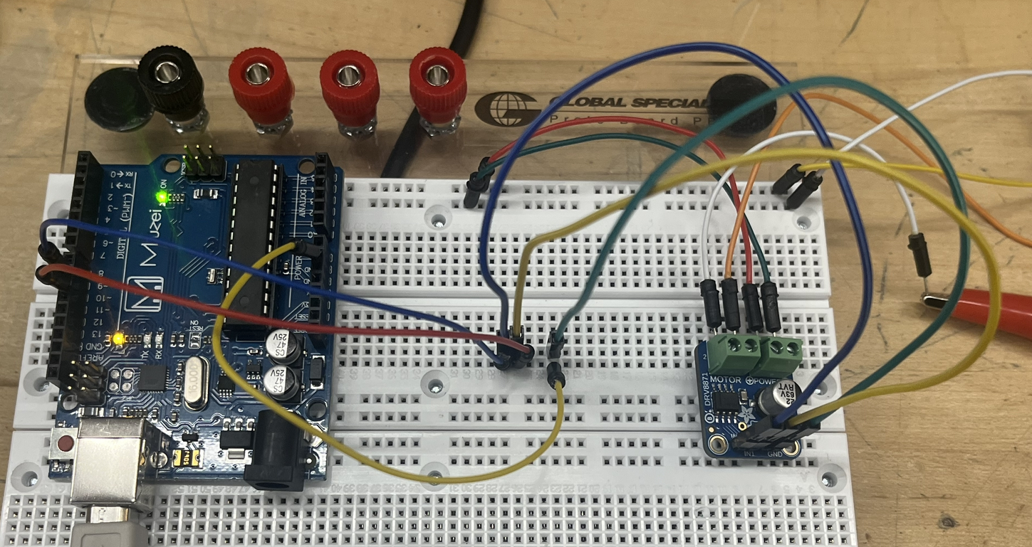
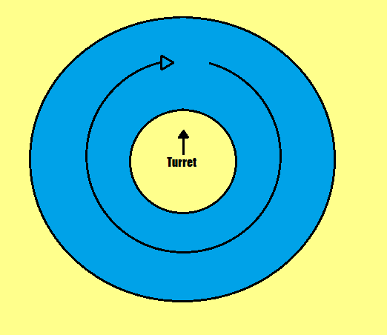
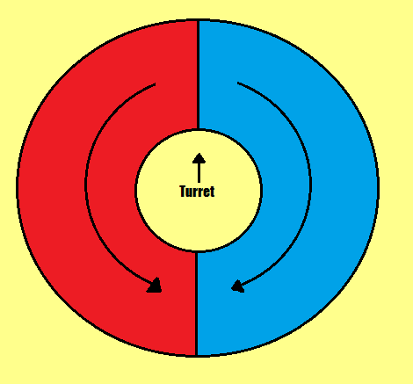
Adafruit DRV8871 Motor Breakout
Andrew Herbert CPE
A key optimization for the speed of the turret is having it move in both directions. Unfortunately, base DC motors only allow for one direction of motion at a time. By using a motor breakout we can solve this problem.
Relays Can be used as Bidirectional rotation
Problem with Mono Directional
Prototype
VS

Slide 13
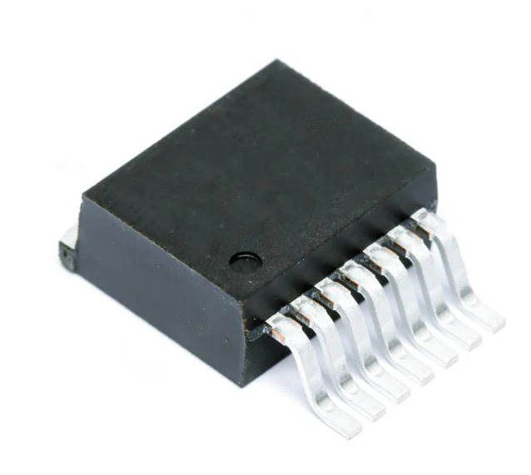
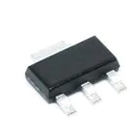
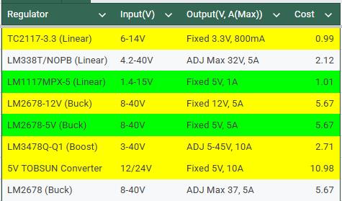
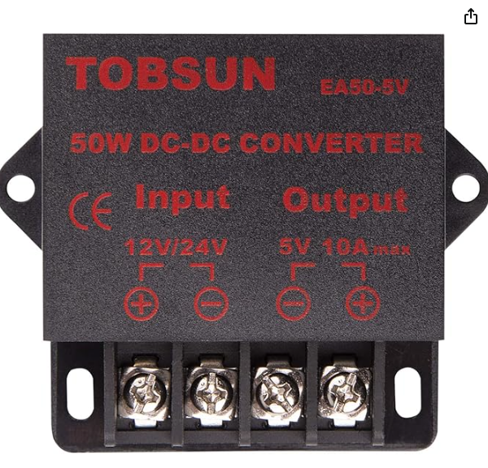
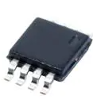
Power converters
Jose Castaneda EE

Slide 14
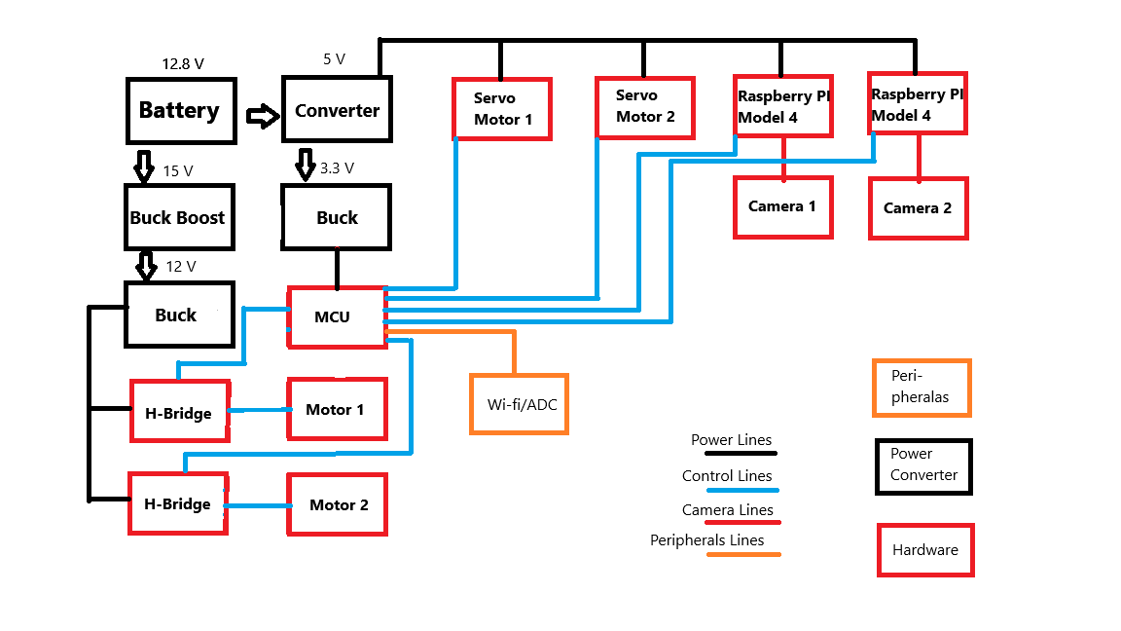
ALT-F4 Block Diagram
Jose Castaneda EE

Slide 15
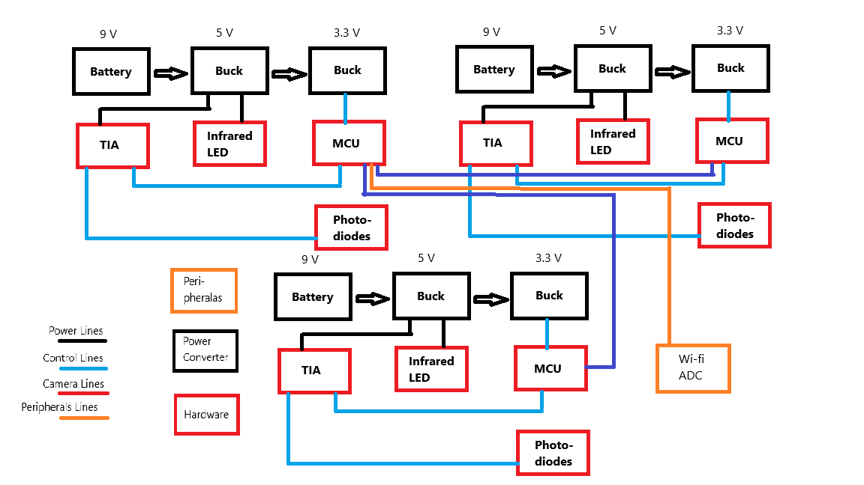
Photodetector Block Diagram
Jose Castaneda EE

Slide 16
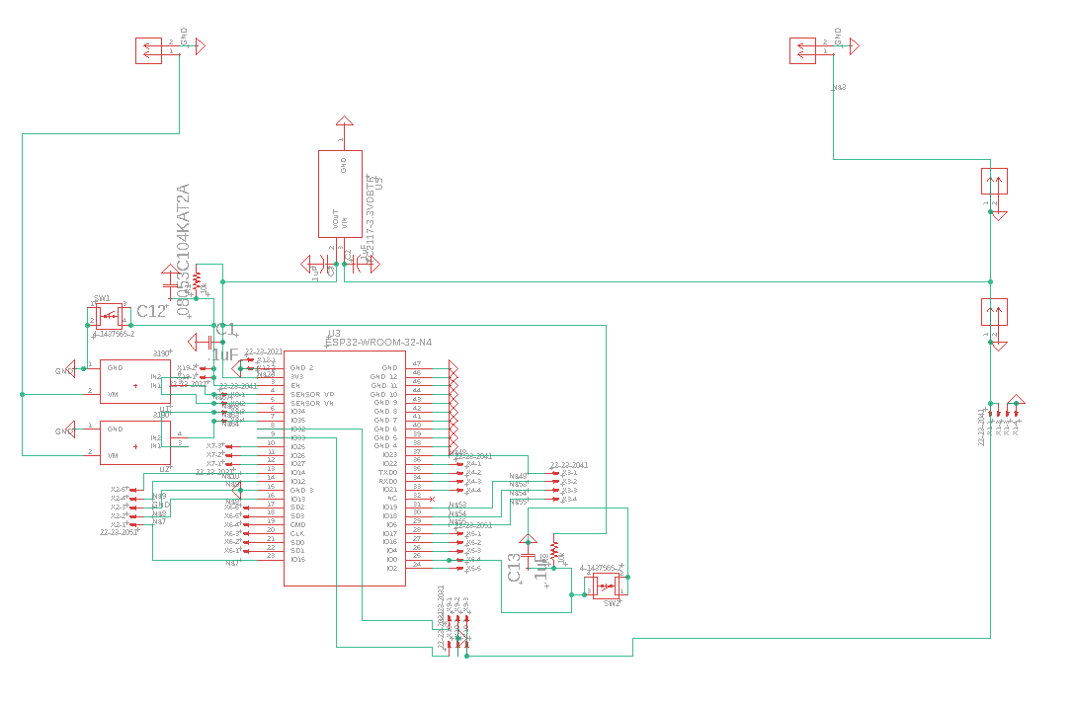
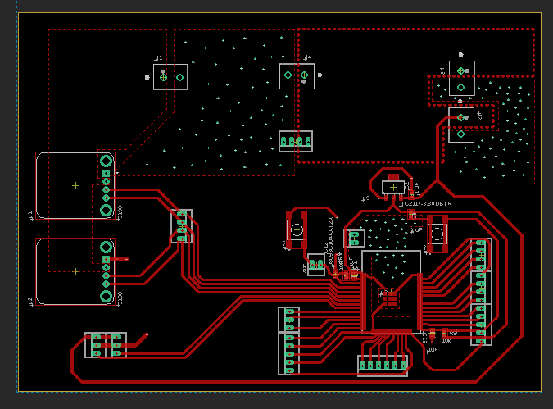
ALT-F4 Schematic and PCB
Jose Castaneda EE

Slide 17
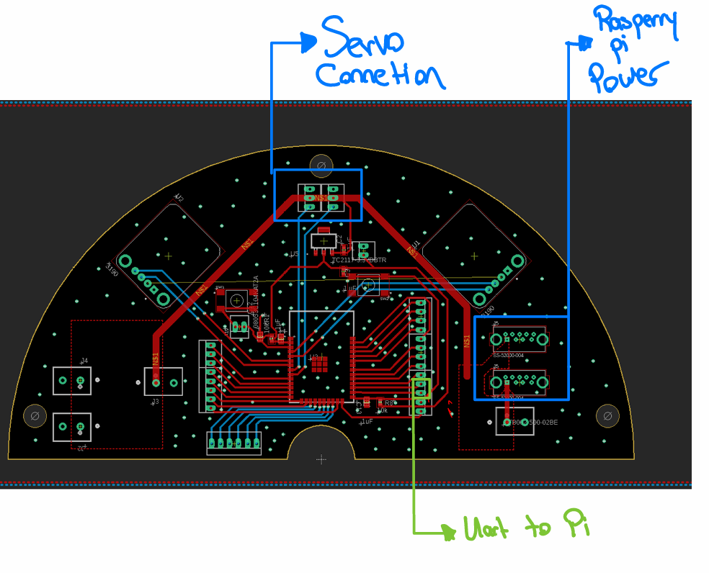
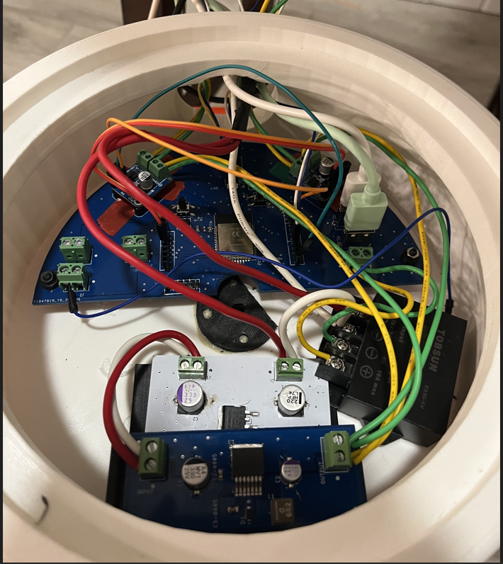
Updated Version of ALT-F4
Jose Castaneda EE

Slide 18
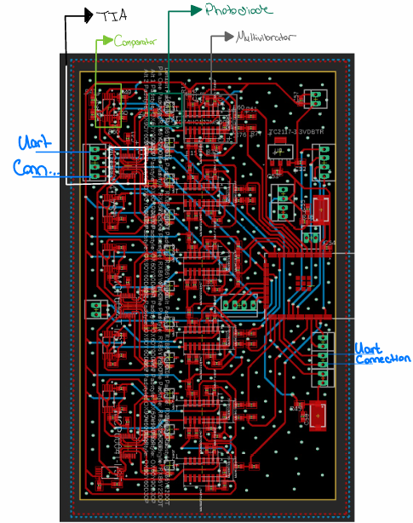
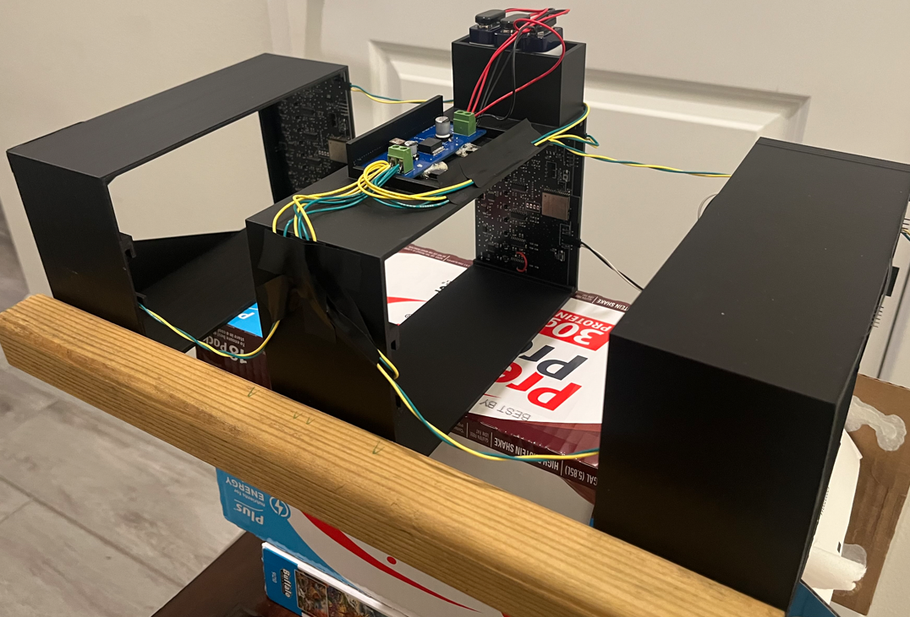
Photodetector PCB
Jose Castaneda EE

Slide 19
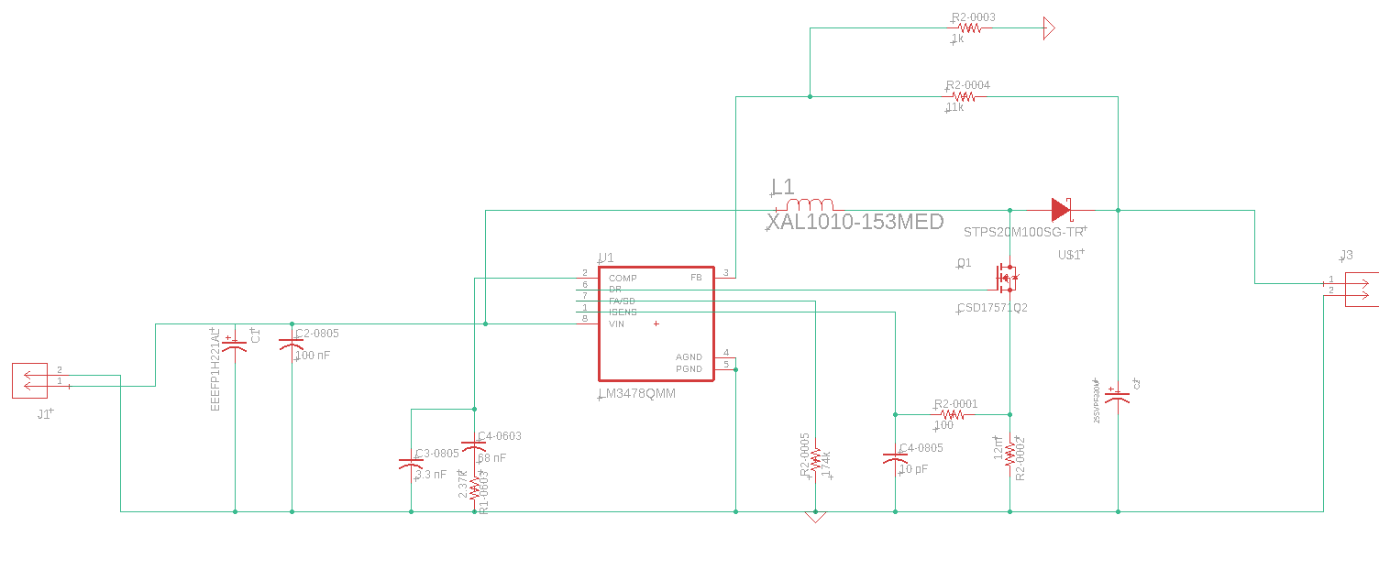
15 Volt Boost Buck Schematic (WEBENCH)
Jose Castaneda EE

Slide 20
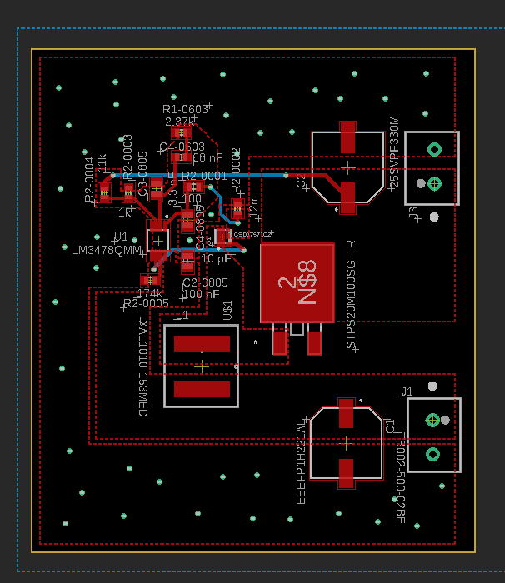
15 Volt Boost Buck PCB (Data Sheet)
Jose Castaneda EE

Slide 21
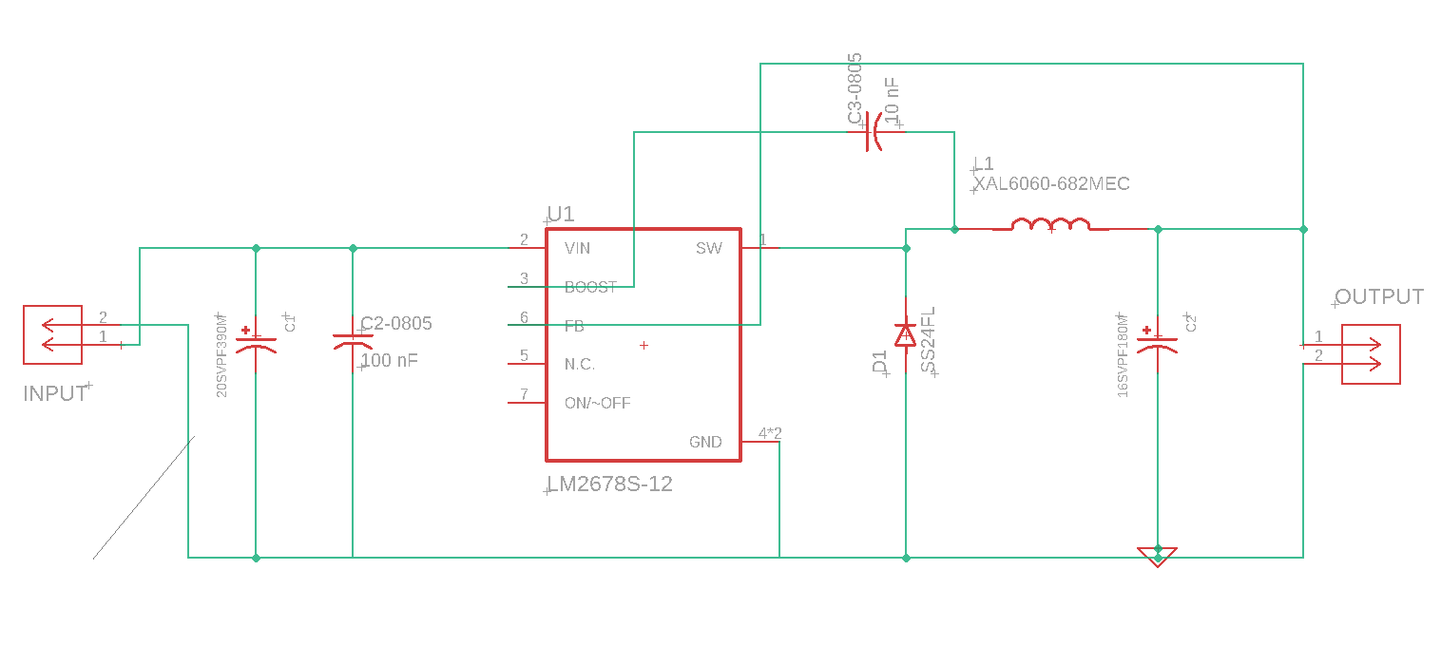
12 Volt Buck Schematic (WEBENCH)
Jose Castaneda EE

Slide 22
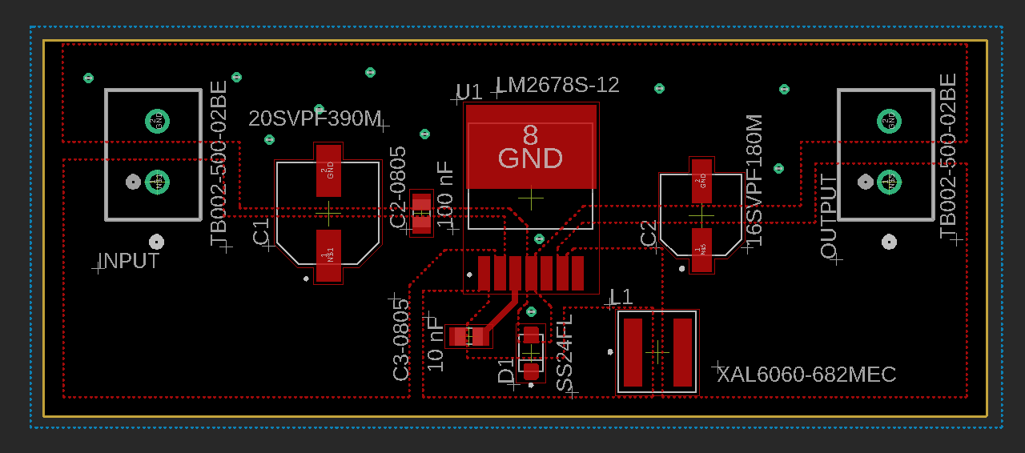
12 & 5 Volt Buck PCB (Data Sheet)
Jose Castaneda EE

Slide 23
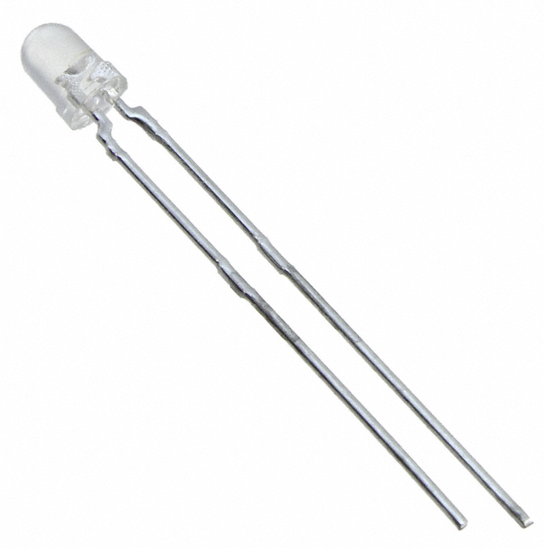
Light Emitting Diodes
Gabriel Taylor PSE
Purpose:
The LEDs emit light to the photodiodes and give a constant signal
The peak wavelength emitted is at 940 nm
They are being run at 100 mA
Product Name | Intensity | Viewing Angle
VSLB3940 | 65 mW/sr | 44°
VSMY2941GX01 | 60 mW/sr | 16°
TSAL4400 | 16 mW/sr | 50°
QED234 | 27 mW/sr | 40°

Slide 24
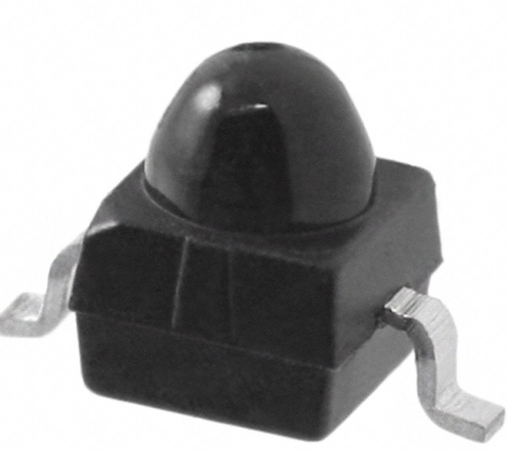
Photodiodes
Gabriel Taylor PSE
Purpose:
The photodiodes give a constant signal and when no signal is sent then the light from the LED must be blocked
The peak spectral sensitivity occurs at 940 nm
The response time is 100 ns
Product Name | Wavelength | Acceptance Angle
VEMD2020X01 | 940 nm | 30°
SFH 203 FA | 900 nm | 40°
076-14-21-011 | 660 nm | 55°

Slide 25
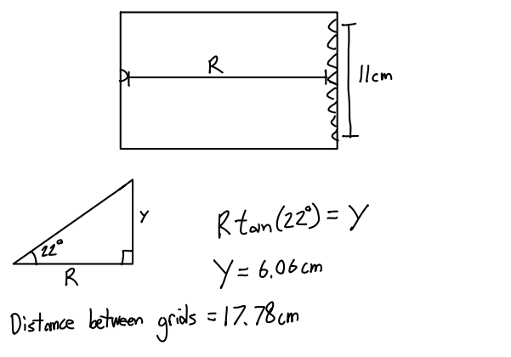
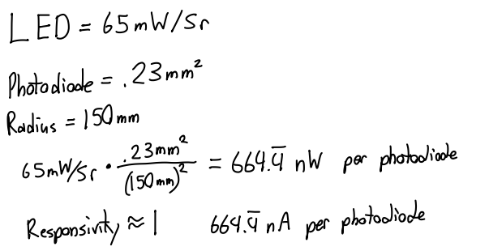
Calculations

Slide 26
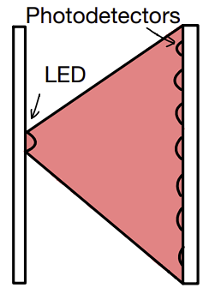
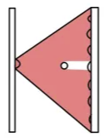
Photodetector Grid
Gabriel Taylor PSE
There will be 3 grids in succession each with 10 photodetectors opposite one LED
The photodetectors will be sending a constant signal when no object is passing through
As an object passes through the grid, the photodetector will stop sending a signal as the object blocks the light from the LED

Slide 27

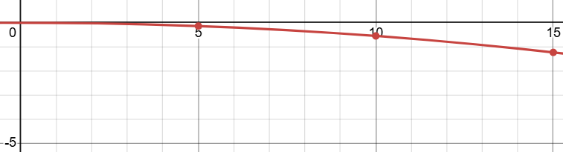
Calculating trajectory
Gabriel Taylor PSE
The photodetectors give us the relative position of the projectile at 3 different points
The trajectory of an object can be represented with the following equation
a represents the launch angle while b represents the initial velocity
A calibration shot is done at a 0 degree launch angle and knowing 3 different points allows for b to be calculated for each NERF blaster

Slide 28
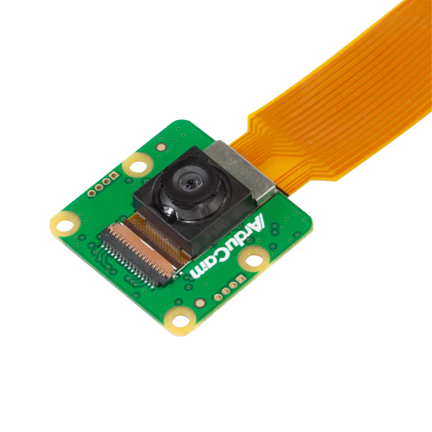
Cameras
Gabriel Taylor PSE
Purpose:
The Arducam Owlsight will provide high quality images to the Raspberry Pi 4s. This will enable image processing for object detection as well as stereo vision with accurate depth calculations
64MP resolution from a 9248x6944 pixel count
There are 2 identical cameras with 32 cm in between them
Product | Quality
Arducam Owlsight | 64MP
Raspberry Pi High Quality Camera | 12.3MP
Arducam 16MP | 16MP

Slide 29
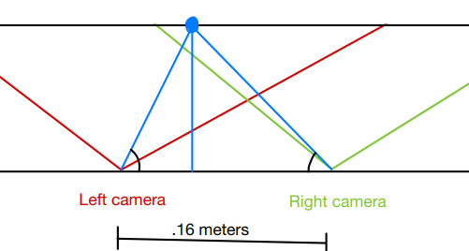
Stereopsis
Gabriel Taylor PSE
Two cameras are used to determine how far away an object is
The relative position of an object in one camera compared to the relative position in the second camera is sent to a code
Python takes this information and can determine how far away an object is

Slide 30
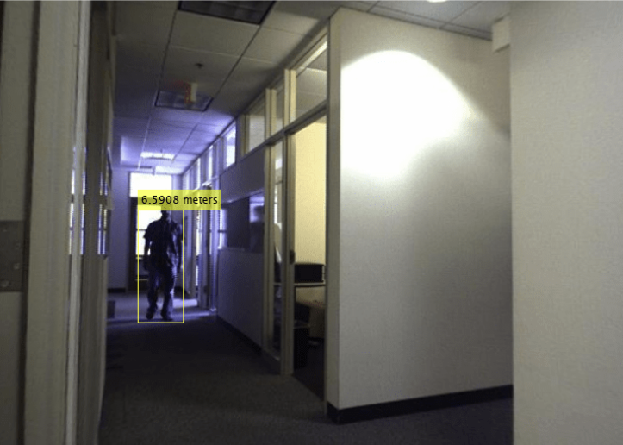
Stereopsis
Gabriel Taylor PSE
In our testing the distance of the object was calculated relatively accurately
In all the tests, distance was within 10% of the actual value
Output Distance | Actual Distance
1.8796 | 1.981
3.048 | 2.896
2.3165 | 2.408
1.615 | 1.674

Slide 31
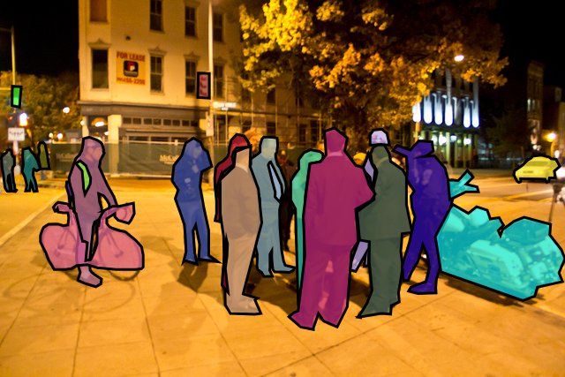
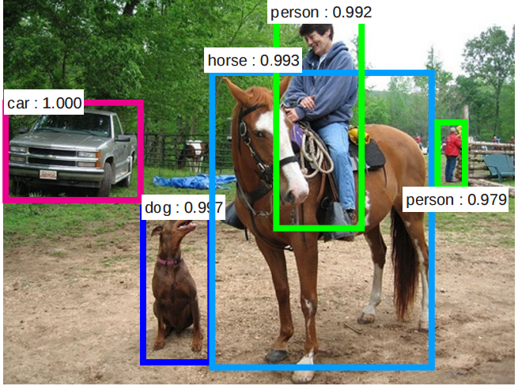
Image Processing
Joshua Nguyen CPE
OpenCV Library with Tensorflow Lite
MobileNet SSD V2 with COCO Dataset
Arducam Camera Module (Owlsight)
  Sends video feed to ML model for image processing
  Search for target within the frame.
Model | Mean Average Precision | FPS
MobileNet SSD V2 (with Coral TPU) | 22-25% | 30 FPS
YOLO v8 Nano | 35-40% | 1-5 FPS
Notes:
UART Serial communication to the pi’s for motor movement

Slide 32
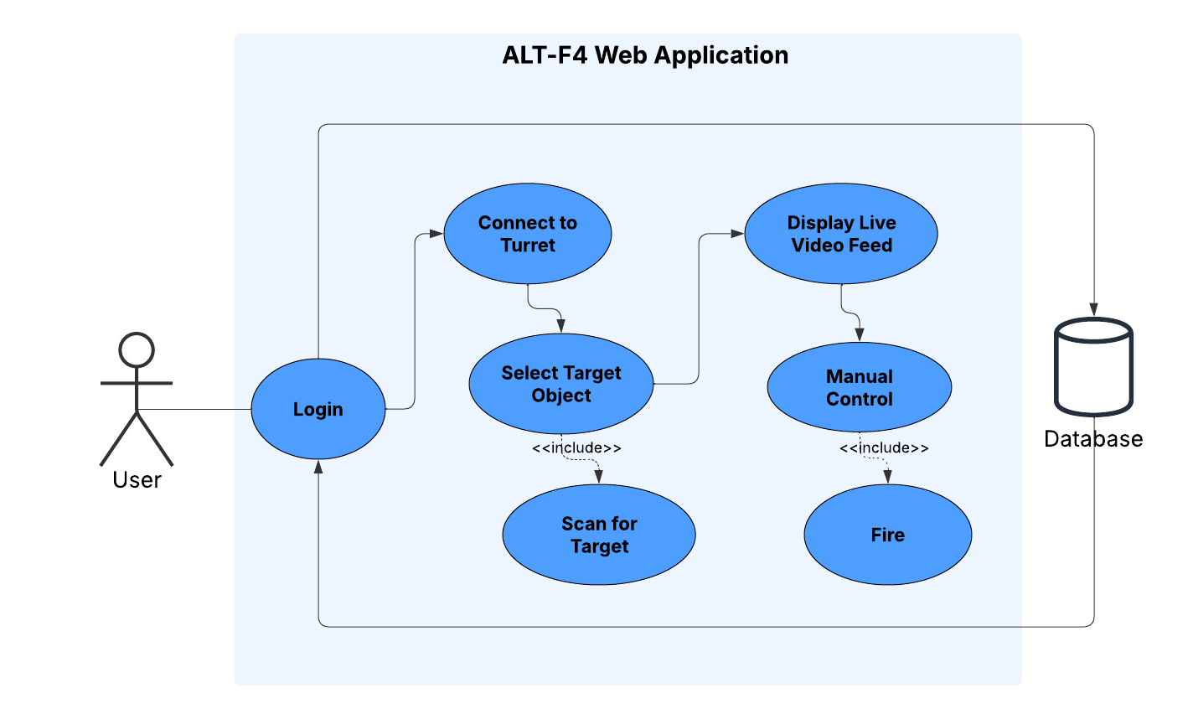
Use Case Diagram
Joshua Nguyen CPE

Slide 33






Web Application Development
Joshua Nguyen CPE
>

Slide 34
Technology Comparison:
Joshua Nguyen CPE
Feature | React (with Vite) | Android (Kotlin) | Flutter (Dart)
Key Features | Components, Hooks, Virtual DOM | Native App Development, Material Design | Cross-platform, Hot Reload, Widgets
Build | Vite, Node.js | Android Studio | Xcode, macOS
Familiarity | High | Medium | Low
Best For | Web Apps | Android | iOS
Web Application
Frontend:
React + Vue + Tailwind:
React (or Vue) as the frontend framework
Vite as the build tool
Tailwind CSS for styling

Slide 35
Technology Comparison:
Joshua Nguyen CPE
Feature | Firebase (Realtime) | MongoDB (Atlas) | AWS (DynamoDB)
Realtime Support | Built-in | Manual Setup | Not built-in
Authentication | Firebase Auth built-in | Manual Setup | Amplify Auth
Complexity of Integration | Easy | Medium | Hard
Cost | Free tier, then pay-as-you-go | Free tier, then usage-based | Pay-as-you-go
Web Application
Backend:
Firebase Realtime Database:
Free Tier pricing and a pay-as-you-go model.
Easy integration with React + Vite
Authentication included with minimal setup

Slide 36





App Interface Design Prototype
Joshua Nguyen CPE

Slide 37


New Web App Interface Design
Joshua Nguyen CPE

Slide 38
Home Page Interface
Joshua Nguyen CPE
Features:
Search for a specific object
  Ex: Human, Car, Bottle
Raspberry Pi Status
  Verify the connection of the Raspberry Pi Cameras
Send signal to find target

Slide 39

Flow Chart
Joshua Nguyen CPE

Slide 40
Turret Body
Andrew Herbert CPE
Comprised of multiple key parts:
Motor Base a stand with an open structure that will have the DC motor responsible for horizontal movement.
The hardware cylinder will spin horizontally with the turret and house our electronics and PCB.
Baseplate is a combination of a lid for the hardware cylinder and contains a compartment for the lithium phosphate battery.
The Arm Mount will be affixed to baseplate and support our rail system that will hold the armament a DC motor mounted to the arm will support vertical movement.
Rail System will attach to the arm and depending on the armament used will be able to adjust its height allowing.

Slide 41


3D Fabrication
Andrew Herbert CPE
Dremel 3D printing allows for non-commercial available parts to be fabricated.
Pros: Allows for custom designs,Quite Affordable, Durable with low infill
Cons: Fabrication time
Onsite Printing options: SD Lab, TI ENG Lab, CMC Library

Slide 42
Administrative Content
Andrew Herbert CPE

Slide 43
Work Distribution
Andrew Herbert CPE
Andrew Herbert | Gabriel Taylor | Joshua Nguyen | Jose Castaneda
ESP32 DC and Servo Motor Programming/ UART | Photodetector LED Grid and Velocity Calculations | Raspberry Pi and Image detection | Power Supply and UART Communication in Photodetector Grid
3D Modeling and Fabrication | Stereopsis and Image Processing | Application and Web Server | PCB board fabrication and design

Slide 44

Bill of Materials
Andrew Herbert CPE

Slide 45
Issues
Andrew Herbert CPE
Making ALT-F4 available for holding and shooting all types of armaments
The NERF blasters are not very accurate meaning it takes multiple shots for calibration
Making the Photodetectors cost effective since TIA can cost up to $6 - $16 each and most can only do up to 2 circuits each. At the moment, we are using OPA2380.
D-Shaped drive shaft holes that required metal reinforced holders to accommodate
Speed of motors changed using RPM or PWM

Slide 46

Questions?
Thank you!

