Slide 1
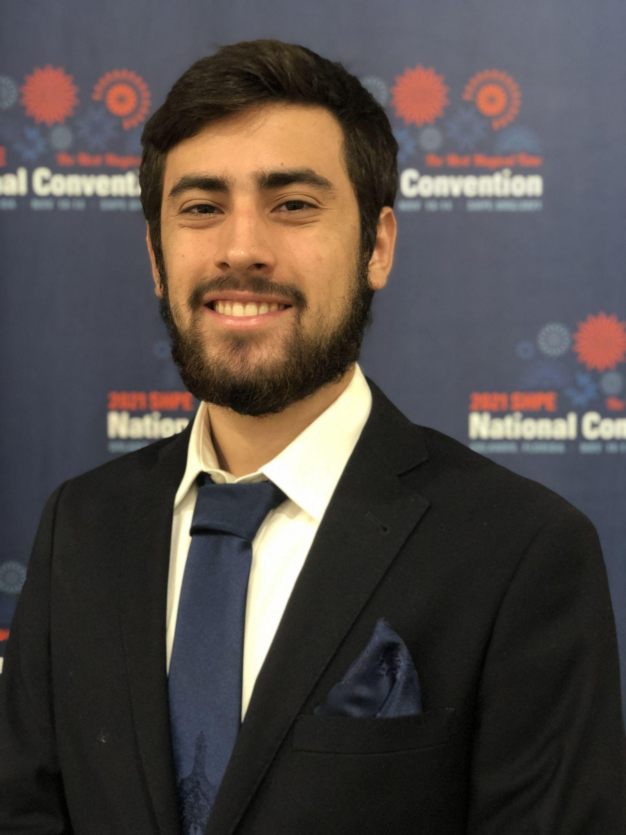



Automatic Solder Paste Dispenser for Prototype Printed Circuit Boards
Group 4 CDR Presentation 2025
Mikell Alfonso
B.S.E.E
Minor - Business Administration
Nathan Boucher
B.S.E.E.
Minor - C.S.
Elizar Tsymlyakov
B.S.P.S.E.
Edward Weir
B.S.C.E.

Slide 2
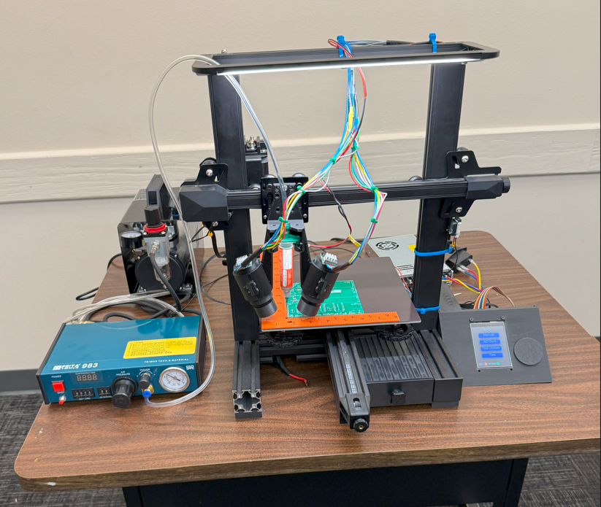
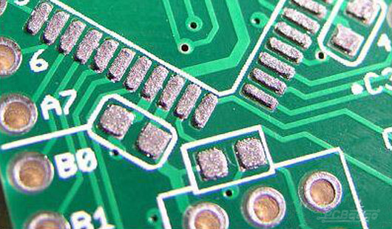
Motivation and Background
Help automate the PCB fabrication process
Alternative to hand solder/laying out paste
Saves time for students
Uses the shell of an old Ender 3
Stereolithography for quality control
Sponsored by Dr. Weeks

Slide 3
Goals and Objectives
Basic Goals:
- Create a solder paste dispenser utilizing the Creality Ender 3
- Implement a schematic/Gerber file upload system
- Determine user’s PCB placement
- Dispense proper amount of solder based on required SMD size
- Achieve SMD package size of 0603(imperial)/1608(metric)
- Design optical inspection system for stereo vision and magnification
- Program Touchscreen display
Advanced Goals:
- Achieve SMD package sizes 0402(imperial)/1005(metric)
- Optimize dispensing time on the max supported PCB size
- Develop image processing software that exports a metric 3D reconstruction of PCB to measure heights.
Stretch Goals:
- Achieve SMD package sizes 0201(imperial)/0603(metric) or less
- Implement a pick-and-place system
- Determine origin point of more uniquely shaped PCBs
- Establish Wi-Fi/Bluetooth modules for schematic upload option and 3D model exports

Slide 4
Goals and Objectives
Objectives to achieve Basic Goals:
- Design custom main PCB, stepper motor driver PCB, power regulator PCB
- Implement schematic file upload system using external USB port and/or SD card reader
- Locate user’s PCB placement using L-bracket and stereoscopy system
- Dispense solder paste at SMD package size 0603(imperial) / 1608(metric) (test)
- Display all information on touchscreen display
Objectives to achieve Advanced Goals:
- Dispense solder paste at SMD package size 0402(imperial) / 1005(metric) (test)
- Test/optimize dispensing time for prototype PCBs within our maximum supported size
- Generate/export 3D reconstruction of dispensed solder dots using OpenCV
Objectives to achieve Stretch Goals:
- Dispense solder paste at SMD package size 0201(imperial) / 0603(metric) or less
- Implement pick and place system utilizing pneumatic pump
- Expand stereoscopy system to determine origin points of differently shaped PCBs
- Implement Wi-Fi module/Bluetooth support for schematic upload

Slide 5
Table of Engineering Specifications
Board Handling
Maximum Board Size (x̂ x ŷ) | 8” x 8” / (203.2mm x 203.2mm)
Minimum Board Size (x̂ x ŷ) | 1” x 1” / (25.4mm x 25.4mm)
Board Securing Method | Rubber mat
Touchscreen
Touchscreen Reactiveness | Registers 95% of light touches
Facilities
Power Requirements | 120V AC
Machine Dimensions (x̂ x ŷ x ẑ) | 45 cm x 45 cm x 50 cm

Slide 6
Table of Engineering Specifications
Print Parameters
Maximum Print Area (x̂ x ŷ) | 200 mm x 200 mm
Solder Dispensing Resolution | 0.2 mm
Minimum Surface Mount Size Supported | 0603 (imperial) 1608 (metric)
Dispenser Head Movement Resolution (x̂ x ŷ x ẑ) | 0.1 mm
Motor Precision (Percent Error) | 5% Margin of Error

Slide 7
Table of Engineering Specifications
Optical System
Image Area | 5 mm x 5 mm (7.07 mm diagonal length)
Effective Magnification (Optical x Digital) | >18x
Minimum Surface Mount Size for Imaging | 0603 (imperial) 1608 (metric)
Stereoscopic Height Resolution | 10 µm
Minimum Depth of Field | 1 mm
Minimum Resolution | 25 µm
Length | <300 mm

Slide 8
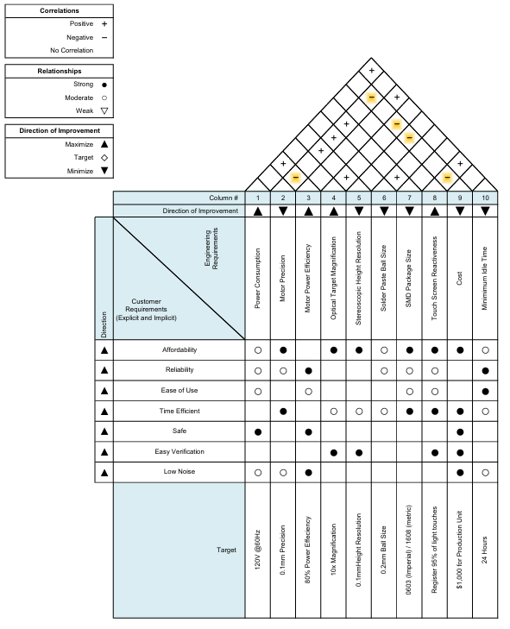
House of Quality

Slide 9
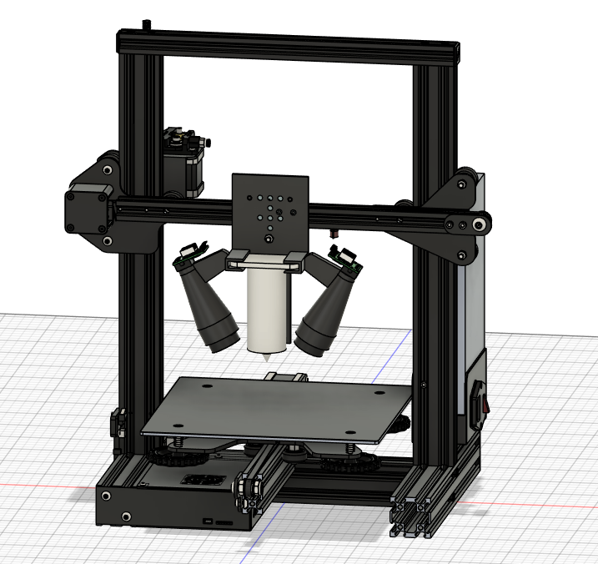
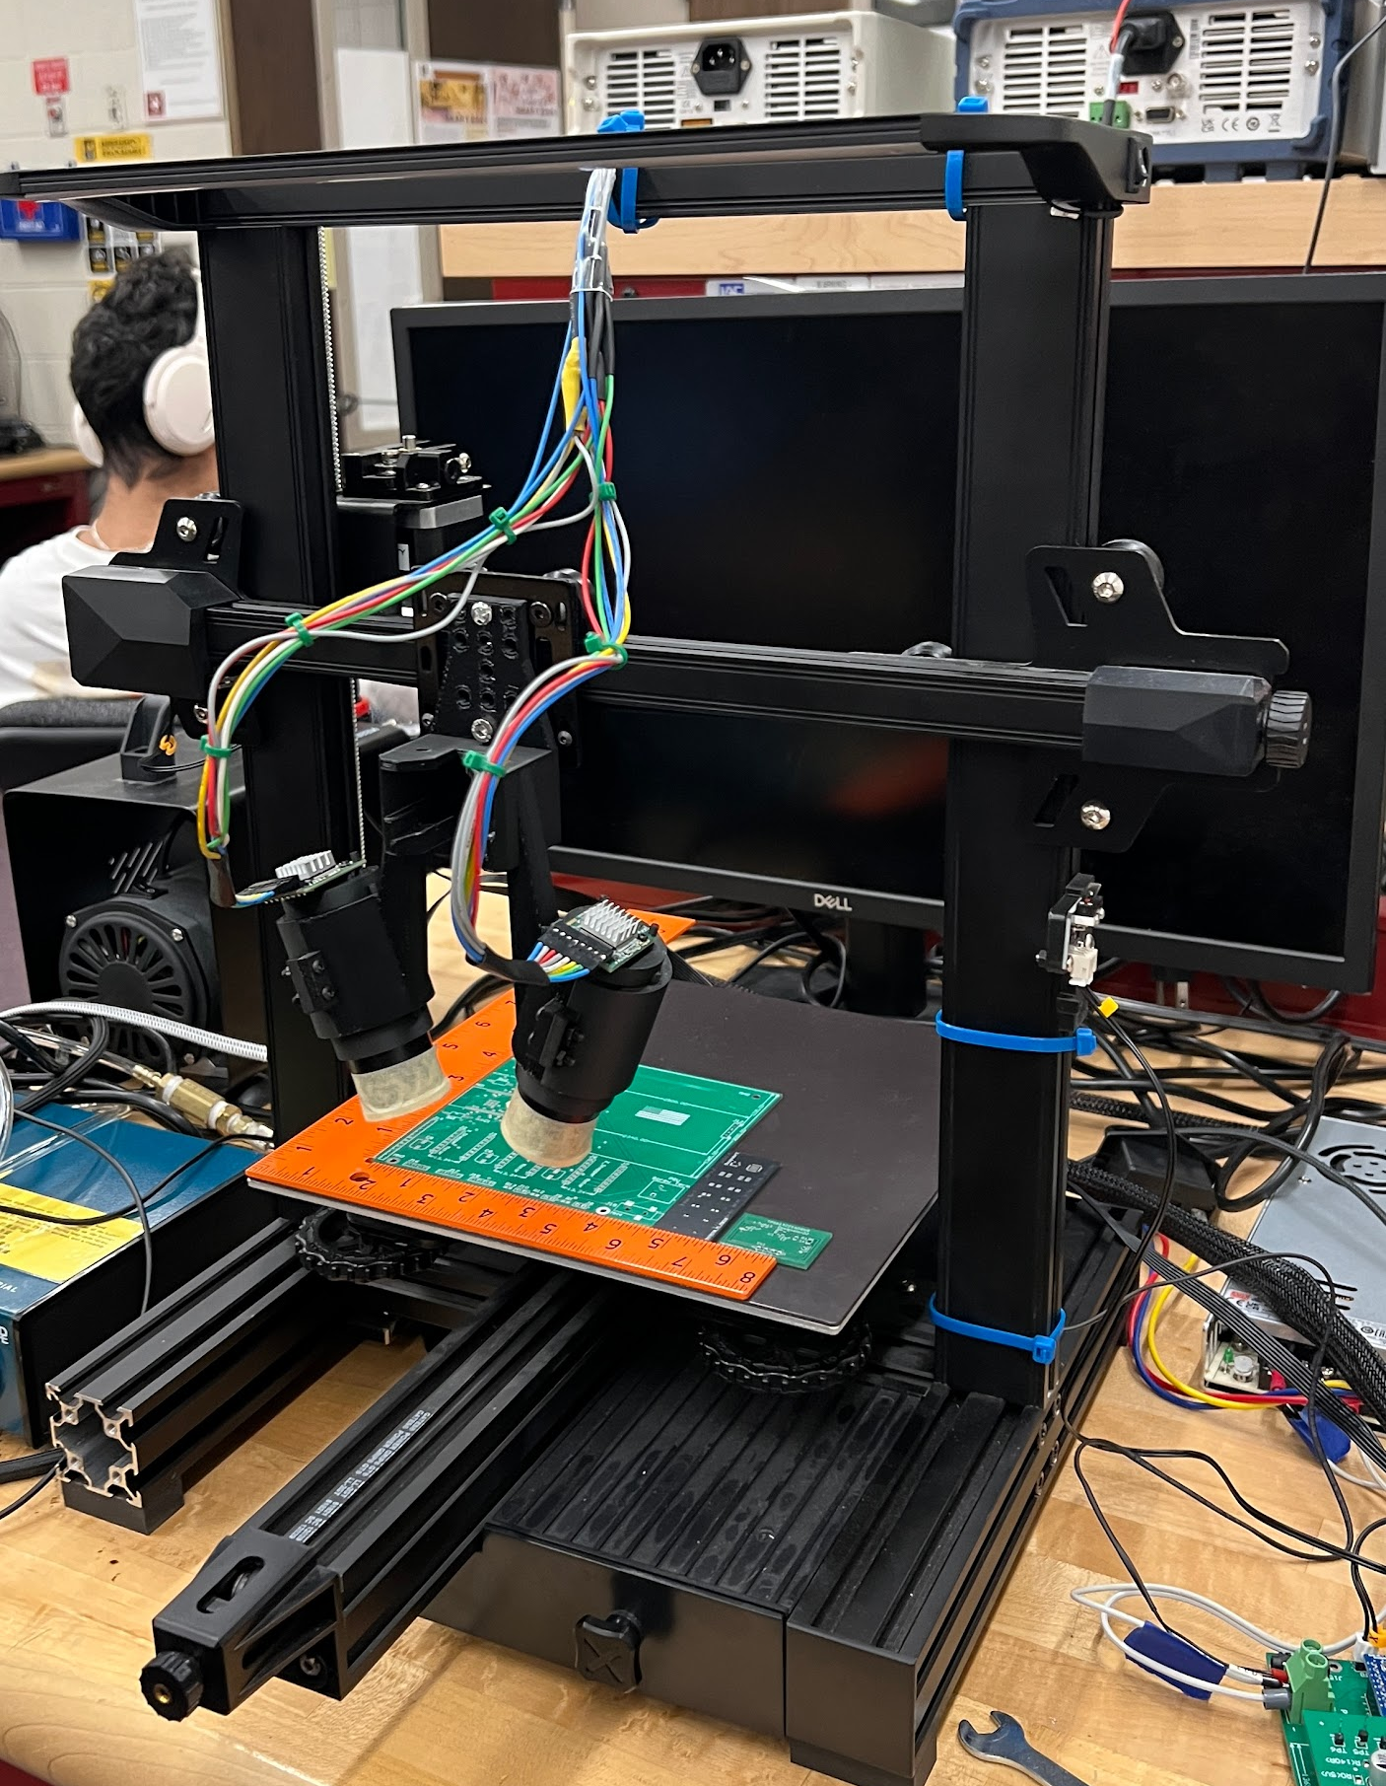
System Overview
Light Panel
Stepper Motors
Lens Aperture and Solder Tube Holder
Compressor/Pneumatic Pump System
L-bracket for origin point location
Limit switch
Dispensing Bed
Machine Dimensions: 45cm x 45cm x 50 cm (l x w x h)

Slide 10
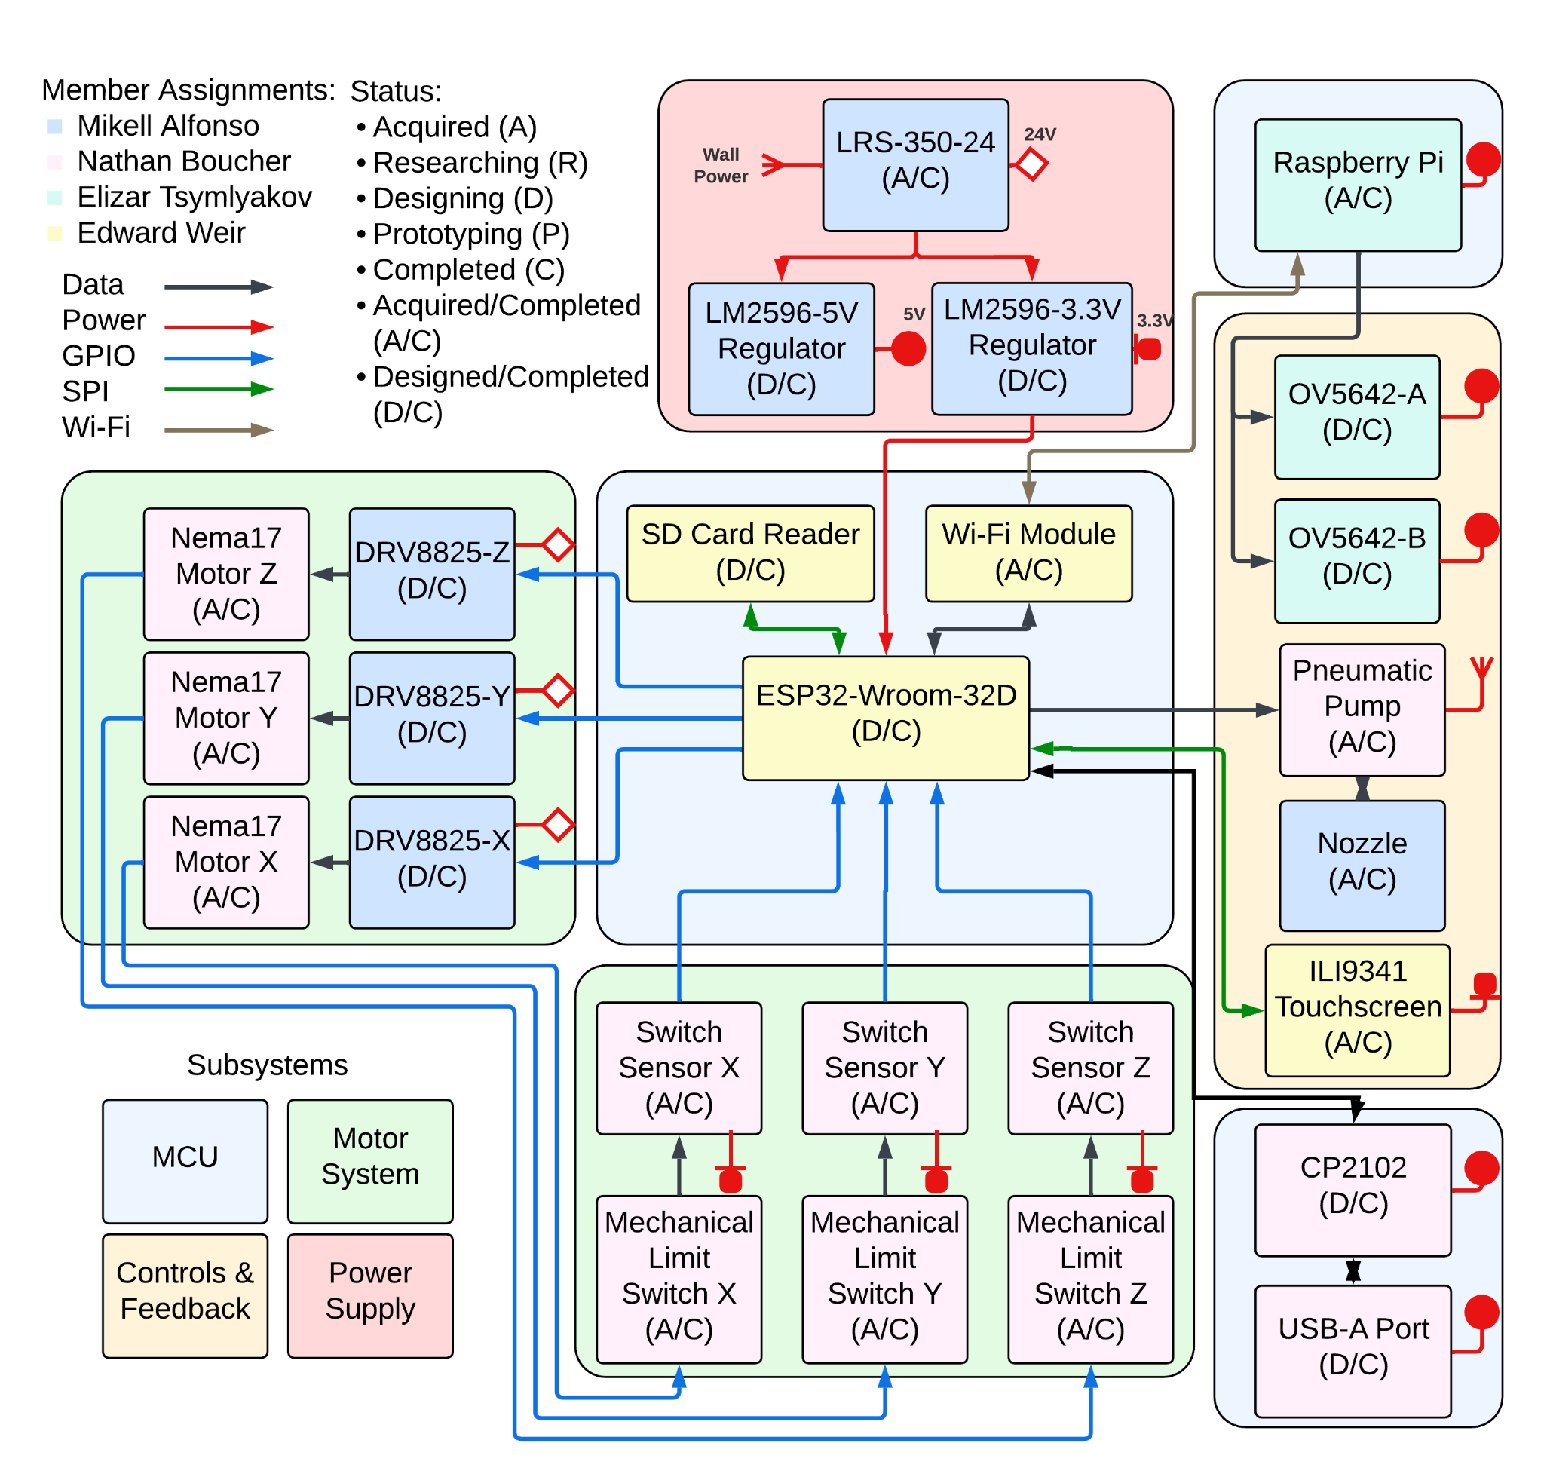
Hardware
Block Diagram
24V Source = LRS-350-24
5V Regulator = LM2596-5V
3.3V Regulator = LM2596-3.3V
Microcontroller = ESP32-Wroom-32D
Wi-Fi Module = Built-in Wi-Fi antenna to ESP32
SD Card Reader = TF-01A microSD Card Reader
Motor Driver = DRV8825
Stepper Motor = NEMA17
Mechanical Limit Switch/Switch Sensor = Creality Endstop Limit Switch
Website Host Microcontroller = Raspberry Pi
Camera = OV5642
Pneumatic Pump = Feita 983
Nozzle = >Metal Needle Nozzle
Touchscreen Display = ILI9341
USB-UART Bridge = CP2102
USB Port = 1932258-1 USB-A Port

Slide 11
Hardware Selection: MicroController Selection
 | ESP32-WROOM-MD | MSP430F6459 | RP2530B
Cores | 2 | 1 | 2
CPU Frequency | 80MHz-240MHz | 20MHz | 150MHz
Wi-Fi Support (Natively) | Yes | No | No
Bluetooth Support (Natively) | Yes | No | No
RAM | 448kb ROM, 520 kb of SRAM | 512kb non-Volatile, 66kb RAM | 520kb of SRAM
Supports External Memory | Yes | No | Yes
GPIO Pins | 38 | 74 | 48
ESP32 was selected because…

Slide 12
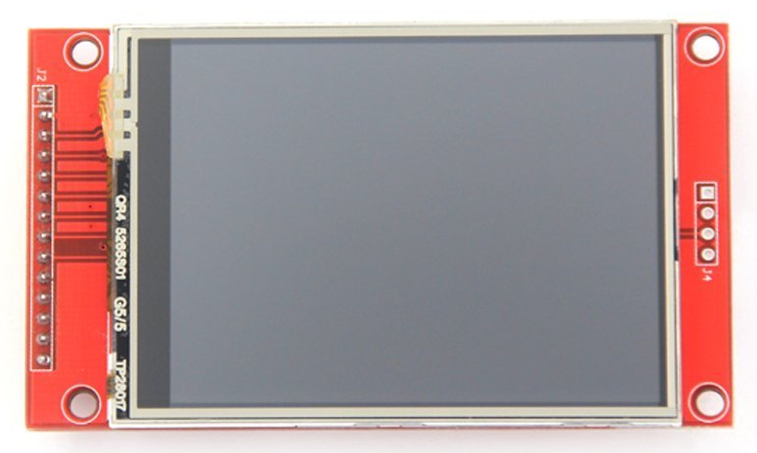
Hardware Selection: Touch Screen
 | ST7789 | ST7735R | HX8357 | ILI9488 | ILI9341
Interface | SPI | SPI | SPI | SPI | SPI
Pixel Resolution (pixels x pixels) | 240 x 320 | 128 x 160 | 320 x 480 | 320 x 480 | 240 x 320
Color Depth (bits) | 18 | 18 | 18 | 16 | 16
Screen Size (inches) | 2 | 1.8 | 3.5 | 3.5 | 3.2
microSD Card Reader | Yes | Yes | Yes | No | No
SD Card Reader | No | No | No | Yes | Yes
ILI9341 chosen for mainly for comm protocol of SPI, decent color depth, and just right size of 3.2 inches

Slide 13
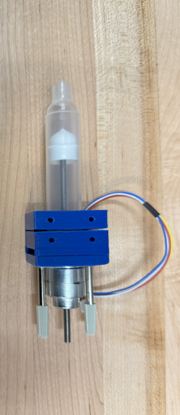
Hardware Selection: Dispensing Methods
 | Pneumatic Dispenser: | Stepper Motor Driven Screw Dispenser:
Precision | High | High
Speed | Fast | Moderate
Calibration needed | Minimal | Maximul
Cost | Moderate | Moderate

Slide 14
Hardware Selection: Stepper Motor Drivers
 | A4988 | DRV8825 | TMC2225
MicroStepping Resolution | 1/16 | 1/32 | 1/256
GPIO Pins Required (Minimum Configuration) | 2 (Step +Dir) | 2 (Step +Dir) | 2 (Step +Dir)
Voltage Input (VMOT) | 8V-35V | 8.2V-45V | 4.75V-36V
Logic Voltage Level (High) | 3V-5.5V | 2.2V-5.25V | 3.3V-5V
Max Current (Per Coil) | 2A | 2.2A | 2A
Price Per Unit (Per IC not the board itself) | $4.25 | $5.73 | $5.61

Slide 15
Hardware Selection: CMOS Sensor
 | Arducam OV2640 | Arducam IMX 230 | Arducam OV5642
Price | $10-$15 | $80-$90 | $40
Sensor size (pixels) | 1600 x 1200 (2 MP) | 5472 x 3648 (21 MP) | 2592x1944 (5 MP)
Pixel Size | 1.75 µm x 1.75 µm | 1.12 µm (w) x 1.12 µm (h) | 1.4 µm x 1.4 µm
Sensor size (mm) | 4.6 mm x 3.4 mm | 7.216 mm x 5.497 mm | 3.67 mm x 2.73 mm
Diagonal Length | 4.5 mm | 7.487 mm | 4.57 mm
Dynamic Range | 50 dB | “High” | 68 dB
SNR | 40 dB | “High” | 36 dB
Power Supply | 2.5~3.0V | 3.3V DC | 5V/390mA
Interface | CSI-2 | CSI-2 | SPI

Slide 16
Hardware Selection: Lens
 | Thorlabs LB1378-ML | Thorlabs TRH-040-A-ML | Thorlabs TRS-040-A-ML
Price | $52.28 | $111.38 | $117.31
Working Distance | 40 mm | 68.2 mm | 68.2 mm
Focal Length | 40 mm | 40 mm | 40 mm
Diameter | 12.7 mm | 25.4 mm | 25.4 mm
Type | Singlet | Hastings Triplet | Steinheil Triplet

Slide 17
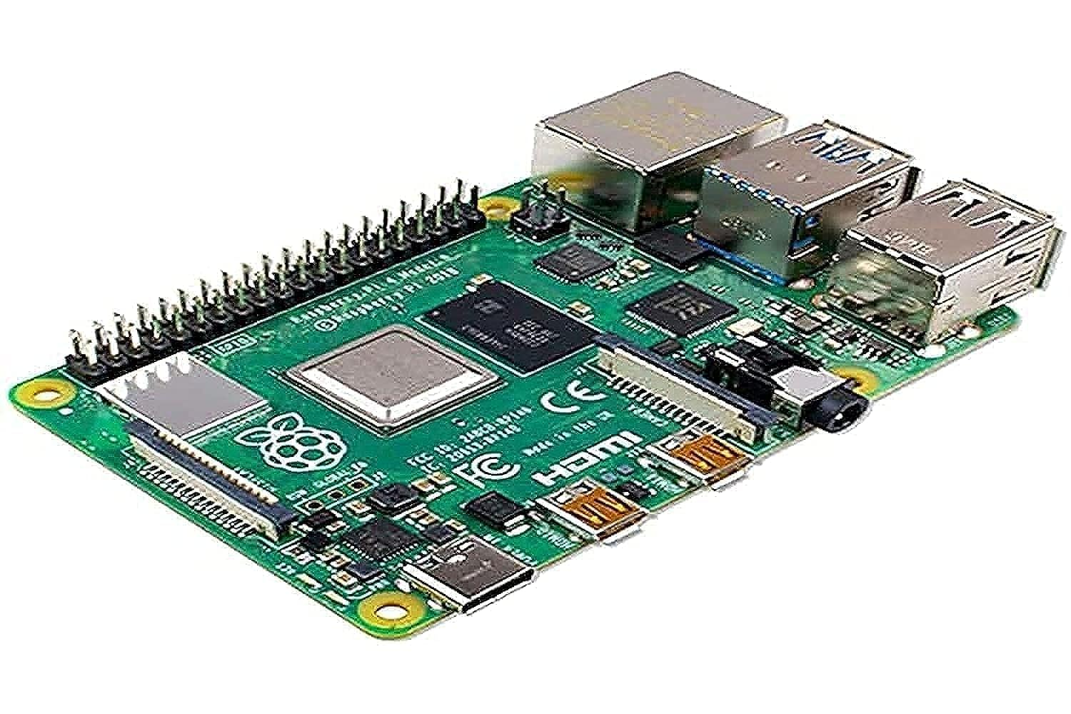
Hardware SubSystem: Raspberry Pi (4)
Hosts the Web Server (including local MongoDB)
Utilizes the two cameras to take pictures
Runs the python Code for the stereoscopy system
UI for users to upload Gerber Files, as well as download their images
Communicates with the ESP-32 in order to POST Gerber-Files, as well as receive a request to take a picture

Slide 18
Power Distribution Table
 | ESP32 | ILI9341 | CP2102 | OV5642 A | OV5642 B | DRV8825 X | DRV8825 Y | DRV8825 Z | Total
Expected Supply Voltage | 3.3V | 3.3V | 3.3V | 5V | 5V | 24V | 24V | 24V | 24V
Expected Supply Current | <300mA | <50mA | 26mA | 390mA | 390mA | 2.5A | 2.5A | 2.5A | 8.656A
Expected Power Consumption | 0.99W | 0.165W | 0.0858W | 1.95W | 1.95W | 60W | 60W | 60W | 185.14W
*Raspberry Pi 4 powered externally due to Wi-Fi Connectivity

Slide 19
Hardware Selection: Power Supply Unit
 | CMS 350-24 | LRS-350-24 | S35024 | UHP-350-24 | PMT-24V350W1AK | WMA350H-24 | 233-6892
Manufacturer | Creality | Mean Well | Mean Well | Mean Well | Delta | Cosel | RS PRO
Output | 24V, 14.6A | 24V, 14.6A | 24V, 14.6A | 24V, 14.6A | 24V, 14.6A | 24V, 14.6A | 24V, 14.6A
Efficiency | NA | 88% | 81% | 94% | 87% | 87% | 93%
MTBF | NA | 328.6K hrs (25℃) | 234.3K hrs (25℃) | 285K hrs (25℃) | 700K hrs (35℃) | NA | >300K hrs (25℃)
Protections | SC, OV, OL, OT | OL, OV, OT | OL, OV | OL, OV, OT | OV, OL, OT, SC | OC, OV | OV, OC, SC
Dimensions (mm) | 215x115x30 | 215x115x30 | 215x115x50 | 220x62x31 | 215x115x50 | 115x30x215 | 130x86x35
Cost | $31.67 (Creality) | $38.11 (DigiKey) | Obsolete | $69.31 (MeanWell) | $74.98 (DigiKey) | $75.88 (DigiKey) | $133.84 (eezee)

Slide 20
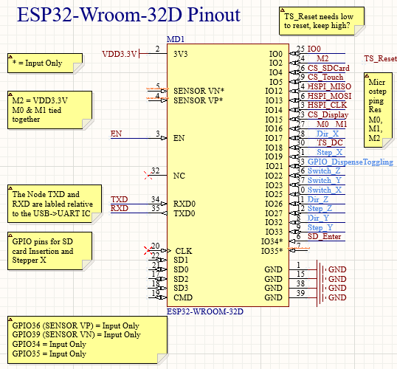
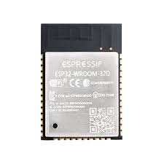
Hardware Design: ESP32-WROOM-32D
Flashing VIA a CP2102 USB -> UART Circuit
Main Driver of the SPD
Built in PCB Antenna for 2.4GHz
Powered by 3.3V from the Regulator Circuit
Responsible for Controlling:
  Stepper Motor Drivers
    Step + Dir
    Microstepping Resolution
  Mechanical Switches
  TouchScreen
  MicroSD Card
  SSR hooked up to the Pneumatic Device
Interfaces VIA Wi-Fi to the Web Server

Slide 21
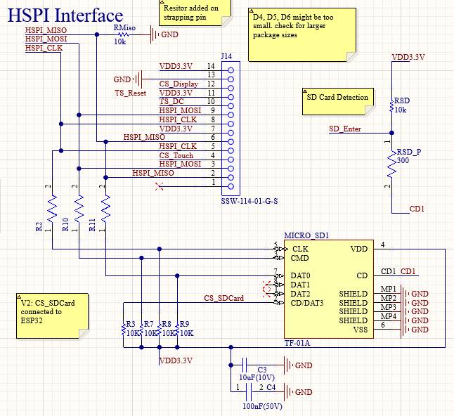
Hardware Design: SPI Interface
Three Slaves:
  MicroSD Card
  TouchScreen Display
  TouchScreen Touch
Header pins to connect to the touch screen
Pull-up resistors and bypass capacitors for the MicroSD Card
Utilizing Chip Detect on the SD Card to determine when it is removed, re-initializes the SD card every time it is plugged back in
0 Ohm resistors for potential impedance matching

Slide 22
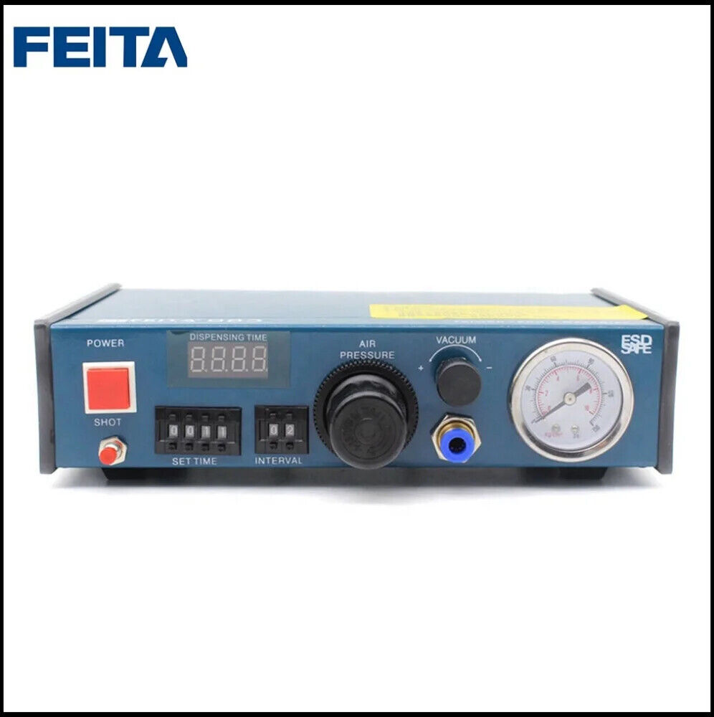
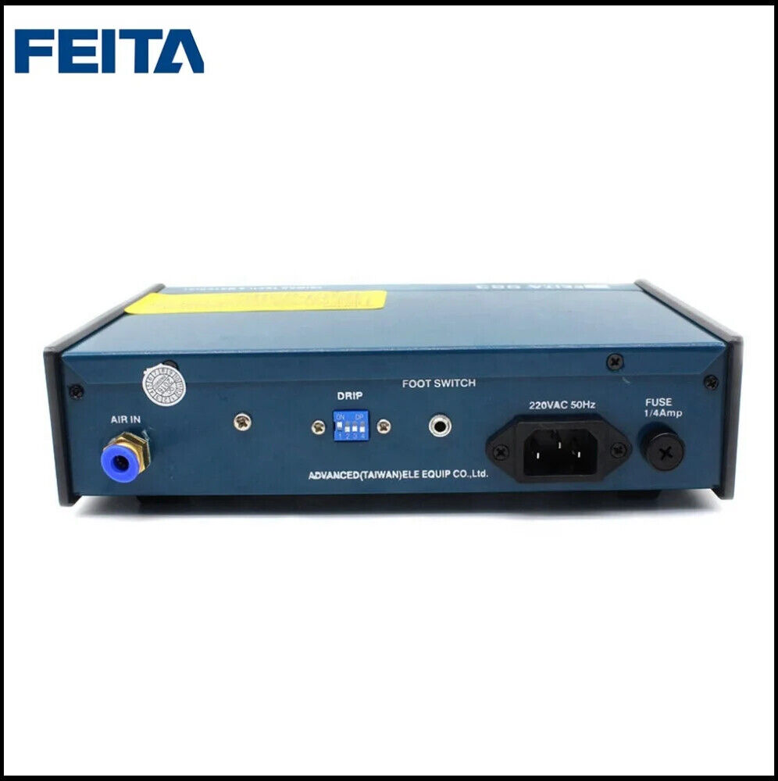
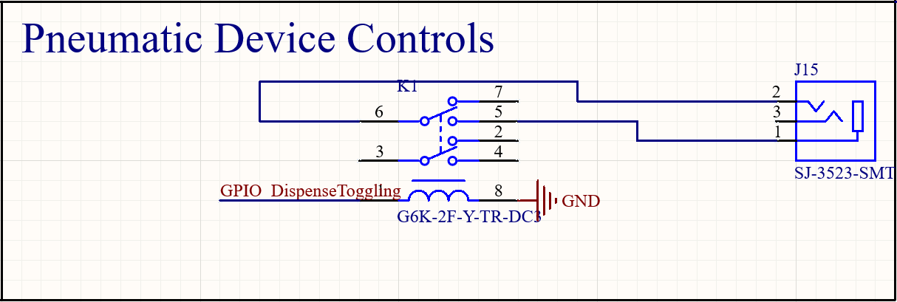
Hardware Design: Dispensing System
Feita 983
Solid-State Relay (SSR) controlled by GPIO pin
Shorts pins 1 and 2 on the 3.5mm headphone jack to dispense
Continuously dispenses while 3.5mm jack is shorted
3.5mm Headphone Jack

Slide 23
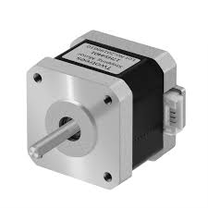
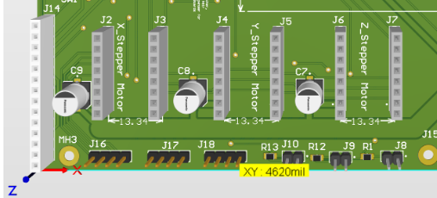
Hardware Design: Stepper Motors
Three NEMA 17 Motors
  X-Axis
  Y-Axis
  Z-Axis
Creality 42-34s
Powered and controlled by the custom DRV8825
1.5Amps Per Phase
1.8* step resolution
2 GPIO pins required per AXIS
External header-pins to wire the motors.
Utilizing 1/32nd Microstepping

Slide 24
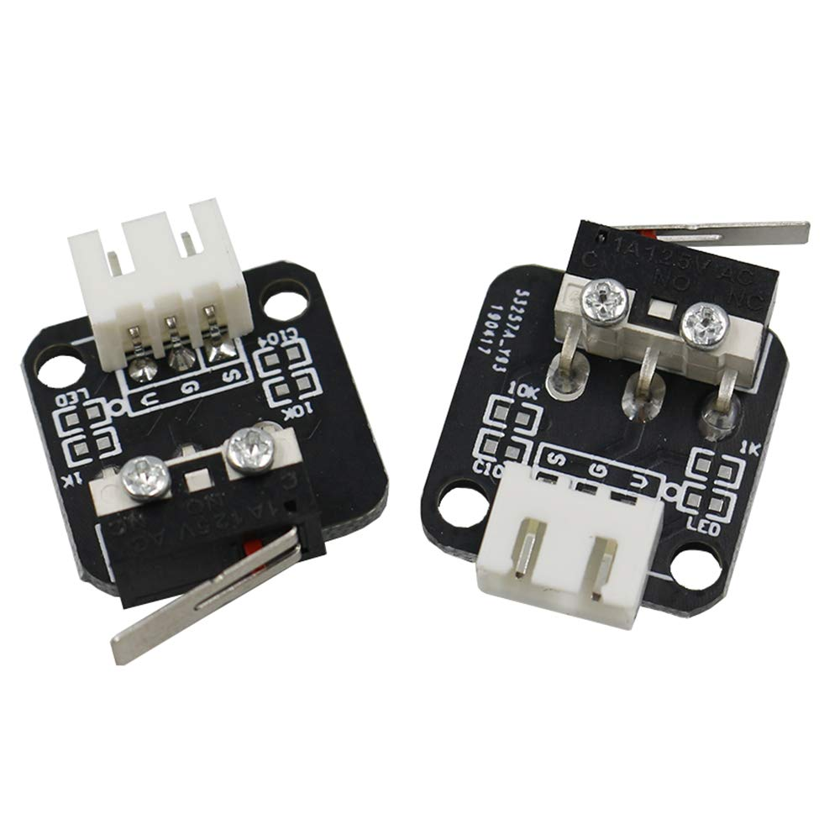
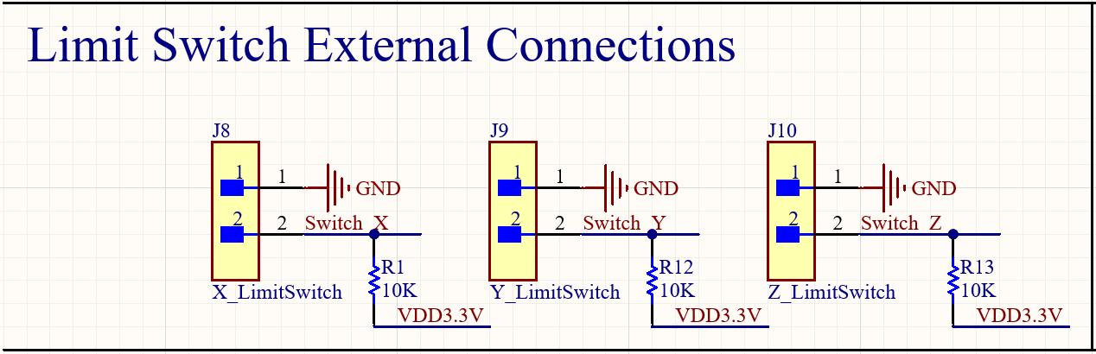
Hardware Design: Mechanical Switches
Creality Mechanical Switches
Three Axis:
  X-Axis
  Y-Axis
  Z-Axis
Initial Calibration Required
Pull-up Resistors
Logic-Low
Connected with a set of Header Pins
3D printed holder for Z-limit Switch

Slide 25
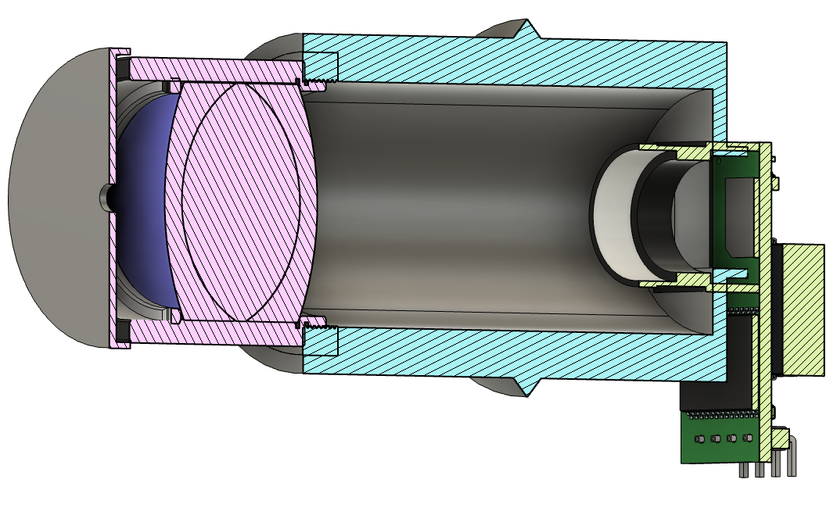
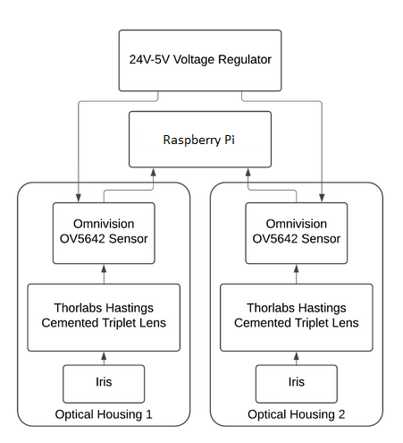
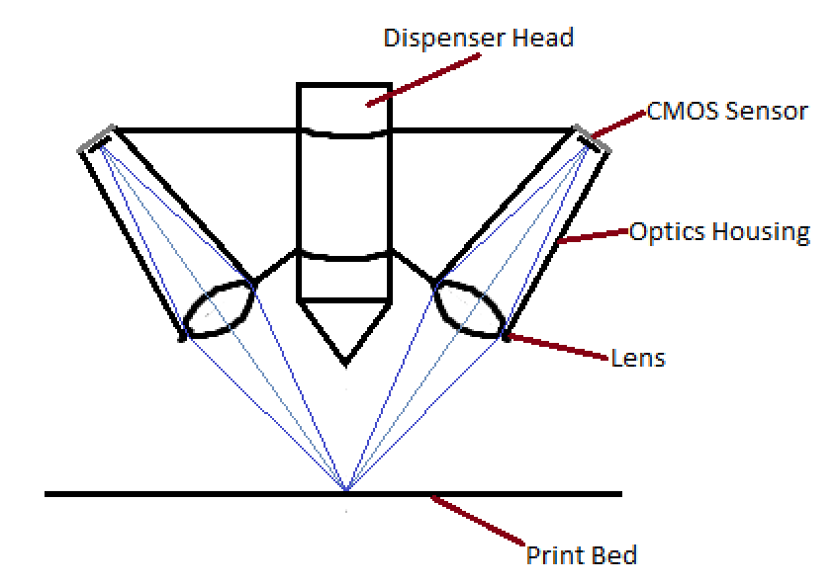
Hardware Design: Optical Stereo System

Slide 26
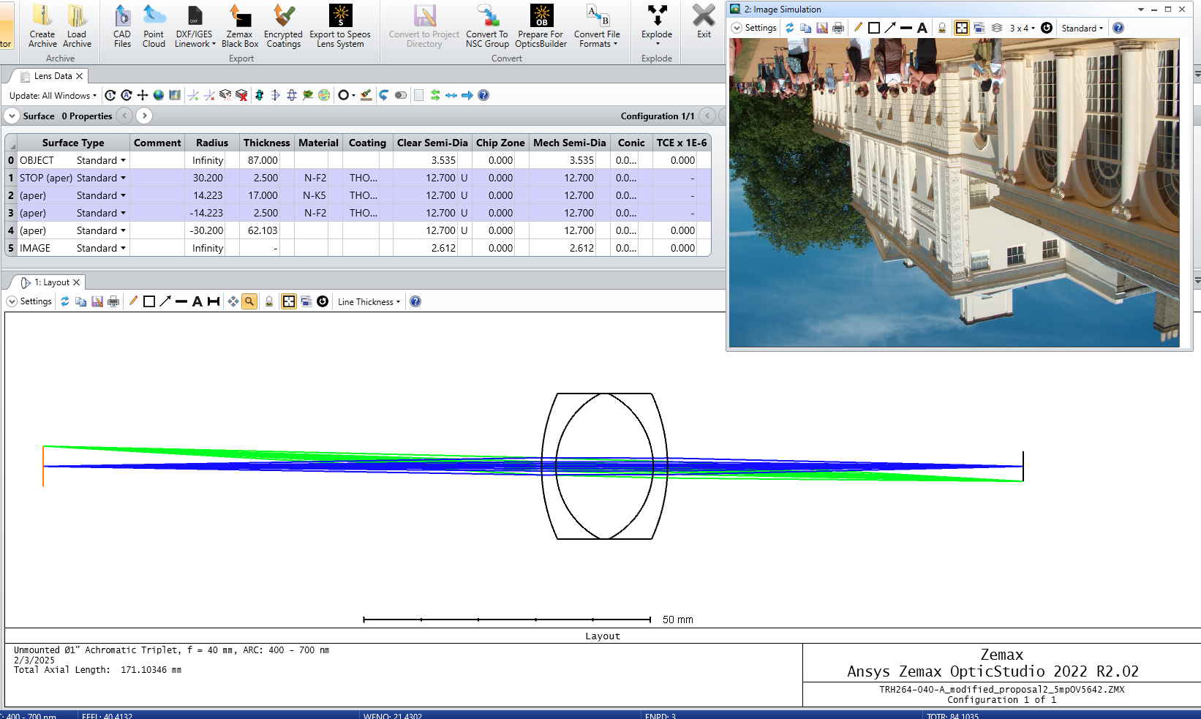
Hardware Design: Optical Stereo System

Slide 27
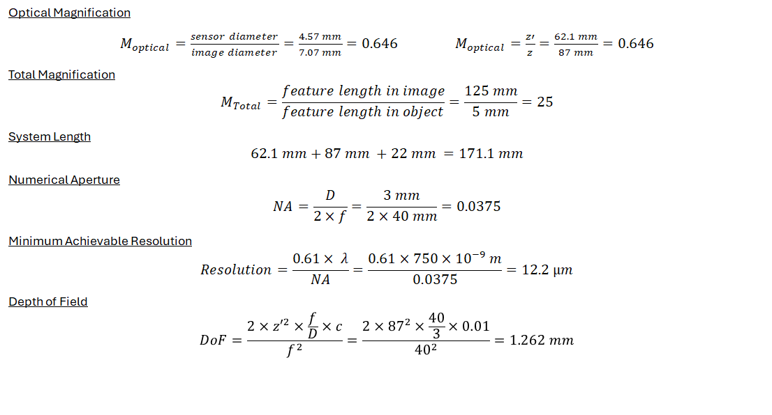
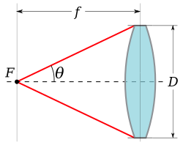
Hardware Design: Optical Stereo System

Slide 28
Hardware Design: Optical Stereo System
Engineering Requirement | Chosen Specification | Calculated Specification | Comparison
Optical Configuration Length | <300 mm | 171.1 mm | Achieved
Numerical Aperture | >0.0183 | 0.0375 | Achieved
Minimum Feature Size | 25 µm | 12.2 µm | Achieved
Total Magnification | >18x | 25x | Achieved
Dynamic Range | >40 dB | 63.3 dB | Achieved
Depth of Field | >1.0 mm | 1.26 mm | Achieved

Slide 29
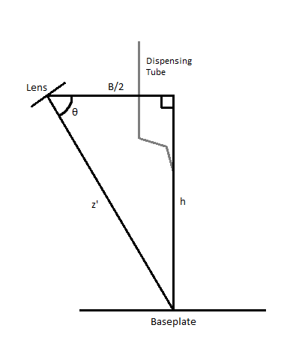
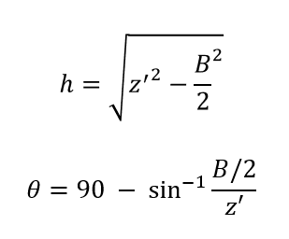
Hardware Design: Optical Stereo System
Increasing baseline (B), increases camera angle. This increases the difficulty of matching pixels for stereo.
Optimal camera angle (θ) 60°-80° (1)
Minimum baseline possible depends on the width of the dispensing tube.
If z’ = 87 mm and we want the optimal camera angle, the baseline length must be be 30 - 87 mm.
X. Liu, W. Chen, H. Madhusudanan, L. Du and Y. Sun, "Camera Orientation Optimization in Stereo Vision Systems for Low Measurement Error," in IEEE/ASME Transactions on Mechatronics, vol. 26, no. 2, pp. 1178-1182, April 2021, doi: 10.1109/TMECH.2020.3019305.

Slide 30
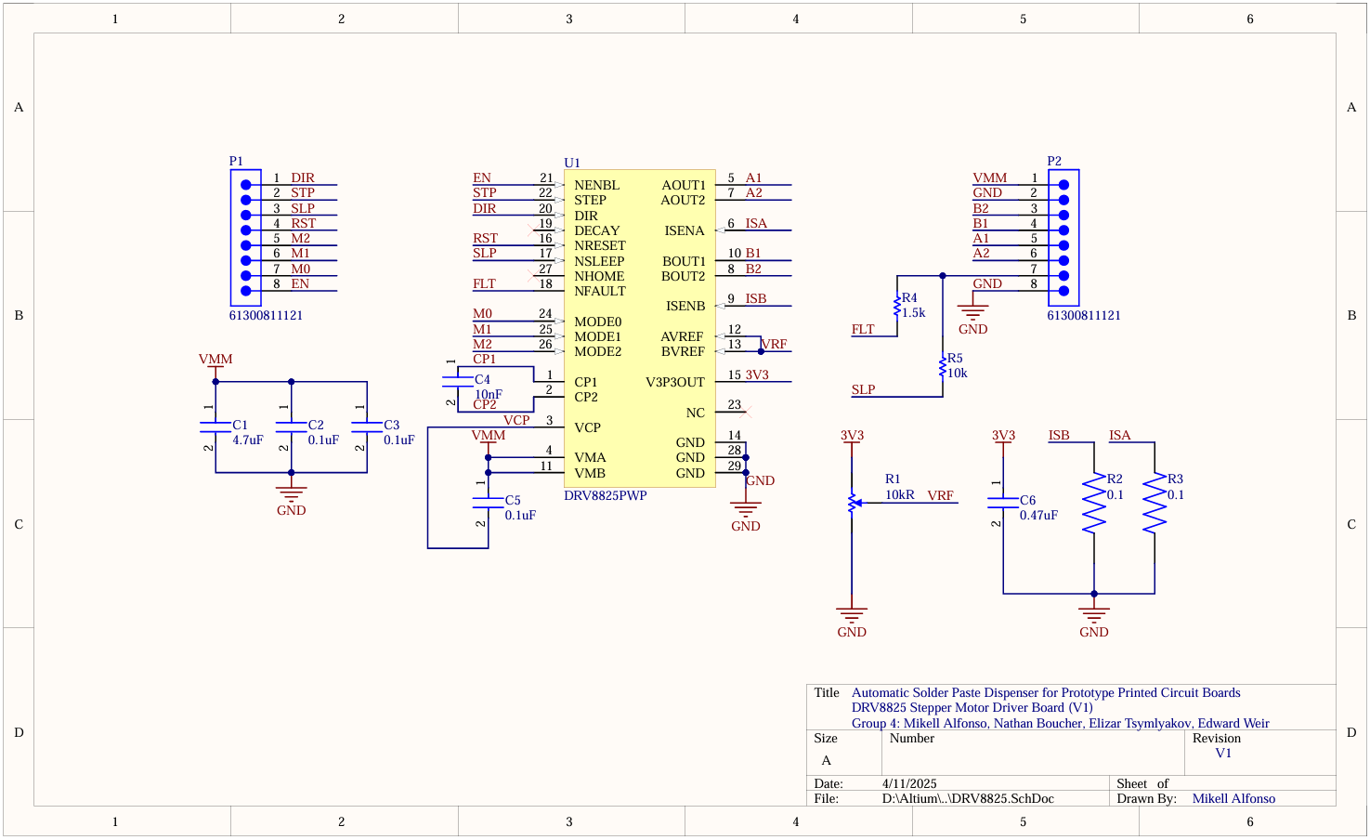
Hardware Design: Motor Driver Schematic

Slide 31
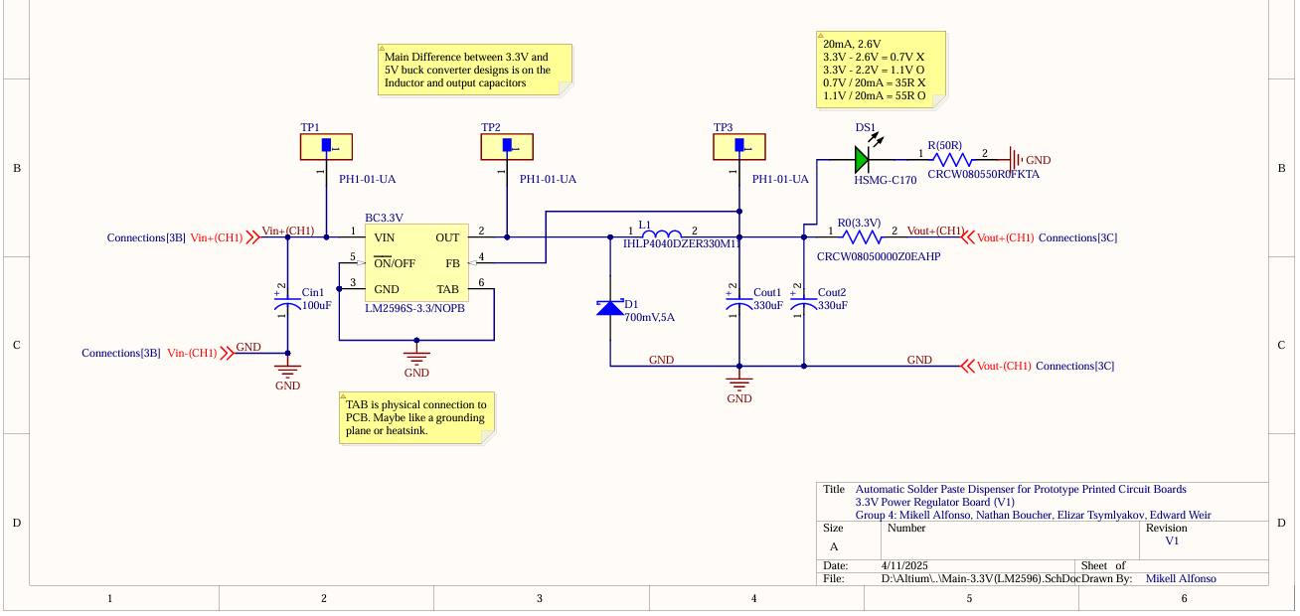
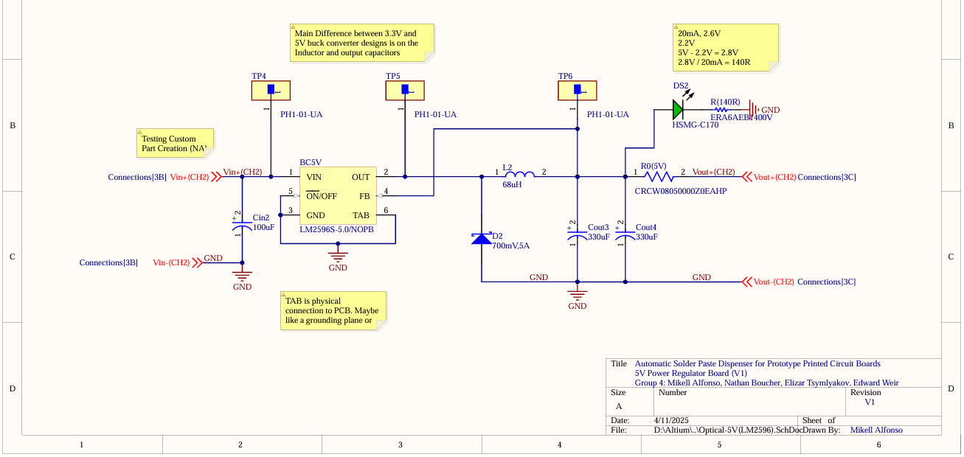
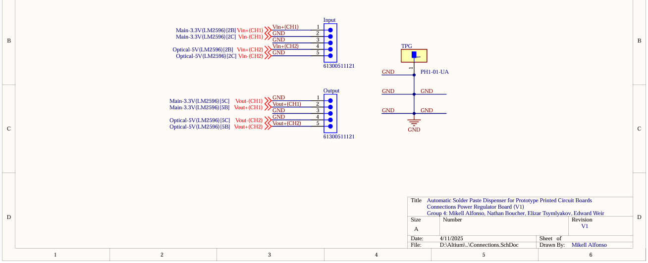
Hardware Design: Power Regulator Schematic

Slide 32
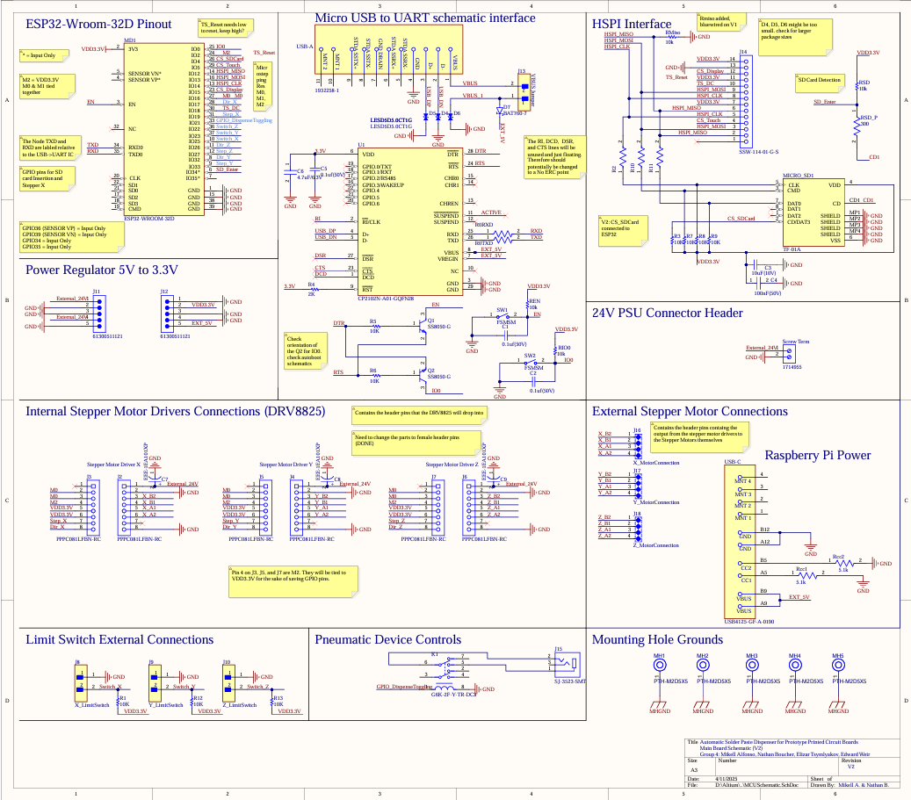
Hardware Design: Main Board Schematic V2

Slide 33
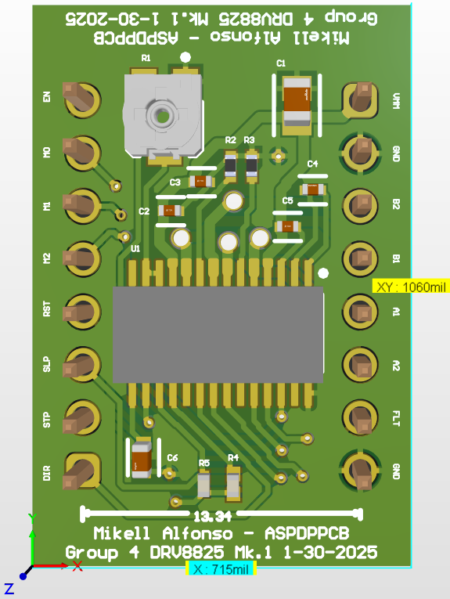
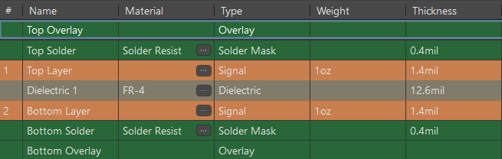
Hardware Design: Motor Driver PCB
Two Layers (Signals)
GND Copper Pour (0.468 in² Top Layer and 0.546 in² Bottom Layer)
Matched pin layout and distance between header pins of DRV8825 modules purchasable online
Three duplicates of these will be used

Slide 34
Hardware Design: Motor Driver PCB
Current Limiting Potentiometer
Power
Step Precision Pins
Coil Connections
Direction & Step
DRV8825 IC

Slide 35
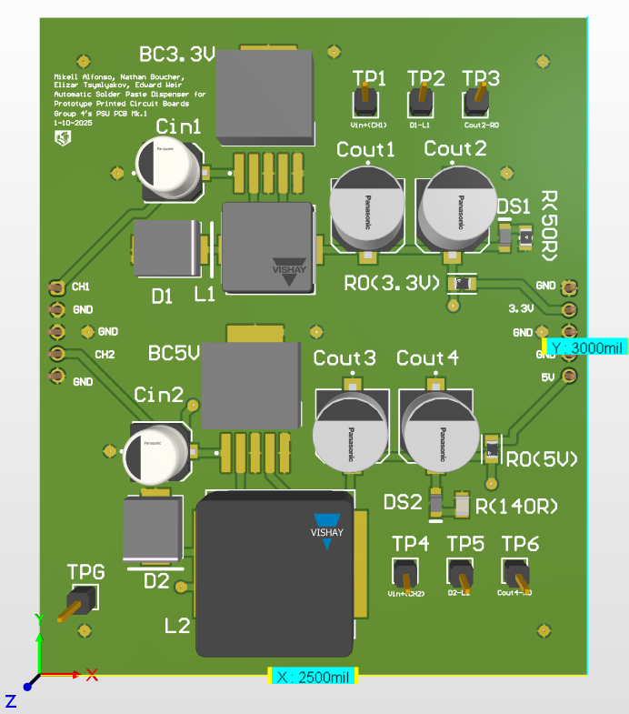
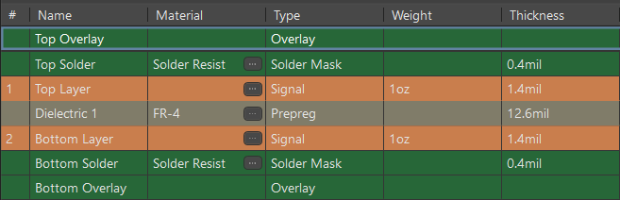
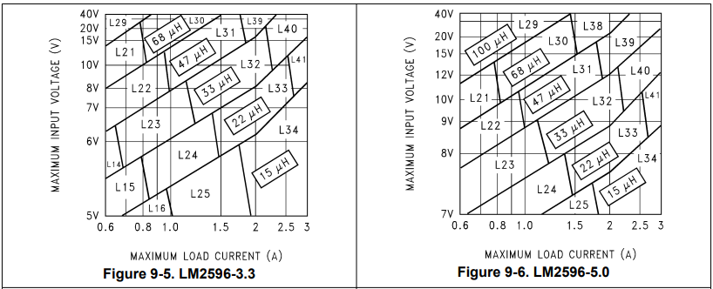
Hardware Design: Power Regulator PCB
Two Layers (Signals)
GND Copper Pour (6.296 in² Top Layer and 7.046 in² Bottom Layer)
LM2596-3.3V and LM2596-5V Fixed Output Versions
Inductor values from datasheet
DS1 and DS2 are LEDs
R0 are zero ohm resistors
Test Points

Slide 36
Hardware Design: Power Regulator PCB
LM2596-3.3V Regulator
Test Points
Input Bypass Capacitor
3.3V Regulator Side
Catch Diode
Output Capacitors & LED
33 uH Inductor
LM2596-5V Regulator
Output Capacitors & LED
Input Bypass Capacitor
5V Regulator Side
Catch Diode
Test Points
68 uH Inductor
Two Layers (Signals)
GND Copper Pour (6.296 in² Top Layer and 7.046 in² Bottom Layer)
LM2596-3.3V and LM2596-5V Fixed Output Versions
Inductor values from datasheet
DS1 and DS2 are LEDs
R0 are zero ohm resistors
Test Points

Slide 37
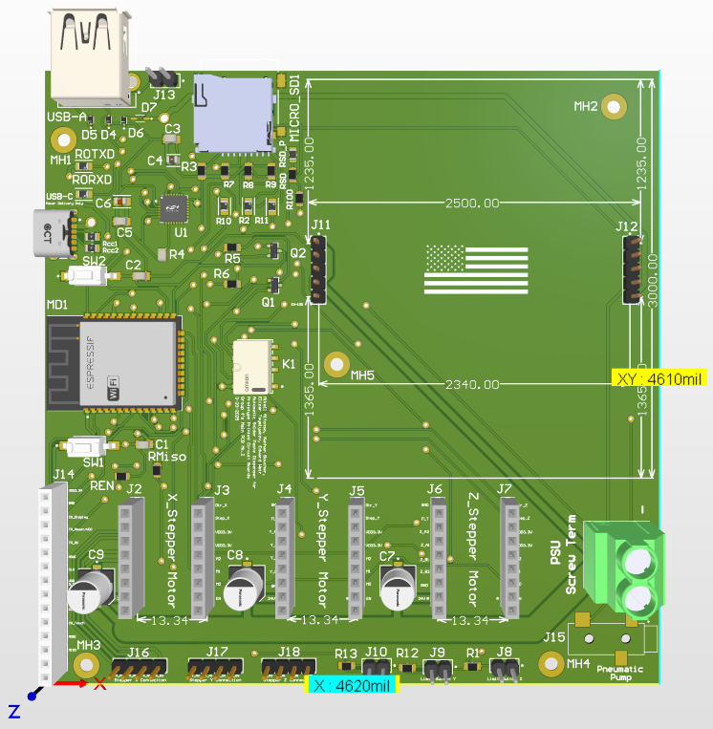
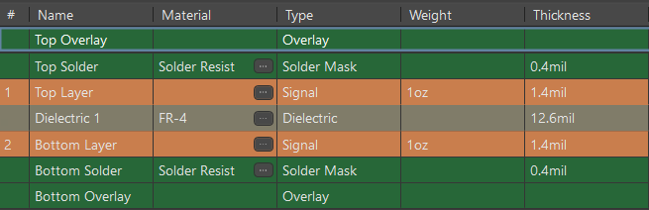
Hardware Design: Main PCB V2
Two Layers (Signals)
GND Copper Pour (16.34 in² Top Layer and 18.652 in² Bottom Layer)
USB-A Port
microSD Card Reader
CP2102 USB-to-UART Bridge
ESP32-Wroom-32D
Solid State Relay (K1 - Pneumatic Pump)
ILI9341 Display Female Header Pins (J14)
DRV8825 Motor Driver Header Pins (J2-J7)
Stepper Motor Connections (J16-J18)
Limit Switches (J8-J10)
Auxiliary Port (J15 - Pneumatic Pump)
Screw Terminal for power from PSU
Male Header Pins for Regulator PCB

Slide 38
Hardware Design: Main PCB V2
microSD Card Reader
USB-A Port
CP2102 IC
USB-C Port
Power Regulator Board
ESP32 IC
USB-A Port
Solid State Relay
Power Screw-In Terminal
Touchscreen pins
Pneumatic Pump Port
Motor Pins
USB-A Port

Slide 39
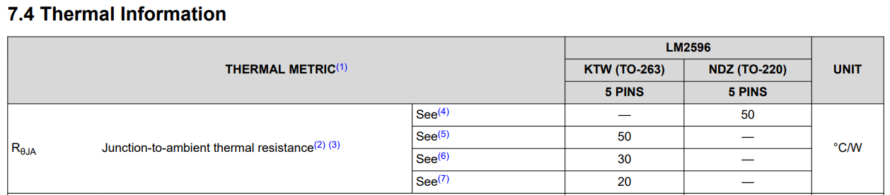
Hardware Testing: Regulator PCB
 | Input Voltage | Input Current | Input Power | Output Voltage | Output Current | Output Power | ΔPower | Operating Temp | Efficiency
3.3V Regulator | 24V | 0.1984A | 4.7612W | 3.2540V | 0.9960A | 3.2410W | 1.5202W | ~45.61℃ | 68.07%
5V Regulator | 24V | 0.2807A | 6.7366W | 4.9950V | 0.9960A | 4.9750W | 1.7616W | ~52.85℃ | 73.85%

Slide 40
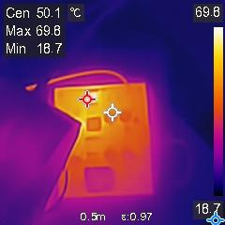
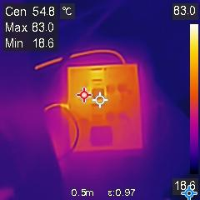
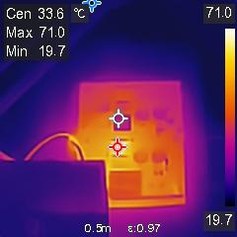
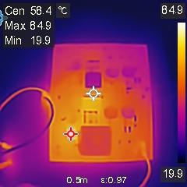
Hardware Testing: Regulator PCB
3.3V Regulator
5V Regulator
Electronic Load: CC 2.5A
Electronic Load: CC 2.5A
3.3V Regulator @ 69.8°C.
To: -40°C ≤ Tj ≤ 150°C.
3.3V Diode @ 83.0°C.
To: -55°C ≤ Tj ≤ 150°C
5V Regulator @ 71.0°C.
To: -40°C ≤ Tj ≤ 150°C.
5V Diode @ 84.9°C.
To: -55°C ≤ Tj ≤ 150°C

Slide 41
PCB Problems with Solutions
Motor PCB
Regulator PCB
Main PCB V1
Problems:
High Frequency Noise
Jittery movement
IC Frying
Solutions:
Impedance matching & trace lengths for V2
Calibration
Replace IC
Problems:
LED Burning (shorted with DMM)
Hot temperatures past 2.5A
Solutions:
Replace LED
2.5A surpasses power consumption
Problems:
Driver pins connected to input only pins on ESP32 (blue wire)
Impedance matching resistors missing (blue wire)
Solutions:
Blue wired for V1, Retraced for V2
Blue wired for V1, added resistors for V2
Introduced SD card sensing
Introduced USB-C for power delivery

Slide 42
COMM PROTOCOL
SPI
WiFi
ESP32 to Touch Screen
  Display
  Touch
ESP32 to SD Card Reader
Cameras to Raspberry Pi
Why: With many peripherals connected to the ESP32, SPI was chosen to reduce the amount of pins needed as the Touch Screen display and touch, and SD Card Reader share the same SPI lines with separate Chip Selects
Raspberry Pi to ESP32
Raspberry Pi to Website
Why: The Raspberry Pi and ESP32 share this Protocol and the Website can be easily accessed after connecting to the Raspberry Pi’s Access Point

Slide 43
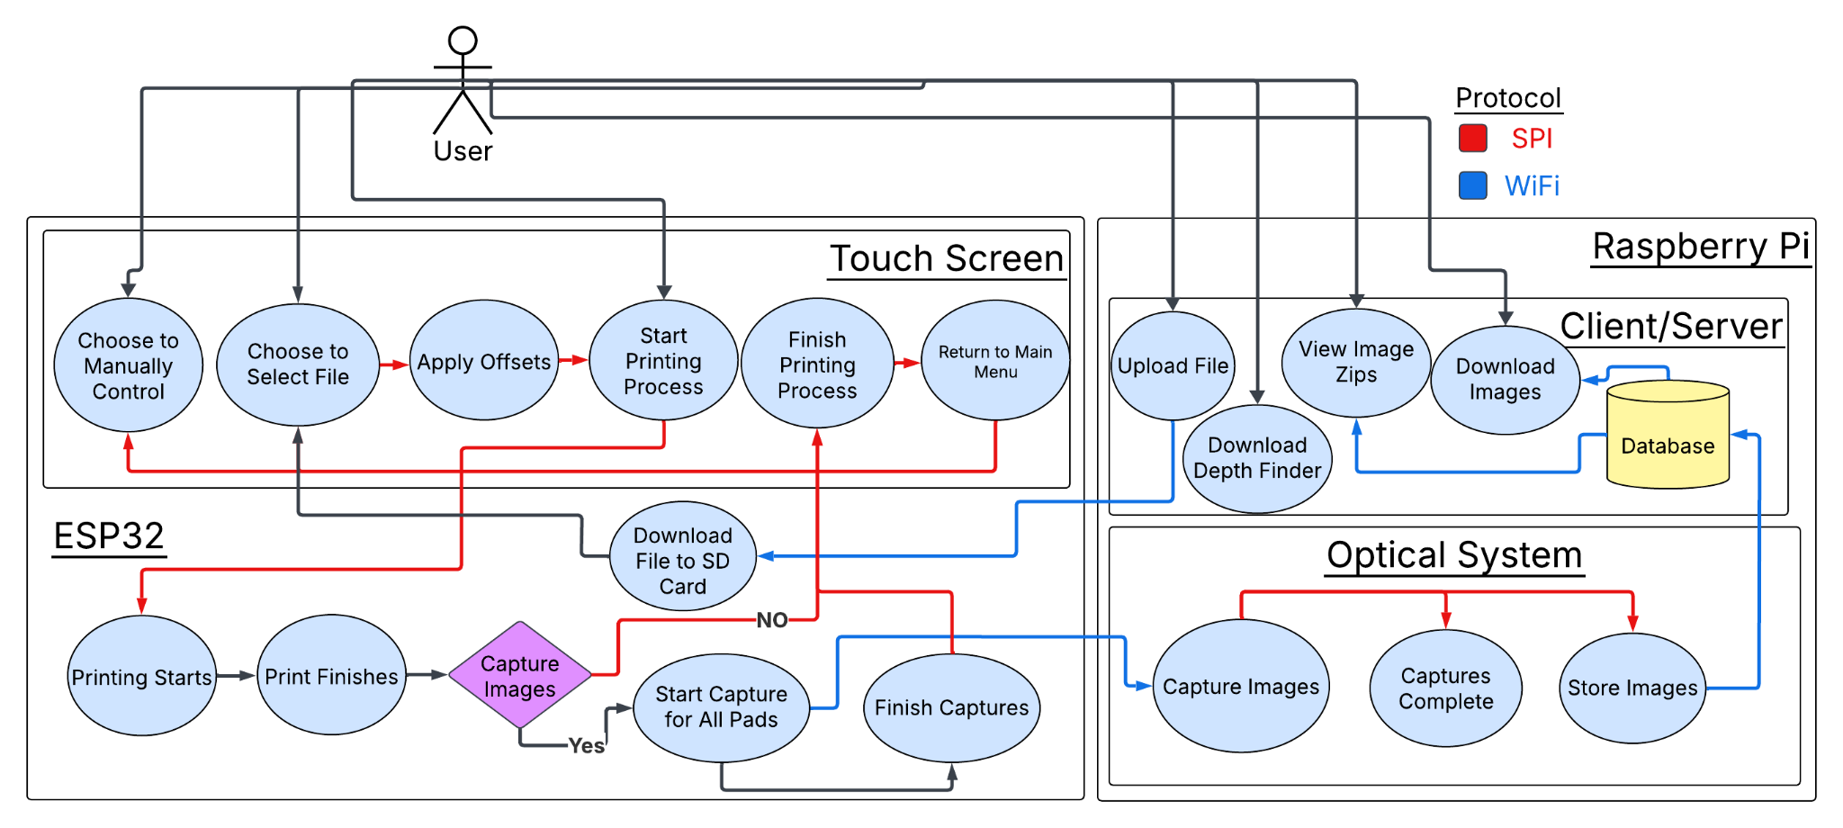
User Diagram

Slide 44
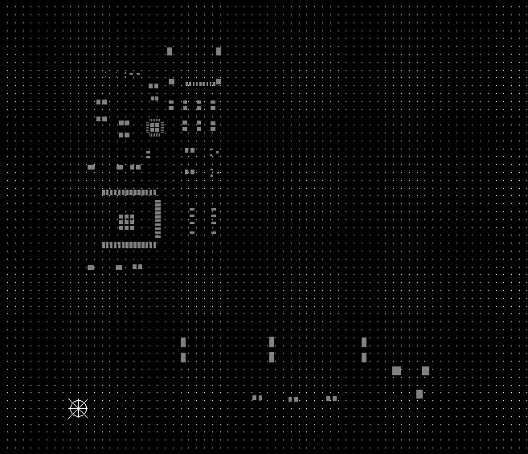
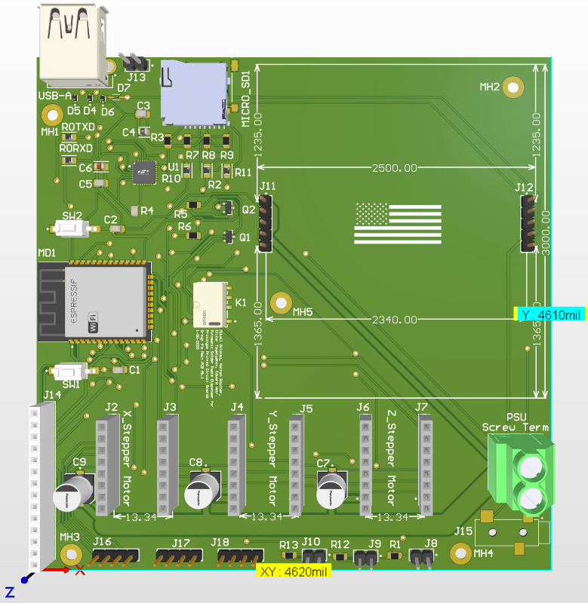

Software Design: Parsing Gerber Files
Objective: Automatically Parser Gerber Files to locate Surface Mount Pads on a X and Y Plane.

Slide 45
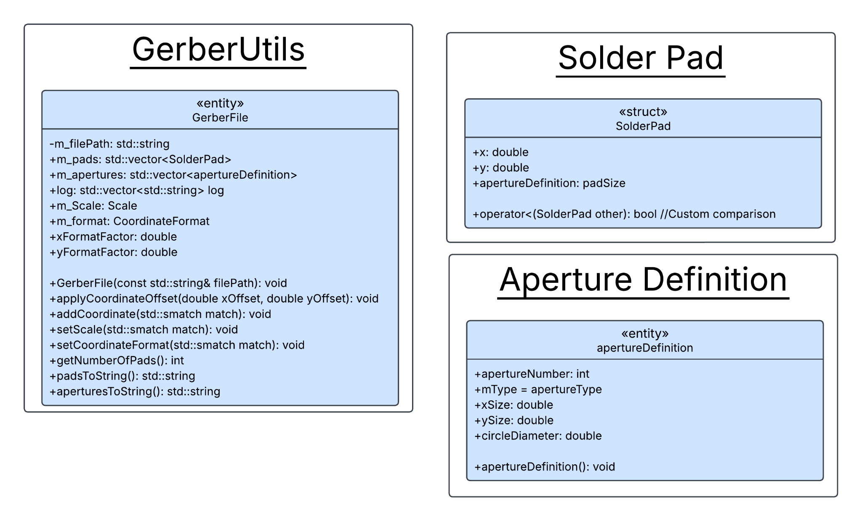
Software Design: Parsing Gerber Files
Features:
  Stores files Format Specification and Unit Selected
  Store Aperture Definitions (Pad Sizes)
  Locates each SMD Pad and stores it with it’s Aperture Definition
  Custom sort of the pads utilizing a snake like track on the PCB
  Offset can be applied prior to printing in order to move origin to the bottom left of the PCB.
  Tested with:
    Altium
    Eagle
    KiCad

Slide 46
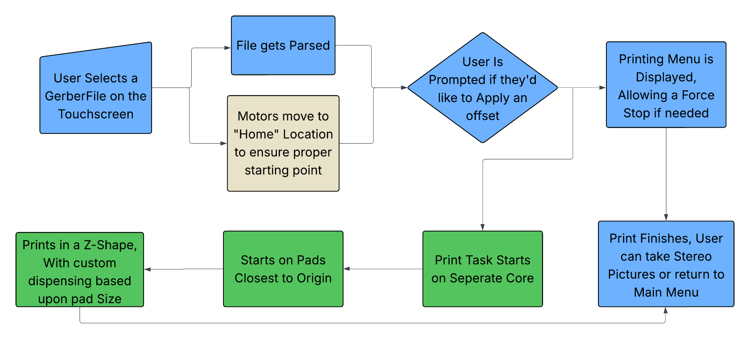
Software Design: Executing a Print
Note: Each Color represents a separate Task Scheduled

Slide 47
Software Comparison: Vision Libraries
 | OpenCV | SimpleCV | TensorFlow
Price | Free and open-source | Free and open-source | Free and open-source
Primary Purpose | Computer vision and image processing | Simplified interface for computer vision tasks | Machine learning and deep learning
Ease of Use | Moderate, involves coding knowledge | High, easy to use and beginner friendly | Moderate to difficult, requires knowledge of machine learning
Programming Languages | C++, Python, Java, JavaScript | Python | Python, C++, JavaScript, Swift, Java
Image processing capabilities | Extensive | Basic | Limited (mostly for data preprocessing)
Stereo vision capabilities | Stereo vision and depth maps | Basic | Limited
Video processing | Real-time video and image processing | Basic video support | Limited, other libraries necessary for integration

Slide 48

Software Design: Depth Estimation Flowchart

Slide 49


Software Design: Stereo Height Measurement
Due to difficulties in reliably identifying corresponding pixels between the left and right images, producing a high-quality 3D reconstruction of the object area is not possible.
Specular reflections in combination with low texture areas in the images further sabotage any efforts towards algorithmic pixel correspondence.
For this reason, the stereo software has been reduced to a manual pixel correspondence which has to be done by the user.
Solder dot heights have been successfully measured using manual pixel correspondence and stereo triangulation.

Slide 50

Software Design: Touch Screen

Slide 51



Software Design: Touch Screen Menus
Main Menu
Manual Mode Menu
File Selection Menu

Slide 52

Software Design: Motor and Dispense Controls

Slide 53




Software Design: Website/Client & Servers
File Upload
Image Download
Download Zip of Images
Delete Zip of Images
Download Height Finder Script

Slide 54
Software Problems with Solutions
Touchscreen
Raspberry Pi 4
Problem: Buttons from other menus would trigger instead of the current menu displayed
Solution: Create Menu abstract class to base all menus from and create a menu handler which uses the shared functions in the abstract class to handle all button presses
Problem: Raspberry Pi 4 CPU ISA is not compatible with current MongoDb releases
Solution: Find unofficial MongoDb binaries that support the Raspberry Pi 4 CPU ISA

Slide 55


Progress Pictures

Slide 56


Progress Pictures

Slide 57
Budget and Financing
Component | Quantity | Cost per Component | Cost Sum
ESP 32 MCU | 1 | $8 | $8
Touch Screen | 1 | $25 | $25
Stepper Motors | 3 | $20 | $60
Power Supply | 1 | $25 | $25
PS Regulator | 1 | $12 | $12
Cameras | 2 | $40 | $80
Optics | 2 | $111 | $222
Raspberry Pi | 1 | $110 | $110
DRV8825 PCB | 3 | $15 | $45
PSU PCB | 1 | $40 | $40
Main PCB | 1 | $55 | $55
Total Cost
$682

Slide 58

Progress and Plan

Slide 59
Work Distributions
Name | Tasks for Project
Nathan Boucher | Code to take XYZ coordinates and translate to stepper motors movement and dispensing, Code to convert Gerber Files, Part of Code for SD Card Utilities, assisted PCB Design
Mikell Alfonso | PCB design and assembly. PCB design for Main Board, Stepper Motors Driver Boards, and Power Regulator Board. Administrative Content and Video-Editing.
Elizar Tsymlyakov | Optical System Design and Image Processing Software for Stereoscopy and 3D reconstruction
Edward Weir | Code for Display GUI, Website frontend and backend, Part of Code for SD Card Utilities, Server for Microcontroller, Server for Optical Software Connection

Slide 60


Thanks!

