Slide 1

Breaker Energy Automation Management System
(B.E.A.M)
Group 26
Sponsored by
Qun Zhou Sun (UCF Professor)
&
Guan Yu Tian (Texas A&M Galveston Professor)

Slide 2





The Team
Tristan Palumbo
Electrical Engineering
Anika Zheng
Electrical Engineering
Nicholas Rubio
Computer Engineering
Hugo Tarira
Electrical
Engineering

Slide 3
Motivation and Background
Key Issues:
Texas Feb 2021 Case Study: Extreme cold led to high demand, power plant failures, and a grid frequency drop below 59.4 Hz, causing rolling blackouts.
Grid Stability: Renewable energy sources lack rapid output control.
Smart Breaker Limitations: Expensive and do not detect grid frequency.
Our Approach:
B.E.A.M: Affordable motorized unit for breaker panels with grid frequency detection.
Features: Automatic load shedding & home energy management.
Inspiration: Sponsors Qun Zhou Sun, Guan Yu Tian & past project on grid stabilization.

Slide 4

Goals and Objectives
Goals:
Enable remote breaker control via a mobile app.
Detect grid frequency drops and automate power shutdown.
Improve energy efficiency by managing high-consumption devices.
Ensure easy installation with a compact, mountable design.
Objectives:
Secure remote access for users.
Frequency drop detection with sensors.
Compact, simple-to-install device.
Reliable performance with high-quality components.
Stretch Goals:
Global control via cloud access.
Adaptability to varied breaker panels.
Advanced features like switch state detection.
Notes:
Goals:
Enable remote control of circuit breaker switches via a secure, user-friendly interface.
Detect frequency drops in the power grid and automatically switch off breakers to protect appliances.
Enhance energy efficiency by turning off high-consumption devices like water heaters and air conditioners.
Ensure easy installation with a compact, reliable, and mountable design.
Key Objectives:
Design a secure remote access system (e.g., mobile app) for user control.
Integrate sensors to detect frequency drops and trigger automatic responses.
Create a compact, low-complexity device using minimal wiring and durable mounting solutions.
Incorporate high-quality components for reliable performance.
Stretch Goals:
Global remote access using cloud-based communication.
Adaptability to different breaker panel types.
Add advanced features like switch state detection.

Slide 5
Engineering Requirements and Specifications
Engineering Requirements and Specifications
Component | Requirement | Specifications
Main Unit (Motor) | Switching Precision | 10 mm
Main Unit (Motor) | Switching Force | 4 lB
Frequency Unit (MCU) | Frequency Detection Accuracy | 1% error
Frequency Unit (MCU) | Max Frequency Detection Reaction Time | 5 seconds
Mobile App (Controls) | Max Response Time | 30 seconds
Batteries | Max Power Consumption | 500 mWh/day
Main Unit and Frequency Unit | Thermal Output | 20 °C – 60 °C

Slide 6
B.E.A.M System Overview

Slide 7
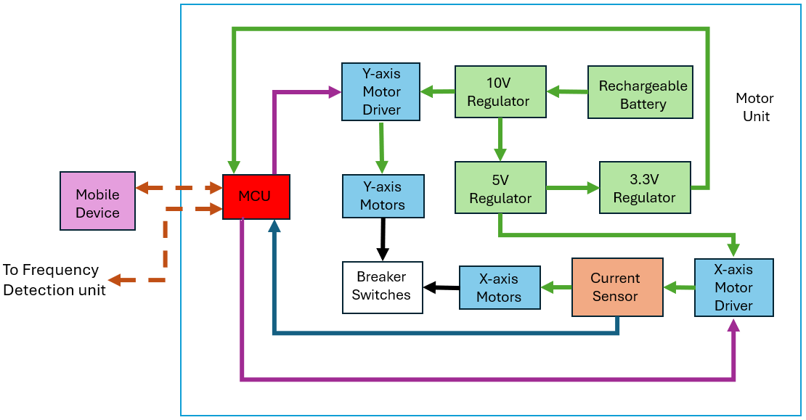
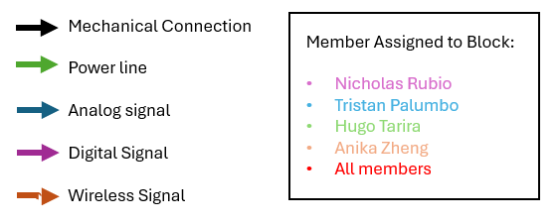
Motor Unit Hardware Diagram

Slide 8
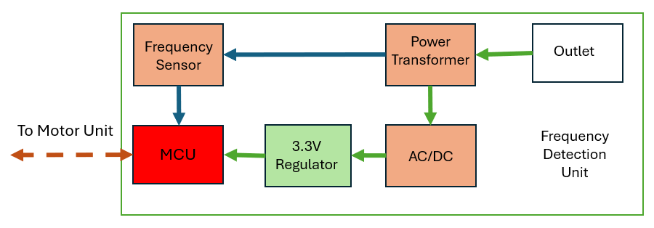
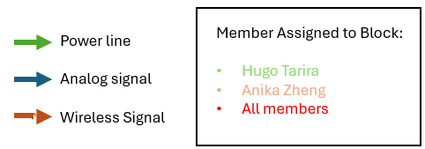
Frequency Detection Unit Hardware Diagram

Slide 9
MCU Selection
ESP32
Most affordable, sufficient processing power
Low power consumption
Sufficient GPIO pins
Has all desired wireless communication modules
Specifications | MCU Models
 | ESP32 | MSP430 | Arduino MKR WiFi 1010 | Arduino Nano 33 IoT | Raspberry Pi 4 Model B
Processing Power | 240 MHz | 25 MHz | 48 MHz | 48 MHz | 1.5GHz
Flash Memory | 16 MB | 256 KB | 256 KB | 256 KB | Depends on MicroSD card used
RAM | 520 KB | 16 KB | 32 KB | 32 KB | 2 GB, 4 GB, or 8 GB
GPIO pins | 32 | 24 | 8 digital 7 analog | 14 digital 8 analog | 40
Power Consumption (W) | 0.1 W | 0.005 W | 0.15 W | 0.14 W | 3-7 W
Operating Voltage (V) | 3.6 V | 5 V | 3.3 V | 3.3 V | 5 V
Cost | $15 | $20 | $38 | $25 | $60
Wi-Fi | Yes | No | Yes | Yes | Yes
Bluetooth | Yes | No | Yes | Yes | Yes

Slide 10
Wired Communication
Specifications | Wired Communications Comparison
 | UART | I2C | SPI
Transmission Speed (bps) | 9600 | 100k-5M | 10M
Minimum # of Wires | 2* | 2 | 4
Transmission Confirmation | Yes** | Yes | No
Max Slaves Per Master | 1 | Depends on # of addresses | Theoretically unlimited
Sync or Async | Async | Sync | Sync
-UART:
Least Complex protocol
Least number of Wires
Takes Up Least Space
CP2102 chip was chosen due to low current draw

Slide 11
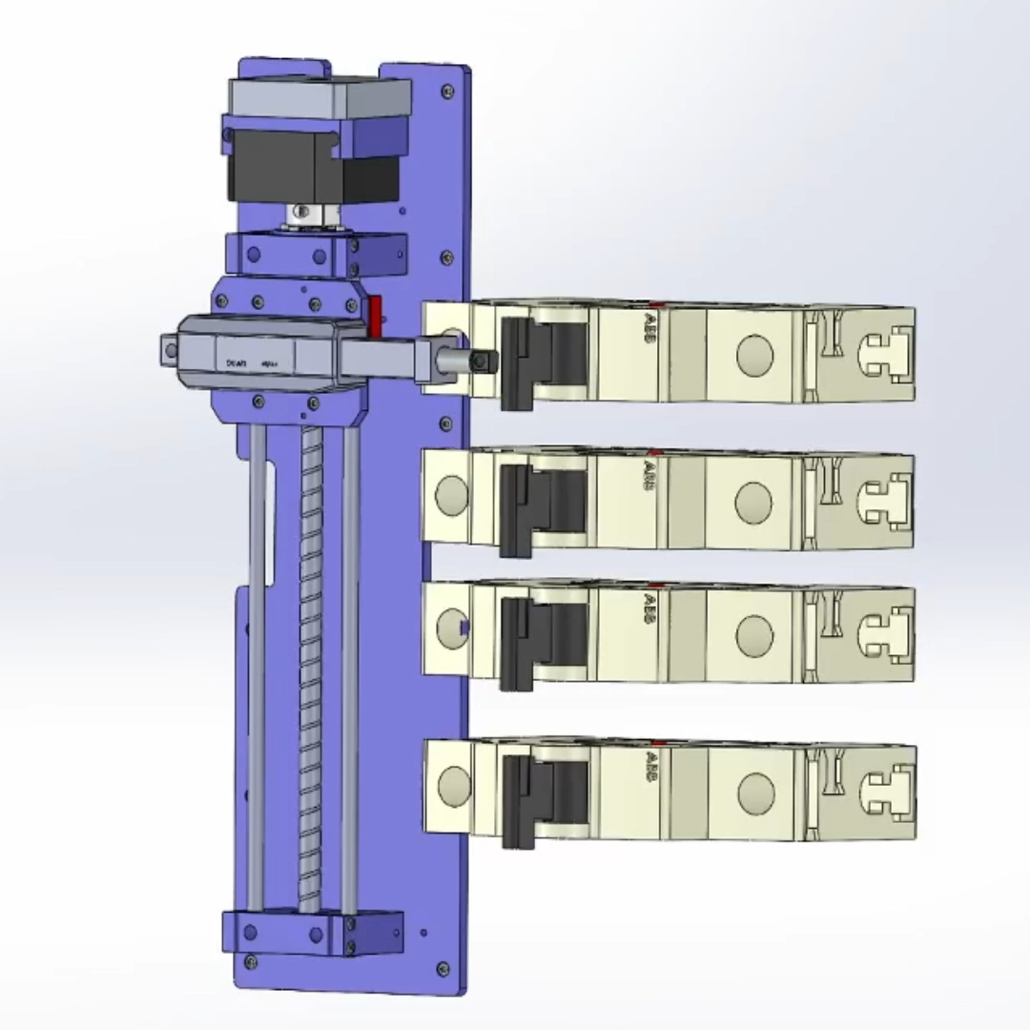
B.E.A.M’s Motor System
Mechanical System for BEAM
Mini-DC Linear Actuator
•Enables circuit breaker to be turned on/off
Linear Guided Stepper Motor
• Moves actuator to different circuit breakers
How Will it Work?
•Attachment for on/off
•Mounted to the side of a breaker panel

Slide 12
Motor Selection
Motor Point Ranking System
Specifications | Motor Comparison
 | Brushed DC | Brushless DC | Stepper | Servo
Precision | 2 | 3 | 4 | 4
Torque at Low Speed | 5 | 3 | 3 | 4
Efficiency | 2 | 4 | 5 | 4
Speed Control | 2 | 4 | 5 | 4
Inexpensiveness | 5 | 4 | 4 | 2
Durability and Maintenance | 2 | 4 | 5 | 4
Compatibility with Controllers | 5 | 4 | 3 | 3
Weight/Size | 4 | 3 | 4 | 3
Power Consumption | 2 | 4 | 3 | 3
Long Lifespan | 3 | 4 | 4 | 4
Total Points | 32 | 37 | 40 | 35
• At least two motors needed for operation
To appeal to the market, BEAM must be
• Easily mountable
• Simple design
• Easily controlled

Slide 13
Motor Driver Selection
DRV8825
TI Chip (easily found schematic)
Wide Voltage Range
Good Efficiency
DRV8833
TI Chip (easily found schematic)
Small
Simplistic Design
Specifications | Stepper Motor Driver
Model Number | L298N | A4988 | TMC2209 | DRV8825
Logical Voltage (V) | 5 | 3.3 - 5 | 3.3 - 5 | 3.3 - 5
Drive Voltage (V) | 5 - 35 | 8 - 35 | 4.75 - 28 | 8.2 - 45
Logical Current (mA) | 20 - 30 | 10 t- 20 | 20 - 30 | 10 - 20
Driving Current (A) | 2 | 2 | 2.8 | 2.2
Quantity | 4 Pack | 5 Pack | 4 Pack | 5 Pack
Price ($) | 9.99 | 10.19 | 22.99 | 14.50
Specifications | DC Motor Driver
Model Number | L298N | DRV8833 | TB6612FNG
Logical Voltage (V) | 5 | 1.8 - 7 | 2.7 - 5.5
Drive Voltage (V) | 5 to 35 | 2.7 - 10.8 | 0 - 10.8
Logical Current (mA) | 0 - 36 | 0 - 40 | 0 - 40
Driving Current (A) | 2 | 1.5 | 1.2
Quantity | 4 Pack | 3 Pack | 3 Pack
Price ($) | 9.99 | 7.99 | 9.99

Slide 14
Current Sensor Selection
Specifications | Current Sensor Parts
Part # | NKN3WSJT-73-0R04 | PNP3WVJR-73-0R1 | TMCS1108A3BQDT | NSM2012-10B3R-DSPR
Sensor type | Shunt resistor | Shunt resistor | Hall-effect | Hall-effect
Maximum Voltage drop | 0.35V | 0.55V | 0V | 0V
Sensitivity | 40mV/A | 100mV/A | 200mV/A | 132mV/A
Maximum measurable current | 8.66A | 5.5A | 7.25A | 10A
Power dissipation | 3W | 3W | 20mW | 25mW
Cost | $0.78 | $0.13 | $2.98 | $1.60
NSM Hall-Effect Sensor
Broad Application
Versatile
High Measurable Current Rating

Slide 15
Power Consumption

Slide 16
Battery Selection
Specifications | Battery Parts
Part # | Samsung 30Q(w/P) | Samsung 25R | Samsung 35E | Sony VTC6 | Molicel M35A
Positive Terminal | button top | flat top | flat top | flat top | flat top
Nominal Capacity(mAh) | 3000 | 2500 | 3500 | 3000 | 3500
Protection included? | Yes | No | No | No | No
Continuous Discharge Rating (max A) | 15 | 20 | 8 | 15 | 10
Price ($/cell) | 9.99 | 2.75 | 2.95 | 4.5 | 4.65
Samsung 30Q
Fuse Protection
Reliable Brand
Easier to Connect
Notes:
When picking the Li-ion battery we decided to pick the batteries that had the highest nominal capacity, with the highest max continuous discharge rating. Something else to note here is that we placed priority on batteries that had protection(and a button top for better connection). The main reason for this is that if we picked a battery without protection, we would have to add the protection to its own PCB(which could potentially delay project completion more), since protection guarantees that the battery will last as long as possible.
What is the included protection? Sadly it does not specify in the product apge. However, it is described as 4 MOSFET protection. When asking Leo(Brave AI), it says that it includes overcharge protection, overdischarge protection,overcurrent protection, and short circuit protection.

Slide 17


Regulator Selection
Specifications | DC to DC Converter Parts
Part Name | LT1377 | AMS1117 | LT1172 | ADP5073 | LTC7149 | LM2596
Vin (V) | 2.7 - 30 | 4.5-10 | 3 - 40 | 2.85 - 15 | 3.4-60 | 4.5-40
Vout (V) | 1.25 - 30 | 0-5V | 1.24 - 65 | Vin-39 | -28 - 0 | 3.3-37
Iout max (A) | 1.5 | 1 | 1.25 | 1.2 | 4 | 3
Inverted out? | No | No | Yes | Yes | Yes | No
Switching Regulator? | Yes | No | Yes | Yes | Yes | Yes
DIP available? | Yes | No | No | No | No | No
Price ($USD) | 10.96 | 0 | 11.14 | 5.8 | 17.40 | 5.29
LM2596
Non-Inverted Output
High Current Rating
Efficient
Reliable & Common
AMS1117
Non-Inverted Output
Notes:
After researching different buck converters. We decided to pick the LM2596. It has a wide-ranging input and output voltage, and it is capable of handling at most 3A. However, the biggest reason to pick this regulator was that it is the best documented regulator we found on our research, it is popular enough that we can find a commercial alternative of this product should our pcb fail for any reason, and it can be designed using thru hole parts.
We also picked the AMS1117 for regulating from 5 to 3.3V. This was done because 5 to 3v3 is a low voltage difference and the current draw from the MCU is expected to be low. Therefore, the chip should not get as hot.

Slide 18
Power Transformer Selection
VTX–120–003-6045
Configurable for Half-Wave and Full-Wave Center-Tap Rectification
Sufficient Secondary Voltage with Power Efficiency Consideration
Fairly Low Cost
Specifications | Power Transformer Parts
Part # | TCT3-11E07AE | VTX-120-003-6045 | VTX-120-003-606 | VPM12-2080
Transformer type | Shell | Shell | Shell | Toroidal
Primary Voltage | 120V | 120V, 240V | 120V, 240V | 100V, 120V, 220V, 240V
Secondary Voltage | 10V | Parallel 4.5V, Series 9V | Parallel 6V, Series 12V | Parallel 6V, Series 12V
Power Rating | 2.5VA | 3VA - 36VA | 3VA -36VA | 25VA
Center-Tap Configuration | No | Yes | Yes | No
Cost | $7.50 | $13.95 | $13.95 | $34.41

Slide 19
AC to DC Converter Selection
SBT Schottky Diode
Dual Schottky Diodes for Half-Wave or Full-Wave Center-Tap Configuration
Low Voltage Drop
High Breakdown Voltage
High Forward Current
Specifications | AC to DC Converter Parts
Part # | 1N4149TR | NSR05301MX4T5G | SBT20120LCT_T0_00001
Breakdown Voltage | 100V | 30V | 120V
Forward Voltage | 1V | 0.8V | 0.82V
Forward Current | 500mA | 500mA | 10A
Reverse Current | 25nA | 25uA | 20uA
Cost | $0.10 | $0.80 | $0.94

Slide 20
Analog Signal Processing Selection
DC Bias and Scaling
Low Sensitivity to Noise
High Sample Rate for Accurate Frequency Detection
Efficient Processing
Specifications | Analog Signal Processing Technologies
 | Zero Crossing Detection | DC Bias and Scaling | Frequency to Voltage
Noise Sensitivity | High | Low | Medium
Sampling Rate (samples per second) | 120 sps | 1 Msps | 60 sps
Circuit Complexity | Low | Medium Low | High
Code Complexity | Low | Medium | Low

Slide 21
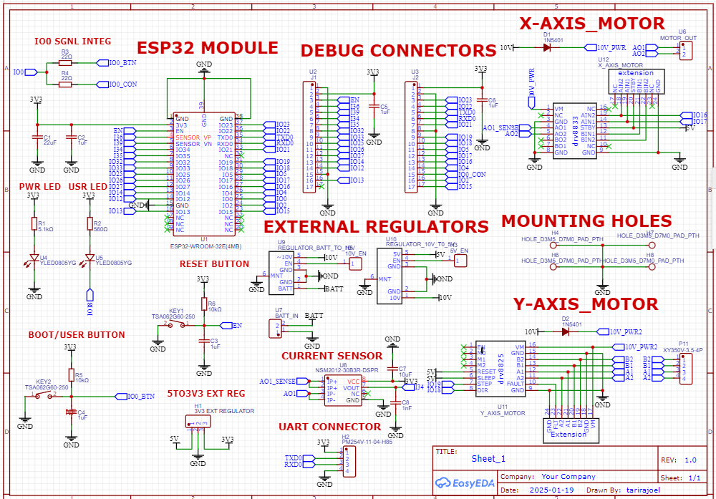
Main Motor Unit Schematic

Slide 22
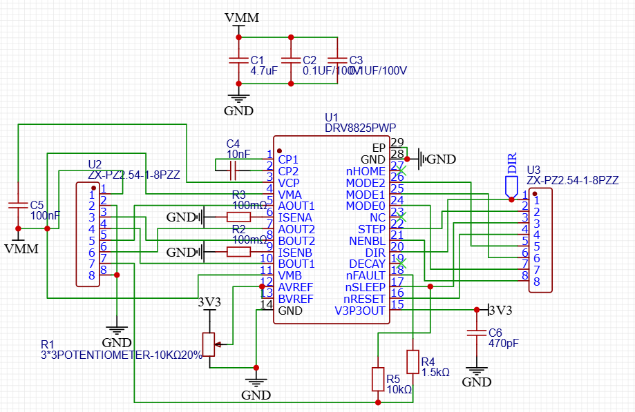
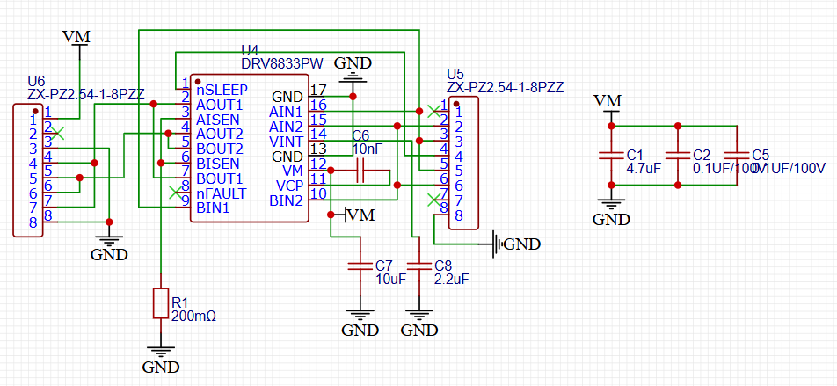
Motor Driver Breakout Schematics
DRV8825
DRV8833

Slide 23
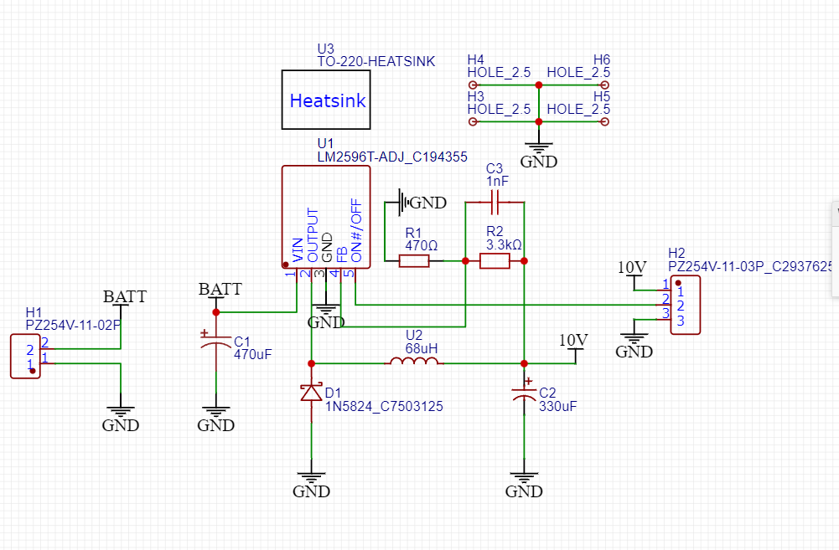
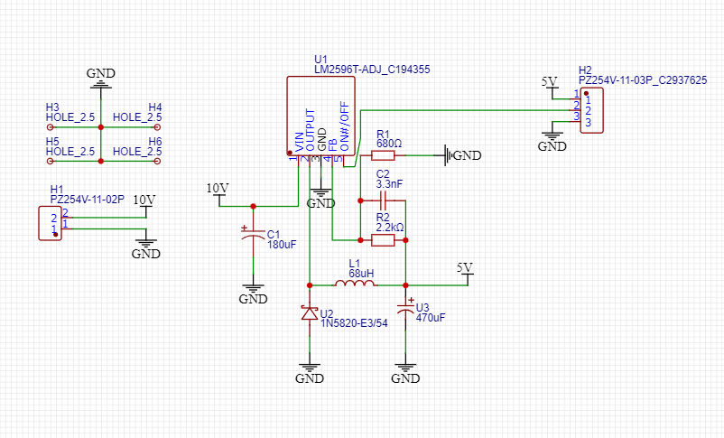
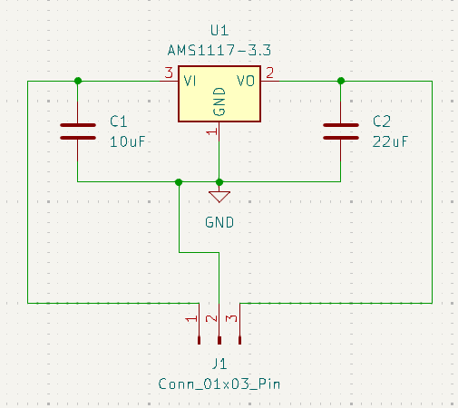
Regulator Breakout Schematic
12V-16V Input to 10V Switching Regulator
10V to 5V Switching Regulator
5V-3.3V Linear Regulator

Slide 24
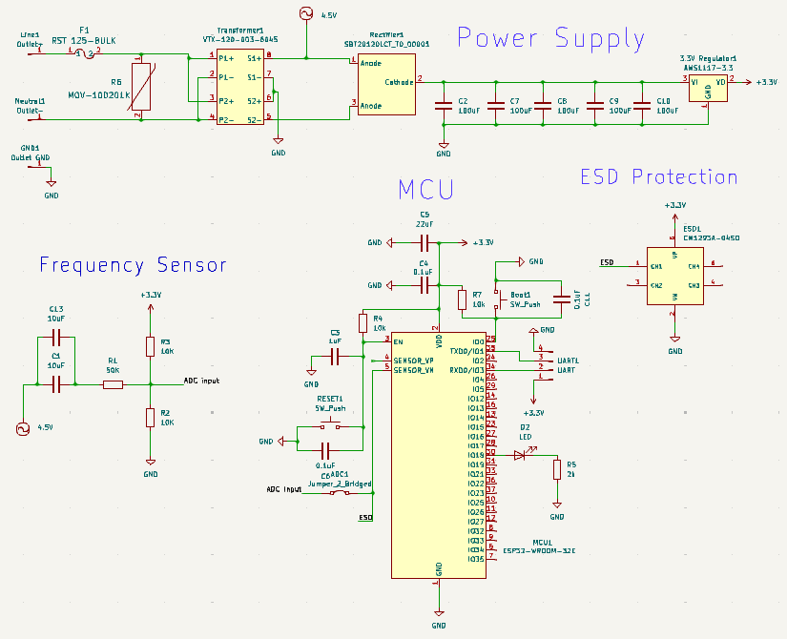
Frequency Detection Unit Schematic

Slide 25
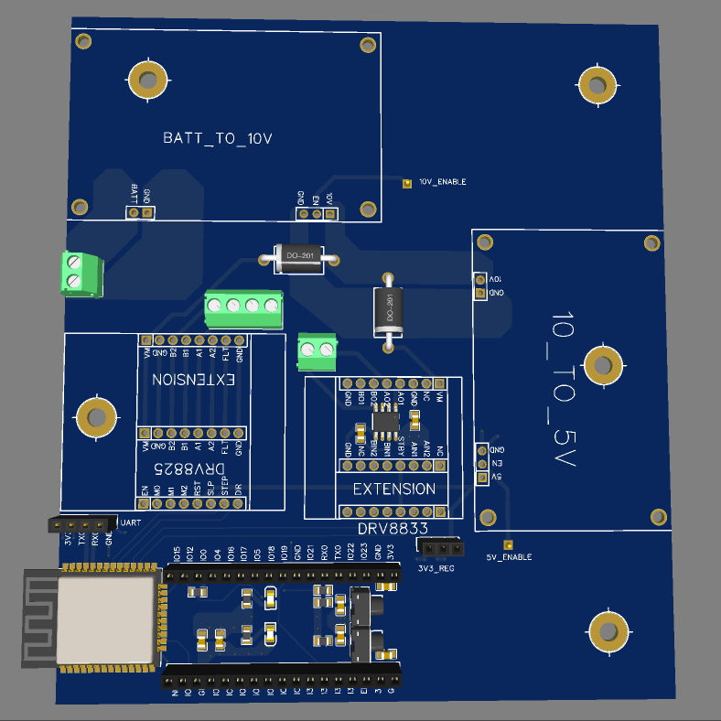
Main Motor Unit PCB
Current Sensor
ESP32 and WiFi Antenna

Slide 26
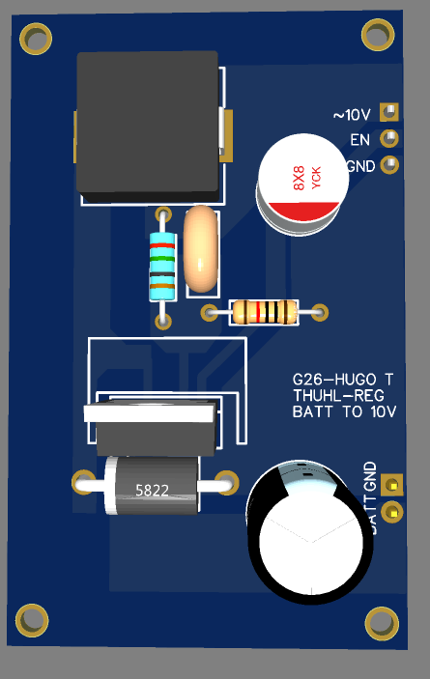
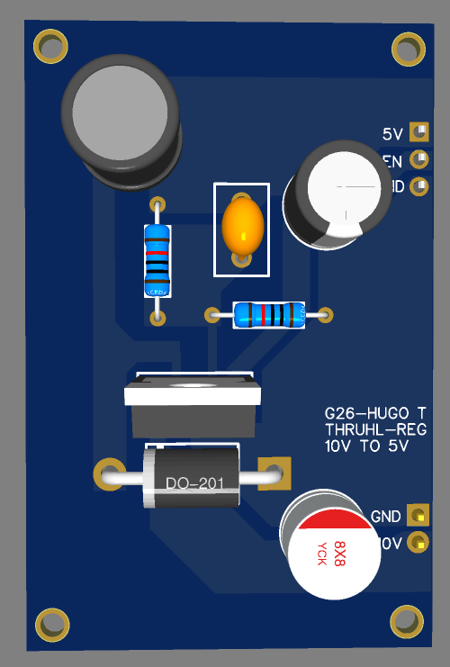
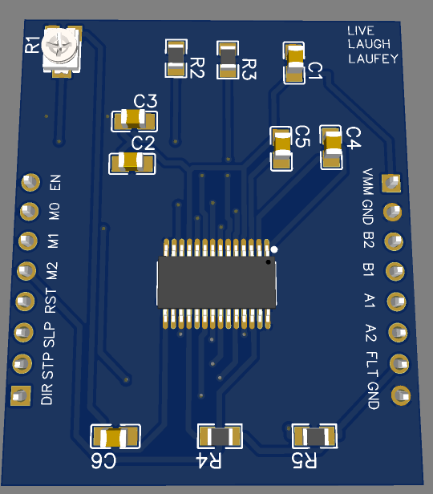
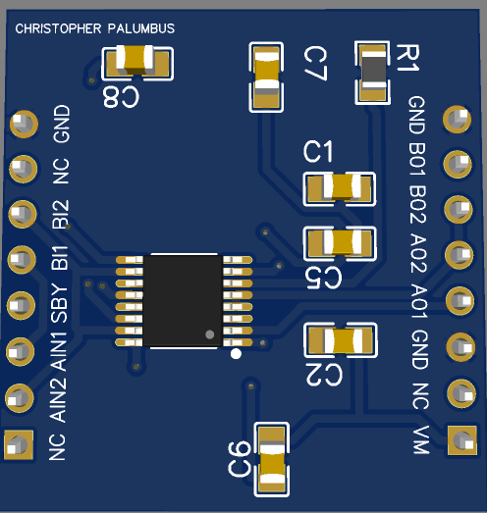
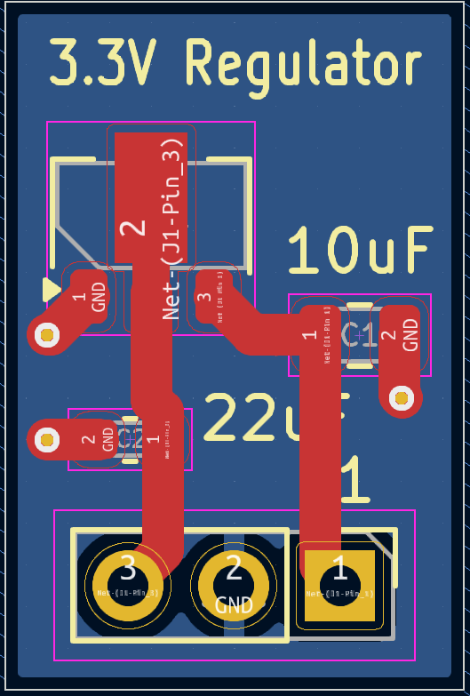
Main Motor Unit Visualization
Stepper Motor
DC
Linear Actuator
Battery Power Supply

Slide 27
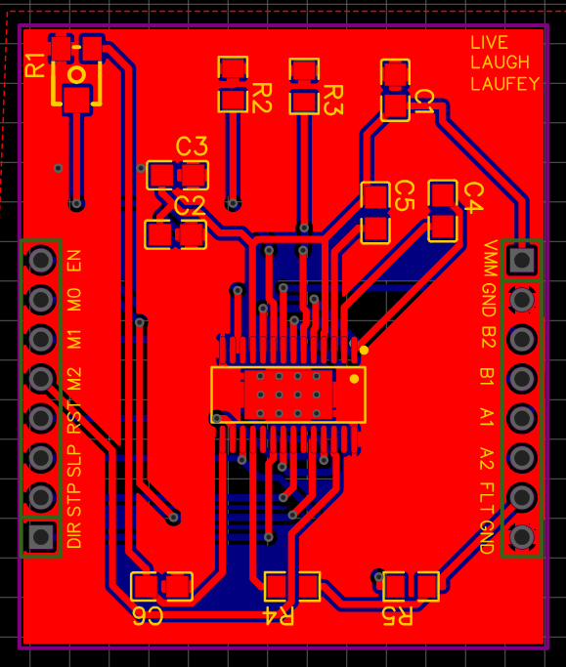
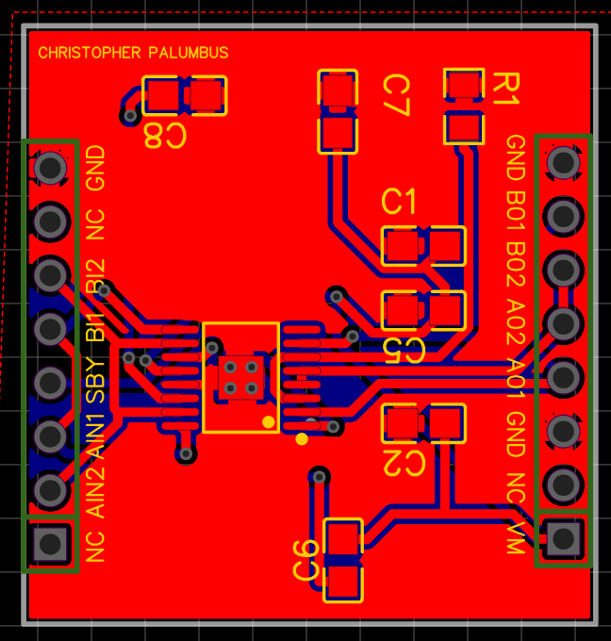
Motor Driver Breakout PCBs
DRV8825
DRV8833

Slide 28
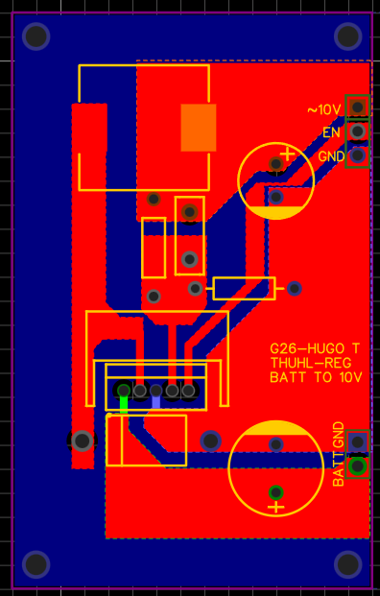
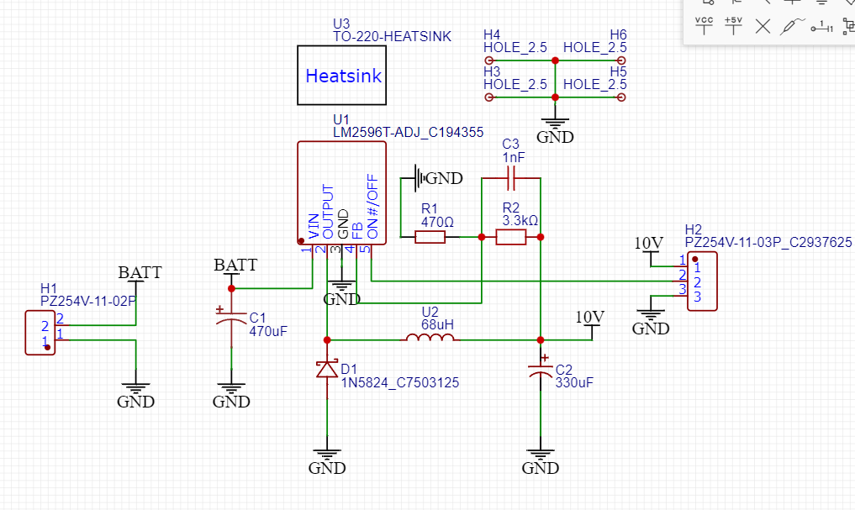
Regulator Breakout PCB (Battery – 10V)(for reference, do not include in video)

Slide 29
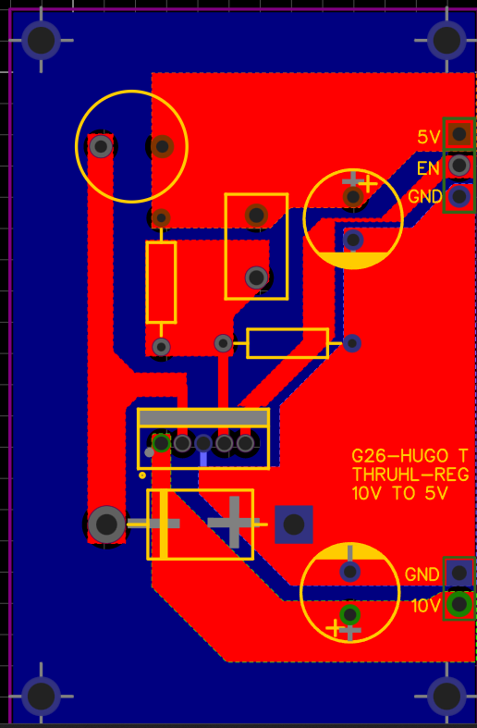
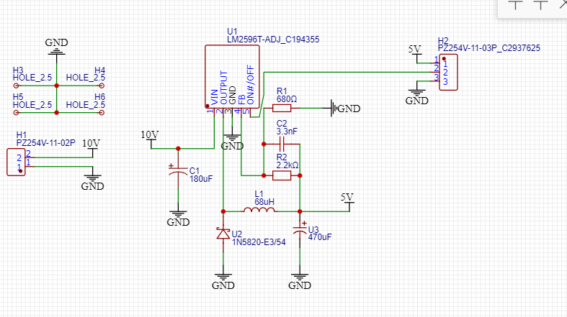
Regulator Breakout PCB (10V - 5V)(do not include)

Slide 30
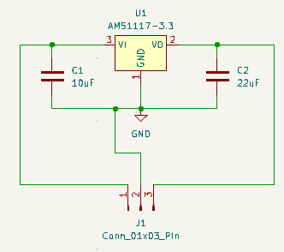
Regulator Breakout PCB(3.3V)(do not include)

Slide 31

Main Motor Unit Schematic
(DO NOT INCLUDE)
Notes:
So for the PCB that will connect the motors to the ESP32. We have the x and y motor drivers, we have 3 regulators, and we have a current sensor. All the other connections are for ensuring that the ESP32 is connected, programmable and working properly. As you may see in the main PCB our motor main PCB uses a lot of daugther boards. The main reason for this is that if one of our regulators or motor drivers fail we can easily replace them with another one that we made.

Slide 32
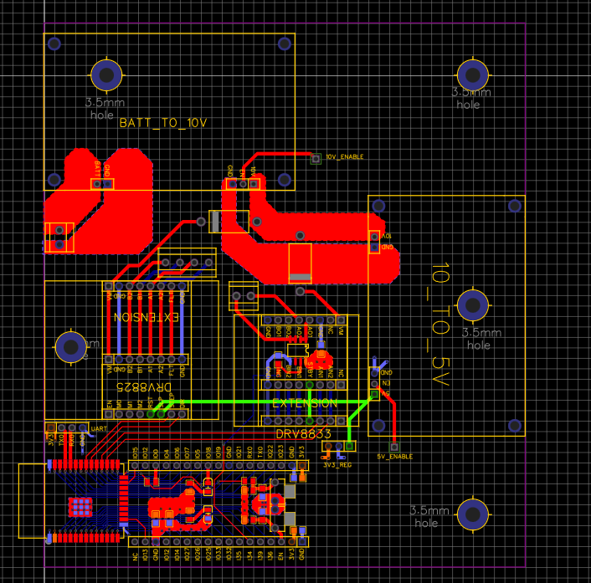
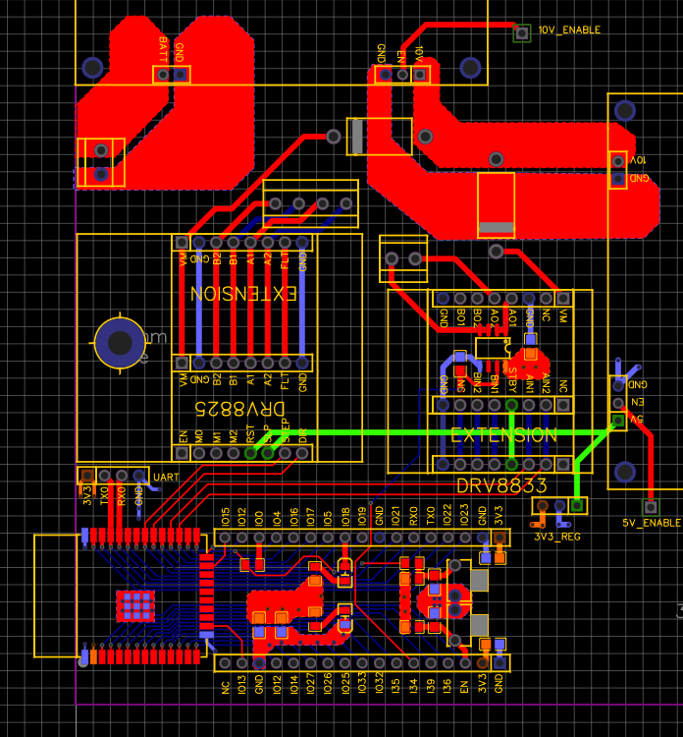
Main Motor Unit PCB(DO NOT INCLUDE)

Slide 33
Main Motor Unit 3D PCB(DO NOT INCLUDE)

Slide 34
Regulator Breakout PCBs
12V-16V Input to 10V Switching Regulator
10V to 5V Switching Regulator
5V to 3.3V Linear Regulator

Slide 35
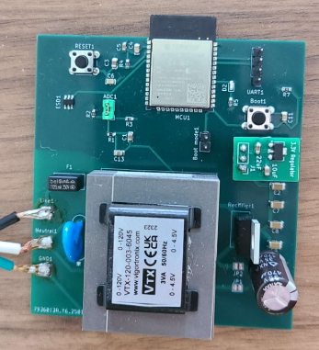
Frequency Detection Unit PCB
ESP32 Microcontroller
Voltage Divider and DC Bias Circuit
3.3V Regulator
Cable from outlet
Full-wave center tap rectification
120V to 4.5V Step Down Transformer

Slide 36
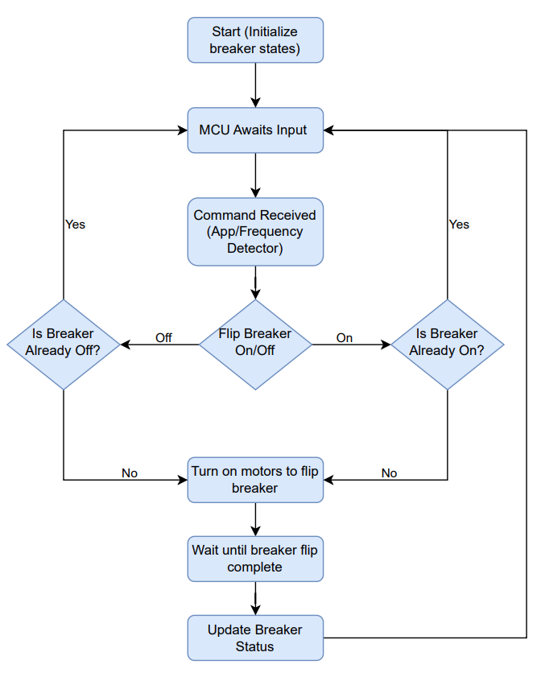
High-Level Software Workflow

Slide 37
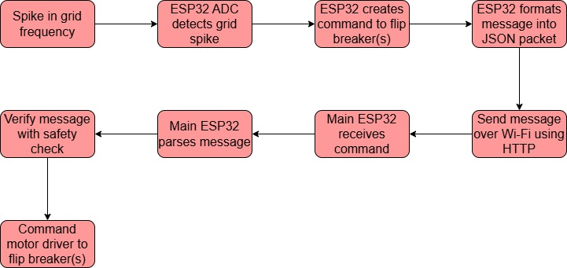
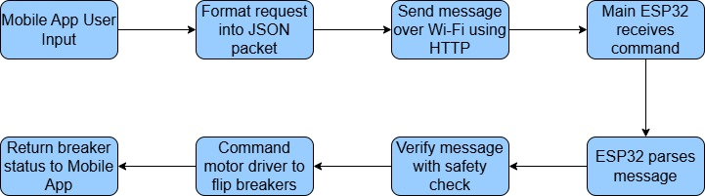
Initiated Software Workflows
Automatic Grid Frequency Detector Software Workflow
User-Initiated Software Workflow

Slide 38
Frequency Measurement Algorithm

Slide 39
Wireless Communication
WiFi
Longer Range
High Connection Capacity
High Transfer Speeds
Good Interoperability
Specifications | Wireless Communications Comparison
 | Bluetooth 4.2/5.0 | Wi-Fi (2.4GHz band)
Range | 4.2: 10-30 meters 5.0: 100 meters | 100 meters
Transfer Speed | 4.2: 1 Mbps 5.0: 2 Mbps | Up to 150 Mbps
Power Consumption | 4.2: ~15mA 5.0: 0.5-1mA | Active: ~200mA Sleep: ~10mA
Latency | 10-20 ms | 5-10 ms
Connection Time | 1-2 seconds | 2-3 seconds
Security Protocols | AES-CCM | WPA, WPA2, WPA3
Max Connections | 4.2: 7 devices 5.0: 20 devices | 10 clients

Slide 40
Mobile App Development
Specifications | Programming Languages
 | C | Python | Java | Dart (with Flutter) | Javascript (With React Native)
Type | Compiled | Interpreted | Compiled | Compiled | Interpreted
Primary Use | System and Embedded program | Scripting | Android and enterprise apps | Mobile apps | Mobile apps
Memory Management | Manual | Automatic | Automatic | Automatic | Automatic
Performance | High | Moderate | High | High | Moderate
Complexity | High | Low | Moderate | Moderate | Moderate
Flutter, a framework by Google for developing mobile apps using Dart
Cross platform support
Quick development features, such as hot reload
Versatile widget toolbox for optimizing developer experience

Slide 41
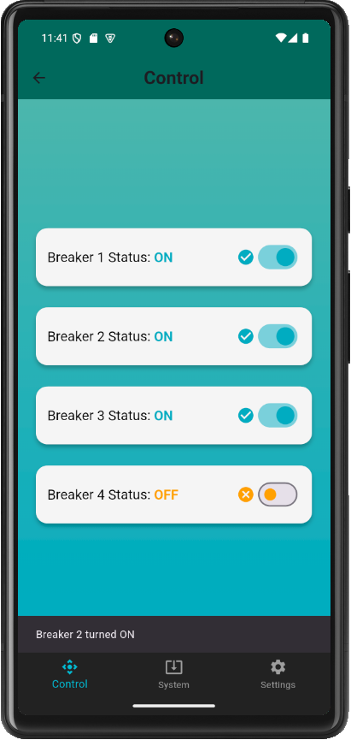
Mobile App Design: Control Page
Page Title
Breaker Control
Main control panel where user can control the different breakers
Shows live updates of the current breaker states
Provides notifications of current processes
Notification Bar
Page Menu Bar

Slide 42
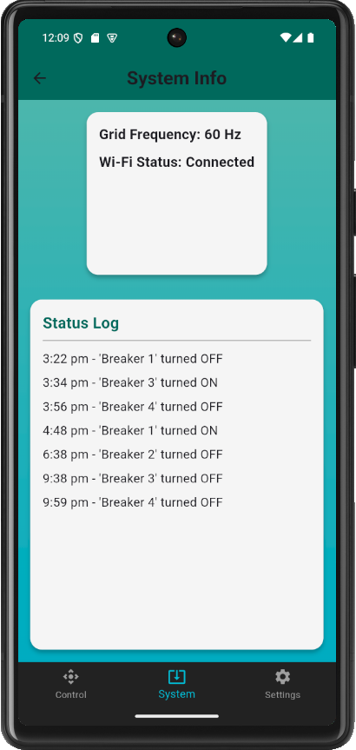
Mobile App Design: System Page
System Info
Displays useful, in-depth system information to the user, such as:
  Grid frequency
  Wi-Fi connection status
Shows log of recent system activity
System Activity Log

Slide 43
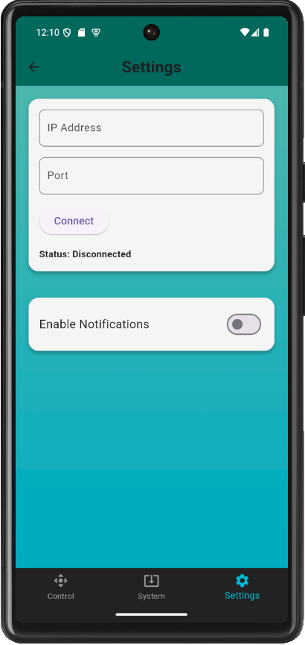
Mobile App Design: Settings Page
Network Preferences
Allows user to configure any system preferences
User can specify network settings to connect to system
Displays connection status
Notification Preferences

Slide 44
Prototyping and Testing
Each hardware component’s functionality was tested over the past several weeks.
All components are functioning as intended
Main Motor Unit
The rail guided stepper motor successfully moves the DC linear actuator across a vertical plane.
Switching from the DC motor outputs sufficient force.
Frequency Unit
The transformer successfully steps down AC voltage and the rectifier turns it into DC.
The ADC calculations are precise when measuring grid frequency.

Slide 45

Problems Encountered
Problem | Solution
Knockoff Motor Driver Choices | Choosing TI Chips Instead
Learning Curve for Stepper Motor Code | Trial and Error
Motor Driver PCB Sizing | Redesigning Main PCB
Laptop Crash Using Mobile Phone Emulator | Must use physical mobile phone for development on laptop
Lack of safety features for the voltage supply | Redesign Frequency Detection unit PCB with fuse, MOV, and proper isolation
Regulator Overheating | Added space for a heatsink in regulator board

Slide 46
Work Distribution
Anika Zheng (EE)
Frequency Detection
Frequency Unit PCB Design
Power for Frequency Detection
MCU Selection and Implementation
Hugo Tarira (EE)
Rechargeable Battery
Main Motor PCB Design
Voltage Regulators
MCU Selection and Implementation
Tristan Palumbo (EE)
Motor Design
Motor Driver PCB Design
Mechanical Design
Motor Code
Nicholas Rubio (CPE)
Mobile App
Wi-Fi Integration
Software Design and Implementation
MCU Selection and Implementation

Slide 47
Cost Breakdown
Component | Quantity | Total Price
Linear Guided Stepper Motor | 1 | $90
Stepper Motor Driver (DRV8825) | 5 | $15
DC Linear Actuator | 1 | $30
DC Motor Driver (DRV8833) | 3 | $8
Devkit ESP32 | 3 | $17
Batteries | 6 | $60
Battery Charger | 1 | $9
AC/DC Transformer | 1 | $14
3D Printing Fillament | 1 | $20
Misc | 1 | $50
Circuit Breaker Panel | 1 | $29
Circuit Breakers | 4 | $27
PCBs and Components | 1 | $410
Total |  | $779

Slide 48
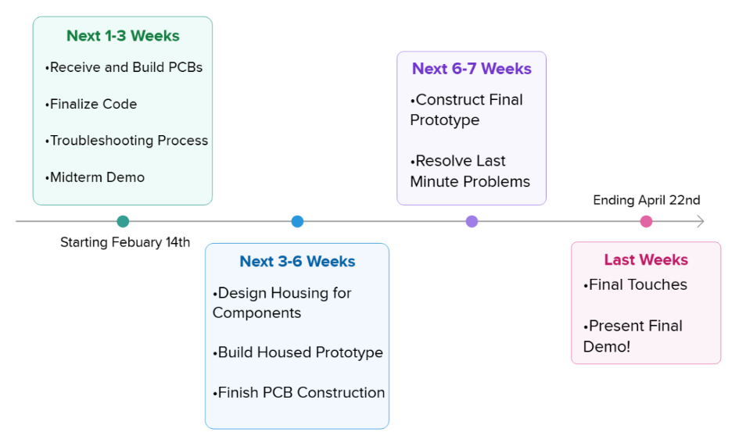
Completion Timeline

