Slide 1
Omnidrum
Wylde Simpson - Electrical Engineer
Soufiane Louiba - Electrical Engineer
Jameson Palmer - Computer Engineer
Group 41

Slide 2
Motivation & Background
Electric drum kits are expensive and not as accessible for amateur players.
Amateur drummers lack a way to transpose their jam sessions into MIDI information.
Not everyone has space for a full drum kit, ours is modular.

Slide 3
Basic Goals
The device will be able to detect input from sensors and play a corresponding sound.
The device should be able to play at least 3 sounds at once.
The device should be able to output MIDI signals corresponding to which sensors are triggered.

Slide 4
Advanced Goals
The device should be able to detect the velocity of each hit and play a different sound depending on the velocity.
The device should have a headphones/line out jack, which mutes the onboard speaker when in use.
Integrate an amplifier for headphone usage listed above.
The device should have multiple sets of built-in sounds.

Slide 5
Stretch Goals
Stylization such as waveform or frequency spectrum display.
Modularity such that an instrument may be added/removed with ease.
Bump/crosstalk detection to prevent sensors from picking up vibrations on the frame from accidental knocks or another struck sensor.
Demo mode where sample drum routines could play on their own while lighting up the instrument that is played. A user may follow along the routine by striking an instrument when it flashes.

Slide 6
Engineering Requirements and Specifications
Requirement & Constraints | Description
Polyphony | Must be able to play at least 3 sounds at once
MIDI Output | Must output correct MIDI information notes 35 through 45
Vel. Sensitivity | Must be able to detect 3 levels of velocity
Detection Rate | Must be able to detect hits that are at least 100ms apart
Low Latency | Latency must be no more than 100ms
Low Power Draw | Target power for circuit board should be less than 15 Watts
Audible Output | External speaker should achieve at least 65 dBA

Slide 7


Hardware Selection Comparison

Slide 8
Hardware Selection Comparison - MCU
Model | STM32F405RGT6W LQFP64 | STM32L562QEI6Q LQFP64 | STM32G473R LQFP64
GPIO Pins | 51 | 52 | 52
12-bit ADC Channels | 16 | 16 | 26
External DACs | 2 | 2 | 3
UART/USART/LPUART | 2/4/0 | 2/3/1 | 2/3/1
SPI | 3 | 8 | 4
Memory | 1024 MB | 512 KB | 512 KB
Price | $11.83 | $6.94 | $8.20
Why We Chose the STM32G473R for OmniDrum?
More ADC Channels (26 vs. 16)
More DAC Channels (3 vs. 2)
Sufficient Memory (512 KB)
MIDI Support (UART/USART) – All options support MIDI communication, so no limitations here.
Balanced Cost ($8.20) – Offers better ADC/DAC features without a significant price increase.

Slide 9
Hardware Selection Comparison -
Internal Speaker
Model | HY7040DS0830-H16.8 | HYB30704R3W | SC700208-1
Price | $1.75 | $2.00 | $4.10
Rated Power | 3W | 3W | 3W
Rated Impedance | 8Ω | 4Ω | 8Ω
Output SPL | 93dB ±3dB | 116dB ±3dB | 100
Total Harmonic Distortion | 10% | 5% | NA
Dimensions | 71mm x 41mm x 17mm | 70mm x 31mm x 17mm | 71mm x 41mm x 25mm
Why We Chose the HY7040DS0830-H16.8 for OmniDrum?
Lowest Cost Option
Good Sound quality from High Impedance
Acceptable Output SPL
Acceptable THD

Slide 10
Hardware Selection Comparison -
Speaker Amplifier
Model | TDA2003 | PAM8403 | LM386
Amplifier Class | AB | D | AB
Output Power | 10W @ 4Ω | 1.8W @ 8Ω | 0.25W - 0.7W @ 8Ω
Supply Voltage | 8V - 18V | 2.5V - 5.5V | 5V - 18V
Impedance Rating | 1Ω - 8Ω | 4Ω - 8Ω | 4Ω - 32Ω
Lifecycle | Obsolete | Active | Active
Why We Chose the PAM8403 for OmniDrum?
Efficient Class D Amplifier
Correct Output Wattage
Supply Voltage in range
Currently Available

Slide 11
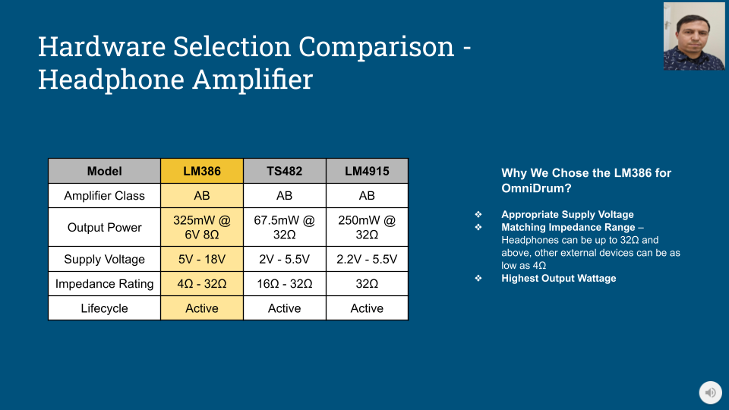

Slide 12
Hardware Selection Comparison - Sensor
Model | Force | Velocity | Vibration
Pins | 2 | 4 | 3
Variance Type | Resistive | I2C | Digital
Price | $3.50 | $9.97 | $6.49/5pk
Required Connection | Analog IO Pin | I2C | Digital IO Pin
Why We Chose the Force Sensor for OmniDrum?
Resistive sensors are very simple to connect
Resistive sensor can output various analog values
Small pin count allows us to easily create connectors

Slide 13
Hardware Selection Comparison - Regulator
Model | BA33DD0WT | LM3940 | LT1085
Input Voltage Range | 3V - 25V | 4.5V - 5.5V | 2.55V - 30V
Output Current | 2A | 1A | 3A
Price | $3.12 | $1.62 | $10.13
Why We Chose the LM3940 Sensor for OmniDrum?
Correct Input Voltage
Lowest Cost
Adequate Output Current Rating

Slide 14
Software Selection Comparison

Slide 15




Software Selection Comparison - IDE
Model | STM32cube IDE | Arduino IDE | VS Code
Support | First Party | Community | Community
Languages | C, C++ | C | C, C++
Complexity | Organized tools, hardware layout, and middleware | Provides example software | Pairs with STM software
Utility | Setup generation, flashing, debugging | Not as many supported MCUs | Setup generation after use of STM software

Slide 16
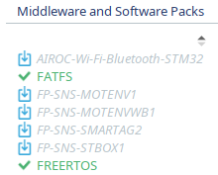
Software Selection Comparison - Operating System
FreeRTOS
Light on resources.
Fast execution.
Useful for threads, tasks, timers, and mutexes.
Schedule predictable operation.
Integrated in STM32cubeIDE.

Slide 17
Software Selection Comparison - Filesystem
Format | Case Sensitive | Sparse Files | Journaling | OS Cross Compatible
FAT32 | No | No | No | Yes
exFAT | No | No | Optional | Yes
NTFS | Yes | Yes | Yes | Yes*
APFS | Yes | Yes | Optional | No**

Slide 18
Software Selection Comparison -
Audio File Format
Format | Compression | CPU Processing | Size
WAV | No | Low | High
FLAC | Lossless | High | Medium
ALAC | Lossless | High | Medium
MP3 | Lossy | High | Low
AAC | Lossy | High | Low
Opus | Lossy | Medium | Low

Slide 19
Project Design

Slide 20
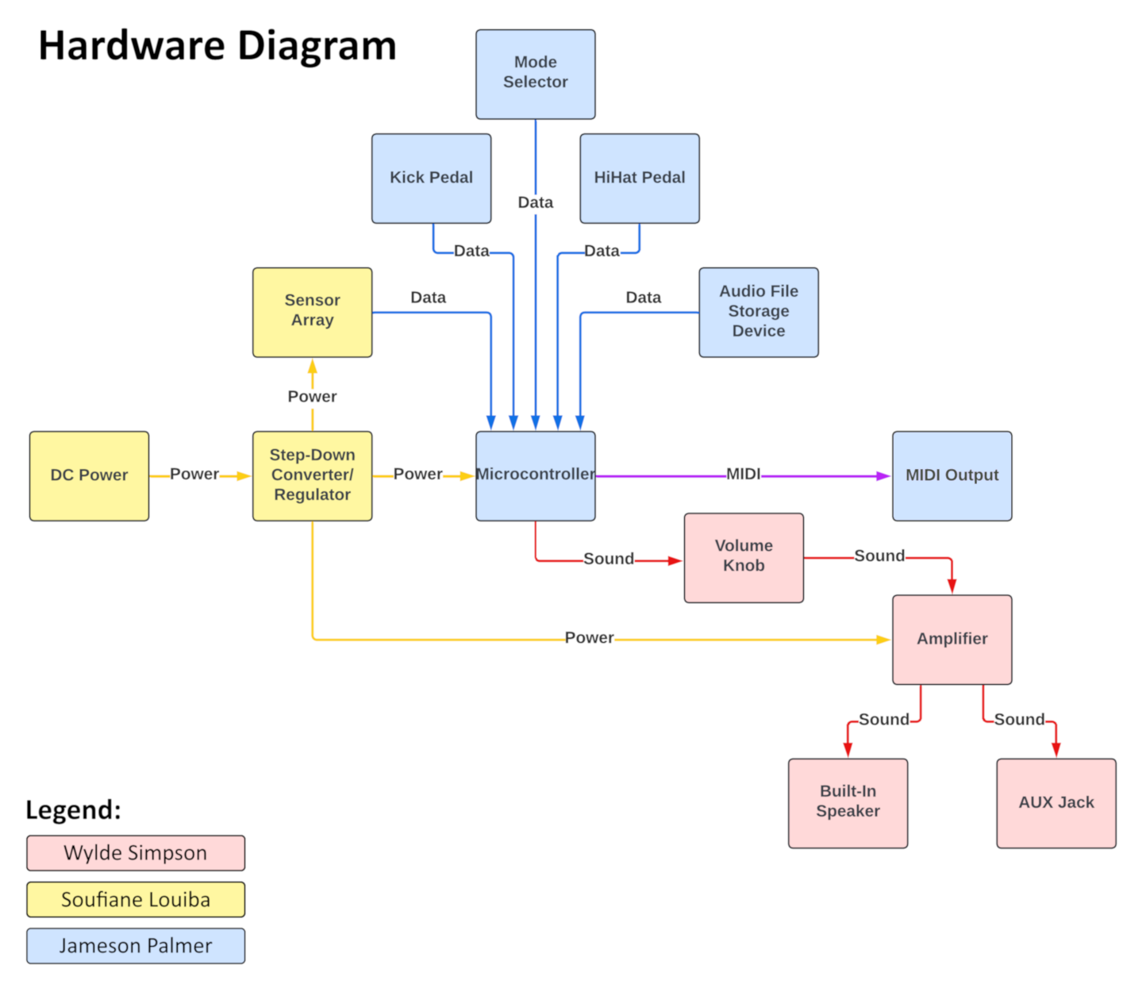
Hardware Block Diagram

Slide 21
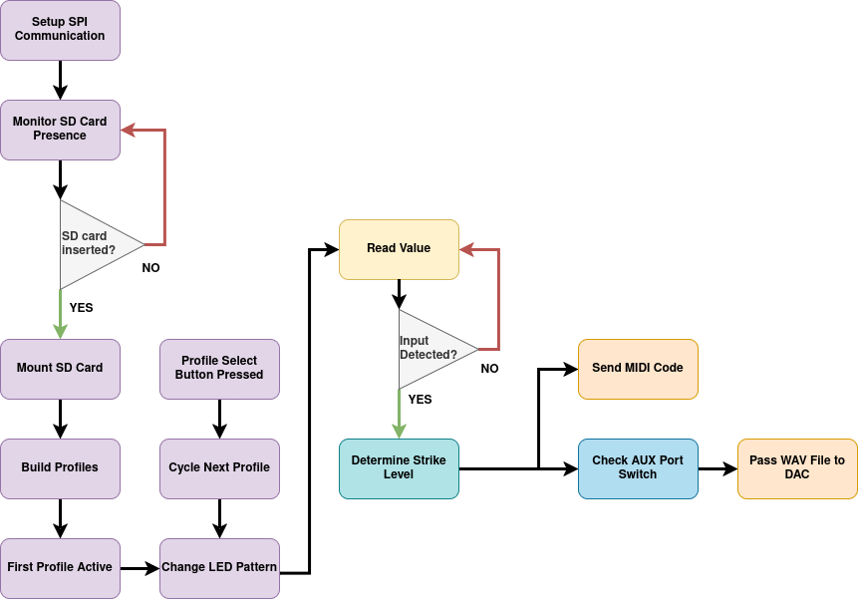
Software Block Diagram

Slide 22
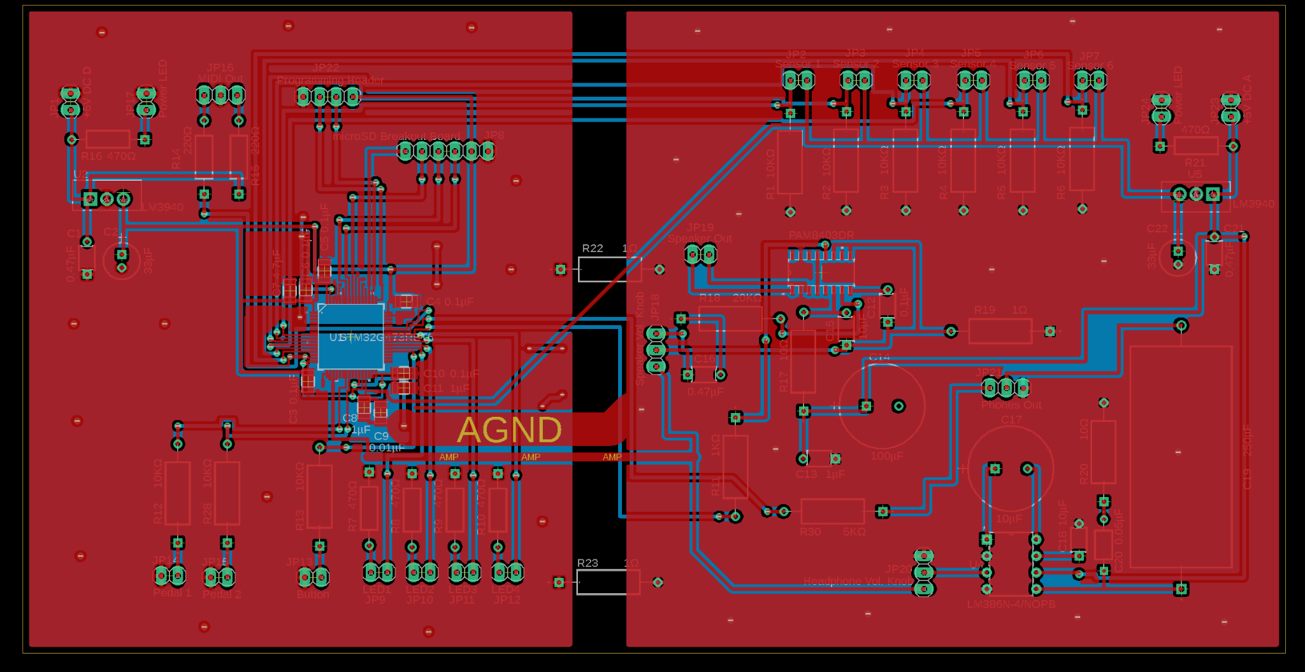
Significant PCB Design

Slide 23
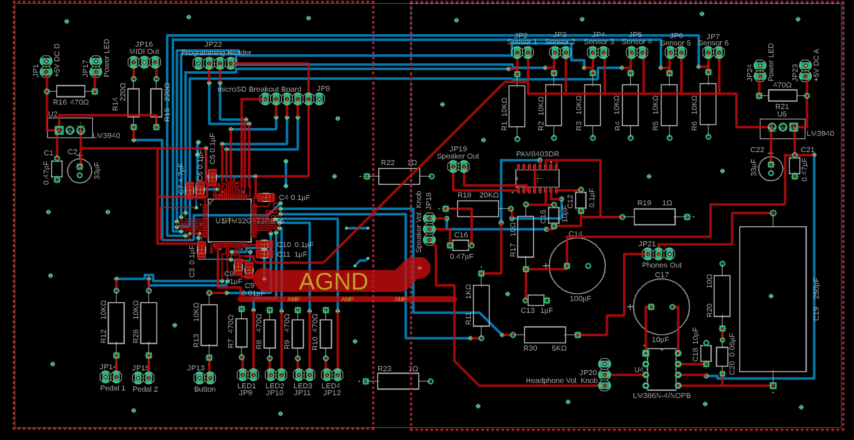
Significant PCB Design

Slide 24
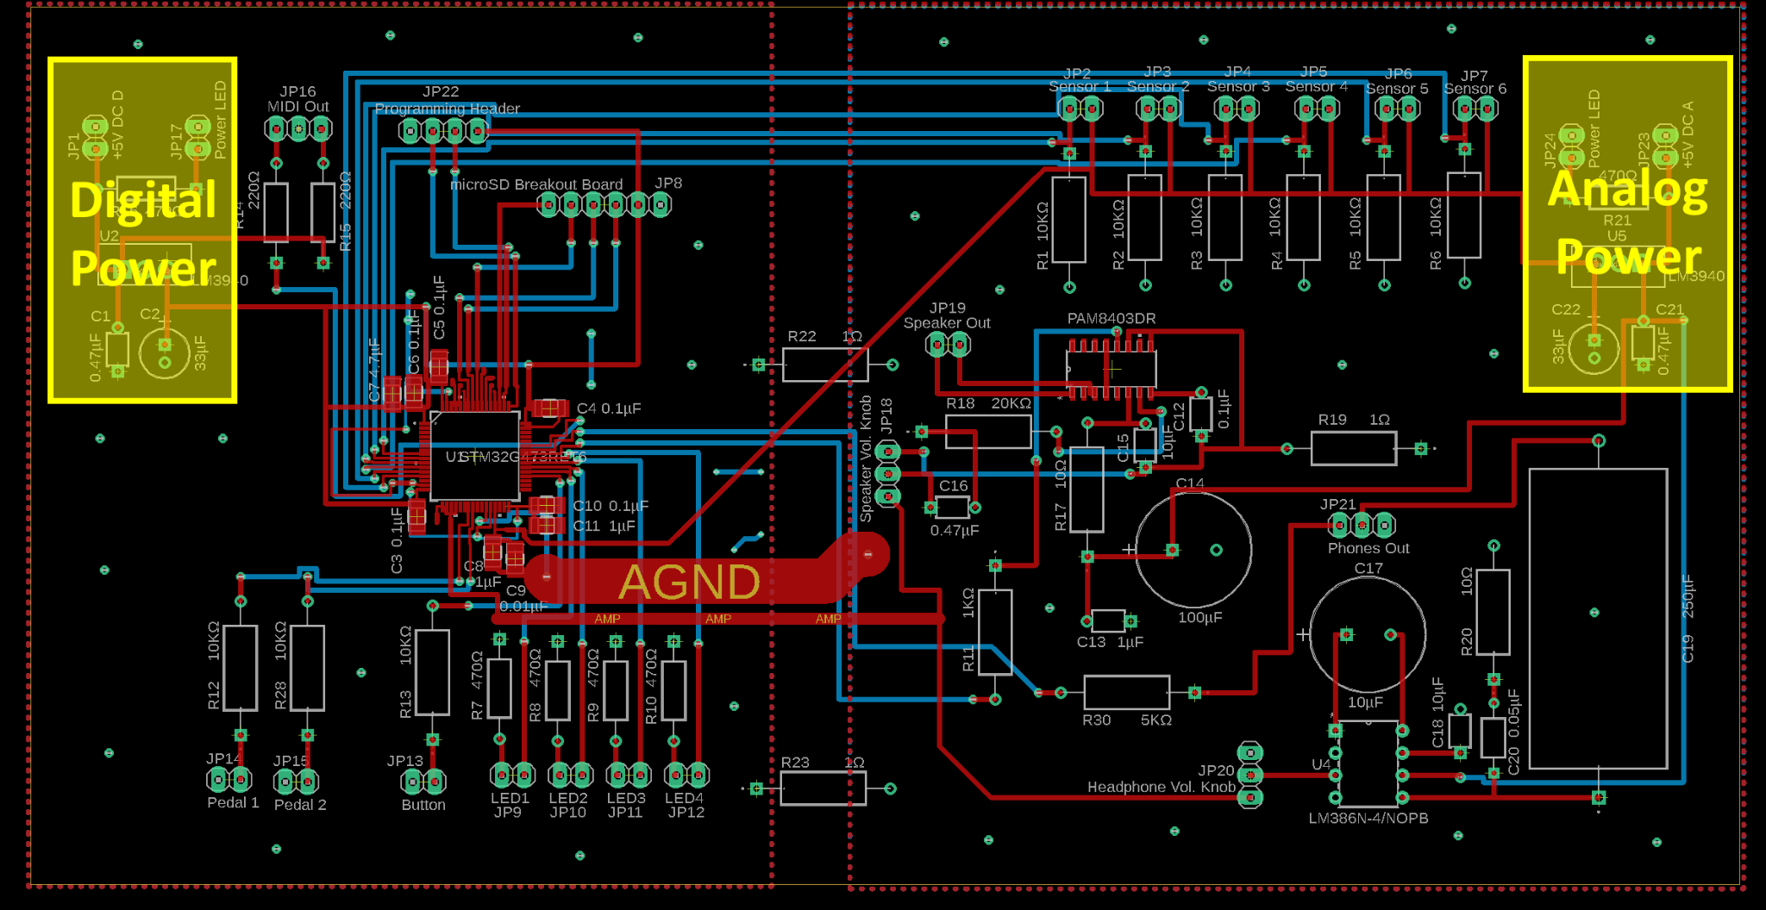
Significant PCB Design

Slide 25
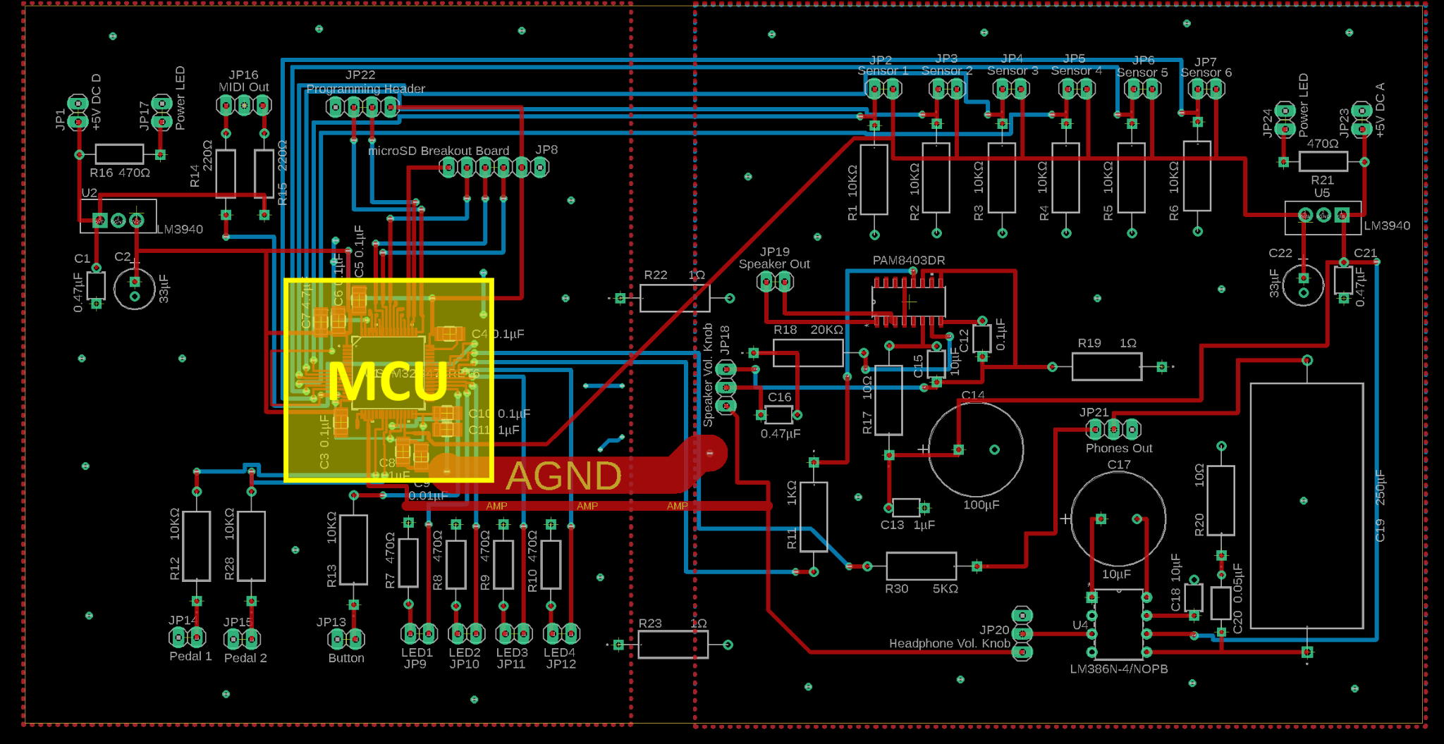
Significant PCB Design

Slide 26
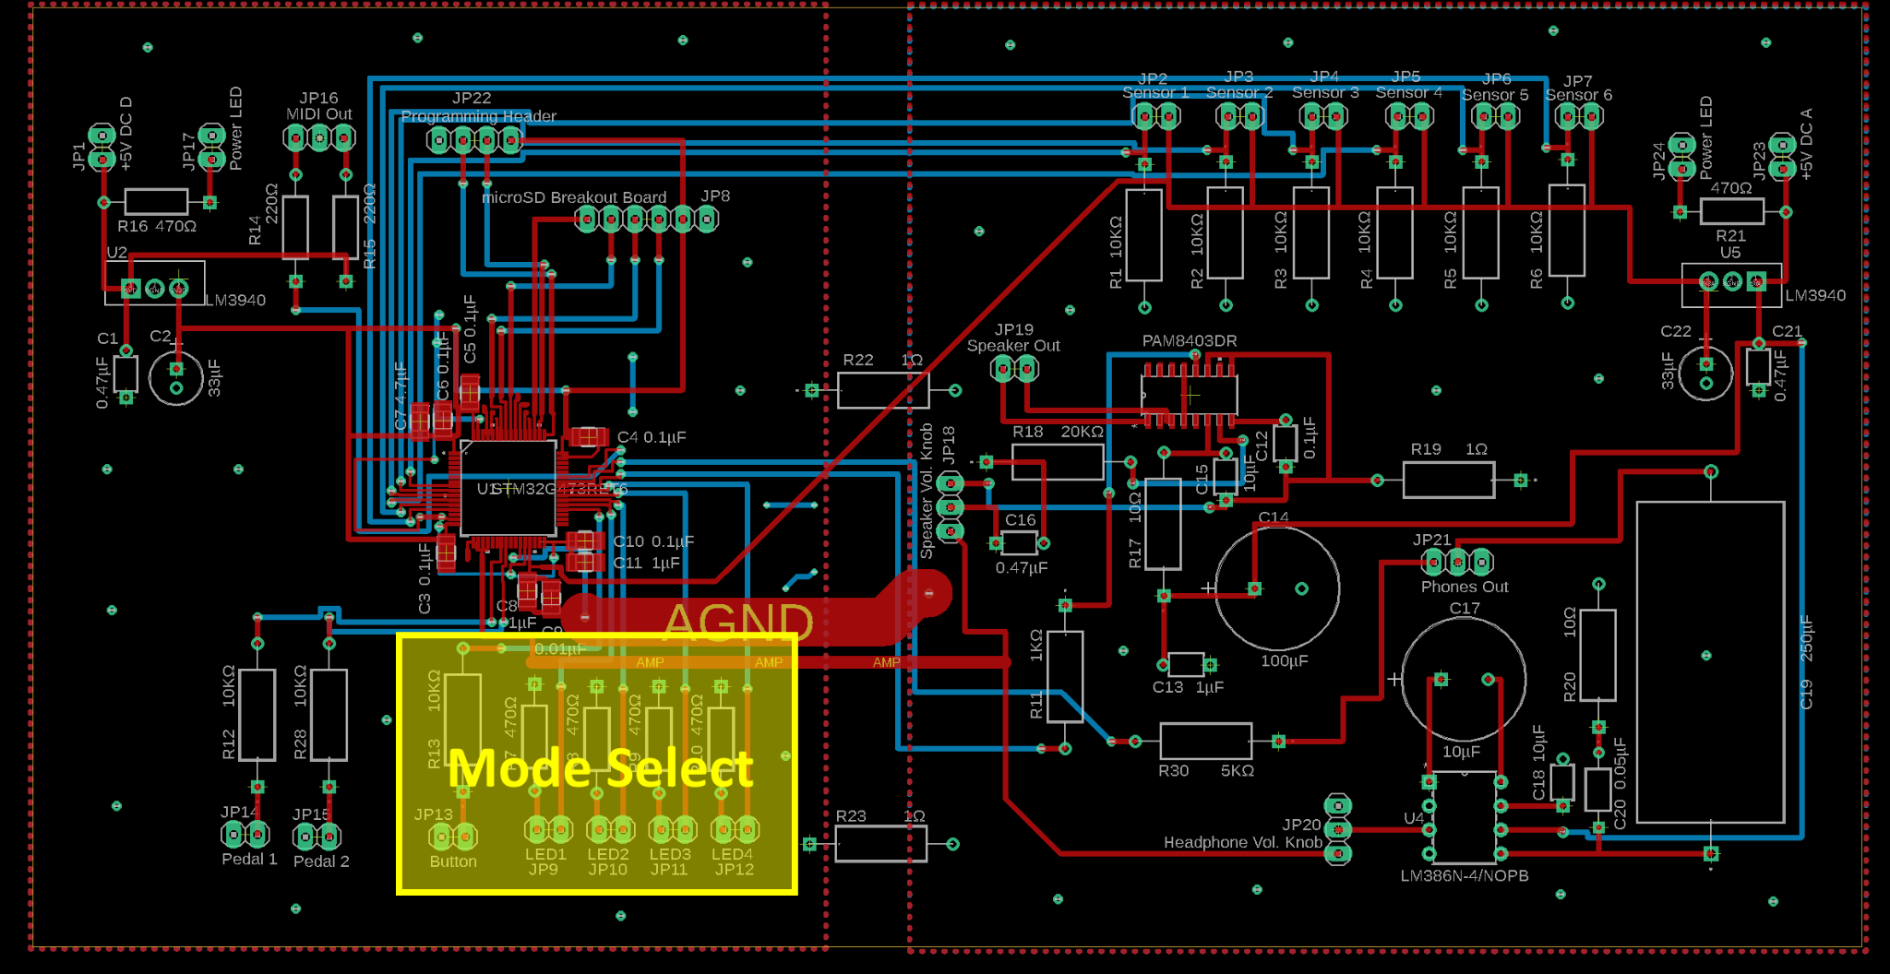
Significant PCB Design

Slide 27
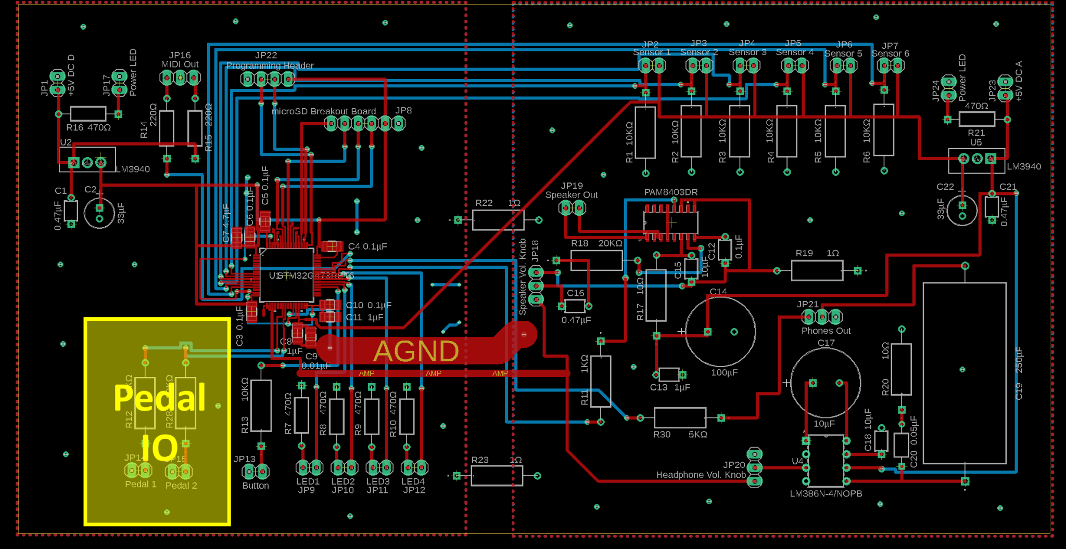
Significant PCB Design

Slide 28
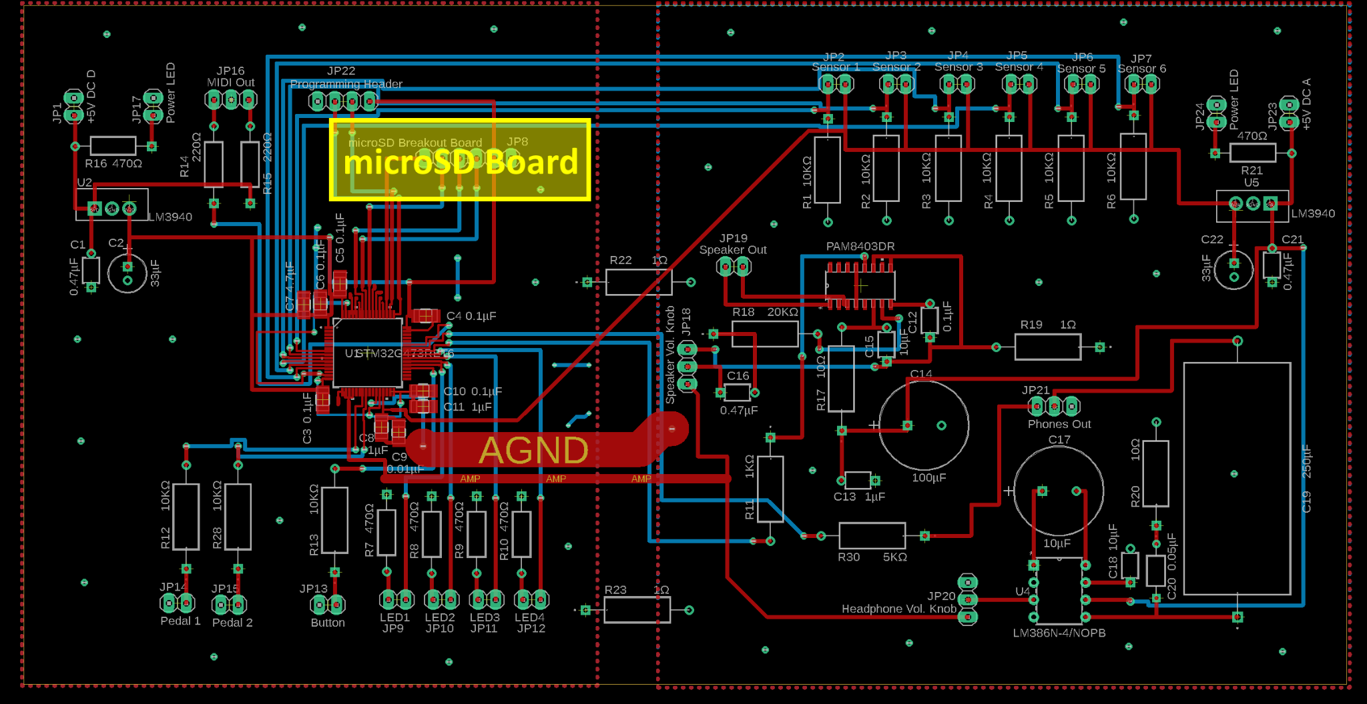
Significant PCB Design

Slide 29
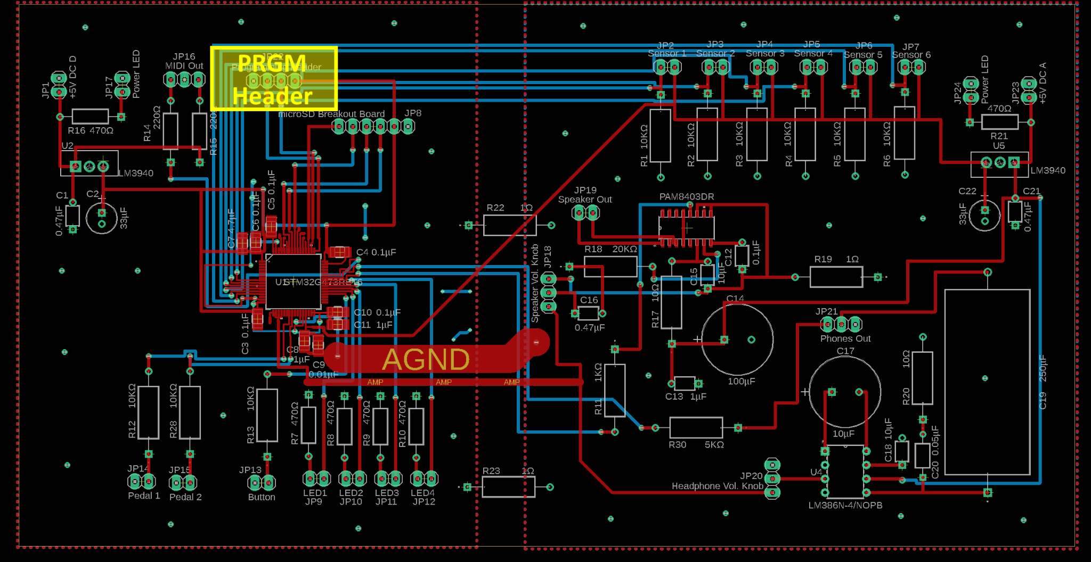
Significant PCB Design

Slide 30
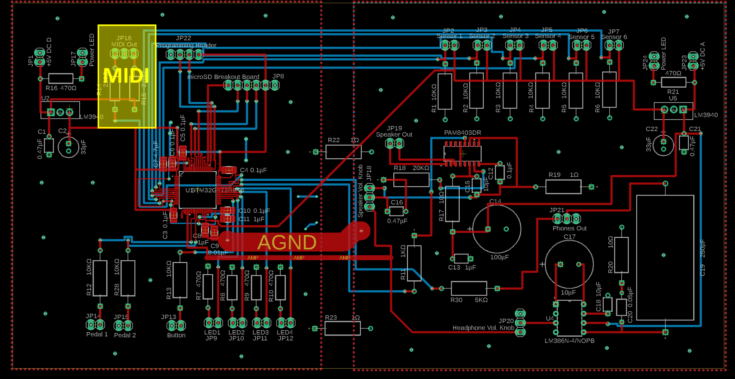
Significant PCB Design

Slide 31
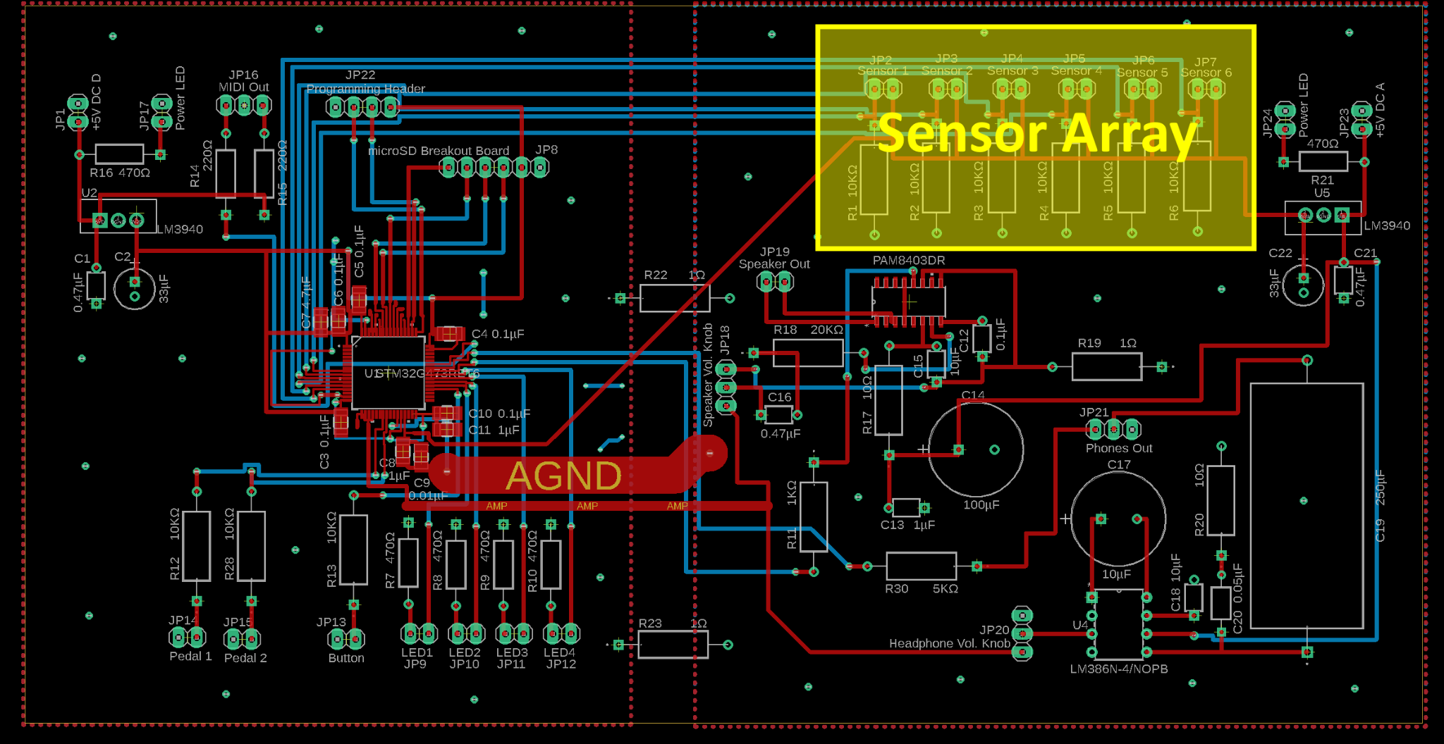
Significant PCB Design

Slide 32
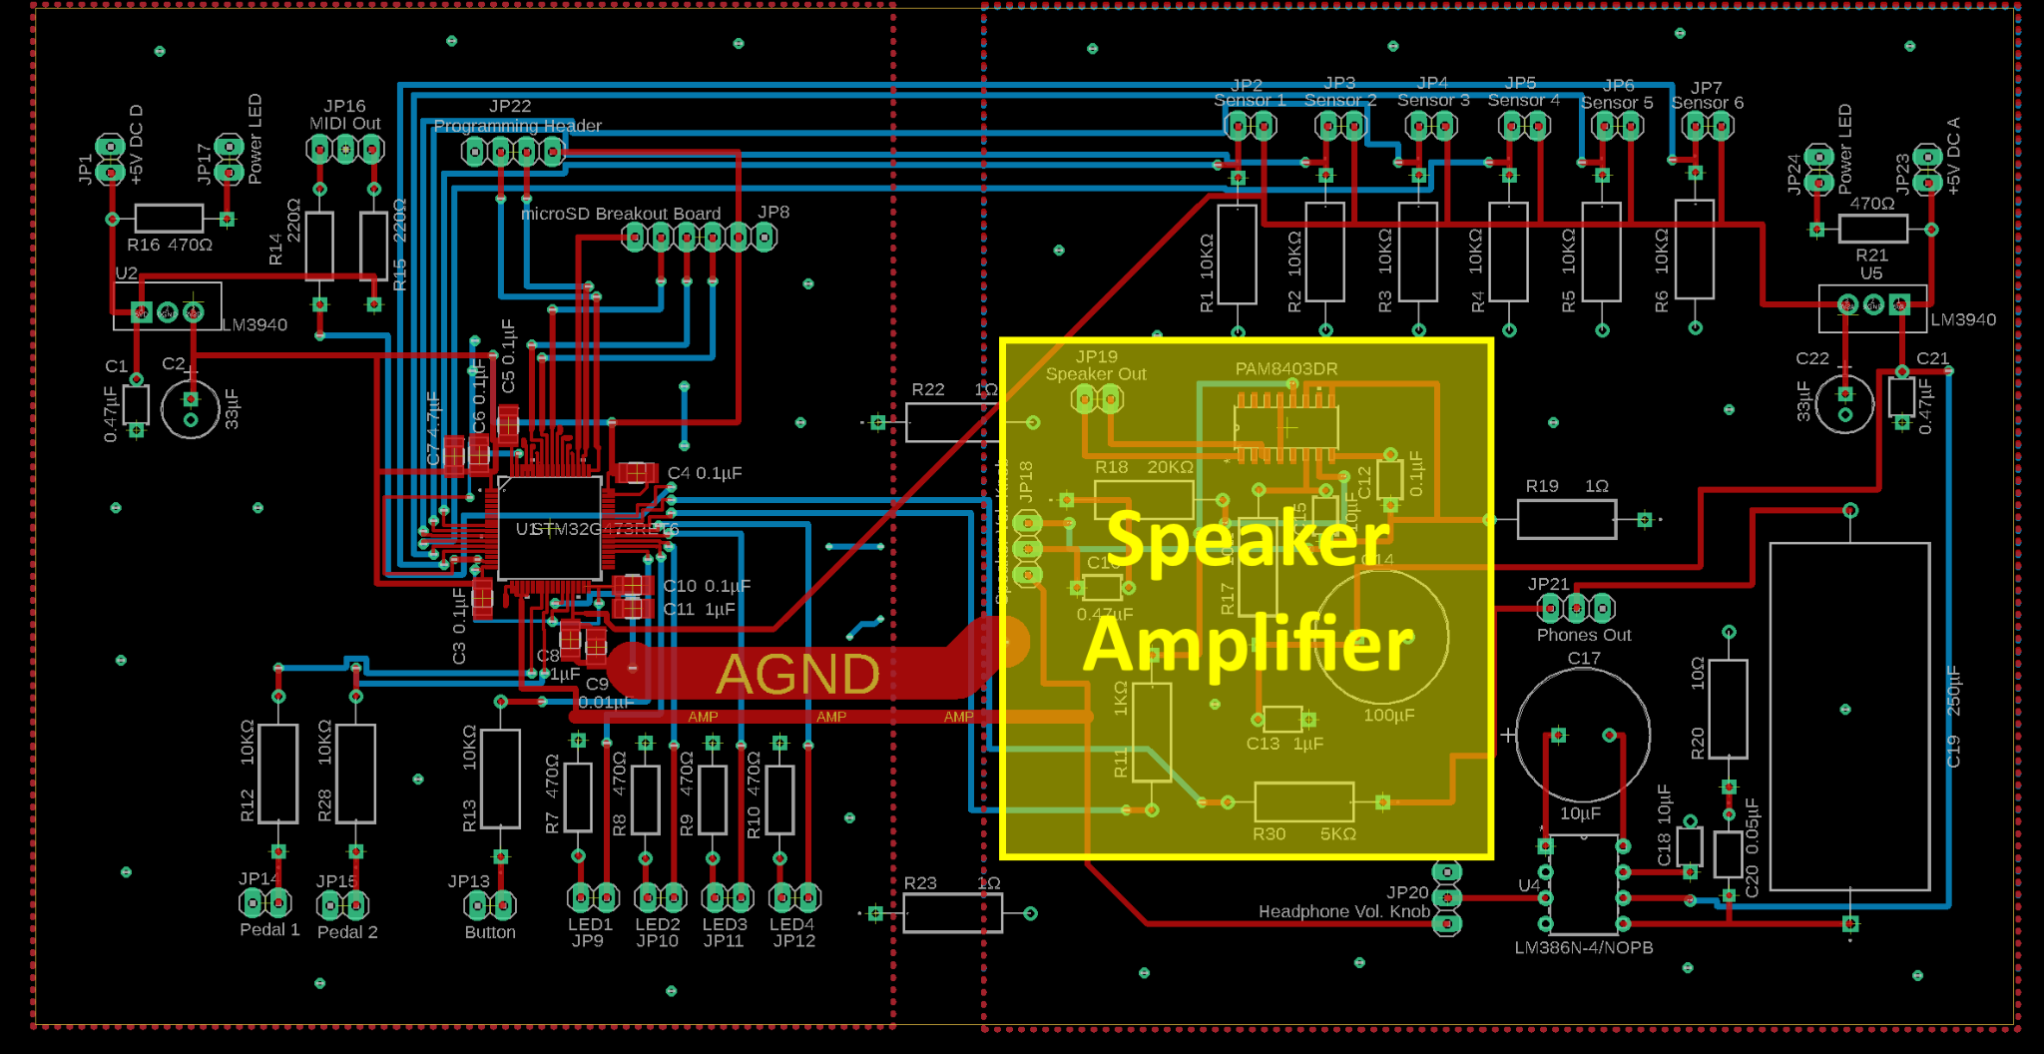
Significant PCB Design

Slide 33
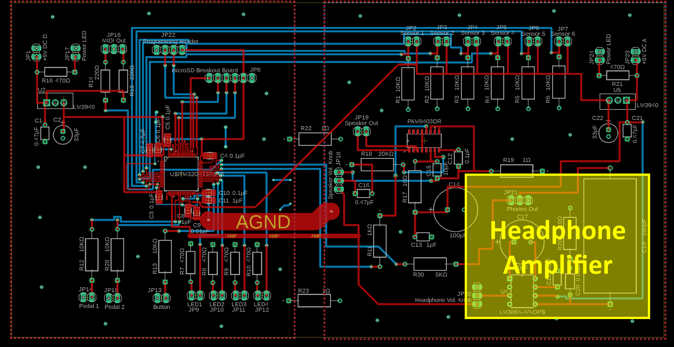
Significant PCB Design

Slide 34
Software Design

Slide 35
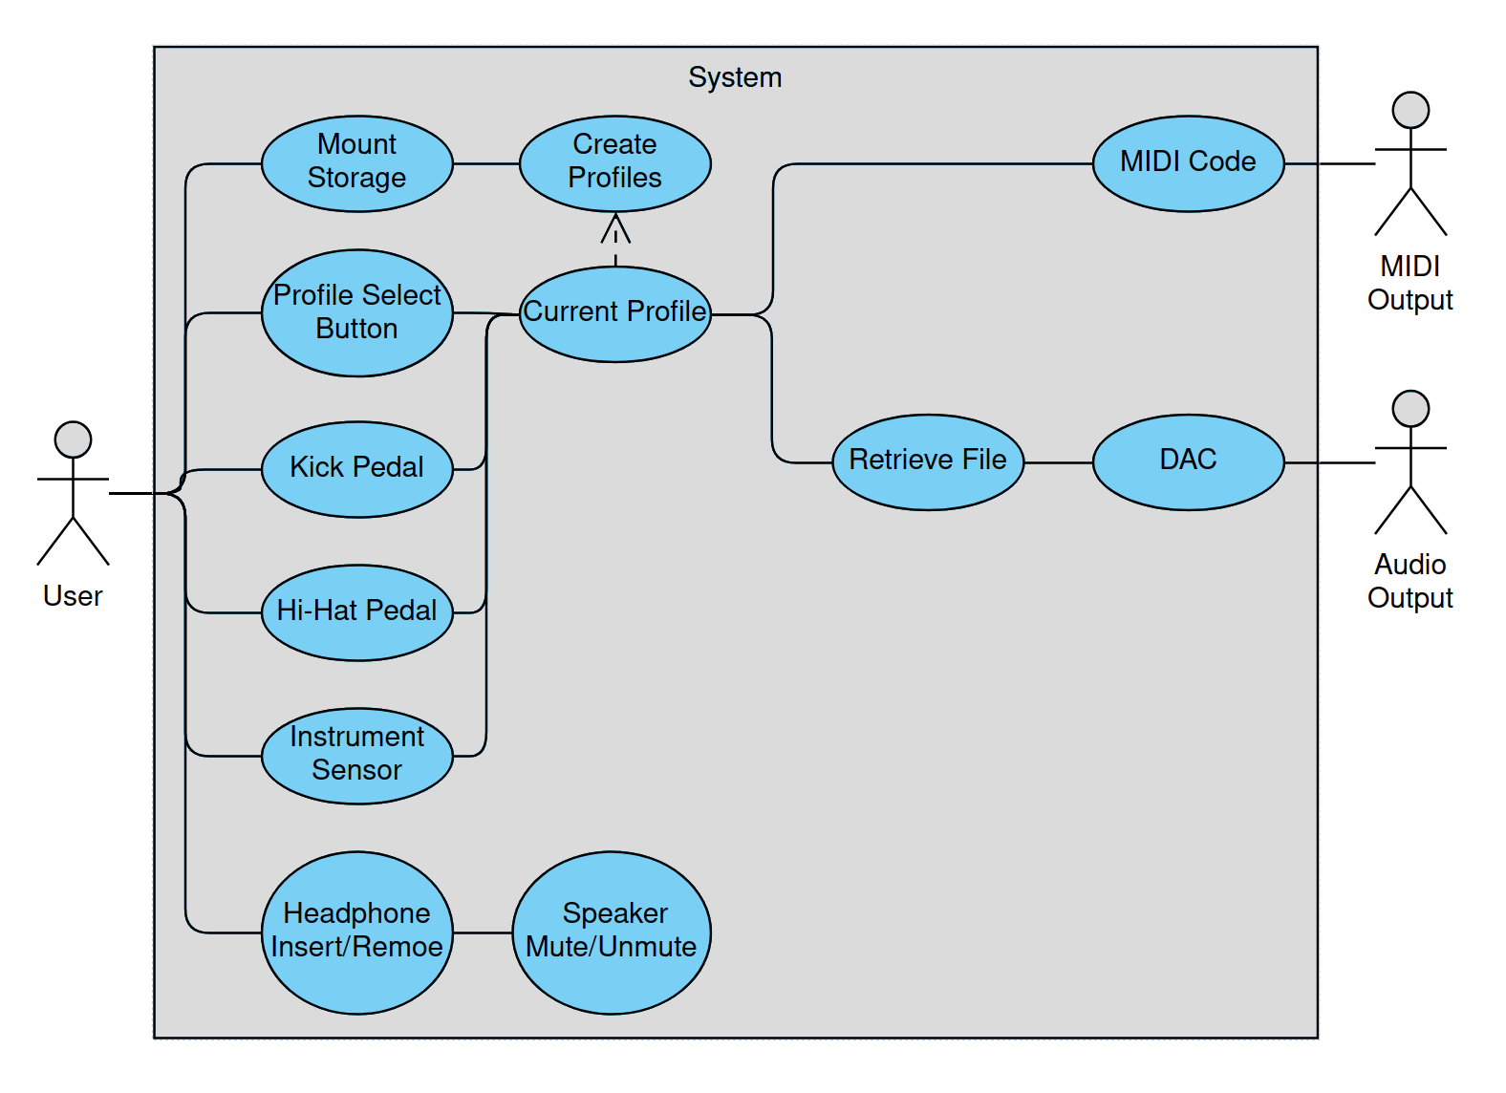
Software Design - Use Case Diagram

Slide 36
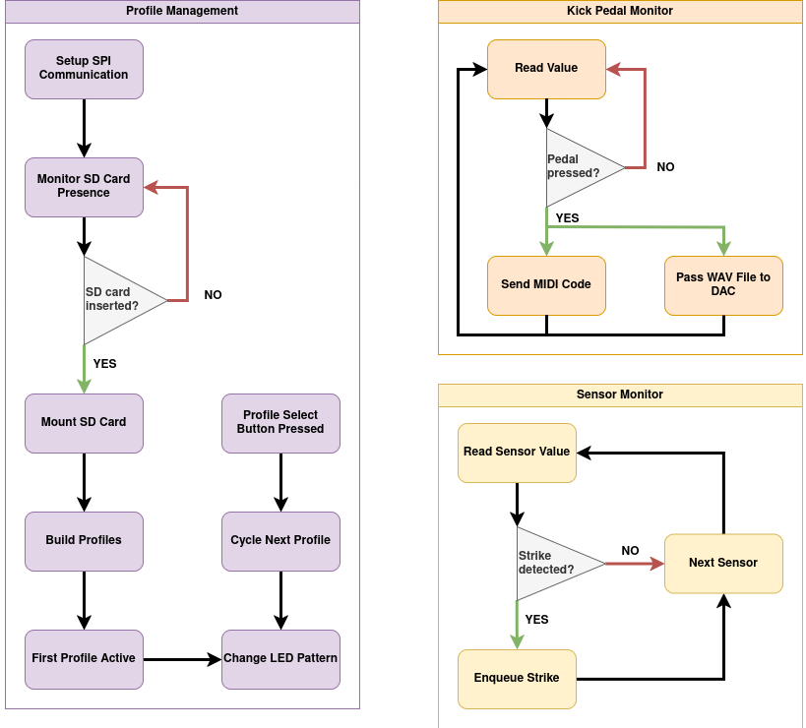
Software Design - Task Separation
OmniDrum depends on the storage medium and sound effects within.
Sensor array is high priority.
Button and switches are lower priority.

Slide 37
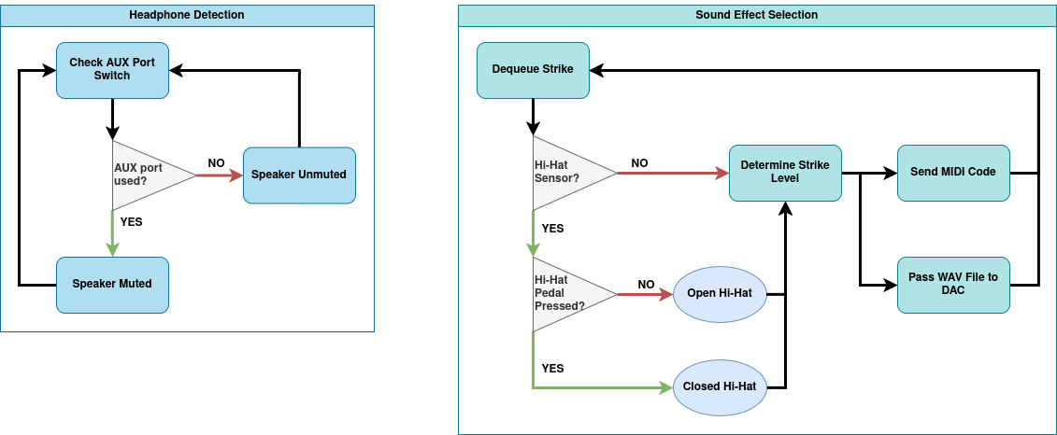
Software Design - Task Separation

Slide 38
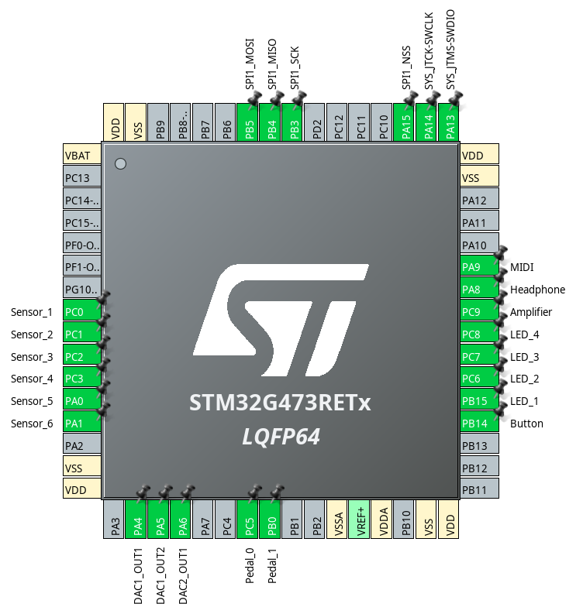
Software Design - Pin Assignment

Slide 39
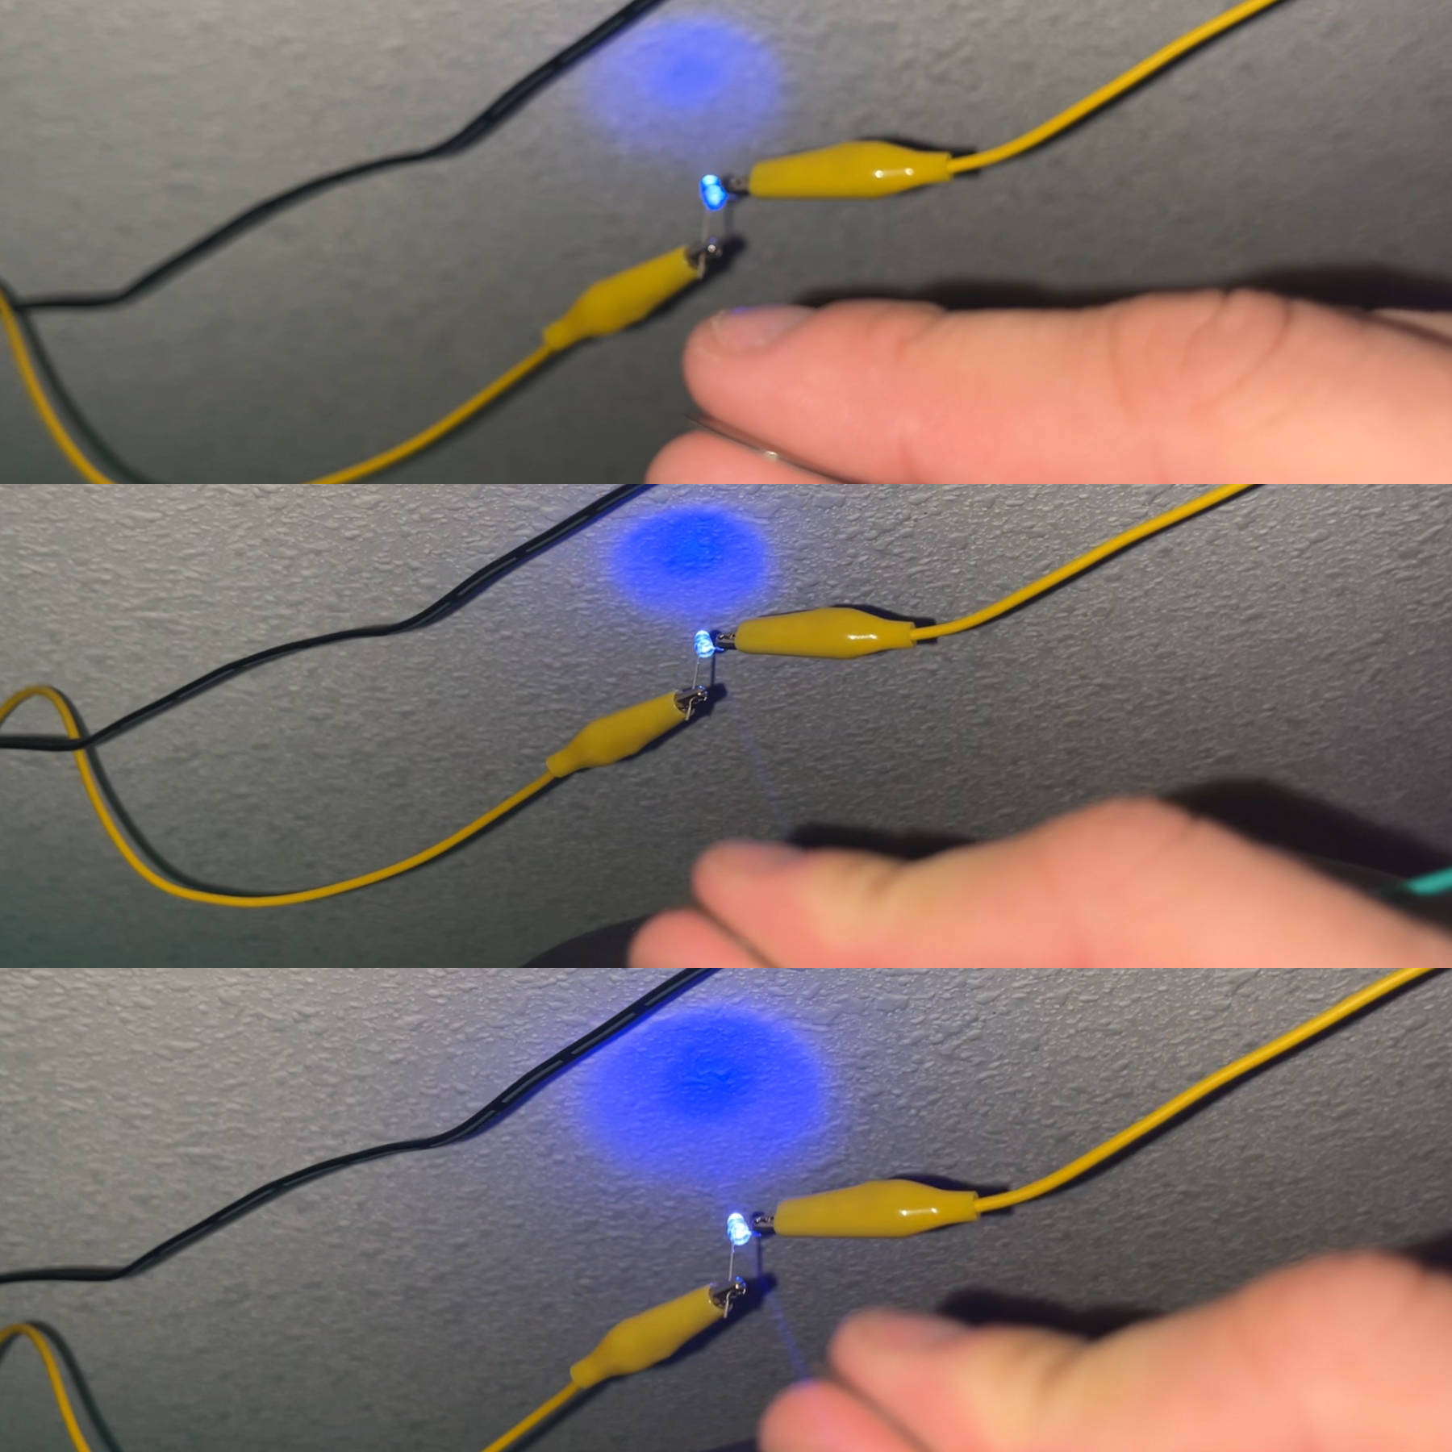
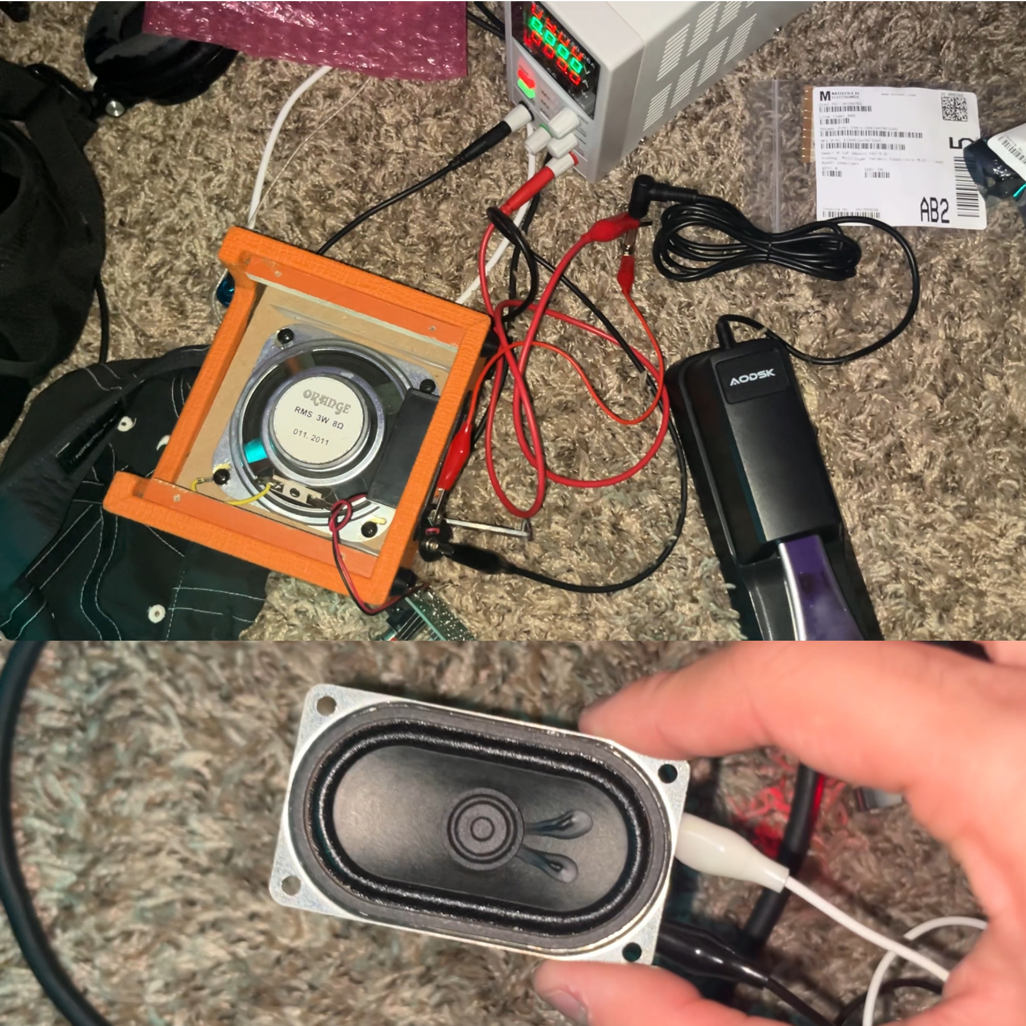
Prototypes / Pictures

Slide 40
Challenges
Current internal speaker is a bit too quiet. A larger speaker or lower impedance could fix this.
Interference issues between the force sensors and ADC pins are currently unknown
Playing multiple overlapping audio files has not been finalized but is WIP

Slide 41
Administrative - Budget
Component | Value | Notes | Qty. | Total Cost
All Capacitors | - | SMD/SMT & THT | 21 | $7.91
All Resistors | - | THT | 21 | $0.72
Potentiometers | - | Panel Mount | 2 | $0.78
ICs | - | SMD/SMT & THT | 2 | $2.65
Regulator | - | THT | 2 | $3.24
Connectors | - | Panel Mount | 15 | $5.64
Speaker | - | Panel Mount | 1 | $1.75
All Hardware | - | - | 19 | $56.57
Sensor | - | - | 6 | $23.70
MCU | STM32G473RET6 | SMD/SMT | 1 | $8.20
PCB | - | - | 5 | $55.97
Total |  |  |  | $167.13

Slide 42
Administrative - Work Distribution

Slide 43
Future Plans
Connect sensors to cables
Construct fixtures for the sensors to be housed in
Construct enclosure for the PCB
Panel mount connectors and IO on main enclosure
Debug software and flash the MCU
Timing of sensor readings and file I/O
Tweak scheduling of tasks in FreeRTOS

