Slide 1
Omnidrum
Wylde Simpson - Electrical Engineer
Soufiane Louiba - Electrical Engineer
Jameson Palmer - Computer Engineer
Group 41

Slide 2




Our Team
Wylde Simpson Jameson Palmer Soufiane Louiba
Electrical Engineering Computer Engineering Electrical Engineering

Slide 3
Motivation & Background
Wylde Simpson
Electrical Engineering
Electric drum kits are expensive and not as accessible for amateur players.
Amateur drummers lack a way to transpose their jam sessions into MIDI information.
Not everyone has space for a full drum kit, ours is modular.

Slide 4
Goals
Wylde Simpson
Electrical Engineering
The device will be able to detect input from sensors and play a corresponding sound.
The device should be able to output MIDI signals corresponding to which sensors are triggered
The device should be able to play at least 3 sounds at once.
The device should be able to detect the velocity of each hit and play a different sound depending on the velocity.

Slide 5
Engineering Requirements and Specifications
Wylde Simpson
Electrical Engineering
Requirement & Constraints | Description
MIDI Output | Must output MIDI information to the user’s device
Polyphony | Must be able to play at least 3 sounds at once
Vel. Sensitivity | Must be able to detect 3 levels of velocity
Detection Rate | Must be able to detect hits that are at least 100ms apart
Low Latency | Latency must be no more than 100ms
Low Power Draw | Target power for circuit board should be less than 15 Watts
Audible Output | External speaker should achieve at least 65 dBA

Slide 6
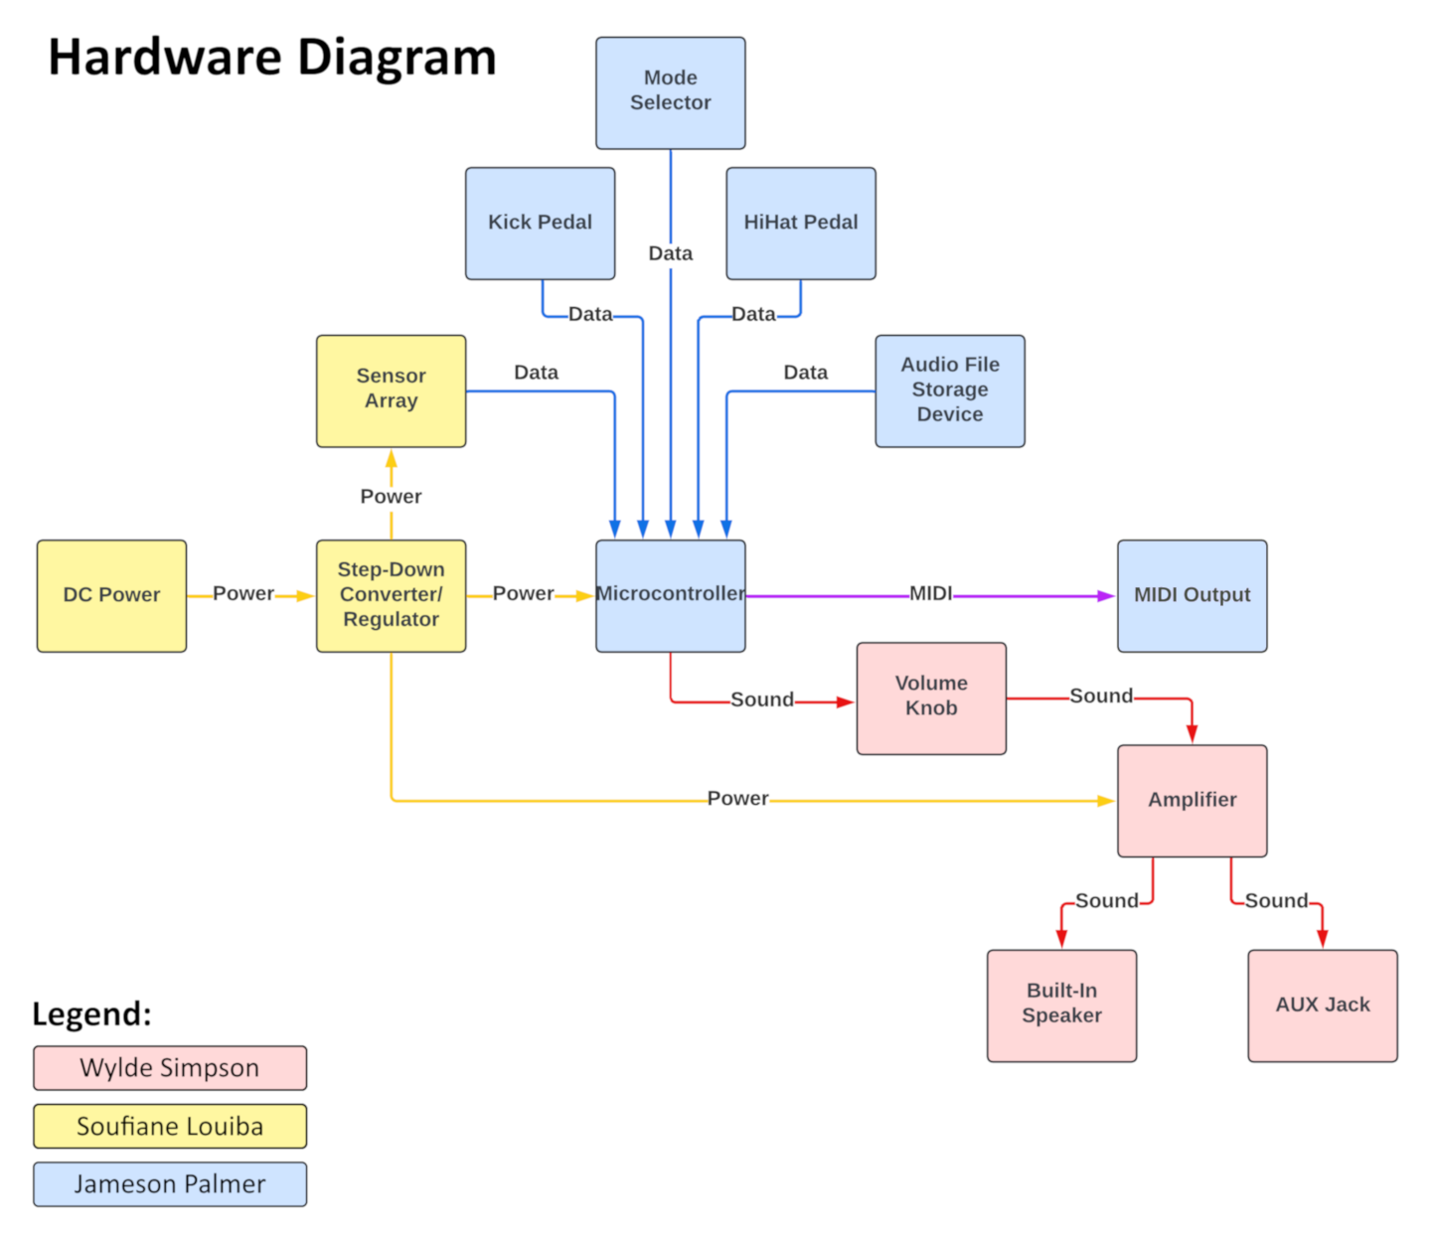
Hardware Block Diagram
Wylde Simpson
Electrical Engineering

Slide 7


Hardware Selection Comparison
Soufiane Louiba
Electrical Engineering

Slide 8
Hardware Selection Comparison - MCU
Soufiane Louiba
Electrical Engineering
Model | STM32F405RGT6W LQFP64 | STM32L562QEI6Q LQFP64 | STM32G473R LQFP64
GPIO Pins | 51 | 52 | 52
12-bit ADC Channels | 16 | 16 | 26
External DACs | 2 | 2 | 3
UART/USART/LPUART | 2/4/0 | 2/3/1 | 2/3/1
SPI | 3 | 8 | 4
Memory | 1024 MB | 512 KB | 512 KB
Price | $11.83 | $6.94 | $8.20
Why We Chose the STM32G473R for OmniDrum?
More ADC Channels (26 vs. 16)
More DAC Channels (3 vs. 2)
Sufficient Memory (512 KB)
MIDI Support (UART/USART) – All options support MIDI communication, so no limitations here.
Balanced Cost ($8.20) – Offers better ADC/DAC features without a significant price increase.

Slide 9
Hardware Selection Comparison -
Internal Speaker
Soufiane Louiba
Electrical Engineering
Model | HY7040DS0830-H16.8 | HYB30704R3W | SC700208-1
Price | $1.75 | $2.00 | $4.10
Rated Power | 3W | 3W | 3W
Rated Impedance | 8Ω | 4Ω | 8Ω
Output SPL | 93dB ±3dB | 116dB ±3dB | 100
Total Harmonic Distortion | 10% | 5% | NA
Dimensions | 71mm x 41mm x 17mm | 70mm x 31mm x 17mm | 71mm x 41mm x 25mm
Why We Chose the HY7040DS0830-H16.8 for OmniDrum?
Lowest Cost Option
Good Sound quality from High Impedance
Acceptable Output SPL
Acceptable THD

Slide 10
Hardware Selection Comparison -
Speaker Amplifier
Soufiane Louiba
Electrical Engineering
Model | TDA2003 | PAM8403 | LM386
Amplifier Class | AB | D | AB
Output Power | 10W @ 4Ω | 1.8W @ 8Ω | 0.25W - 0.7W @ 8Ω
Supply Voltage | 8V - 18V | 2.5V - 5.5V | 5V - 18V
Impedance Rating | 1Ω - 8Ω | 4Ω - 8Ω | 4Ω - 32Ω
Lifecycle | Obsolete | Active | Active
Why We Chose the PAM8403 for OmniDrum?
Efficient Class D Amplifier
Correct Output Wattage
Supply Voltage in range
Currently Available

Slide 11
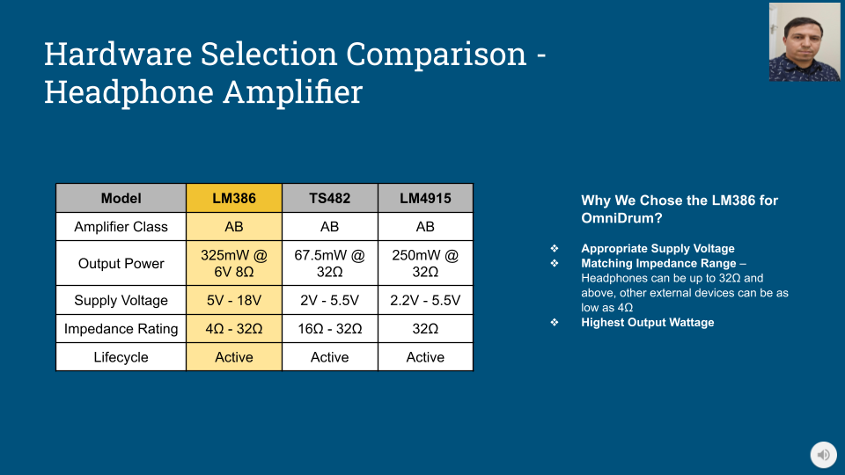
Soufiane Louiba
Electrical Engineering

Slide 12
Hardware Selection Comparison - Sensor
Soufiane Louiba
Electrical Engineering
Model | Force | Velocity | Vibration
Pins | 2 | 4 | 3
Variance Type | Resistive | I2C | Digital
Price | $3.50 | $9.97 | $6.49/5pk
Required Connection | Analog IO Pin | I2C | Digital IO Pin
Why We Chose the Force Sensor for OmniDrum?
Resistive sensors are very simple to connect
Resistive sensor can output various analog values
Small pin count allows us to easily create connectors

Slide 13
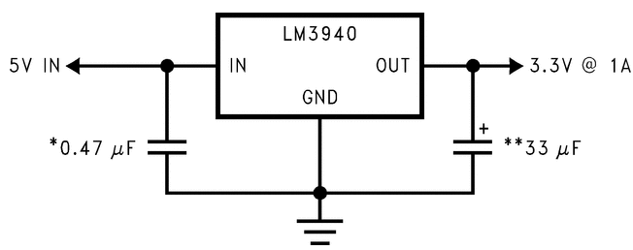
Hardware Selection Comparison - Regulator
Soufiane Louiba
Electrical Engineering
Model | BA33DD0WT | LM3940 | LT1085
Input Voltage Range | 3V - 25V | 4.5V - 5.5V | 2.55V - 30V
Output Current | 2A | 1A | 3A
Price | $3.12 | $1.62 | $10.13
Why We Chose the LM3940 Sensor for OmniDrum?
Correct Input Voltage
Lowest Cost
Adequate Output Current Rating

Slide 14
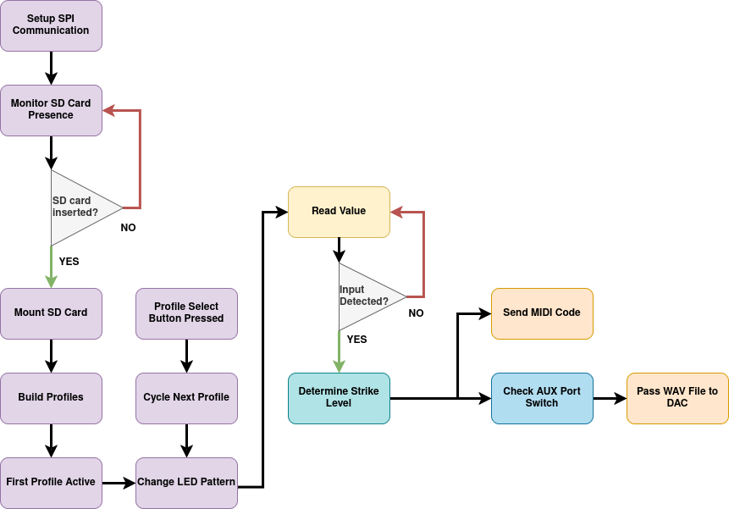
Software Design - Block Diagram
Jameson Palmer
Computer Engineering

Slide 15
Software Selection Comparison
Jameson Palmer
Computer Engineering

Slide 16




Software Selection Comparison - IDE
Jameson Palmer
Computer Engineering
Model | STM32cube IDE | Arduino IDE | VS Code
Support | First Party | Community | Community
Languages | C, C++ | C | C, C++
Complexity | Organized tools, hardware layout, and middleware | Provides example software | Pairs with STM software
Utility | Setup generation, flashing, debugging | Not as many supported MCUs | Setup generation after use of STM software

Slide 17
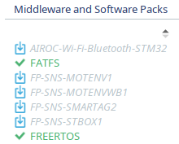
Software Selection Comparison - Operating System
Jameson Palmer
Computer Engineering
FreeRTOS
Light on resources.
Useful for threads, tasks, timers, queues, and mutexes.
Schedule predictable operation.
Integration with STM32cubeIDE.

Slide 18
Software Selection Comparison - Filesystem
Jameson Palmer
Computer Engineering
Format | Case Sensitive | Sparse Files | Journaling | OS Cross Compatible
FAT32 | No | No | No | Yes
exFAT | No | No | Optional | Yes
NTFS | Yes | Yes | Yes | Yes*
APFS | Yes | Yes | Optional | No**

Slide 19
Software Selection Comparison -
Audio File Format
Jameson Palmer
Computer Engineering
Format | Compression | CPU Overhead | Data Size
WAV | No | Low | 690 kbps
FLAC | Lossless | High | 450 kbps
ALAC | Lossless | High | 425 kbps
MP3 | Lossy | High | 160 kbps
AAC | Lossy | High | 160 kbps
Opus | Lossy | Medium | 80 kbps

Slide 20
Project Design

Slide 21
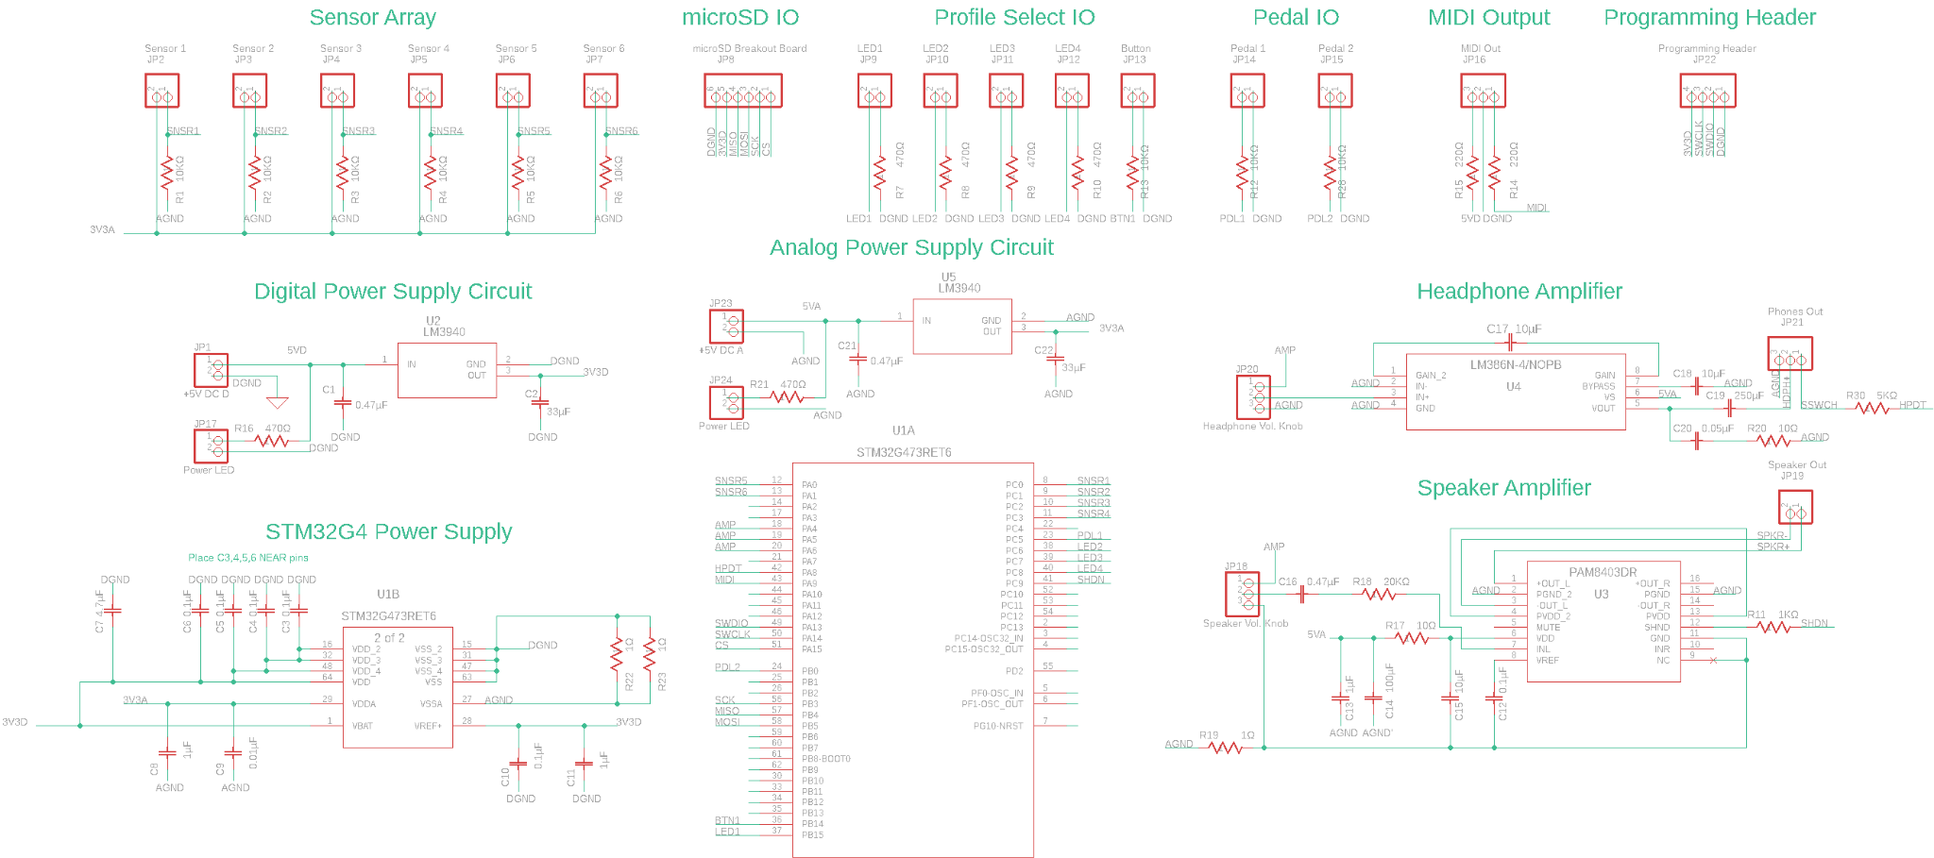
Overall Schematic
Wylde Simpson
Electrical Engineering

Slide 22
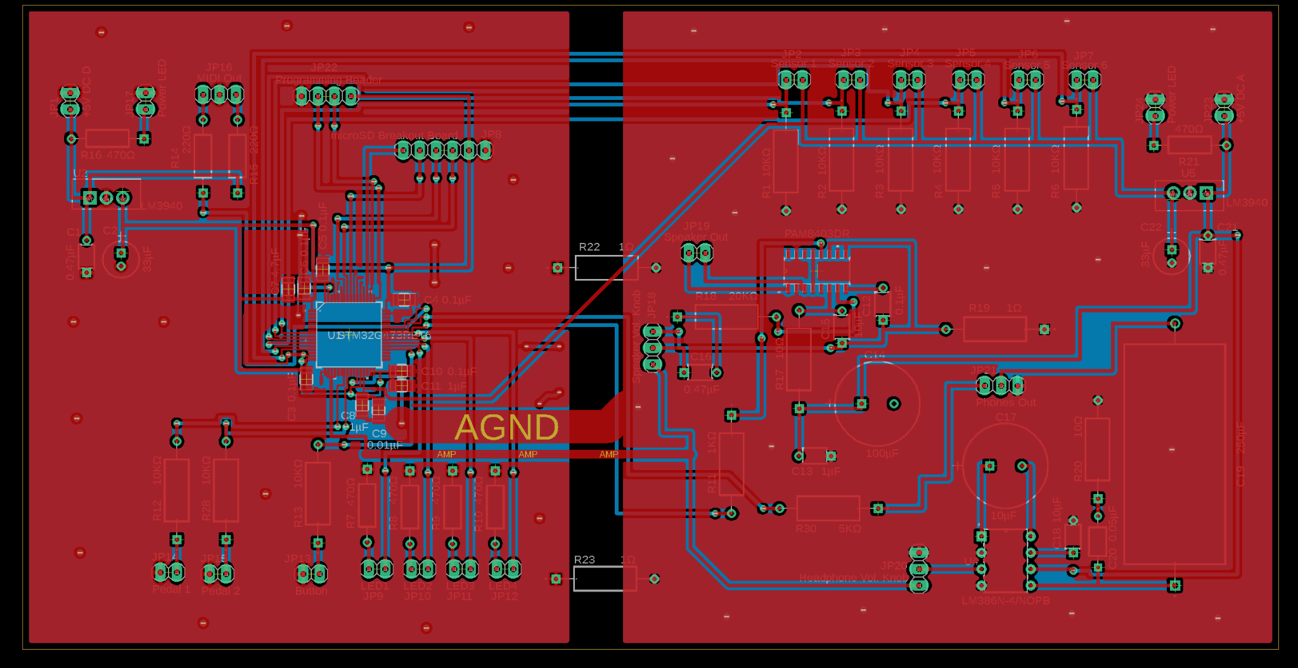
Significant PCB Design
Wylde Simpson
Electrical Engineering

Slide 23
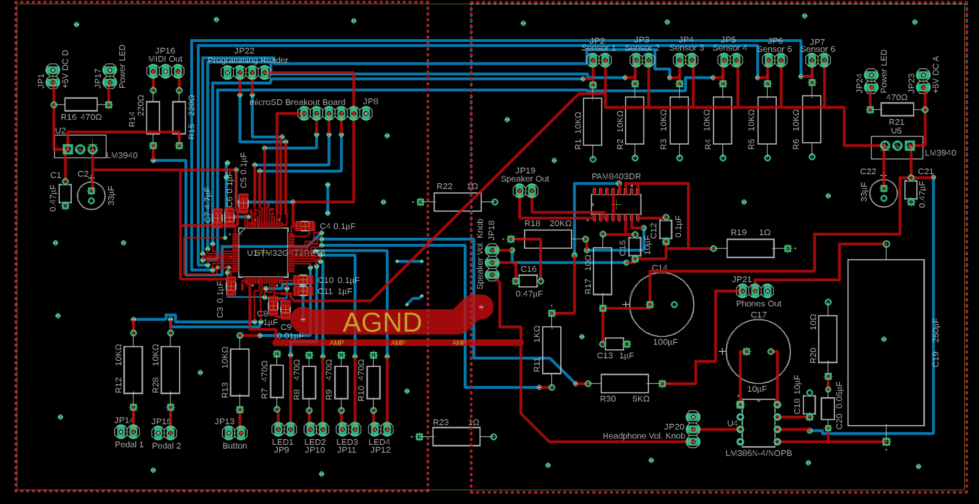
Significant PCB Design
Wylde Simpson
Electrical Engineering

Slide 24
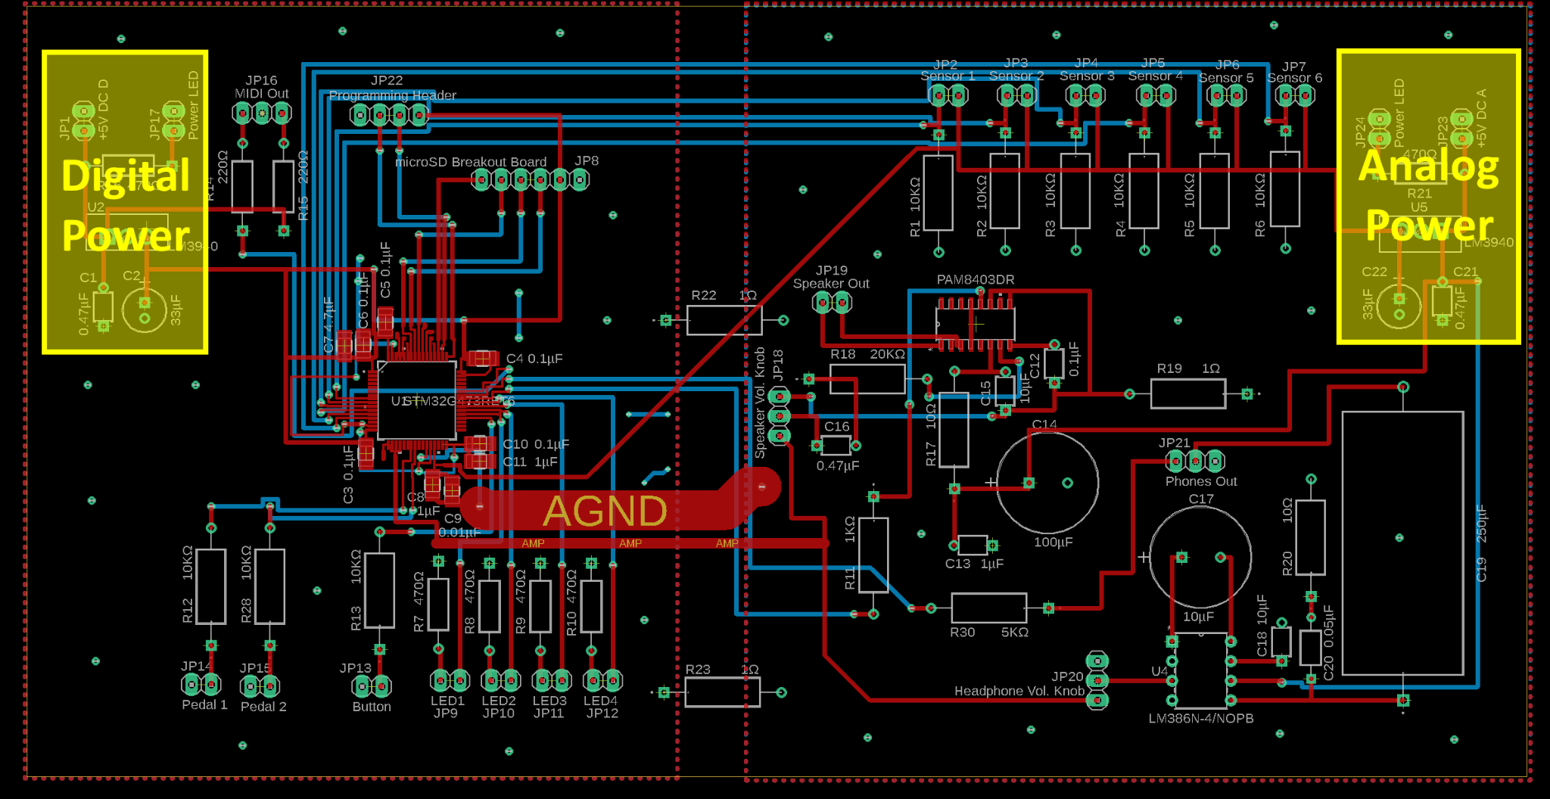
Significant PCB Design
Wylde Simpson
Electrical Engineering

Slide 25
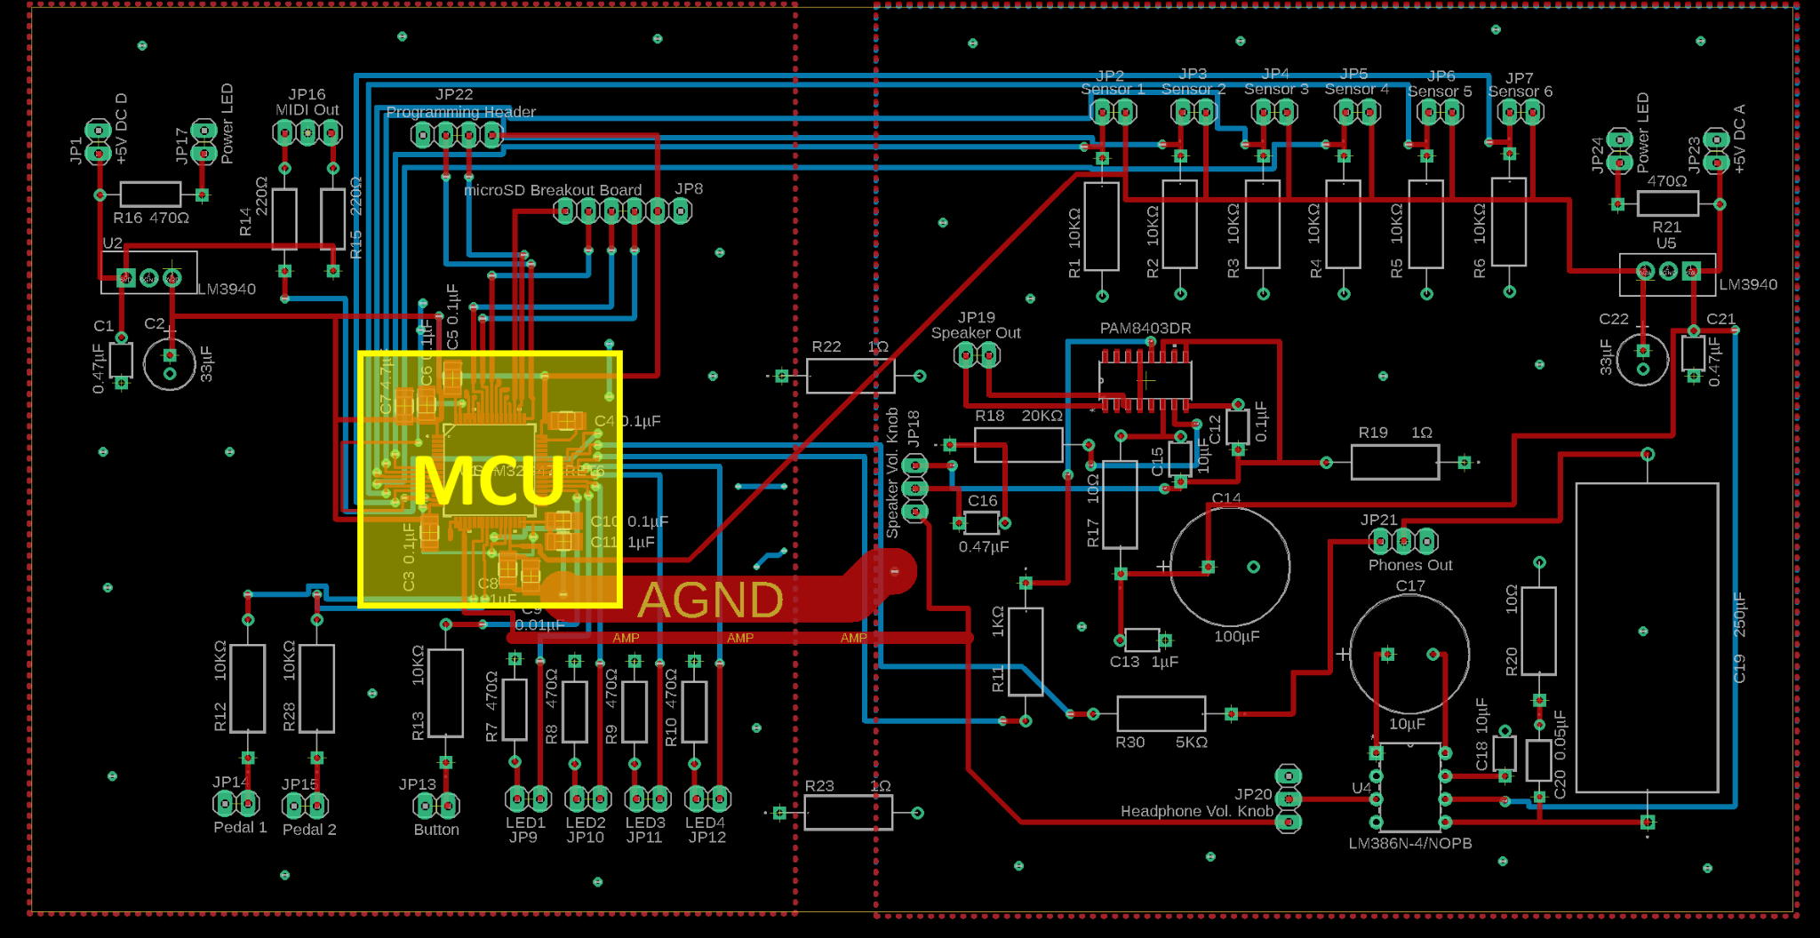
Significant PCB Design
Wylde Simpson
Electrical Engineering

Slide 26
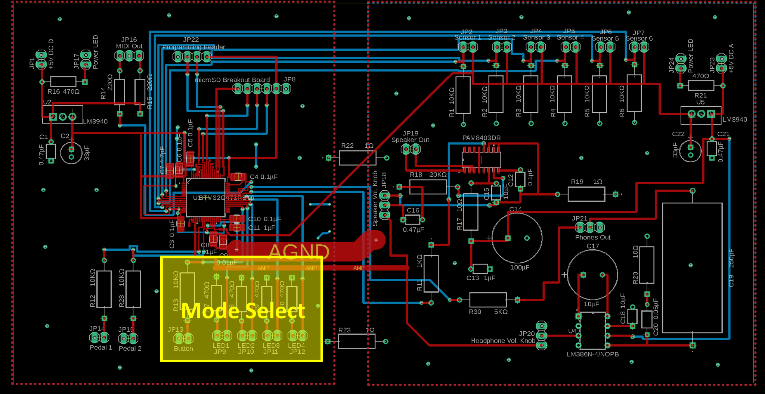
Significant PCB Design
Wylde Simpson
Electrical Engineering

Slide 27
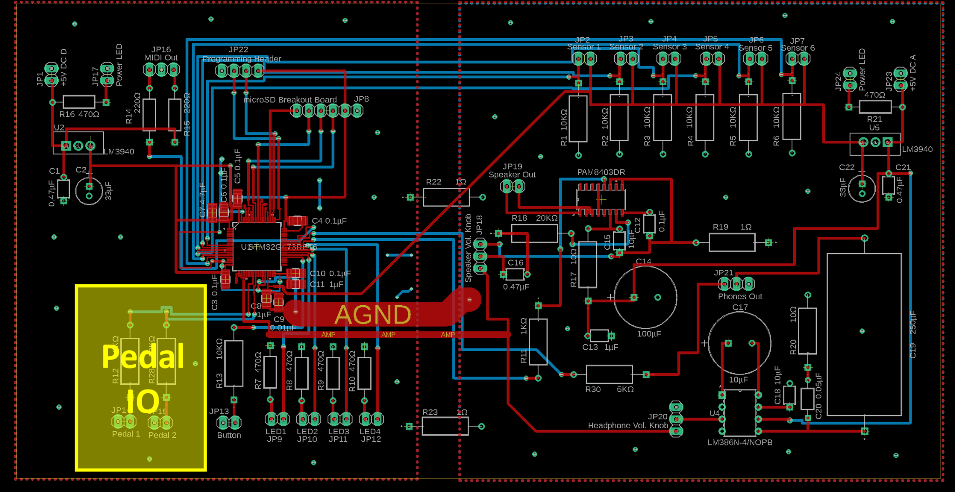
Significant PCB Design
Wylde Simpson
Electrical Engineering

Slide 28
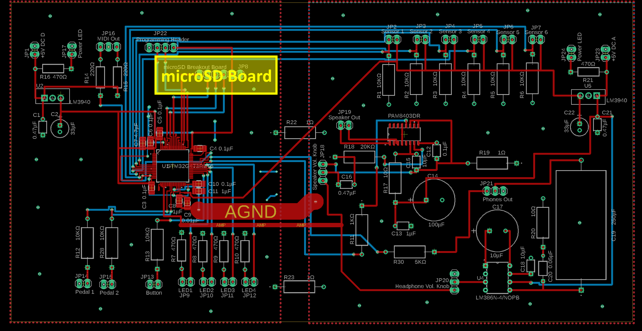
Significant PCB Design
Wylde Simpson
Electrical Engineering

Slide 29
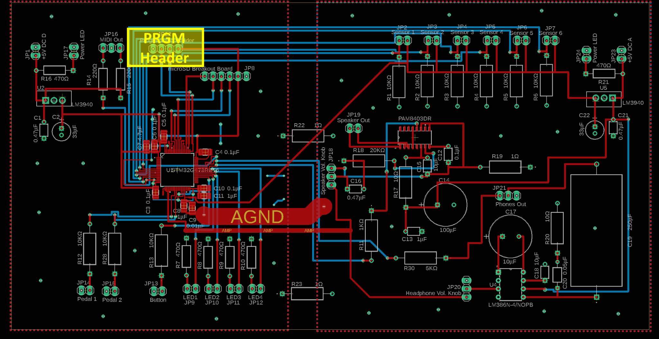
Significant PCB Design
Wylde Simpson
Electrical Engineering

Slide 30
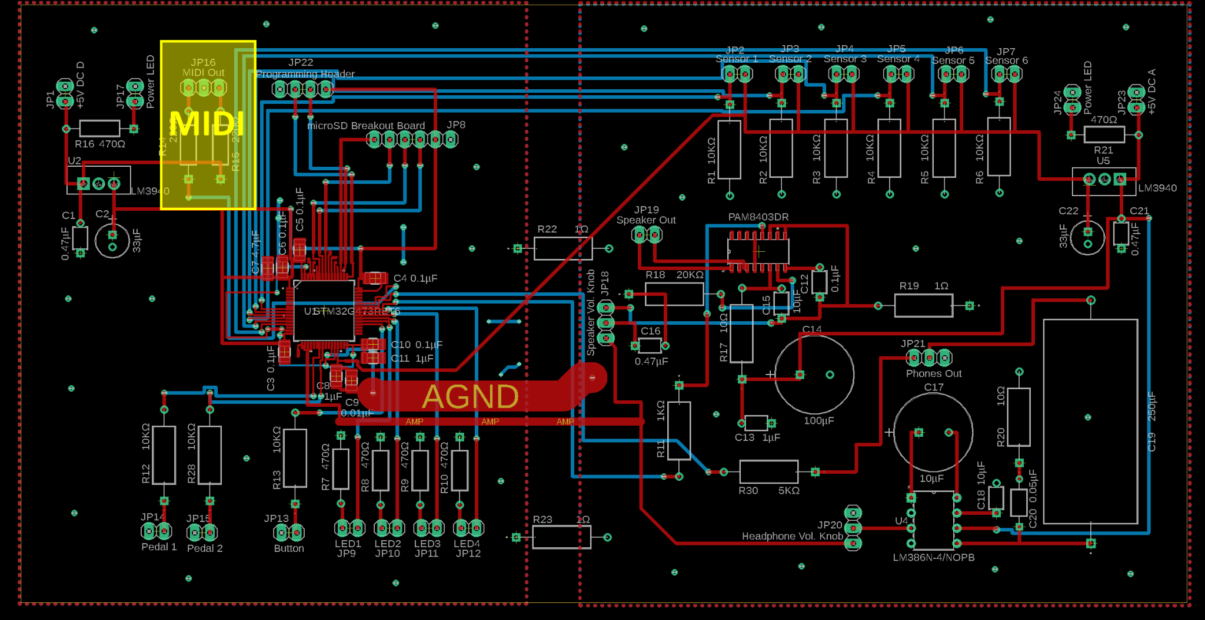
Significant PCB Design
Wylde Simpson
Electrical Engineering

Slide 31
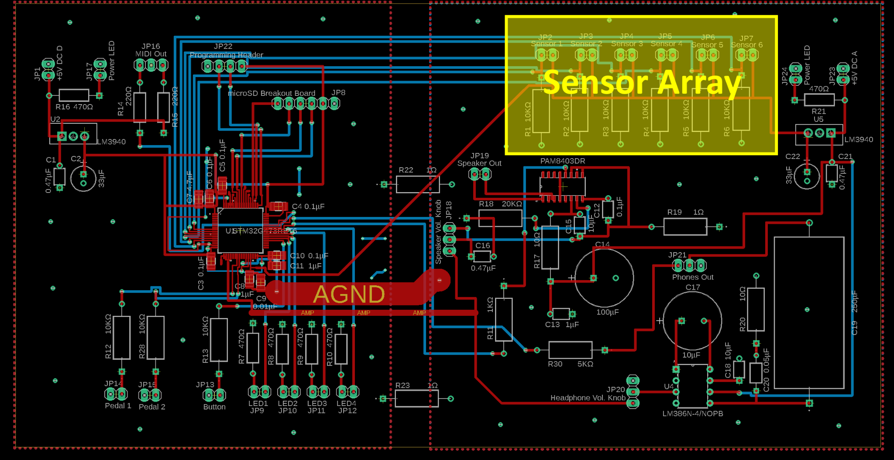
Significant PCB Design
Wylde Simpson
Electrical Engineering

Slide 32
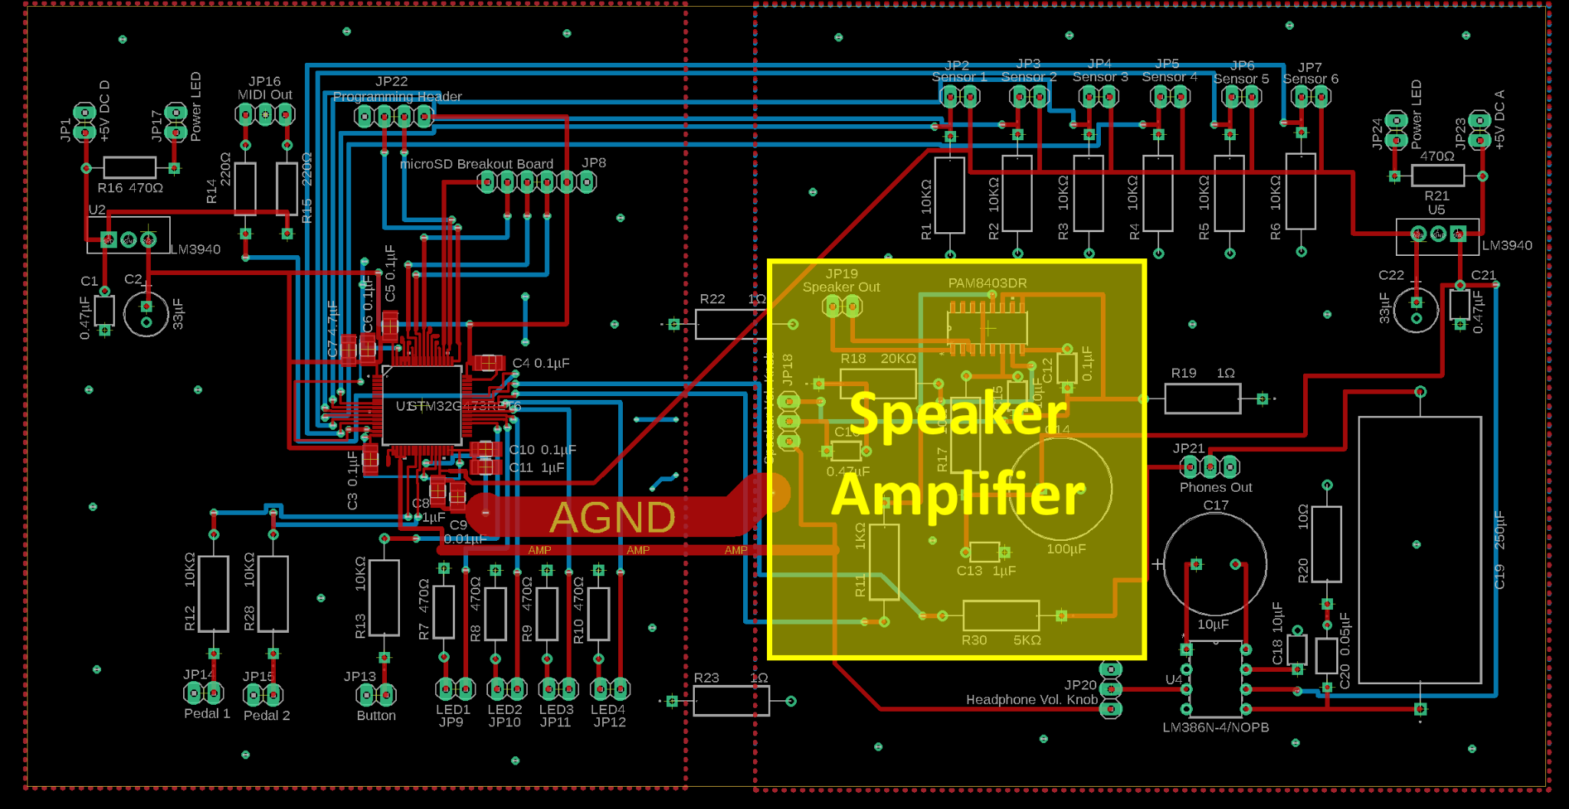
Significant PCB Design
Wylde Simpson
Electrical Engineering

Slide 33
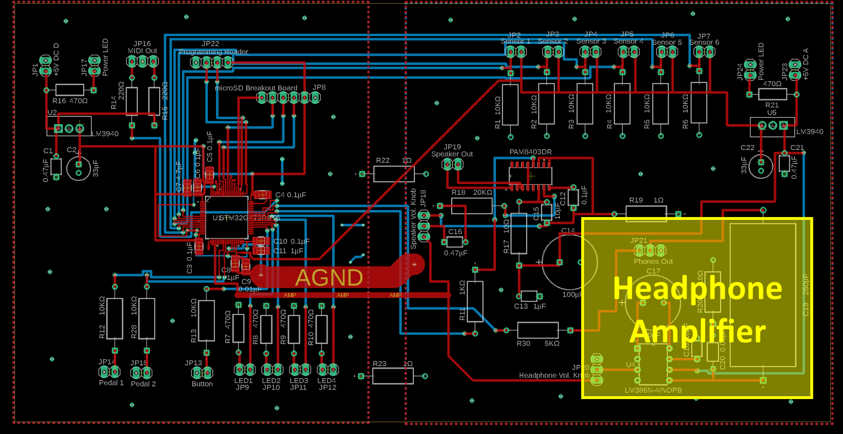
Significant PCB Design
Wylde Simpson
Electrical Engineering

Slide 34
Software Design
Jameson Palmer
Computer Engineering

Slide 35
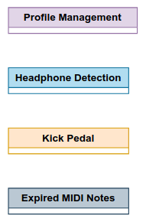
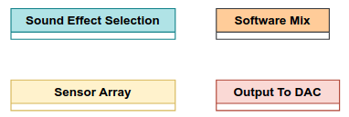
Software Design - Task Separation
Jameson Palmer
Computer Engineering
OmniDrum depends on the storage device and sound effects.
The sensor array can be sampled multiple times within the duration of a sensor spike.
The button and switches are polled at less regular intervals.

Slide 36
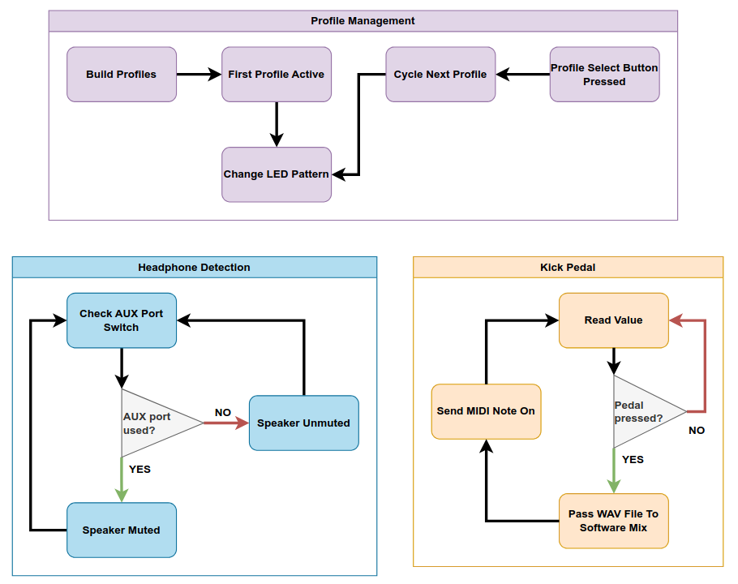
Software
Jameson Palmer
Computer Engineering

Slide 37
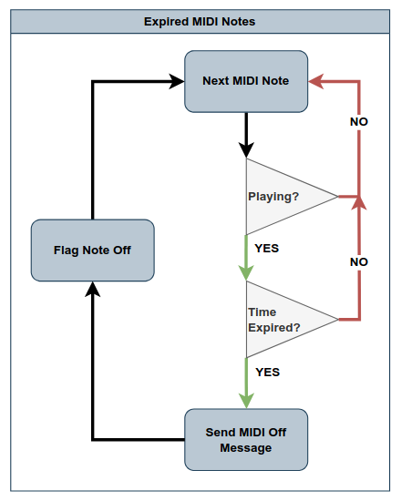
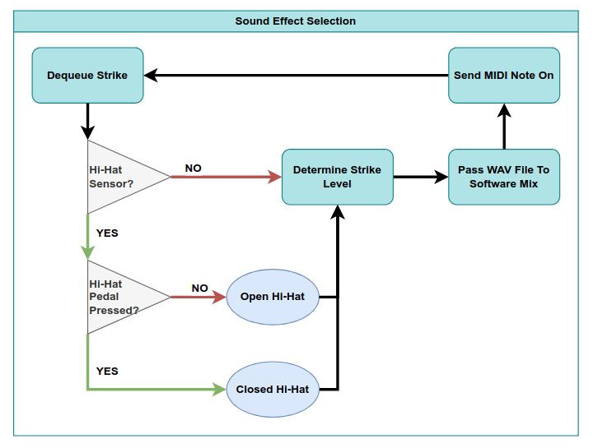
Software
Jameson Palmer
Computer Engineering

Slide 38
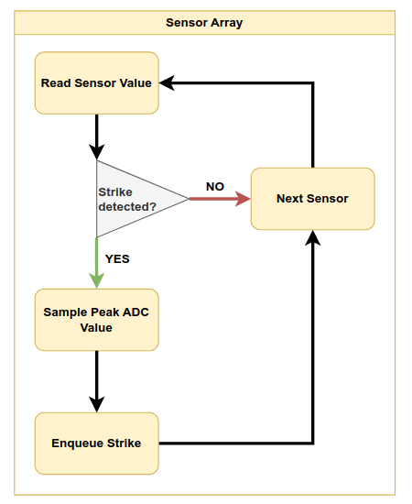
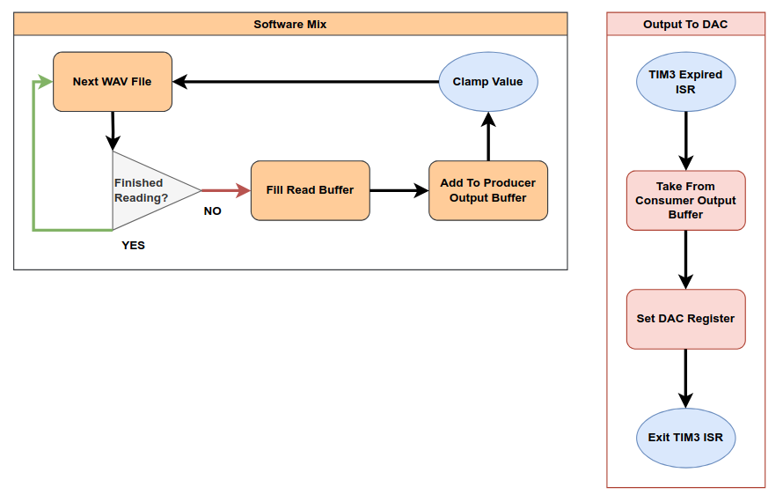
Software
Jameson Palmer
Computer Engineering

Slide 39
Software Design - Periodic Timer
Jameson Palmer
Computer Engineering
FreeRTOS tick rate is 1 kHz.
A periodic interrupt for our DAC output needs to be in the microsecond range.
Hardware timer is configured for 44100 Hz interrupts to place data into our DAC register.
Must have a sample in the consumer buffer, otherwise we exit ISR.

Slide 40
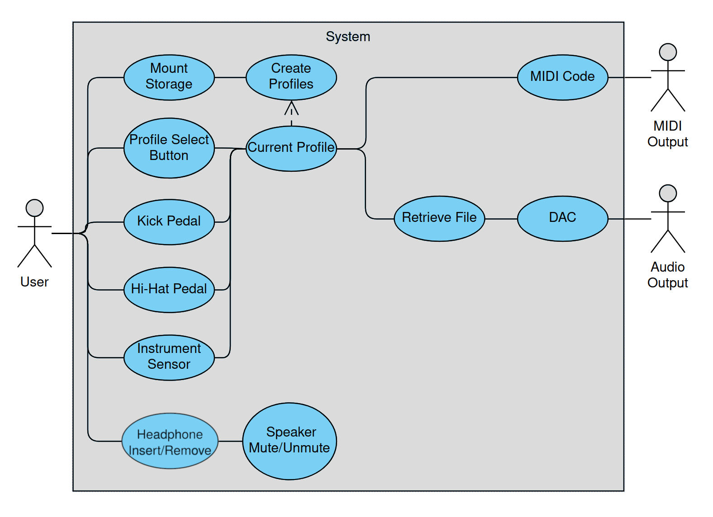
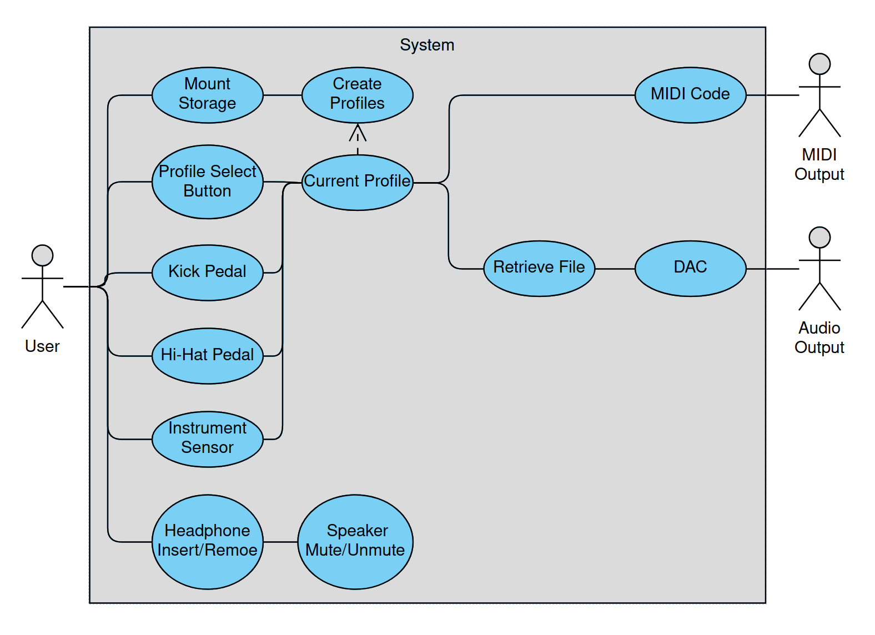
Software Design - Use Case Diagram
Jameson Palmer
Computer Engineering

Slide 41
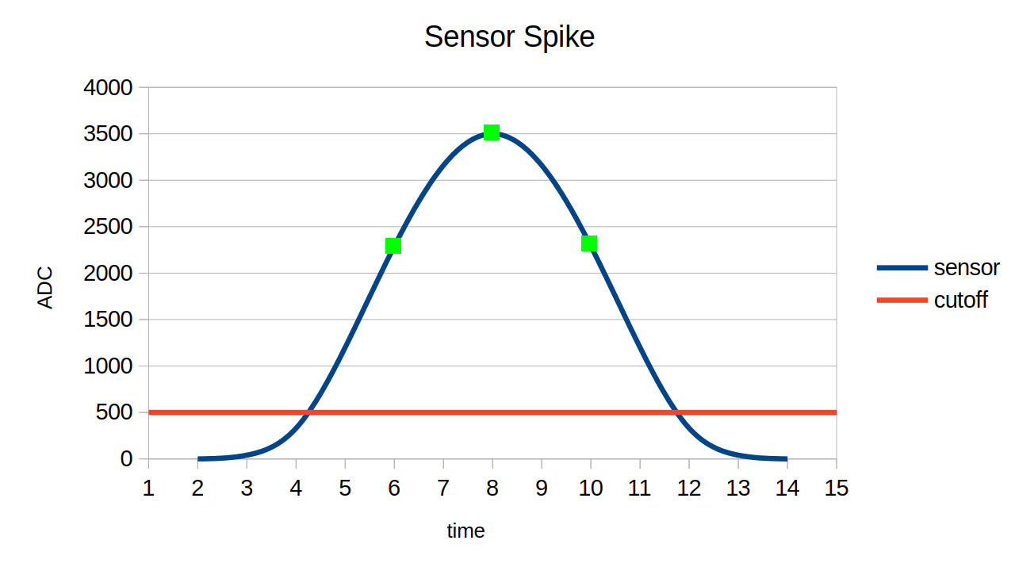
Software Design - ADC Sensor Reading
Jameson Palmer
Computer Engineering

Slide 42
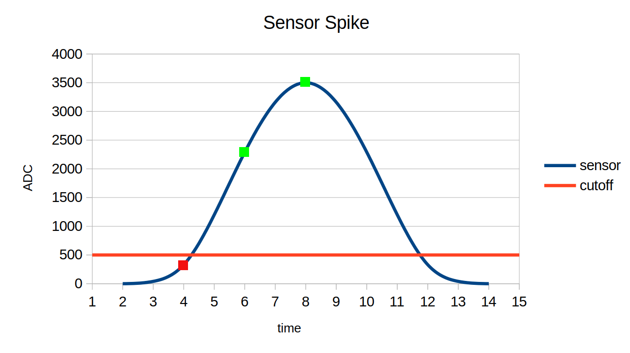
Software Design - ADC Sensor Reading
Jameson Palmer
Computer Engineering

Slide 43
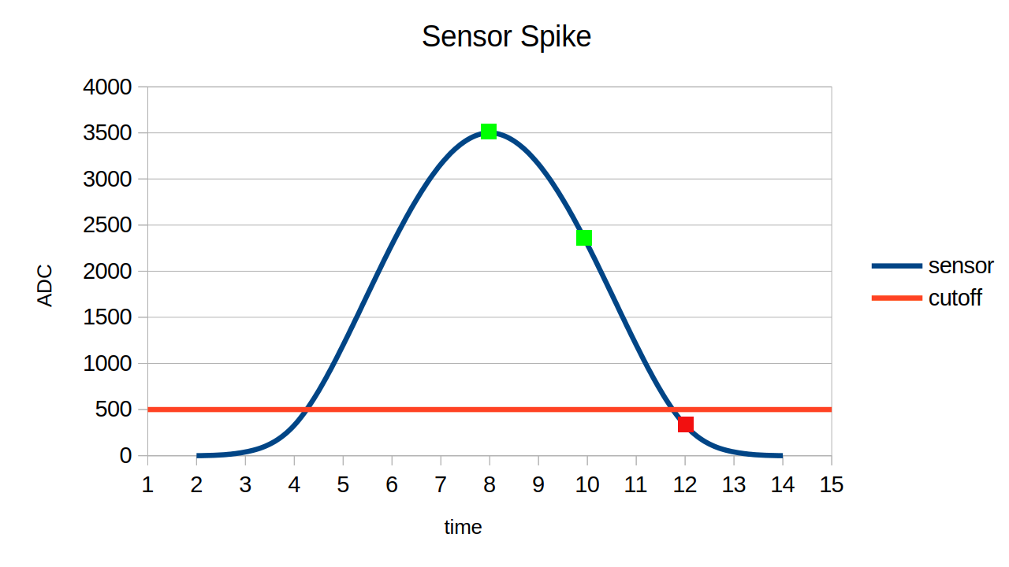
Software Design - ADC Sensor Reading
Jameson Palmer
Computer Engineering

Slide 44
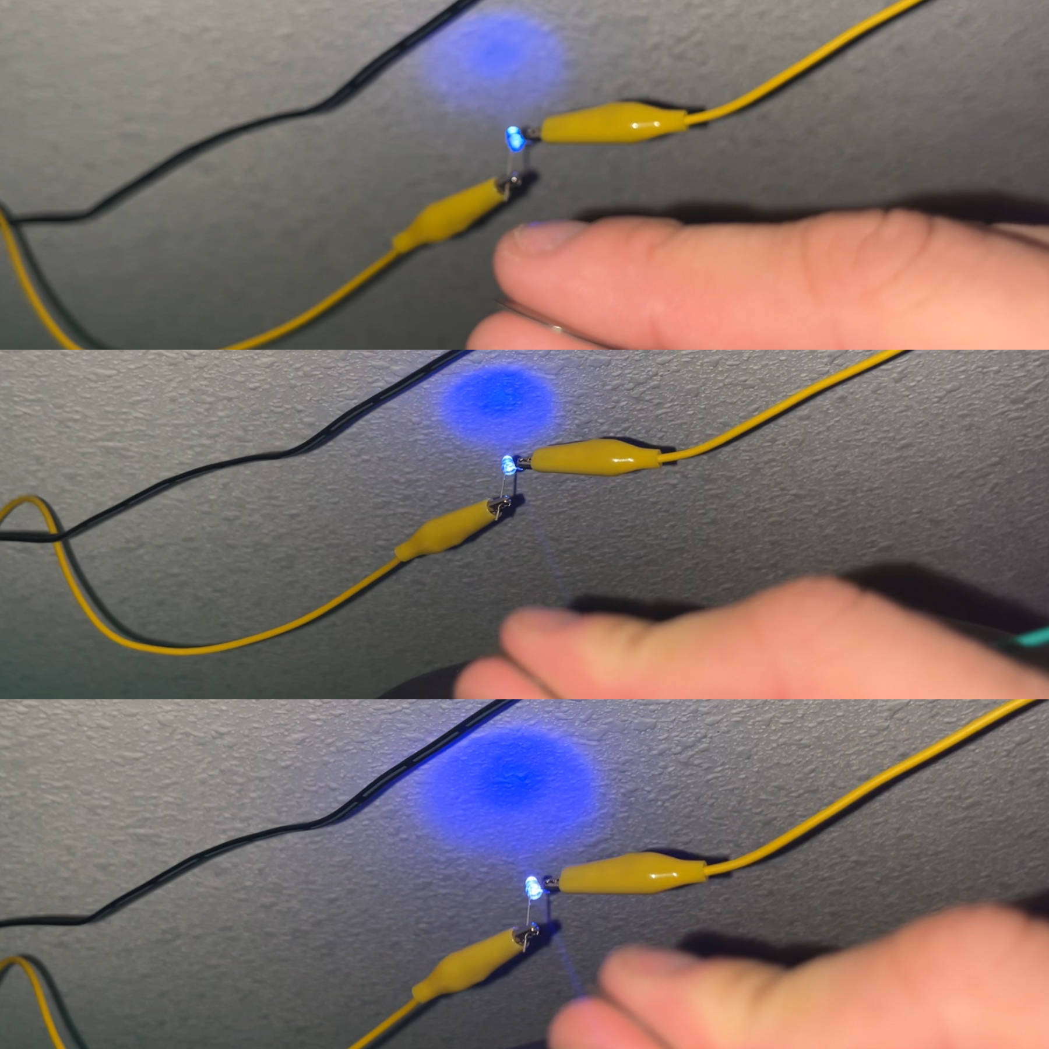
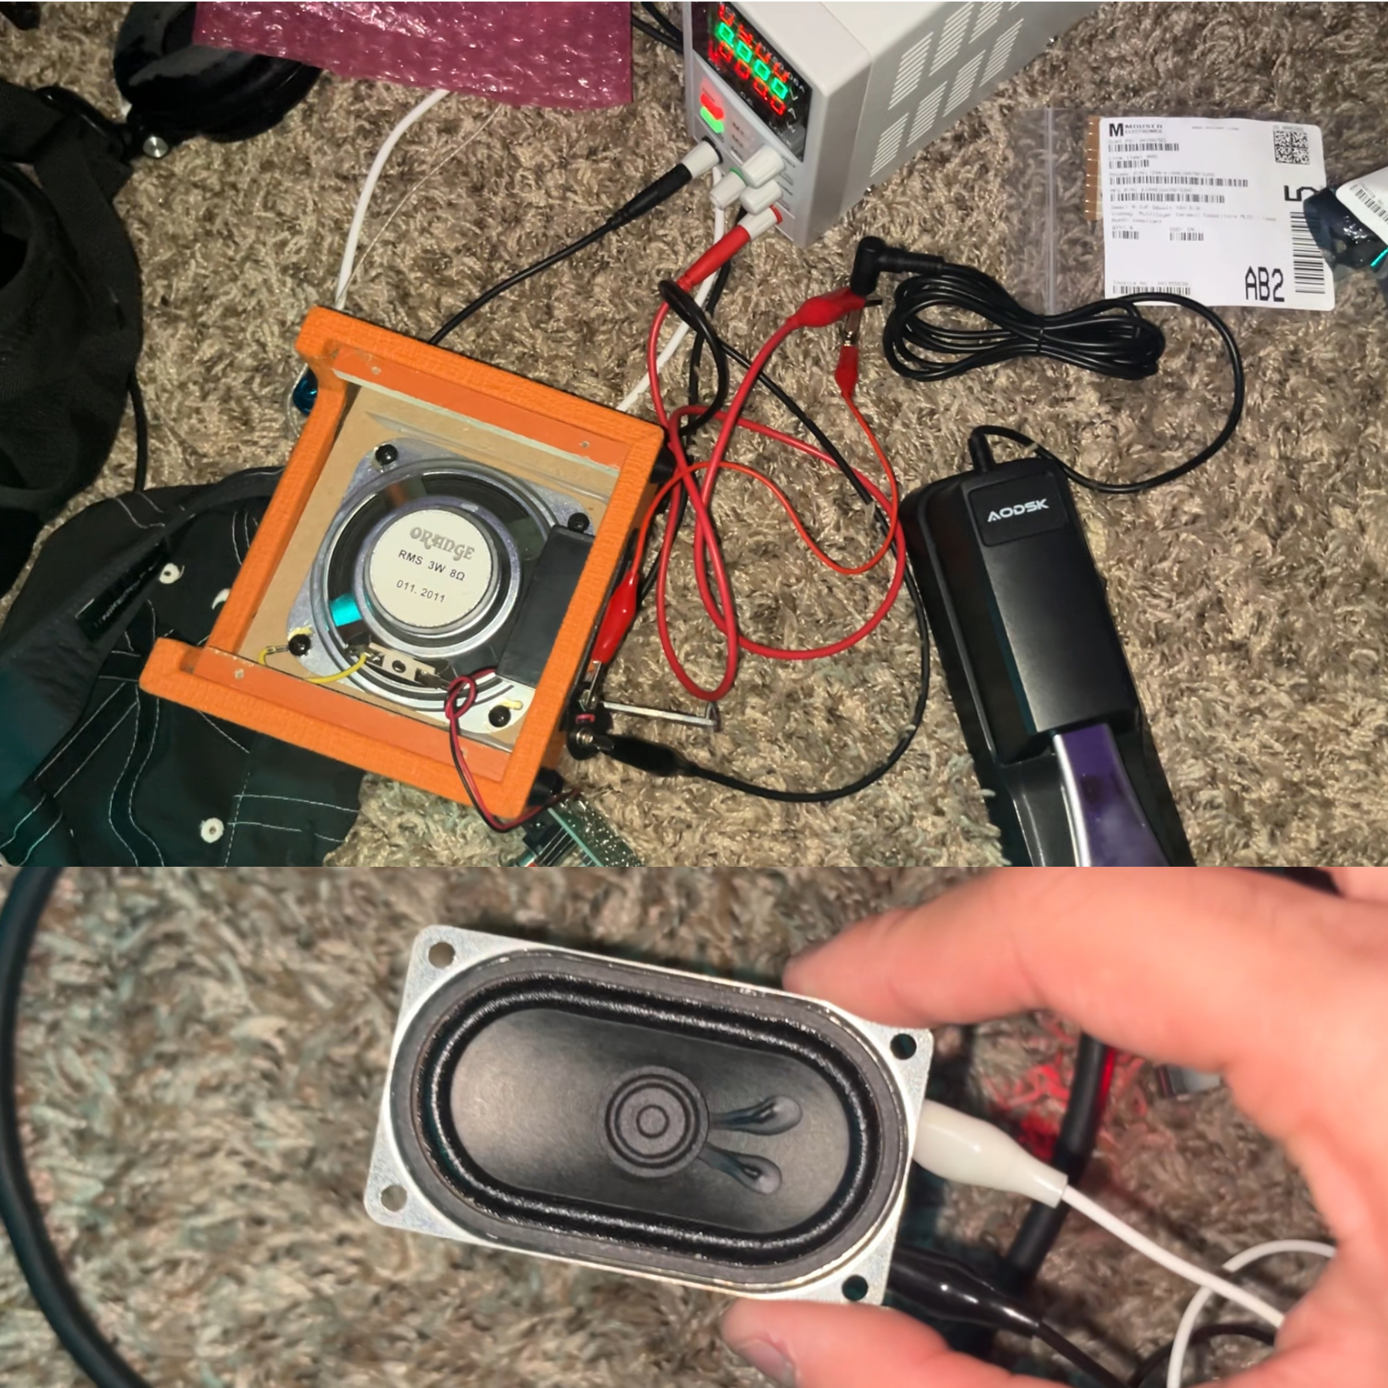
Prototypes / Pictures
Wylde Simpson
Electrical Engineering

Slide 45

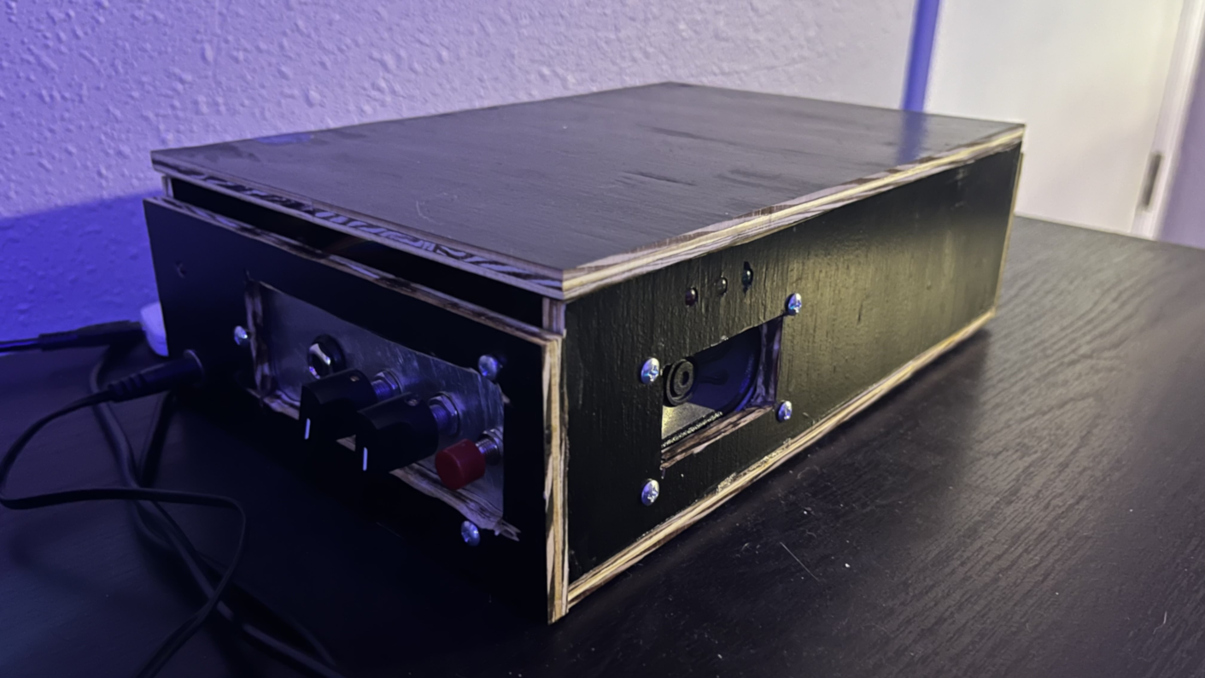
Prototypes / Pictures
Wylde Simpson
Electrical Engineering

Slide 46
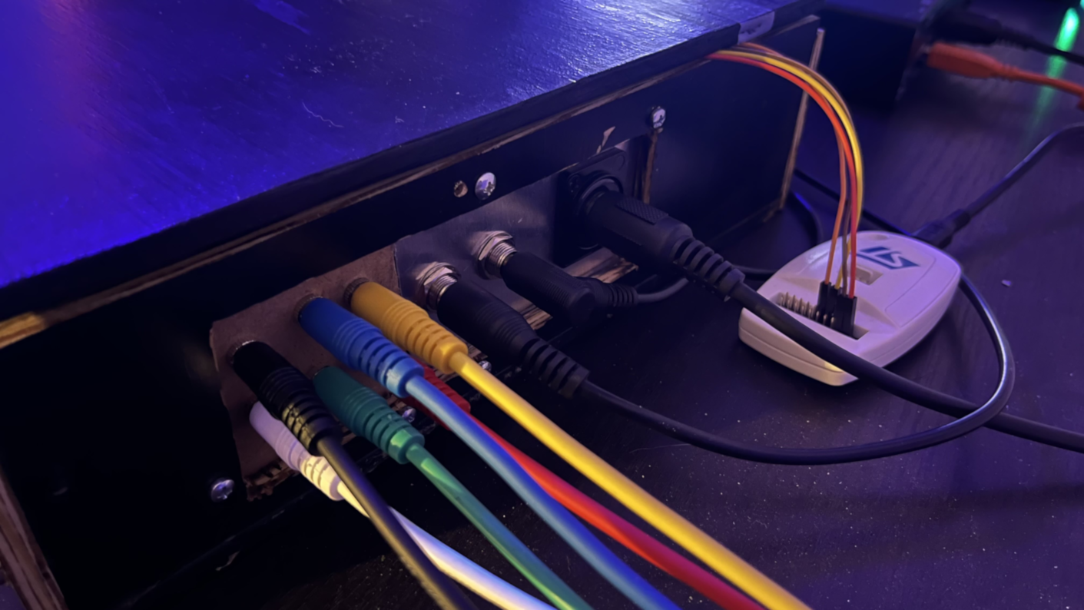
Prototypes / Pictures
Wylde Simpson
Electrical Engineering

Slide 47

Prototypes / Pictures
Wylde Simpson
Electrical Engineering

Slide 48
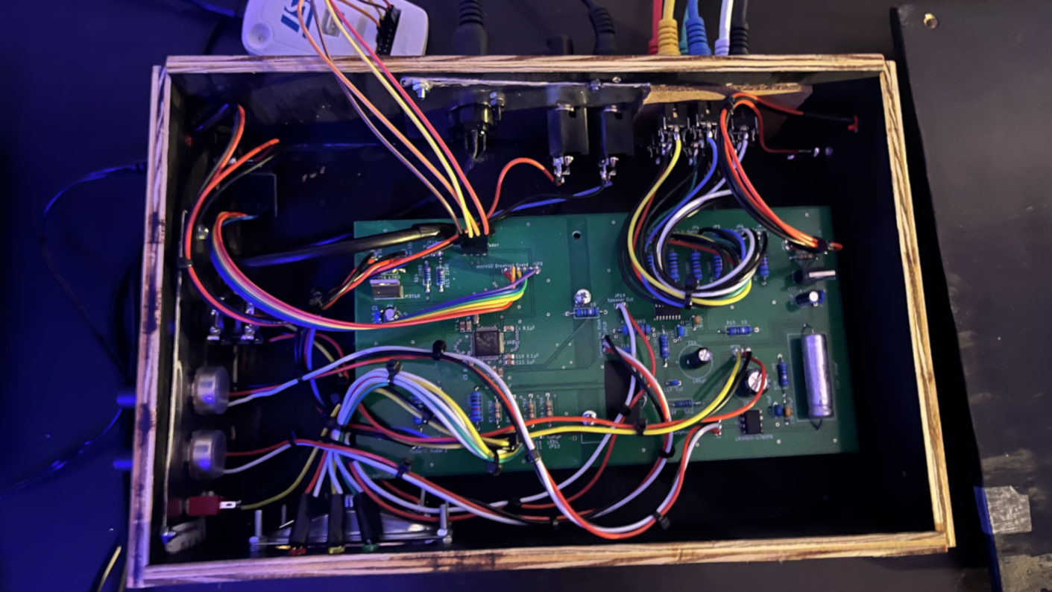
Prototypes / Pictures
Wylde Simpson
Electrical Engineering

Slide 49
Challenges
Wylde Simpson
Electrical Engineering
Unable to get stable SPI connection
Due to lack of SPI, audio playback will be moved to user’s device
Notes may actuate multiple times during one strike

Slide 50
Administrative - Budget
Wylde Simpson
Electrical Engineering
Part | Estimated Cost
PCB | $30
Microcontroller | $3
IO Jacks | $3
Main Housing | $20
Sensors | $10
Pedals | $15
Speaker | $3
Amplifier Circuitry | $3
Power Delivery Circuitry | $5
Connecting Cables | $15
Other Components (Indicators, Buttons) | $3
Storage Device | $5
Total | $115

Slide 51
Administrative - Budget
Wylde Simpson
Electrical Engineering
Component | Value | Notes | Qty. | Total Cost
Electrical Components | - | SMD/SMT & THT | 21 | $22.69
All Hardware | - | - | 19 | $56.57
Sensor | - | - | 6 | $23.70
MCU | - | SMD/SMT | 1 | $8.20
PCB | - | - | 5 | $55.97
Total |  |  |  | $167.13

Slide 52
Administrative - Work Distribution
Soufiane Louiba
Electrical Engineering
Task | Primary | Secondary
Kit Assembly and Housing Design | Wylde | Soufiane
Instrument Sensor and Housing Design | Soufiane | Wylde
Sound Library Storage | Soufiane | Jameson
Connection between Sensors and Control Board | Soufiane | Wylde
Strike Level Detection | Jameson | Wylde
Sound Library Instrument Selection | Jameson | Soufiane
Sensor Instrument Assignment | Wylde | Jameson
Sound Library Mode Switching | Jameson | Soufiane
Auxiliary port passthrough | Wylde | Soufiane
MIDI cable data path | Jameson | Wylde
Control Board PCB Layout | Wylde | Jameson
Power Supply | Soufiane | Jameson
Control Board Software | Jameson | Wylde

Slide 53
Future Plans
Jameson Palmer
Computer Engineering
Achieve function with internal speaker
Sensor debouncing
Prototype a form of Drum Pad that could be optionally added alongside the device

