Slide 1


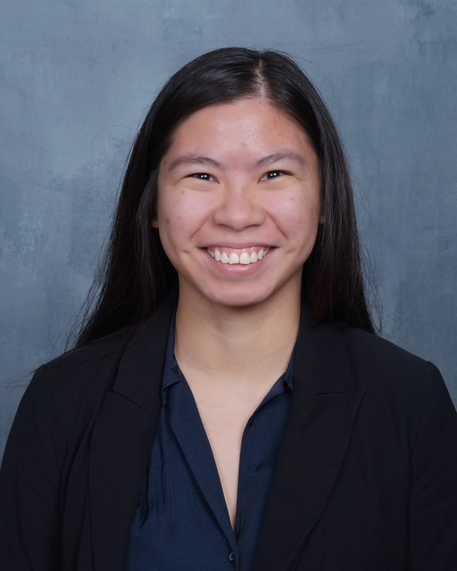
Laser Beam Characterizer
Senior Design Fall 25 – Spring 26
Group 3
Zachary Andreasen PSE & EE | Thomas Cunningham EE | Lynzie Smith CpE
Sponsor: Lockheed Martin

Slide 2
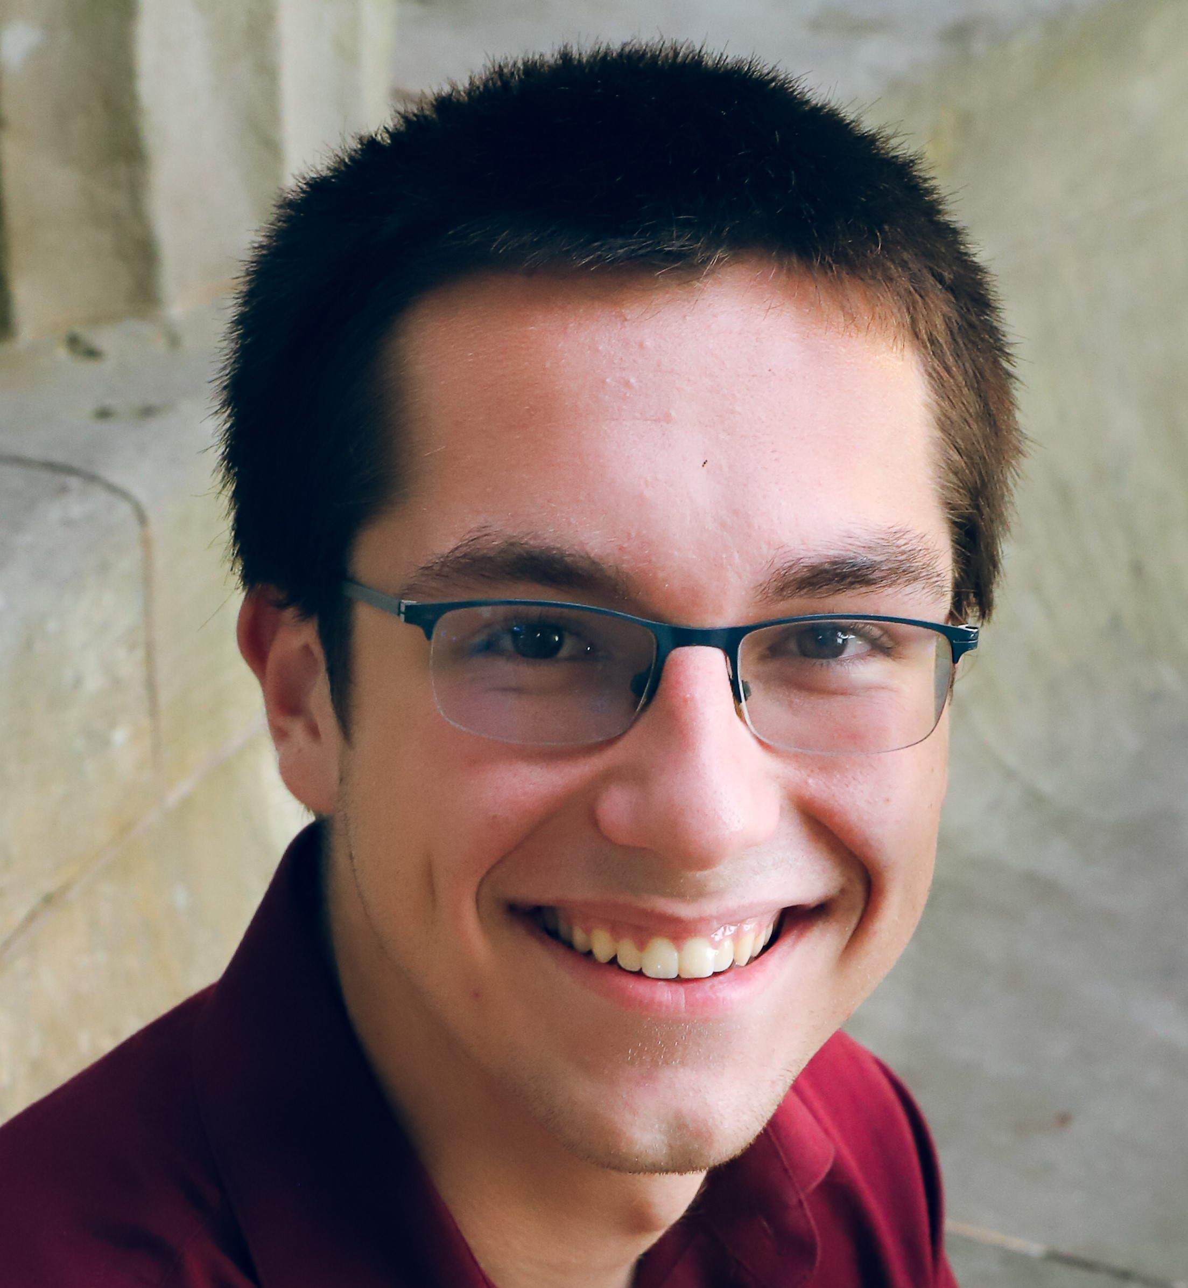
Motivation and Background
Proper characterization of a laser is necessary in any laser application
Model matching important for sponsor’s applications
Need to know as many properties of laser as possible
  Wavelength
  Polarization
  Divergence
  Beam Quality

Slide 3
Basic Goals and Objectives
Goal | Objective | Goal | Objective
Measure Polarization | Motorized Quarter Waveplate with Fixed Linear Polarizer | Light Weight | System under 30 lbs.
Measure Wavelength | Michelson Interferometer with Photodiode Detector | Under Budget | Coordinate with Sponsor and follow BOM
Measure Divergence | Location control for Focal Point of Lens | Easy to Use | Alignment Irises and user-friendly interface
Measure M² factor | Long Focal Length Lens with Scanning Slit Detector

Slide 4
Advanced Goals and Objectives
Goal | Objective
Broad Range of Input Powers | Ensure Optics meet power spec
 | Implement Removable ND filter
Broad Range of Input Beam Sizes | Minimum 40 mm clear aperture on all necessary optics
Ability to detect errors in measurements | Implement checks in data processing

Slide 5
Stretch Goals and Objectives
Goal | Objective
Broad Range of Input Wavelengths | Achromatic Components
 | Use wavelength measurement to adjust measurements when needed
Measure Waist Size and Location | Use M² factor data to calculate waist information
Allow for pulsed lasers | Scan slits fast enough
Report beam wavelength and polarization data live | Time measurement with PC communication properly

Slide 6
Engineering System Specifications
Input Beam Parameters
Parameter | Value | Units
Wavelength | 1.2 – 2.1 | µm
Maximum Power | 1 – 10 | W
Minimum Power | 1 – 50 | mW
Beam Diameter | 4 – 35 | mm
Measurement Parameters
Parameter | Value | Units
Normalized Stokes Parameters | ±0.05 for all Parameters | N/A
Wavelength | ±10 | nm
M² factor | ±0.1 | N/A
Beam Divergence | ±10 | µrad
Total Power | < 5 | % Error

Slide 7
Work Distribution
Photonics Engineering | Responsibilities
Zachary Andreasen | Project Lead Optical Alignment Polarimeter, Michelson, M² System Design Photodiode Selection
Electrical Engineering | Responsibilities
Tee Cunningham | MCU Selection + Design Motor/Motor Driver Selection + Design Power Supply Design
Zachary Andreasen | Michelson TIA Design Power Meter Variable TIA Design
Computer Engineering | Responsibilities
Lynzie Smith | GUI Software architecture + Implementation Serial Communication Integration STM32 Firmware Website Design

Slide 8
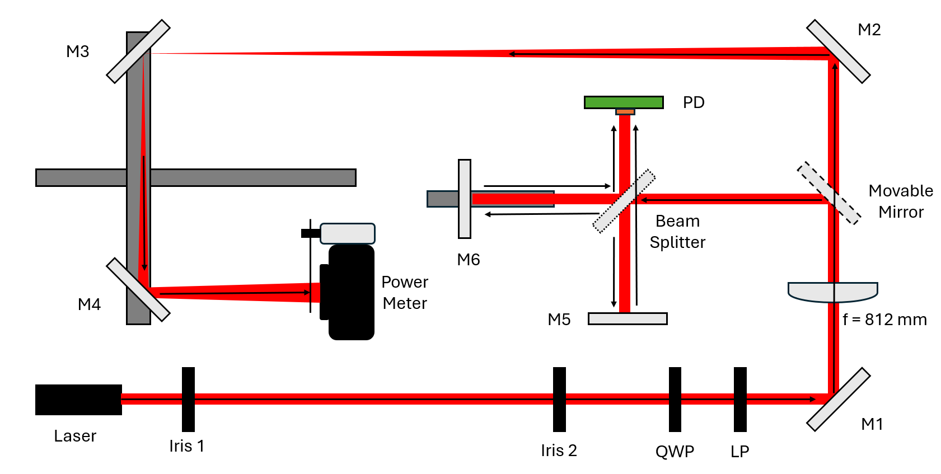
Hardware Design: Optics

Slide 9
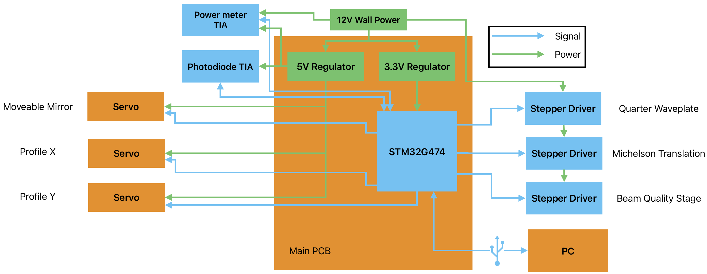
Block Diagram

Slide 10
Software Comparison and Selection: STM32 programming languages
Language | Real-time/Determinism | Hardware Access | Speed/DSP Suitability
Embedded C | Highest | Full | Highest
C++ | High | Full | High
MicroPython | Low | Limited | Low-Moderate
Arduino-style C++ | Moderate | Moderate | Moderate

Slide 11
Software Comparison: GUI Framework
Framework | Performance | Scientific Visualization | Ease of Development
PySide6 (Qt) | High | Excellent | High
PyQt5 | High | Excellent | Moderate
Tkinter | Low-Moderate | Basic plotting only | Very easy
Electron (JS) | Moderate | Good (web charts) | Moderate

Slide 12
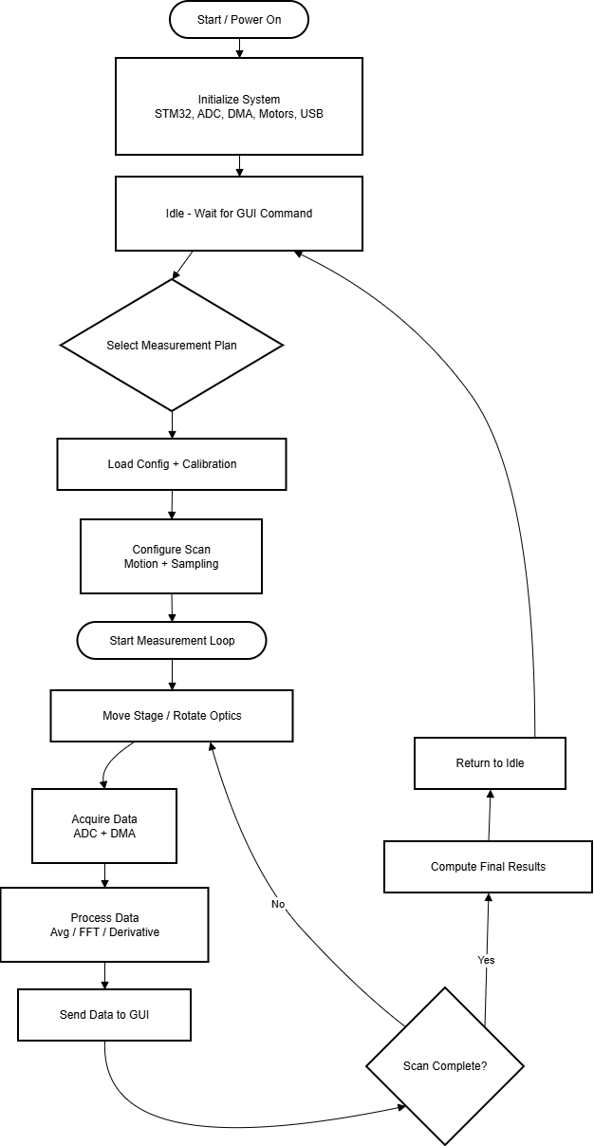
Software Design:
Embedded Software
System initializes STM32 peripherals (ADC, DMA, timers, motors, USB)
Firmware waits for measurement plan selection from GUI
Selected plan configures scan parameters and calibration
Closed-loop measurement process:
  Motion control (stages/optics)
  Sensor data acquisition (ADC + DMA)
  Real-time signal processing
Processed data is streamed to GUI for visualization
Final beam parameters computed and system returns to idle

Slide 13
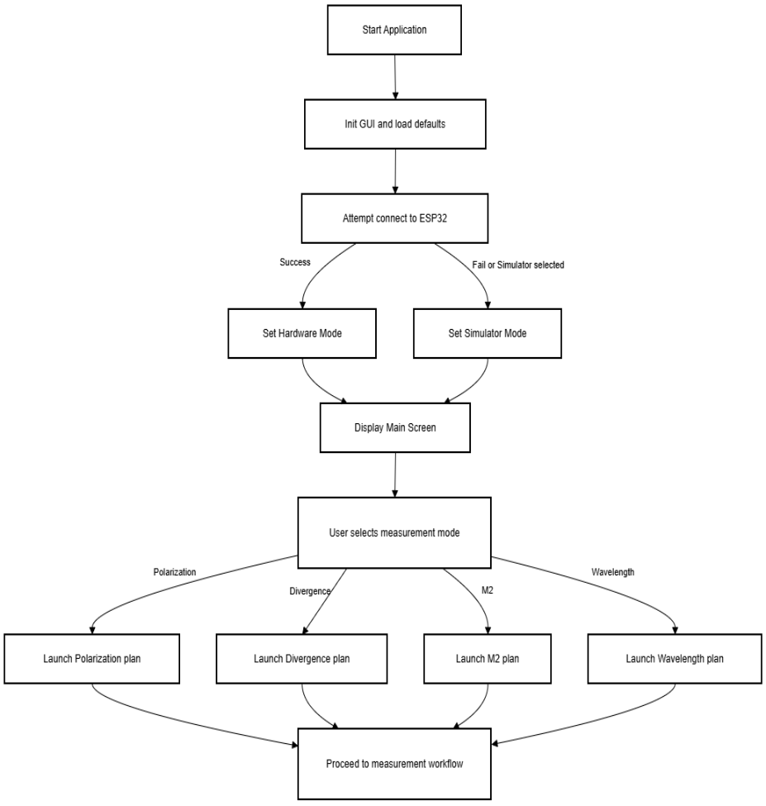
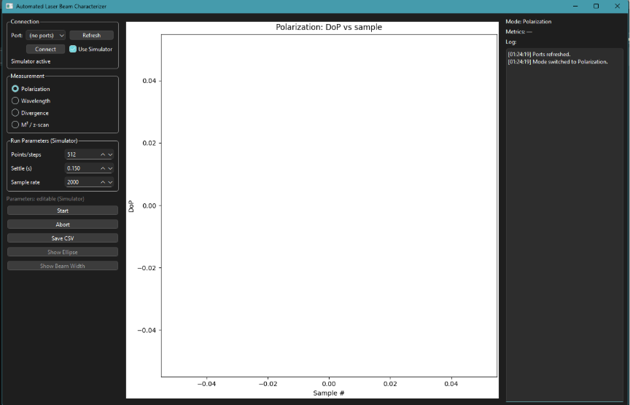
Software Design:
Graphical User Interface

Slide 14
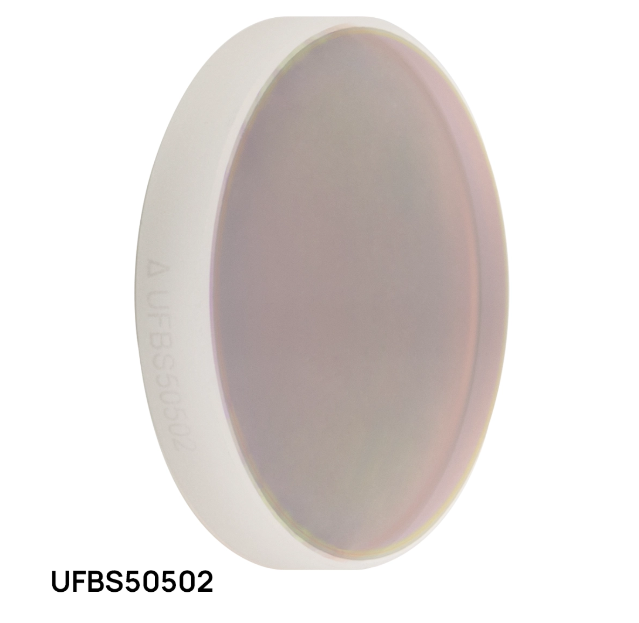
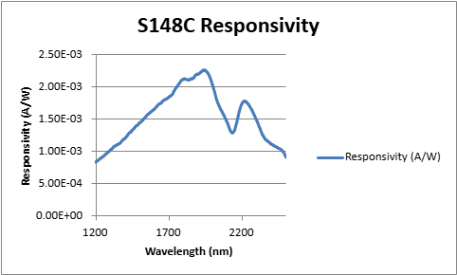
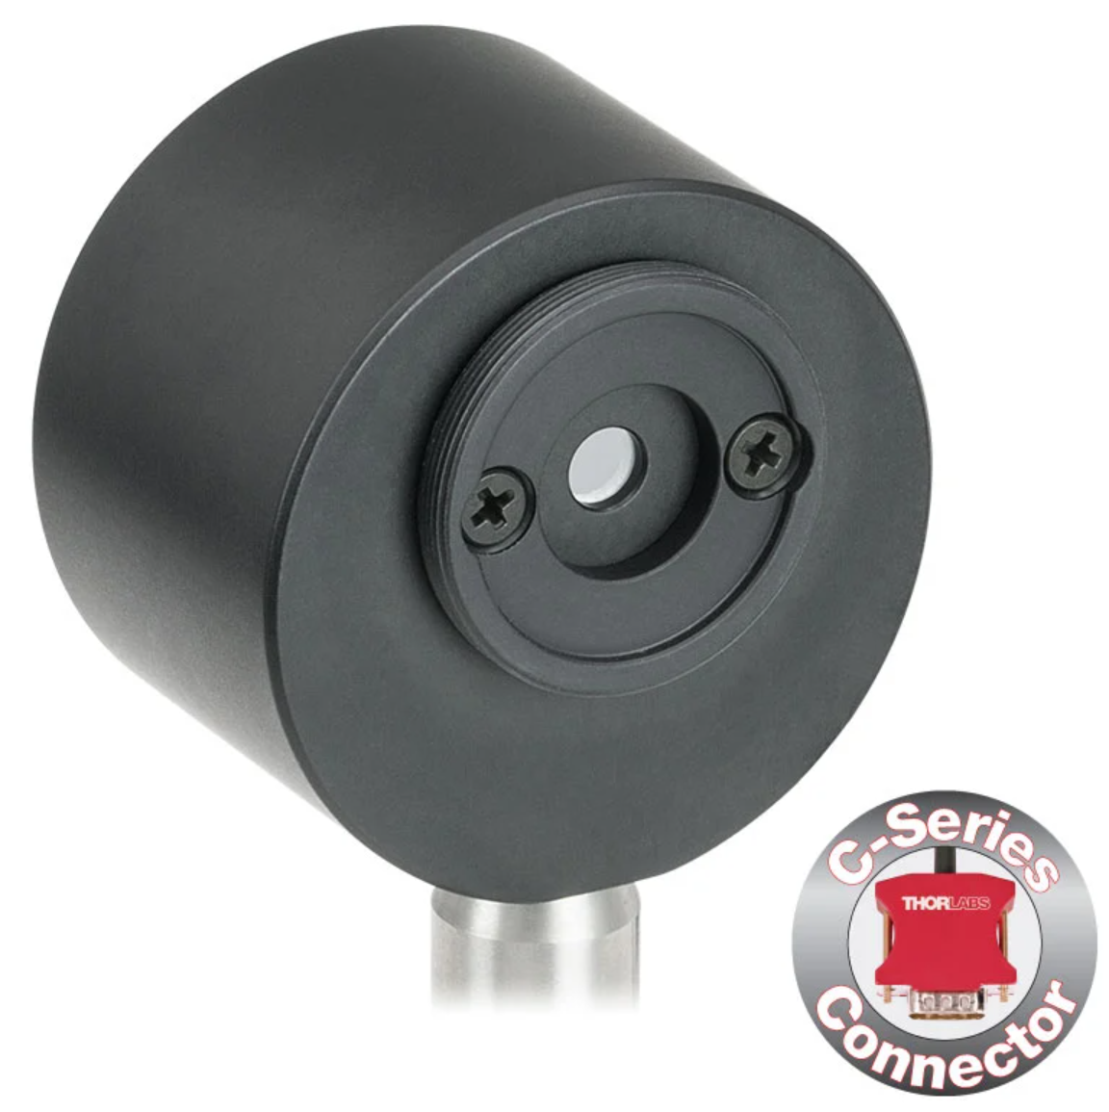
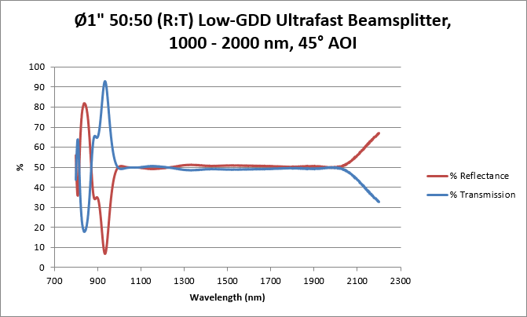
Hardware Selection: Optics

Slide 15
Hardware Selection: Microcontroller
Important features of microcontroller compared
Feature | STM32 | ESP32
Reliable ADC | Known for linearity 16-24 ADC channels across 2-3 ADCs Flexible DMA | Struggles with noise 18 ADC channels across 2 ADCs DMA via digital control
Robust Motor Driving | Many GPIO with advanced timers Native software support | Less advanced timers Community libraries available for motor driving
USB Support | Native and robust | Included + drivers required
Additional Perks | Industry standard microcontroller family | Many native wireless communications

Slide 16
Hardware Selection: Motors and Drivers
Motor Technology | Pros | Cons | Desired for application
 |  |  | QWP Rotation | Linear Translation | Beam Profiling | Mirror Switching
Stepper | Precise angle stepping | Getting absolute position
Servo | Precise absolute angle | Limited range
Brushed DC | Constant speed | No position control without feedback
Brushless DC | Constant speed and high torque | "

Slide 17
Hardware Selection: Power
The project will be powered by a 12V 5A DC wall adapter
The 12V rail will be split into 5V and 3.3V for the following components
We have chosen LM2679-3.3V and 5.0V due to their ease of use, good efficiency, and high current output.
3.3V STM32 (200µA) | 5V Power meter TIA (70µA) Photodiode TIA (70µA) Servo motors (10-50mA) | 12V Stepper motors (0.3-1.5A) Power meter switch (1mA)

Slide 18
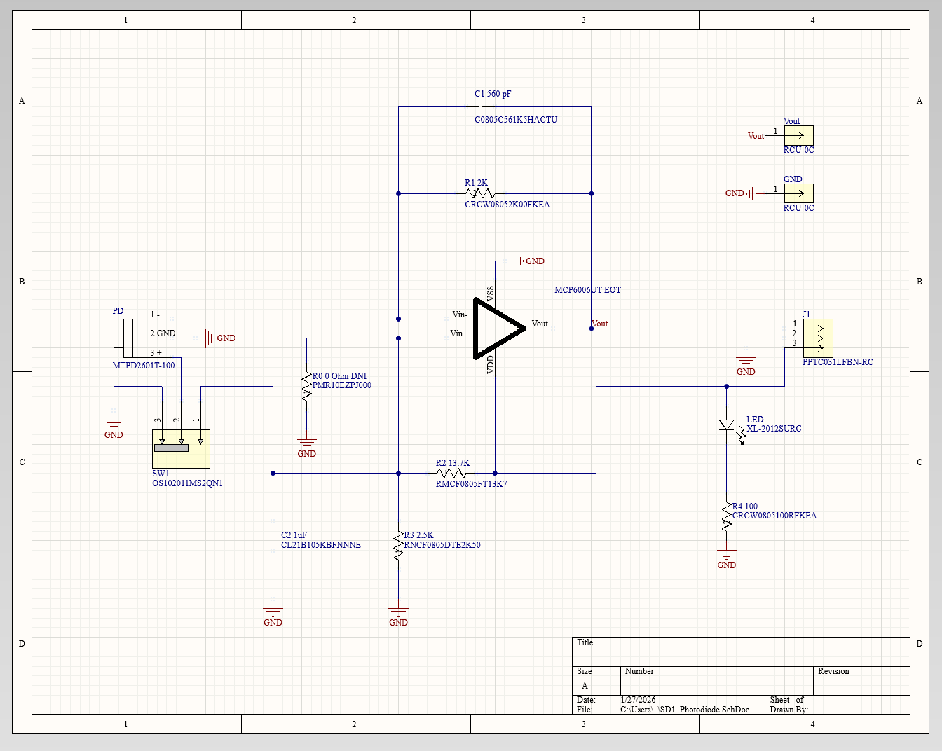
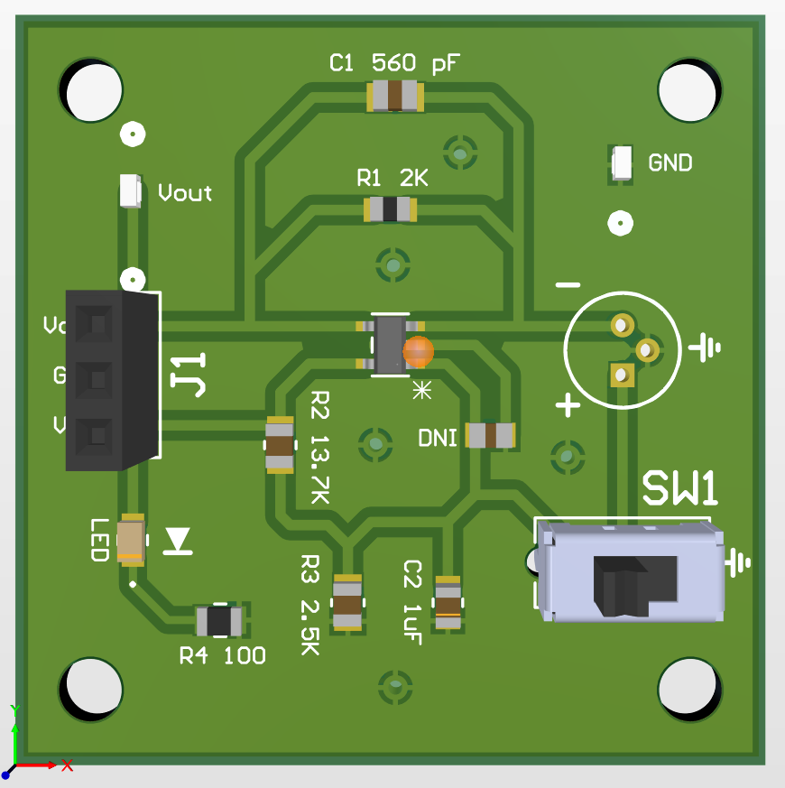
PCB Design: Photodiode TIA

Slide 19
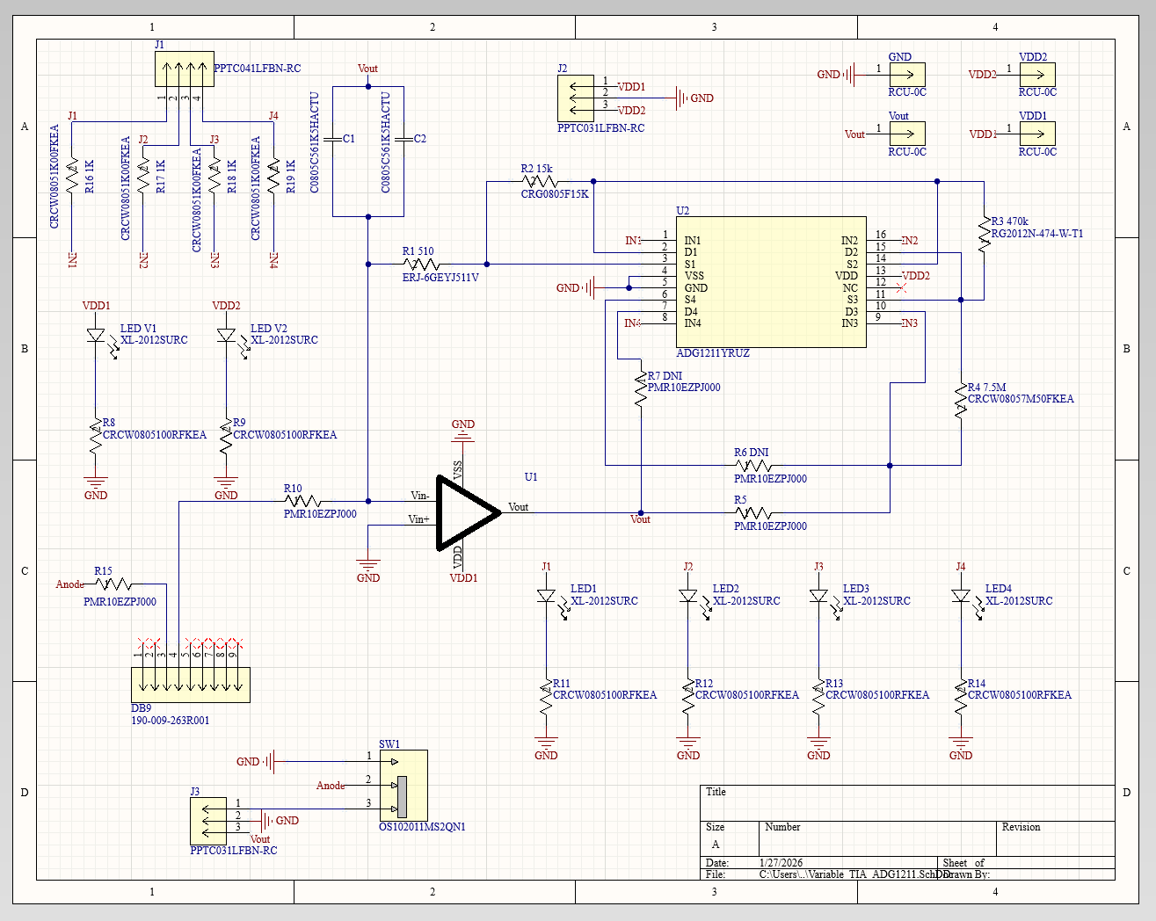
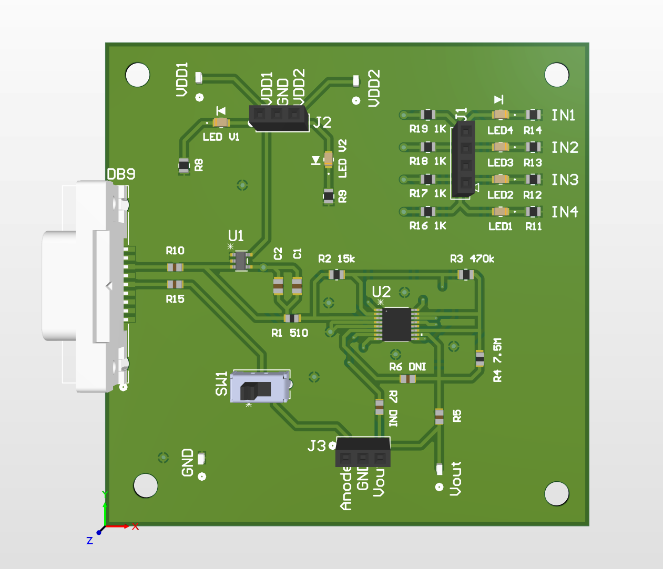
PCB Design: Variable TIA

Slide 20
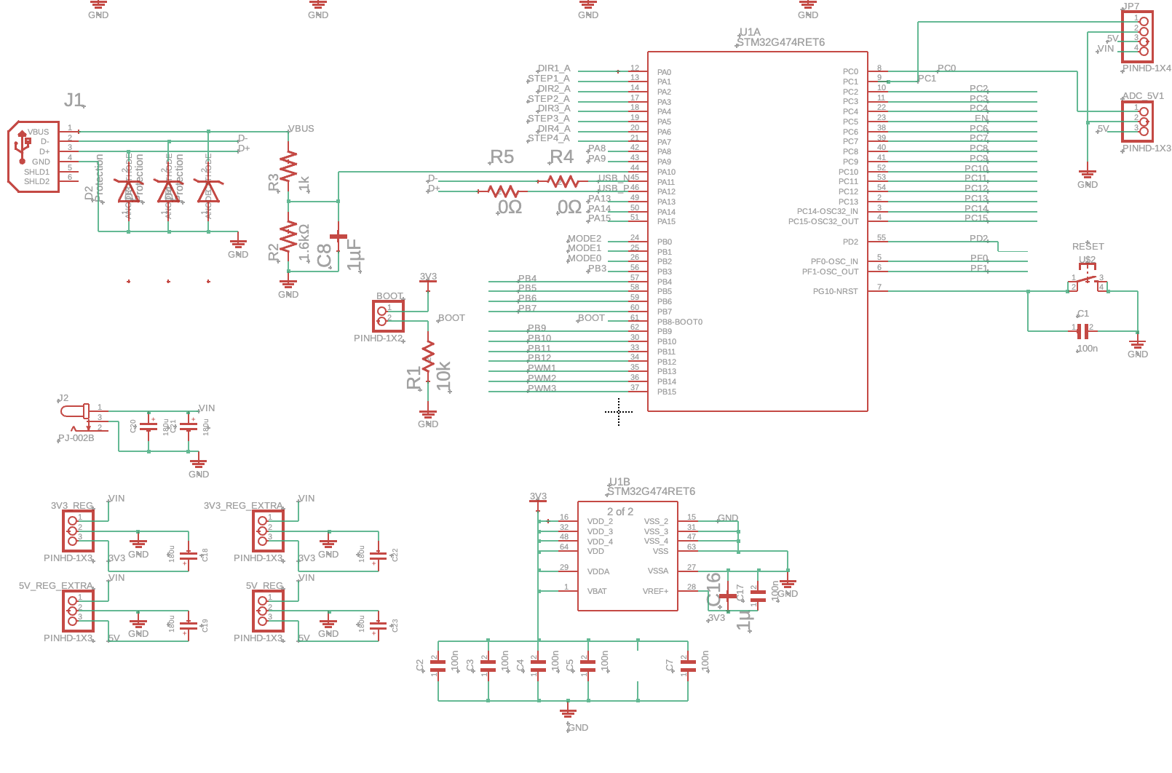
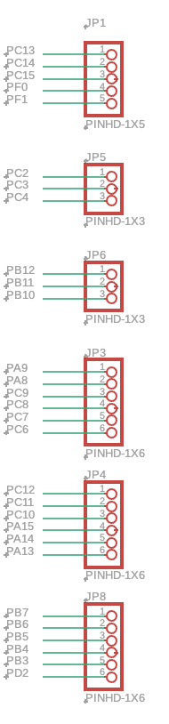
PCB Design: Microcontroller

Slide 21
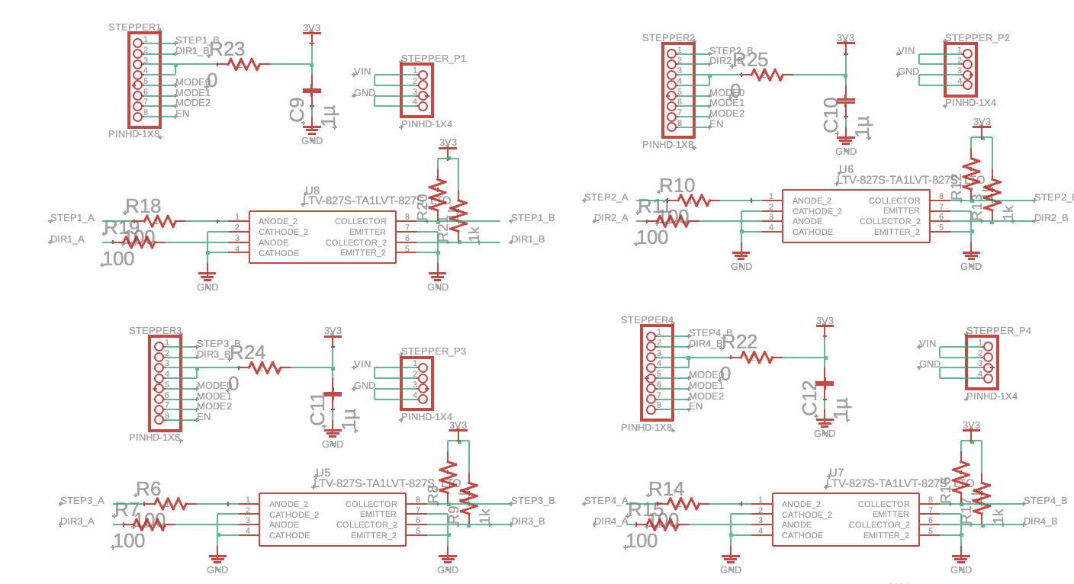
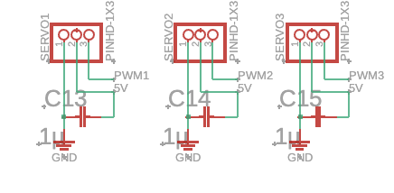
PCB Design: Microcontroller (cont.)

Slide 22
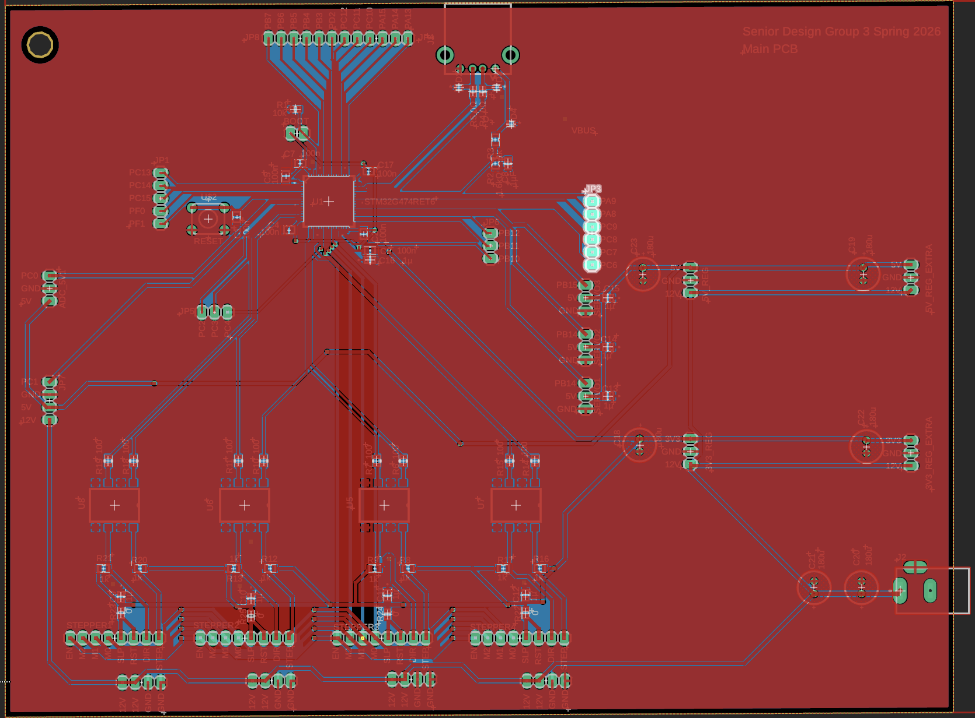
PCB Design: Microcontroller (cont.)

Slide 23
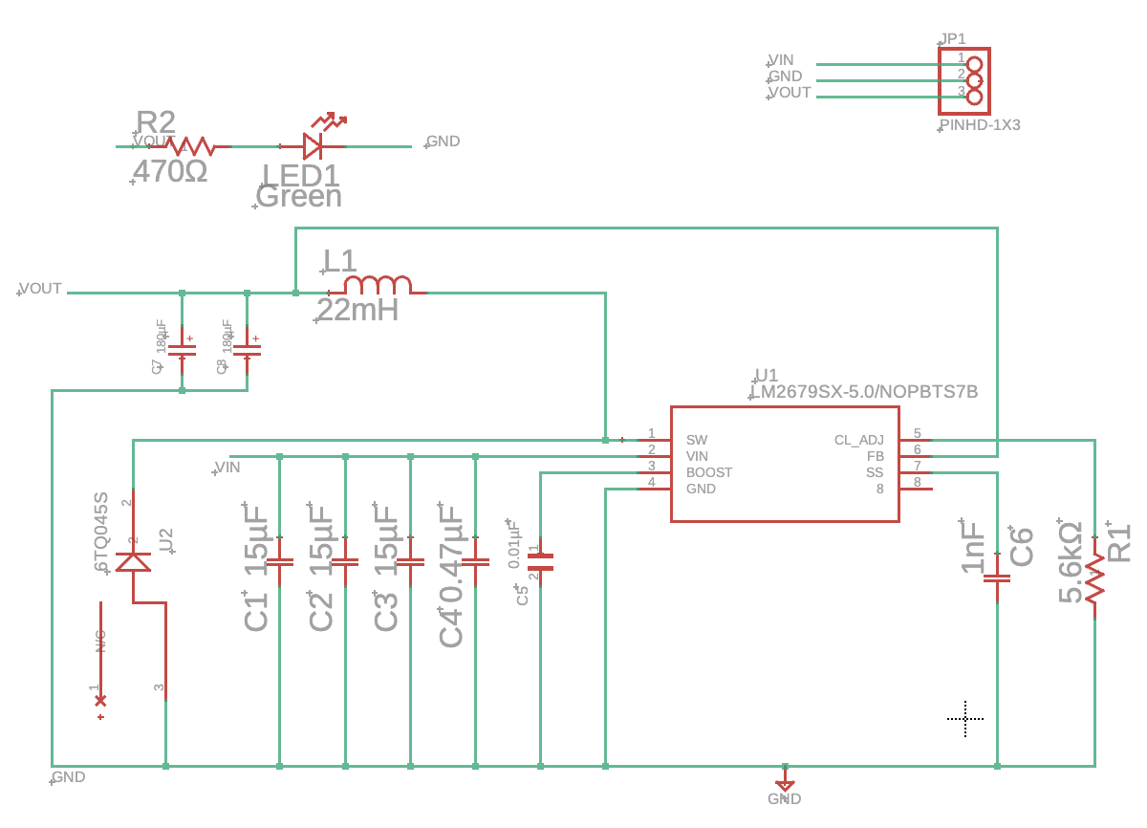
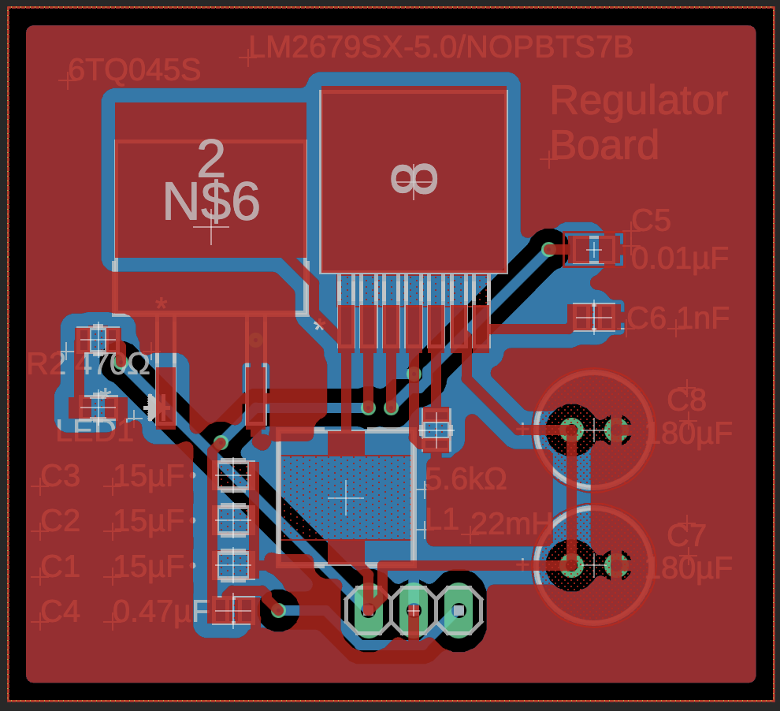
PCB Design: Regulators

Slide 24
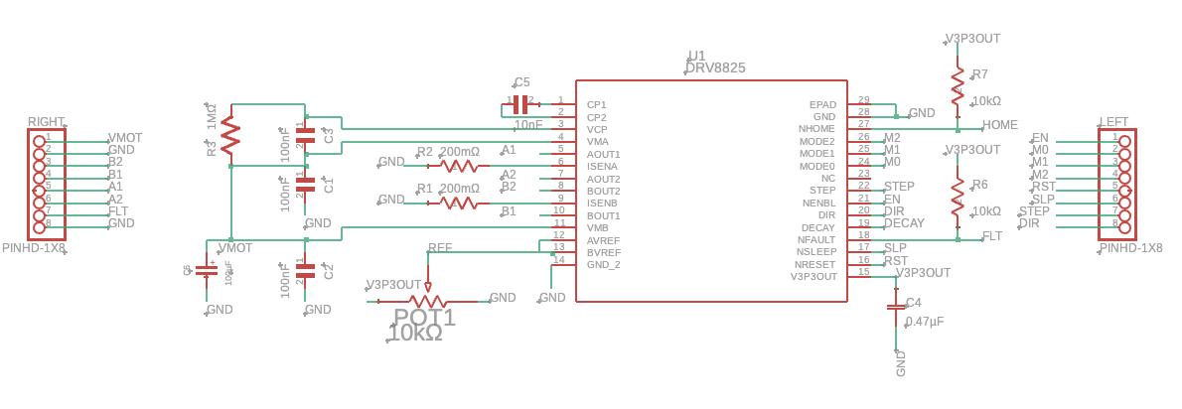
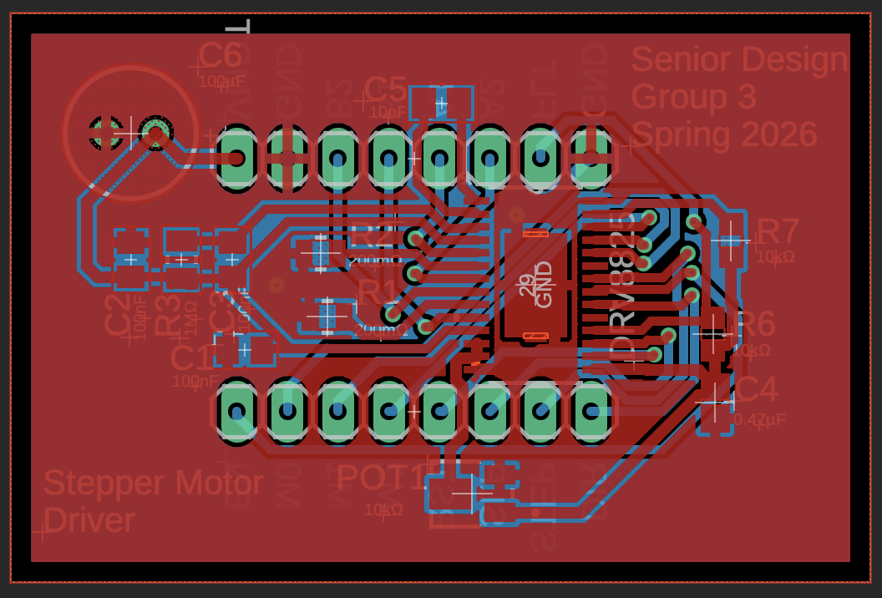
PCB Design: Stepper Motor Drivers

Slide 25
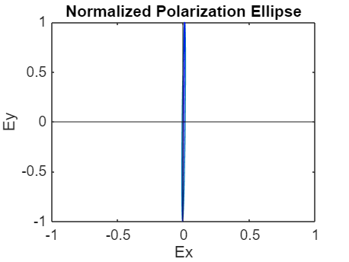
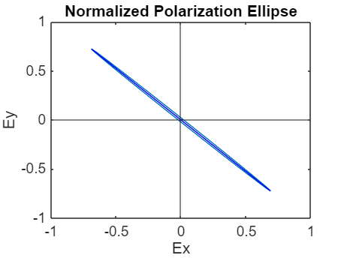
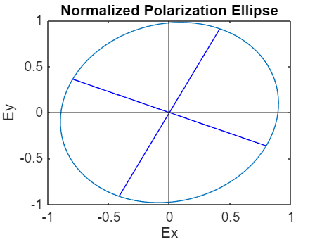
Polarimeter Testing
Vertical Polarization
45-degree Polarization
Circular Polarization

Slide 26
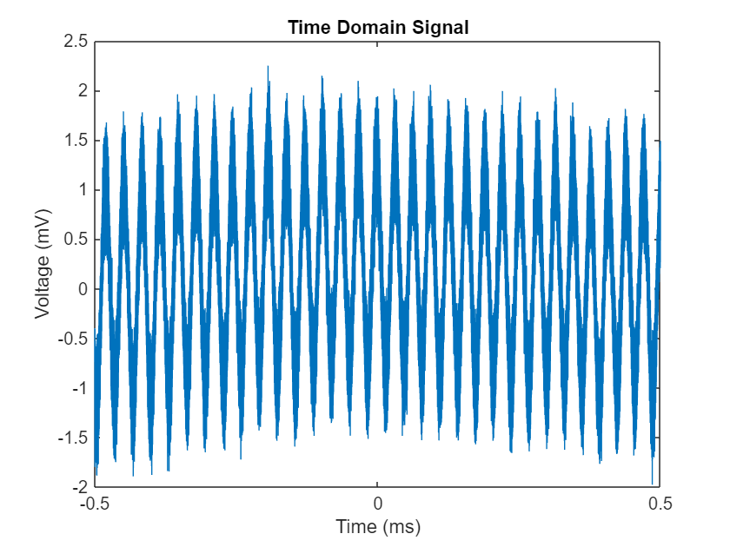
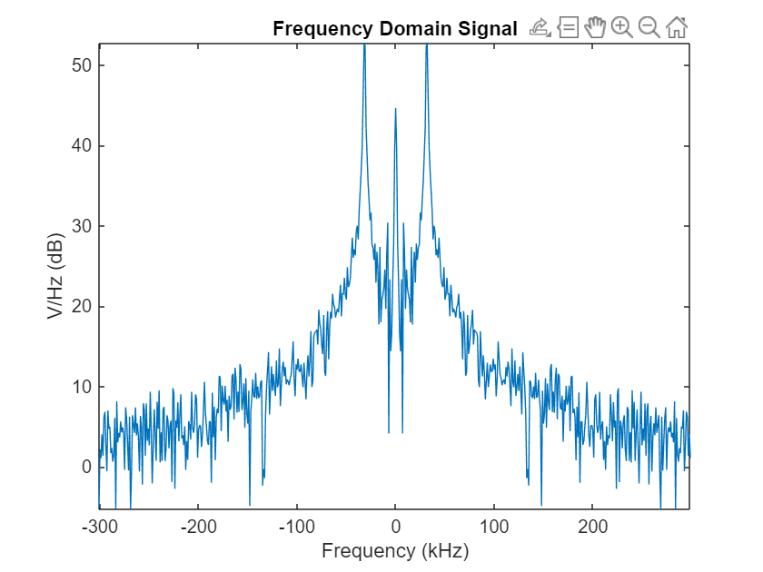
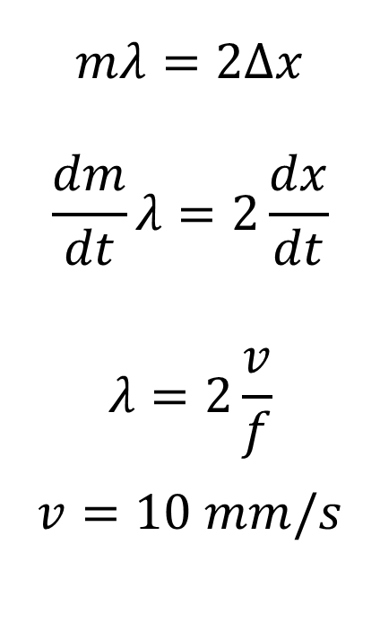
Interferometer Testing
$$mλ=2Δx$$
$$\frac{dm}{dt}λ=2\frac{dx}{dt}$$
$$λ=2\frac{v}{f}$$
$$v=10 mm/s$$
Data Results
Sampling Frequency | 1.25 GS/s | 1.25 MS/s | 125 kS/s | 62.5 kS/s
Avg. Max Frequency | 31.6 kHz | 31.6 kHz | 31.7 kHz | 30.6 kHz
Calculated Wavelength | 632.9 nm | 632.9 nm | 630.9 nm | 654.7 nm

Slide 27
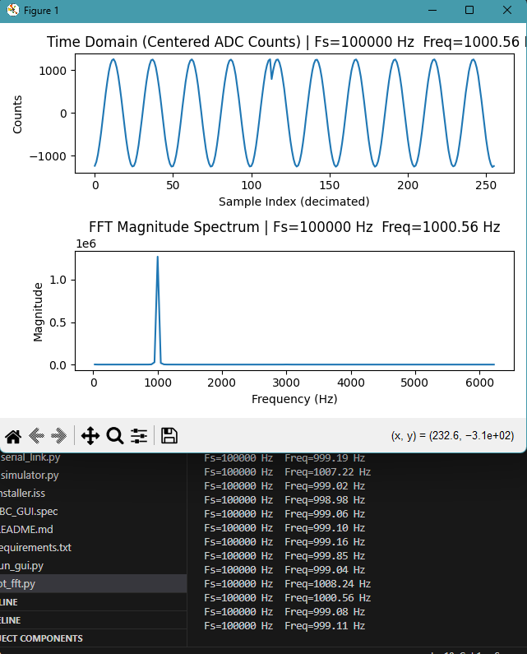
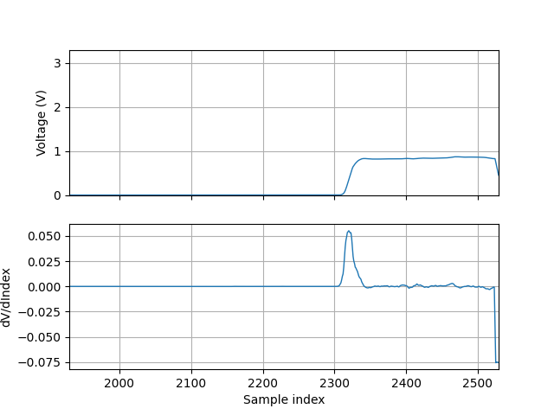
STM32 ADC Functionality

Slide 28
Administrative Content
BOM | Component | Quantity | Cost
Optics | QWP | 1 | 550
 | Lin. Pol. | 1 | 2000
 | Power Meter | 1 | 1050
 | Mirrors | 6 | 480
 | Beam Splitter | 1 | 380
 | Lens | 1 | 380
 | ND Filters | 3 | 225
Electrical | PCBs | 5 | 500
 | Steppers | 3 | 160
 | Servos | 3 | 30
Mechanical | Baseplate | 1 | 700
 | Mounts | 10 | 460
 |  | Budget | 7000
 |  | Total | 6915

Slide 29
Progress and Future Plans
Hardware Integration
  Receive remaining hardware
  Build/Test PCBs
  Set up and align optical layout
System Test
  Confirm STM32 ADC functionality with integrated setup
  Confirm motor control accuracy (Concern with QWP stepper)
  Implement system measurement procedures
Sensor Calibration
  Power Meter TIA for accurate voltage-power transfer function
  QWP rotation to accurate angle-power correlation
  Michelson mirror motion and photodiode-TIA frequency response

