Slide 1

Automated Lens Metrology
Lens in, Datasheet out.

Slide 2
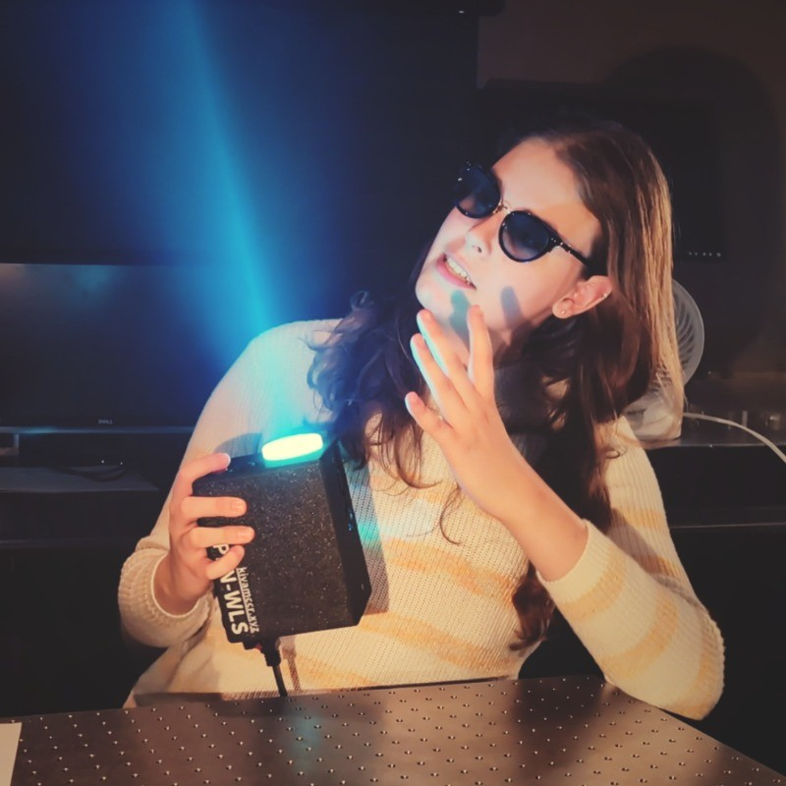

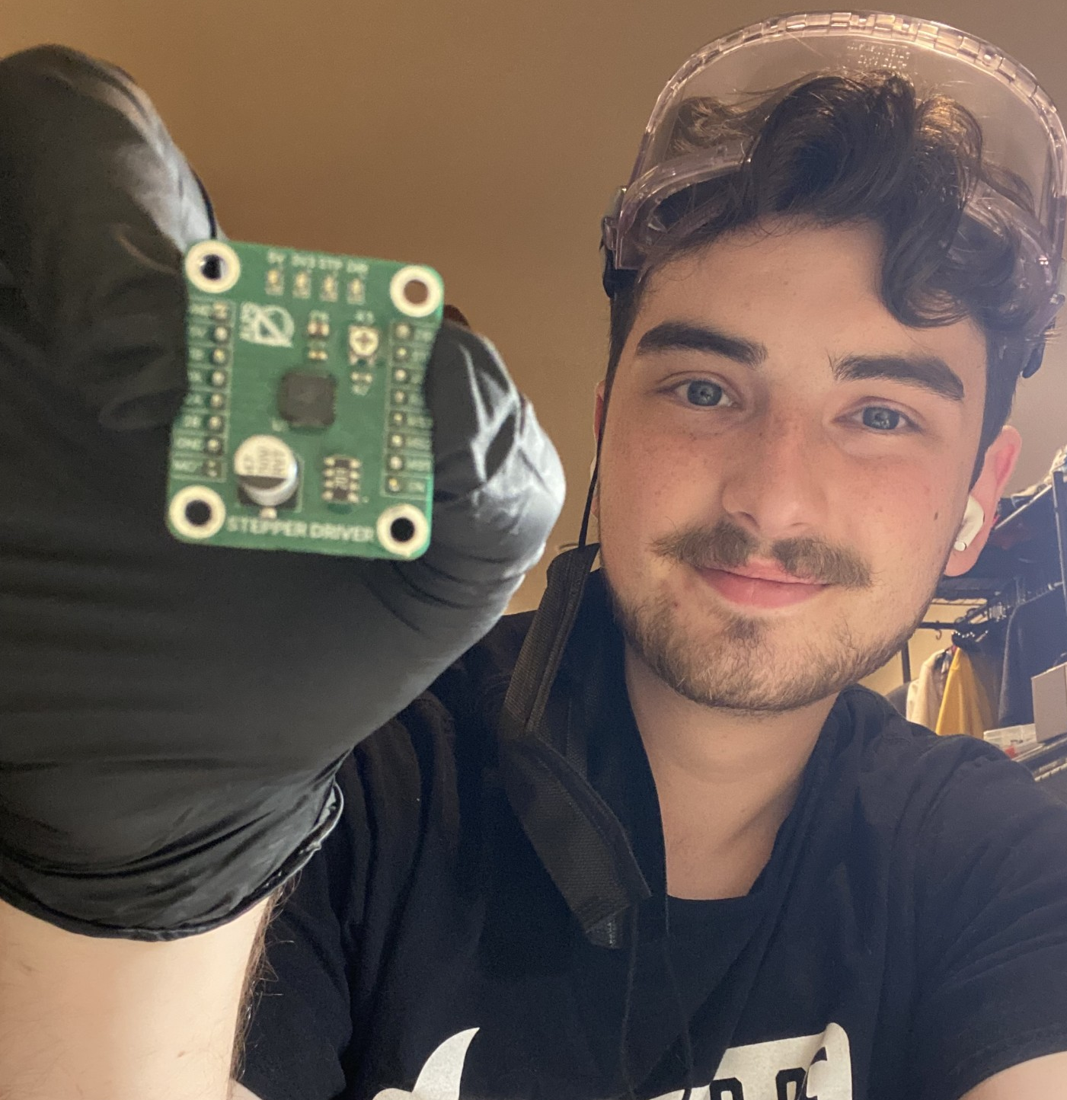

Illumination & Processing
Lead
Spectral
Processing
Lead
PCB & Electrical
Lead
Integration &
Software
Lead
Kiva
McCracken
(PSE)
Ollie
Mueller
(PSE)
Zachary Kassner
(EE)
Daniel
Gomez
(CpE)

Slide 3
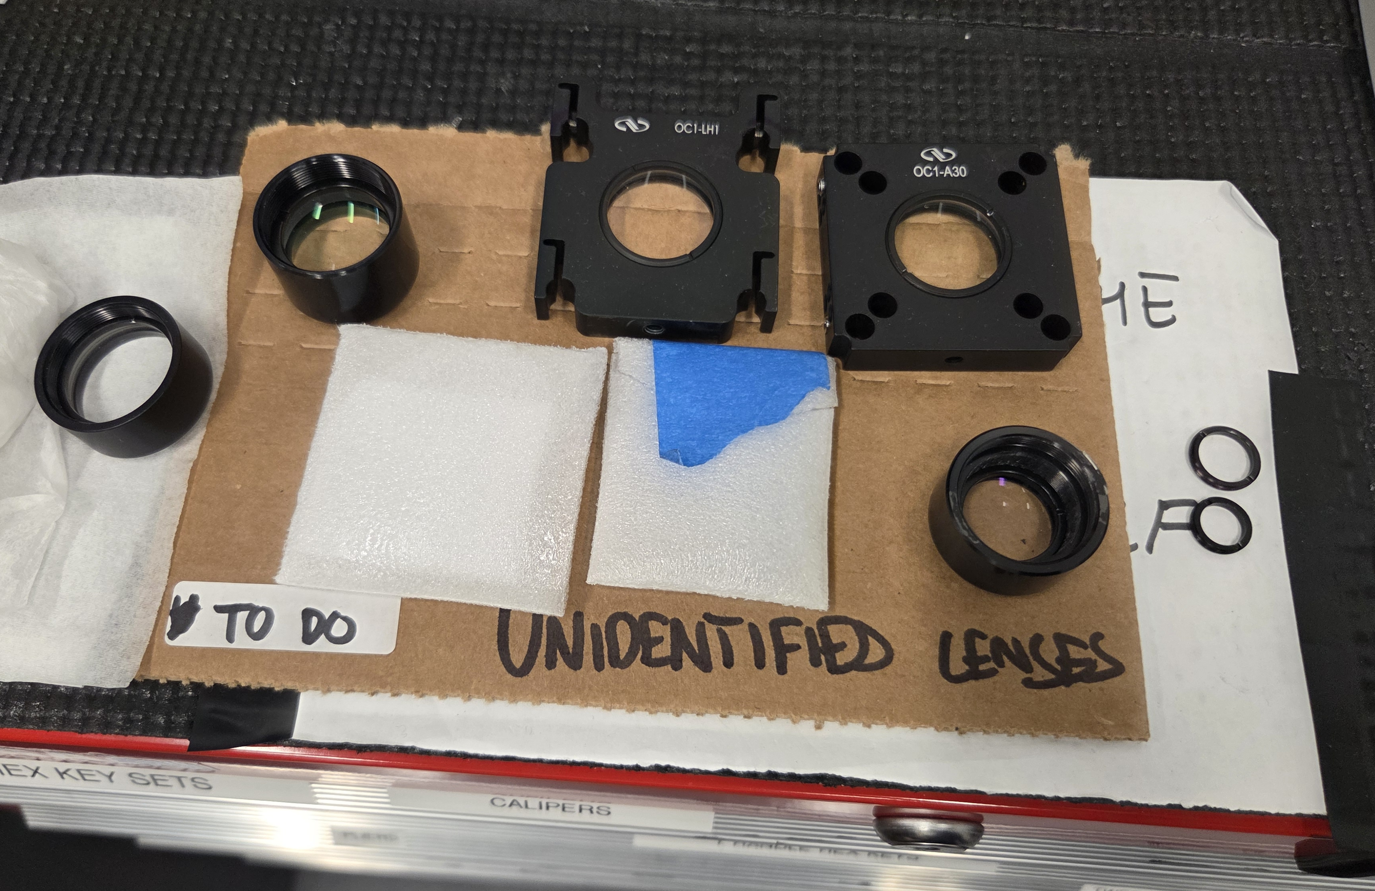
Motivation & Background
Notes:
Optical laboratories suffer from a chronic lens organization issue. Specifically, it is hard to label and keep track of lenses that perform vastly different tasks because they tend to look very similar. As a result, there are tens of thousands of dollars of unsorted optics in our department that are not utilized effectively.
As optical engineers, many of us have experienced this problem first-hand. A typical sight in our labs is a teaching assistant standing over a set of lenses to compare their focal lengths by the naked eye alone. This is an imprecise and time-consuming sorting method that is not suitable for research. Our design project aims to remedy this issue by autonomously creating a comprehensive datasheet for a given test lens. This design’s intended users are students, researchers, and professors in a lab setting.
The lens metrology systems currently available are generally geared towards production and high-accuracy single data point measurement. Our system serves as a middle ground, providing researchers with data they otherwise might not have about their lenses in a timely and convenient manner. It is designed to work on a macroscopic scale, listing lens characteristics rather than data on quality control.

Slide 4
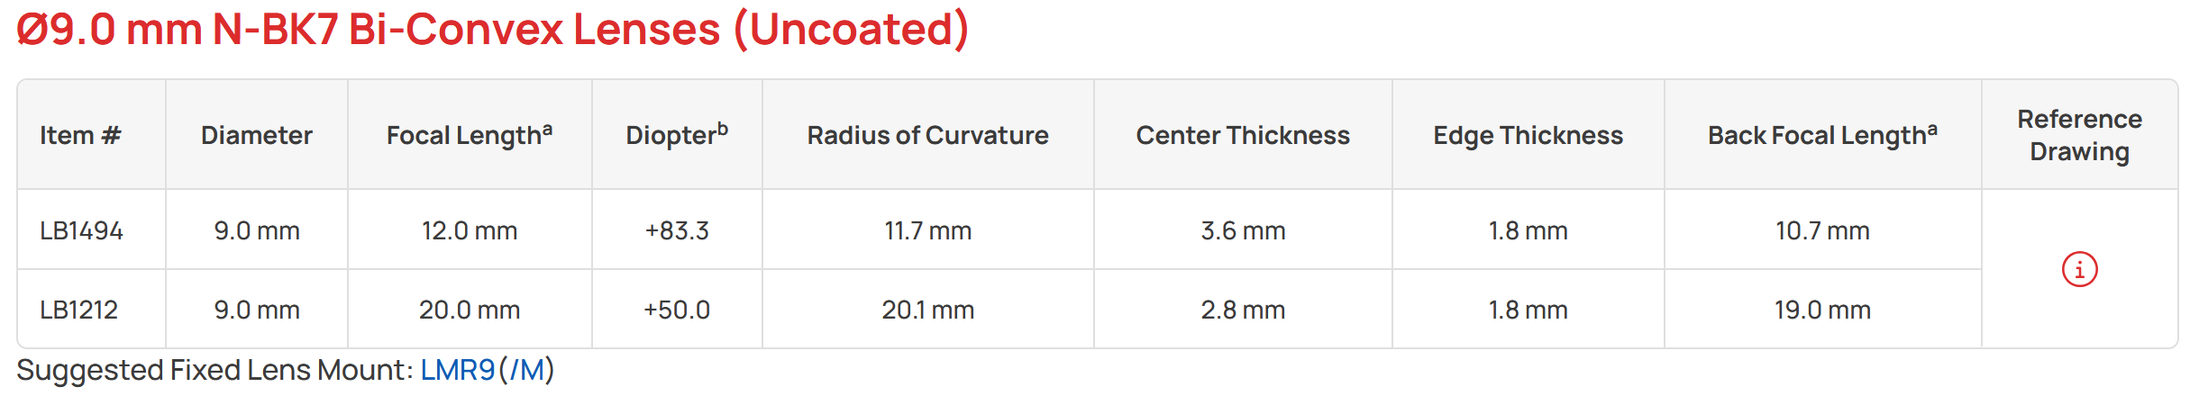
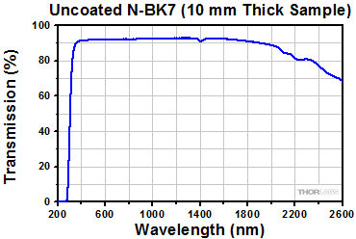
Sample Datasheets
Industry (Thorlabs)
Ours
Notes:
Typical datasheets in the optics industry take the form of tables detailing the geometric and optical data of a particular lens. While some datasheets are more thorough than
others, most include specifications for diameter, focal length, index of refraction, radii of curvature, lens material, coating, and Abbe number. Many also provide a transmission or reflection graph over the visible spectrum.

Slide 5
Goals & Objectives
 | Goals | Objectives
Basic | Measure focal length Measure transmissive and reflective spectra Measure geometry | WLS built WLS collimated Single monochromator IAS records an image
Advanced | Data output in plain text format Data output recoverable via flash drive | Calculate optical values based on measured geometry
Stretch | System graphical touch interface Data output in a PDF Data output recoverable via QR code Lens product number estimation | Lens product catalog lookup algorithm
Notes:
2.32 Basic Goals
• The system will measure the focal length of the test lens.
• The system will measure the transmissive and reflective spectra of the test lens.
• The system will manually measure the test lens’ geometric features.
2.33 Basic Objectives
• The white light source will be built.
• The white light source will be collimated.
• The wavelength selection will be done by a single monochromator.
• The image acquisition system will record an image.
2.34 Advanced Goals
• The data produced by the system will be output in a plain text format.
• The data produced by the system will be recoverable with a flash drive.
2.35 Advanced Objectives
• The wavelength selection will be done by a double monochromator.
• The system will derive optical values from the measured geometry.
2.36 Stretch Goals
• The system will have a graphical touch interface.
• The system will generate a datasheet as a PDF.
• The datasheet output by the system will be accessible by QR code or printed
document.
• The code will estimate the test lens’ product number by comparing the specs to a
known product database

Slide 6

Hardware design / Overview
Zachary
Kassner
Show the overall block diagram

Slide 7
Optical Design Overview

Slide 8
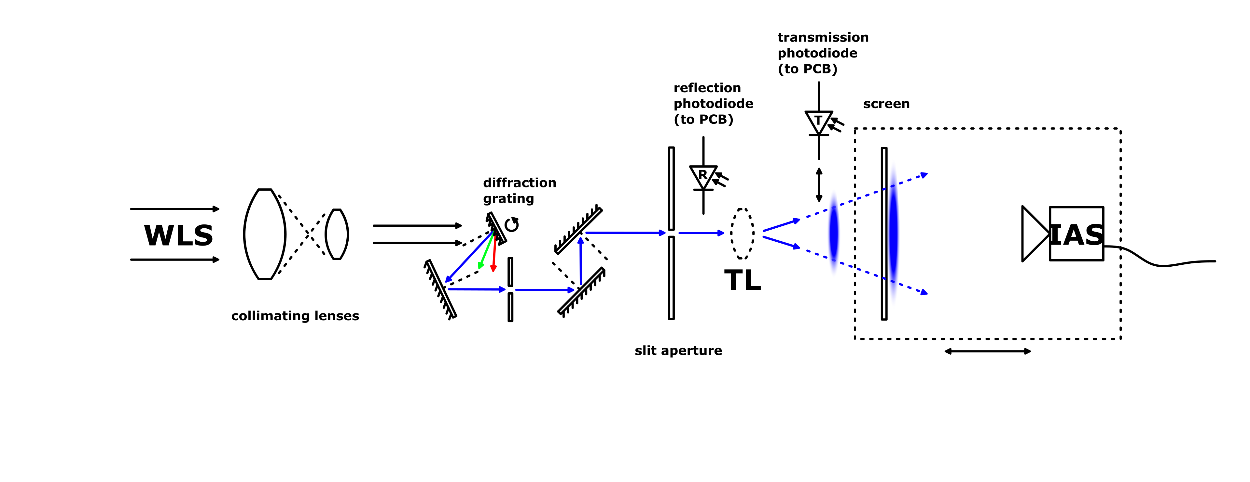
Optical Design Overview

Slide 9
WLS Overview/Spec
Capture and project as much 400 to 700nm light as possible in a 10mm diameter collimated beam

Slide 10
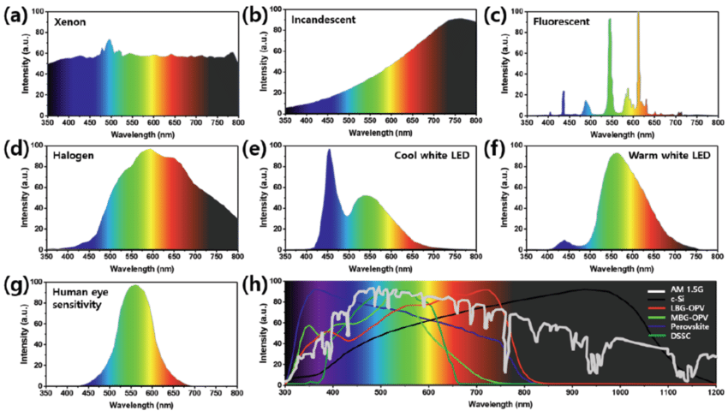
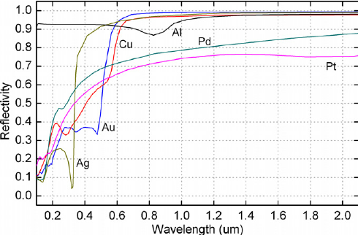
WLS Comparison & Selection
Source + Relay
Mirror + Source + Relay
Mirror + Source + Asphere + Relay
Small vs. Large Reflector
Collimation Architecture
Source
Reflector Material

Slide 11
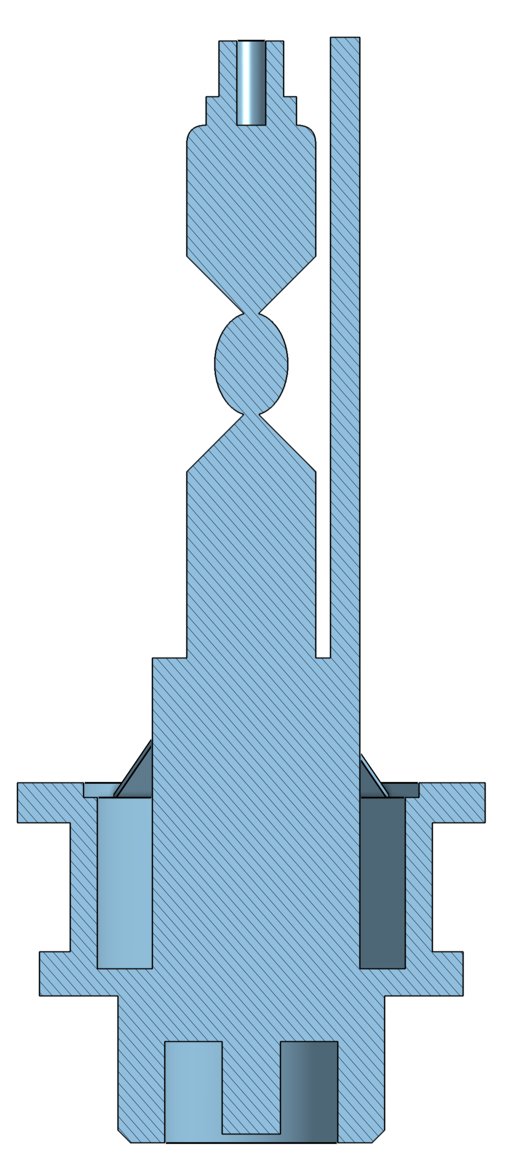



Source + Relay
-4%
-4%
-4%
For a lens system of NA = .35 expected loss is about 76% minimum

Slide 12
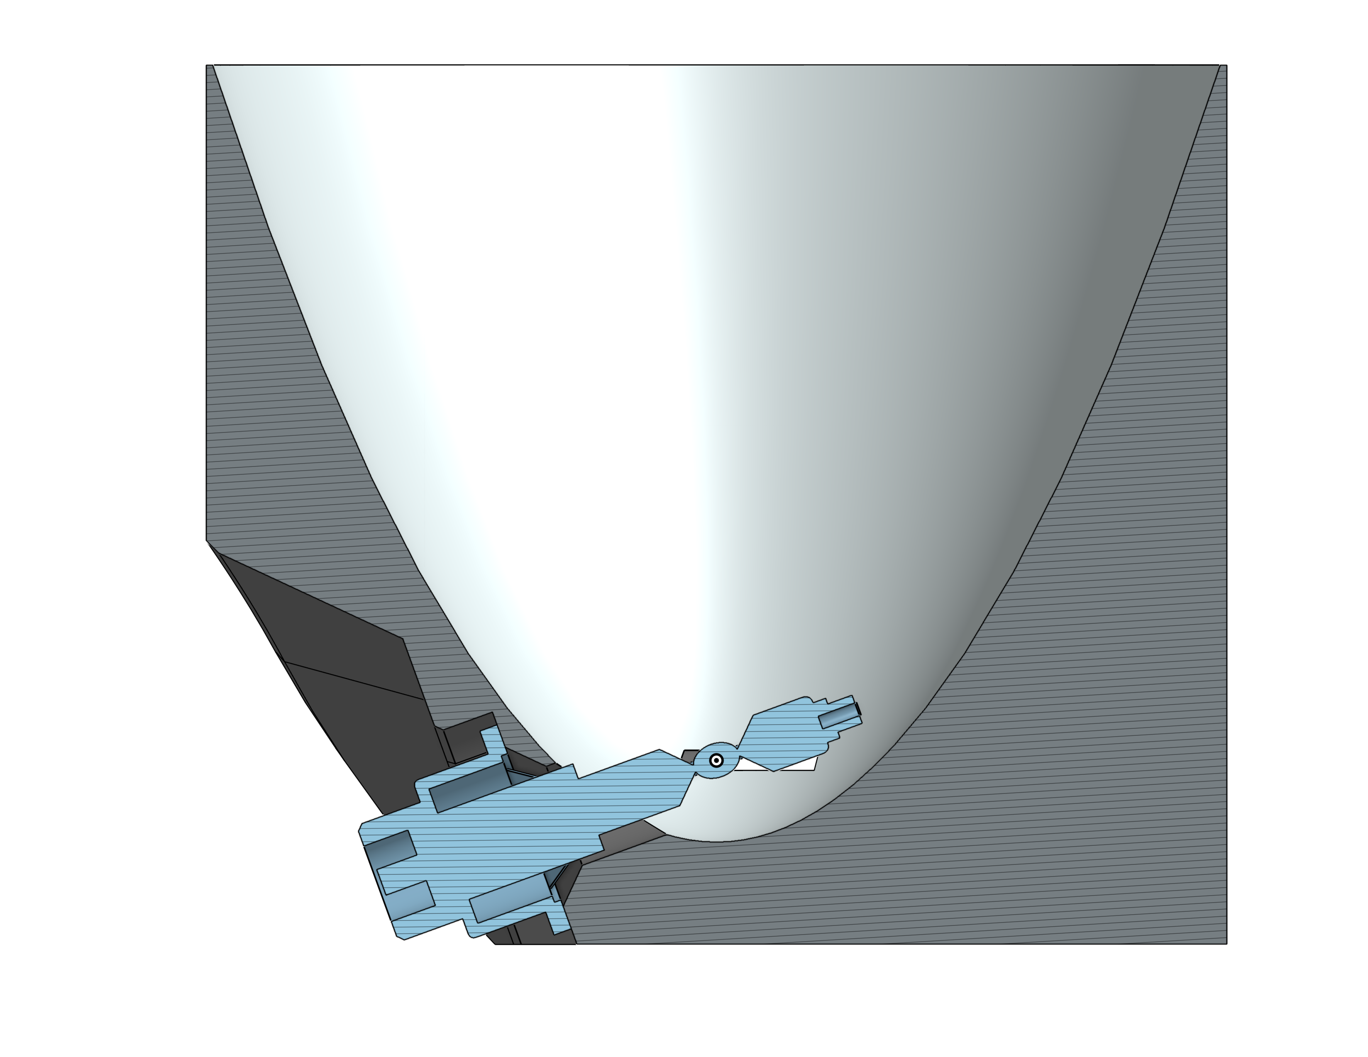
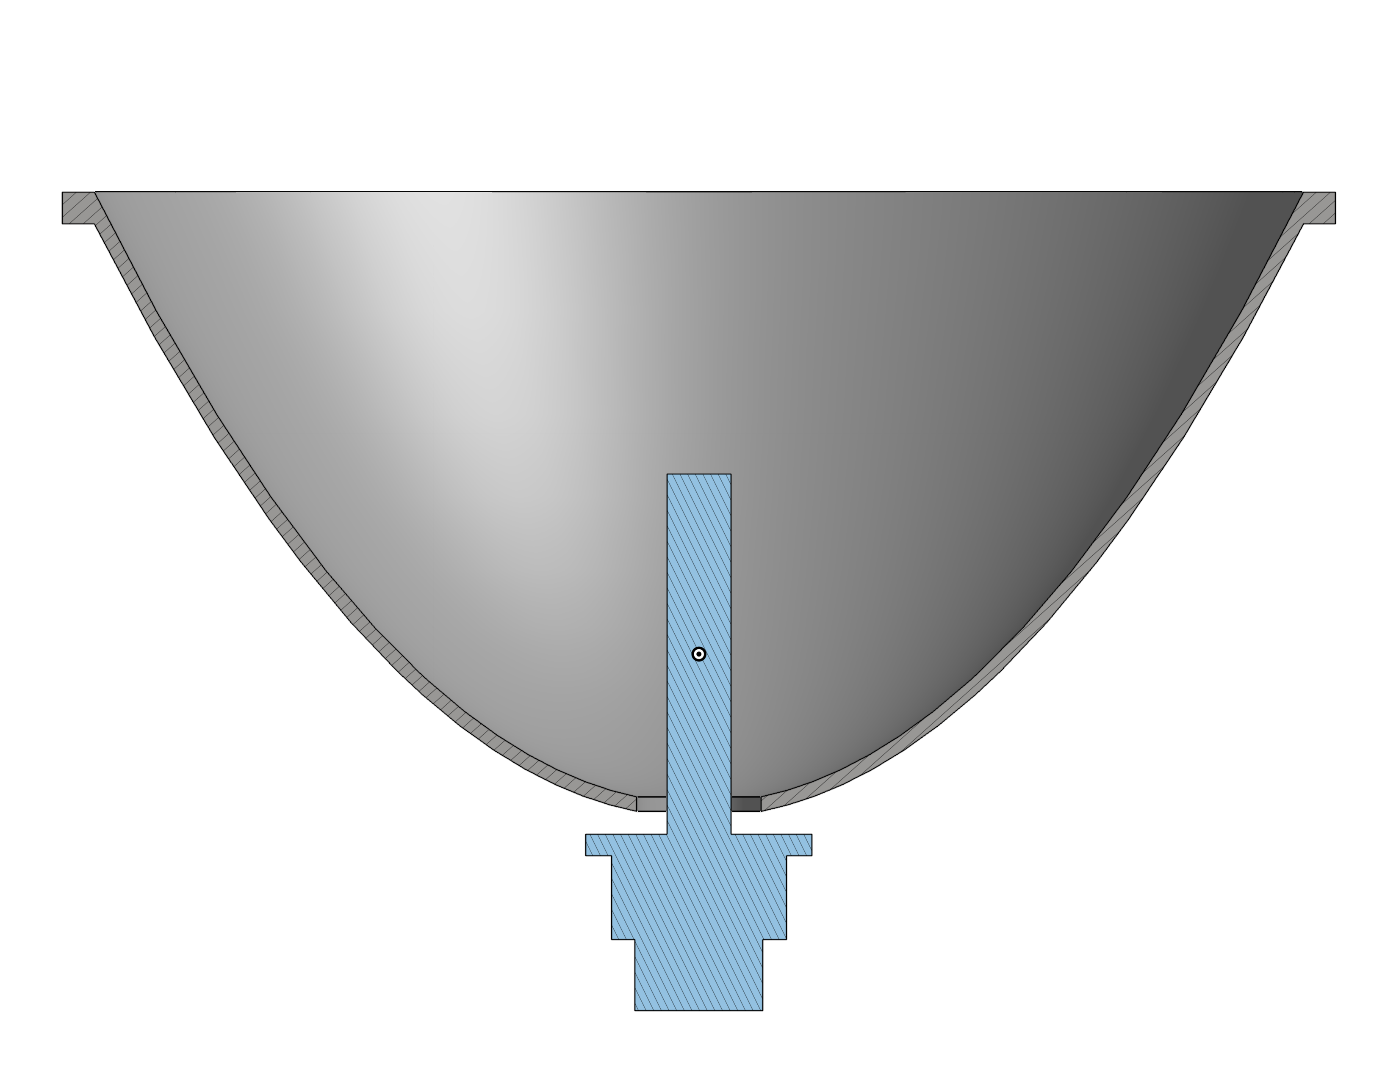
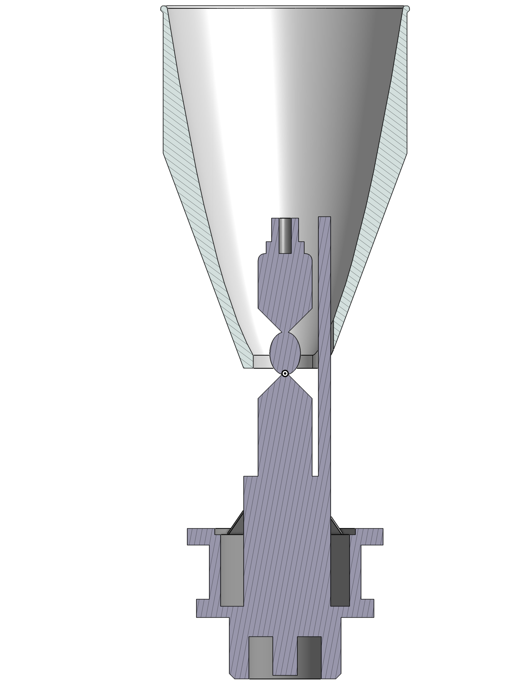
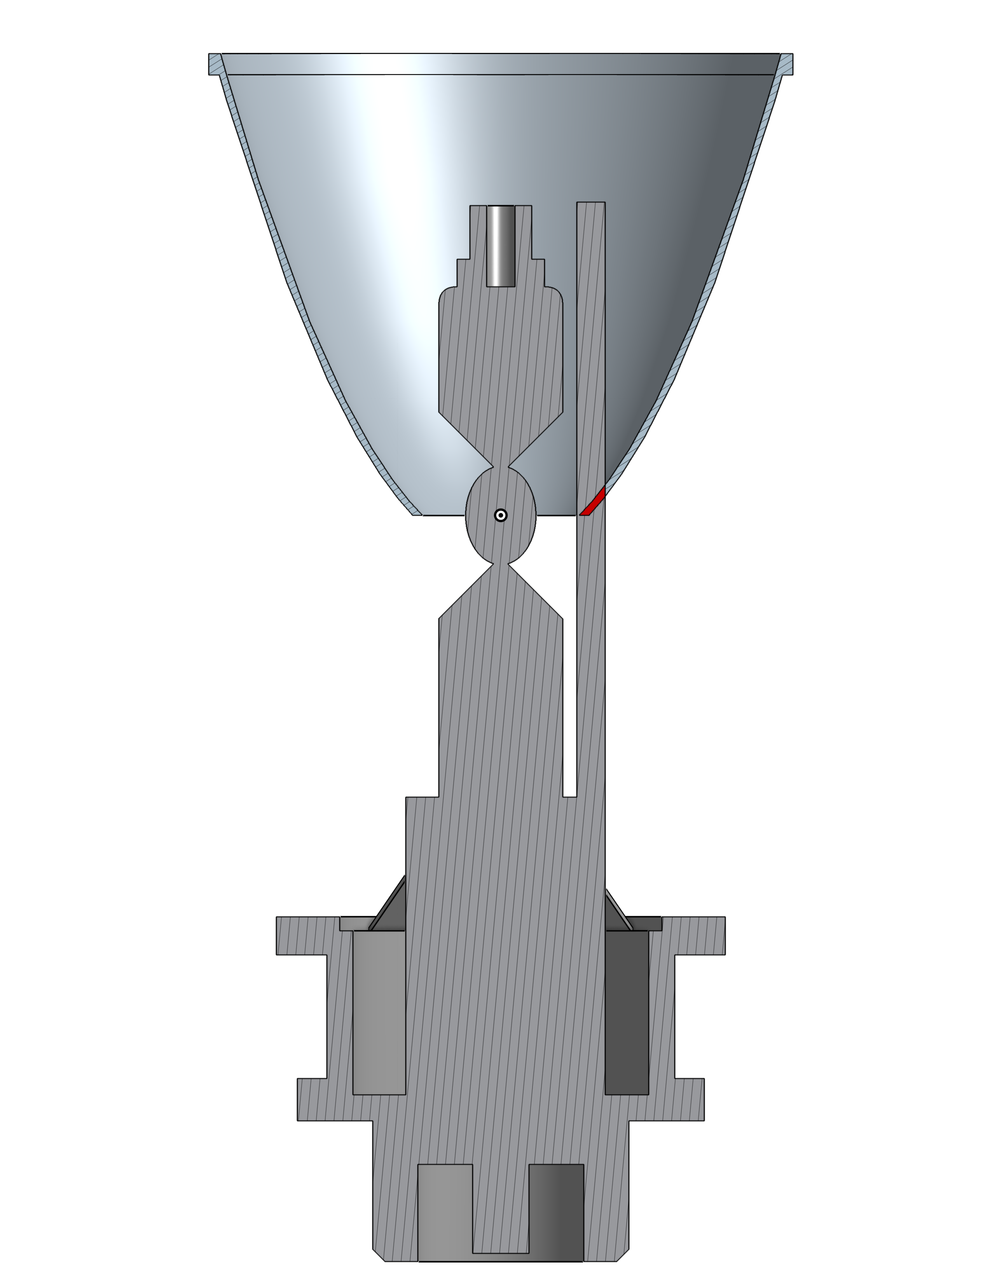




Mirror + Source + Relay
-66%
-60%
-32%
-20%

Slide 13
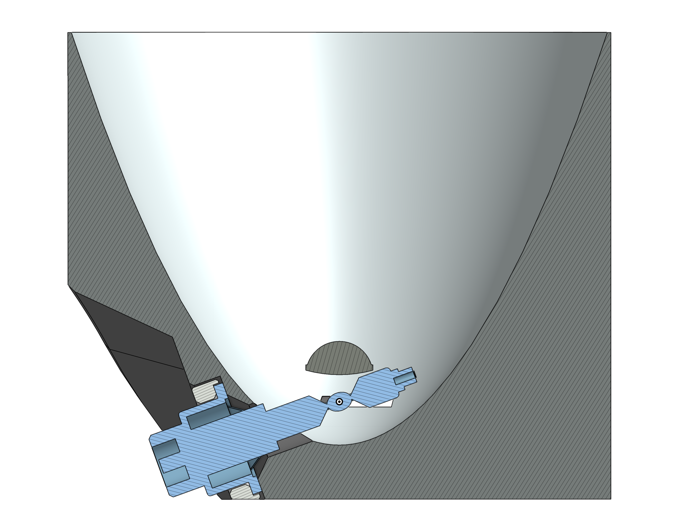
Mirror + Source + Asphere + Relay
~90% Collection / Collimation

Slide 14
Small vs. Large Reflector
Small Reflector = Very Small Focal Length = More Divergence
Large Reflector = Larger Focal Length = Less Divergence
Output beam size = exit aperture size
Bigger output = more compression needed = more loss

Slide 15
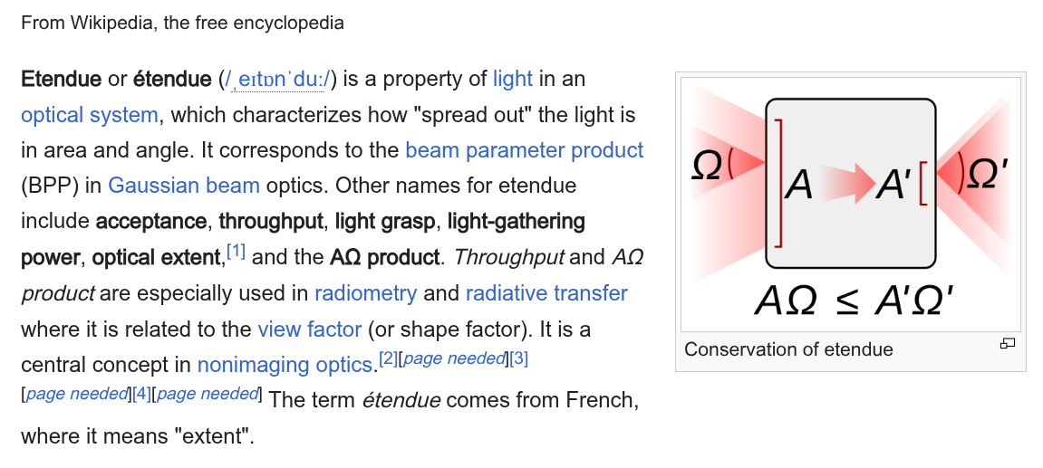
The Horrors of Entropy

Slide 16
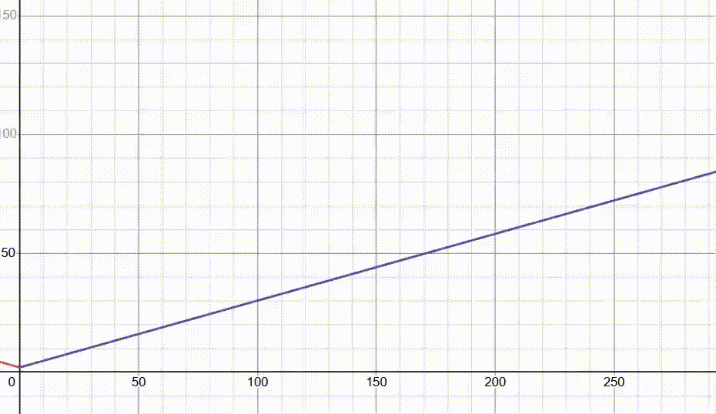
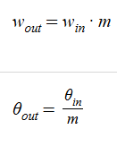
The Hope in the Darkness

Slide 17
WLS Design Matrix
Architecture | Efficiency | Collimation | Complexity | Score
Source + Relay | LOW (+1) | HIGH (+3) | LOW (-1) | +3
Mirror + Source + Relay | MID (+2) | MID (+2) | MID (-2) | +2
Mirror + Source + Asphere + Relay | HIGH (+3) | HIGH (+3) | HIGH (-3) | +3
Large Reflector | HIGH (+3) | HIGH (+3) | HIGH (-3) | +3
Small Reflector | LOW (+1) | LOW (+1) | LOW (-1) | +1

Slide 18
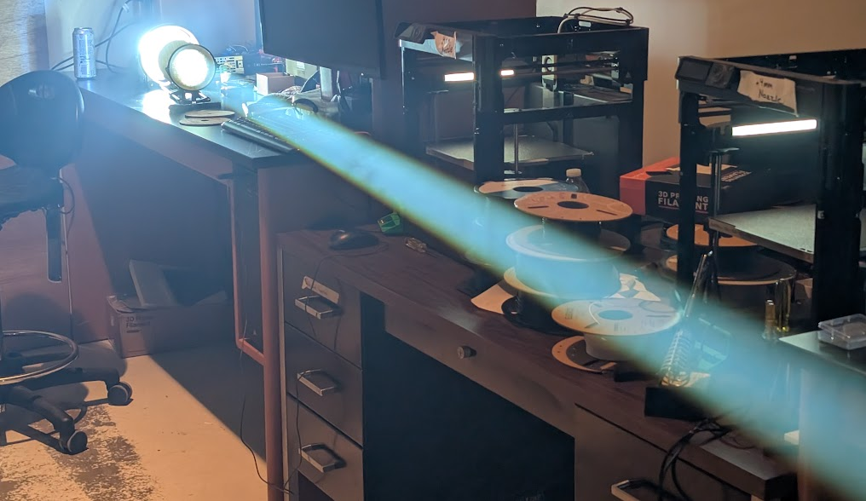
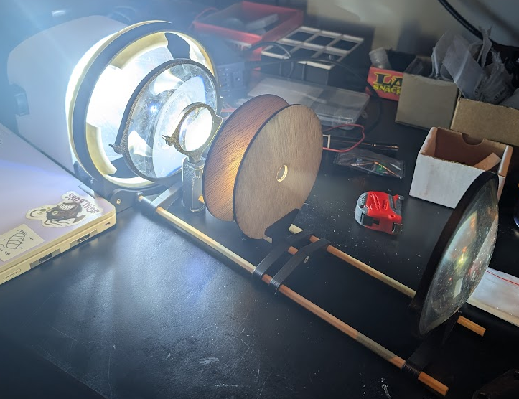
Blender Sim
WLS Testing
WLS as of Feb 13th

Slide 19
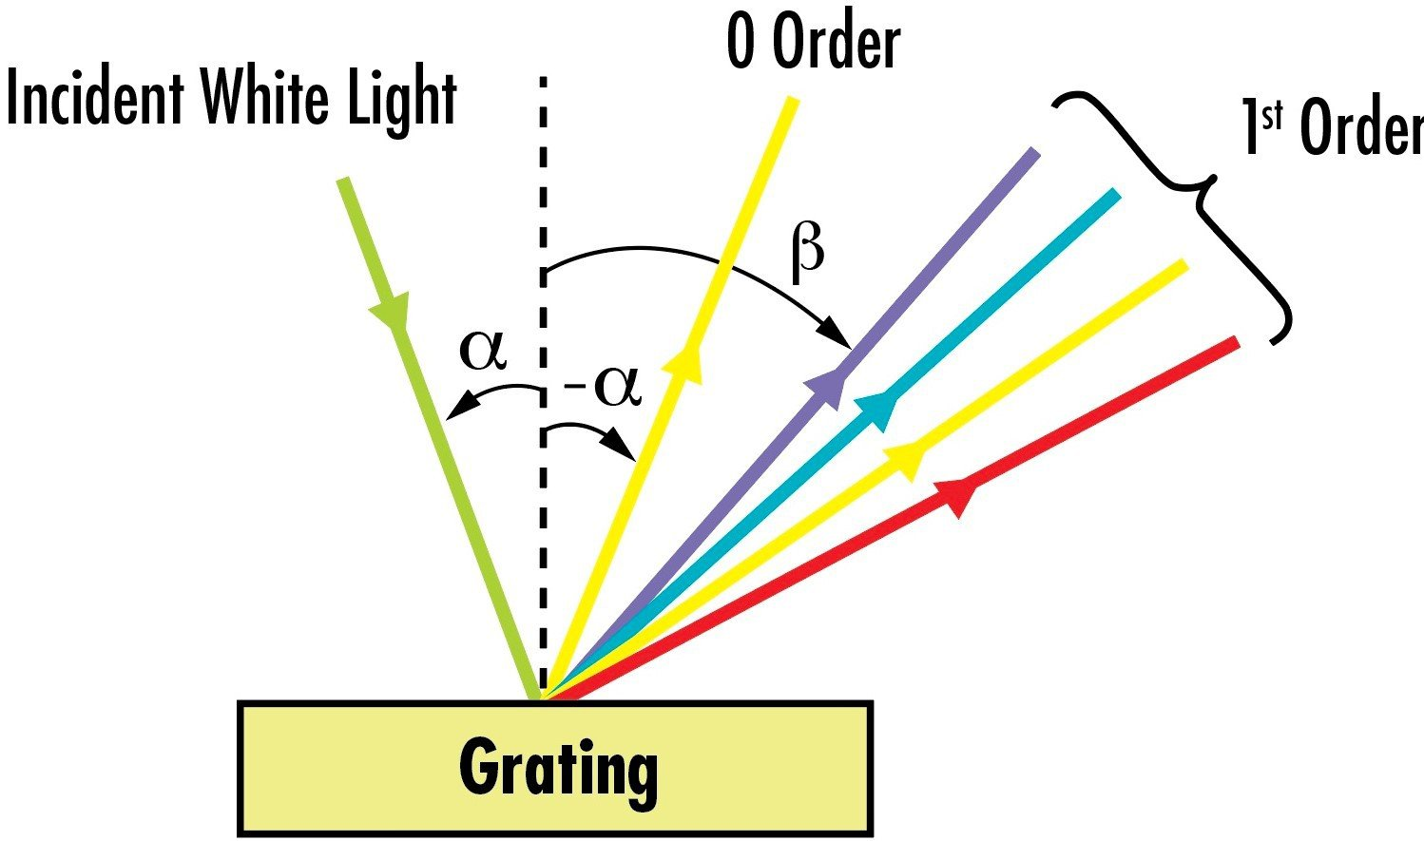
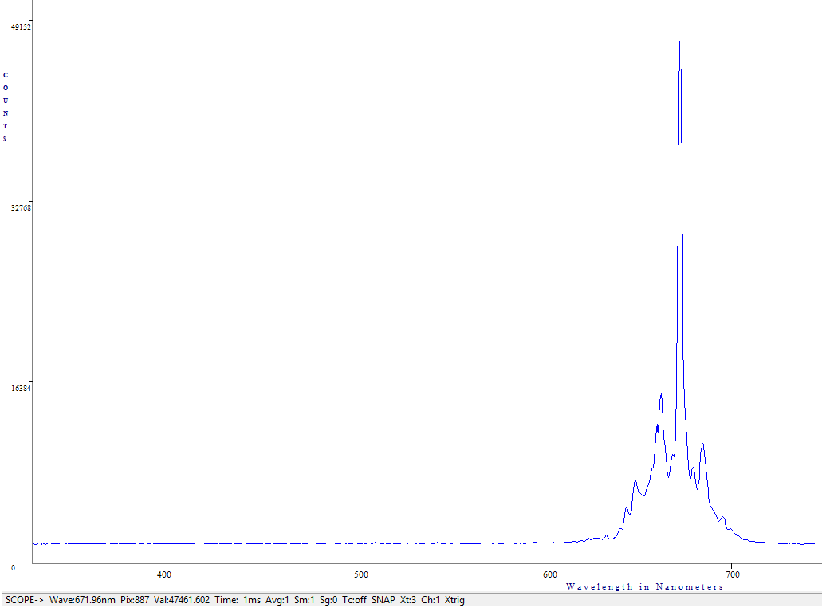
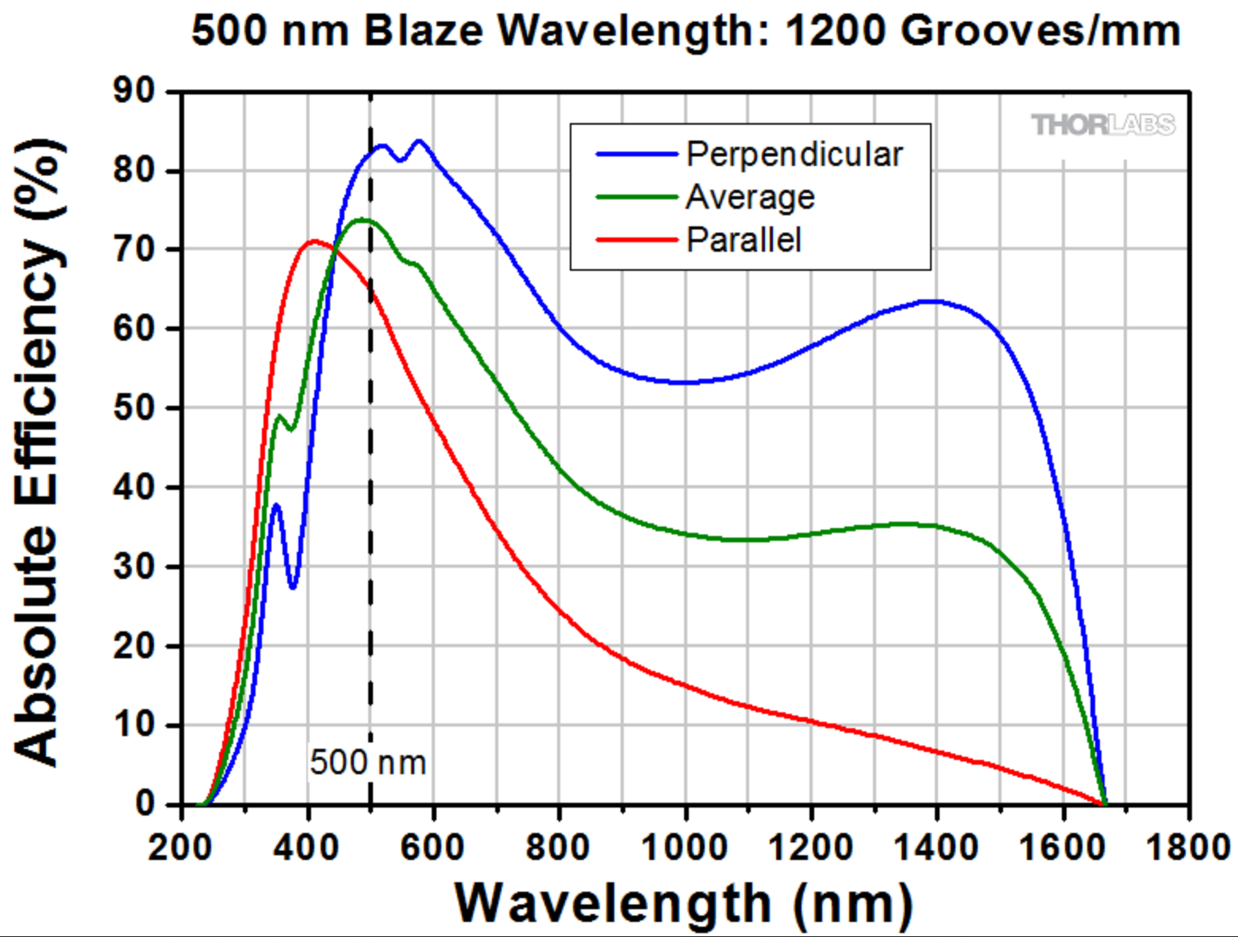
Monochromator Comparison & Selection
~ 3.5 nm FWHM
Notes:
Gratings, photodetectors, etc...

Slide 20
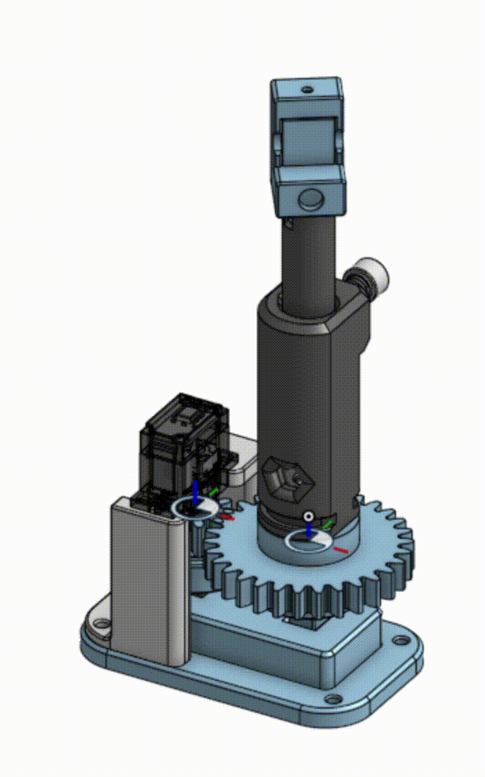
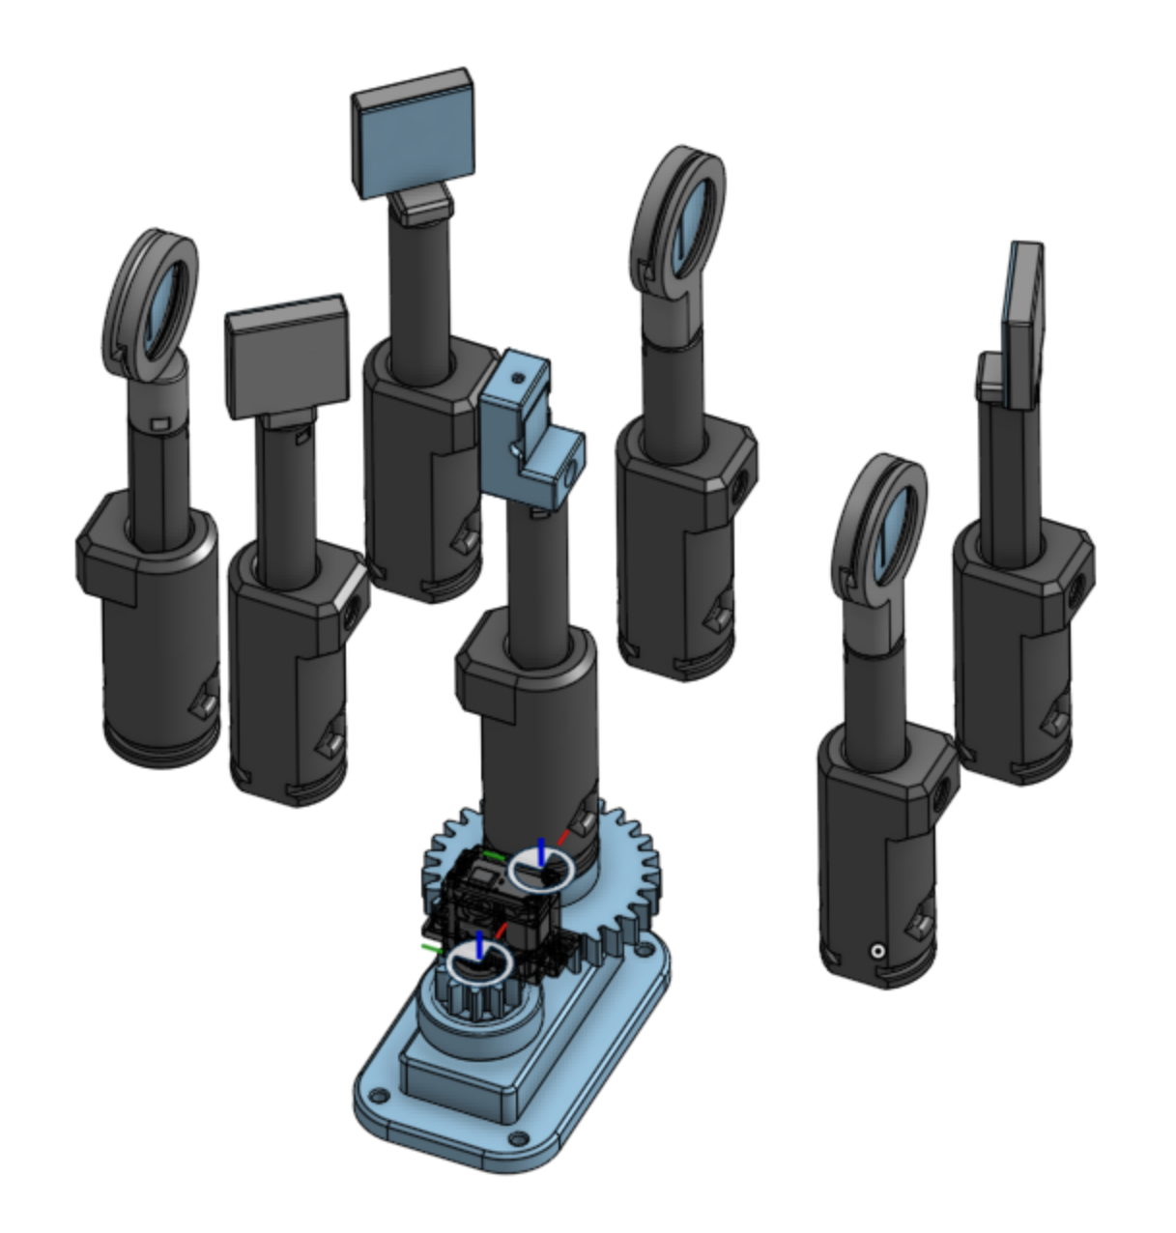
Monochromator Design
Notes:
Gratings, photodetectors, etc...

Slide 21
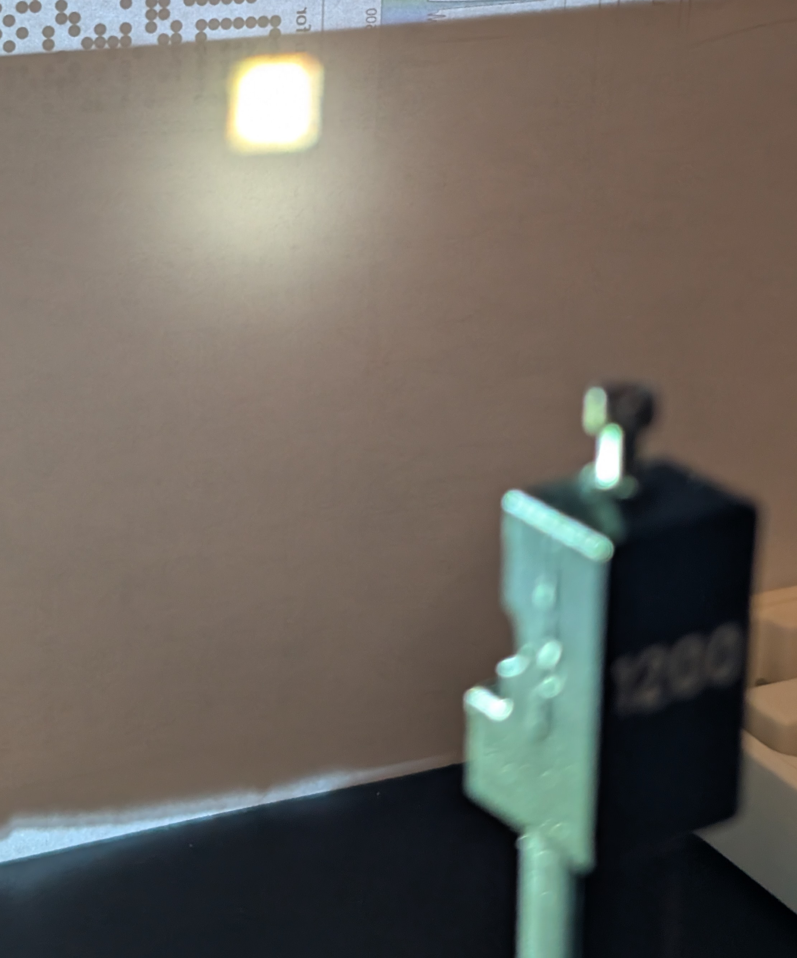
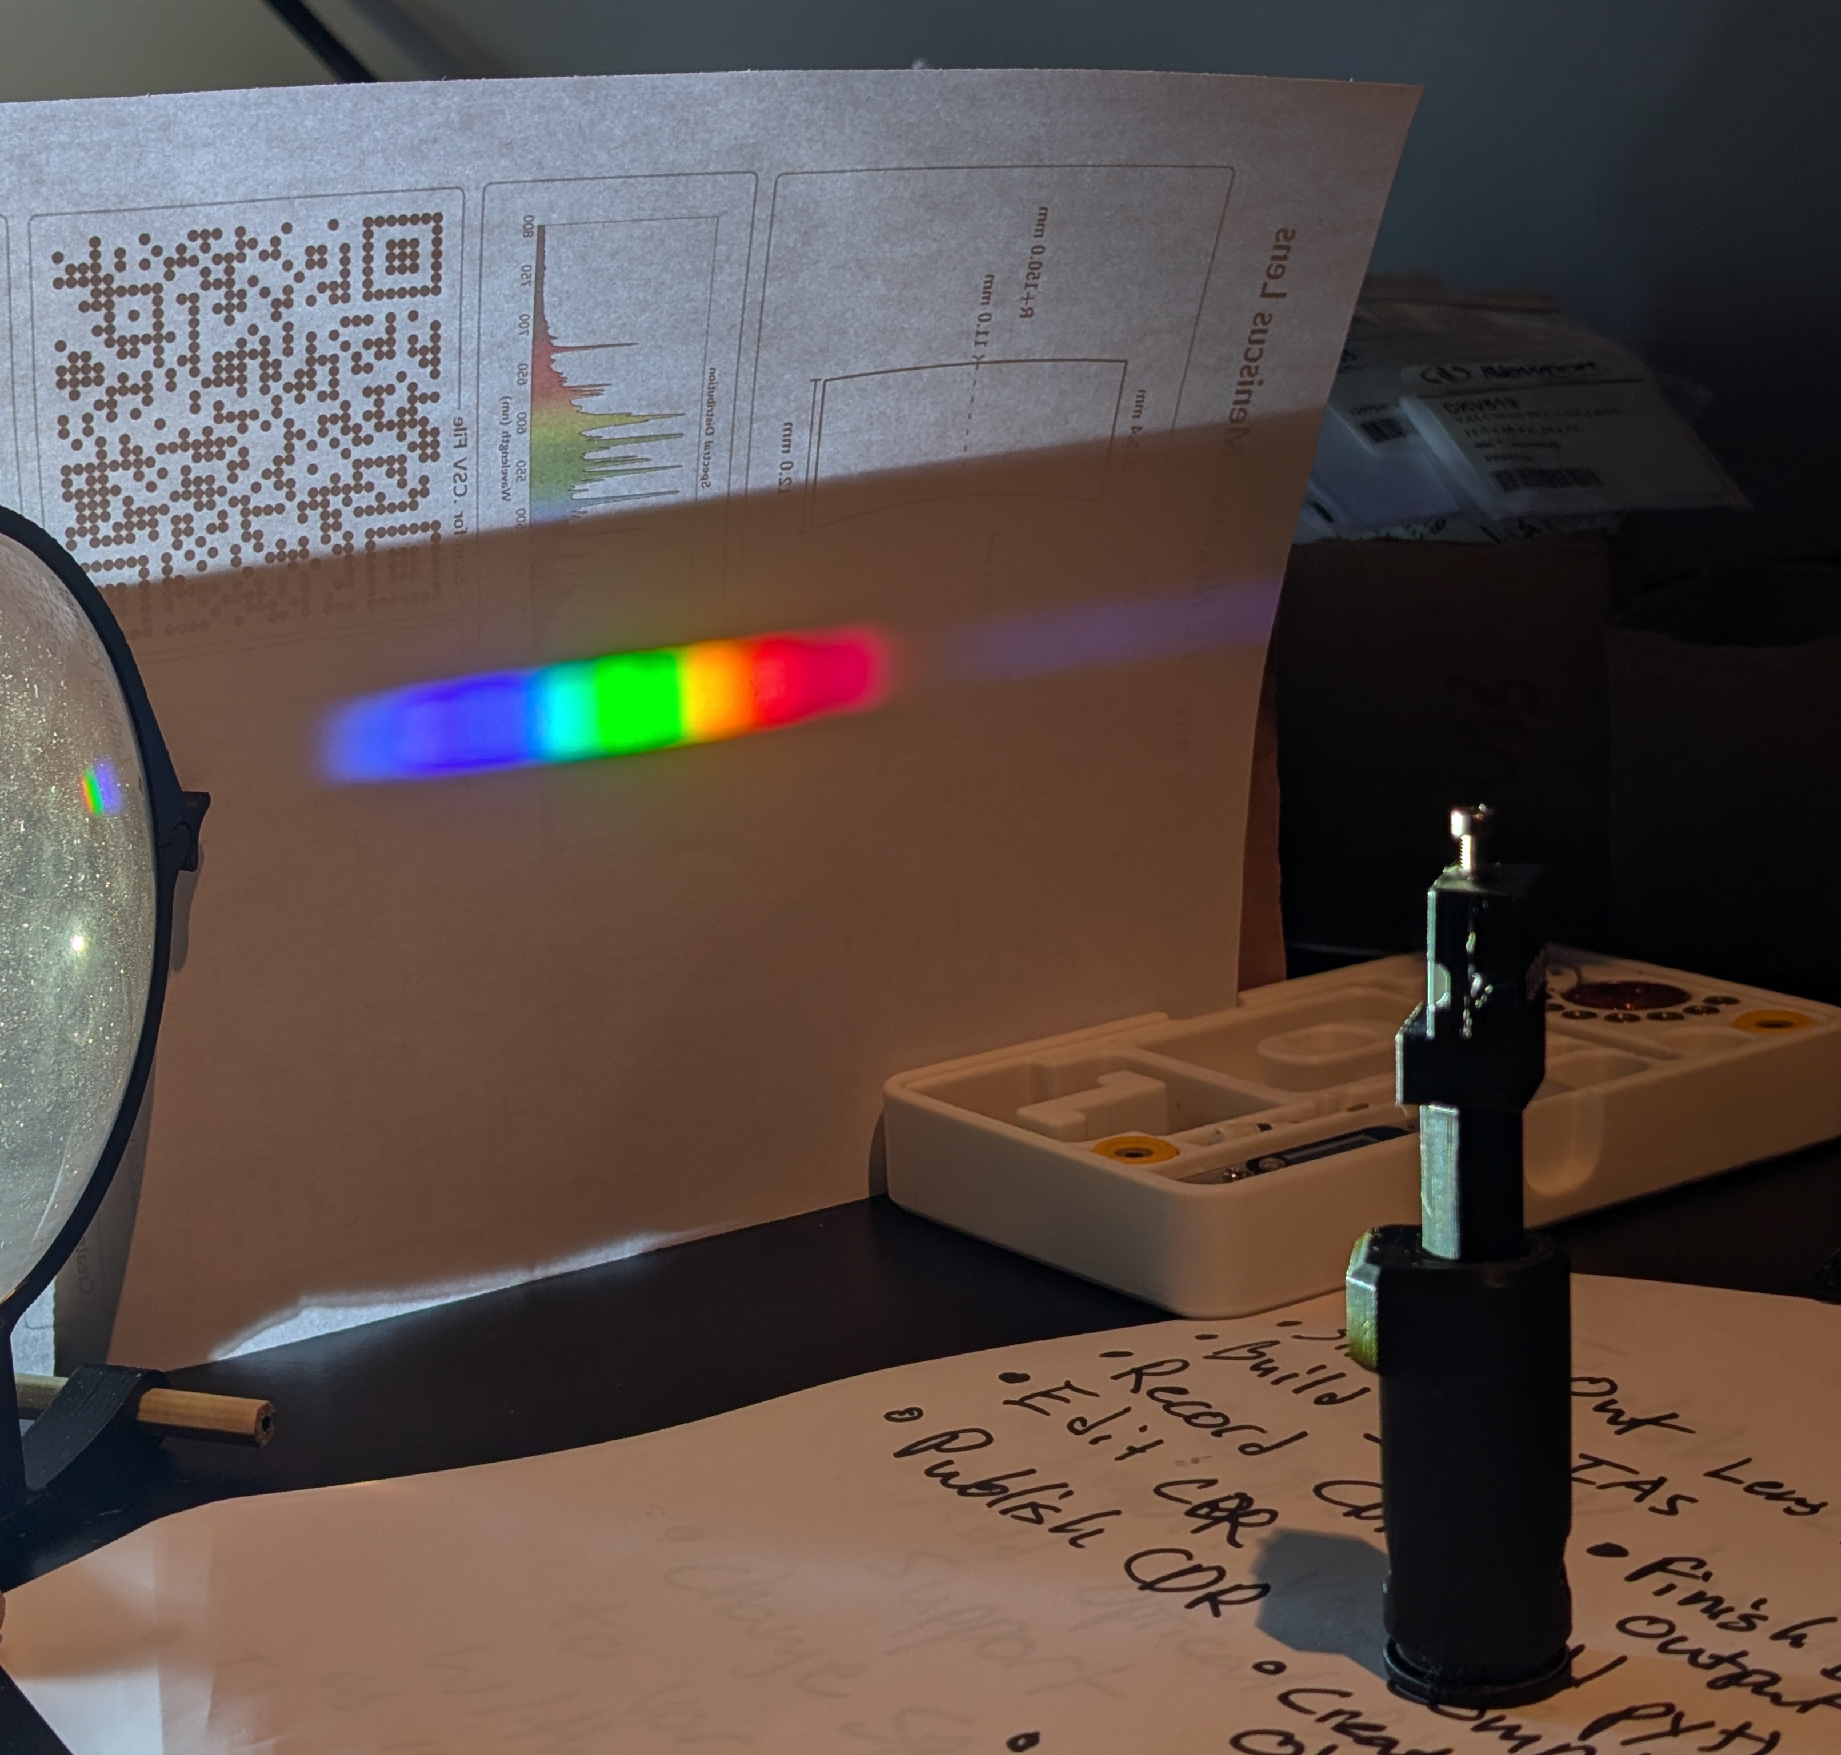
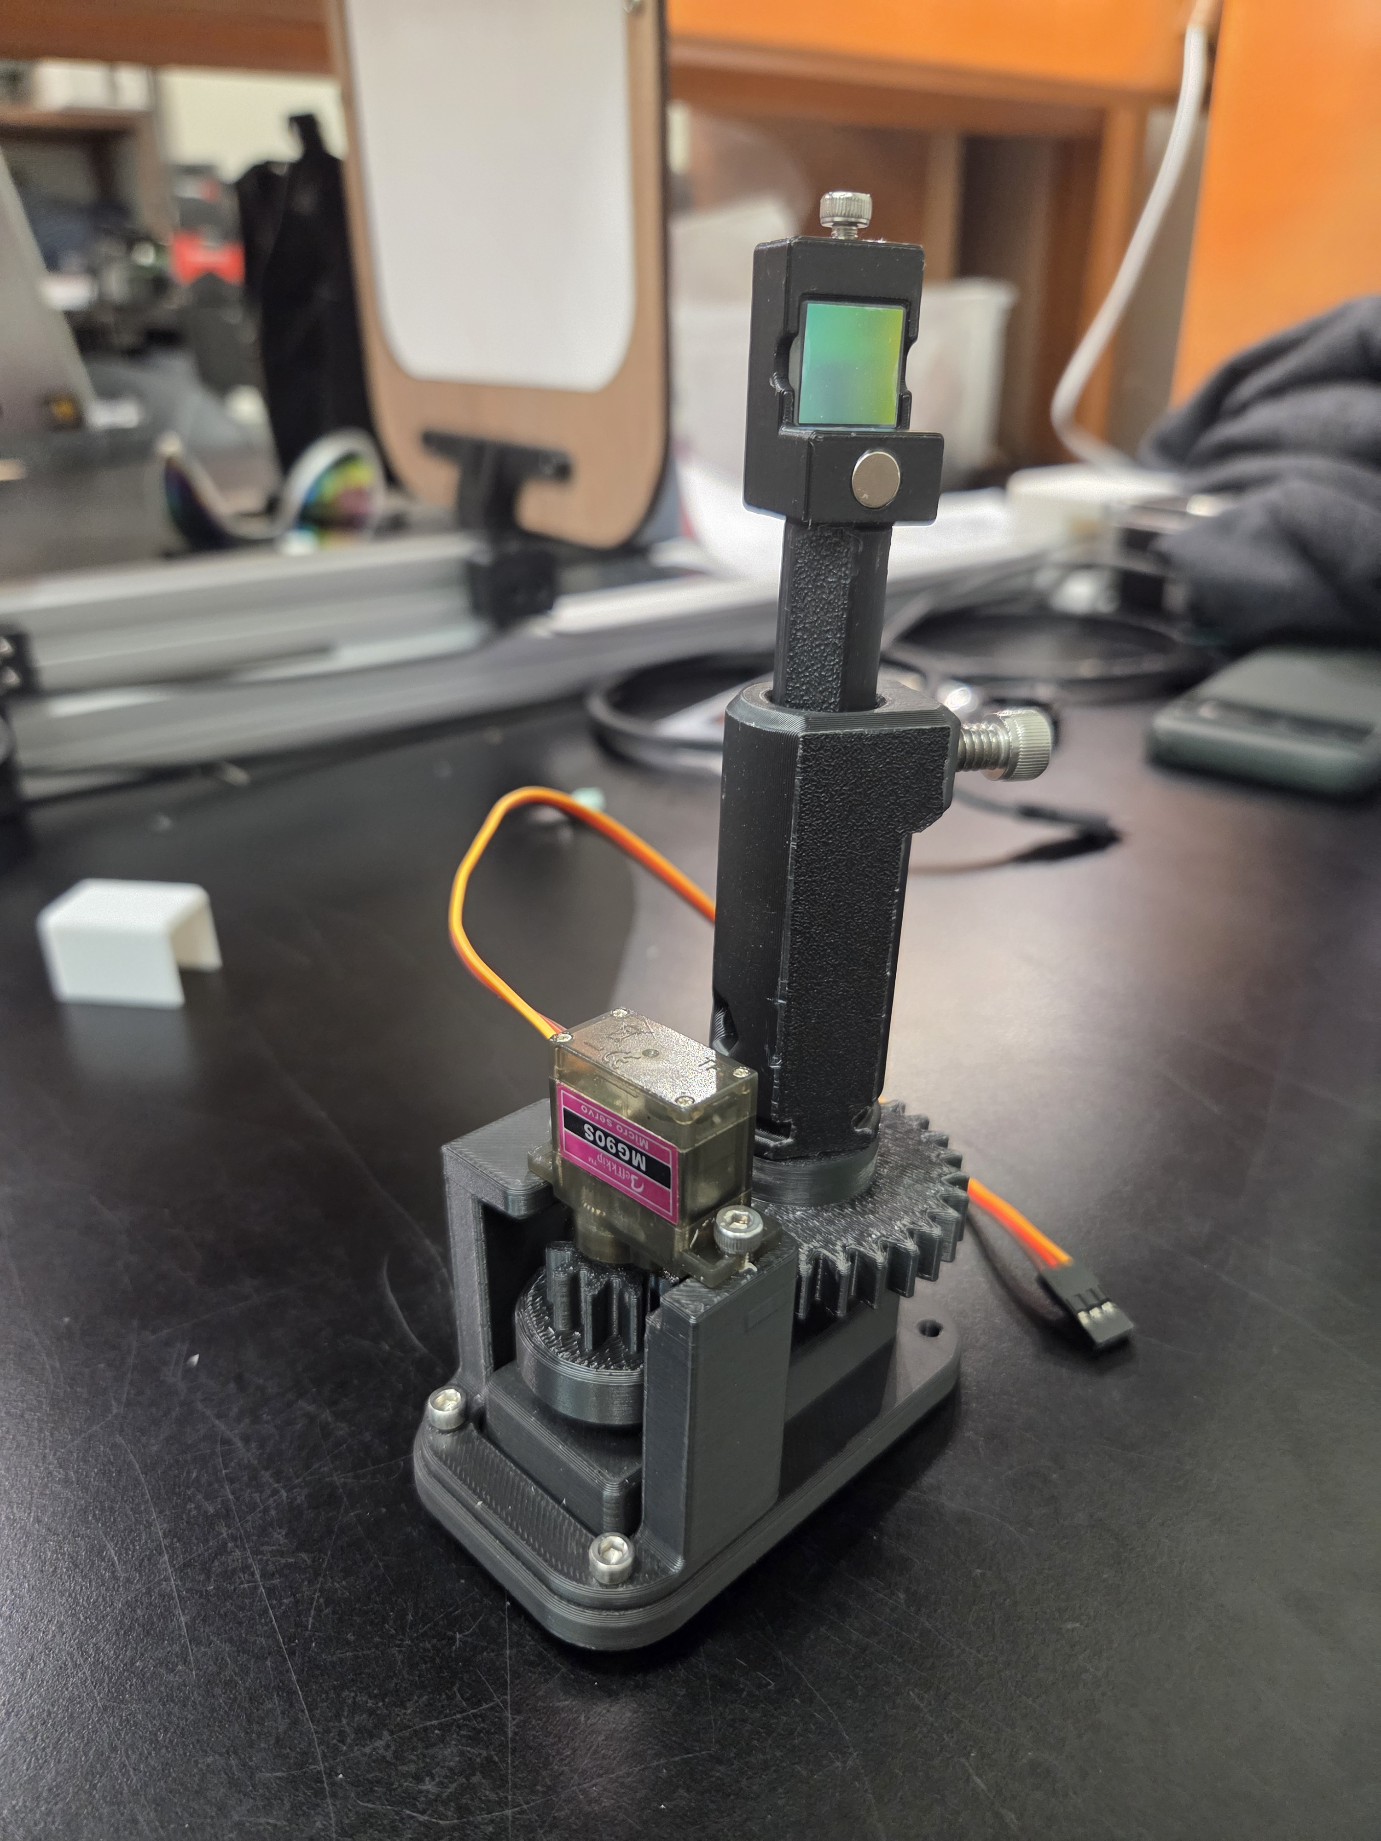
Monochromator Testing
Notes:
Gratings, photodetectors, etc...

Slide 22
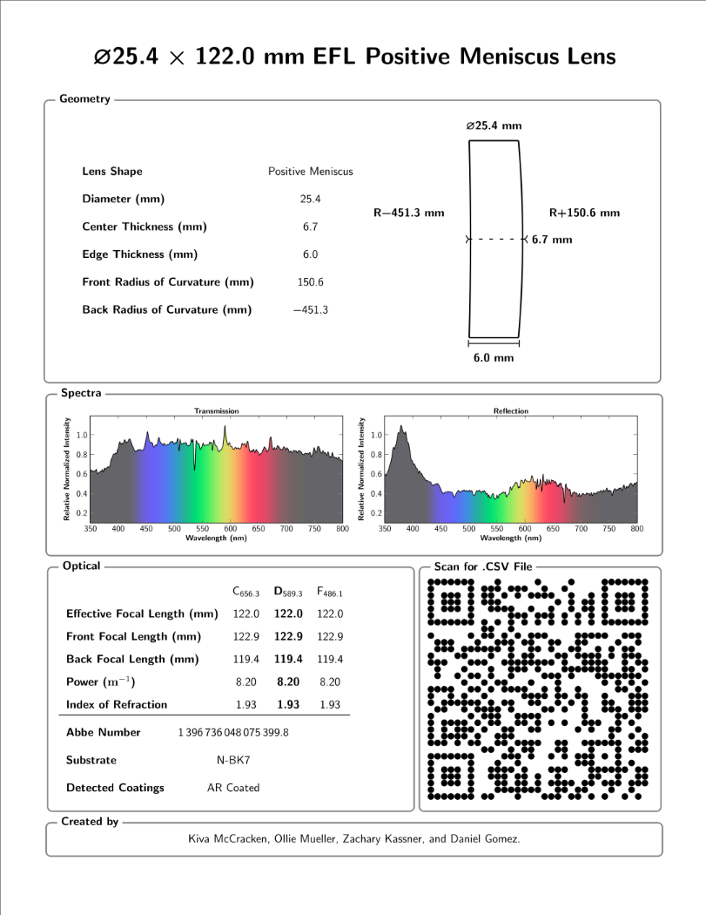
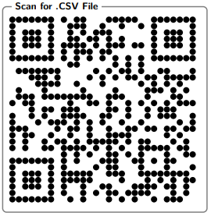
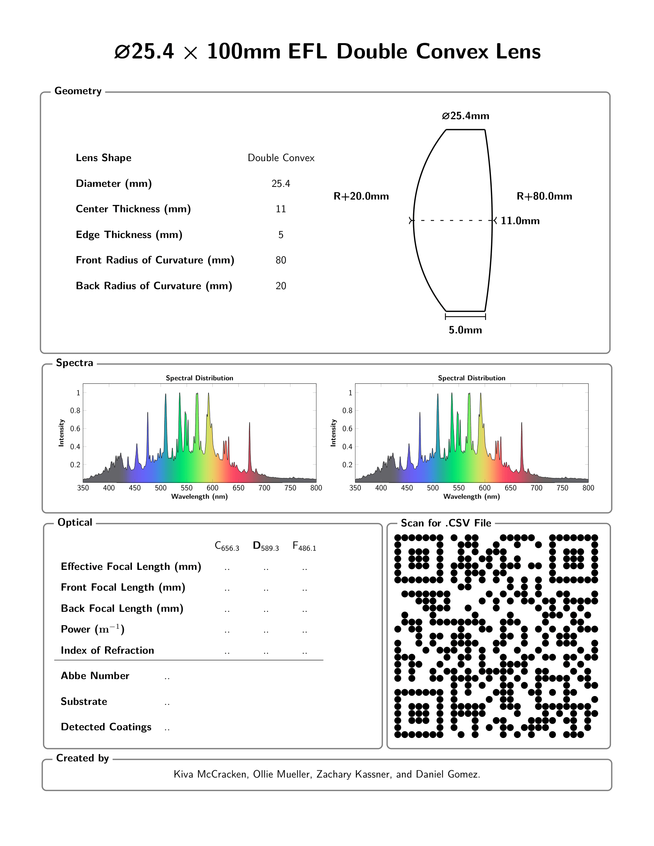
Datasheet Generation

Slide 23
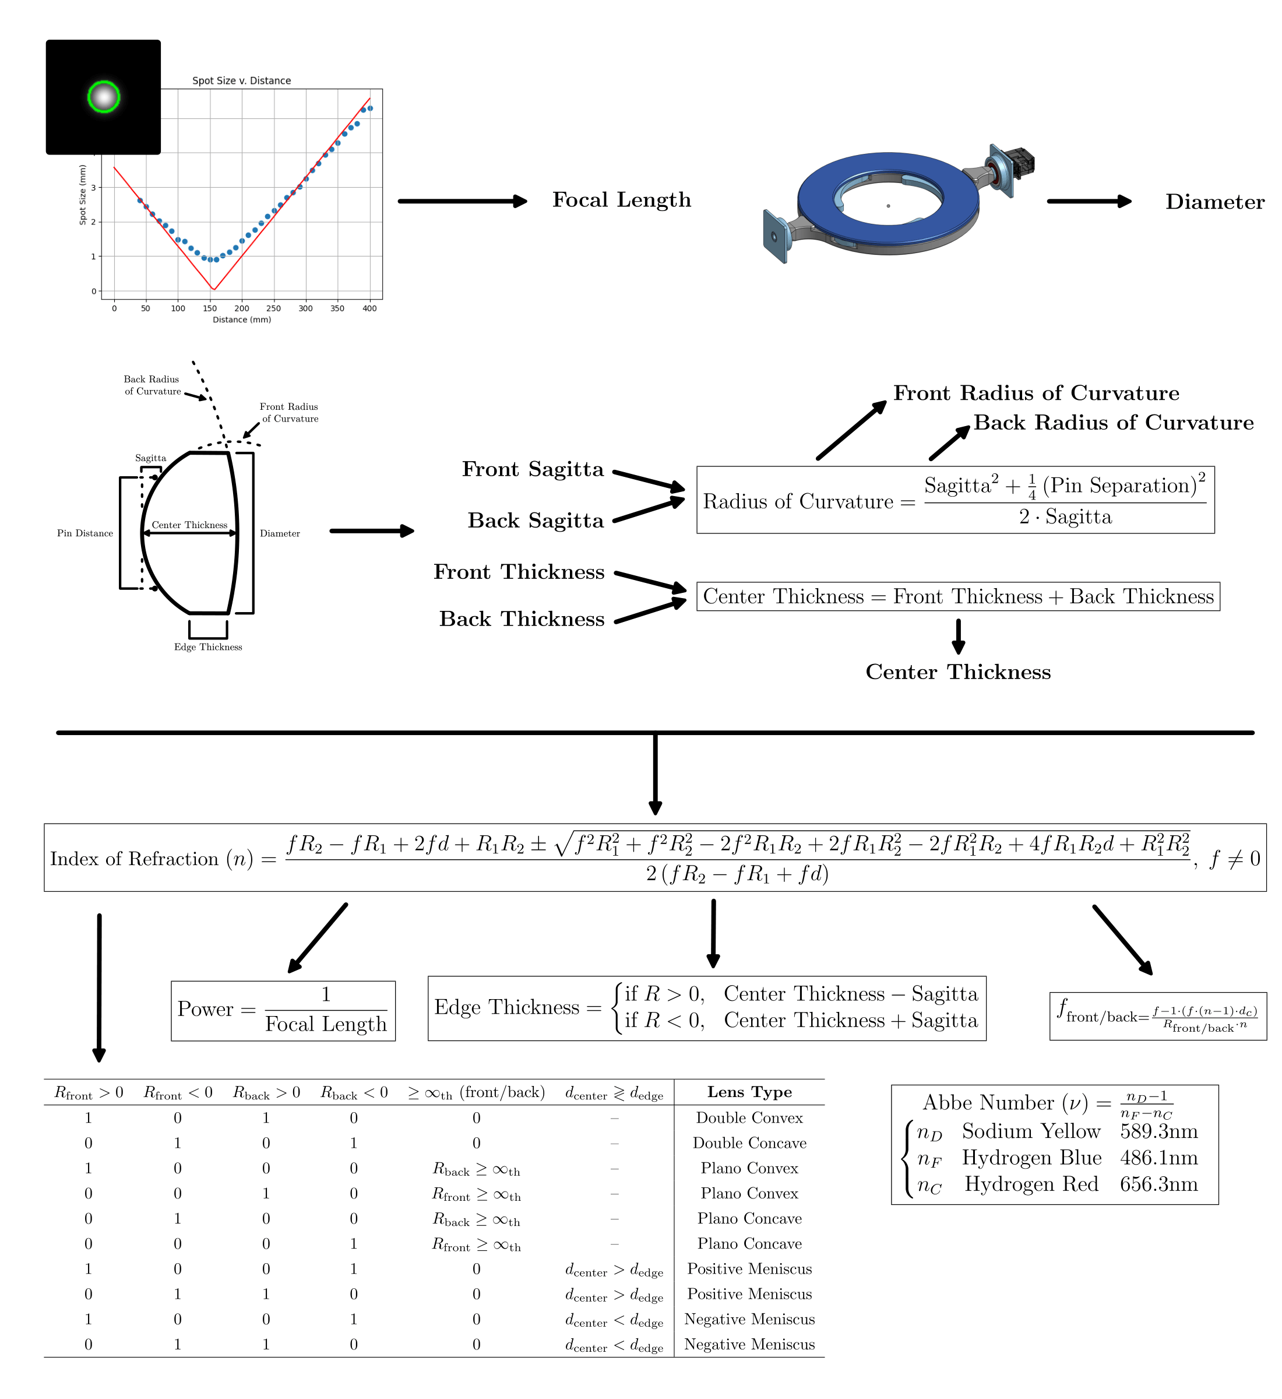
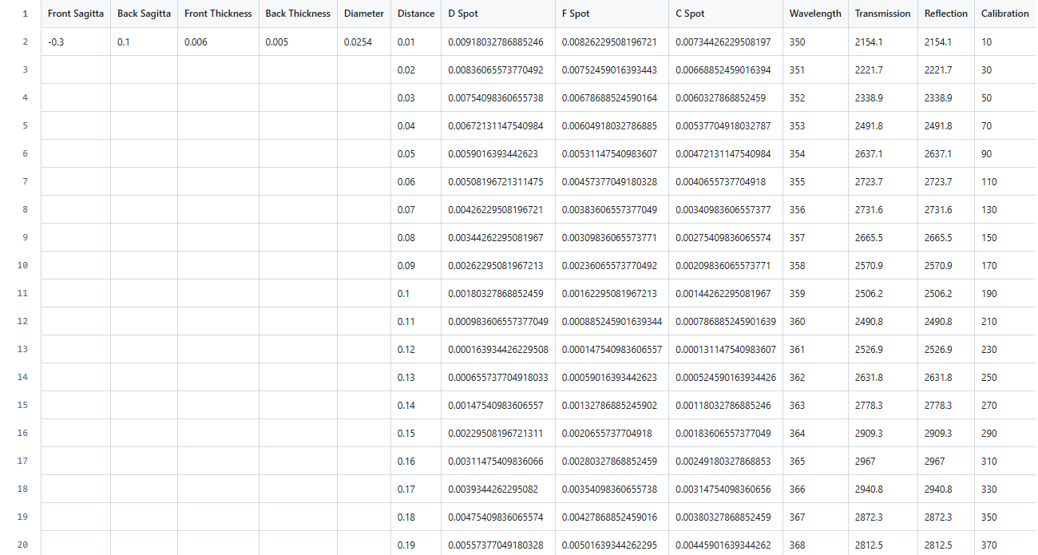
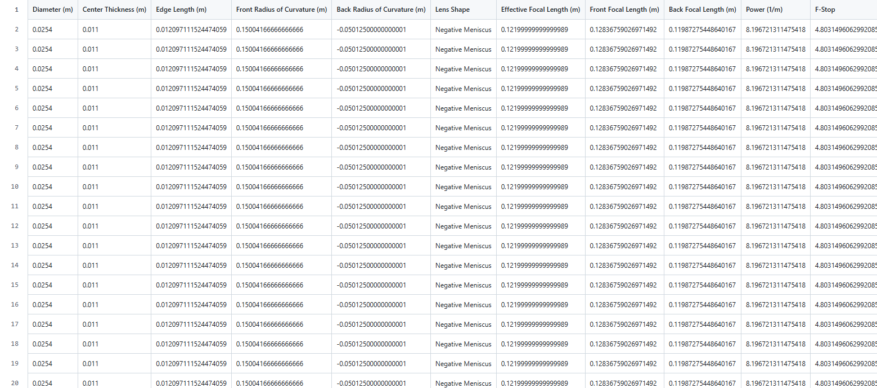

Slide 24
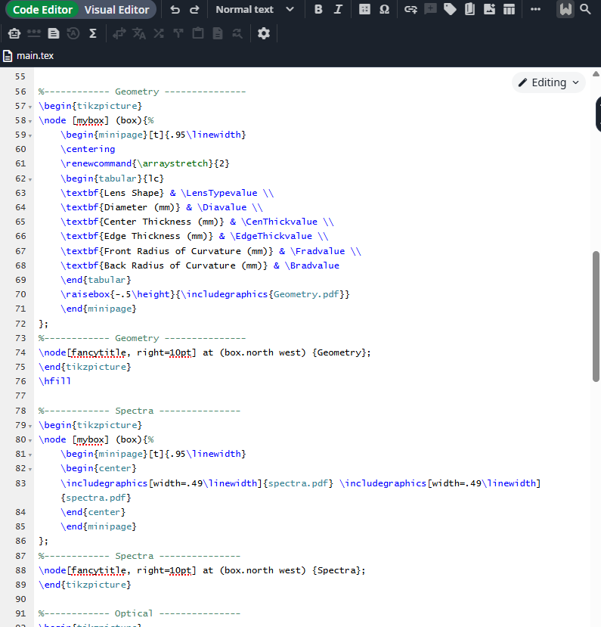
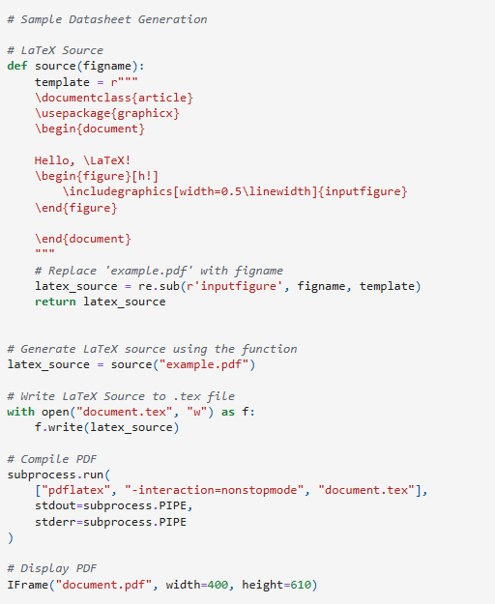




Slide 25
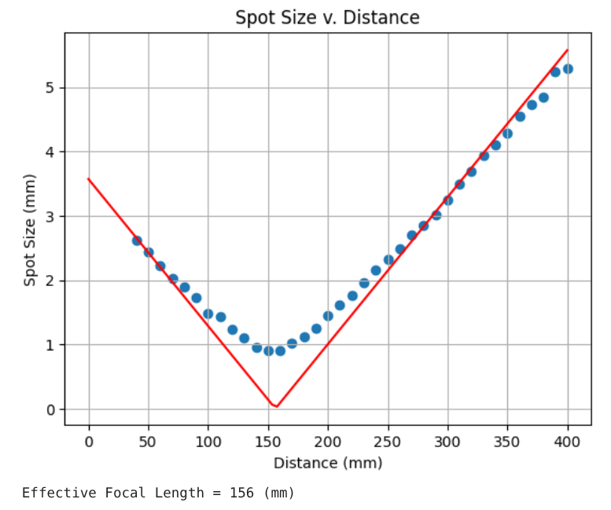
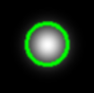
IAS Design

Slide 26
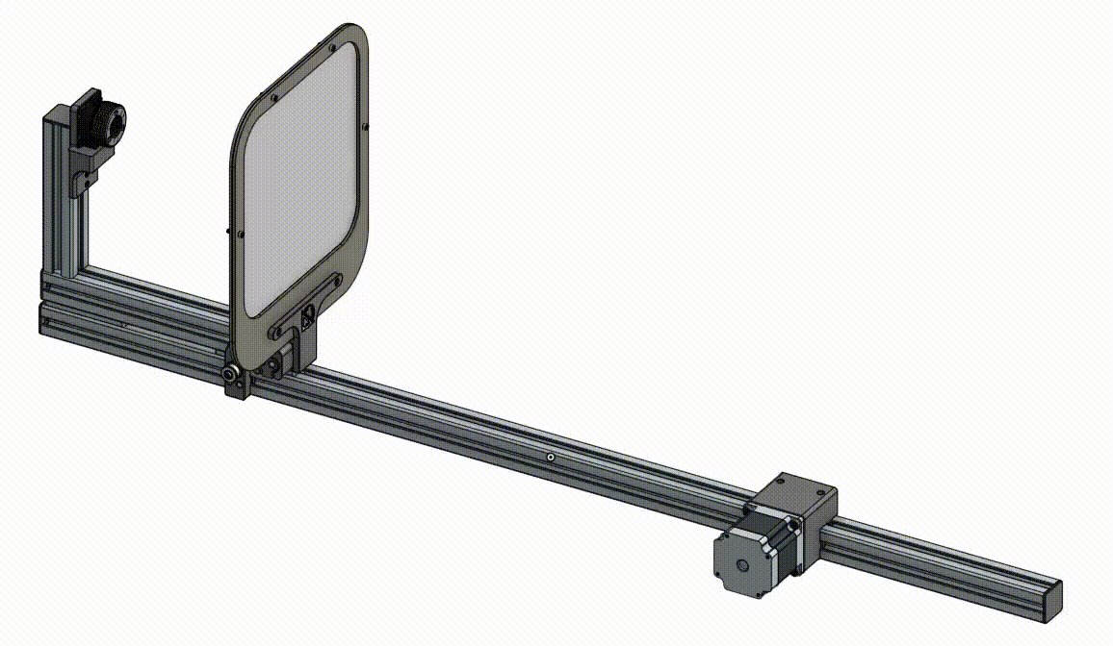
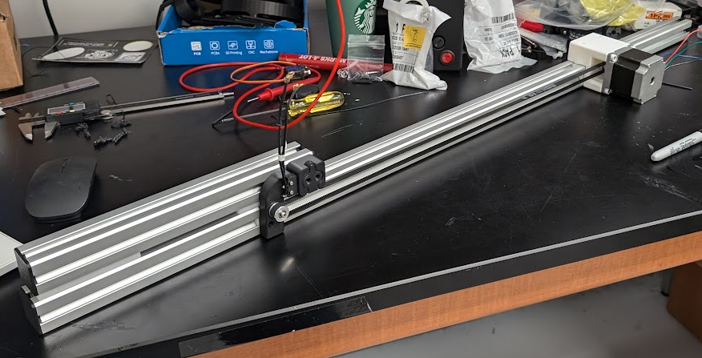
IAS Linear Gantry

Slide 27
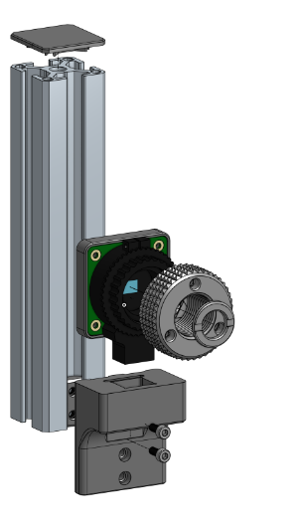
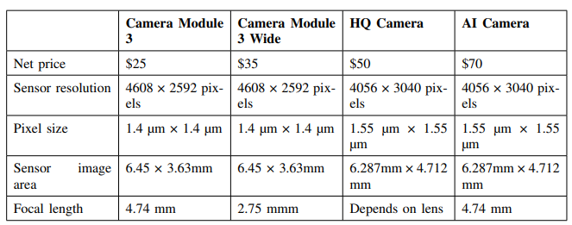
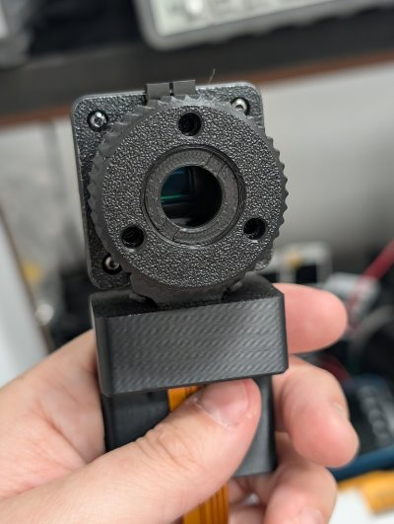
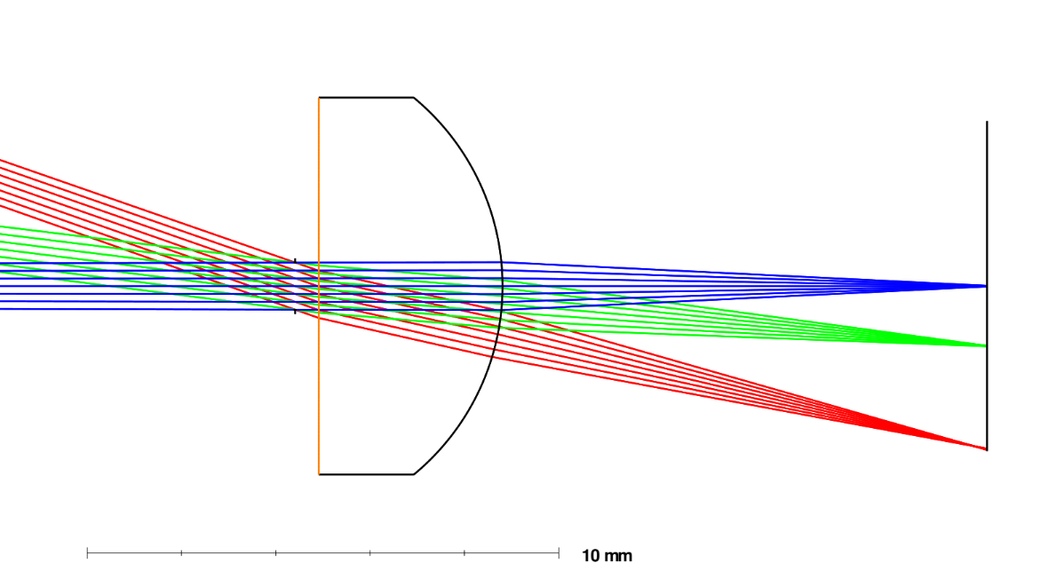
IAS Comparison & Selection

Slide 28
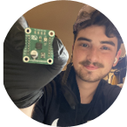
PCB Design Verification Strategy
Talk about gonig from adafruit like modules for verification to breadbboarding to building those modules and re breadboarding
Find Pre-Built Modules that Accomplish Given Project Objective
Breadboard these Pre-Built Modules to Verify System
Design PCBs to Replace Pre-Built Modules in System
Breadboard New Modules to Verify New PCB Integrity

Slide 29
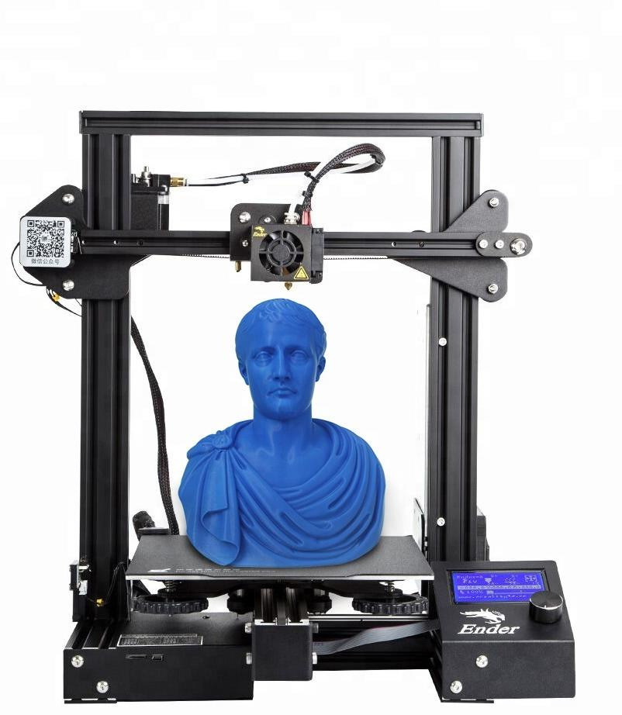

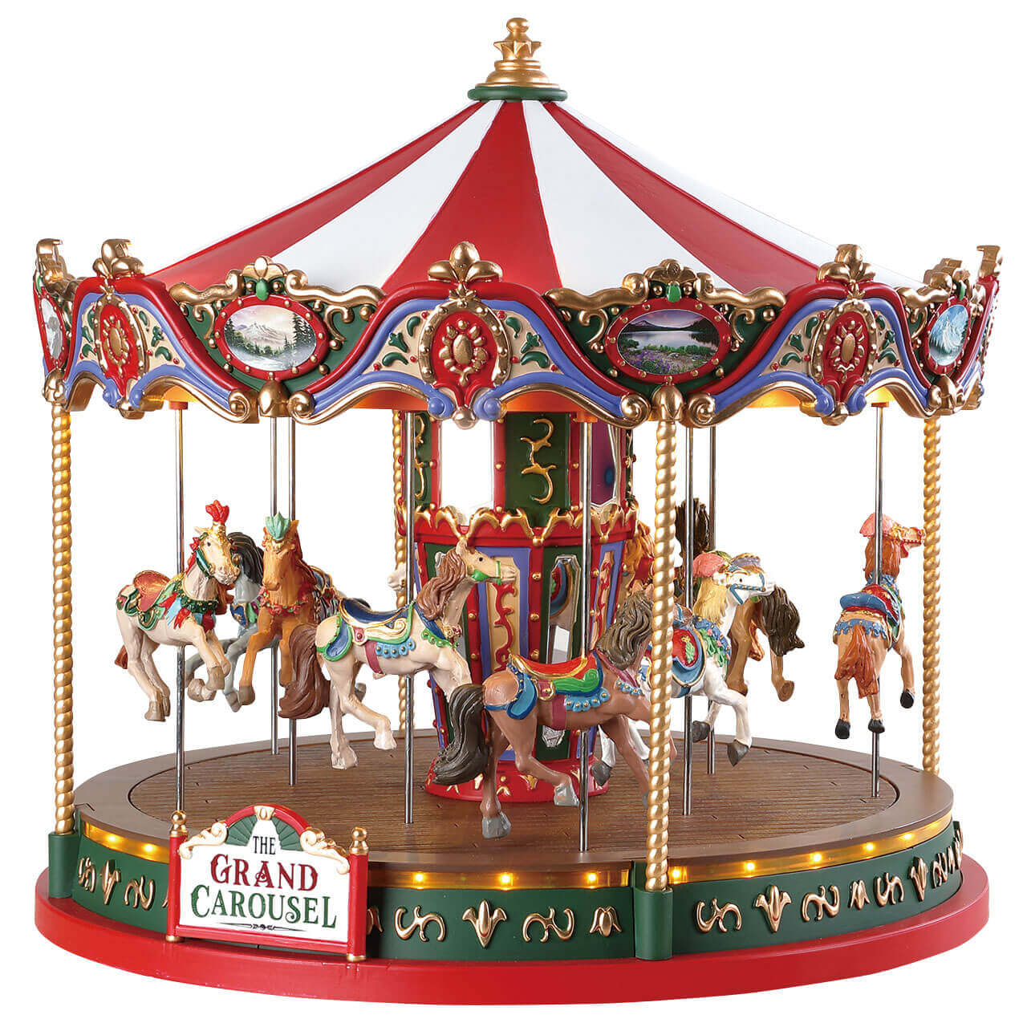
PCB Design Main Objective
Talk about primary objective of project is to provide stepper motors interfacable with software that allow for X axis movement and rotational movement around the z-axis
X-Axis
Z-Axis

Slide 30
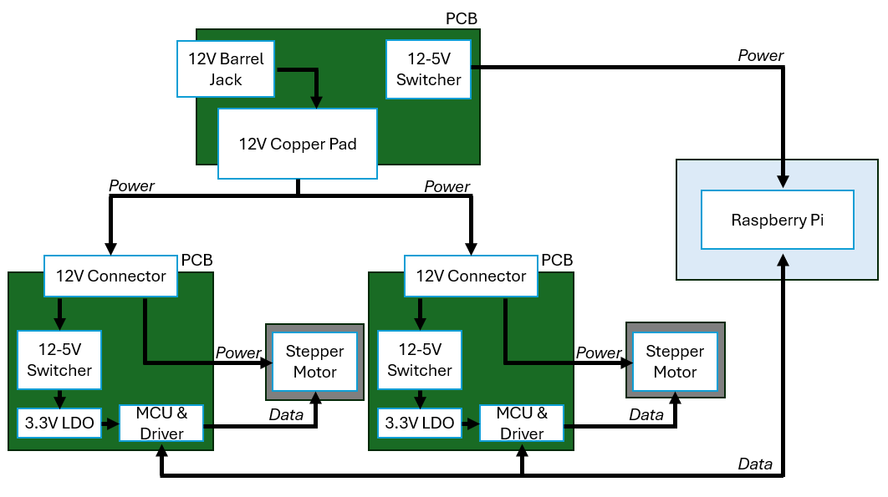
Block Diagram for Achieving Objective
Just explain the block diagram really tbh

Slide 31
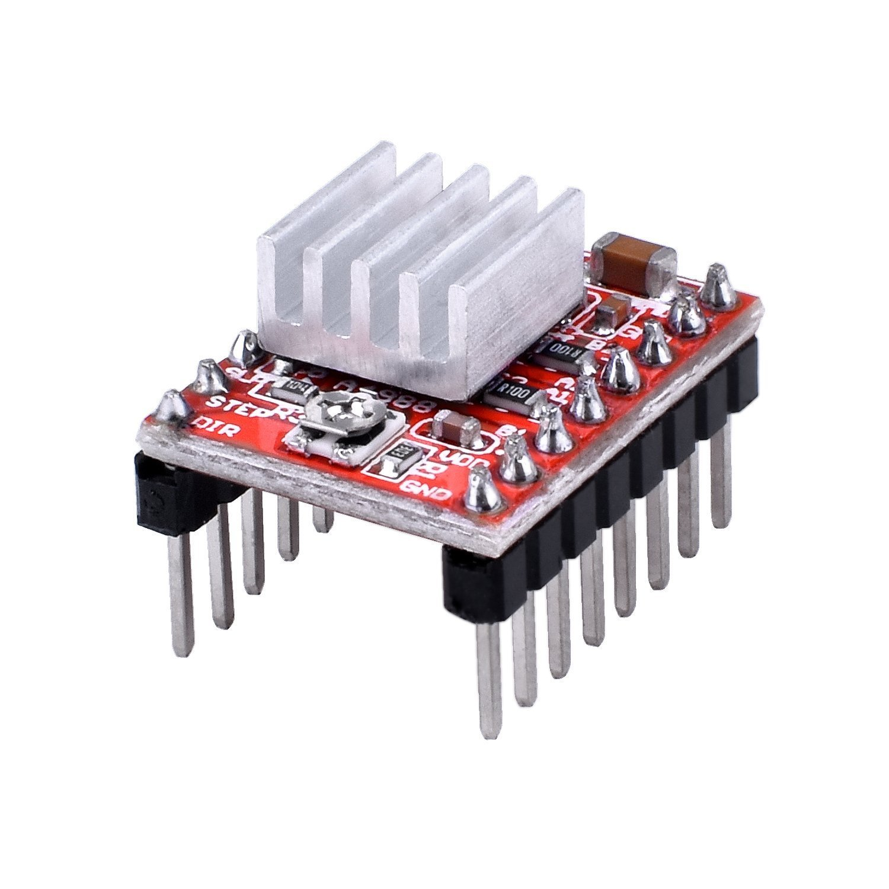
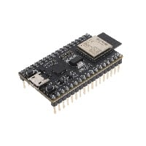
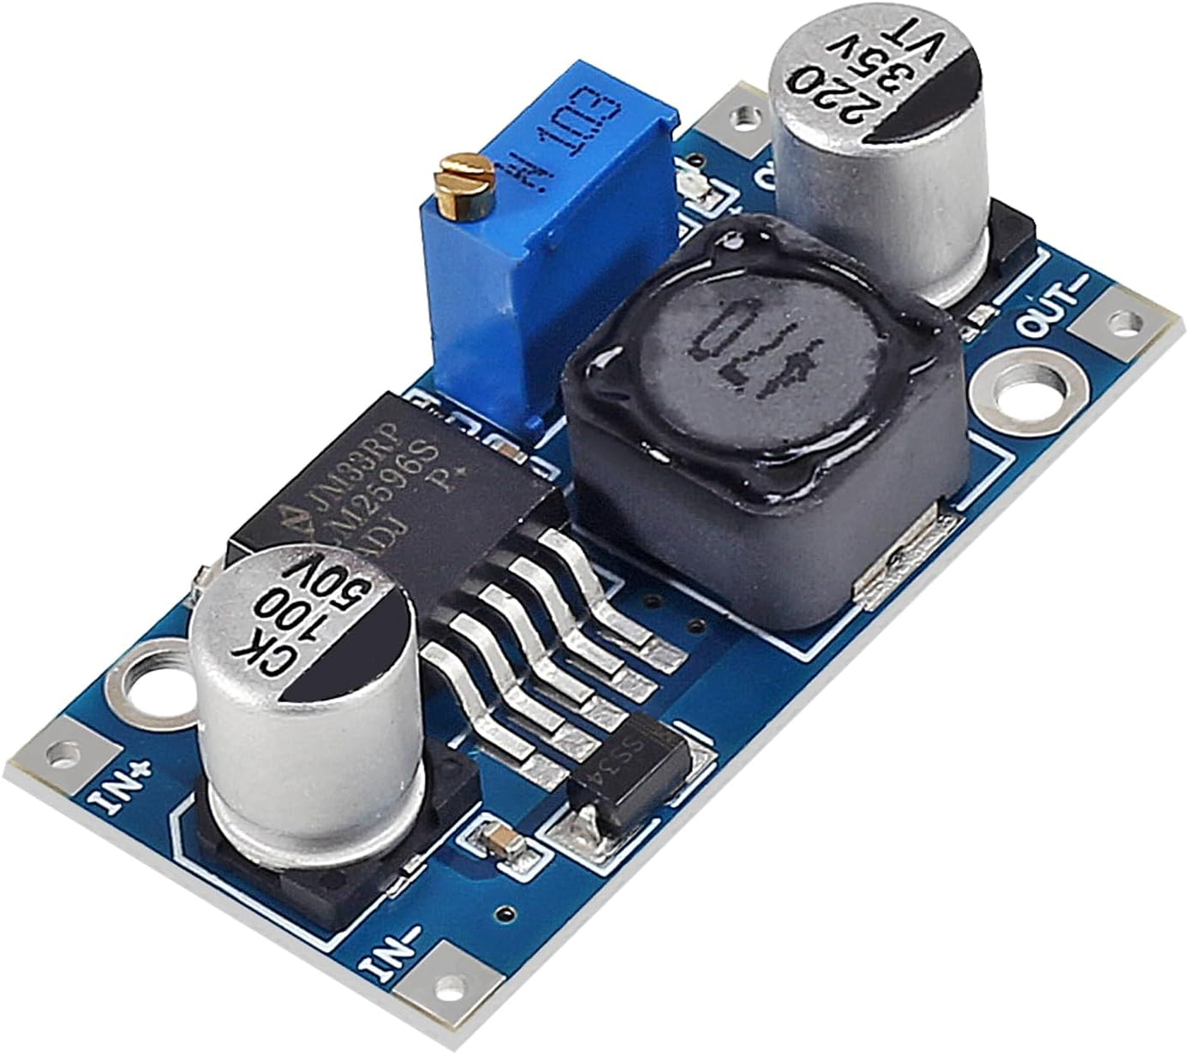
Finding Pre-Built Modules to Verify
System
Explain the quick arrangement of a demo Circuit with amazon parts
Cheap Stepper Driver
From Amazon
Cheap Microcontroller
from Amazon
Cheap DC-DC Convertor
from Amazon

Slide 32



Hardware Selection
Finding ICs to Make Better Hardware
Explain the selection of ICs to make better versions of the amazon parts
Stepper Driver
MCU
Switching Regulator
a4988 Stepper Driver IC
By Allegro MicroSystems
STM8S003F3P6TR
By STMicroelectronics
TPS62932DRLR
By Texas Instruments

Slide 33


Why Use that Stepper Driver?
Explain the selection of ICs to make better versions of the amazon parts
Simple STEP/DIR interface (no SPI, UART, or firmware configuration required)
Very low cost compared to newer drivers (DRV8825, TMC2209, etc.)
Massive ecosystem and proven reliability from years of 3D-printer/CNC use
Easy hardware integration
Microstepping set with pins, not registers
Built-in current limiting and chopper control (no external current regulation needed)
Existing Adafruit module makes PCB layout easier
PCB Layout

Slide 34


Why Use that MCU?
Explain the selection of ICs to make better versions of the amazon parts
Incredibly low price of only $0.40 per MCU
Strong price-to-peripheral ratio. It gives us GPIO, timers, ADC, UART, SPI, I²C, watchdogs, etc. without paying for high-end features we don't need.
Lower firmware complexity than larger MCUs like Arduino and ESP32. With fewer abstraction layers, it becomes easier to write low-level code
PCB Layout

Slide 35

Why Use that Switching Regulator?
Explain the selection of ICs to make better versions of the amazon parts
Ultra-low quiescent current (~12 µA)
Wide input range (3.8 V–30 V) allows use to use 12-24V to power our project
Spread-spectrum EMI reduction built-in which lowers noise emissions compared to legacy regulators
High duty-cycle capability (~98%)
Peak current-mode control with fast transient response, necessary when steppers cause current spikes
PCB Layout

Slide 36

Verification
Explain the selection of ICs to make better versions of the amazon parts
Switching regulator PCB has been manufactured but still needs to be assembled
All other PCBs have been verified to work in demo
All that’s left is integration and programming

Slide 37

What's Next?
Just need to build a PCB to plop all the modules together
The modules will be soldered together permanently.
This will integrate the components in a way that satisfies the SD2 requirements.

Slide 38

Software Required
ALMS Software
STM8 Programming
Raspberry Pi Automation
CSV Data Visualization
In this slide explain the three main uses of Software needed in this project.

Slide 39
Software Block Diagram
User begins program
Pi controls STM8s via UART/I2C
STM8 peripherals (Sensors, Stepper Driver, Buzzer)
Pi receives STM8s data
CSV Generation
Data Visualization
Final Datasheet

Slide 40
IDE Options for the STM8
This slide here explain how all options were explored and why ST Visual Develop was the better option
IDE / Toolchain | Compiler Support | Debugging Support | Ease of Setup | Cost | Pros | Cons
ST Visual Develop (STVD) | Cosmic C, Raisonance, SDCC | Full ST-LINK hardware debugging | Moderate | Free (IDE) | Native STM8 support, strong debugger integration, stable, professional workflow | Requires external compiler install
IAR Embedded Workbench | IAR C Compiler | Excellent debugging | Easy | Expensive (license required) | Very optimized compiler, professional toolchain | High cost, limited free version
PlatformIO (VS Code) | SDCC | Limited STM8 debug support | Moderate | Free | Modern UI, cross-platform | STM8 support is not mature
Eclipse CDT + SDCC | SDCC | Manual configuration | Difficult | Free | Highly customizable | Complex setup, not STM8-specific
Raisonance Ride | Raisonance C | Yes | Moderate | Limited free version | Good integration | License restrictions
ST Visual Develop was the better option because it contains native STM8 support, it was free and compatible with the ST-Link hardware debug functionality.

Slide 41


STM8 Programming via STVP/ST-Link V2
Software is natively compatible with ST-Link V2
Loads the generated .s19 or .hex firmware into the stm8
Reliable flash programming
For programming the stm8 mcus, we plan on programming them via swim. The ST-Link V2 was the best option we went with. While there are cheap clones that can program the stm8, they are susceptible to bricking suddenly. The software we used to program to the stm8 is the ST Visual Programmer. While there are other softwares that can upload to the stm8, this one is natively compatible with the ST-Link V2,

Slide 42

STM8 Libraries Required
STM8 Standard Peripheral Library (SPL)
  Official STMicroelectronics firmware library
  Used for GPIO, UART, I2C, Timer/PWM, Clock Configuration, ADC, etc.
  Hardware abstraction for STM8 peripherals

Slide 43


Single Board Computer Selection
Raspberry Pi 5 has built in Wi-Fi, more memory, and a faster CPU.
Raspberry Pi 5 CPU is favored for general-purpose computing, while the Jetson Nano CPU is favored for embedded AI projects.

Slide 44


Electronic Case
The case will act as an enclosure for all the PCBs and the Raspberry Pi.
Wire clamps make sure wires are not suddenly yanked from PCBs.
Cooling fan helps regulate temperature for all the electronics.

Slide 45

CSV Generation
Sensor data coming from stm8 will be inputted and categorized into csv via a python script
The C spot, D spot, and F spot will also be calculated and inputted into the csv.
This csv will then be inputted into LaTeX to start the datasheet process.

Slide 46
STM8 Communication Protocol Testing
Pi sends start signal over UART to STM8 to start sending strings over UART back to the Pi. This tests the UART protocol reception on both ends.
Pi
STM8
Terminal

Slide 47
STM8 PWM/Stepper Motor Testing
STM8
High signal gets sent to STM8 from Pi GPIO, this triggers PWM to start. The PWM signals are sent to stepper driver which steps the motor very slightly. This tests basic functionality with stm8 pwm and stepper driver.
Pi
Stepper Driver
Stepper Motor

Slide 48

Administrative content
 | Hardware | Optics | Electronics | Total
Budget Total | $350 | $350 | $2,500 | $3,200
Budget Spent | $106.97 | $288.38 | $1,934.12 | $2,329.47
Notes:
Budget & work distribution

Slide 49
Our next steps

