Slide 1

NG RISC-V ASIC Design
Critical Design Review
Group 13 - Anna Craig, Alexander DeFalco, Joshua Joseph, Daniel Odi, Alyssa Pinnock

Slide 2





Team Members
Anna Craig
Electrical Engineering
Alexander DeFalco
Computer Engineering
Joshua Joseph
Computer Engineering
Daniel Odi
Computer Engineering
Alyssa Pinnock
Computer Engineering
Notes:
*can re-arrange if photo circles are too small

Slide 3
Project Overview
The SCALER project is a Side Channel Leakage Reduction extension for a RISC-V Core. Its purpose is to design and layout a security extension to mitigate side channel attacks using boolean masking, noise injection, and random clock generation.
Notes:
For our senior design project, we decided to build SCALER, which is an extension to a RISC-V core that aims to mitigate side-channel attacks. -> Our main goal is to create our extension through following the full-flow ASIC design process, and we aim to mitigate side-channel attacks through implementing boolean masking, noise injection, and randomized clock generation.

Slide 4
Motivation & Background
The industry lacks new grads with capabilities in the ASIC flow
As hardware security becomes increasingly critical, side-channel attacks pose a serious threat by exploiting physical leakages such as power and timing. SCALER was motivated by the need to explore hardware-level countermeasures that can be integrated directly into processor architectures to improve security.
Notes:
For our senior design project, we decided to build SCALER, which is an extension to a RISC-V core that aims to mitigate side-channel attacks. -> Our main goal is to create our extension through following the full-flow ASIC design process, and we aim to mitigate side-channel attacks through implementing boolean masking, noise injection, and randomized clock generation. Mention RTL-GDSII flow?

Slide 5
What is a Side-Channel Attack?
Types of SCAs
Type of passive hardware attack based on obtaining data through side channels while a device is in operation
Side-channel leakage can include cryptographic keys, user data, memory information, etc.
Simple Power Analysis (SPA): Visual inspection of power traces to find clear patterns
Differential Power Analysis (DPA): One of the most powerful techniques that utilizes statistical analysis on power traces to find differences in power draw
Correlation Power Analysis (CPA): A form of DPA that uses statistical techniques to correlate power consumption with predicted data values
Notes:
alyssa

Slide 6
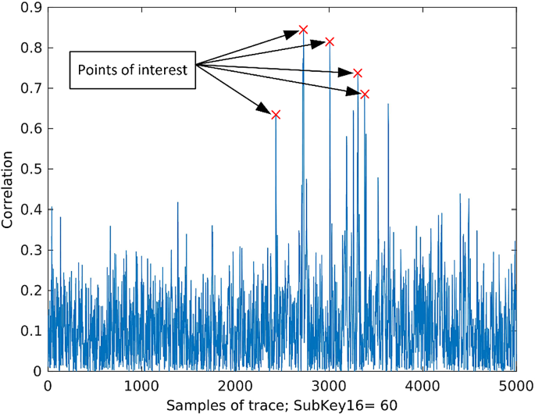
Why CPA for SCALER?
Most effective against AES-128 encryption
CPA is more sensitive and requires fewer traces than DPA
Provides a clear and measurable baseline for comparison
Power Trace Analysis
Red spikes indicate high correlation between power and key byte predictions
Notes:
Edit slide to continue from previous one - alyssa

Slide 7
Basic Goals:
Become familiar with the ASIC design process
Learn to effectively use Cadence EDA tools
Develop extension(s) to a baseline RISC-V core design that reflect mitigation to power-based side-channel attacks
Synthesize modified RISC-V core using a 45nm process node
Perform functional verification of RTL designs through directed testbenches and UVM-based environments
Execute RISC-V assembly programs to validate ISA compliance and system-level functionality
Produce clear documentation describing design methodology, flow, and encountered challenges/troubleshooting
Notes:
Alex (someone else can do too) [will reduce the information on this slide soon]

Slide 8
Basic Objectives
Instantiate baseline RISC-V core to ensure functional foundation
Develop RTL modules to integrate custom extension(s), enforcing noise injection and clock randomization, targeting the modified core
Run a RISC-V compliance test suite in assembly to confirm ISA correctness
Document tool usage and workflow in a step-by-step manner
Simulate the modified RTL design in Cadence Xcelium using representative workloads
Complete various cadence training courses pertaining to the ASIC design flow

Slide 9
Engineering Specifications
Parameter | Specification
Instruction Set | RV32I
Operating Temperature Range | 0 C-120 C
Operating Voltage Range | 0.95 V - 1.25 V
Process Node | ~ 45nm
IR Drop | ≤ 5%
Average Frequency | ≥ 250 MHz
Parameter | Specification
Masking Order | First-Order Minimum
Instructions per Cycle (IPC) | ≤ 1.2
Cache Size | ≥ 16 MB
Timing Failure Count | 0 Faults
Interrupt Latency | ≤ 12
Leakage Power (25 C) | ≤ 5 mW
Notes:
These are our engineering specifications. These were obtained through extensive research, as well as discussions with our sponsors and group members. The RV32I instruction set was selected to provide a standardized, lightweight baseline architecture that minimizes unnecessary complexity while still supporting full software toolchain compatibility. Our other measurable requirement is the 45nm process node, which balances manufacturability, cost, and predictable leakage characteristics. Lastly, our timing failure count was 0 faults, which we proved in our functional verification of the modules.

Slide 10
Software Comparison & Selection
Software | Cadence Design Suite | Synopsys Tools | Siemens EDA | Open Source
Strengths / Pros | Widely adopted EDA flows, large variety of tools such as Xcelium, Genus, SimVision. Extensive learning resources & documentation. | Industry standard for digital design, synthesis, STA, and signoff. Best-in-class verification and timing closure tools. Strong silicon signoff trust. | Extremely strong in verification, DFT, and PCB/system design. Popular tools include QuestaSim, Tessent, and HyperLynx. Strong system validation presence. | Zero licensing cost. Highly customizable. Growing digital ASIC flow support easy automation and scripting.
Weaknesses / Cons | High licensing cost & steep learning curve. | High licensing cost. Toolchain integration sometimes complex across flows. | Smaller ecosystem for full ASIC flow. Some tools are niche focused. Licensing still expensive. | Limited advanced node support. Limited official vendor support. Less mature signoff flows. Tool compatibility issues.
Best Use Case | Full custom IC design, mixed-signal ASICs, analog front-ends, and advanced SoC physical design. | Large scale digital ASIC and SoC production flows requiring silicon signoff accuracy. | Verification heavy environments, DFT workflows, automotive and aerospace electronics, and PCB + system level validation. | Academic research, prototyping, startups, early architecture exploration.
Notes:
For ASIC design flow, there are many different tools that have the capabilities we need. To confirm our choice, we compared a few different EDA design environments. Cadence ultimately had the best ratio of pros/cons for our purposes. Its use case is for Full custom IC design, which aligns perfectly with out project. Since were sponsored, we were able to obtain licensing at no cost.

Slide 11
Process Node Selection
Feature | SkyWater SKY130 (130 nm) | GlobalFoundries GF180MCU (180 nm) | Cadence GPDK 45 nm
Process Node | 130 nm CMOS | 180 nm CMOS/MCU | 45 nm CMOS (generic)
Strengths / Pros | Active open-source ecosystem; rich digital and analog cells; documented tapeout path; strong community support; mixed-signal friendly | Strong analog / I/O support; robust MCU-oriented process; predictable and mature device models; well-suited for high-voltage interfaces | Smallest feature size among the three; high density; faster switching speeds; better energy efficiency; representative of modern processes
Weaknesses / Cons | Larger geometry than advanced nodes; slower switching speeds; higher power for equivalent functionality | Larger geometry; slower switching speeds; less area-efficient; more limited open-source tooling and flows than SKY130 | Generic PDK rather than a full production process; often assumes commercial Cadence EDA tools for advanced flows
Best Use Case | Academic research, teaching, prototyping, mixed-signal ASICs, and open-source shuttle tapeouts | MCU design, embedded systems, high-voltage-tolerant blocks, and robust analog integration | High-performance digital ASIC prototyping, methodology and tool evaluation, and technology comparison studies
Community / Ecosystem | Large, active open-source community; strong OpenLANE and open-flow support | Smaller community; some open documentation but less community tooling than SKY130 | Minimal open-source community; primarily used in Cadence training and academic EDA flows
Notes:
Josh wrote about this i think? Not entirely sure

Slide 12
ISA Comparisons
Category | License | ISA Type | Customization | Common Uses
RISC-V | Open-source, free | RISC (simple) | Very high (extensions allowed) | Research, FPGA, custom SoC, IoT
ARM | Proprietary license | RISC (moderate) | Limited | Mobile, embedded systems
x86 | Proprietary license | CISC (complex) | Very limited | PCs, laptops, servers
Notes:
I think i wrote abt this idk ill have to look -anna

Slide 13
Hardware/Baseline Core Comparison
Core | μarch | Language | Verification | + | -
Rocket Chip | In-order, Single-cycle datapath, RV32/64 | Chisel (generates Verilog) | Mature via Chipyard regressions | Showcased SoC integration, scalable ecosystem | Chisel abstraction layer, large codebase
NEORV32 | In-order, 2-stage pipeline, Configurable RV32-I/IMC/EMC | VHDL | Solid self-tests, emphasis on precise exceptions | Beginner-friendly, fit on small FPGAs (stretch goal) | VHDL, no pre-packaged SoC/MMU integration
PicoRV32 | In-order, RV32IMC | Verilog | Open-source maturity shows significant coverage | Fit on small FPGAs (stretch goal), high documented max frequency on 7-series chips, straightforward integration | No cache/MMU (limits SoC integration)
Ibex | In-order, configurable 2/3-stage pipeline, RV32IMC | SystemVerilog | Strong UVM environment, formal proofs, and OpenTitan DV coverage | Clear SV RTL, flexible configurations, security-conscious design philosophy, pre-packaged test env | No cache/MMU, modest performance documented
Notes:
Alex will fill in rest of table

Slide 14
Hardware/Core Comparison
Note: convert image into table
Core | μarch | Language | Verification Maturity | + | -
Rocket Chip | In-order, Single-cycle datapath, RV32/64 | Chisel (generates Verilog) | Mature via Chipyard regressions | Showcased SoC integration, scalable ecosystem | Chisel abstraction layer, large codebase
NEORV32 | In-order, 2-stage pipeline, multi-cycle datapath, Configurable RV32-I/IMC/EMC | VHDL | Solid self-tests, emphasis on precise exceptions | Beginner-friendly, fit on small FPGAs (stretch goal) | VHDL, no pre-packaged SoC/MMU integration
Xiangshan | Out-of-Order, superscalar, speculative, RV64GCV | Chisel (generates Verilog) | Active simulation development, comprehensive coverage | High-performance, multi-level cache and MMU structure, vector instruction support | Heavy dependencies, incomplete English documentation, Chisel abstraction layer, 64-bit
PicoRV32 | In-order, RV32IMC | Verilog | Open-source maturity shows significant coverage | Fit on small FPGAs (stretch goal), high documented max frequency on 7-series chips, straightforward integration | No cache/MMU (limits SoC integration)
Ibex | In-order, configurable 2/3-stage pipeline, RV32IMC | SystemVerilog | Strong UVM environment, formal proofs, and OpenTitan DV coverage | Clear SV RTL, flexible configurations, security-conscious design philosophy, pre-packaged test environment | No cache/MMU, modest performance documented (trade-off area/power/perf)
Core | Microarchitecture | Language | Strengths | Weaknesses
Rocket Chip (Rocket CPU) | In-order, single-issue (RV32/64) | Chisel (generates Verilog)
NEORV32 | In-order, 32-bit MCU-class | VHDL
Xiangshan | Out-of-order, superscalar, speculative (RV64GCV) | Chisel
PicoRV32 | In-order, minimalist RV32IMC | Verilog-2001
Ibex | In-order, 2-stage RV32IMC (configurable) | SystemVerilog
Notes:
Alex will fill in rest of table

Slide 15
Hardware Realization (ASIC vs. PCB)
Much of Senior Design is oriented around the research, design, layout/implementation, and fabrication of PCBs in order to realize some functionality,
This project is unique in the sense that there is no PCB deliverable (or any direct physical component)
  Instead, our deliverables will include:
    Synthesized fabric netlist(s) of our design
    Cadence Innovus layout(s)
    GDS-II (mock-tapeout)
    STA/power/IR analysis reports

Slide 16
Design

Slide 17
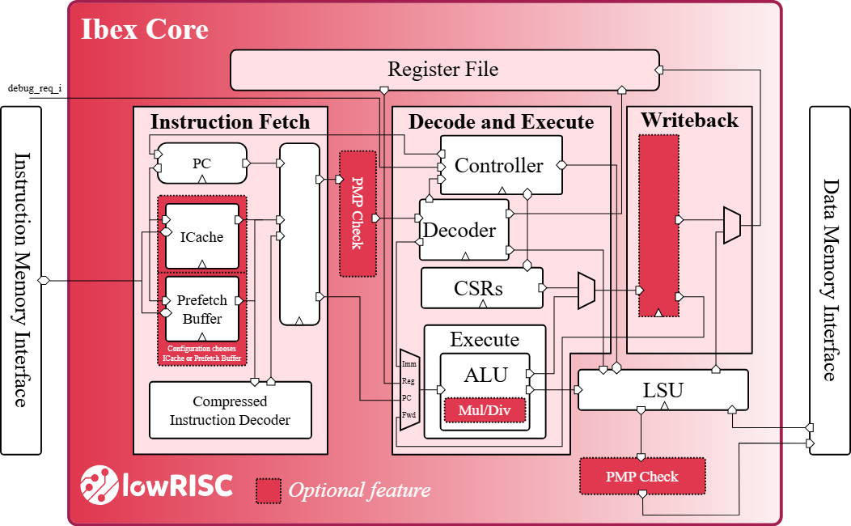
Ibex Core
32-bit, open-source RISC-V CPU developed by lowRISC
Implements the RV32IMC instruction set
Two-stage or three-stage pipeline options
  Opted for two-stage

Slide 18
Hiding Techniques
Technique | Purpose / Mechanism | Advantages | Limitations / Challenges
Random Noise Injection | Adds randomness to power usage; uses LFSRs, ring oscillators, toggle logic; lowers signal-to-noise ratio for attackers | Simple hardware integration; works with existing RTL/software; complements other techniques | Only hides leakage; increases power overhead; may affect timing stability
Random Dynamic Frequency Scaling/Clock Randomization | Randomizes operating frequency; misaligns power traces | Low hardware cost; highly effective misalignment; protects all workloads during use | Still allows leakage with many traces;; performance and power efficiency vary
Random Delay Instruction Insertion (RDII) | Inserts random NOPs or stalls; misaligns event timing; added via compiler or hardware stalls | Very low hardware cost; adjustable randomness; ISA-compatible for RISC-V | Requires toolchain modification; adds execution time variability; vulnerable to advanced trace alignment
Notes:
josh

Slide 19
Masking Techniques
Technique | Leakage Resistance Level | Glitch Resistance | Hardware Overhead (Area/Power) | Randomness Requirement
First-Order Boolean Masking | First-order (protects against single-point leakages) | No | Low to Moderate | Moderate (requires fresh randoms for secure gates)
Higher-Order Boolean Masking | Up to n-th order (depending on number of shares) | No | High (scales with number of shares) | High (more random shares needed)
Arithmetic Masking | First- to higher-order (depends on share count) | No | Moderate to High | High (requires many fresh randoms, especially in hybrid schemes)
Threshold Implementation (TI) | High (provably secure against glitch-induced leakage) | Yes | High (increased gate count and latency) | Moderate (additional randoms for uniformity)
Domain-Oriented Masking (DOM) | High (resists higher-order and glitch-induced leakages) | Yes (separates domains to prevent share interaction) | Moderate to High | Moderate (fresh randoms used for cross-domain operations)
Notes:
josh

Slide 20
Evaluation of Generating Randomness
Type | Source / Mechanism | Typical Role / Notes | Limitations / Challenges
True Random Number Generator (TRNG) | Physical noise (thermal noise, jitter, metastability) | High-entropy, unpredictable bits; used to seed other generators and generate long-term keys | Only hides leakage; increases power overhead; may affect timing stability
Non-cryptographic PRNG (e.g., rand()) | Simple deterministic algorithm | Fast and easy to implement; suitable for simulations and non-security uses; not safe against attackers | Still allows leakage with many traces; may cause timing or synchronization issues; performance and power efficiency vary
Notes:
josh

Slide 21
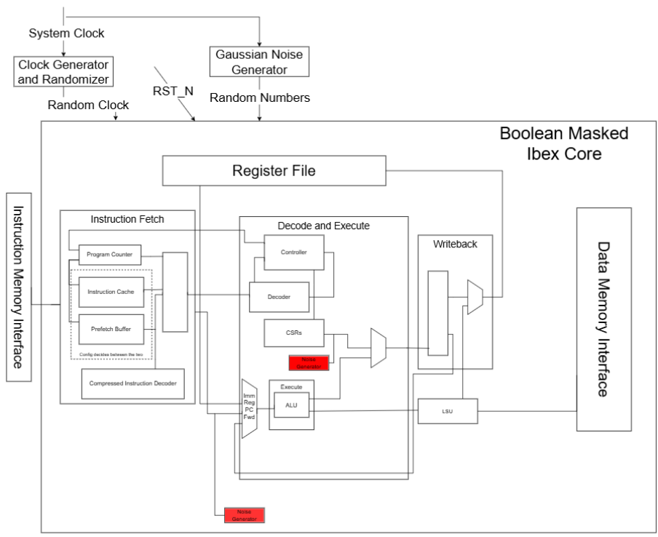
Core Redesign
Main design changes:
Clock Generator and Randomizer
Boolean Masked Core
  Random Numbers generated for GNG IP Core
Noise Generators
  Ring Oscillators
  CASRs

Slide 22
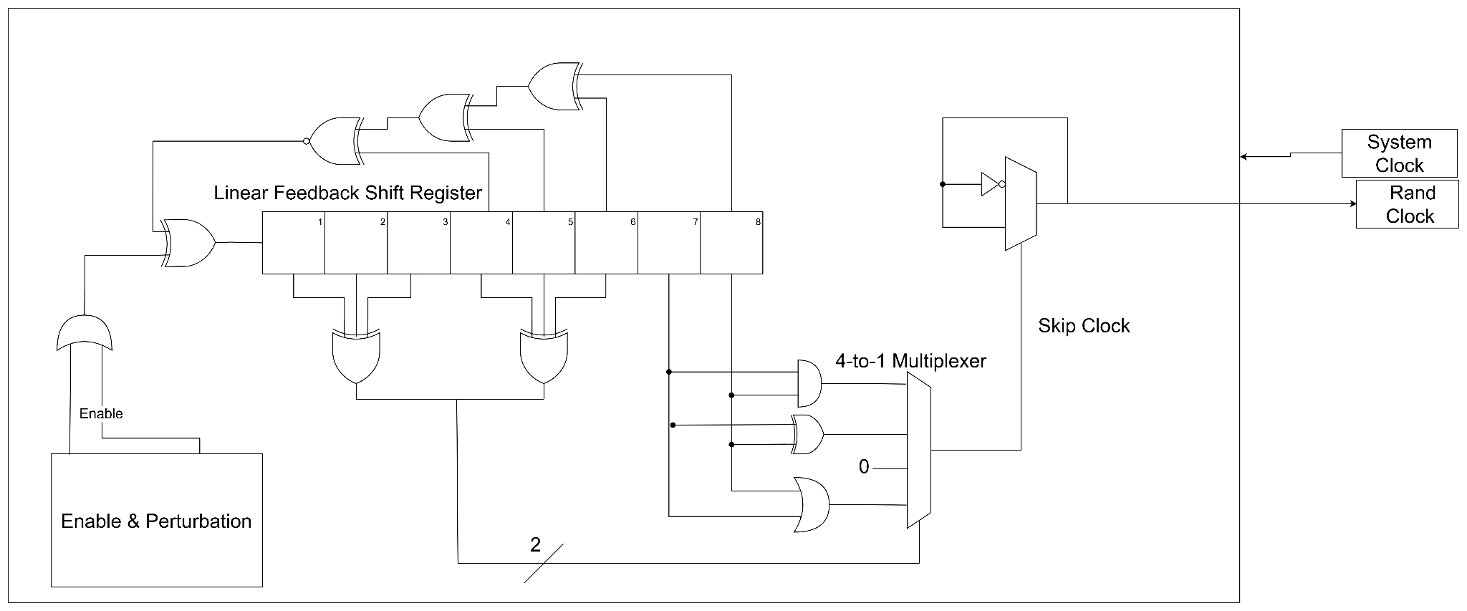
Clock Generator and Randomizer
Generates Random Clock based on System Clock and LFSR outputs

Slide 23
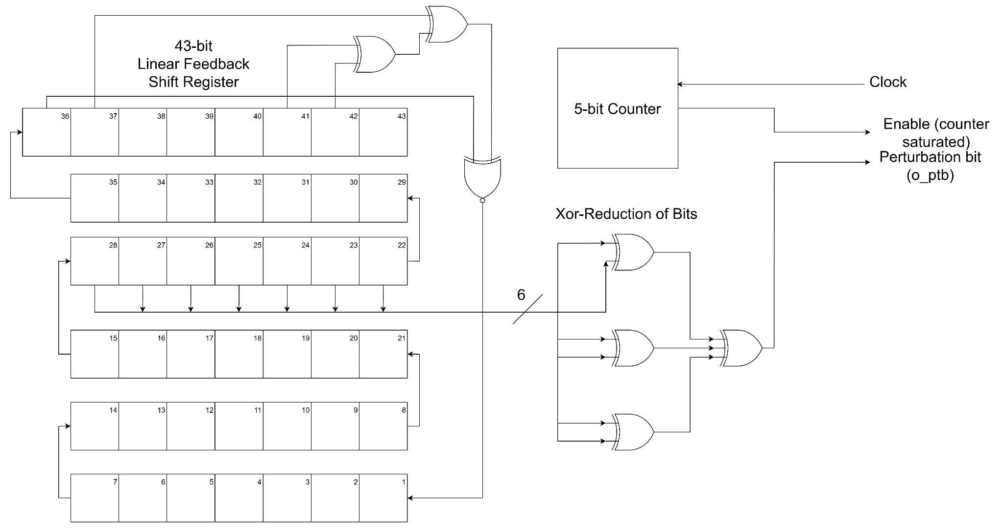
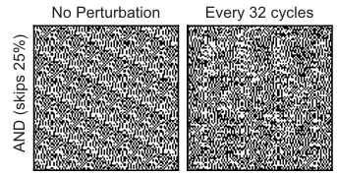
Perturbation Logic to Increase Randomness
Generates Random Clock based on System Clock and LFSR outputs

Slide 24
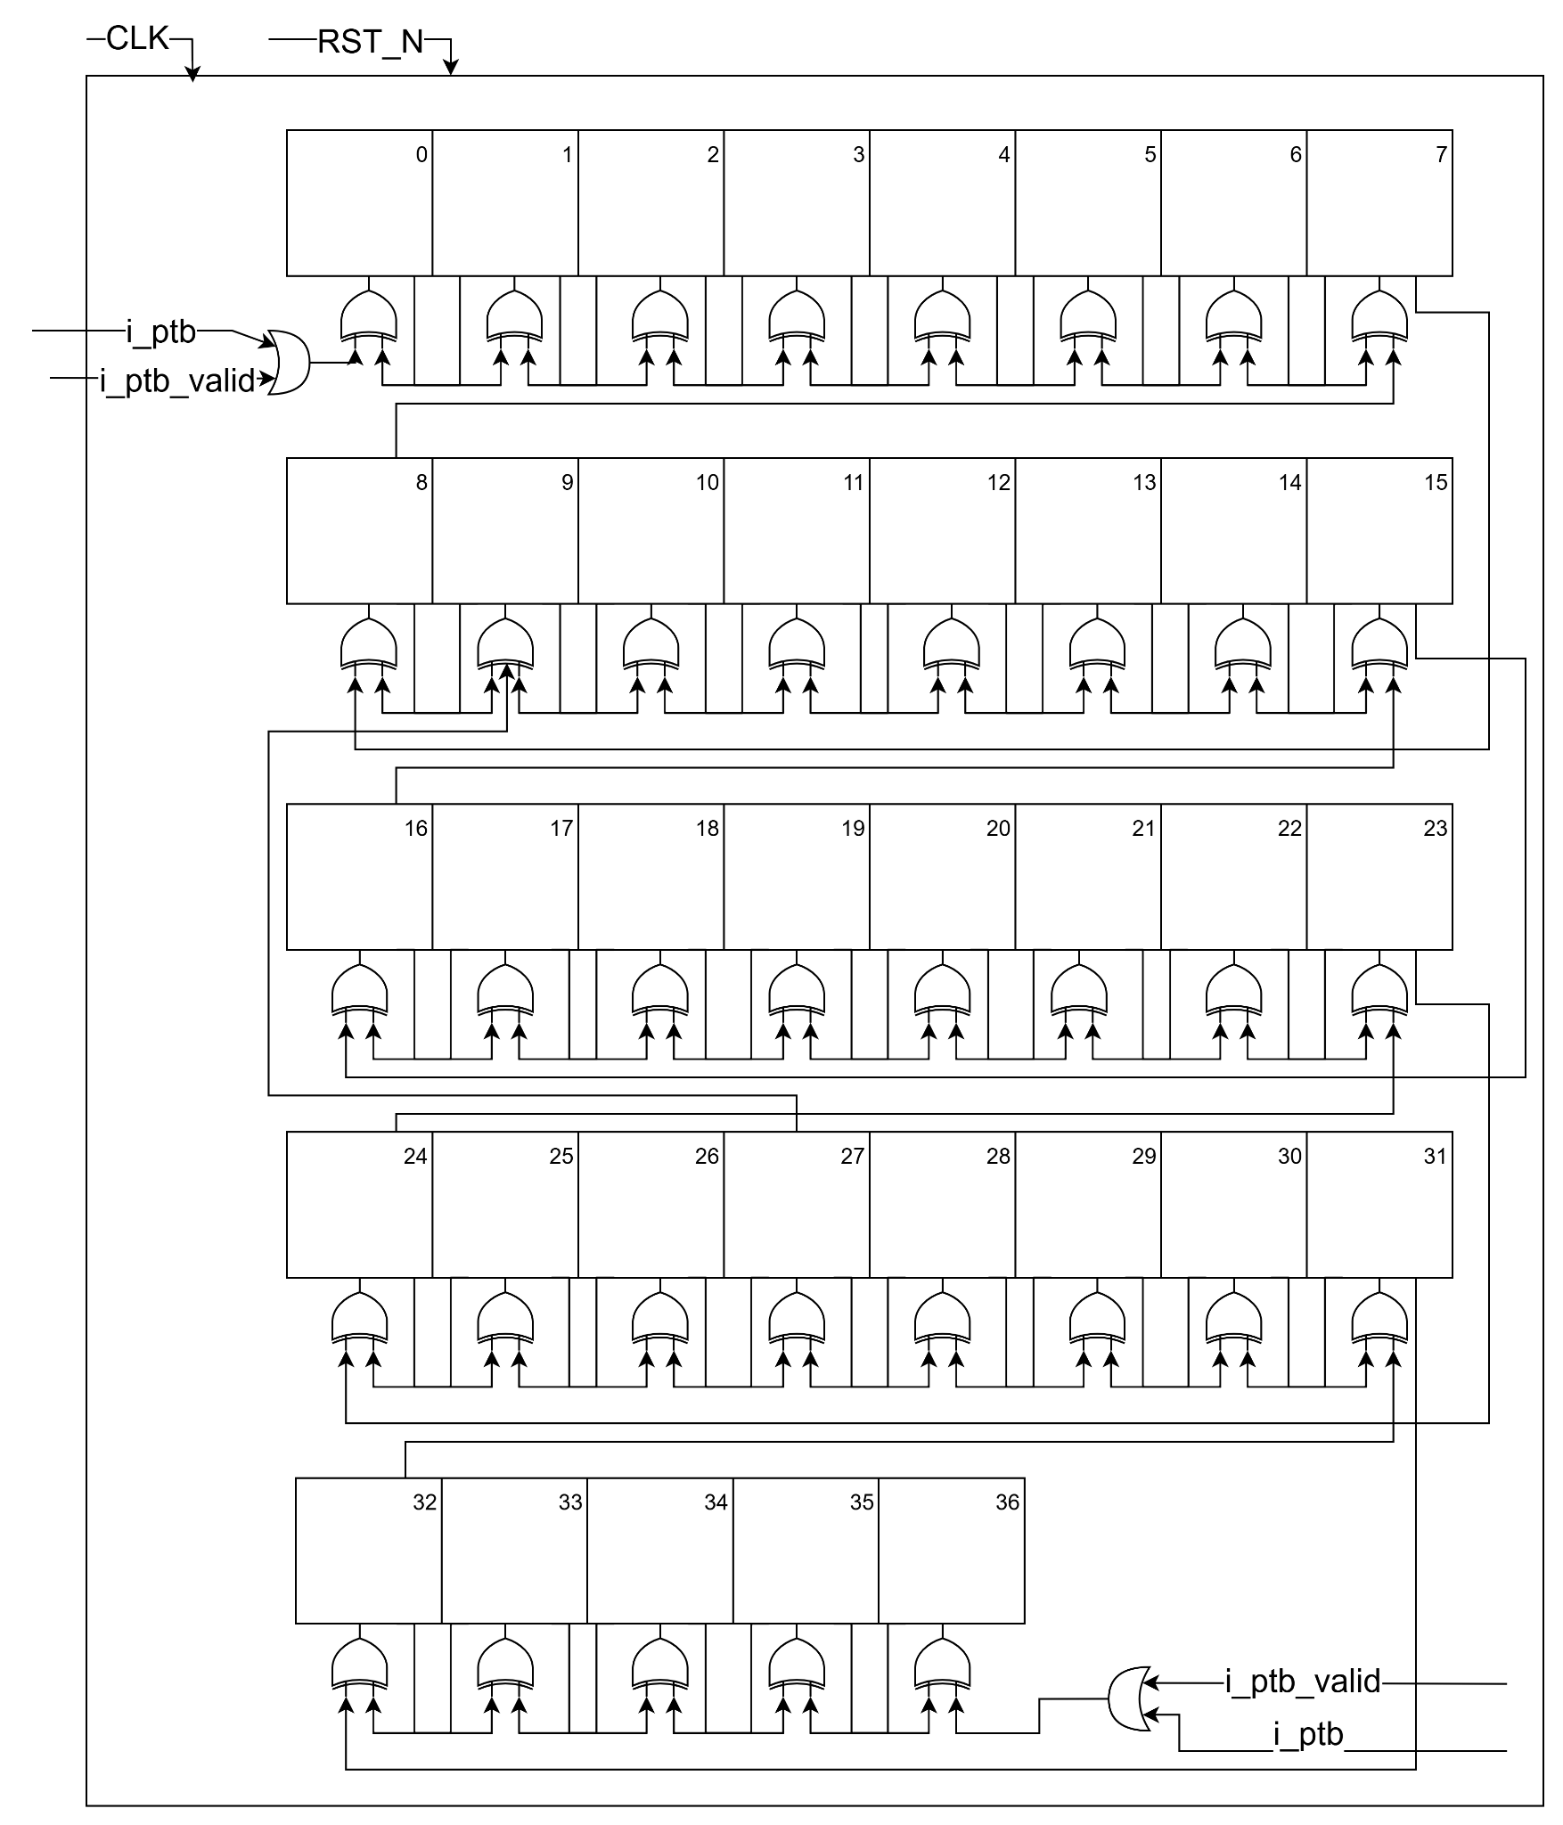
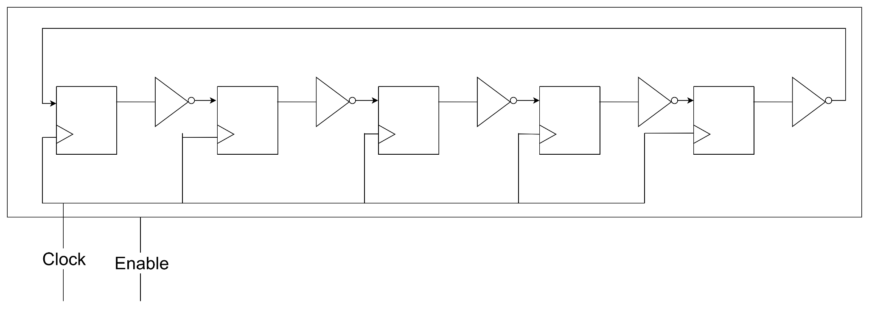
Noise Generators
Increases power consumption in circuit to obfuscate correlation between power and data being processed
Enable bit to trigger activation depending on certain activity in circuit
Types of Noise Generators
  Ring Oscillators
  CASRs

Slide 25
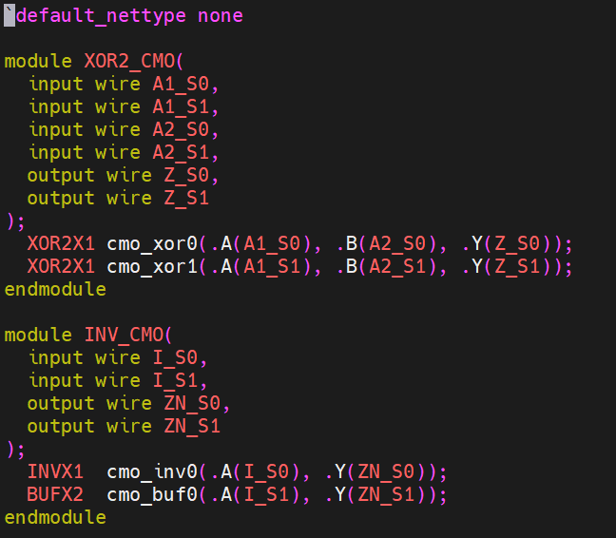
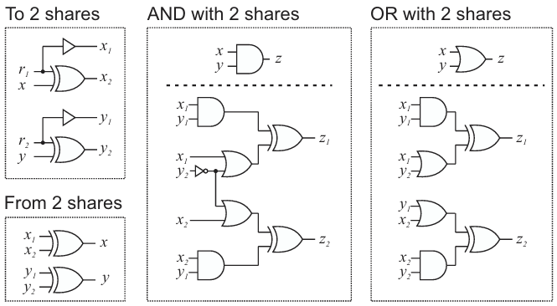
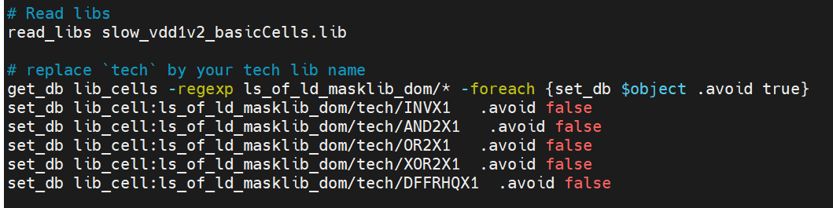
Boolean Masking
Replace gates in processor with secure variations
  Secure gates are made with gate primitives from Standard Cell Library (GSCLIB045)
  Design is first synthesized with limited gate set, then replaced with secure gates

Slide 26
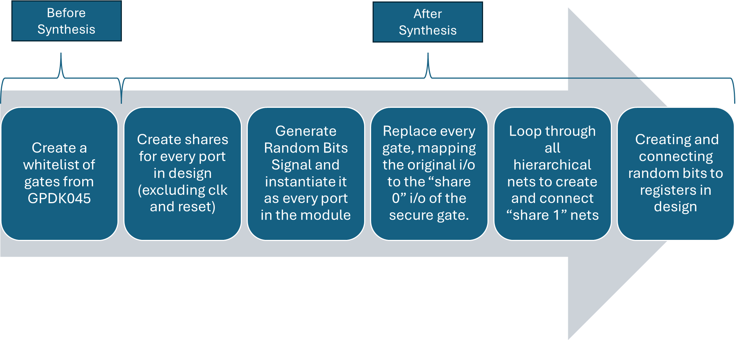
Utilization of Tcl scripts for Boolean Masking

Slide 27
Verification

Slide 28
Verification for ASIC designs
1
2
3
4
Verification Planning
Functional Verification
Universal Verification Methodology (UVM)
Signoff & Final Validation
Define coverage goals
Establish test strategies
Converse with design team
RTL correctness
ISA compliance
Security logic functional correctness
Corner cases
Coverage closure
Security stress testing
Full regression pass
STA sign-off confirmation
Final behavior validation
Notes:
This slide shows the overall verification journey we follow to make sure our ASIC design is fully functional. We start with verification planning, where we define our coverage goals and how we will test the design. Next, functional verification checks that the RTL actually does what it is supposed to do, including architecture compliance and making sure security features behave correctly. After that, we scale testing using UVM to hit corner cases, close coverage gaps, and stress test security mechanisms, and finally we move into signoff where we run full regressions, confirm timing through STA, and validate final behavior before tapeout.

Slide 29
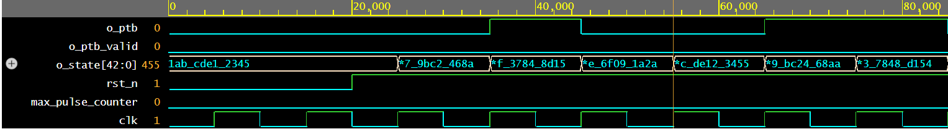
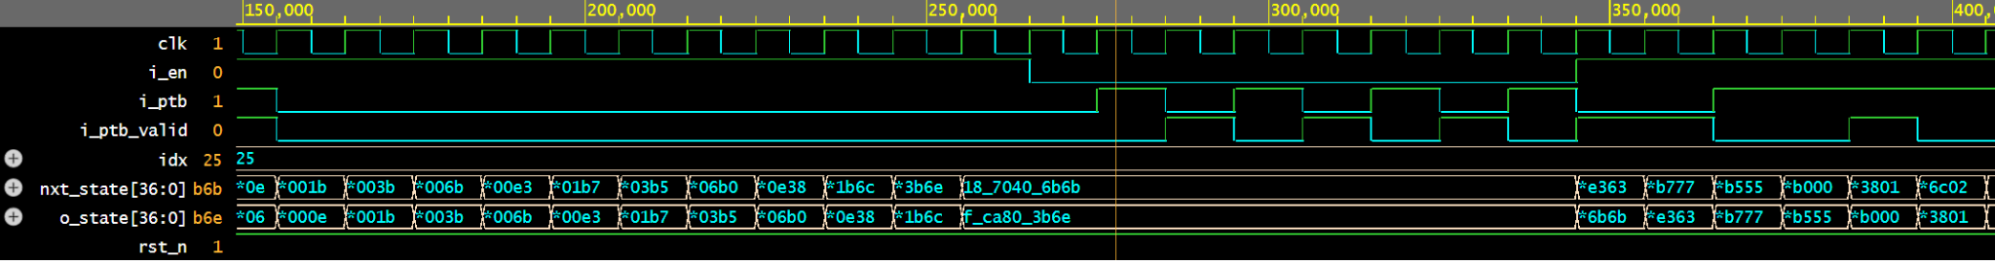
Functional Verification
Linear Feedback Shift Register
Cellular Automata Shift Register
Notes:
To verify each module, we built basic functional testbenches that generated waveforms showing how the signals behaved on every clock cycle. The goal was to confirm that the internal state, outputs, and control signals all matched the expected behavior from our design specification. We used EDA Playground for quick simulation, clocking, reset control, and stimulus generation.
On this slide, you can see examples from two modules. In the LFSR, the o_state register shifts left every cycle with a new feedback bit inserted, showing the expected pseudo-random progression. In the Cellular Automata shift register, you can see nxt_state updating based on the neighbor rules, and signals like i_ptb and i_ptb_valid correctly controlling perturbation at the boundaries.

Slide 30
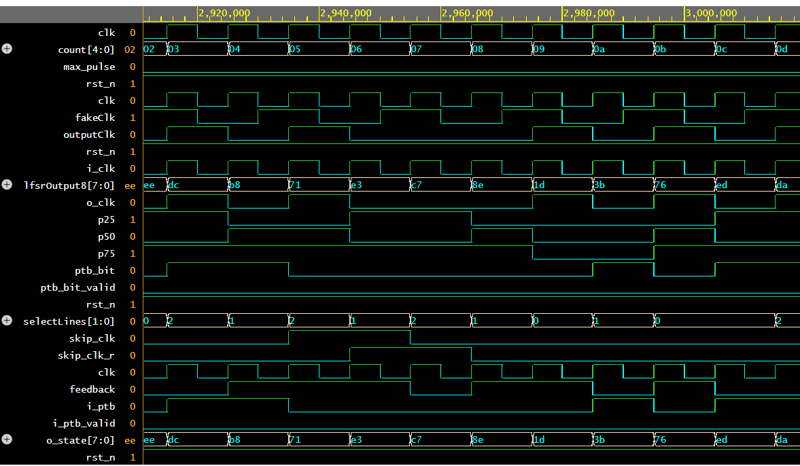
Clkgen Module Verification
Running testbench for clkgen.v
Verification of clock randomizer with results shown in waveform:
Notes:
***other modules?
Alyssa
Here, we were able to verify the clock generation module, which is the clock randomizer design that Josh explained earlier.
In this simulation, we ran our clkgen testbench to observe how the module handles clock edge skipping based on the LFSR-generated patterns. (LFSR = linear feedback shift register)
As shown in the waveform, the output clock toggles irregularly and confirms that our randomization logic works as intended.
You can also see the initial reset and the regular 100 MHz input clock driving the module, with the skipped edges visible in the simulation waveform results.

Slide 31
DV, Program-Driven Verification Flow
Key Idea: execute real RISC-V programs on the modified Ibex core, with testbenches checking for architectural correctness
RISCV-DV, an open-source instruction generator for RISC-V processor verification, generates constrained-random assembly programs
These programs are compiled with RISC-V GCC
UVM testbench loads the binary into a shared memory model
Modified Ibex core executes tests in simulation while monitors and scoreboards
check behavior
Outputs a pass/fail with first memory trace mismatch location

Slide 32
Co-Simulation Dataflow
Co-simulation invokes Spike, a RISC-V ISA simulator, to act as a golden reference model
Upon an instruction retiring, Ibex emits an RVFI (Risc-V Formal Interface) record, logging such
UVM scoreboard steps Spike one instruction forward, comparing Ibex/modified core results to the golden model
  Any divergence is logged immediately, and is noted as the first memory trace mismatch

Slide 33
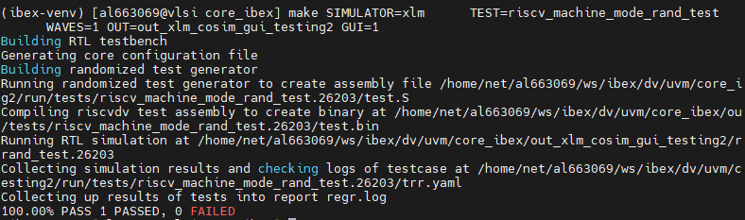
DV + Co-Simulation Environment
DV + Co-sim environment enables constrained, random testing of our core
An expansion of the environment packaged with the lowRISC Ibex Core
Can control simulator, testcase(s), seeding, iterations, and waveform output
Last line showcases the Pass/fail output

Slide 34
DV Environment “Software Design”
Diagrams 6.20-6.23 from SD1 report could be used in this (Alex)
Notes:
Alex

Slide 35
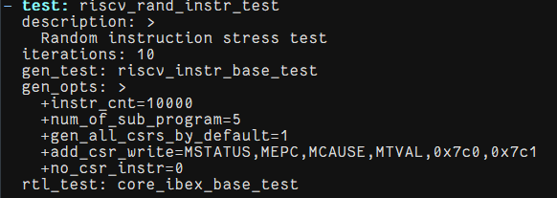
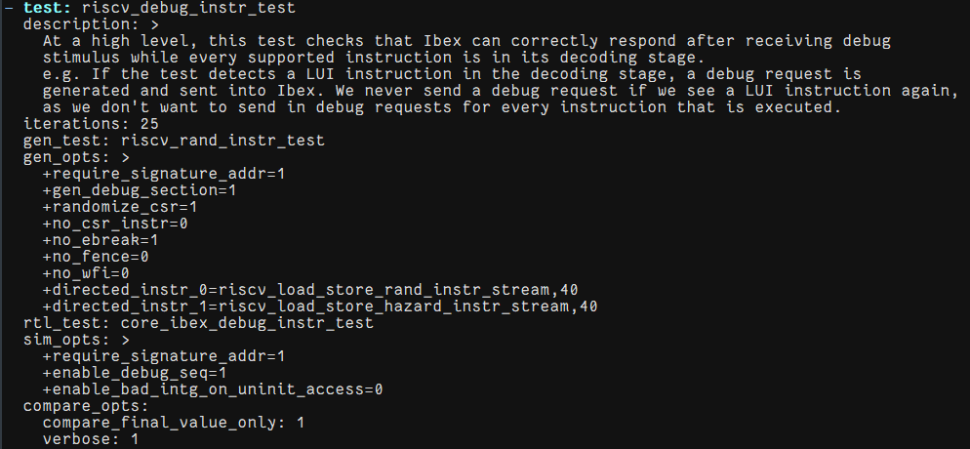
Design Verification + Co-Simulation Test suites
Pre-packaged YAML file includes various tests that build off one another
  Great foundation for improving coverage of our extension
Notes:
Alex

Slide 36
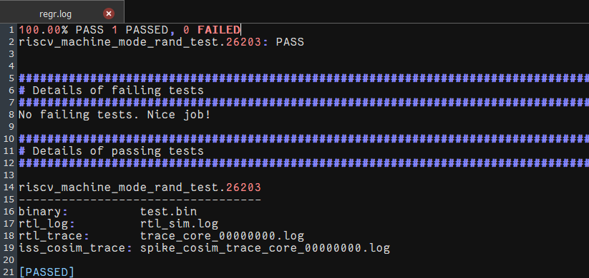
Design Verification + Co-Simulation Output 1
Various granularities of output files are generated
  Regression.log for simple throughput
Notes:
Alex

Slide 37
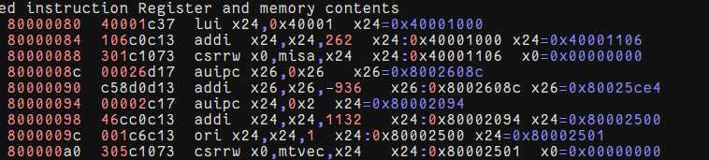
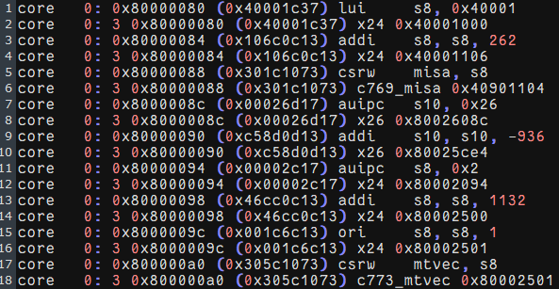
Design Verification + Co-Simulation Output 1
Various granularities of output files are generated
  Ibex/SCALER vs SPIKE ISS (co-sim) memory traces
SoC:
Spike:
Notes:
Alex

Slide 38
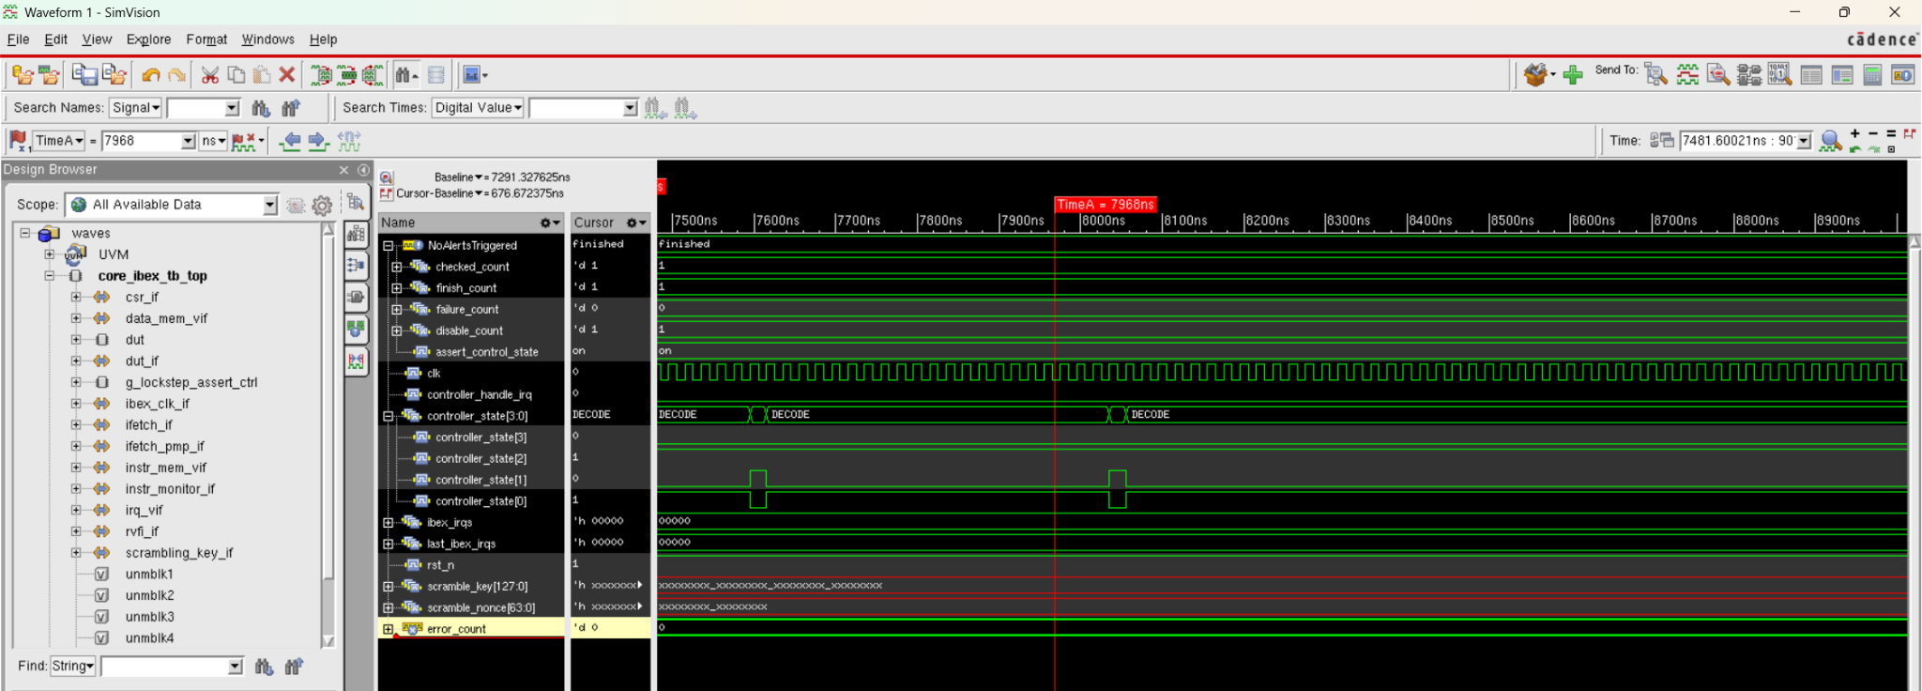
Design Verification + Co-Simulation Output 2
Various granularities of output files are generated
  .shm output to view waveforms in SimVision (Cadence Toolchain)
Notes:
Alex

Slide 39
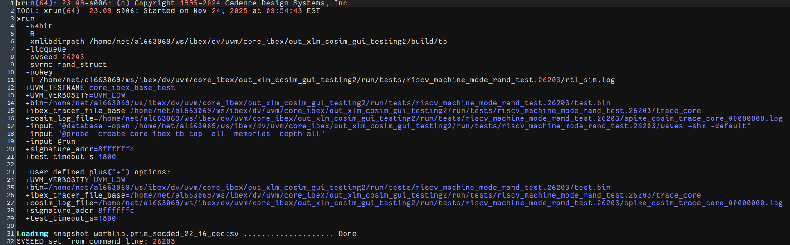
Design Verification + Co-Simulation Output 4
Various granularity of output files are generated
  rtl_sim.log
Notes:
Alex

Slide 40
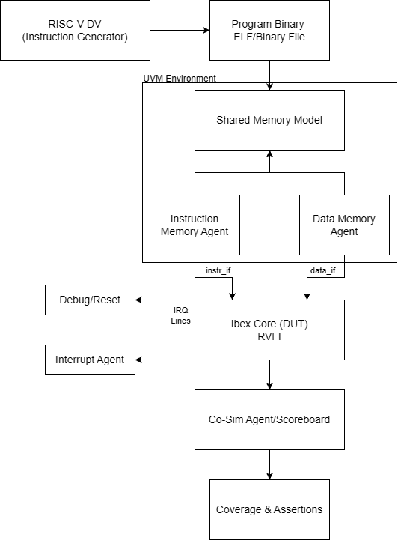
Ibex UVM Testbench Architecture Overview
6.20 in paper

Slide 41
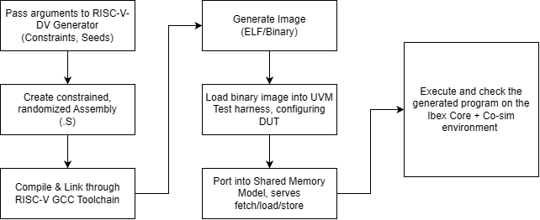
RISC-V-DV Test Generation and Integration Flow
6.21 in paper

Slide 42
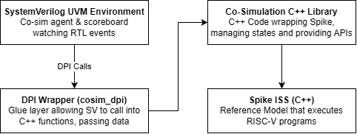
Co-Simulation Software Stack for Ibex and Spike
6.22 in paper

Slide 43
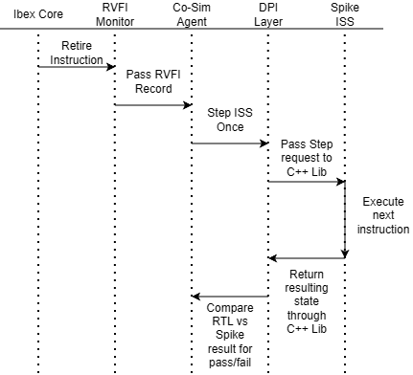
Per-Instruction Co-Sim Seq. b/w Ibex and Spike
6.23 in paper

Slide 44
Prototyping & Testing

Slide 45
System Testing & Verification
Purpose: verify architectural correctness of the design through utilizing the Ibex DV environment
Steps to system testing:
Test program generated with RISC-V DV
Program compiled and loaded into UVM memory model
Core executes program under memory timing, interrupt patterns, and debug events
UVM monitors activity during execution
An end condition is met, which will be evaluated to determine whether it had passed or not

Slide 46
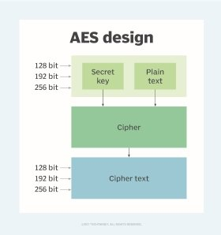
Functional Testing
Attacker Model
Testing the pre and post-modified Ibex core
Functional testing requires an attacker model and a leakage model to properly analyze
Simulation of AES-128 for encryption of plaintext schedule
Attacker can exploit the key through observing power traces per encryption

Slide 47
Leakage Model Comparison
Utilized to properly measure leakage for proper evaluation and testing of the SCALER extension for preventing or reducing leakage
Model | Target Mechanism | Strengths | Weaknesses
Hamming Weight (HW) | State Value (Static) | Simplest to implement Requires no knowledge of the previous state Good for S-box output | Physically inaccurate for CMOS registers Lower correlation
Hamming Distance (HD) | State Transition (Dynamic) | Physically accurate for CMOS logic Highly correlated to ASIC power Standard for register updates | Requires a detailed profiling phase to determining weights Difficult to apply in simulation

Slide 48
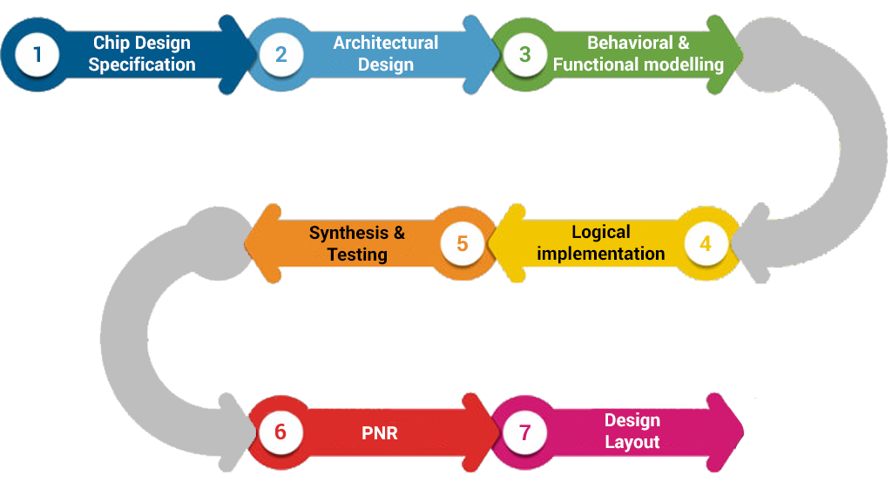
Performance Evaluation
Continuous evaluation and verification throughout design process
Success evaluated through following standard ASIC design process and comparing outcomes to initial engineering specifications and standards
Notes:
Using pic for reference for now

Slide 49
Challenges & Solutions
Our challenges are more centered around moving through the ASIC design process and software-related issues rather than hardware-related and parts issues in a typical project
Challenges | Solutions
Verification is dependent on design steps and may cause delays in the process | Assist in debugging design issues to successfully move through ASIC design steps according to our estimated timeline
One setback or mistake in either design or verification can significantly delay project completion | Carefully evaluate the work completed at each step to rule out any errors or mistakes before moving onto the next step in the process

Slide 50
Administrative Content

Slide 51
Bill of Materials
Category | Item | Source / Cost
EDA Tools | Cadence Xcelium, Genus, and Innovus. | Provided via project sponsor
HDL Design Environment | SystemVerilog and UVM. | Open Source
Open-Source Core | Ibex RISC-V Core, baseline RTL. | Open Source
RISC-V Toolchain | GCC / LLVM with custom ISA extensions. | Open Source
Computing Resources | UCF HPC Servers and department workstations. | Provided by University
Documentation Tools | Overleaf (LaTeX) & Github. | Free Academic Access
Training Resources | Cadence Training portal, online ASIC flow modules. | Provided via project sponsor
Notes:
This is our projects BOM, thankfully all of our resources were either open source, provided via UCF academic licesne, or from our sponsors licesne.

Slide 52
Work Distribution:
SD 1 - Front End VLSI | SD 2 - Back-End VLSI
RTL Design: Joshua Daniel | Physical Design: Everyone
Verification: Alex Anna Alyssa | Final Verification: Everyone

Slide 53
Progress & Plan for Completion
Current Progress:
Finalizing the synthesis stage
Moving into Place and Route
Completing any final toolchain set up for layout
Plan for completion:
Physical design completed by end of March
  Floorplanning, PNR, Clock tree synthesis, & physical verification

Slide 54

THANK YOU!
OUR SPONSOR:
OUR REVIEWERS:
Dr. Chung Yong Chan
Dr. Mike Borowczak
Brian McNulty
Steve Leonard
Marlon J Fuentes
Aaron Lingerfelt
Alberto Reategui

