Slide 1

NG RAD: Next-Generation RISC-V ASIC Design
Final Demo
Group 13 - Anna Craig, Alexander DeFalco, Joshua Joseph, Daniel Odi, Alyssa Pinnock

Slide 2





Team Members
Alyssa Pinnock
Computer Engineering
Alexander DeFalco
Computer Engineering
Joshua Joseph
Computer Engineering
Daniel Odi
Computer Engineering
Anna Craig
Electrical Engineering
Notes:
*can re-arrange if photo circles are too small

Slide 3



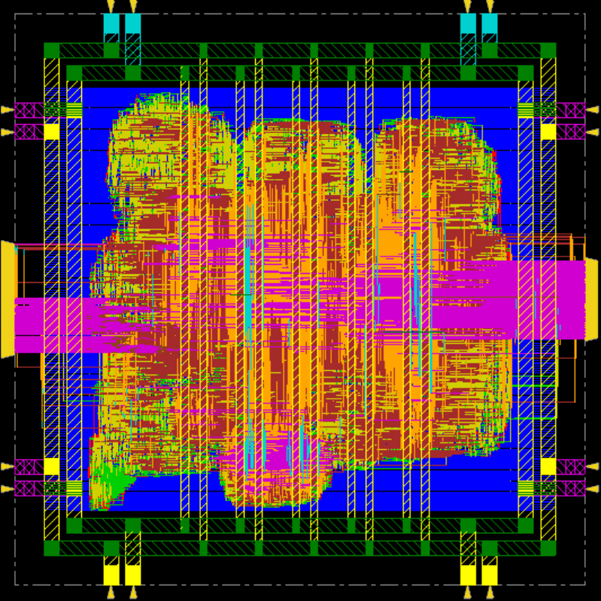
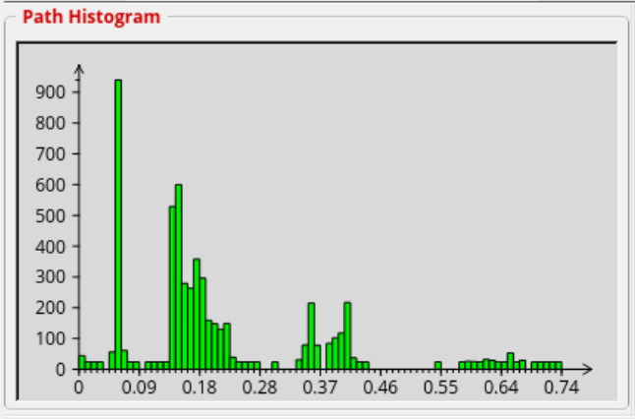
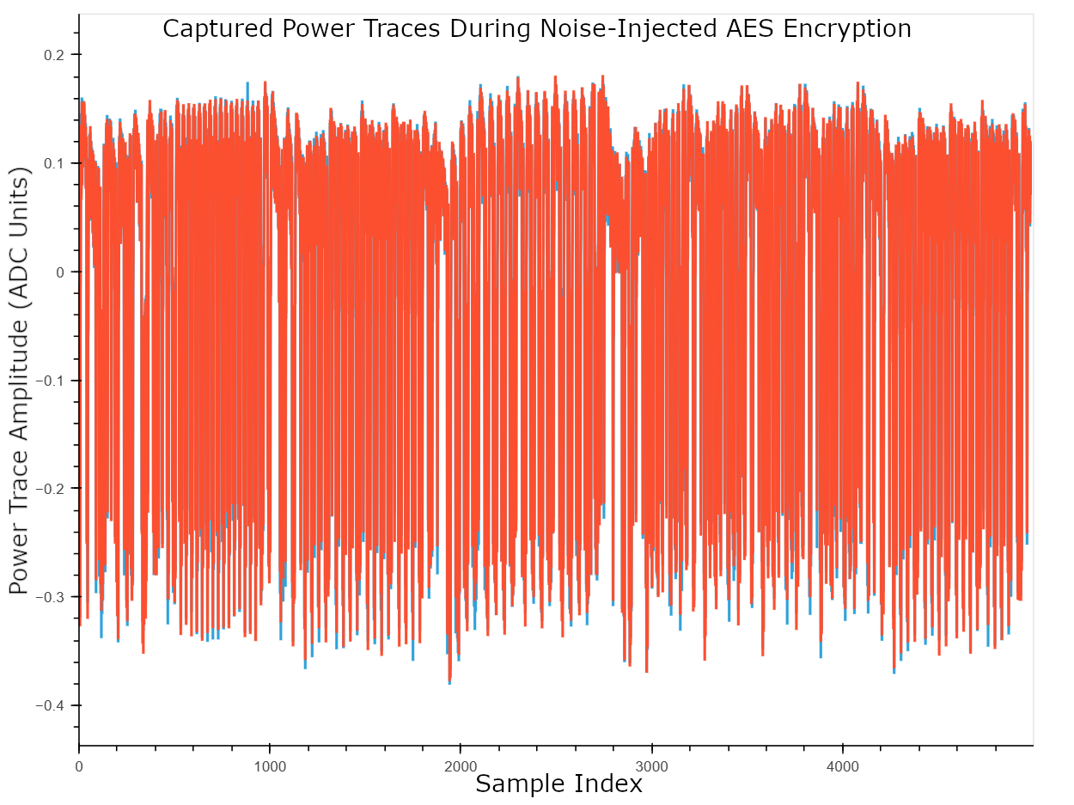
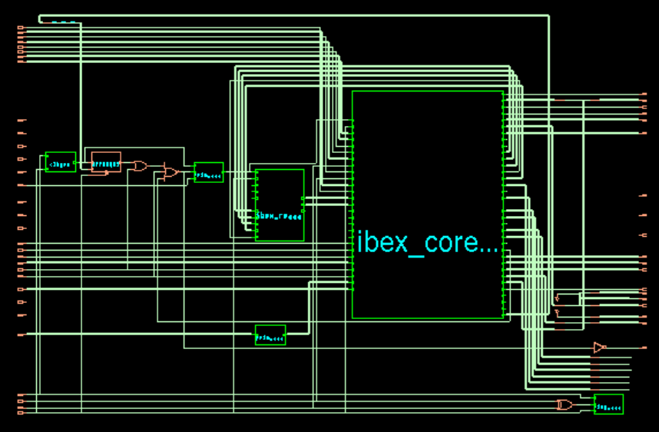
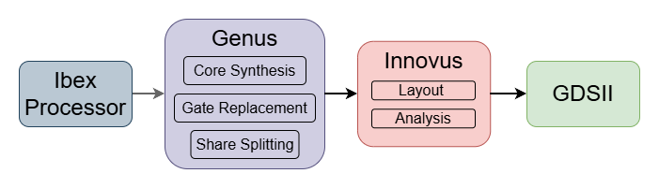
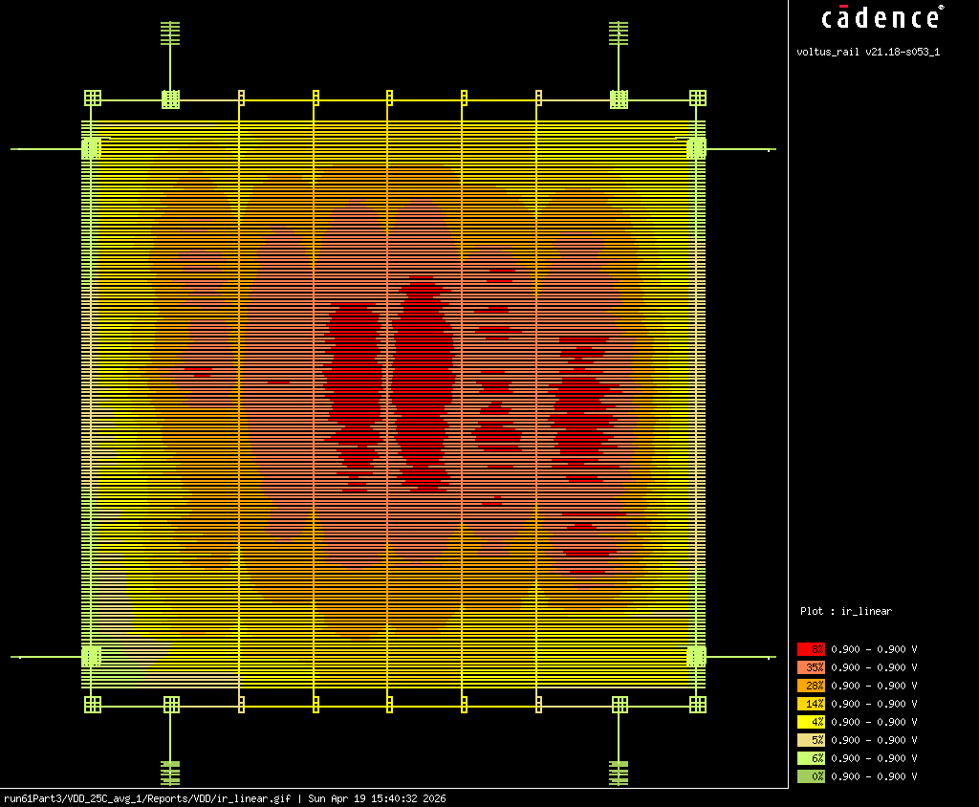
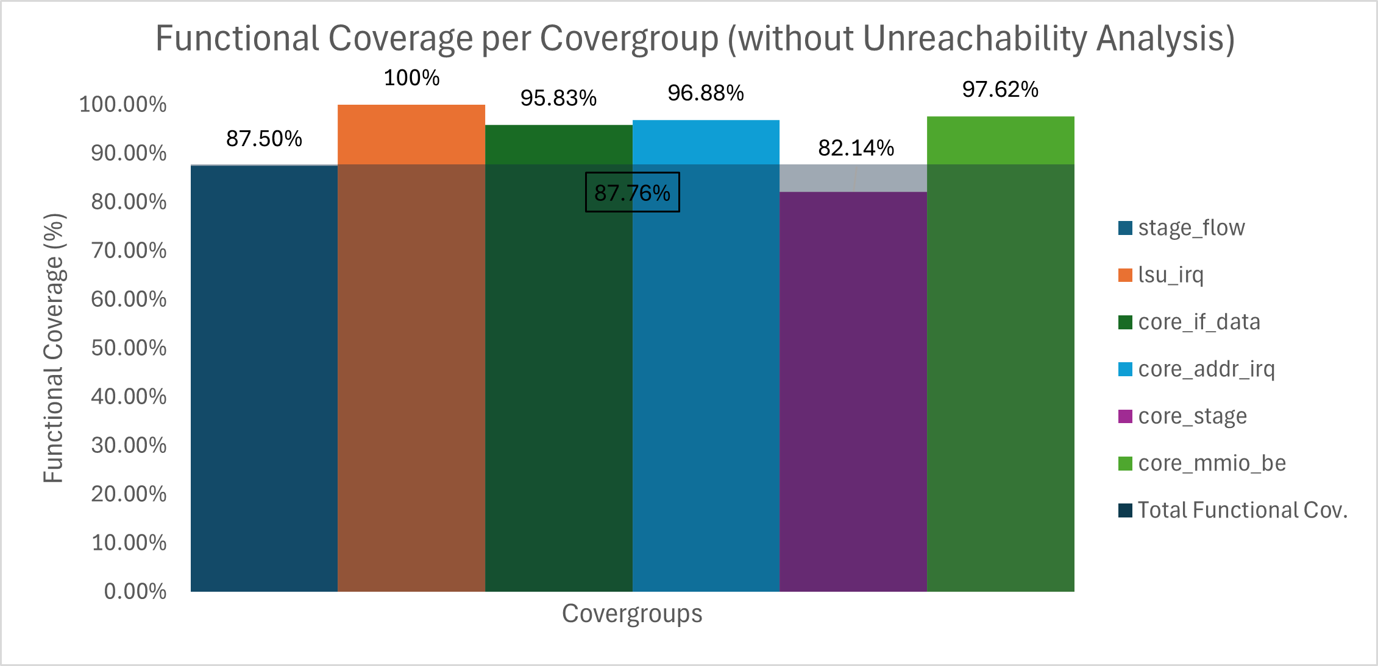
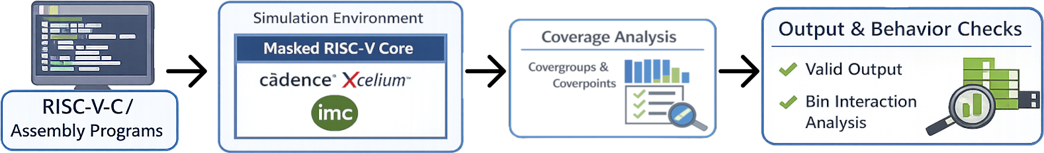
NG RAD: Next-Generation RISC-V ASIC Design
Anna Craig, Alexander DeFalco, Joshua Joseph, Daniel Odi, Alyssa Pinnock
University of Central Florida, Orlando, FL
Abstract
Results
Discussion
Application Specific Integrated Circuits (ASICs) are specialized computer hardware that are optimized to perform a particular task set. ASICs can be highly optimized for performance, power, and area, while also providing a lower manufacturing cost per unit.
Side-channel attacks exploit physical leakage to extract cryptographic keys, user data, and memory information. This presents a vulnerability for hardware in mission critical systems.
NG RAD is a secure processor architecture that integrates hiding and masking techniques into the open-source Ibex core such that is mitigates first-order side channel attacks, most notably being Correlation Power Analysis (CPA) attacks. This extension of the processor includes the addition of a clock generator/randomizer, noise generators, and boolean masking. This processor was implemented on Cadence's 45nm GPDK process node and is taken through the RTL-to-GDS flow using Cadence tooling.
The design successfully went through synthesis and physical implementation with a clock speed of 20Mhz. The design consumes 3.7mW of power and has a leakage power of 0.0041mW. Post-route STA confirms timing closure with zero setup and hold violations across all timing paths, with all DRV constraints satisfied. Static IR drop analysis confirms power distribution remains within the <5% specification.
Figure 3: Finalized physical implementation of design
Methodology
For this project, we used the Cadence digital design tools to implement and verify the chip. This project is divided into two parts: design and verification.
For the design phase, we used Cadence Genus to synthesize the original core, resulting in a Verilog netlist. We then utilized Tcl scripting to integrate the security extensions into the design. Cadence Innovus was then used for physical implementation.
Verification is being handled with a functional methodology, in which we compile RISC-V C programs and execute them on our modified Ibex Core through the usage of Cadence Xcelium, recording covergroup/coverpoint metrics within our testbench, and processing them with Cadence Integrated Metrics Center (IMC).
Figure 8: Post-route path slack histogram
Code Coverage for our masked design reached 97.85%, and functional coverage as explored through our covergroups and coverpoints reached an aggregate of 87.76% prior to any unreachability analysis. Our weakest points comes from the "core_stage" group, where we observed limited closure in the "x_pipe_flow" group (25%, 4/16). Many of its theoretical bins appear constrained by pipeline control behavior (stalls, flushes, etc) in our implementation, making them strong candidates for unreachability justification in final signoff.
Figure 5: Synthesized masked core
Figure 4: CPA-mitigated Power Trace of an AES Encryption Execution
Figure 1: Core Design and Implementation Workflow
References
[1] K. Stangherlin and M. Sachdev, “Design and implementation of a secure risc-v micro-processor,” 2022.
[2] A. Biryukov, D. Dinu, Y. L. Corre, and A. Udovenko, “Optimal first-order boolean
masking for embedded iot devices,” 2018. Accessed: 2025-10-20.
Acknowledgements
Figure 6: Functional Coverage Results
This work was supported by Northrop Grumman, which provided access to Cadence Design Systems software.
Figure 2: Functional Verification Workflow
Figure 7: IR Drop of Design

Slide 4
Project Description & Introduction
NG RAD is a Side Channel Leakage Reduction Extension for a RISC-V core. involves the implementation of security features throughout the ASIC design flow, in order to increase security against side-channel attacks*.
In this project, side-channel attacks are mitigated through the implementation of boolean masking, noise injection, and random clock generation.
*side-channel attacks = gaining secret information by observing physical signals from a system
Notes:
Copied from CDR
For our senior design project, we decided to build SCALER, which is an extension to a RISC-V core that aims to mitigate side-channel attacks. -> Our main goal is to create our extension through following the full-flow ASIC design process, and we aim to mitigate side-channel attacks through implementing boolean masking, noise injection, and randomized clock generation.

Slide 5
Engineering Specifications
Parameter | Specification
Instruction Set | RV32I
Operating Temperature Range | 0 C-120 C
Operating Voltage Range | 0.95 V - 1.25 V
Process Node | ~ 45nm
IR Drop | ≤ 5%
Average Frequency | ≥ 250 MHz
Parameter | Specification
Instruction Set | RV32I
Operating Temperature Range | 0 C-120 C
Operating Voltage Range | 0.90 V - 1.20 V
Process Node | ~ 45nm
IR Drop | ≤ 5%
Average Frequency | ≥ 15 MHz
Parameter | Specification
Masking Order | First-Order Minimum
Instructions per Cycle (IPC) | ≤ 1.2
Cache Size | ≥ 16 MB
Timing Failure Count | 0 Faults
Interrupt Latency | ≤ 12
Leakage Power (25 C) | ≤ 5 mW
Parameter | Specification
Masking Order | First-Order Minimum
Chip Density | ≥ 60
Cache Size | ≥ 4 kB
Timing Failure Count | 0 Faults
Interrupt Latency | ≤ 12
Leakage Power (25 C) | ≤ 5 mW
Notes:
These are our engineering specifications. These were obtained through extensive research, as well as discussions with our sponsors and group members. The RV32I instruction set was selected to provide a standardized, lightweight baseline architecture that minimizes unnecessary complexity while still supporting full software toolchain compatibility. Our other measurable requirement is the 45nm process node, which balances manufacturability, cost, and predictable leakage characteristics. Lastly, our timing failure count was 0 faults, which we proved in our functional verification of the modules.

Slide 6
Final Demo Overview
01
System Overview
02
Side Channel Attack Demo
Side Channel Attack Demo
03
Subsystem Overview
Individual Demos
04
Functional Demo
Functional Demo
Physical Design
05
Physical Design

Slide 7
Side Channel Attack Demo
Notes:
Adding slides like this as “dividers” for the 3 main requirements of the Midterm Demo. ~Alex

Slide 8
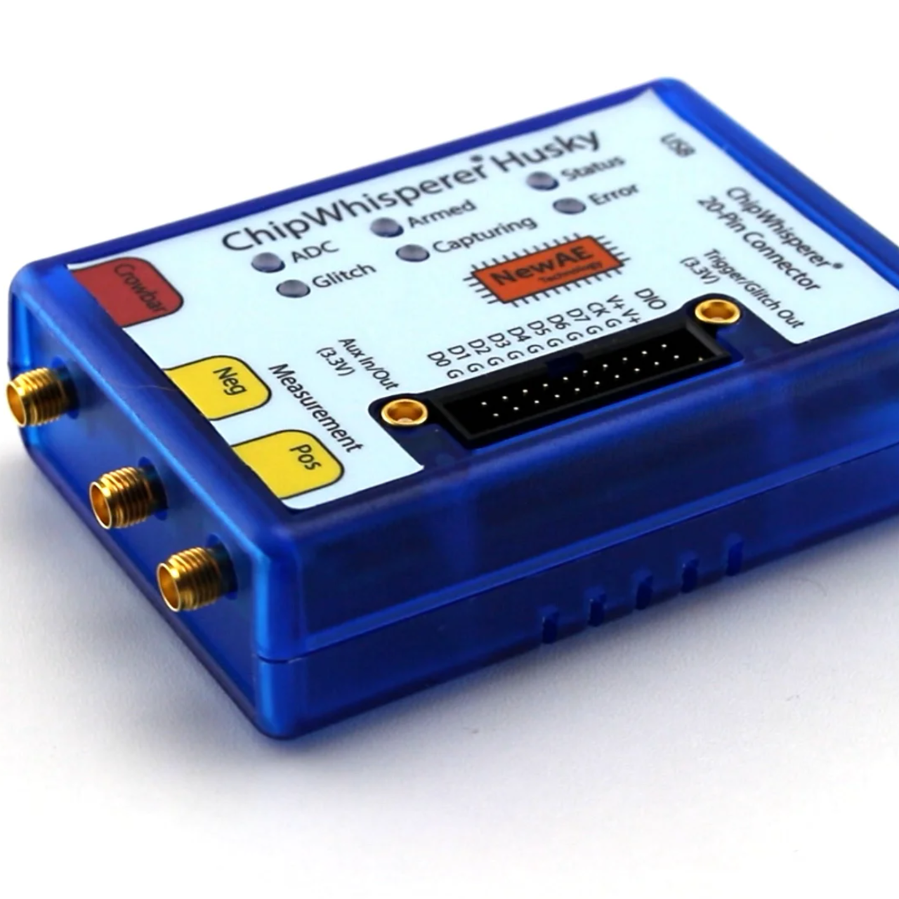
SCA Demo - Background
Up next is a series of Correlation Power Analysis (CPA) attacks executed on a microcontroller through a ChipWhisperer Husky, meant to simulate an environment like our RISC-V core.
More specifically, the CPA attack will be performed on a core running an AES encryption workload, attempting to resolve the AES encryption key.
The showcased workloads intend to highlight the impact of the mitigation techniques that we are implementing into our design, showing that they are meaningful towards mitigating leakage in a CPA scenario.
  Techniques being Gaussian Noise Generation and Clock Randomization
Notes:
Slide Title copied from Daniel’s original powerpoint document

Slide 9
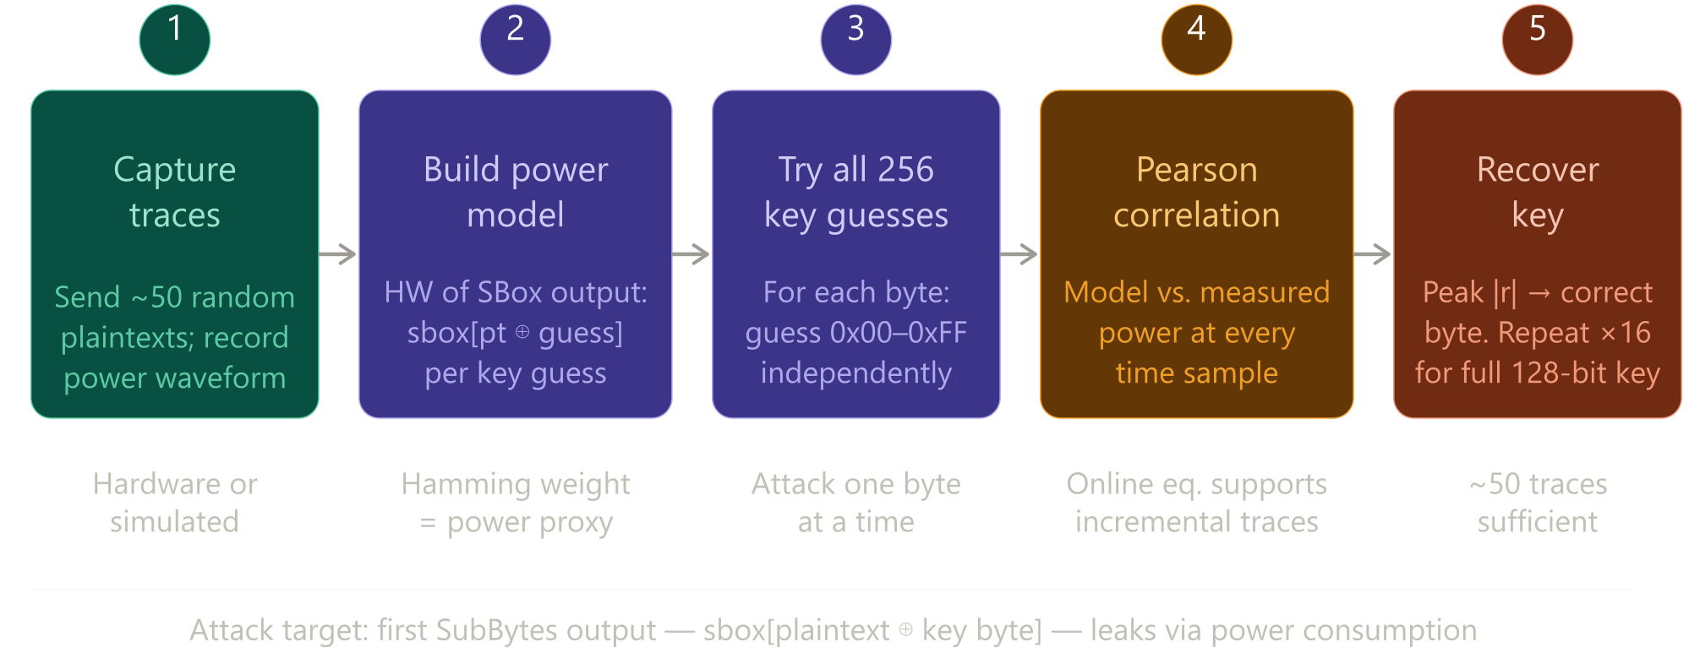
SCA Demo - Workflow
Notes:
Slide Title copied from Daniel’s original powerpoint document

Slide 10
SCA - Demo (happens during this slide)

Slide 11
SCA Demo
Baseline CPA
Gaussian Noise Generation
Clock Randomizer

Slide 12
Questions?

Slide 13
System Overview
A brief explanation of our whole system / the ASIC design process
Notes:
Adding slides like this as “dividers” for the 3 main requirements of the Midterm Demo. ~Alex

Slide 14
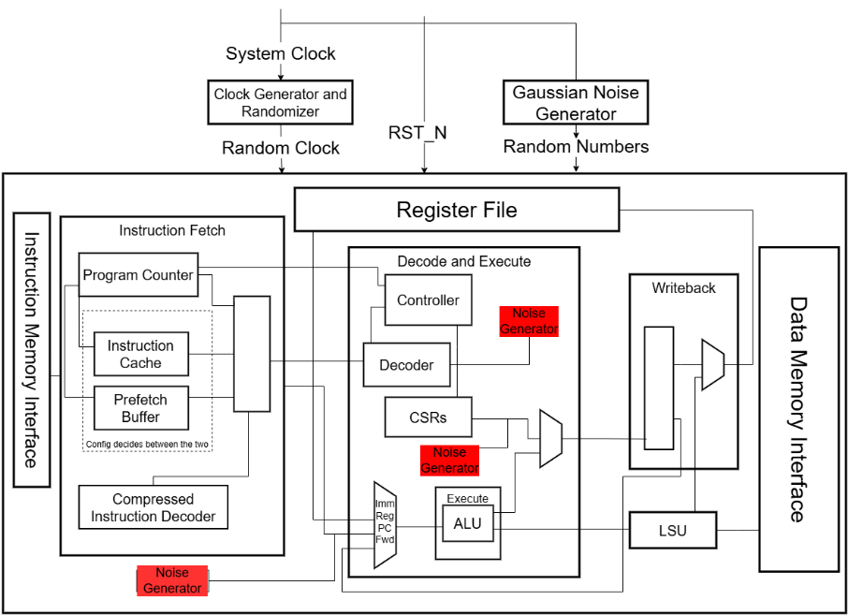
Augmented Ibex Core

Slide 15
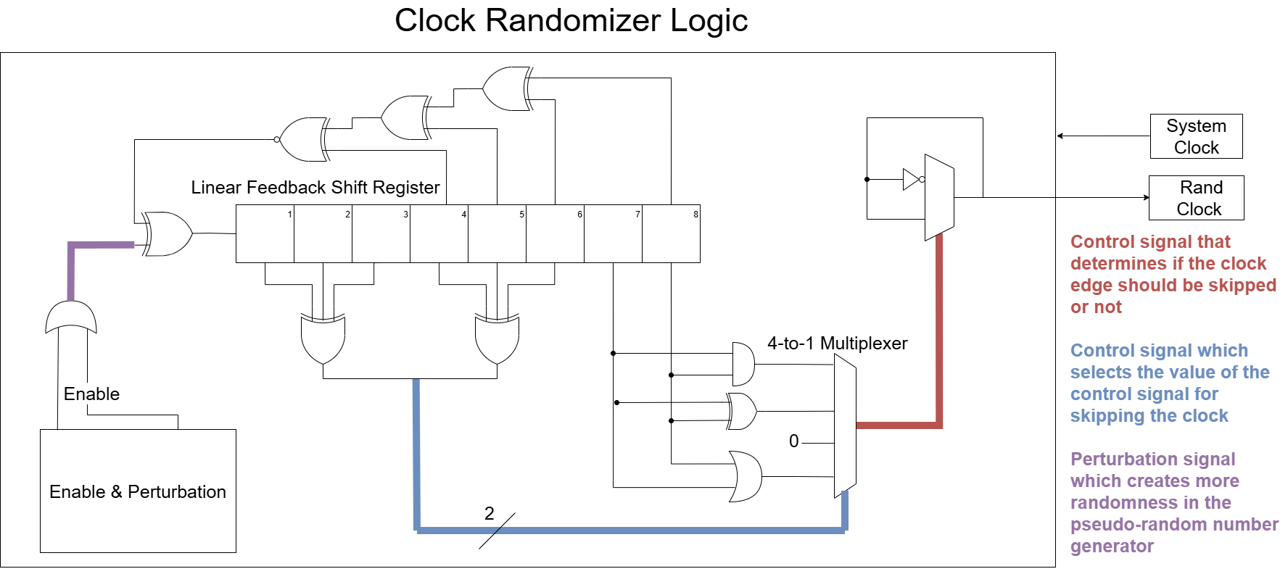
Clock Randomizer

Slide 16
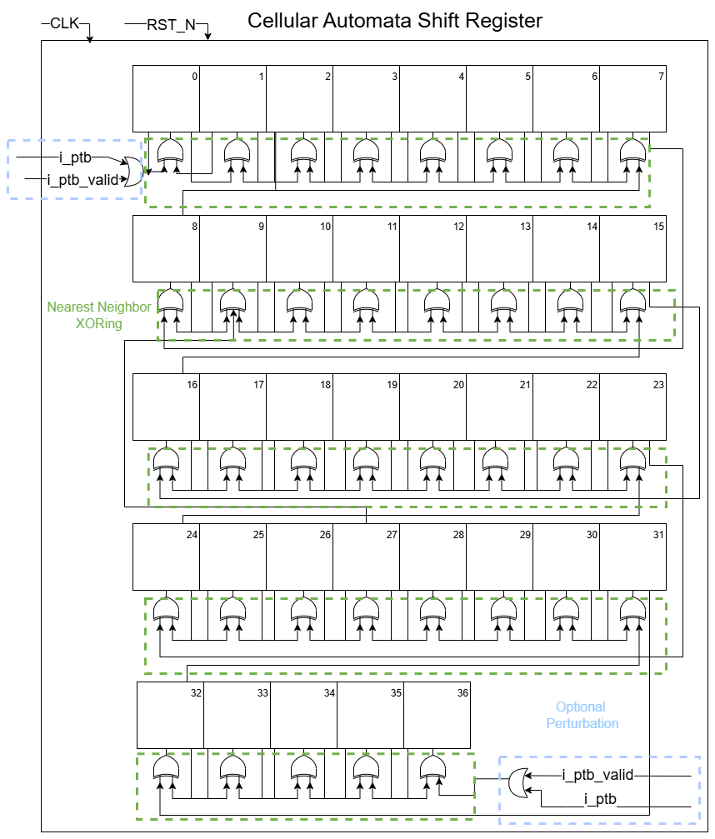
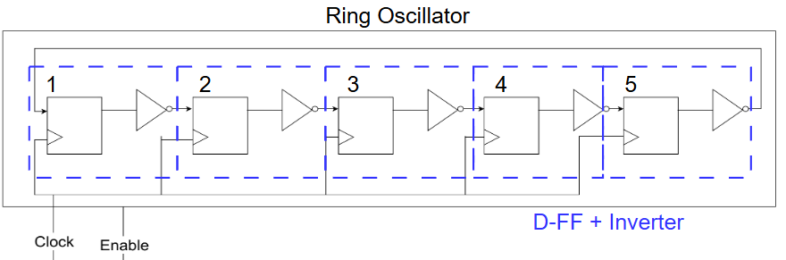
Noise Generators

Slide 17
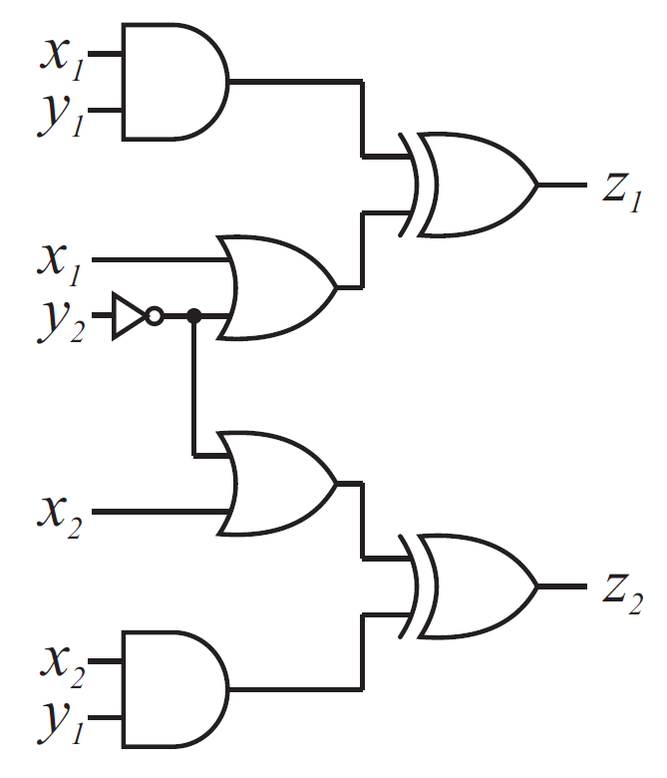
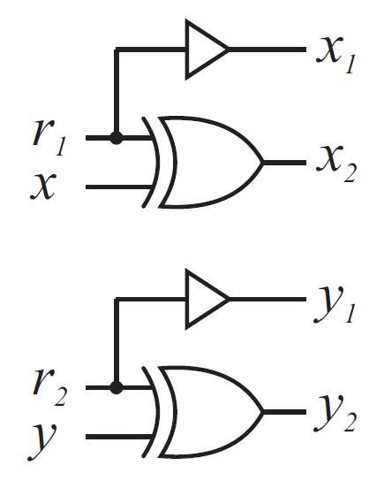
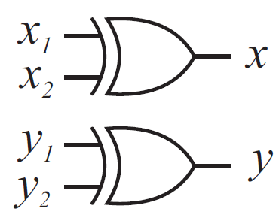
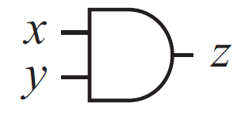
Share Splitting and Gate Replacement
Each signal is split into shares and propagated throughout the processor
Every logic gate is transformed into secure gates to work with the split signals
  Design is first synthesized with limited gate set, then replaced with secure gates
Share Splitting
Share Recombination
Secure Gate Replacement
Random Bits
Split Shares
Original Values

Slide 18
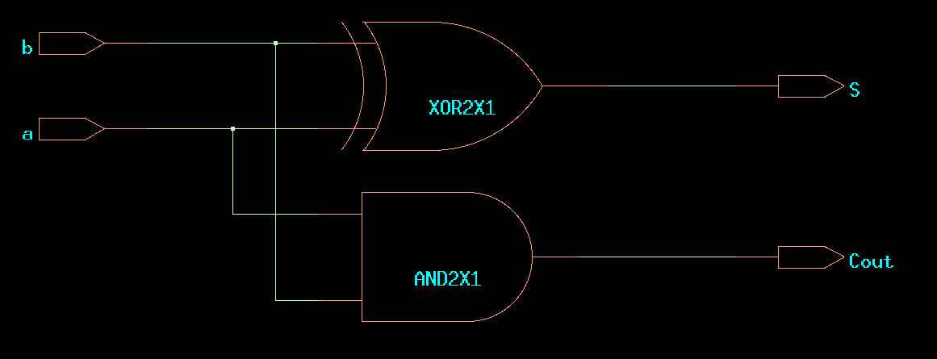
Basic Adder Example

Slide 19
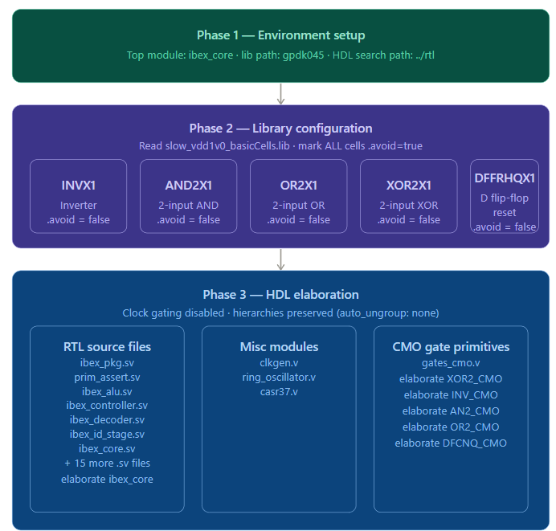
Tcl Scripting: Setup

Slide 20
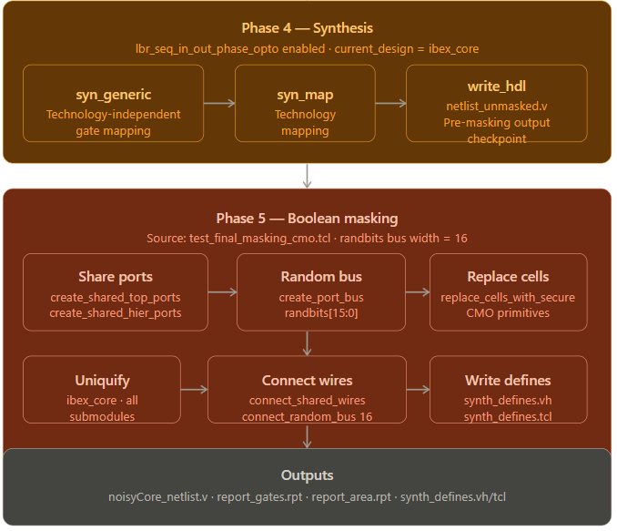
Tcl Scripting: Core Changes

Slide 21
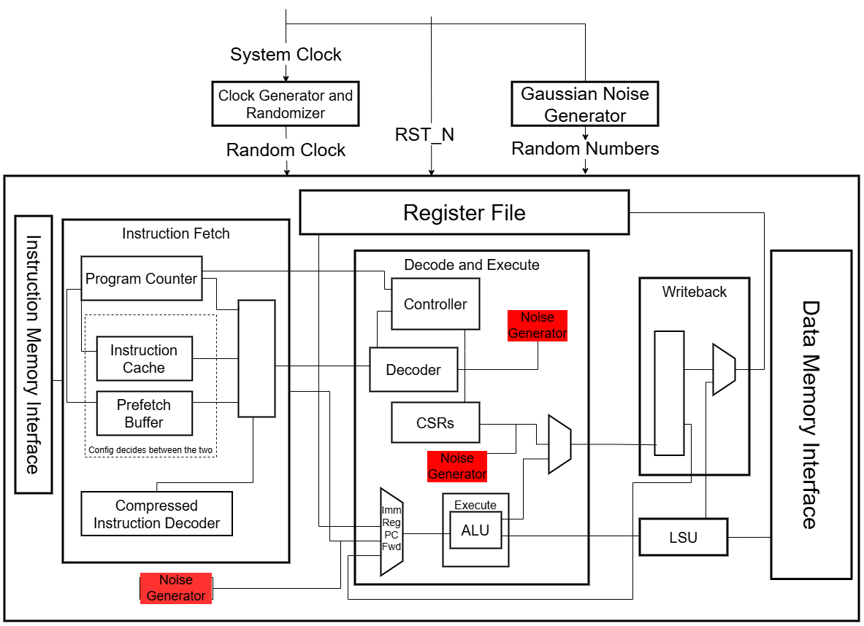
Ibex Diagram
Baseline Ibex RISC-V with instruction fetch, decode/execute, writeback, register file, and memory
Noise generators added to sensitive data paths to introduce controlled randomness
Reduces correlation between processor activity and power/EM signatures
Noise generators integrated without modifying the core pipeline structure
Notes:
Slide Title copied from Daniel’s original powerpoint document

Slide 22

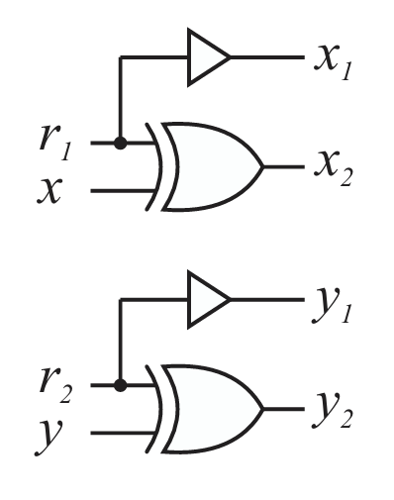

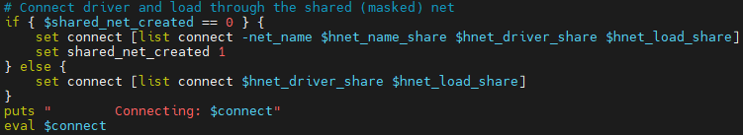
Share Splitting
Each signal is split into two shares (S0 and S1) to implement masking
Masking script creates duplicate ports/wires with “_s1” suffix
A global randbits bus distributes randomness to masked flip-flops, ensuring independent shares
Shared wires connected across hierarchy, skipping clock/reset signals
Notes:
Slide Title copied from Daniel’s original powerpoint document

Slide 23
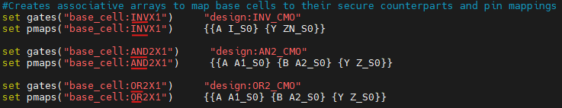
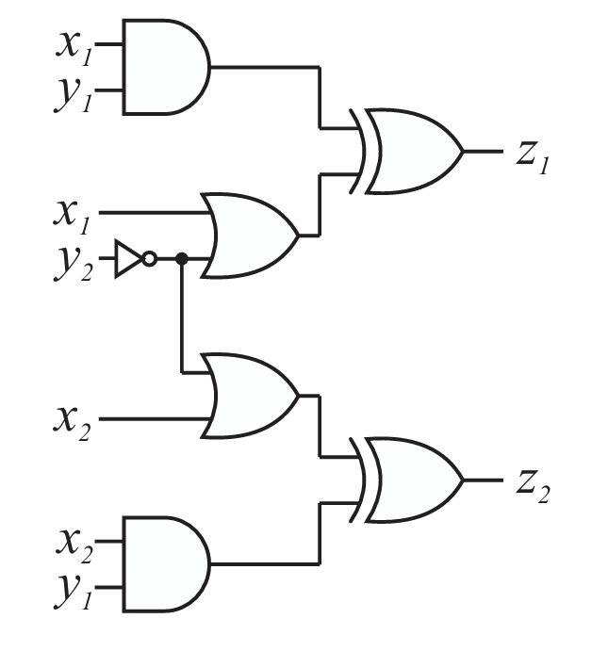
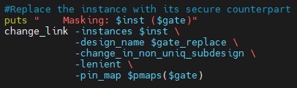
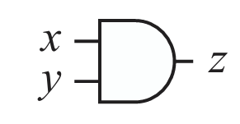
Secure Gate Replacement
Standard gates (INV, AND, OR, XOR, DFF) replaced with secure masked CMO cells
Synthesized netlist scanned and gates replaced while preserving hierarchy
Lookup tables (gates, pmaps) map original gates to secure versions and remap pins
Secure
Original
Notes:
Slide Title copied from Daniel’s original powerpoint document

Slide 24
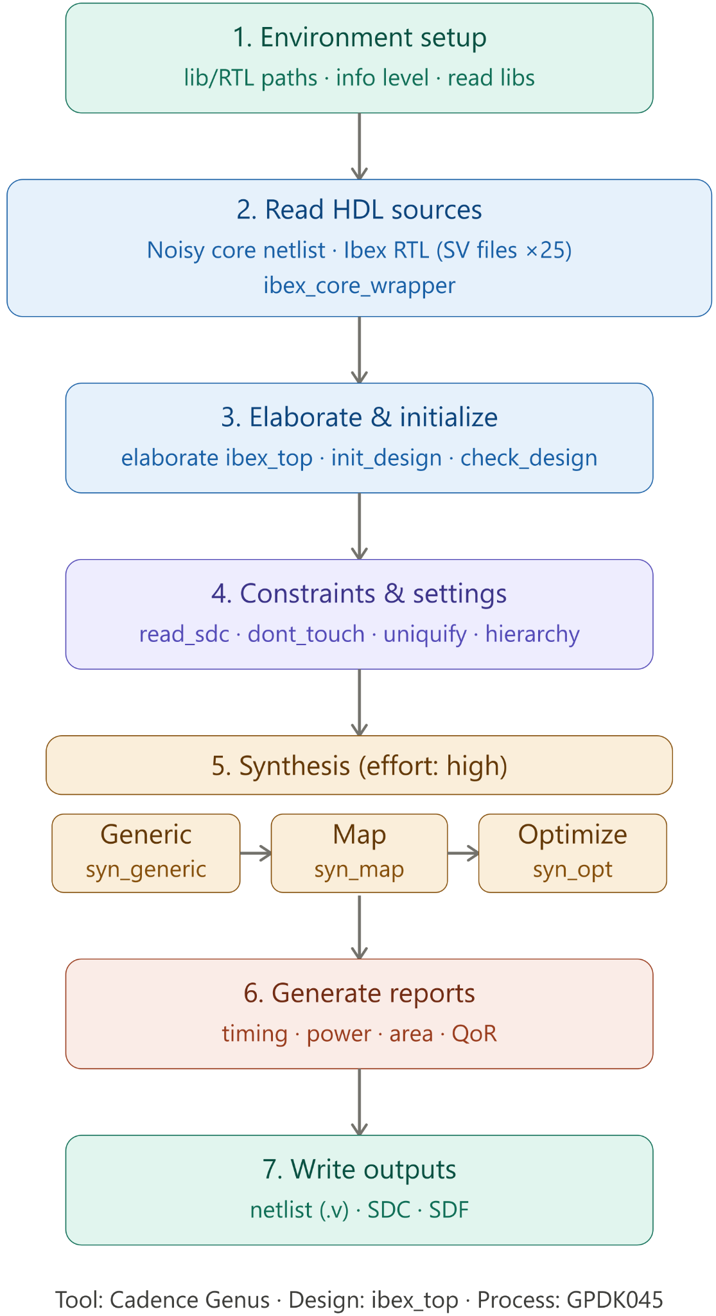
Synthesizing Masked Core with SoC
Once masked core is synthesized, it must be integrated with the System on Chip (SoC)
During this stage timing, is evaluated to ensure all paths can operate at the specified frequency
Notes:
Josh

Slide 25
Engineering Spec #1 - Timing (> 15 Mhz)
Notes:
Adding slides like this as “dividers” for the 3 main requirements of the Midterm Demo. ~Alex

Slide 26
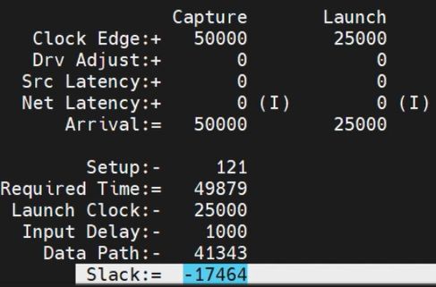
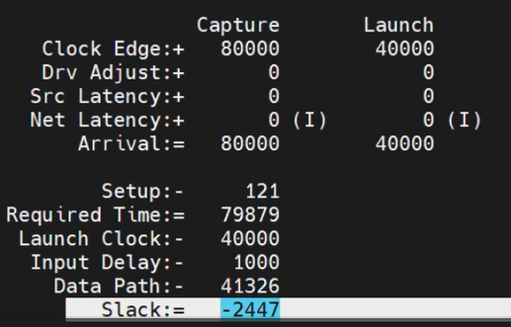
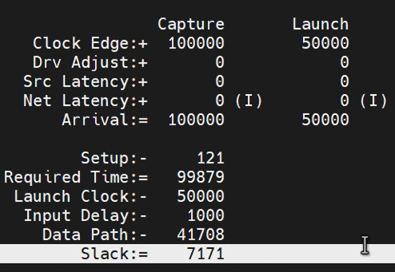
Timing (> 15 Mhz)
During synthesis, Cadence Genus reads in a constraints file that calculates timing and generates a timing report.
Frequency is reasonable given the limited gate library and increased gate depth in datapaths
Period: 20ns
Period: 40ns
Period: 50ns (20Mhz)
Notes:
Josh

Slide 27
Functional Demo - Interrupt Latency Specification

Slide 28




Pre-Synthesis Testbench Workflow & Overview
2.
2b.
Per Instruction
1.
Once per test
programs executed by baseline Ibex core with RVFI passthrough
RVFI signals processed through SPIKE as a “golden model”, ensuring RISC-V compliance
Once Test Program Finishes
Once per test
2.
RISC-V programs are randomly generated by CHIPS Alliance’s riscv-dv
3.
Once Test Program Finishes
programs executed by modified Ibex core with RVFI logging
Baseline and Modified Ibex core trace files are compared
Notes:
Alex

Slide 29
Latency measurement recording will sit here

Slide 30
Engineering Spec #2 - Interrupt Latency
Ibex DV/Co-sim (riscv-dv) generates interrupt-enabled programs, and a custom testbench periodically flags interrupts during their execution. Latency is then measured for each interrupt and the min/max/average latency for each test is recorded, in simulated clock cycles.
Each test was executed with 9 unique seeds, with 200 interrupts injected per test/seed.
Test Name | Description | Min | Max | Avg
riscv_single_interrupt_test | Issues interrupts one at a time, checks for proper return | 6 | 43 | 15.2
riscv_multiple_interrupt_test | Issues multiple interrupts at a time, heavier stability test | 6 | 43 | 16
riscv_interrupt_wfi_test | Issues interrupts after sending a WFI (wait for interrupt) signal | 6 | 44 | 10.7
riscv_nested_interrupt_test | Issues an interrupt while the interrupt handler is already running | 6 | 43 | 16.8
riscv_interrupt_csr_test | Issues interrupts during writes to interrupt-related CSR | 6 | 44 | 15.1
We measured an Average Interrupt Latency of 15.1 Cycles.

Slide 31
Functional Demo - GLS, Verification, and Coverage

Slide 32
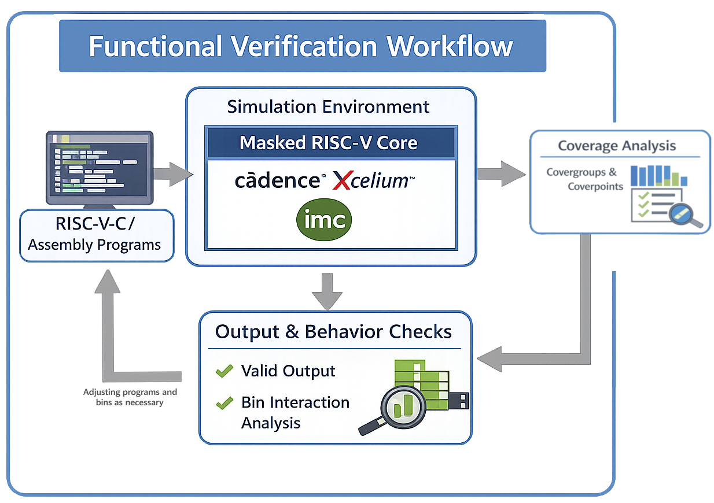
Functional Verification - Methodology
Verification and coverage is handled through a functional method:
a series of RISC-V programs are compiled and run on a simulated version of the masked Ibex core on Cadence Xcelium, with various covergroups and coverpoints defined in order to check for desired stimulus.
These executions are checked for valid terminal outputs, as well as anticipated coverpoint behavior.
Test programs and coverpoints are regularly iterated upon to expand coverage.
Since we are operating on the masked Ibex core, we are performing Gate-Level Simulations
Adjusting programs and
bins as necessary

Slide 33
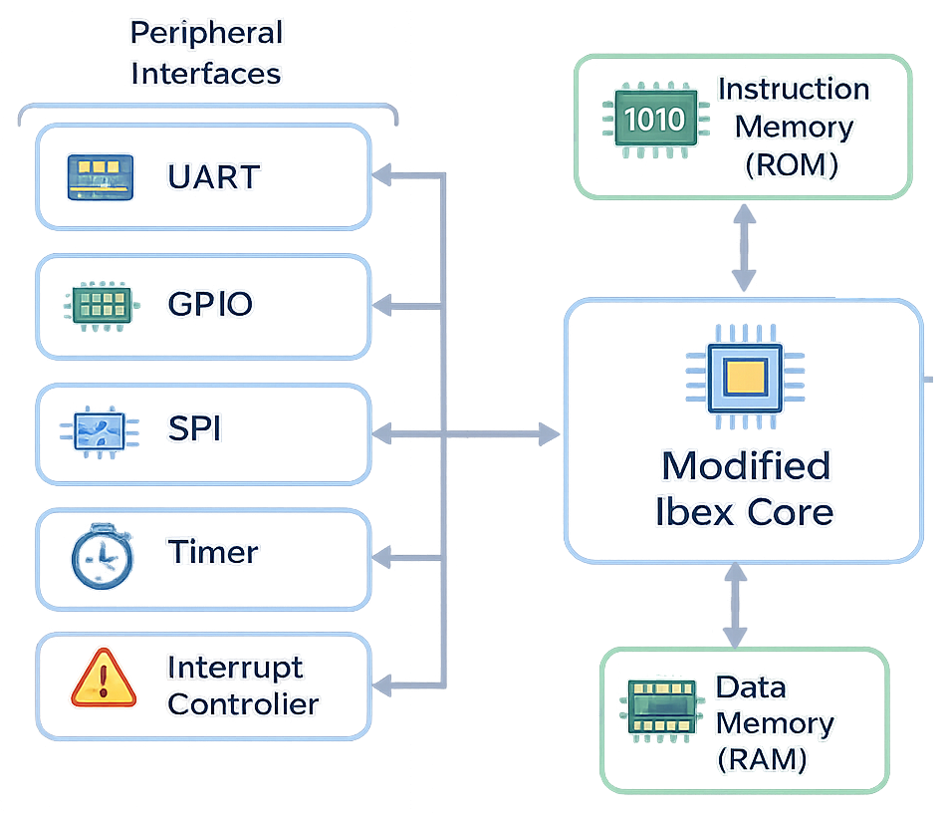
Functional Verification - Simulation Environment
We leverage Ibex’s Simple System environment, providing us with a lightweight SoC to simulate our modified Ibex core.
It consists of Instruction/data memory and various peripheral interfaces, all interconnected using SiFive’s TileLink Uncached Lightweight (TL-UL) bus protocol
The Simple System also includes a basic framework to ensure RISC-V-compiled C programs can properly be executed
Our main “contribution” to this ecosystem is the inclusion of our masked core, which was built using post-synthesis transformations (masking). This enables us to perform Gate-Level Simulations.

Slide 34
Functional demo (happens during this slide)

Slide 35
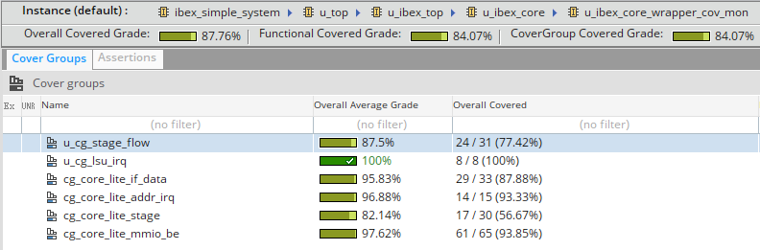
Functional Coverage Results
After running multiple iterations of test programs and merging results, Cadence IMC reports the following coverage results:
  84.07% Functional Coverage prior to Ignore Bins
  87.76% Functional Coverage compensating with Ignore Bins
    No other UNR analysis has been performed on this coverage data

Slide 36
Questions?

Slide 37
Functional Demo
Notes:
Adding slides like this as “dividers” for the 3 main requirements of the Midterm Demo. ~Alex

Slide 38
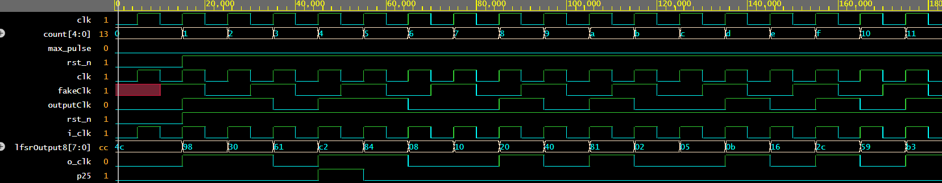
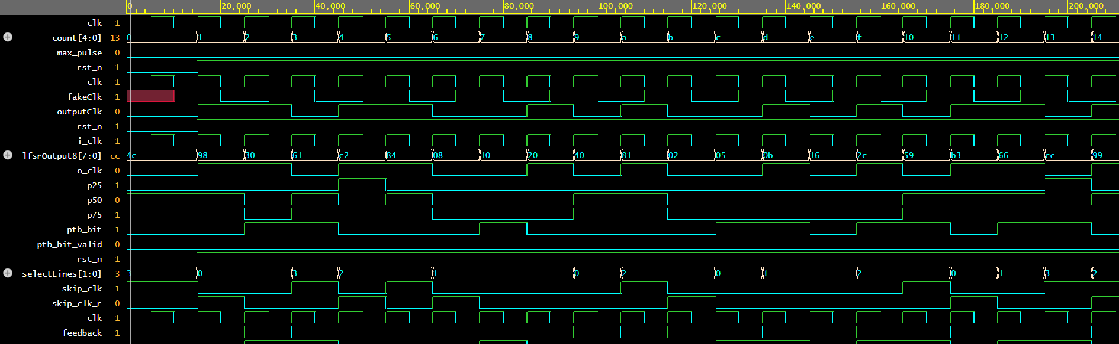
Initial Clock Randomizer Results
Initial functional verification checked the clock edge skipping, randomization, and ensuring that unpredictable clock patterns were generated.
Original Input Clock:
New Output Clock (with randomization and clock edge skipping):
Notes:
Alyssa
Here, we were able to verify the clock generation module, which is the clock randomizer design that Josh explained earlier.
In this simulation, we ran our clkgen testbench to observe how the module handles clock edge skipping based on the LFSR-generated patterns. (LFSR = linear feedback shift register)
As shown in the waveform, the output clock toggles irregularly and confirms that our randomization logic works as intended.
You can also see the initial reset and the regular 100 MHz input clock driving the module, with skipped edges clearly visible in the simulation waveform results.

Slide 39
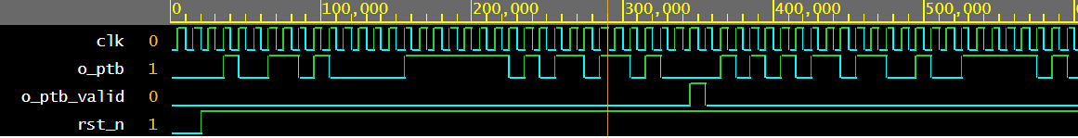
Functional Verification
LFSR43.v
o_ptb should appear “psuedo random”
clk, o_ptb_valid & rst_n showing deterministic behavior
Notes:
This waveform verifies the correct operation of the LFSR43 module by showing that the pseudo-random output signal (o_ptb) updates synchronously with the system clock after the reset (rst_n) is released. The irregular transitions of o_ptb indicate the expected pseudo-random behavior of the LFSR, while o_ptb_valid confirms when the generated output bits are valid for use by the rest of the design.

Slide 40
Physical Design
Notes:
Adding slides like this as “dividers” for the 3 main requirements of the Midterm Demo. ~Alex

Slide 41
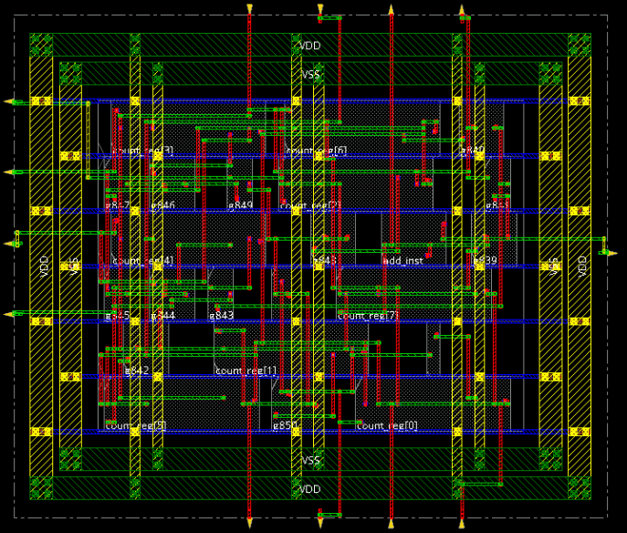
Floor Planning
POWER ROUTING:
SIGNAL ROUTING:
= power stripes
= vertical routing
(Metal2 / Metal4)
= power ring
= horizontal routing
(Metal3 / Metal5)
Basic Floorplan
= cells
Source: Cadence Design Systems, RTL-to-GDSII Implementation Flow Lab Manual, Section 8-1.
Notes:
Once finalizing our netlist, we then created our floorplan, which defines the physical layout of the design including cell placement, power distribution, and signal routing. For the purposes of visibility, this is a simplified floorplan image where you can see the main components of the physical design: the standard cells in the core area, the surrounding power ring, vertical power stripes used for distributing VDD and VSS, and the routing layers used to connect signals throughout the design. The red and blue lines represent vertical and horizontal signal routing on different metal layers, which helps organize routing and reduce congestion during implementation.

Slide 42
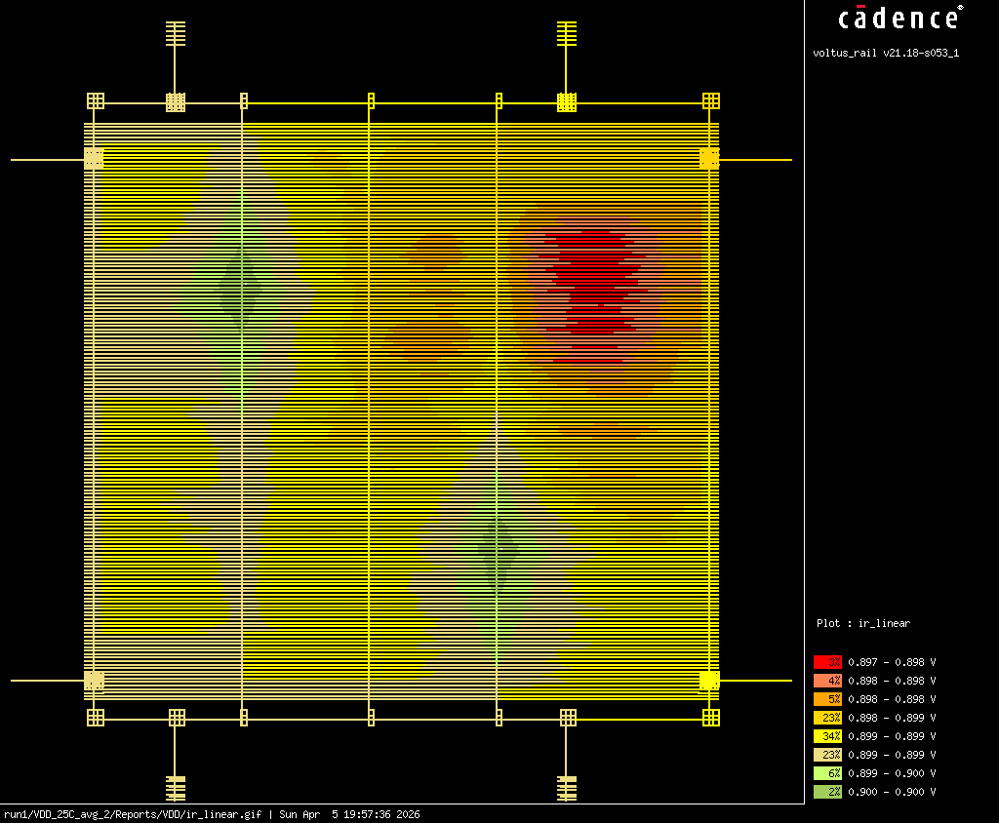
Iteration #1
3 stripes, max IR was ~ .03 V
While this result is very acceptable, we wanted to see how we could improve the design further.

Slide 43
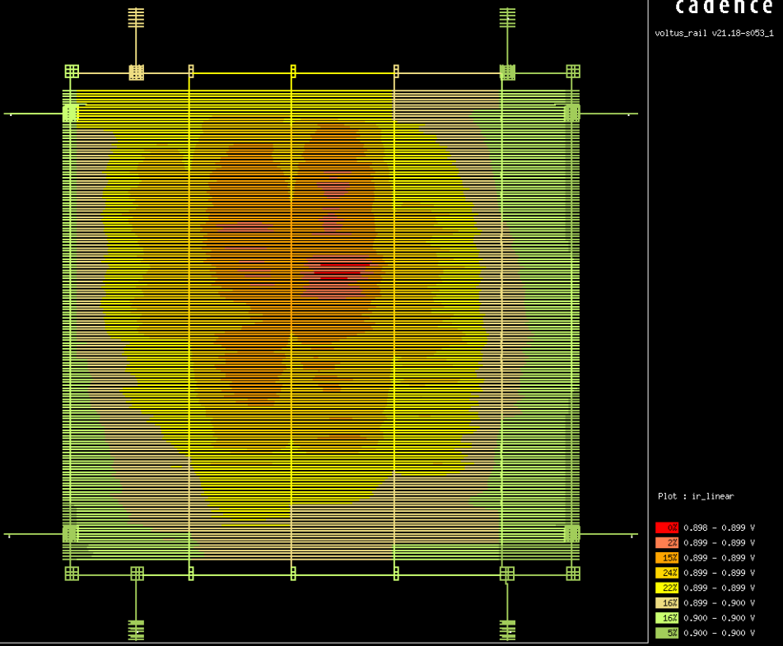
Iteration #2
4 stripes, max IR was ~ .02 V

Slide 44
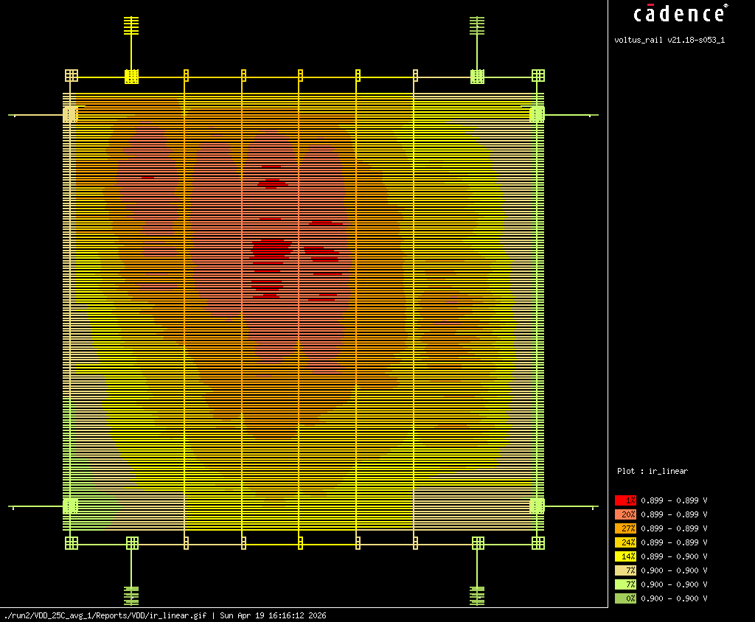
Iteration #3
(current)
5 stripes, max IR was ~ .01 V

Slide 45
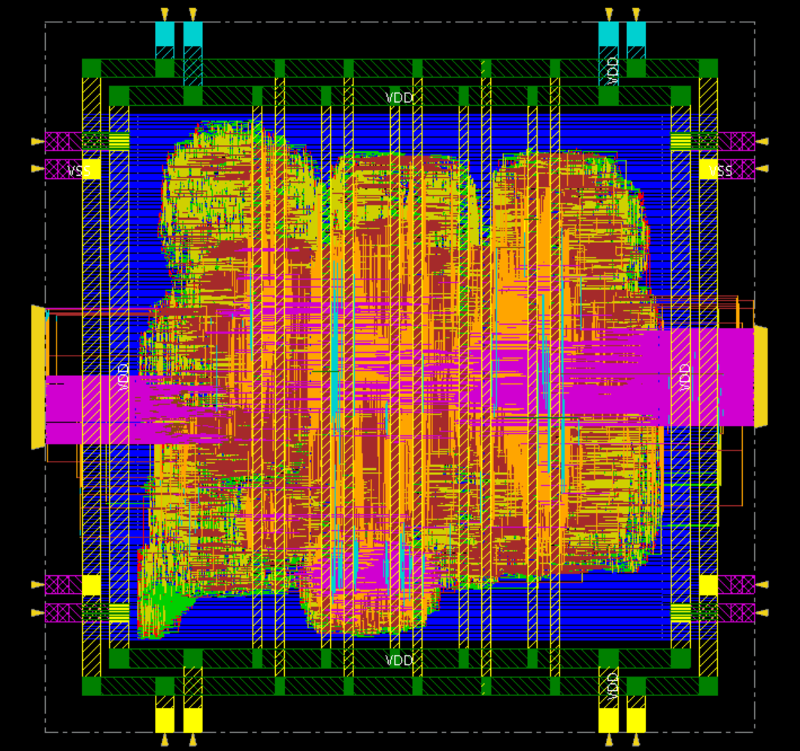
VDD / VSS pins
Current Floorplan
Output pins
Input pins
Power stripes
Notes:
This slide shows the current floorplan after placement. The core region contains the standard cells and routing layers. We organized the pin placement by functionality: inputs are placed on the left edge, outputs on the right edge, clock and reset on the top edge for global distribution, and interrupt/status signals on the bottom edge. Grouping signals this way helps reduce routing congestion and improves overall layout organization before moving into clock tree synthesis and final routing.
To ensure the pin placement is efficient, we analyze various results from the physical design tool. Using commands like This helps verify that input and output pins are positioned close to the logic they interact with most, minimizing routing distance and improving overall timing and layout efficiency.

Slide 46
(record power & rail analysis)
Notes:
This slide shows the current floorplan after placement. The core region contains the standard cells and routing layers. We organized the pin placement by functionality: inputs are placed on the left edge, outputs on the right edge, clock and reset on the top edge for global distribution, and interrupt/status signals on the bottom edge. Grouping signals this way helps reduce routing congestion and improves overall layout organization before moving into clock tree synthesis and final routing.
To ensure the pin placement is efficient, we analyze various results from the physical design tool. Using commands like This helps verify that input and output pins are positioned close to the logic they interact with most, minimizing routing distance and improving overall timing and layout efficiency.

Slide 47
Engineering Specifications
Demo
Frequency/Timing
Area
Interrupt Latency
Notes:
Adding slides like this as “dividers” for the 3 main requirements of the Midterm Demo. ~Alex

Slide 48
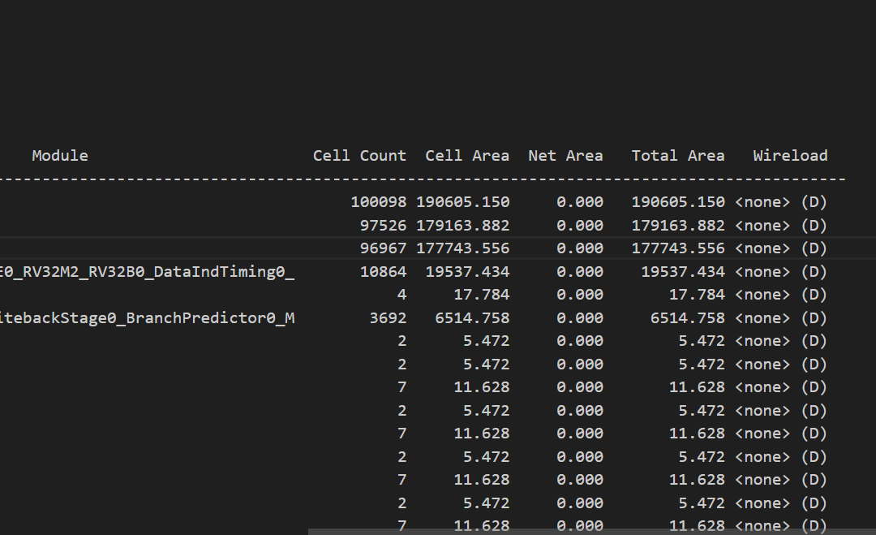
Engineering Spec #2 - Area
Cadence Genus give us area counts once synthesis is completed
Area is reasonable given the limited gate library and increased gate depth in datapaths
Core | Secure Ibex | Original
Area (um) | 190,605.150 | 26,121.96
Notes:
Joshua

Slide 49
Engineering Spec - Interrupt Latency
Ibex DV/Co-sim (riscv-dv) generates interrupt-enabled programs, and a custom testbench periodically flags interrupts during their execution. Latency is then measured for each interrupt and the min/max/average latency for each test is recorded, in simulated clock cycles.
Each test was executed with 9 unique seeds, with 200 interrupts injected per test/seed.
Test Name | Description | Min | Max | Avg
riscv_single_interrupt_test | Issues interrupts one at a time, checks for proper return | 6 | 43 | 15.2
riscv_multiple_interrupt_test | Issues multiple interrupts at a time, heavier stability test | 6 | 43 | 16
riscv_interrupt_wfi_test | Issues interrupts after sending a WFI (wait for interrupt) signal | 6 | 44 | 10.7
riscv_nested_interrupt_test | Issues an interrupt while the interrupt handler is already running | 6 | 43 | 16.8
riscv_interrupt_csr_test | Issues interrupts during writes to interrupt-related CSR | 6 | 44 | 15.1
We measured an Average Interrupt Latency of 15.1 Cycles.

Slide 50
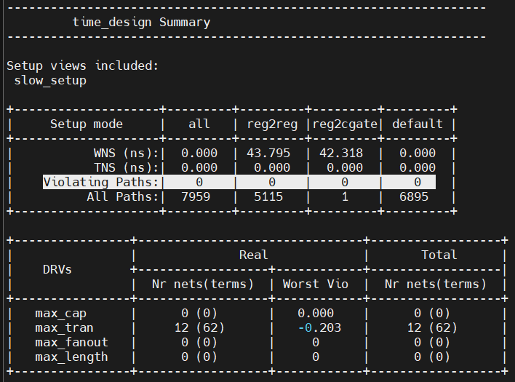
Post-Route Timing Analysis
Post-PnR STA verifies all signals meet setup and hold requirements
Boolean masking overhead contributes to setup violations on critical paths
opt_design resolves violations through buffer insertion and cell resizing
Post-optimization: zero setup and hold violations across all timing paths

Slide 51

THANK YOU!
OUR SPONSOR:
OUR REVIEW TEAM:
Dr. Chung Yong Chan (program advisor)
Dr. Mike Borowczak
Brian McNulty
Steve Leonard
Marlon J Fuentes
Aaron Lingerfelt
Alberto Reategui
Stuart Bernhardt
Austin Maxson

Slide 52
Questions?

