Slide 1

NG RAD: Next-Generation RISC-V ASIC Design
Final Presentation
Group 13 - Anna Craig, Alexander DeFalco, Joshua Joseph, Daniel Odi, Alyssa Pinnock

Slide 2





Team Members
Anna Craig
Electrical Engineering
Alexander DeFalco
Computer Engineering
Joshua Joseph
Computer Engineering
Daniel Odi
Computer Engineering
Alyssa Pinnock
Computer Engineering
Notes:
*can re-arrange if photo circles are too small

Slide 3
Project Overview
The Next-Generation ASIC Design is intended to add increased security to a RISC-V core. Its function is to design and layout a security extension to mitigate side channel attacks using boolean masking, noise injection, and random clock generation.
Notes:
For our senior design project, we decided to build SCALER, which is an extension to a RISC-V core that aims to mitigate side-channel attacks. -> Our main goal is to create our extension through following the full-flow ASIC design process, and we aim to mitigate side-channel attacks through implementing boolean masking, noise injection, and randomized clock generation.

Slide 4
Motivation & Background
Growing Demand for Secure Hardware
Higher demand for ASICs for data centers, edge devices, defense systems, etc.
Side-channel attacks exploit physical leakage to extract cryptographic keys, user data, memory information, etc.
ASIC Design Education Gap
Most undergraduate curriculum for engineering students don’t cover full ASIC design flow
The industry lacks new grads with hands-on exposure to tools like Cadence
Notes:
For our senior design project, we decided to build SCALER, which is an extension to a RISC-V core that aims to mitigate side-channel attacks. -> Our main goal is to create our extension through following the full-flow ASIC design process, and we aim to mitigate side-channel attacks through implementing boolean masking, noise injection, and randomized clock generation. Mention RTL-GDSII flow?

Slide 5
Basic Goals:
Become familiar with the ASIC design process
Learn to effectively use Cadence EDA tools
Expand upon a baseline RISC-V core to mitigate power-based side-channel attacks
Synthesize modified RISC-V core using a 45nm process node
Perform functional verification of RTL designs through directed testbenches
Execute RISC-V programs to validate ISA compliance and system-level functionality
Produce clear documentation describing design methodology, flow, and encountered challenges/troubleshooting
Notes:
Alex (someone else can do too) [will reduce the information on this slide soon]

Slide 6
Basic Objectives:
Instantiate baseline RISC-V core to ensure functional foundation
Develop RTL modules to integrate custom extension(s), enforcing noise injection and clock randomization, targeting the modified core
Run a RISC-V compliance test suite in assembly to confirm ISA correctness
Document tool usage and workflow in a step-by-step manner via GitBook
Simulate the modified RTL design in Cadence Xcelium using representative workloads
Complete various cadence training courses pertaining to the ASIC design flow
Notes:
Alex (someone else can do too) [will reduce the information on this slide soon]

Slide 7
What is a Side-Channel Attack?
Types of SCAs
Type of passive hardware attack based on obtaining data through side channels while a device is in operation
Side-channel leakage can include cryptographic keys, user data, memory information, etc.
Simple Power Analysis (SPA): Visual inspection of power traces to find clear patterns
Differential Power Analysis (DPA): One of the most powerful techniques that utilizes statistical analysis on power traces to find differences in power draw
Correlation Power Analysis (CPA): A form of DPA that uses statistical techniques to correlate power consumption with predicted data values
Notes:
alyssa

Slide 8
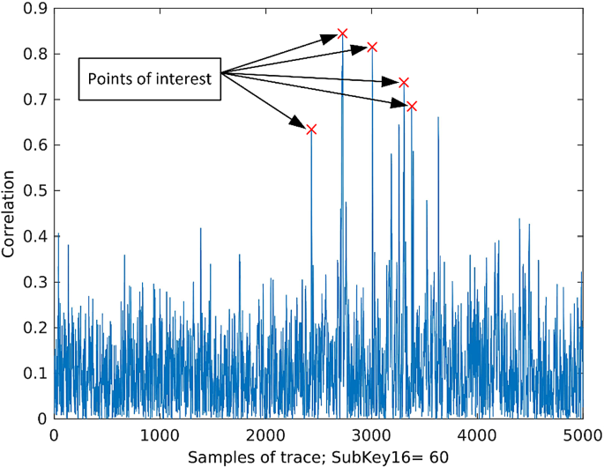
Correlation Power Analysis (CPA)
Most effective against AES-128 encryption
CPA is more sensitive and requires fewer traces than DPA
Provides a clear and measurable baseline for comparison
Power Trace Analysis
Red spikes indicate high correlation between power and key byte predictions
Notes:
Edit slide to continue from previous one - alyssa

Slide 9
CPA Theory
PLACEHOLDER SLIDE
Will talk about how CPA is performed to explain our ChipWhisperer Demo
>Hamming Distance/Measurements, Correlation, etc.

Slide 10
Leakage Model Comparison
Utilized to accurately measure leakage for proper evaluation and testing
Model | Target Mechanism | Strengths | Weaknesses
Hamming Weight (HW) | State Value (Static) | Simplest to implement Requires no knowledge of the previous state Good for S-box output | Physically inaccurate for CMOS registers Lower correlation
Hamming Distance (HD) | State Transition (Dynamic) | Physically accurate for CMOS logic Highly correlated to ASIC power Standard for register updates | Requires a detailed profiling phase to determining weights Difficult to apply in simulation

Slide 11
CPA on Firmware Implementation of AES
AES Trace Capture
Process Traces for Hamming Weight
Correlation Algorithm
placeholder
placeholder
placeholder
Notes:
This slide is just a high levl overview of the main steps in the process. Following slides may break them down in more detail (though maybe brief slides)

Slide 12
Engineering Specifications
Parameter | Specification
Instruction Set | RV32I
Operating Temperature Range | 0 C-120 C
Operating Voltage Range | 0.95 V - 1.25 V
Process Node | ~ 45nm
IR Drop | ≤ 5%
Average Frequency | ≥ 250 MHz
Parameter | Specification
Instruction Set | RV32I
Operating Temperature Range | 0 C-120 C
Operating Voltage Range | 0.90 V - 1.20 V
Process Node | ~ 45nm
IR Drop | ≤ 5%
Average Frequency | ≥ 15 MHz
Parameter | Specification
Masking Order | First-Order Minimum
Instructions per Cycle (IPC) | ≤ 1.2
Cache Size | ≥ 16 MB
Timing Failure Count | 0 Faults
Interrupt Latency | ≤ 12
Leakage Power (25 C) | ≤ 5 mW
Parameter | Specification
Masking Order | First-Order Minimum
Chip Density | ≥ 60
Cache Size | ≥ 4 kB
Timing Failure Count | 0 Faults
Interrupt Latency | ≤ 12
Leakage Power (25 C) | ≤ 5 mW
Notes:
These are our engineering specifications. These were obtained through extensive research, as well as discussions with our sponsors and group members. The RV32I instruction set was selected to provide a standardized, lightweight baseline architecture that minimizes unnecessary complexity while still supporting full software toolchain compatibility. Our other measurable requirement is the 45nm process node, which balances manufacturability, cost, and predictable leakage characteristics. Lastly, our timing failure count was 0 faults, which we proved in our functional verification of the modules.

Slide 13
Software Comparison & Selection
Software | Cadence Design Suite | Synopsys Tools | Siemens EDA | Open Source
Strengths / Pros | Widely adopted EDA flows, large variety of tools such as Xcelium, Genus, SimVision. Extensive learning resources & documentation. | Industry standard for digital design, synthesis, STA, and signoff. Best-in-class verification and timing closure tools. Strong silicon signoff trust. | Extremely strong in verification, DFT, and PCB/system design. Popular tools include QuestaSim, Tessent, and HyperLynx. Strong system validation presence. | Zero licensing cost. Highly customizable. Growing digital ASIC flow support easy automation and scripting.
Weaknesses / Cons | High licensing cost & steep learning curve. | High licensing cost. Toolchain integration sometimes complex across flows. | Smaller ecosystem for full ASIC flow. Some tools are niche focused. Licensing still expensive. | Limited advanced node support. Limited official vendor support. Less mature signoff flows. Tool compatibility issues.
Best Use Case | Full custom IC design, mixed-signal ASICs, analog front-ends, and advanced SoC physical design. | Large scale digital ASIC and SoC production flows requiring silicon signoff accuracy. | Verification heavy environments, DFT workflows, automotive and aerospace electronics, and PCB + system level validation. | Academic research, prototyping, startups, early architecture exploration.
Notes:
For ASIC design flow, there are many different tools that have the capabilities we need. To confirm our choice, we compared a few different EDA design environments. Cadence ultimately had the best ratio of pros/cons for our purposes. Its use case is for Full custom IC design, which aligns perfectly with out project. Since were sponsored, we were able to obtain licensing at no cost.

Slide 14
Process Node Selection
Feature | SkyWater SKY130 (130 nm) | GlobalFoundries GF180MCU (180 nm) | Cadence GPDK 45 nm
Process Node | 130 nm CMOS | 180 nm CMOS/MCU | 45 nm CMOS (generic)
Strengths / Pros | Active open-source ecosystem; rich digital and analog cells; documented tapeout path; strong community support; mixed-signal friendly | Strong analog / I/O support; robust MCU-oriented process; predictable and mature device models; well-suited for high-voltage interfaces | Smallest feature size among the three; high density; faster switching speeds; better energy efficiency; representative of modern processes
Weaknesses / Cons | Larger geometry than advanced nodes; slower switching speeds; higher power for equivalent functionality | Larger geometry; slower switching speeds; less area-efficient; more limited open-source tooling and flows than SKY130 | Generic PDK rather than a full production process; often assumes commercial Cadence EDA tools for advanced flows
Best Use Case | Academic research, teaching, prototyping, mixed-signal ASICs, and open-source shuttle tapeouts | MCU design, embedded systems, high-voltage-tolerant blocks, and robust analog integration | High-performance digital ASIC prototyping, methodology and tool evaluation, and technology comparison studies
Community / Ecosystem | Large, active open-source community; strong OpenLANE and open-flow support | Smaller community; some open documentation but less community tooling than SKY130 | Minimal open-source community; primarily used in Cadence training and academic EDA flows
Notes:
Josh wrote about this i think? Not entirely sure

Slide 15
ISA Comparisons
Category | License | ISA Type | Customization | Common Uses
RISC-V | Open-source, free | RISC (simple) | Very high (extensions allowed) | Research, FPGA, custom SoC, IoT
ARM | Proprietary license | RISC (moderate) | Limited | Mobile, embedded systems
x86 | Proprietary license | CISC (complex) | Very limited | PCs, laptops, servers
Notes:
I think i wrote abt this idk ill have to look -anna

Slide 16
Hardware/Baseline Core Comparison
We opted for the Ibex core primarily due to its substantial documentation, pre-packaged test environments to expand upon, as well as progress within the Open Source community with the OpenTitan project (Earl Grey Tapeout)
Core | μarch | Language | Verification | + | -
Rocket Chip | In-order, Single-cycle datapath, RV32/64 | Chisel (generates Verilog) | Mature via Chipyard regressions | Showcased SoC integration, scalable ecosystem | Chisel abstraction layer, large codebase
NEORV32 | In-order, 2-stage pipeline, Configurable RV32-I/IMC/EMC | VHDL | Solid self-tests, emphasis on precise exceptions | Beginner-friendly, fit on small FPGAs (stretch goal) | VHDL, no pre-packaged SoC/MMU integration
PicoRV32 | In-order, RV32IMC | Verilog | Open-source maturity shows significant coverage | Fit on small FPGAs, high documented max frequency on 7-series FPGAs | No cache/MMU (limits SoC integration)
Ibex | In-order, configurable 2/3-stage pipeline, RV32IMC | SystemVerilog | Strong UVM environment, formal proofs, and OpenTitan DV coverage | Clear SV RTL, flexible configurations, security-aware design, pre-packaged test env, strong open-source community, OpenTitan Taped out | No base MMU, modest performance documented
Notes:
Alex will fill in rest of table

Slide 17
Hardware Realization (ASIC vs. PCB)
Much of Senior Design is oriented around the research, design, layout/implementation, and fabrication of PCBs in order to realize some functionality,
This project is unique in the sense that there is no PCB deliverable (or any direct physical component)
  Instead, our deliverables will include:
    Synthesized fabric netlist(s) of our design
    Cadence Innovus layout(s)
    GDS-II (mock-tapeout)
    STA/power/IR analysis reports

Slide 18
Design

Slide 19
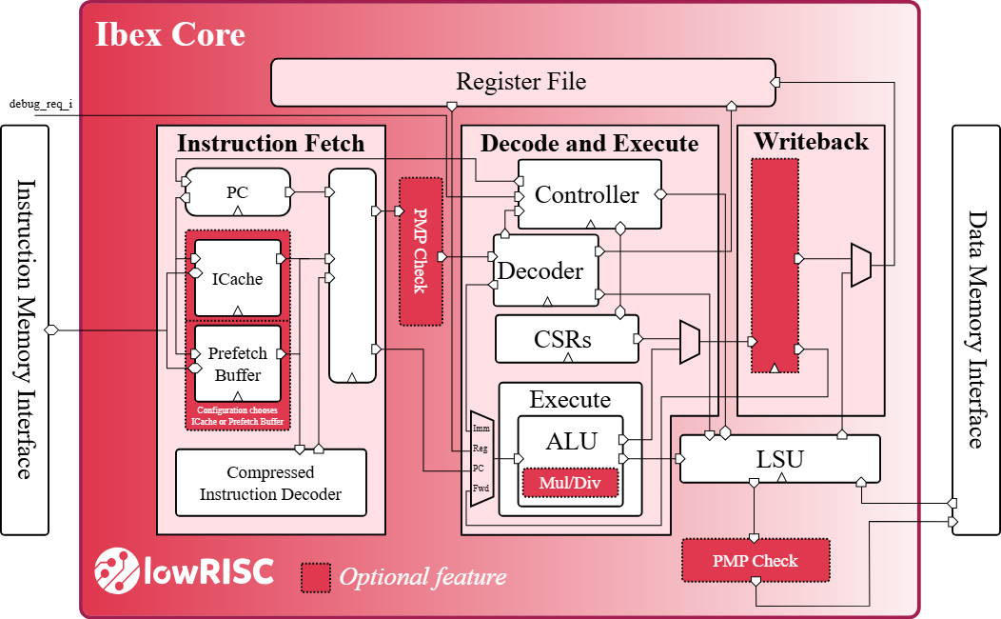
Ibex Core
32-bit, open-source RISC-V CPU developed by lowRISC
Implements the RV32IMC instruction set
Two-stage or three-stage pipeline options
  Opted for two-stage
Source: IBEX Core Documentation

Slide 20
Hiding Techniques
Technique | Purpose / Mechanism | Advantages | Limitations / Challenges
Random Noise Injection | Adds randomness to power usage; uses LFSRs, ring oscillators, toggle logic; lowers signal-to-noise ratio for attackers | Simple hardware integration; works with existing RTL/software; complements other techniques | Only hides leakage; increases power overhead; may affect timing stability
Random Dynamic Frequency Scaling/Clock Randomization | Randomizes operating frequency; misaligns power traces | Low hardware cost; highly effective misalignment; protects all workloads during use | Still allows leakage with many traces; performance and power efficiency vary
Random Delay Instruction Insertion (RDII) | Inserts random NOPs or stalls; misaligns event timing; added via compiler or hardware stalls | Very low hardware cost; adjustable randomness; ISA-compatible for RISC-V | Requires toolchain modification; adds execution time variability; vulnerable to advanced trace alignment
Random noise injection and Clock Randomization present easy to integrate solutions with low hardware overhead for SCA mitigation
Notes:
josh

Slide 21
Masking Techniques
Technique | Leakage Resistance Level | Glitch Resistance | Hardware Overhead (Area/Power) | Randomness Requirement
First-Order Boolean Masking | First-order (protects against single-point leakages) | No | Low to Moderate | Moderate (requires fresh randoms for secure gates)
Higher-Order Boolean Masking | Up to n-th order (depending on number of shares) | No | High (scales with number of shares) | High (more random shares needed)
Arithmetic Masking | First- to higher-order (depends on share count) | No | Moderate to High | High (requires many fresh randoms, especially in hybrid schemes)
Threshold Implementation (TI) | High (provably secure against glitch-induced leakage) | Yes | High (increased gate count and latency) | Moderate (additional randoms for uniformity)
First-Order Boolean Masking provides the mitigation while not detrimentally impacting area
Notes:
josh

Slide 22
Evaluation of Generating Randomness
Type | Source / Mechanism | Typical Role / Notes | Limitations / Challenges
True Random Number Generator (TRNG) | Physical noise (thermal noise, jitter, metastability) | High-entropy, unpredictable bits; used to seed other generators and generate long-term keys | Only hides leakage; increases power overhead; may affect timing stability
Non-cryptographic PRNG (e.g., rand()) | Simple deterministic algorithm | Fast and easy to implement; suitable for simulations and non-security uses; not safe against attackers | Still allows leakage with many traces; may cause timing or synchronization issues; performance and power efficiency vary
Notes:
josh

Slide 23
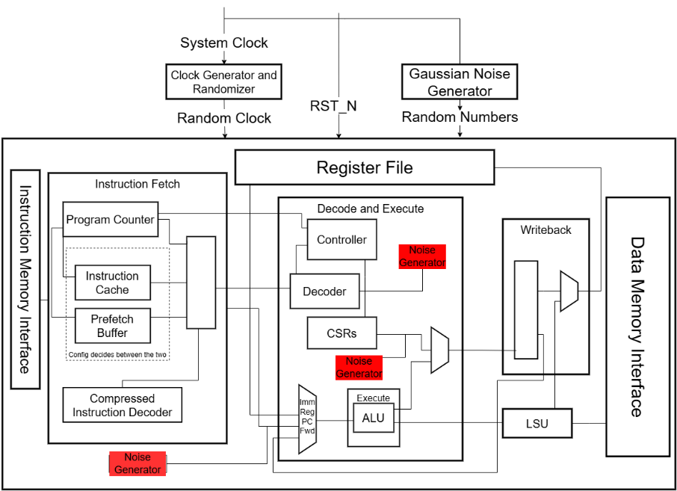
Core Redesign
Main design changes:
Clock Generator and Randomizer
Boolean Masked Core
  Random Numbers generated for GNG IP Core
Noise Generators
  Ring Oscillators
  CASRs

Slide 24
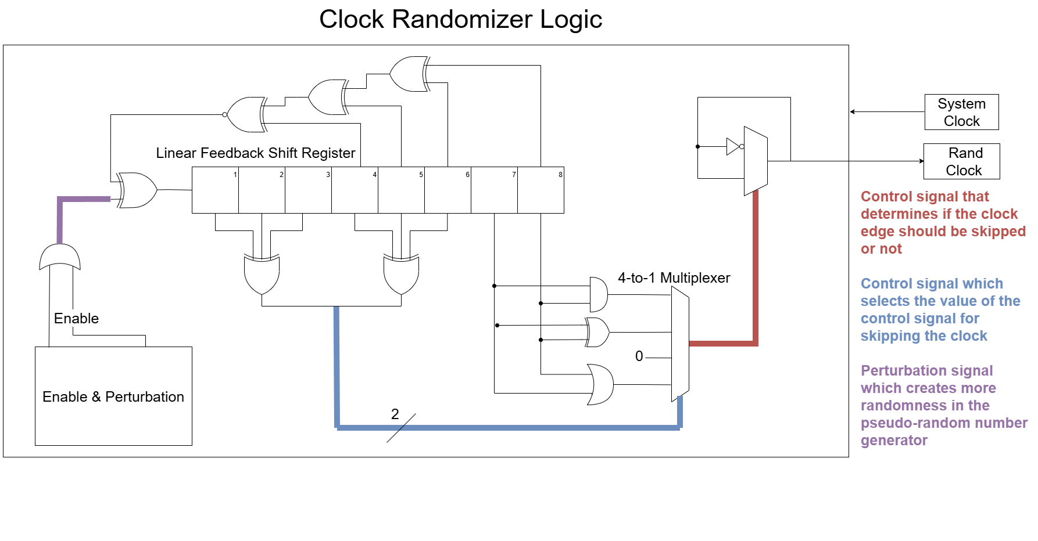
Clock Generator and Randomizer
Generates Random Clock based on System Clock and LFSR outputs

Slide 25
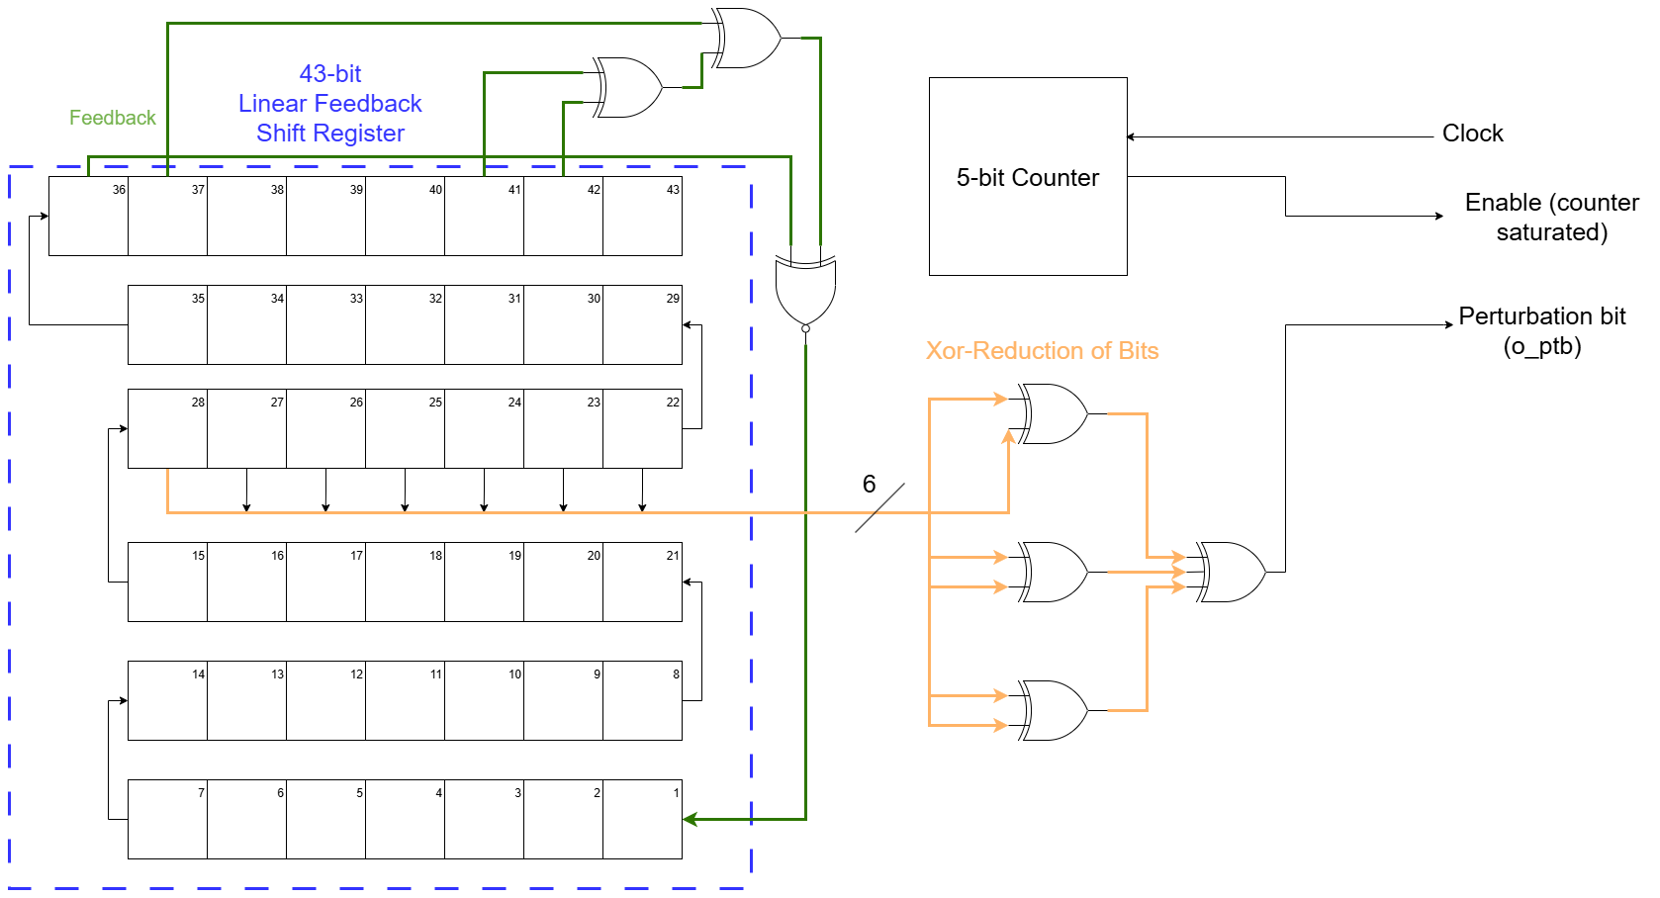
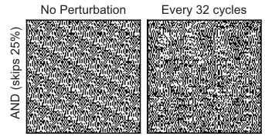
Perturbation Logic to Increase Randomness
Generates Random Clock based on System Clock and LFSR outputs
Visible Patterns
More Scrambled

Slide 26
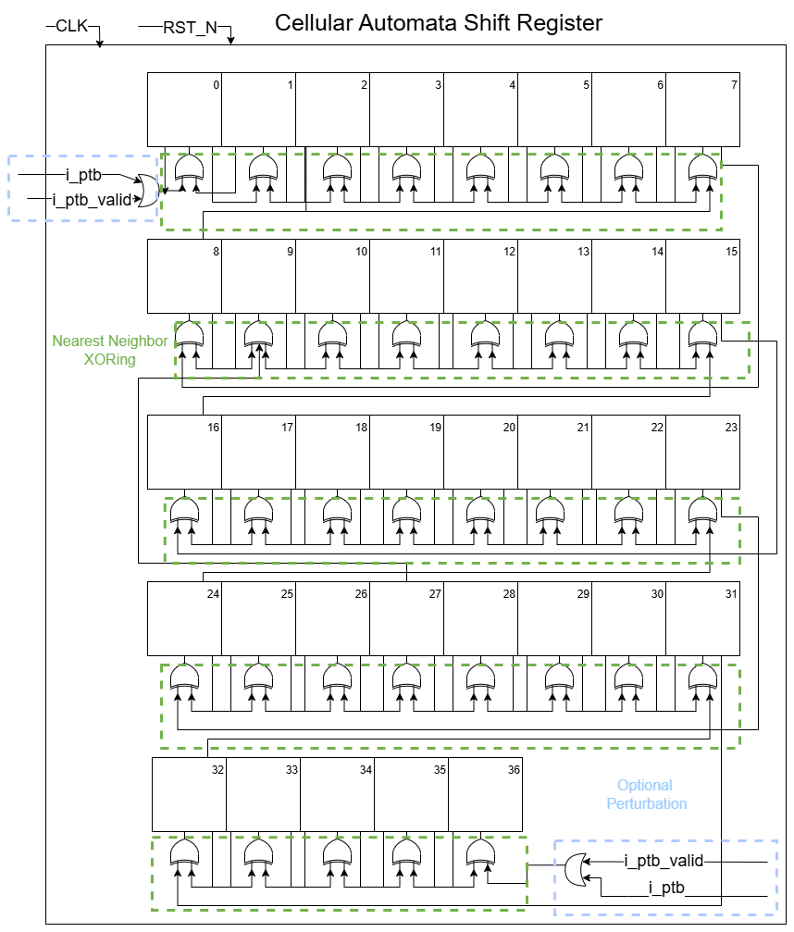
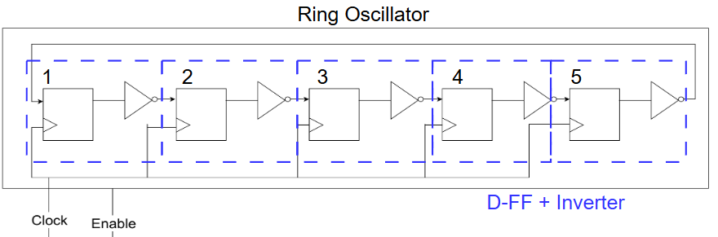
Noise Generators
Increases power consumption in circuit to obfuscate correlation between power and data being processed
Enable bit to trigger activation depending on certain activity in circuit
Types of Noise Generators
  Ring Oscillators
  CASRs

Slide 27
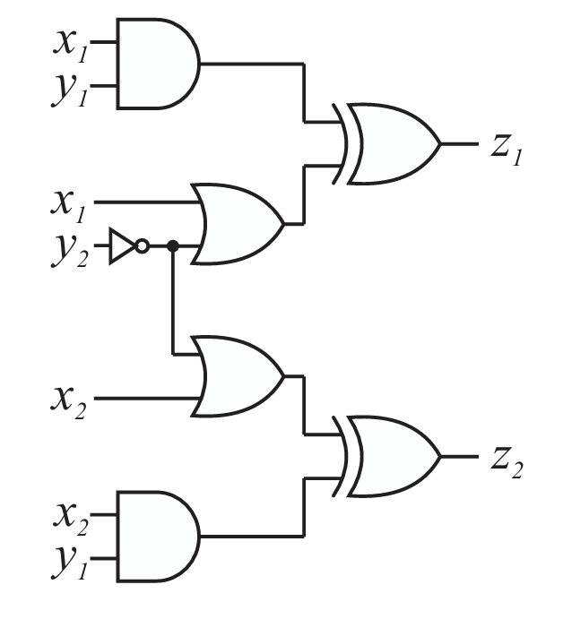
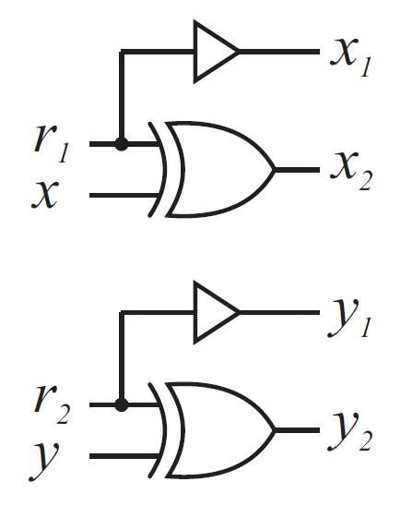
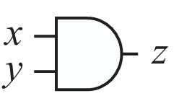
Boolean Masking
Replace gates in processor with secure variations
  Secure gates are made with gate primitives from Standard Cell Library
  Design is first synthesized with limited gate set, then replaced with secure gates
Secure
Share Splitting
Gate Replacement
Original
Random Bits
Split Shares
Original Values

Slide 28
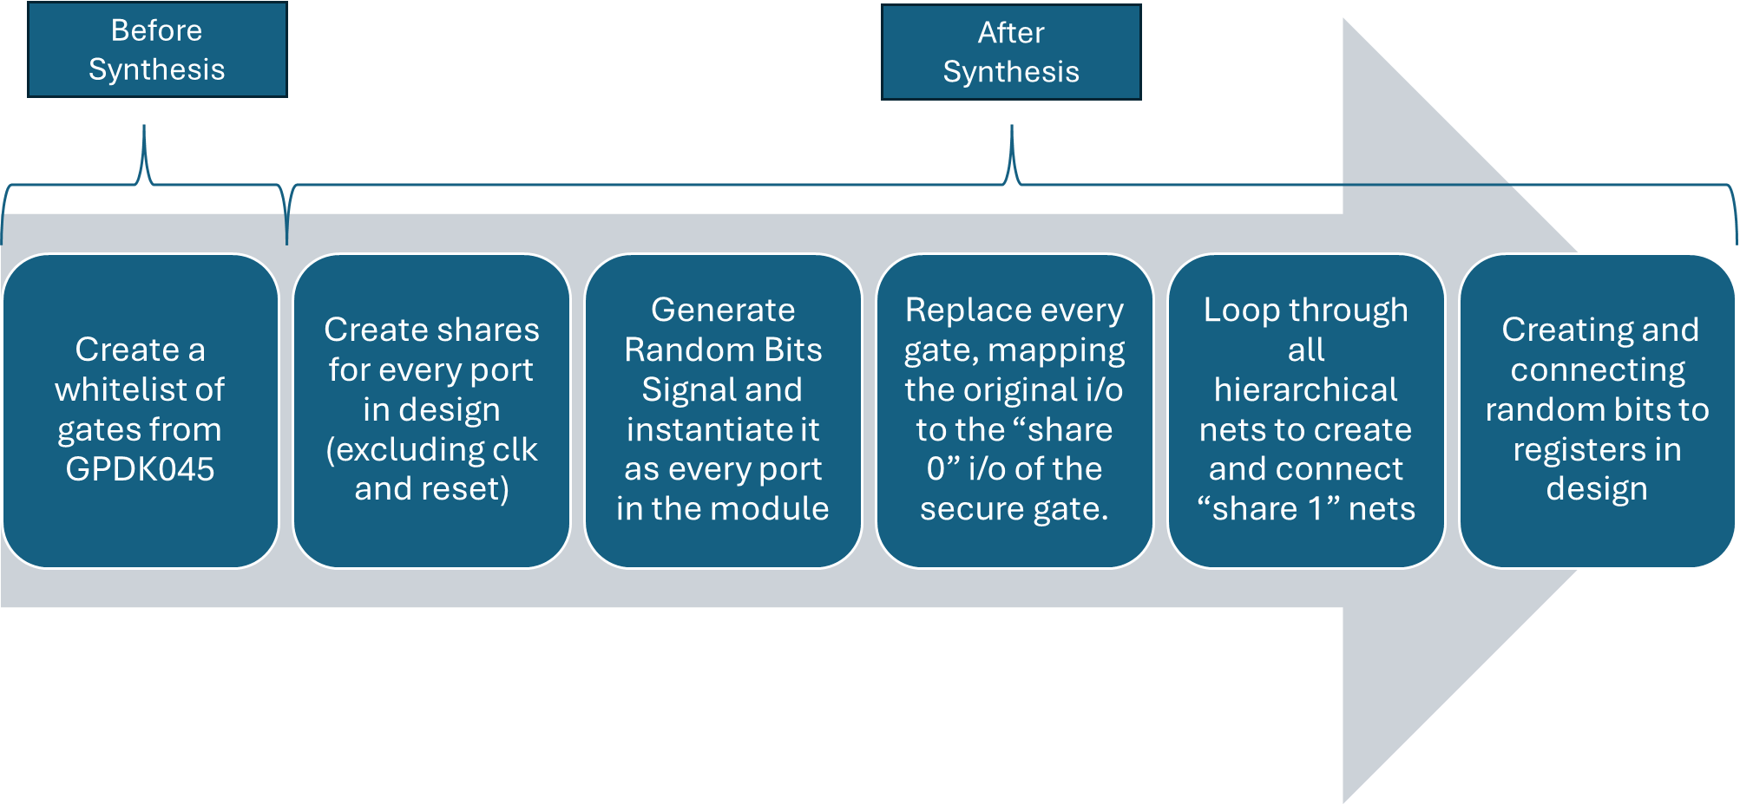
Utilization of Tcl scripts for Boolean Masking

Slide 29
Verification

Slide 30
Verification for ASIC designs
1
2
3
4
Verification Planning
Functional Verification
Universal Verification Methodology (UVM)
Signoff & Final Validation
Define coverage goals
Establish test strategies
Converse with design team
RTL correctness
ISA compliance
Security logic functional correctness
Corner cases
Coverage closure
Security stress testing
Full regression pass
STA sign-off confirmation
Final behavior validation
Notes:
This slide shows the overall verification journey we follow to make sure our ASIC design is fully functional. We start with verification planning, where we define our coverage goals and how we will test the design. Next, functional verification checks that the RTL actually does what it is supposed to do, including architecture compliance and making sure security features behave correctly. After that, we scale testing using UVM to hit corner cases, close coverage gaps, and stress test security mechanisms, and finally we move into signoff where we run full regressions, confirm timing through STA, and validate final behavior before tapeout.

Slide 31
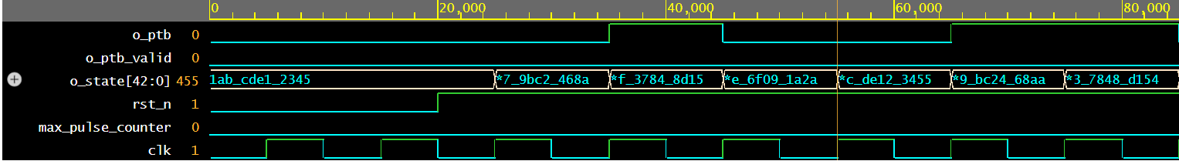
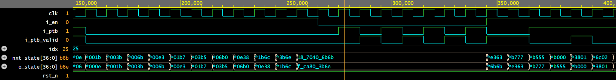
Functional Verification
Linear Feedback Shift Register
Cellular Automata Shift Register
Notes:
To verify each module, we built basic functional testbenches that generated waveforms showing how the signals behaved on every clock cycle. The goal was to confirm that the internal state, outputs, and control signals all matched the expected behavior from our design specification. We used EDA Playground for quick simulation, clocking, reset control, and stimulus generation.
On this slide, you can see examples from two modules. In the LFSR, the o_state register shifts left every cycle with a new feedback bit inserted, showing the expected pseudo-random progression. In the Cellular Automata shift register, you can see nxt_state updating based on the neighbor rules, and signals like i_ptb and i_ptb_valid correctly controlling perturbation at the boundaries.

Slide 32
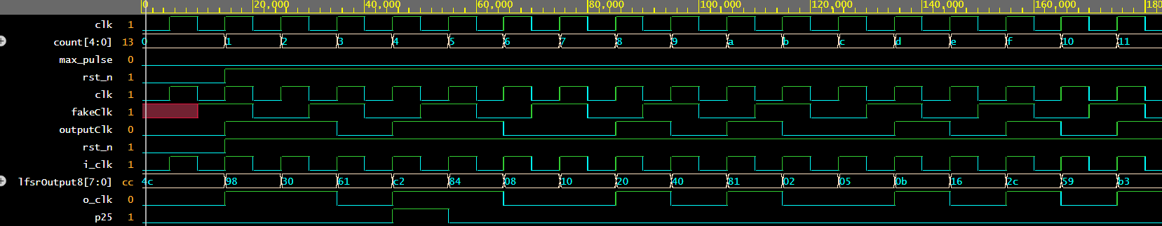
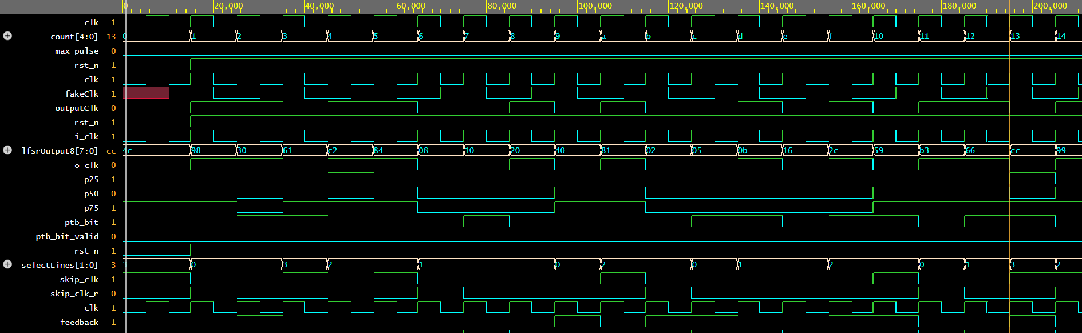
Functional Clock Randomizer Verification
Initial functional verification checked the clock edge skipping, randomization, and ensuring that unpredictable clock patterns were generated.
Original Input Clock:
New Output Clock (with randomization and clock edge skipping):
Notes:
Alyssa
Here, we were able to verify the clock generation module, which is the clock randomizer design that Josh explained earlier.
In this simulation, we ran our clkgen testbench to observe how the module handles clock edge skipping based on the LFSR-generated patterns. (LFSR = linear feedback shift register)
As shown in the waveform, the output clock toggles irregularly and confirms that our randomization logic works as intended.
You can also see the initial reset and the regular 100 MHz input clock driving the module, with skipped edges clearly visible in the simulation waveform results.

Slide 33
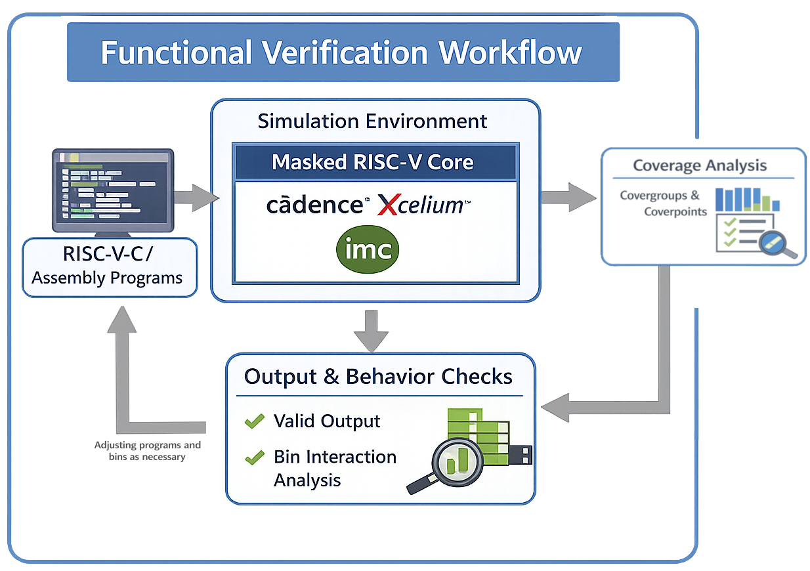
Functional Verification - Methodology
Verification and coverage is handled through a functional method:
a series of RISC-V programs are compiled and run on a simulated version of the masked Ibex core on Cadence Xcelium, with various covergroups and coverpoints defined in order to check for desired stimulus.
These executions are checked for valid terminal outputs, as well as anticipated coverpoint behavior.
Test programs and coverpoints are regularly iterated upon to expand coverage.
Since we are operating on the masked Ibex core, we are performing Gate-Level Simulations
Adjusting programs and
bins as necessary

Slide 34
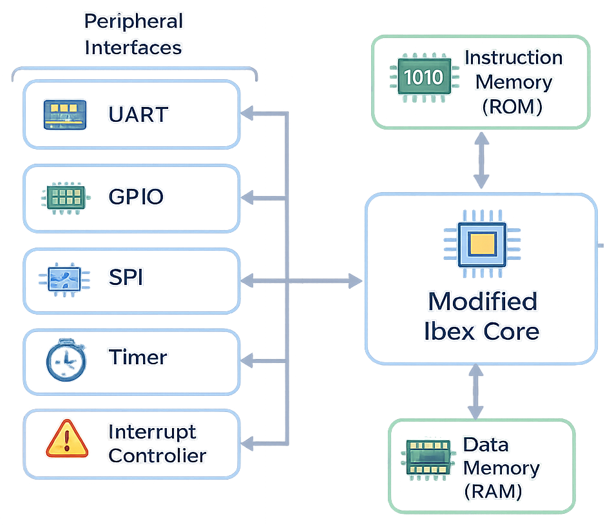
Functional Verification - Simulation Environment
We leverage Ibex’s Simple System environment, providing us with a lightweight SoC to simulate our modified Ibex core.
It consists of Instruction/data memory and various peripheral interfaces, all interconnected using SiFive’s TileLink Uncached Lightweight (TL-UL) bus protocol
The Simple System also includes a basic framework to ensure RISC-V-compiled C programs can properly be executed
Our main “contribution” to this ecosystem is the inclusion of our masked core, which was built using post-synthesis transformations (masking). This enables us to perform Gate-Level Simulations.

Slide 35
Verification - Test Programs Executed
Test Program | Description
Coremark | Standard C Benchmark
Bubble Sort | C Sorting Algorithm
CRC32 Checksum | Cycling Redundancy Check Algorithm
Fibonacci Sequence | Calculates & outputs first 20 numbers in Fibonacci sequence
Sieve of Eratosthenes | Calculates & outputs the highest prime number up to a given input
Branch & Pipeline Stress (ASM) | Assembly program focusing on inducing branch behavior and pipeline coverage
Basic Timer Test | Read/write to specific SimCtrl registers, invoking Simple System timer peripheral
MMIO & Byte-enabled coverage (ASM) | Memory-Mapped I/O and partial data word stimulus, 3x different test programs
IRQ & Misaligned Access | Bitwise operations to force memory transactions, writing half-words to registers, invoking Timer and LSU to watch for interrupt behavior
Basic RISC-V Arithmetic Test | Basic arithmetic, targeting RV32IM instruction set (most/all opcodes targeted)

Slide 36
Covergroup #1 - stage_flow
High-level pipeline/activity coverage across IF/ID/EX/WB, branch behavior, and opcode classes.
Captures whether key execution-stage events occur and how IF/ID/WB co-occur.
Coverpoints: {bins}
cp_if_valid: {0, 1}
cp_if_busy: {0, 1}
cp_id_valid: {0, 1}
cp_id_exv: {0, 1}
cp_ex_valid: {0, 1}
cp_branch: {0, 1}
cp_wb_done: {0, 1}
cp_rf_we_wb: {0, 1}
cp_opcode: load(0000011), store(0100011), branch(1100011), jal(1101111), jalr(1100111), op_imm(0010011), op(0110011), misc(default)
x_if_id_wb: cross of cp_if_valid × cp_id_valid × cp_wb_done

Slide 37
Covergroup #2 - lsu_irq
LSU transaction activity monitor (request/busy/data request/read-write intent).
Used to confirm both load and store paths are exercised while LSU is active.
Coverpoints: {bins}
cp_lsu_req: {0, 1}
cp_lsu_busy: {0, 1}
cp_data_req: {0, 1}
cp_data_we: {read(0), write(1)}

Slide 38
Covergroup #3 - core_if_data
Instruction/data interface handshake and response-quality coverage.
Tracks req/gnt/rvalid/error behavior and key handshake crosses on both instruction and data channels.
Coverpoints: {bins}
cp_instr_req: {0, 1}
cp_instr_gnt: {0, 1}
cp_instr_rvalid: {0, 1}
cp_instr_err: {0} with ignore_bins {1}
cp_data_req: {0, 1}
cp_data_gnt: {0, 1}
cp_data_rvalid: {0, 1}
cp_data_err: {0, 1}
cp_data_we: {read(0), write(1)}
x_instr_hs: cross cp_instr_req × cp_instr_gnt × cp_instr_rvalid with ignore for req/gnt mismatch
x_data_hs: cross cp_data_req × cp_data_gnt × cp_data_rvalid
x_data_rsp: cross cp_data_we × cp_data_err

Slide 39
Covergroup #4 - core_addr_irq
Address-region and alignment coverage for data transactions, with read/write interaction.
Ensures RAM/SimCtrl/Timer/other regions are exercised and correlated with access direction.
Coverpoints: {Bins}
cp_region: {ram(00), simctrl(01), timer(10), other(11)}
cp_align: {aligned(00), misalign1(01), misalign2(10), misalign3(11)} with ignore 01/10/11
x_region_rw: cross cp_region × data_we_o iff data_req_o
x_align_rw: cross cp_align × data_we_o iff data_req_o with ignore on misaligned bins

Slide 40
Covergroup #5 - core_stage
Compact pipeline occupancy model focused on simultaneous IF/ID/EX/WB validity states.
Useful for identifying legal/observed stage-concurrency patterns (x_pipe_flow) and EX-vs-LSU coupling.
Coverpoints: {Bins}
cp_if_valid: {0, 1}
cp_id_valid: {0, 1}
cp_ex_valid: {0, 1}
cp_wb_done: {0, 1}
cp_lsu_busy: {idle(0), busy(1)}
x_pipe_flow: cross cp_if_valid × cp_id_valid × cp_ex_valid × cp_wb_done
x_ex_lsu: cross cp_ex_valid × cp_lsu_busy

Slide 41
Covergroup #6 - core_stage
MMIO quality coverage: region, byte-enable pattern, MMIO sub-register class, and read/write direction.
Designed to validate realistic MMIO behavior and byte-lane utilization across regions.
Coverpoints: {Bins}
cp_region_req*: {ram(00), simctrl(01), timer(10), other(11)}
cp_data_be*: {byte0(0001), byte1(0010), byte2(0100), byte3(1000), half0(0011), half1(1100), word(1111), other(default)}
cp_mmio_reg*: {non_mmio(0), simctrl_out(1), simctrl_ctrl(2), mmio_other(3), timer_mtime_l(4), timer_mtime_h(5), timer_cmp_l(6), timer_cmp_h(7)}
cp_rw*: {read(0), write(1)}
x_be_region: cross cp_data_be × cp_region_req
x_mmio_rw: cross cp_mmio_reg × cp_rw
*all cp_ bins are gated with (iff data_req_o).

Slide 42
Functional Verification - Aggregating Results
Each execution of a C program results in an output of a .ucd file, containing various verification and coverage metrics
Cadence’s Integrated Metrics Center (IMC) allows for us to not only view these results in a GUI, but also to merge the results from various executions of the same filelist into a single database.
A sample of this workflow might look like:
  1. Creating a “runlist” for IMC
printf "path/to/testA/ucdFile \n
path/to/testB/ucdFile \n "
> /tmp/demo.runlist
  2. Invoking IMC to merge and process results
imc -execcmd "merge -runfile /tmp/demo.runlist -out work/cov/outputs/demo_merged_output -overwrite; load -run work/cov/outputs/demo_merged_output;
report_metrics -out /tmp/merged_report; exit"
  3. Viewing results
GUI: imc -gui -load work/cov/outputs/demo_merged_output
Browser: firefox work/cov/outputs/demo_merged_output

Slide 43
Verification - Govergoups & Functional Coverage
87.5%
100%
95.83%
96.88%
82.14%
97.62%
stage_flow
lsu_irq
lite_if_data
lite_addr_irq
core_lite_stage
core_lite_mmio_be

Slide 44
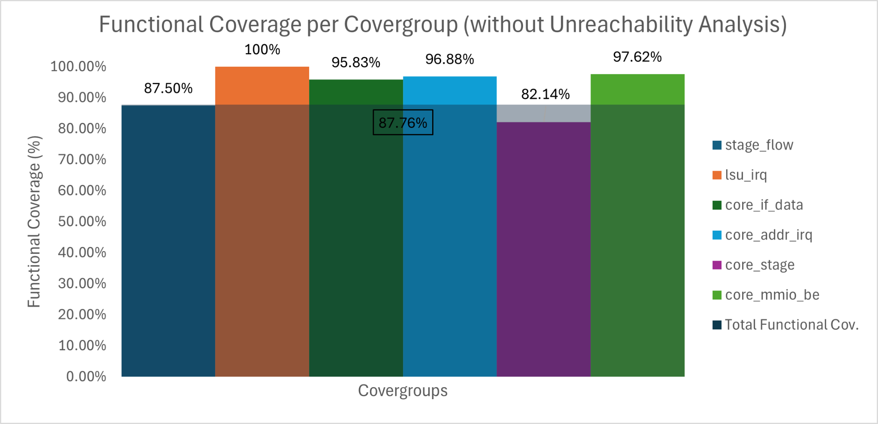
Verification - Govergoups & Functional Coverage

Slide 45
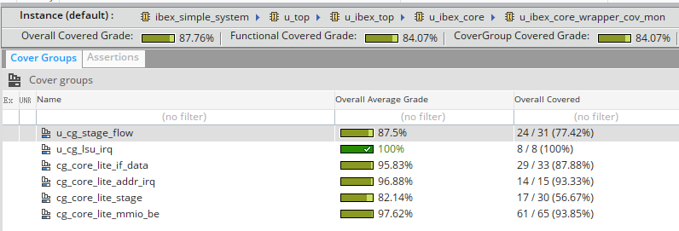
Verification - Govergoups & Functional Coverage
Recognizing that we have a few bins ignored, we see a direct functional coverage of 84.07%, and including the ignored bins we see a functional coverage of 87.76%.
  This value does not include any UNR (Unreachability) enabled in Cadence IMC.

Slide 46
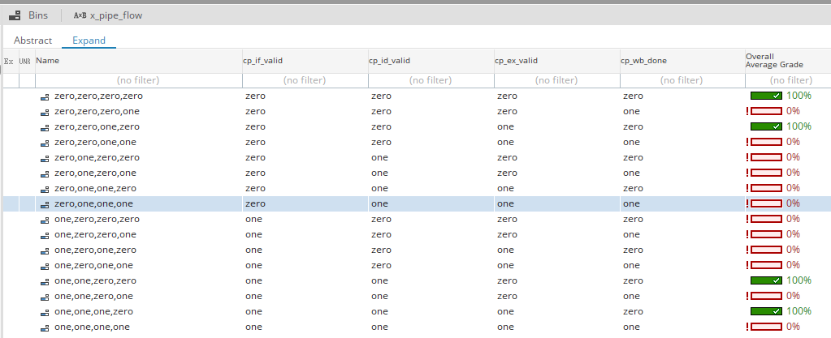
Functional Coverage - Gaps/Unreachability (1)
Cross coverpoint within the “core_lite_stage” covergroup, lacking significant input stimulus (12 dead bins)
Difficult to saturate specific pipeline stages without disabling all compiler optimization of programs run on the core or re-designing the Ibex Simple System memory hierarchy

Slide 47
Prototyping & Testing

Slide 48
System Testing & Verification
Purpose: verify architectural correctness of the design through utilizing the Ibex DV environment
Steps to system testing:
Test program generated with RISC-V DV
Program compiled and loaded into UVM memory model
Core executes program under memory timing, interrupt patterns, and debug events
UVM monitors activity during execution
An end condition is met, which will be evaluated to determine whether it had passed or not

Slide 49
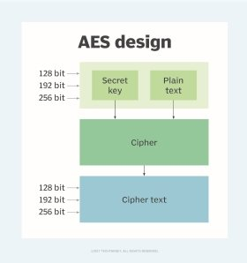
Functional Testing
Attacker Model
Testing the pre and post-modified Ibex core
Functional testing requires an attacker model and a leakage model to properly analyze
Simulation of AES-128 for encryption of plaintext schedule
Attacker can exploit the key through observing power traces per encryption

Slide 50
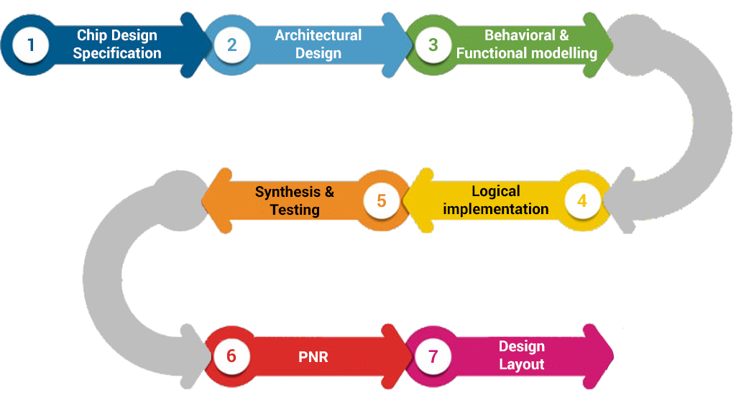
Performance Evaluation
Continuous evaluation and verification throughout design process
Success evaluated through following standard ASIC design process and comparing outcomes to initial engineering specifications and standards
Notes:
Using pic for reference for now

Slide 51
(change these) Challenges & Solutions
Challenges | Solutions
Verification is dependent on design steps and may cause delays in the process | Assist in debugging design issues to successfully move through ASIC design steps according to our estimated timeline
One setback or mistake in either design or verification can significantly delay project completion | Carefully evaluate the work completed at each step to rule out any errors or mistakes before moving onto the next step in the process

Slide 52
Results

Slide 53
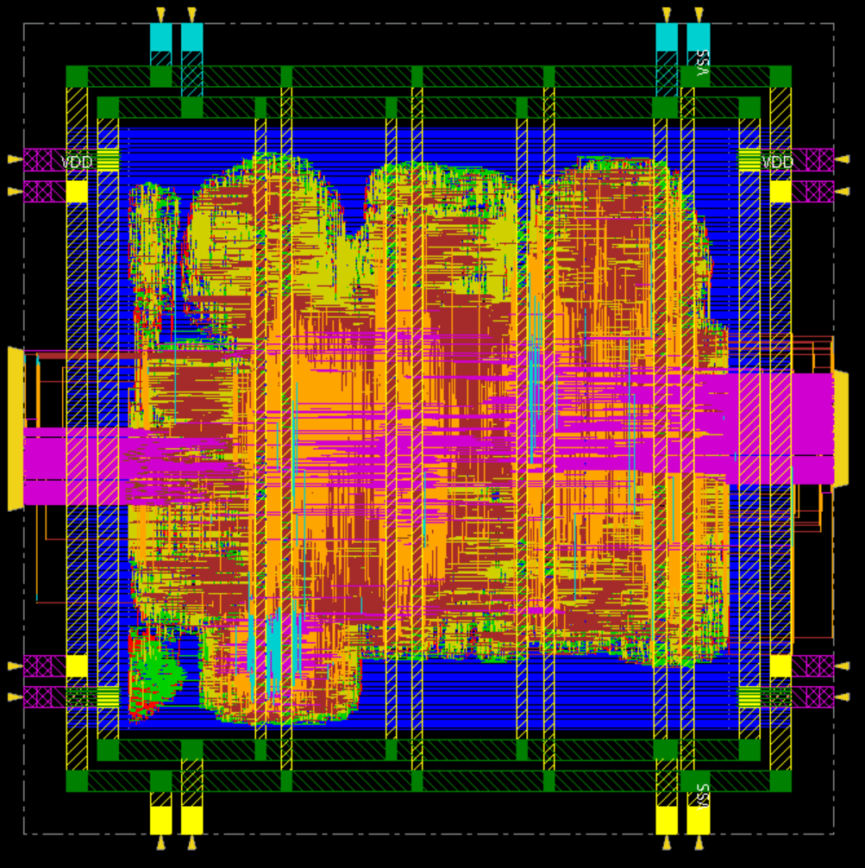
Physical Design
VDD / VSS pins
Output pins
Input pins
Power stripes

Slide 54
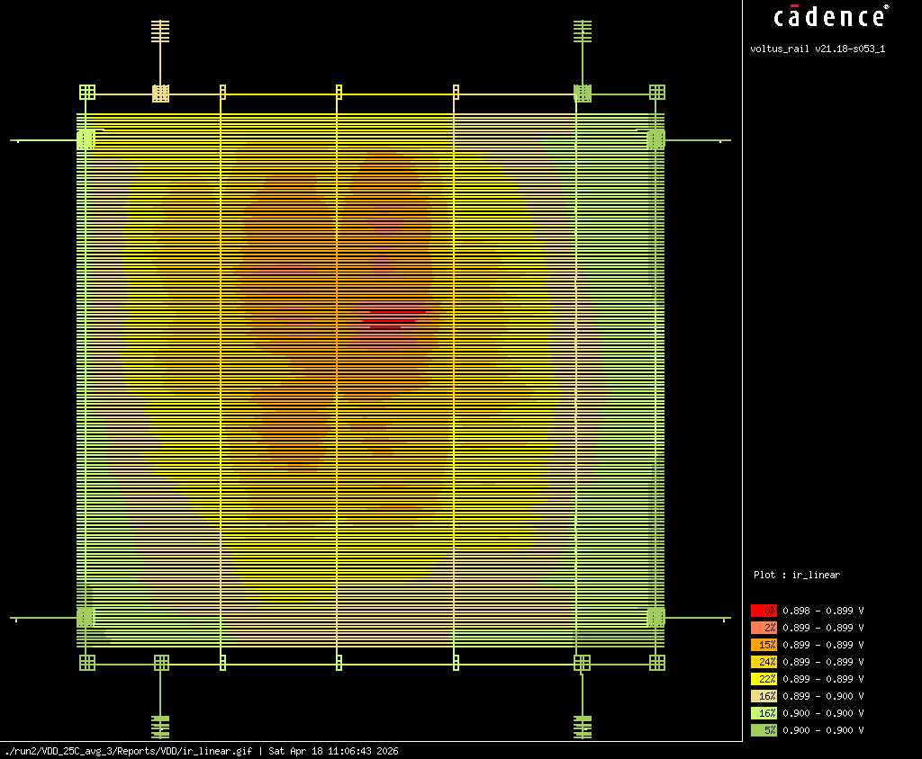
IR Drop
Max IR Drop
< .899V
= .22 %

Slide 55
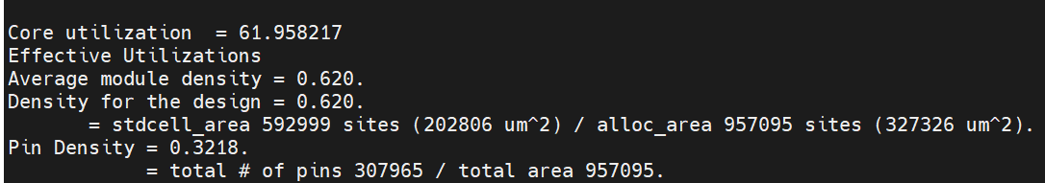
Chip Density
Core utilization = 61.958%

Slide 56

Functional Coverage Results
258 / 294 (87.76%) Functional Bins through all covergroups prior to Unreachability Analysis

Slide 57
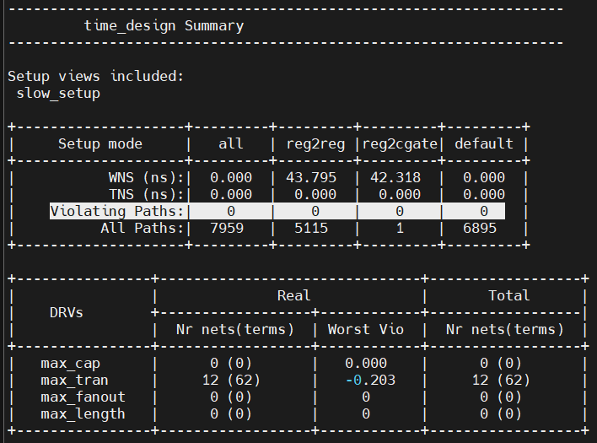
Post-Route Timing Analysis
opt_design resolves violations through buffer insertion and cell resizing
Post-PnR STA confirms zero setup and hold violations across all timing paths
WNS of 0.000ns, no paths are late
Meets specifications of zero timing failures

Slide 58
Our Challenges & Solutions
Challenges | Solutions
Gate-level simulation with coverage metrics significantly increased execution time | Carefully selecting test stimulus and prioritizing targeted inputs allowed for more efficient use of simulation time.
Uneven IR drop areas found during physical design | Widening power stripes and adding vertical power routing helped distribute power more evenly across the core
Managing version control and sequencing across team members, since some steps depended on completed outputs from prior stages | Shared VLSI server directory and regular communication to keep database updates synchronized

Slide 59
Administrative Content

Slide 60
Bill of Materials
Category | Item | Source / Cost
EDA Tools | Cadence Xcelium, Genus, and Innovus. | Provided via project sponsor
HDL Design Environment | SystemVerilog and UVM. | Open Source
Open-Source Core | Ibex RISC-V Core, baseline RTL. | Open Source
RISC-V Toolchain | GCC / LLVM with custom ISA extensions. | Open Source
Computing Resources | UCF HPC Servers and department workstations. | Provided by University
Documentation Tools | Overleaf (LaTeX) & Github. | Free Academic Access
Training Resources | Cadence Training portal, online ASIC flow modules. | Provided via project sponsor
Demo Hardware | ChipWhisperer Husky | Free, on loan from University
Notes:
This is our projects BOM, thankfully all of our resources were either open source, provided via UCF academic licesne, or from our sponsors licesne.

Slide 61
Work Distribution:
SD 1 - Front End VLSI | SD 2 - Back-End VLSI
RTL Design: Joshua Daniel | Physical Design: Everyone
Verification: Alex Anna Alyssa | Final Verification: Everyone

Slide 62

THANK YOU!
OUR SPONSOR:
OUR REVIEWERS:
Dr. Chung Yong Chan
Dr. Mike Borowczak
Brian McNulty
Steve Leonard
Marlon J Fuentes
Aaron Lingerfelt
Alberto Reategui

