Slide 1
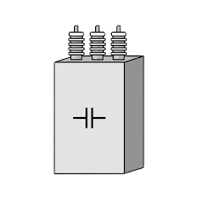

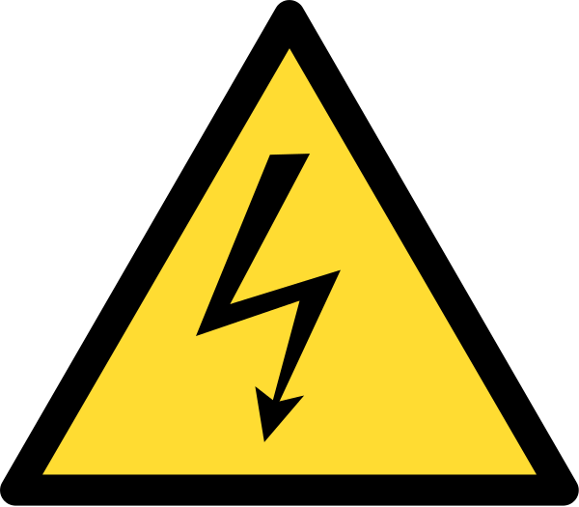
High Voltage Capacitor Discharge Tool
Group 14
Sponsored by NextEra Energy

Slide 2

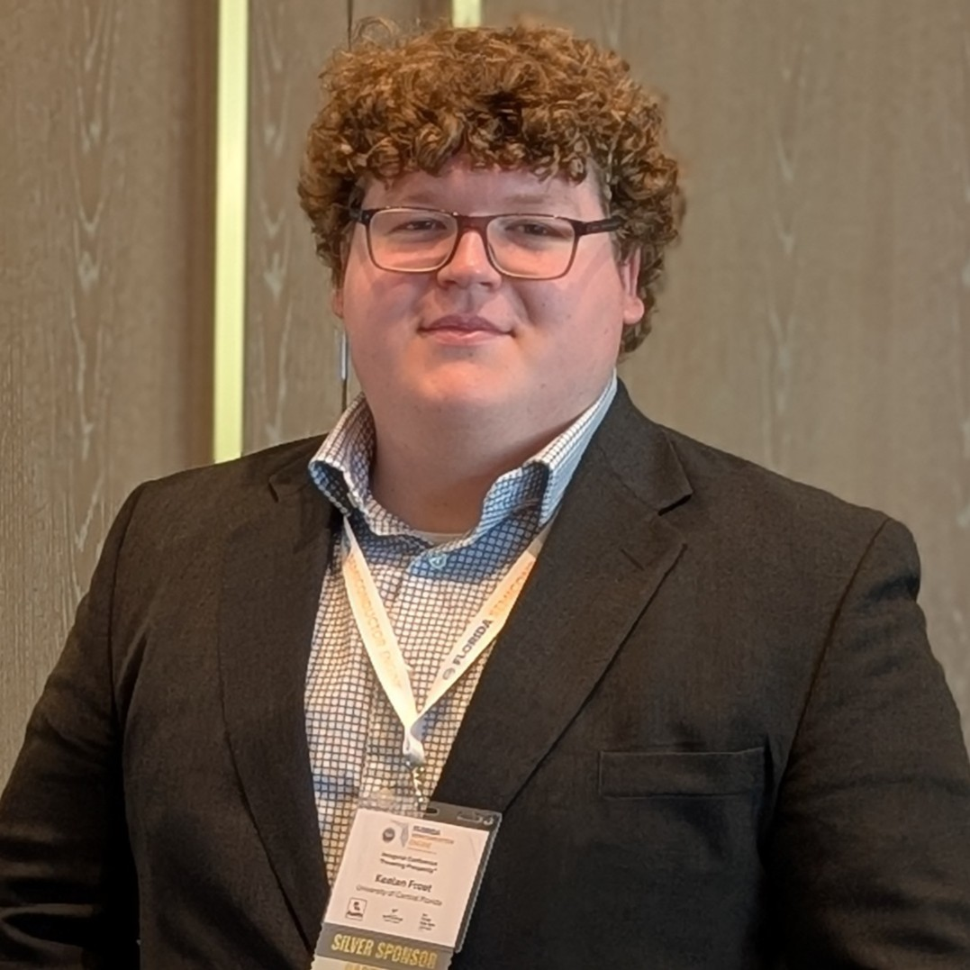


The Team
Javier Lopez-Marrero
Kealan Frost
Will Serface
Zeeshan Asif
Electrical Engineering
Electrical Engineering
Computer Engineering
Electrical Engineering

Slide 3
Table of contents
01
02
03
04
05
06
Background & Administration
System Design & Hardware Selection
Schematics & PCB Layouts
Software Design
Future Plans
Prototyping & Testing

Slide 4
01
Background & Administration

Slide 5



Motivation and Background
NextEra uses capacitor banks for their inverters
Safety is a big concern with high amounts of voltage and risk of electric shock and potential system breakdown.
NextEra has tasked the team with designing a capacitor bank discharge tool prototype.

Slide 6
Goals and Objectives
Designed System Should Be:
Safe & Reliable
Quick
User-friendly
Configurable
Scalable
This Led to the Following Objectives:
Implement 3 controllable, resistive discharge stages
Discharge capacitor in < 30 secs
Provide 4 status indications
Provide 4 configurable setpoints
Scale system to support 1200V
Notes:
Clarify testing only at 12V

Slide 7
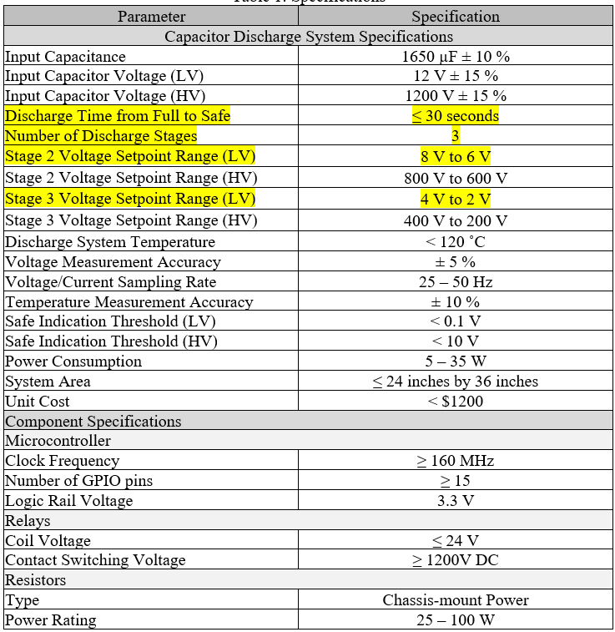
Engineering Specifications
Critical Design Specifications:
Discharge time <= 30 seconds
3 Stage discharge
Stage voltage setpoints
Prototype Levels:
High voltage design (1200V nominal, 1500V max)
Low voltage design (12V nominal, 15V max)

Slide 8



Work Distribution and Flow
Subsystem | Primary | Secondary | Responsibilities
Sensing and Isolation | Kealan Frost | Will Serface | Sensor research and selections
 |  |  | Sensor circuit designs
 |  |  | Sensor, MCU, and relay integration
 |  |  | Isolation from high voltage
Discharge | Javier Lopez-Marrero | Kealan Frost | Power resistor research and selection
 |  |  | Relay research and selection
 |  |  | Discharge network design
 |  |  | Relay and MCU integration
Computing | Will Serface | Zeeshan Asif | MCU research and selection
 |  |  | Display and I/O research and selection
 |  |  | Embedded Programming
 |  |  | User interface design
Power | Zeeshan Asif | Javier Lopez-Marrero | External power research and selection
 |  |  | Regulator designs
 |  |  | Capacitor charging circuit design
 |  |  | Chassis grounding
Team Meets 2-3x a Week
PCB Design Work is Collaborative
Manufacturing/Testing is also Collaborative

Slide 9
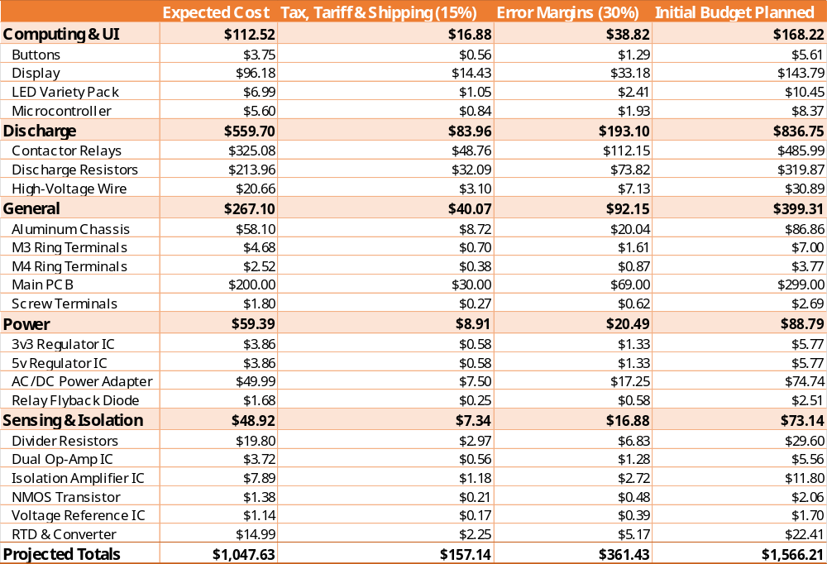
Initial Budget

Slide 10
02
System Design & Hardware Selection

Slide 11
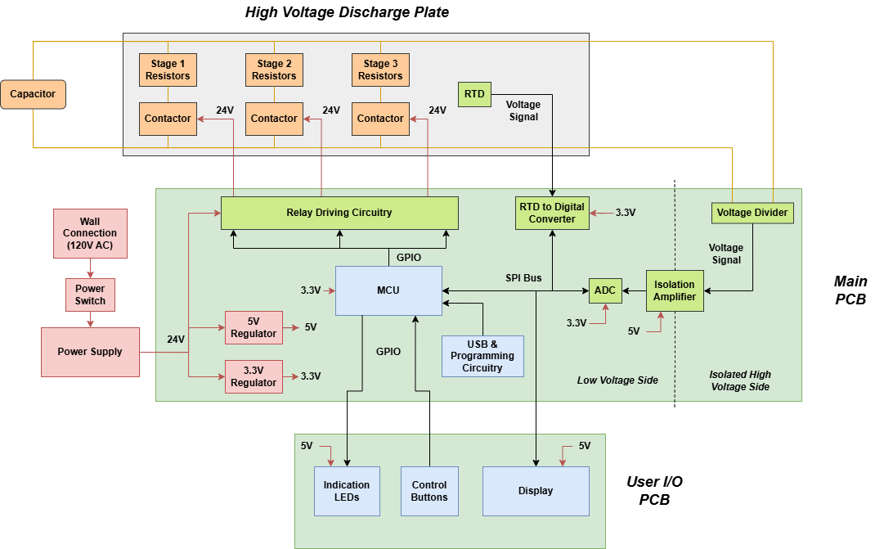
Hardware Block Diagram
Notes:
Add USB connection/Programming (Done)

Slide 12
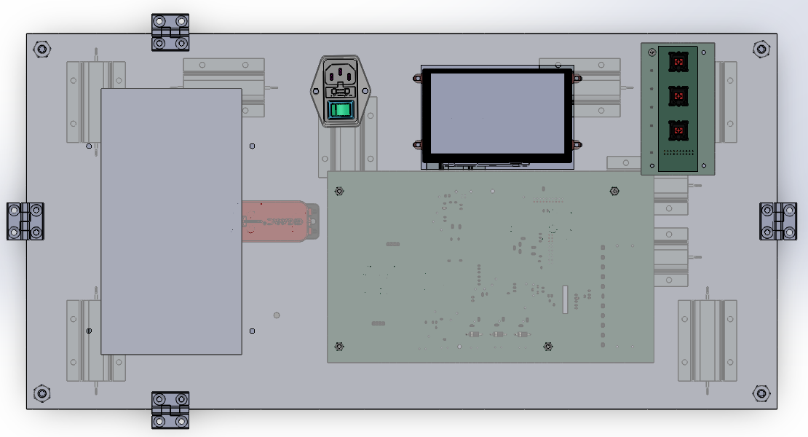
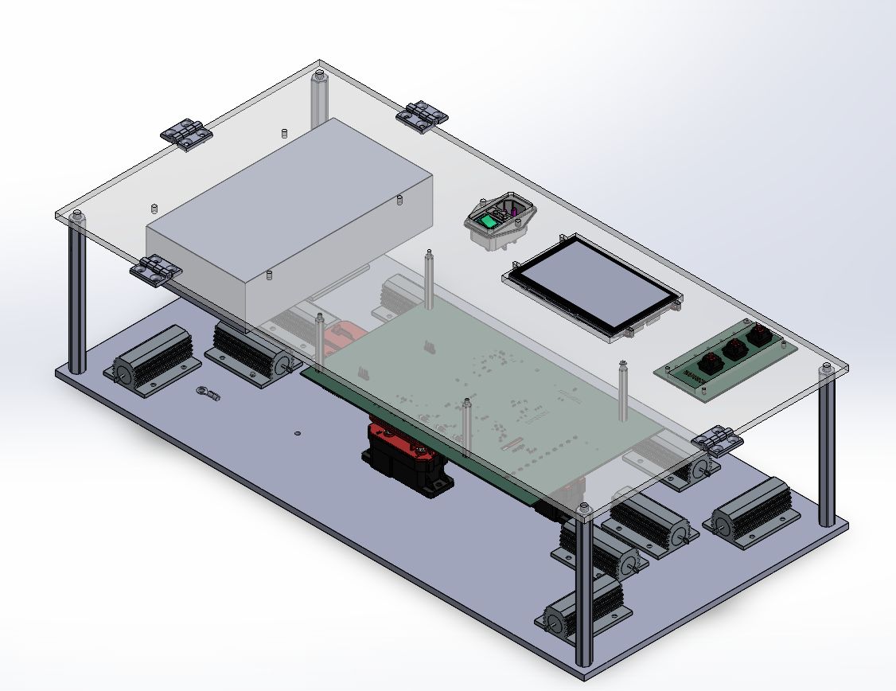
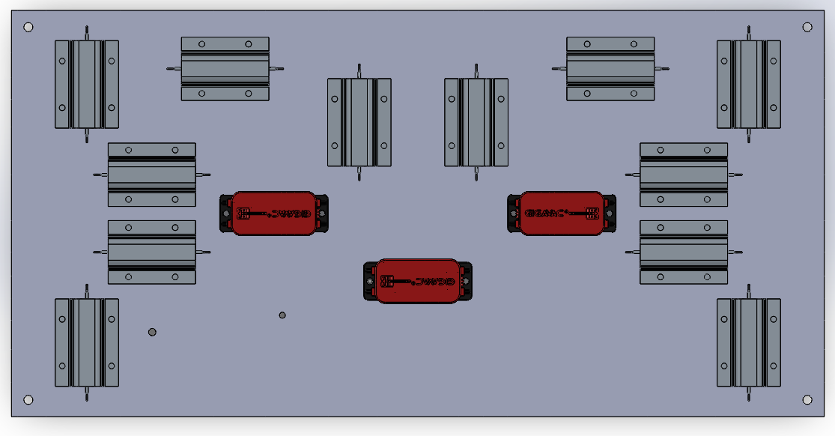
System CAD
Power
Display
I/O PCB
Main PCB
6’’
24’’
12’’
Relays and Contactors
Notes:
Add Tags for Things (Done)

Slide 13
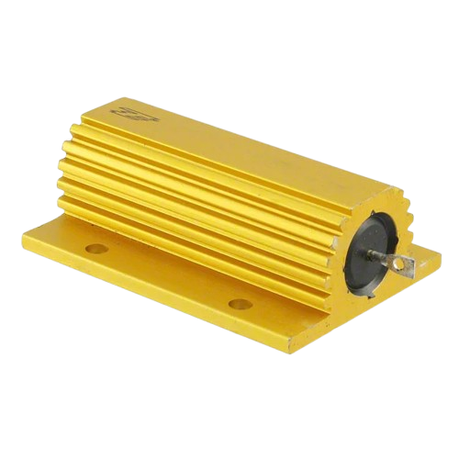
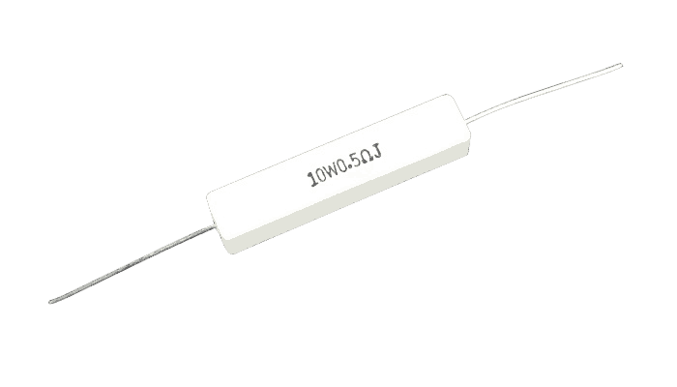
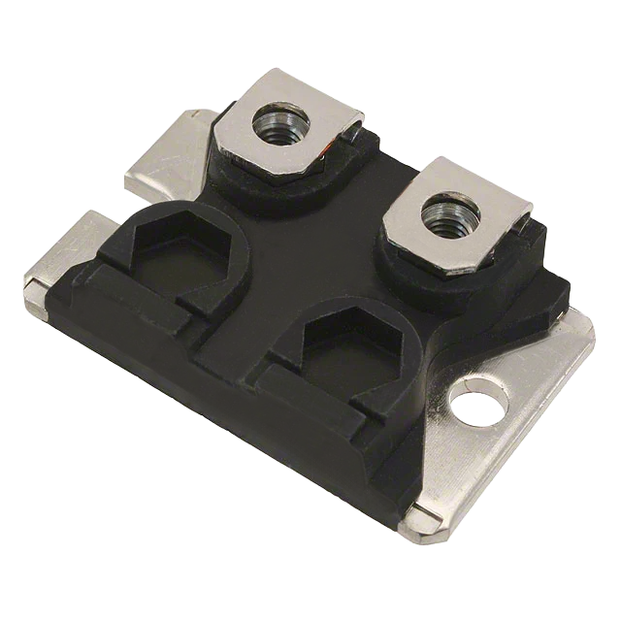
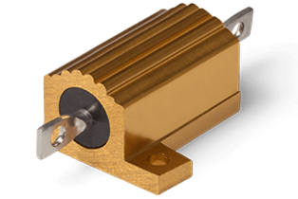
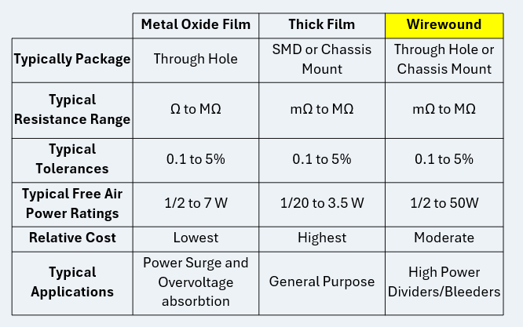
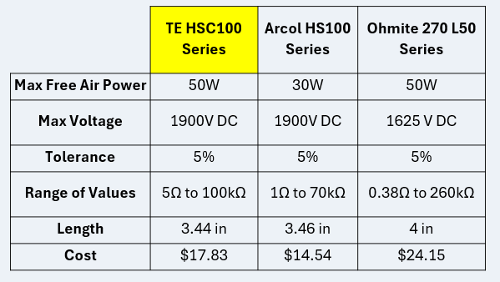
Power Resistor Selection
Key Factors in Selection Included:
Voltage and Power Handling Ability
Product Availability / Resistance Value Availability
Overall Size and Mounting Style
Cost

Slide 14
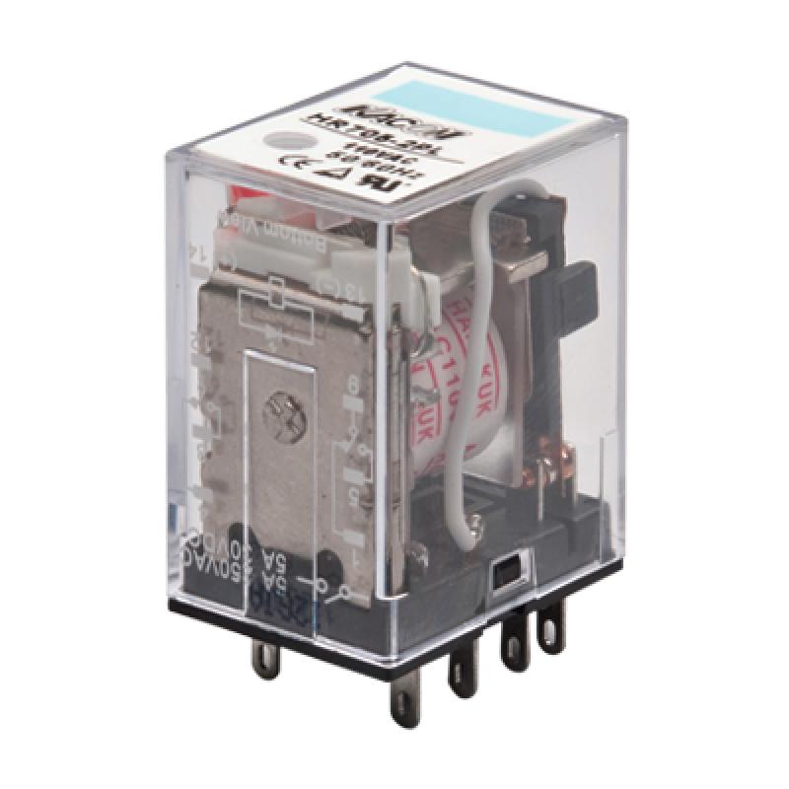
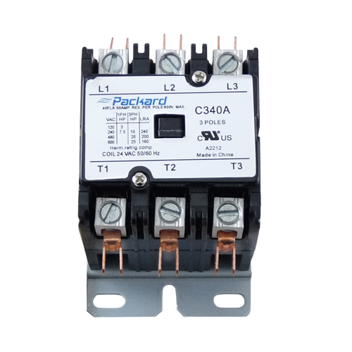
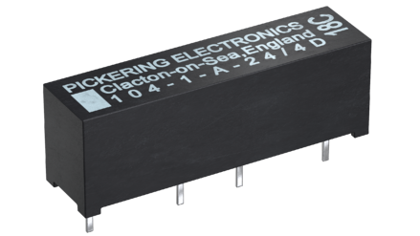
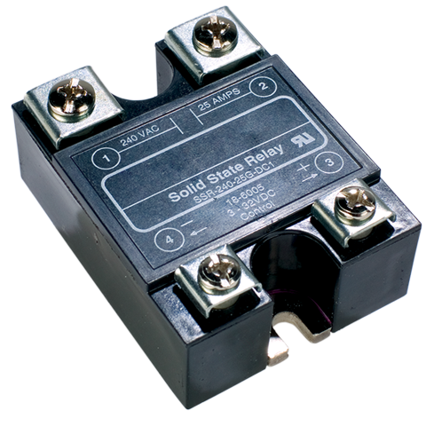
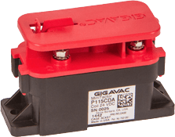
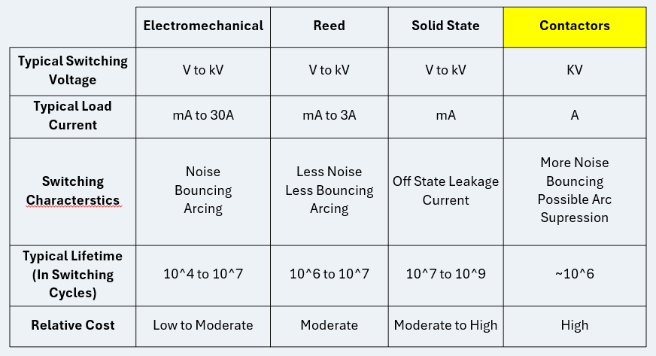
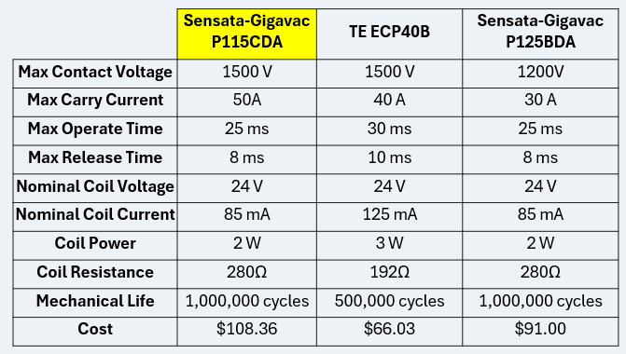
Relay Selection
Key Factors in Selection Included:
Switching/Contact Voltage and Carry/Load Current
Coil Characteristics (Voltage and Current)
Typical Lifetime (Mechanical/Electrical)
Cost

Slide 15
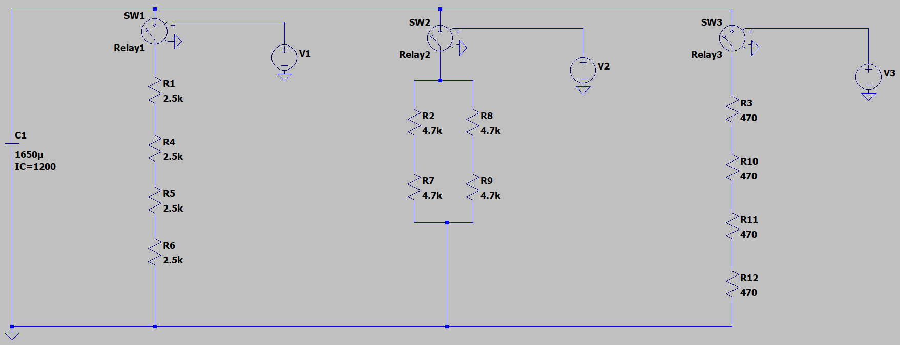
Configuration of Discharge Stages
Stage 1 Resistance: 10k
Stage 2 Resistance: 4.7k
Stage 3 Resistance: 1.88k
Max Discharge Time: ~24 secs
Min Discharge Time: ~18 secs
Energy/Power Dissipated: 1188 J / 49.5 W

Slide 16
Isolation Hardware Technology
Technology | Use | Accuracy | Simplicity
Analog Isolation | Copying analog signals across boundary | High | High
Digital Isolation | Transferring digital signals across boundary | Very High | Low
Device | Input Range | Isolation Rating | Integration Complexity
ADUM3195BRQZ | Op amp input | 3000 Vrms | Very High
AMC3330Q1 | +/- 1V | 4250 Vrms | Low
AMC1301DWVR | +/- 250mV | 5000 Vrms | High
Key factors:
Design complexity and robustness
Device input range, isolation rating, and supporting component complexity

Slide 17
Temperature Sensing Technology
Technology | RTD | NTC | Thermocouple | Analog IC | Digital IC | IR non-contact
Sensing Range | -50 to 250 C | -40 to 125 C | 0 to 800 C | -40 to 125C | -40 to 125C | -70 to 350 C
Accuracy | +/- 0.3 to 0.8 C | +/- 0.5 to 2 C | +/- 1.1 to 2.2 C | +/- 0.5 to 2 C | +/- 0.5 C | +/- 0.5 C
Linearity | High | Nonlinear | Nonlinear | Medium | Medium | Nonlinear
Cost | Medium-High | Low | Medium | Low | Low | High
Integration Effort | Medium | Low | High | Very Low | Low | High
Key factors:
Temperature sensing range
Integration effort / linearity

Slide 18
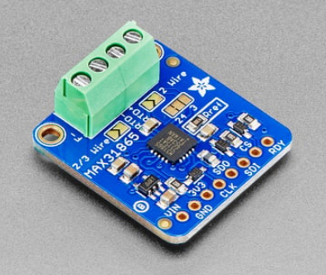
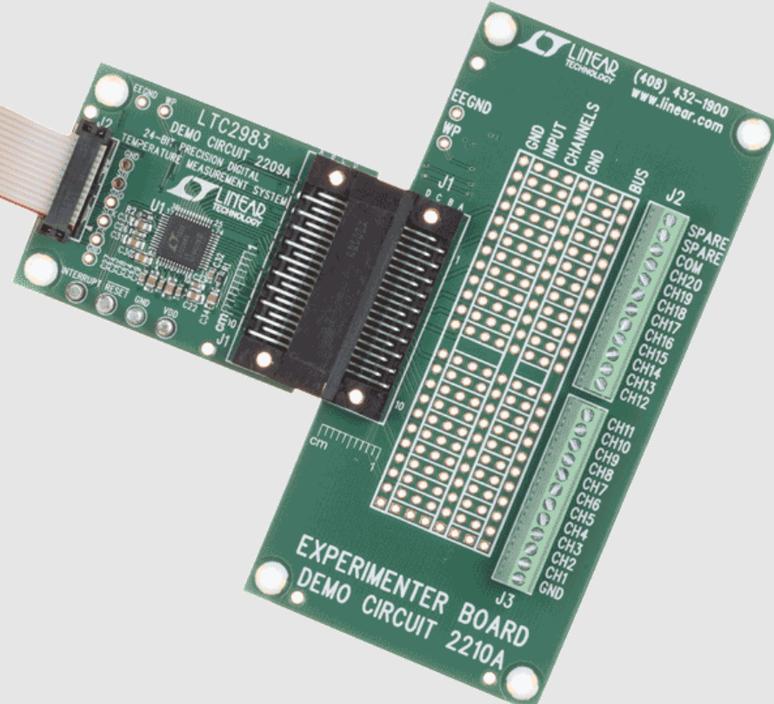
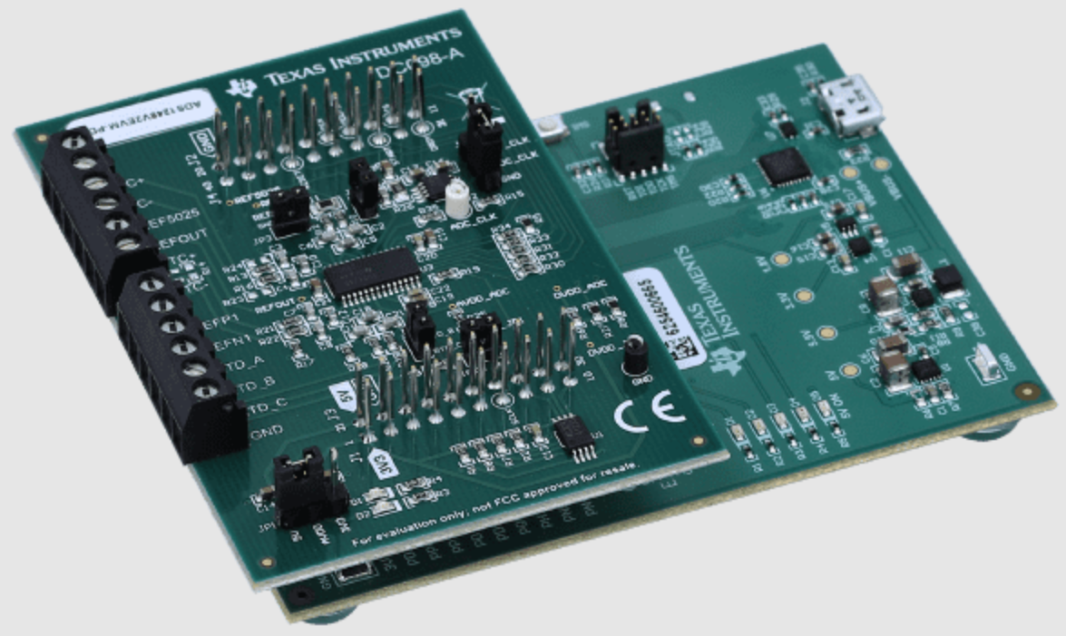
Temperature Sensing Component
Device | MAX31865AAP+ | LTC2983HLX | ADS1248IPWR
Type & Channels | Dedicated RTC-digital converter, 1 channel | Multi temp sensor input system, 20 inputs | General sensor input system, 8 channels
Integration Complexity | Very Low | Medium | High
Key factors:
Required external circuitry / integration complexity

Slide 19
Microcontroller Technology
 | Arduino | ESP32 | STM32
Familiarity | Medium | Low | Medium
Compatibility | High | Medium | Low
Power | Medium | High | Low
Speed | Medium | High | Medium
I/O | Low | Medium | High
Key Factors:
  Availability of documentation and supporting libraries
  Product knowledge and support from Dr. Weeks

Slide 20
Microcontroller Selection
ESP32 Model | WROOM-32D | C3FH4AZ
GPIO Pins | 32 | 16
CPU Frequency | 240 MHz | 160 MHz
RAM | 520 kB | 400 kB
Flash Storage | 4 MB | 4 MB
Architecture | Xtensa RISC-V | RISC-V
Key Factors:
  Availability of documentation and supporting libraries
  Product knowledge and support from Dr. Weeks

Slide 21
User Interface Technology
 | Liquid Crystal | E-Ink | Segmented
GPIO Required | Low to Medium | Medium | High
Visibility | Medium | High | High
Versatility | High | High | Low
Information Density | High | Medium | Low
Key Factors:
  Ability to convey changing types of data to users at various distances
  Physical controls for PPE-wearing users

Slide 22
User Interface Selection
Display Models | KD50G21-40NT-A1 | NHD-5.0-800480FT | GDEY042T81
Screen Size | 5” | 5” | 4.2”
Resolution | 800x400 | 800x480 | 400x300
Coprocessor | None | FDTI FT812Q | STM32
Color Space | sRGB | sRGB | B&W
Interface | 24-bit Parallel | SPI | SPI
Key Factors:
  Ability to convey changing types of data to users at various distances
  Physical controls for PPE-wearing users

Slide 23
Power Table
Component | Maximum Current Required | Voltage Required | Quantity | Maximum Power Consumption
Isolation Amplifier | 48 mA | 5V | 1 | 240 mW
Dual Operational Amplifier | 15 mA | 5V | 2 | 150 mW
General Voltage Reference | 50 mA | 5V | 1 | 250 mW
Relays | 85 mA | 24V | 3 | 6.12 W
Transistor | 20 mA | 3.3 V | 3 | 199 mW
RTD to Digital | 3.5 mA | 3.3V | 1 | 11.5 mW
MCU | 50 mA | 3.3V | 1 | 165 mW
Display | 100 mA | 3.3V | 1 | 330 mW
LED’s | 20 mA | 3.3V | 4 | 26.4 mW
Current limiting resistors for buttons | 40 mA | 3.3 V | 3 | 396 mW
3.3- and 5-volt regulators | 3 A(for both) | 3.3 V/5V | 2(1 of each) | 5V- 274 mW 3.3V- 1.414 W
Display driver | 590 mA | 3.3V | 1 | 1.947 W
Total Current Consumption (3.3 V) | 980 mA
Total Current Consumption (5 V) | 128 mA
Total Power Consumption | - | - | - | 11.52 W
Component level power estimates guided power supply selection.
The total current estimation from the 3.3- and 5-volt rails was evaluated to choose serviceable regulators

Slide 24
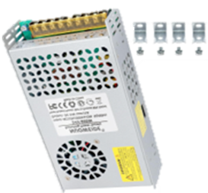
Power Supply Selection
Several power supply options available
Factors of consideration
Earth ground/proper grounding
Mounting adaptability
Enclosure safety
Adapter | MPE100C | RWS50B-24 TDK | Mean Well RPS-200 | NUOWEIDE | PMT-24V100W2BA
Wattage | 100 W | 50 W | 200 W | 600 W | 100 W
Current capability | 0-4.5A | 0-2.2A | 0-5.9A | 0-25A | 0-4.5A
Voltage capability | 85-264 VAC | 100-240 VAC | 80-264 VAC | 110-220 VAC | 90-260 VAC
Efficiency | 90% | 87% | 94% | 90% | 90%
Price | $52.74 | $37.17 | $46.00 | $29.99 | $23.93

Slide 25
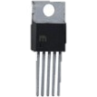
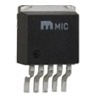
Regulator Selection
Voltage stepped down so buck converter is the best option
Factors for selection
Switching frequency
Load Current
Thermal performance
PCB construction
Category | LM 2576 | LM 2575 | LM 2596 | LM 2678 | TPS 5430
Maximum Output Current | 3 A | 1 A | 3 A | 5 A | 3-4 A
Input voltage range | 4-40 V | 4.75-40 V | 4.5-40V | 8-40V | 5.5-36V
Output voltage range | 1.25-37V [91] | 1.25-37V [94] | 1.25-37V [92] | 1.25-37V [93] | 1.22-32V [95]
Switching Frequency | 52 kHz | 52 kHz | 150 kHz | 260 kHz | 500 kHz
General Efficiency | 75-88% | 75-88% | 73-90% | 82-92% | 95%(maximum)

Slide 26
03
Schematics & PCB Layouts

Slide 27
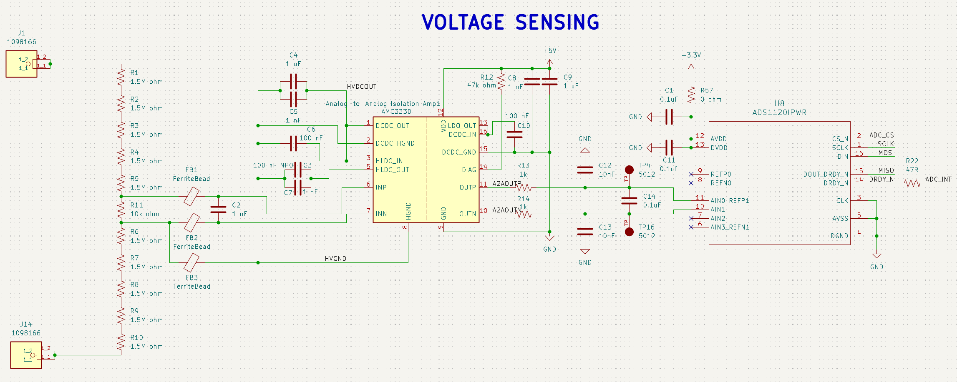
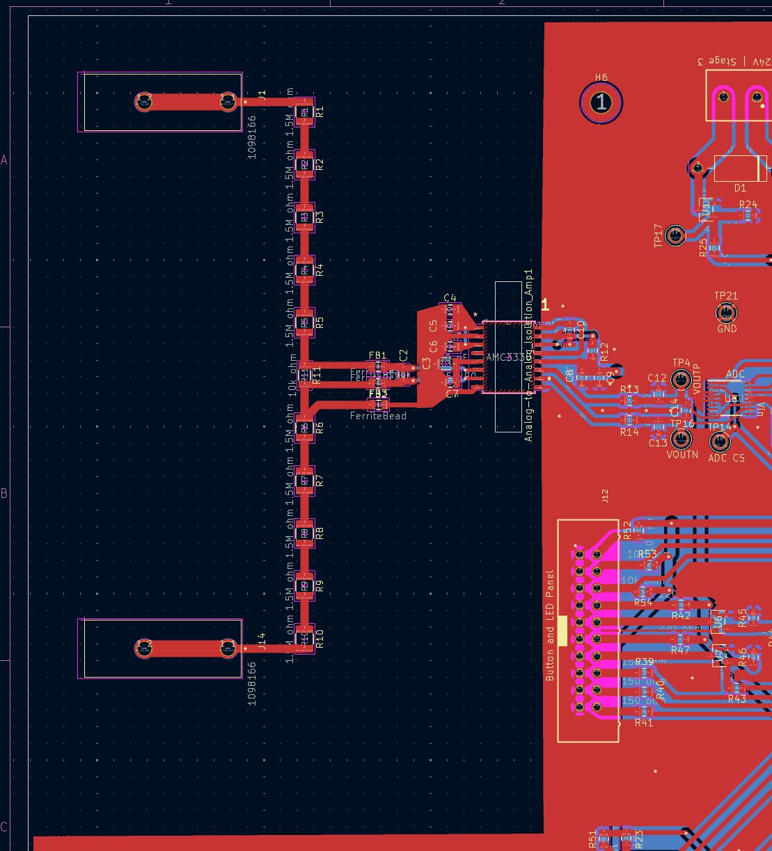
Main Board – HV Measurement

Slide 28
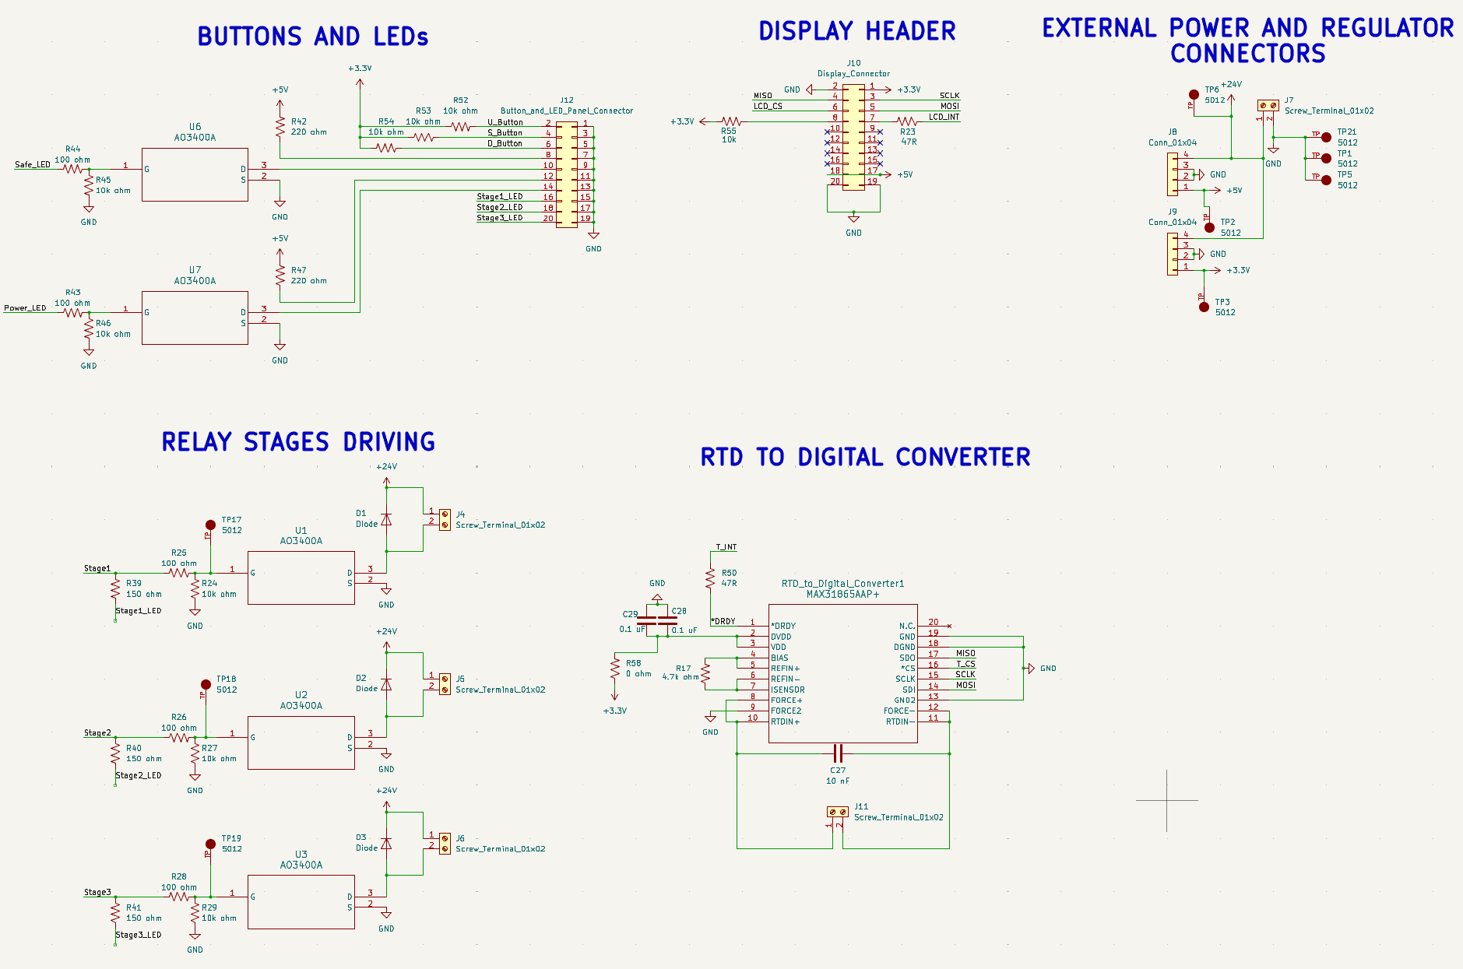
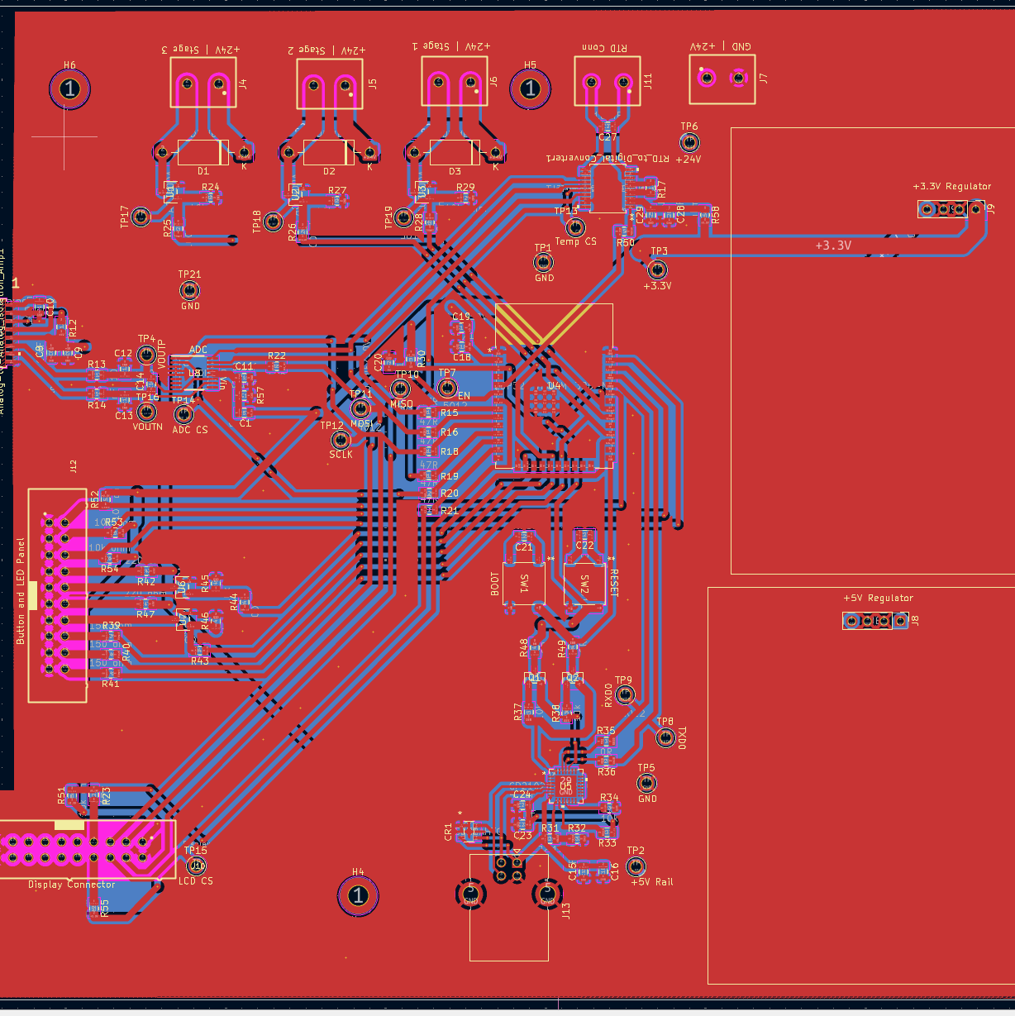
Main Board – Input/Output

Slide 29
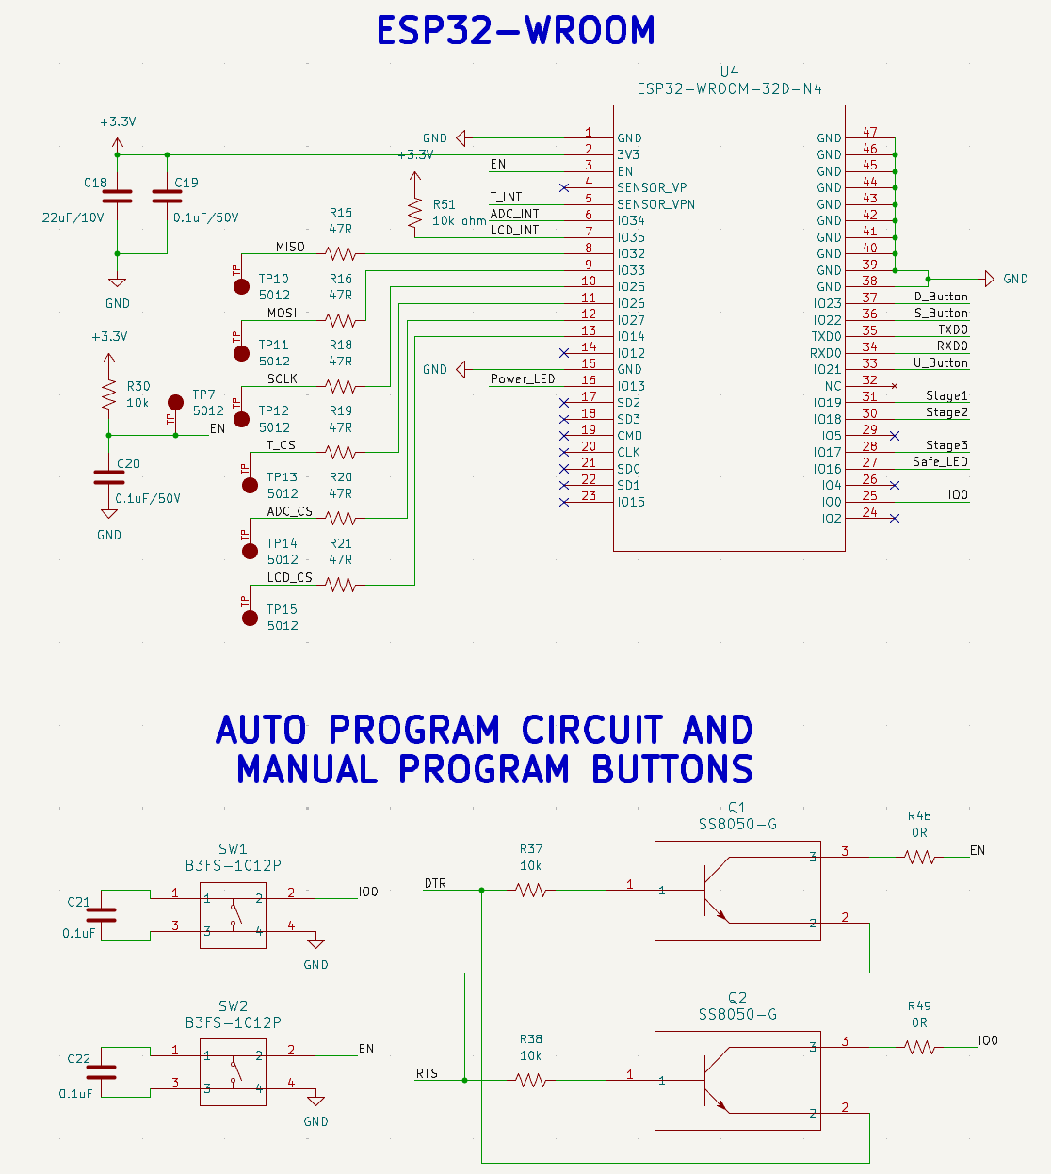
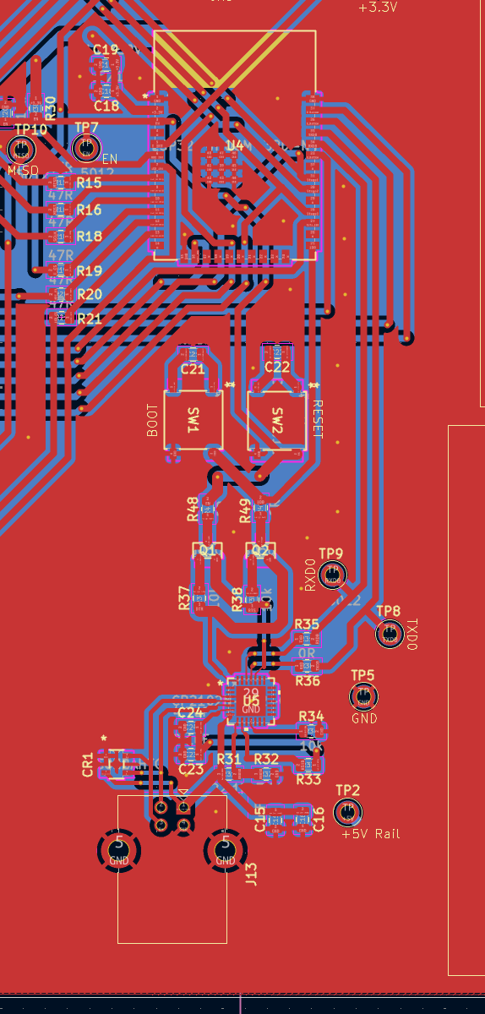
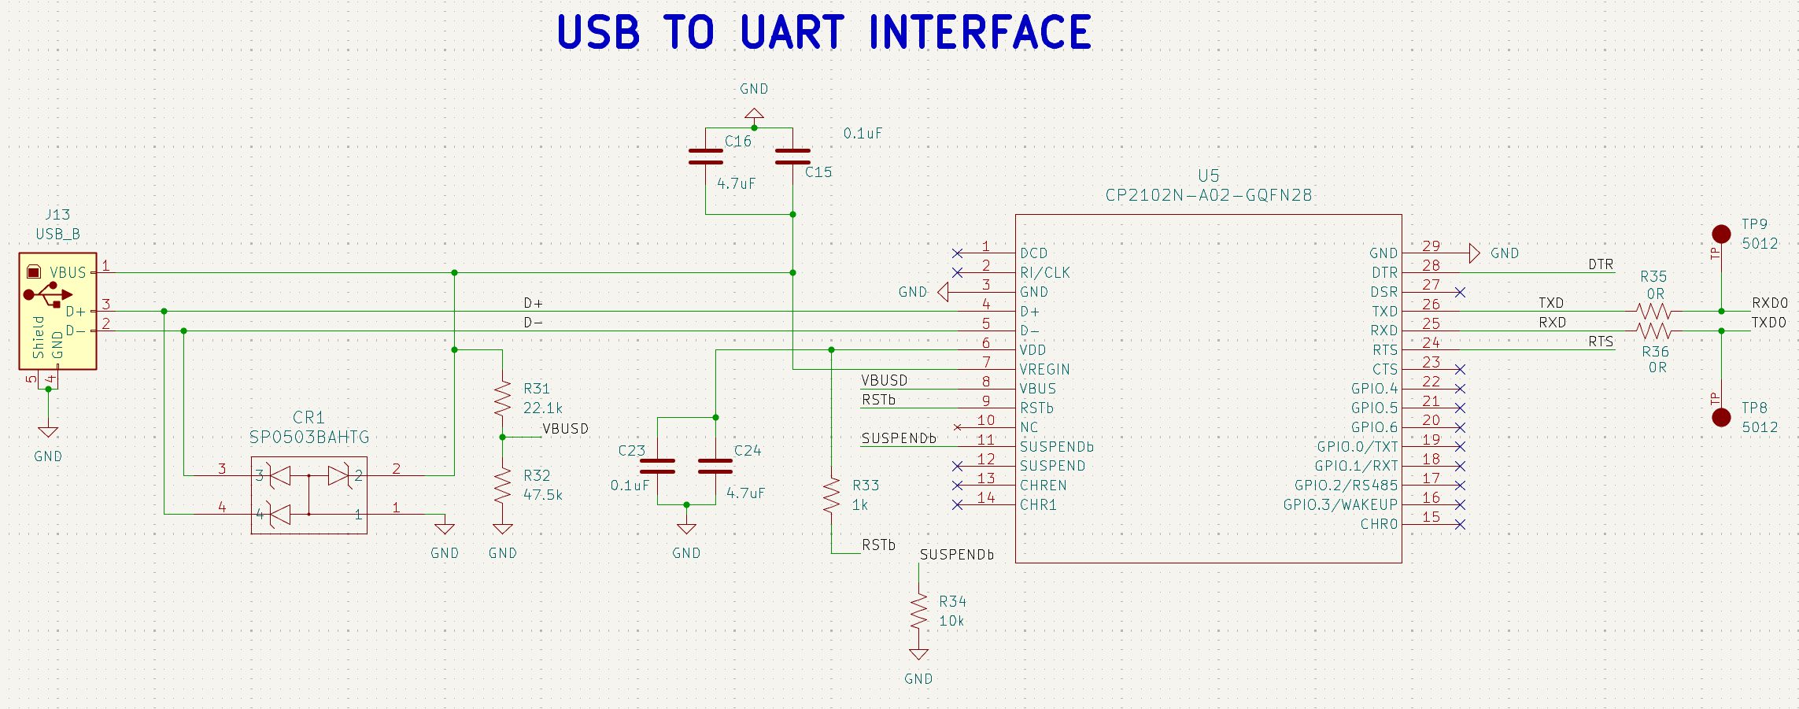
Main Board – MCU & Programmer

Slide 30
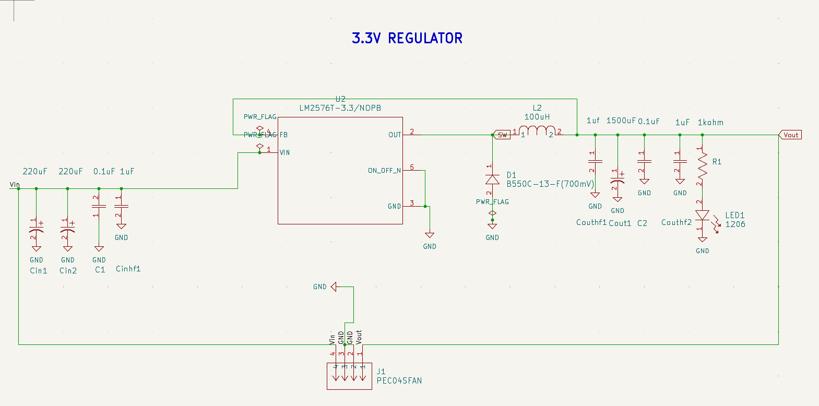
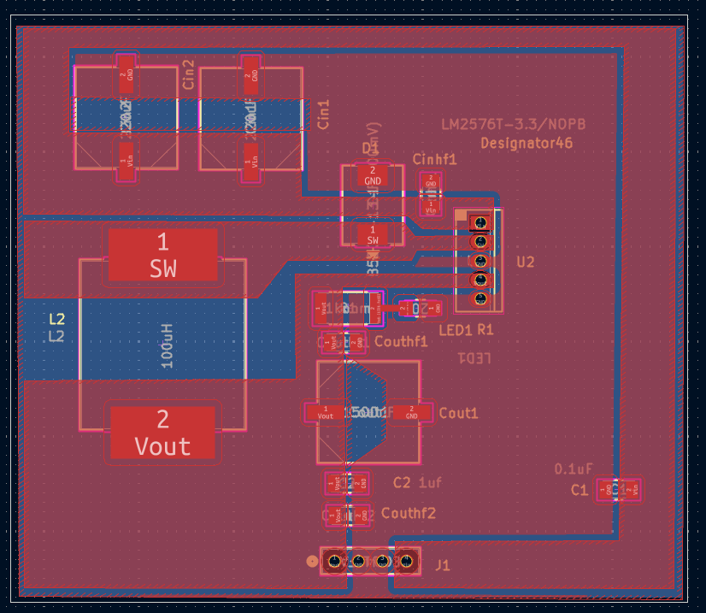
Regulator Boards- 3.3V

Slide 31
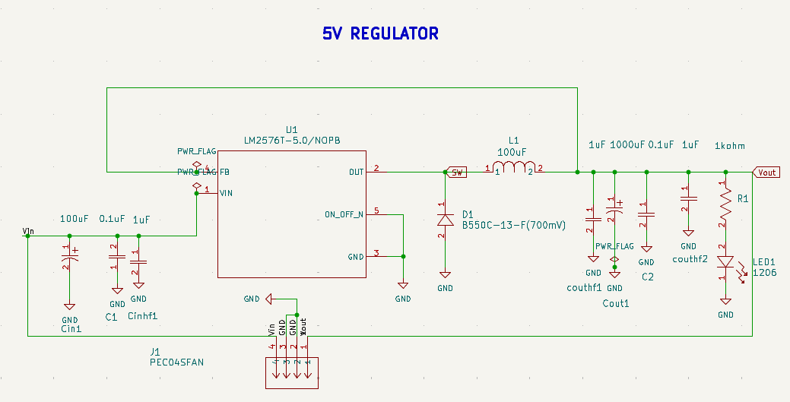
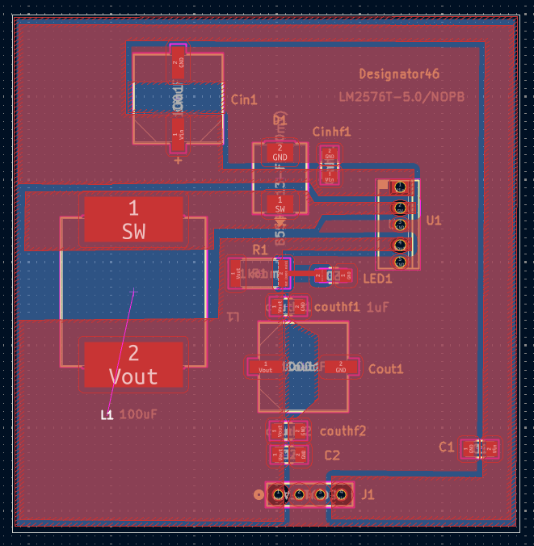
Regulator Boards- 5V

Slide 32
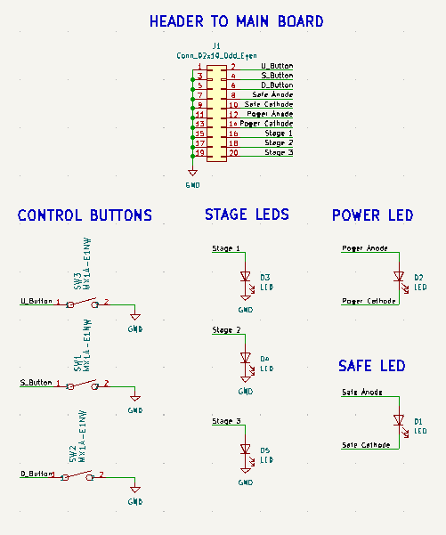
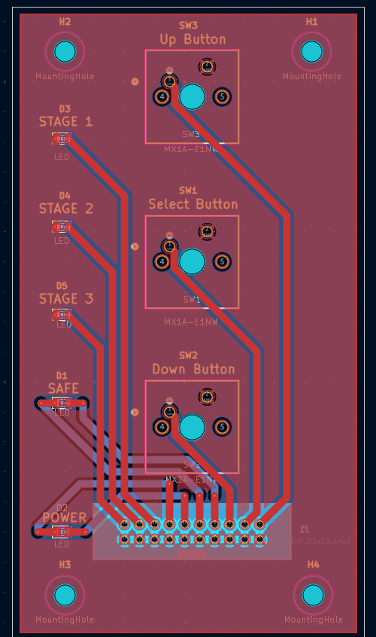
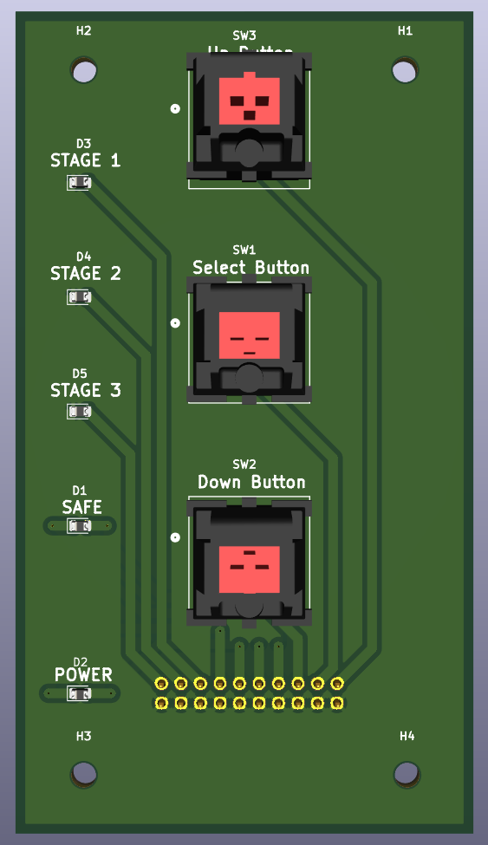
User Interface Board

Slide 33
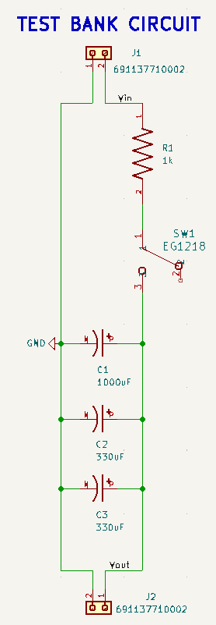
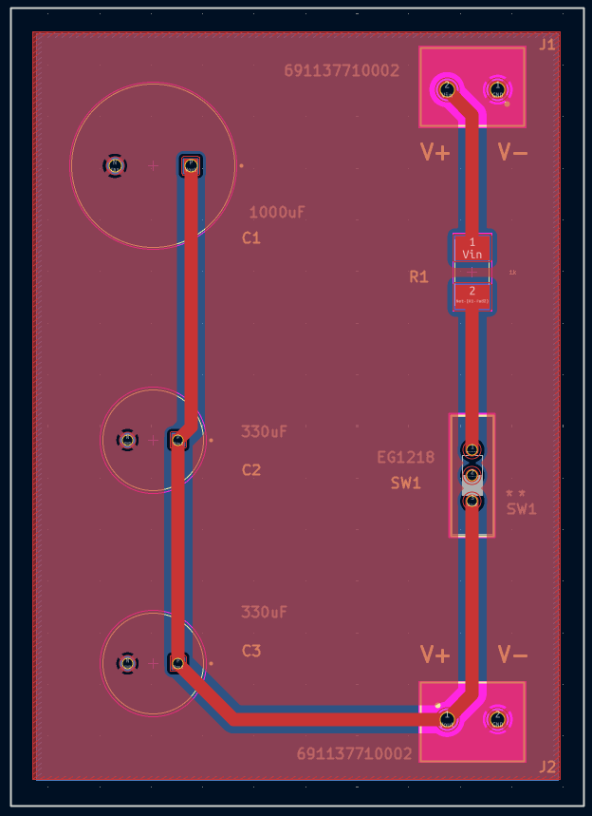
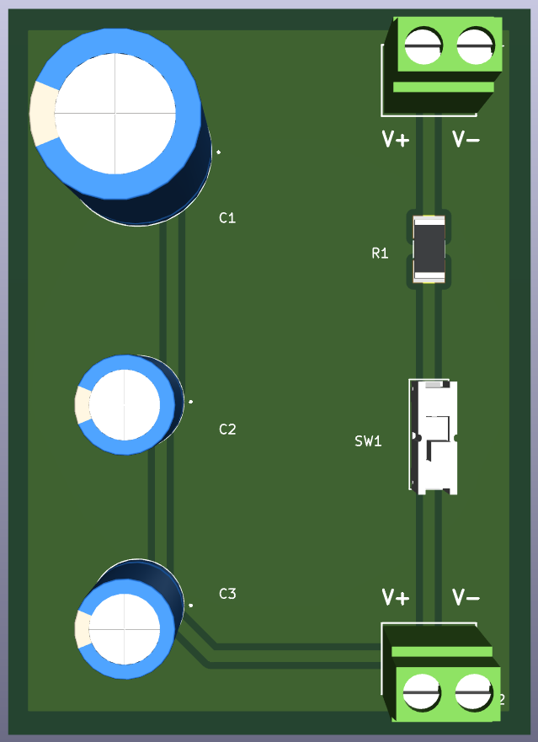
Test Bank Board

Slide 34
04
Software Design

Slide 35
Interaction Flowchart
Power On
Setup Menu
Adjust Setpoint
Discharge Sequence
Maintain Safe Voltage
Display Warning

Slide 36
Interaction Flowchart
Power On
Setup Menu
Adjust Setpoint
Discharge Sequence
Maintain Safe Voltage
Display Warning

Slide 37
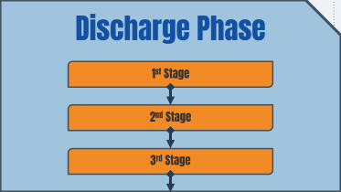
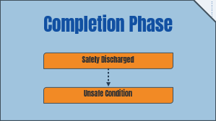
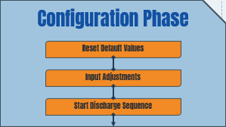
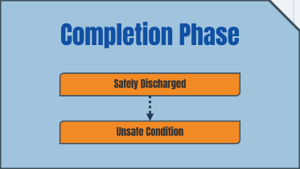


Program Phases & States

Slide 38


Configuration Phase
Reset Default Values
Input Adjustments
Select 2nd Stage Option
Modifies Stage 2 starting voltage when selected
Adjust 2nd Stage Threshold
Keeps value within $\left[600, 800\right]$ volt range
Adjust 3rd Stage Threshold
Keeps value within $\left[200, 400\right]$ volt range
Select 3rd Stage Option
Modifies Stage 3 starting voltage when selected
Start Discharge Sequence

Slide 39

Reset Default Values
Clears customizations when selected
Select 2nd Stage Option
Modifies Stage 2 starting voltage when selected
Adjust 2nd Stage Threshold
Keeps value within $\left[600, 800\right]$ volt range
Select 3rd Stage Option
Modifies Stage 3 starting voltage when selected
Adjust 3rd Stage Threshold
Keeps value within $\left[200, 400\right]$ volt range
Start Discharge Sequence
Select
Using provided setpoints for each Stage
Up/Down

Slide 40
Discharge Phase
1st Stage
2nd Stage
3rd Stage

Slide 41
User Cancel
(back to menu)
Close First Contactor
Turn On Stage 1 LED
1st Stage
Keep Stage 1 Contactor and LED Enabled
Power Stage 2 Contactor and LED
2nd Stage
3rd Stage
Hold all 3 Contactors
Show Stage 3 LED
Select Button
Open all
Contactors
(to Unsafe Condition)
Next Setpoint
Unsafe State

Slide 42
Completion Phase
Safely Discharged
Unsafe Condition

Slide 43
Select to Reset
Stage 3 drops below 10V
Any Unsafe State
Safely Discharged
Unsafe Condition

Slide 44
05
Prototyping & Testing

Slide 46

State Simulation

Slide 47


RTD Testing
Initialized and read temperature data from the MAX RTD-to-Digital converter

Slide 48



Display Testing
Initialized and displayed graphics on the screen / simultaneous testing with RTD

Slide 49
06
Future Plans

Slide 50
Manufacturing Plan
Discharge plate material currently in UCF Machine Shop
Future Machining of Acrylic Still Needed
PCBs have been manufactured by JLCPCB and are en route
Task | Date completed/ongoing
PCBs Delivered to Team | 2/12
All PCBs Assembled | 2/20
Discharge Plate Manufactured | 2/20
Assembled PCB Testing | 2/23 to 2/27
Discharge Plate Assembled | 2/27
Integration Testing | 3/2 to 3/6
Midterm Demo Submission | 3/7
Acrylic Manufactured | 3/13
Full System Assembly | 3/20
Continued Testing & Potential Repairs | 3/23 to 3/27
Final Demo Dates | 4/20 to 4/23
Notes:
Check dates/table (Done)

Slide 51
Potential High Voltage Test
Prototype requirement for low voltage (12 V input)
NextEra long term goal for high voltage (1200 V input)
Testing potentially available for high voltage (Dr Weeks)
Calculations and design for both high and low voltage

Slide 52

Budget Update
Type | Cost($)
Discharge Chassis | 797.44
Main PCB | 187.24
Test Bank | 7.28
Power Supply | 94.44
Regulators | 36.22
Manufacturing | 700.00
Total | 1833.78
1833 total after tax lines up with prior estimates.

Slide 53
Thanks!

