Slide 1
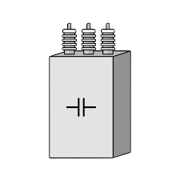


High Voltage Capacitor Discharge Tool
Group 14
Sponsored by NextEra Energy

Slide 2
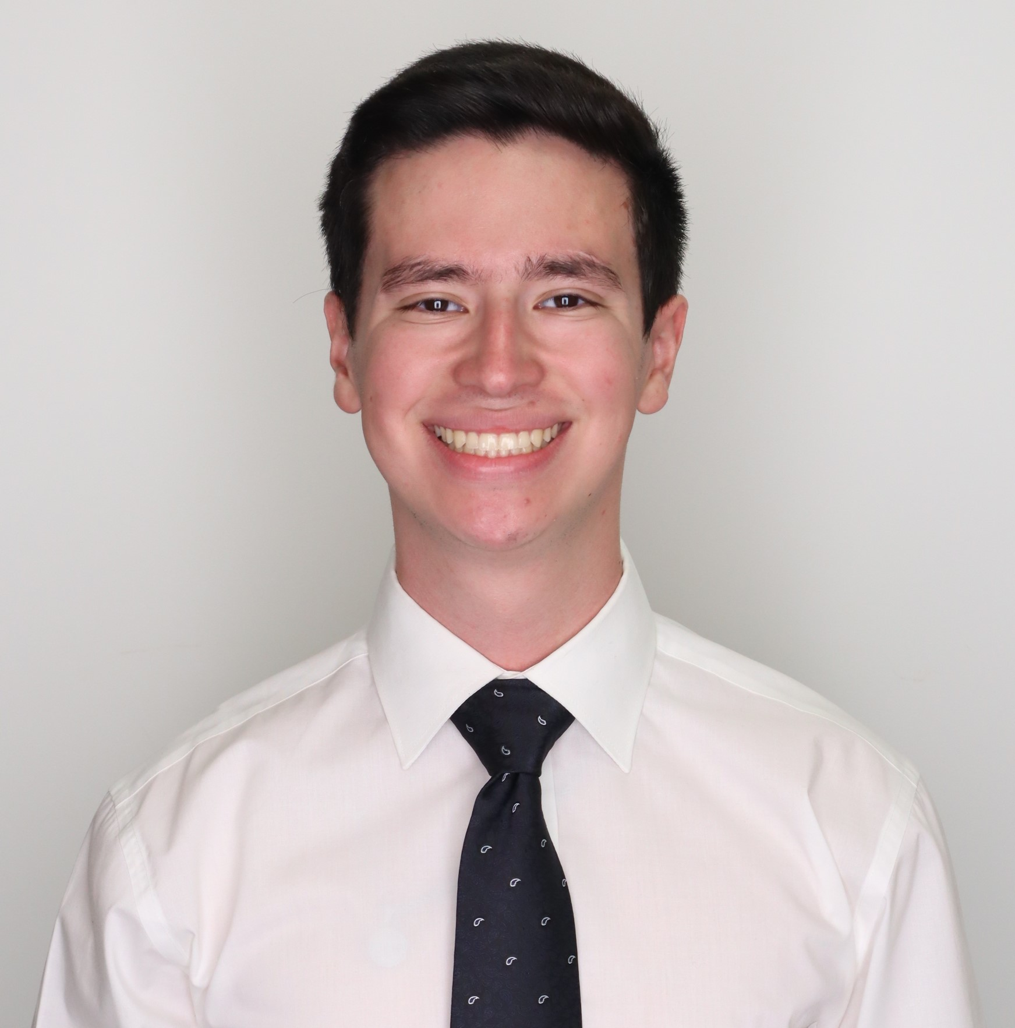
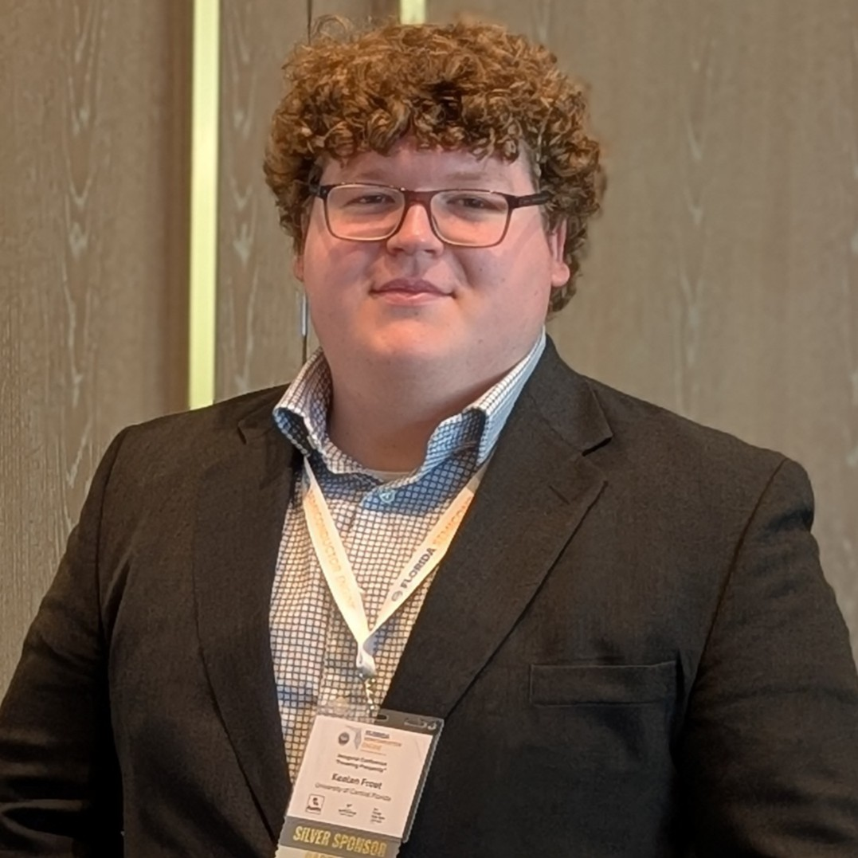


The Team
Javier Lopez-Marrero
Kealan Frost
Will Serface
Zeeshan Asif
Electrical Engineering
Electrical Engineering
Computer Engineering
Electrical Engineering

Slide 3
01
Project Background

Slide 4



Motivation and Background
NextEra uses 1200V DC capacitor banks
Residual voltage pose safety risks.
NextEra tasked the team to design a discharge tool

Slide 5
Project Goals: The Tool Shall…
Basic Goals
Be safe and reliable.
Fully discharge the capacitor quickly.
Advanced Goals
Communicate the real time capacitor voltage to the user.
Communicate the elapsed discharge time to the user.
Stretch Goals
Log/store measured data over time for future access and/or analysis.
Visibly indicate the discharge stages to the user.
Be configurable based on voltage setpoints.
Monitor thermal conditions for potential overheating.
All basic and advanced goals met in current design
Notes:
Clarify testing only at 12V

Slide 6
Project Objectives: The Tool Shall…
Basic Objectives
Fully discharge a 1650uF capacitor in less than 30 seconds.
Advanced Objectives
Display capacitor voltage measurements with an error tolerance of 5%
Stretch Objectives
The tool shall be able to record up to 30 seconds of data while discharging for future analysis.
Include 4 configurable logic alarms to activate at specified voltage setpoints
Be powered off 24V DC
Function at a 12V input, but must be scalable to a 1200V input.
Display total elapsed discharge time with an error tolerance of 5%
Display internal device temperature in degrees Celsius with an error tolerance of 10%
All basic and advanced objectives met in current design
Notes:
Clarify testing only at 12V

Slide 7
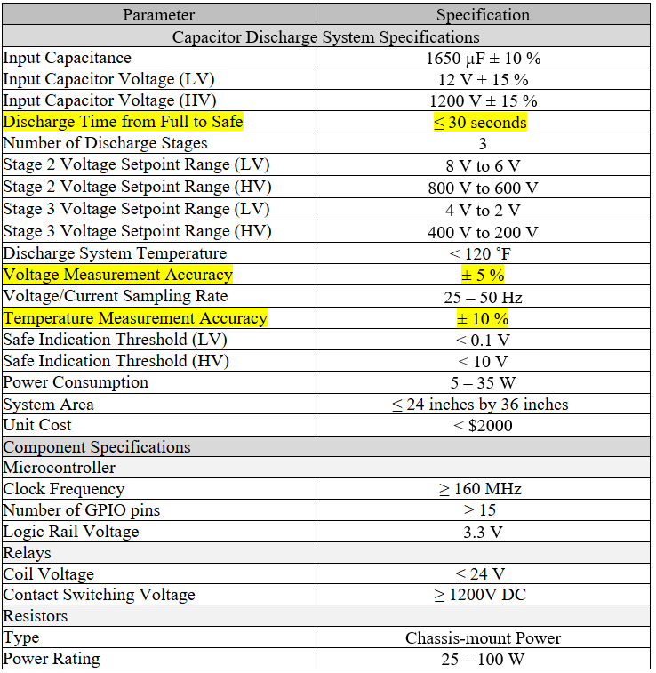
Engineering Specifications
Critical Performance Specifications:
Discharge time of ≤ 30 seconds
Voltage Measurement Accuracy of ±5%
Temperature Measurement Accuracy of ±10%
Prototype Levels:
High voltage design (1200V nominal, 1500V max)
Low voltage design (12V nominal, 15V max)

Slide 8
02
System Design & Hardware Selection

Slide 9
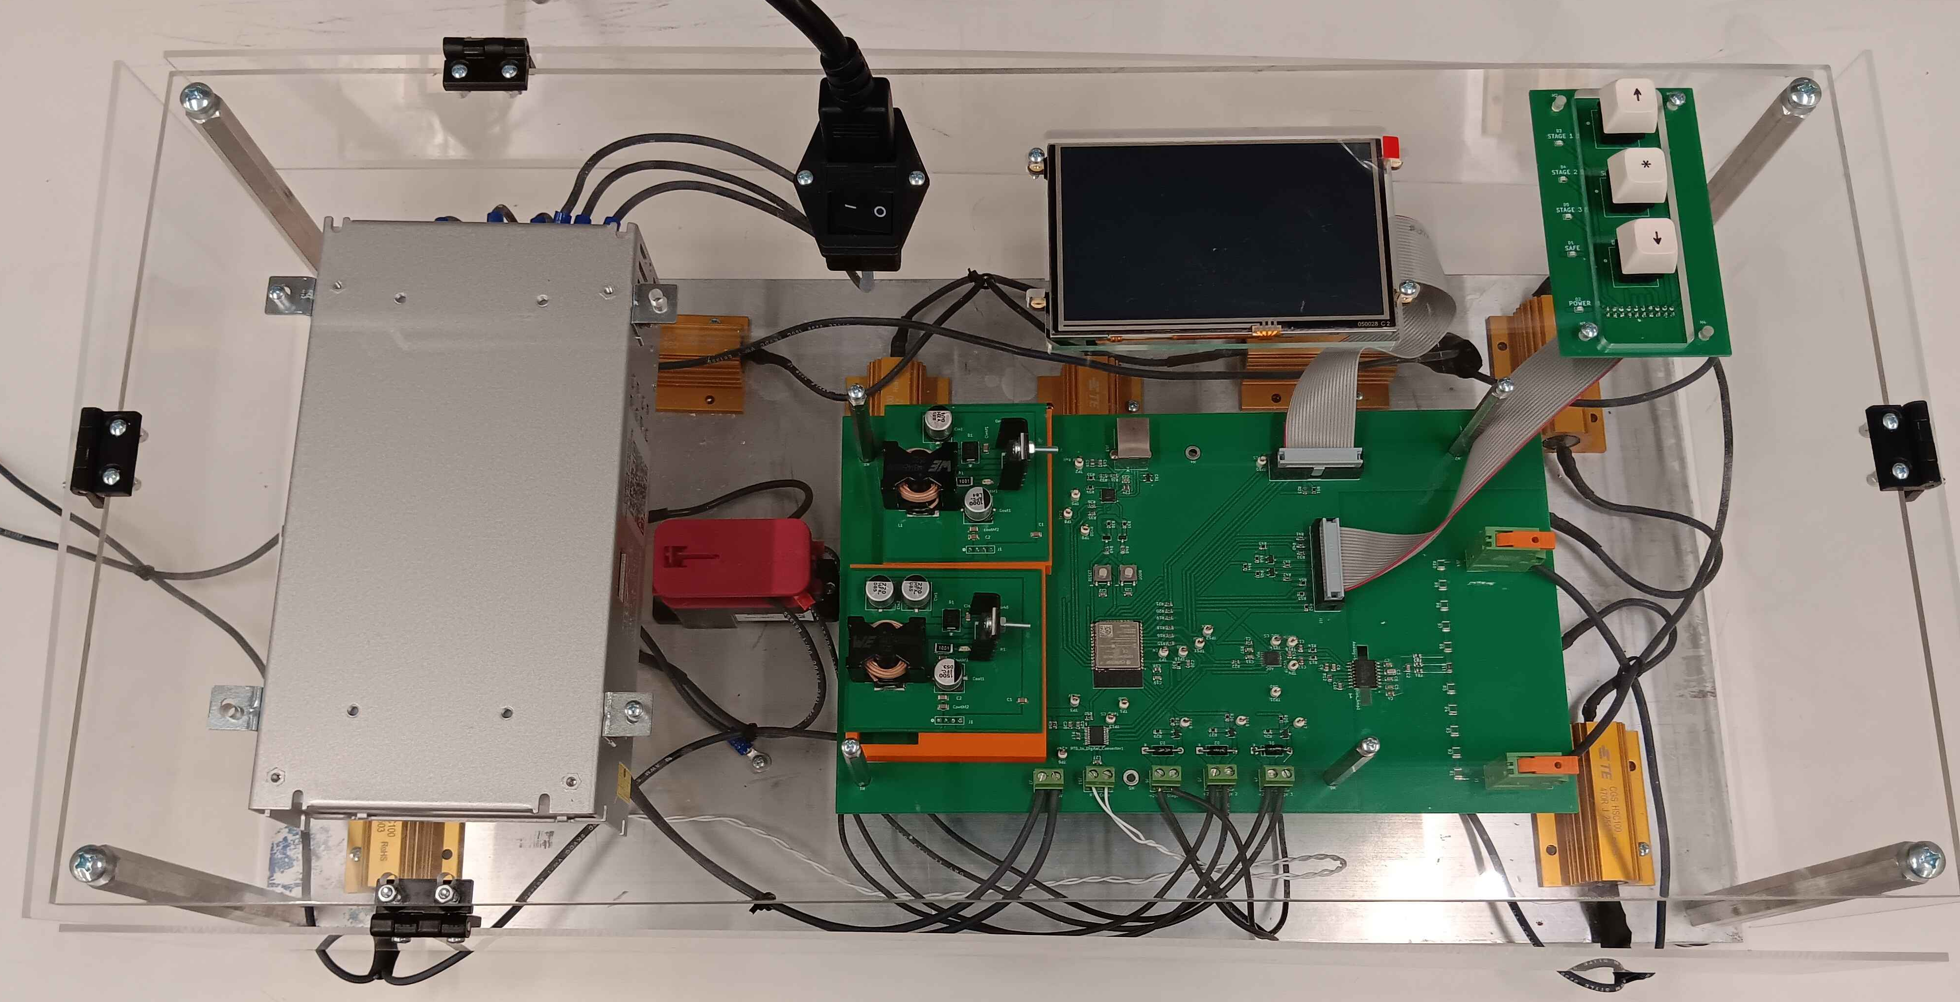
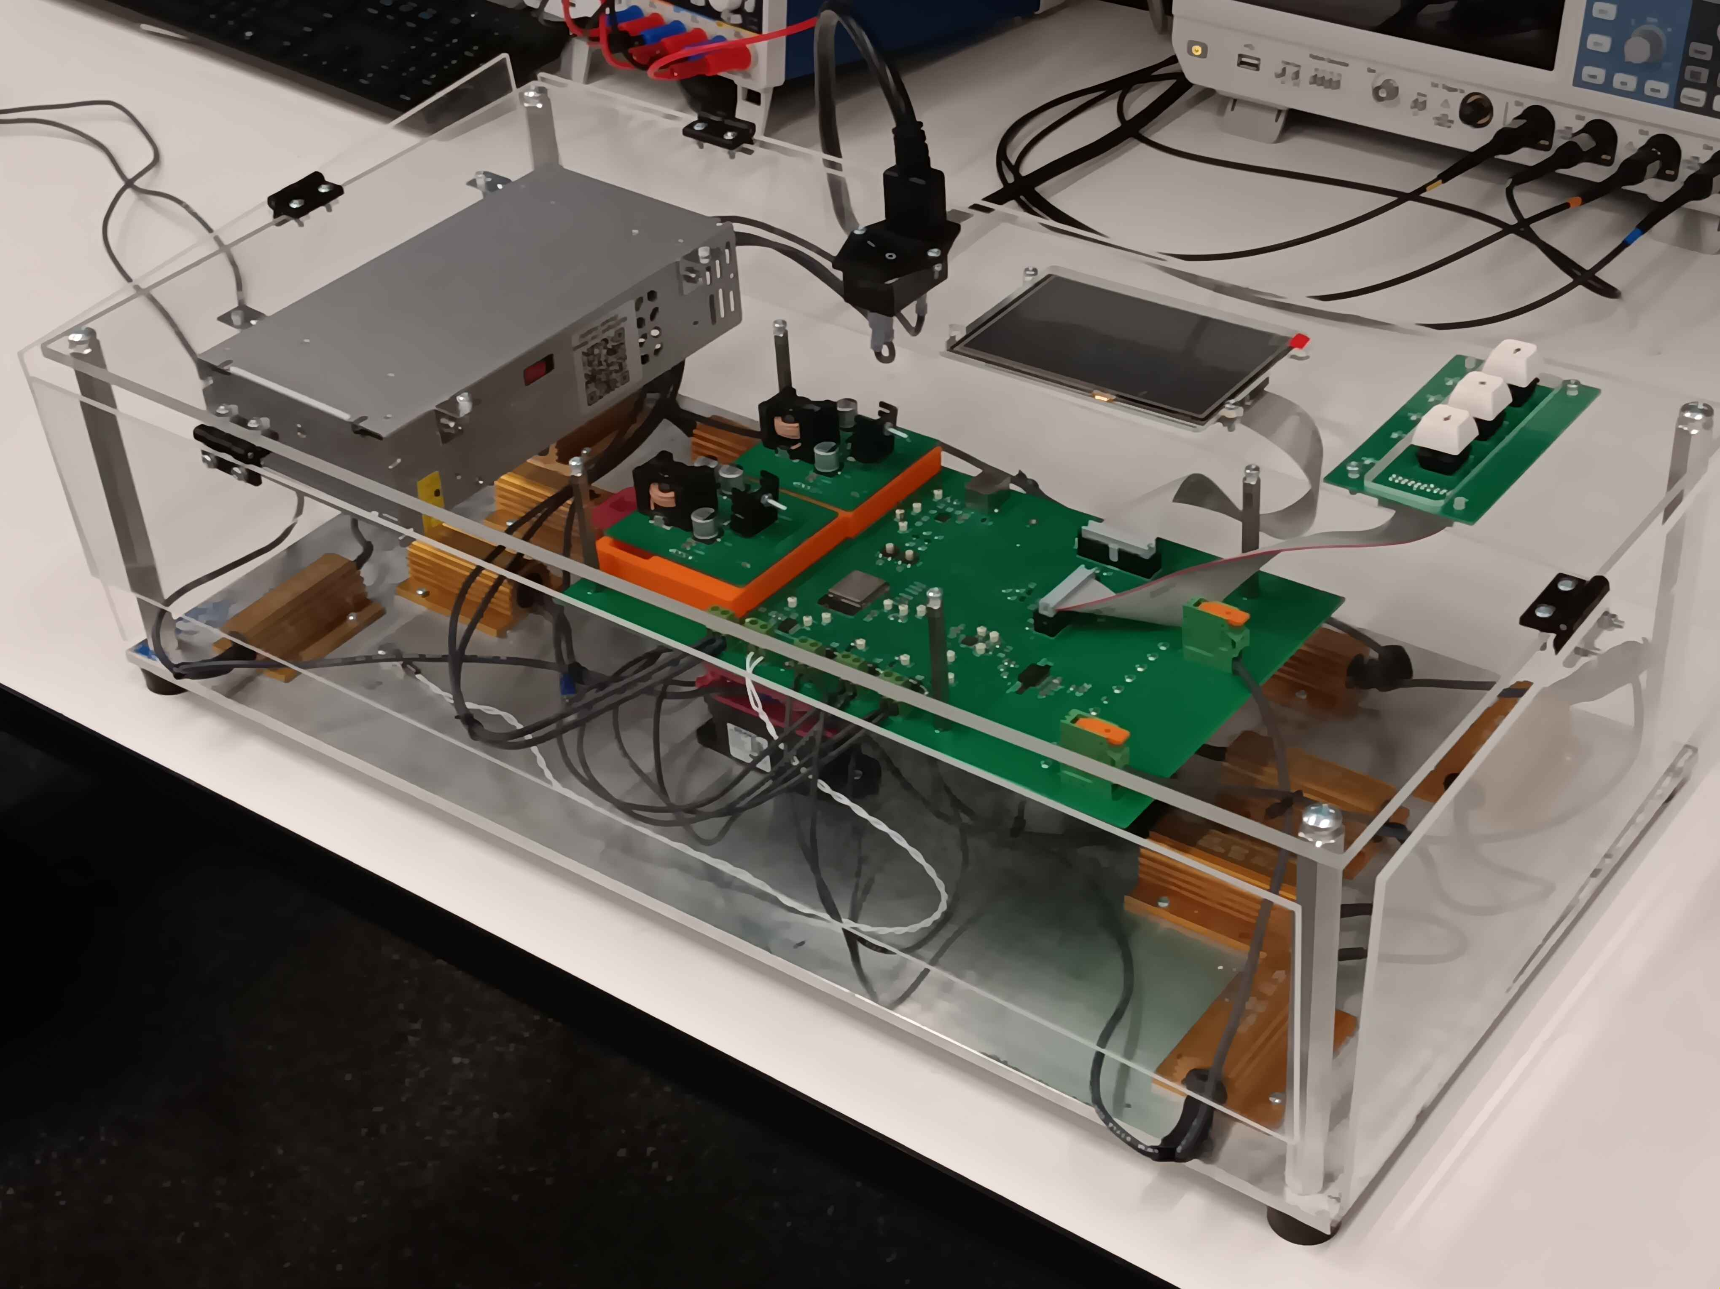
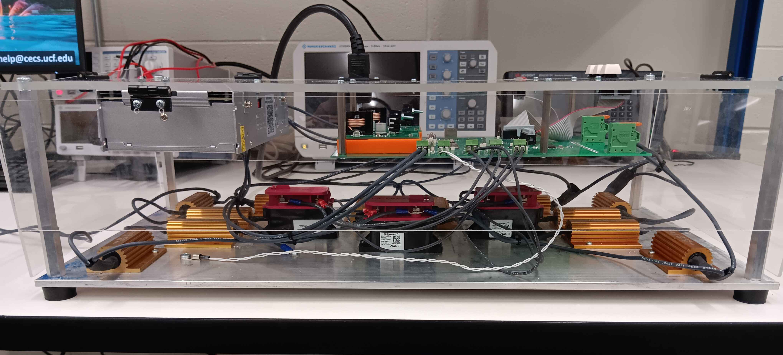
Full System
AC/DC Converter
Display
I/O Board
Control PCB
RTD
Contactors
Resistors
Notes:
Add Tags for Things (Done)

Slide 10
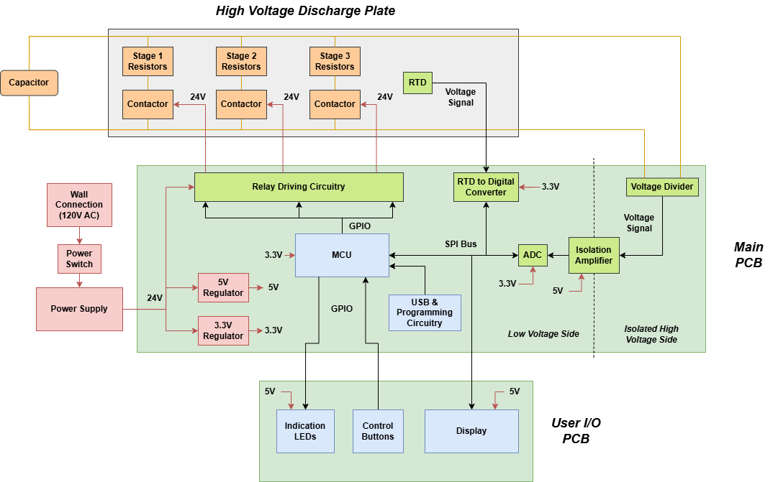
Hardware Block Diagram
Notes:
Add USB connection/Programming (Done)

Slide 11
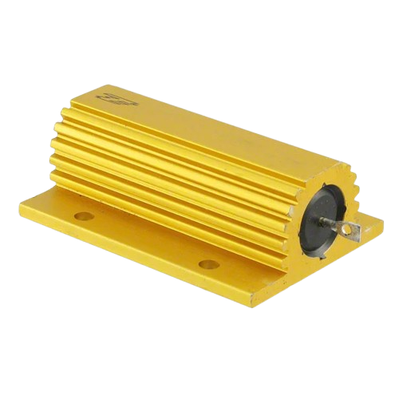
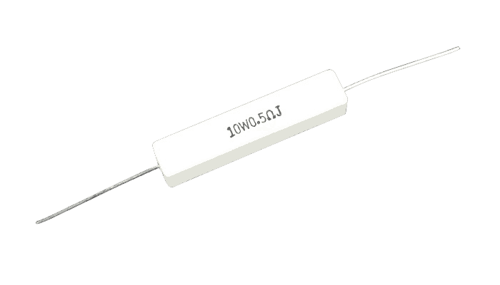
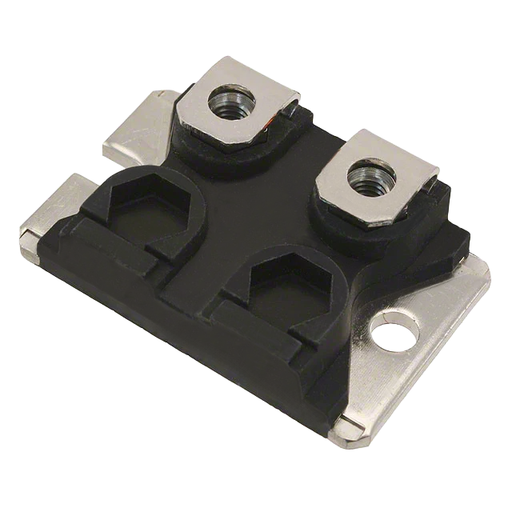
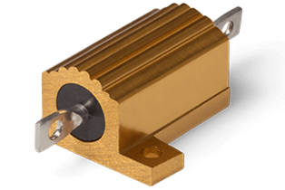
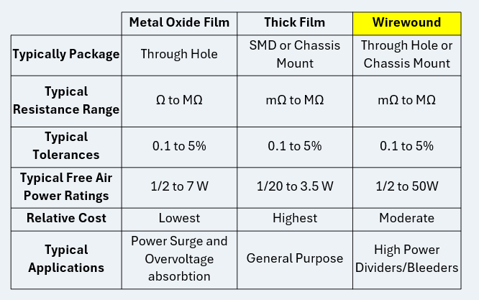
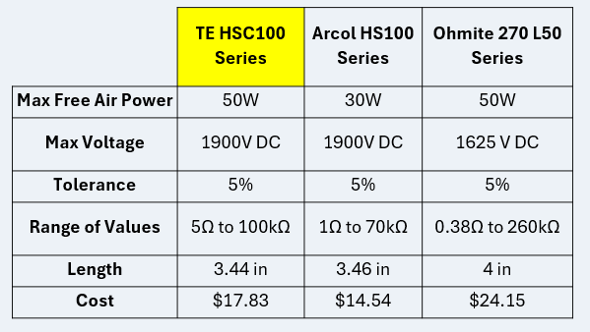
Power Resistor Selection
Key Factors in Selection Included:
Voltage and Power Handling Ability
Product Availability / Resistance Value Availability
Overall Size and Mounting Style
Cost

Slide 12
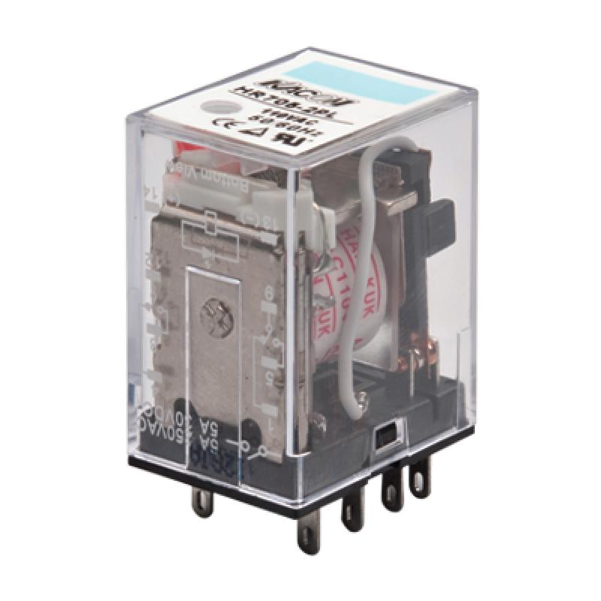
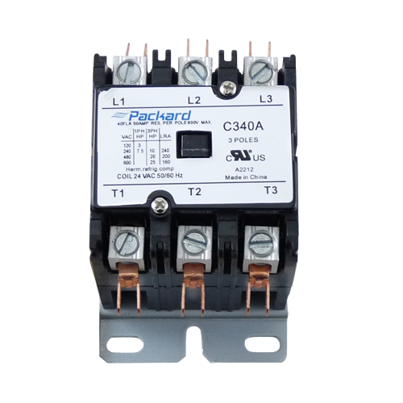
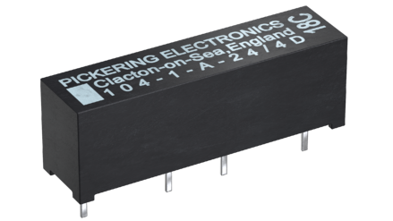
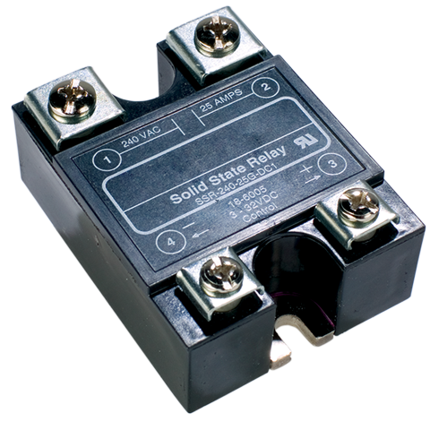
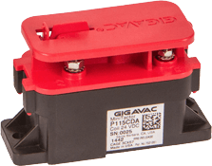
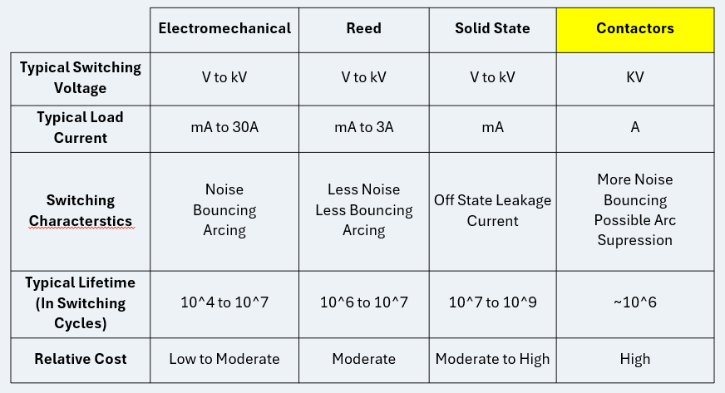
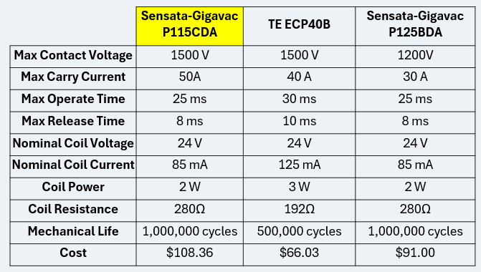
Relay Selection
Key Factors in Selection Included:
Switching/Contact Voltage and Carry/Load Current
Coil Characteristics (Voltage and Current)
Typical Lifetime (Mechanical/Electrical)
Cost

Slide 13
Isolation Hardware Technology
Technology | Use | Accuracy | Simplicity
Analog Isolation | Copying analog signals across boundary | High | High
Digital Isolation | Transferring digital signals across boundary | Very High | Low
Device | Input Range | Isolation Rating | Integration Complexity
ADUM3195BRQZ | Op amp input | 3000 Vrms | Very High
AMC3330Q1 | +/- 1V | 4250 Vrms | Low
AMC1301DWVR | +/- 250mV | 5000 Vrms | High
Key factors:
Design complexity and robustness
Device input range, isolation rating, and supporting component complexity

Slide 14
Analog to Digital Conversion
Technology
Technology | Resolution | Sampling Rate | Latency | Relative Cost
Comparators | N/A | N/A | Very Low | Low
SAR ADCs | 10-14 bits | 1 to 1000 ksps | Low | Very Low
Delta-Sigma ADCs | 16-24 bits | 1 to 100 ksps | Medium to High | Low
Device | Resolution | Sampling Rate | Integration Complexity
AD7124 | 24 bit | 19.2 ksps | High
MCP3421 | 12 bit | 240 sps | Medium
ADS1120 | 16 bit | 2 ksps | Medium
Key factors:
Design complexity
Adequate resolution and sampling rates
Costs are similar among brands

Slide 15
Temperature Sensing Technology
Technology | RTD | NTC | Thermocouple | Analog IC | Digital IC | IR non-contact
Sensing Range | -50 to 250 C | -40 to 125 C | 0 to 800 C | -40 to 125C | -40 to 125C | -70 to 350 C
Accuracy | +/- 0.3 to 0.8 C | +/- 0.5 to 2 C | +/- 1.1 to 2.2 C | +/- 0.5 to 2 C | +/- 0.5 C | +/- 0.5 C
Linearity | High | Nonlinear | Nonlinear | Medium | Medium | Nonlinear
Cost | Medium-High | Low | Medium | Low | Low | High
Integration Effort | Medium | Low | High | Very Low | Low | High
Key factors:
Temperature sensing range
Integration effort / linearity

Slide 16
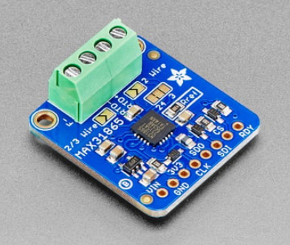
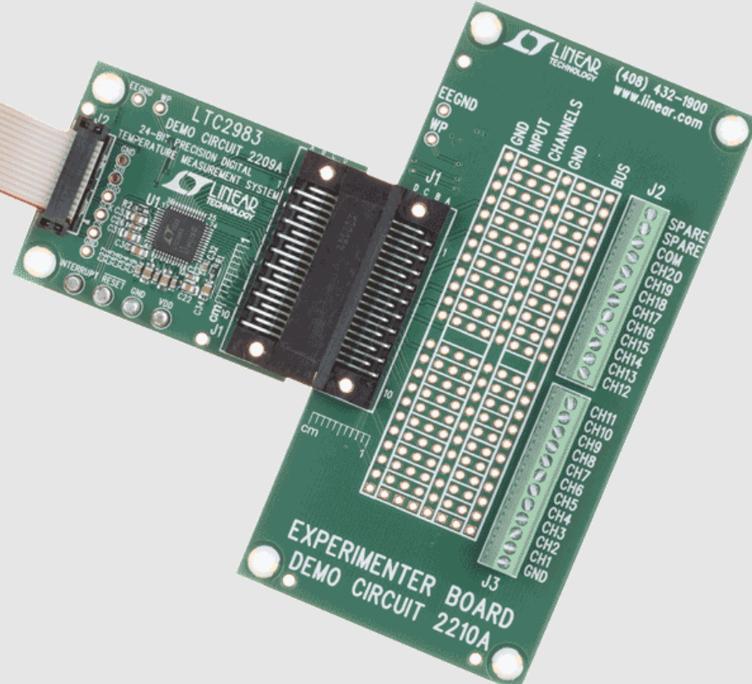
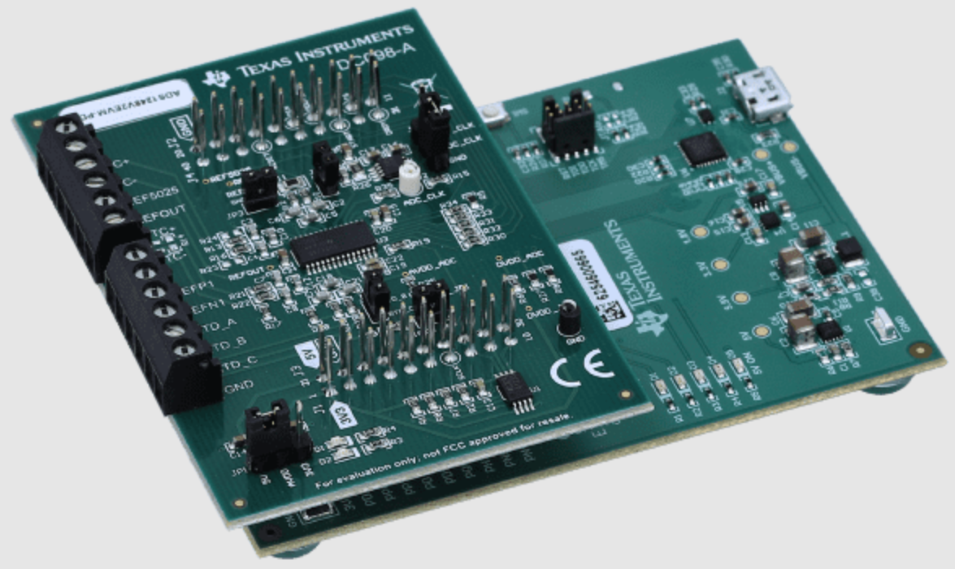
Temperature Sensing Component
Device | MAX31865AAP+ | LTC2983HLX | ADS1248IPWR
Type & Channels | Dedicated RTC-digital converter, 1 channel | Multi temp sensor input system, 20 inputs | General sensor input system, 8 channels
Integration Complexity | Very Low | Medium | High
Key factors:
Required external circuitry / integration complexity

Slide 17
Microcontroller Technology
 | Arduino | ESP32 | STM32
Familiarity | Medium | Low | Medium
Compatibility | High | Medium | Low
Power | Medium | High | Low
Speed | Medium | High | Medium
I/O | Low | Medium | High
Key Factors:
  Availability of documentation and supporting libraries
  Product knowledge and support from Dr. Weeks

Slide 18
Microcontroller Selection
ESP32 Model | WROOM-32D | C3FH4AZ
GPIO Pins | 32 | 16
CPU Frequency | 240 MHz | 160 MHz
RAM | 520 kB | 400 kB
Flash Storage | 4 MB | 4 MB
Architecture | Xtensa RISC-V | RISC-V
Key Factors:
  Availability of documentation and supporting libraries
  Product knowledge and support from Dr. Weeks

Slide 19
User Interface Technology
 | Liquid Crystal | E-Ink | Segmented
GPIO Required | Low to Medium | Medium | High
Visibility | Medium | High | High
Versatility | High | High | Low
Information Density | High | Medium | Low
Key Factors:
  Ability to convey changing types of data to users at various distances
  Physical controls for PPE-wearing users

Slide 20
User Interface Selection
Display Models | KD50G21-40NT-A1 | NHD-5.0-800480FT | GDEY042T81
Screen Size | 5” | 5” | 4.2”
Resolution | 800x400 | 800x480 | 400x300
Coprocessor | None | FDTI FT812Q | STM32
Color Space | sRGB | sRGB | B&W
Interface | 24-bit Parallel | SPI | SPI
Key Factors:
  Ability to convey changing types of data to users at various distances
  Physical controls for PPE-wearing users

Slide 21
Power Table
Component | Maximum Current Required | Voltage Required | Quantity | Maximum Power Consumption
Isolation Amplifier | 48 mA | 5V | 1 | 240 mW
Dual Operational Amplifier | 15 mA | 5V | 2 | 150 mW
ADC | 10 mA | 3.3V | 1 | 33 mW
Relays | 85 mA | 24V | 3 | 6.12 W
Transistor | 20 mA | 3.3 V | 3 | 199 mW
RTD to Digital | 3.5 mA | 3.3V | 1 | 11.5 mW
MCU | 50 mA | 3.3V | 1 | 165 mW
Display | 100 mA | 3.3V | 1 | 330 mW
LED’s | 20 mA | 3.3V | 4 | 264 mW
Current limiting resistors for buttons | 40 mA | 3.3 V | 3 | 396 mW
3.3- and 5-volt regulators | 3 A(for both) | 3.3 V/5V | 2(1 of each) | 5V- 274 mW 3.3V- 1.414 W
Display driver | 590 mA | 3.3V | 1 | 1.947 W
Total Current Consumption (3.3 V) | 980 mA
Total Current Consumption (5 V) | 88 mA
Total Power Consumption | - | - | - | 11.56 W
Used to:
Understand current draw of 3.3V and 5V components
Design regulators accordingly
Select power supply accordingly
Highest Power Draws:
Relays
Display + Display Driver

Slide 22
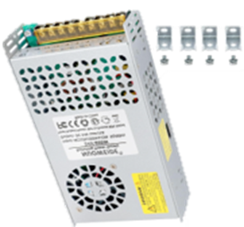
Power Supply Selection
Several power supply options available
Factors of consideration
Earth ground/proper grounding
Mounting adaptability
Enclosure safety
Adapter | MPE100C | RWS50B-24 TDK | Mean Well RPS-200 | NUOWEIDE | PMT-24V100W2BA
Wattage | 100 W | 50 W | 200 W | 600 W | 100 W
Current capability | 0-4.5A | 0-2.2A | 0-5.9A | 0-25A | 0-4.5A
Voltage capability | 85-264 VAC | 100-240 VAC | 80-264 VAC | 110-220 VAC | 90-260 VAC
Efficiency | 90% | 87% | 94% | 90% | 90%
Price | $52.74 | $37.17 | $46.00 | $29.99 | $23.93

Slide 23
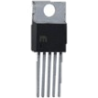
Regulator Selection
Buck converter steps voltage
Factors for selection
Switching frequency
Load Current
Thermal performance
PCB construction
Category | LM 2576 | LM 2575 | LM 2596 | LM 2678 | TPS 5430
Maximum Output Current | 3 A | 1 A | 3 A | 5 A | 3-4 A
Input voltage range | 4-40 V | 4.75-40 V | 4.5-40V | 8-40V | 5.5-36V
Output voltage range | 1.25-37V [91] | 1.25-37V [94] | 1.25-37V [92] | 1.25-37V [93] | 1.22-32V [95]
Switching Frequency | 52 kHz | 52 kHz | 150 kHz | 260 kHz | 500 kHz
General Efficiency | 75-88% | 75-88% | 73-90% | 82-92% | 95%(maximum)

Slide 24
Communication Protocol Selection
Protocols | UART | SPI | I2C
Architecture | Asynchronous | Synchronous | Synchronous
Peripheral Availability | Some | All | Some
Data Rate | Medium | Fastest | Slowest
GPIO Required | 2: 1 in + 1 out | 6: 1 in + 5 out | 2: 1 in + 1 out
Key Factors:
Compatibility of selected peripheral devices
Single-target bus controlled by MCU
Notes:
Finally, to ensure a seamless connection between the microcontroller and the other ICs in our system, we put our ADC, RTD and LCD display onto a SPI bus hosted by the ESP32.
We chose SPI as the communication protocol for two reasons:
All our peripheral devices, apart from the USB to UART interface for programming, supported communication over SPI.
Our ADC and RTD require time between measuring and reading, so a shared SPI bus with individual chip select signals allows the microcontroller to communicate with one device without interfering with the others.
And while SPI does require the most GPIO of the communication protocols we compared, it can facilitate communication between more than 2 devices and doesn’t drastically slow down when more devices are added.

Slide 25
03
Schematics & PCB Layouts

Slide 26
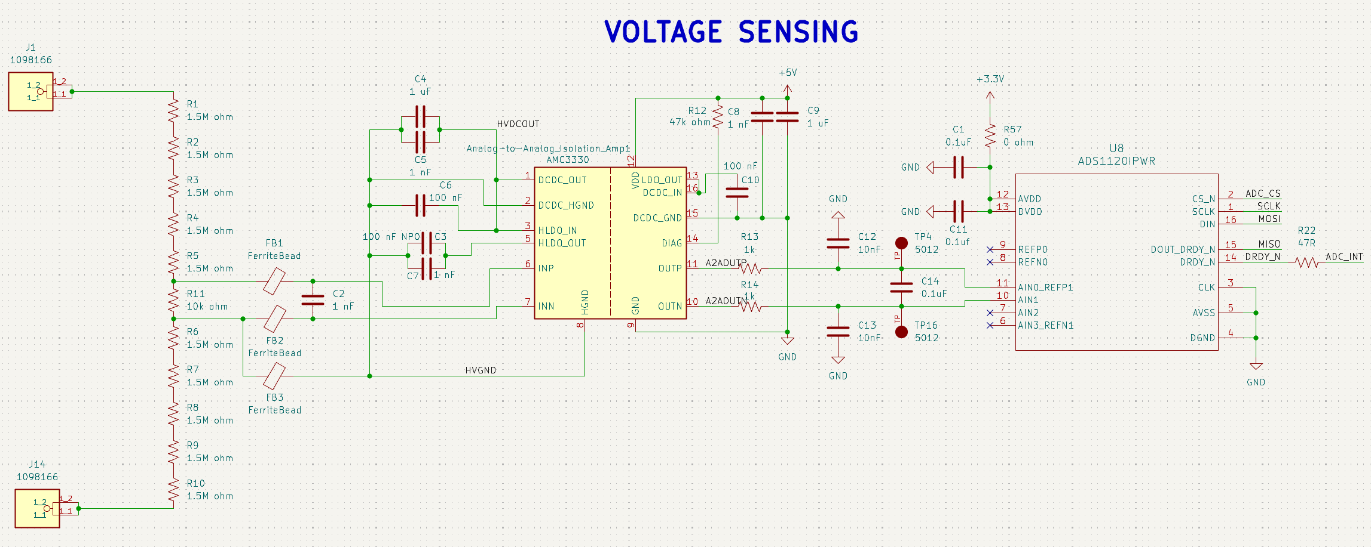
Main Board – HV Measurement

Slide 27
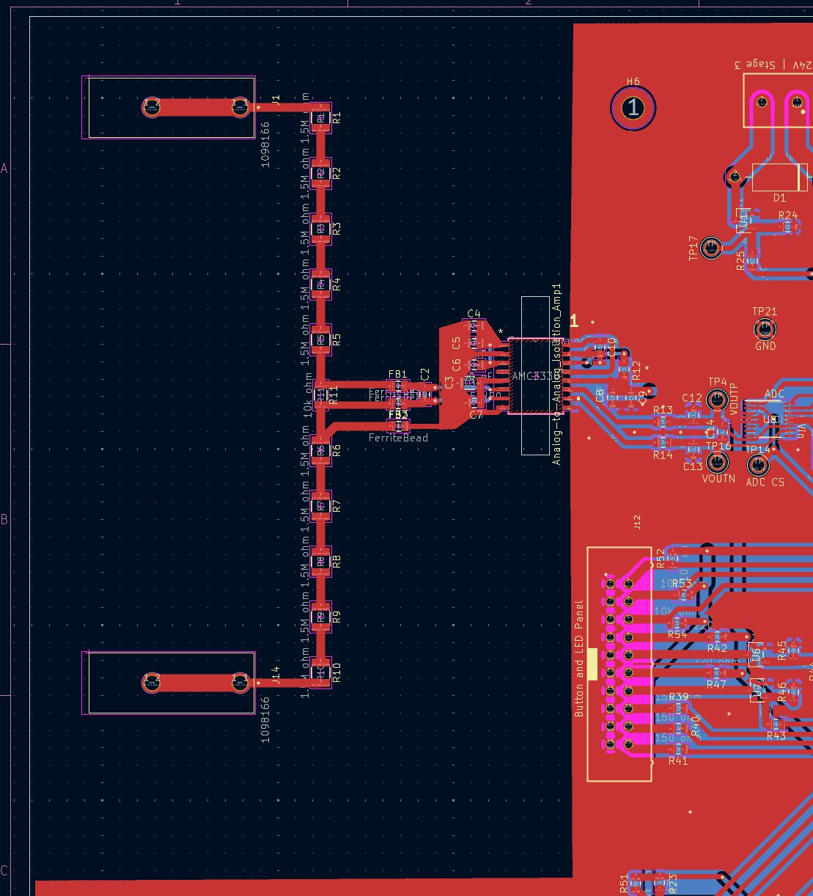
Main Board – HV Measurement
High Voltage Connectors & Resistor Divider
`
Isolation Amplifier
`
Analog to Digital Converter

Slide 28
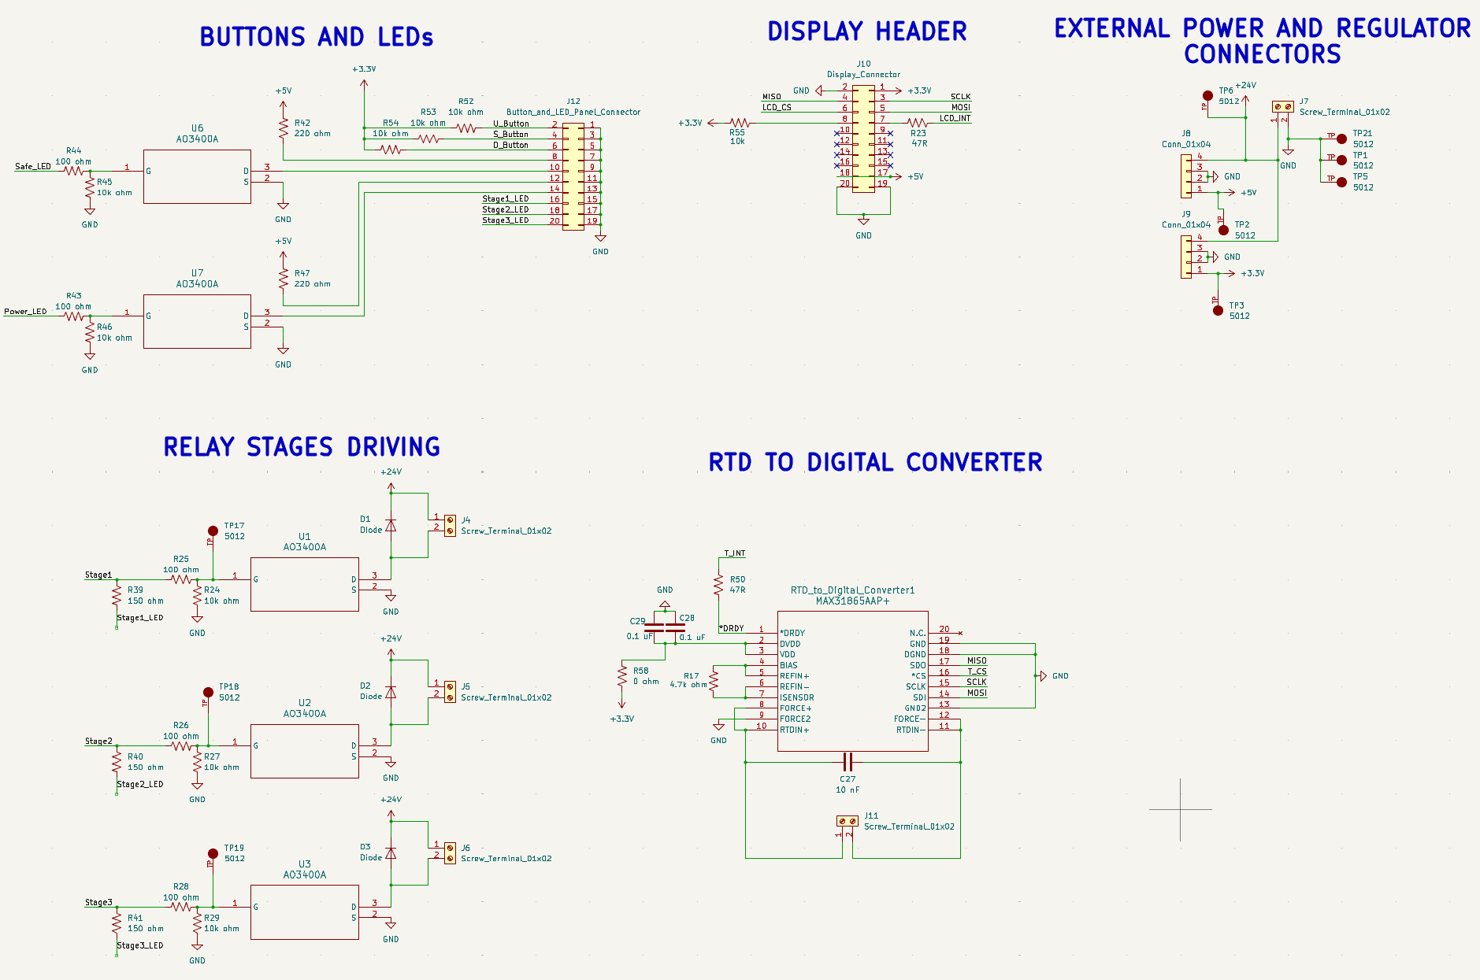
Main Board – Input/Output

Slide 29
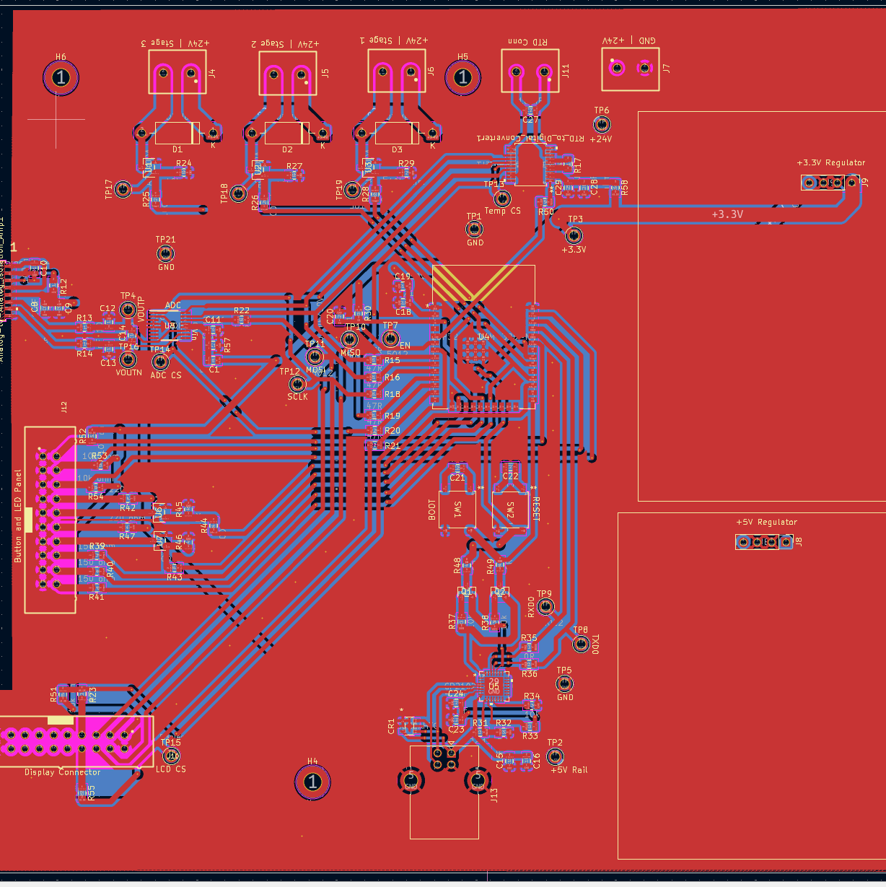
Main Board – Input/Output
RTD & Power Inputs
Relay Stage Outputs
I/O Board Connector
Regulator Board Connectors
Display Connector

Slide 30
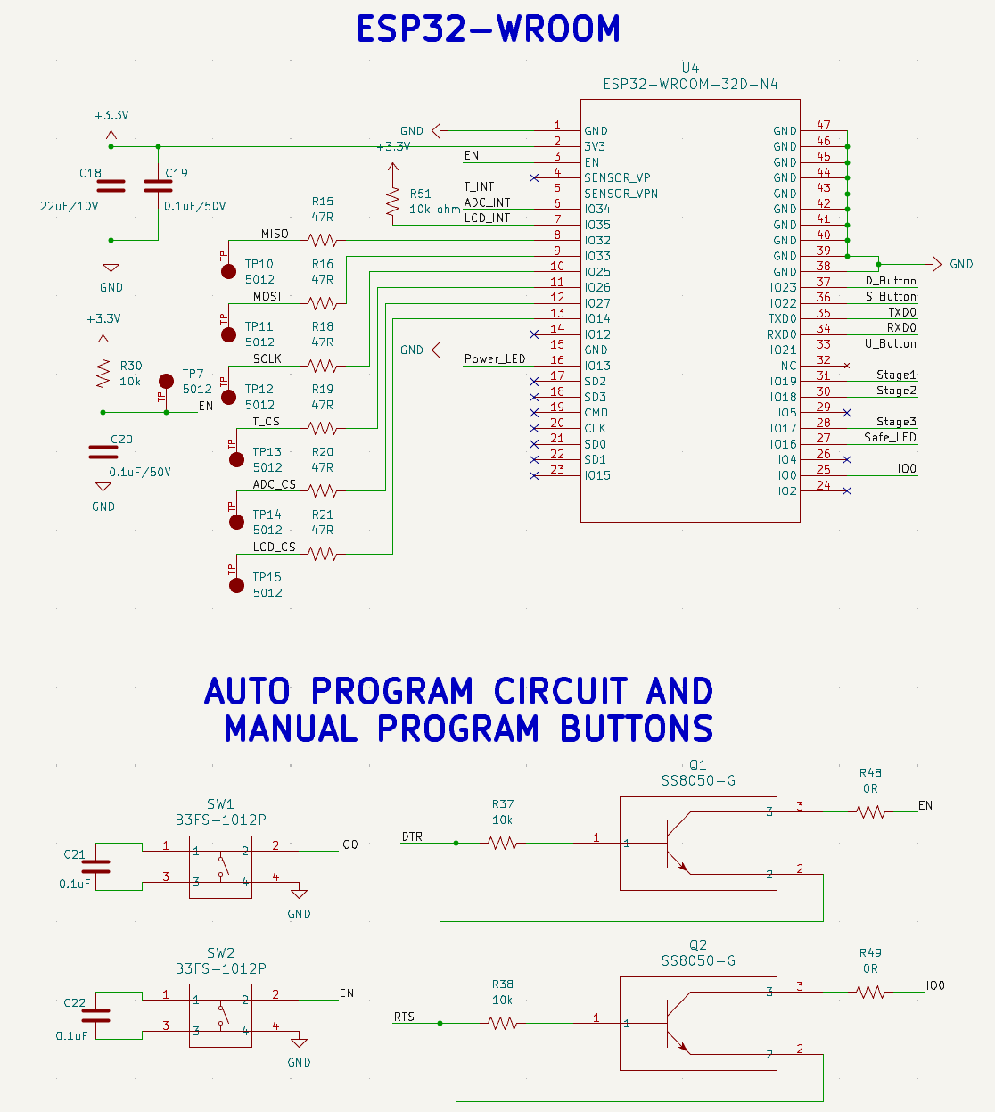
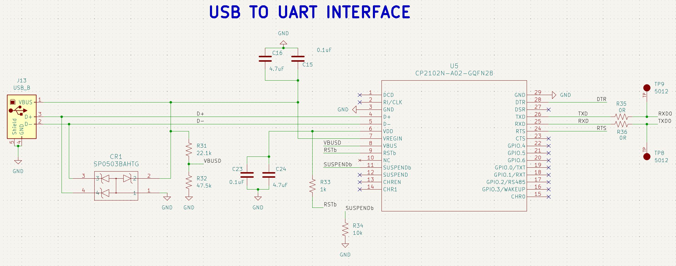
Main Board – MCU & Programmer

Slide 31
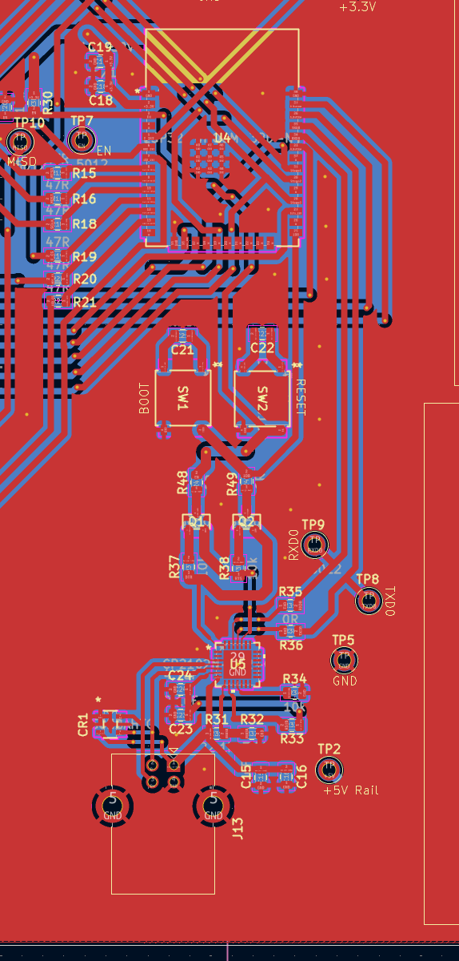
Main Board – MCU & Programmer
ESP32 Microcontroller
USB-to-UART Bridge
USB Type B Connector

Slide 32
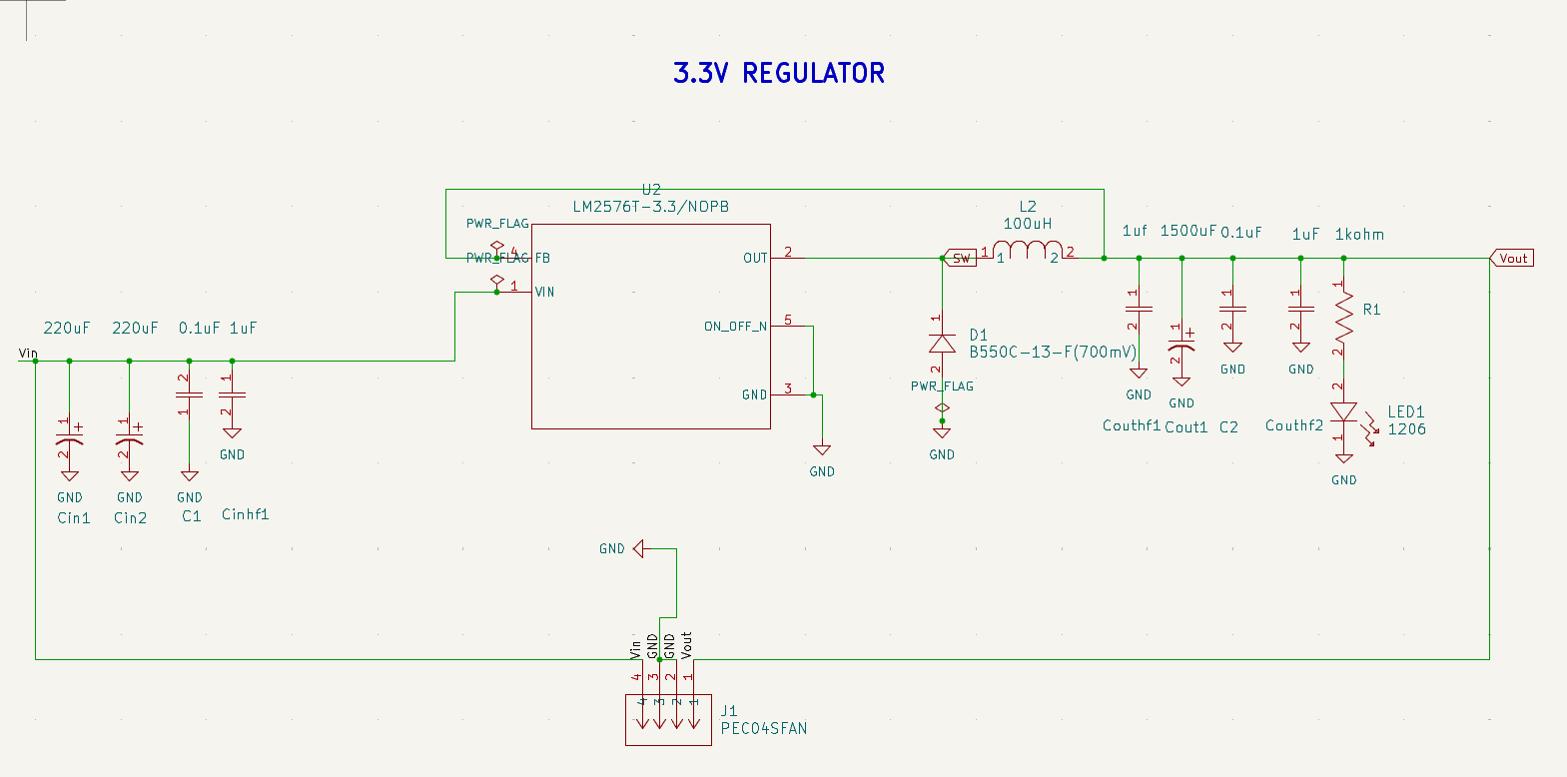
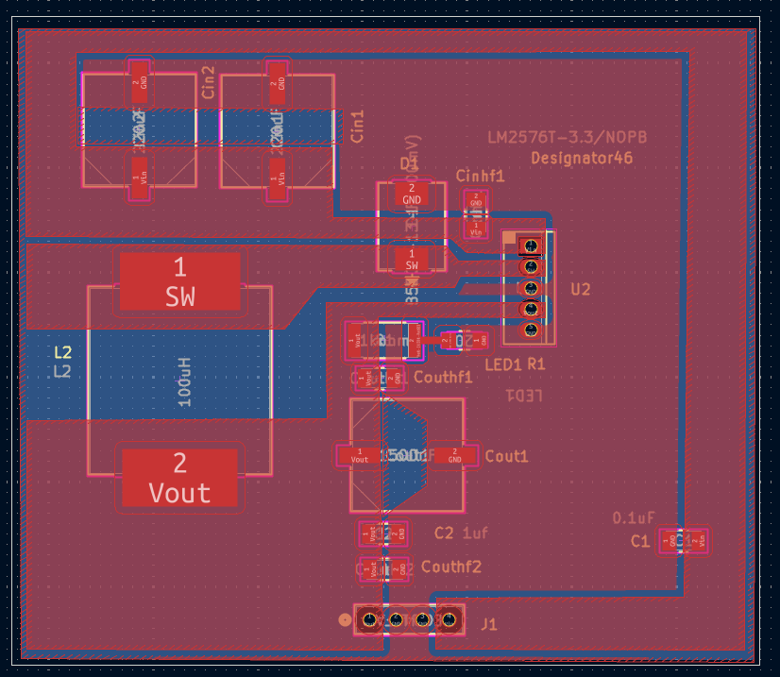
Regulator Boards- 3.3V

Slide 33
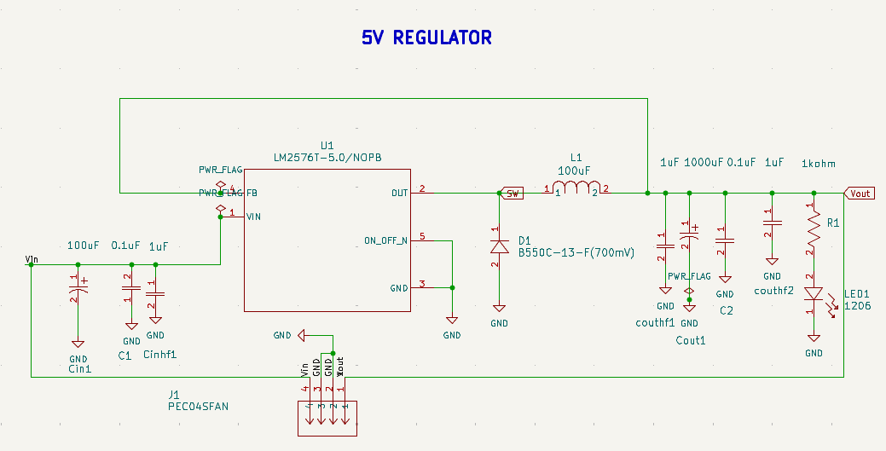
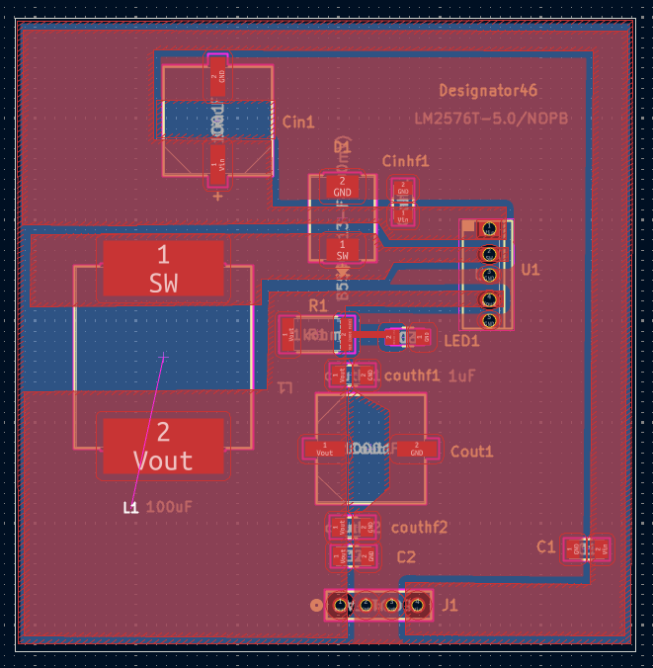
Regulator Boards- 5V

Slide 34
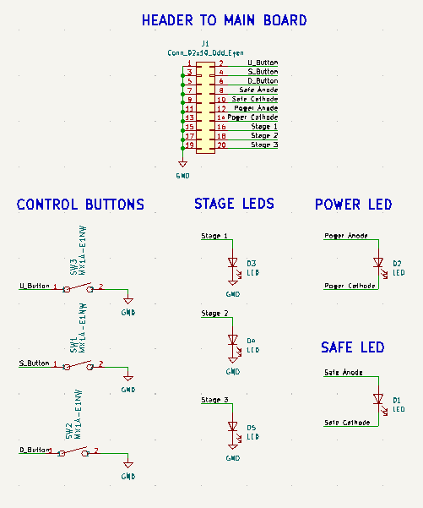
User Interface Board

Slide 35
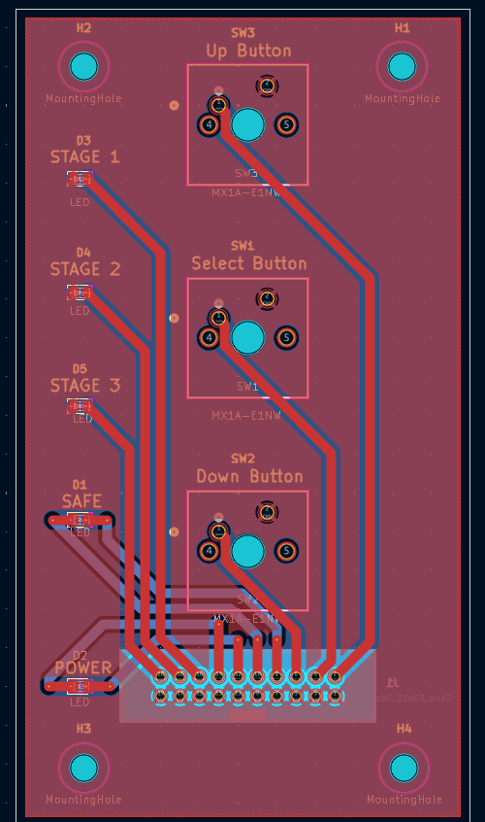
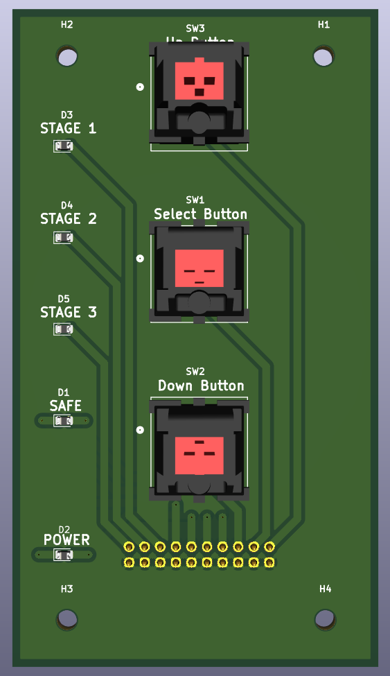
User Interface Board

Slide 36
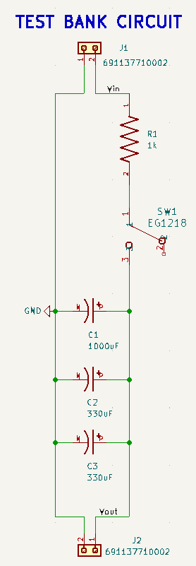
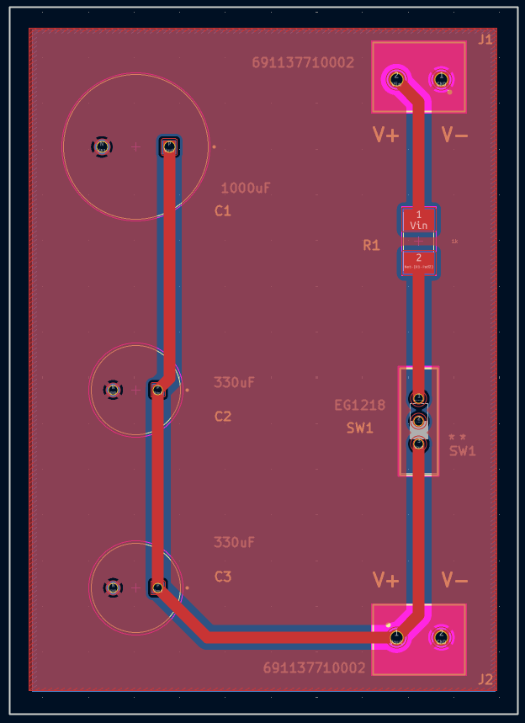
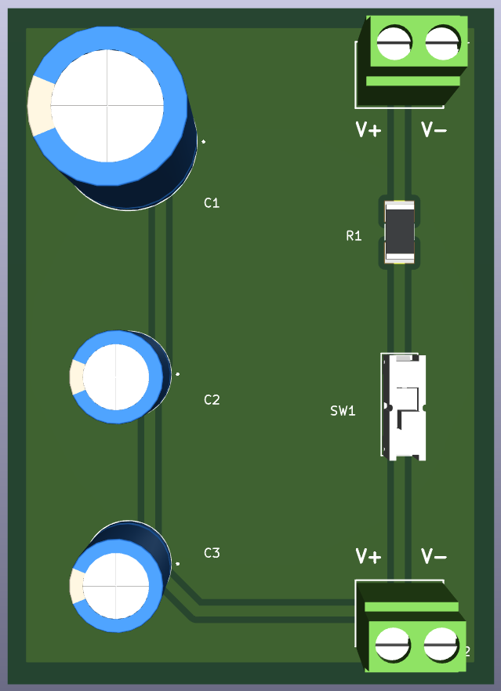
Test Bank Board

Slide 37
04
Software Design

Slide 38
Programming Language Selection
Language | C | C++ | Python
Familiarity | High | High | Medium
Speed | High | High | Low
Abstraction | Low | Medium | High
MCU Support | Native | Native | Interpreted
Key Factors:
Higher familiarity
Lower overhead
Abstraction Features
Notes:
The code for our project was implemented in C++, as it strikes the perfect balance between the performance and control offered by C, while also offering a variety of features such as classes and operator overloading found in other languages.
Combining a high familiarity with the C family of languages with the interpreter overhead inherent to MicroPython, using C++ was an easy decision when also considering which development tools to use.

Slide 39
Development Tools Selection
IDE | Espressif | Arduino | CLion | Visual Studio
Familiarity | Low | Medium | High | Medium
License | Apache 2.0 | CC-BY-SA-4.0 | JetBrains Student License | Microsoft Student License
MCU Flashing | Native | First-party Plugin | Third-party Tool | Third-party Tool
Feature Set | Medium | Low | High | Medium
Library Availability | Low | High | Manual Import | Medium
Key Factors:
Open-source toolchain
Official support from Espressif
Notes:
Our project’s code is compiled using the Arduino toolchain provided by Espressif.
The three largest factors that guided our choice of software development tools were familiarity with the IDE, a license available to both students and sponsor, and how third-party libraries for interfacing with the devices on our SPI bus could be included into the code.

Slide 40
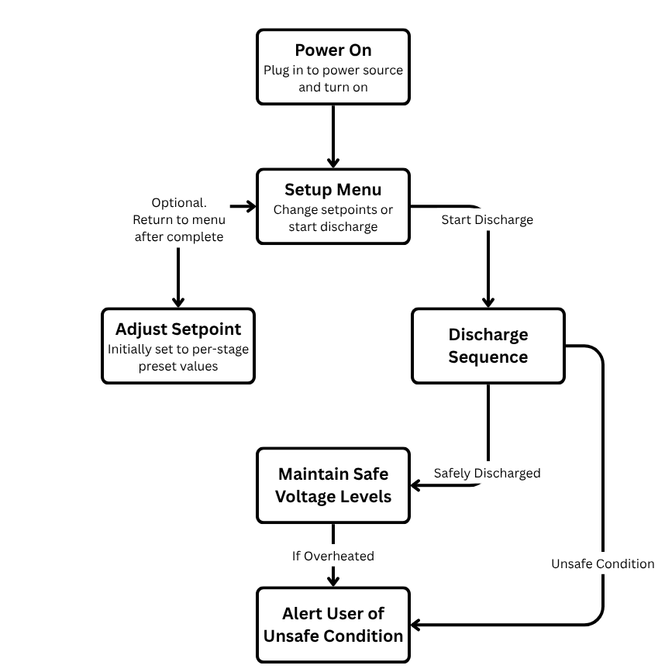
User Interaction Flow
Notes:
Here is a flowchart to visualize how a user can interact with our tool.
After they plugged it in, a user is presented with a configuration menu, where is able to see the voltage thresholds at which each relay will be activated.
Next, the user can adjust the setpoints that indicate the start of the 2nd and 3rd discharge stage if desired. After configuring to their needs, the user can start the discharge sequence to drain the capacitor.
Once completed, the tool will indicate that the measured voltage is less than 10V, and maintain safe voltage levels by continuing to drain any residual charge left in the capacitor.
In the event of an unsafe condition, such as overheating, the tool will automatically stop discharging and alert the user.
To achieve this behavior, the software running on the microcontroller implements a state machine that receives updates from both the user and real-time measurements of voltage and temperature.

Slide 41
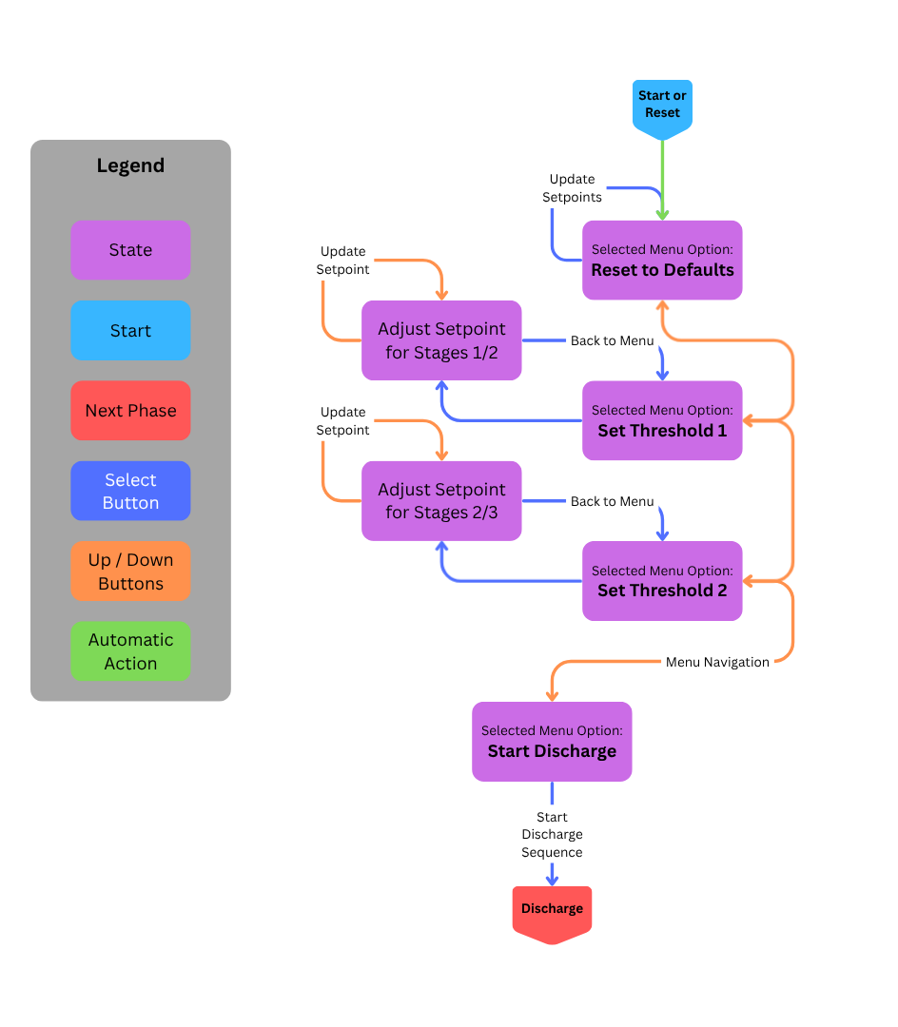
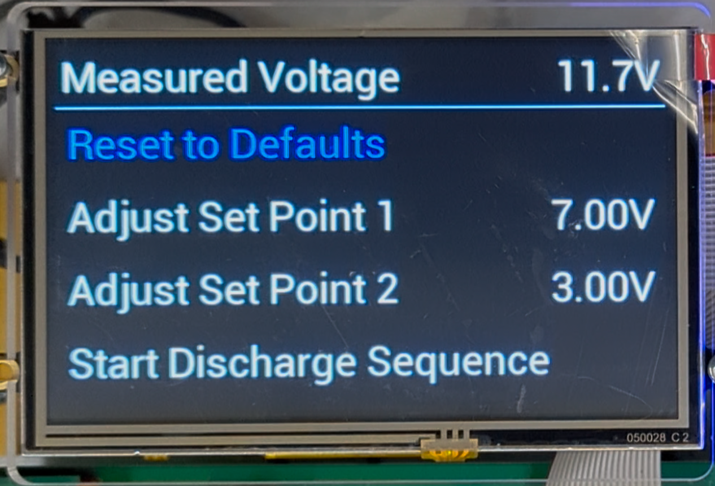
Software States: Configuration Menu
State Flowchart of Configuration Menu
Configuration Menu as presented by the User Interface.
Notes:
The configuration menu has 4 options that represent 6 distinct states that are selected by the user interacting with the buttons on the I/O PCB. Users are able to move up and down the menu, or adjust the setpoints using the two up and down button, while the middle button serves as the primary "Select" option.

Slide 42
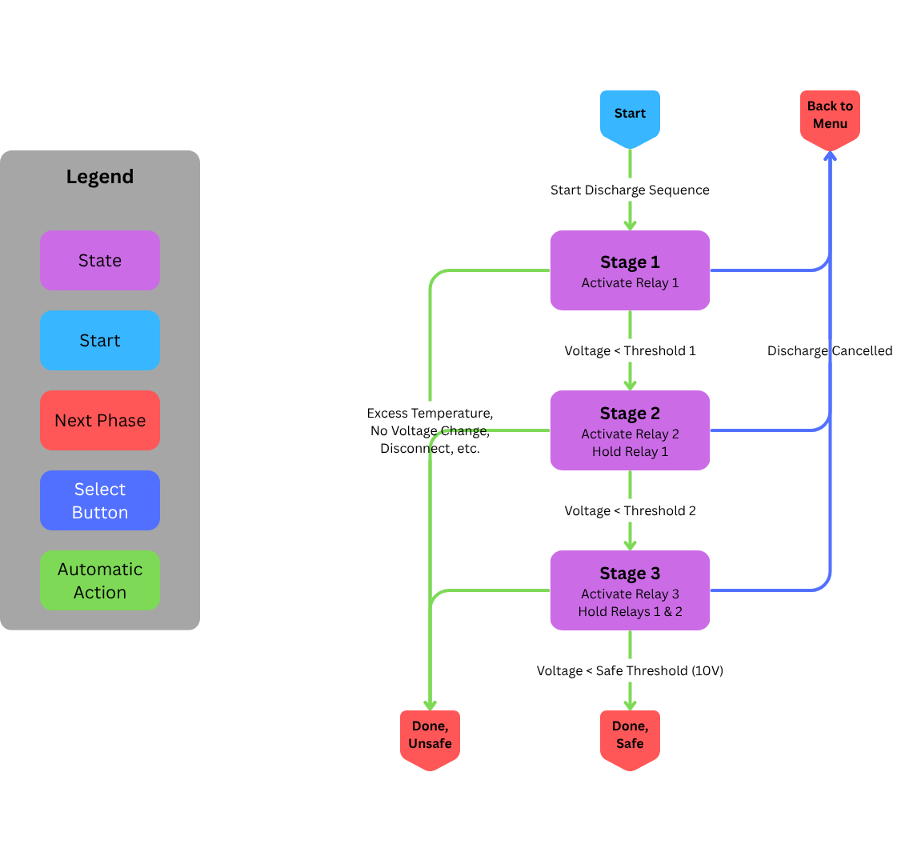
Software States: Discharge Sequence
State Flowchart of Discharge Sequence
Discharge Sequence as presented by the User Interface.
Notes:
Once the user starts the discharge sequence, the program follows an sequence of states that update the relays according to the setpoints provided by the user. If the user interrupts the discharge sequence by pressing the select button, they are returned to the configuration menu.

Slide 43
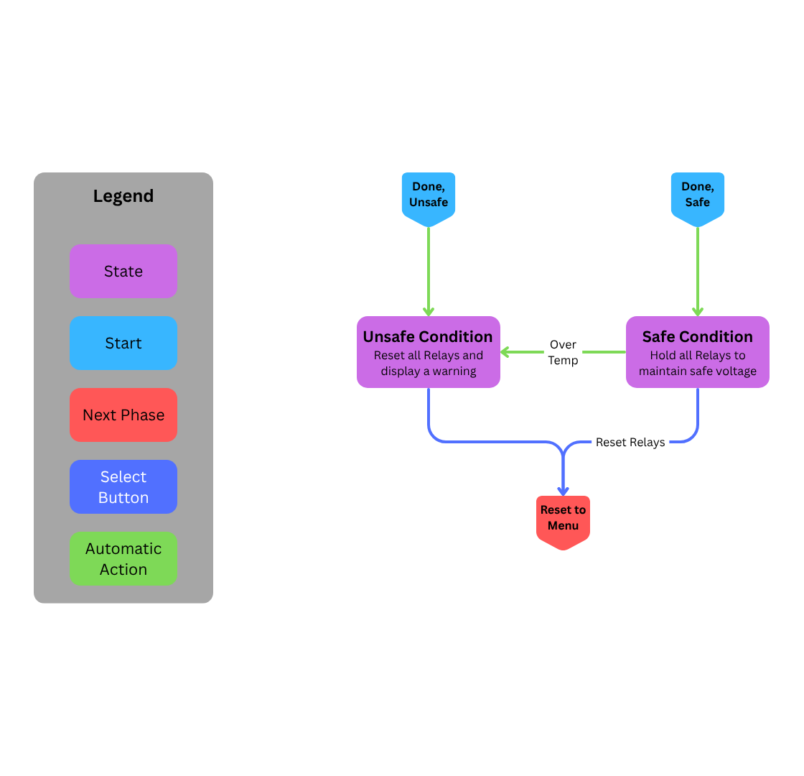
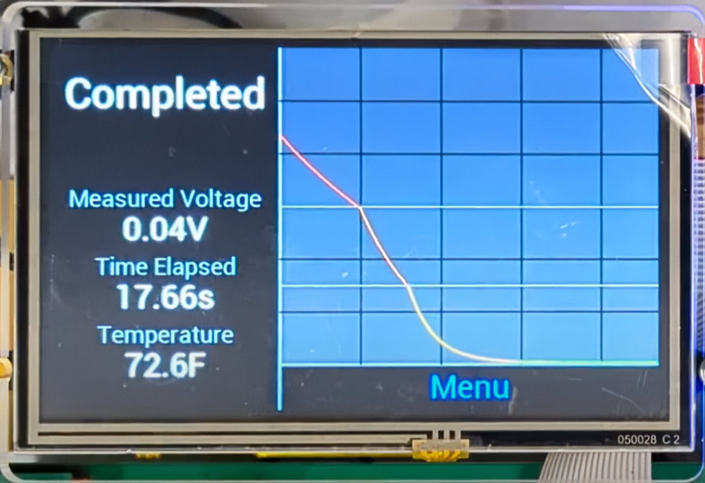
Software States: Safe vs. Unsafe
State Flowchart of Safe and Unsafe Conditions
Safely Discharged UI
Unsafe Condition (thermal)
Notes:
Otherwise, the discharge sequence completes after the capacitor's voltage is safe. However, at all times during and after a discharge, the program monitors the temperature and other factors that can indicate an unsafe condition. If one of these is detected, the program enters a state which shuts off all relays and alerts the user of the problem. Once the user presses the select button in either state, the program reverts to the configuration menu and returns to the beginning of the interaction.

Slide 44
Data Acquisition
uint64_t
Timestamp
State
float
Voltage
float
Temperature
Represents the milliseconds elapsed since the microcontroller’s last power cycle.
Represents the state which the program was in when the data point was recorded.
Recorded and scaled voltage from latest ADC measurement.
Recorded and scaled temperature from latest RTD measurement.
uint8_t
Can be configured at compile-time to use either Celsius or Fahrenheit.
Discharge collects up to 30s of data
Number of datapoints can be configured.
Displayed as real-time discharge graph
Data can also be exported over USB for further analysis.
Notes:
Each time the user starts a discharge sequence, the program starts recording for up to 30 seconds.
The recorded data includes the program’s timestamp and state, along with the updated measurements of voltage and temperature.
While the capacitor is being safely drained, the data is used to plot the discharge graph which is shown to the user.
The data is stored in memory until the next discharge sequence is started, allowing for a computer to export the data for further analysis using the USB interface.

Slide 45
05
System Simulation and Testing

Slide 46
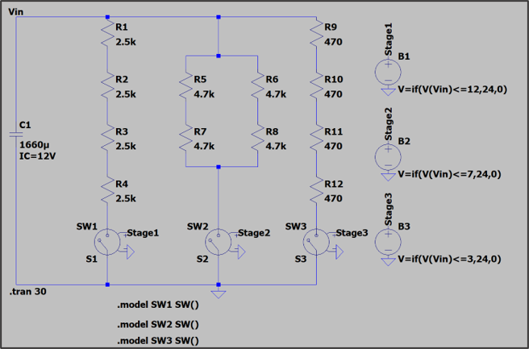
Discharge Simulation Setup
Stage 1 Resistance: 10k
Stage 2 Resistance: 4.7k
Stage 3 Resistance: 1.88k
Max Discharge Time: ~24 secs
Min Discharge Time: ~18 secs
Energy/Power Dissipated: 1188 J / 49.5 W

Slide 47
Notes:
Add onto graph other data for different runs.

Slide 48

System Test Setup

Slide 49
Real Vs Simulated Discharge Times
Projected Shortest Time Test Conditions: Stage 2 Setpoint = 8V, Stage 3 Setpoint = 4V, Safe Voltage Setpoint = 0.1
Starting Voltage (V) | LTSPICE Time (sec) | Trial 1 (sec) | Trial 2 (sec) | Trial 3 (sec) | Trial 4 (sec) | Trial 5 (sec) | Average Time (sec) | Error (%)
12 | 17.67 | 19.29 | 19.11 | 19.23 | 19.23 | 19.04 | 19.18 | 8.55%
9 | 12.89 | 14.37 | 14.17 | 14.17 | 14.17 | 14.37 | 14.25 | 10.55%
6 | 9.42 | 10.75 | 10.74 | 10.94 | 10.77 | 10.74 | 10.788 | 14.52%
3 | 6.71 | 7.92 | 7.89 | 7.9 | 7.94 | 7.95 | 7.92 | 18.03%
Projected Longest Time Test Conditions: Stage 2 Setpoint = 6V, Stage 3 Setpoint = 2V, Safe Voltage Setpoint = 0.1
Starting Voltage (V) | LTSPICE Time (sec) | Trial 1 (sec) | Trial 2 (sec) | Trial 3 (sec) | Trial 4 (sec) | Trial 5 (sec) | Average Time (sec) | Error (%)
12 | 23.25 | 24.53 | 24.71 | 24.71 | 24.54 | 24.52 | 24.602 | 5.82%
9 | 18.48 | 19.63 | 19.84 | 19.89 | 19.68 | 19.66 | 19.74 | 6.82%
6 | 11.72 | 13.17 | 12.95 | 13.16 | 12.82 | 13.15 | 13.05 | 11.35%
3 | 8.04 | 9.31 | 9.32 | 9.13 | 9.32 | 9.3 | 9.276 | 15.37%
In Between Test Conditions: Stage 2 Setpoint = 7V, Stage 3 Setpoint = 3V, Safe Voltage Setpoint = 0.1
Starting Voltage (V) | LTSPICE Time (sec) | Trial 1 (sec) | Trial 2 (sec) | Trial 3 (sec) | Trial 4 (sec) | Trial 5 (sec) | Average Time (sec) | Error (%)
12 | 20.16 | 21.46 | 21.46 | 21.67 | 21.53 | 21.52 | 21.528 | 6.79%
9 | 15.35 | 16.6 | 16.8 | 16.4 | 16.46 | 16.61 | 16.574 | 7.97%
6 | 10.38 | 11.75 | 11.74 | 11.56 | 11.59 | 11.54 | 11.636 | 12.10%
3 | 6.71 | 7.93 | 7.93 | 7.89 | 7.97 | 7.9 | 7.924 | 18.09%
Discharge time was always under 30 seconds!

Slide 50
06
Administrative Content

Slide 51



Work Distribution and Flow
Subsystem | Primary | Secondary | Responsibilities
Sensing and Isolation | Kealan Frost | Will Serface | Sensor research and selections
 |  |  | Sensor circuit designs
 |  |  | Sensor, MCU, and relay integration
 |  |  | Isolation from high voltage
Discharge | Javier Lopez-Marrero | Kealan Frost | Power resistor research and selection
 |  |  | Relay research and selection
 |  |  | Discharge network design
 |  |  | Relay and MCU integration
Computing | Will Serface | Zeeshan Asif | MCU research and selection
 |  |  | Display and I/O research and selection
 |  |  | Embedded Programming
 |  |  | User interface design
Power | Zeeshan Asif | Javier Lopez-Marrero | External power research and selection
 |  |  | Regulator designs
 |  |  | Capacitor charging circuit design
 |  |  | Chassis grounding
Team Meets 2-3x a Week
PCB Design Work is Collaborative
Manufacturing/Testing is also Collaborative

Slide 52

Budget Update
Initial Budget Presented to Sponsor:
System Cost by End of Project:
Type | Cost
Discharge Chassis | $804.99
Main PCB | $198.40
Test Bank | $7.28
Power Supply | $95.72
Regulators | $36.22
Manufacturing | $580.00
Total Unit Cost | $1722.61
Total After Tax | $1843.1927
With Headroom Used | $2359.98

Slide 53
Next Steps/Potential Improvements
Issue #1
Team cannot safely test system at higher voltages
Solution #1
NextEra tests system at 1200V in-house
Solution #2
UCF does lower voltage testing (ex: 100V)
Issue #2
System size can be inconvenient for transport
Solution #1
4-Layer PCBs for smaller boards
Solution #2
Better/more complex enclosure design
Issue #3
Stretch goals not implemented in current design
Solution #1
NextEra continues code development
Solution #2
Leave system in current operational state

Slide 54
Thanks For Watching!
Special Thanks To:
Dr.Chung-Yong Chan | Dr.Arthur Weeks | Dr. Gabriel Vazquez-Ramos
Gerardo Acosta | Nicholas Wayne | Sharon Campbell

