Slide 1
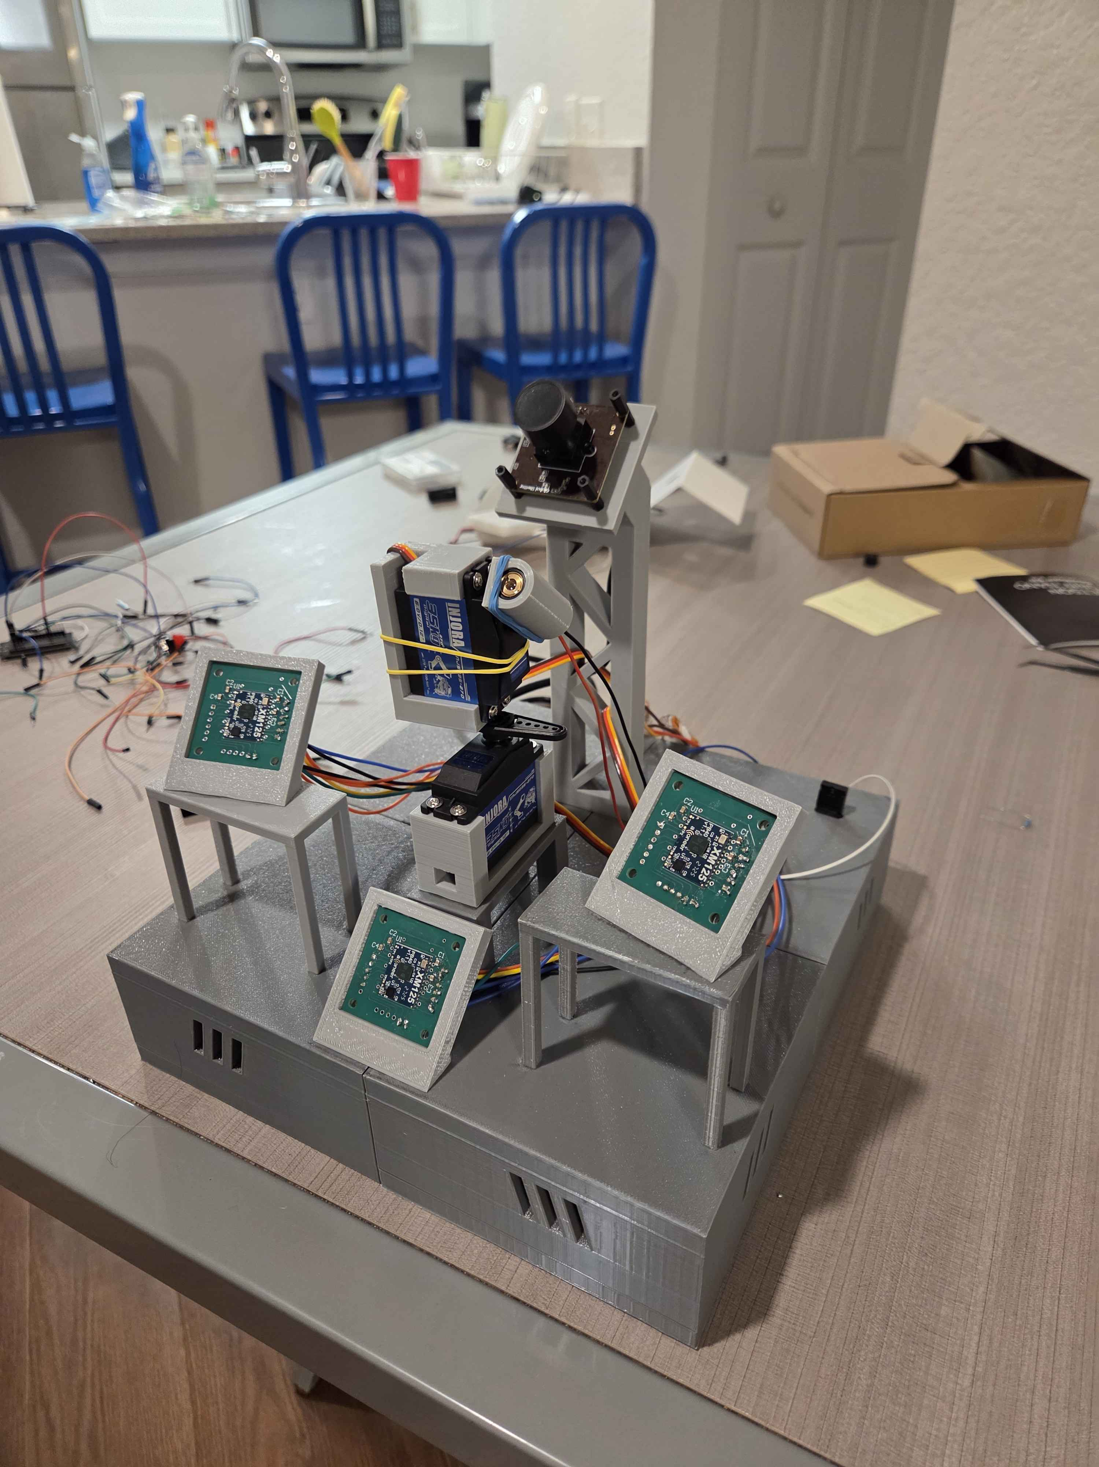


Portable Unitary Throwable Target Interceptor (P.U.T.T.I)
Group 18

Slide 2



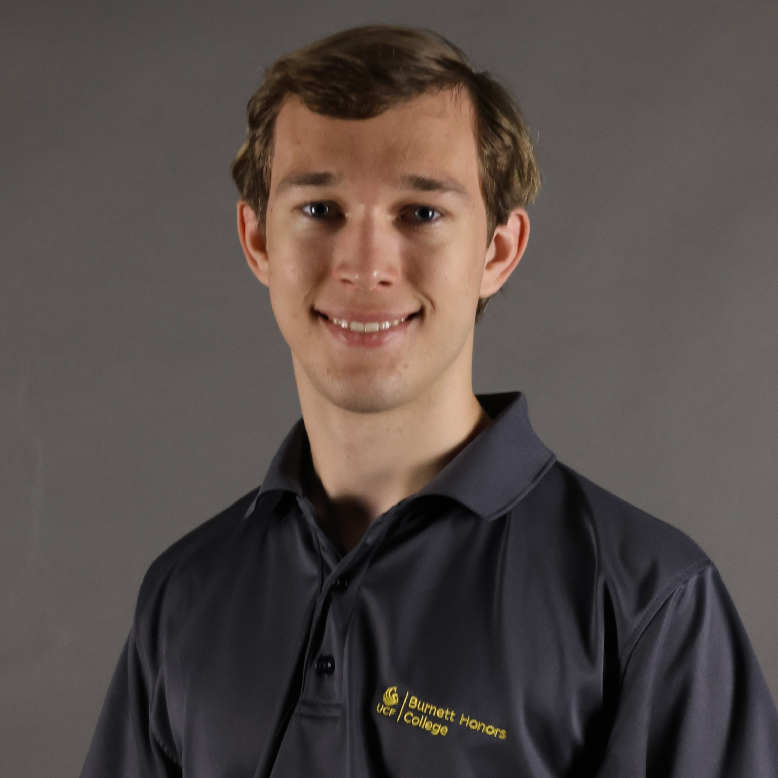
  OUR TEAM
Alex
Evison
Electrical Engineering
Callum
Fuller
Electrical Engineering
Nathan Kimmel
Electrical Engineering
Jake Tattersall
Computer Engineering

Slide 3
  WORK DISTRIBUTION
Name/Major | Primary Responsibilities | Secondary Responsibilities
Alex Evison Electrical Engineering | PCB Design | Peripheral Integration
 | Motors and Motor Control | Testing
 | Project Lead | MCU Implementation
Callum Fuller Electrical Engineering | Peripheral Integration | Chassis Design
 | PCB Design | Safety Constraints
 | Administrative Documentation | Soldering/Component Installation
Nathan Kimmel Electrical Engineering | Microwave Sensor Implementation | PCB Design
 | MCU Implementation | Detection System Design
 | User Interfacing | Testing
Jake Tattersall Computer Engineering | Detection System Design | Website Design
 | Camera Setup | User Interfacing
 | Administrative Documentation | MCU Implementation

Slide 4
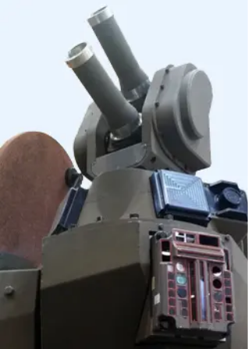
  BACKGROUND & MOTIVATIONS
Humans have always developed technology for protection against threats
Modern warfare increasingly uses small drones, UAVs, and other projectiles
Threats impact both military personnel and civilians
Traditional defenses (missiles + firearms) are costly, complex, or impractical
Existing active defense systems are effective but large/inaccessible
Need for smaller, faster, and more adaptable solutions

Slide 5
  BASIC GOALS & OBJECTIVES
Create a compact defense system capable of detecting and targeting stationary targets
Use cameras and microwave sensors in combination to detect targets in the field of vision
Allow the device to be quickly deployed and moved
Use 3D printing to create a shell for the components of the device to be placed in
Cover a significant target space in near-ideal room conditions
Use a camera that covers at least 120 degrees horizontal field of vision and at least 60 degrees vertical field of vision
Buzzer notifies user of successful targeting
Use a Single-board computer to control the camera and communicate with the microcontroller to move the motors and lasers

Slide 6
  ADVANCED/STRETCH GOALS & OBJECTIVES
Target and track low-velocity projectiles with predictable trajectories
Use the Single-board computer and microwave sensors to detect faster moving targets with a latency of less than 100 ms
Make the device fully weather resistant to harsh conditions, including sandstorms, rain, and snow
Use aluminum to create the shell of the device for increased durability whilst staying low weight
Allow the device to attach to different faces such as walls and ceilings
Add suction cups to the base of the device whilst still allowing for the device to be deployed in less than one minute
Be able to detect and disable a small drone, and detect humans to avoid accidental friendly-fire
Use a small projectile powered by pressurized gas to hit the projectile

Slide 7
  ENGINEERING SPECIFICATIONS
Overall System Specifications
Parameter | Description | Target Values
Detection Latency | Time from projectile entering field of view to detection. | ≤ 100 ms
Targeting Response Time | End-to-end delay from detection to targeting. | ≤ 500 ms
Range | Maximum distance at which projectiles can be detected and tracked. | 1 ft -> 5+ ft
Field of View | Angular coverage. | ≥ 120° H × 60° V
Targeting Success Rate | Probability of successfully detecting and targeting projectiles. | 80% -> 100%
Target Size | Approximate size of targets to be detected. | 6 in -> 18+ in
Operational Lifespan | Minimum continuous operation time. | ≥ 1 Hour
Weight | Total system weight. | 2 – 5 kg
Device Dimensions | Overall size of device. | ≤ 0.5 m × 0.5 m × 0.5 m
Component Specifications
Components | Parameters | Target Values
Laser Module | Wavelength Output Power | 630 nm – 680 nm ≤ 5 mW
Motors | Angular speed Resolution | ≥ 150°/s ≤ 1°
Camera | Frame Rate | ≥ 60 fps
Microwave Sensor | Detection Range | ≥ 5 m
Microcontroller | Communication | UART/I2C Interface

Slide 8
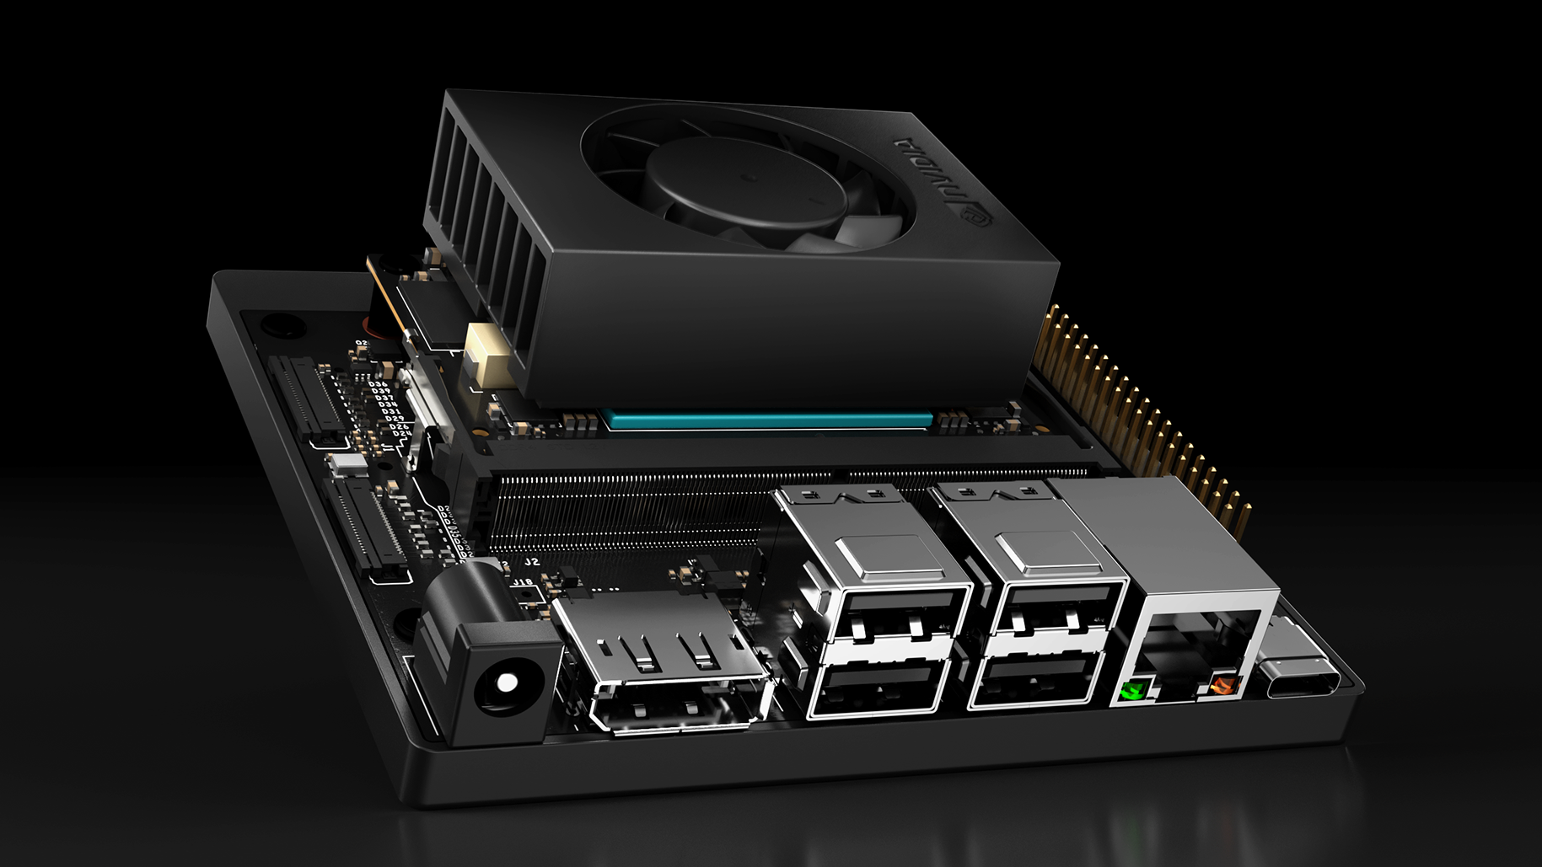
  SINGLE BOARD COMPUTER COMPARISON
Feature | Raspberry Pi | Coral Dev Board | Nvidia Orin Nano Super DevKit | Firefly ROC-RK3588S
# GPIO | 40 | 40 | 40 | 20
Bluetooth | Bluetooth 5.0 | Bluetooth 4.2 | No | Bluetooth 4.2
Clock Speed (GHz) | 1.8 | 1.5 | 1.7 | 2.4
CSI | 1xMIPI CSI-2 | 1xMIPI CSI-2 | 2xMIPI CSI-2 | 2xMIPI CSI-2
GPU | Broadcom VideoCore VI | GC7000 Lite | Ampere | Mali-G610
Operating System | Linux | Mendel/Linux | Linux | Linux
Power Consumption (W) | ~7 | ~2 | ~7-25 | ~7
Price | ~$60 | ~$130 | ~$250 | ~$200
Processor | Quad-core ARM Cortex-A72 | Quad-core Cortex A-53 | 6-core Arm Cortex-A78AE | Quad-core ARM Mali-G610
Size (mm) | 85.6 x 56.5 | 56 x 85 | 103 x 90.5 x 34.77 | 90 x 60
USB | 2 x USB 2.0, 2 x USB 3.0 | 1 x USB 3.0, 1x USB Type C, 1x USB 2.0 | 1 x USB 3.2, 1 x USB Type C | 1 x USB 3.0, 2 x USB 2.0, 1 x USB Type C
Weight (g) | ~70 | ~50 | ~176 | ~50
Wi-Fi | Dual-band 802.11ac | Dual-band 802.11 ac | GbE Connector | Dual-band 2.4 / 5 GHz
Notes:
In addition to having an MCU, the project required a single-board computer capable of performing real-time image processing. Initially, ideas like the Raspberry Pi came into mind; however, the choice of the SBC would be determined by the image processing method. If the method chosen was resource demanding or would benefit from a GPU, then a more powerful board would be needed. In the end, a computationally heavy method was required, so the Nvidia Jetson Orin Nano was selected. The Orin Nano was advertised to perform well with computer vision models, and could allow us to select a more accurate computer vision model thanks to its GPU.

Slide 9
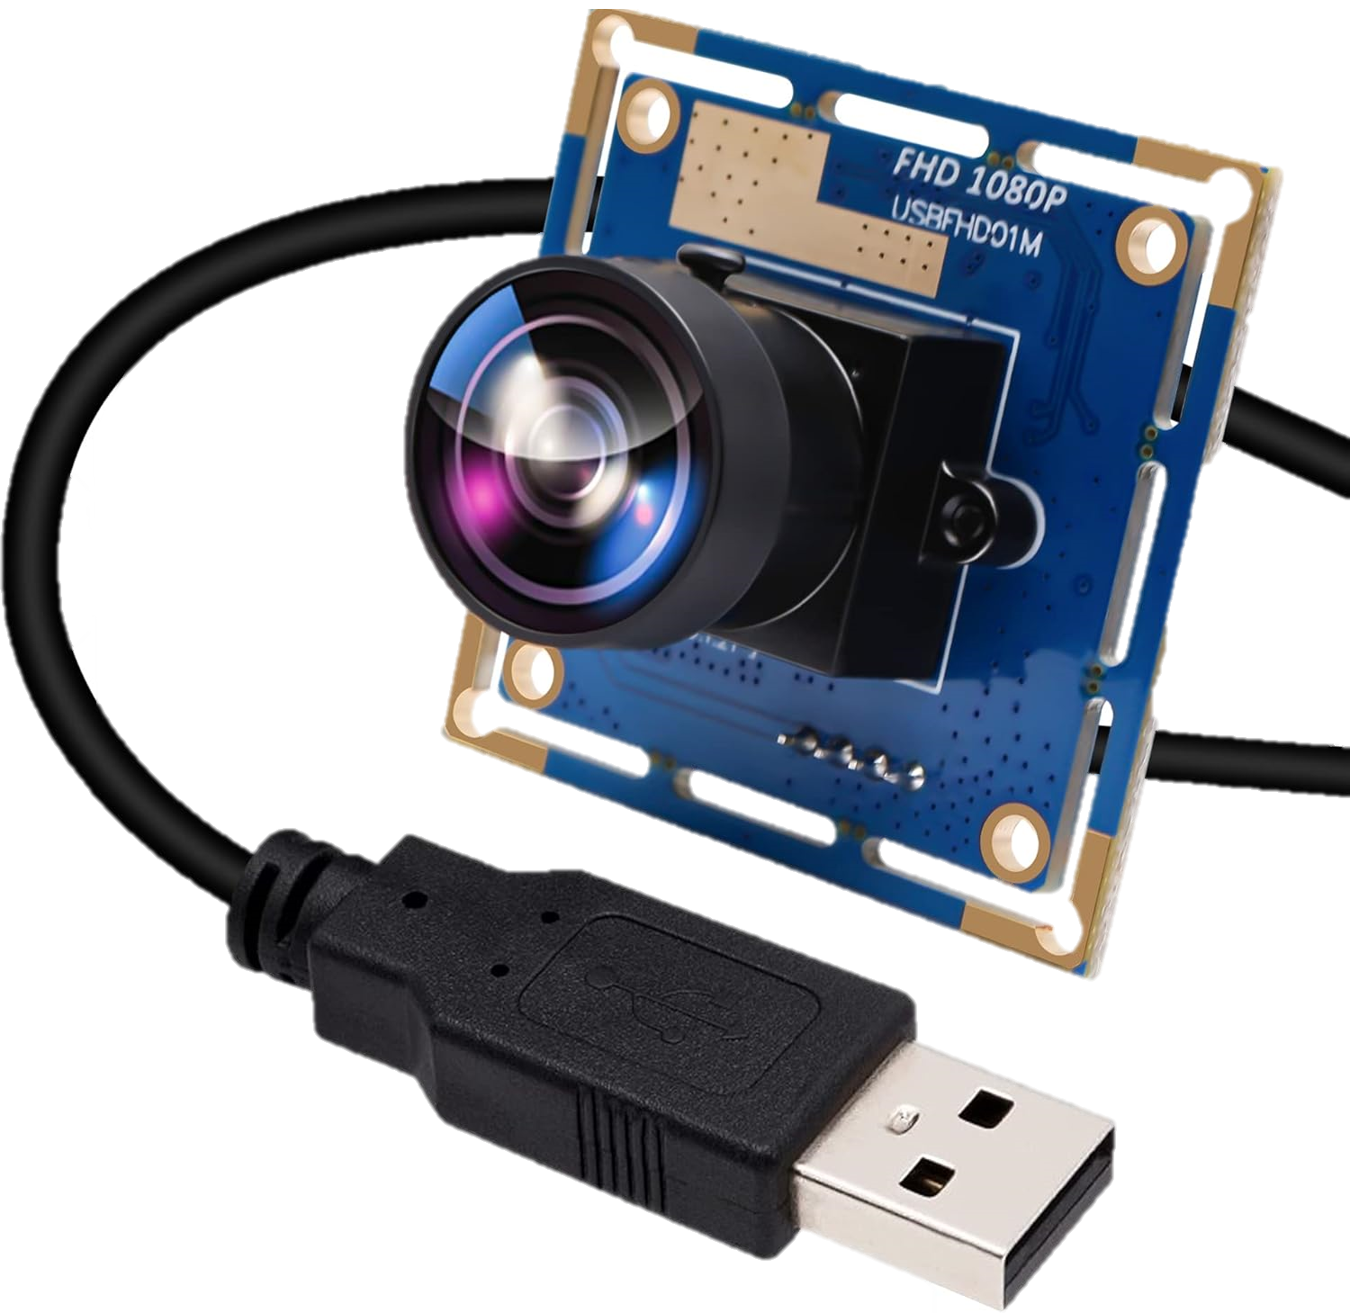
  CAMERA COMPARISON
Feature | IFWATER AR0144 | ELP OV2710 | Arducam 222 | Arducam 175 | Coolwell 160
FOV (degrees) | 170 | 170 | 222 | 175 | 160
FPS @ Max Quality | 20 | 30 | 21 | 21 | 21
Size (mm x mm) | 38 x 38 | 38 x 38 | 25 x 24 | 25 x 24 | 25 x 24
Price | $49 | $43 | $26 | $36 | $21
Connection | USB | USB | CSI | CSI | CSI
Notes:
The camera is the method of which the SBC will capture images to do image processing. The camera should have a wide field of vision and be capable of hitting high frames per second. With the Orin Nano having both USB and CSI camera slots, a decision was first made between these two options. CSI is a popular interface for embedded cameras and imaging, and has the capabilities of outperforming a USB camera while using a much smaller ribbon cable compared to a longer USB cable. While the CSI cameras were typically cheaper and could bring better quality, users on the Nvidia forums noted problems in getting the CSI cameras to function even though they were advertised as supported. Additionally, the benefits of having better quality will be hindered since the images will need to be in low resolution for successful processing on the Orin Nano. As a result, the ELP OV2710 USB camera was selected since it had a wide field of vision and could function well with the Orin Nano.

Slide 10

  DETECTION FRAMEWORK COMPARISONS
Feature | OpenCV | YOLO | Single Shot MultiBox | Faster R-CNN
Stages | Depends | One | One | Two
Speed | Depends | Very Fast | Fast | Slow
Accuracy | Depends | Moderate/High | Moderate | High
Complexity | Low | Moderate | Moderate | High
Dataset? | No | Yes | Yes | Yes
Size | Small | Small / Moderate | Moderate | Large
Notes:
The detection framework for detecting our targets is a key part of this project, and heavily influenced the SBC selection. OpenCV will be used in the project to access the camera and perform other tasks, but will not be the primary detection framework. Instead, a YOLO model from Ultralytics will be used. The YOLO model is unique in that it performs only a single pass over the image to search for objects, so it will provide the real-time detection speeds necessary while providing a high level of accuracy. The YOLO model used will be custom trained using the camera chosen.

Slide 11
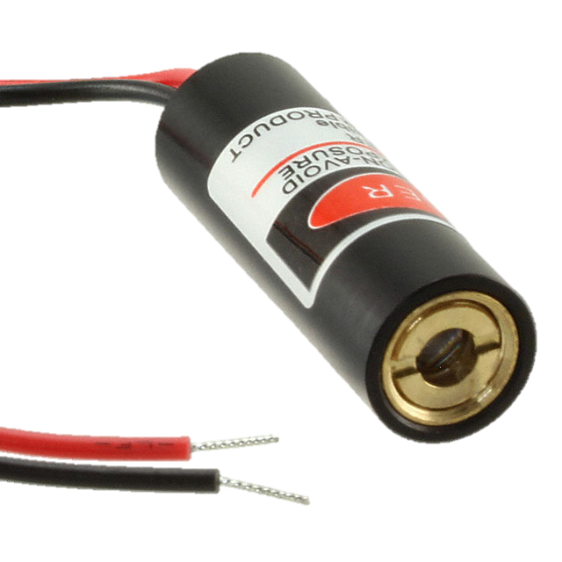
  LASER COMPARISON
Feature | 1054 | PLT5520DB_P | VLM-650-04 LPA | D405-120 | RLD85NZJ4-00A
Wavelength | 650nm | 515nm | 650nm | 405nm | 852nm
Input Voltage | 2.8V ~ 5.2V | 5.8V | 2.6V ~ 5V | 4.8V | 2.8V
Current Rating | 25mA | 60mA | 40mA | 150mA | 350mA
Power | 5mW | 10mW | 2.5mW | 120mW | 220mW
Package/Case | Cylinder (10mm Dia) | Radial, Can – 3 Lead | Cylinder (6.55mm Dia) | Radial, Can, 3 Lead (5.6mm TO-18) | Radial, Can – 3 Lead

Slide 12
  I2C MULTIPLEXER COMPARISONS
Feature | PANE1033954 | AL03006-535K-141-G1 | B574G1103F000 | NRCE105K4400B1KS | 192-103KET-A01
Resistance in Ohms @ 25°C | 10k | 1M | 10k | 100k | 10k
Resistance Tolerance | ±2.0% | ±10.0% | ±1.0% | ±10.0% | ±1.3%
Operating Temperature | -50°C ~ 150°C | -50°C ~ 204°C | -55°C ~ 200°C | -40°C ~ 125°C | -60°C ~ 150°C
Max Power | 125mW | - | 18mW | 450mW | -
Length of Lead Wire | 150.00mm | 29.20mm | 65.00mm | 6.5mm | 38.00mm

Slide 13
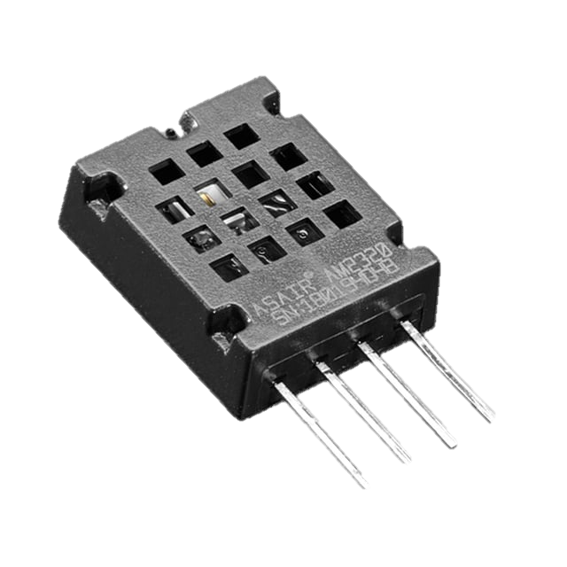
  HUMIDITY SENSOR COMPARISONS
Feature | HS12SP | HPP801A031 | HIH-4021-003 | AM2320 | CHS-MSS
Humidity Range | 30 ~ 90% RH | 1 ~ 99% RH | 0 ~ 100% RH | 0 ~ 99% RH | 20 ~ 85% RH
Output | 60k @ 50% RH | 180pF @ 55% RH | 3.268V @ 75.3 RH | I2C Output | 500mV @ 50% RH
Accuracy | ±5.0% | ±2.0% | ±3.5% | ±3.0% | ±5.0%
Response Time | 120s | 3s | 5s | 5s | 60s
Voltage Supply | 1V | 10V | 5V ~ 5.8V | 3.1V ~ 5.5V | 4.75V ~ 5.25V
Notes:
The humidity sensor will be used to measure the relative humidity of the surrounding environment. This is particularly useful to the microwave sensor modules which are very susceptible to electrostatic discharge. We compared 5 different sensors based on their humidity range they can detect, the type of output they produce, the response time, and the voltage supply required to power the sensor. Based on this we decided to go with the AM2320 by Adafruit. It operates at the correct voltage supply, has a range large enough to encapsulate all environments, has a short response time, and outputs the values via I2C making it easy to use. Additionally, it can also be used to measure temperature which provides us with the opportunity to also read the external temperature in addition to the internal temperature.

Slide 14
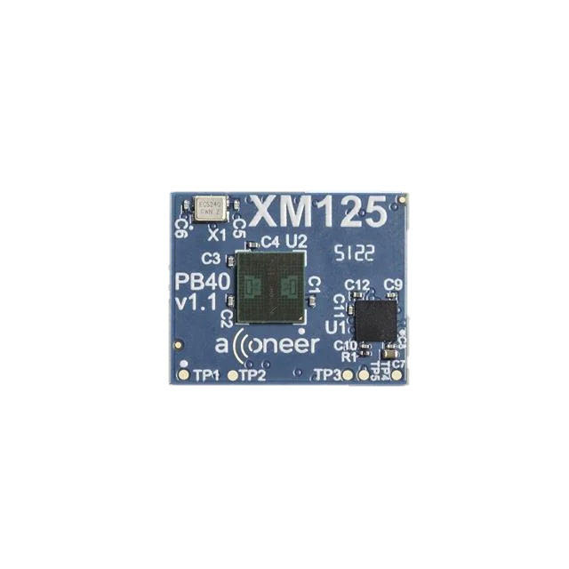
  MICROWAVE SENSOR COMPARISONS
Feature | A121 | IWRL6432AOP | XM125 | IWR6843AOP
Frequency Band | 60 GHz | 57 – 63.5 GHz | 60 GHz | 60 - 64 GHz
Onboard Processing | None | Cortex-M4F | Cortex-M4 | Cortex-M4F + C674x (DPS)
Communication | SPI | UART, SPI, I2C | UART, I2C | UART, SPI, I2C
Detection Range | 23 meters | 20 meters | 23 meters | Not Specified
Field of View | 65 H × 53 V | Detailed pattern plots (no explicit values) | 65 H × 53 V | Not Specified
Supply Voltage | 1.8V, 3.3V | 1.8V, 3.3V | 1.8V, 3.3V | 1.2V, 1.3V, 1.8V, 3.3V

Slide 15
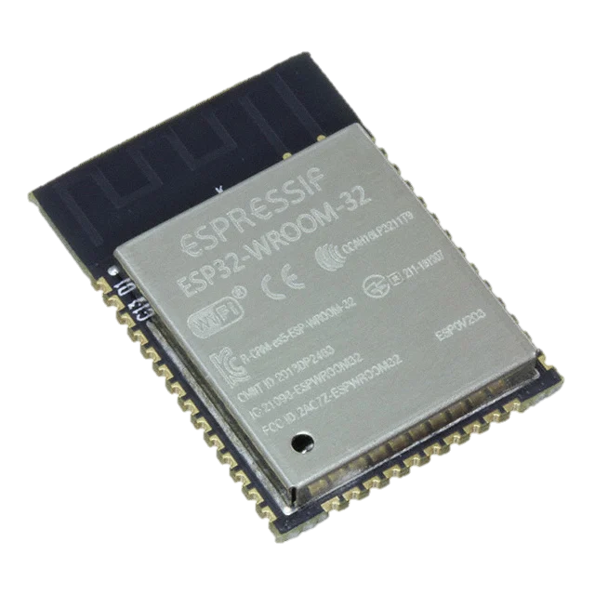

  MICROCONTROLLER COMPARISONS
Feature | PIC18F46K22 | ATmega328P | ESP32-WROOM-32 | STM32F103C8T6
Clock Speed | 16 MHz (64 MHz with PLL) | 16 MHz | 40 MHz | 16 MHz
SRAM | 3.8 kB | 2 kB | 520 kB (8 kB RTC) | 20 kB
Flash Memory | 64 kB | 32 kB | 4 mB | 64 kB
Operating Voltage | 2.3V - 5.5V | 2.7V - 5.5V | 3.3V | 3.3V
GPIO Pins | Up to 35 | Up to 23 | Up to 32 | Up to 37
Interfaces | 2 UART, I2C, SPI | UART, I2C, SPI | 2 UART, I2C, SPI | 3 UART, 2 I2C, 2 SPI

Slide 16

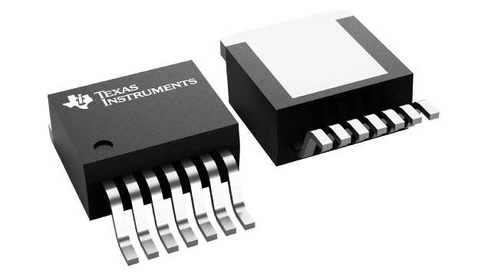
  REGULATOR COMPARISONS
Feature | AP64502SP-13 | TPS54531DDAR | LM2679S3.3/5 | RT6285GSP
Input Voltage Range | 3.8V to 40V | 3.5V to 28V | 8V to 40V | 5.5V to 30V
Output Voltage | 0.8V to 40V | 0.8V to 26.04V | 3.3V/5V | 0.8V to 24V
Max Output Current | 5A | 5A | 5A | 5A
Efficiency | Up to 90% | Up to 92% | Up to 92% | Up to 90%
Switching Frequency | 100 kHz to 2.2 Mhz (typically 500 kHz) | 570 kHz | 260kHz | 500 kHz
Protection Features | UVLO, OVP, cycle-by-cycle current limit, thermal shutdown | UVLO, OVP, thermal shutdown, current limit | UVLO, cycle-by-cycle current limit, thermal shutdown | Cycle-by-cycle over-current limit, thermal shutdown, soft-start
Cost | $2.09 | $2.04 | $7.42 | $0.84

Slide 17
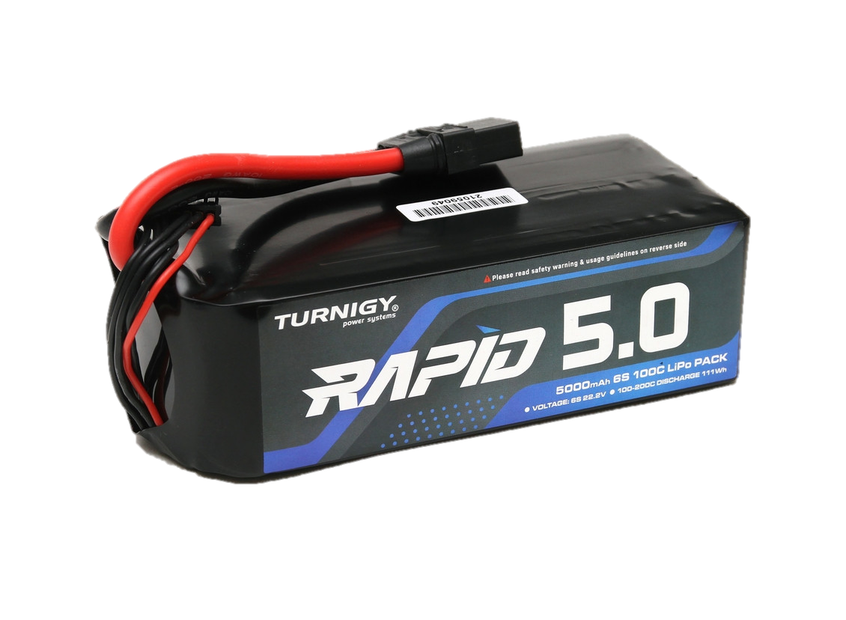
  POWER SUPPLY COMPARISONS
Feature | Nihewo | Spektrum | Turnigy Rapid
Voltage | 14.8 V | 14.8 V | 22.2 V
Capacity | 4500 mAh | 5000 mAh | 5000 mAh
Discharge Rate | 80 C | 30 C | 100 C
Dimensions | 136 mm x 35 mm x 45 mm | 143 mm x 36 mm x 42 mm | 136 mm x 44 mm x 64 mm
Weight | 430 g | 486 g | 713 g
Cost | $25.00 | $105.00 | $49.43

Slide 18
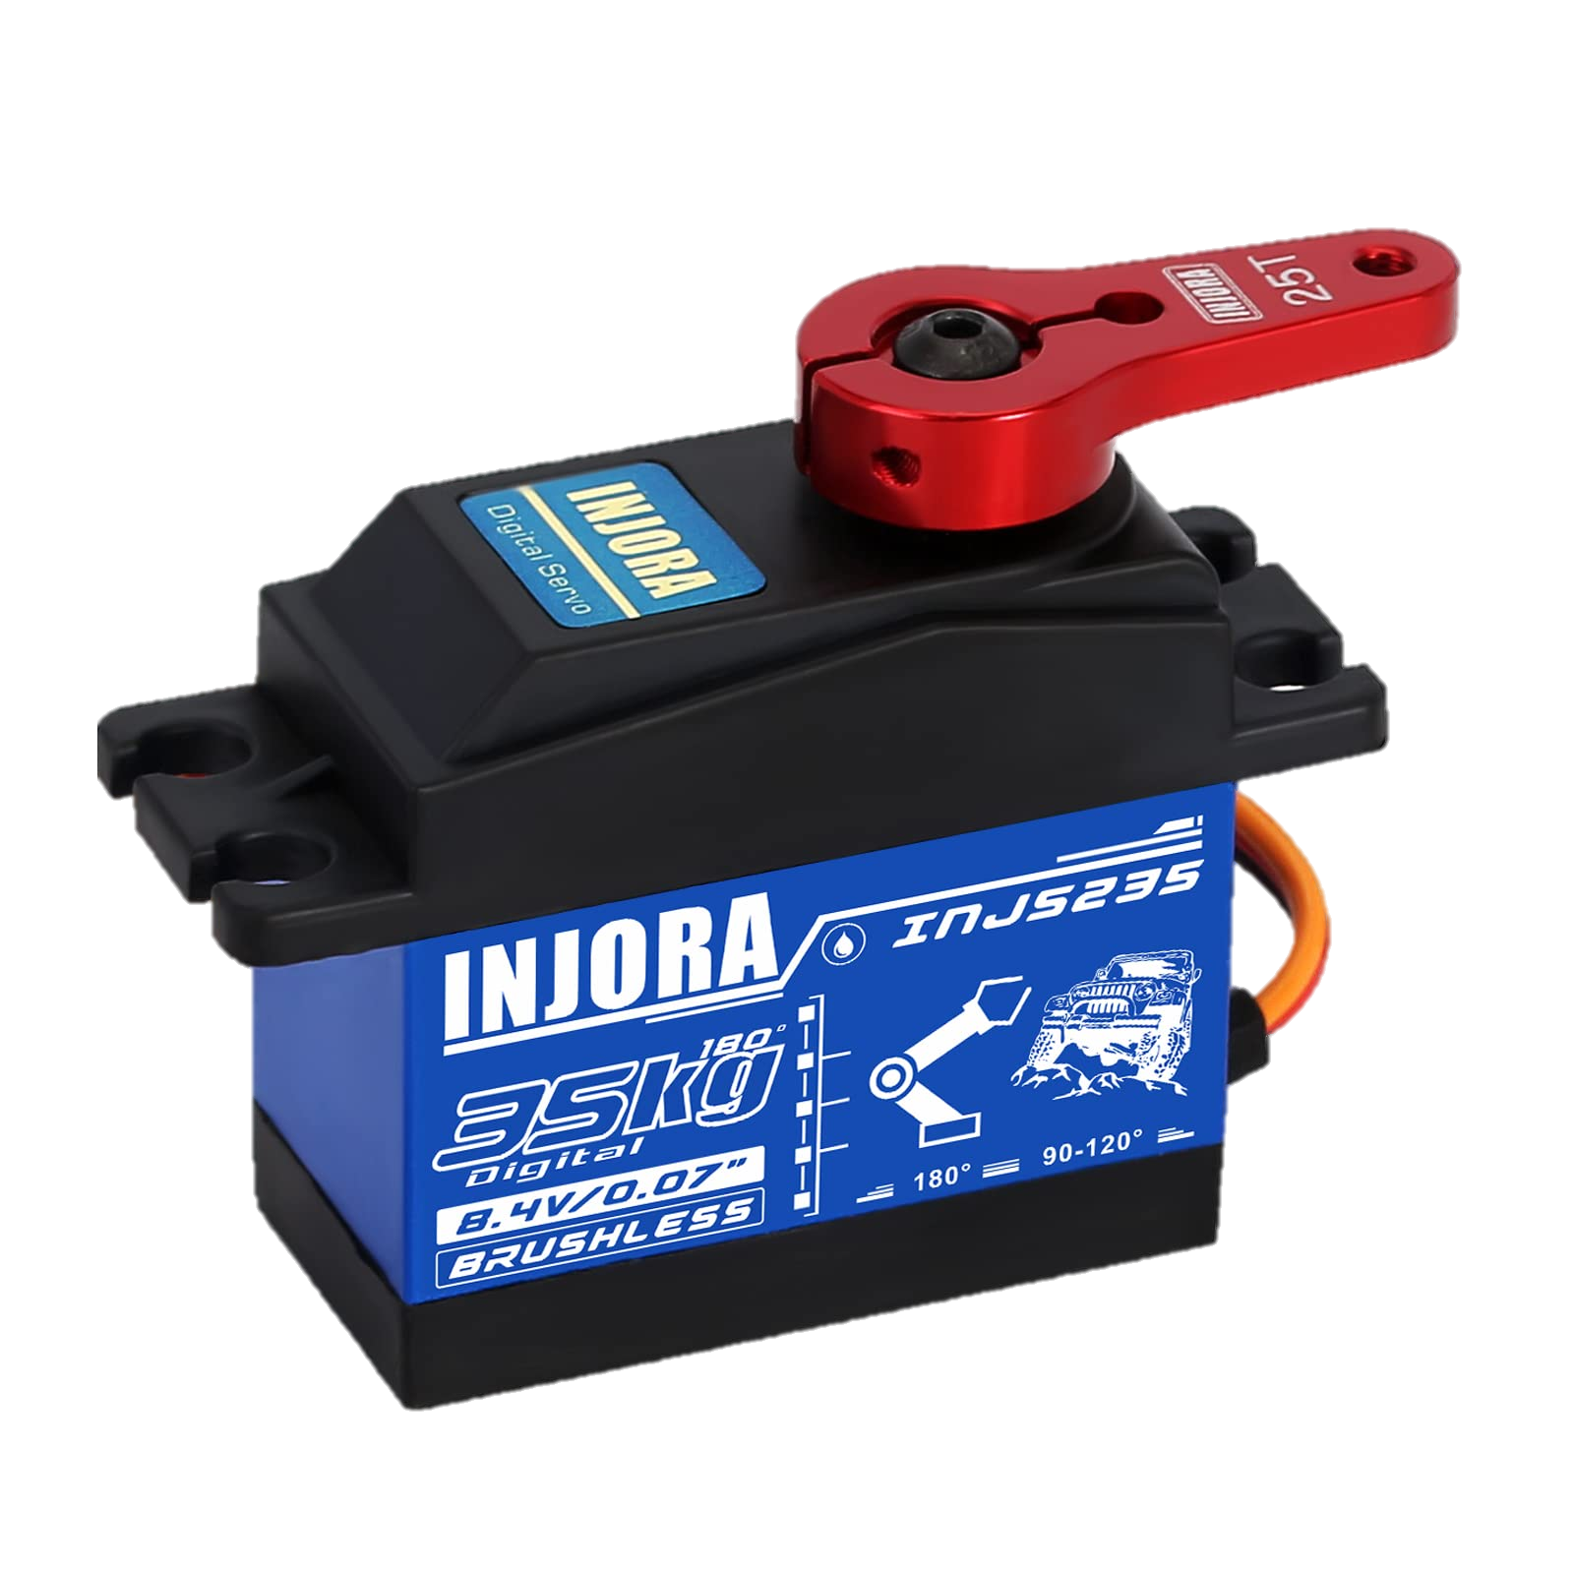
  SERVO COMPARISONS
Feature | INJORA | MEUS | M8 Brushless Servo
Input Voltage | 4.8 V – 8.4 V | 4.8 V – 8.4 V | 4.8 V – 8.4 V
Torque | 35 kg cm | 12.5 kg cm | 8.5 kg cm
Size | 63 mm x 38 mm x 54 mm | 23 mm x 12 mm x 27 mm | 28.5 mm x 13.4 mm x 29.0 mm
Weight | 85 g | 22.1 g | 28.6 g
Cost | $35.00 | $61.00 | $60.00
Waterproof Rating | Yes (IP67 rated) | Partial | Partial

Slide 19
1.8 V Regulator
Alex
Callum
Wired
Nathan
Power
Microwave Sensor Modules
Jake
LCD
ESP32
Laser
ESP32
ESP32
5.0 V Regulator
Pan and Tilt Unit
Buzzer
Humidity Sensor
Temperature Sensor
Nvidia Orin Nano
Camera
3.3 V Regulator
19.0 V Regulator
Notes:
The hardware block diagram outlines the responsibilities for each team member and shows how the power is distributed to each component and how each of the devices and peripherals interact with one another. The LCD, pan-tilt motors, humidity sensor, and temperature sensor are powered by the 5 V regulator. The laser, buzzer, camera, and ESP32 are powered by the 3.3 V regulator. The microwave sensor modules operate from the 1.8 V regulator, while the single-board computer (SBC) is powered by the 19 V regulator. Knowing how each of the components communicates is also important. The temperature and humidity sensor communicates with the ESP32 using I²C. The microwave sensors and LCD communicate over SPI. The motors are controlled using PWM signals. The SBC and microcontroller exchange data through UART. The laser and buzzer are controlled through simple GPIO outputs.

Slide 20
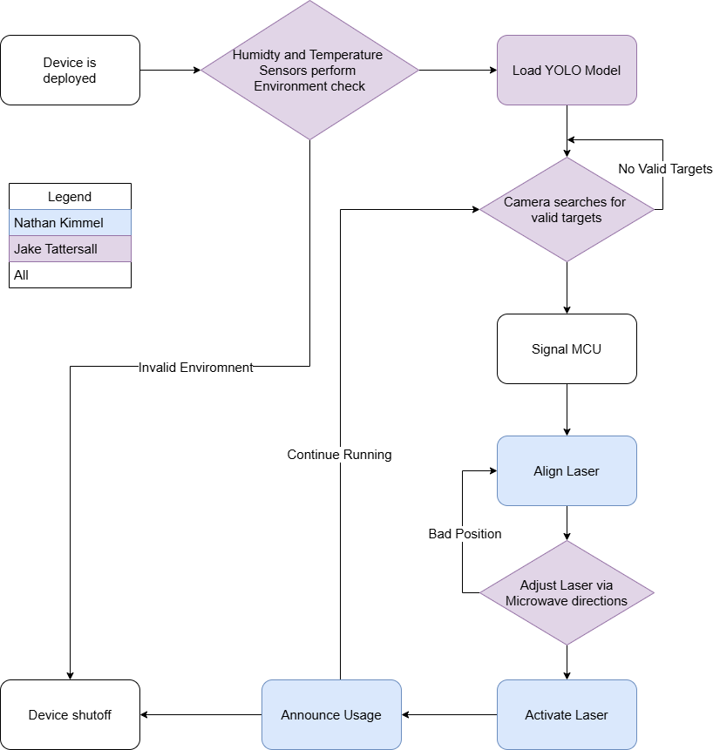
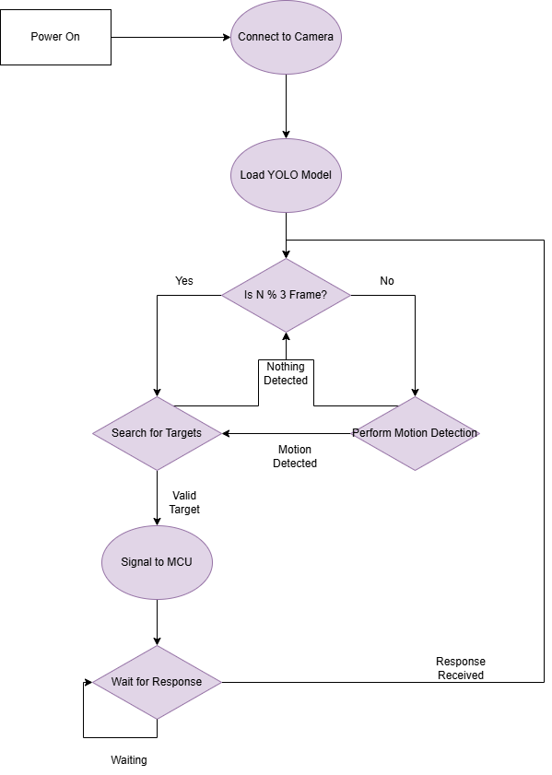
  Software Flowcharts
Notes:
These are the General and SBC Software Flowchart diagrams. To go into more detail on the General Flowchart on the Left, the device will start being turned on. After performing a handshake between the SBC and the MCU, we will first check to see if the Humidity and Temperature are at valid measurements to ensure that the Microwave modules or other modules are not damaged, as the Microwave modules in particular do have moderate ranges. After we are OK to run, the YOLO model will be used by the SBC to search for valid targets. Once we have a target and its projected trajectory, the angle and direction will be transmitted to the MCU, which will then use this information in tandem with the Microwave modules to identify and track the targets. Once the laser is aligned, the laser will be activated, simulating our target being neutralized, and a buzzer will announce that a quote-on-quote threat has been detected and handled. The device may repeat this loop as we see fit.
On the right is the SBC flowchart. To go into more detail on this, we will use OpenCV to connect to the camera and then load the YOLO model. So that the device is not continuously detecting frames which are unchanging, a gating method will be implemented to first check if some motion is occurring, but we will check intermittent frames regardless in case the motion is minor. Once we have detected a target, we will signal the MCU with the previously mentioned information and wait for a response from the MCU before continuing to run.

Slide 21
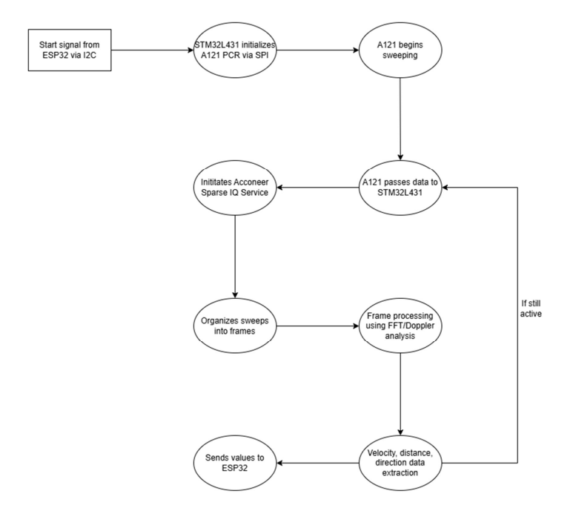
Radar Software Flowchart

Slide 22
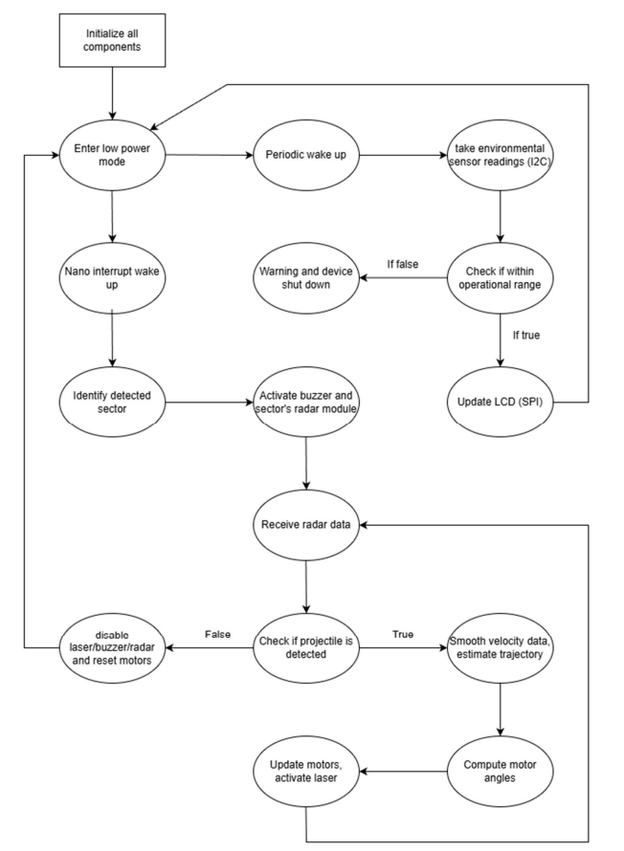
ESP32 Software Flowchart

Slide 23
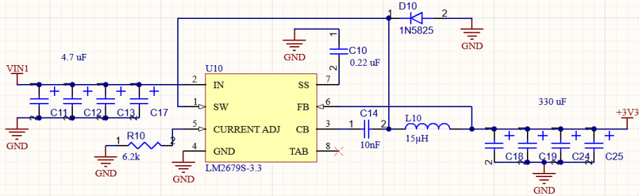
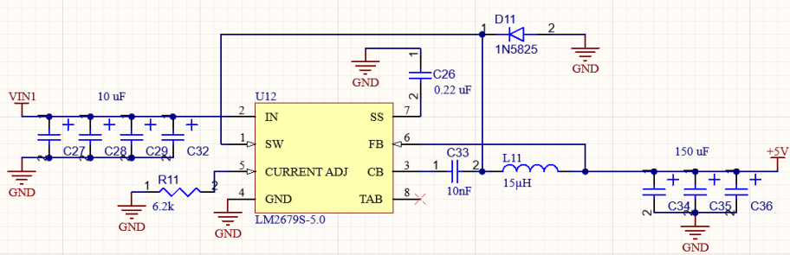
REGULATOR SCHEMATICS
3.3V Regulator:
Switching regulator at frequency of 256kHz
92% efficiency
5A output current
Supplies microcontroller, buzzer, and humidity sensor
3.3 V Regulator
5.0V Regulator:
Switching regulator at frequency of 256kHz
92% efficiency
5A output current
Supplies both pan and tilt servos, LCD, and laser
5.0 V Regulator
Notes:
These four regulators provide power to the entire P.U.T.T.I. system. The 3.3 V, 5.0 V, and 19.0 V supplies use buck converter, while the 1.8 V supply uses an LDO since it powers only a few components that have a low current requirement.

Slide 24
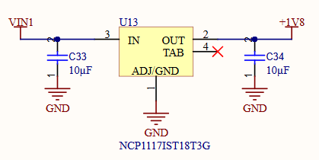
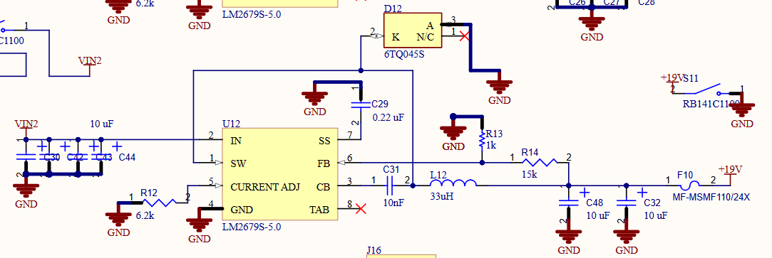
REGULATOR SCHEMATICS
1.8V Regulator:
Low-Dropout regulator
1A output current
Supplies three microwave sensor modules
1.8 V Regulator
19V Regulator:
Switching regulator at frequency of 256kHz
92% efficiency
5A output current
Individual switch to turn on/off
Supplies single-board computer
19.0 V Regulator
Notes:
These four regulators provide power to the entire P.U.T.T.I. system. The 3.3 V, 5.0 V, and 19.0 V supplies use buck converter, while the 1.8 V supply uses an LDO since it powers only a few components that have a low current requirement.

Slide 25
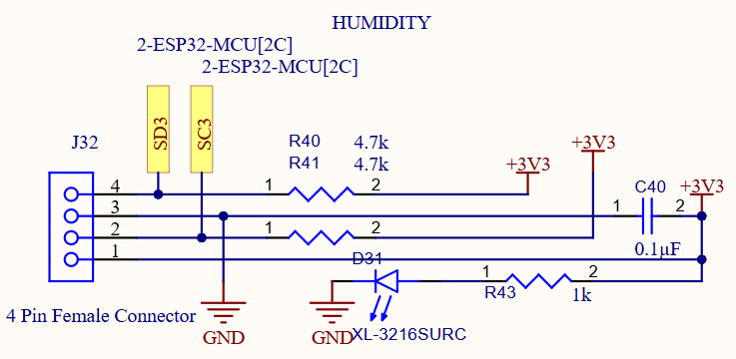
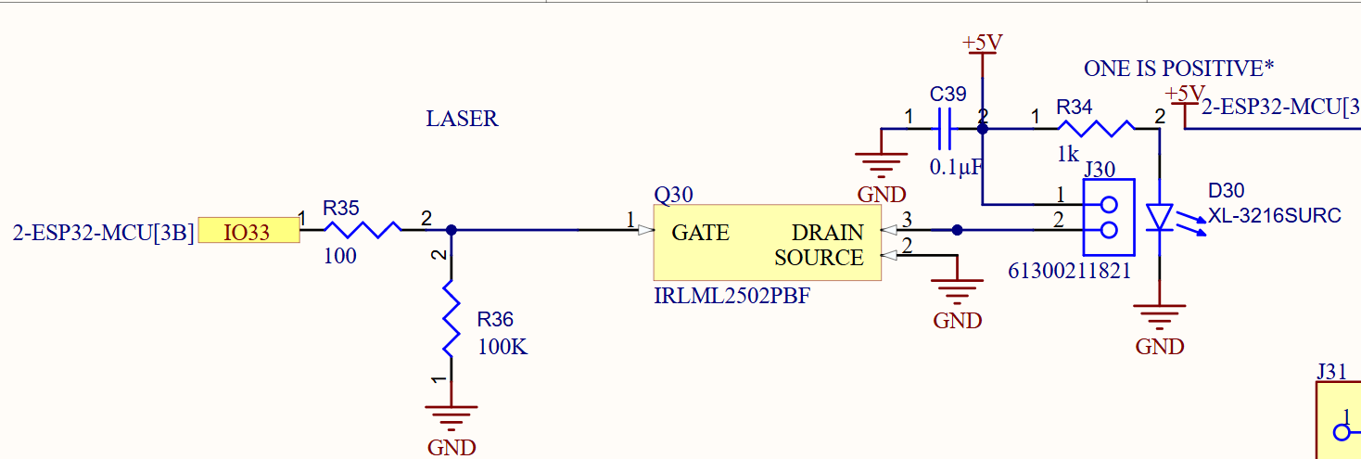
PERIPHERAL SCHEMATICS
Humidity/Temperature Sensor:
4.7kΩ pull up resistors
Measures temperature in Celsius but will be converted to Fahrenheit
Measured relative humidity from 0-99%
Laser:
Class IIIa laser
5mW power
650nm wavelength
Use of MOSFET to increase efficiency and reduce heat, also allows for pulse width modulation for higher powered lasers to control power
Notes:
These are some of the peripheral schematics, in the top left we have the humidity sensor, next to that is the buzzer which is controlled by an NPN BJT which amplifies the current from the microcontrollers GPIO pin, in the bottom left is the laser diode schematic which utilizes an N-channel MOSFET, and in the bottom right we have the temperature sensor which uses a 10 kΩ NTC thermistor and a voltage divider connected to an ADC channel of the microcontroller to determine the temperature.

Slide 26
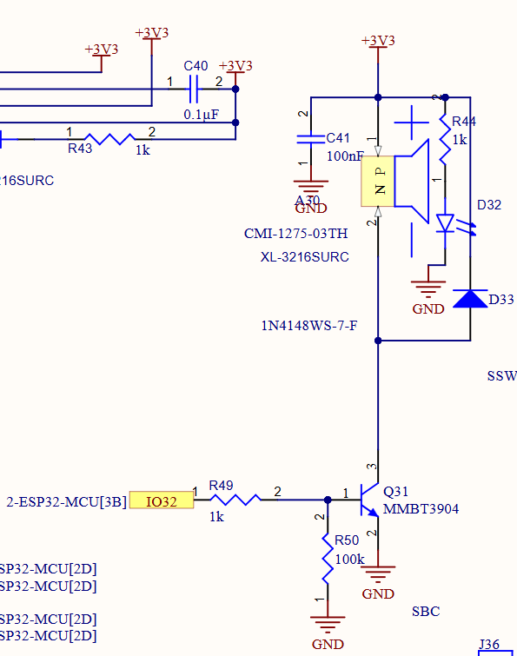
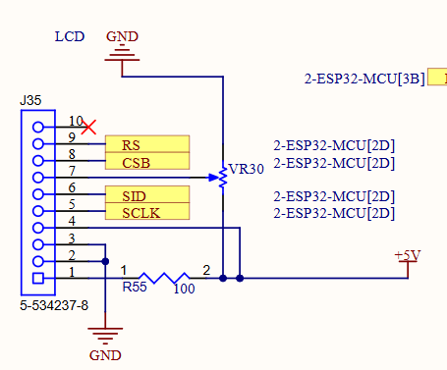
PERIPHERAL SCHEMATICS
Buzzer:
Magnetic buzzer
85dB @ 10cm
Flyback diode to prevent voltage spiking from damaging the transistor
LCD:
    Level shifter connects between 5V and backlight pin to drop 5V down to 3.3V
Notes:
These are some of the peripheral schematics, in the top left we have the humidity sensor, next to that is the buzzer which is controlled by an NPN BJT which amplifies the current from the microcontrollers GPIO pin, in the bottom left is the laser diode schematic which utilizes an N-channel MOSFET, and in the bottom right we have the temperature sensor which uses a 10 kΩ NTC thermistor and a voltage divider connected to an ADC channel of the microcontroller to determine the temperature.

Slide 27
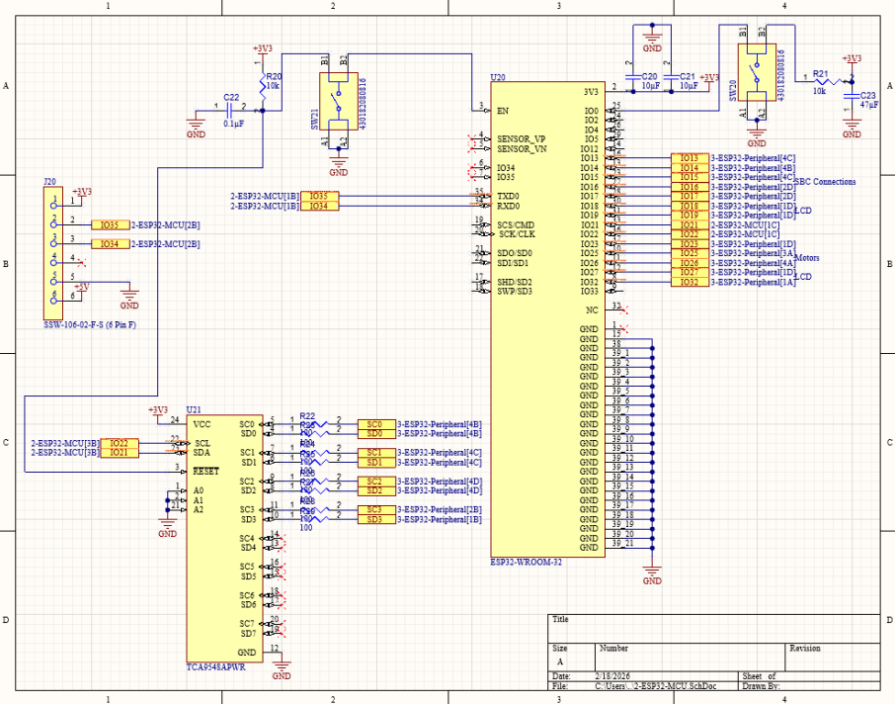
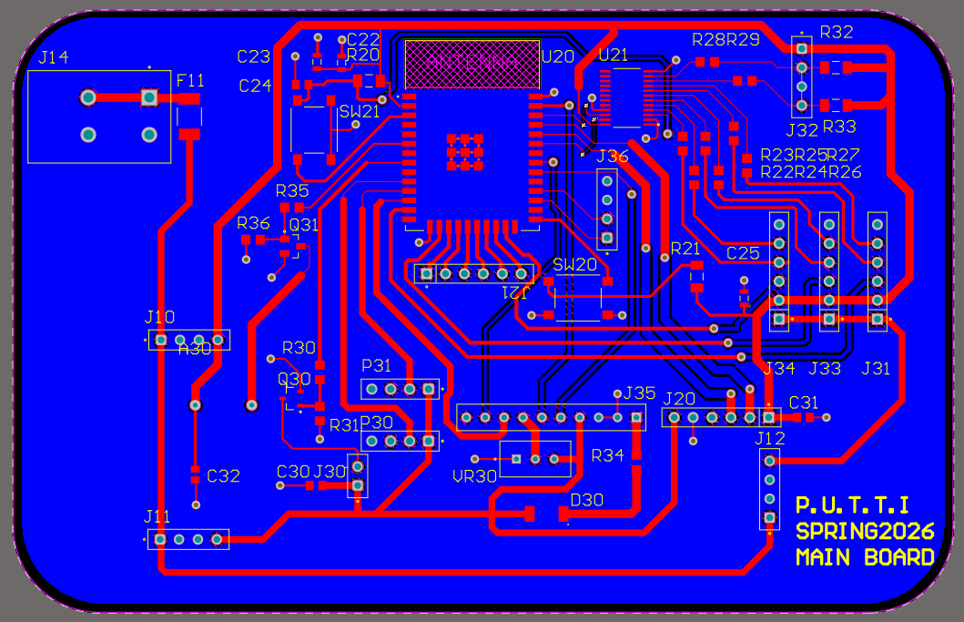
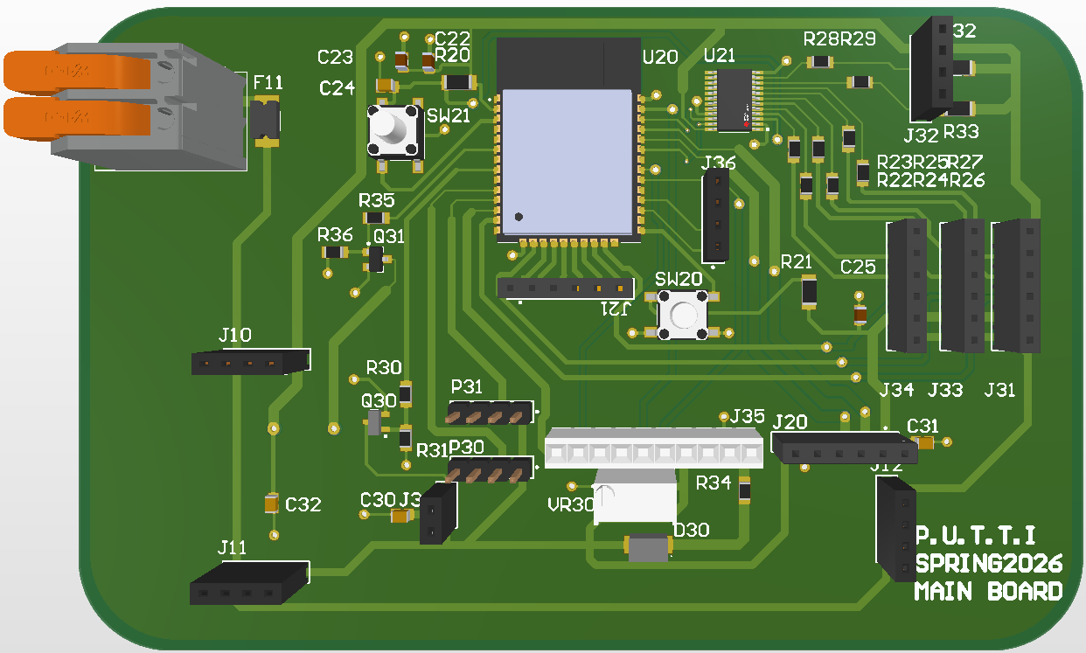
MAIN PCB Design

Slide 28
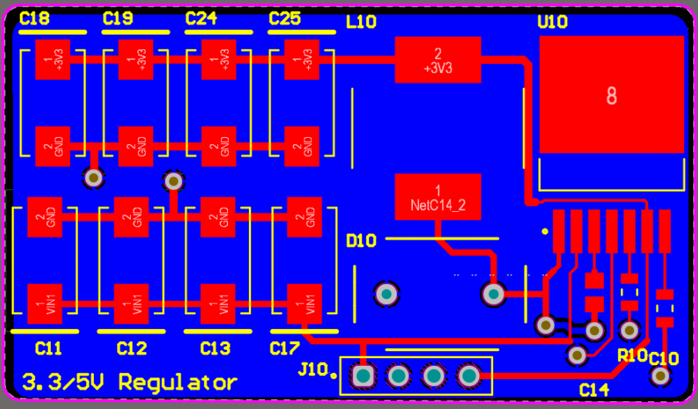
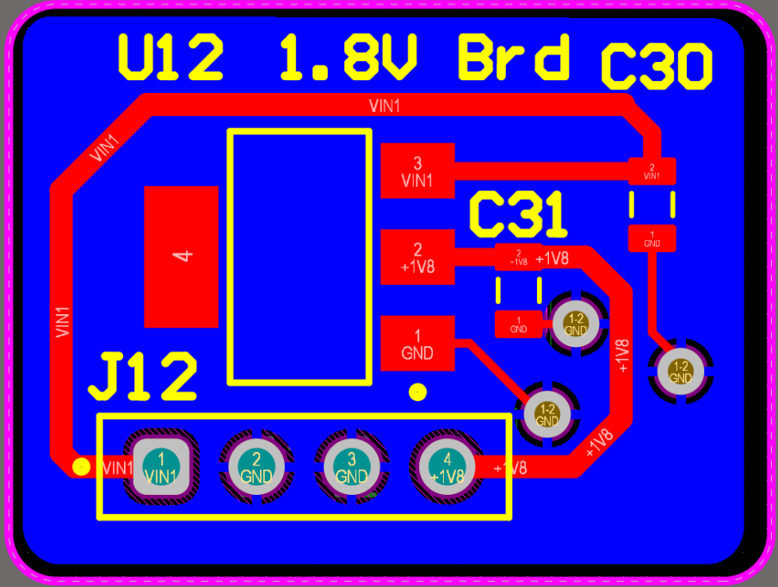
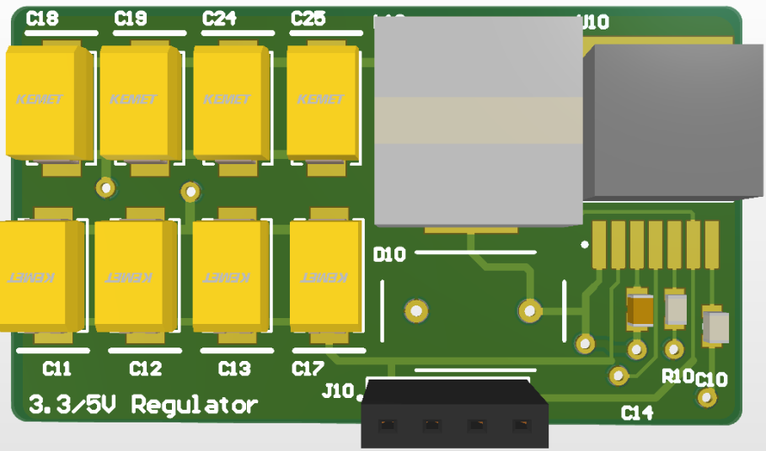
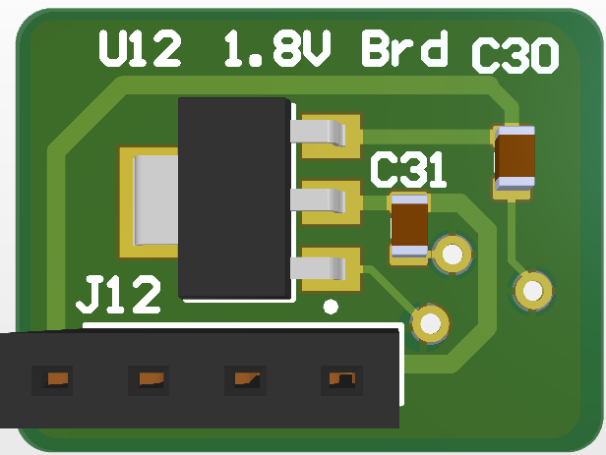
REGULATOR PCB Design

Slide 29
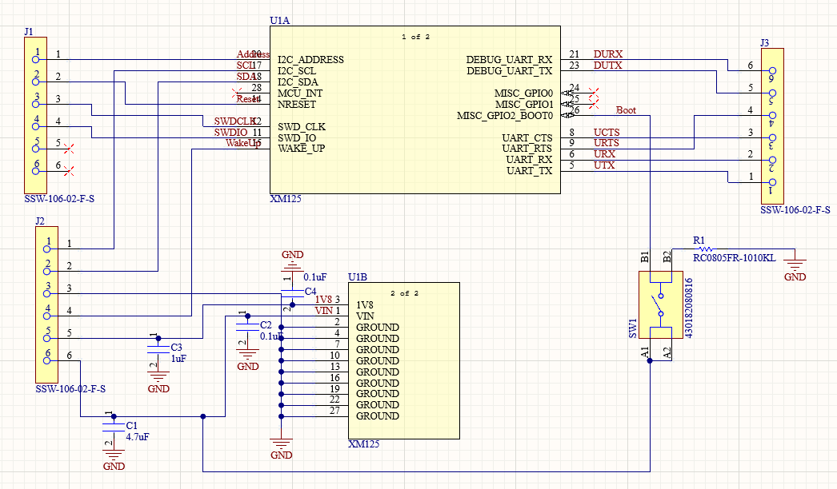
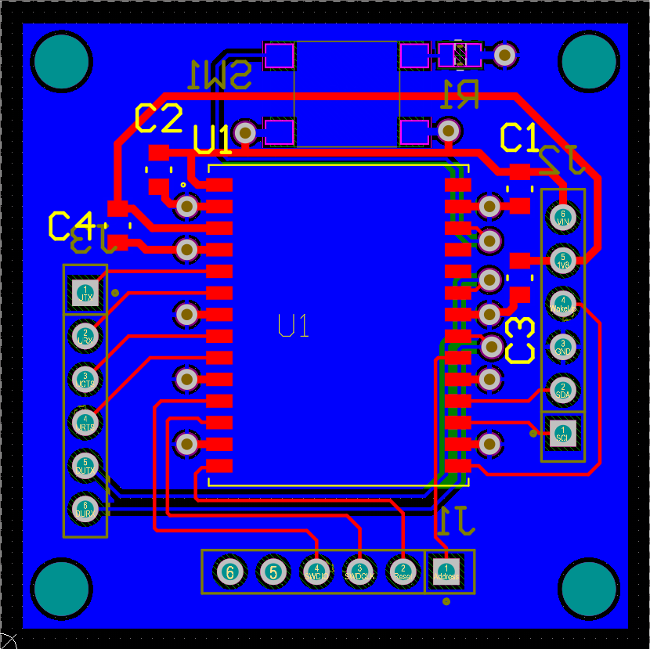
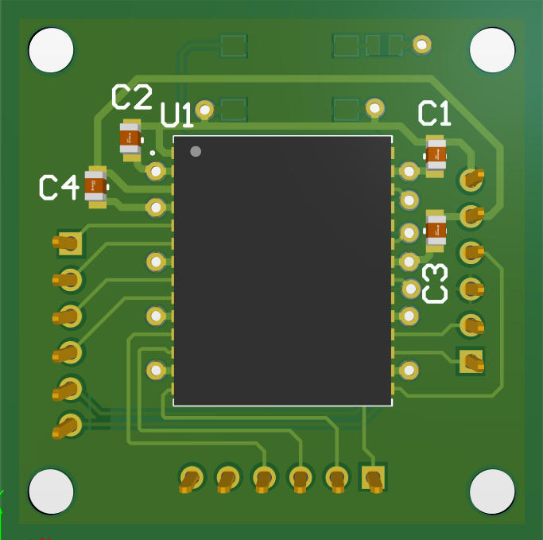
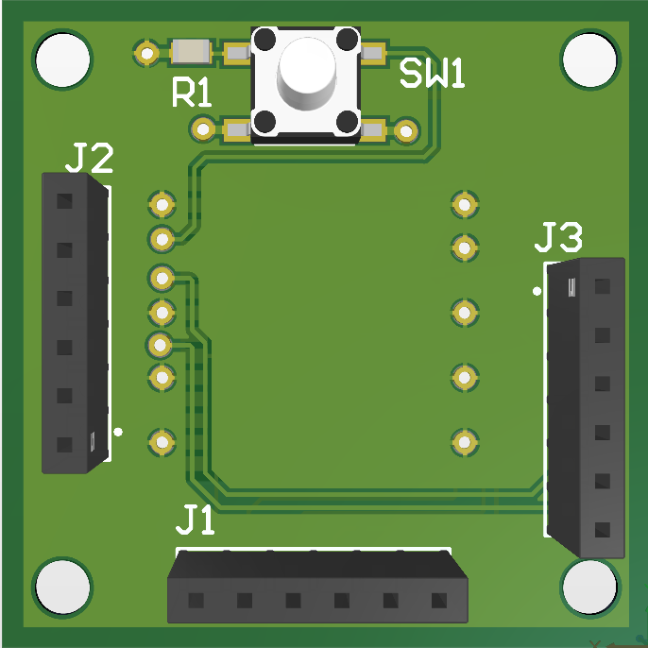
Radar Schematics/PCB

Slide 30
  BUDGET
Item | Unit Cost | Quantity | Total Cost
Nvidia Orin Nano Super | $ 249.99 | 1 | $ 249.99
ELP OV2710 | $ 20.99 | 1 | $ 42.99
1054 Laser Diode | $ 5.95 | 1 | $ 5.95
B57540G1103F000 Thermistor | $ 2.76 | 1 | $ 2.76
3721 Humidity Sensor | $ 3.95 | 1 | $ 3.95
XM125 Radar Sensor Module | $ 21.21 | 3 | $ 63.63
LCD | $ 11.21 | 1 | $ 11.21
Microcontroller | $ 5.33 | 3 | $ 15.99
Buck Regulator | $ 1.55 | 10 | $ 15.45
Brushless Servo | $ 33.99 | 2 | $ 67.98
Buzzer | $ 1.10 | 1 | $ 1.10
PCBs | $ 29.22 | 1 | $ 29.22
Total |  |  | $ 510.22

Slide 31
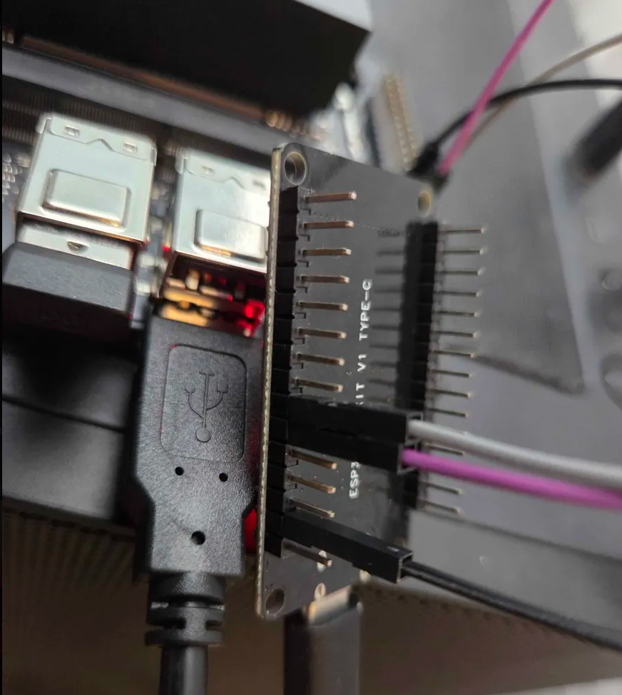
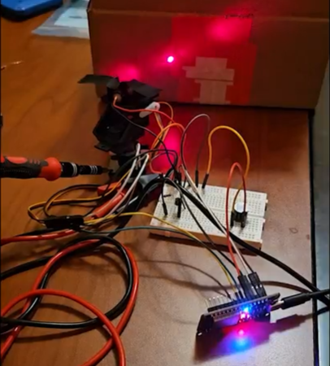
  PROTOTYPING & TESTING
  Completed Testing
  YOLO vision model testing
  SBC to ESP32 via UART
  Laser + motor + ESP32 breadboarding
  Humidity sensor validation
  Basic UART, SPI, and I2C communication using ESP32
  Upcoming Testing
  Radar module validation and integration
  Range
  Efficiency through acrylic
  FOV and coordinate mapping
  I2C multiplexing
  Full integration of all systems
    Combining camera, radar, peripheral systems

Slide 32
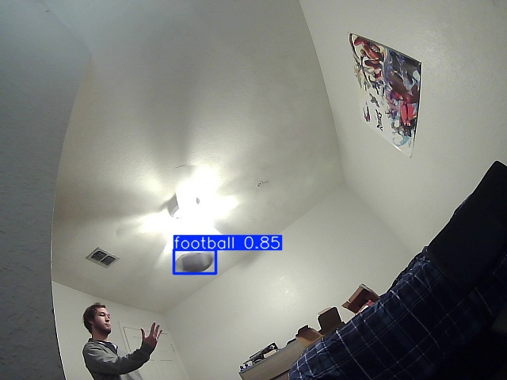
  SBC + YOLO Testing
  Dataset
  Dataset of ~3800 positive images obtained in varied environments
  Model trained on these positive images and ~2000 negative images
  Resulted in a high percentage of true positives and a low amount of false positives during initial testing.
  Further detailed testing required.
  Orin Nano
  Using a Docker container to automate deployment
Docker container able to access all necessary components
  Able to maintain ~20-30 frames per second
Notes:
In order to test the YOLO model, a dataset was manually collected and labeled. The dataset contained approximately 3800 positive images containing a football and approximately 2800 negative images containing no football to show what should not be detected. The resulting YOLOv8 model trained on these images resulted in a highly-accurate model with little to no false positives, but more testing must be done. The Orin Nano will use Docker Compose to automate deployment, and we have tested that the container can access all necessary components like the camera and GPIO and UART. When running the model, the fps maintained between 20 and 30, which is ideal for our project.

Slide 33
  FUTURE PLANS
Hardware Optimization
Any final PCB revisions
Software Optimization
Detection filtering
Stretch Goals
Optimization under non-ideal conditions
Refining power regulation
Radar testing
Finalizing 3D printed chassis
Merging sensors
Targeting multiple projectiles
Wireless connectivity to ESP32

Slide 34
  REFERENCES

