Slide 1
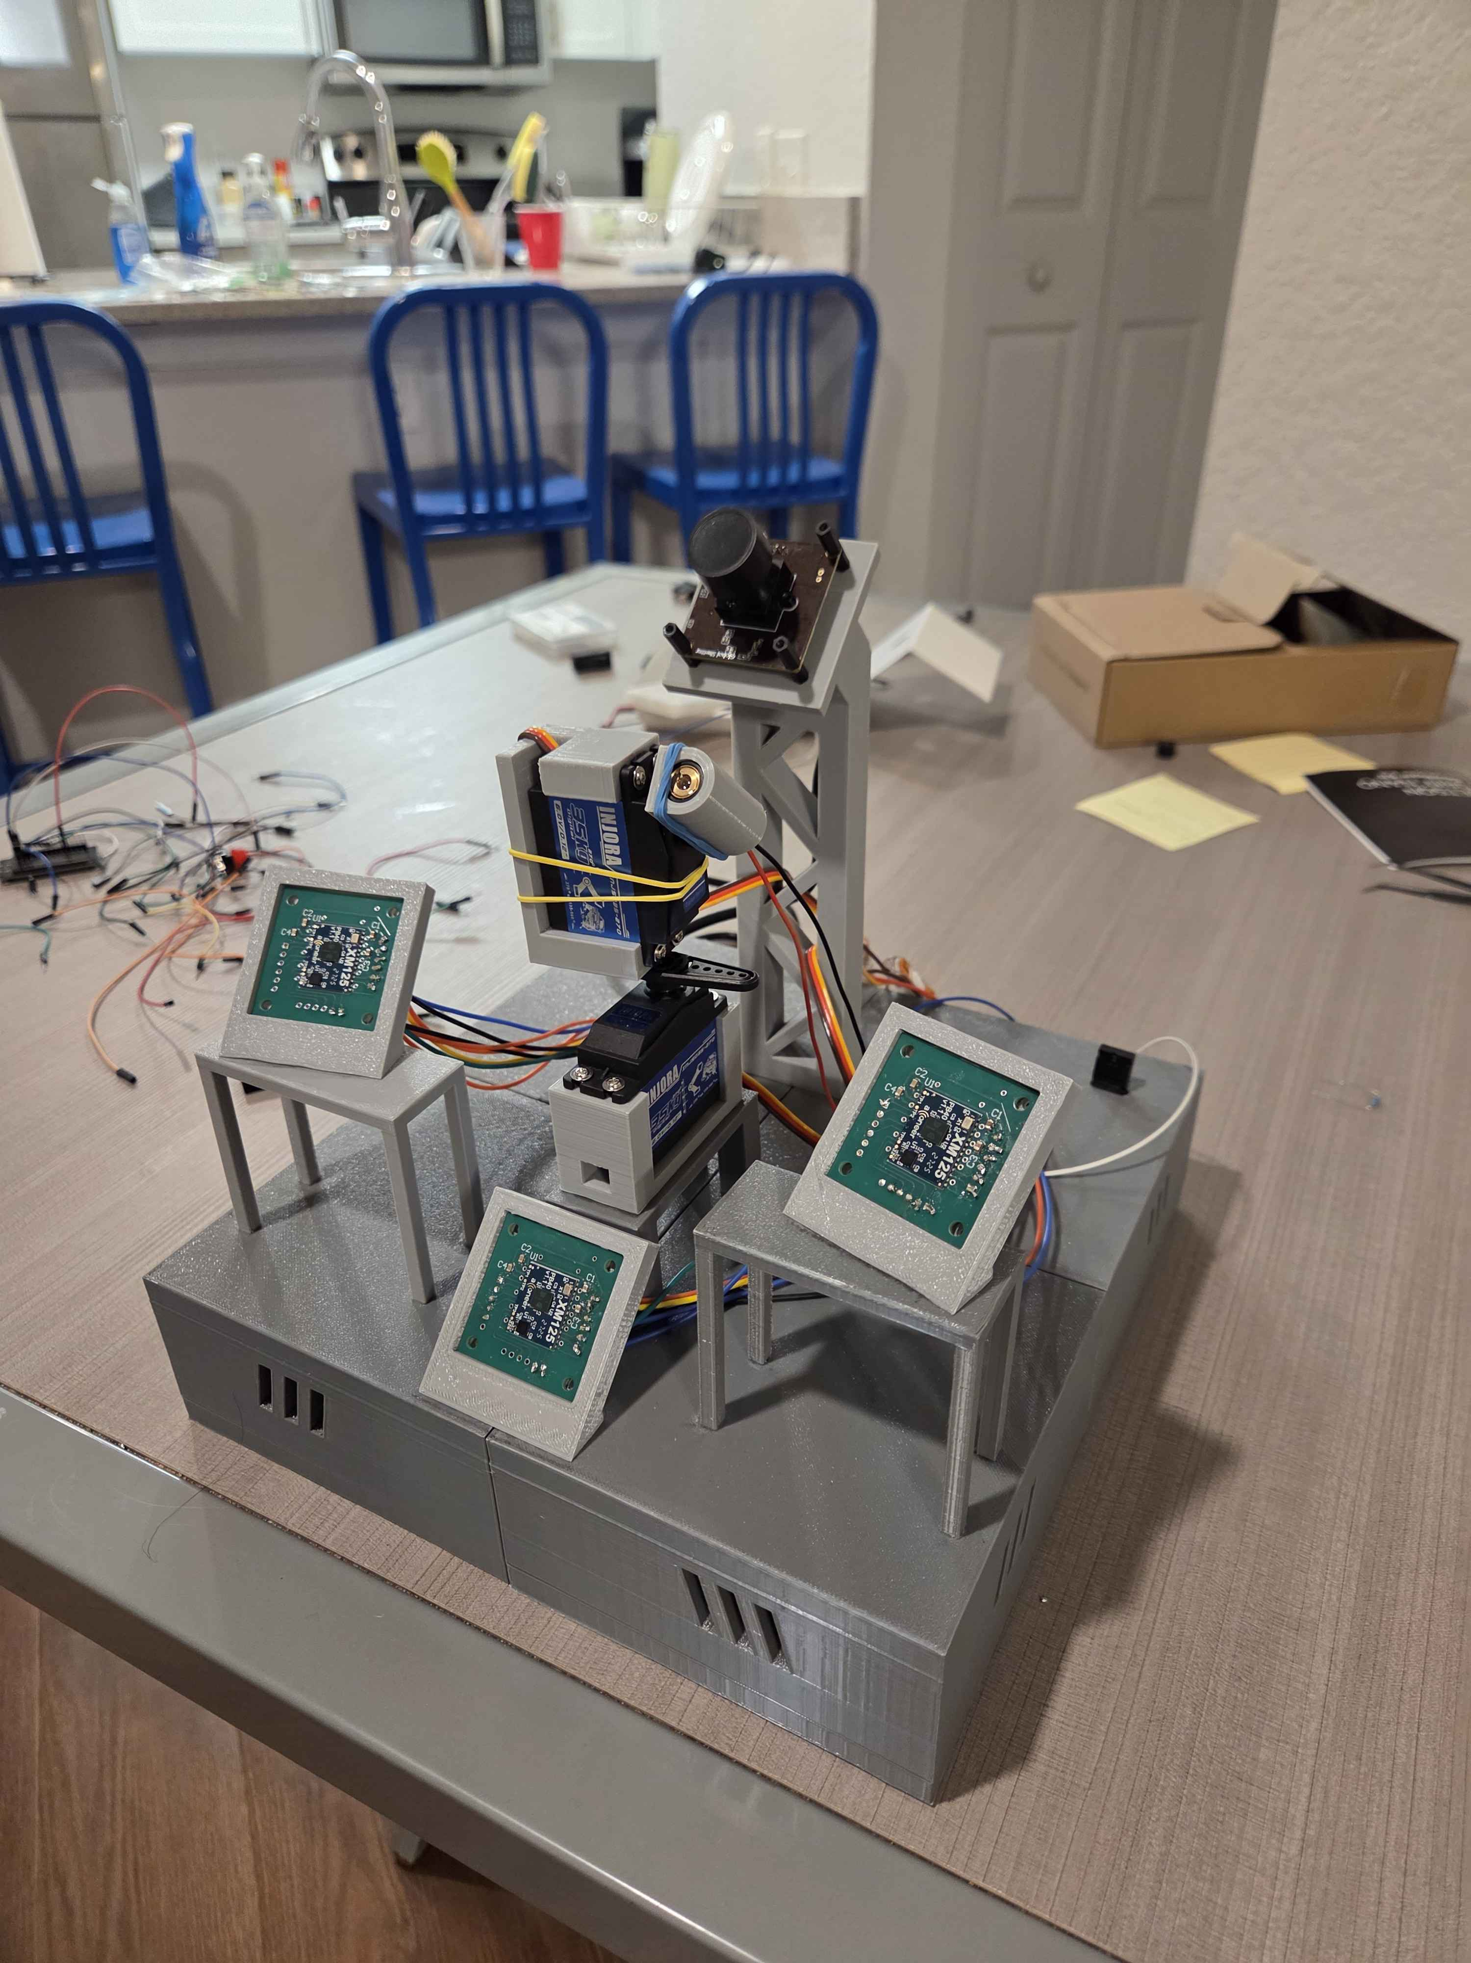


Portable Unitary Throwable Target Interceptor (P.U.T.T.I)
Group 18

Slide 2



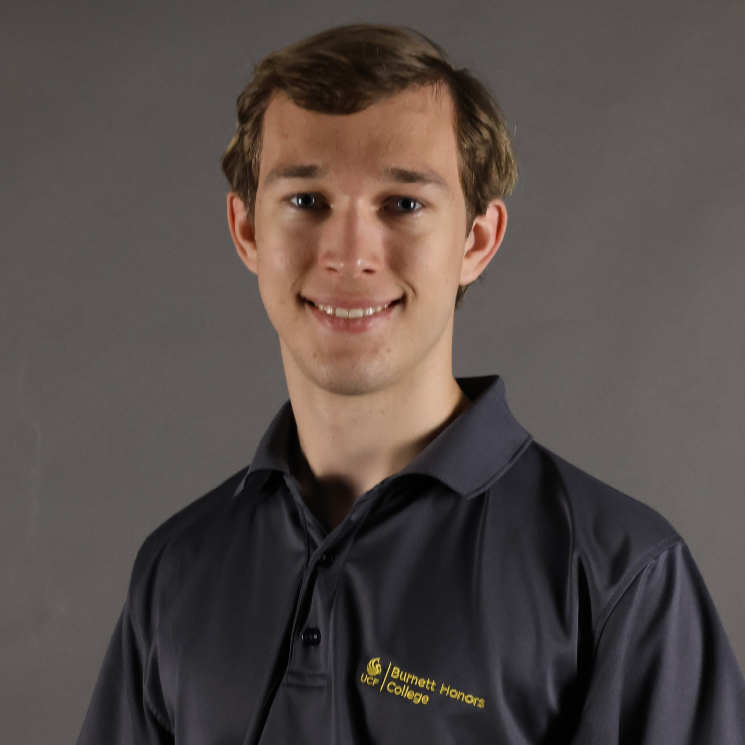
  OUR TEAM
Alex
Evison
Electrical Engineering
Callum
Fuller
Electrical Engineering
Nathan Kimmel
Electrical Engineering
Jake Tattersall
Computer Engineering

Slide 3
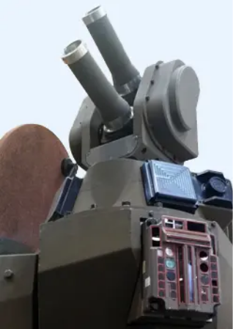
  BACKGROUND & MOTIVATIONS
Humans have always developed technology for protection against threats
Modern warfare increasingly uses small drones, UAVs, and other projectiles
Threats impact both military personnel and civilians
Traditional defenses (missiles + firearms) are costly, complex, or impractical
Existing active defense systems are effective but large/inaccessible
Need for smaller, faster, and more adaptable solutions
Iron Fist Active Protection System
Image from https://www.gdots.com/protection-systems/active-protection-systems/iron-fist-active-protection-system/

Slide 4
  BASIC GOALS & OBJECTIVES
Goal: Create a compact defense system capable of detecting and targeting stationary targets
Objective: Use cameras and microwave sensors in combination to detect targets in the field of vision
Goal: Allow the device to be quickly deployed and moved
Objective: Use 3D printing to create a shell for the components of the device to be placed in
Goal: Cover a significant target space in near-ideal room conditions
Objective: Use a camera that covers at least 120 degrees horizontal field of vision and at least 60 degrees vertical field of vision
Objective: Buzzer notifies user of successful targeting
Objective: Use a Single-board computer to control the camera and communicate with the microcontroller to move the motors and lasers

Slide 5
  ADVANCED/STRETCH GOALS & OBJECTIVES
Advanced Goal: Target and track low-velocity projectiles with predictable trajectories
Objective: Use the Single-board computer and microwave sensors to detect faster moving targets with a latency of less than 100 ms
Stretch Goal: Make the device fully weather resistant to harsh conditions, including sandstorms, rain, and snow
Objective: Use aluminum to create the shell of the device for increased durability whilst staying low weight
Stretch Goal: Allow the device to attach to different faces such as walls and ceilings
Objective: Add suction cups to the base of the device whilst still allowing for the device to be deployed in less than one minute
Stretch Goal: Be able to detect and disable a small drone, and detect humans to avoid accidental friendly-fire
Objective: Use a small projectile powered by pressurized gas to hit the projectile

Slide 6
  ENGINEERING SPECIFICATIONS
Overall System Specifications
Parameter | Description | Target Values
Detection Latency | Time from projectile entering field of view to detection. | ≤ 100 ms
Targeting Response Time | End-to-end delay from detection to targeting. | ≤ 500 ms
Range | Maximum distance at which projectiles can be detected and tracked. | 1 ft -> 5+ ft
Field of View | Angular coverage. | ≥ 120° H × 60° V
Targeting Success Rate | Probability of successfully detecting and targeting projectiles. | ≥ 80%
Target Size | Approximate size of targets to be detected. | 6 in -> 12+ in
Operational Lifespan | Minimum continuous operation time. | ≥ 1 Hour
Weight | Total system weight. | 2 – 5 kg
Device Dimensions | Overall size of device. | ≤ 0.5 m × 0.5 m × 0.5 m
Component Specifications
Components | Parameters | Target Values
Laser Module | Wavelength Output Power | 630 nm – 680 nm ≤ 5 mW
Motors | Angular speed Resolution | ≥ 150°/s ≤ 1°
Camera | Max Frame Rate | ≥ 30 fps
Microwave Sensor | Detection Range | ≥ 5 m
Microcontroller | Communication | UART/I2C Interface
Notes:
Should redo this slide.
Also somewhere in here, mention our green playground balls as our targets and why we chose them (allows us to train a concept of a green ball rather than specific colors or shapes. Can use different models and sized balls)

Slide 7
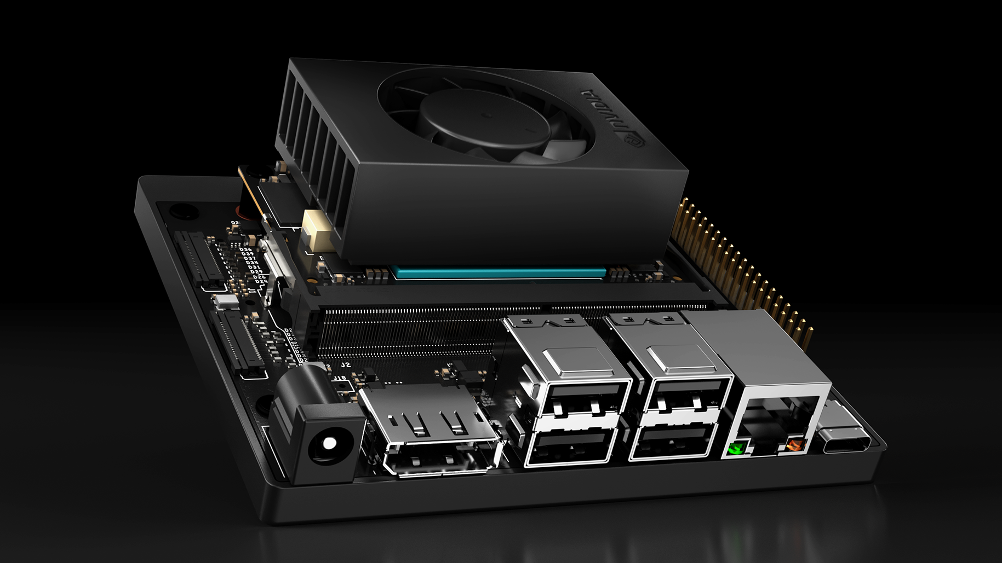
  SINGLE BOARD COMPUTER COMPARISON
Feature | Raspberry Pi | Coral Dev Board | Nvidia Orin Nano DevKit | Firefly ROC-RK3588S
# GPIO | 40 | 40 | 40 | 20
Bluetooth | Bluetooth 5.0 | Bluetooth 4.2 | No | Bluetooth 4.2
Clock Speed (GHz) | 1.8 | 1.5 | 1.7 | 2.4
CSI | 1xMIPI CSI-2 | 1xMIPI CSI-2 | 2xMIPI CSI-2 | 2xMIPI CSI-2
GPU | Broadcom VideoCore VI | GC7000 Lite | Ampere | Mali-G610
Operating System | Linux | Mendel/Linux | Linux | Linux
Power Consumption (W) | ~7 | ~2 | ~7-25 | ~7
Price | ~$60 | ~$130 | ~$250 | ~$200
Processor | Quad-core ARM Cortex-A72 | Quad-core Cortex A-53 | 6-core Arm Cortex-A78AE | Quad-core ARM Mali-G610
Size (mm) | 85.6 x 56.5 | 56 x 85 | 103 x 90.5 x 34.77 | 90 x 60
USB | 2 x USB 2.0, 2 x USB 3.0 | 1 x USB 3.0, 1x USB Type C, 1x USB 2.0 | 1 x USB 3.2, 1 x USB Type C | 1 x USB 3.0, 2 x USB 2.0, 1 x USB Type C
Weight (g) | ~70 | ~50 | ~176 | ~50
Wi-Fi | Dual-band 802.11ac | Dual-band 802.11 ac | GbE Connector | Dual-band 2.4 / 5 GHz
The Nvidia Orin Nano development kit.
https://www.nvidia.com/en-us/autonomous-machines/embedded-systems/jetson-orin/nano-super-developer-kit/
A single board computer was needed to perform computer vision, as the MCU was not strong enough.
The Orin Nano provided sufficient processing power to run the desired computer vision model.
It also featured ports to allow communication to the other components, like MCU and camera.
Notes:
In addition to having an MCU, the project required a single-board computer capable of performing real-time image processing. Initially, ideas like the Raspberry Pi came into mind; however, the choice of the SBC would be determined by the image processing method. If the method chosen was resource demanding or would benefit from a GPU, then a more powerful board would be needed. In the end, a computationally heavy method was required, so the Nvidia Jetson Orin Nano was selected. The Orin Nano was advertised to perform well with computer vision models, and could allow us to select a more accurate computer vision model thanks to its GPU.

Slide 8
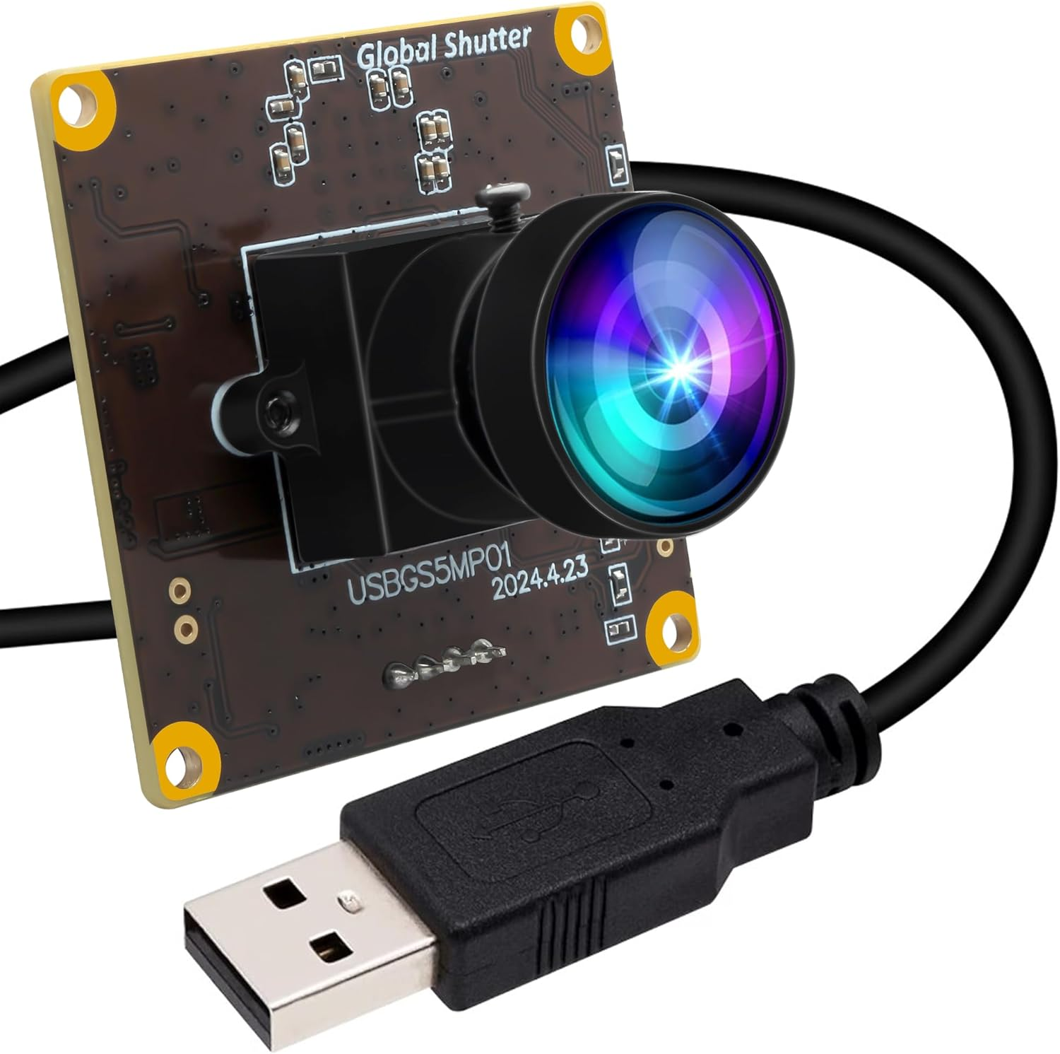
  CAMERA COMPARISON
Feature | IFWATER AR0144 | ELP OV2710 | Arducam 222 | Arducam 175 | Coolwell 160 | ELP OG05B10
FOV (degrees) | 170 | 170 | 222 | 175 | 160 | 170
FPS @ Max Quality | 20 | 30 | 21 | 21 | 21 | 50
Size (mm x mm) | 38 x 38 | 38 x 38 | 25 x 24 | 25 x 24 | 25 x 24 | 38 x 38
Price | $49 | $43 | $26 | $36 | $21 | $163
Connection | USB | USB | CSI | CSI | CSI | USB
The ELP OG05B10 camera.
Image from https://www.elpcctv.com/elp-5mp-50fps-1080p-60fps-global-shutter-usb-camera-module-with-155-degree-fisheye-lens-p-578.html
A camera was needed to perform initial target detection.
The ELP OG05B10 camera was more expensive, but allowed for more robust implementation.
It had a higher resolution, faster runtime, and featured a global shutter.
USB was chosen over CSI due to potential problems with CSI listed on Nvidia forums.
Notes:
The camera is the method of which the SBC will capture images to do image processing. The camera should have a wide field of vision and be capable of hitting high frames per second. With the Orin Nano having both USB and CSI camera slots, a decision was first made between these two options. CSI is a popular interface for embedded cameras and imaging, and has the capabilities of outperforming a USB camera while using a much smaller ribbon cable compared to a longer USB cable. While the CSI cameras were typically cheaper and could bring better quality, users on the Nvidia forums noted problems in getting the CSI cameras to function even though they were advertised as supported. The camera chosen was the ELP og 05 B 10. Although it was priced higher, it featured a global shutter, meaning reduced motion blur, which would significantly help with object detection at high speeds. It also had incredible resolution and frames per second.

Slide 9
  DETECTION FRAMEWORK COMPARISONS
Feature | OpenCV | YOLO | Single Shot MultiBox | Faster R-CNN
Stages | Depends | One | One | Two
Speed | Depends | Very Fast | Fast | Slow
Accuracy | Depends | Moderate / High | Moderate | High
Complexity | Low | Moderate | Moderate | High
Dataset? | No | Yes | Yes | Yes
Size | Small | Small / Moderate | Moderate | Large
YOLO is an acronym for “You Only Look Once”.
It performs a single pass over the image to search for objects, saving time at the expense of accuracy, but is still fairly accurate.
The model allowed for easy training of our targets and allowed for generalization of targets, rather than focusing on one specific brand and model.
The model will be custom trained on the designated targets.
OpenCV will still be used to perform undistortion and camera access, but will not be the primary solution.
Notes:
The detection framework for detecting our targets is a key part of this project, and heavily influenced the SBC selection. OpenCV will be used in the project to access the camera and perform other tasks, but will not be the primary detection framework. Instead, a YOLO model from Ultralytics will be used. The YOLO model is unique in that it performs only a single pass over the image to search for objects, so it will provide the real-time detection speeds necessary while providing a high level of accuracy. The YOLO model used will be custom trained using the camera chosen.

Slide 10
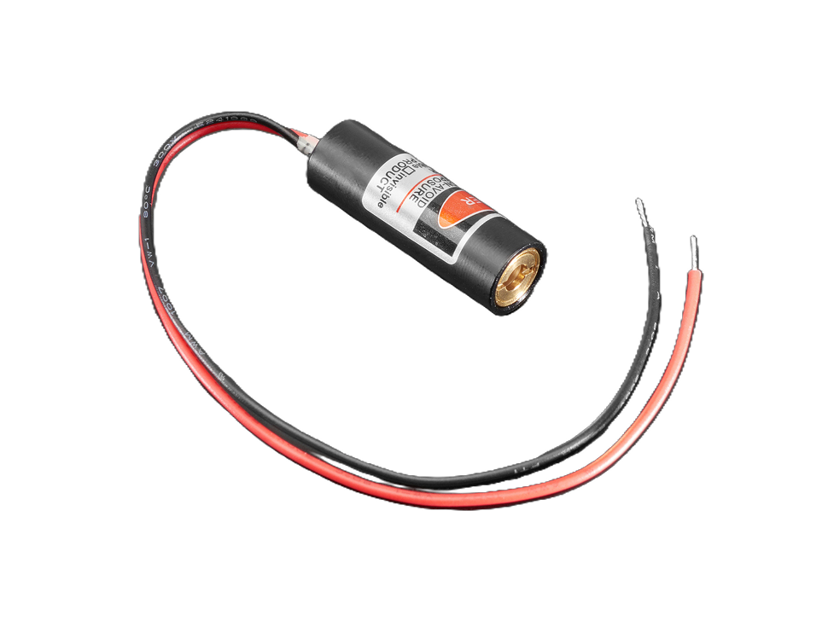
  LASER COMPARISON
Feature | 1054 | PLT5520DB_P | VLM-650-04 LPA | D405-120 | RLD85NZJ4-00A
Wavelength | 650nm | 515nm | 650nm | 405nm | 852nm
Input Voltage | 2.8V ~ 5.2V | 5.8V | 2.6V ~ 5V | 4.8V | 2.8V
Current Rating | 25mA | 60mA | 40mA | 150mA | 350mA
Power | 5mW | 10mW | 2.5mW | 120mW | 220mW
Package/Case | Cylinder (10mm Dia) | Radial, Can – 3 Lead | Cylinder (6.55mm Dia) | Radial, Can, 3 Lead (5.6mm TO-18) | Radial, Can – 3 Lead
The 1054 Adafruit laser diode.​
Image from https://www.adafruit.com/product/1054?srsltid=AfmBOoqdZixF-iaNudxsp96Os8HxnMQi4XzH7fClixH9s0kGtS2qTxsb
Needs to be low power for safety concerns and be in red wavelength
The 1054 laser diode was a cheap, low power choice
It had a wavelength of 650nm so produced a red light
5mW power means the laser is a Class IIIa laser so is safe to run without eye protection
Notes:
The laser is an incredibly important component of the P.U.T.T.I as it will follow the target throughout the air ensuring proper detection and targeting occurs. In a real world practical case a much higher powered laser would be used as it would have the actual capabilities to disable or completely destroy the targets, however due to the safety concerns with this and the huge costs we opted to use a much lower powered laser. Out of all the laser diodes we considered we ended up choosing the 1054 laser diode by Adafruit. This laser diode is within the red wavelength that we wanted having a wavelength of 650nm, it accepts an input voltage of either 3.3V or 5.0V meaning it will be easily incorporated into the PCB, and the power of the device is very small at 5mW. This means that the laser diode is only considered a Class IIIa laser so eye protection is not required when operating the laser. Additionally the small packaging of the laser means it will be compact and easy to fit into the CAD of the device.

Slide 11
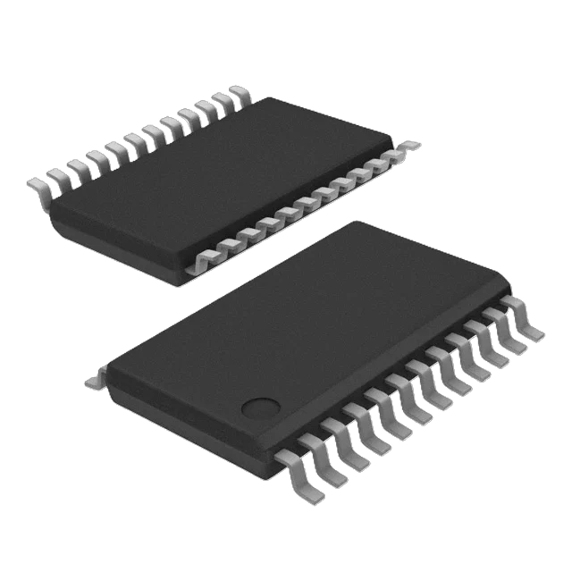
  I2C MULTIPLEXER COMPARISONS
Feature | NC7SZ157P6X | SN74LVC157APWR | TCA9548APWR | 74HC151D | 74LVC1G157GW-Q100H
Circuit | 1 x 2:1 | 4 x 2:1 | 1 x 8:1 | 1 x 8:1 | 1 x 2:1
Output Current High, Low | 32mA, 32mA | 24mA, 24mA | 25mA, 25mA | 5.2mA, 5.2mA | 32mA, 32mA
Supply Voltage | 1.65V ~ 5.5V | 2V ~ 3.6V | 1.65V ~ 5.5V | 2V ~ 6V | 1.65V ~ 5.5V
Operating Temperature | -40°C ~ 85°C | -40°C ~ 85°C | -40°C ~ 85°C | -40°C ~ 125°C | -40°C ~ 125°C
The TCA9548APWR I2C multiplexer
Image from https://www.digikey.com/en/products/detail/texas-instruments/TCA9548APWR/3615458?s=N4IgTCBcDaICoGECCBOArAFgBxIAoHUAlEAXQF8g
Needs to be at least 2:1 and take 3.3V or 5.0V as supply voltage
The TCA9548APWR has 8 channels which allows for more than enough channels in the case that we need additional or certain channels do not work
Can be powered by 3.3V regulator and has higher output current allowing for larger pull-up resistors and faster signal rise times
Notes:
The I2C multiplexer is required for the P.U.T.T.I since all of the radars will use the same I2C channel however the ESP32 only has a limited number of channels. The multiplexer will then allow us to use all the components that communicate via I2C working when we need them to. The I2C multiplexer that we decided upon was the TCA9548APWR. We wanted a multiplexer that had at least 2 channels and took 3.3V or 5.0V. Even though the TCA9548APWR has many more channels at 8, we thought it was worth the additional expense incase any of the channels had issues or we wanted to have additional components. Whilst the 74HC151D multiplexer is very similar the key differences between why we didn’t choose this multiplexer is because its incredibly small footprint making it difficult to solder, and the very low current which would limit the size of the pull up resistors we could attach to the I2C lines.

Slide 12
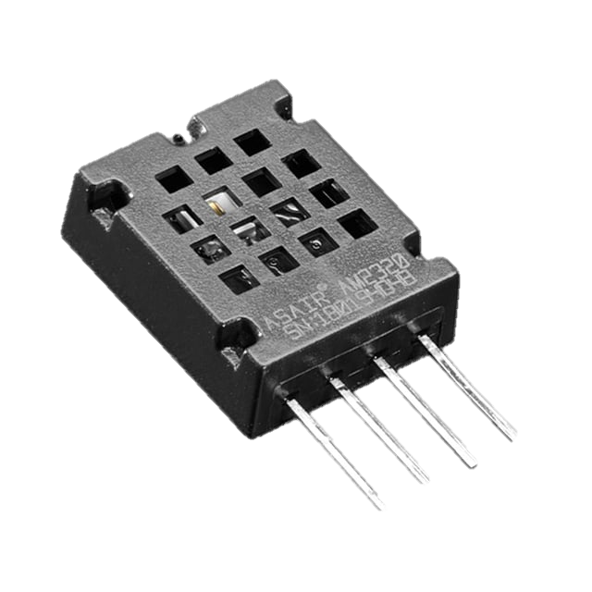
  HUMIDITY SENSOR COMPARISONS
Feature | HS12SP | HPP801A031 | HIH-4021-003 | AM2320 | CHS-MSS
Humidity Range | 30 ~ 90% RH | 1 ~ 99% RH | 0 ~ 100% RH | 0 ~ 99% RH | 20 ~ 85% RH
Output | 60k @ 50% RH | 180pF @ 55% RH | 3.268V @ 75.3 RH | I2C Output | 500mV @ 50% RH
Accuracy | ±5.0% | ±2.0% | ±3.5% | ±3.0% | ±5.0%
Response Time | 120s | 3s | 5s | 5s | 60s
Voltage Supply | 1V | 10V | 5V ~ 5.8V | 3.1V ~ 5.5V | 4.75V ~ 5.25V
The AM2320 humidity sensor.​
Image from https://www.adafruit.com/product/3721?srsltid=AfmBOoqp9wD-n-tTioYdUKmYEOItQVfleKFxudYQXQMbdXBBIwr-eFN-
Required to have a range of at least 0-99%, be able to measure humidity and temperature, and be accurate
The AM2320 uses I2C allowing for easy conversions from raw data
It had high accuracy of reading whilst still having a short response time
Measured up to 99% relative humidity as well as temperature
Runs on 3.3V or 5.0V which will integrate into the device seamlessly
Notes:
The humidity sensor will be used to measure the relative humidity of the surrounding environment as well as the ambient temperature. Collecting this data is particularly useful to the microwave sensor modules as are the most susceptible components on the device in regard to electrostatic discharge. We compared 5 different sensors based on their humidity range they can detect, the type of output they produce, the response time, and the voltage supply required to power the sensor. Based on this we decided to go with the AM2320 by Adafruit. It operates at the correct voltage supply, has a range large enough to encapsulate all environments, has a short response time, and outputs the values via I2C making it easy to use. Additionally, as mentioned before we also want to use this device to measure the ambient temperature which the AM2320 is capable of.

Slide 13
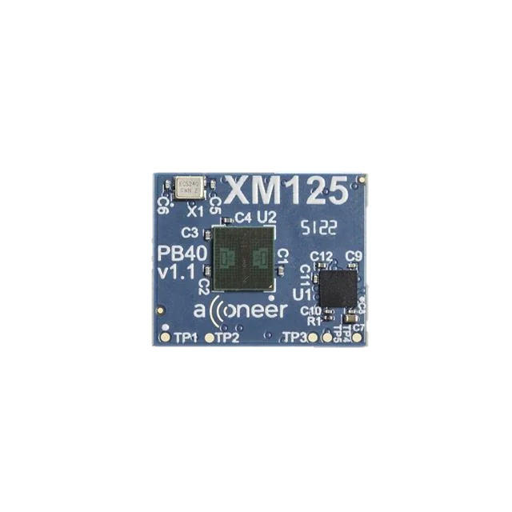
  MICROWAVE SENSOR COMPARISONS
Feature | A121 | IWRL6432AOP | XM125 | IWR6843AOP
Frequency Band | 60 GHz | 57 – 63.5 GHz | 60 GHz | 60 - 64 GHz
Onboard Processing | None | Cortex-M4F | Cortex-M4 | Cortex-M4F + C674x (DPS)
Communication | SPI | UART, SPI, I2C | UART, I2C | UART, SPI, I2C
Detection Range | 23 meters | 20 meters | 23 meters | Not Specified
Field of View | 65 H × 53 V | Detailed pattern plots (no explicit values) | 65 H × 53 V | Not Specified
Supply Voltage | 1.8V, 3.3V | 1.8V, 3.3V | 1.8V, 3.3V | 1.2V, 1.3V, 1.8V, 3.3V
The XM125 Radar Module
Image from https://www.digikey.com/en/products/detail/acconeer-ab/XM125/17883267?gclsrc=aw.ds&gad_source=1&gad_campaignid=20232005509&gbraid=0AAAAADrbLlhmyCm-tOwJV_MZGn-ZWmvxG&gclid=EAIaIQobChMIgLW8sMn7kwMVEFz_AR1ERyNZEAQYASABEgIk9fD_BwE
Simple integration and low processing load on MCU
Sufficient for desired range
Relatively cheaper
Avoids complex DSP alternatives

Slide 14
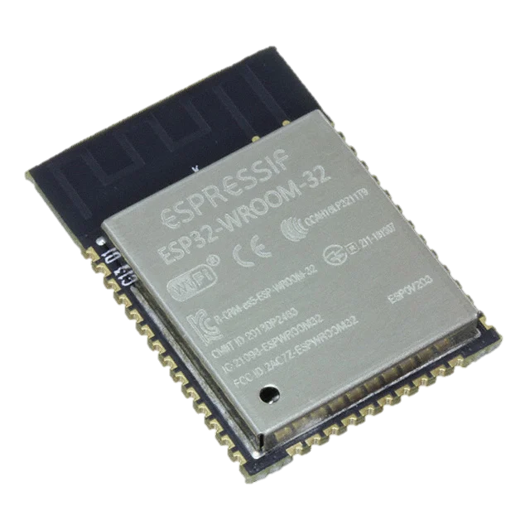

  MICROCONTROLLER COMPARISONS
Feature | PIC18F46K22 | ATmega328P | ESP32-WROOM-32 | STM32F103C8T6
Clock Speed | 16 MHz (64 MHz with PLL) | 16 MHz | 40 MHz | 16 MHz
SRAM | 3.8 kB | 2 kB | 520 kB (8 kB RTC) | 20 kB
Flash Memory | 64 kB | 32 kB | 4 mB | 64 kB
Operating Voltage | 2.3V - 5.5V | 2.7V - 5.5V | 3.3V | 3.3V
GPIO Pins | Up to 35 | Up to 23 | Up to 32 | Up to 37
Interfaces | 2 UART, I2C, SPI | UART, I2C, SPI | 2 UART, I2C, SPI | 3 UART, 2 I2C, 2 SPI
The ESP32-WROOM_32
Image from https://www.digikey.com/en/products/detail/espressif-systems/ESP32-WROOM-32-N4/8544298
High RAM
WiFi and Bluetooth support
Sufficient communication protocol support
Good for future scaling

Slide 15
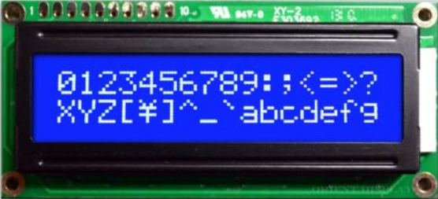
  LCD COMPARISONS
Feature | NHD-0216K1Z-NSW-BBW-L | CN0295D | AMC1602AR-B-B6WTDW-SPI | NHD-0216K1Z-NSW-BBW-33v3
Communication Interface | Parallel (GPIO) | I2C | SPI | Parallel (GPIO)
Supply Voltage | 5V | 5V | 5V | 3.3V
Current Draw | 1.0 mA | Not given | 1.2 mA | 1.5 mA
GPIO Pins | 11 pins | 2 pins | 4 pins | 11 pins
Cost | $7.45 | $8.95 | $11.21 | $14.04
The AMC1602AR-B-B6WTDW-SPI
Image from https://www.digikey.com/en/products/detail/orient-display/AMC1602AR-B-B6WTDW-SPI/22531861
SPI will not affect other peripherals, unlike I2C
SPI requires significantly less GPIOs than parallel wiring
Sufficient power requirements
Will require a 3.3V to 5V level shifter for operation by the ESP32
  Using the SN74AHCT125N level shifter

Slide 16

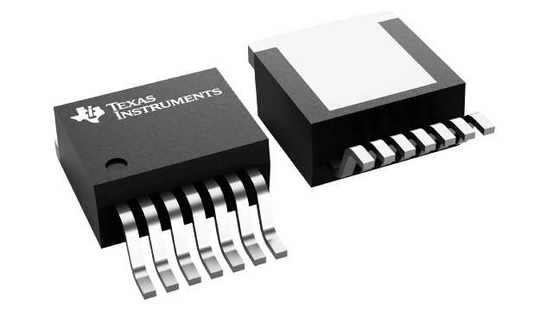
  REGULATOR COMPARISONS
Feature | AP64502SP-13 | TPS54531DDAR | LM2679S3.3/5 | RT6285GSP
Input Voltage Range | 3.8V to 40V | 3.5V to 28V | 8V to 40V | 5.5V to 30V
Output Voltage | 0.8V to 40V | 0.8V to 26.04V | 3.3V/5V | 0.8V to 24V
Max Output Current | 5A | 5A | 5A | 5A
Efficiency | Up to 90% | Up to 92% | Up to 92% | Up to 90%
Switching Frequency | 100 kHz to 2.2 Mhz (typically 500 kHz) | 570 kHz | 260kHz | 500 kHz
Protection Features | UVLO, OVP, cycle-by-cycle current limit, thermal shutdown | UVLO, OVP, thermal shutdown, current limit | UVLO, cycle-by-cycle current limit, thermal shutdown | Cycle-by-cycle over-current limit, thermal shutdown, soft-start
Cost | $2.09 | $2.04 | $7.42 | $0.84
The LM2678S 3.3/5
Image from https://www.digikey.com/en/products/detail/texas-instruments/LM2679S-5-0-NOPB/363832
Lower Frequency means less noise/emi effects
Additionally means less complicated PCB Design

Slide 17
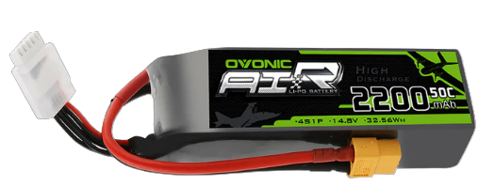
  POWER SUPPLY COMPARISONS
Feature | Nihewo | Spektrum | Turnigy Rapid | OVONIC
Voltage | 14.8 V | 14.8 V | 22.2 V | 14.5V
Capacity | 4500 mAh | 5000 mAh | 5000 mAh | 2200 mAh
Discharge Rate | 80 C | 30 C | 100 C | 130 C
Dimensions | 136 mm x 35 mm x 45 mm | 143 mm x 36 mm x 42 mm | 136 mm x 44 mm x 64 mm | 105 mm x 33 mm x 28 mm
Weight | 430 g | 486 g | 713 g | 216 g
Cost | $25.00 | $105.00 | $49.43 | $22.08
The OVONIC 4S LiPo Battery 22mAh 14.8V 130C
Image from https://www.amazon.com/dp/B0DF23MSJY?ref=ppx_yo2ov_dt_b_fed_asin_title
Small and Lightweight
Most inexpensive out of all the batteries
Can make up for small capacity by having multiple

Slide 18
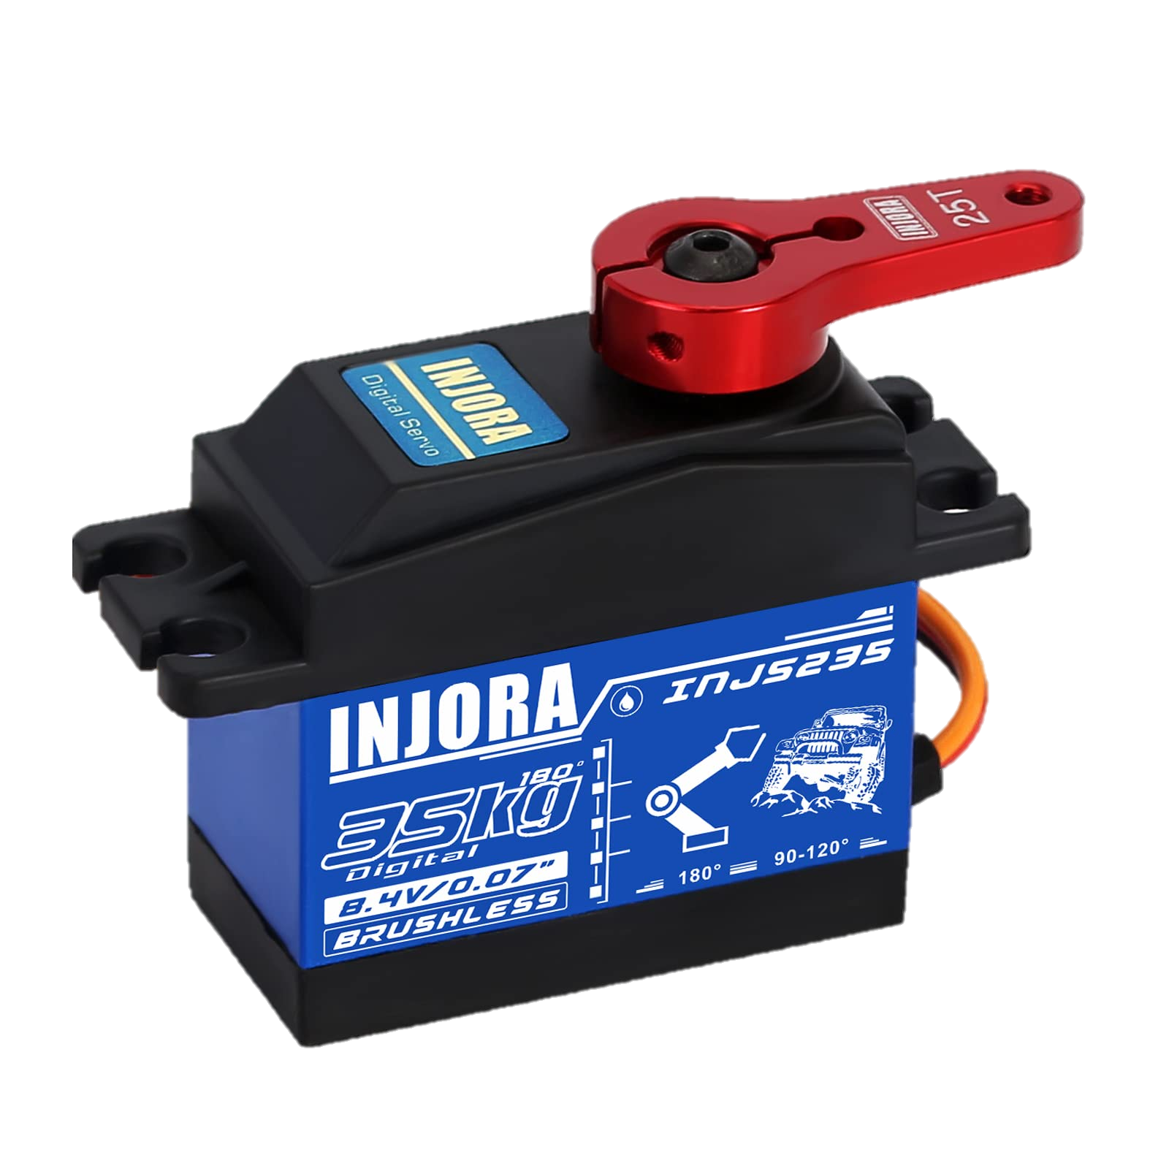
  SERVO COMPARISONS
Feature | INJORA | MEUS | M8 Brushless Servo
Input Voltage | 4.8 V – 8.4 V | 4.8 V – 8.4 V | 4.8 V – 8.4 V
Torque | 35 kg cm | 12.5 kg cm | 8.5 kg cm
Size | 63 mm x 38 mm x 54 mm | 23 mm x 12 mm x 27 mm | 28.5 mm x 13.4 mm x 29.0 mm
Weight | 85 g | 22.1 g | 28.6 g
Cost | $22.00 | $61.00 | $60.00
Waterproof Rating | Yes (IP67 rated) | Partial | Partial
The INJORA Servo 35KG High Torque Servo
Image from https://www.amazon.com/dp/B0922R8KFK?ref=ppx_yo2ov_dt_b_fed_asin_title&th=1
Gives the most torque out of all motors
Is the most inexpensive out of the servos
Weight and size are made up for by other two factors

Slide 19
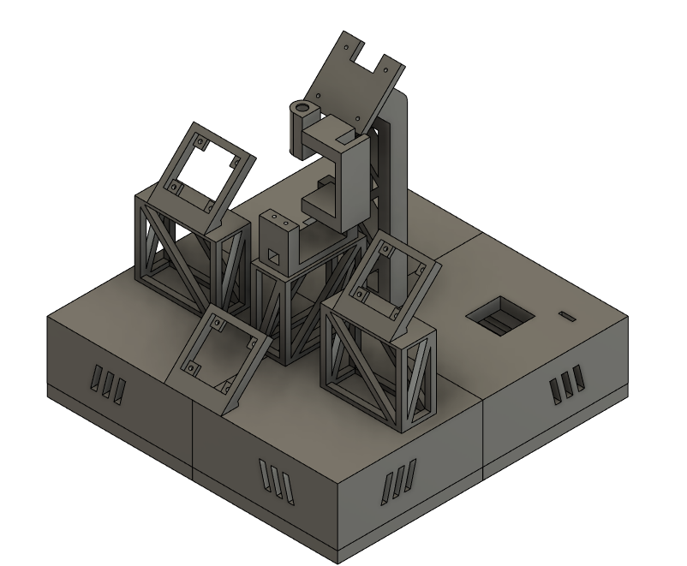
  VISUALIZATION OF DEVICE
Rendering of device using Fusion360
Complete P.U.T.T.I device

Slide 20
1.8 V Regulator
  HARDWARE DIAGRAM
4S Battery
Alex
Microwave Sensor Modules
Callum
Wired
Nathan
Power
Level Shifter
Jake
I2C Multiplexer
LCD
ESP32
Humidity/Temperature Sensor
ESP32
ESP32
5.0 V Regulator
Pan Servo
Buzzer
Tilt Servo
Laser
Nvidia Orin Nano
Camera
3.3 V Regulator
4S Battery
19.0 V Regulator
8S Battery
1.8V regulator
Notes:
The hardware block diagram outlines the responsibilities for each team member and shows how the power is distributed to each component and how each of the devices and peripherals interact with one another. The LCD, both the pan servo and tilt servo, the laser, and level shifter will be powered by the 5V regulato. The buzzer, ESP32, humidity/temperature sensor, and I2C multiplexer are powered by the 3.3 V regulator. The microwave sensor modules operate from the 1.8 V regulator, while the single-board computer (SBC) is powered by the 19 V regulator, additionally the SBC will power the camera through the USB port. We will have two power supplies with a 4S LiPo battery providing power to most of the board, connecting to the 1.8V, 3.3V, and 5.0V regulator whilst an 8S LiPo will connect to the 19V regulator. Knowing how each of the components communicates is also important. The humidity/temperature sensor along with the microwave sensor modules communicates with the ESP32 using I²C via the I2C multiplexer. The LCD communicates to the ESP32 over SPI. The motors are controlled using pulse width modulation signals. The SBC and microcontroller exchange data through UART. The laser and buzzer are controlled through simple GPIO outputs.

Slide 21
  POWER TABLE
Component | Supply Voltage | Maximum Current Draw | Maximum Power
Single-board computer | 19V | 2.37A | 45W
Camera | 5V | 230mA | 1.15W
Microwave Sensors | 1.8V | 10mA | 3.12mW
Laser | 5V | 25mA | 5mW
I2C Multiplexer | 3.3V | 25mW | 1mW
Humidity/Temperature Sensor | 3.3V | 1.5mA | 4.75mW
Microcontroller | 3.3V | 300mA | 1.2W
LCD | 5V | 1.2mA | 8.25mW
Pan Servo | 5V | 4A | 25W
Tilt Servo | 5V | 4A | 25W
Level Shifter | 5V | 0.7mA | 3.5mW
Buzzer | 3.3V | 30mA | 90mW
Notes:
Understanding how much power we will be using is incredibly important to understanding how long the device will be able to function for. Here we have the maximum power that each component can produce, the largest consumers of power are the SBC at a maximum power of 45W, the servos which both have a maximum power usage of 25W, the camera which has a maximum power of 1.15W, and the MCU which has a maximum power usage of 1.2W.

Slide 22
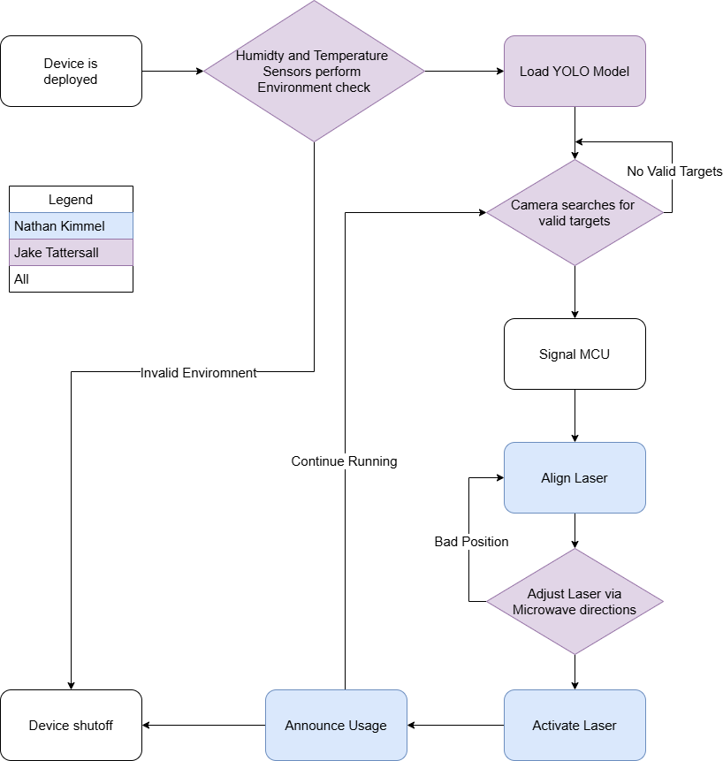
  General Software Flowchart
The program starts by performing a handshake between MCU and SBC. The sensors verify that the environment is OK.
The SBC loads the YOLO model and begins using the camera to search for targets.
When a target is detected, the MCU is signaled with predicted pan and tilt values.
The laser is aligned to these predicted locations while the Microwave sensors adjust the laser as needed.
While this happens, the laser is activated and the buzzer is turned on.
While the target is in frame, the laser and buzzer will continue to move and sound, respectively.
Once finished, the device will start over.
Notes:
These are the General and SBC Software Flowchart diagrams. To go into more detail on the General Flowchart on the Left, the device will start being turned on. After performing a handshake between the SBC and the MCU, we will first check to see if the Humidity and Temperature are at valid measurements to ensure that the Microwave modules or other modules are not damaged, as the Microwave modules in particular do have moderate ranges. After we are OK to run, the YOLO model will be used by the SBC to search for valid targets. Once we have a target and its projected trajectory, the angle and direction will be transmitted to the MCU, which will then use this information in tandem with the Microwave modules to identify and track the targets. Once the laser is aligned, the laser will be activated, simulating our target being neutralized, and a buzzer will announce that a quote-on-quote threat has been detected and handled. The device may repeat this loop as we see fit.
On the right is the SBC flowchart. To go into more detail on this, we will use OpenCV to connect to the camera and then load the YOLO model. So that the device is not continuously detecting frames which are unchanging, a gating method will be implemented to first check if some motion is occurring, but we will check intermittent frames regardless in case the motion is minor. Once we have detected a target, we will signal the MCU with the previously mentioned information and wait for a response from the MCU before continuing to run.

Slide 23
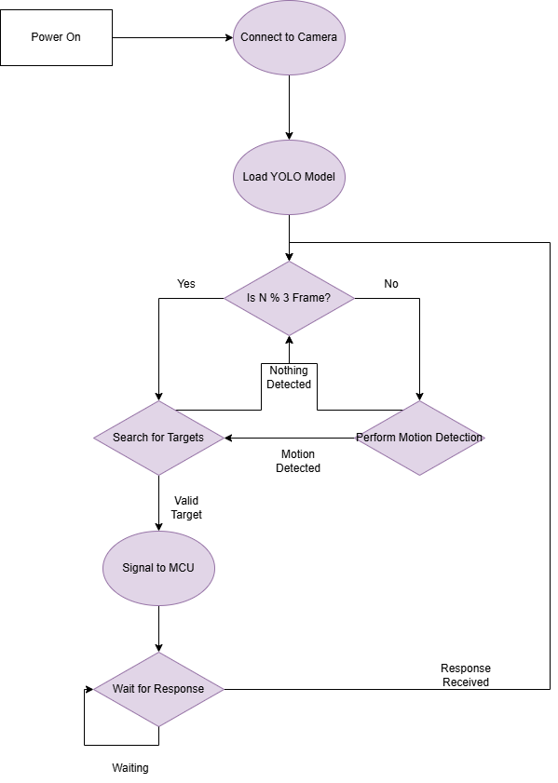
  SBC Software Flowchart
The SBC first connects to the camera and loads the YOLO model.
In this process, an undistortion algorithm is applied to ensure that calculated angles and locations are appropriate. This algorithm is based on pre-determined constants.
The algorithm then searches for targets.
Once a target is detected after a pre-determined minimum, it is considered a valid target and values are sent to the MCU.
This continues while the current target is in frame.

Slide 24
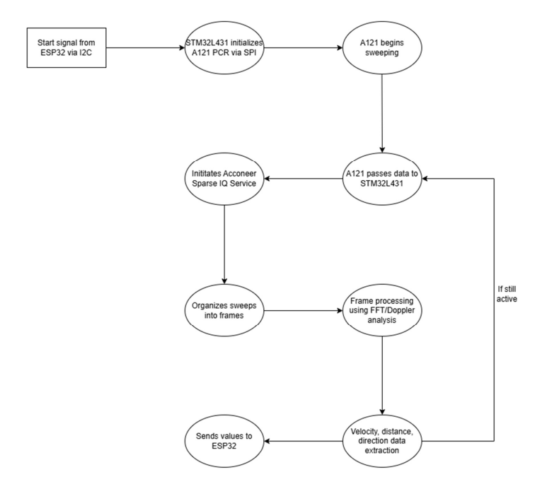
Radar Software Flowchart
ESP32 first connects to onboard STM microchip by sending a start command over I2C
STM chip initializes the Acconeer A121 sensor via SPI communication
A121 sensor initiates sparse sensing mode for continuous sweeping
Raw sweep data is streamed from A121 to the STM chip
STM chip organizes raw sweep data into structured data frames and applies Sparse IQ processing
FFT processing and Doppler analysis is applied to each frame
Usable distance data is extracted from processed data and transmitted to ESP32 back over I2C
The cycle repeats continuously while the wake up is set high by the ESP32

Slide 25
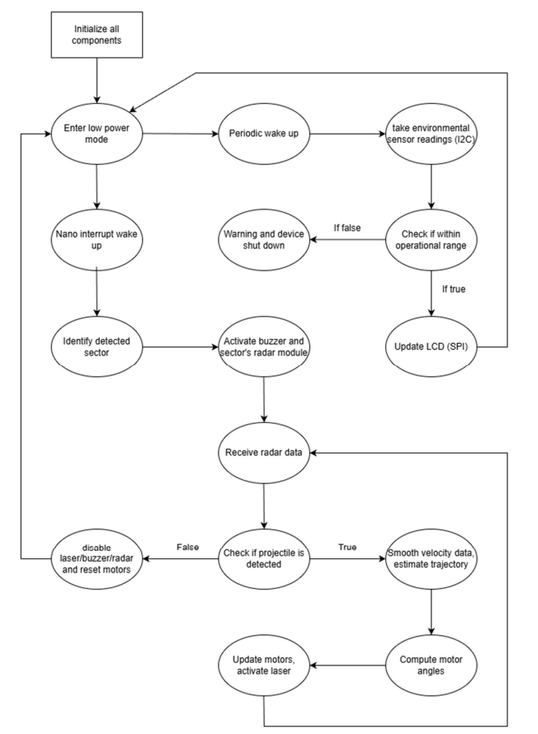
ESP32 Software Flowchart
System initializes all components, including camera sbc subsystem, I2C multiplexor, sensors, LCD, and motors
ESP32 enters low power mode
Periodic wake-ups read environmental data via I2C humidity sensor
Measured conditions are checked against safe operating ranges
If out of range, warning is displayed on the LCD
If valid, LCD is updated with values, and the system returns to low power mode
SBC interrupt triggers ESP32 to begin active tracking
Radar modules and buzzer are activated, and object detection is verified through camera
Distance to object is evaluated through radars
Disables laser if object is too close
Velocity and trajectory are estimated using SBC
Motor angles are computed and the pan/tilt system is updated, laser is activated
Loop continues until no object is detected, in which the laser, buzzer, and radars shut down and the motors return to resting position

Slide 26
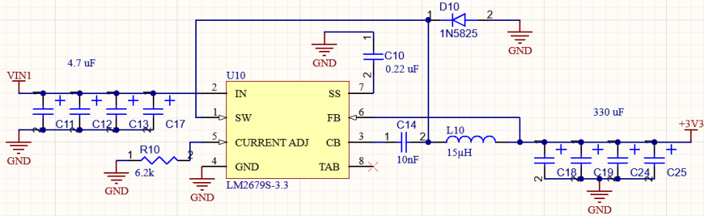
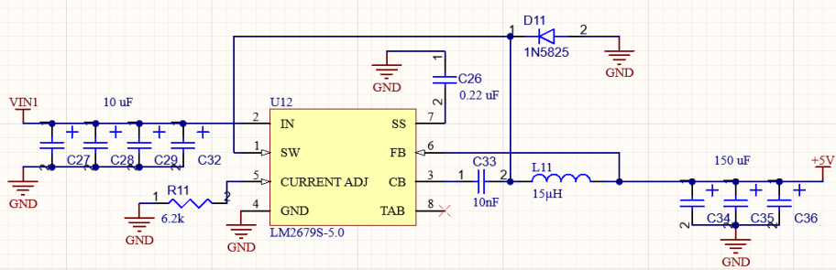
REGULATOR SCHEMATICS
3.3V Regulator:
Switching regulator at frequency of 256kHz
92% efficiency
5A output current
Supplies microcontroller, buzzer, humidity/temperature sensor, and I2C multiplexer
3.3 V Regulator
5.0V Regulator:
Switching regulator at frequency of 256kHz
92% efficiency
5A output current
Supplies both pan and tilt servos, LCD, camera, laser, and level shifter
5.0 V Regulator
Notes:
Here we have the 3.3V and 5.0V regulators. Both of these regulators are the same except from some minor changes in values of capacitors, as a result they have the same switching frequency, efficiency, and output current at 256kHz, 92%, and 5A respectively. The 3.3V regulator supplies power to the microcontroller, buzzer, humidity/temperature sensor, and I2C multiplexer whilst the 5.0V regulator supplies both pan and tilt servos, the LCD, laser, and level shifter.

Slide 27
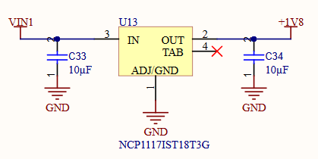
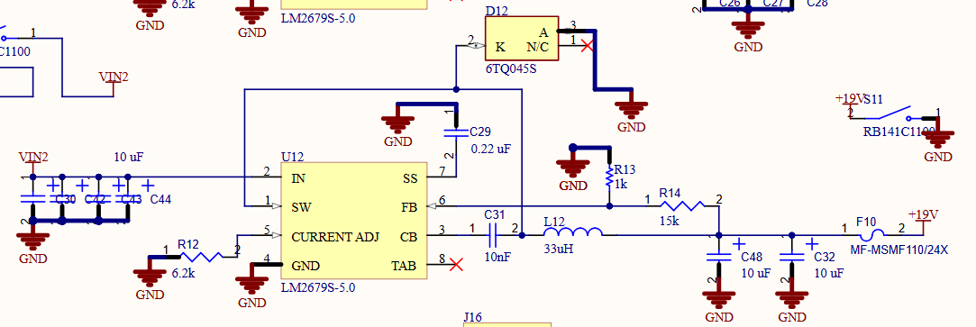
REGULATOR SCHEMATICS
1.8V Regulator:
Low-Dropout regulator
1A output current
Supplies three microwave sensor modules
1.8 V Regulator
19V Regulator:
Switching regulator at frequency of 256kHz
92% efficiency
5A output current
Individual switch to turn on/off
Supplies single-board computer
19.0 V Regulator
Notes:
The other two regulators are required to power very specific components. The 1.8V regulator is a low-dropout regulator that has a 1A output current and is required to power the three microwave sensor modules. We were able to use an LDO since the voltage is very small and the load of the regulator would also be quite low. The 19V regulator is the same regulator base as the 3.3V and 5.0V regulator however the footprint is quite different to accommodate for the much larger output voltage that is required. It once again has a switching frequency of 256kHz, operates at around 92% efficiency, and has a maximum output current of 5A. This regulator only powers the single-board computer and due to the large output voltage will have its own battery and switch.

Slide 28
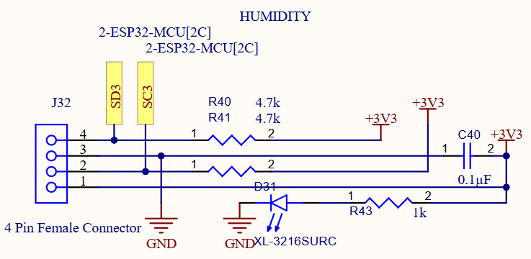
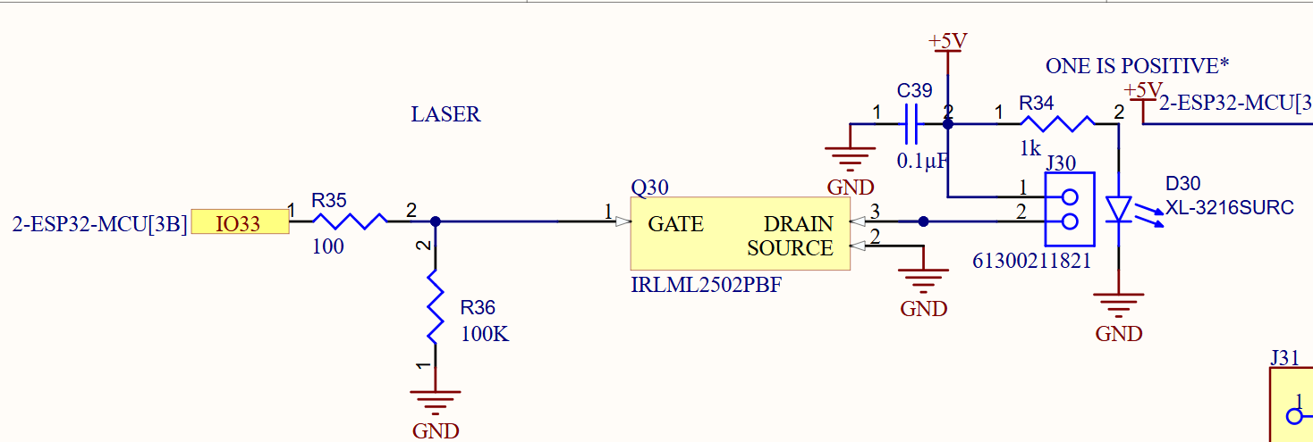
PERIPHERAL SCHEMATICS
Humidity/Temperature Sensor:
4.7kΩ pull up resistors
Measures temperature in Celsius but will be converted to Fahrenheit
Measured relative humidity from 0-99%
Laser:
Class IIIa laser
5mW power
650nm wavelength
Use of MOSFET to increase efficiency and reduce heat, also allows for pulse width modulation for higher powered lasers to control power
Notes:
These are some of the peripheral schematics, we have the humidity/temperature sensor that has 4.7k ohm pull up resistors and will be have a header to ensure the sensor is able to measure the ambient temperature rather than the internal temperature of the device. We also have the laser schematic which utilizies a MOSFET to increase the efficiency and reduce heat from excess current. It would also allow for pulse width modulation in a higher-powered laser that would allow for the laser’s power to be changes but since we are using a lower powered laser it is mostly a safety consideration.

Slide 29
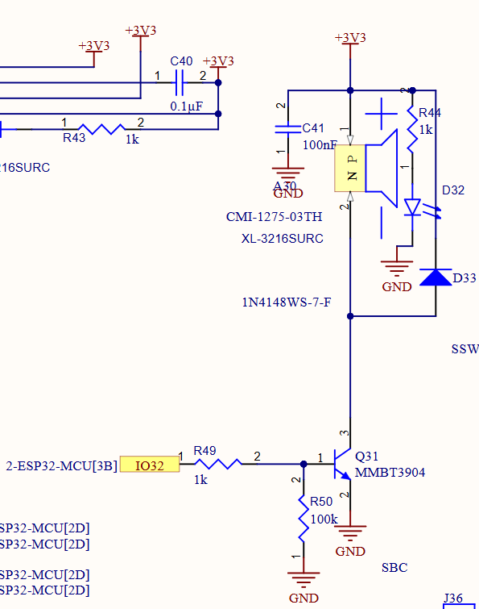
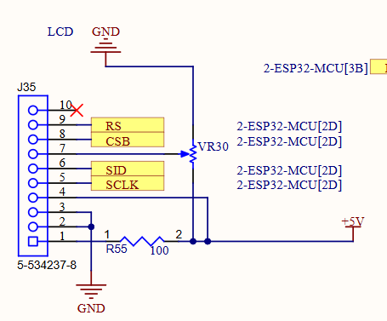
PERIPHERAL SCHEMATICS
Buzzer:
Magnetic buzzer
85dB @ 10cm
Flyback diode to prevent voltage spiking from damaging the transistor
LCD:
    Level shifter steps the 3.3V from the MCU up to 5V to power the LCD
Notes:
Some other peripherals are here, we have the buzzer which is controlled by an NPN BJT which amplifies the current from the microcontrollers GPIO pin it also has a flyback diode since we are using a magnetic buzzer we don’t want the transistor to be damages in the case of a voltage spike. We also have the LCD which is connected to the level shifter that steps up the 3.3V from the MCU up to 5V to power the LCD and contains a potentiometer to control the contrast of the LCD. There are some additional schematics however these are mostly headers which just connect components such as the pan servo and tilt servo, as well as the UART connection to write code to the ESP32, and the radar boards which Nathan will talk about next.

Slide 30
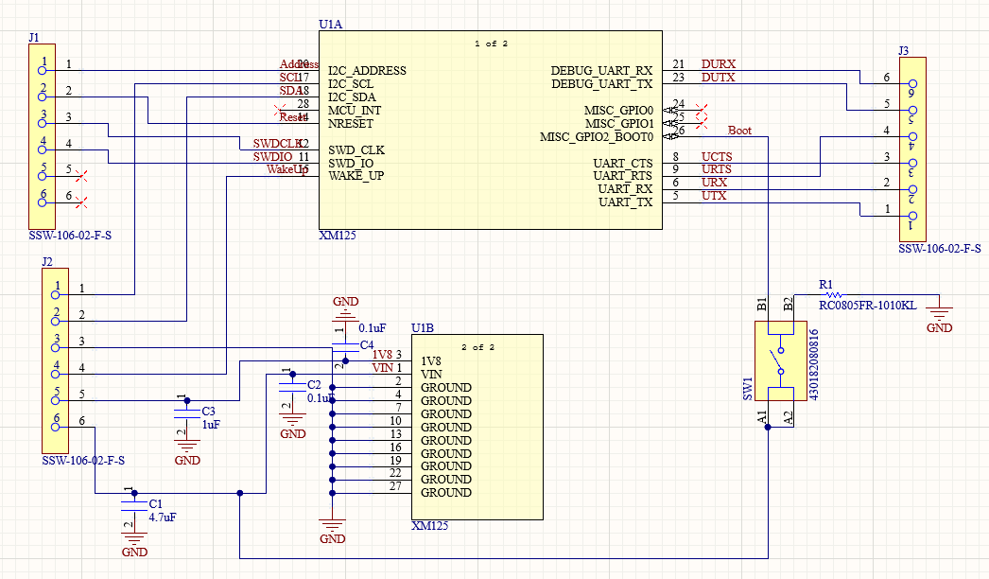
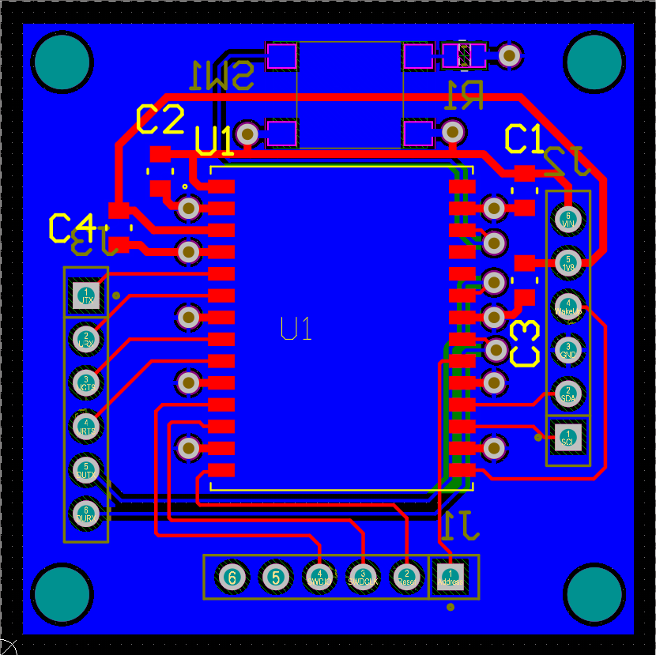
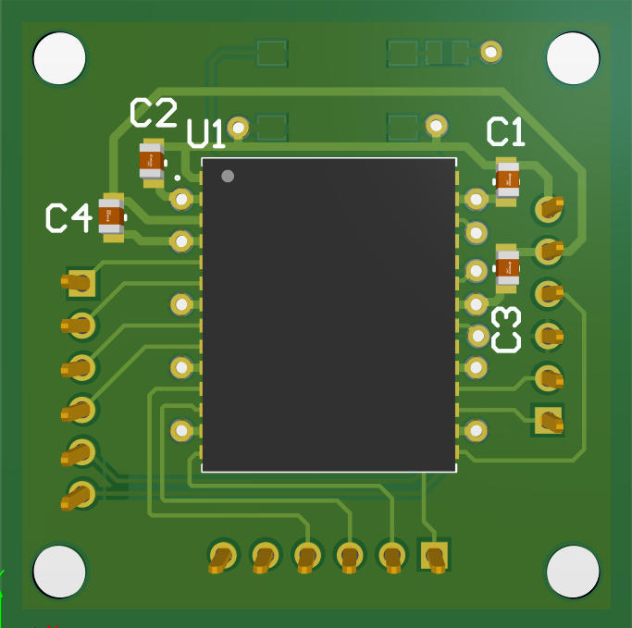
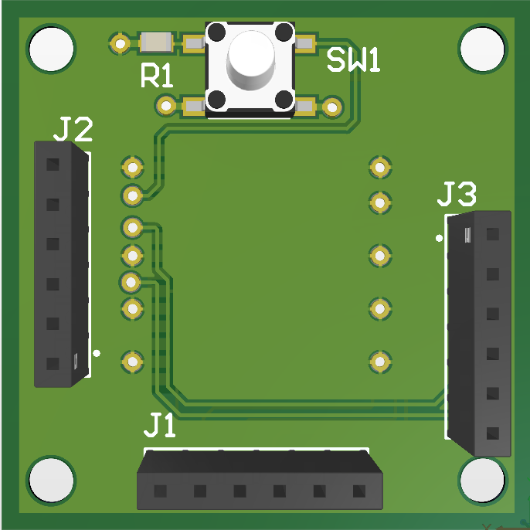
Radar Schematics/PCB
Front of Custom Radar PCB
Back of Custom Radar PCB

Slide 31
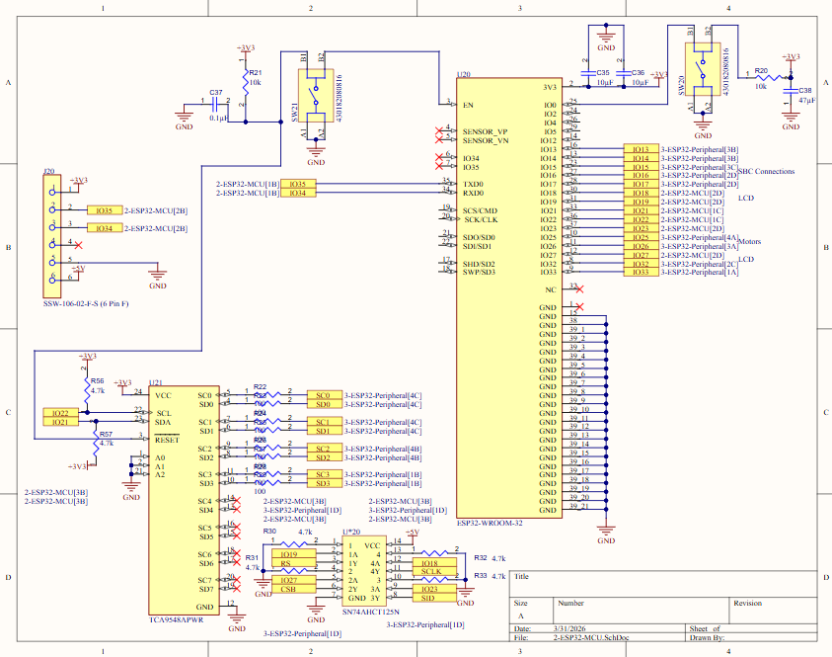
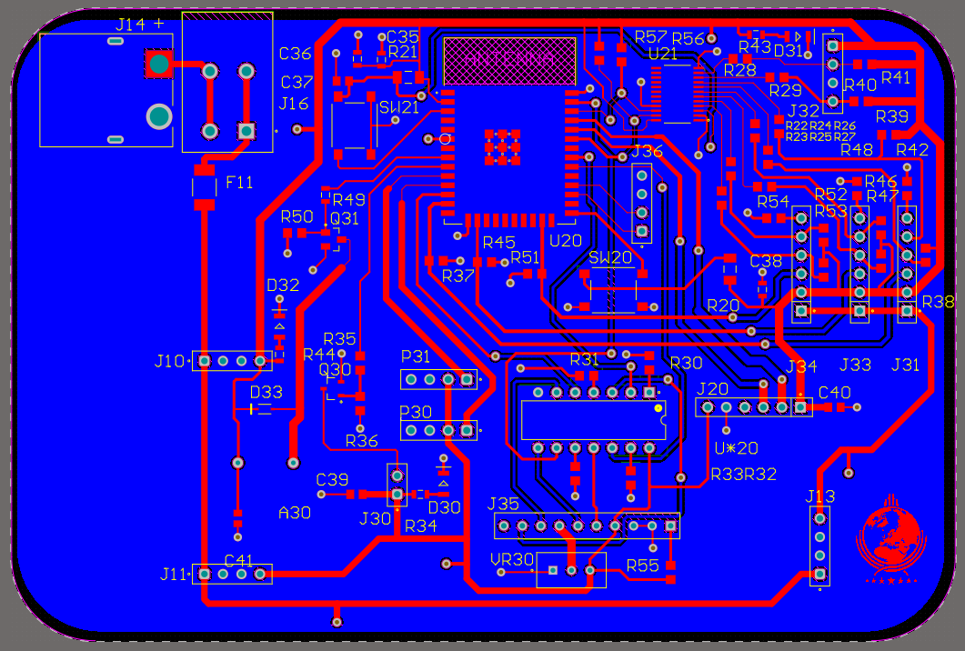
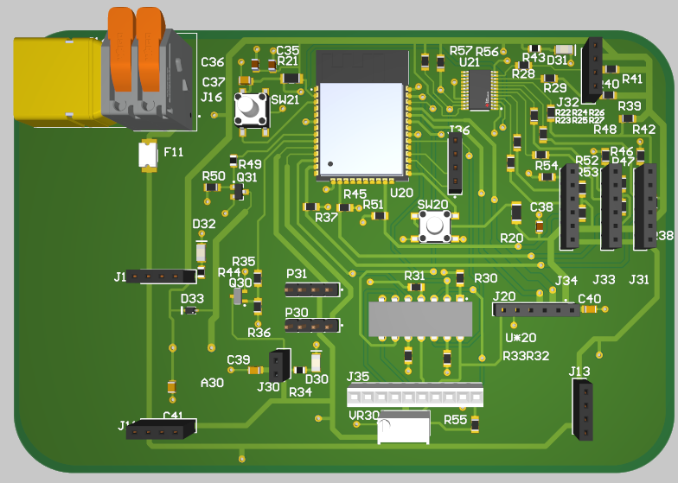
MAIN PCB Design
Major Changes:
- Vias added on all power rails
Level shifter added for LCD
LEDs to indicate if power was received for ease of testing
Power
MCU
MUX
Humidity
Regulators
SBC UART
Radars
Buzzer
Laser
Motors
LCD
UART
2.
3.
4.
6.
1.
10.
11.
5.
7.
8.
12.
9.
5.
5.

Slide 32
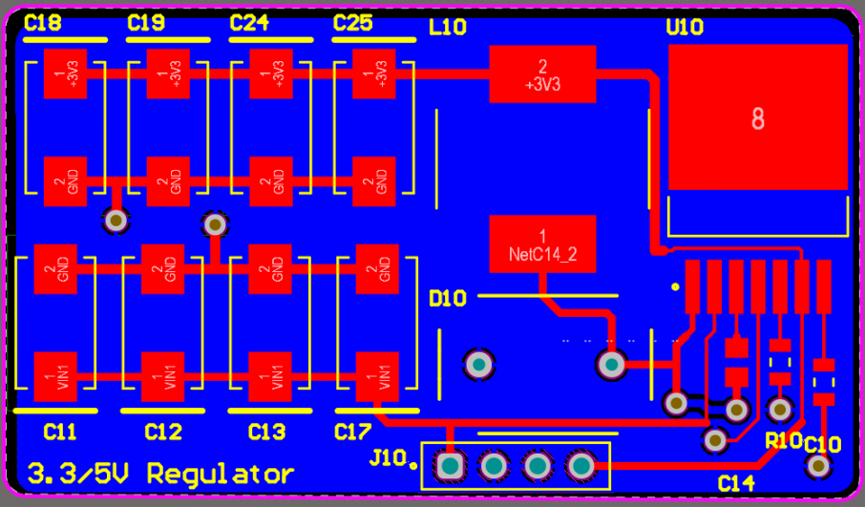
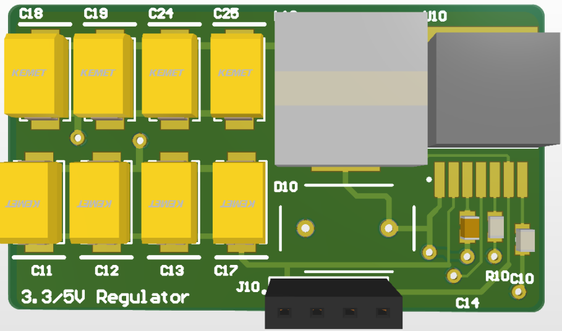
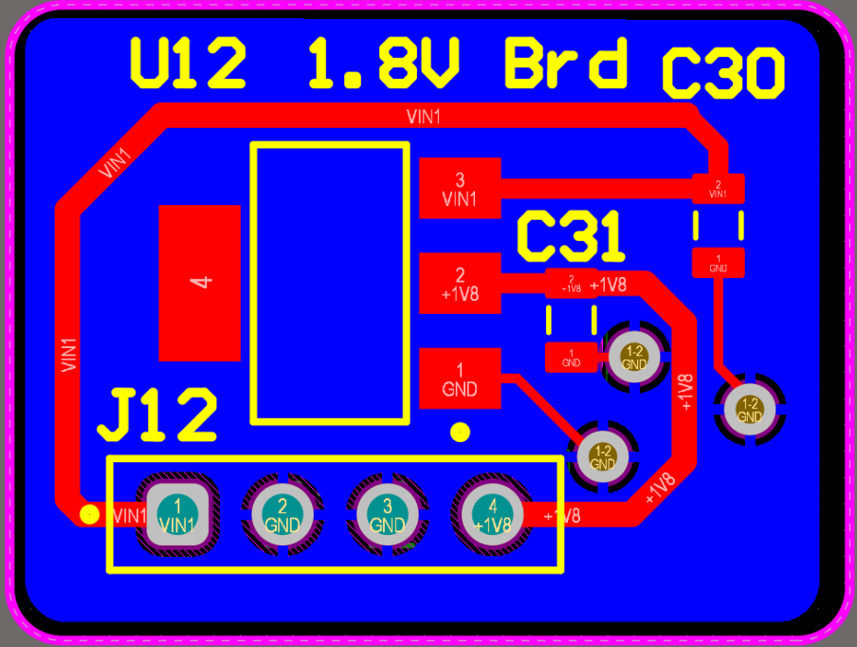
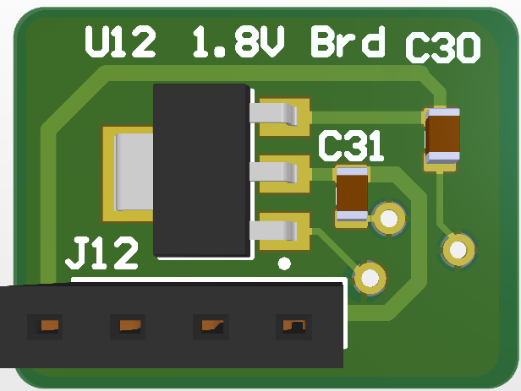
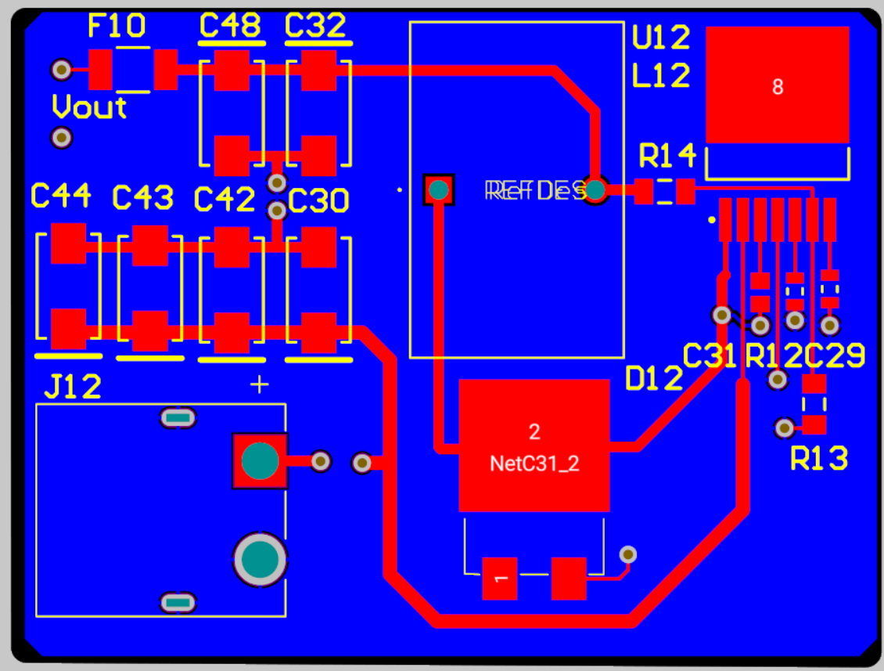
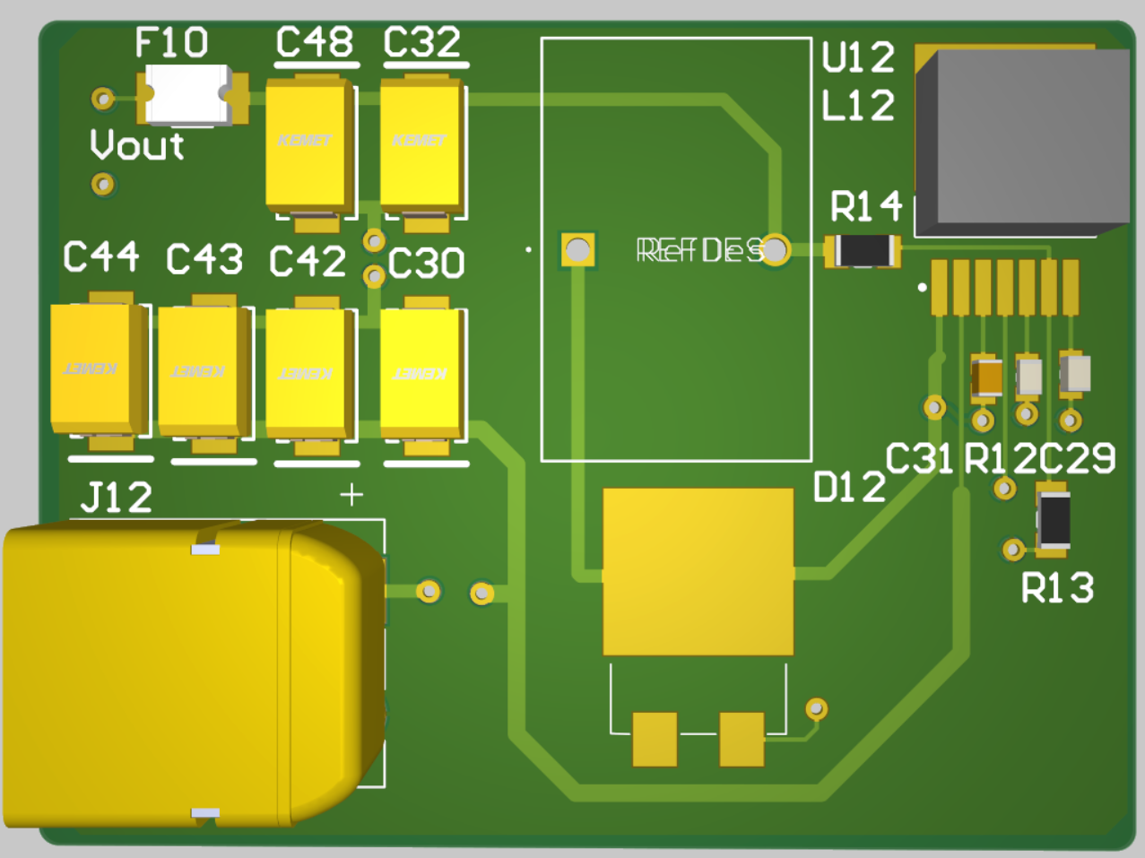
REGULATOR PCB Design
3.
2.
1.
3.3/5V Regulator
4.
5.
1.
Voltage Regulating Chip
Inductor
Output Capacitors
Input Capacitors
Diode
1.8V Regulator
3.
2.
1.
4.
19V Regulator
5.

Slide 33
  BUDGET
Item | Unit Cost | Quantity | Total Cost
Nvidia Orin Nano | $ 249.99 | 1 | $ 249.99
ELP OG05B10 | $ 163.00 | 1 | $ 163.00
1054 Laser Diode | $ 6.35 | 1 | $ 6.35
AM2320 Humidity Sensor | $ 4.21 | 1 | $ 4.21
XM125 Radar Sensor Module | $ 21.21 | 3 | $ 63.63
LCD | $ 11.21 | 1 | $ 11.21
Microcontroller | $ 5.20 | 1 | $ 5.20
Buck Regulator | $ 8.15 | 3 | $ 24.45
Brushless Servo | $ 23.42 | 2 | $ 46.84
LiPo Battery | $ 24.50 | 1 | $ 24.50
UART | $ 3.33 | 1 | $ 3.33
PCBs | $ 21.07 | 1 | $ 21.07
Miscellaneous PCB Parts | $ 109.68 | 1 | $ 109.68
Total |  |  | $ 733.47
Budget: $1000
Stayed under by $266.53
Largest Expenses: Nvidia Orin Nano, ELP OG05B10, and PCB parts
Notes:
We set ourselves a budget of $1000 and stayed well below that budget by just under $267. The largest expenses were the nvidia orin nano at $249.99, the ELP OG05B10 camera at $163, and the miscellaneous PCB parts such as capacitors, resistors, inductors, etc. at $109.68. Overall we ended up spending $733.47 throughout the development and implementation of the P.U.T.T.I.
Orin Nano
Camera – ELP
Laser
Humidity
XM125 Radars
1 x Battery (NO CHARGER)
PCB (Price of the boards individually without shipping costs)
LCD
Servos
Regulators
The remaining Digikey items ( Just conglomerate it into one category as “Componenets”)

Slide 34
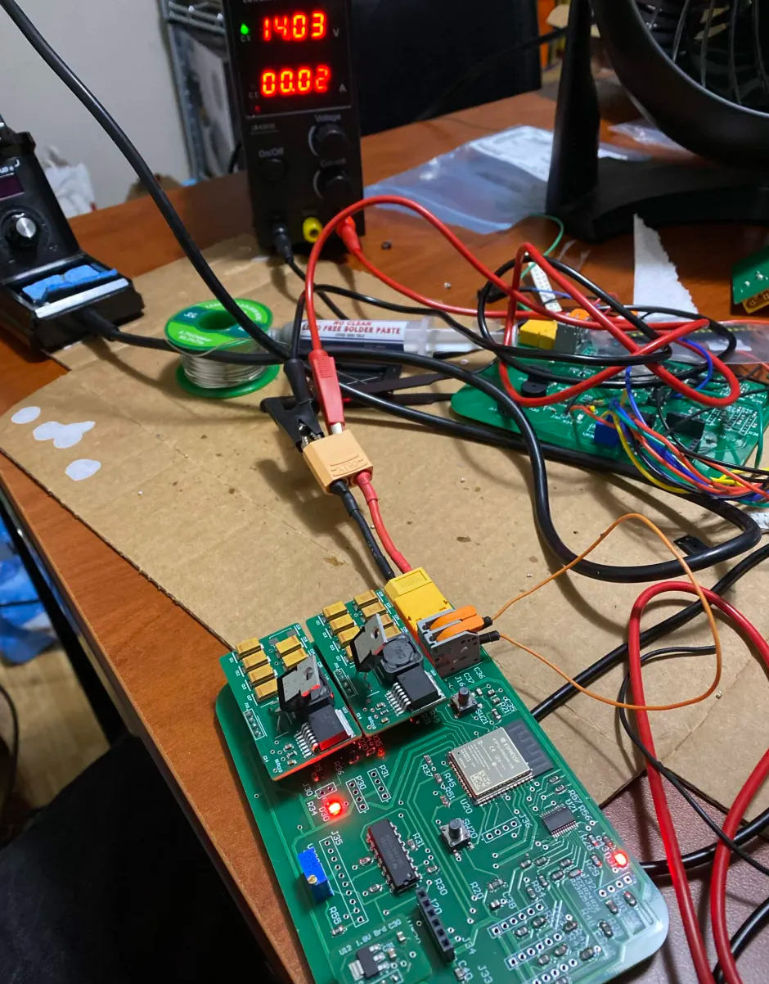
  PROTOTYPING & TESTING
YOLO model testing
  Evaluated detection accuracy and response time
  Stationary and moving target detection
Communication protocol testing
  Validated UART, SPI, and I2C communications
Breadboarded laser, motos, and ESP32 logic
  Developed pan/tilt motor control and laser activation
Humidity sensor validation
  Verified accurate readings using ambient conditions
Radar module characterization
  Tested response time, accuracy, and minimum time between readings
  Determined performance limitations for real time tracking
I2C multiplexor testing
  Implementation using radars and humidity sensors
LCD level shifter testing
  Verified communications between LCD and ESP32
Full system integration
  Combined camera subsystem, radar sensing, motor control, laser activation, buzzer activation, and lcd display
  Complete operation using the final 3D-printed apparatus
Custom PCB Testing

Slide 35
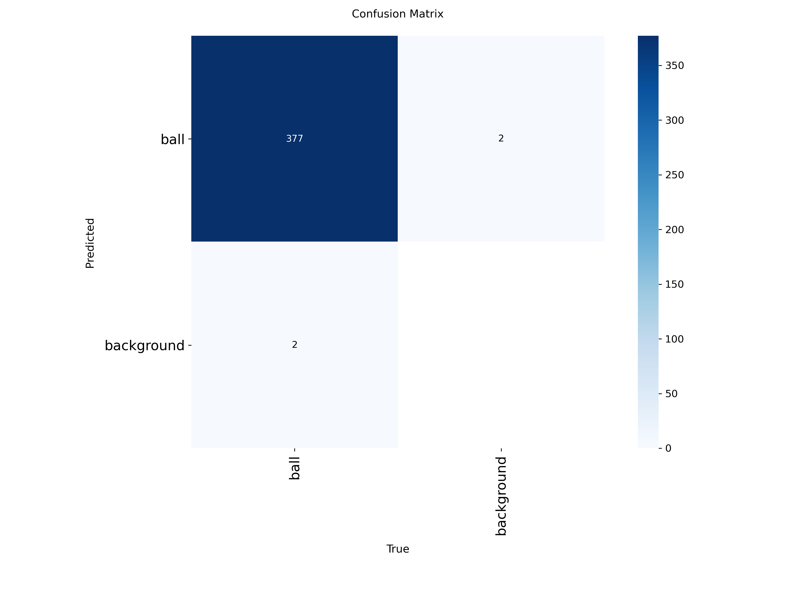
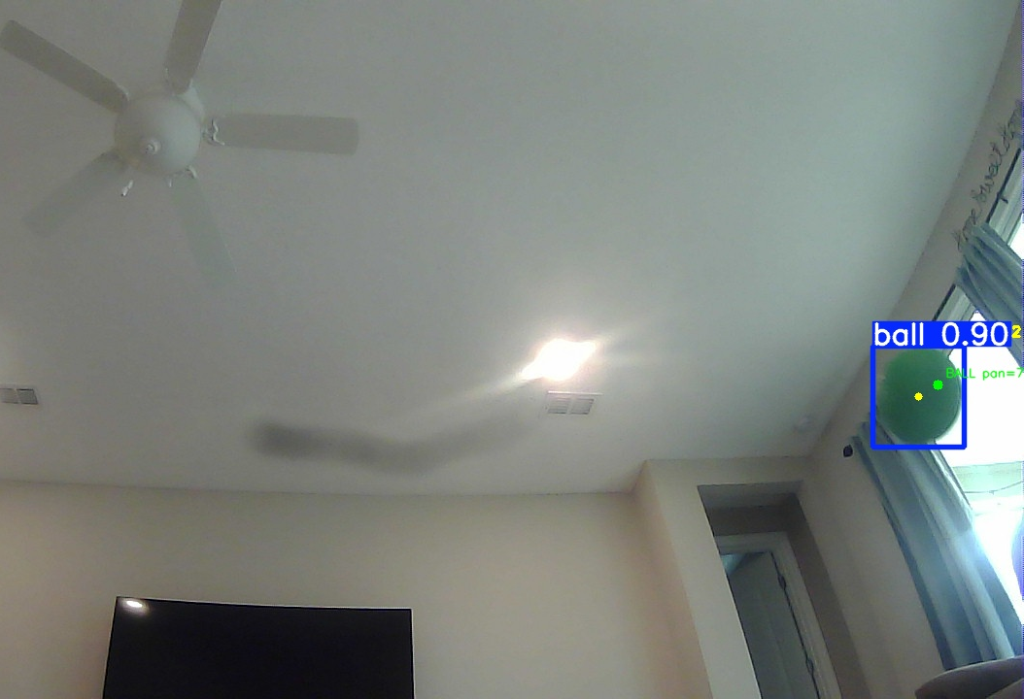
  SBC + YOLO Testing
  Dataset
  Dataset of ~2500 images used in training the green playground balls.
      Both playground balls are considered the same object. Training was meant to generalize the idea of the green playground ball.
  High success rate as shown by the Confusion Matrix, a product of the training process.
Confusion Matrix of the latest model.
  Orin Nano
  Using a Docker container to automate deployment
Docker container able to access all necessary components
  Able to maintain ~20-30 frames per second
Green playground ball detected with 90% confidence.
Notes:
In order to test the YOLO model, a dataset was manually collected and labeled. The dataset contained approximately 3800 positive images containing a football and approximately 2800 negative images containing no football to show what should not be detected. The resulting YOLOv8 model trained on these images resulted in a highly-accurate model with little to no false positives, but more testing must be done. The Orin Nano will use Docker Compose to automate deployment, and we have tested that the container can access all necessary components like the camera and GPIO and UART. When running the model, the fps maintained between 20 and 30, which is ideal for our project.

Slide 36
  WORK DISTRIBUTION
Name/Major | Primary Responsibilities | Secondary Responsibilities
Alex Evison Electrical Engineering | PCB Design | Peripheral Integration
 | Motors and Motor Control | Testing
 | Administrative Documentation | MCU Implementation
Callum Fuller Electrical Engineering | Peripheral Integration | Chassis Design
 | PCB Design | Safety Constraints
 | Administrative Documentation | Soldering/Component Installation
Nathan Kimmel Electrical Engineering | Microwave Sensor Implementation | PCB Design
 | MCU Implementation | Detection System Design
 | User Interfacing | Testing
Jake Tattersall Computer Engineering | Detection System Design | Website Design
 | Camera Setup | User Interfacing
 | Project Lead | MCU Implementation

Slide 37
  FUTURE PLANS
Hardware Optimization
Any final PCB revisions
Software Optimization
Detection filtering
Stretch Goals
Optimization under non-ideal conditions
Refining power regulation
Radar testing
Finalizing 3D printed chassis
Merging sensors
Targeting multiple projectiles
Wireless connectivity to ESP32

Slide 38
  REFERENCES

